Slide 1
Lesson 36.2
Gas Exchange across Respiratory Surfaces

Slide 2
Objectives
Name and describe lung volumes and capacities.
Understand how gas pressure influences how gases move into and out of the body.

Slide 3
Basic Principles of Gas Exchange
Gas exchange during respiration occurs primarily through diffusion.
In diffusion, the movement of a substance is driven by a concentration gradient. Gas molecules spontaneously move from a region of high concentration to a region of low concentration.
Blood that is low in oxygen and high in carbon dioxide undergoes gas exchange with air in the lungs.
Partial pressure is a measure of the concentration of the individual components in a mixture of gases.
The total pressure exerted by the mixture is the sum of the partial pressures of the components in the mixture.
The rate of diffusion of a gas is proportional to its partial pressure within the total gas mixture.

Slide 4
Science and You₁
Scuba divers must take special precautions to prevent a life-threatening condition called decompression sickness, or "the bends."
This happens when blood gases decompress—much like the decompression that occurs when popping open a soda can.
Notes:
This is included as a relevant application for this topic.

Slide 5

Lung Volumes and Capacities₁
Different animals have different lung capacities that correlate to their oxygen demands.
Cheetahs have evolved a much higher lung capacity than humans, to run fast.
Elephants have higher lung capacity as they are larger body size.
36.2 Figure 1
Sammy Wong on Unsplash. "Cheetahs."
Notes:
Figure 1: Cheetahs' high lung volume is one aspect of their physiology that enables them to run fast.

Slide 6
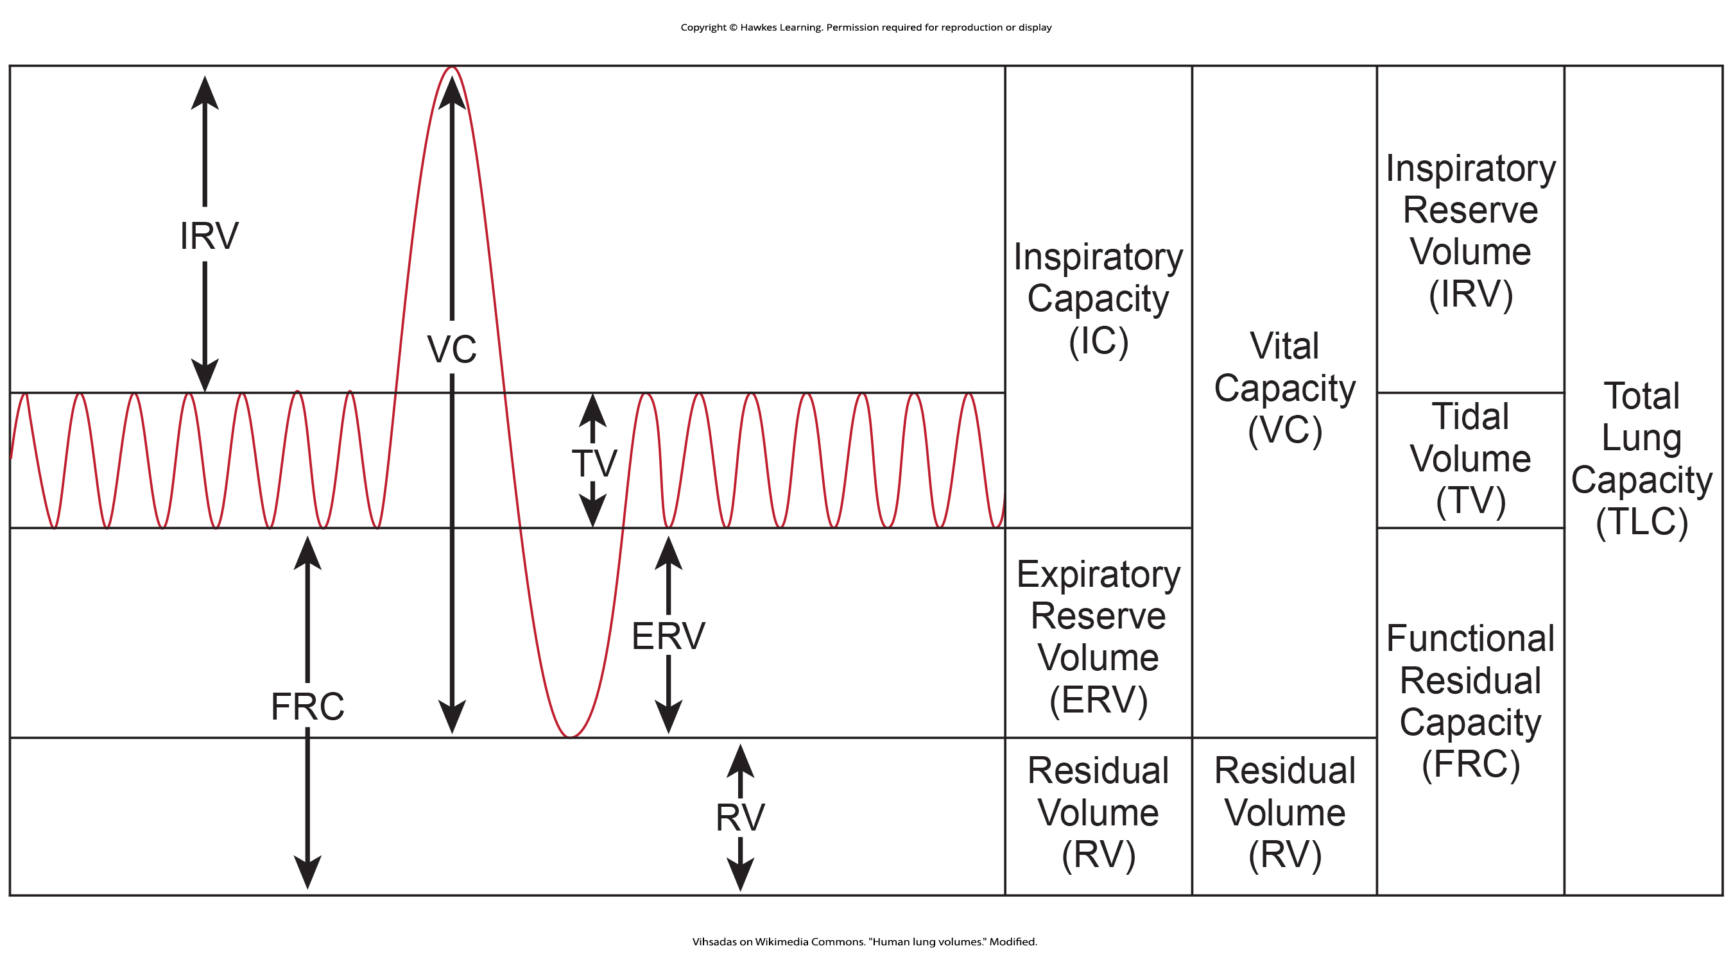
Lung Volumes and Capacities₂
Air in the lungs is measured in terms of lung volumes and lung capacities. Lung volume measures the amount of air for one function (such as inhalation or exhalation). Lung capacity is any two or more volumes (for example, how much can be inhaled from the end of a maximal exhalation).
36.2 Figure 2
Vihsadas on Wikimedia Commons. "Human lung volumes." Modified.
Notes:
Figure 2: Human lung volumes and capacities are shown. The total lung capacity of the adult male is 6 liters. Tidal volume is the volume of air inhaled in a single, normal breath. Inspiratory capacity is the amount of air taken in during a deep breath, and residual volume is the amount of air left in the lungs after forceful respiration.

Slide 7
Table 1: Lung Volumes and Capacities for the Average Human Adult Male
Volume/Capacity | Definition | Volume (liters) | Equations
tidal volume (TV) | amount of air inhaled during a normal breath | 0.5 | -
expiratory reserve volume (ERV) | amount of air that can be exhaled after a normal exhalation | 1.2 | -
inspiratory reserve volume (IRV) | amount of air that can be further inhaled after a normal inhalation | 3.1 | -
residual volume (RV) | air left in the lungs after a forced exhalation | 1.2 | -
vital capacity (VC) | maximum amount of air that can be moved in or out of the lungs in a single respiratory cycle | 4.8 | ERV+TV+IRV
inspiratory capacity (IC) | volume of air that can be inhaled in addition to a normal exhalation | 3.6 | TV+IRV
functional residual capacity (FRC) | volume of air remaining after a normal exhalation | 2.4 | ERV+RV
total lung capacity (TLC) | total volume of air in the lungs after a maximal inspiration | 6.0 | RV+ERV+TV+IRV
forced expiratory volume (FEV1) | how much air can be forced out of the lungs over a specific time period, usually one second | ∼4.1 to 5.5 | -

Slide 8
Group Activity
How might you use a balloon to obtain crude measurements for some of the measurable aspects of lung volume and capacity listed in Table 1?
Be inventive! Come up with a method for estimating two of these quantities using a normal balloon.

Slide 9
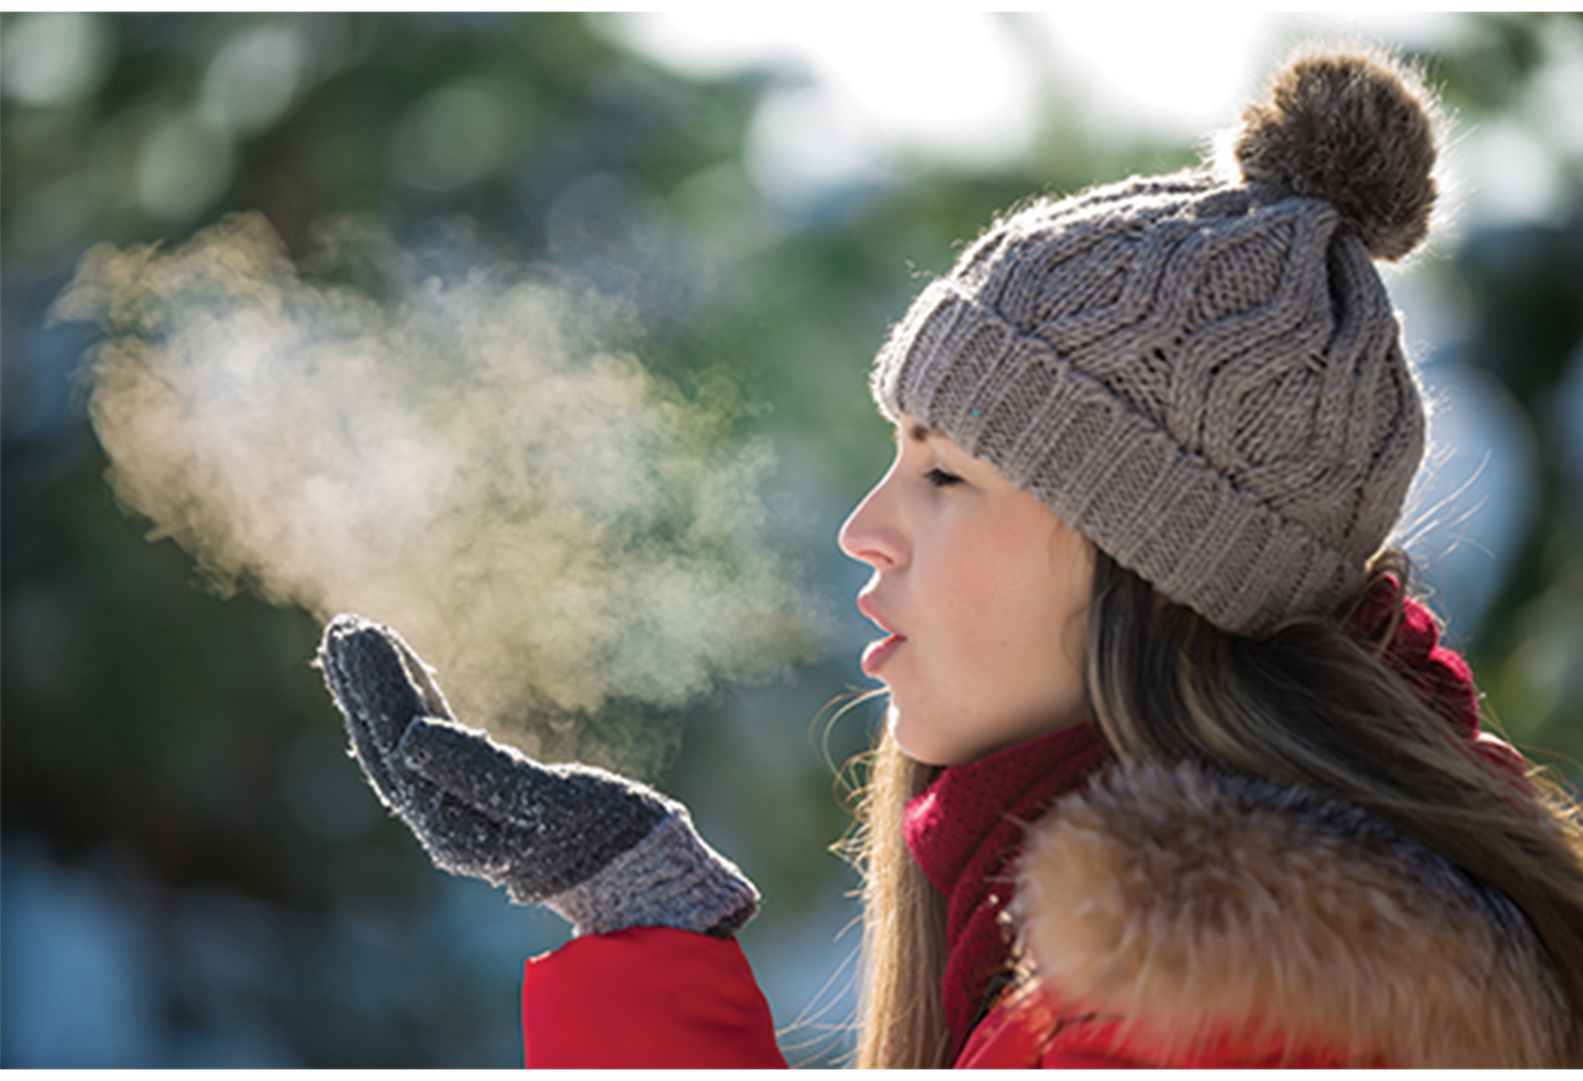
Lung Volumes and Capacities₃
The volume in the lung can be divided into four units: tidal volume, expiratory reserve volume, inspiratory reserve volume, and residual volume.
Tidal volume (TV) measures the amount of air that is inspired and expired during a normal breath.
The expiratory reserve volume (ERV) is the additional amount of air that can be exhaled after a normal exhalation.
The inspiratory reserve volume (IRV) is the additional amount of air that can be inhaled after a normal inhalation.
The residual volume (RV) is the amount of air left after the expiratory reserve volume is exhaled.
36.2 Figure 3
Notes:
Figure 3: After a normal exhalation, an amount of air called the expiratory reserve volume remains in the lungs. Even after a complete exhalation, the lungs are not completely empty.

Slide 10
Lung Volumes and Capacities₄
Capacities are measurements of two or more volumes.
The vital capacity (VC) measures the maximum amount of air that can be inhaled or exhaled during a respiratory cycle.
The inspiratory capacity (IC) is the amount of air that can be inhaled after the end of a normal expiration.
The functional residual capacity (FRC) measures the amount of additional air that can be exhaled after a normal exhalation.
The total lung capacity (TLC) is a measurement of the total amount of air that the lung can hold.

Slide 11
Lung Volumes and Capacities₅
Lung volumes are measured by a technique called spirometry.
An important measurement taken during spirometry is the forced expiratory volume (FEV), which measures how much air can be forced out of the lung over a specific period, usually one second (FEV1).
The forced or functional vital capacity (FVC), which is the total amount of air that can be forcibly exhaled, is also measured.
The ratio of these values (FEV1/FVC ratio) is used to diagnose lung diseases including asthma, emphysema, and fibrosis.
If the FEV1/FVC ratio is high, the lungs are not compliant, and the patient most likely has lung fibrosis.
When the FEV1/FVC ratio is low, there is resistance in the lung characteristic of asthma.

Slide 12

Gas Pressure and Respiration₁
Air is a mixture of gases, primarily nitrogen (N₂; 78.6%), oxygen (O₂; 20.9%), water vapor (H₂O; 0.5%), and carbon dioxide (CO₂; 0.04%).
Each gas component of that mixture exerts a pressure.
The pressure for an individual gas in the mixture is the partial pressure of that gas.
Approximately 21% of atmospheric gas is oxygen. Carbon dioxide, however, is found in relatively small amounts (0.04%).
36.2 Figure 4
Min An on Pexels. "Sky."

Slide 13
Gas Pressure and Respiration₂
The partial pressure of any gas can be calculated by:
P = (P_{atm}) × (percent content in mixture)
P_{atm}, the atmospheric pressure, is the sum of all the partial pressures of the atmospheric gases added together:
P_{atm}=P_{N2}+ P_{O2}+ P_{H2O}+ P_{CO2}= 760 mmHg × (percent content in mixture)
The pressure of the atmosphere at sea level is 760 mmHg.
Therefore, the partial pressure of oxygen is:
P_{O2}= (760 mmHg)(0.21) = 160 mmHg
For carbon dioxide, it is: P_{CO2}= (760mmHg)(0.0004) = 0.3 mmHg
At high altitudes, P_{atm} decreases, but concentration does not change; the partial pressure decrease is due to the reduction in P_{atm}.

Slide 14
Gas Pressure and Respiration₃
When the air mixture reaches the lung, it has been humidified. The pressure of the water vapor in the lung does not change the pressure of the air, but it must be included in the partial pressure equation.
For this calculation, the water pressure (47 mmHg) is subtracted from the atmospheric pressure:
760mmHg − 47mmHg = 713mmHg
and the partial pressure of oxygen is:
(760mmHg − 47mmHg) × 0.21 = 150mmHg
These pressures determine the gas exchange in the system. Oxygen and carbon dioxide will flow according to their pressure gradient from high to low.

Slide 15
Gas Exchange across the Alveoli₁
In the body, oxygen is used by cells of the body's tissues, and carbon dioxide is produced as a waste product.
The ratio of carbon dioxide production to oxygen consumption is the respiratory quotient (RQ).
RQ varies between 0.7 and 1.0. If the body only used glucose for fuel, the RQ would equal 1.
When the body breaks down glucose for energy, one carbon dioxide molecule is produced for every oxygen molecule consumed.
Breaking down proteins and fats for energy produces less carbon dioxide decreases the ratio of carbon dioxide produced to oxygen consumed.
For this reason, the RQ is, on average, about 0.7 for fat and about 0.8 for protein.

Slide 16
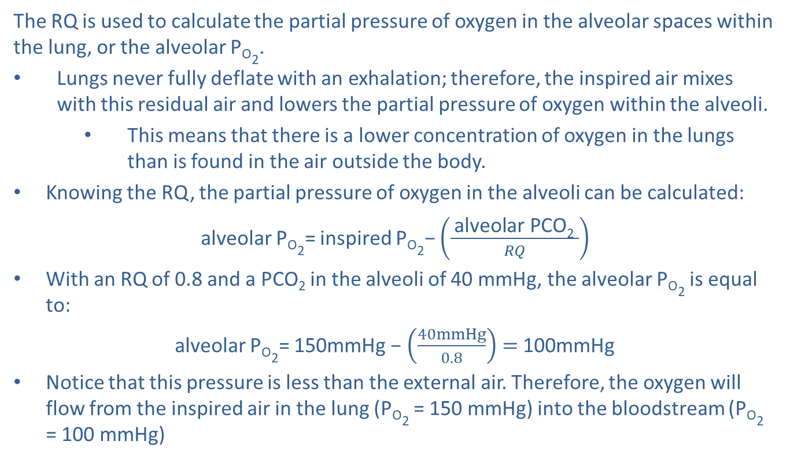
Gas Exchange across the Alveoli₂
The RQ is used to calculate the partial pressure of oxygen in the alveolar spaces within the lung, or the alveolar P_{O2}.
Lungs never fully deflate with an exhalation; therefore, the inspired air mixes with this residual air and lowers the partial pressure of oxygen within the alveoli.
This means that there is a lower concentration of oxygen in the lungs than is found in the air outside the body.
Knowing the RQ, the partial pressure of oxygen in the alveoli can be calculated:
alveolar P_{O2}= inspired P_{O2}− $\left(\frac{ \text{alveolar} \text{PCO}\text{2} }{RQ}\right)$
With an RQ of 0.8 and a PCO₂ in the alveoli of 40 mmHg, the alveolar P_{O2} is equal to:
alveolar P_{O2}= 150mmHg −$\left(\frac{40mmHg}{0.8}\right)=$100mmHg
Notice that this pressure is less than the external air. Therefore, the oxygen will flow from the inspired air in the lung (P_{O2} = 150 mmHg) into the bloodstream (P_{O2} = 100 mmHg)

Slide 17
Gas Exchange across the Alveoli₃
In the lungs, oxygen diffuses out of the alveoli and into the capillaries.
Oxygen (about 98%) binds reversibly to the respiratory pigment hemoglobin found in red blood cells (RBCs).
RBCs carry oxygen to the tissues where oxygen dissociates from the hemoglobin and diffuses into the cells of the tissues.
Alveolar P_{O2} is higher in the alveoli (P_{ALVO2} = 100 mmHg) than blood P_{O2} (40 mmHg) in the capillaries, causing oxygen to move out of the alveoli.
Alveolar P_{CO2} is lower (P_{ALVCO2} = 40 mmHg) than blood (P_{CO2} = 45 mmHg). C_{O2} diffuses down its pressure gradient, moving out of the capillaries and entering the alveoli.
The change in partial pressure from the alveoli to the capillaries drives the oxygen into the tissues and the carbon dioxide into the blood from the tissues.
The blood is then transported to the lungs where differences in pressure in the alveoli result in the movement of carbon dioxide out of the blood into the lungs and oxygen into the blood because of the pressure difference between the tissues and blood.

Slide 18
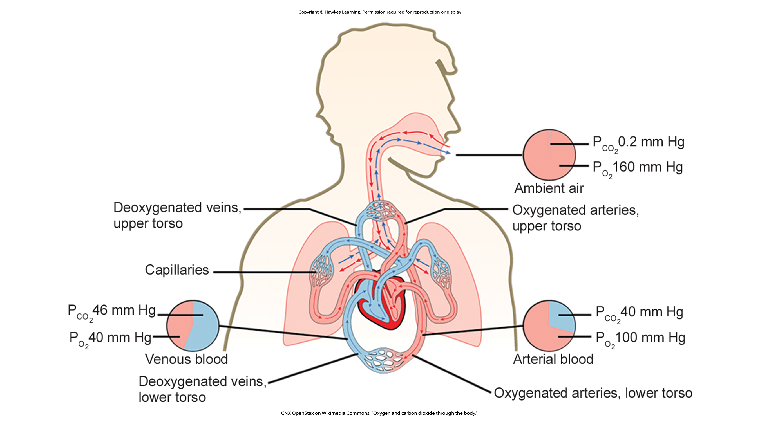
Lesson 36.2 Figure 5
CNX OpenStax on Wikimedia Commons. "Oxygen and carbon dioxide through the body."
Notes:
Figure 5: The partial pressures of oxygen and carbon dioxide change as blood moves through the body.

Slide 19
Science and You₂
Do Respiration-Related Career Options Exist?
Yes! Respiratory therapists or respiratory practitioners evaluate and treat patients with lung and cardiovascular diseases. They work as part of a medical team to develop treatment plans for patients.
Respiratory therapists may treat premature babies with underdeveloped lungs, patients with chronic conditions such as asthma, or older patients suffering from lung disease, such as emphysema and chronic obstructive pulmonary disease (COPD). They may operate advanced equipment such as compressed gas delivery systems, ventilators, blood gas analyzers, and resuscitators.
How Can I Become a Respiratory Therapist?
There are specialized programs to become a respiratory therapist. Generally, these programs lead to a bachelor's degree with a respiratory therapist specialty. Because of a growing aging population, career opportunities as a respiratory therapist are expected to remain strong.

Slide 20
Summary
The lungs can hold a large volume of air, but they are not usually filled to maximal capacity.
Lung volume measurements include tidal volume, expiratory reserve volume, inspiratory reserve volume, and residual volume.
Gas movement into or out of the lungs is dependent on the pressure of the gas.
The difference between the partial pressure of the gas in the air drives oxygen into the tissues and carbon dioxide out of the body.

Slide 21

End of Hawkes Learning PowerPoint

