Slide 1
Lesson 36.3
Breathing

Slide 2
Objectives
Describe how the structures of the lungs and thoracic cavity control the mechanics of breathing.
Discuss problems that may arise due to a V/Q mismatch.
Explain the importance of compliance and resistance in the lungs.

Slide 3
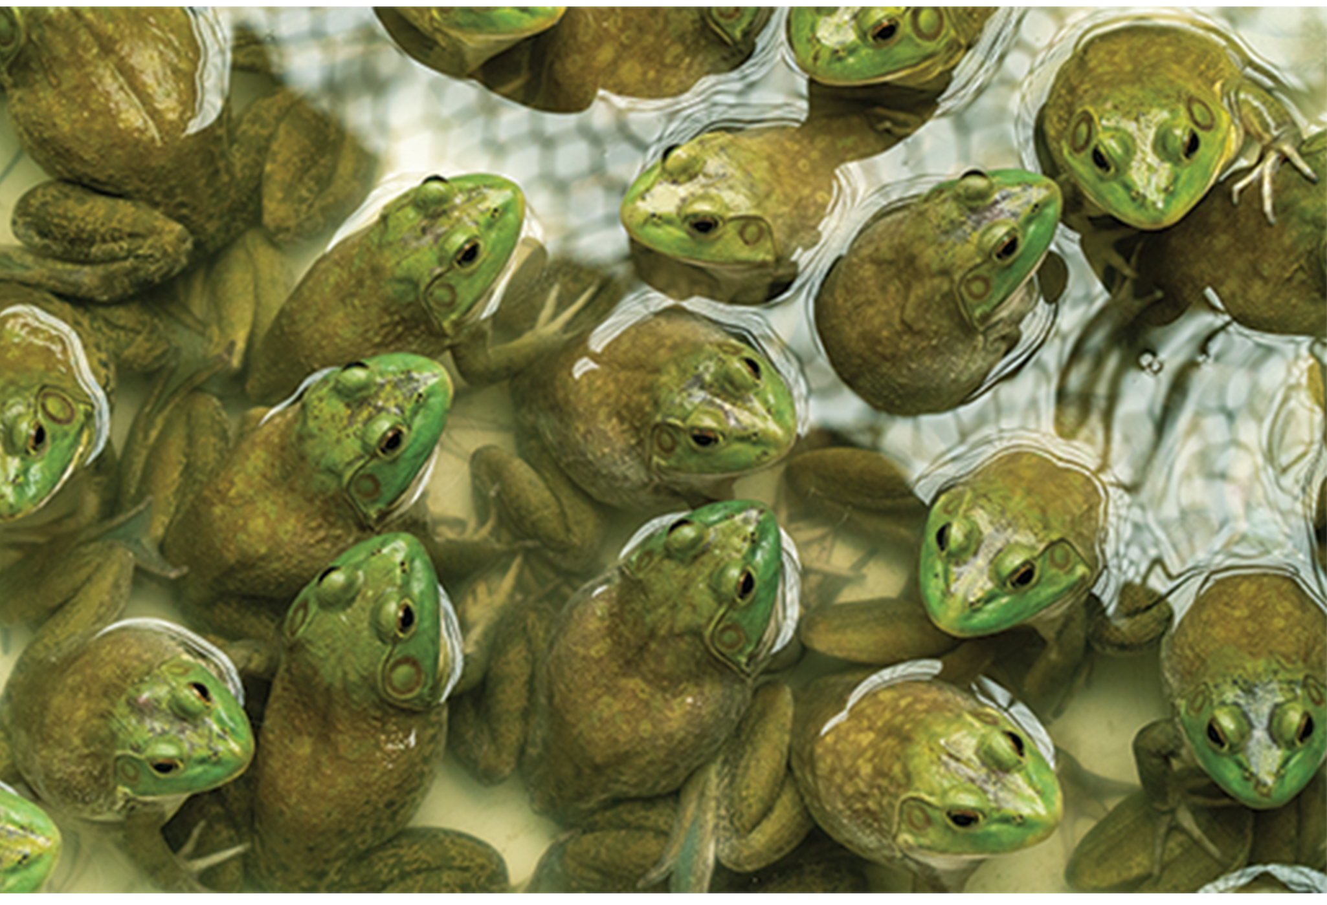
Types of Breathing₁
Amphibians have evolved multiple ways of breathing.
Young amphibians use gills to breathe and don't leave the water.
Some amphibians retain gills for life.
Others lose their gills and grow lungs as they develop.
These lungs are primitive and not as evolved as mammalian lungs.
Adult amphibians have a reduced diaphragm or lack one entirely, so breathing via lungs is forced.
Amphibians also breath across their skin using diffusion. To aid this diffusion, amphibian skin must remain moist.
36.3 Figure 1
Notes:
Figure 1: Amphibian skin must remain moist for oxygen (O2) to diffuse properly.

Slide 4

Types of Breathing₂
Birds face a unique challenge with respect to breathing in that they fly.
Flying consumes a great amount of energy; therefore, birds require a lot of oxygen to aid their metabolic processes.
Like mammals, birds have lungs.
The details of breathing between birds and mammals differ substantially.
Birds have air sacs inside their body. Air flows in one direction from the posterior air sacs to the lungs and out of the anterior air sacs.
The flow of air is in the opposite direction from blood flow, and gas exchange takes place much more efficiently.
This directionality of airflow requires two cycles of air intake and exhalation to completely get the air out of the lungs.
36.3 Figure 2
Boris Smokrovic on Unsplash. "Warbling white-eye."
Notes:
Figure 2: Like all birds, this warbling white-eye (Zosterops japonicus) has evolved an efficient respiratory system capable of supplying the oxygen needed to fly.

Slide 5
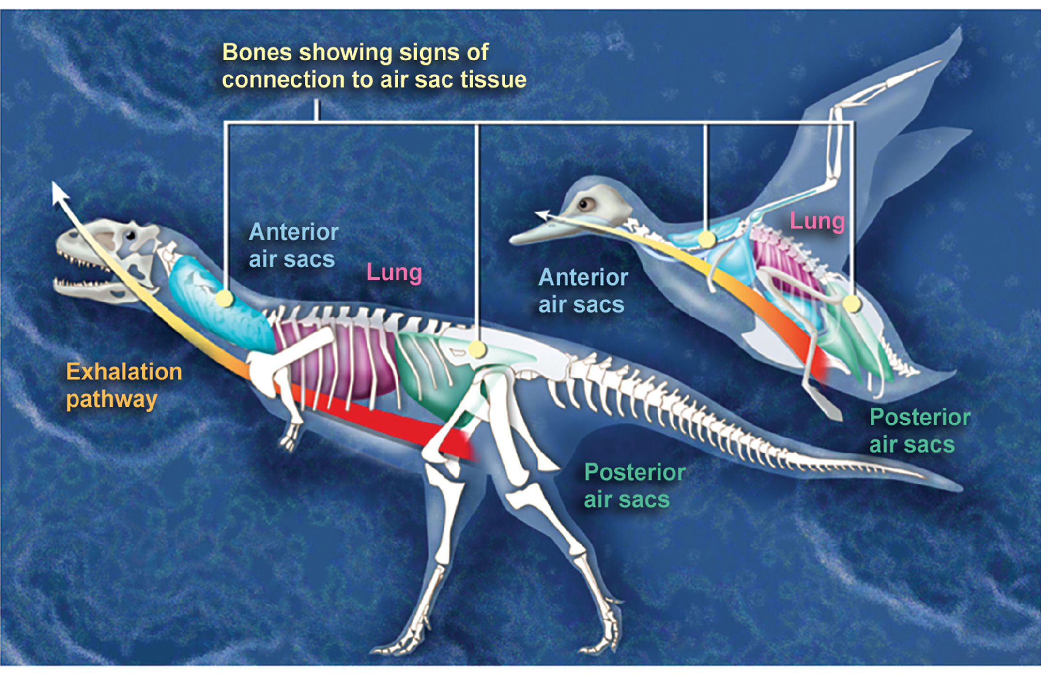
Evolution Connection
Avian Respiration
How did birds evolve such a unique respiratory system?
Decades of research by paleontologists have shown that birds evolved from therapods, or meat-eating dinosaurs
In fact, fossil evidence shows that meat-eating dinosaurs that lived more than 100 million years ago had a similar flow-through respiratory system with lungs and air sacs.
Archaeopteryx and Xiaotingia, for example, were flying dinosaurs and are believed to be early precursors of birds.
Most of us consider dinosaurs to be extinct, but modern birds are descendants of avian dinosaurs.
36.3 Figure 3
Zina Deretsky, National Science Foundation. "Dinosaur respiratory system."

Slide 6
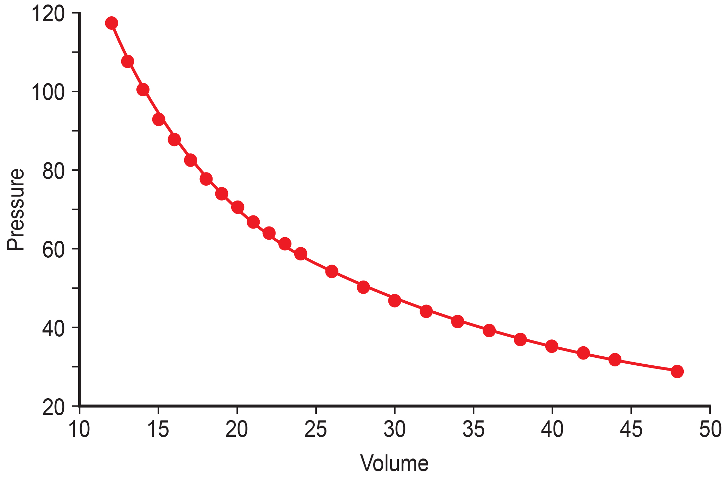
The Mechanics of Human Breathing₁
Boyle's law is the gas law that states that in a closed space, pressure and volume are inversely related.
As volume decreases, pressure increases, and vice versa.
The relationship between gas pressure and volume helps to explain the mechanics of breathing.
There is always a slightly negative pressure within the thoracic cavity, which aids in keeping the airways of the lungs open.
During inhalation, the contraction of the diaphragm increases the volume of the thoracic cavity.
According to Boyle's law, such an increase in volume decreases the pressure in the cavity.
36.3 Figure 4
CNX OpenStax on Wikimedia Commons. "Pressure and volume inversely related."
Notes:
Figure 4: This graph shows data from Boyle's original 1662 experiment, which shows that pressure and volume are inversely related. No units are given, as Boyle used arbitrary units in his experiments.

Slide 7
The Mechanics of Human Breathing₂
The decrease of pressure in the thoracic cavity relative to the environment during inhalation makes the pressure in the cavity less than the atmospheric pressure.
Because of this drop in pressure, air rushes into the respiratory passages.
To increase the volume of the lungs, the chest wall expands. This results from the contraction of the intercostal muscles—the muscles that are connected to the rib cage.
This increase in the volume of the thoracic cavity lowers pressure compared to the atmosphere, so air rushes into the lungs.
The lungs are elastic; therefore, when air fills the lungs, the elastic recoil within the tissues of the lung exerts pressure back toward the interior of the lungs.
These outward and inward forces compete to inflate and deflate the lung with every breath.
Upon exhalation, the lungs recoil to force the air out and the intercostal muscles relax, returning the chest wall back to its original position.
The movement of air out of the lungs is a passive event; no muscles contract to expel the air.

Slide 8
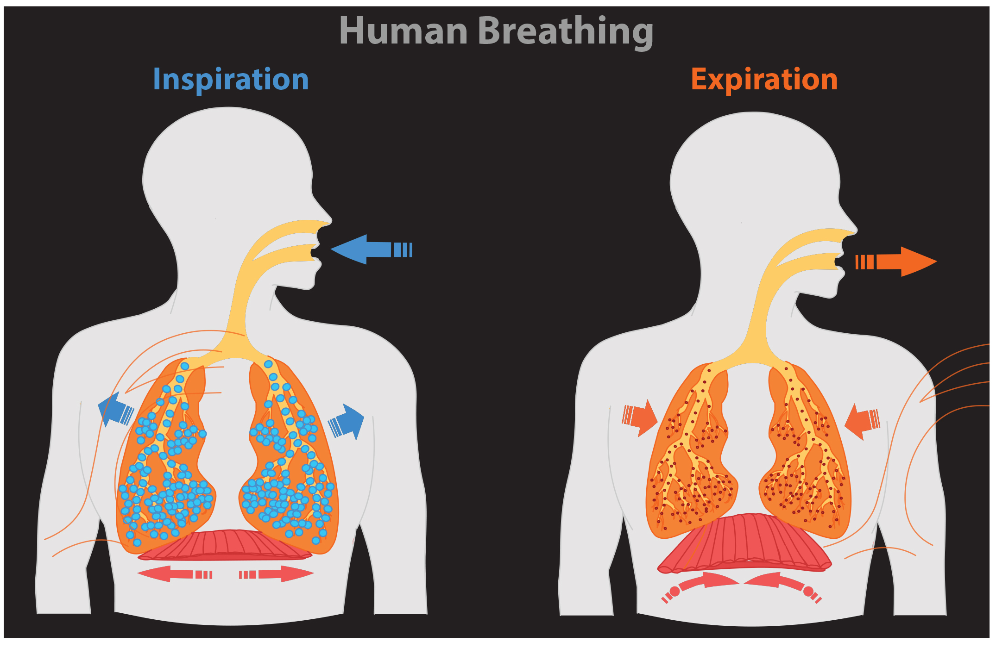
Lesson 36.3 Figure 5
Notes:
Figure 5: The lungs, chest wall, and diaphragm are all involved in respiration, both inspiration and expiration.

Slide 9
The Mechanics of Human Breathing₃
Each lung is surrounded by a membrane that folds back in on itself to create a two-layered membrane sac (called the pleural sac).
The layer of this sac that covers the lung and dips into spaces is called the visceral pleura.
The layer that lines and is attached to the thoracic cavity is called the parietal pleura.
The space between these layers, the intrapleural space, contains a small amount of fluid that protects the tissue and reduces the friction generated from rubbing the tissue layers together as the lungs contract and relax.
Pleurisy results when these layers of tissue become inflamed; it is painful because the inflammation increases the pressure within the thoracic cavity and reduces the volume of the lung.

Slide 10
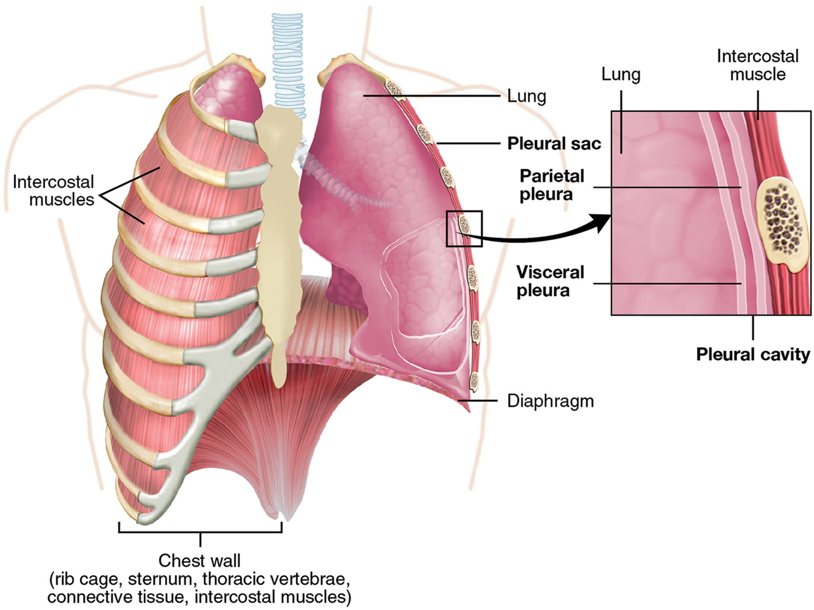
Lesson 36.3 Figure 6
OpenStax College on Wikimedia Commons. "Lung pleura."
Notes:
Figure 6: A tissue layer called pleura surrounds the lung and interior of the thoracic cavity.

Slide 11
The Work of Breathing₁
The number of breaths per minute is the respiratory rate.
On average the human respiratory rate is 12–15 breaths/minute.
The respiratory rate contributes to the alveolar ventilation, or how much air moves into and out of the alveoli.
There are two ways to keep the alveolar ventilation constant: increase the respiratory rate while decreasing the tidal volume of air per breath or decrease the respiratory rate while increasing the tidal volume per breath.

Slide 12
The Work of Breathing₂
There are two types of work conducted during respiration: flow-resistive and elastic work.
Flow-resistive refers to the work of the alveoli and tissues in the lung in inflating and deflating as air enters and exits, whereas elastic work refers to the work of the intercostal muscles, chest wall, and diaphragm in expanding and contracting the chest.
Increasing the respiration rate while decreasing the volume of air per breath increases the flow-resistive work of the airways and decreases the elastic work of the muscles.
Decreasing the respiratory rate and increasing the tidal volume per breath decreases the flow-resistive work and increases the elastic work.

Slide 13

Surfactant
The air-tissue/water interface of the alveoli has a high surface tension.
This surface tension pulls the surfaces of the alveoli in toward one another after exhalation.
To avoid cells collapsing on each other, cells of the lungs produce surfactant.
Surfactant is a complex mixture of phospholipids and lipoproteins that works to reduce the surface tension that exists between the alveoli tissue and the air found within the alveoli.
Babies born prematurely sometimes do not produce enough surfactant. As a result, they suffer from respiratory distress syndrome because it requires more effort to inflate their lungs.
36.3 Figure 7
Pixabay on Pexels. "Water droplet."
Notes:
Figure 7: The high surface tension of the alveoli's air-tissue/water interface is similar to the surface tension of the liquid-air interface on this water droplet that allows it to hang off the blade of grass without falling.

Slide 14
Lung Resistance and Compliance₁
Pulmonary diseases reduce the rate of gas exchange into and out of the lungs.
Two main causes of decreased gas exchange are compliance (how well the lungs expand) and resistance (how much obstruction exists in the airways).
Compliance is a measurement of the change in lung volume divided by the change in pleural pressure.
Examples of restrictive diseases are respiratory distress syndrome, pulmonary edema, and pulmonary fibrosis.

Slide 15
Lung Resistance and Compliance₂
The intrapleural pressure is more positive, which contributes to the inability of the lungs to expand. Forced or functional vital capacity (FVC), which is the amount of air that can be forcibly exhaled after taking the deepest breath possible, is much lower than in normal patients because the amount of air that can be inhaled and held in the lungs is reduced.
In both respiratory distress syndrome and pulmonary fibrosis, the airways are stiff, fibrotic, and less compliant.
Those with pulmonary edema experience reduced compliance due to fluid buildup in the lungs and an increase in hydrostatic pressure.

Slide 16
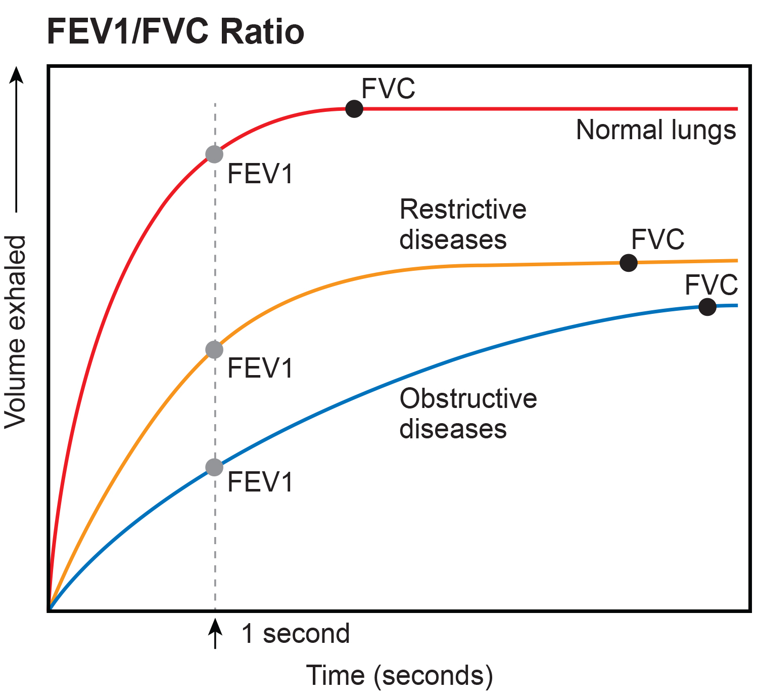
Lesson 36.3 Figure 8
CNX OpenStax on Wikimedia Commons. "Graph of exhale."
Notes:
Figure 8: The ratio of FEV1 (the amount of air that can be forcibly exhaled in one second after taking a deep breath) to FVC (the total amount of air that can be forcibly exhaled) can be used to diagnose whether a person has restrictive or obstructive lung disease. In restrictive lung disease, FVC is reduced, but airways are not obstructed, so the person is able to expel air reasonably fast. In obstructive lung disease, airway obstruction results in slow exhalation as well as reduced FVC. Thus, the FEV1/FVC ratio is lower in persons with obstructive lung disease (less than 69%) than in persons with restrictive lung disease (88 to 90%).

Slide 17
Obstructive Diseases₁
Obstructive diseases and conditions include emphysema, asthma, bronchitis, bronchiectasis, cystic fibrosis, obstructive sleep apnea, and bronchopulmonary dysplasia.
Some obstructive diseases can have restrictive properties and vice versa.
In emphysema, which mostly arises from smoking tobacco, the walls of the alveoli are destroyed, decreasing the surface area for gas exchange.

Slide 18
Obstructive Diseases₂
Asthma is a disease in which inflammation, or obstruction of the airways, is often triggered by environmental factors.
The obstruction may be due to edema (fluid accumulation), smooth muscle spasms in the walls of the bronchioles, increased mucus secretion, damage to the epithelia of the airways, or a combination of these events.
Those with obstructive diseases have large volumes of air trapped after exhalation, limiting the room in the alveoli to add more volume.

Slide 19
Dead Space: V/Q Mismatch₁
Pulmonary circulation pressure is very low compared to systemic circulation pressure. It is also independent of cardiac output.
This is because of recruitment, which is the process of opening airways that normally remain closed when cardiac output increases.
As cardiac output increases, the number of capillaries and arteries that are perfused increases. These capillaries and arteries are not always in use but are ready if needed.
At times, however, there is a mismatch between the amount of air (ventilation, V) and the amount of blood (perfusion, Q) in the lungs. This is referred to as ventilation/perfusion (V/Q) mismatch.

Slide 20
Dead Space: V/Q Mismatch₂
There are two types of V/Q mismatch. Both produce dead space—regions of broken down or blocked lung tissue.
Anatomical dead space, or anatomical shunt, arises from an anatomical failure.
Physiological dead space, or physiological shunt, arises from a functional impairment of the lung or arteries.
The lung can compensate for these mismatches in ventilation and perfusion.
If ventilation is greater than perfusion, the arterioles dilate, and the bronchioles constrict.
If ventilation is less than perfusion, the arterioles constrict, and the bronchioles dilate to correct the imbalance.

Slide 21
Think It Through
Why are dead spaces a problem? Use the definitions of physiological and anatomical air space to explain why physiological dead space is generally of greater clinical importance.
Notes:
Originally an On Your Own. This is included here to use as a talking point or for a think-pair-share activity.

Slide 22
Summary
The structure of the lungs and thoracic cavity control the mechanics of breathing.
Inhalation causes the diaphragm to contract and lower. The intercostal muscles contract and expand the chest wall causing the lungs to expand. When exhaling, the intercostal muscles and diaphragm relax, returning the intrapleural pressure back to the resting state.
Surfactant acts like a detergent in the airways to reduce surface tension and allow for opening of the alveoli.
Breathing and gas exchange are both altered by changes in the compliance and resistance of the lung.
Alterations in the ventilation of the airways or perfusion of the arteries can affect gas exchange.

Slide 23

End of Hawkes Learning PowerPoint

