Slide 1
Lesson 36.4
Gas Transport in Human Body Fluids

Slide 2
Objectives
Describe how oxygen is bound to hemoglobin and transported to body tissues.
Explain how carbon dioxide is transported from body tissues to the lungs.

Slide 3
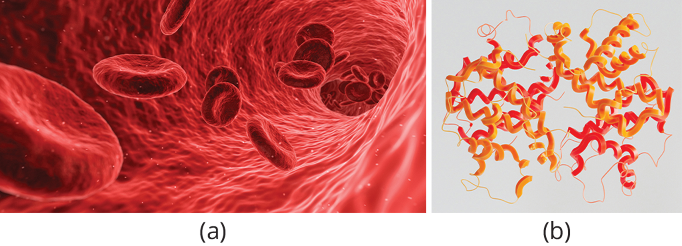
Transport of Oxygen in the Blood
Most oxygen—98.5%—is bound to a protein called hemoglobin and carried to the tissues.
Hemoglobin, or Hb, is a protein molecule found in red blood cells made of four subunits: two alpha subunits and two beta subunits.
Each subunit surrounds a central heme group that contains iron (Fe) and binds one oxygen molecule, allowing each hemoglobin molecule to bind four oxygen molecules.
The binding of oxygen to hemoglobin can be plotted as a function of the partial pressure of oxygen in the blood versus the relative Hb-oxygen saturation.
The resulting graph—an oxygen dissociation curve—is sigmoidal, or S-shaped.
As the partial pressure of oxygen increases, the hemoglobin becomes increasingly saturated with oxygen.
36.4 Figure 1
Arek Socha on Pixabay. "Red blood cells."
ANIRUDH on Unsplash. "Hemoglobin structure."
Notes:
Figure 1: The protein inside (a) red blood cells that carries oxygen to cells and carbon dioxide to the lungs is (b) hemoglobin. Hemoglobin is made up of four symmetrical subunits and four heme groups. Iron associated with the heme binds oxygen. It is the iron in hemoglobin that gives blood its red color.

Slide 4
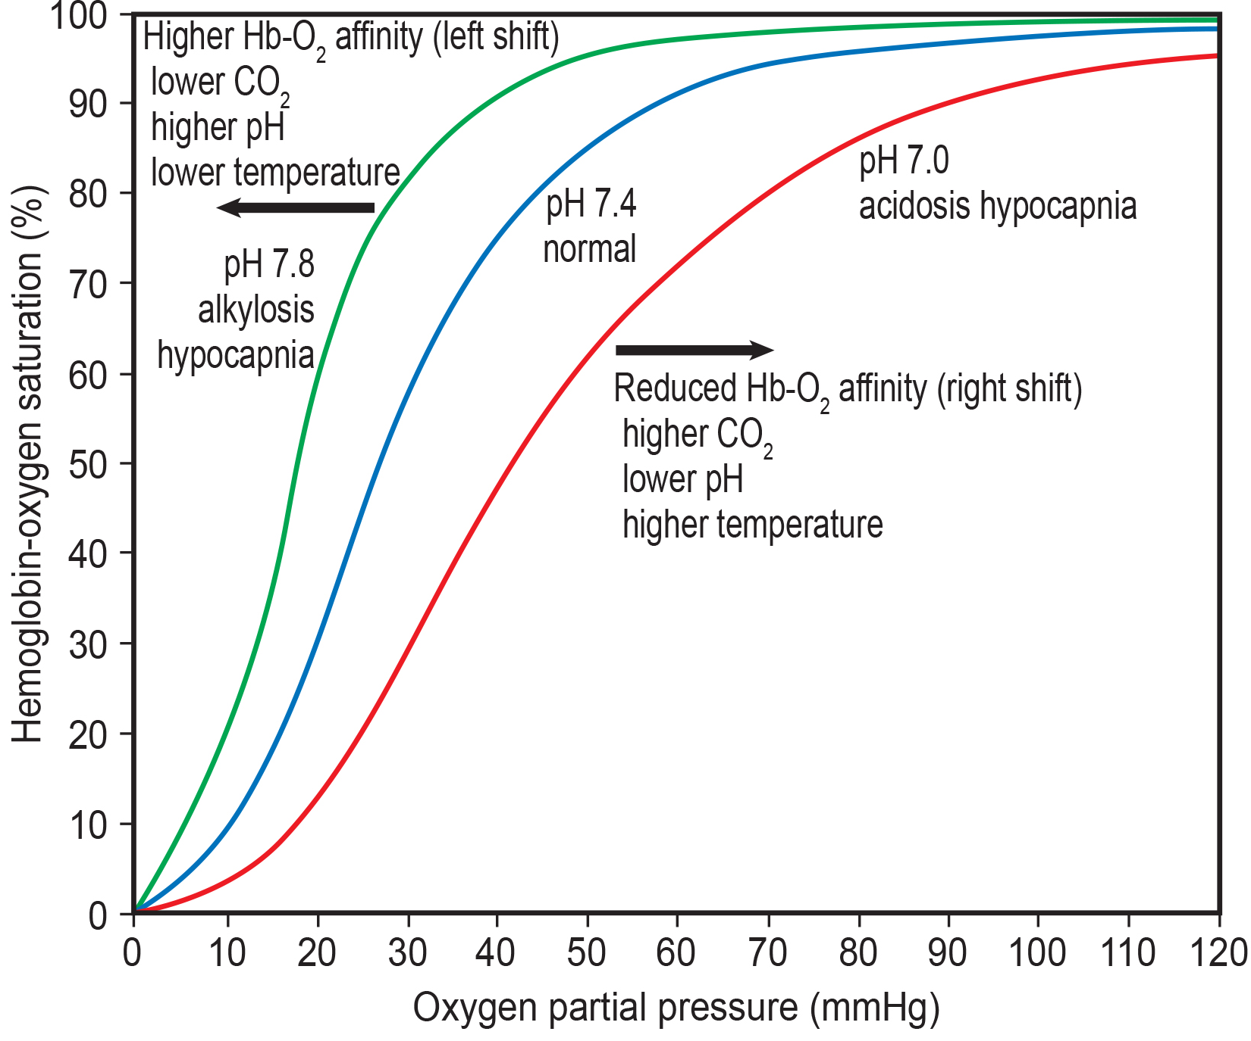
Lesson 36.4 Figure 2
Peter Southwood on Wikimedia Commons. "Oxygen-hemoglobin dissociation curves."
Notes:
Figure 2: The oxygen dissociation curve demonstrates that, as the partial pressure of oxygen increases, more oxygen binds hemoglobin. However, the affinity of hemoglobin for oxygen may shift to the left or the right depending on environmental conditions.

Slide 5
Think It Through
The kidneys are responsible for removing excess hydrogen ions (H⁺) from the blood. If the kidneys were to fail, the pH of the blood would decrease.
In this scenario, what would happen to blood pH and to hemoglobin (Hb) affinity for oxygen?
Notes:
Originally an On Your Own. This is included here to use as a talking point or for a think-pair-share activity.

Slide 6
Science and You
Methemoglobinemia is a rare blood condition in which much of the blood's hemoglobin exists in an alternate form called methemoglobin. Unlike hemoglobin, methemoglobin doesn't bind well to oxygen. So, rather than bright red, methemoglobin appears dark, chocolate brown. Usually, this condition is inherited.
How Does Elevated Methemoglobin Affect the Person?
People with this condition develop headaches, dizziness, and other issues caused by tissue hypoxia due to the blood's reduced ability to deliver oxygen. Sufferers also develop a distinctive blue tinge to their skin, caused by the dark-colored blood.
Can Methemoglobinemia Be Treated?
Yes, and the treatments are usually very successful. Treatments include oxygen therapy and methylene blue—a medication that helps transform methemoglobin into hemoglobin.
Notes:
This is included as a relevant application for this topic.

Slide 7
Factors That Affect Oxygen Binding₁
The oxygen-carrying capacity of hemoglobin determines how much oxygen is carried in the blood. In addition to the partial pressure of oxygen (P_{O2}), other environmental factors such as blood pH, CO₂ levels body temperature as well as diseases can affect oxygen carrying capacity and delivery.
For example: more oxygen is needed to reach the same hemoglobin saturation level when the pH is higher.

Slide 8
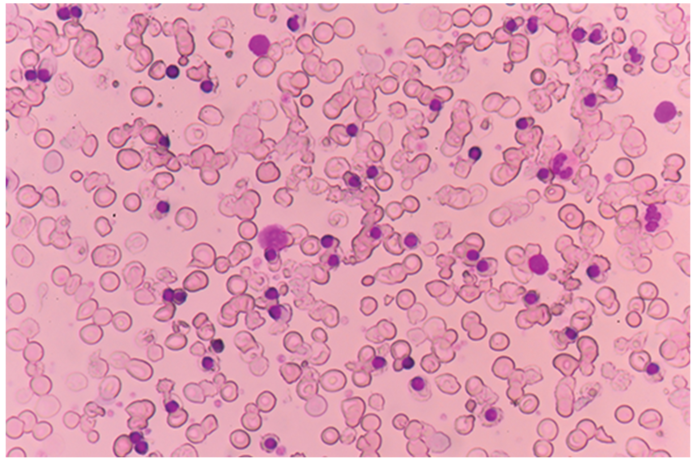
Factors That Affect Oxygen Binding₂
Diseases like sickle cell anemia and thalassemia decrease the blood's ability to deliver oxygen to tissues and its oxygen-carrying capacity.
In sickle cell anemia, the shape of the red blood cell is crescent-shaped, elongated, and stiffened, reducing its ability to deliver oxygen. In this form, red blood cells cannot pass through the capillaries; this is painful when it occurs.
Thalassemia is a rare genetic disease caused by a defect in either the alpha or the beta subunit of Hb. Patients with thalassemia produce a high number of red blood cells, but these cells have lower-than-normal levels of hemoglobin. Therefore, the oxygen-carrying capacity is diminished.
36.4 Figure 3
Notes:
Figure 3: Beta thalassemia is a genetic disorder that results in decreased hemoglobin production and red blood cells with an oval or elongated shape, as in this blood smear.

Slide 9
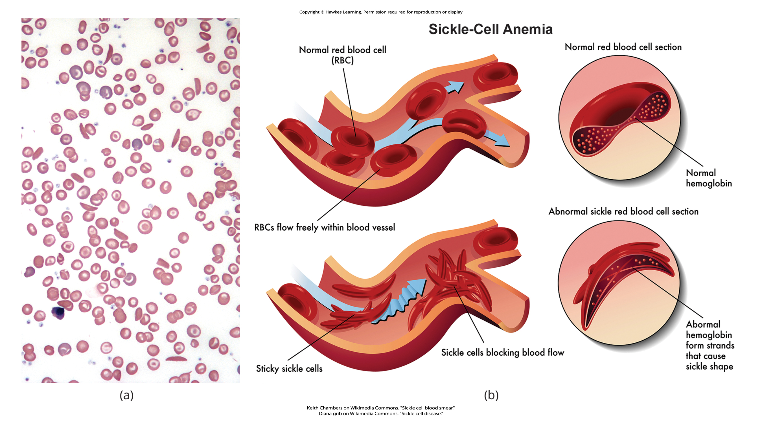
Lesson 36.4 Figure 4
Keith Chambers on Wikimedia Commons. "Sickle cell blood smear."
Diana grib on Wikimedia Commons. "Sickle cell disease."
Notes:
Figure 4: Individuals with sickle cell anemia have (a) crescent-shaped red blood cells that (b) can block blood flow.

Slide 10
Transport of Carbon Dioxide in the Blood₁
Carbon dioxide (CO₂) molecules are transported in the blood from body tissues to the lungs by one of three methods.
By dissolving directly into the blood
Binding to hemoglobin
Being carried as a bicarbonate ion

Slide 11
Transport of Carbon Dioxide in the Blood₂
Carbon dioxide can bind to plasma proteins or enter red blood cells and bind to hemoglobin (Hb).
When CO₂ binds to hemoglobin, a molecule called carbaminohemoglobin is formed.
85% of carbon dioxide molecules are carried as part of the bicarbonate buffer system, a system that helps maintain both the concentration of carbon dioxide in the blood and the pH of the blood within a certain physiological range.
As CO₂ diffuses into red blood cells, carbonic anhydrase (CA) converts the CO₂ into carbonic acid (H₂CO₃). Carbonic acid immediately breaks down into bicarbonate ions (HCO₃⁻) and hydrogen (H⁺) ions.
Bicarbonate ions are transported out of the red blood cells and into the liquid component of blood in exchange for a chloride (Cl⁻) ions, a process called the chloride shift.
The H⁺ ions produced during the formation of bicarbonate ions bind to hemoglobin, preventing these ions from disrupting the blood pH.

Slide 12
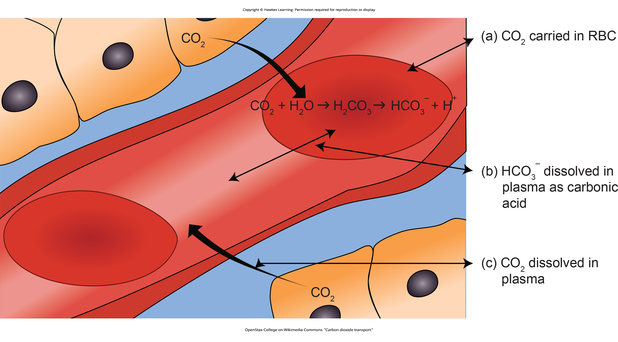
Lesson 36.4 Figure 5
OpenStax College on Wikimedia Commons. "Carbon dioxide transport."
Notes:
Figure 5: In the bicarbonate buffer system, carbon dioxide (CO2) that diffuses into red blood cells (a) is converted into bicarbonate ions (HCO3−) that are (b) transported by the blood. The conversion of carbon dioxide to bicarbonate reduces the concentration of carbon dioxide in the bloodstream, which promotes (c) the diffusion of more carbon dioxide from the body's tissues into the blood.

Slide 13
Transport of Carbon Dioxide in the Blood₃
When blood reaches the lungs, bicarbonate ions are transported back into red blood cells in exchange for chloride ions.
H⁺ ions dissociate from hemoglobin and bind to bicarbonate ions to produce carbonic acid, which is converted back to carbon dioxide through the enzymatic activity.
The carbon dioxide produced at the lungs is then expelled during exhalation.
The following equation summarizes the bicarbonate buffer system. In the equation, the double-headed areas indicate the reversibility of each step in the process.
CO₂ + H₂O ↔ H₂CO₃ ↔ HCO₃ + H⁺
(carbonic acid) (bicarbonate)
The benefit of the bicarbonate buffer system is that carbon dioxide is "soaked up" into the blood with little change to the pH of the system.

Slide 14
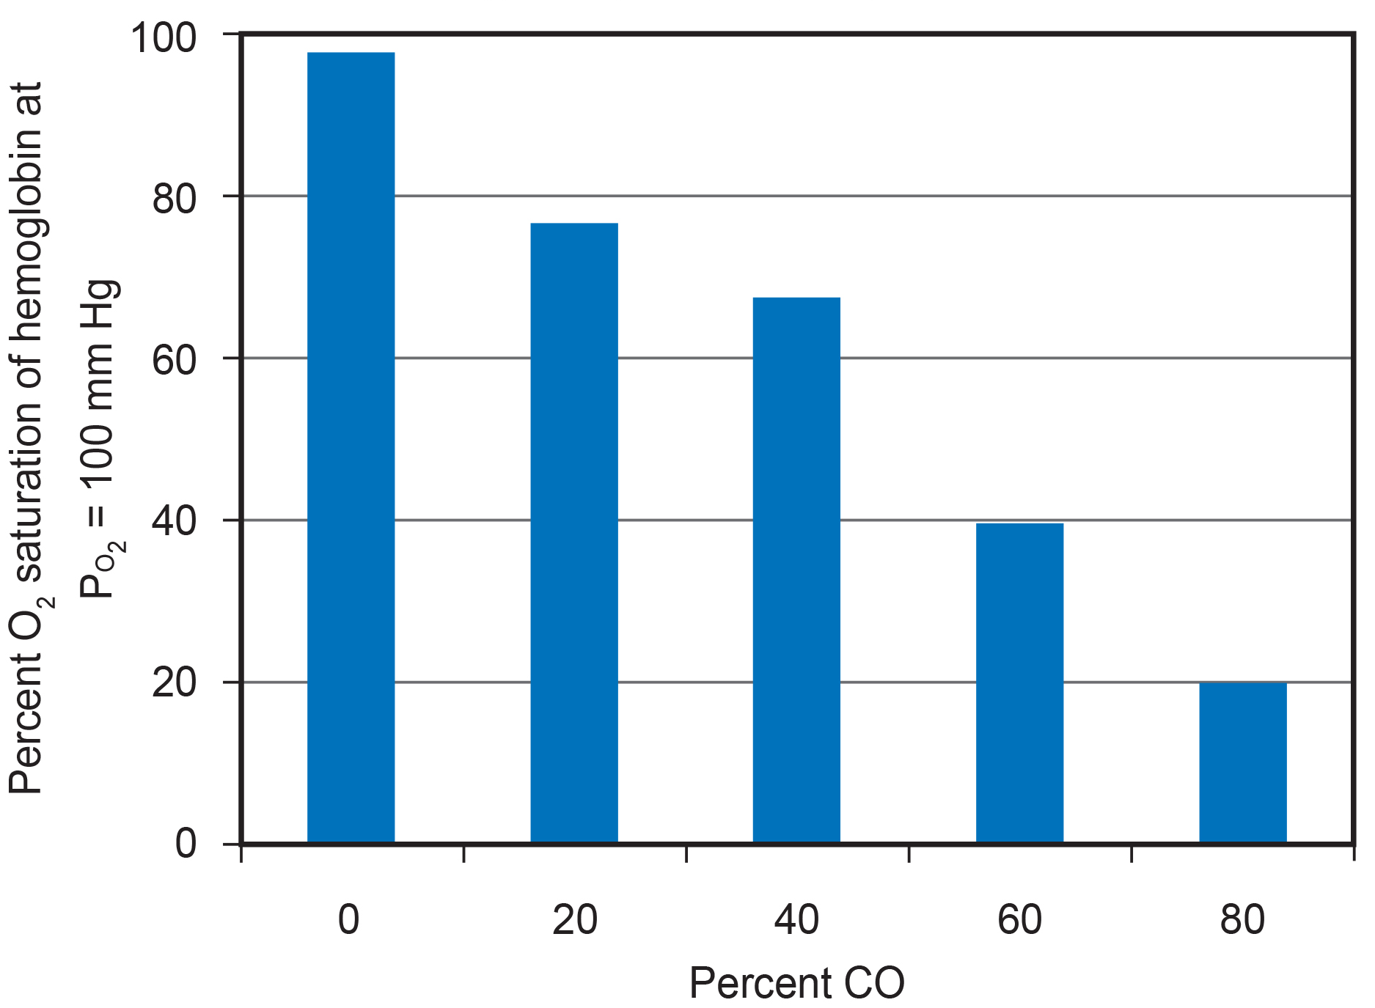
Carbon Monoxide Poisoning
Carbon dioxide (CO₂) readily associates and dissociates from hemoglobin, carbon monoxide (CO) cannot.
Carbon monoxide has a greater affinity for hemoglobin (Hb) than oxygen (O₂).
When carbon monoxide is present, it binds to hemoglobin preferentially over oxygen.
Carbon monoxide is a colorless, odorless gas and is therefore difficult to detect.
Carbon monoxide exposure can cause headaches, confusion, and nausea; long-term exposure can cause brain damage or death.
Administering 100% (pure) oxygen is the usual treatment for carbon monoxide poisoning.
36.4 Figure 6
CNX OpenStax on Wikimedia Commons. "Carbon dioxide percentage." Modified.

Slide 15
Summary
Hemoglobin is a protein found in red blood cells, comprised of four subunits surrounding an iron containing heme group which binds to oxygen.
Disease states and altered conditions in the body can affect the binding ability of oxygen and increase or decrease its ability to dissociate from hemoglobin.
Carbon dioxide can be dissolved directly in the blood, bound to plasma proteins or hemoglobin, or converted into bicarbonate, with the majority being converted to bicarbonate.

Slide 16

End of Hawkes Learning PowerPoint

