Slide 1
Lesson 37.1
Innate Immune Response

Slide 2
Objectives
  Describe physical and chemical immune barriers.
  Explain immediate and induced innate immune responses.
  Discuss natural killer cells.
  Describe major histocompatibility complex class I molecules.
  Summarize how the proteins in a complement system function to destroy extracellular pathogens.

Slide 3
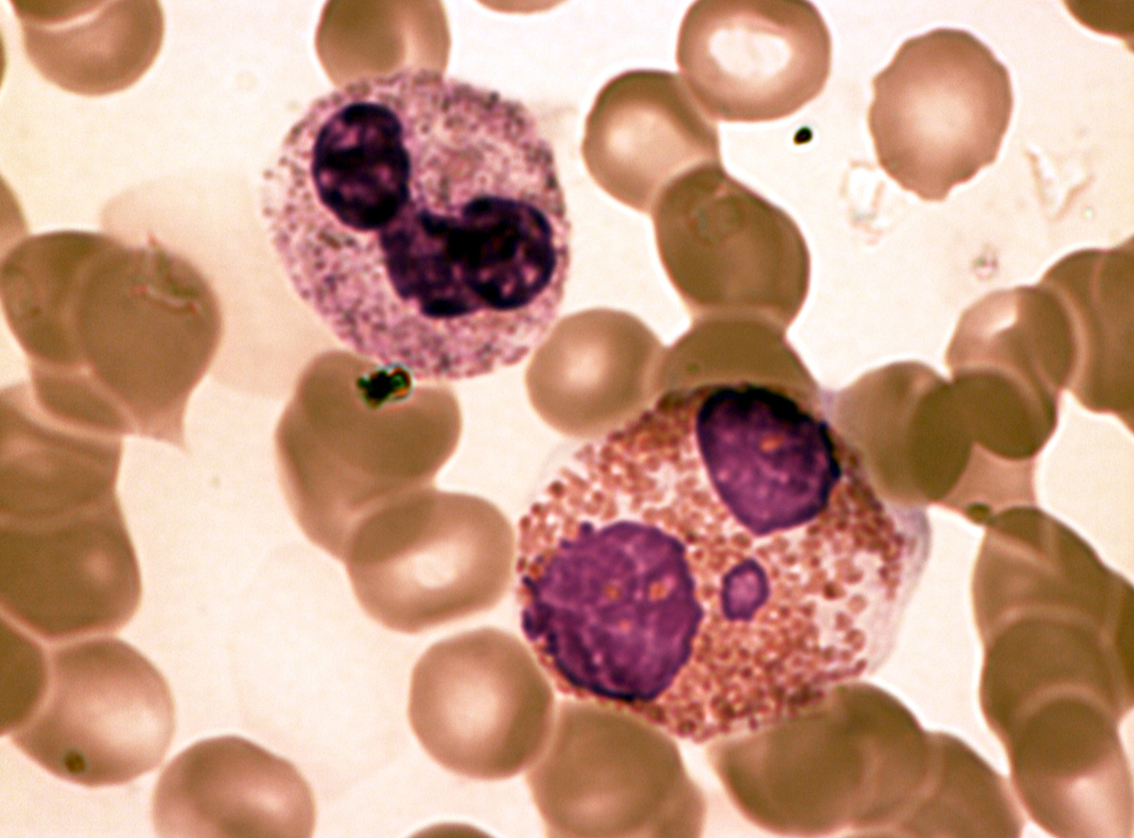
The Immune System₁
The environment consists of numerous pathogens, which are agents (usually microorganisms) that cause diseases in their hosts.
A host is the organism that is invaded and often harmed by a pathogen. Pathogens include bacteria, protists, fungi, and other infectious organisms.
To protect against such pathogens, mammalian immune systems evolved to be an extremely diverse array of specialized cells and soluble molecules to provide protection from most disease agents.
37.1 Figure 1
Dr. David Csaba L. on Wikimedia Commons. "Neutrophil and eosinophil."
Notes:
Figure 1: In this compound light micrograph, the purple-stained neutrophil (upper left) and eosinophil (lower right) are white blood cells that float among red blood cells in this blood smear. Neutrophils provide an early, rapid, and nonspecific defense against invading pathogens. Eosinophils play a variety of roles in the immune response. Red blood cells are about 7–8 μm (micrometer) in diameter, and a neutrophil is about 10–12 μm in diameter.

Slide 4
The Immune System₂
When pathogens are found, immune factors are mobilized to the site of an infection.
The immune factors identify the nature of the pathogen, combat it efficiently, and halt the immune response after the infection is cleared to avoid unnecessary host cell damage.
Features of the immune system, such as pathogen identification, specific response, amplification, retreat, and remembrance are essential for survival against pathogens.
Notes:
Figure 1: In this compound light micrograph, the purple-stained neutrophil (upper left) and eosinophil (lower right) are white blood cells that float among red blood cells in this blood smear. Neutrophils provide an early, rapid, and nonspecific defense against invading pathogens. Eosinophils play a variety of roles in the immune response. Red blood cells are about 7–8 μm (micrometer) in diameter, and a neutrophil is about 10–12 μm in diameter.

Slide 5
The Immune System₃
The immune response can be classified as either innate or active.
The innate immune response is always present and attempts to defend against all pathogens rather than focusing on specific ones.
The adaptive immune response stores information about past infections and mounts pathogen-specific defenses.
Notes:
Figure 1: In this compound light micrograph, the purple-stained neutrophil (upper left) and eosinophil (lower right) are white blood cells that float among red blood cells in this blood smear. Neutrophils provide an early, rapid, and nonspecific defense against invading pathogens. Eosinophils play a variety of roles in the immune response. Red blood cells are about 7–8 μm (micrometer) in diameter, and a neutrophil is about 10–12 μm in diameter.

Slide 6
Innate Immune Response
Innate immunity occurs naturally because of genetic factors or physiology; it provides a generalized response to pathogens that works to reduce the workload for the adaptive immune response.
Both the innate and adaptive levels of the immune response involve the secretion of proteins, signaling pathways mediated by cell-surface receptors, and intricate cell-to-cell communication.
Innate immunity has a limited number of specific targets. Any pathogenic threat triggers a consistent sequence of events that can identify the type of pathogen and either clear the infection independently or mobilize a highly specialized adaptive immune response.

Slide 7
Physical and Chemical Barriers
Before any immune factors are triggered, the skin functions as a continuous, impassable barrier to potentially infectious pathogens.
Pathogens are killed or inactivated on the skin by desiccation and the skin's acidity.
  Also, beneficial microorganisms that coexist on the skin compete with invading pathogens, preventing infection.
Regions of the body not protected by skin have alternative methods of defense, like tears, or mucus secretions and hairlike cilia that push mucus with the pathogens out of the body.
  Other parts of the body have other defenses, such as the low pH of the stomach, blood proteins that bind and disrupt bacterial cell membranes, and the process of urination.
Some pathogens have evolved specific mechanisms that allow them to overcome physical and chemical barriers.

Slide 8
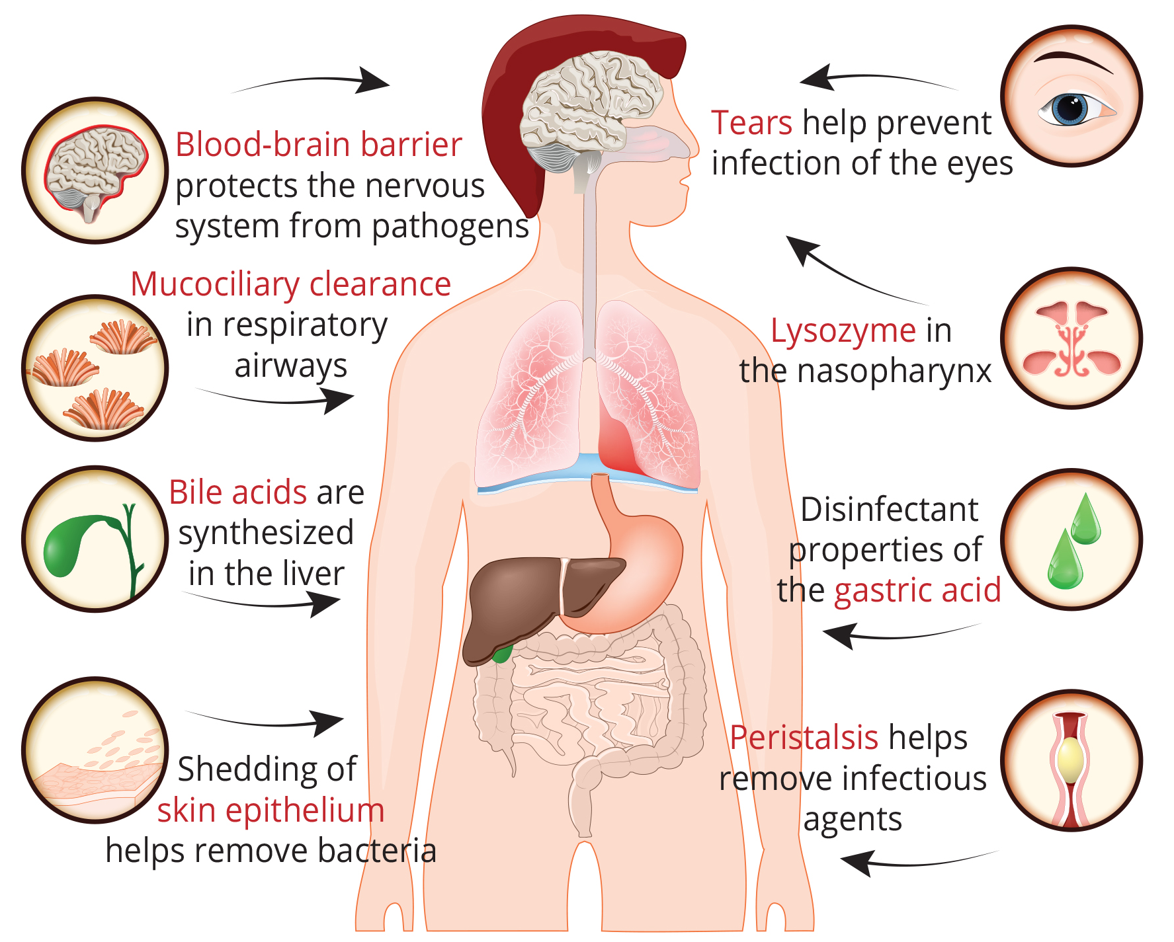
Lesson 37.1 Figure 2
Notes:
Figure 2: The body has many physical and chemical barriers to prevent an infection by a pathogen. For example, cilia in the airway help clear pathogens trapped in mucus (mucociliary clearance). Lysozyme is an enzyme found in the nasal passages and in tears that helps kill microbes. Peristalsis (the contraction of the muscles that line the digestive tract) helps ensure ingested pathogens are pushed out of the body.

Slide 9
Pathogen Recognition₁
When a pathogen enters the body, cells in the blood and lymph detect the specific pathogen-associated molecular patterns (PAMPs) on the pathogen's surface.
PAMPs are carbohydrate, polypeptide, and nucleic acid "signatures" expressed by viruses, bacteria, and parasites but differ from molecules on host cells.

Slide 10
Pathogen Recognition₂
The immune system has specific cells, with receptors that recognize these PAMPs.
A macrophage is a large phagocytic cell that engulfs foreign particles and pathogens. Macrophages recognize PAMPs using complementary pattern recognition receptors (PRRs). PRRs are molecules on the surfaces of macrophages and dendritic cells that are in contact with the external environment.
A monocyte is a type of white blood cell that circulates in the blood and lymph and differentiates into macrophages after it moves into infected tissue.
Dendritic cells bind molecular signatures of pathogens and promote pathogen engulfment and destruction.
Toll-like receptors (TLRs) are a type of PRR that recognize molecules that are shared by pathogens but are distinguishable from host molecules.

Slide 11
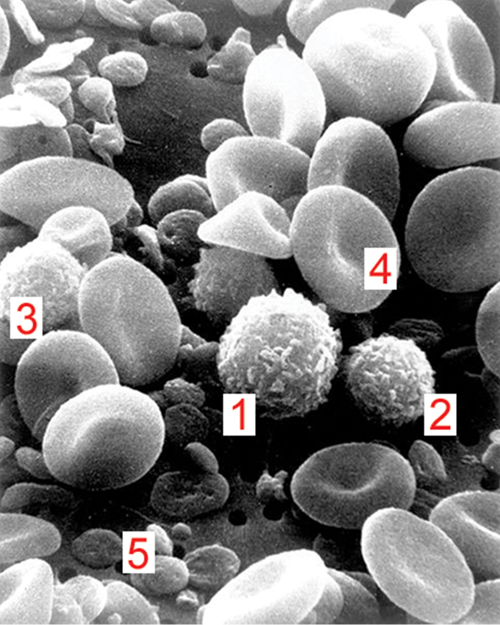
Lesson 37.1 Figure 3
Bruce Wetzel and Harry Schaefer on Wikimedia Commons. "Immune cells."
Notes:
Figure 3: Cells of the blood include (1) monocytes, (2) lymphocytes, (3) neutrophils, (4) red blood cells, and (5) platelets. Note the very similar morphologies (structures) of the leukocytes (1, 2, 3).

Slide 12
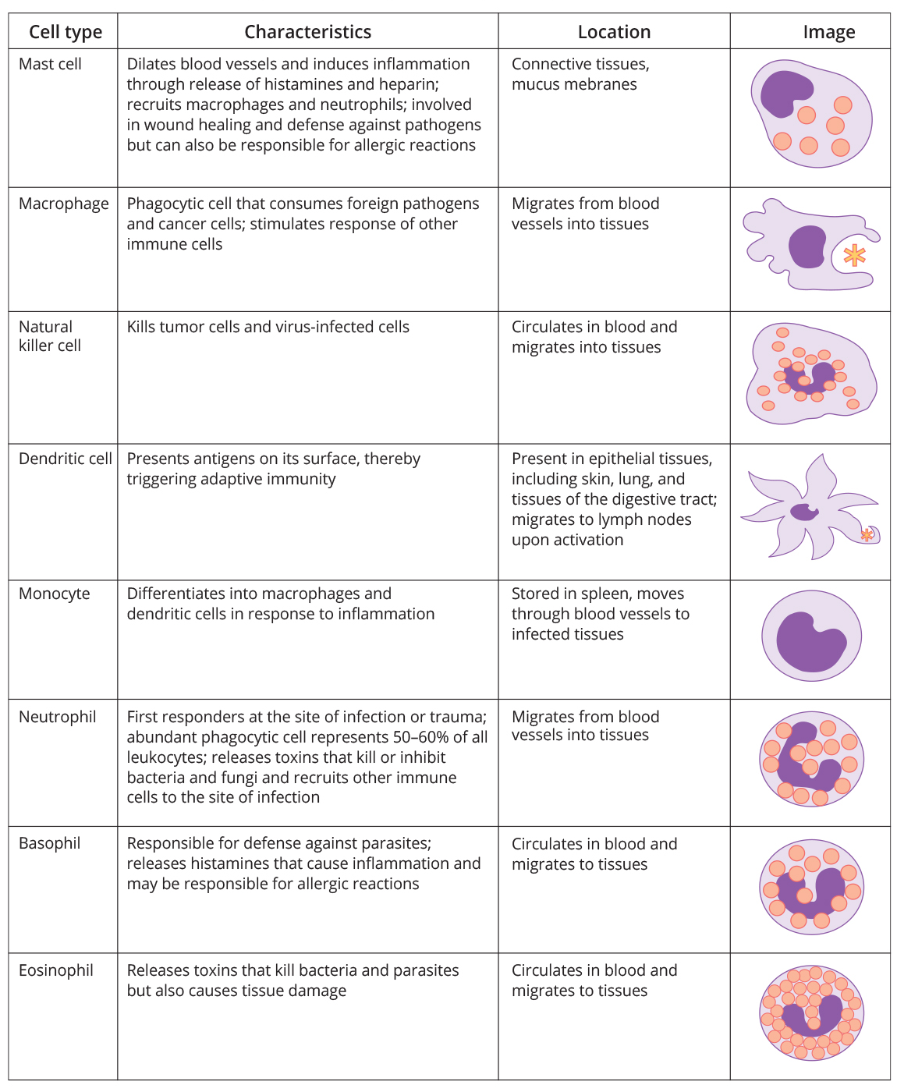
Lesson 37.1 Figure 4
NIH. "Immune system cells."
Notes:
Figure 4: The characteristics and location of leukocytes, or white blood cells, involved in the innate immune system are described.

Slide 13
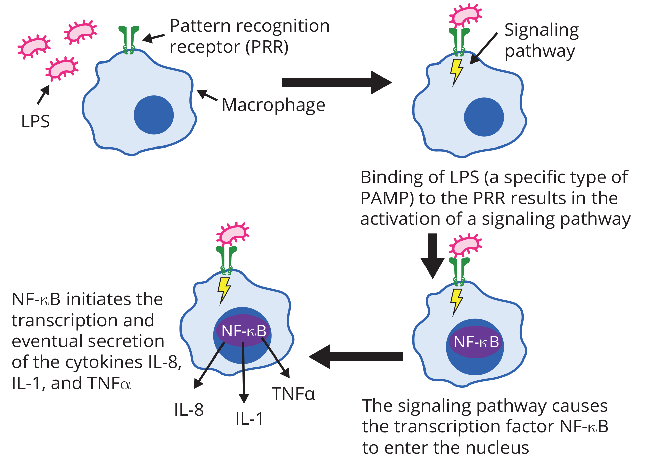
Lesson 37.1 Figure 5
Immcarle105 on Wikimedia Commons. "PAMP and PRR interaction."
Notes:
Figure 5: The lipopolysaccharide (LPS) on the cell surface of gram-negative bacteria (bacteria with relatively thin cell walls, such as E. coli) is an example of a PAMP. A PAMP is recognized by a PRR on a macrophage. Binding stimulates a change in gene expression within the macrophage. In this case, the transcription factor NF-κB is moved from the cytoplasm into the nucleus. In this nucleus, it stimulates the transcription of the cytokines IL-8, IL-1, and TNFα. These molecules signal that the pathogen is present and needs to be destroyed.

Slide 14
Reflection Question
Some bacteria are very good at evading the human immune system. What characteristics might these bacteria have that enable them to avoid detection by macrophages?
Notes:
The reflection question is included here to use as a talking point or for a think-pair-share activity.

Slide 15
Cytokine Release Effect
The binding of PRRs with PAMPs triggers cytokines to be released, which signal a pathogen is present and needs to be destroyed along with any infected cells.
A cytokine is a chemical messenger that regulates cell differentiation, proliferation, and gene expression to affect immune responses.
One class is the interleukin (IL), so named because they mediate interactions between leukocytes. Interleukins are involved in bridging the innate and adaptive immune responses.
A second class is interferons, which are released by infected cells as a warning to nearby uninfected cells.
  Interferons work by signaling neighboring uninfected cells to destroy RNA and reduce protein synthesis, signaling neighboring infected cells to undergo apoptosis and activating immune cells.
In response to interferons, uninfected cells alter their gene expression, which increases the cells' resistance to infection.

Slide 16
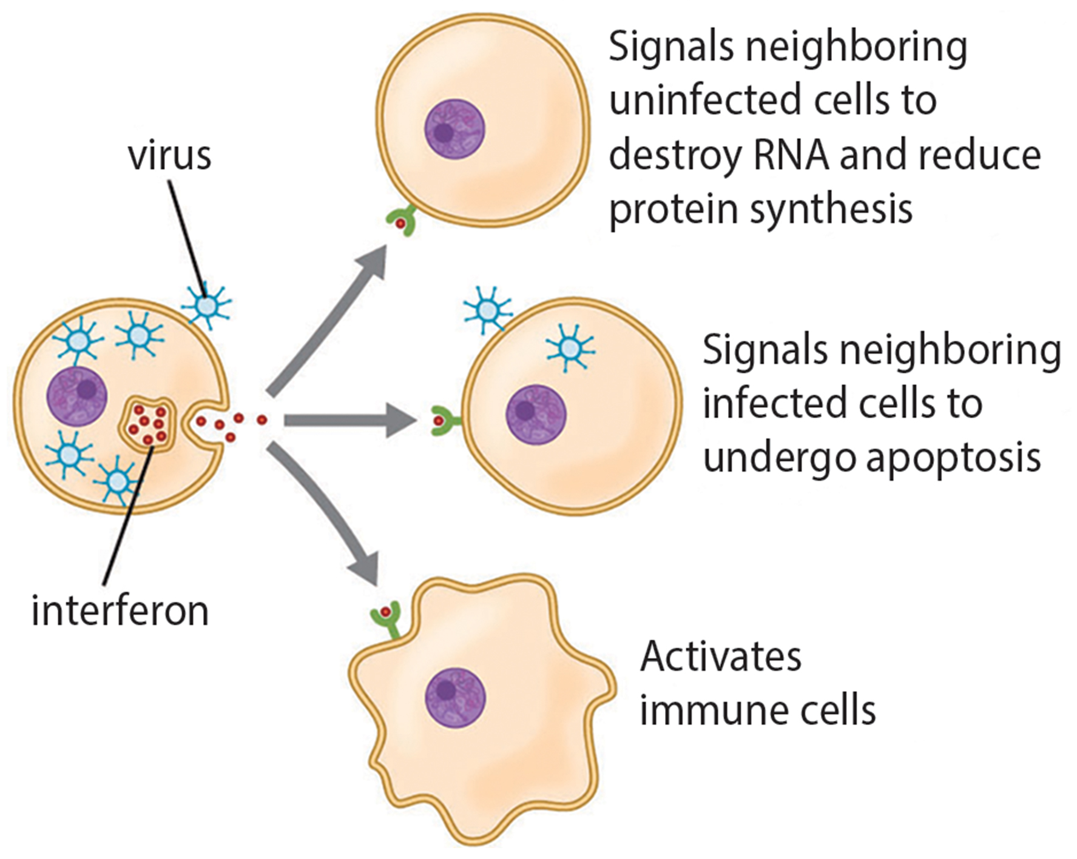
Lesson 37.1 Figure 6
CNX OpenStax on Wikimedia Commons. "Interferons."
Notes:
Figure 6: Interferons are cytokines that are released by a cell infected with a virus. The response of neighboring cells to interferons helps stem the infection.

Slide 17
Think It Through
Interferons induce the destruction of RNA in uninfected cells that neighbor a cell infected by a virus. How does this help to limit viral infection?
Notes:
Originally an On Your Own. This is included here to use as a talking point or for a think-pair-share activity.

Slide 18
Phagocytosis and Inflammation₁
The first cytokines encourage inflammation, the localized redness, swelling, heat, and pain that result from the movement of leukocytes and fluid through increasingly permeable capillaries to a site of infection.
  Macrophages and dendritic cells engulf pathogens and cellular debris through phagocytosis.
  A neutrophil is also a phagocytic leukocyte that engulfs and digests pathogens.
  An eosinophil is a leukocyte that works with other eosinophils to surround a parasite; it is involved in the allergic response and in protection against helminths.
  A mast cell is a leukocyte that produces inflammatory molecules, such as histamine, in response to large pathogens to stimulate the inflammatory response.
  A basophil is a leukocyte that, like a neutrophil, releases chemicals.

Slide 19
Phagocytosis and Inflammation₂
A hypersensitive immune response to harmless antigens, such as in pollen, often involves the release of histamine by basophils and mast cells.
Cytokines send feedback to cells of the nervous system to bring about the overall symptoms of feeling sick, which include lethargy, muscle pain, and nausea.

Slide 20
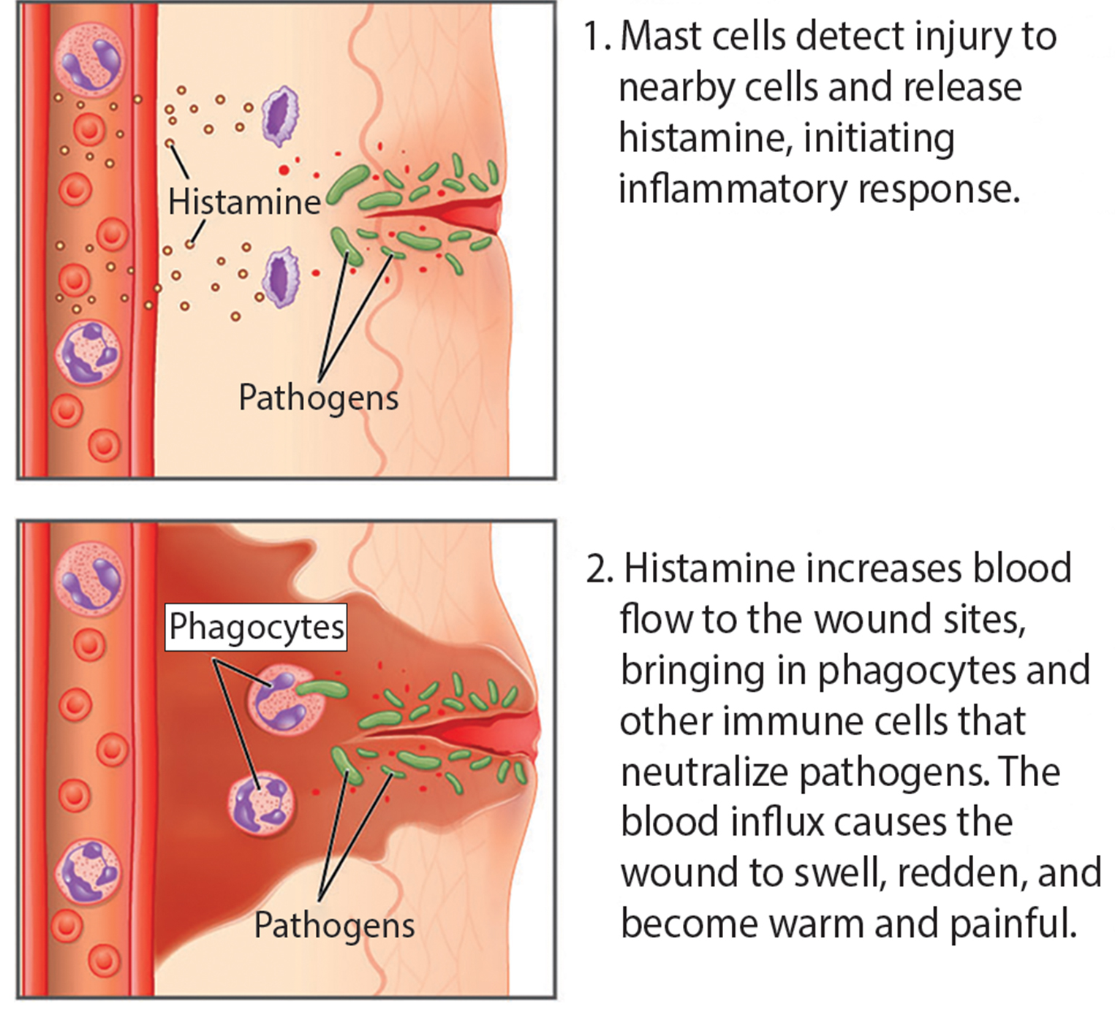
Lesson 37.1 Figure 7
OpenStax College on Wikimedia Commons. "Inflammatory process."
Notes:
Figure 7: In response to a cut, mast cells secrete histamines that cause nearby capillaries to dilate. Phagocytes (neutrophils and monocytes) leave the capillaries. Monocytes mature into macrophages. Neutrophils, dendritic cells, and macrophages release chemicals to stimulate the inflammatory response. Neutrophils and macrophages also consume invading bacteria by phagocytosis.

Slide 21

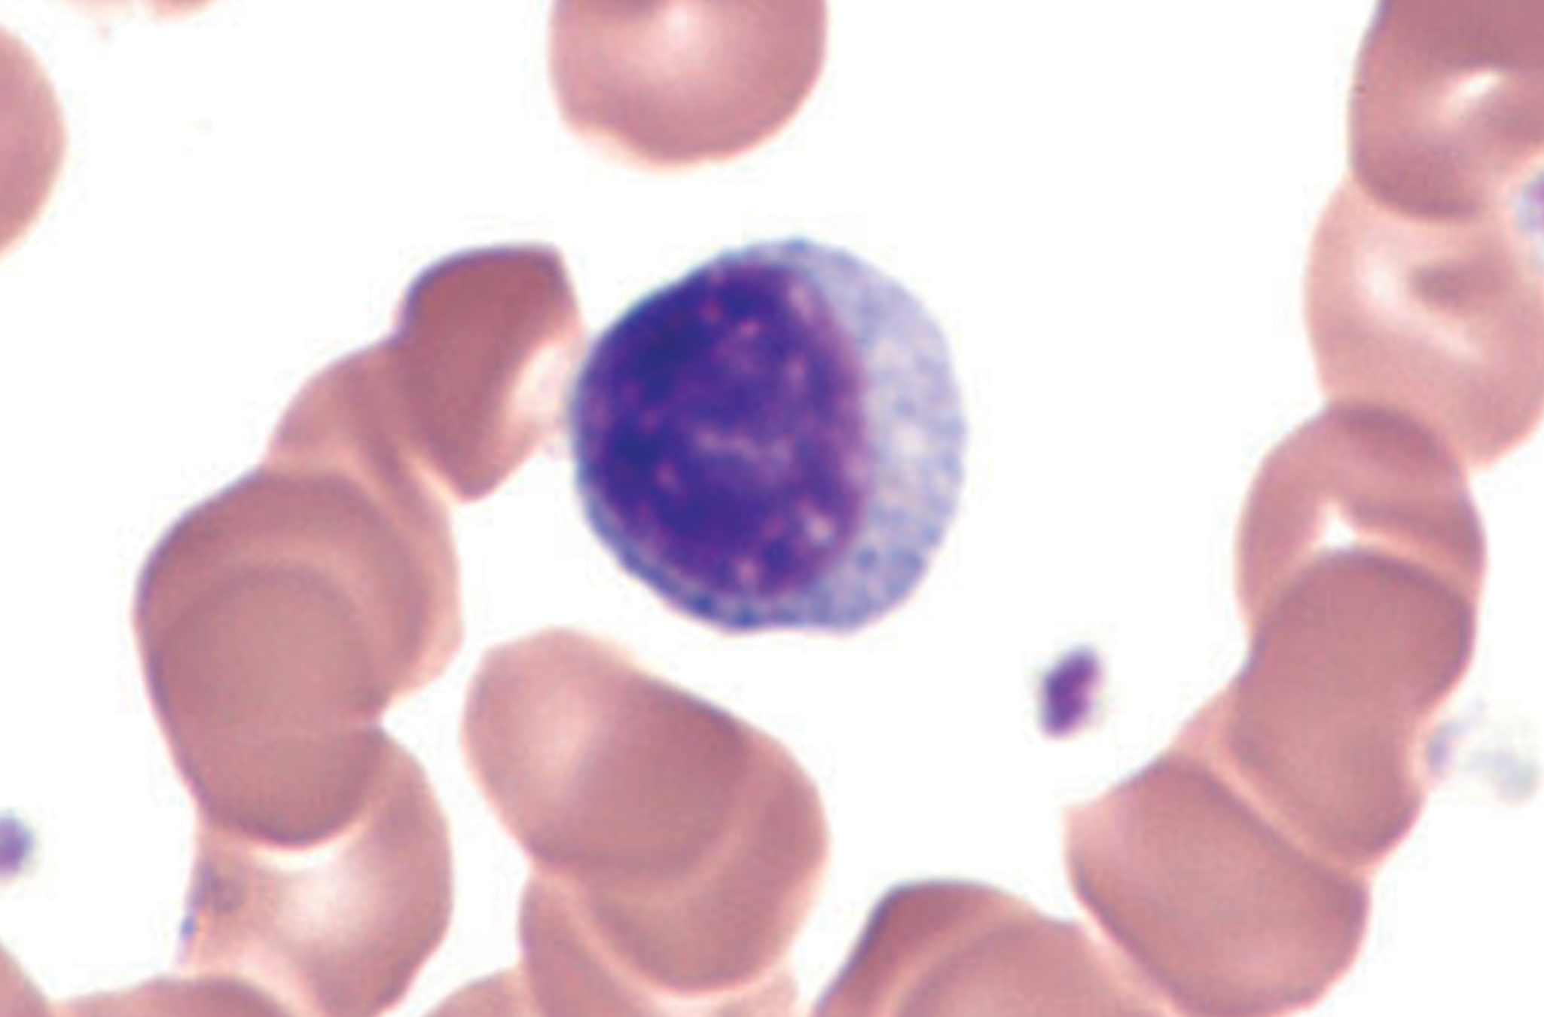
Natural Killer Cells₁
Infected cells are identified and destroyed by natural killer (NK) cells, lymphocytes that can kill cells infected with viruses or tumor cells.
Lymphocytes are leukocytes that are identifiable by their large, darkly staining nuclei; they are small cells with very little cytoplasm.
  T cells and B cells of the adaptive immune system are also classified as lymphocytes.
    T cells are lymphocytes that mature in the thymus gland.
    B cells are lymphocytes that mature in the bone marrow.
Guy Waterval on Wikimedia Commons. "Small lymphocyte."
Notes:
Figure 8: Lymphocytes, such as NK cells, are characterized by their large nuclei that actively absorb Wright stain (a mix of red and blue dyes that is used to identify blood cells) and, therefore, appear darkly colored under a microscope.

Slide 22
Natural Killer Cells₂
NK cells identify intracellular infections, especially from viruses, by the altered expression of major histocompatibility complex class I (MHC class I) molecules on the surface of infected cells.
MHC class I molecules are proteins on the surfaces of all nucleated cells and display fragments of proteins from the infectious agents within the cell to T cells.
MHC class II molecules are found on cells containing antigens ("non-self" proteins) and on lymphocytes.
MHC class II molecules interact with helper T cells to trigger the appropriate immune response, including the inflammatory response.

Slide 23
Natural Killer Cells₃
An infected cell (or a tumor cell) is usually incapable of synthesizing and displaying MHC class I molecules appropriately.
The reduced MHC class I on host cells varies from virus to virus.
This process can deplete host MHC class I molecules on the cell surface, which NK cells detect as "unhealthy" or "abnormal" while searching for cellular MHC class I molecules.
The dramatically altered gene expression of tumor cells leads to expression of extremely deformed or absent MHC class I molecules that also signal as "unhealthy" or "abnormal."

Slide 24
Science and You
People might have the ability to smell each other's MHC genes! Researchers believe that this ability is evolutionarily beneficial and an important factor in the selection of mates.
MHC genes are codominant; an individual who is heterozygous for MHC genes has a greater diversity of MHC molecules on their cell surfaces. A higher diversity of MHC molecules is associated with a stronger immune system.
Researchers hypothesize that individuals preferentially select mates with different MHC genes than their own to ensure their offspring have a diverse set of these genes.
  They've found that people with different MHC genes have distinctly different body odors, and females are more attracted to the scent of individuals whose MHC genes differ from their own.
These findings support the hypothesis that the perception of MHC genes allows females to select mates that will promote MHC diversity—and stronger immune function—in their offspring.
  MHC-based mate selection through olfactory cues has also been found in fish, mice, birds, and reptiles.
Notes:
This is included as a relevant application for this topic.

Slide 25
Natural Killer Cells₄
NK cells are always active; an interaction with normal, intact MHC class I molecules on a healthy cell disables the killing sequence, and the NK cell moves on.
After the NK cell detects an infected or tumor cell, its cytoplasm secretes granules of perforin, a destructive protein that creates a pore in the target cell.
Granzymes are then released along with the perforin in the immunological synapse.
A granzyme is a protease that digests cellular proteins and induces the target cell to undergo programmed cell death, or apoptosis.
Phagocytic cells digest the cell debris left behind. NK cells are constantly patrolling the body and are an effective mechanism for controlling potential infections and preventing cancer progression.

Slide 26
Complement
An array of approximately 20 types of soluble proteins, called a complement system, functions to destroy extracellular pathogens.
Cells of the liver and macrophages synthesize complement proteins continuously; these proteins are abundant in the blood serum and can respond immediately to infecting microorganisms.
Complement proteins bind to the surfaces of microorganisms and are particularly attracted to pathogens that are already bound by antibodies.
The binding of complement proteins occurs in a specific and highly regulated sequence.
Complement proteins perform several functions. The proteins serve as a marker to indicate the presence of a pathogen to phagocytic cells and enhance engulfment; this process is called opsonization.
  Certain complement proteins can combine to form attack complexes that open pores in microbial cell membranes. These structures destroy pathogens by causing their contents to leak.

Slide 27
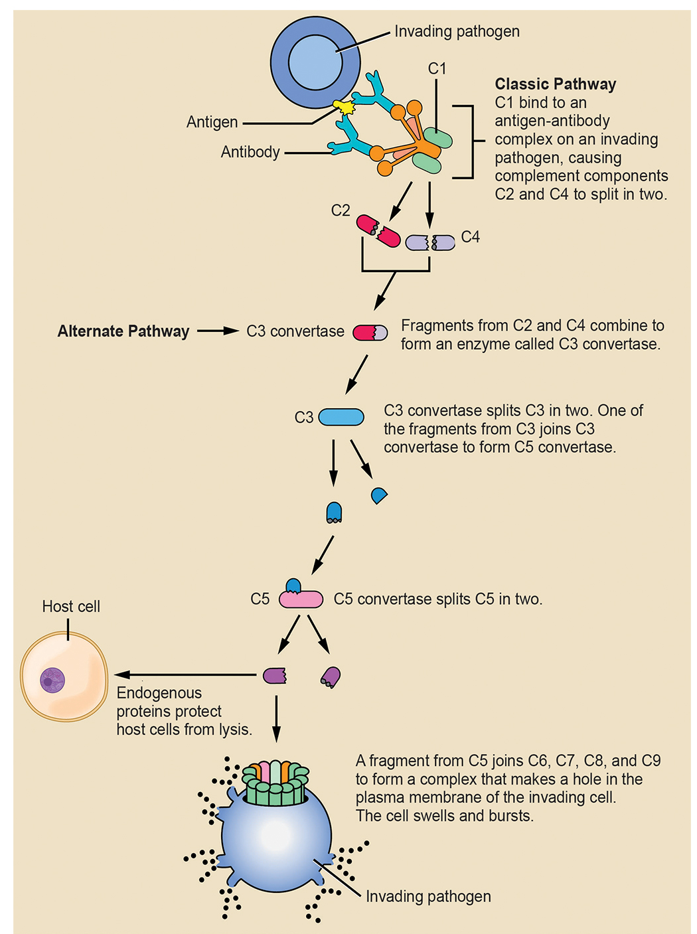
Lesson 37.1 Figure 9
NIH. "Complement cascade."
Notes:
Figure 9: In the classic pathway for the complement cascade, the complement protein C1 binds to an antigen-antibody complex on a pathogen, which causes other complement proteins to split in two. These fragments combine to form the enzyme C3 convertase, which initiates a sequence of cleavage and binding events that ends in the production of a complex that makes holes in the membrane and cell wall of the pathogen. Once the pathogen is perforated, it swells and bursts (lyses). The alternate pathway does not involve antibody activation. Rather, C3 convertase spontaneously breaks down C3. Endogenous regulatory proteins prevent the complement complex from binding to host cells. Pathogens lacking these regulatory proteins are bound by the complement system and ultimately lysed.

Slide 28
Summary
The innate immune system serves as a first responder to pathogenic threats that bypass natural, physical, and chemical barriers of the body.
Using a combination of cellular and molecular attacks, the innate immune system identifies the nature of the pathogen and responds with inflammation, phagocytosis, cytokine release, destruction by NK cells, and/or a complement system.
When innate mechanisms are insufficient to clear an infection, the adaptive immune response is informed and mobilized.

Slide 29

End of Hawkes Learning PowerPoint

