Slide 1
Lesson 37.2
Adaptive Immune Response

Slide 2
Objectives
Explain adaptive immunity.
Compare and contrast adaptive and innate immunity.
Describe cell-mediated immune response and humoral immune response.
Describe immune tolerance.
Describe hypersensitivity.

Slide 3
Adaptive Immune Response₁
The adaptive immune response is more specific to pathogens and produces a memory of the pathogens that have been previously been encountered.
Adaptive immunity is an immunity that occurs after exposure to an antigen either from a pathogen or a vaccination.
There are two types of adaptive responses:
Cell-mediated immune response, which is carried out by T cells
Humoral immune response, which is controlled by activated B cells and antibodies

Slide 4
Adaptive Immune Response₂
Activated T cells and B cells that are specific to molecular structures on the pathogen multiply and attack the invading pathogen.
Their attack can kill pathogens directly or secrete antibodies that enhance the phagocytosis of pathogens and disrupt the infection.
Adaptive immunity also involves a memory to provide the host with long-term protection from reinfection with the same type of pathogen.

Slide 5
Adaptive Immune Response₃
B cells are a type of white blood cell that gives rise to antibodies.
T cells are a key component in the cell-mediated response.
There are three types of T cells:
Cytotoxic T cells, which destroy virus-infected cells
Helper T cells, which help activate both the antibody and the cell-mediated immune responses.
Regulatory T cells, which deactivate T cells and B cells when needed.

Slide 6
Antigen-Presenting Cells₁
An antigen is a foreign, or "non-self," macromolecule that reacts with cells of the immune system.
An antigen-presenting cell (APC) is an immune cell that detects, engulfs, and informs the adaptive immune response about an infection.
APCs phagocytize the pathogen and digest it to form many different fragments of the antigen.
Antigen fragments are transported to the surface of the APC.
Dendritic cells and macrophages are APCs.
Before activation and differentiation, B cells can also function as APCs.
Dendritic cells are immune cells that process antigen material; they are present in the skin and the lining of the nose, lungs, stomach, and intestines.

Slide 7
Antigen-Presenting Cells₂
After phagocytosis by APCs, the phagocytic vesicle fuses with an intracellular lysosome, forming a phagolysosome.
Within the phagolysosome, the components are broken down into fragments; the fragments are then loaded onto MHC class I or MHC class II molecules and transported to the cell surface.
APCs express MHC on their surfaces, and when combined with a foreign antigen, these complexes signal a "non-self" invader.
T lymphocytes cannot properly respond to the antigen unless it is embedded in an MHC molecule.
Helper T cells are one of the main lymphocytes that respond to antigen-presenting cells.

Slide 8
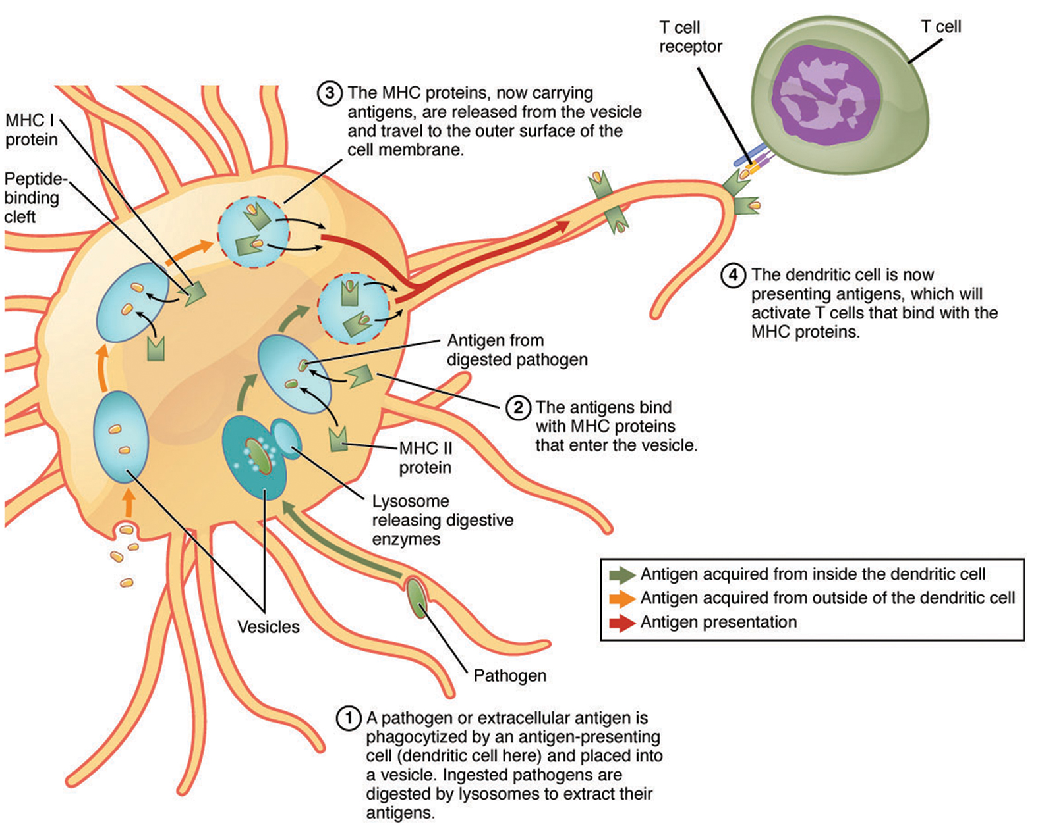
Lesson 37.2 Figure 1
OpenStax College on Wikimedia Commons. "Antigen processing."
Notes:
Figure 1: An APC, such as a macrophage, engulfs and digests a foreign bacterium (pathogen). An antigen from the bacterium is presented on the cell surface in conjunction with an MHC class II molecule. Lymphocytes of the adaptive immune response interact with antigen-embedded MHC class II molecules to mature into functional immune cells.

Slide 9
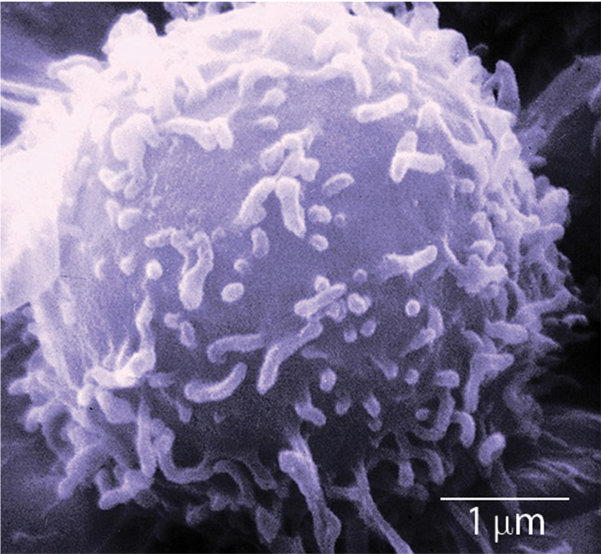
T and B Lymphocytes₁
Lymphocytes in human circulating blood are approximately 80–90% T cells and 10–20% B cells.
Some T cells respond to APCs of the innate immune system and indirectly induce immune responses by releasing cytokines.
Other T cells stimulate B cells.
Another population of T cells directly kill the infected cells.
Other T cells are involved in suppressing inappropriate immune reactions to harmless antigens.
37.2 Figure 2
Dr. Triche, National Cancer Institute on Wikimedia Commons. "Lymphocyte."
Notes:
Figure 2: This scanning electron micrograph shows a T lymphocyte, which is responsible for the cell-mediated immune response. T cells are able to recognize antigens.

Slide 10
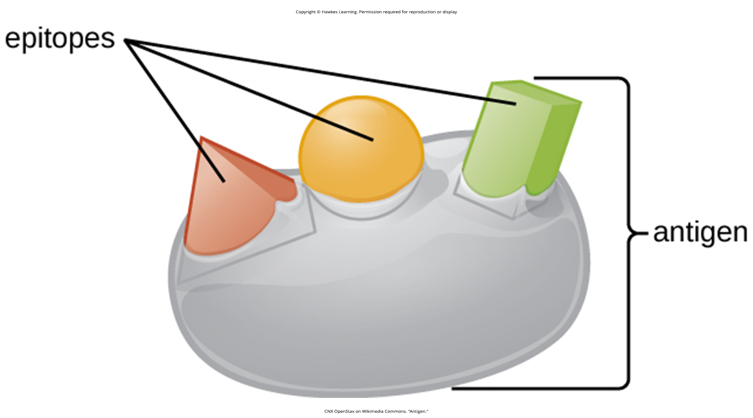
T and B Lymphocytes₂
Both B and T cells recognize and bind to specific antigens using a complementary receptor.
Each T and B lymphocyte only expresses one type of antigen receptor.
Everyone's B and T cell population combination can express a near limitless variety of antigen receptors.
T and B cells are activated when they recognize small components of antigens, called epitopes, presented by APCs.
In the absence of information from APCs, T and B cells remain inactive, or naïve, and are unable to prepare an immune response.
37.2 Figure 3
CNX OpenStax on Wikimedia Commons. "Antigen."
Notes:
Figure 3: An antigen is a macromolecule that reacts with components of the immune system. A given antigen may contain several motifs (distinctive sequences) that are recognized by immune cells. Each motif is an epitope. In this figure, the entire structure is an antigen, and the salmon triangle, orange circle, and green rectangle projecting from it represent potential epitopes.

Slide 11
T and B Lymphocytes₃
Naïve T cells can express one of two different molecules, CD4 or CD8, on their surface, which classifies them as CD4+ or CD8+ cells.
Naïve CD4+ cells bind APCs via their antigen-embedded MHC class II molecules and become helper T (T_{H}) lymphocytes, cells that go on to stimulate B cells (or cytotoxic T cells) directly or secrete cytokines to inform other cells about the pathogenic threat.
CD8+ cells engage antigen-embedded MHC class I molecules on APCs and become cytotoxic T lymphocytes (CTLs), which directly kill infected cells by secreting molecules that induce apoptosis.
CTLs also emit cytokines to amplify the immune response.
The CD4 or CD8 surface molecules differentiate whether the TCR will engage an MHC class II or an MHC class I molecule.

Slide 12
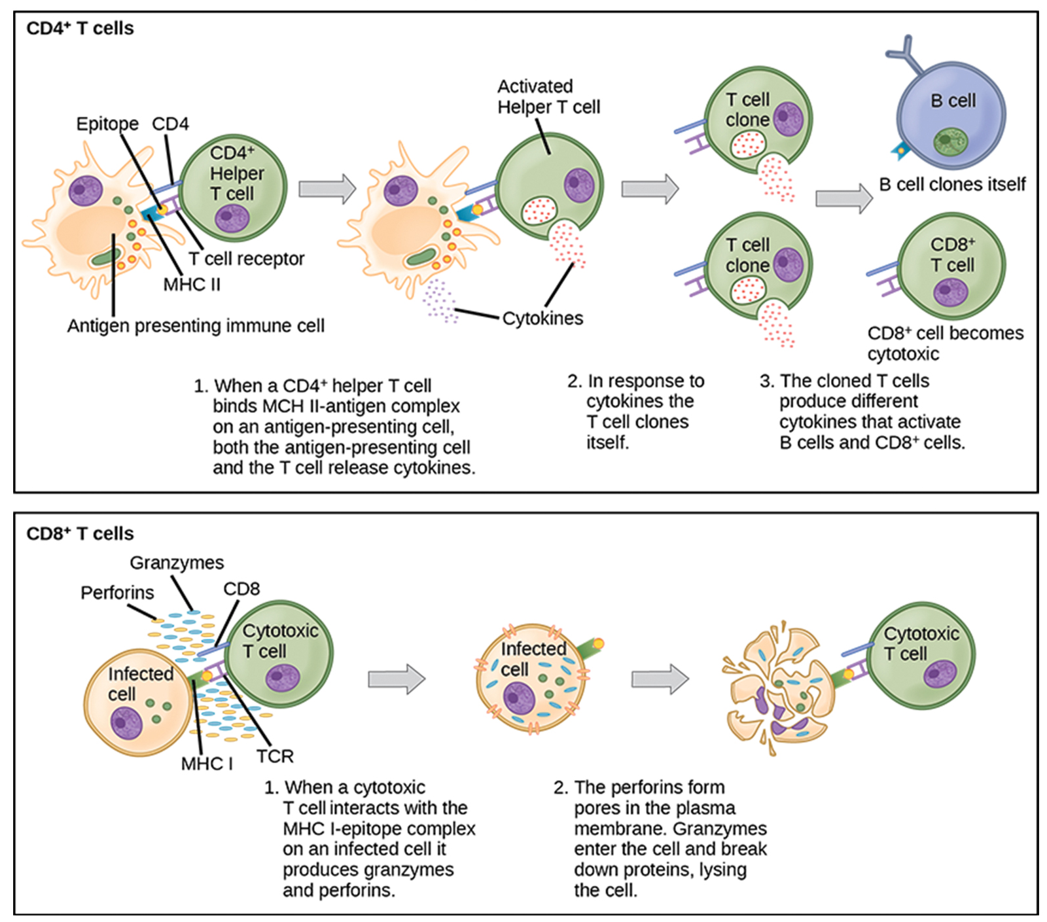
Lesson 37.2 Figure 4
CNX OpenStax on Wikimedia Commons. "T cells."
Notes:
Figure 4: Naïve CD4+ T cells engage MHC II molecules on antigen-presenting cells (APCs) and become activated. Clones of the activated helper T cell, in turn, activate B cells and CD8+ T cells, which become cytotoxic T cells. Cytotoxic T cells kill infected cells.

Slide 13
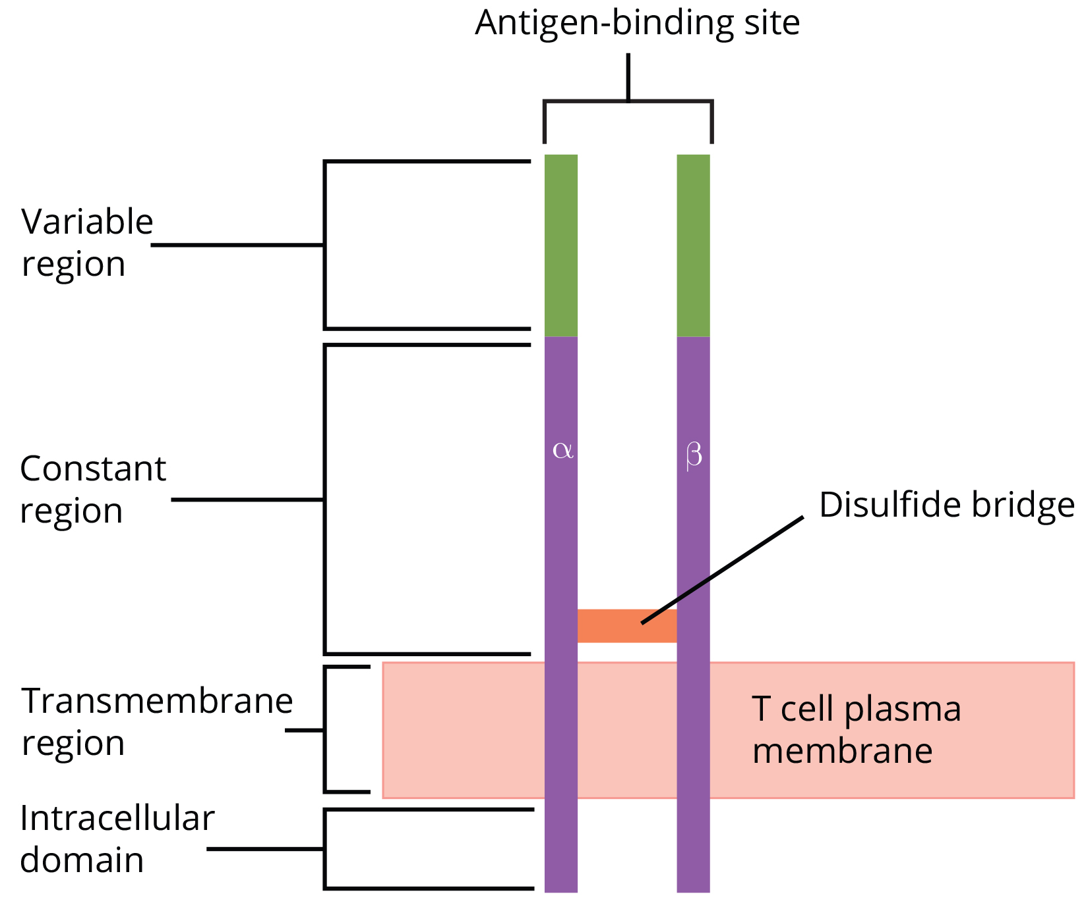
T Cell Receptors
Each TCR consists of two protein chains that span the T cell membrane.
The intracellular domain is involved in intracellular signaling.
The extracellular domain is involved in antigen recognition and binding.
This domain has a constant region and a variable region.
The specificity of the adaptive immune system occurs because it synthesizes millions of different T cell populations, each expressing a TCR that differs in its variable domain.
37.2 Figure 5
OpenStax. "T cell receptor."
Notes:
Figure 5: A T cell receptor spans the membrane and projects its variable binding regions into the extracellular space. The variable region binds complementary processed antigens presented by MHC molecules on APCs.

Slide 14
Helper T Lymphocytes
The T_{H} lymphocytes indirectly identify potential pathogens for other cells of the immune system.
T_{H} lymphocytes recognize specific antigens displayed in the MHC class II complexes of APCs.
T_{H}1 cells secrete cytokines to enhance the activities of macrophages and other T cells.
T_{H}1 cells activate cytotoxic T cells as well as macrophages and is associated with inflammation.
T_{H}2 cells stimulate naïve B cells to destroy foreign invaders via antibody secretion.
T_{H}1 responses are directed toward intracellular invaders.
T_{H}2 responses are aimed at those that are extracellular.

Slide 15
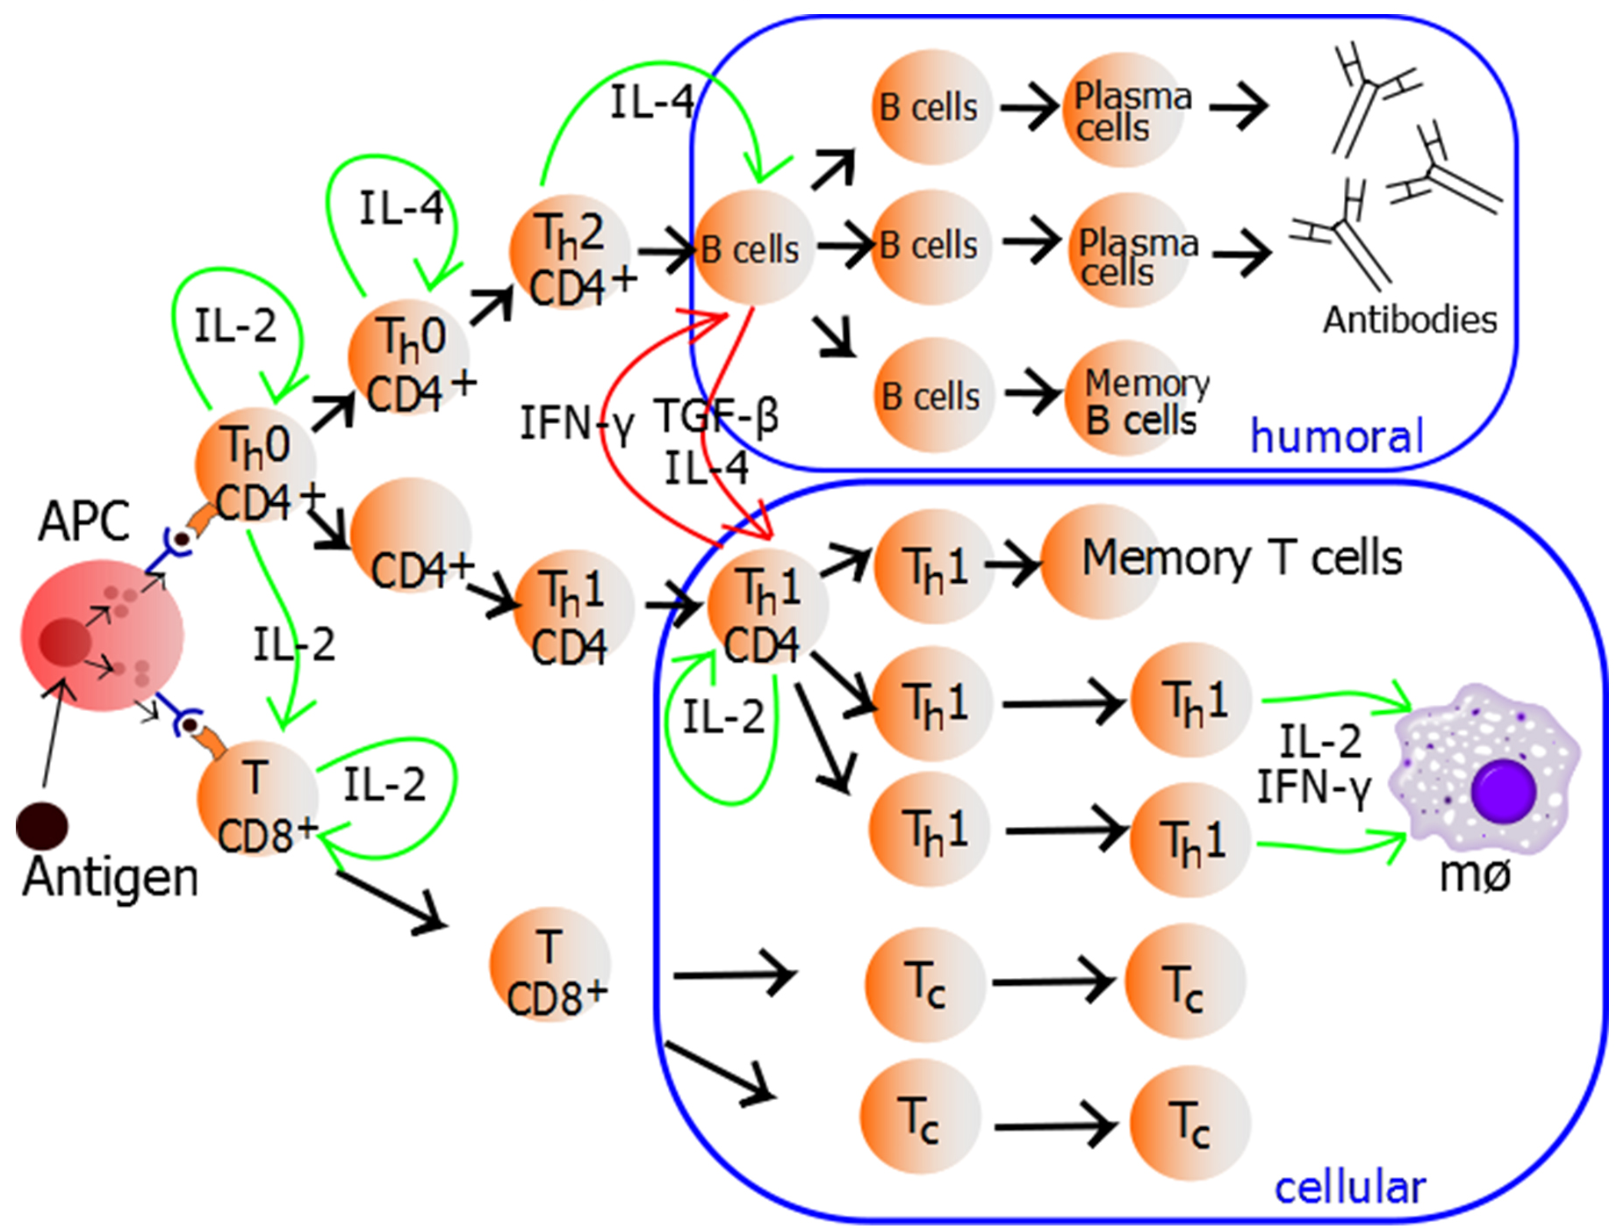
Lesson 37.2 Figure 6
Mikael Häggström on Wikimedia Commons. "Lymphocyte activation."
Notes:
Figure 6: After activation by an APC, T cells may differentiate into helper T (TH) lymphocytes or cytotoxic T (TC) lymphocytes. TH cells may differentiate into either TH1 or TH2 cells. TH1 cells make cytokines that enhance macrophage activity (promoting inflammation) and activate cytotoxic T cells; both of these processes aim to kill infected or cancerous cells. TH2 cells stimulate antibody production by B cell to kill humoral pathogens (pathogens in extracellular fluids).

Slide 16
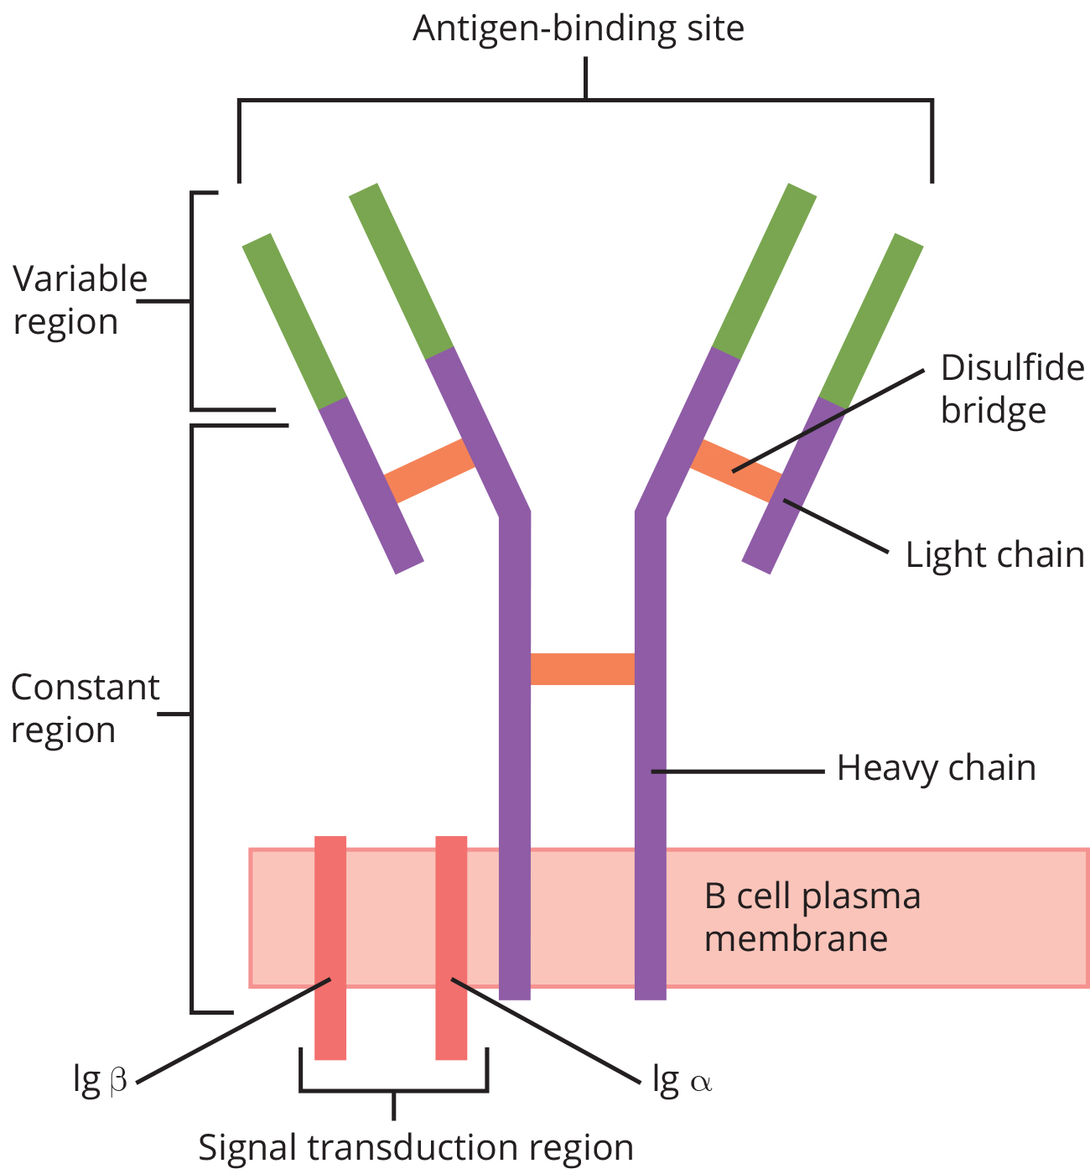
B Lymphocytes₁
Naïve B cells differentiate into antibody-secreting plasma cells.
A plasma cell is an immune cell that secrets antibodies; these cells arise from B cells that were stimulated by antigens.
Naïve B cells initially are coated in thousands of B cell receptors (BCRs), which are membrane-bound forms of Ig.
The B cell receptor has two heavy chains and two light chains connected by disulfide linkages.
Each chain has a constant and a variable region; the latter is involved in antigen binding.
Two other membrane proteins, Ig-α and Ig-β, are involved in signaling.
37.2 Figure 7
CNX OpenStax on Wikimedia Commons. "B cell receptor."
Notes:
Figure 7: B cell receptors are embedded in the membranes of B cells and bind a variety of antigens through their variable regions. The signal transduction region transfers the signal into the cell.

Slide 17
B Lymphocytes₂
Once a B cell has bound an antigen complementary to its antigen binding domain, it can act as an APC.
When a T_{H}2 cell detects a B cell is bound to a relevant antigen, it secretes specific cytokines that induce the B cell to proliferate rapidly and synthesize and secrete antibodies with the same antigen recognition pattern.
The activation of B cells corresponding to one specific BCR variant and the dramatic proliferation of that variant is known as clonal selection.
B cells function as APCs that bind intact antigens that have not been processed.
B cells must be able to bind intact antigens because they secrete antibodies that must recognize the pathogen directly.
Bacterial carbohydrate and lipid molecules can activate B cells independently from the T cells.

Slide 18
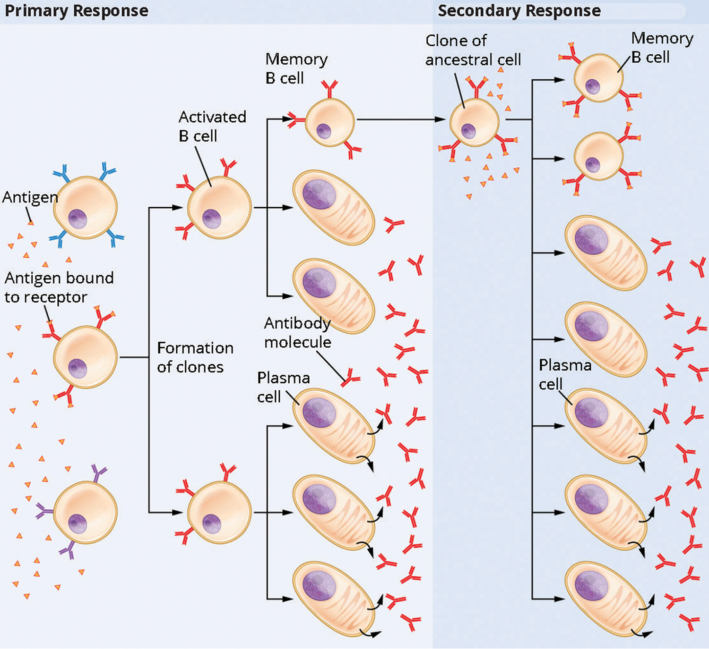
Lesson 37.2 Figure 8
OpenStax College on Wikimedia Commons. "Clonal selection of B cells."
Notes:
Figure 8: When a TH2 cell detects that a B cell is bound to a certain antigen, it secretes cytokines that cause the B cell to rapidly proliferate to form many clones. Most of these clones develop into plasma cells that produce large amounts of the specific antibody corresponding to the BCR that initially bound the antigen. Some of these clones differentiate into memory cells that provide long-term immunity; these clones will later proliferate if the same antigen is again encountered in the body.

Slide 19
Cytotoxic T Lymphocytes
CTLs function to clear infections directly and are important in protecting against viral infections.
When APCs present MHC class I-embedded antigens to naïve CD8+ T cells that express complementary TCRs, the CD8+ T cells proliferate according to clonal selection.
Plasma cells and CTLs are collectively called effector cells. They are involved in bringing about the immune defense of killing pathogens and infected host cells.
CTLs attempt to identify and destroy infected cells before the pathogen can replicate and escape.
CTLs also support NK cells in destroying early cancers.
CTLs sense MHC class I-embedded antigens by directly interacting with infected cells.
Binding of TCRs with antigens activates CTLs to release perforin and granzymes, degradative enzymes that will induce apoptosis of the infected cell.

Slide 20
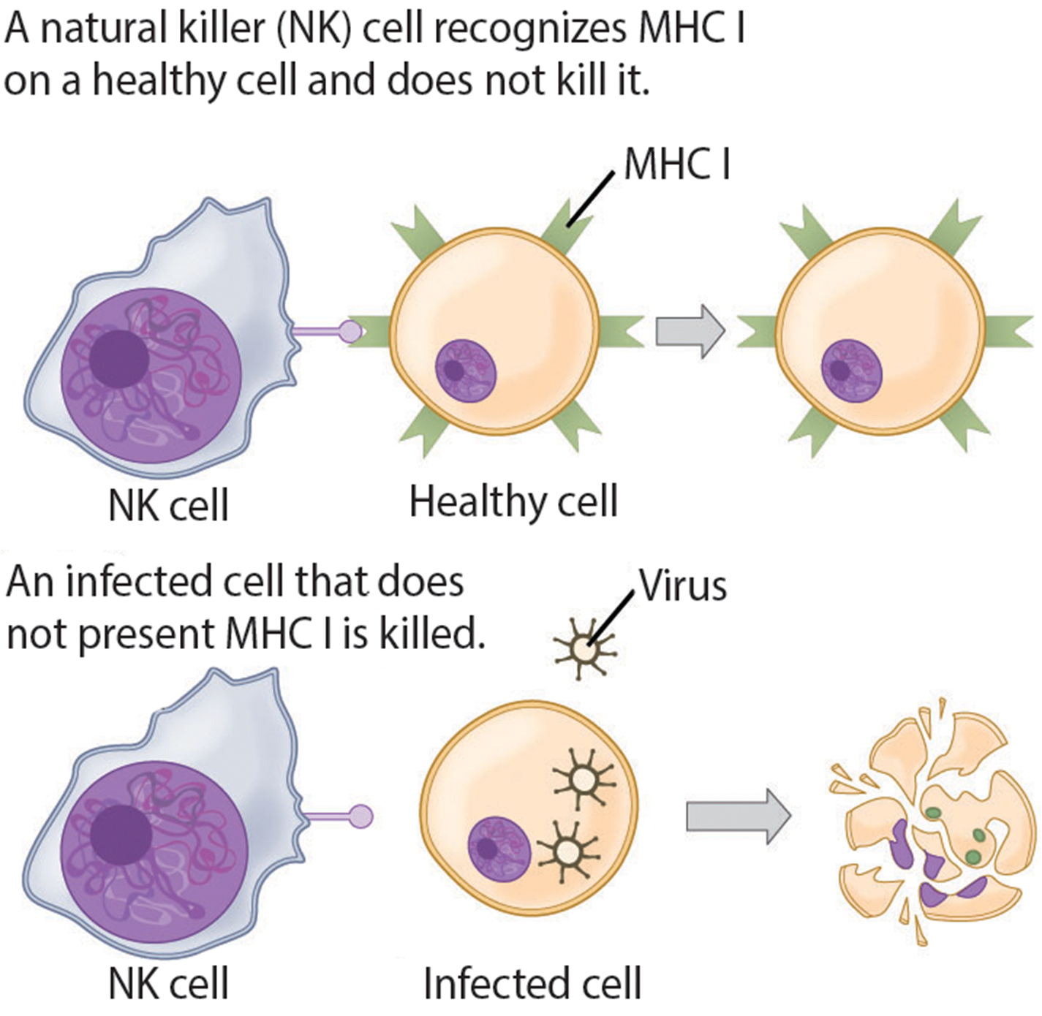
Lesson 37.2 Figure 9
CNX OpenStax on Wikimedia Commons. "NK cells."
Notes:
Figure 9: Natural killer (NK) cells recognize the MHC class I receptor on healthy cells. If MHC class I is absent, the cell is lysed.

Slide 21
Think It Through₁
In what ways are natural killer cells and cytotoxic T lymphocytes different?
In what ways are they the same?
Notes:
Originally an On Your Own. This is included here to use as a talking point or for a think-pair-share activity.

Slide 22
Group Activity
As a group, brainstorm a short list of different infectious diseases.
Then, assign each group member one disease. Using internet resources, identify the type of pathogen that causes that disease: virus, free-living bacterium, intracellular bacterium, fungus, protist, or helminth.
Which diseases do you think stimulate a strong humoral immune response?
Which do you think stimulate a strong cell-mediated immune response? Why?

Slide 23
Mucosal Surfaces₁
Mucosal immunity is formed by mucosa-associated lymphoid tissue, which functions independently of the systemic immune system.
Mucosa-associated lymphoid tissue (MALT), is a collection of lymphatic tissue that combines with epithelial tissue lining the mucosa throughout the body.
This tissue functions as the immune barrier and response in areas of the body with direct contact to the external environment.

Slide 24
Mucosal Surfaces₂
Foreign particles found in MALT are taken up by absorptive epithelial cells called M cells and delivered to APCs directly below the mucosal tissue.
Antigens displayed on APCs are detected by T cells in the MALT and at mucosal induction sites.
Activated T cells migrate through the lymphatic system and into the circulatory system to mucosal sites of infection.
MALT is a crucial component of a functional immune system because mucosal surfaces are the first tissues onto which inhaled or ingested pathogens are deposited.

Slide 25
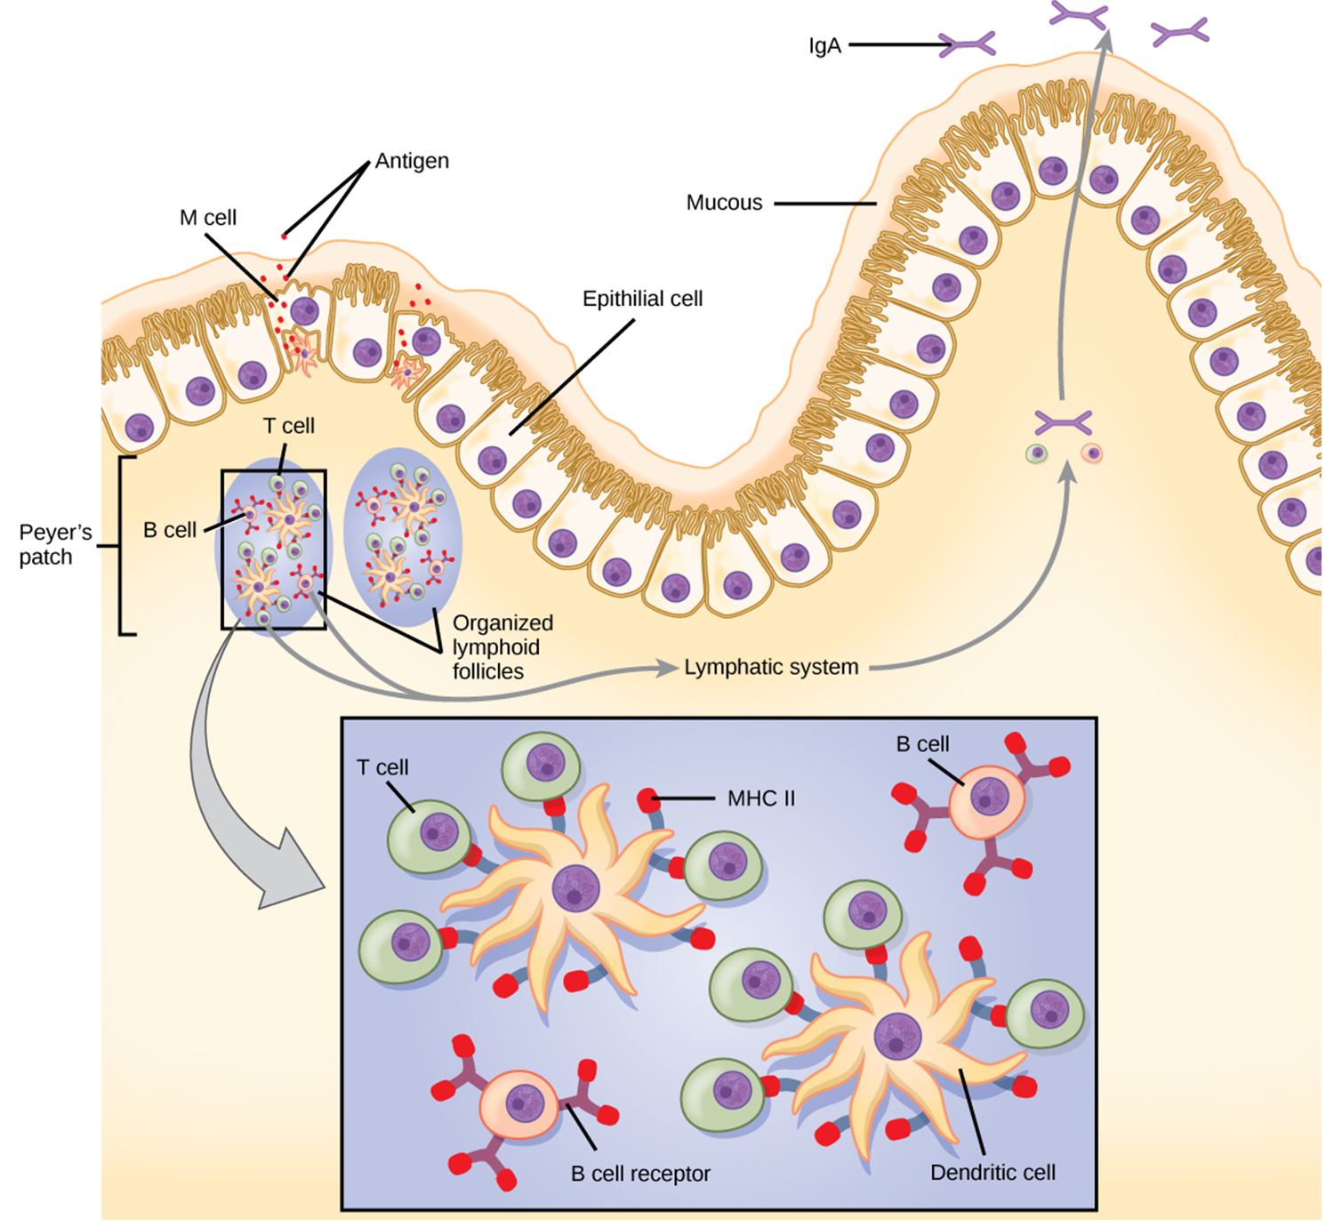
Lesson 37.2 Figure 10
CNX OpenStax on Wikimedia Commons. "Intestinal MALT."
Notes:
Figure 10: The topology and function of intestinal MALT is shown. Pathogens are taken up by M cells in the intestinal epithelium and excreted into a pocket formed by the inner surface of the cell. The pocket contains antigen-presenting cells, such as dendritic cells, which engulf antigens and present them through the MHC II molecules on the cell surface. The dendritic cells migrate to an underlying tissue called a Peyer's patch. Antigen-presenting cells, T cells, and B cells aggregate within the Peyer's patch, forming organized lymphoid follicles. There some T cells and B cells are activated. Other antigen-loaded dendritic cells migrate through the lymphatic system where they activate B cells, T cells, and plasma cells in the lymph nodes. The activated cells then return to MALT tissue effector sites. IgA and other antibodies are secreted into the intestinal lumen (opening in the bowels).

Slide 26
Immune Tolerance
The acquired ability to prevent an unnecessary or harmful immune response to a detected foreign substance known not to cause disease is described as immune tolerance.
In the intestinal tract, immune tolerance is crucial for maintaining mucosal homeostasis.
Immune tolerance is created by specialized APCs in the liver, lymph nodes, small intestine, and lung that present harmless antigens to regulatory T (T_{reg}) cells, specialized lymphocytes that suppress local inflammation and inhibit the secretion of stimulatory immune factors.
Other subsets of T_{reg} cells are involved in the prevention of the autoimmune response, which is an inappropriate immune response to host cells or self-antigens.
Another T_{reg} class suppresses immune responses to harmful pathogens after the infection has cleared to minimize host cell damage induced by inflammation and cell lysis.

Slide 27
Immunological Memory₁
The adaptive immune system possesses a memory component that allows for an efficient and dramatic response upon reinvasion of the same pathogen.
Memory is handled by the adaptive immune system with little reliance on cues from the innate response.
During the adaptive immune response to a pathogen that has not been encountered before, called a primary response, plasma cells secreting antibodies and differentiated T cells increase then plateau over time.
As B and T cells mature into effector cells, a subset of the naïve populations differentiates into B and T memory cells with the same antigen specificities.
A memory cell is an antigen-specific B or T lymphocyte that does not differentiate into effector cells during the primary immune response but can immediately become effector cells upon re-exposure to the same pathogen.

Slide 28
Think It Through₂
Rhesus (Rh) factor is an antigen that can be found on red blood cells. Red blood cells can be Rh-positive (carry the antigen) or Rh-negative (do not carry the antigen). A pregnant Rh-negative person can usually carry an Rh-positive fetus to term without difficulty. However, having a second Rh-positive fetus may trigger an immune attack that causes hemolytic disease of the newborn.
Why do you think hemolytic disease is only a problem during the second pregnancy or subsequent pregnancies?
Notes:
Originally an On Your Own. This is included here to use as a talking point or for a think-pair-share activity.

Slide 29
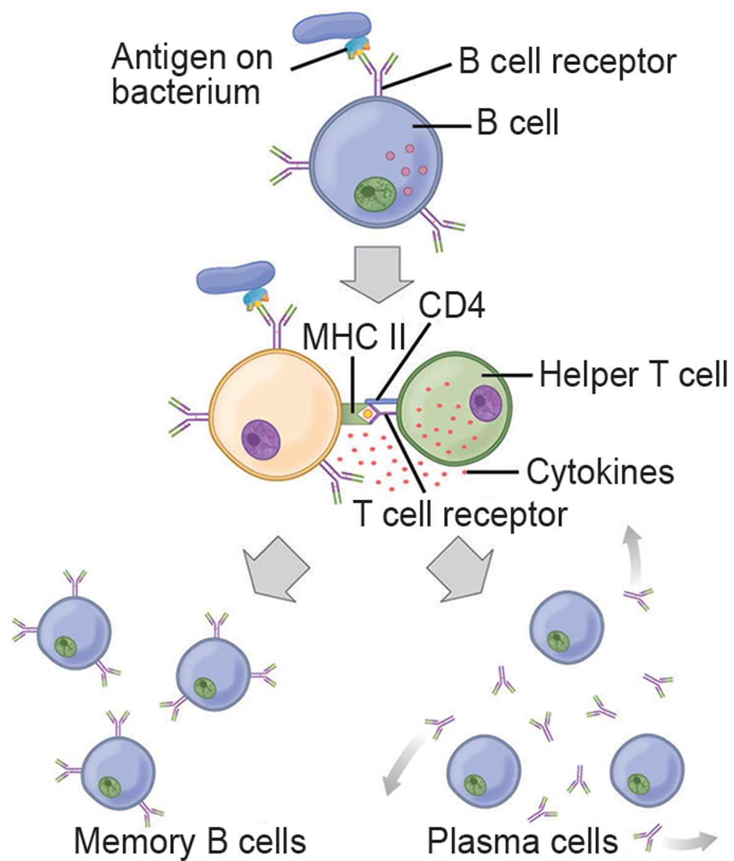
Lesson 37.2 Figure 11
CNX OpenStax on Wikimedia Commons. "Production of memory B and plasma cells." Modified.
Notes:
Figure 11: After initially binding an antigen to the B cell receptor (BCR), a B cell internalizes the antigen and presents it on MHC II. A helper T cell recognizes the MHC II-antigen complex and activates the B cell. As a result, memory B cells and plasma cells are made.

Slide 30
Immunological Memory₂
If the pathogen is never encountered again during the individual's lifetime, B and T memory cells will circulate for a few years or even several decades and will gradually die off, having never functioned as effector cells.
If the host is re-exposed to the same pathogen type, memory cells will immediately differentiate into plasma cells and CTLs.
Memory B cells that differentiate into plasma cells output ten- to hundred-fold greater antibody amounts than were secreted during the primary response.
Vaccination is based on the knowledge that exposure to noninfectious antigens, derived from known pathogens, generates a mild primary immune response. The immune response to vaccination may not be perceived by the host as illness but still confers immune memory.
When exposed to the corresponding pathogen to which an individual was vaccinated, the reaction is like a secondary exposure.

Slide 31
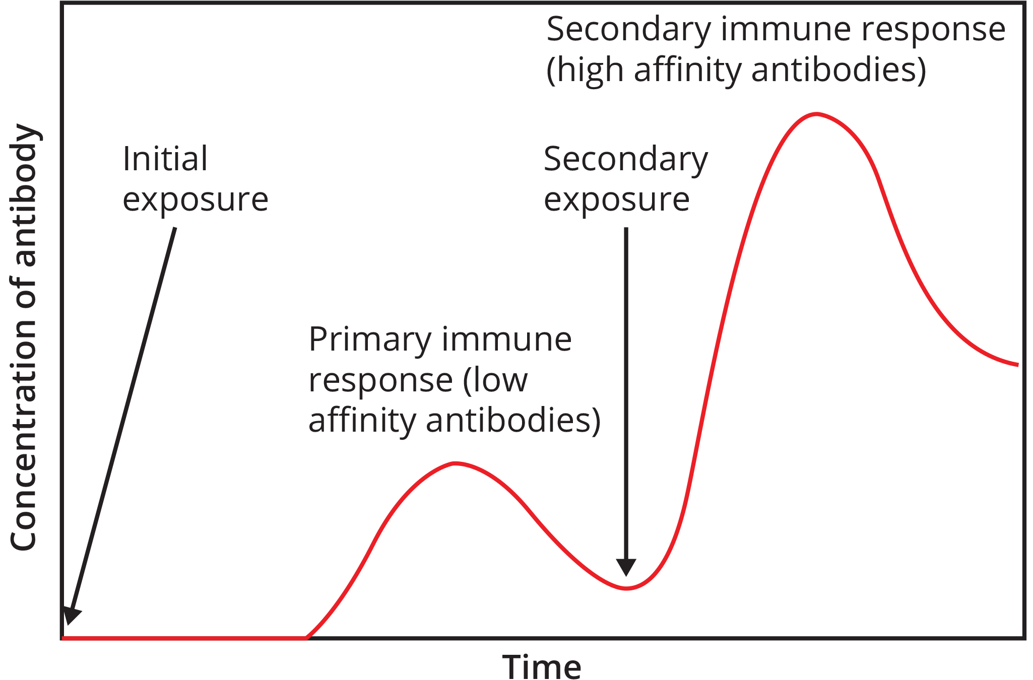
Lesson 37.2 Figure 12
CNX OpenStax on Wikimedia Commons. "Immune response."
Notes:
Figure 12: In the primary response to infection, antibodies are secreted first from plasma cells. Upon re-exposure to the same pathogen, memory cells differentiate into antibody-secreting plasma cells that output a greater amount of antibody for a longer period of time.

Slide 32
Science and You₁
Vaccine Development Strategies
There are multiple strategies used to develop vaccines.
Inactivated vaccines: The pathogen grown and then killed using heat, chemicals, or radiation without destroying the antigenic component before administration.
Subunit vaccines: A single antigenic subunit, is prepared using recombinant methods.
Toxoid vaccines: An inactivated bacterial toxin, called a toxoid, is prepared and then administered.
Conjugate vaccines: A conjugate vaccine is like a subunit vaccine. A protein made by the pathogen is conjugated to a bacterial capsule polysaccharide.
Live-attenuated vaccines: The pathogen is attenuated, or weakened, in some way before administration.
Vector vaccines: For these vaccines, a virus that is not typically harmful serves as a vector for genes encoding the antigens of a more virulent pathogen.
Notes:
This is included as a relevant application for this topic.
Figure 13: An mRNA vaccine can be used to stimulate an immune response to a pathogen. Here, the gene encoding the spike protein from a pathogenic virus (like COVID-19) is used to develop mRNA that encodes the protein. The mRNA is packaged in lipid nanoparticles and then injected into humans. In human cells, the mRNA is translated to produce the spike protein, which in turn induces an immune response.

Slide 33
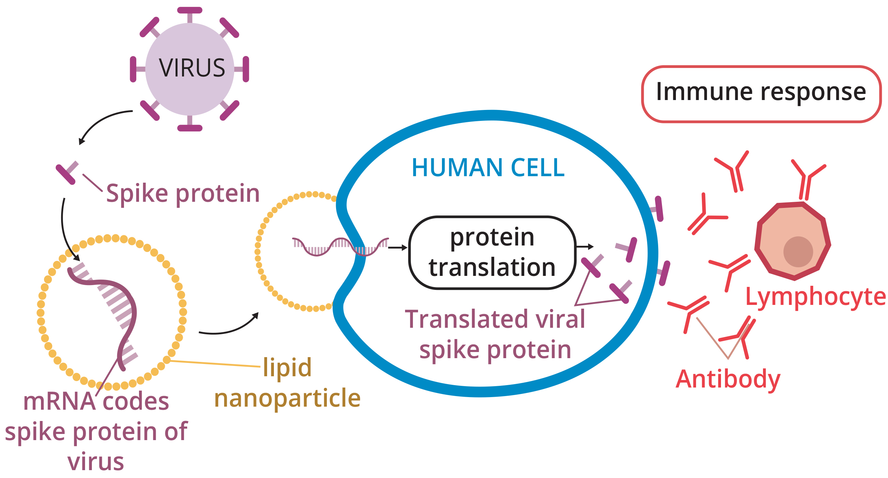
Science and You₂
An innovative technology for vaccine production was used to develop vaccines to protect against SARS-CoV-2, the virus that causes COVID-19. Pfizer-BioNTech and Moderna, successfully developed and launched mRNA vaccines against SARS-CoV-2. These vaccines each contained the mRNA encoding the antigenic COVID-19 spike protein packaged in lipid nanoparticles.
When the vaccine is injected, the protein machinery in human cells creates the spike protein from the mRNA, and the spike proteins stimulate the disease.
37.2 Figure 13
Notes:
This is included as a relevant application for this topic.
Figure 13: An mRNA vaccine can be used to stimulate an immune response to a pathogen. Here, the gene encoding the spike protein from a pathogenic virus (like COVID-19) is used to develop mRNA that encodes the protein. The mRNA is packaged in lipid nanoparticles and then injected into humans. In human cells, the mRNA is translated to produce the spike protein, which in turn induces an immune response.

Slide 34
Mucosal Immune Memory
A subset of T and B cells of the mucosal immune system differentiates into memory cells just as in the systemic immune system.
Upon reinvasion of the same pathogen type, a pronounced immune response occurs at the mucosal site where the original pathogen was deposited, but a collective defense is also organized within interconnected or adjacent mucosal tissue.

Slide 35
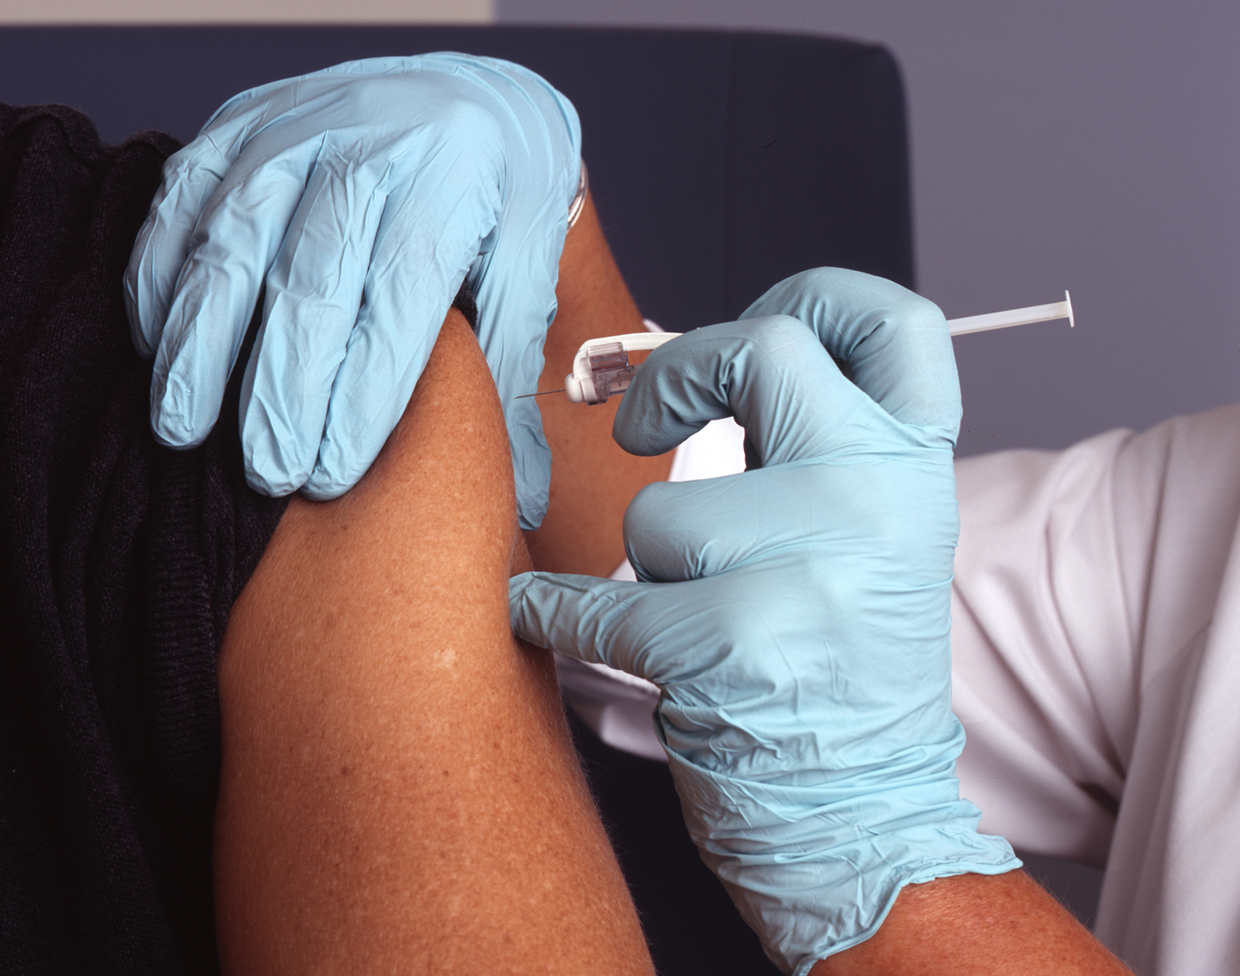
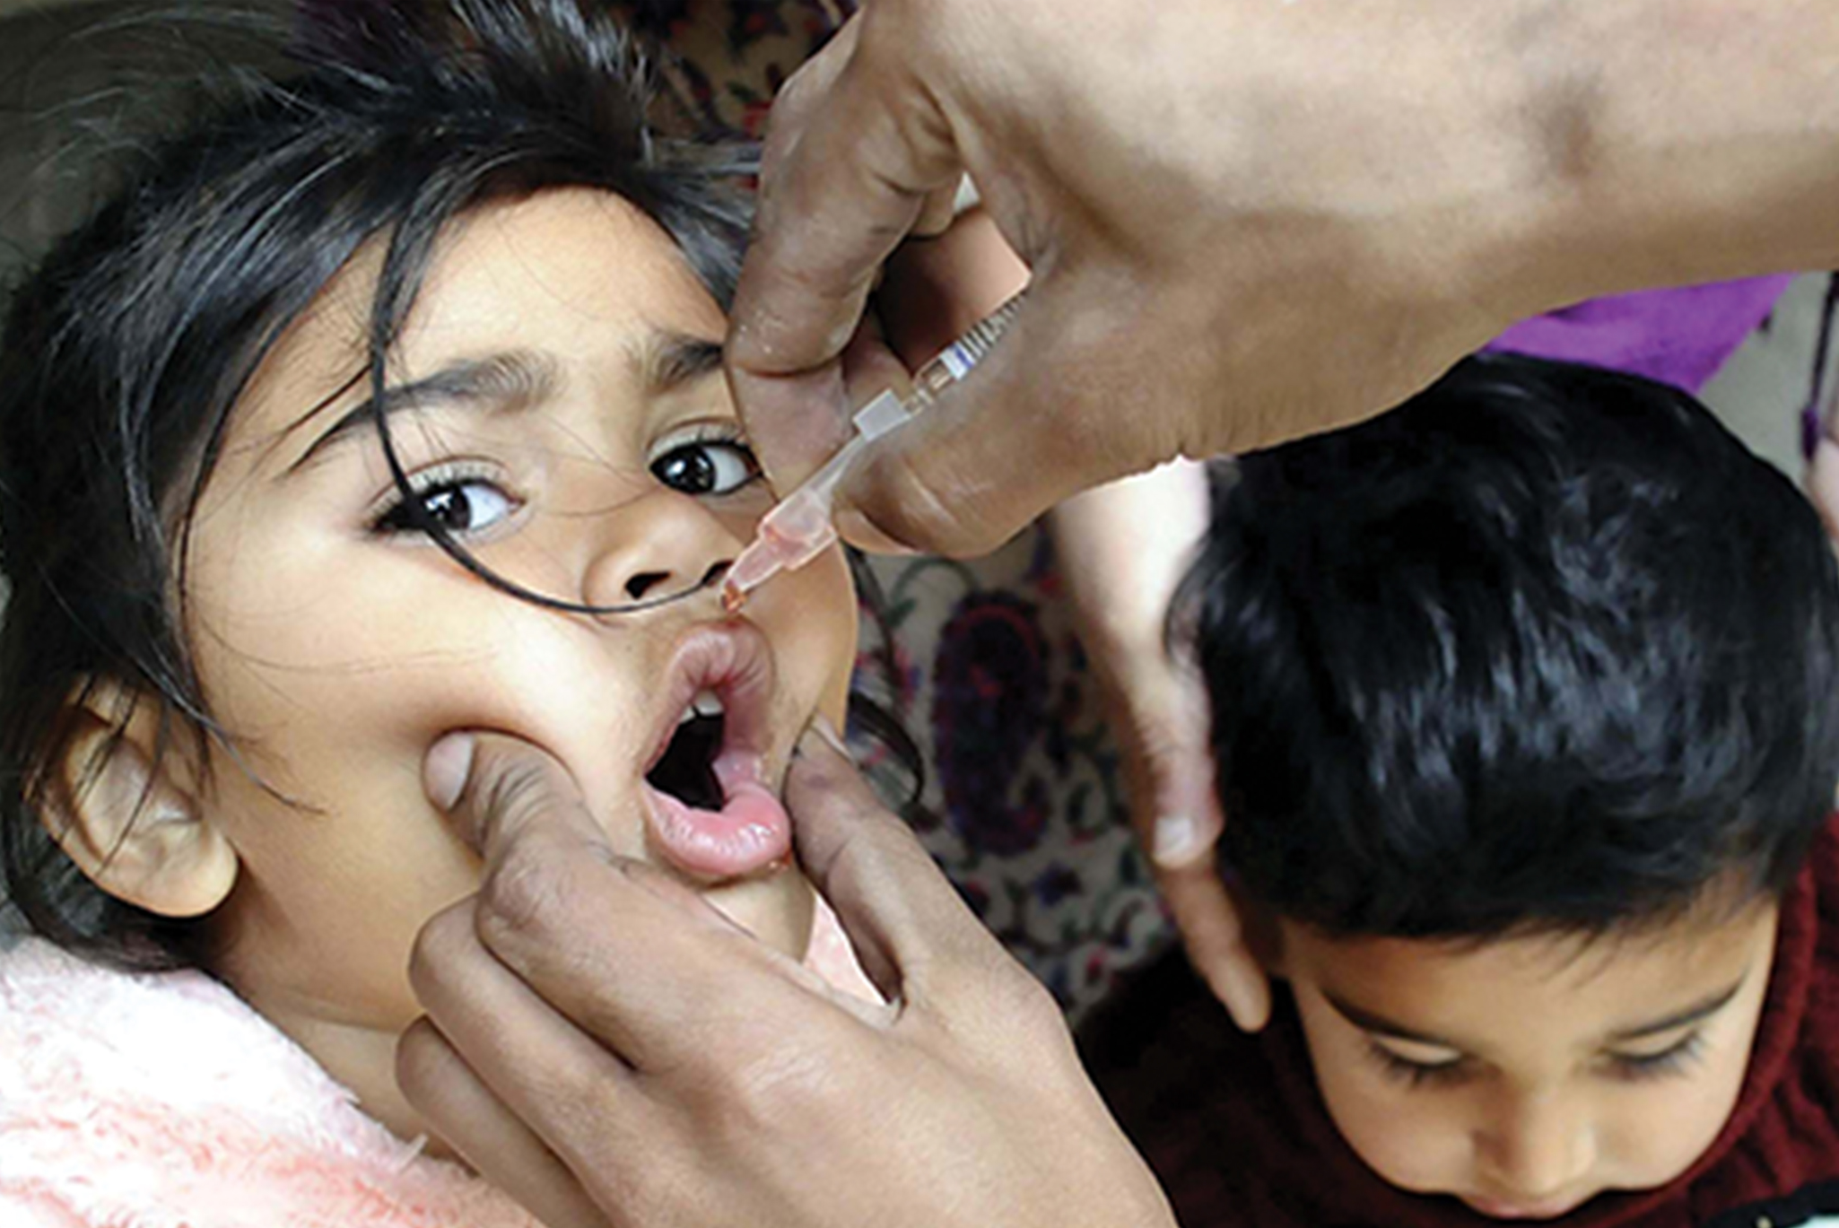
Science and You₃
Career: Vaccinologist
Vaccinologists are actively involved in developing new vaccines that are applied via intranasal, aerosol, oral, or transcutaneous (absorbed through the skin) delivery methods.
Importantly, mucosal-administered vaccines elicit both mucosal and systemic immunity and produce the same level of disease resistance as injected vaccines.
Currently, a version of intranasal influenza vaccine is available, and the polio and typhoid vaccines can be administered orally.
As new vaccines are being developed and adapted for being administer via pathways other than injection, these vaccines will mobilizing the mucosal immune response, and may end the anxiety associated with injections and, in turn, improve patient participation.
37.2 Figure 14
Trinset on iStock. "mRNA vaccine."
37.2 Figure 15
Rhoda Baer on Wikimedia Commons. "Nurse administers vaccine."
Notes:
This is included as a relevant application for this topic.
Figure 14: Vaccines are often delivered by injection into the arm.
Figure 15: The polio vaccine can be administered orally.

Slide 36
Primary Centers of the Immune System₁
Lymph is a watery fluid that bathes tissues and organs with protective white blood cells and does not contain red blood cells.
Cells of the immune system can travel between the distinct lymphatic and blood circulatory systems.
The cells of the immune system originate from hematopoietic stem cells in the bone marrow.
B cell maturation occurs in the bone marrow, while T cells mature in the thymus gland.
In the thymus, immature T cells that express TCRs complementary to self-antigens are destroyed.
On maturation, T and B lymphocytes circulate to various destinations. Lymph nodes scattered throughout the body house large populations of T and B cells, dendritic cells, and macrophages.
Lymph gathers antigens as it drains from tissues. APCs in the lymph nodes capture and process antigens and inform nearby lymphocytes about potential pathogens.

Slide 37
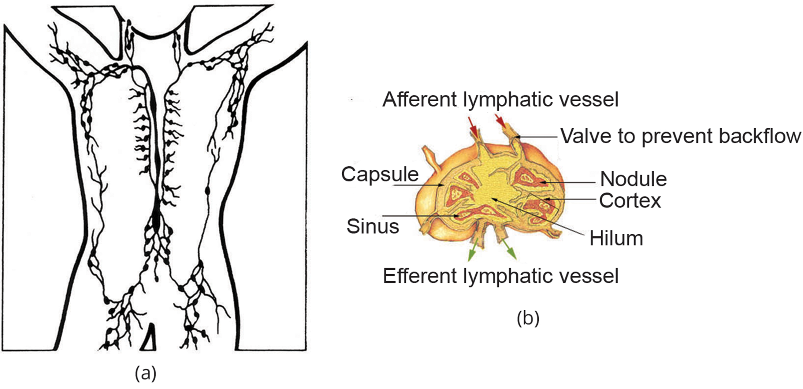
Lesson 37.2 Figure 16
National Cancer Institute on Wikimedia Commons. "Lymph nodes illustration."
SEER on Wikimedia Commons. "Lymph node structure."
Notes:
Figure 16: (a) Lymphatic vessels carry a clear fluid called lymph throughout the body. The liquid enters (b) lymph nodes through afferent (conducting inward) vessels. Lymph nodes are filled with lymphocytes that purge infecting cells. The lymph then exits through efferent (conducting outward) vessels.

Slide 38
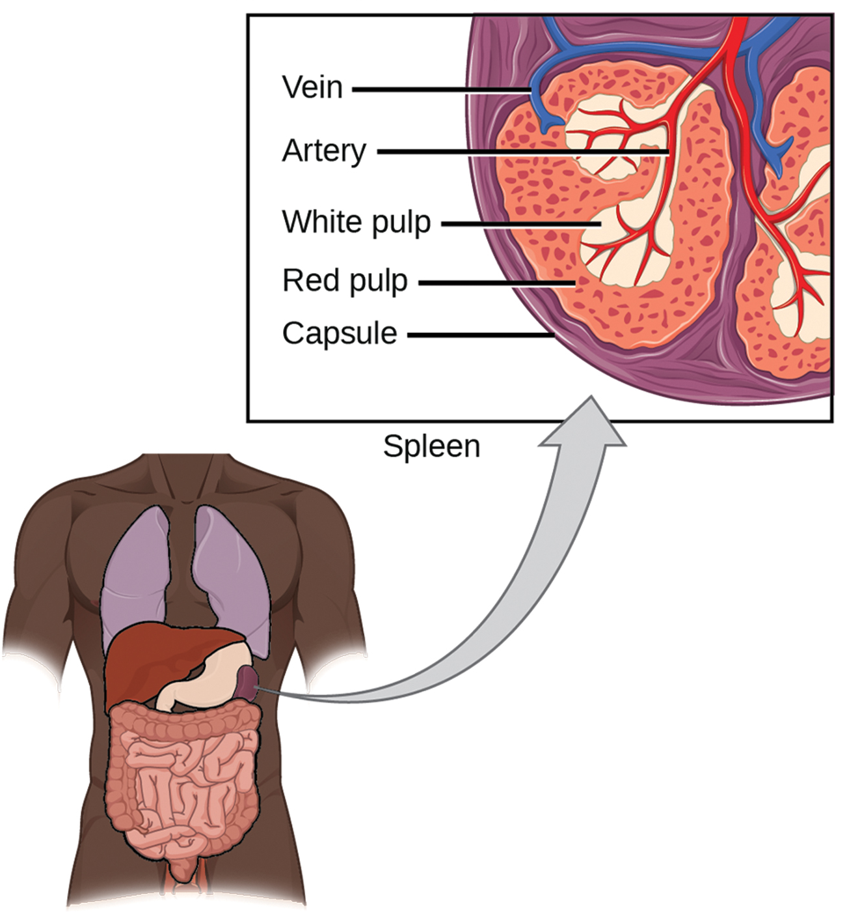
Primary Centers of the Immune System₂
The spleen houses B and T cells, macrophages, dendritic cells, and NK cells.
The spleen is the site where APCs that have trapped foreign particles in the blood can communicate with lymphocytes.
Antibodies are synthesized and secreted by activated plasma cells in the spleen, and the spleen filters foreign substances and antibody-complexed pathogens from the blood.
Functionally, the spleen is to the blood as lymph nodes are to the lymph.
37.2 Figure 17
NCI. "Spleen."
Notes:
Figure 17: The spleen is similar to a lymph node but is much larger and filters blood instead of lymph. Blood enters the spleen through arteries and exits through veins. The spleen contains two types of tissue: red pulp and white pulp. Red pulp consists of cavities that store blood. Within the red pulp, damaged red blood cells are removed and replaced by new ones. White pulp is rich in lymphocytes that remove antigen-coated bacteria from the blood.

Slide 39
Chronic Disease
In the competition between immune protection and pathogen evasion, pathogens have the advantage of more rapid evolution because of their shorter generation time and other characteristics.
Streptococcus pneumoniae surrounds itself with a capsule that inhibits phagocytes from engulfing it and displaying antigens to the adaptive immune system.
Staphylococcus aureus synthesizes a toxin called leukocidin that kills phagocytes after they engulf the bacterium.
HIV infects T_{H} cells via their CD4 surface molecules, gradually depleting the number of T_{H} cells in the body. As a result, HIV-infected are immune-compromised and often suffer from infections.
Maladaptive responses of immune cells and molecules themselves can also disrupt the proper functioning of the entire system, leading to host cell damage that could become fatal.

Slide 40
Immunodeficiency
Immunodeficiency is the failure, insufficiency, or delay in the response of the immune system, which may be acquired or inherited.
Immunodeficiency can be acquired because of infection with certain pathogens (such as HIV), chemical exposure (including certain medical treatments), malnutrition, or possibly by extreme stress.
Dozens of genetic disorders result in immunodeficiencies, including severe combined immunodeficiency (SCID), bare lymphocyte syndrome, and MHC class II deficiencies.
Rarely, primary immunodeficiencies that are present from birth may occur.
Neutropenia is one form in which the immune system produces a below-average number of neutrophils, the body's most abundant phagocytes. As a result, bacterial infections may go unrestricted in the blood, causing serious complications.

Slide 41
Hypersensitivities
Maladaptive immune responses toward harmless foreign substances or self-antigens that occur after tissue sensitization are termed hypersensitivities. The types of hypersensitivities include immediate, delayed, and autoimmunity. A large proportion of the population is affected by one or more types of hypersensitivity.

Slide 42
Allergies
The immune reaction that results from immediate hypersensitivities in which an antibody-mediated immune response occurs within minutes of exposure to a harmless antigen is called an allergy.
Upon initial exposure to a potential allergen, an allergic individual synthesizes antibodies of the IgE class.
Upon subsequent exposure to the same allergen, IgE molecules on mast cells bind the antigen and stimulate the mast cell to release the modified amino acids histamine and serotonin which recruit eosinophils, which mediate allergic responses.
The effects of an allergic reaction range from mild symptoms, like sneezing and itchy, watery eyes, to more severe or even life-threatening reactions (anaphylactic shock) involving intensely itchy welts or hives, airway contraction with severe respiratory distress, and plummeting blood pressure.

Slide 43
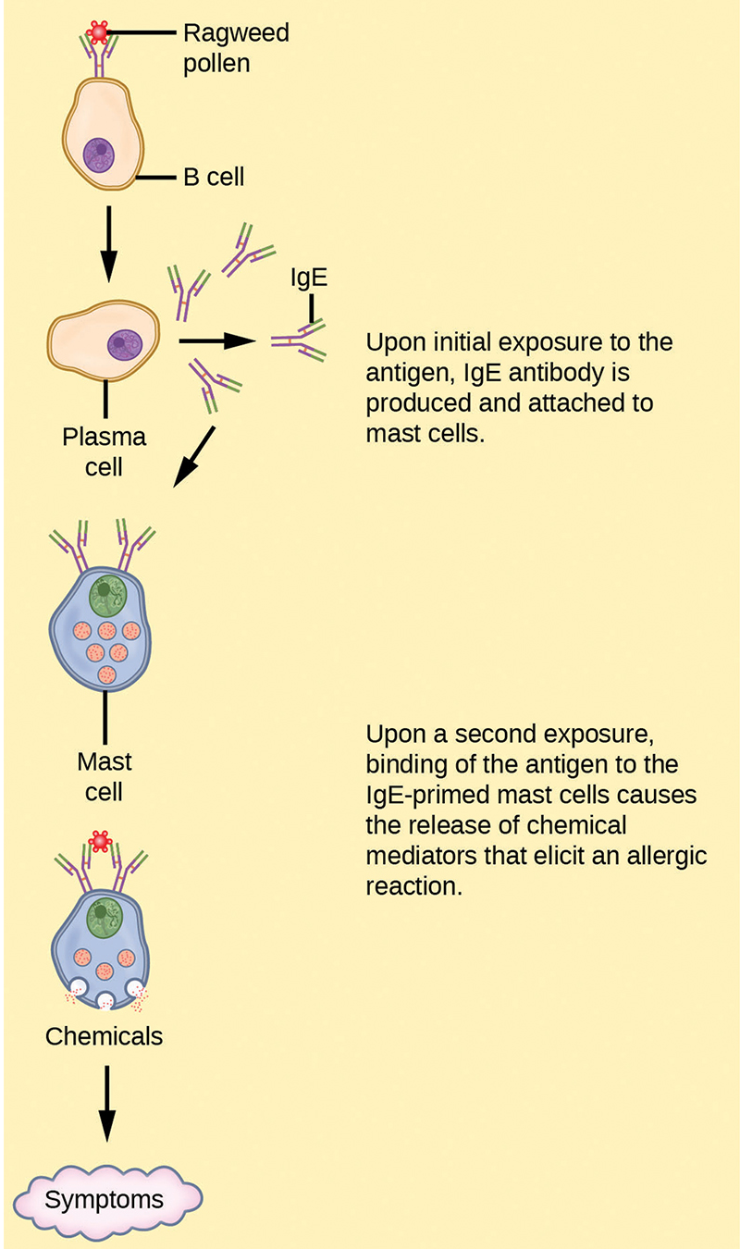
Lesson 37.2 Figure 18
NIH. "Allergic response."
Notes:
Figure 18: On first exposure to an allergen, an IgE antibody is synthesized by plasma cells in response to a harmless antigen. The IgE molecules bind to mast cells, and on secondary exposure, the mast cells release histamines and other modulators that affect the symptoms of allergy.

Slide 44
Delayed Hypersensitivity
Delayed hypersensitivity is a cell-mediated immune response that takes approximately one to two days after secondary exposure for a maximal reaction to be observed.
This type of hypersensitivity involves the T_{H}1 cytokine-mediated inflammatory response and may manifest as local tissue lesions or contact dermatitis.
Delayed hypersensitivity occurs in some individuals in response to contact with certain types of jewelry or cosmetics and facilitates the immune response to poison ivy.
That is why cortisone is used to treat such responses; it will inhibit cytokine production.

Slide 45
Autoimmunity
Autoimmunity is a type of hypersensitivity to self-antigens.
Most types of autoimmunity involve the humoral immune response. Antibodies that inappropriately mark self components as foreign are termed autoantibodies.
Autoimmunity can develop with time, and its causes may be rooted in molecular mimicry. Antibodies and TCRs may bind self-antigens that are structurally like pathogen antigens, which the immune receptors first raised.
As an example, infection with Streptococcus pyogenes may generate antibodies or T cells that react with heart muscle, which has a similar structure to the surface of S. pyogenes. These antibodies can damage heart muscle, leading to rheumatic fever.
Insulin-dependent (type 1) diabetes mellitus arises from a destructive inflammatory T_{H}1 response against insulin-producing cells of the pancreas.

Slide 46
Think It Through₃
Multiple sclerosis is a disease in which the immune cells attack myelin, the protective sheath that covers nerve fibers. As myelin degrades, the nerves become less able to send electrical signals, leading to symptoms such as numbness and muscle weakness. Researchers have found that previous infection with the Epstein-Barr virus increases the odds of developing multiple sclerosis.
How do you think infection with this virus may contribute to the development of multiple sclerosis?
Notes:
Originally an On Your Own. This is included here to use as a talking point or for a think-pair-share activity.

Slide 47
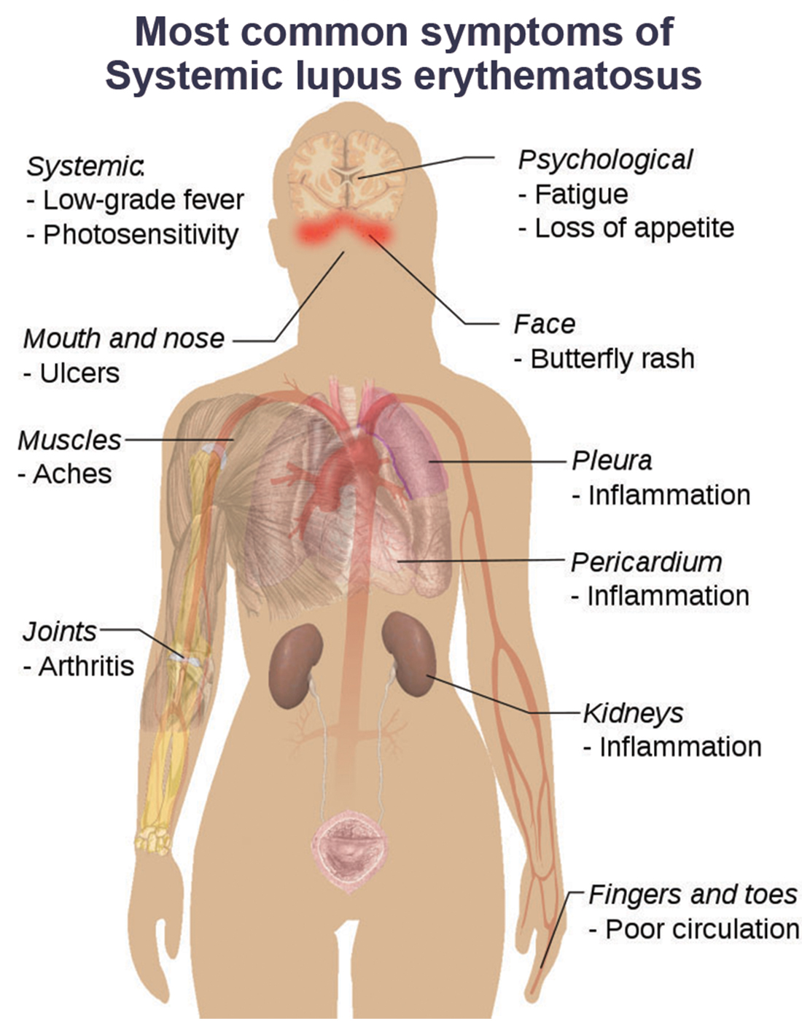
Lesson 37.2 Figure 19
Mikael Häggström, M.D. on Wikimedia Commons. "Lupus symptoms."
Notes:
Figure 19: Systemic lupus erythematosus (SLE) is characterized by autoimmunity to the individual's own DNA and/or proteins, which leads to varied dysfunction of the organs.

Slide 48
Summary
The adaptive immune response is a slower-acting, longer-lasting, and more specific response than the innate response.
APCs display antigens via MHC molecules to complementary naïve T cells. In response, the T cells differentiate and proliferate, becoming T_{H} cells or CTLs. T_{H} cells stimulate B cells that have engulfed and presented pathogen-derived antigens. B cells differentiate into plasma cells that secrete antibodies, whereas CTLs induce apoptosis in intracellularly infected or cancerous cells.
Memory cells persist after a primary exposure to a pathogen. If re-exposure occurs, memory cells differentiate into effector cells and create a fast, robust immune response.
The mucosal immune system is largely independent from the systemic immune system but functions in a parallel fashion to protect the extensive mucosal surfaces of the body.
Immune disruptions may involve insufficient immune responses or inappropriate immune targets.

Slide 49

End of Hawkes Learning PowerPoint

