Slide 1
Lesson 37.3
Antibodies

Slide 2
Objectives
Describe the structure and function of antibodies.
Discuss antibody production.
Explain cross-reactivity.

Slide 3
Antibodies
An antibody, also known as an immunoglobulin (Ig), is a protein that is produced by plasma cells after stimulation by an antigen.
Antibodies are the functional basis of humoral immunity.
Antibodies occur in the blood, in gastric and mucus secretions, and in breast milk.
Antibodies in these fluids can bind pathogens and mark them for destruction by phagocytes.

Slide 4
Antibody Structure₁
An antibody molecule is comprised of four polypeptides: two identical heavy chains partially bound to each other in a "Y" formation and flanked by two identical light chains. Disulfide bonds between the cysteine amino acids in the antibody molecule attach the polypeptides to each other.
The areas where the antigen is recognized on the antibody are variable domains, and the antibody base is composed of constant domains.
In germ-line B cells, the variable region of the light chain gene has 40 variable (V) and 5 joining (J) segments.
Recombination and splicing may result in over 106 possible VJ combinations.

Slide 5
Antibody Structure₂
The constant (C) domain, which does not bind antigens, is the same for all antibodies of the same Ig class.
Similarly, the heavy chain gene segment includes 44 V segments, 6 J segments, 2 C segments, and 27 diversity (D) segments.
After recombination and splicing, each heavy chain contains one of each of the four segment types.

Slide 6
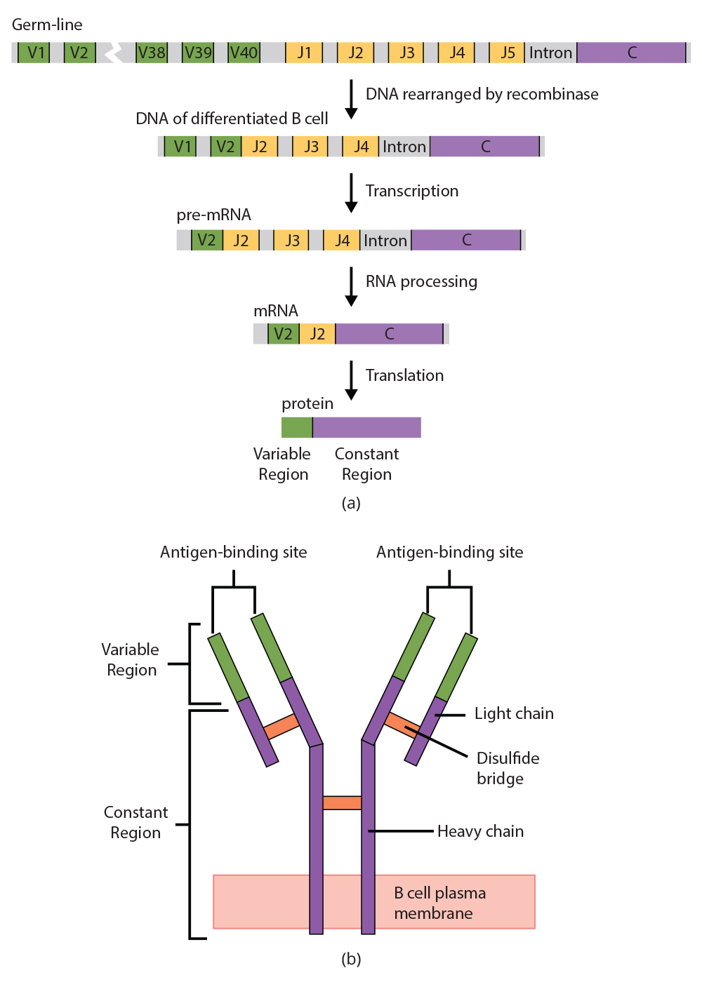
Lesson 37.3 Figure 1
CNX OpenStax on Wikimedia Commons. "Antibody formation." Modified.
Notes:
Figure 1: (a) As a germ-line B cell matures, an enzyme called DNA recombinase randomly excises unwanted V, D, and J segments from the full-length heavy chain gene segment. Splicing at the mRNA level results in further gene rearrangement. As a result, (b) each antibody has a unique variable region capable of binding a different antigen.

Slide 7
Reflection Question
Consider that antibodies are produced by the splicing and recombination of many possible gene segments. What benefit might this mode of antibody production have to an organism?
Notes:
The reflection question is included here to use as a talking point or for a think-pair-share activity.

Slide 8
Antibody Classes
Antibodies can be divided into five classes—IgM, IgG, IgA, IgD, IgE—based on their physiochemical, structural, and immunological properties.
IgGs make up about 80% of all antibodies, have heavy chains consisting of one variable domain, three identical constant domains and are secreted by plasma cells in the blood.
IgA and IgD also have three constant domains per heavy chain. IgA is present in mucus, saliva, tears and breast milk while IgD activates mast and basophile cells.
IgM and IgE each have four constant domains per heavy chain. IgM is responsible for early stages of immunity, while IgE is responsible for allergic reactions.

Slide 9
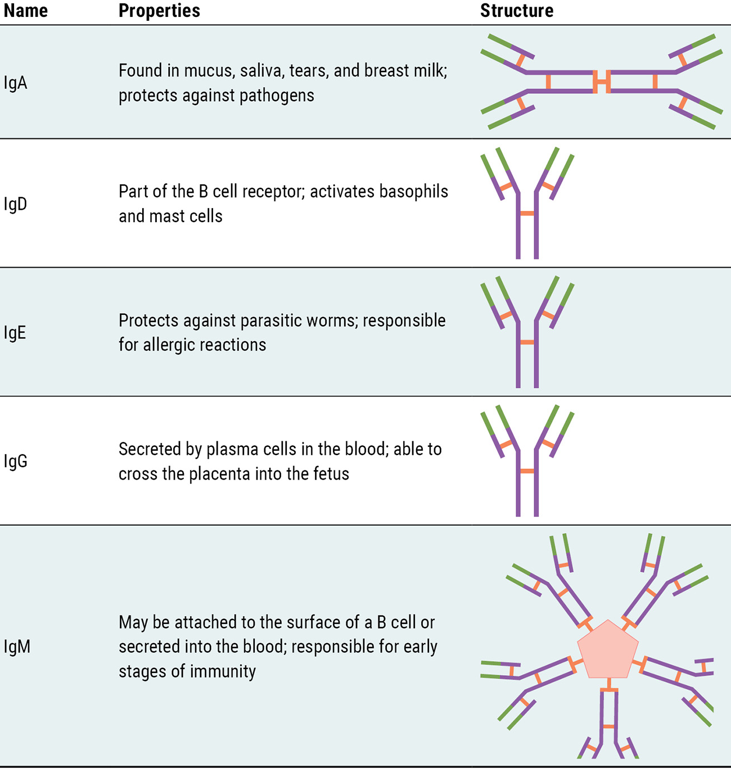
Lesson 37.3 Figure 2
CNX OpenStax on Wikimedia Commons. "Immunoglobulins." Modified.
Notes:
Figure 2: Immunoglobulins have different functions, but all are composed of light and heavy chains that form a Y-shaped structure.

Slide 10
Antibody Functions
Antibodies mark pathogens for destruction by phagocytic cells because phagocytic cells are highly attracted to macromolecules complexed with antibodies.
Phagocytic enhancement by antibodies is called opsonization.
Antibodies can also cause the agglutination, or cross-linking, of pathogens to create large aggregates that are more easily filtered from blood and more easily phagocytized.
Antibodies can coat extracellular pathogens and neutralize them by blocking key sites on the pathogen that enhance their infectivity.
Antibody neutralization can prevent pathogens from entering and infecting host cells.
In a process called complement fixation, IgM and IgG in serum bind to antigens and provide docking sites onto which sequential complement proteins can bind.

Slide 11
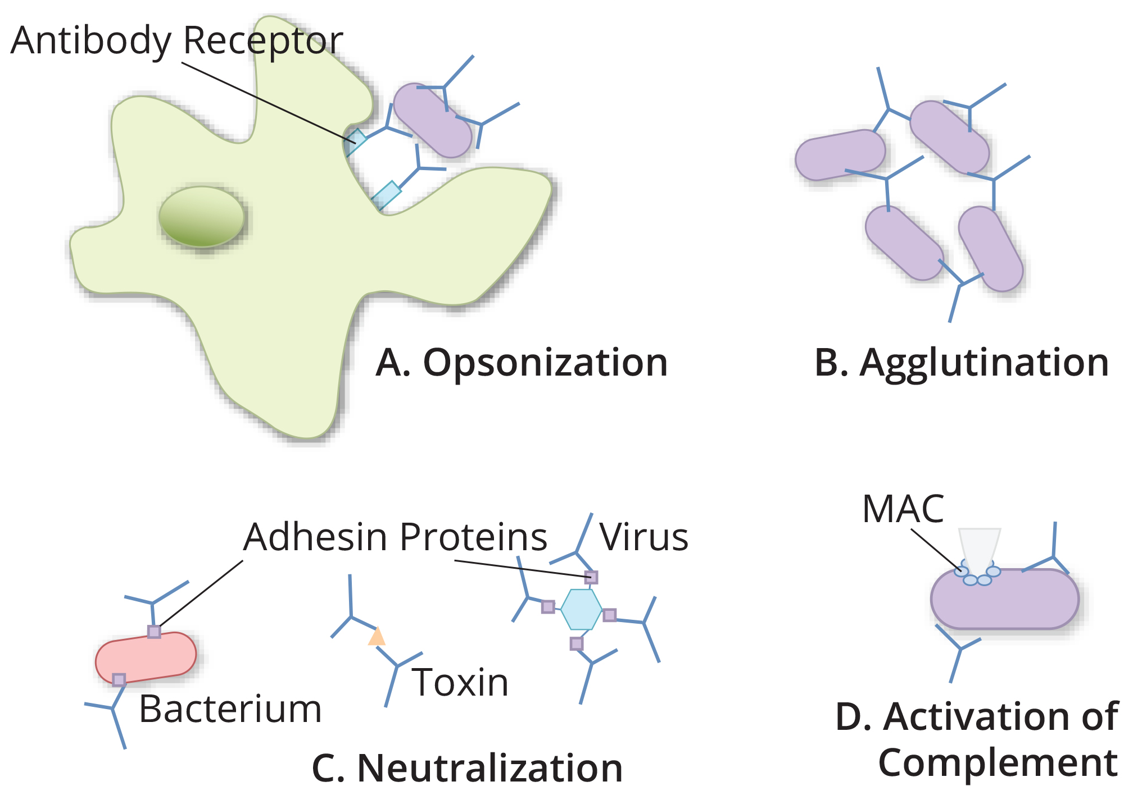
Lesson 37.3 Figure 3
Becky Boone on Wikimedia Commons. "Antibody actions."
Notes:
Figure 3: Antibodies may inhibit infection by opsonization, agglutination, neutralization, or activation of the complement cascade. (a) Opsonization is the tagging of a pathogen with antibodies for consumption by a macrophage or neutrophil. (b) Agglutination is the cross-linking of pathogens to form large aggregates. (c) Neutralization occurs when the binding of antibodies to a virus or toxic protein prevents the virus or toxin protein from binding to its target. (d) Activation of the complement results in the formation of pores in the pathogen, destroying the pathogen.

Slide 12
Affinity, Avidity and Cross Reactivity
Not all antibodies bind with the same strength, specificity, and stability. In fact, antibodies exhibit different affinities depending on the molecular complementarity between antigen and antibody molecules.
The term avidity describes binding by antibody classes that are secreted as joined, multivalent structures such as IgM and IgA.
Antibodies secreted after binding to one epitope on an antigen may exhibit cross-reactivity for the same or similar epitopes on different antigens. Cross-reactivity occurs when an antibody binds to an antigen that is different from the one that elicited its synthesis and secretion.

Slide 13
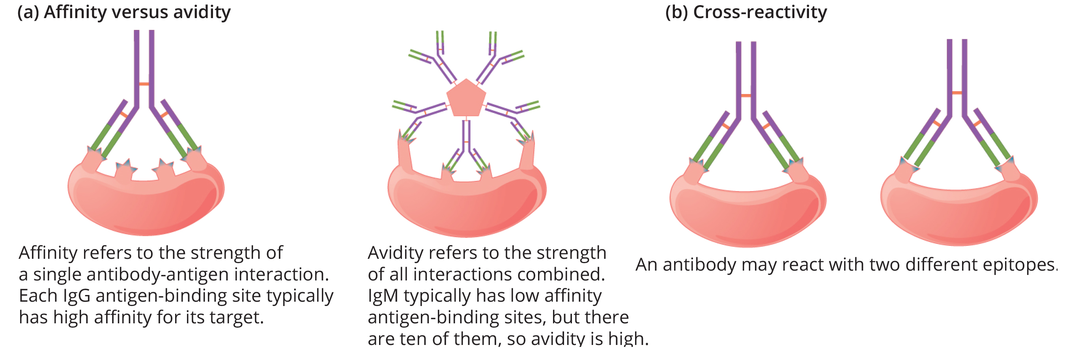
37.3 Figure 4
CNX OpenStax on Wikimedia Commons. "Affinity, avidity, and cross reactivity."
Notes:
Figure 4: (a) Affinity refers to the strength of a single interaction between antigen and antibody, while avidity refers to the strength of all interactions combined. (b) An antibody may cross-react with different epitopes.

Slide 14
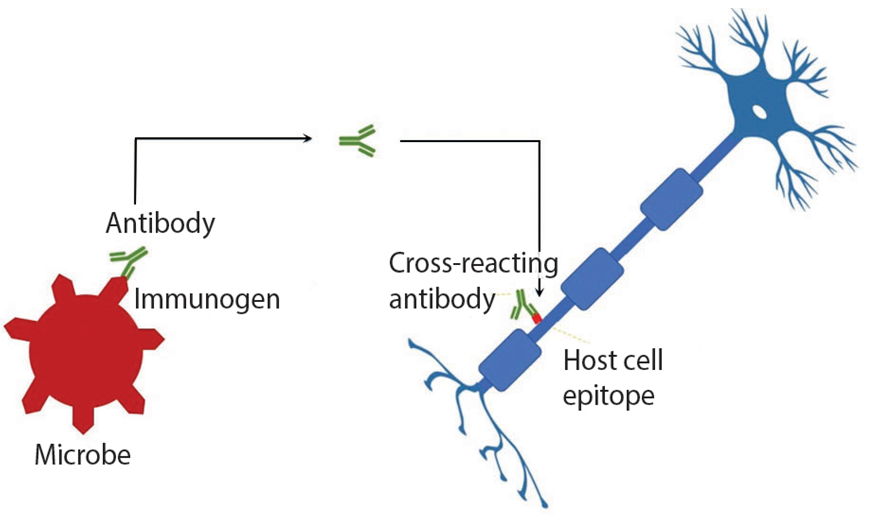
Cross Reactivity
Cross-reactivity can be beneficial if an individual develops immunity to several related pathogens despite having only been exposed to or vaccinated against one of them.
Conversely, antibodies raised against pathogenic molecular components that resemble self molecules may incorrectly mark host cells for destruction and cause autoimmune disorders.
Patients who develop systemic lupus erythematosus (SLE) commonly exhibit antibodies that react with their own DNA. These antibodies may have been initially raised against the nucleic acid of microorganisms but later cross-reacted with self-antigens.
37.3 Figure 5
immunopaedia.org. "Molecular mimicry." Modified.
Notes:
Figure 5: Antibodies that develop against a specific microbe can cross-react with proteins on host cells, leading to an autoimmune response.

Slide 15
Antibodies of the Mucosal Immune System
Antibodies synthesized by the mucosal immune system include IgA and IgM.
Activated B cells differentiate into mucosal plasma cells that synthesize and secrete dimeric IgA, and pentameric IgM.
Secreted IgA is abundant in tears, saliva, breast milk, and in secretions of the gastrointestinal and respiratory tracts.
Antibody secretion results in a local humoral response at epithelial surfaces and prevents infection of the mucosa by binding and neutralizing pathogens.

Slide 16
Types of Adaptive Immunity
There are several major types of adaptive immunity, often mediated by antibodies.
Active immunity may be either natural (resulting from natural illness) or acquired (resulting from vaccination).
Passive immunity results from the transfer of antibodies made in one individual to another to temporarily protect against infectious disease.
Breastfed infants are resistant to certain infections during the first few months of life due to the antibodies they consume from milk.
Artificial passive immunity can occur when a person who has recently produced a successful immune response against a particular disease donates blood to a nonimmune recipient. This process confers temporary immunity in the recipient through antibodies found in the donor's blood serum.

Slide 17
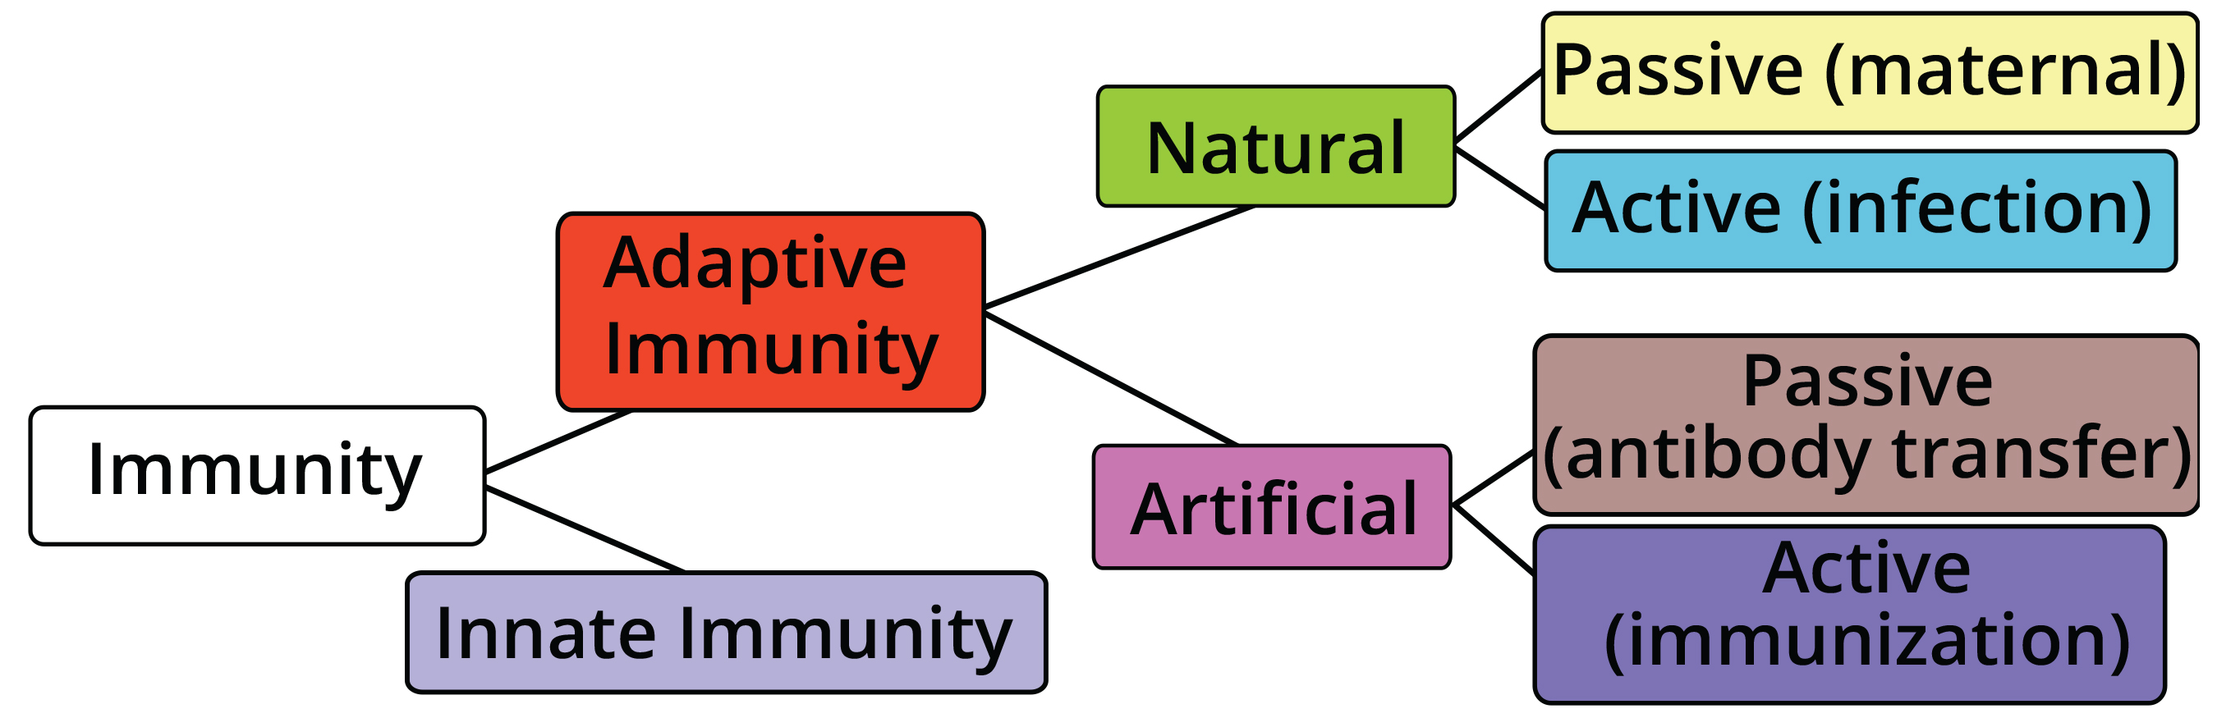
Lesson 37.3 Figure 6
Pixelsquid on Wikimedia Commons. "Immunity."
Notes:
Figure 6: There are four main types of adaptive (acquired) immunity. Active versus passive immunity refers to whether an individual develops their own immune response or they receive antibodies made by someone else. Natural versus artificial immunity refers to whether the individual develops the immunity as a natural part of life or they instead acquire immunity due to a medical intervention.

Slide 18
Antibodies in Detection and Measurement
The variety, specificity, and reliability of antibodies makes them ideally suited for certain medical tests and investigations.
Radioimmunoassays (RIA) rely on the antigen-antibody interaction to detect the presence and/or concentration of certain antigens.
It is used in narcotics detection, blood bank screening, early cancer screening, hormone measurement, and allergy diagnosis.
The basic principle of RIA is competitive binding, where a radioactive antigen competes with a nonradioactive antigen for a fixed number of binding sites.
First, an antigen is made radioactive (tagged), and then it is mixed with a known quantity of its specific antibody.
When a sample, such as one from the patient's blood, is introduced, antibodies will cease binding to the tagged antigen and instead bind to the untagged one, a process called displacement.
The amount of newly unbound tagged antigens is measured to see how much displacement occurred, which indicates the presence and concentration of the antigen in the blood.

Slide 19
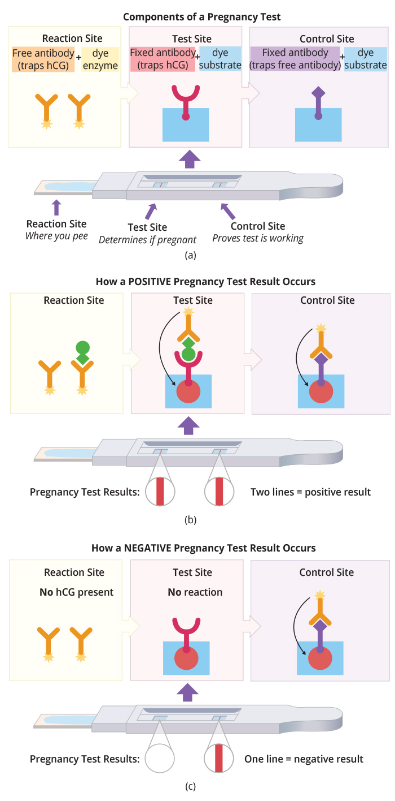
Science and You₁
The specificity of the interaction between antibody and antigen has been used for various medical purposes.
With a home pregnancy test, urine is applied at one end of a test strip and then wicks through the test strip by capillary action.
The urine first reaches the reaction site where it encounters unbound antibodies that bind to hCG. Next, the urine encounters the test line containing immobilized antibodies that also bind to hCG.
If hCG is present, it is bound to free antibodies with the tag, which interacts with a substrate located in the test site and causes a color change, indicating a positive test for the presence of hCG and pregnancy.
Next, as urine progresses further up the strip, any free antibodies not bound to hCG interact with the fixed antibodies at the control site, which also contains substrate, leading to a color change.
37.3 Figure 7
BioNinja. "Pregnancy test." Modified.
Notes:
This is included as a relevant application for this topic.
Figure 7: A home pregnancy test uses antibodies to detect the presence of hCG in urine, indicative of pregnancy. (a) There are three locations in a test strip. The first location (the reaction site) contains free antibodies that bind hCG and are linked to a dye enzyme. The second location (the test site) contains fixed antibodies that also bind hCG as well as a substrate that changes color in the presence of the dye enzyme. The third location (the control site) contains fixed antibodies that bind any free antibodies as well as the color-changing substrate. (b) If hCG is present in the urine, it will bind to free antibodies with the dye enzyme in the first location and carry them to the test site. At the test site, the binding of hCG with its dye enzyme results in a color change of the dye substrate. Free antibodies that carry the dye enzyme but are not bound to hCG will bind to the control site, causing a color change in the substrate. (c) In the absence of hCG (and pregnancy), the test line does not change color, but the control site still does.

Slide 20
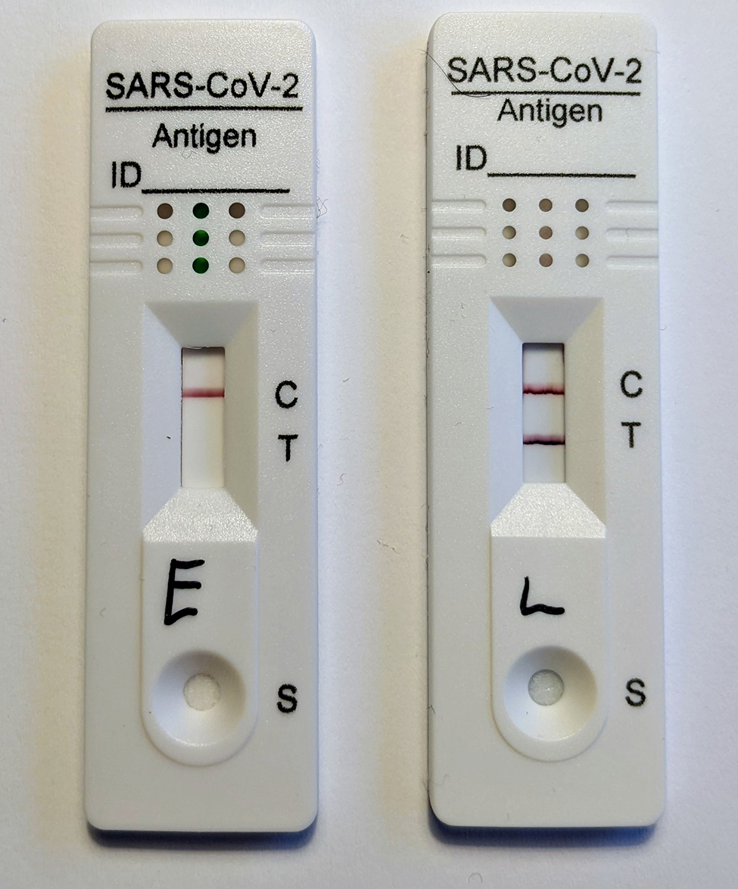
Science and You₂
The lateral flow technology used in home pregnancy tests has been used to develop other types of diagnostic tests as well, including the rapid antigen test used to detect COVID-19 infection.
In this case, the antigen being detected is the nucleocapsid (N) protein of the SARS-CoV-2 virus.
37.3 Figure 8
Boldie on Wikimedia Commons. "COVID-19 test results."
Notes:
This is included as a relevant application for this topic.
Figure 8: The rapid antigen test used for COVID-19 detection is also a lateral flow test involving the interaction of a viral antigen in a sample with specific antibodies in the test strip. Here, both negative (left) and positive (right) test results are shown. Note that the control site must change color for the test to be valid.

Slide 21
Summary
Antibodies (immunoglobulins) are the molecules secreted from plasma cells that mediate the humoral immune response.
There are five antibody classes; an antibody's class determines its mechanism of action and production site but does not control its binding specificity.
Antibodies bind antigens via variable domains and can either neutralize pathogens, mark them for phagocytosis, or activate the complement cascade.

Slide 22

End of Hawkes Learning PowerPoint

