Slide 1
Lesson 38.1
Osmoregulation and Osmotic Balance

Slide 2
Objectives
Define osmosis and explain its role within molecules.
Explain why osmoregulation and osmotic balance are important body functions.
Describe active transport mechanisms
Explain osmolarity and the way in which it is measured.
Describe osmoregulators or osmoconformers and how these tools allow animals to adapt to different environments.

Slide 3
Osmoregulation Overview
The amount of human water consumption (8–10 glasses per day) should equal the amount excreted through:
  Urination
  Defecation
  Sweating
  Respiration (to a small extent)
The body's organs and tissues are soaked in fluids that are maintained at constant
  Temperature
  pH
  Solute concentration
Osmotic regulation is the process by which concentrations of body solutes (mainly salts and sugars) are kept in balance, despite external factors like temperature, diet, and weather conditions.

Slide 4
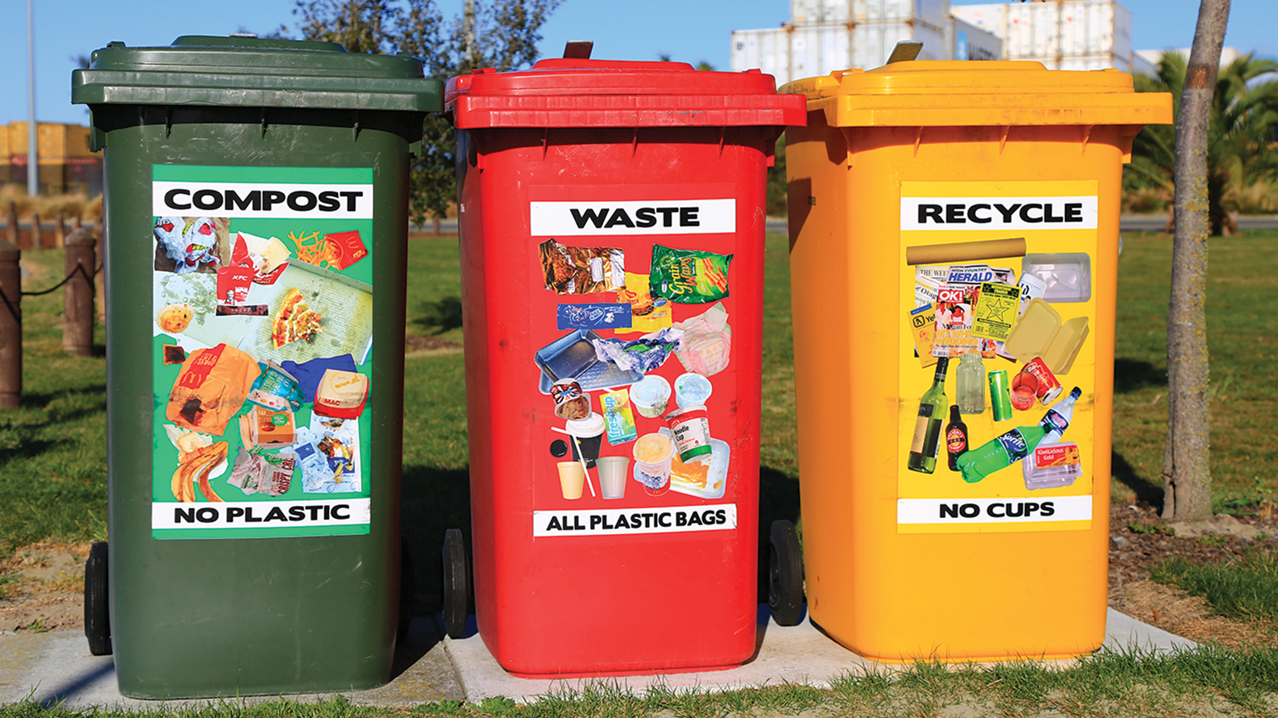
38.1 Figure 1
Nareeta Martin on Unsplash. "Compost, trash, and recycling bins."
Notes:
38.1 Figure 1: Just as humans recycle what we can and dump the remains into landfills, our bodies use and recycle what they can and excrete the remaining waste products. Our bodies' complex systems have developed ways to treat waste and maintain a balanced internal environment.

Slide 5
Osmosis and Osmoregulation
Osmosis is the diffusion of water across a membrane in response to osmotic pressure caused by an imbalance of molecules on either side of the membrane.
Diffusion is the passive movement of a substance from a region of high concentration to a region of low concentration.
Osmoregulation is the process of maintaining salt and water balance (osmotic balance) across membranes within the body's fluids, which are composed of water, electrolytes, and nonelectrolytes.
An electrolyte is a solute that dissociates into ions when dissolved in water.
A nonelectrolyte is a solute that does NOT dissociate into ions when dissolved in water.
Both electrolytes and nonelectrolytes contribute to the osmotic balance.

Slide 6
Body Fluids
The body's fluids include:
Blood plasma
Cytosol within cells
Interstitial fluid: the fluid that exists in the spaces between cells and tissues of the body
In the body, there is a constant input of water and electrolytes into the system.
While osmoregulation is achieved across membranes in the body, excess electrolytes and wastes are transported to the kidneys for excretion.

Slide 7
Body Membranes Are Semipermeable
The body's membranes include:
Cell membranes
Serous membranes that line internal body cavities and organs
Pleural membranes that line the chest wall and lungs
The body's membranes are semipermeable membranes which allow certain types of solutes and water to flow across them.

Slide 8
Movement Across Semipermeable Membranes
Solutions on 2 sides of a semipermeable membrane equalize in solute concentration by the movement of solutes and/or water across the membrane.
Compared to the cells, a solution may be:
  Hypotonic
  Hypertonic
  Isotonic

Slide 9
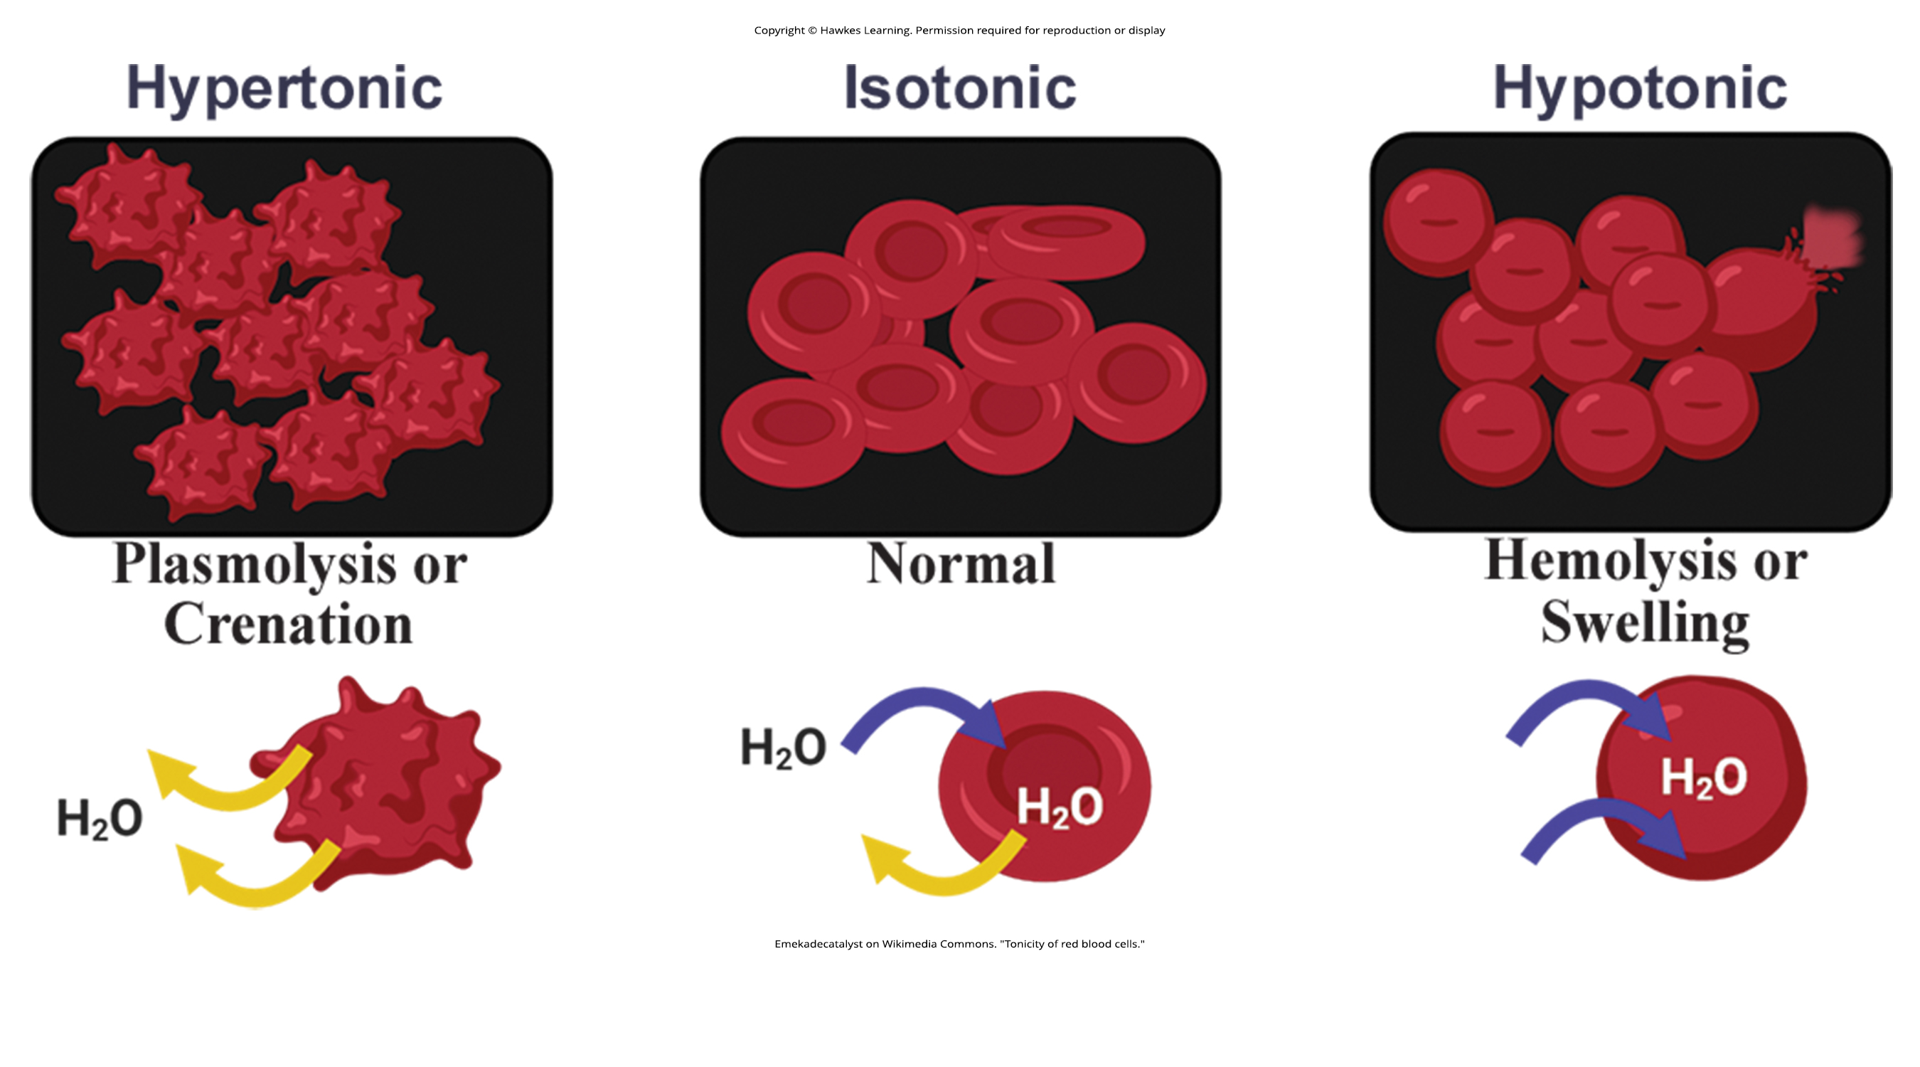
Hypotonic Solution
Cells placed into a hypotonic or "low salt" solution tend to swell due to water movement into the cells.
38.1 Figure 2
Emekadecatalyst on Wikimedia Commons. "Tonicity of red blood cells."

Slide 10
Hypertonic Solution
Cells placed into a hypertonic or “high salt” solution tend to shrivel up due to water loss out of the cells.
38.1 Figure 2
Emekadecatalyst on Wikimedia Commons. "Tonicity of red blood cells."

Slide 11
Isotonic Solution
Isotonic cells have an equal concentration of solutes inside and outside the cell, which equalizes the osmotic pressure on either side of the cell membrane.
38.1 Figure 2
Emekadecatalyst on Wikimedia Commons. "Tonicity of red blood cells."

Slide 12
Group Activity
Work in small groups to complete this simple experiment.
First, slice up a vegetable, such as a potato or carrot, into uniformly sized strips.
Then, soak some strips in fresh water and others in salt water.
After 24–72 hours, check the strips.
  Compare the texture, size, and appearance of the strips that had been soaked in the salt water to the strips that had been soaked in the fresh water.
  Use your knowledge of osmosis to explain any changes you observe.

Slide 13
Need for Osmoregulation
Biological systems constantly interact and exchange water and nutrient with the environment by:
  Eating
  Drinking
  Sweating
  Urinating
  Defecating
Without osmoregulation, toxic waste and/or water would accumulate.
  Some diseases damage the osmoregulatory system.

Slide 14
Mammals Also Regulate Specific Concentrations of Electrolytes In Their Fluid Compartments
In addition to osmotic pressure, mammalian systems have evolved to regulate specific concentrations of important electrolytes in their 3 major fluid compartments:
  Blood plasma
  Extracellular fluid
  Intracellular fluid
Due to water movement resulting from osmoregulation, the volume of these compartments can temporarily change.
Because blood plasma is one compartment, osmotic pressures directly affect blood pressure.

Slide 15
Science and You₁
Why IVs Contain Saline Solution Rather Than Pure Water
The saline solution in an IV bag is formulated to match the electrolyte concentration of blood.
Pure water is hypotonic to blood and would cause water to rush into the cells of the body, potentially leading to hemolysis.
What Is Hemolysis?
Hemolysis is a dangerous condition in which blood cells swell and rupture due to excessive water uptake.
It could result in death.
Notes:
This is included as a relevant application for this topic.

Slide 16
Transport of Electrolytes Across Cell Membranes
Electrolytes dissociate into their component ions in water.
NaCl dissociates into Na⁺ and Cl⁻.
The most important ions whose concentrations are closely regulated in body fluids are:
Sodium (Na⁺)
Potassium (K⁺)
Calcium (Ca²⁺)
Magnesium (Mg²⁺)
Chloride (Cl⁻)
Carbonate (CO₃²⁻)
Bicarbonate (HCO₃⁻)
Phosphate (PO₃⁻)
Electrolytes are lost during urination and perspiration.
Athletes should replace electrolytes and fluids during activity.

Slide 17
Relationship Between Osmotic Pressure and Number of Solute Atoms or Molecules
Osmotic pressure is directly proportional to the number of solute atoms or molecules.
As the number of solute particles increases, osmotic pressure increases.
The size of the solute matter has no effect.
Because electrolytes dissociate into their component ions, they add more solute particles to solution and hence have a greater effect on osmotic pressure than compounds that do not dissociate.

Slide 18
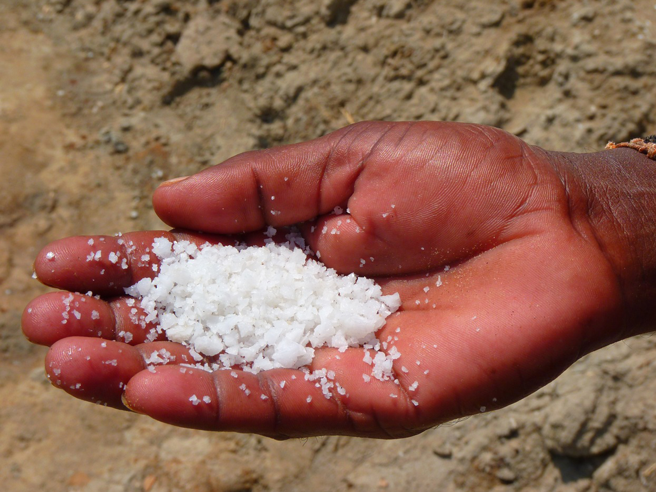
38.1 Figure 3
LoggaWiggler on Pixabay. "Salt."
Notes:
38.1 Figure 3: Sodium chloride is an electrolyte because, when dissolved in water, the ions dissociate into sodium ions (Na+) and chloride ions (Cl−).

Slide 19
Types of Transport Across Membranes
Electrolytes cannot move through biological membranes directly
Passive diffusion is the movement of a solute directly through a membrane with (down) its concentration gradient.
  Example: water
Facilitated diffusion is the movement of a solute with (down) its concentration through protein-based channels in the membrane.
Active transport is the movement of a solute against (up) its concentration gradient using energy through specialized membrane pumps and carrier proteins.
  Energy is used as either ATP or from coupling the movement of a solute against its concentration gradient with the movement of a solute with its concentration gradient.

Slide 20
The Mole, Molarity, and Molality
A mole:
  Is the unit for measuring solutes
  Is defined as 6.02 X 10²³ particles of solute
  Has a mass equivalent to the molecular weight of the solute, expressed in grams per mole
    Since the molecular weight of NaCl is 58.44, then the mass of one mole is 58.44 grams.
The molarity of a solution is the number of moles of solute per liter.
The molality of a solution is the number of moles of solute per kilogram of solvent.
  If the solvent is water, 1 kg of water = 1 L of water.

Slide 21
Milliequivalents and Milliosmoles
Electrolyte concentrations are expressed in milliequivalents per liter (mEq/L).
  The mEq/L is equal to the ion concentration (in millimoles, mmol) multiplied by the number of electrical charges on the ion, taking into account the ions present and their charges.
  For an ion having a charge of 1 (like Na⁺), 1 mEq = 1 mmol
  For an ion having a charge of 2 (like Ca²⁺), 1 mmol = 2 mEq, so 1 mEq = 0.5 mmol
A milliosmole (mOsm) is the number milliequivalents of solute per kilogram of solvent.
  Body fluids are maintained at a range of 280–300 mOsm.

Slide 22
Stenohaline Versus Euryhaline Organisms
Stenohaline organisms can tolerate only a relatively narrow range of salinity.
  Humans cannot adapt to drinking seawater.
  About 90% of all bony fish must live in either fresh water or seawater but cannot adapt to the other.
Euryhaline organisms can tolerate a relatively wide range of salinities.
  Salmon spend part of their lives in fresh water and part in seawater.
  Mollies are also euryhaline fish.

Slide 23
Osmoregulators
Euryhaline fish are examples of osmoregulators, organisms that can live in both hypotonic and hypertonic environments by adjusting how their bodies process salts and electrolytes.
When living in fresh water, they take up water naturally because the environment is hypotonic.
  They do not drink much water.
  They make a lot of dilute urine.
  They take in electrolytes by active transport of salt through their gills.
When living in a seawater, their environment is hypertonic.
  They drink seawater.
  They excrete excess salt through their gills and urine.

Slide 24

38.1 Figure 4
danny moore on Pixabay. "Salmon."
Notes:
38.1Figure 4: Salmon are one of the few fish that spend part of their lives in fresh water and part in salt water. Therefore, they can tolerate very wide ranges in salinity.

Slide 25
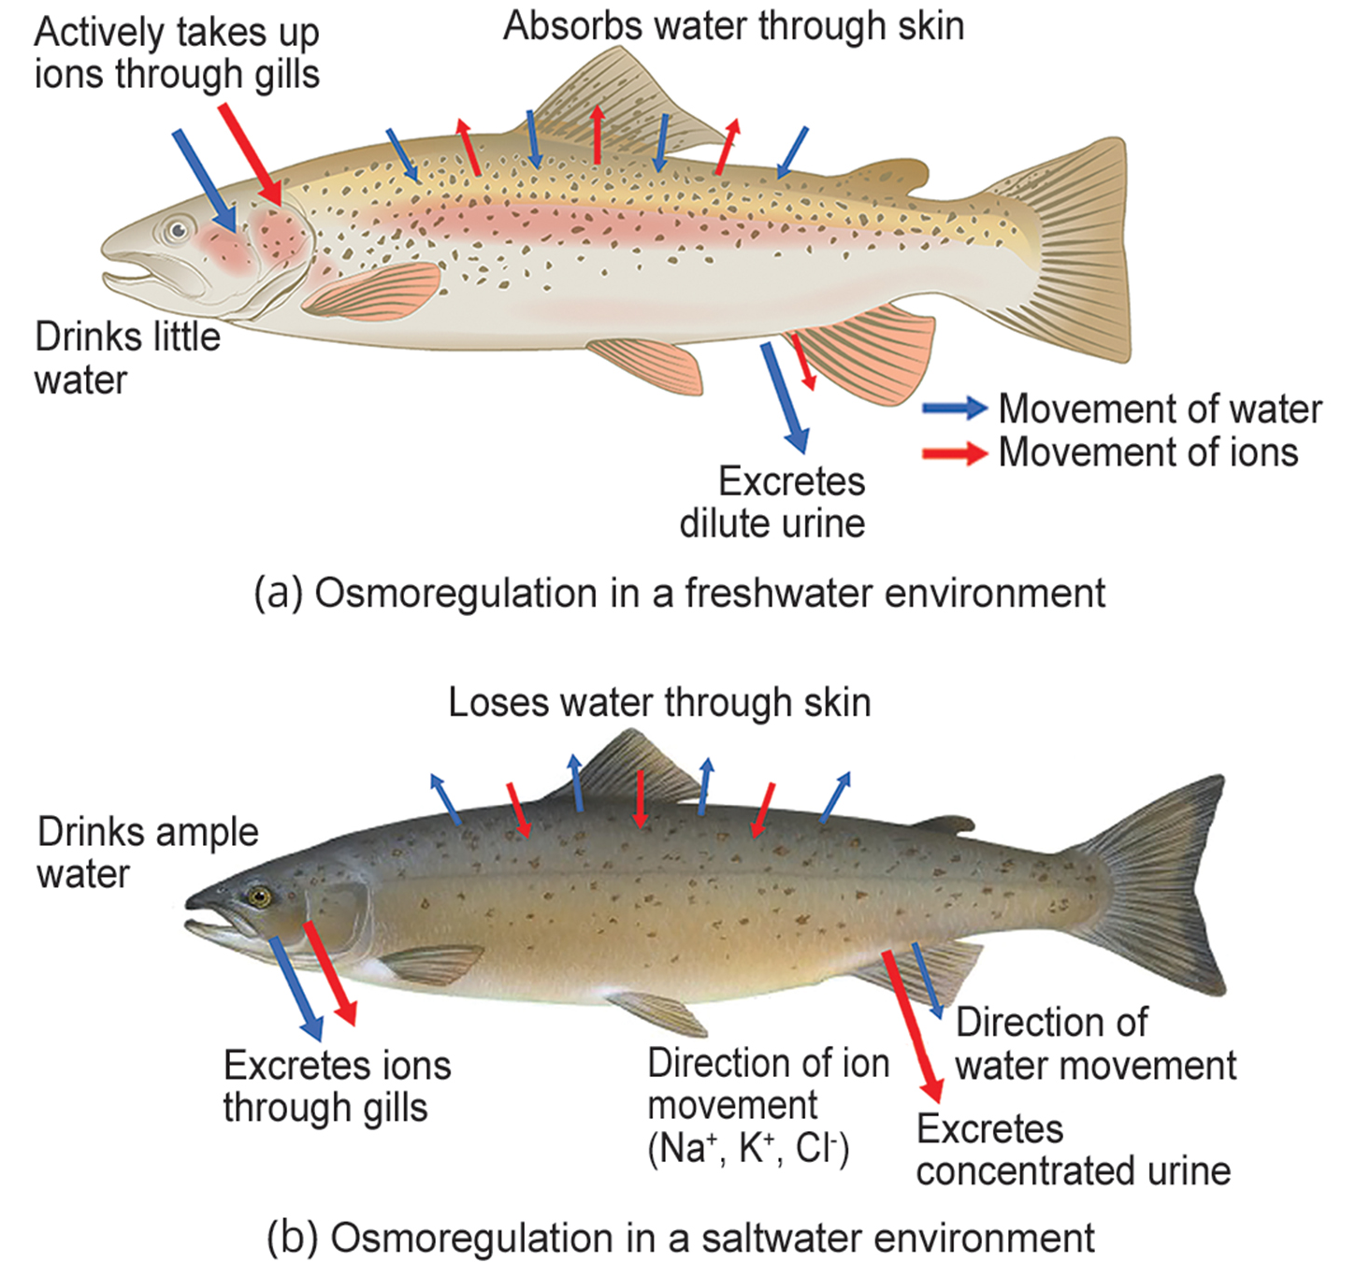
38.1 Figure 5
Duane Raver, NOAA on Wikimedia Commons. "Osmoregulation."
Notes:
38.1 Figure 5: Some fish are osmoregulators, but they must use different mechanisms to survive in (a) freshwater or (b) saltwater environments.

Slide 26
Osmoconformers
Most marine invertebrates are osmoconformers, keeping their body temperatures isotonic to the concentration of the seawater.
The electrolyte composition within the osmoconformer's blood does not need to be similar to that of seawater.
  Shark blood is of similar salt composition to that of bony fish, but it also contains urea and trimethylamine oxide (TMAO).
    Urea helps to achieve isotonicity.
    TMAO stabilizes proteins in the presence of high urea levels which would normally denature them.
    Sharks are ureotelic, meaning that they secrete urea.
  They secrete salts through rectal glands.

Slide 27
Think It Through
For a person lost at sea, why would drinking seawater put them at risk of dehydration?
Notes:
Originally an On Your Own. This is included here to use as a talking point or for a think-pair-share activity.

Slide 28
Science and You₂
Career: Dialysis Technician
Dialysis:
  Medically removes wastes and excess water from blood by diffusion and ultrafiltration
  Is used when kidney function would be unable to keep a patient alive, sometimes for the rest of their life or until they get a kidney transplant (if eligible)
Dialysis technicians:
  Work in hospitals or clinics, often directly with patients
  Commonly are supervised by registered nurses
  Review patient history and current condition, assess and respond to patient needs before and during the treatment, and monitor the treatment
  May prepare solutions and equipment for dialysis
Notes:
This is included as a relevant application for this topic.

Slide 29
Summary
Relative solute concentrations on each side of a semipermeable membrane influence water and solute movement across it.
Osmosis (a type of passive diffusion) occurs to equalize the concentration of solute across a semipermeable membrane by moving water to the side of higher solute concentration.
Facilitated diffusion is a type of diffusion using protein channels to facilitate solute movement.
Active transport is a type of transport that uses energy to move a solute against its concentration gradient.
Osmolarity considers the number of solute particles and their charges and is measured in mEq or mOsm.
Osmoregulation and osmotic balance are important bodily functions resulting in water and salt balance.
Fish that live in fresh water or salt water adapt by being either osmoregulators or osmoconformers.

Slide 30

End of Hawkes Learning PowerPoint

