Slide 1
Lesson 38.2
The Kidneys and Osmoregulatory Organs

Slide 2
Objectives
Explain how the kidneys serve as the main osmoregulatory organs in mammalian systems.
Describe the structure of the kidneys and the functions of the parts of the kidney.
Describe how the nephron is the functional unit of the kidney and explain how it actively filters blood and generates urine.
Detail the three steps in the formation of urine: glomerular filtration, tubular reabsorption, and tubular secretion.

Slide 3
Osmoregulatory Organs in Humans
There are multiple osmoregulatory organs in humans:
The skin is an important site of water and electrolyte loss through sweating, which also helps moisturize and cool the body's surface.
The lungs expel a small amount of water in the forms of mucus secretions and the evaporation of water.
The kidneys are the main osmoregulatory organ.

Slide 4
Kidneys: The Main Osmoregulatory Organ
The kidneys are a pair of bean-shaped organs located just below and posterior to the liver in the peritoneal cavity.
The adrenal glands (also called the suprarenal glands) sit atop each kidney.
Kidneys filter blood and purify it.
They filter all of the body's blood many times a day.
They use up nearly 25% of the O₂ absorbed through the lungs to make ATP to support this function.
Urine is the filtrate leaving the kidneys.

Slide 5
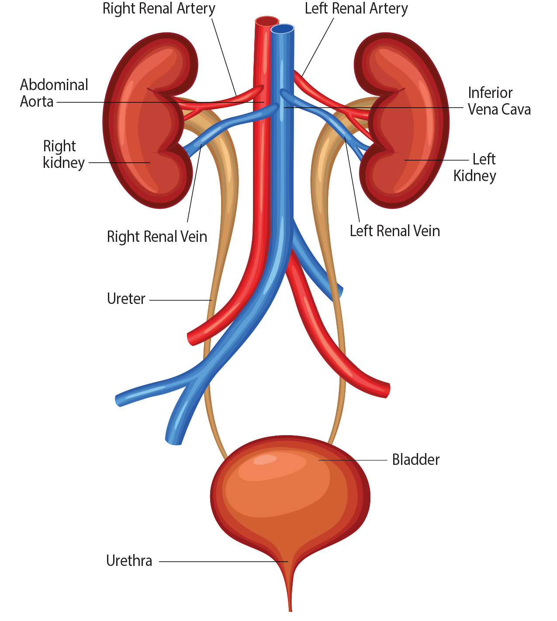
38.2 Figure 1
Notes:
38.2 Figure: Kidneys filter the blood, producing urine that is stored in the bladder prior to elimination through the urethra.

Slide 6
Kidney Structure
Each kidney is surrounded externally by 3 layers:
The renal fascia is the outermost layer and is composed of tough connective tissue.
The perirenal fat capsule is the second layer and help to anchors the kidney in place.
The renal capsule is the innermost layer.
Each kidney has 3 internal regions:
The outer cortex
The medulla, which lies in the middle of the other 2 layers
The renal pelvis

Slide 7
Kidney Structure: Internal Regions
Each kidney has 3 internal regions:
The outer cortex is granular and contains nephrons, the functional units of the kidney.
The medulla consists of multiple pyramidal tissue masses called the renal pyramids, with intervening spaces called renal columns through which blood vessels pass.
  The renal papillae are the tips of the pyramids and point toward the renal pelvis.
  There are ~8 renal pyramids per kidney.
  The lobes of the kidney include the renal pyramids and the adjoining cortical region.
The renal pelvis, which is found within the hilum (the concaves part of the bean shape where blood vessels and nerves enter and exit), leads to the ureter (a urine-bearing tube) that exits the kidney and empties into the urinary bladder.
  The pelvis branches into 2–3 calyces, extensions that branch further into minor calyces.

Slide 8
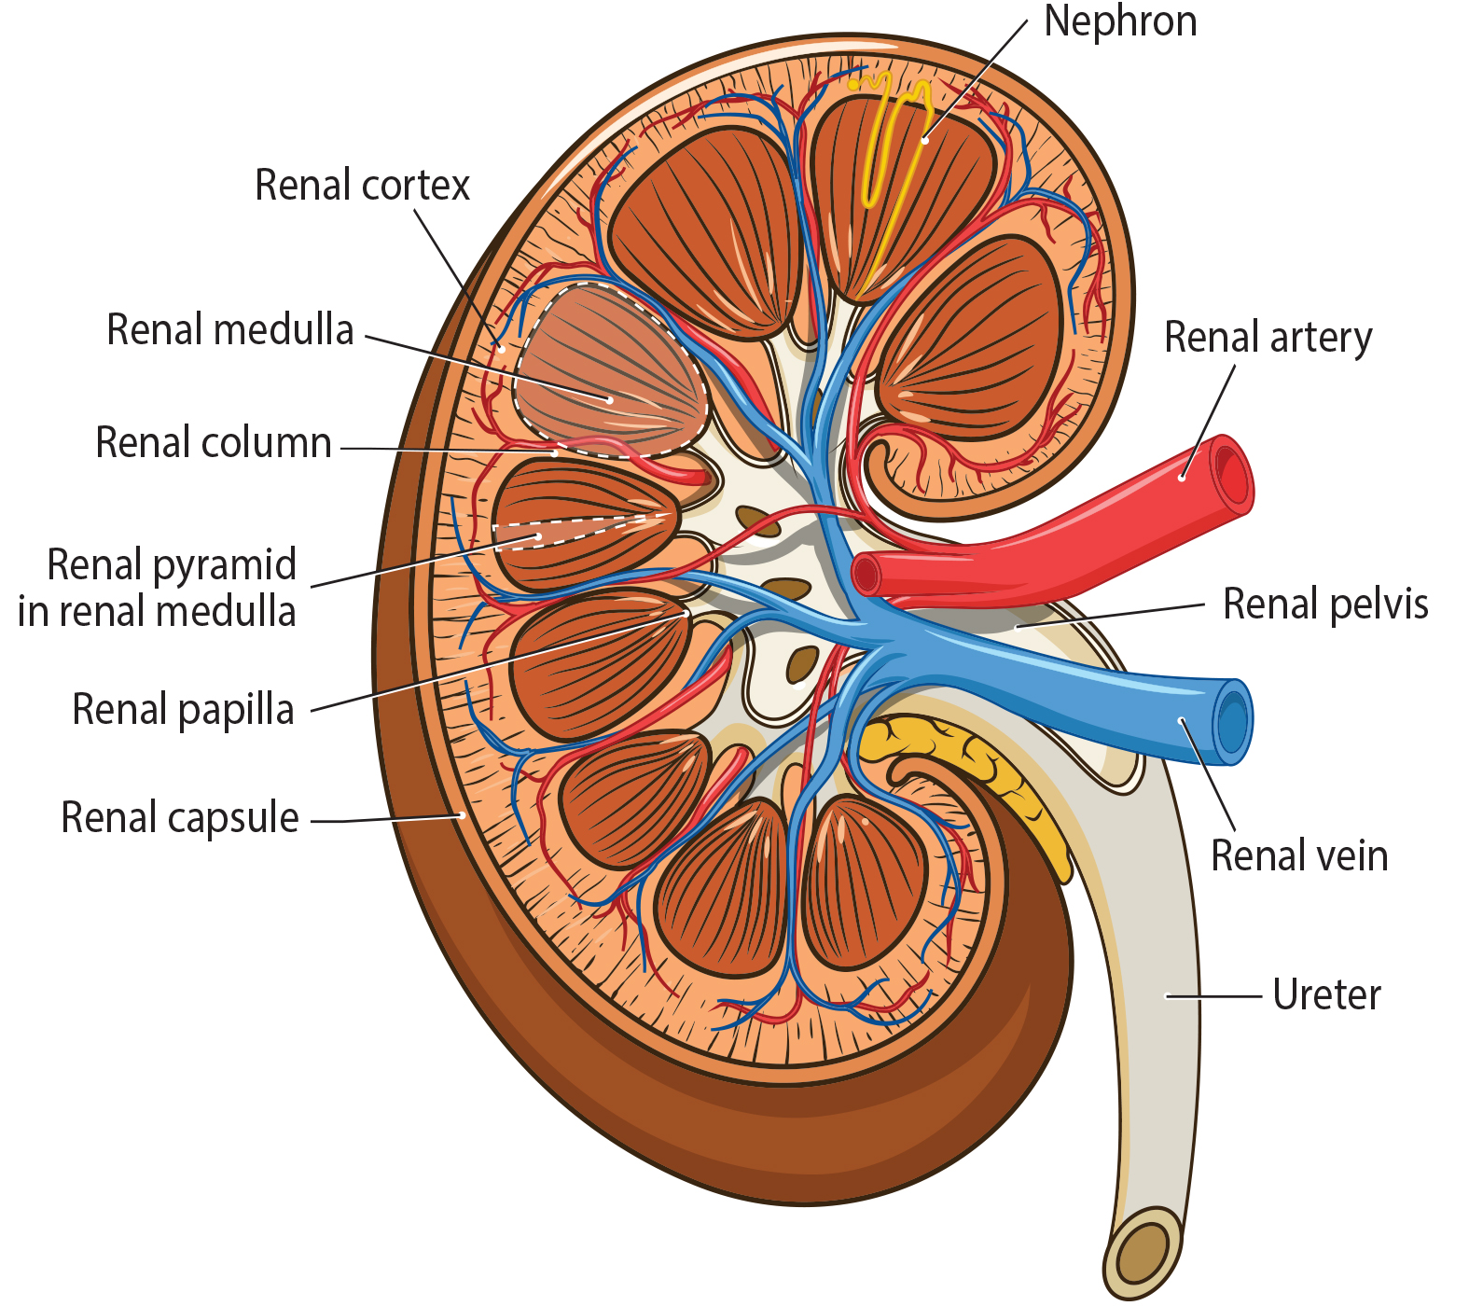
38.2 Figure 2
Notes:
38.2 Figure 2: The internal structure of the kidney is shown.

Slide 9
Blood Vessels Supplying the Kidney
The arteries, veins, and nerves supplying the kidney enter and exit at the renal hilum.
The aorta branches into the renal arteries.
  Each renal artery splits into several segmental arteries upon entering the kidney.
  Each segmental artery splits into several interlobar arteries that enter the renal columns and supply the renal lobes.
  The interlobar arteries split at the junction of the cortex and medulla to form the arcuate arteries that form arcs along the base of the medullary pyramids.
  Cortical radiate arteries radiate from the arcuate arteries and branch into numerous afferent arterioles, then enter the capillaries supplying the nephrons.

Slide 10
Blood Vessels Exiting the Kidney
Blood leaving the kidneys follows a reverse route, with veins tracing the path of the arteries and having similar names (except there are no segmental veins).
The renal veins leave the kidneys to join the inferior vena cava.

Slide 11
Nephrons As the Functional Unit
The nephron is the functional unit of the kidney.
Each kidney has over 1 million nephrons that dot the renal cortex, making it appear granular.
There are 2 types of nephrons:
  85% are cortical nephrons which are found deep in the renal cortex.
  15% are juxtamedullary nephrons which lie in the renal cortex near the renal medulla.
Each neuron has 3 parts:
  A renal corpuscle
  A renal tubule
  The associated capillary network, which originates from the cortical radiate arteries

Slide 12
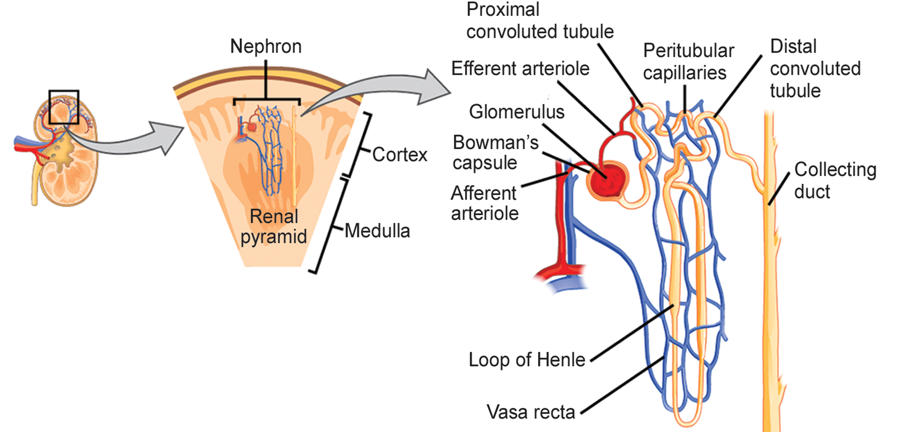
38.2 Figure 3
NIDDK. "Nephron."
Notes:
38.2 Figure 3: The nephron is the functional unit of the kidney. The glomerulus and convoluted tubules are located in the kidney cortex, while collecting ducts are located in the pyramids of the medulla.

Slide 13
Nephron Structure: The Renal Corpuscle
The renal corpuscle, located in the renal cortex, is made up of:
The glomerulus: a network of capillaries
The glomerular or Bowman's capsule: a cup-shaped chamber that surrounds it

Slide 14
Nephron Structure: The Renal Tubule
The renal tubule is a long, convoluted structure emerging from the glomerulus and can be divided into 3 parts:
The proximal convoluted tubule (PCT) is closest to the glomerulus and stays within the renal cortex.
The loop of Henle (nephritic loop) has descending and ascending limbs and goes through the renal medulla.
The distal convoluted tubule (DCT), which is also restricted to the renal cortex, is the last part of the renal tubule and empties its contents into collecting ducts that line the medullary pyramids.
  One collecting duct can amass the contents from multiple nephrons.
  Multiple collecting ducts fuse as they enter the papillae.

Slide 15
Nephron Structure: The Capillary Network
The capillary network originates from the renal arteries and supply the nephron with blood that needs to be filtered.
The afferent arteriole is the branch that enters the glomerulus.
The glomerular capillary bed is the capillary network within the glomerulus.
The efferent arteriole exits the glomerulus.
The peritubular network is surrounds and interacts with parts of the renal tubule.
  It surrounds the PCT and DCT in a cortical nephron.
  It is called the vasa recta and is a network around the loop of Henle in a juxtamedullary nephron.

Slide 16
Think It Through₁
For each structure, determine whether it is part of the renal corpuscle, the renal tubule, or the nephron's capillary network.
loop of Henle
vasa recta
glomerulus
PCT
Bowman's capsule
Notes:
Originally an On Your Own. This is included here to use as a talking point or for a think-pair-share activity.

Slide 17
Kidney Physiology: Nephron Filtration
Kidneys filter blood in a 3-step process:
Nephrons filter blood that runs through the capillary network in the glomerulus.
  Nearly all solutes except for proteins are pushed out of the glomerulus into the Bowman's capsule during glomerular filtration.
The filtrate moves into the renal tubule where most solutes are reabsorbed by tubular reabsorption in the PCT.
  In the loop of Henle, water and solutes in the filtrate continue to be exchanged with those in the blood of the peritubular capillary network, and water is reabsorbed.
Additional solutes and wastes are secreted by tubular secretion.

Slide 18
Kidney Physiology: Filtrate Collection And Removal
The collecting ducts collect filtrate from the nephrons, then fuse in the medullary papillae.
The papillae deliver the filtrate, now called urine, into the minor calyces.
The minor calyces connect to the ureters through the renal pelvis.

Slide 19
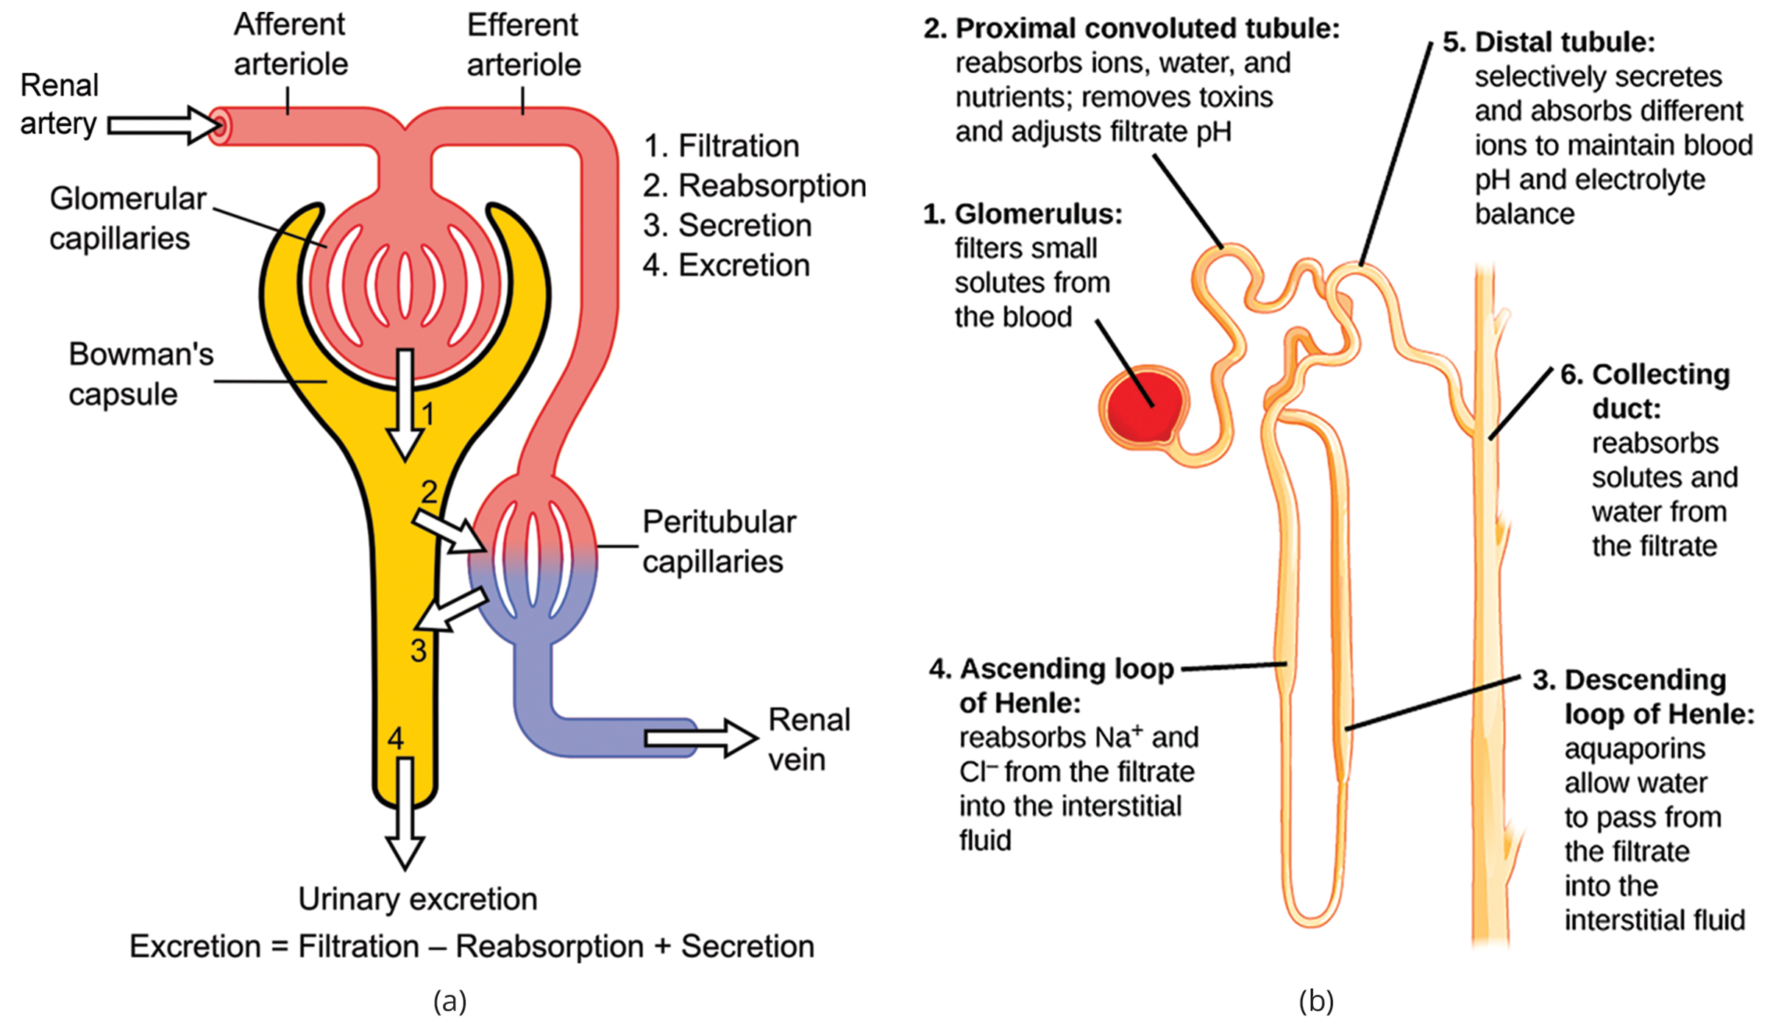
38.2 Figure 4
Madhero88 on Wikimedia Commons. "Nephron physiology."
Notes:
38.2 Figure 4: (a) The basic steps of glomerular filtration, tubular reabsorption, and tubular secretion are summarized. (b) Each part of the nephron performs a different function in filtering waste and maintaining homeostatic balance. (1) The glomerulus forces small solutes out of the blood by pressure. (2) The proximal convoluted tubule reabsorbs ions, water, and nutrients from the filtrate into the interstitial fluid and actively transports toxins and drugs from the interstitial fluid into the filtrate. The proximal convoluted tubule also adjusts blood pH by selectively secreting ammonia (NH3) into the filtrate, where it reacts with H+ to form NH4+. The more acidic the filtrate, the more ammonia is secreted. (3) The descending loop of Henle is permeable to water but not solutes, allowing water to pass from the filtrate into the interstitial fluid. (4) In the thin part of the ascending loop of Henle, Na+ and Cl− ions diffuse into the interstitial fluid. In the thick part, these same ions are actively transported into the interstitial fluid. Because salt, but not water, is lost, the filtrate becomes more dilute as it travels up the limb. (5) In the distal convoluted tubule, K+ and H+ ions are selectively secreted into the filtrate, while Na+, Cl−, and HCO3− ions are reabsorbed to maintain pH and electrolyte balance in the blood. (6) The collecting duct reabsorbs solutes and water from the filtrate, forming dilute urine.

Slide 20
Think It Through₂
Correctly order the flow of blood through the kidney from entry to exit.
Renal artery
Efferent arteriole
Renal vein
Glomerulus
Afferent arteriole
Peritubular capillary network
Notes:
Originally an On Your Own. This is included here to use as a talking point or for a think-pair-share activity.

Slide 21
Glomerular Filtration
Glomerular filtration filters out most of the solutes due to the high blood pressure and specialized membranes in the afferent arteriole.
The blood pressure is the glomerulus is independent of factors affecting systemic blood pressure.
The leaky connections between the endothelial cells (called podocytes) of the glomerular capillary network allow solutes to easily pass through.
  All solutes, except for macromolecules like proteins, pass through by passive diffusion, requiring no energy.
Glomerular filtration rate (GFR) is the volume of glomerular filtrate formed per minute by the kidneys.
  GFR is regulated by multiple mechanisms and is an important indicator of kidney function.

Slide 22
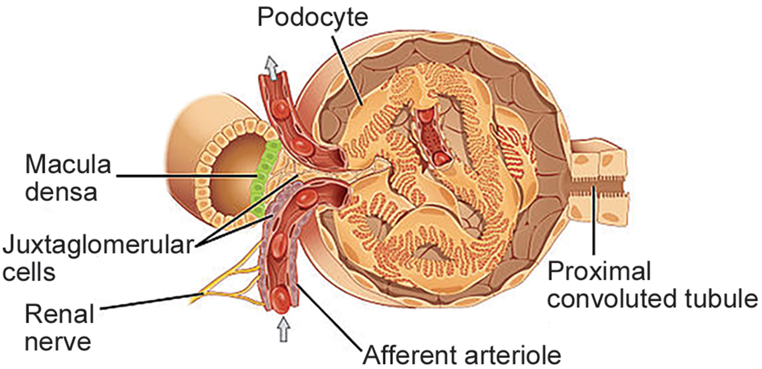
38.2 Figure 5
OpenStax College on Wikimedia Commons. "Glomerulus."
Notes:
38.2 Figure 5: Blood enters the glomerulus from the afferent arteriole. In the glomerulus, high blood pressure pushes fluid and most solutes out of the capillaries through the leaky connections between the endothelial cells that compose the glomerular capillary walls.

Slide 23
Reflection Question
Why do you think the presence of red blood cells and/or protein in the urine is a sign of kidney dysfunction?
Notes:
The reflection question is included here to use as a talking point or for a think-pair-share activity.

Slide 24
Tubular Reabsorption and Secretion
Tubular reabsorption occurs in the PCT.
Almost all nutrients are reabsorbed by either passive or active transport.
  Na⁺ is the most abundant ion, and most is reabsorbed by active transport and transported to the peritubular capillaries.
  Water then follows the Na⁺ by osmosis.
  Water is also reabsorbed through aquaporins (water channels) in the PCT and collecting duct.
    This occurs due to the low blood pressure and high osmotic pressure in the peritubular capillaries.
  Every solute has a transport maximum, and excess cannot be reabsorbed.
Reabsorption of water and some key electrolytes are regulated and can be influenced by hormones.

Slide 25
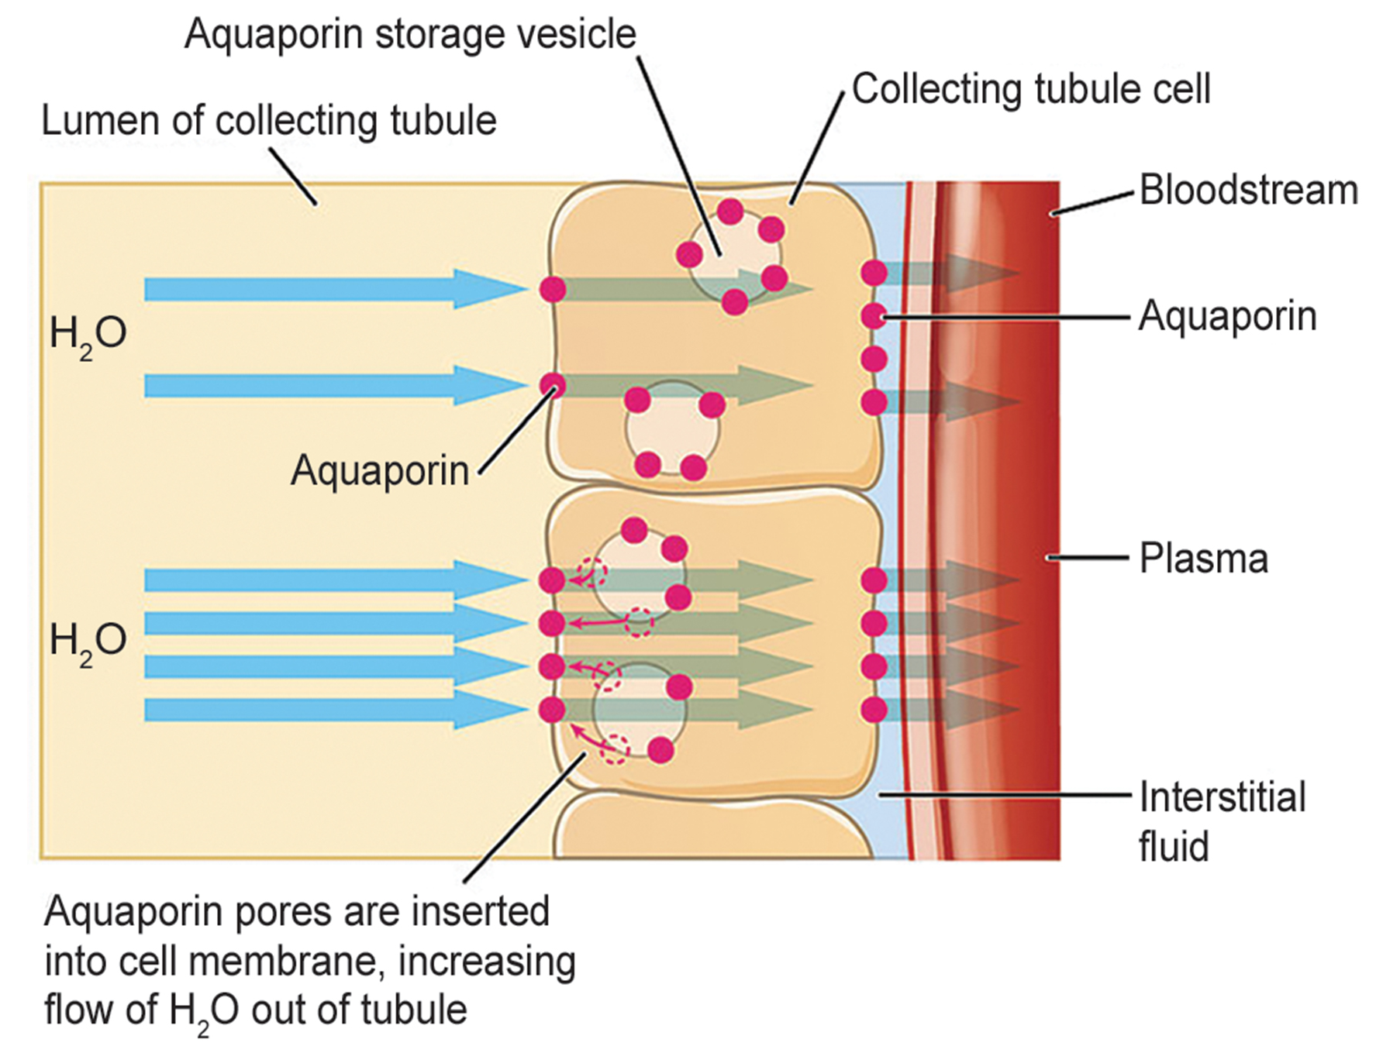
38.2 Figure 6
OpenStax College on Wikimedia Commons. "Aquaporins."
Notes:
38.2 Figure 6: Aquaporins are water channels that facilitate water movement across membranes. When there is a need for increased water reabsorption, aquaporins are inserted into the cells lining the nephron (here, the collecting tubule cells).

Slide 26
The Role of the Loop of Henle
In the loop of Henle, membrane permeability changes.
  The descending limb is permeable to water, but not solutes.
  The ascending limb is permeable to solutes, but not water.
The loop of Henle penetrates the renal medulla, which naturally has a high salt concentration and tends to absorb water from the renal tubule, concentrating the filtrate.
  The osmotic gradient increases as the loop moves further into the medulla.
Because the 2 sides are performing opposite function, the loop acts as a countercurrent multiplier.
The vasa recta around it acts as a countercurrent exchanger (fluid whose concentration gradient runs in the opposite direction of the loop’s concentration gradient).

Slide 27
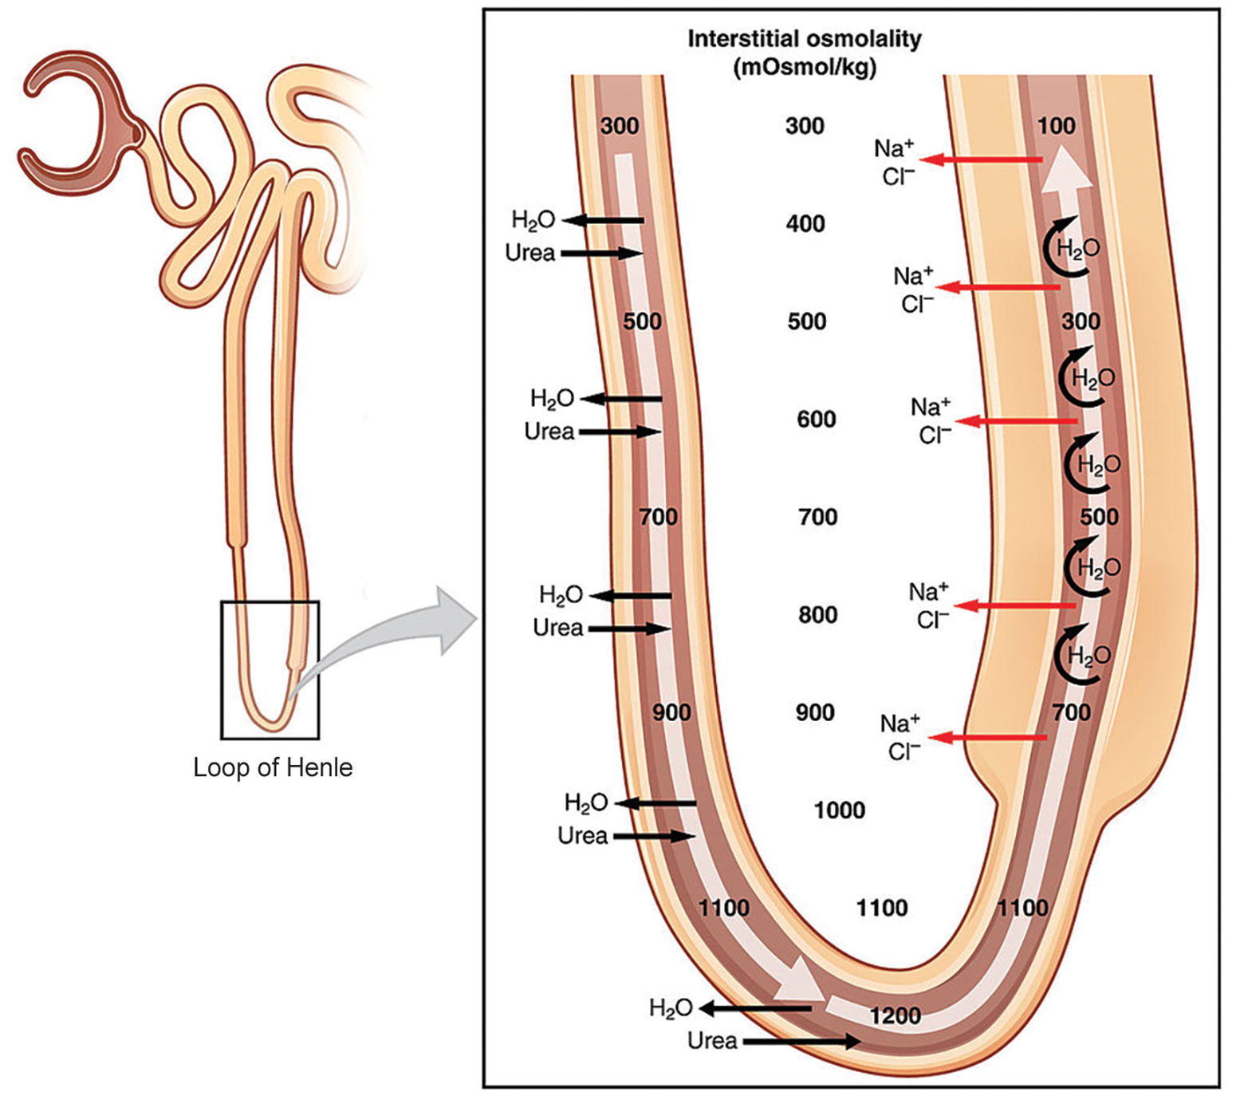
38.2 Figure 7
OpenStax College on Wikimedia Commons. "Loop of Henle."
Notes:
38.2 Figure 7: The loop of Henle acts as a countercurrent multiplier that uses energy to create concentration gradients. The descending limb is water permeable. Water flows from the filtrate to the interstitial fluid, so osmolality inside the limb increases as it descends into the renal medulla. At the bottom, the osmolality is higher inside the loop than in the interstitial fluid. Thus, as filtrate enters the ascending limb, Na+ and Cl− ions exit through ion channels present in the cell membrane. Further up, Na+ is actively transported out of the filtrate and Cl− follows. Osmolarity is given in units of milliosmoles per liter (mOsm/L).

Slide 28
Think It Through₃
Loop diuretics are drugs sometimes used to treat hypertension.
These drugs inhibit the reabsorption of Na⁺ and Cl⁻ ions by the ascending limb of the loop of Henle.
A side effect is that they increase urination.
Why do you think this is the case?
Notes:
Originally an On Your Own. This is included here to use as a talking point or for a think-pair-share activity.

Slide 29
Tubular Secretion the DCT
By the time the filtrate reaches the DCT, most of the water and solutes have been reabsorbed.
Further water reabsorption, controlled by hormones, can occur here.
Waste excretion occurs here due to a lack of reabsorption with tubular secretion.
Metabolic wastes, urea, uric acid, certain drugs, and excess H⁺ (important in maintaining acid-base balance) are excreted by tubular secretion.
While most tubular secretion happens here, some occurs in the early parts of the collecting duct.

Slide 30
The PCT and DCT Are Actually Close
The PCT and DCT are actually positioned close together and are in contact with each other and the glomerulus.
This allows for the exchange of chemical messengers.
  The macula densa is mass of cells found at the junction of the loop of Henle's ascending limb and the DCT.
  The macula densa is in contact with juxtaglomerular cells found in the walls of the afferent arterioles.
  Together, the macula densa and juxtaglomerular cells form the juxtaglomerular complex (JGC), an endocrine structure that secretes the enzyme renin and the hormone erythropoietin.
Variations in blood volume, blood pressure, or electrolyte balance can stimulate hormones to trigger the macula densa cells, which can then communicate with the afferent and efferent arterioles.
  They can constrict or relax to change the GFT accordingly.

Slide 31
Science and You
Career: Nephrologist
A nephrologist studies and deals with diseases of the kidney including:
  Those that cause kidney failure (such as diabetes)
  Conditions produced by kidney disease (such as hypertension and electrolyte imbalance)
Nephrologists work with other physicians who consult with them or refer patients to them.
  Patients with symptoms such as blood or protein in the urine, high blood pressure, kidney stones, or renal failure may be referred.
Nephrology is a subspecialty of internal medicine.
  Medical school, following by more training, is needed to become certified in internal medicine.
  Then, 2 or more years is spent studying kidney disorders.
Notes:
Originally an On Your Own. This is included here to use as a talking point or for a think-pair-share activity.

Slide 32
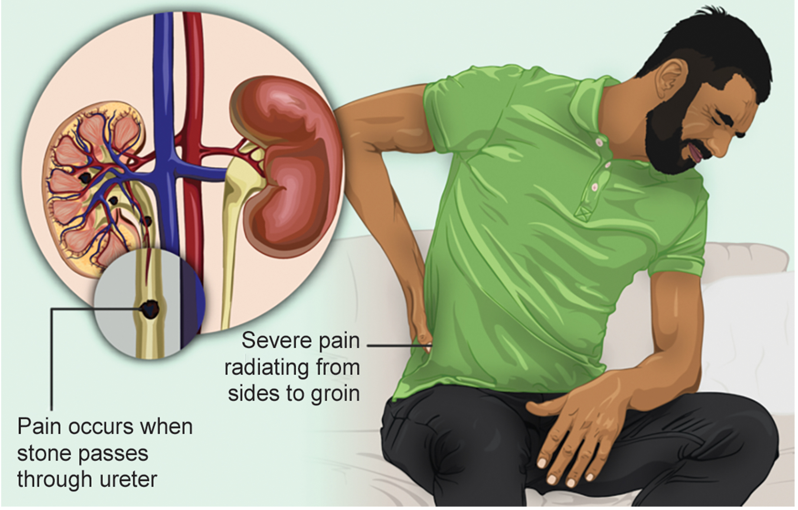
38.2 Figure 8
www.myupchar.com/en on Wikimedia Commons. "Kidney stones."
Notes:
38.2 Figure 8: Kidney stones are deposits of salts and minerals that can form inside of kidneys for various reasons. They may cause severe pain, vomiting, and blood in the urine.

Slide 33
Summary
The kidneys are the main osmoregulatory organs in mammals.
They filter blood and maintain the osmolarity of body floods at 300 mOsm.
They are surrounded by 3 layers and internally made up of 3 regions: the cortex, the medulla, and the renal pelvis.
Blood vessels transported into the kidneys arise from the aorta, while those leaving the kidney merge with the inferior vena cava.
Within the kidney, the blood vessels successfully divide into segmental, interlobar, arcuate, and cortical radiate arteries.
The nephron is the functional unit of the kidney.
It is made up of the renal corpuscle and the the renal tubule.
Cortical nephrons are found deep in the renal cortex, while juxtamedullary nephrons are found in the cortex near the medulla.
The nephron filters and exchanges water and solutes with blood and tissue fluids, forming urine in 3 steps: glomerular filtration, tubular reabsorption, and tubular secretion.

Slide 34

End of Hawkes Learning PowerPoint

