Slide 1
Lesson 38.3
Excretion Systems and Nitrogenous Wastes

Slide 2
Objectives
Explain how vacuoles, present in microorganisms, work to excrete waste.
Describe the way in which flame cells and nephridia in worms perform excretory functions and maintain osmotic balance.
Explain how insects use Malpighian tubules to excrete wastes and maintain osmotic balance.
Compare and contrast the way in which aquatic animals and terrestrial animals can eliminate toxic ammonia from their systems.
Compare the major byproduct of ammonia metabolism in vertebrate animals to that of birds, insects, and reptiles.

Slide 3
Primitive Excretory Systems
Microorganisms and invertebrates use simpler and more primitive mechanisms to get rid of their metabolic wastes, which include:
Vacuoles
Flame cells
Malpighian tubules

Slide 4
Contractile Vacuoles in Microorganisms
Some unicellular eukaryotes can engulf food by endocytosis, similar to how human leukocytes can.
  Endocytosis is the formation of vesicles by the inward folding of the cell membrane.
  These same vesicles can interact and exchange metabolites with the intracellular environment.
Some unicellular eukaryotes, such as amoeba and paramecia, have contractile vacuoles, specialized structures for maintaining osmotic balance.
  These organisms typically live in freshwater (hypotonic) environments and naturally take up water.
  The contractile vacuole stores excess water and waste for expulsion by exocytosis, whereby the contractile vacuole merges with the cell membrane to release its contents outside of the cell.

Slide 5
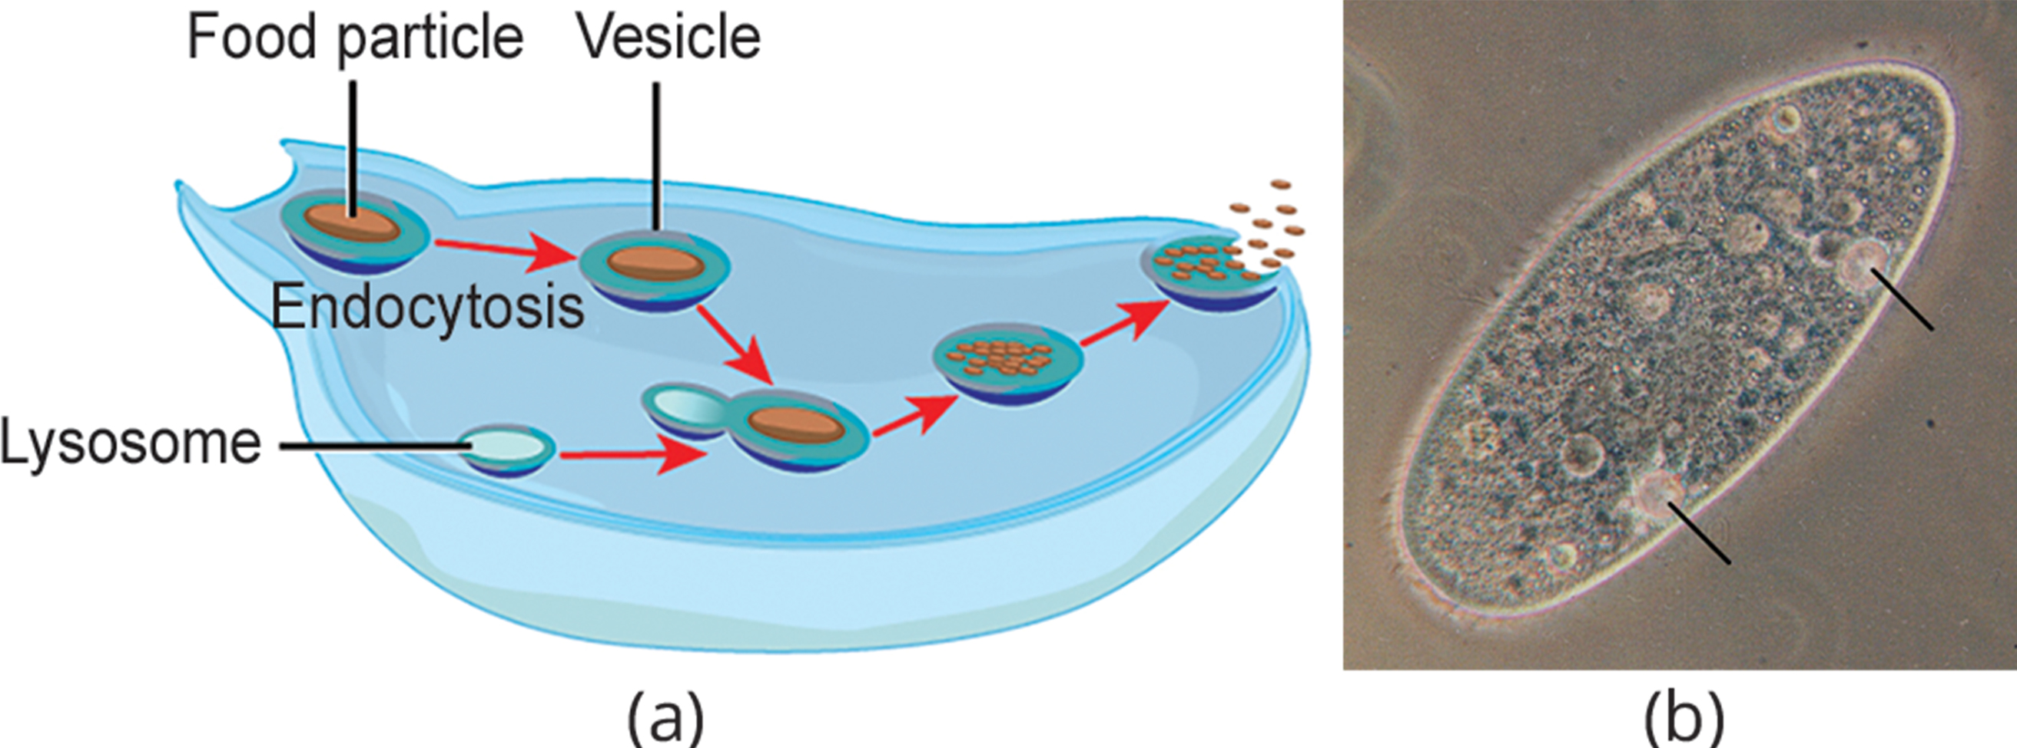
38.3 Figure 1
Josh Grosse on Wikimedia Commons. "Paramecium."
Notes:
38.3 Figure 1: (a) Some unicellular organisms ingest food through endocytosis. The food vesicle fuses with a lysosome, which digests the food. Waste is excreted by exocytosis. (b) Some protists, such as this paramecia, have contractile vacuoles (marked by the black lines) to regulate water and waste removal. Once these vacuole are full, they fuse with the cell membrane to release their contents outside the cell.

Slide 6
Flame Cells of Planaria
Flatworms:
Include both parasitic tapeworms and free-living planaria that live in fresh water
Each have an excretory system made of 2 tubules connected to a highly branched duct system.
  The predominant cell in the tubules is the flame cell (or protonephridia), each of which has a cluster of cilia that looks like a flickering flame microscopically.
    The cilia propel waste matter down the tubules and out of the body through excretory pores that open on the body's surface.
    The cilia also draw water from the interstitial fluid, allows for filtration and reabsorption.
    The flame cells are important in maintaining osmotic balance.

Slide 7
Nephridia of Earthworms
Earthworms:
Have slightly more evolved excretory structures called nephridia.
  A pair of nephridia is present on each segment of the earthworm.
  Nephridia are like flame cells in that they each have a tubule with cilia.
  Excretion occurs through a pore called the nephridiopore.
  They are more evolved because they have a system for tubular reabsorption by a capillary network before excretion.

Slide 8
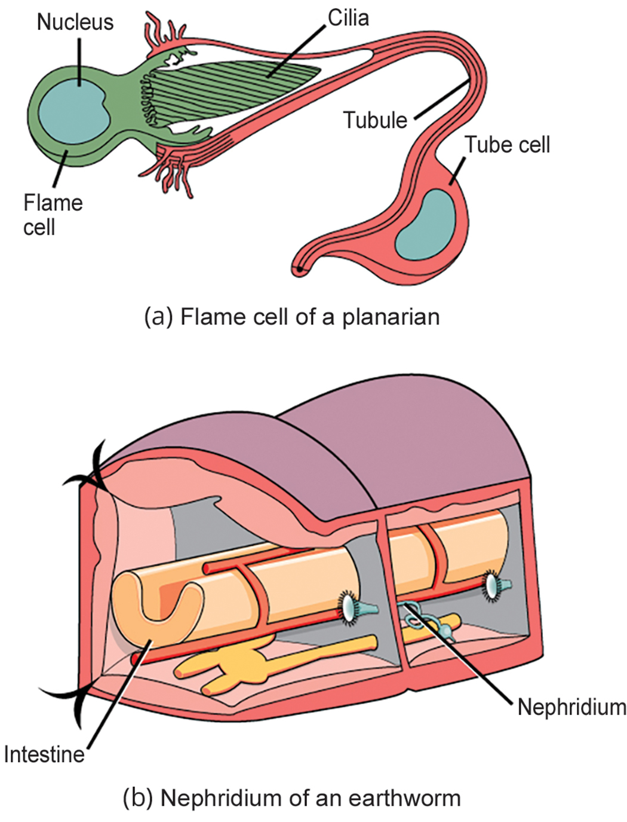
38.3 Figure 2
CNX OpenStax on Wikimedia Commons. "Flame cells and nephridum."
Notes:
38.1 Figure 2: In the excretory system of the (a) planaria, cilia of flame cells propel waste through a tubule formed by a tube cell. Tubules are connected into branched structures that lead to pores located all along the sides of the body. The filtrate is secreted through these pores. In (b) annelids, such as earthworms, nephridia filter fluid from the coelom, or body cavity. Beating cilia at the opening of the nephridium draw water from the coelom into a tubule. As the filtrate passes down the tubules, nutrients and other solutes are reabsorbed by capillaries. Filtered fluid containing nitrogenous and other wastes is stored in a bladder and then secreted through a pore in the side of the body.

Slide 9
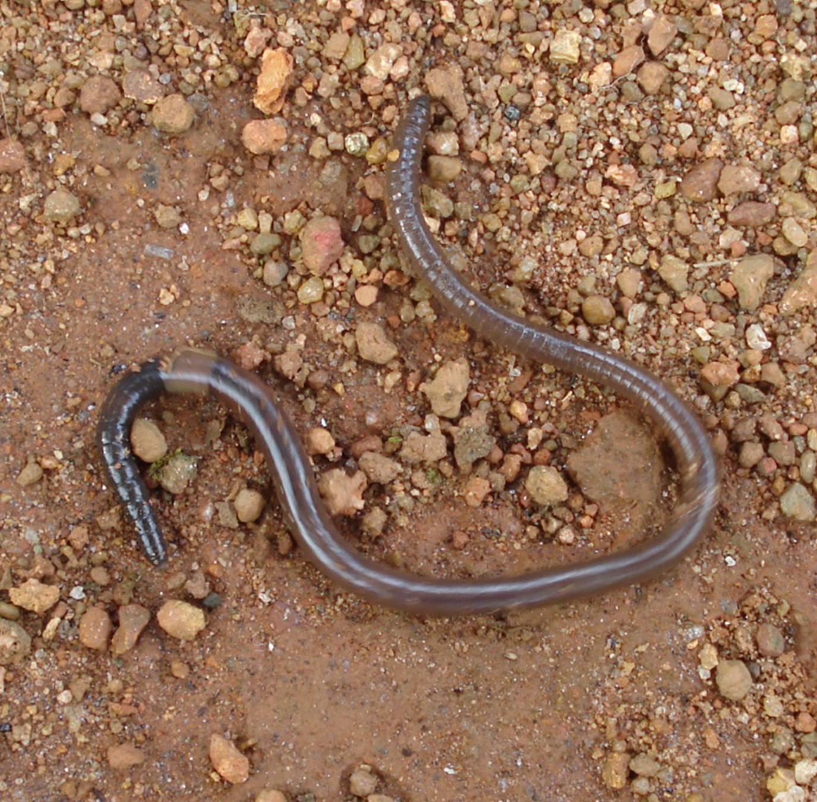
38.3 Figure 3
Aruna on Wikimedia Commons. "Earthworm."
Notes:
38.3 Figure 3: Earthworms use nephridia for excretion.

Slide 10
Think It Through₁
Which of the following is the predominant cell that contributes to excretion in planaria?
excretory cell
nephrons
nephridia
flame cell
Notes:
Originally an On Your Own. This is included here to use as a talking point or for a think-pair-share activity.

Slide 11
Malpighian Tubules of Insects
Malpighian tubules:
Are found lining the gut of some arthropod species
Are commonly found in pairs, with the number of tubules varying by insect species
Are convoluted and lined with microvilli to increase their surface area for reabsorption
Are bathed in hemolymph (a mix of blood and interstitial fluid)
Are lined with pumps that actively transport H⁺ into the cell and K⁺ or Na⁺ out, with water and nitrogenous waste (uric acid) following passively, forming urine
Work with rectal glands
  The urine passes through the intestine and into the rectum, where rectal glands reabsorb nutrients via diffusion, and Na⁺ and K⁺ are pumped back into the hemolymph, with water following
Produce concentrated waste as a thick paste or powder

Slide 12
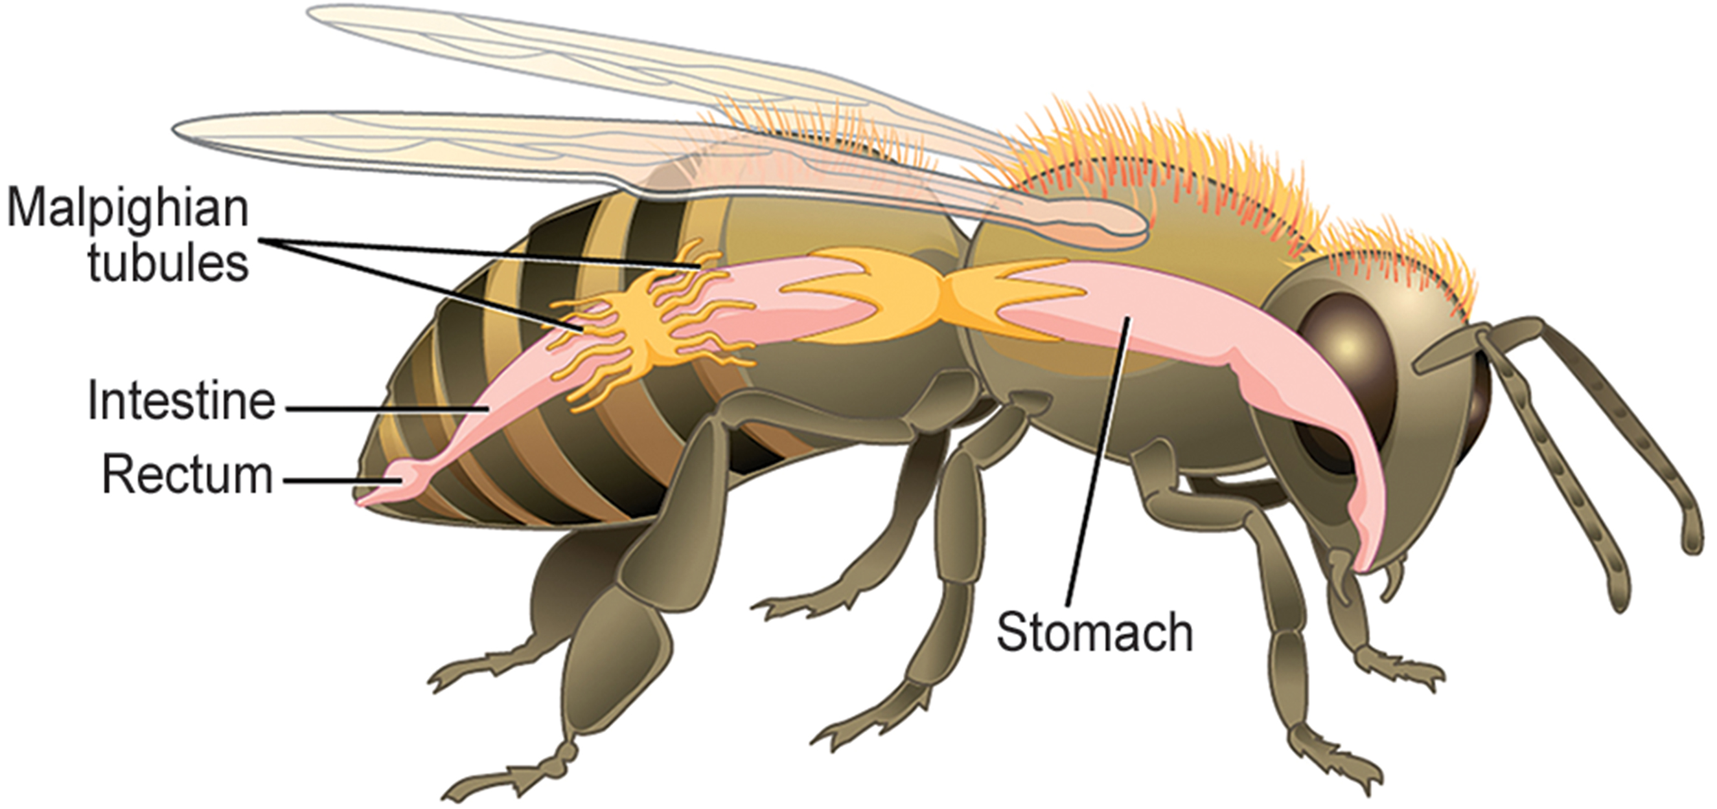
38.3 Figure 4
CNX OpenStax on Wikimedia Commons. "Malpighian tubules of a bee."
Notes:
38.3 Figure 4: Malpighian tubules of insects and other terrestrial arthropods remove nitrogenous wastes and other solutes from the hemolymph. Na+ and/or K+ ions are actively transported into the lumen of the tubules. Water then enters the tubules via osmosis, forming urine. The urine passes through the intestine and into the rectum. There, nutrients diffuse back into the hemolymph. Na+ and/or K+ ions are pumped into the hemolymph, and water follows. The concentrated waste is then excreted.

Slide 13
Think It Through₂
Which of the following is false about Malpighian tubules?
Water is pumped into the tubules by active transport.
The microvilli lining the tubules enable reabsorption.
Na⁺ ions are pumped out of the tubules by active transport.
The cells lining the tubules are bathed in hemolymph.
Notes:
Originally an On Your Own. This is included here to use as a talking point or for a think-pair-share activity.

Slide 14
Nitrogenous Waste Results from Protein and Nucleic Acid Catabolism
Of the 4 major macromolecules, both proteins and nucleic acids contain N.
During their catabolism, C, H, and O are stored as carbohydrates and fates, while excess N is excreted.
Nitrogenous wastes tend to form toxic ammonia (NH₃), which increases the pH of body fluids.
Ammonia formation uses ATP and lots of water to dilute it out of the system.

Slide 15
Categories of Animals Based Upon Nitrogenous Waste Excretion
Aquatic animals commonly release ammonia into the water.
  Animals that excrete ammonia are ammonotelic.
Terrestrial animals must detoxify ammonia into a relatively nontoxic form, either urea or uric acid, before excretion.
  Mammals, including humans, that produce urea are ureotelic animals.
  Reptiles and many terrestrial invertebrates produce uric acid.

Slide 16
The Urea Cycle
The urea cycle (also called the ornithine cycle) is the primary way that mammals convert ammonia to urea.
Urea is made in the liver and excreted in urine.
The chemical reaction by which this occurs is:
2NH₃(ammonia) + CO₂ + H₂O + 3ATP → H₂N‒CO‒NH₂(urea) + 2ADP + 2P_{i} + PP_{i} + AMP
This involves 5 steps, each catalyzed by a different enzyme.
  The amino acid L-ornithine gets converted into different intermediates before being regenerated.
  Ornithine transcarbamylase catalyzes a key step, and its deficiency leads to ammonia accumulation.
  The first 2 reactions occur in the mitochondria, while the last 3 occur in the cytosol.
Blood urea nitrogen (BUN) is the urea concentration in the blood and is a measure of kidney function.

Slide 17
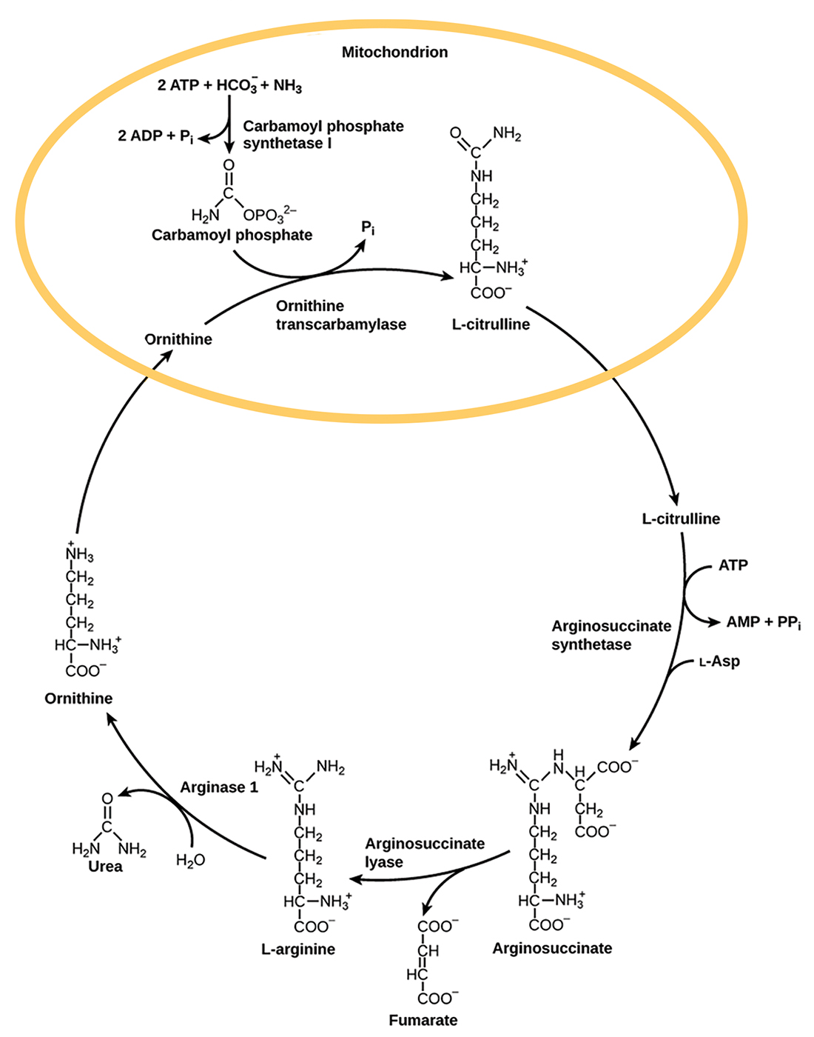
38.3 Figure 5
OpenEd CUNY. "Urea cycle."
Notes:
38.3 Figure 5: To enter the urea cycle, ammonia first combines with bicarbonate (HCO3-, which is produced from carbon dioxide in the blood) to produce carbamoyl phosphate in a reaction catalyzed by the enzyme carbamoyl phosphate synthetase I and that uses energy in the form of ATP. Carbamoyl phosphate enters the urea cycle, where it combines with ornithine and is converted to L-citrulline by the enzyme ornithine transcarbamylase. L-citrulline is then converted by the enzyme arginosuccinate synthetase to arginosuccinate, which is subsequently converted to L-arginine by the enzyme arginosuccinate lyase. L-arginase is then broken down by the enzyme arginase 1 to produce urea, which exits the cycle and will be excreted as waste. This reaction also regenerates the ornithine needed for the cycle to continue.

Slide 18
Evolution Connection
Excretion of Nitrogenous Waste
Because the theory of evolution proposes that life started in an aquatic environment, it is not surprising to see that biochemical pathways, like the urea cycle, evolved to adapt to a changing environment when terrestrial life forms evolved.
Arid conditions probably led to the evolution of the uric acid pathway as a means of conserving water.

Slide 19
Nitrogenous Waste in Birds and Reptiles: Uric Acid
Uric acid:
  Is similar to purines (the nitrogenous bases A and G in DNA), each having 2 fused rings
  Is water insoluble, forming a white paste or powder.
  Is made by birds, insects, and reptiles
  Is also made in small amounts by mammals during nucleic acid breakdown
  Is more complex and harder to make than urea
A related compound guanine (guano) is made by some animals instead of uric acid.

Slide 20
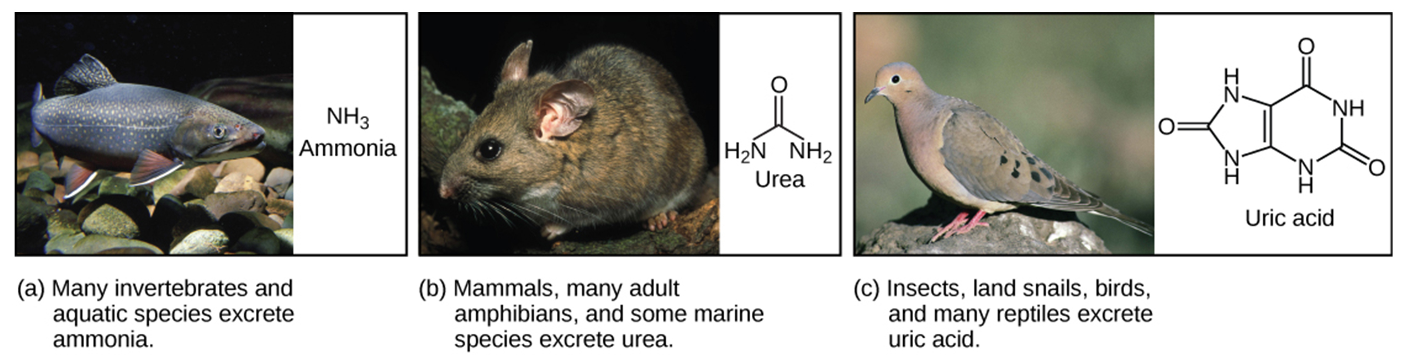
38.3 Figure 6
Eric Engbretson on USFWS. "Walleye, ammonia." Modified.
Moose Peterson on USFWS. "Riparian woodrat, urea." Modified.
OpenStax. "Mourning dove, uric acid." Modified.
Notes:
38.3 Figure 6: Nitrogenous waste is excreted in different forms by different species. (a) Many invertebrates and aquatic species excrete ammonia. (b) Mammals, many adult amphibians, and some marine species excrete urea. (c) Insects, land snail

Slide 21
Science and You
Gout
Mammals use uric acid crystals as an antioxidant in their cells.
  Antioxidants prevent damaging oxidation reactions that contribute to cellular aging and death.
However, too much uric acid tends to form:
  Kidney stones
  Gout, a painful condition where uric acid crystals accumulate in the joints
The risk of gout can be reduced by proper food choices that reduce the amount of nitrogenous bases in the diet.
  Foods like tea, coffee, and chocolate have purine-like compounds, called xanthines, and should be avoided by people with gout and kidney stones.
Notes:
This is included as a relevant application for this topic.

Slide 22
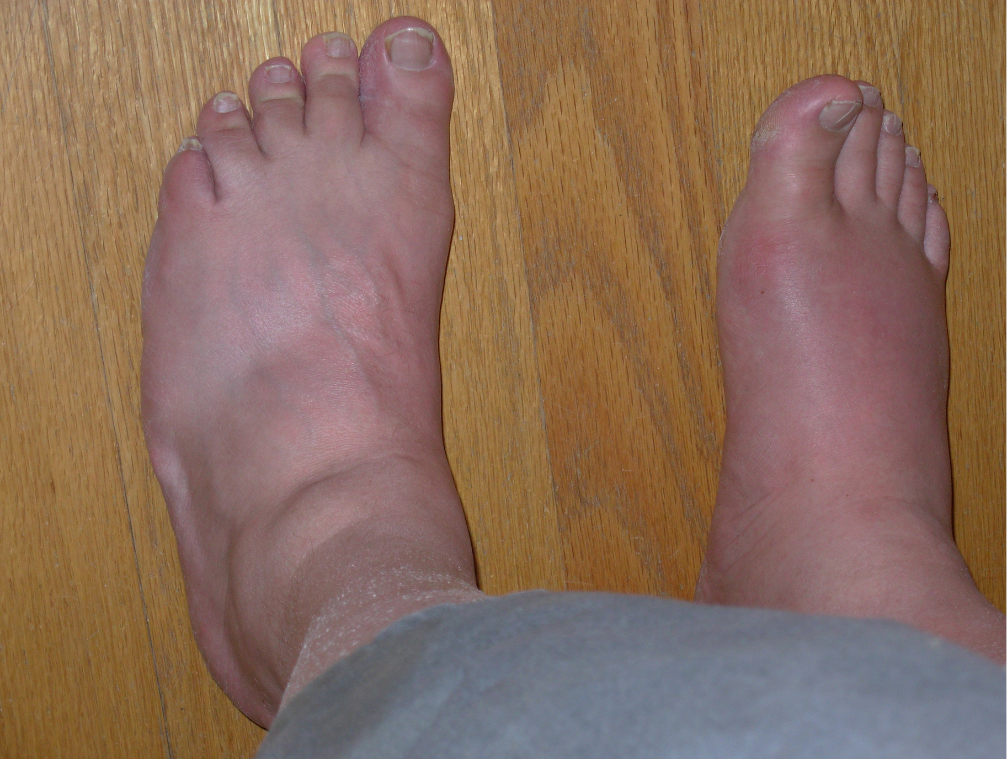
38.3 Figure 7
Wrerick on Wikimedia Commons. "Gout."
Notes:
Figure 7: Gout causes the inflammation visible in this person's right big toe.

Slide 23
Summary
Many additional systems have evolved for excretion that are simpler than the kidney and urinary systems of vertebrates.
The simplest is that of contractile vacuoles in microorganisms.
Flame cells (flatworms) and nephridia (earthworms) perform excretion and maintain osmotic balance.
Some insects have Malpighian tubules for excretion and osmoregulation.
Ammonia is the waste produced during the metabolism of proteins and nucleic acids, both containing nitrogen.
Aquatic animals easily excrete ammonia.
Terrestrial animals excrete nitrogen as either:
  Urea, which is the form produced by vertebrates
  Uric acid, which is the form produced by birds, terrestrial arthropods, and reptiles

Slide 24

End of Hawkes Learning PowerPoint

