Slide 1
Lesson 38.4
Hormonal Control of Osmoregulatory Functions

Slide 2
Objectives
Explain how hormonal cues help the kidneys synchronize the osmotic needs of the body.
Describe how hormones like epinephrine, norepinephrine, renin-angiotensin, aldosterone, anti-diuretic hormone, and atrial natriuretic peptide help regulate waste elimination, maintain correct osmolarity, and perform other osmoregulatory functions.

Slide 3
Hormonal Control of Osmoregulatory Functions
Hormones help control osmoregulatory functions.
Table 1: Hormones That Affect Osmoregulation
Hormone | Where Produced | Function
epinephrine and norepinephrine | adrenal medulla | can decrease kidney function temporarily by vasoconstriction
renin | kidney nephrons | increases blood pressure by acting on angiotensinogen
angiotensin | liver | increases blood pressure by constricting blood vessels; stimulates release of aldosterone
aldosterone | adrenal cortex | increases reabsorption of sodium (Na) and excretion of potassium (K); prevents water loss
antidiuretic hormone (vasopressin) | hypothalamus (stored in the posterior pituitary) | prevents water loss
atrial natriuretic peptide | heart atrium | decreases blood pressure by acting as a vasodilator and increasing glomerular filtration rate; decreases sodium reabsorption in kidneys

Slide 4
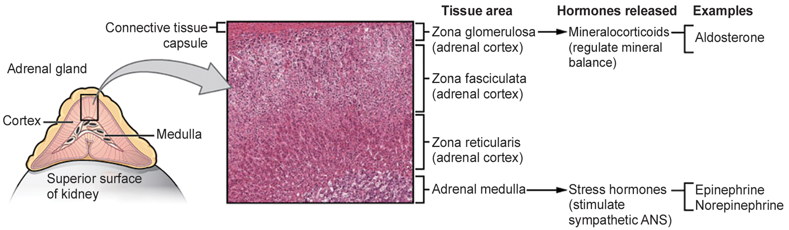
36.4 Figure 1
OpenStax College on Wikimedia Commons. "Adrenal glands."
Notes:
The adrenal gland, which sits on top of the kidney, secretes several hormones involved in osmoregulation. Aldosterone, which prevents loss of sodium and water, is secreted from the adrenal cortex. Epinephrine and norepinephrine, which can suppress kidney function, are secreted by the adrenal medulla.

Slide 5
Epinephrine and Norepinephrine
Epinephrine and norepinephrine are released by the adrenal medulla and nervous system.
Fight-or-flight hormones that temporarily stop kidney function.
Constrict the smooth muscles of blood vessels to constrict them, causing blood flow in the nephron to stop.
They also trigger the renin-angiotensin-aldosterone system.

Slide 6
Renin-Angiotensin-Aldosterone System
The renin-angiotensin-aldosterone system helps stabilize blood pressure and volume through a series of steps producing angiotensin II.
Renin, secreted by the juxtaglomerular complex, converts liver-produced angiotensinogen to angiotensin I.
Angiotensin-converting enzyme (ACE) converts angiotensin I to angiotensin II.
Angiotensin II raises blood pressure by constricting blood vessels, triggering aldosterone release (increasing sodium reabsorption), stimulating ADH release (increasing water retention), and decreasing glomerular filtration rate.
Blood pressure can be medically controlled using ACE inhibitors, which interrupt this system.

Slide 7
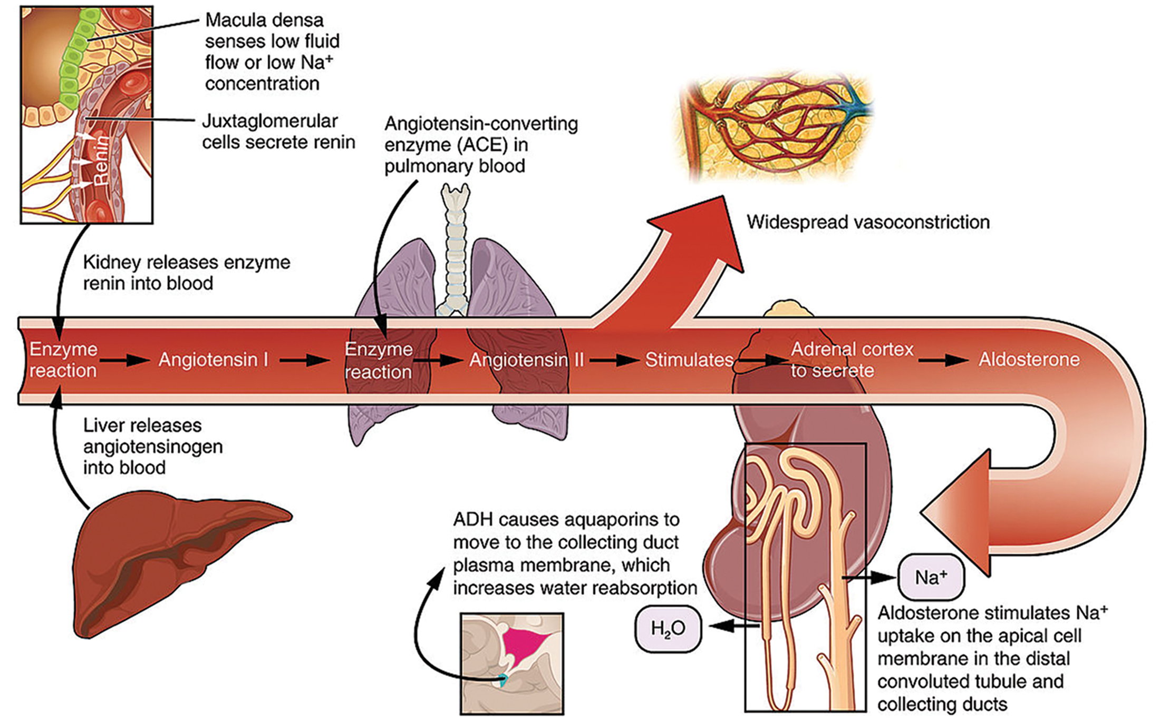
38.4 Figure 2
OpenStax College on Wikimedia Commons. "Renin-angiotensin-aldosterone."
Notes:
Juxtaglomerular cells secrete renin in response to low fluid or sodium concentration. Renin converts angiotensin in the blood to angiotensin II, which triggers the release of aldosterone from the adrenal cortex and ADH from the hypothalamus. Aldosterone stimulates sodium uptake in the collecting ducts, while ADH promotes the insertion of aquaporins (water channels) into the collecting duct to increase water reabsorption.

Slide 8
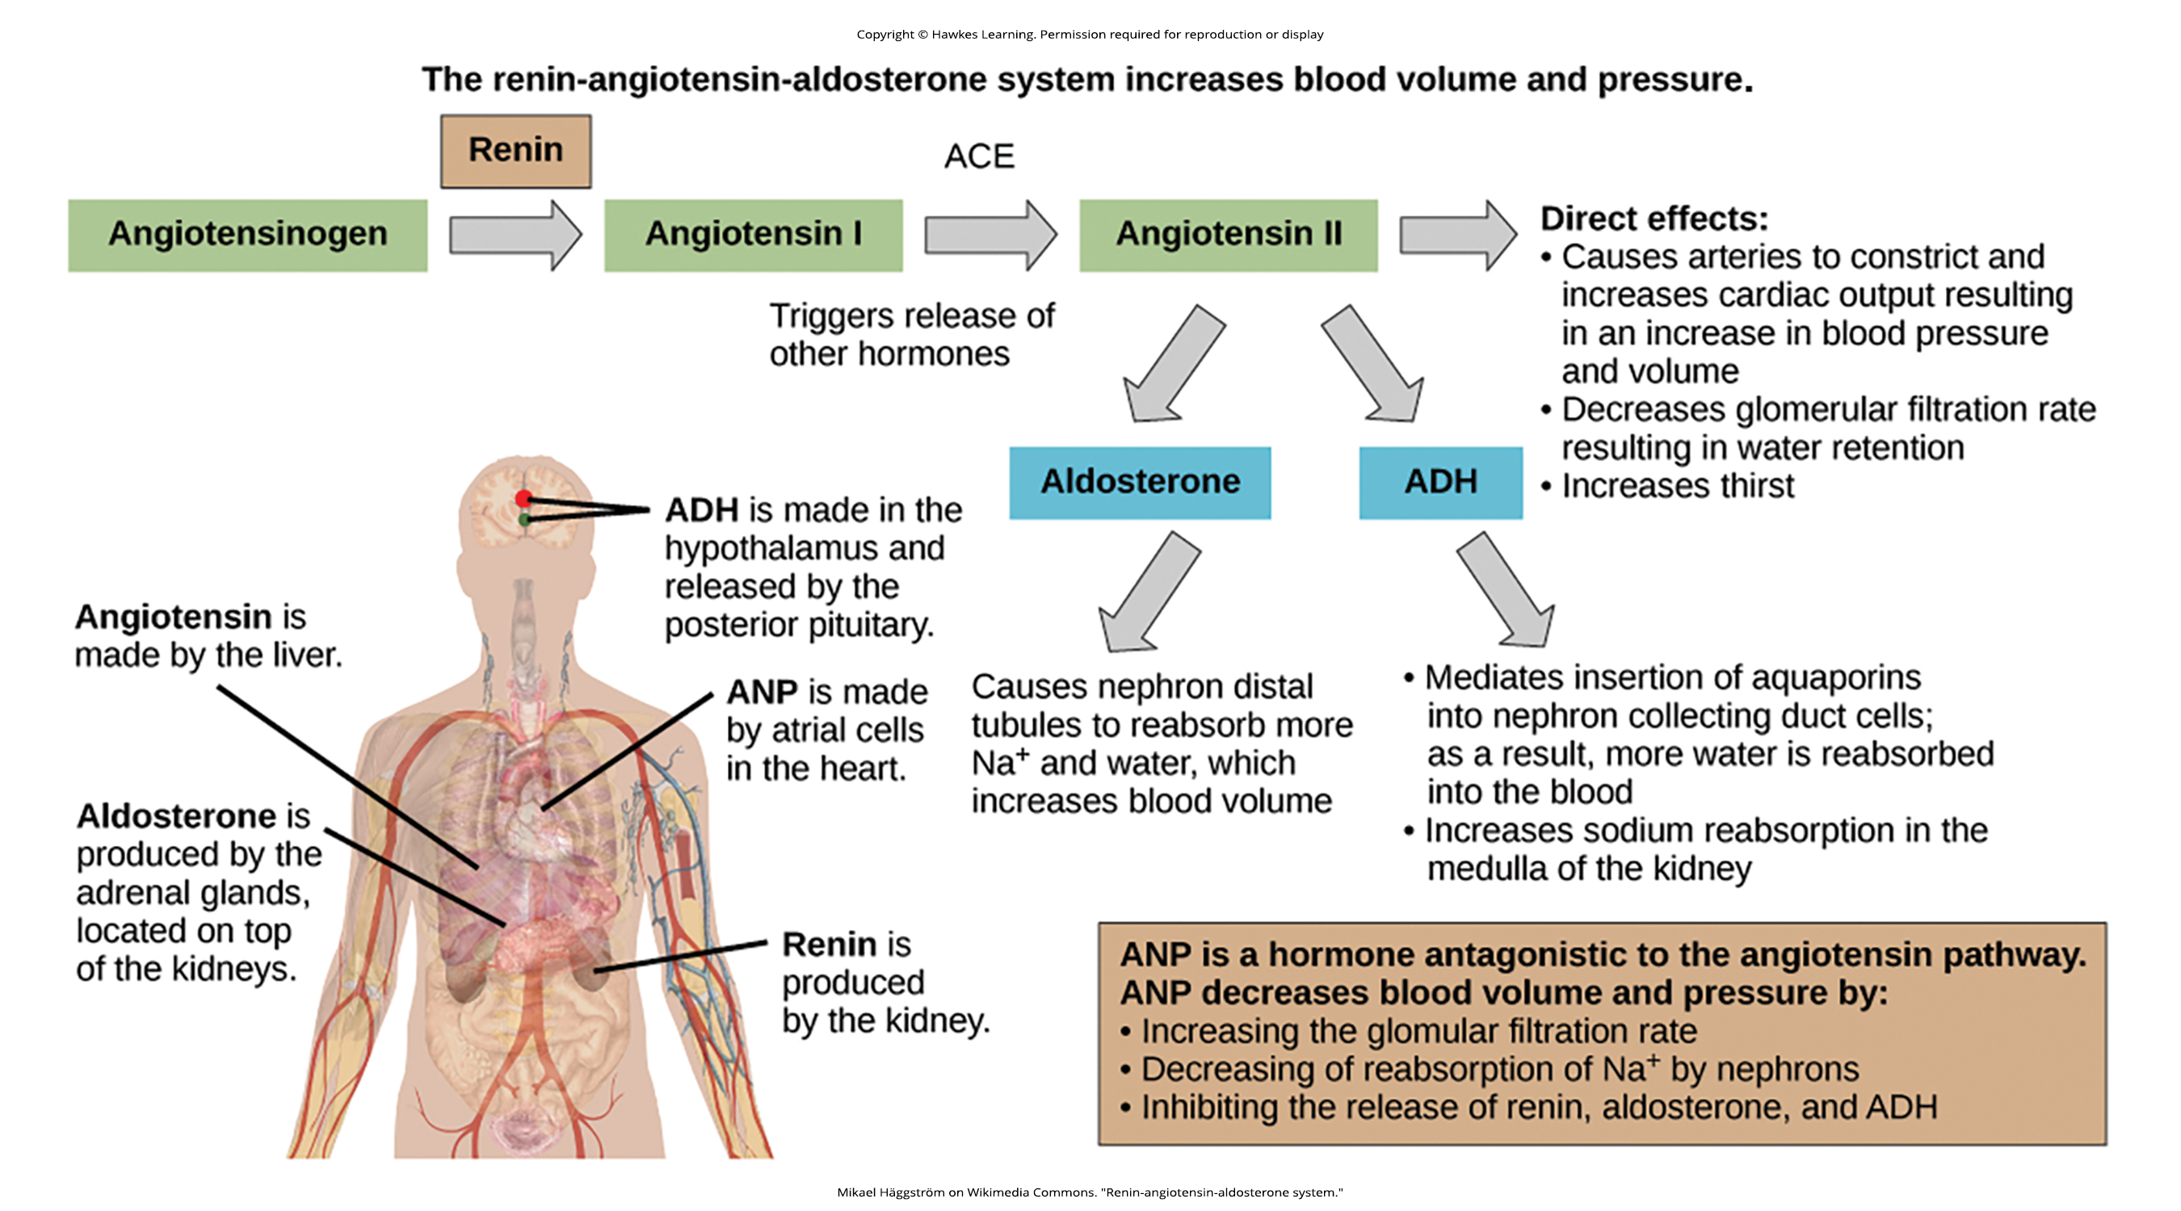
38.4 Figure 3
Mikael Häggström on Wikimedia Commons. "Renin-angiotensin-aldosterone system."
Notes:
The renin-angiotensin-aldosterone system increases blood pressure and volume by promoting the reabsorption of sodium and water. The hormone atrial natriuretic peptide (ANP) has antagonistic effects on this system. ANP decreases blood pressure by decreasing the reabsorption of sodium (which reduces sodium content in the blood, making water less likely to be reabsorbed), increasing the glomerular filtration rate, and inhibiting the release of renin, aldosterone, and ADH.

Slide 9
Mineralocorticoids
Mineralocorticoids are hormones synthesized by the adrenal cortex that affect osmotic balance.
Aldosterone promotes sodium reabsorption in renal tubules, which indirectly affects water retention and blood volume.
Aldosterone also stimulates potassium secretion in the kidneys.
The absence of aldosterone (as in Addison's disease) leads to excessive sodium loss in urine and dangerous potassium retention, which can be fatal if untreated.

Slide 10
Think It Through
Through what mechanism do patients with Addison's disease lose excessive amounts of sodium in their urine?
Notes:
Originally an On Your Own. This is included here to use as a talking point or for a think-pair-share activity.

Slide 11
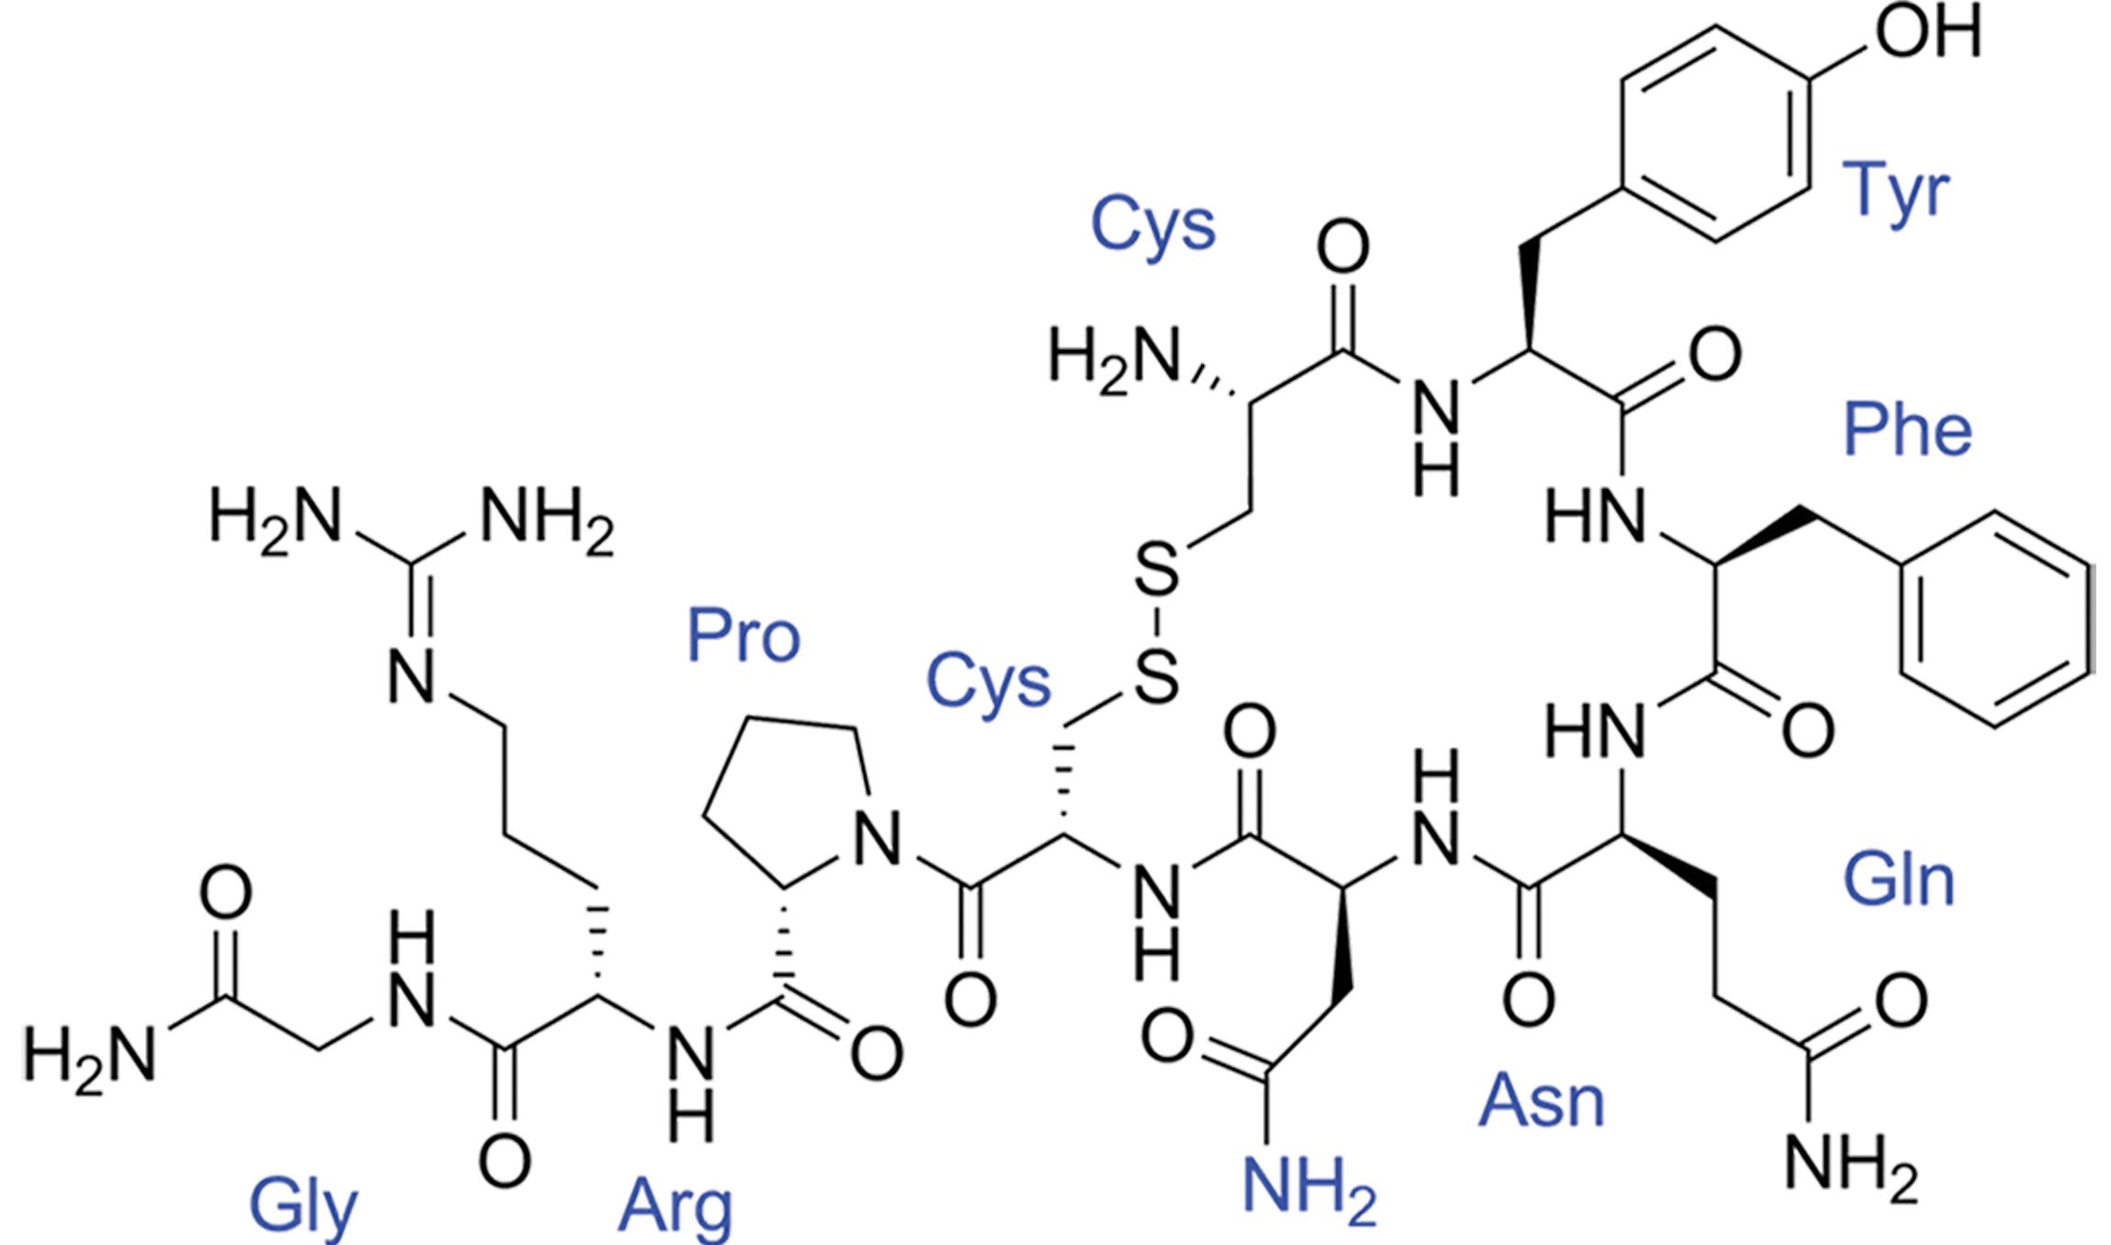
Antidiuretic Hormone
The antidiuretic hormone (ADH), also known as vasopressin, helps the body conserve water when necessary.
Created by the hypothalamus and stored and released by the posterior pituitary
Inserts aquaporins in the collecting ducts to promote reabsorption
Acts as a vasoconstrictor (narrows the blood vessels) and increases blood pressure during hemorrhaging
38.4 Figure 4: Vasopressin
Edgar181 on Wikimedia Commons. "Vasopressin chemical structure."

Slide 12
Science and You
While an antidiuretic helps conserve water, a diuretic is a substance that promotes water loss. Caffeine is a mild diuretic, meaning that excessive consumption of caffeine can lead to dehydration (though moderate consumption carries little risk).
Notes:
This is included as a relevant application for this topic.

Slide 13
Atrial Natriuretic Peptide Hormone
The atrial natriuretic peptide (ANP) lowers blood pressure by acting as a vasodilator (opens the blood vessels).
Released by cells in the atrium of the heart in response to high blood pressure and those with sleep apnea
Increases sodium release and also has a diuretic effect
Prevents sodium reabsorption in the renal tubules which decreases water reabsorption and lowers blood pressure

Slide 14
Group Activity
In a group, list the organs involved in osmoregulation, the hormones each organ produces, and the effect of each hormone on osmoregulation and blood pressure.

Slide 15
Summary
Hormonal cues help the kidneys synchronize the osmotic needs of the body.
Hormones like epinephrine, norepinephrine, renin-angiotensin, aldosterone, antidiuretic hormone, and atrial natriuretic peptide help regulate the needs of the body as well as the communication between the different organ systems.

Slide 16

End of Hawkes Learning PowerPoint

