Slide 1
Lesson 39.1
Hormone Function

Slide 2
Objectives
Discuss the role of different types of hormone receptors.
Explain how hormones work.
Explain hormones' roles in maintaining homeostasis.
List the different types of hormones.

Slide 3
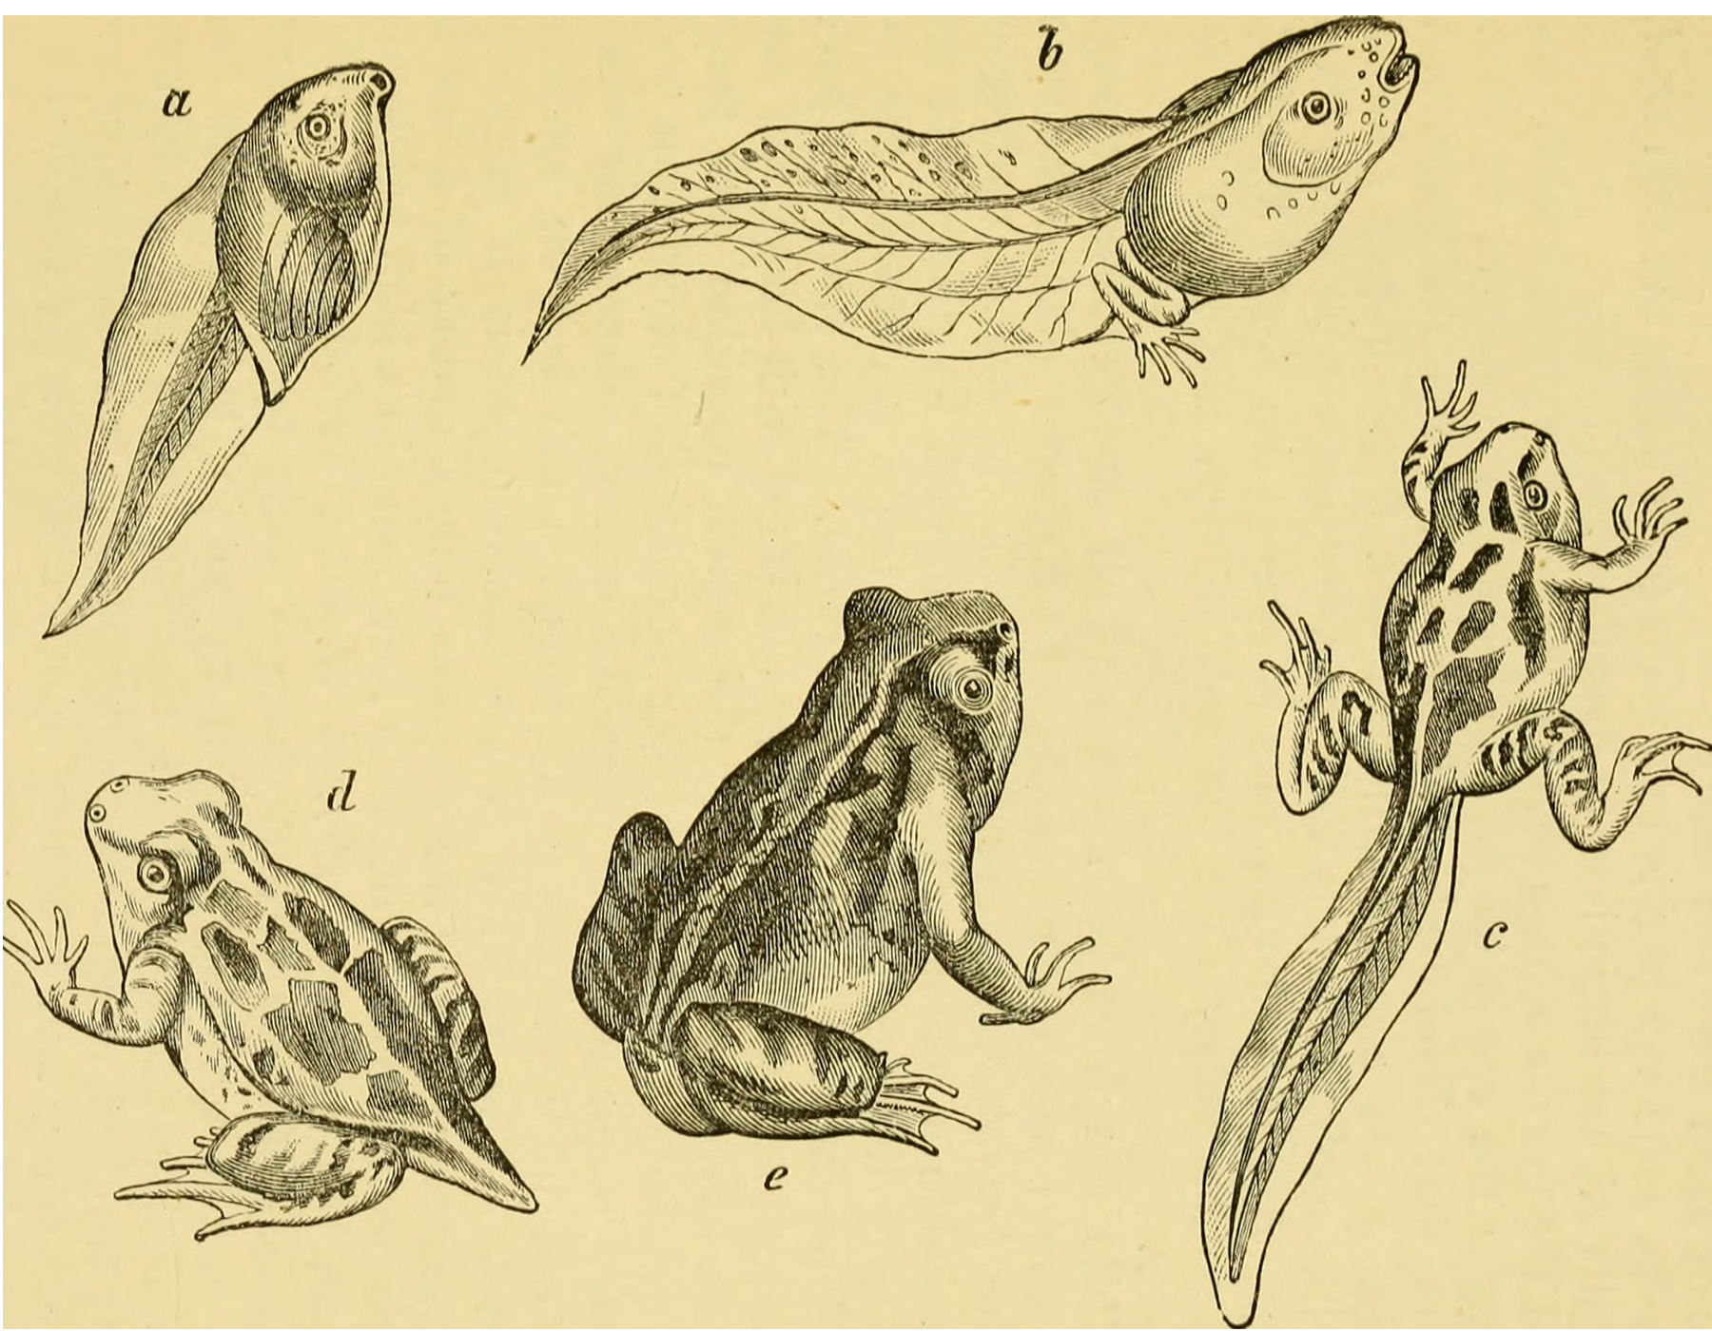
The Endocrine System
An animal's endocrine system controls body processes through the production, secretion, and regulation of hormones, which serve as chemical "messengers" that regulate cellular and organ activity and, ultimately, maintain the body's homeostasis.
The endocrine system plays a role in growth, metabolism, and sexual development.
In organisms that undergo metamorphosis, the process is controlled by the endocrine system.
39.1 Figure 1
Internet Archive Book Images on Wikimedia Commons. "British reptiles and batrachians."
Notes:
Figure 1: The process of amphibian metamorphosis, as shown in the tadpole-to-frog stages here, is driven by hormones.

Slide 4
Hormone Function
Maintaining homeostasis within the body requires the coordination of many different systems and organs.
Communication between neighboring cells and among cells and tissues in distant parts of the body occurs through the release of chemicals called hormones.
Hormones are released into body fluids that carry these chemicals to their target cells. At the target cells the hormone elicits a response.
The cells, tissues, and organs that secrete hormones make up the endocrine system.
Hormones can be divided into three classes based on their chemical structure: lipid-derived, amino acid-derived, and peptide hormones.

Slide 5
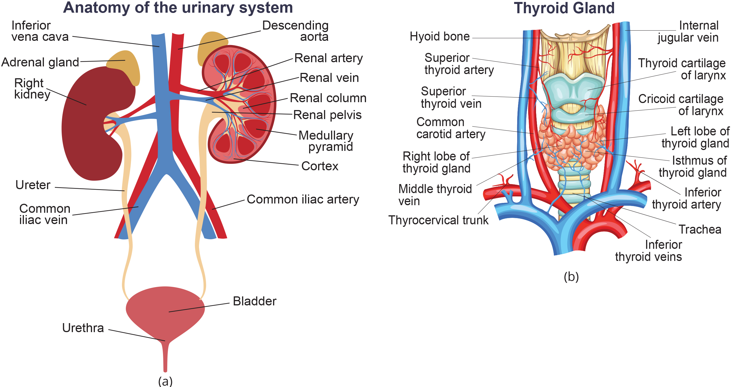
Lesson 39.1 Figure 2
Notes:
Figure 2: (a) The adrenal glands are located on top of the kidneys. (b) The thyroid glands are located in the front of the neck, on top of the trachea.

Slide 6
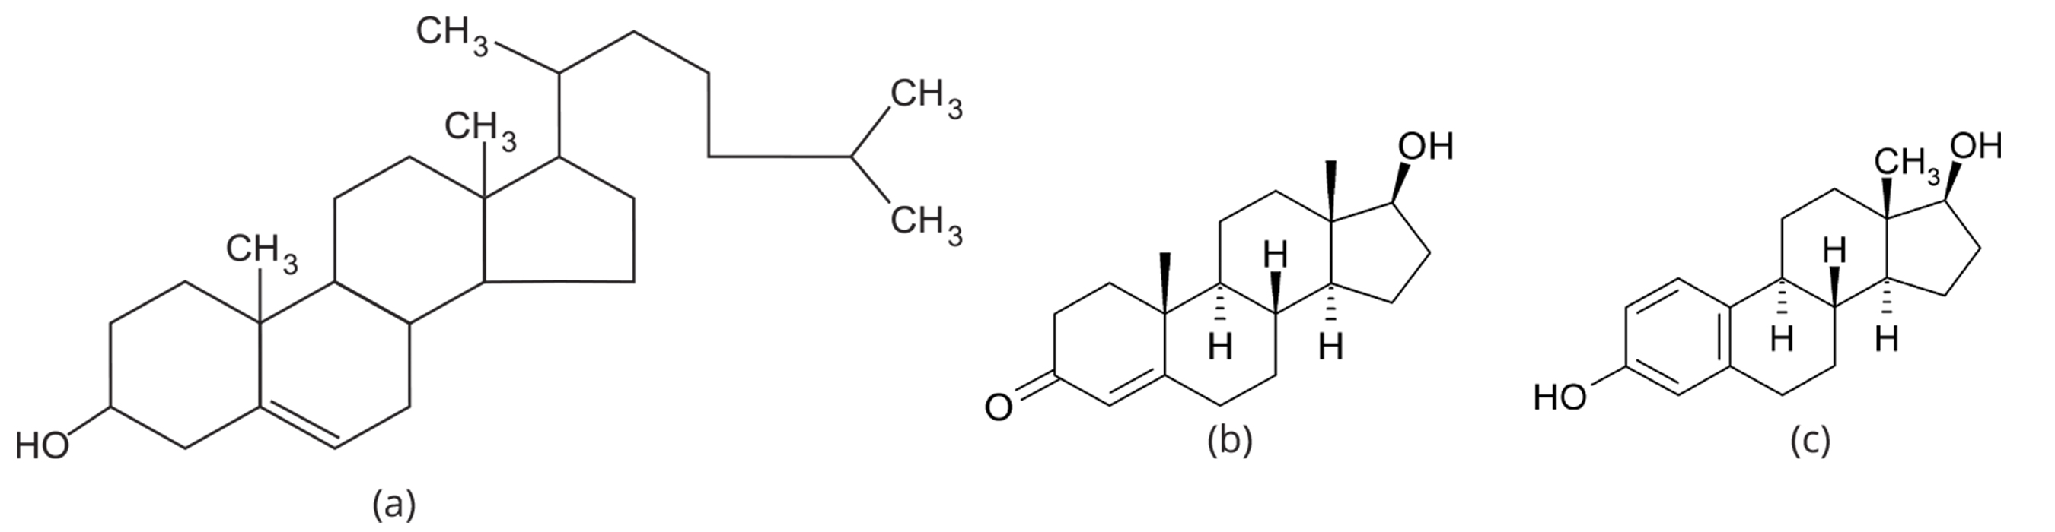
Lipid-Derived Hormones (or Lipid-Soluble Hormones)
Most lipid hormones are derived from cholesterol.
The primary class of lipid hormones in humans is the steroid hormones.
Chemically, these hormones are usually ketones or alcohols; their chemical names will end in -ol for alcohols or -one for ketones.
Steroid hormones are insoluble in water, and they are transported by transport proteins in blood.
39.1 Figure 3
Klaus Hoffmeier on Wikimedia Commons. "Testosterone and estradiol chemical structures."
Notes:
Figure 3: The structures shown here represent (a) cholesterol and the steroid hormones (b) testosterone and (c) estradiol.

Slide 7
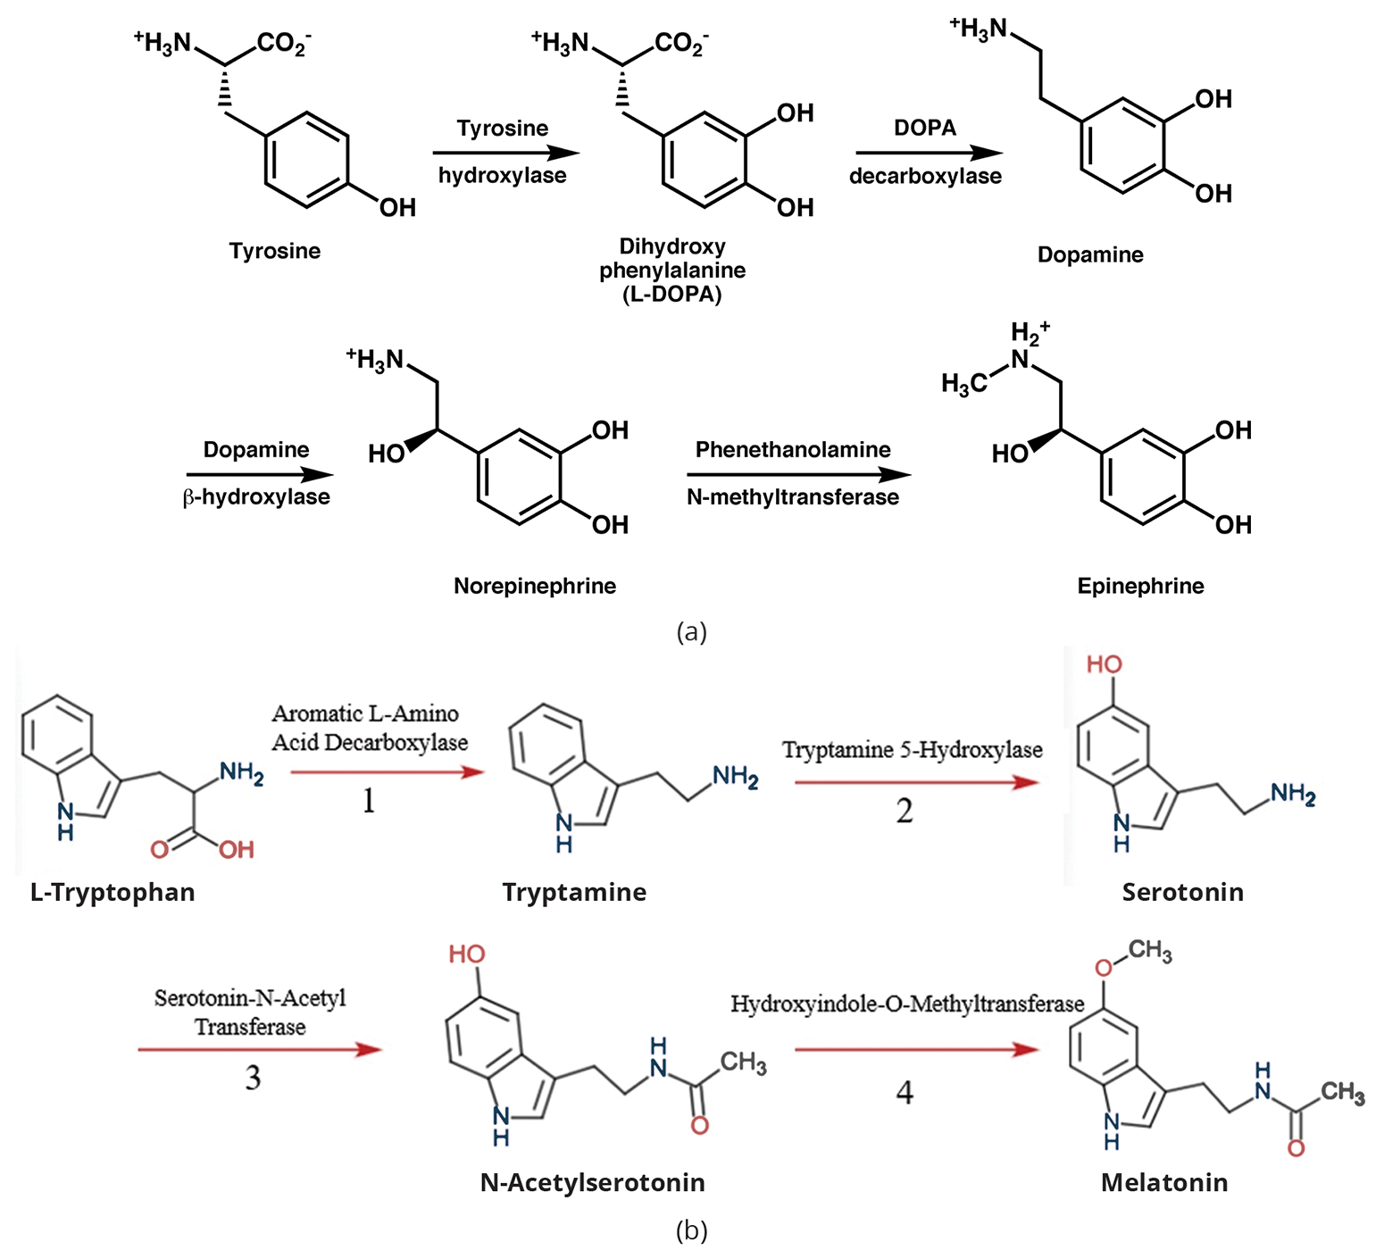
Amino Acid-Derived Hormones
The amino acid-derived hormones are relatively small molecules that are derived from the amino acids tyrosine and tryptophan.
If a hormone is amino acid derived, its chemical name will end in -ine.
The pineal gland in the brain makes and secretes melatonin, which regulates sleep cycles.
39.1 Figure 4
Boghog2 on Wikimedia Commons. "Tyrosine metabolism."
Kwingfield on Wikimedia Commons. "Tryptamine biosynthesis pathway."
Notes:
Figure 4: (a) The hormone epinephrine, which triggers the fight-or-flight response, is derived from the amino acid tyrosine. (b) The hormone melatonin, which regulates circadian rhythms, is derived from the amino acid tryptophan.

Slide 8
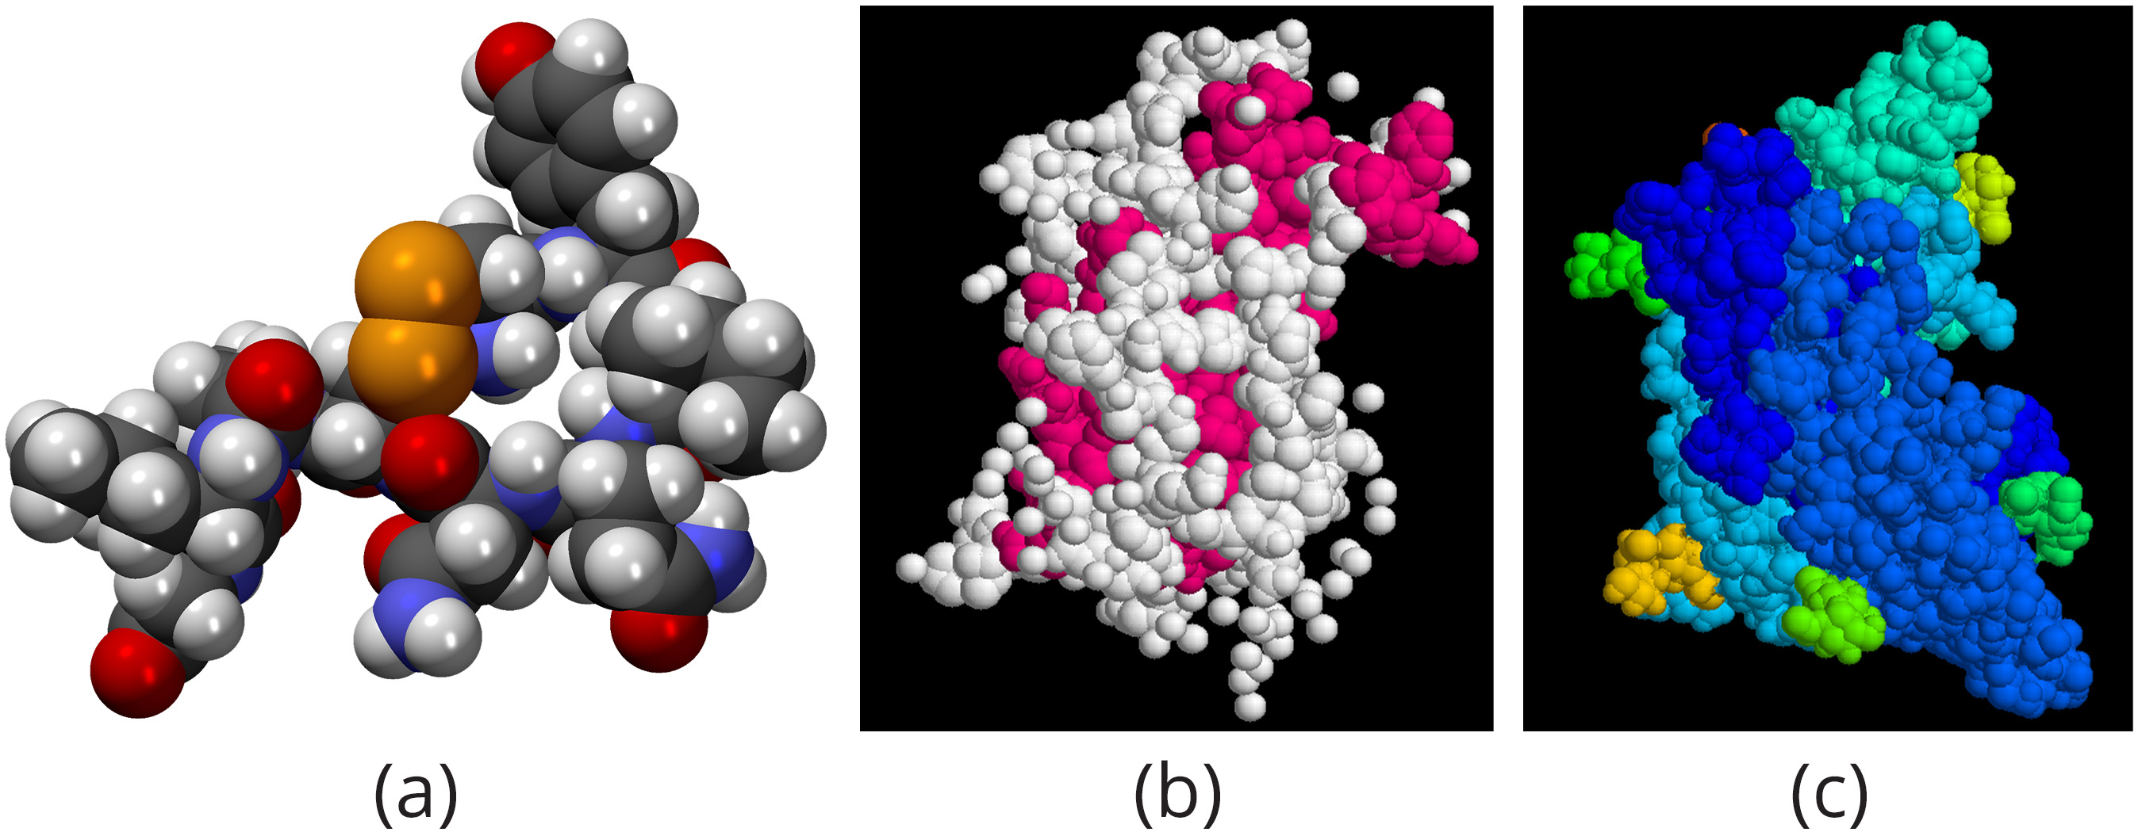
Peptide Hormones
The structure of peptide hormones is that of a polypeptide chain.
This class includes small proteins, like growth hormones produced by the pituitary, and large glycoproteins, like the follicle-stimulating hormone produced by the pituitary.
Secreted peptides, like insulin, are stored within vesicles in the cells that synthesize them.
Amino acid-derived and polypeptide hormones are water-soluble and insoluble in lipids.
These hormones cannot pass through plasma membranes of cells.
39.1 Figure 5
MindZiper on Wikimedia Commons. "Oxytocin."
Protein Data Bank on Wikimedia Commons. "Growth hormone."
Rombik&#153; on Wikimedia Commons. "Follicle-stimulating hormone."
Notes:
Figure 5: The structures of peptide hormones (a) oxytocin, (b) growth hormone, and (c) follicle-stimulating hormone are shown. These peptide hormones are much larger than those derived from cholesterol or amino acids.

Slide 9
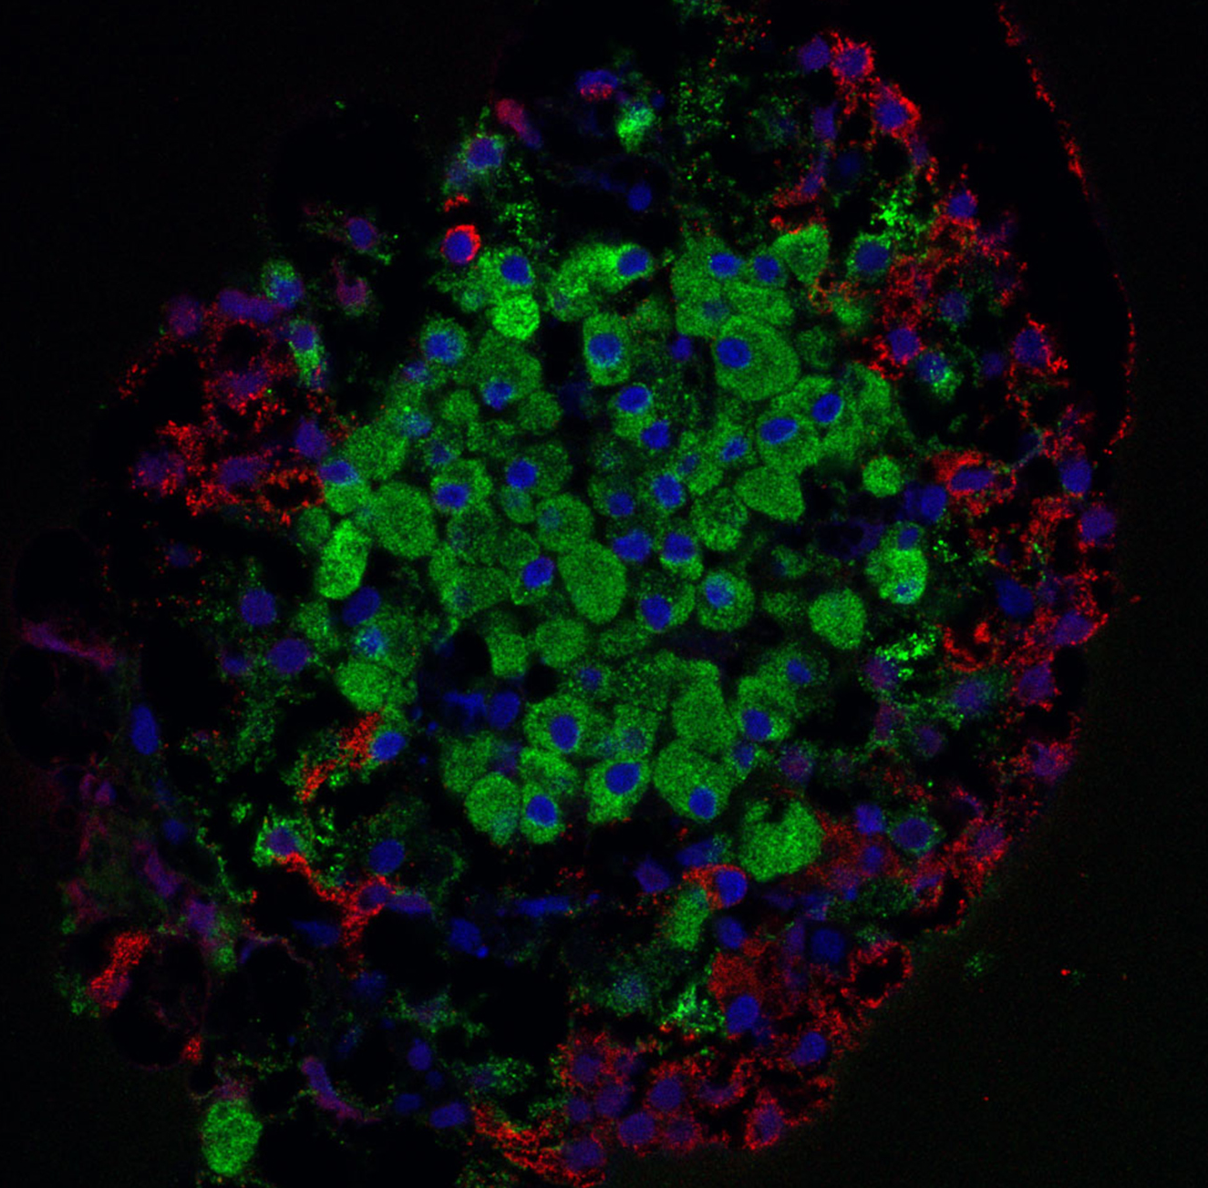
Science and You
Insulin is produced by specialized cells, known as beta cells, in the pancreas.
Beta cells form clusters referred to as islets.
Type 1 diabetes is an autoimmune disease, usually manifested soon after birth, where the immune system fails to recognize beta cells as "self."
This leads to a destructive immune response against beta cells, depleting the body of islets and the only source of insulin, thereby preventing the normal regulation of blood glucose levels.
39.1 Figure 6
Masur on Wikimedia Commons. "Islet-forming beta cells."
Notes:
This is included as a relevant application for this topic.
Figure 6: This is a laser scanning confocal microscope image of islet-forming beta cells in the pancreas. Cell nuclei are stained blue and present as the smaller dots scattered throughout. Insulin is stained green and presents as the slightly larger dots concentrated in the center. The presence of insulin indicates the location of beta cells, among other cell types.

Slide 10
How Hormones Work₁
Hormones mediate changes in target cells by binding to specific hormone receptors.
Hormones circulate throughout the body and meet many different cell types, affecting cells that possess the necessary receptors.
Receptors for a specific hormone may be found on many different cells or a small number of specialized cells.

Slide 11
How Hormones Work₂
The number of receptors that respond to a hormone determines the cell's sensitivity to that hormone and the resulting cellular response.
The number of receptors that respond to a hormone can change over time, resulting in increased or decreased cell sensitivity.
In up-regulation, the number of receptors increases in response to rising hormone levels, making the cell more sensitive to the hormone and allowing for more cellular activity.
When the number of receptors decreases in response to rising hormone levels, called down-regulation, cellular activity is reduced.
Hormones can mediate changes directly by binding to intracellular hormone receptors and modulating gene transcription, or indirectly by binding to cell surface receptors and stimulating signaling pathways.

Slide 12
Intracellular Hormone Receptors
Lipid-derived (lipid-soluble) hormones, diffuse across the membranes of the endocrine cell in which they are synthesized.
Once outside the cell, they bind to transport proteins that keep them soluble in the bloodstream.
At the target cell, the hormones are released from the carrier protein and diffuse across the lipid bilayer of the plasma membrane of cells.
Once inside the cell, hey adhere to intracellular receptors residing in the cytoplasm or in the nucleus.
The cell signaling pathways induced by the steroid hormones regulate the expression of specific genes in the cell's DNA.
The hormones and receptor complex act as transcription regulators by binding to a specific region of DNA and increasing or decreasing the synthesis of mRNA of specific genes.
The amount of mRNA determines the amount of the protein synthesized.
Other lipid-soluble hormones that are not steroid hormones, such as vitamin D and thyroxine, have receptors located in the nucleus.

Slide 13
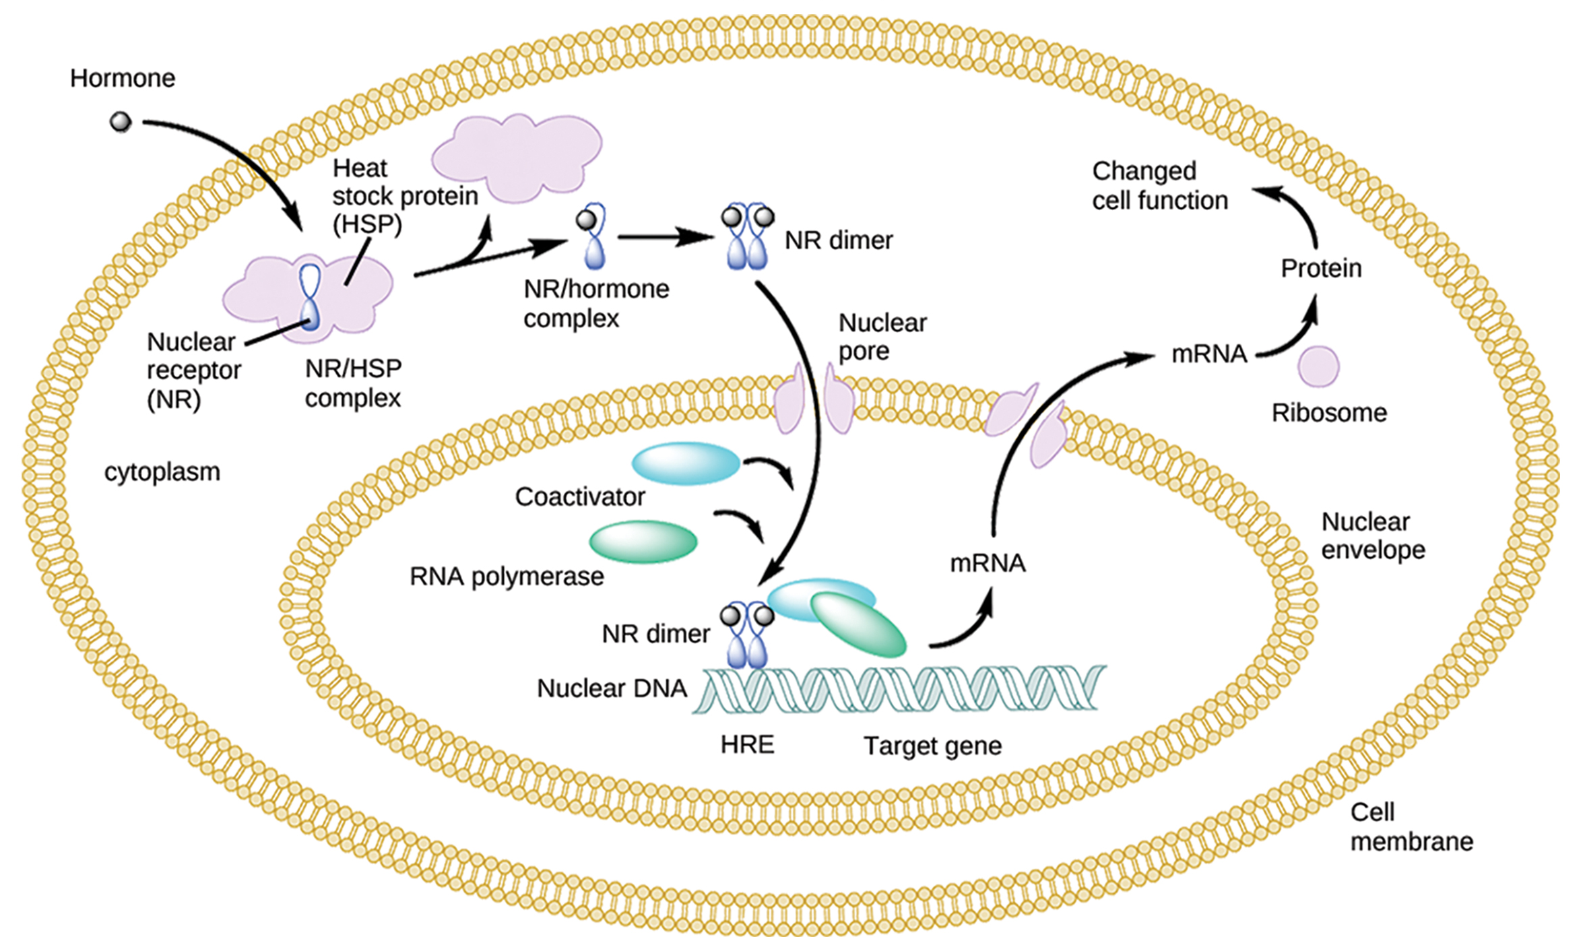
Lesson 39.1 Figure 7
CNX OpenStax on Wikimedia Commons. "Intracellular nuclear receptor and heat shock protein." Modified.
Notes:
Figure 7: A lipid-derived hormone diffuses through the cell membrane and binds to an intracellular nuclear receptor (NR), itself bound to a heat shock protein (HSP), in the cytoplasm. Once the hormone has bound the receptor, the NR/hormone complex dissociates from the heat shock protein and enters the nucleus through a nuclear pore. In the nucleus, the hormone-receptor complex binds to a DNA sequence called a hormone response element (HRE), which triggers gene transcription to produce an mRNA copy of the gene. The mRNA travels out of the nucleus to a ribosome in the cytoplasm, where the mRNA is translated into a protein. The corresponding protein product can then mediate changes in cell function.

Slide 14
Think It Through
Some types of cancer cells grow and divide in response to the steroid hormone estrogen. The drug Fulvestrant is one treatment for such cancer. Fulvestrant binds to the nuclear receptor for estrogen, causing it to become unstable and eventually degrade.
How would this mechanism of action help slow the growth and spread of the cancer cells?
Notes:
Originally an On Your Own. This is included here to use as a talking point or for a think-pair-share activity.

Slide 15
Plasma Membrane Hormone Receptors₁
Amino acid-derived hormones and polypeptide hormones are not lipid and, therefore, generally cannot diffuse through the plasma membrane of cells.
Lipid insoluble hormones bind to receptors on the outer surface of the plasma membrane called plasma membrane hormone receptors.
Lipid insoluble hormones do not directly affect the target cell because they cannot enter the cell and act directly on DNA.
Binding of these hormones to a cell surface receptor results in activation of a signaling pathway.
The hormone that initiates the signaling pathway is called a first messenger, which activates a second messenger in the cytoplasm.

Slide 16
Plasma Membrane Hormone Receptors₂
One very important second messenger is cyclic AMP (cAMP). When a hormone binds to its membrane receptor, a G protein that is associated with the receptor is activated.
G proteins are proteins separate from receptors that are found in the cell membrane.
When a hormone is not bound to the receptor, the G protein is inactive and is bound to GDP.
When a hormone binds to the receptor, the G protein is activated by binding GTP, in place of GDP.
The activated G protein activates a membrane-bound enzyme called adenylyl cyclase.

Slide 17
Plasma Membrane Hormone Receptors₃
Adenylyl cyclase catalyzes the conversion of ATP to cAMP. cAMP then activates protein kinases, which transfer a phosphate group from ATP to a substrate molecule through phosphorylation.
The phosphorylation of a substrate molecule changes its structural orientation, activating it. These activated molecules can then mediate changes in cellular processes.
The effect of a hormone is amplified as the signaling pathway progresses.
To stop hormone activity, cAMP is deactivated by the cytoplasmic enzyme phosphodiesterase, or PDE.

Slide 18
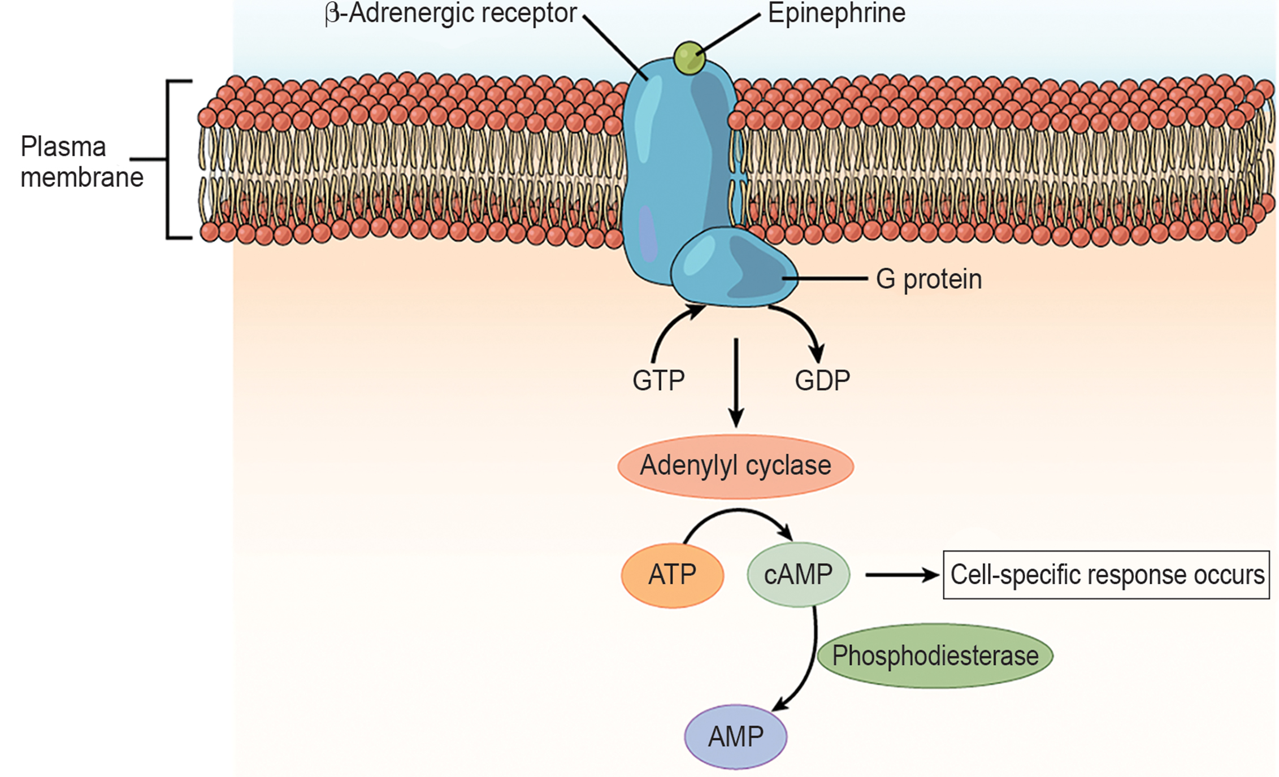
Lesson 39.1 Figure 8
CNX OpenStax on Wikimedia Commons. "Epinephrine and nonrepinephrine bind to beta-andrenergic receptors."
Notes:
Figure 8: The amino acid-derived hormones epinephrine and norepinephrine bind to β-adrenergic receptors on the plasma membrane of cells. Hormones binding to the receptor activates a G protein, which in turn activates adenylyl cyclase, converting ATP to cyclic AMP (cAMP). cAMP is a second messenger that mediates a cell-specific response. An enzyme called phosphodiesterase breaks down cAMP, terminating the signal.

Slide 19
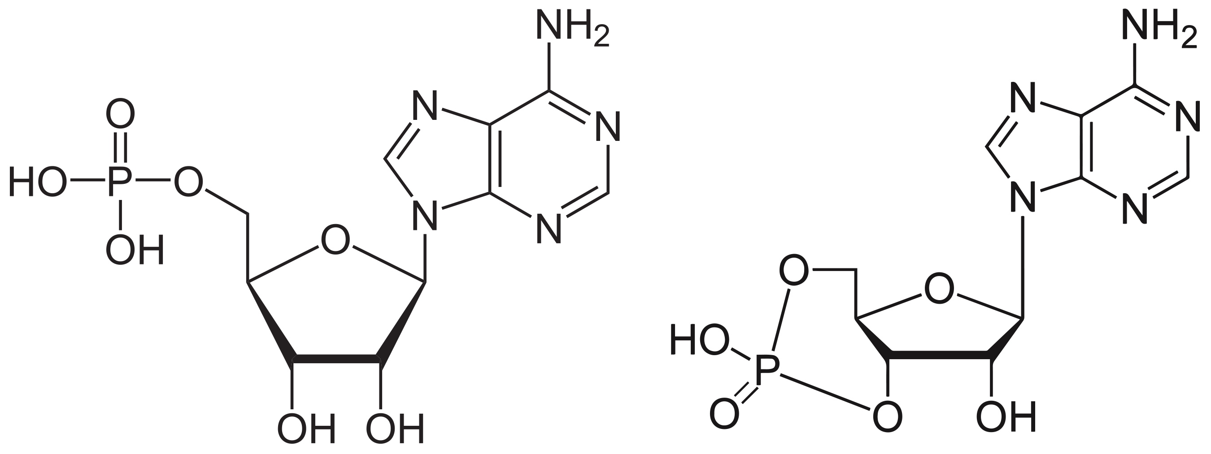
Plasma Membrane Hormone Receptors₄
Adenylyl cyclase catalyzes the conversion of ATP to cAMP. cAMP then activates a group of proteins called protein kinases, which transfer a phosphate group from ATP to a substrate molecule in a process called phosphorylation.
The phosphorylation of a substrate molecule changes its structural orientation, thereby activating it. These activated molecules can then mediate changes in cellular processes.
The effect of a hormone is amplified as the signaling pathway progresses.
To stop hormone activity, cAMP is deactivated by the cytoplasmic enzyme phosphodiesterase, or PDE. PDE is always present in the cell and breaks down cAMP to control hormone activity, preventing the overproduction of cellular products.
39.1 Figure 9
NEUROtiker on Wikimedia Commons. "AMP."
Benjah-bmm27 on Wikimedia Commons. "cAMP."
Notes:
Figure 9: Structures of AMP (left) and cAMP (right)

Slide 20
Summary
There are three basic types of hormones: lipid-derived, amino acid-derived, and peptide.
Hormones cause cellular changes by binding to receptors on target cells.
Lipid-derived (lipid-soluble) hormones can enter the cell by diffusing across the plasma membrane.
Lipid-insoluble hormones bind to receptors on the plasma membrane surface and trigger a signaling pathway to change the cell's activities.

Slide 21

End of Hawkes Learning PowerPoint

