Slide 1
Lesson 39.2
Hormone Regulation

Slide 2
Objectives
Describe how hormones regulate metabolism.
Discuss the different stimuli that control hormone levels in the body.
Discuss the role of hormones in the reproductive system.
Explain how hormones regulate the excretory system.
Explain the role of hormones in different diseases.

Slide 3
Hormone Regulation₁
Hormones have a wide range of effects and modulate many different body processes.
Many of the body's regulatory processes are controlled by the hypothalamus.
The hypothalamus is a small structure located near the base of the brain, above the brain stem and below the thalamus.
The hypothalamus helps keep your body in a steady state by regulating temperature, the sleep-wake cycle, thirst, appetite, and blood pressure; it is also involved in the regulation of mood, sex drive, and pregnancy and childbirth.
The hypothalamus controls these functions by acting as the link between the nervous system and endocrine systems.
The hypothalamus contains neurosecretory cells, which are neuron-like cells that produce hormones.

Slide 4
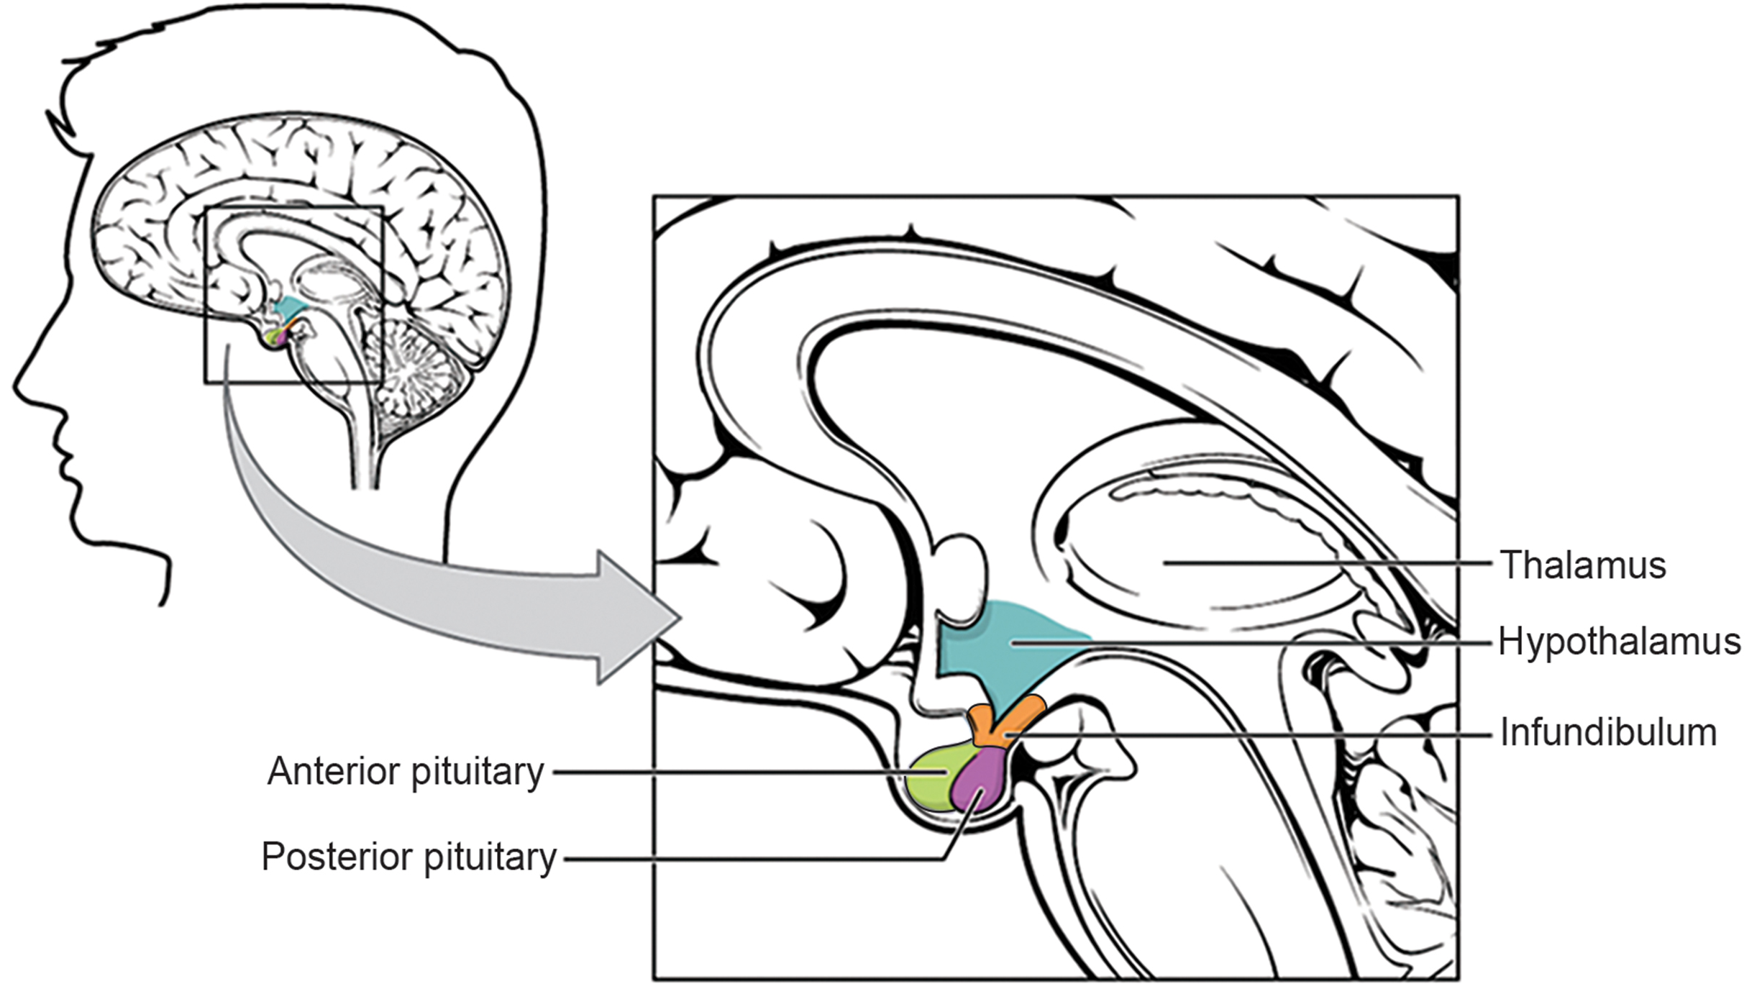
Hormone Regulation₂
The hypothalamus sits right above the pituitary gland, which itself produces and releases several hormones in response to signals from the hypothalamus.
The pituitary gland has two components: anterior and posterior.
The anterior pituitary is composed of glandular cells that secrete protein hormones.
The posterior pituitary is an extension of the hypothalamus and is composed largely of the axons of neurosecretory cells from the hypothalamus.
Hormones from the hypothalamus can enter blood circulation when they are released at the posterior pituitary.
39.2 Figure 1
OpenStax College on Wikimedia Commons. "Hypothalamus-pituitary complex."
Notes:
Figure 1: The hypothalamus is located below the thalamus near the base of the brain, and the pituitary gland is located below the hypothalamus. Axons of neurosecretory cells from the hypothalamus project into the posterior pituitary through the infundibulum (a tube-like structure).

Slide 5
Hormonal Regulation of the Excretory System₁
The water concentration of the body is monitored by osmoreceptors in the hypothalamus, which detect the concentration of electrolytes in the extracellular fluid.
The concentration of electrolytes in the blood rises when there is water loss caused by excessive perspiration, inadequate water intake, or low blood volume due to blood loss.
An increase in blood electrolyte levels results in a neuronal signal being sent from the osmoreceptors in hypothalamic nuclei.
The hypothalamus produces a polypeptide hormone known as antidiuretic hormone (ADH), which is transported to and released from the posterior pituitary gland.
The principal action of ADH is to regulate the amount of water excreted by the kidneys.
As ADH causes water reabsorption from the kidney tubules into the blood, the remaining salts and wastes in the tubules are concentrated in the urine.

Slide 6
Hormonal Regulation of the Excretory System₂
Dehydration or physiological stress can cause an increase in blood osmolarity above 300 mOsm/L along with a decrease in blood pressure. This raises ADH secretion, resulting in water retention and an increase in blood pressure.
To increase water retention, ADH first needs to travel in the bloodstream from the posterior pituitary to the kidneys.
Once at the kidneys, ADH changes the kidneys to be more permeable to water by temporarily inserting aquaporins into the kidney tubules.
Water moves out of the kidney tubules through the aquaporins, reducing urine volume. The water is reabsorbed into the capillaries, lowering blood osmolarity back toward normal.
As blood osmolarity decreases, a negative feedback mechanism reduces osmoreceptor activity in the hypothalamus, and ADH secretion is reduced.
ADH release can be reduced by certain substances, including alcohol.
Chronic underproduction of ADH or a mutation in the ADH receptor results in diabetes insipidus.

Slide 7
Hormonal Regulation of the Excretory System₃
Another hormone responsible for maintaining electrolyte concentrations is aldosterone, a steroid hormone that is produced by the adrenal cortex.
Aldosterone maintains proper water balance by enhancing Na⁺ reabsorption and K⁺ secretion from extracellular fluid of the cells in kidney tubules.
Aldosterone is referred to as a mineralocorticoid, a corticosteroid that affects ion and water balance.
Aldosterone release is stimulated by a decrease in blood sodium levels, blood volume, or blood pressure, or an increase in blood potassium levels.

Slide 8
Hormonal Regulation of the Excretory System₄
When blood pressure drops, the renin-angiotensin-aldosterone system (RAAS) is activated. Cells in the juxtaglomerular apparatus detect this and release renin.
Renin, an enzyme, circulates in the blood and reacts with a plasma protein produced by the liver called angiotensinogen. When angiotensinogen is cleaved by renin, it produces angiotensin I, which is then converted into angiotensin II in the lungs.
Angiotensin II functions as a hormone and causes the release of aldosterone by the adrenal cortex.
Angiotensin II, in addition to being a potent vasoconstrictor, also causes an increase in ADH and increased thirst, both of which help to raise blood pressure.

Slide 9
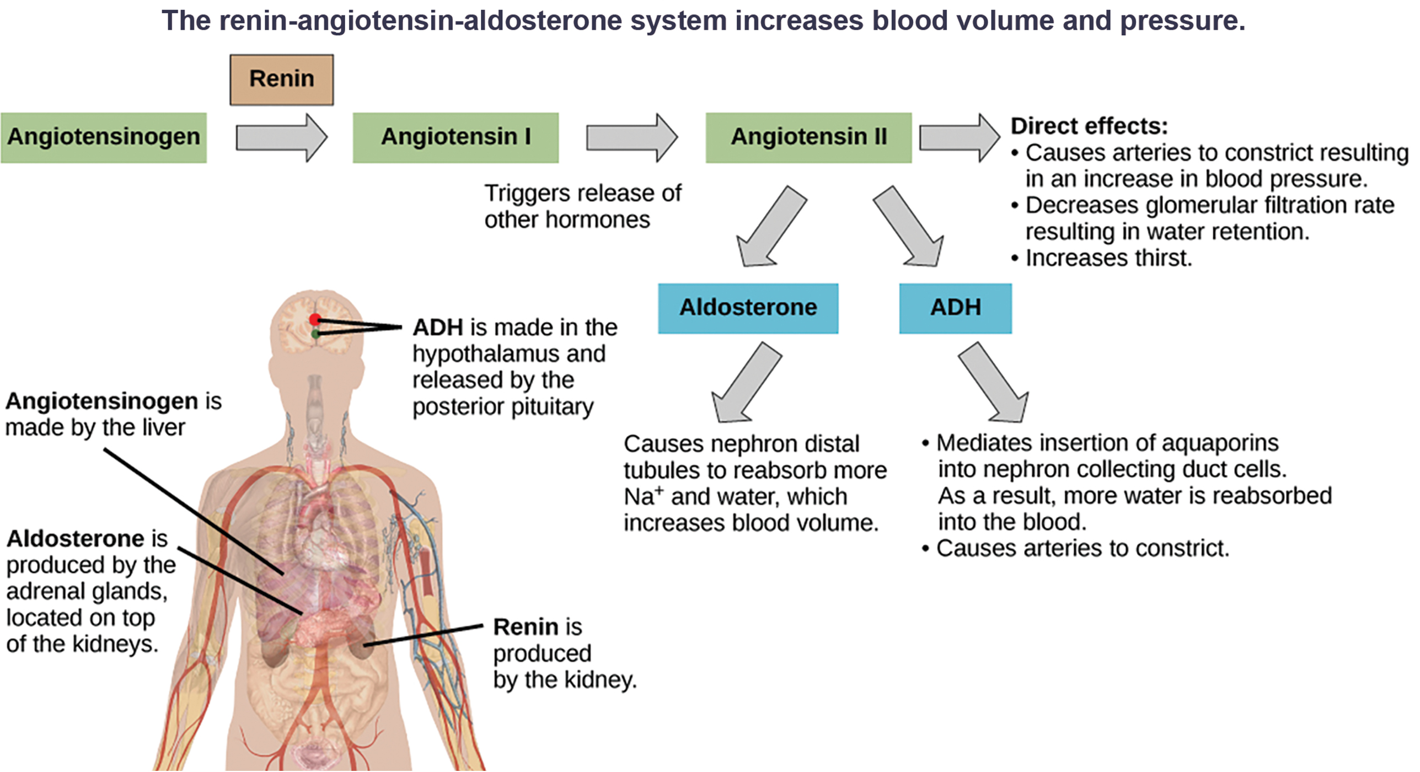
Lesson 39.2 Figure 2
Mikael Häggström on Wikimedia Commons. "Renin-angiotensin-aldosterone system."
Notes:
Figure 2: ADH and aldosterone increase blood pressure and volume. Angiotensin II directly stimulates release of these hormones. Angiotensin II, in turn, is formed from angiotensin I, which is formed when renin cleaves angiotensinogen.

Slide 10
Hormone Regulation of the Reproductive System
Regulation of the reproductive system requires the action of hormones from the pituitary gland, the adrenal cortex, and the gonads.
During puberty in both males and females, the hypothalamus produces gonadotropin-releasing hormone (GnRH), which stimulates the production and release of follicle-stimulating hormone (FSH) and luteinizing hormone (LH) from the anterior pituitary gland.
These hormones regulate the gonads and are called gonadotropins.
In both males and females, FSH stimulates gamete production, and LH stimulates production of hormones by the gonads.
An increase in gonad hormone levels inhibits GnRH production through a negative feedback loop.

Slide 11
Regulation of the Testicular Reproductive System
In the testes, FSH stimulates the maturation of sperm cells.
FSH production is inhibited by the hormone inhibin, which is released by the testes.
LH stimulates production of the sex hormones (androgens) by the interstitial cells of the testes and is called interstitial cell-stimulating hormone.
Testosterone promotes the production of sperm and a suite of secondary sex characteristics, such as the growth and development of the testes and penis, increased skeletal and muscular growth, enlargement of the larynx, increased growth and redistribution of body hair, and increased sexual drive.
Testosterone secretion is regulated by both the hypothalamus and the anterior pituitary gland.
The hypothalamus sends releasing hormones that stimulate the release of gonadotropins from the anterior pituitary gland.

Slide 12

Science and You₁
The Dangers of Synthetic Hormones
Some athletes attempt to boost their performance by using artificial hormones that enhance muscle performance. Anabolic steroids, a form of the male sex hormone testosterone, are one of the most widely known performance-enhancing drugs.
Steroids are used to help build muscle mass. Other hormones that are used to enhance athletic performance include erythropoietin, which triggers the production of red blood cells, and human growth hormone, which can help in building muscle mass.
Androgens produce several complications, such as liver dysfunctions and liver tumors, prostate gland enlargement, difficulty urinating, premature closure of epiphyseal cartilages, testicular atrophy, infertility, and immune system depression.
The physiological strain caused by these substances is often greater than what the body can handle, leading to unpredictable and dangerous effects, like increased risk of heart attacks, stroke, and impaired cardiac function.
39.2 Figure 3
bryce_edwards on Wikimedia Commons. "Jason Giambi."
Notes:
This is included as a relevant application for this topic.
Figure 3: Professional baseball player Jason Giambi publicly admitted to, and apologized for, his use of anabolic steroids supplied by a trainer.

Slide 13
Regulation of the Ovarian Reproductive System₁
In the ovaries, FSH stimulates development of egg cells, called ova, which develop in structures called follicles.
Follicle cells produce the hormone inhibin, which inhibits FSH production.
LH also plays a role in the development of ova, induction of ovulation, and stimulation of estradiol and progesterone production by the ovaries. Estradiol and progesterone are steroid hormones, called estrogens, that serve several functions in the human body.
During puberty, estradiol produces a suite of characteristics such as the increased development of breast tissue, redistribution of fat towards hips, legs, and breast, and the maturation of the uterus and vagina.
Both estradiol and progesterone regulate the menstrual cycle.

Slide 14
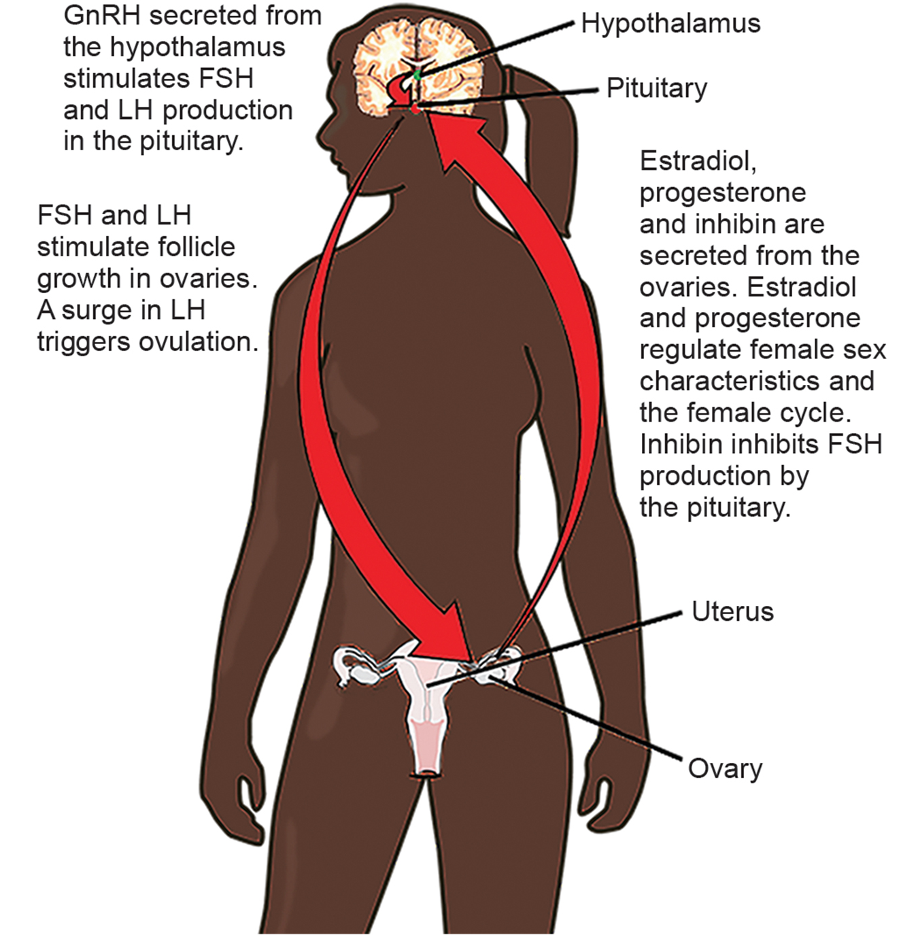
Lesson 39.2 Figure 4
CNX OpenStax on Wikimedia Commons. "Hormone regulation of female." Modified.
Notes:
Figure 4: Hormonal regulation of the female reproductive system involves hormones from the hypothalamus, pituitary, and ovaries.

Slide 15
Regulation of the Ovarian Reproductive System₂
The anterior portion of the pituitary gland also produces the hormone prolactin (PRL).
Prolactin stimulates the production of milk following childbirth.
Prolactin levels are regulated by the hypothalamic hormones prolactin-releasing hormone (PRH) and prolactin-inhibiting hormone (PIH), which is now known to be dopamine.
PRH stimulates the release of prolactin, and PIH inhibits it.
The posterior pituitary releases the hormone oxytocin, which stimulates uterine contractions during childbirth.
Oxytocin also stimulates the contraction of myoepithelial cells around the mammary glands. As these cells contract, milk is forced into milk ducts and is ejected from the breasts in the milk ejection, or let down, reflex.
Oxytocin release is stimulated by the suckling of an infant.

Slide 16
Regulation of Blood Glucose Levels by Insulin and Glucagon₁
To manage nutrient intake, storing excess intake and utilizing reserves, when necessary, the body uses hormones to moderate energy stores.
Insulin is produced by the beta cells of the pancreas, which are stimulated to release insulin as blood glucose levels rise.
Insulin lowers blood glucose levels by enhancing the rate of glucose uptake and utilization by target cells.
It also stimulates the liver to convert glucose to glycogen, which is then stored by cells of the liver for later use. Insulin also increases the rate of glucose transport into certain cells, such as muscle cells and the liver.
Insulin mediates an increase in the number of glucose transporter proteins (GLUTs) in the membrane. GLUTs allow glucose to enter a cell through facilitated diffusion.
Some cells, including those in the kidneys and brain, can access glucose without the use of insulin.
Actions mediated by insulin cause blood glucose concentrations to fall, called a hypoglycemic ("low sugar") effect, which inhibits further insulin release from beta cells through a negative feedback loop.

Slide 17
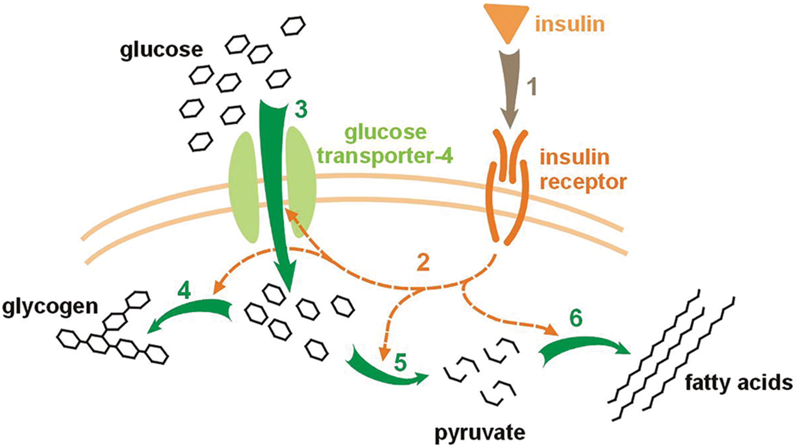
Lesson 39.2 Figure 5
Meiquer on Wikimedia Commons. "Insulin glucose metabolism."
Notes:
Figure 5: Insulin has several effects on glucose uptake and metabolism in a cell. (1) When insulin binds to its receptor, (2) it can initiate a signaling pathway (3) that increases the number of glucose transporter proteins in the cell membrane, thereby increasing the rate at which glucose diffuses into the cell. In liver cells, (4) insulin stimulates the conversion of glucose to glycogen. (5) Insulin also increases the rate of glycolysis (the process through which glucose is broken down to generate the molecule pyruvate and energy as ATP) and (6) promotes the conversion of glucose into fatty acids and the synthesis of proteins.

Slide 18
Regulation of Blood Glucose Levels by Insulin and Glucagon₂
Impaired insulin function can lead to a condition called diabetes mellitus.
This condition can be caused by low levels of insulin production or by reduced sensitivity of tissue cells to insulin.
Low insulin levels prevent glucose from being absorbed by cells, causing high levels of blood glucose, or hyperglycemia ("high sugar").
High blood glucose levels make it difficult for the kidneys to recover all the glucose from urine. High glucose levels also result in less water being reabsorbed by the kidneys, causing high amounts of urine to be produced.
Over time, high blood glucose levels can cause nerve damage to the eyes and peripheral body tissues as well as damage to the kidneys and cardiovascular system.
Oversecretion of insulin can cause hypoglycemia, or low blood glucose levels. This causes insufficient glucose availability to cells, often leading to muscle weakness, and can sometimes cause unconsciousness or death if left untreated.

Slide 19
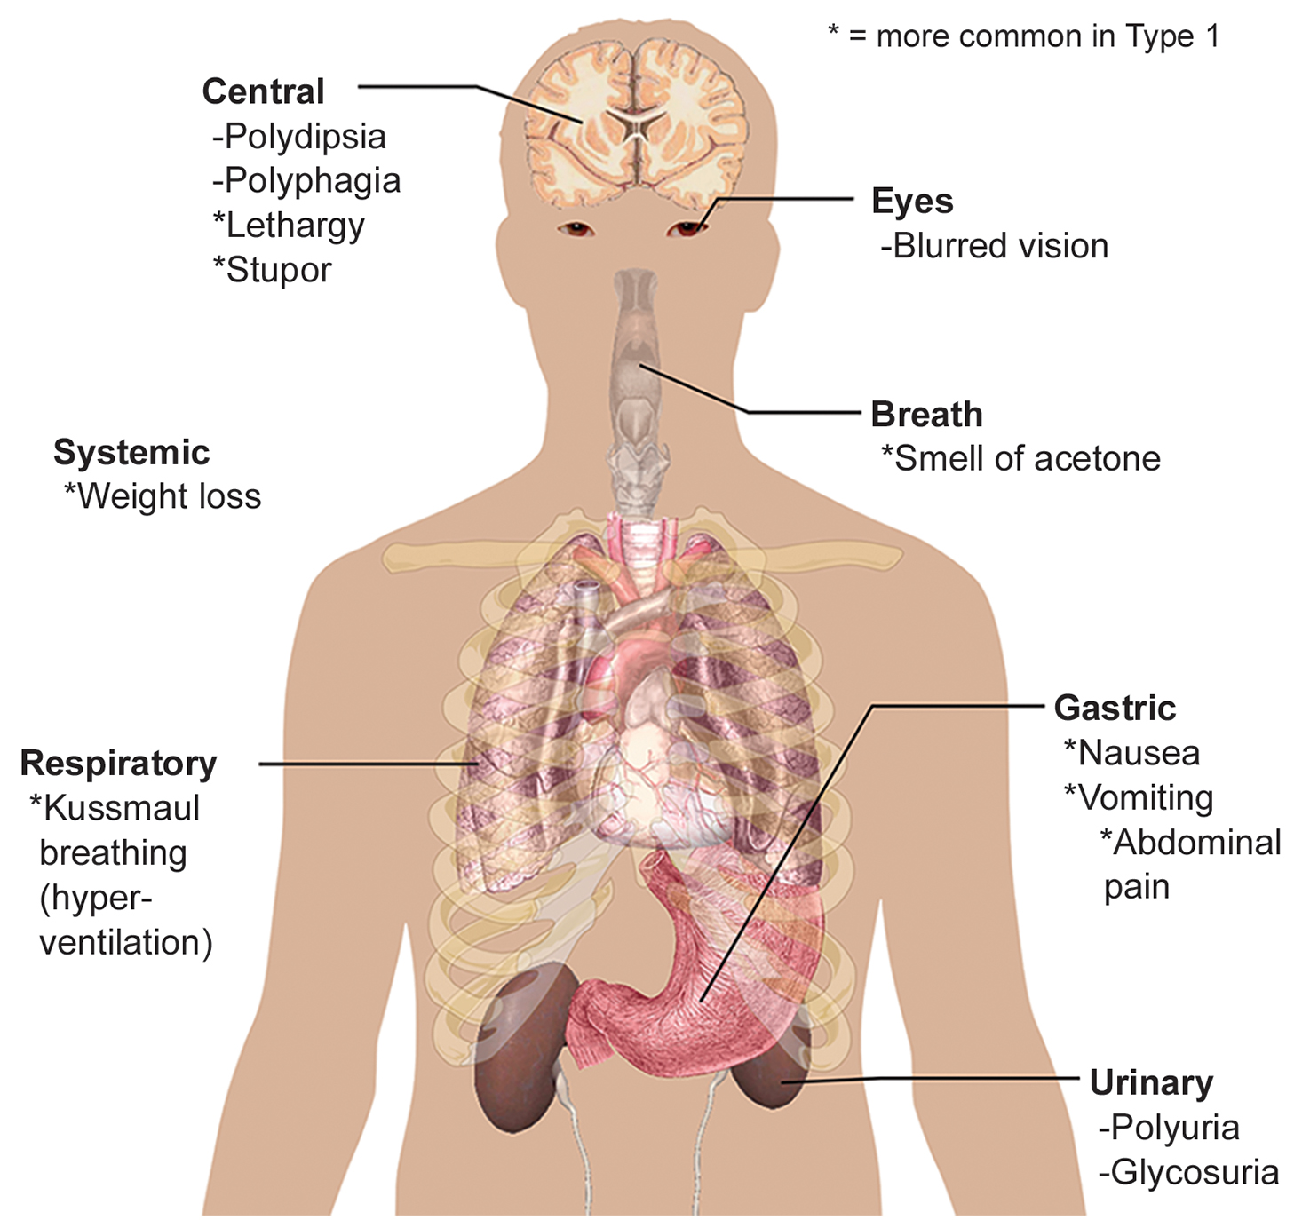
Lesson 39.2 Figure 6
Mikael Häggström on Wikimedia Commons. "Diabetes symptoms."
Notes:
Figure 6: The main symptoms of diabetes are shown. Polydipsia (excessive thirst) and polyphagia (excessive hunger) are symptoms of the central nervous system. Polyuria (frequent urination) and glycosuria (glucose in the urine) are urinary symptoms.

Slide 20
Regulation of Blood Glucose Levels by Insulin and Glucagon₃
When blood glucose levels decline below normal levels the hormone glucagon is released from the alpha cells of the pancreas.
Glucagon raises blood glucose levels by stimulating the breakdown of glycogen to glucose in skeletal muscle cells and liver cells in a process called glycogenolysis.
Glucagon also stimulates absorption of amino acids from the blood by the liver, which then converts them to glucose. This process of glucose synthesis is called gluconeogenesis.
Glucagon also stimulates adipose cells to release fatty acids into the blood.
These actions mediated by glucagon result in an increase in blood glucose levels to normal homeostatic levels.
Rising blood glucose levels inhibit further glucagon release by the pancreas via a negative feedback mechanism.
Insulin and glucagon work together to maintain homeostatic glucose levels.

Slide 21
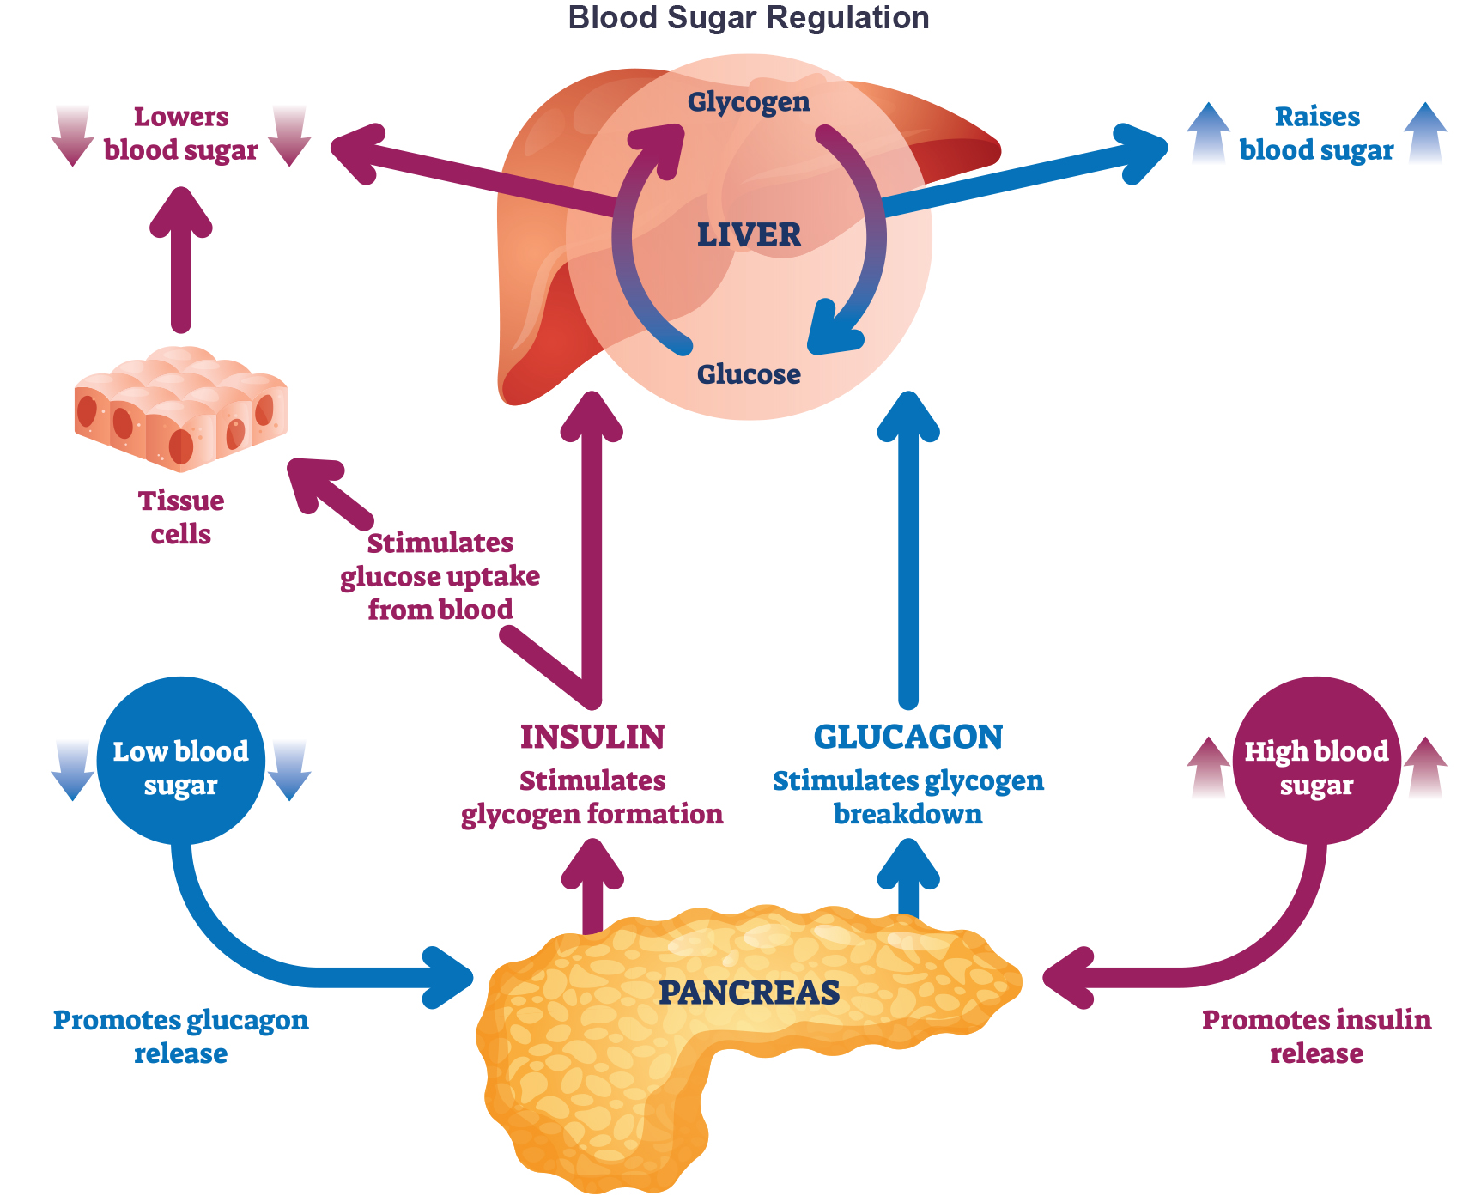
Lesson 39.2 Figure 7
Notes:
Figure 7: Insulin and glucagon regulate blood glucose levels.

Slide 22
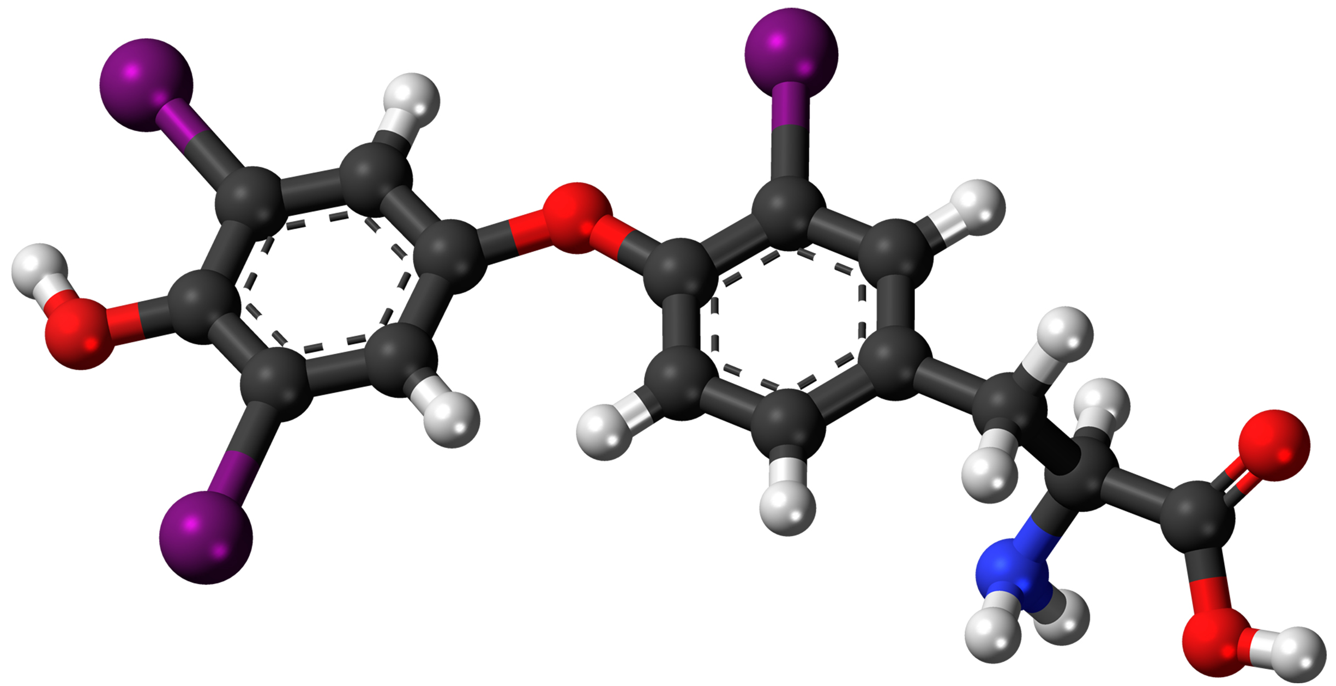
Regulation of Blood Glucose by Thyroid Hormones₁
The basal metabolic rate, which is the amount of calories required by the body at rest, is determined by two hormones produced by the thyroid gland: thyroxine, also known as tetraiodothyronine or T4, and triiodothyronine, also known as T3.
These hormones affect nearly every cell in the body except for the adult brain, uterus, testes, blood cells, and spleen. They are transported across the plasma membrane of target cells and bind to receptors on the mitochondria, resulting in increased ATP production.
In the nucleus, T3 and T4 activate genes involved in energy production and glucose oxidation.
This results in increased rates of metabolism and body heat production, which is known as the hormone's calorigenic effect.
39.2 Figure 8
Jynto on Wikimedia Commons. "Triiodothyronine structure."
Notes:
Figure 8: This demonstrates the structure of triiodothyronine. Carbon atoms are depicted as the black, central spines; hydrogen atoms are the shorter, white nodules; oxygen atoms are the red, medium-sized nodules on the left, middle, and right; a nitrogen atom is the blue nodule on the bottom right; and iodine atoms are the large, purple nodules on the left and center.

Slide 23
Science and You₂
As defined in its name, triiodothyronine contains three iodine (I) atoms. Similarly, thyroxine (or tetraiodothyronine) contains four iodine atoms.
Iodine is an essential component of our diet, requiring a daily intake of about 150 micrograms.
Iodine is mostly found in seaweed, fish, and dairy.
Therefore, iodine supplementation, in the form of iodized table salt, for example, is often necessary.
Inadequate iodine intake results in reduced thyroid hormone synthesis, a condition known as hypothyroidism.

Slide 24
Regulation of Blood Glucose by Thyroid Hormones₂
The release of T3 and T4 from the thyroid gland is stimulated by thyroid-stimulating hormone (TSH), which is produced by the anterior pituitary.
TSH binding at the receptors of the follicle of the thyroid triggers the production of T3 and T4 from a glycoprotein called thyroglobulin.
T3 is more active than T4 and is responsible for most of the effects of thyroid hormones, tissues of the body convert T4 to T3 by the removal of an iodine ion.
Most of the released T3 and T4 become attached to transport proteins in the bloodstream and are unable to cross the plasma membrane of cells.
These protein-bound molecules are only released when blood levels of the unattached hormone begin to decline.
Notes:
Figure 8: This demonstrates the structure of triiodothyronine. Carbon atoms are depicted as the black, central spines; hydrogen atoms are the shorter, white nodules; oxygen atoms are the red, medium-sized nodules on the left, middle, and right; a nitrogen atom is the blue nodule on the bottom right; and iodine atoms are the large, purple nodules on the left and center.

Slide 25
Regulation of Blood Glucose by Thyroid Hormones₃
Increased T3 and T4 levels in the blood inhibit the release of TSH, which results in lower T3 and T4 release from the thyroid.
The follicular cells of the thyroid require iodides (I-; anions of iodine) to synthesize T3 and T4.
Inadequate iodine intake results in an inability to synthesize T3 and T4 hormones. The thyroid gland enlarges in a condition called goiter, which is caused by overproduction of TSH without the formation of thyroid hormone.
Disorders can arise from both the underproduction and overproduction of thyroid hormones.
Hypothyroidism, underproduction of the thyroid hormones, can cause a low metabolic rate leading to weight gain, sensitivity to cold, and reduced mental activity, among other symptoms.
Hyperthyroidism, the overproduction of thyroid hormones, can lead to an increased metabolic rate and its effects: weight loss, excess heat production, sweating, and an increased heart rate. Graves' disease is one example of a hyperthyroid condition.
Notes:
Figure 8: This demonstrates the structure of triiodothyronine. Carbon atoms are depicted as the black, central spines; hydrogen atoms are the shorter, white nodules; oxygen atoms are the red, medium-sized nodules on the left, middle, and right; a nitrogen atom is the blue nodule on the bottom right; and iodine atoms are the large, purple nodules on the left and center.

Slide 26
Think It Through
Hyperthyroidism is a condition in which the thyroid gland is overactive. Hypothyroidism is a condition in which the thyroid gland is underactive. Which of the conditions do the following two patients most likely have?
Patient A has symptoms including weight gain, cold sensitivity, low heart rate, and fatigue.
Patient B has symptoms including weight loss, profuse sweating, increased heart rate, and difficulty sleeping.
Notes:
Originally an On Your Own. This is included here to use as a talking point or for a think-pair-share activity.

Slide 27
Hormonal Control of Blood Calcium Levels₁
Regulation of blood calcium (Ca2+) concentrations is important for generation of muscle contractions and nerve impulses, which are electrically stimulated.
Blood calcium levels are regulated by parathyroid hormone (PTH), which is produced by the parathyroid glands. PTH is released in response to low blood Ca2+ levels.
In the skeleton, PTH stimulates osteoclasts, which causes bone to be reabsorbed, releasing Ca2+ from bone into the blood. PTH also inhibits osteoblasts, which form new bone, reducing Ca2+ deposition in bone.
In the intestines, PTH increases dietary Ca2+ absorption. PTH triggers the formation of calcitriol, an active form of vitamin D, which acts on the intestines to increase absorption of dietary calcium.
In the kidneys, PTH stimulates reabsorption of the Ca2+.
PTH release is inhibited by rising blood calcium levels.

Slide 28
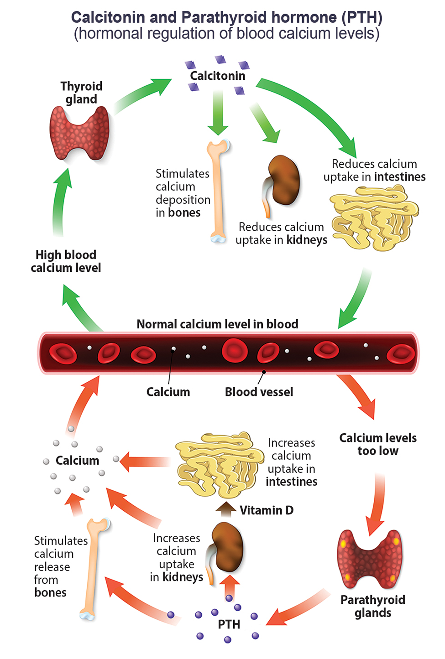
Lesson 39.2 Figure 9
Notes:
Figure 9: Parathyroid hormone (PTH) is released in response to low blood calcium levels. It increases blood calcium levels by targeting the skeleton, the kidneys, and the intestine.

Slide 29
Hormonal Control of Blood Calcium Levels₂
Hyperparathyroidism results from an overproduction of parathyroid hormone.
This results in excessive calcium being removed from bones and introduced into blood circulation, producing structural weakness of the bones, plus nervous system impairment due to high blood calcium levels.
Hypoparathyroidism results in extremely low levels of blood calcium, which causes impaired muscle function and may result in tetany.
The hormone calcitonin, which is produced by the parafollicular or C cells of the thyroid, has the opposite effect on blood calcium levels of PTH.
Calcitonin decreases blood calcium levels by inhibiting osteoclasts, stimulating osteoblasts, and stimulating calcium excretion by the kidneys.
Calcitonin is most important in children, during pregnancy, and during prolonged starvation.

Slide 30
Hormonal Regulation of Growth₁
Hormonal regulation is required for the growth and replication of most cells in the body.
Growth hormone (GH), produced by the anterior portion of the pituitary gland, accelerates the rate of protein synthesis, particularly in skeletal muscle and bones.
Growth hormone has direct and indirect mechanisms of action.
GH stimulates the breakdown of triglycerides and release into the blood. This results in a switch by most tissues from utilizing glucose as an energy source to utilizing fatty acids. This process is called a glucose-sparing effect.
GH also stimulates glycogen breakdown in the liver; the glycogen is then released into the blood as glucose.
The GH-mediated increase in blood glucose levels is called a diabetogenic effect because it is like the high blood glucose levels seen in diabetes mellitus.

Slide 31
Hormonal Regulation of Growth₂
The indirect mechanism of GH action is mediated by insulin-like growth factors (IGFs), or somatomedins.
IGFs are a family of growth-promoting proteins, produced by the liver, that stimulate tissue growth.
GH levels are regulated by two hormones produced by the hypothalamus. GH release is stimulated by growth hormone-releasing hormone (GHRH) and is inhibited by growth hormone-inhibiting hormone (GHIH), also called somatostatin.

Slide 32
Hormonal Regulation of Growth₃
A balanced production of growth hormone is critical for proper development.
Underproduction of GH in adults does not appear to cause any abnormalities, but in children, it can result in pituitary dwarfism, in which growth is reduced.
Pituitary dwarfism is characterized by symmetric body formation.
Oversecretion of growth hormone can lead to gigantism in children, causing excessive growth.
In adults, excessive GH can lead to acromegaly, a condition in which there is enlargement of bones in the face, hands, and feet that are still capable of growth.

Slide 33
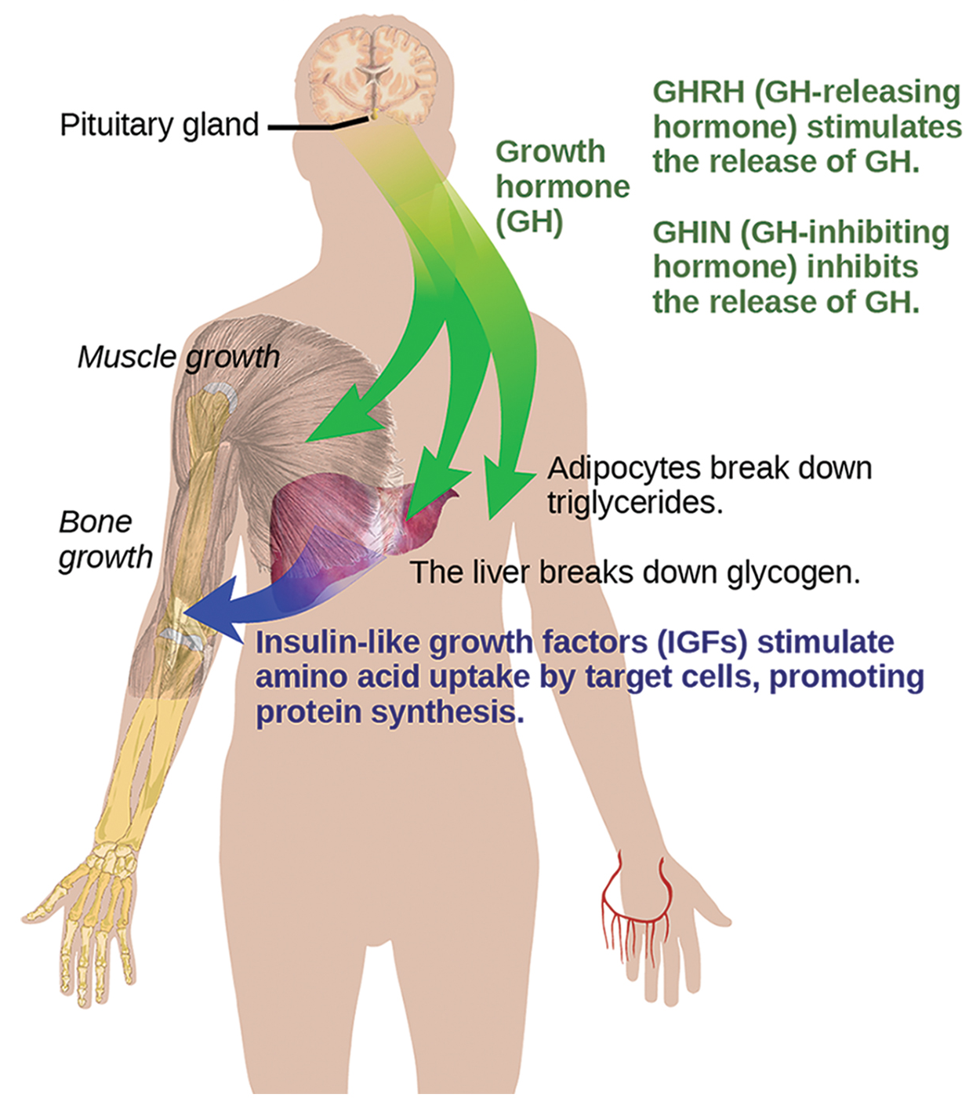
Lesson 39.2 Figure 10
Mikael Häggström on Wikimedia Commons. "GHRH and GHIH."
Notes:
Figure 10: Growth hormone directly accelerates the rate of protein synthesis in skeletal muscle and bones. Insulin-like growth factor 1 (IGF-1) is activated by growth hormone and allows formation of new proteins in muscle cells and bone.

Slide 34
Science and You₃
Career: Endocrinologist
An endocrinologist is a medical doctor who specializes in treating disorders of the endocrine glands, hormone systems, and glucose and lipid metabolic pathways.
An endocrine surgeon specializes in the surgical treatment of endocrine diseases and glands.
Endocrinologists are required to assess patients and diagnose endocrine disorders through extensive use of laboratory tests. Many endocrine diseases are diagnosed using tests that stimulate or suppress endocrine organ functioning.
Once a disease has been diagnosed, endocrinologists can prescribe lifestyle changes and/or medications to treat the disease.
Some cases of diabetes mellitus can be managed by exercise, weight loss, and a healthy diet; in other cases, medications may be required to enhance insulin release. If the disease cannot be controlled by these means, the endocrinologist may prescribe insulin injections.
In addition to clinical practice, endocrinologists may also be involved in primary research and development activities. For example, ongoing islet transplant research is investigating how healthy pancreas islet cells may be transplanted into diabetic patients.

Slide 35
Hormonal Regulation of Stress
When a threat or danger is perceived, the body responds by releasing hormones that will ready it for the "fight-or-flight" response.
The effects of this response are familiar to anyone who has been in a stressful situation: increased heart rate, dry mouth, and hair standing up.
The sympathetic nervous system regulates the stress response via the hypothalamus.
Stressful stimuli cause the hypothalamus to signal:
The adrenal medulla via nerve impulses
The adrenal cortex using the hormone adrenocorticotropic hormone (ACTH), which is produced by the anterior pituitary

Slide 36
Short-Term Stress Response
When presented with a stressful situation, the body responds by calling for the release of hormones that provide a burst of energy.
The hormones epinephrine (also known as adrenaline) and norepinephrine (also known as noradrenaline) are released by the adrenal medulla.
Epinephrine and norepinephrine increase blood glucose levels by stimulating the liver and skeletal muscles to break down glycogen and by stimulating glucose release by liver cells.
These hormones increase oxygen availability to cells by increasing the heart rate and dilating the bronchioles.
The hormones also prioritize body function by increasing blood supply to essential organs, such as the heart, brain, and skeletal muscles, while restricting blood flow to organs not in immediate need, such as the skin, digestive system, and kidneys.

Slide 37
Evolution Connection
Fight or Flight Response
The sympathetic division of the vertebrate autonomic nervous system has evolved the fight-or-flight response to counter stress-induced disruptions of homeostasis.
In the initial alarm phase, the sympathetic nervous system stimulates an increase in energy levels through increased blood glucose levels. This prepares the body for physical activity that may be required to respond to stress: to either fight for survival or flee from danger.
The body has evolved a response to counter long-term stress through the actions of the glucocorticoids, which ensure that long-term energy requirements can be met. The glucocorticoids mobilize lipid and protein reserves, stimulate gluconeogenesis, conserve glucose for use by neural tissue, and stimulate the conservation of salts and water.
The mechanisms to maintain homeostasis that are described here are those observed in the human body. However, the fight-or-flight response exists in some form in all vertebrates.

Slide 38
Long-Term Stress Response
The hypothalamus triggers the release of ACTH from the anterior pituitary gland. The adrenal cortex is stimulated by ACTH to release steroid hormones called corticosteroids.
Corticosteroids turn on transcription of certain genes in the nuclei of target cells. They change enzyme concentrations in the cytoplasm and affect cellular metabolism.
There are two main corticosteroids: glucocorticoids, such as cortisol, and mineralocorticoids, such as aldosterone.
The glucocorticoids primarily affect glucose metabolism by stimulating glucose synthesis. Glucocorticoids also have anti-inflammatory properties through inhibition of the immune system.
Mineralocorticoids function to regulate the ion and water balance of the body. The hormone aldosterone stimulates the reabsorption of water and sodium ions in the kidney, resulting in increased blood pressure and volume.
Hypersecretion of glucocorticoids can cause a condition known as Cushing's disease, characterized by a shifting of fat storage areas of the body. Hyposecretion of the corticosteroids can cause Addison's disease, which may result in bronzing of the skin, hypoglycemia, and low electrolyte levels in the blood.

Slide 39
Regulation of Hormone Production
Hormone production and release are primarily controlled by negative feedback.
In negative feedback systems, a stimulus elicits the release of a substance; once the substance reaches a certain level, it sends a signal that stops further release of the substance. In this way, the concentration of hormones in blood is maintained within a narrow range.
There are three mechanisms by which endocrine glands are stimulated to synthesize and release hormones: humoral stimuli, hormonal stimuli, and neural stimuli.

Slide 40
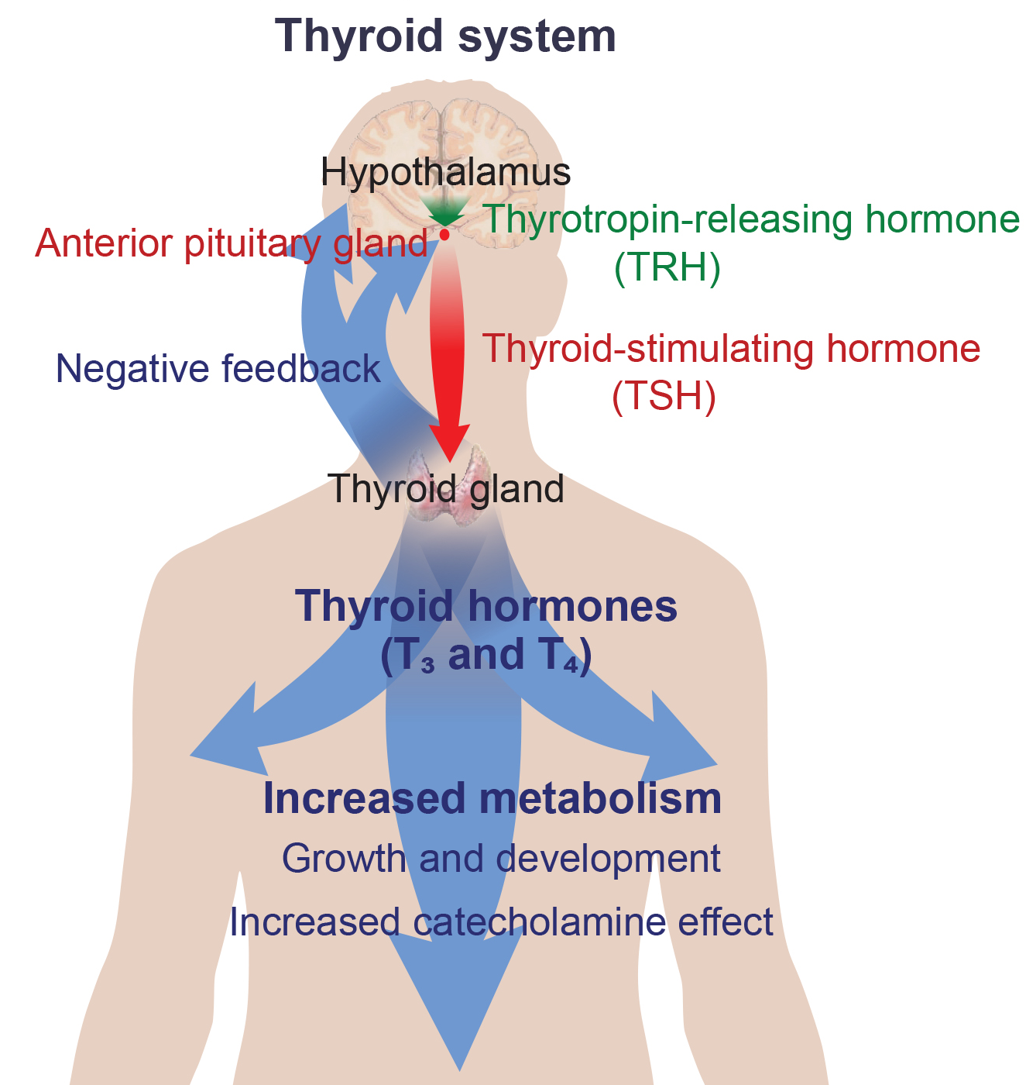
Lesson 39.2 Figure 11
Mikael Häggström on Wikimedia Commons. "Thyroid system."
Notes:
Figure 11: The anterior pituitary stimulates the thyroid gland to release the thyroid hormones T3 and T4. Increasing levels of these hormones in the blood results in feedback to the hypothalamus and anterior pituitary to inhibit further signaling to the thyroid gland.

Slide 41
Humoral Stimuli
A humoral stimulus refers to the control of hormone release in response to changes in extracellular fluids, such as blood or the ion concentration in the blood.
A rise in blood glucose levels triggers the pancreatic release of insulin.
Insulin causes blood glucose levels to drop, which signals the pancreas to stop producing insulin in a negative feedback loop.

Slide 42
Hormonal Stimuli
Hormonal stimulus refers to the release of a hormone in response to another hormone. Several endocrine glands release hormones when stimulated by hormones released by other endocrine glands.
The hypothalamus produces hormones that stimulate the anterior portion of the pituitary gland.
The anterior pituitary, in turn, releases hormones that regulate hormone production by other endocrine glands.
The anterior pituitary releases the thyroid-stimulating hormone, which then stimulates the thyroid gland to produce the hormones T3 and T4.
As blood concentrations of T3 and T4 rise, they inhibit both the pituitary and the hypothalamus in a negative feedback loop.

Slide 43
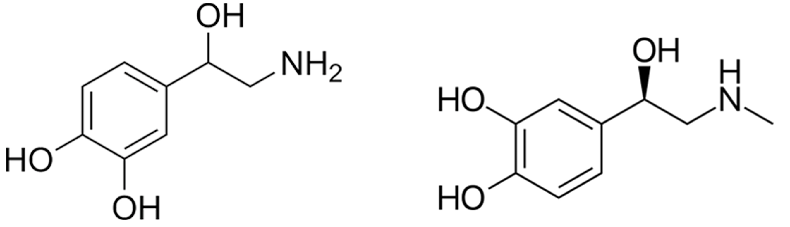
Neural Stimuli
The nervous system directly stimulates endocrine glands to release hormones, which is referred to as neural stimuli.
In a short-term stress response, the hormones epinephrine and norepinephrine are important for providing the bursts of energy required for the body to respond.
Neuronal signaling from the sympathetic nervous system directly stimulates the adrenal medulla to release the hormones epinephrine and norepinephrine in response to stress.
39.2 Figure 12
Edgar181 on Wikimedia Commons. "Norepinephrine structure."
Roland1952 on Wikimedia Commons. "Epinephrine structure."
Notes:
Figure 12: The structures of norepinephrine (left) and epinephrine (right)

Slide 44
Summary
Water levels in the body are controlled by antidiuretic hormone (ADH), which is produced in the hypothalamus and triggers the reabsorption of water by the kidneys.
The reproductive system is controlled by the gonadotropins follicle-stimulating hormone (FSH) and luteinizing hormone (LH), which are produced by the pituitary gland.
Insulin and glucagon work together to maintain blood glucose levels.
The body's basal metabolic rate is controlled by the thyroid hormones thyroxine (T4) and triiodothyronine (T3).
Parathyroid hormone (PTH) is produced by the parathyroid glands in response to low blood Ca2+ levels.
Hormone levels are primarily controlled through negative feedback, in which rising levels of a hormone inhibit its further release.

Slide 45

End of Hawkes Learning PowerPoint

