Slide 1
Lesson 39.3
Endocrine Glands

Slide 2
Objectives
  Describe the role of different glands in the endocrine system.
  Explain how the different glands work together to maintain homeostasis.

Slide 3
Endocrine Glands
The endocrine and nervous systems use chemical signals to communicate and regulate the body's physiology.
The endocrine system releases hormones that act on target cells to regulate development, growth, energy metabolism, reproduction, and many behaviors.
The nervous system releases neurotransmitters or neurohormones that regulate neurons, muscle cells, and endocrine cells.
  Because the neurons can regulate the release of hormones, the nervous and endocrine systems work in a coordinated manner to regulate the body's physiology.

Slide 4
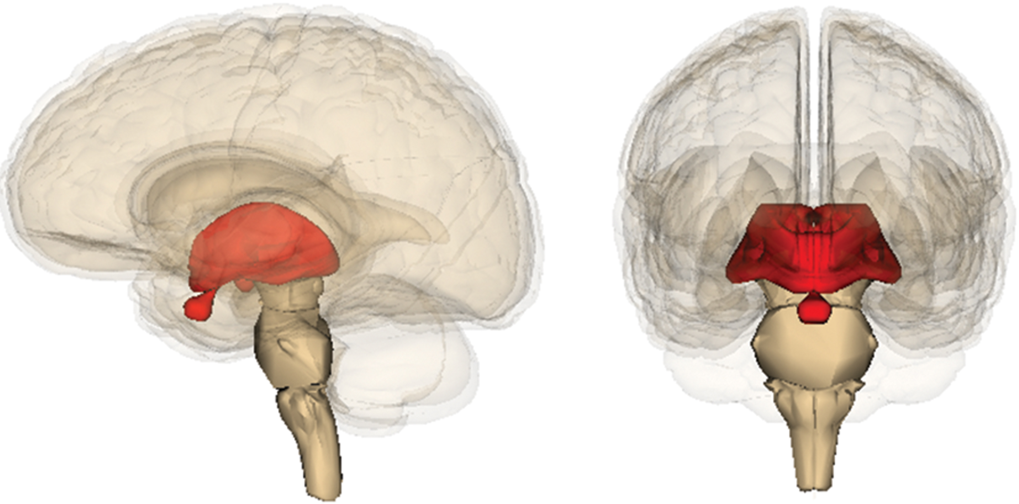
Hypothalamic-Pituitary Axis
The hypothalamus in vertebrates integrates the endocrine and nervous systems.
It is an endocrine organ located in the diencephalon of the brain and receives input from the body and other brain areas and initiates endocrine responses to environmental changes.
The hypothalamus also acts as an endocrine organ, synthesizing hormones and transporting them along axons to the posterior pituitary gland.
  It synthesizes and secretes regulatory hormones that control the endocrine cells in the anterior pituitary gland.
The hypothalamus contains autonomic centers that control endocrine cells in the adrenal medulla via neuronal control.
39.3 Figure 1
Anatomography maintained by Life Science Databases (LSDB) on Wikimedia Commons. "Diencephalon."
Notes:
Figure 1: The diencephalon is the posterior portion of the forebrain. It is located at the center of the brain, above the brain stem.

Slide 5
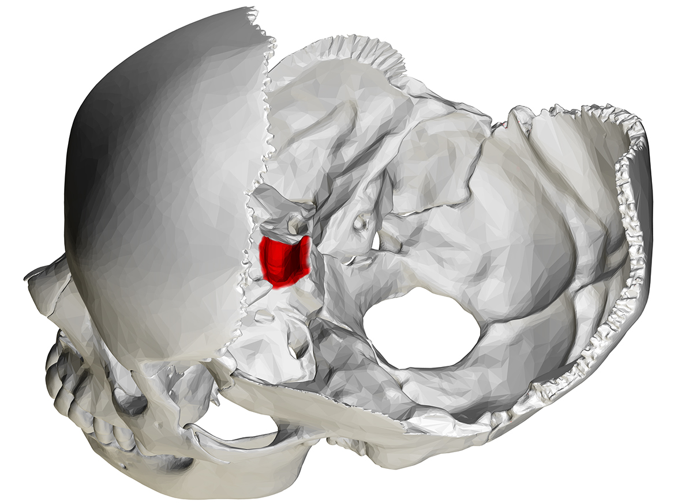
Pituitary Gland
The pituitary gland, sometimes called the hypophysis or "master gland," is located at the base of the brain in the sella turcica, a groove of the sphenoid bone of the skull.
It is attached to the hypothalamus via a stalk called the pituitary stalk.
The anterior portion of the pituitary gland is regulated by releasing or release-inhibiting hormones produced by the hypothalamus.
The posterior pituitary receives signals via neurosecretory cells to release hormones produced by the hypothalamus.
The pituitary has two distinct regions—the anterior pituitary and the posterior pituitary—which secrete nine different peptide or protein hormones between them.
The posterior lobe of the pituitary gland contains axons of the hypothalamic neurons.
39.3 Figure 2
BodyParts3D on Wikimedia Commons. "Sella turcica."
Notes:
Figure 2: The sella turcica is a groove in the skull within which the pituitary gland sits.

Slide 6
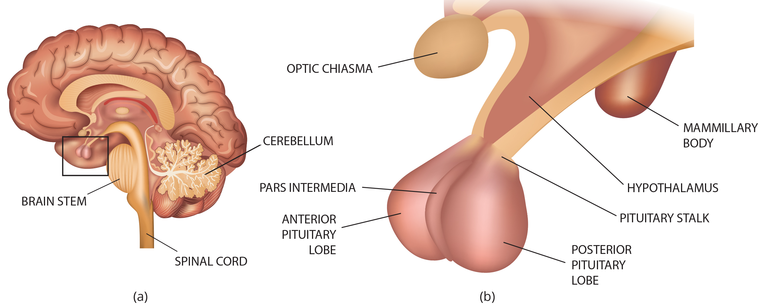
Lesson 39.3 Figure 3
Notes:
Figure 3: (a) The pituitary gland is located at the base of the brain and is connected to the (b) hypothalamus by the pituitary stalk.

Slide 7
Anterior Pituitary
The anterior pituitary gland, or adenohypophysis, is surrounded by a capillary network that extends from the hypothalamus, down along the infundibulum, and to the anterior pituitary.
This capillary network is a part of the hypophyseal portal system that carries substances from the hypothalamus to the anterior pituitary and hormones from the anterior pituitary into the circulatory system.
The anterior pituitary produces seven hormones: growth hormone (GH), prolactin (PRL), thyroid-stimulating hormone (TSH), melanocyte-stimulating hormone (MSH), adrenocorticotropic hormone (ACTH), follicle-stimulating hormone (FSH), and luteinizing hormone (LH).
While these hormones are produced by the anterior pituitary, their production is controlled by regulatory hormones produced by the hypothalamus.
Negative feedback then regulates how much of these regulatory hormones are released and how much anterior pituitary hormone is secreted.

Slide 8
Posterior Pituitary
The posterior pituitary is significantly different in structure from the anterior pituitary.
  It is a part of the brain, extending down from the hypothalamus, and contains mostly nerve fibers and neuroglial cells, which support axons that extend from the hypothalamus to the posterior pituitary.
  The posterior pituitary and the infundibulum together are referred to as the neurohypophysis.
The hormones antidiuretic hormone (ADH), also known as vasopressin, and oxytocin are produced by neurons in the hypothalamus and transported along the infundibulum to the posterior pituitary.
  These hormones are considered to be posterior pituitary hormones even though they are produced by the hypothalamus because this is where they are released into the circulatory system.
The posterior pituitary itself does not produce hormones but instead stores hormones produced by the hypothalamus and releases them into the bloodstream.

Slide 9
Thyroid Gland₁
The thyroid gland is located in the neck, just below the larynx and in front of the trachea.
  It is a butterfly-shaped gland with two lobes that are connected by the isthmus and has a dark red color due to its extensive network of blood vessels.
When the thyroid swells due to dysfunction, it can be felt under the skin of the neck.
The thyroid gland is made up of many spherical thyroid follicles, which are lined with a simple cuboidal epithelium.
These follicles contain a viscous fluid, called colloid, which stores the glycoprotein thyroglobulin, the precursor to the thyroid hormones.
  The follicles produce hormones that can be stored in the colloid or released into the surrounding capillary network.

Slide 10
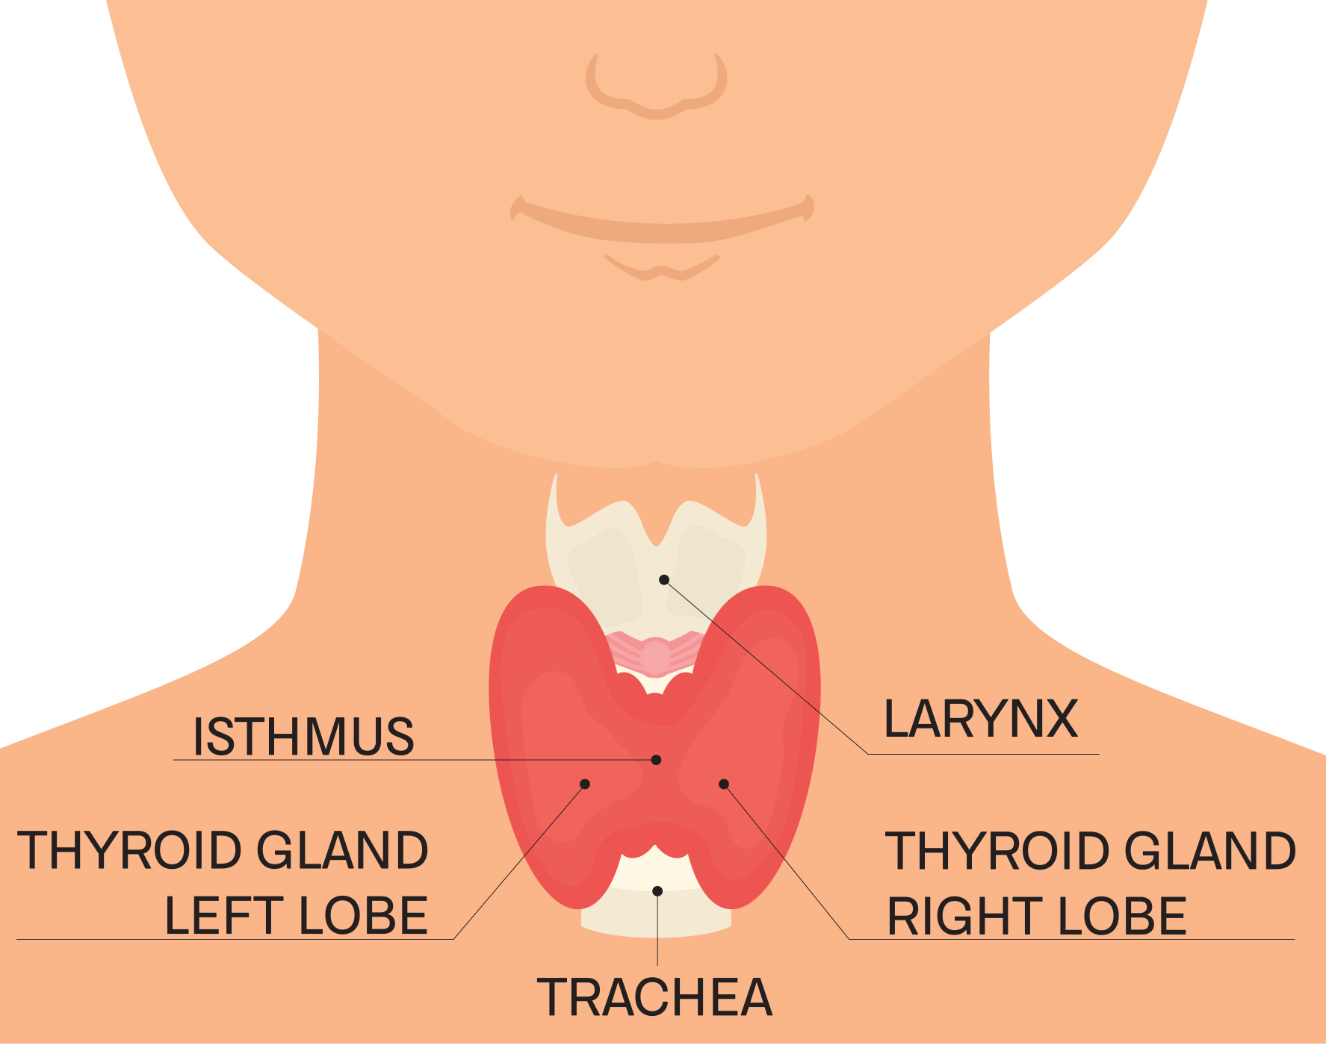
Lesson 39.3 Figure 4
Notes:
Figure 4: This illustration shows the location of the thyroid gland.

Slide 11
Thyroid Gland₂
Thyroid follicle cells synthesize the hormone thyroxine (T4) and triiodothyronine (T3).
Follicle cells are stimulated to release stored T3 and T4 by thyroid-stimulating hormone (TSH), which is produced by the anterior pituitary.
A third hormone, calcitonin, is produced by the parafollicular cells of the thyroid and either releases hormones or inhibits them.
Calcitonin release is not controlled by TSH but instead is released when calcium ion (Ca2+) concentrations in the blood rise.
  Calcitonin functions to help regulate calcium concentrations in body fluids.

Slide 12
Parathyroid Gland
Most people have four parathyroid glands. These glands are located on the posterior surface of the thyroid gland.
  There is a superior gland and an inferior gland associated with each of the thyroid's two lobes.
The parathyroid glands produce parathyroid hormone (PTH). PTH increases blood calcium concentrations when calcium ion levels fall below normal by doing the following:
  It enhances reabsorption of Ca²⁺ by the kidneys.
  It stimulates osteoclast activity and inhibits osteoblast activity.
  It stimulates synthesis and secretion of calcitriol by the kidneys, which enhances Ca²⁺ absorption by the digestive system.
PTH is produced by chief cells of the parathyroid. PTH and calcitonin work in opposition to one another to maintain homeostatic Ca²⁺ levels in body fluids.

Slide 13
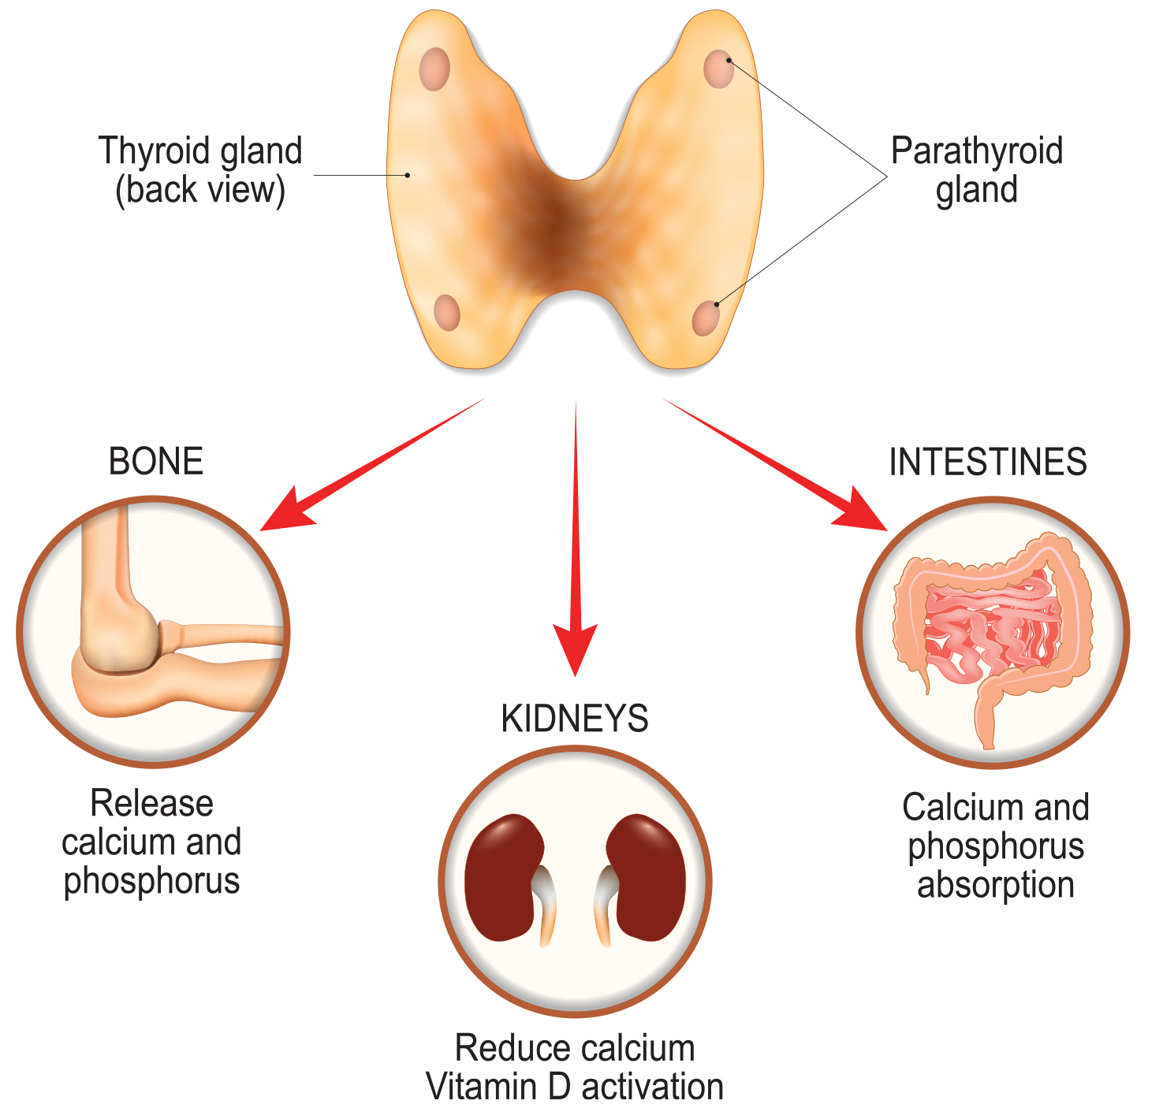
Lesson 39.3 Figure 5
Notes:
Figure 5: The parathyroid glands are located on the posterior, or back, of the thyroid gland.

Slide 14
Think It Through
With respect to calcium regulation, what hormones are produced by the thyroid and parathyroid?
How do they regulate calcium levels?
Notes:
Originally an On Your Own. This is included here to use as a talking point or for a think-pair-share activity.

Slide 15
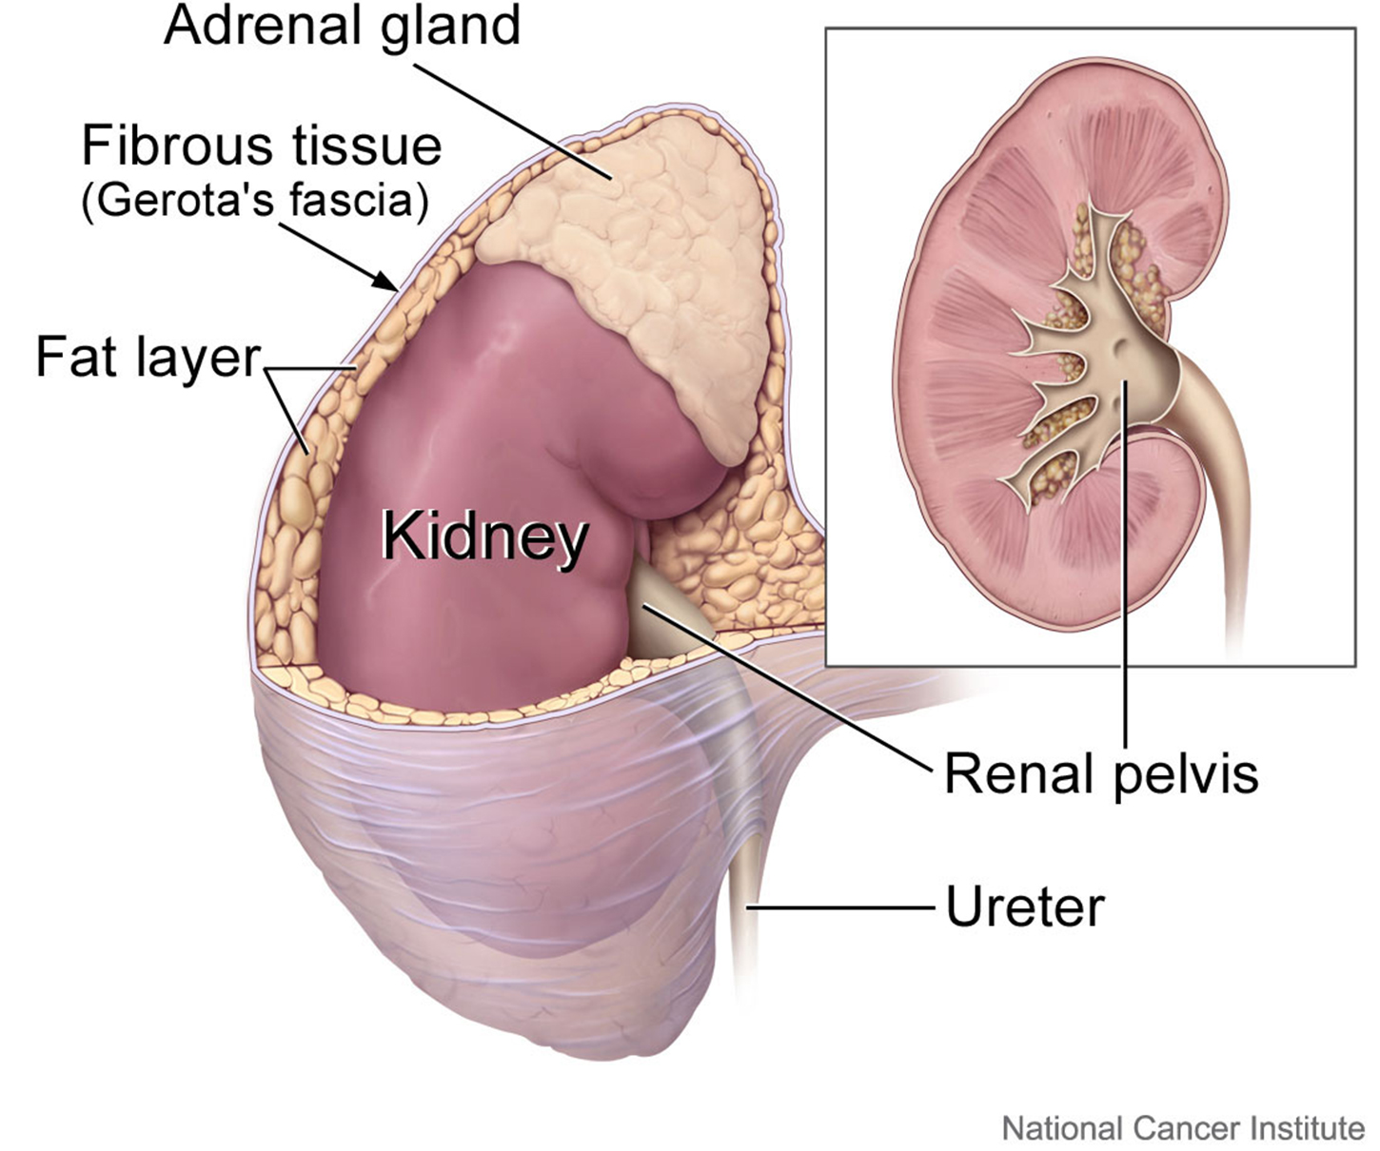
Adrenal Glands
The adrenal glands are associated with the kidneys; one gland is located on top of each kidney.
The adrenal glands consist of an outer adrenal cortex and an inner adrenal medulla.
These regions secrete different hormones.
39.3 Figure 6
National Cancer Institute on Wikimedia Commons. "Kidney and adrenal gland."
Notes:
Figure 6: The adrenal glands are located at the top of the kidneys.

Slide 16
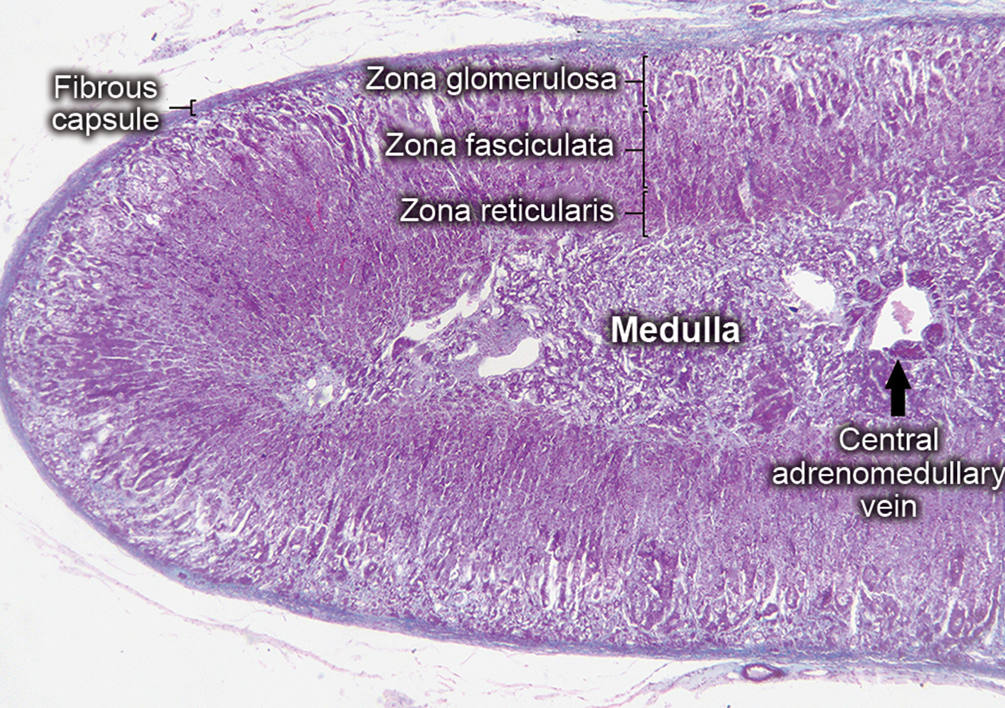
Adrenal Cortex₁
The adrenal cortex is made up of layers of epithelial cells and associated capillary networks.
These layers form three distinct regions:
An outer zona glomerulosa that produces mineralocorticoids
A middle zona fasciculata that produces glucocorticoids
An inner zona reticularis that produces androgens
39.3 Figure 7
Jpogi on Wikimedia Commons. "Adrenal gland."
Notes:
Figure 7: In this cross section of a human adrenal gland, the zona glomerulosa, zona fasciculata, and zona reticularis appear as layers between the outer fibrous capsule and inner medulla.

Slide 17
Adrenal Cortex₂
The main mineralocorticoid is aldosterone, which regulates the concentration of Na+ ions in urine, sweat, saliva, and the pancreas.
Aldosterone release from the adrenal cortex is stimulated by a decrease in blood concentrations of Na+, blood volume, or blood pressure, or by an increase in blood potassium levels.
The three main glucocorticoids are cortisol, corticosterone, and cortisone.
  The glucocorticoids stimulate the synthesis of glucose and gluconeogenesis by liver cells, and they promote the release of fatty acids from adipose tissue.
  The adrenal cortex also produces small amounts of testosterone precursor.
  Testosterone secretion is regulated by both the hypothalamus and the anterior pituitary gland. The hypothalamus sends releasing hormones that stimulate the release of gonadotropins from the anterior pituitary gland.

Slide 18
Adrenal Medulla
The adrenal medulla contains large, irregularly shaped cells that are closely associated with blood vessels. These cells are innervated by nerve fibers from the autonomic nervous system.
The adrenal medulla contains two types of secretory cells: one that produces epinephrine and another that produces norepinephrine. Epinephrine is the primary adrenal medulla hormone accounting for 75 to 80% of its secretions.
  Epinephrine and norepinephrine increase heart rate, breathing rate, cardiac muscle contractions, blood pressure, and blood glucose levels. They also accelerate the breakdown of glucose in skeletal muscles and stored fats in adipose tissue.
The release of epinephrine and norepinephrine is stimulated by neural impulses from the sympathetic nervous system.
  Secretion of these hormones is stimulated by the release of the neurotransmitter acetylcholine from the sympathetic nerve fibers that innervate the adrenal medulla.

Slide 19
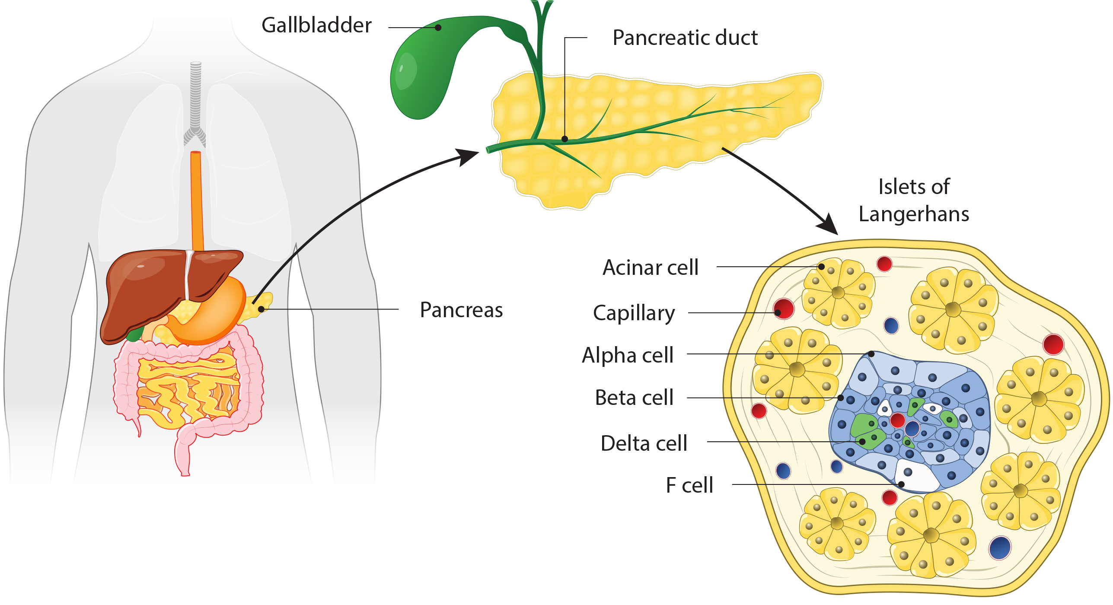
Pancreas₁
The pancreas is an elongated organ that is located between the stomach and the proximal portion of the small intestine. It contains both exocrine cells that excrete digestive enzymes and endocrine cells that release hormones. It is sometimes referred to as a heterocrine gland because it has both endocrine and exocrine functions.
39.3 Figure 8
Notes:
Figure 8: The pancreas is found underneath the stomach and points toward the spleen. The pancreas contains clusters of cells known as islets of Langerhans.

Slide 20
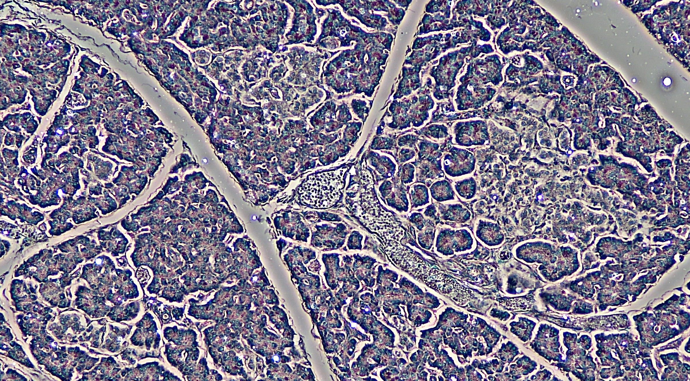
Pancreas₂
The endocrine cells of the pancreas form clusters called pancreatic islets, or the islets of Langerhans.
The pancreatic islets contain two primary cell types:
Alpha cells which produce the hormone glucagon
Beta cells which produce the hormone insulin
These hormones regulate blood glucose levels.
39.3 Figure 9
Berkshire Community College Bioscience Image Library on Wikimedia Commons. "Islets of Langerhans."
Notes:
Figure 9: The islets of Langerhans are clusters of endocrine cells found in the pancreas; they stain lighter than surrounding cells.

Slide 21
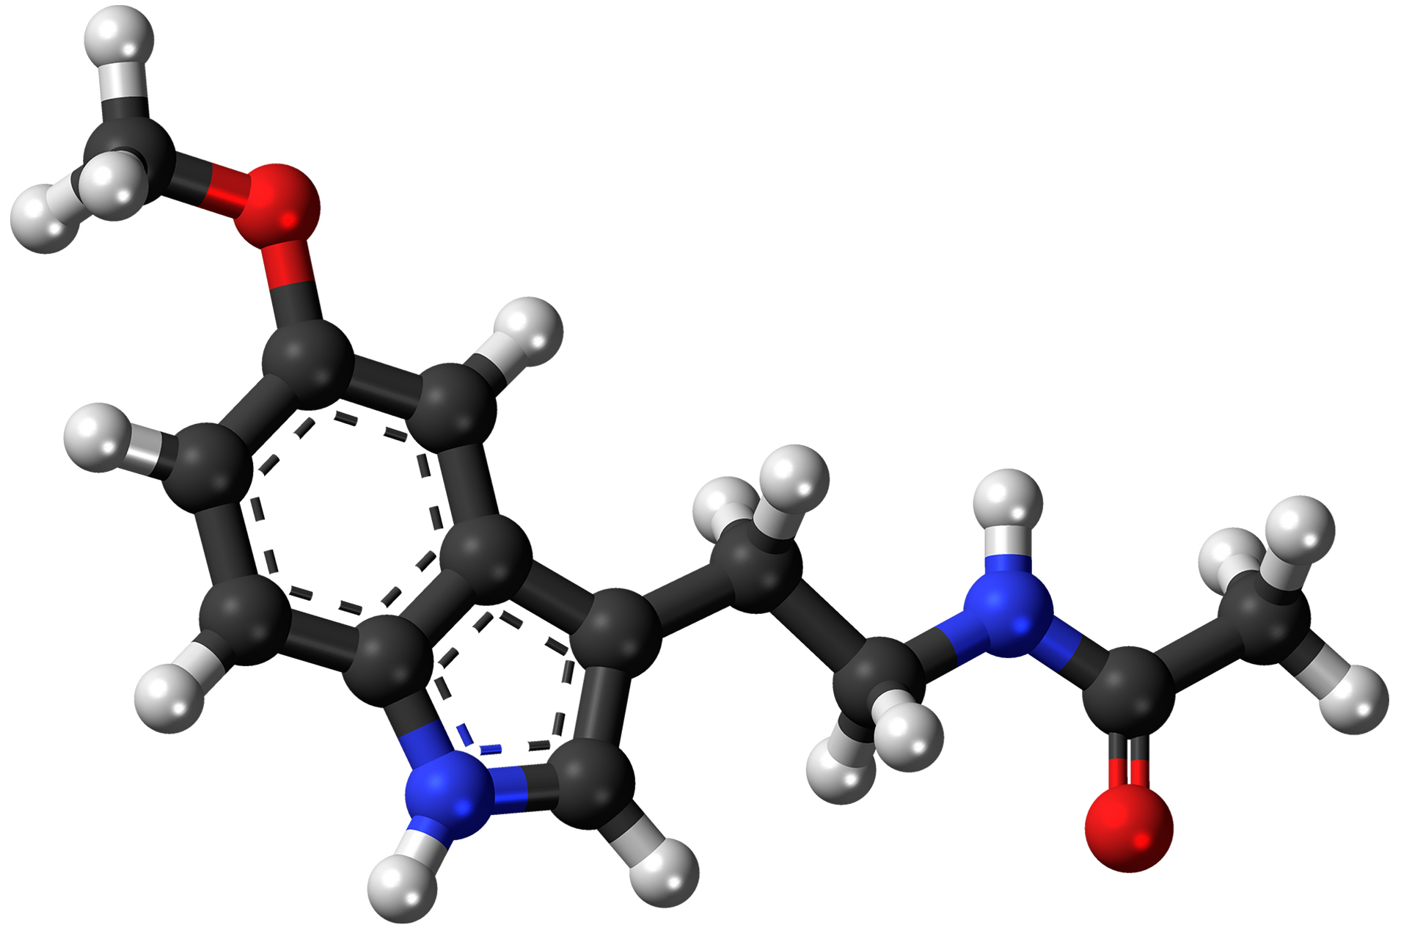
Pineal Gland
The pineal gland produces melatonin. The rate of melatonin production is affected by the photoperiod.
Collaterals from the visual pathways innervate the pineal gland. During the day, little melatonin is produced.
  Melatonin production increases during the dark.
Melatonin is an effective antioxidant, protecting the central nervous system from free radicals.
Melatonin is involved in biological rhythms, particularly circadian rhythms, such as the sleep-wake cycle and eating habits.
39.3 Figure 10
Jynto on Wikimedia Commons. "Melatonin molecule."
Notes:
Figure 10: This shows the structure of melatonin. Carbon atoms are shown as the black spine that runs the length of the molecule; hydrogens are shown as the white, short nodules; oxygens are shown as red, medium-sized nodules on the left and right; and nitrogen is shown as blue and connected to the spine.

Slide 22
Science and You
A circadian rhythm is an approximately 24-hour cycle of behavior and/or physiology and is controlled by an internal timekeeper, the circadian clock.
This clock generates an internal 24-hour rhythm that is synchronized to the daily light/dark cycle.
One of the outputs of the circadian clock is the secretion of melatonin. Melatonin acts on receptors throughout your body to encourage sleep.
Watching TV at night, looking at a computer, or checking your phone while getting ready for bed can all decrease or delay melatonin production, making it harder for you to fall asleep and stay asleep.
Sleep is essential for brain repair, memory formation, and a host of other cognitive functions.
Chronic sleep deprivation has been linked to high blood pressure, diabetes, heart attack, heart failure, and stroke.
For these reasons, many scientists and doctors advocate good sleep hygiene which involves maintaining a consistent bedtime and avoiding the use of bright lights, televisions, or other screens within the hour before bed.
Notes:
This is included as a relevant application for this topic.

Slide 23
Gonads
The gonads—the testes and ovaries—produce steroid hormones.
The testes produce androgens, testosterone being the most prominent, which allow for the development of secondary sex characteristics and the production of sperm cells.
The ovaries produce estradiol and progesterone, which cause secondary sex characteristics and prepare the body for childbirth.

Slide 24
Table 1: Endocrine Glands and Their Associated Hormones₁
Endocrine Gland | Associated Hormones | Effect
Hypothalamus | releasing and inhibiting hormones | regulate hormone release from pituitary gland; produce oxytocin; produce uterine contractions and milk secretion in females
 | antidiuretic hormone (ADH) | water reabsorption from kidneys; vasoconstriction to increase blood pressure
Pituitary (Anterior) | growth hormone (GH) | promotes growth of body tissues; protein synthesis; metabolic functions
 | prolactin (PRL) | promotes milk production
 | thyroid-stimulating hormone (TSH) | stimulates thyroid hormone release
 | adrenocorticotropic hormone (ACTH) | stimulates hormone release by adrenal cortex; glucocorticoids
 | follicle-stimulating hormone (FSH0) | stimulates gamete production (both ova and sperm); secretion of estradiol
 | luteinizing hormone (LH) | stimulates androgen production by gonads; ovulation; secretion of progesterone
 | melanocyte-stimulating hormone (MSH) | stimulates melanocytes of the skin, increasing melanin pigment production

Slide 25
Table 1: Endocrine Glands and Their Associated Hormones₂ (Cont.)
Endocrine Gland | Associated Hormones | Effect
Pituitary (Posterior) | antidiuretic hormone (ADH) | stimulates water reabsorption by kidneys
 | oxytocin | stimulates uterine contractions during childbirth; milk ejection; stimulates ductus deferens and prostate gland contraction during emission
Thyroid | thyroxine, triiodothyronine | stimulate and maintain metabolism; growth and development
 | calcitonin | reduces blood Ca²⁺ levels
Parathyroid | parathyroid hormone (PTH) | increases blood Ca²⁺ levels
Adrenal (Cortex) | aldosterone | increases blood Na⁺ levels; increases K⁺ secretion
 | cortisol, corticosterone, cortisone | increase blood glucose levels; anti-inflammatory effects
Adrenal (Medulla) | epinephrine, norepinephrine | stimulate fight-or-flight response; increase blood glucose levels; increase metabolic activities
Pancreas | insulin | reduces blood glucose levels
 | glucagon | increases blood glucose levels
Pineal Gland | melatonin | regulates some biological rhythms and protects CNS from free radicals

Slide 26
Table 1: Endocrine Glands and Their Associated Hormones₃ (Cont.)
Endocrine Gland | Associated Hormones | Effect
Testes | androgens | regulate, promote, increase, or maintain sperm production; male secondary sexual characteristics
Ovaries | estrogen | promotes uterine lining growth; female secondary sexual characteristics
 | progestins | promote and maintain uterine lining growth

Slide 27
Organs with Secondary Endocrine Functions₁
There are several organs whose primary functions are non-endocrine but also possess endocrine functions. These include the heart, kidneys, intestines, thymus, gonads, and adipose tissue.
The heart possesses endocrine cells in the walls of the atria that are specialized cardiac muscle cells. These cells release the hormone atrial natriuretic peptide (ANP) in response to increased blood volume.
  ANP causes a reduction in blood volume and blood pressure through and reduces the concentration of Na⁺ in the blood.
The gastrointestinal (GI) tract produces several hormones that aid in digestion. The endocrine cells are in the mucosa of the GI tract throughout the stomach and small intestine.
Some of the hormones produced include gastrin, secretin, and cholecystokinin, which are secreted in the presence of food.
Others act on other organs, such as the pancreas, gallbladder, and liver. They trigger the release of gastric juices, which help to break down and digest food in the GI tract.

Slide 28
Organs with Secondary Endocrine Function₂
The adrenal glands associated with the kidneys are major endocrine glands, the kidneys themselves also possess endocrine function.
Renin is released in response to decreased blood volume or pressure and is part of the renin-angiotensin-aldosterone system that leads to the release of aldosterone.
The kidneys also release calcitriol, which aids in the absorption of Ca2+ and phosphate ions.
Erythropoietin (EPO) is a protein hormone that triggers the formation of red blood cells in the bone marrow. EPO is released in response to low oxygen levels.
  Because red blood cells are oxygen carriers, increased production results in greater oxygen delivery throughout the body.

Slide 29
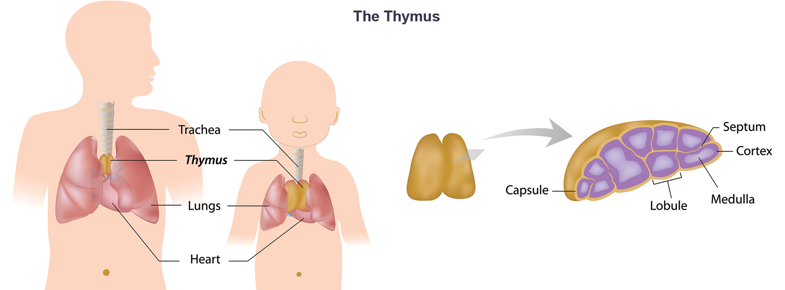
Thymus
The thymus is found behind the sternum; it is most prominent in infants, becoming smaller in size through adulthood.
The thymus produces hormones referred to as thymosins, which contribute to the development of the immune response.
39.3 Figure 11

Slide 30
Adipose Tissue
Adipose tissue is a connective tissue found throughout the body. It produces the hormone leptin in response to food intake.
Leptin increases the activity of anorexigenic neurons and decreases that of orexigenic neurons producing a feeling of satiety after eating and affecting appetite and reducing the urge for further eating.
Leptin is also associated with reproduction. It must be present for gonadotropin-releasing hormone (GnRH) and gonadotropin synthesis to occur.
Extremely thin females may enter puberty late; however, if adipose levels increase, more leptin will be produced, improving fertility.

Slide 31
Summary
The anterior pituitary receives products from the hypothalamus by the hypophyseal portal system and produces six hormones while the posterior pituitary is an extension of the brain and releases hormones produced by the hypothalamus.
The adrenal glands consist of the renal cortex and renal medulla. The adrenal cortex produces the corticosteroids, glucocorticoids, and mineralocorticoids while the adrenal medulla produces the catecholamines epinephrine and norepinephrine.
Clusters of endocrine cells in the pancreas form the islets of Langerhans, which are composed of alpha cells that release glucagon and beta cells that release insulin.
Some organs possess endocrine activity as a secondary function but have another primary function.

Slide 32

End of Hawkes Learning PowerPoint

