Slide 1
Lesson 4.1
Prokaryotic Cells

Slide 2
Objectives
Compare and contrast light microscopy and electron microscopy.
Compare and contrast prokaryotic and eukaryotic cells.
Describe the role of cells in organisms.
Explain why cells must be small.
Summarize cell theory.

Slide 3
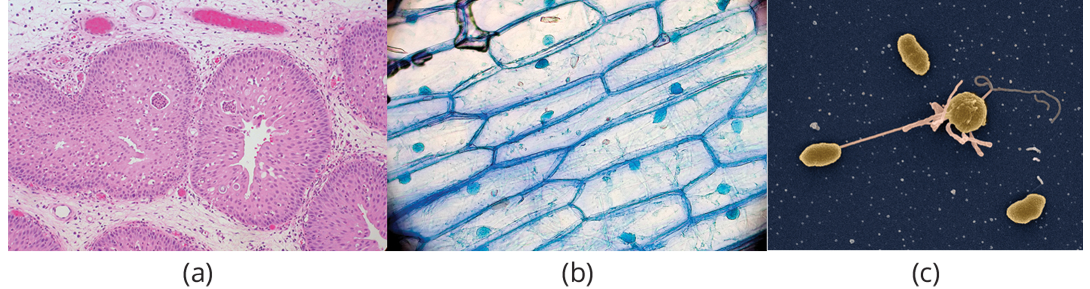
Cell Structure
Cells are the basic building blocks that make up the human body, just like bricks form a wall.
The human body is constructed from many specialized cell types, each performing a vital role for growth, development, and maintenance.
Despite their variety, cells from all organisms share certain fundamental characteristics.
4.1 Figure 1
Ed Uthman on Wikimedia Commons. "Cylindrical cell."
Umberto Salvagnin on Wikimedia Commons. "Onion cells."
Anthony D'Onofrio on Wikimedia Commons. "Vibrio cells."

Slide 4
Cells
A cell is the smallest unit of a living organism, whether the organism is single-celled or multicellular.
Multiple cells of one kind interconnect to form tissues, which combine to form organs, organ systems, and ultimately an entire organism.
Scientists categorize cells into two broad groups: prokaryotic and eukaryotic cells.
Plants and animal cells are eukaryotic.

Slide 5
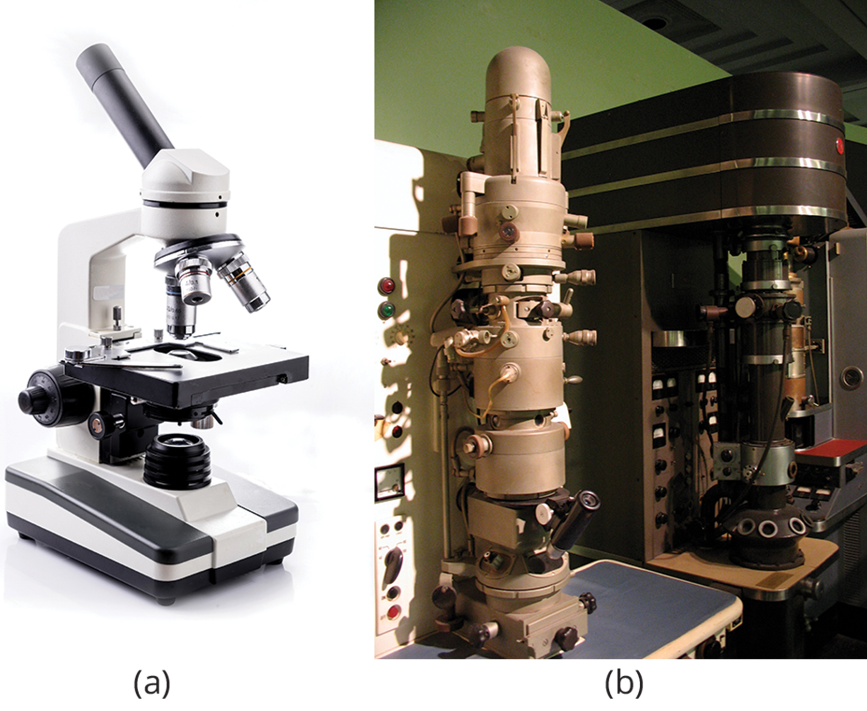
Light Microscopes₁
Light microscopes use visible light to magnify specimens, such as cells.
Cells are translucent and staining is required to distinguish components of individual cells but also kills the cells.
4.1 Figure 2: (a) light microscope and (b) electron microscope
Jacopo Werther on Wikimedia Commons via Flickr. "Powerful microscopes."

Slide 6
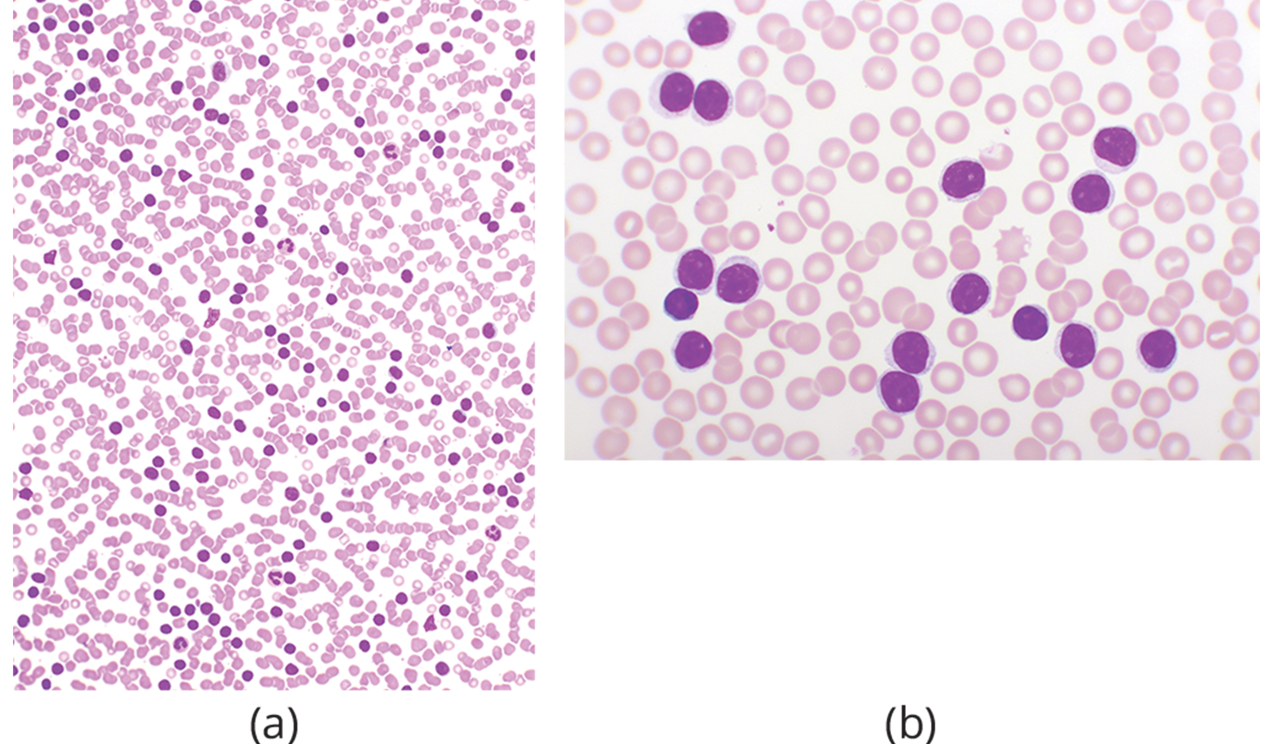
Light Microscopes₂
Magnification is process of enlarging an object's appearance
Compound microscopes have multiple lenses, and the overall magnification equals the product of each lens's magnification.
If one lens magnifies 10X and the eyepiece 10X, then the total magnification is 100X.
4.1 Figure 3: Light micrographs of blood taken from a patient with chronic lymphocytic leukemia. The first image (a) is at a magnification of 400X, while the second image (b) is at a magnification of 1,000X.

Slide 7
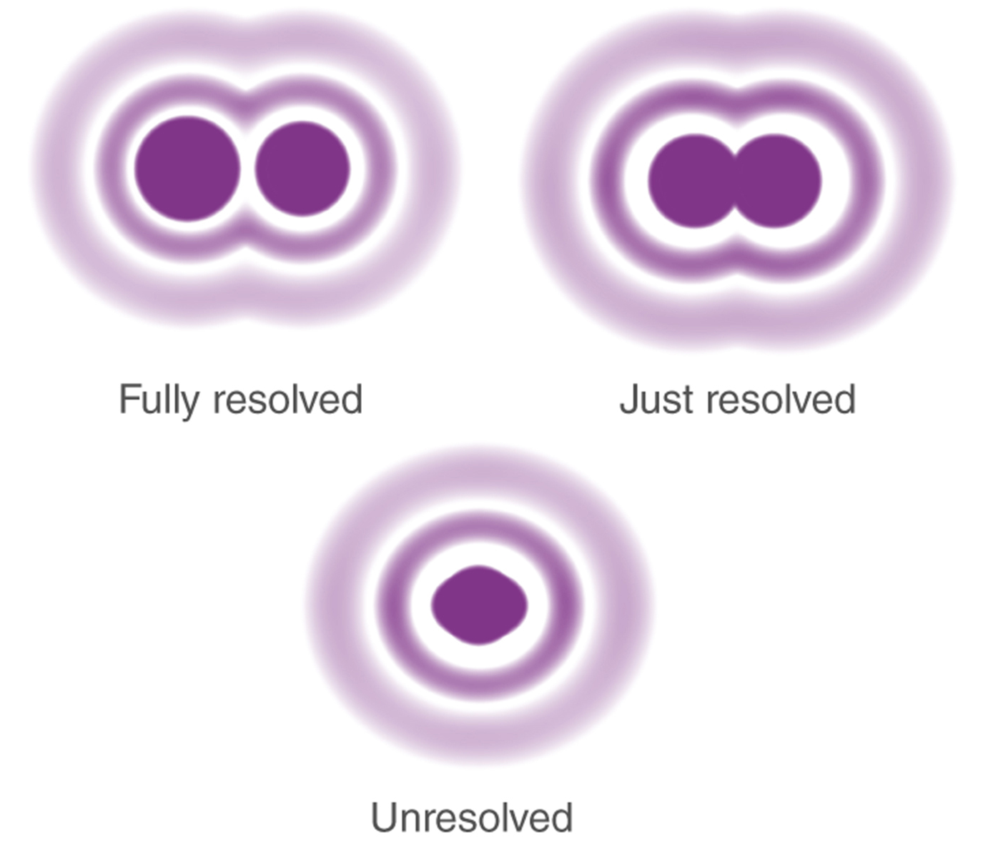
Light Microscopes₃
A higher magnification reduces resolving power (resolution), which is the ability to distinguish adjacent structures as separate objects.
While immersion oil can improve the resolution at high magnifications, electron microscopes are ultimately needed for the best resolution to study cellular structure and function in detail.
4.1 Figure 4
BYJU'S. "Resolving power."

Slide 8
Think It Through₁
A typical laboratory microscope usually has three objective lenses—lenses that can be used one by one and rotated into place for use. The magnifications for the three objective lenses are commonly 10X, 40X, and 100X.
A typical compound microscope also commonly has an eyepiece with 10X magnification that cannot be changed and is used for observing all specimens, no matter which objective lens is used.
What total magnifications are possible for a typical compound microscope?
What happens to the resolution as the magnification increases?
How could the resolution using the 100X objective lens be improved?
Notes:
Originally an On Your Own. This is included here to use as a talking point or for a think-pair-share activity.

Slide 9
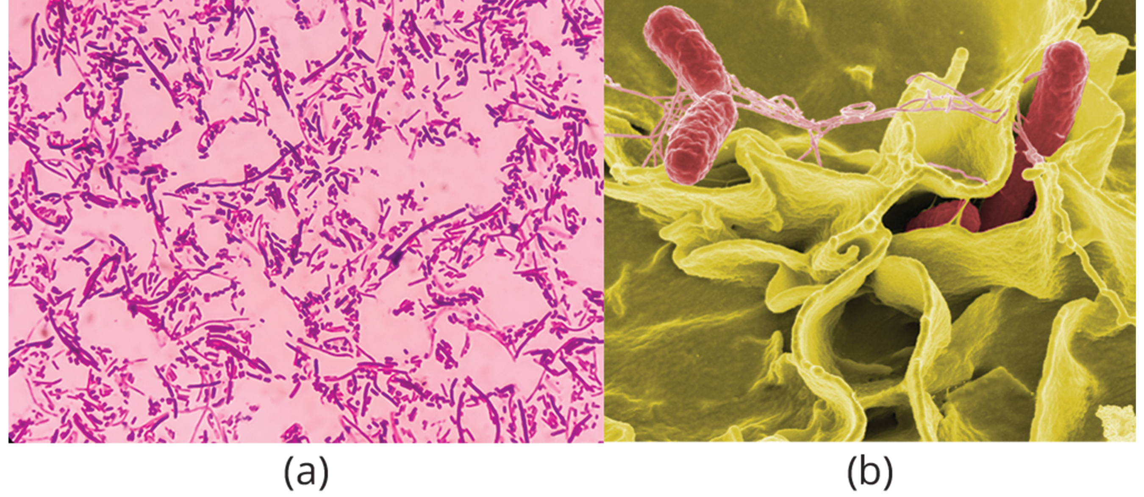
Electron Microscopes
Electron microscopes utilize an electron beam for higher magnification and resolution.
Scanning electron microscopes image surface features, while transmission electron microscopes visualize internal structures.
Specimen preparation for electron microscopes is destructive to cells.
4.1 Figure 5: (a) Salmonella bacteria under a light microscope. (b) A scanning electron micrograph of Salmonella bacteria.
Volker Brinkmann, Max Planck Institute for Infection Biology on Wikimedia Commons. "Salmonella typhimurium."
Rocky Mountain Laboratories, NIAID, NIH on Wikimedia Commons. "Salmonella typhimurium (red)."

Slide 10
Cell Theory₁
Antony van Leeuwenhoek crafted lenses to observe single-celled "animalcules" in the 1600s.
Robert Hooke coined the term "cell" after viewing box-like structures in cork tissue through a lens.
Van Leeuwenhoek discovered bacteria and protozoa, while improvements enabled seeing components inside cells.
Schleiden and Schwann proposed the first two tenets of cell theory: all organisms are made of cells, and cells are the basic units of life.
The third tenet, that all cells arise from pre-existing cells, was added later.

Slide 11
Cell Theory₂
Modern Cell Theory
All known living things are made up of one or more cells.
All living cells arise from pre-existing cells by division.
The cell is the fundamental unit of structure and function in all living organisms.
The activity of an organism depends on the total activity of independent cells.
Energy flow (metabolism) occurs within cells.
Cells contain DNA in chromosomes and RNA in the nucleus and cytoplasm.
All cells are basically the same in chemical composition in organisms of similar species.

Slide 12
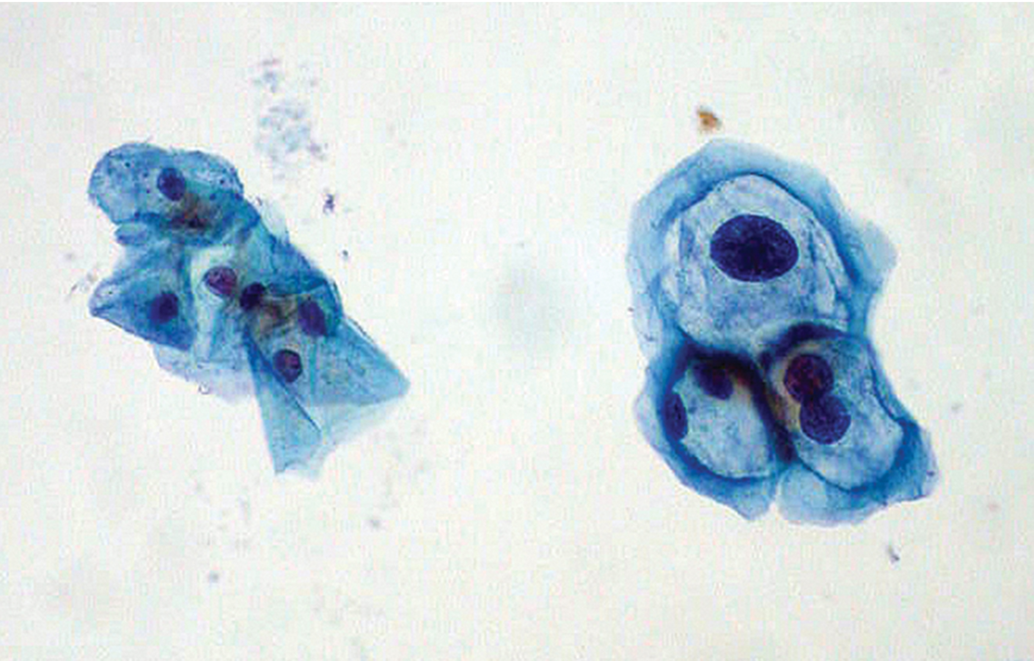
Science and You₁
Career: Cytotechnologist
Pap smear is a medical test where a sample of cells is taken from a patient’s uterine cervix and sent to a lab to be examined.
A cytotechnologist stains and studies the cells under microscope and analyze the cells for abnormalities.
Early detection improves treatment outcomes.
4.1 Figure 6: Normal uterine cervical cells are on the left, while cells infected with HPV are on the right.
Ed Uthman, MD on Wikimedia Commons. "HPV."
Notes:
This is included as a relevant application for this topic.

Slide 13
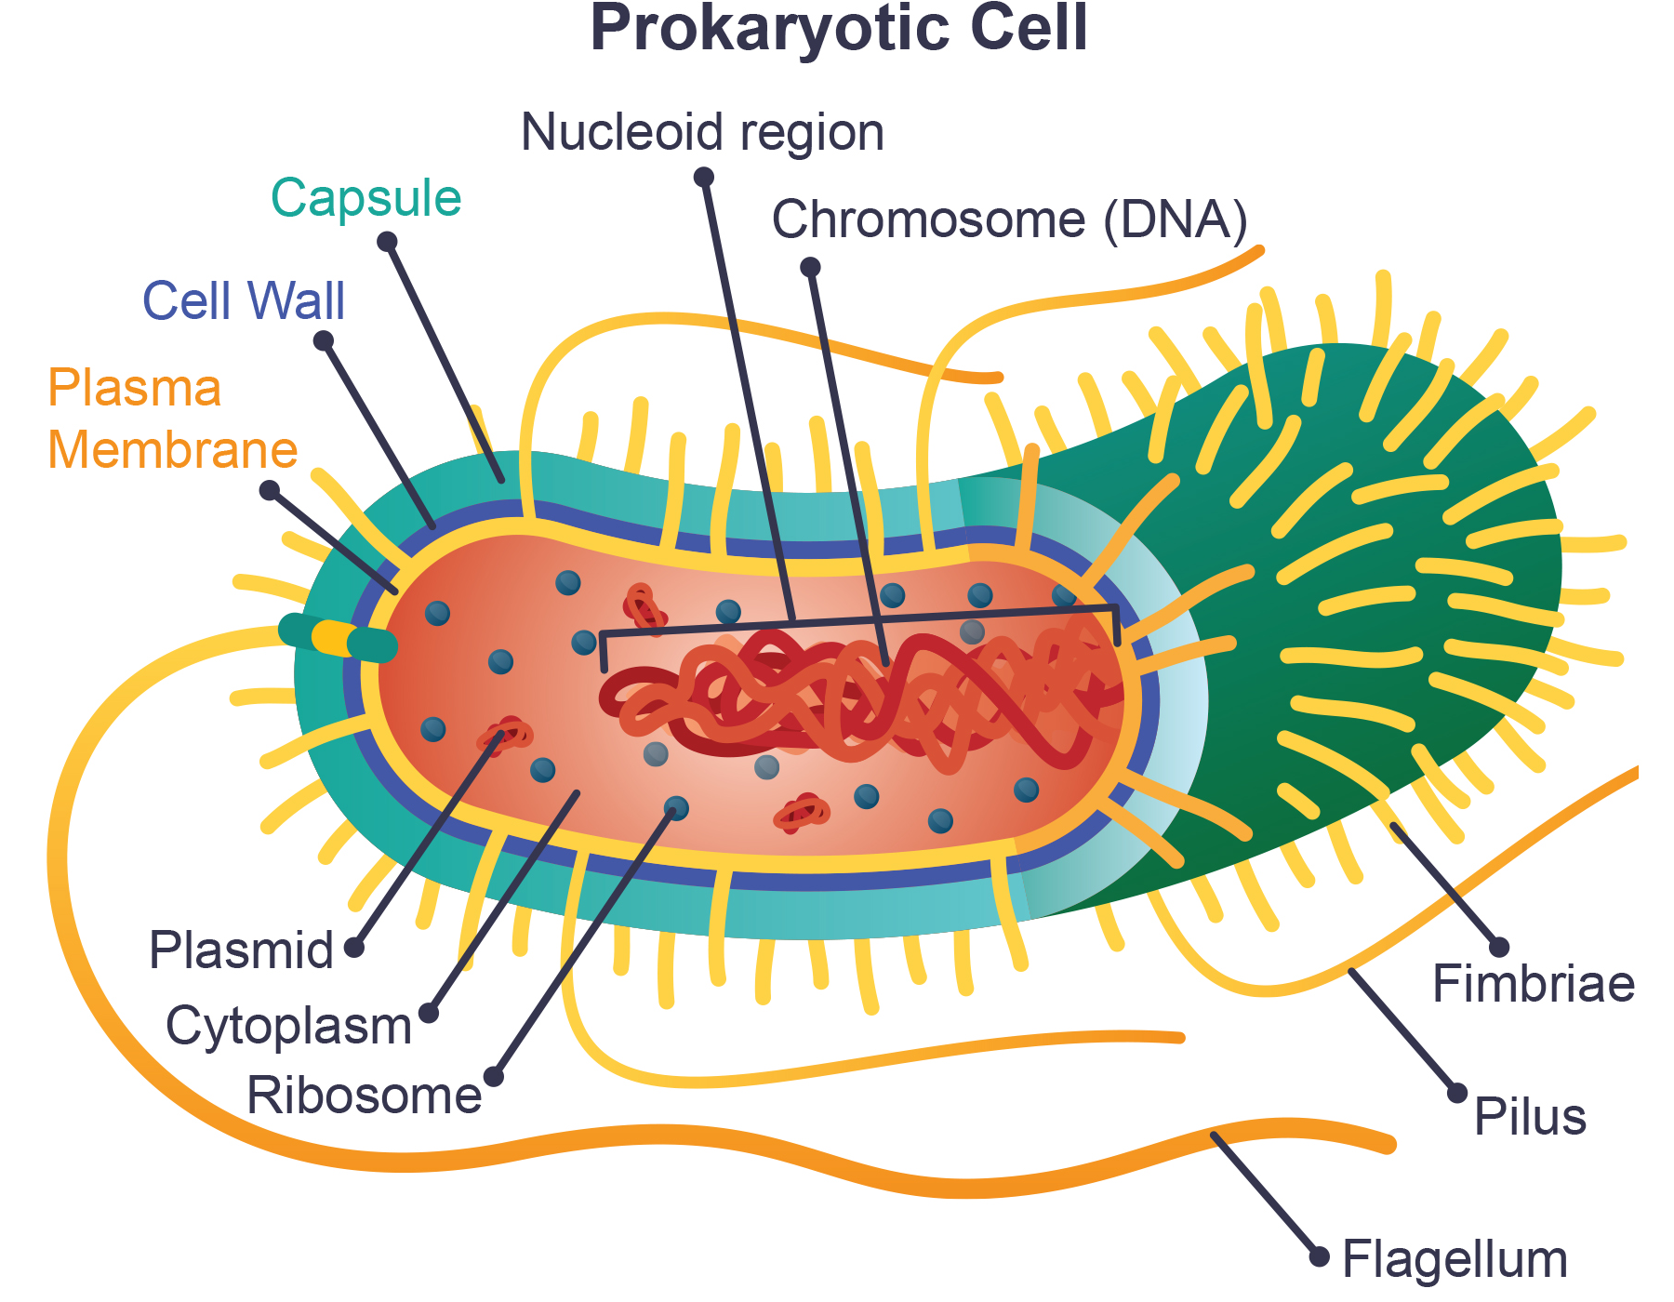
Components of Prokaryotic Cells
Prokaryotes like Bacteria and Archaea are single-celled, while eukaryotes include animals, plants, fungi, and protists.
All cells have a plasma membrane, cytoplasm, DNA, and ribosomes in common.
A prokaryote lacks a nucleus, having its DNA in the central nucleoid region instead.
Often have a peptidoglycan cell wall to maintain shape and prevent dehydration
Often have a polysaccharide capsule (slime-like covering made of carbohydrates) to attach to surfaces
4.1 Figure 7

Slide 14
Science and You₂
Career: Microbiologist
Washing hands prevents the spread of microbes, tiny organisms seen only through microscopes.
Not all microbes cause disease; some are beneficial, like those producing vitamin K.
Microbiologists study microbes and work in food, veterinary, medical, and pharmaceutical industries.
Environmental microbiologists use microbes for bioremediation of pollutants and contaminants.
Microbiologists also work in bioinformatics, creating models for situations like bacterial epidemics.
Notes:
This is included as a relevant application for this topic.

Slide 15
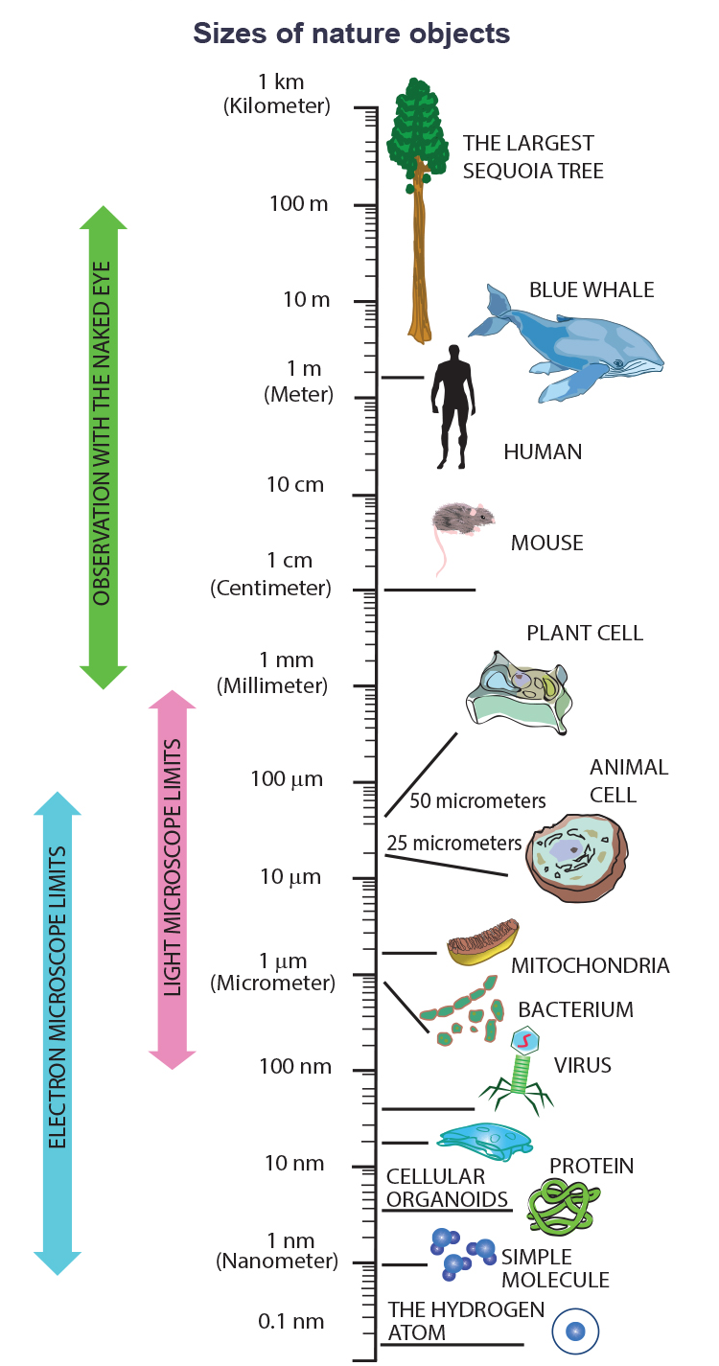
Cell Size₁
4.1 Figure 8
Prokaryotes (0.1–5.0 μm) are smaller than eukaryotes (10–100 μm).
Allows efficient diffusion in prokaryotes while eukaryotes have structural adaptations for intracellular transport.

Slide 16
Group Activity
As a group, use Figure 8 to estimate the diameter (distance across) and radius (half the distance across) of a typical bacterial cell and a typical animal cell. Then, assuming that both are spherical cells, calculate the surface area and volume of each. Next, determine the surface-area-to-volume ratio for each. How do they compare? (Note: The surface area of a sphere with a radius of r is given by , while the volume of a sphere with a radius of r is given by .)
4.1 Figure 8

Slide 17
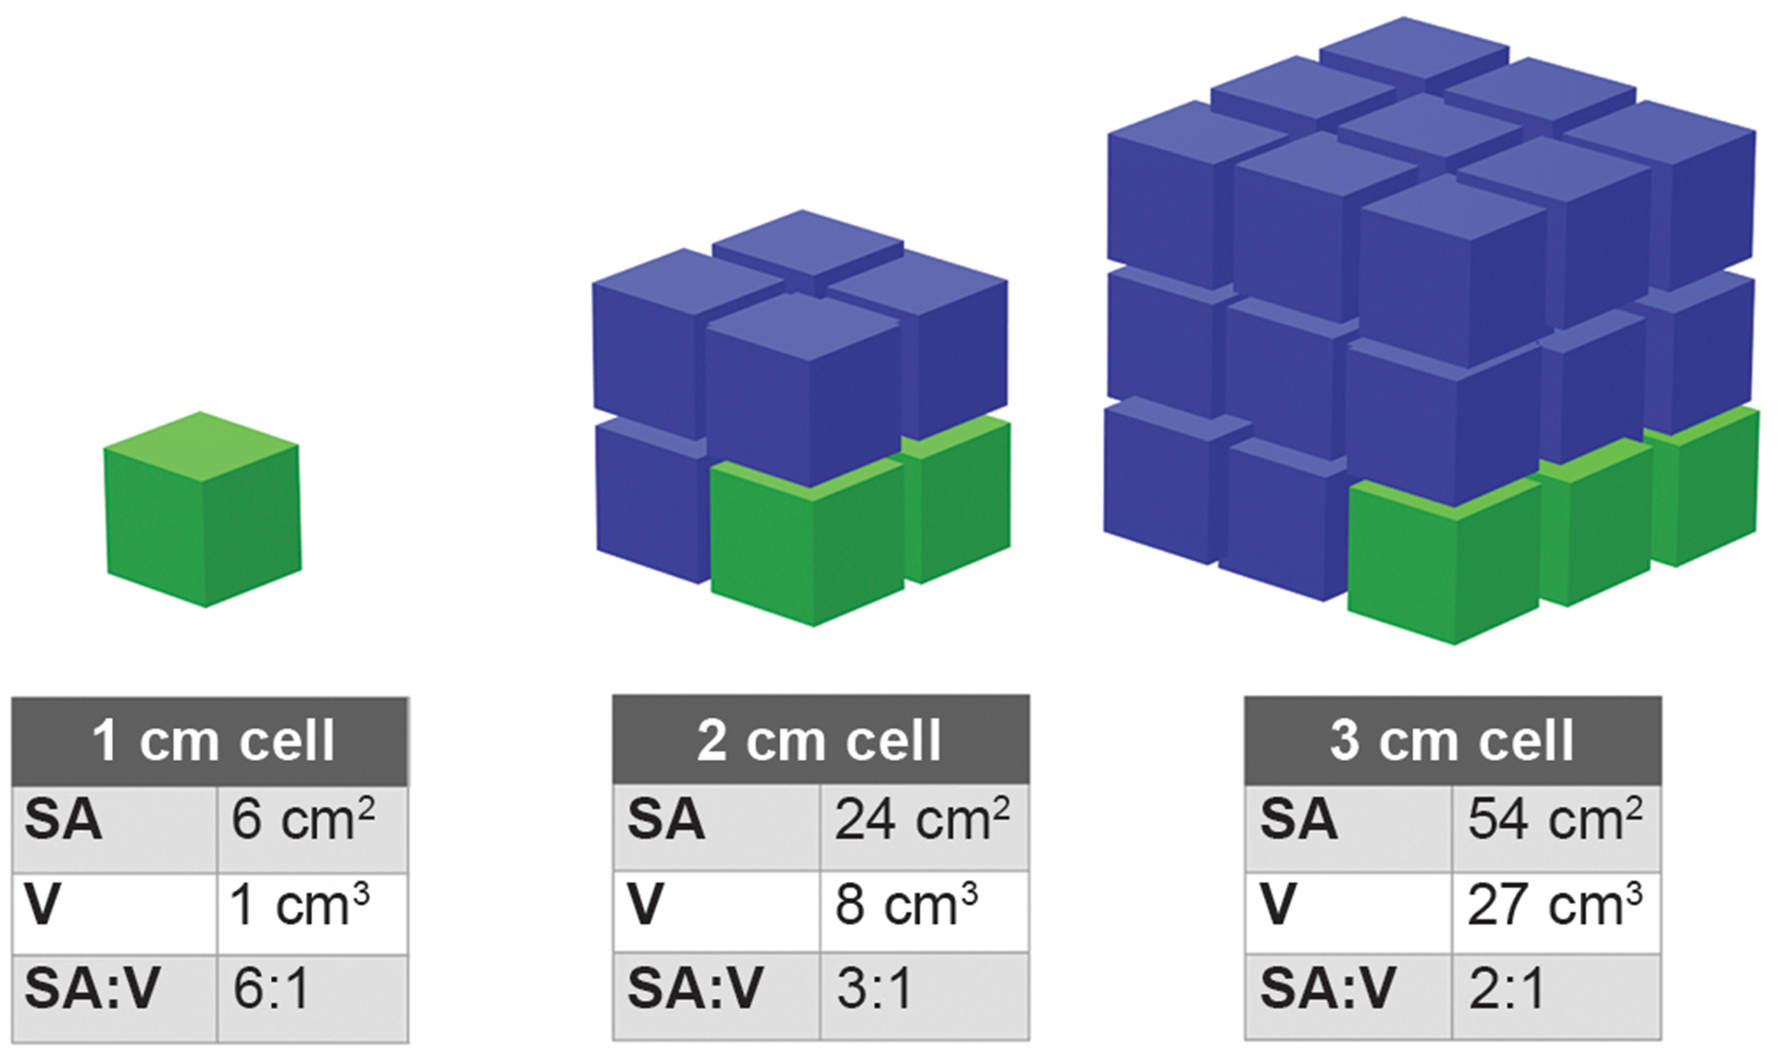
Cell Size₂
Cells need small size for an efficient surface area-to-volume ratio that enables diffusion.
Larger cells adapt by dividing, increasing surface area, becoming flat and elongated, or developing organelles (eukaryotes).
4.1 Figure 9
Christinelmiller on Wikimedia Commons. "Surface-area-to-volume ratio."

Slide 18
Think It Through₂
Prokaryotic cells are much smaller than eukaryotic cells. What advantages might small cell size confer on a cell? What advantages might large cell size have?
Notes:
Originally an On Your Own. This is included here to use as a talking point or for a think-pair-share activity.

Slide 19
Summary
Unified Cell Theory
A cell is the smallest unit of life.
One or more cells comprise all organisms
New cells arise from existing cells
Microscopes are required to study microscopic cells.
Electron microscopes offer higher magnification and resolution than light microscopes.
Prokaryotes are single-celled organisms with cytoplasm, ribosomes, and unbound DNA.

Slide 20


End of Hawkes Learning PowerPoint

