Slide 1
Lesson 4.2
Eukaryotic Cells

Slide 2
Objectives
Understand the comparison of animal and plant cells.
Describe the structure of eukaryotic cells.
State the role of the plasma membrane.
Summarize the functions of the major cell organelles.

Slide 3

Eukaryotic Cells
The phrase "form follows function" means an object's design should serve its purpose.
In architecture, buildings are constructed to facilitate their intended activities.
4.2 Figure 1
Max Vakhtbovych on Pexels. "Modern kitchen."

Slide 4
Eukaryotic Cell Structure
Have a membrane-bound nucleus (true nucleus)
Numerous membrane-bound organelles (like endoplasmic reticulum and mitochondria)
  Specialized compartments with specific function, similar to organs in the human body
  Examples: endoplasmic reticulum, Golgi apparatus, chloroplasts, and mitochondria
Several rod-shaped chromosomes

Slide 5
Reflection Question
Consider the activities you've done today. Identify one example of an activity that was made easier by the design of the space where you completed that activity. How is the relationship between the activity and the activity's specialized space similar to how eukaryotic cells function?
Notes:
The reflection question is included here to use as a talking point or for a think-pair-share activity.

Slide 6
Think It Through₁
If the nucleolus were not able to carry out its function, what other cellular organelles would be affected?
Notes:
Originally an On Your Own. This is included here to use as a talking point or for a think-pair-share activity.

Slide 7
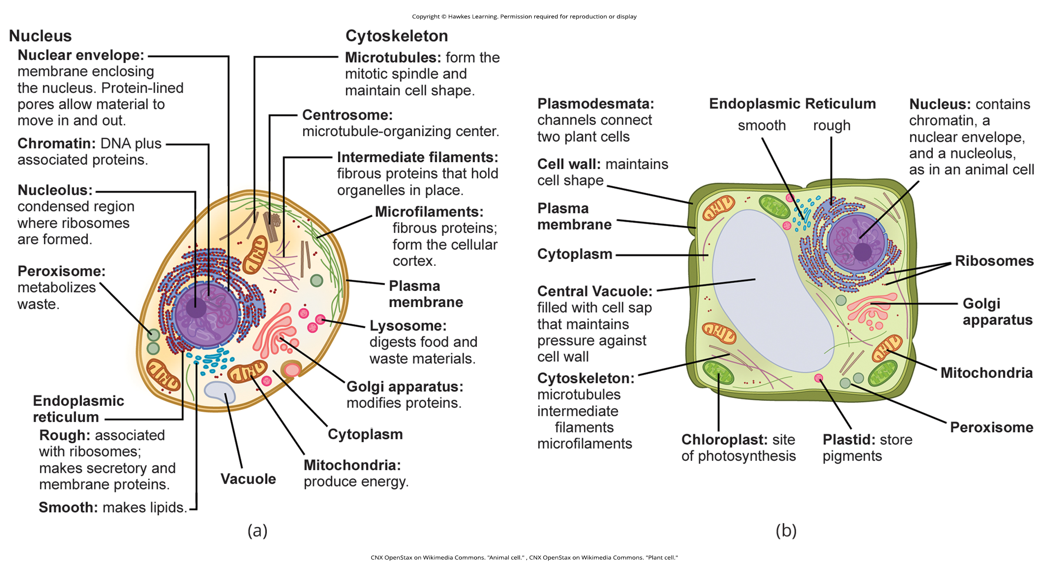
4.2 Figure 2
CNX OpenStax on Wikimedia Commons. "Animal cell." CNX OpenStax on Wikimedia Commons. "Plant cell."
Notes:
These figures show the major organelles and other cell components of (a) a typical animal cell and (b) a typical eukaryotic plant cell. The plant cell has a cell wall, chloroplasts, plastids, and a central vacuole—structures not in animal cells. Unlike animal cells, plant cells lack centrosomes and most do not have lysosomes.

Slide 8
The Plasma Membrane
Eukaryotic cells, like prokaryotes, have a plasma membrane: a phospholipid bilayer with embedded proteins that separates the cell from its environment.
Regulates the movement of organic molecules, ions, water, oxygen (O) into and out of the cell
Allows waste products like carbon dioxide [CO₂] and ammonia [NH₃] to exit the cell

Slide 9
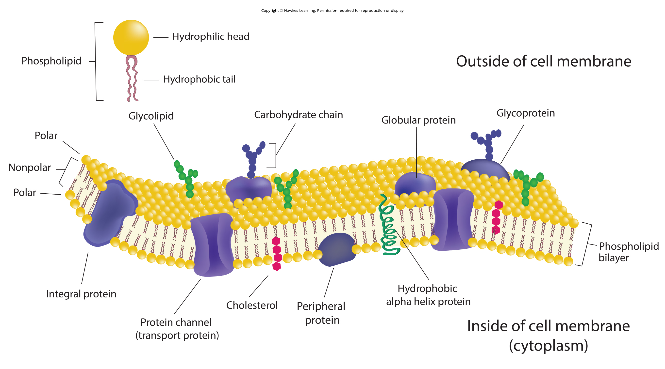
4.2 Figure 3
Notes:
The eukaryotic plasma membrane is a phospholipid bilayer with proteins and cholesterol embedded in it.

Slide 10
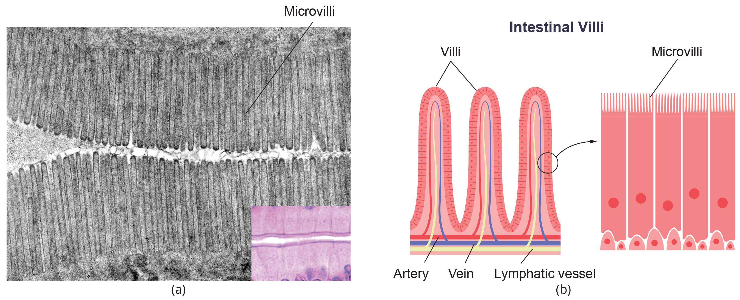
Microvilli and Celiac Disease
In specialized cells for absorption like those lining the small intestine, the plasma membrane has fingerlike projections called microvilli to increase surface area.
In celiac disease, an immune response to gluten damages the microvilli, impairing nutrient absorption.
  Leads to malnutrition, cramping, and diarrhea
4.2 Figure 4

Slide 11
The Cytoplasm
The cytoplasm is the region between the plasma membrane and nuclear envelope, containing organelles suspended in the gel-like cytosol (aqueous portion of the cytoplasm).
Consists of 70–80% water but has a semisolid consistency due to the proteins present
Contains glucose, other sugars, amino acids, nucleic acids, fatty acids, and glycerol derivatives
Has dissolved ions like sodium (Na⁺), potassium (K⁺), and calcium (Ca²⁺)
Hosts many metabolic reactions, including protein synthesis

Slide 12
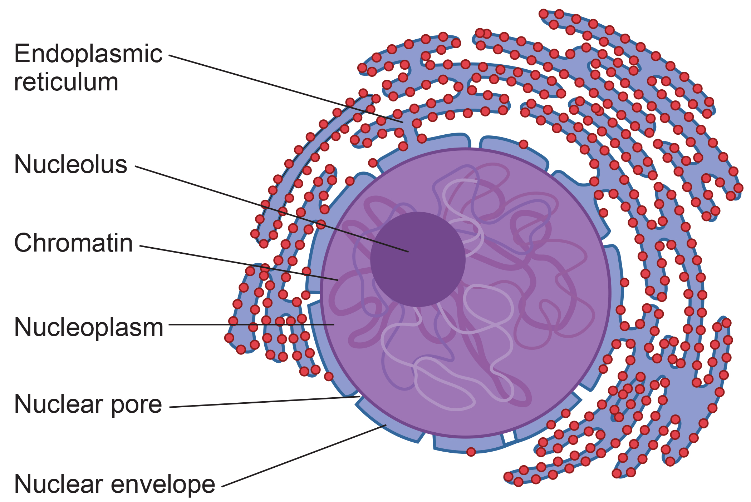
The Nucleus₁
The nucleus houses the cell's DNA and directs the synthesis of ribosomes and proteins.
The nuclear envelope is a double-membrane structure that constitutes the nucleus’s outermost portion.
Its pores control the movement of ions, molecules, and RNA between the nucleoplasm (semisolid fluid containing chromatin and nucleolus) and the cytoplasm.
4.2 Figure 5
CNX OpenStax on Wikimedia Commons. "Nucleus."

Slide 13
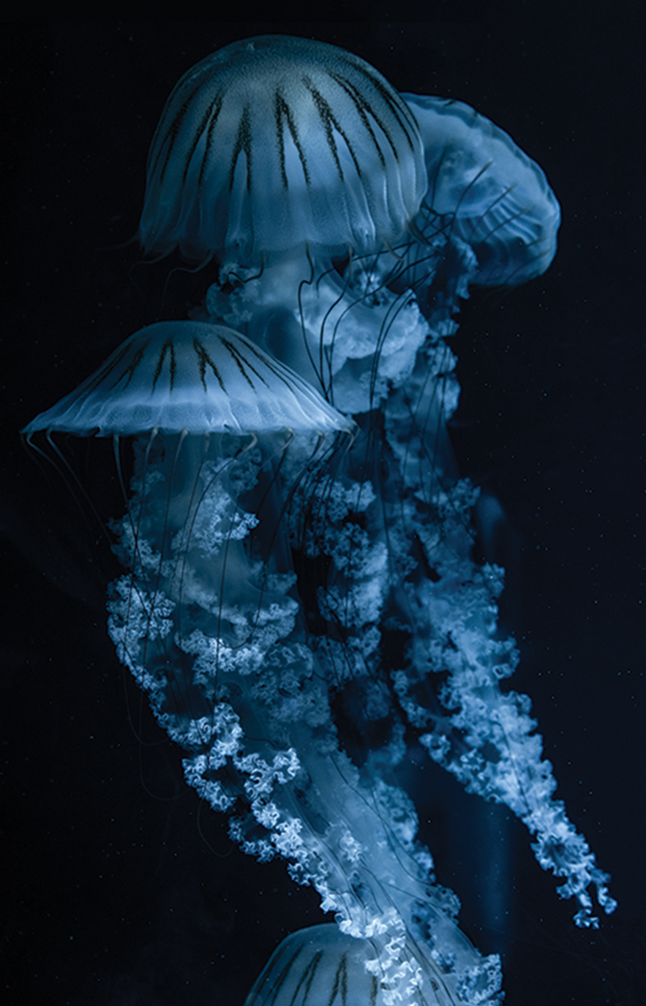
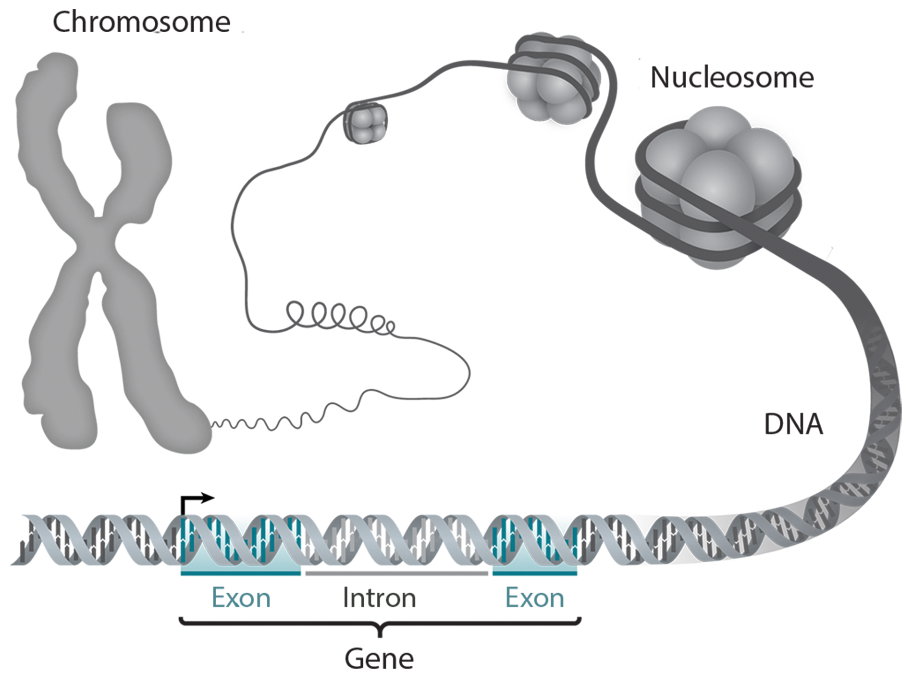
The Nucleus₂
Contains chromosomes: linear DNA-protein structures, with a specific number per eukaryotic species
Chromatin is the condensed (during cell division) and decondensed (non-dividing) forms of the DNA-protein complexes.
The nucleolus is area within the nucleus that assembles and exports ribosomal subunits to the cytoplasm using sections of DNA that encode for ribosomal RNA.
4.2 Figure 6: Jellyfish cells contain DNA to ensure their proper development.
Cristian Muduc on Pexels. "Jellyfish."
4.2 Figure 7
Thomas Splettstoesser on Wikimedia Commons. "DNA organization."

Slide 14
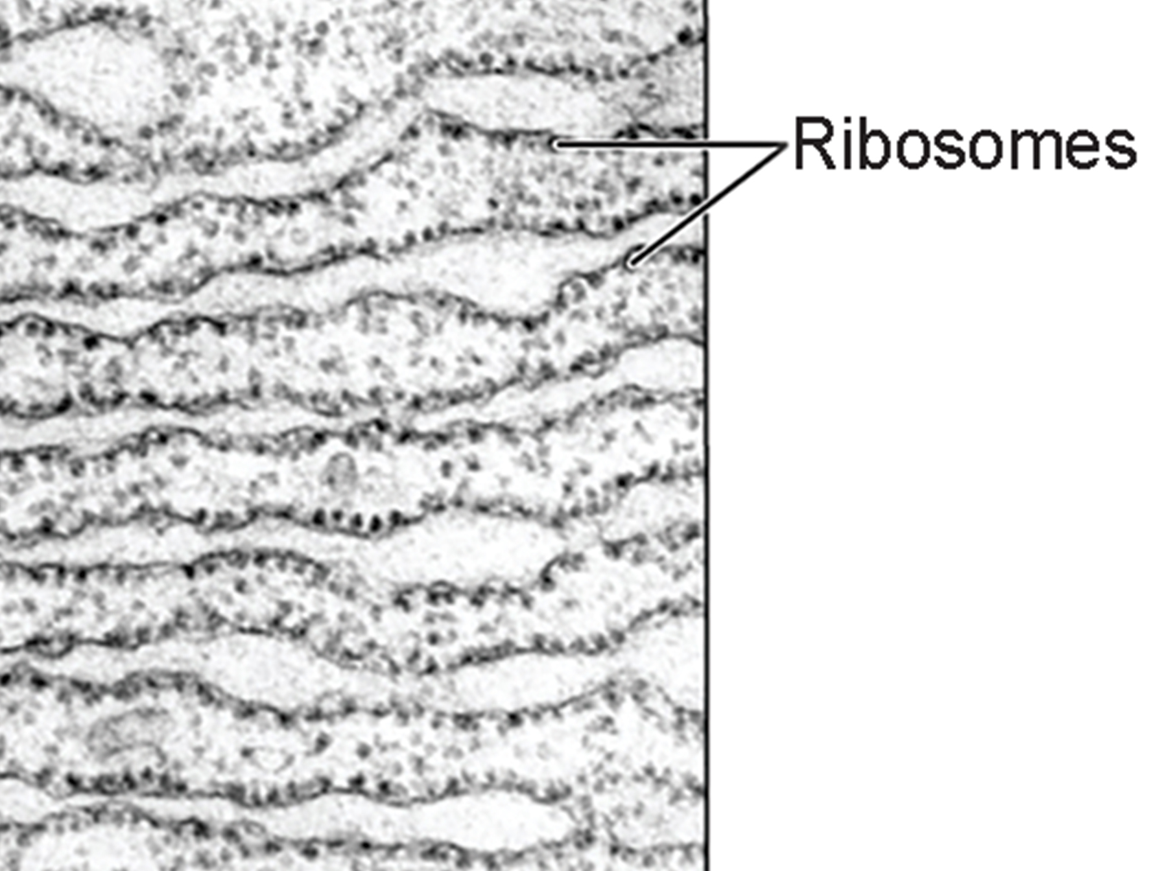
Ribosomes₁
Ribosomes are cellular organelles responsible for protein synthesis.
Can be attached to plasma membrane, endoplasmic reticulum, or nuclear envelope membranes
Location relates to the destination of the proteins they synthesize
4.2 Figure 8
OpenStax on Wikimedia Commons. "Endoplasmic reticulum."

Slide 15
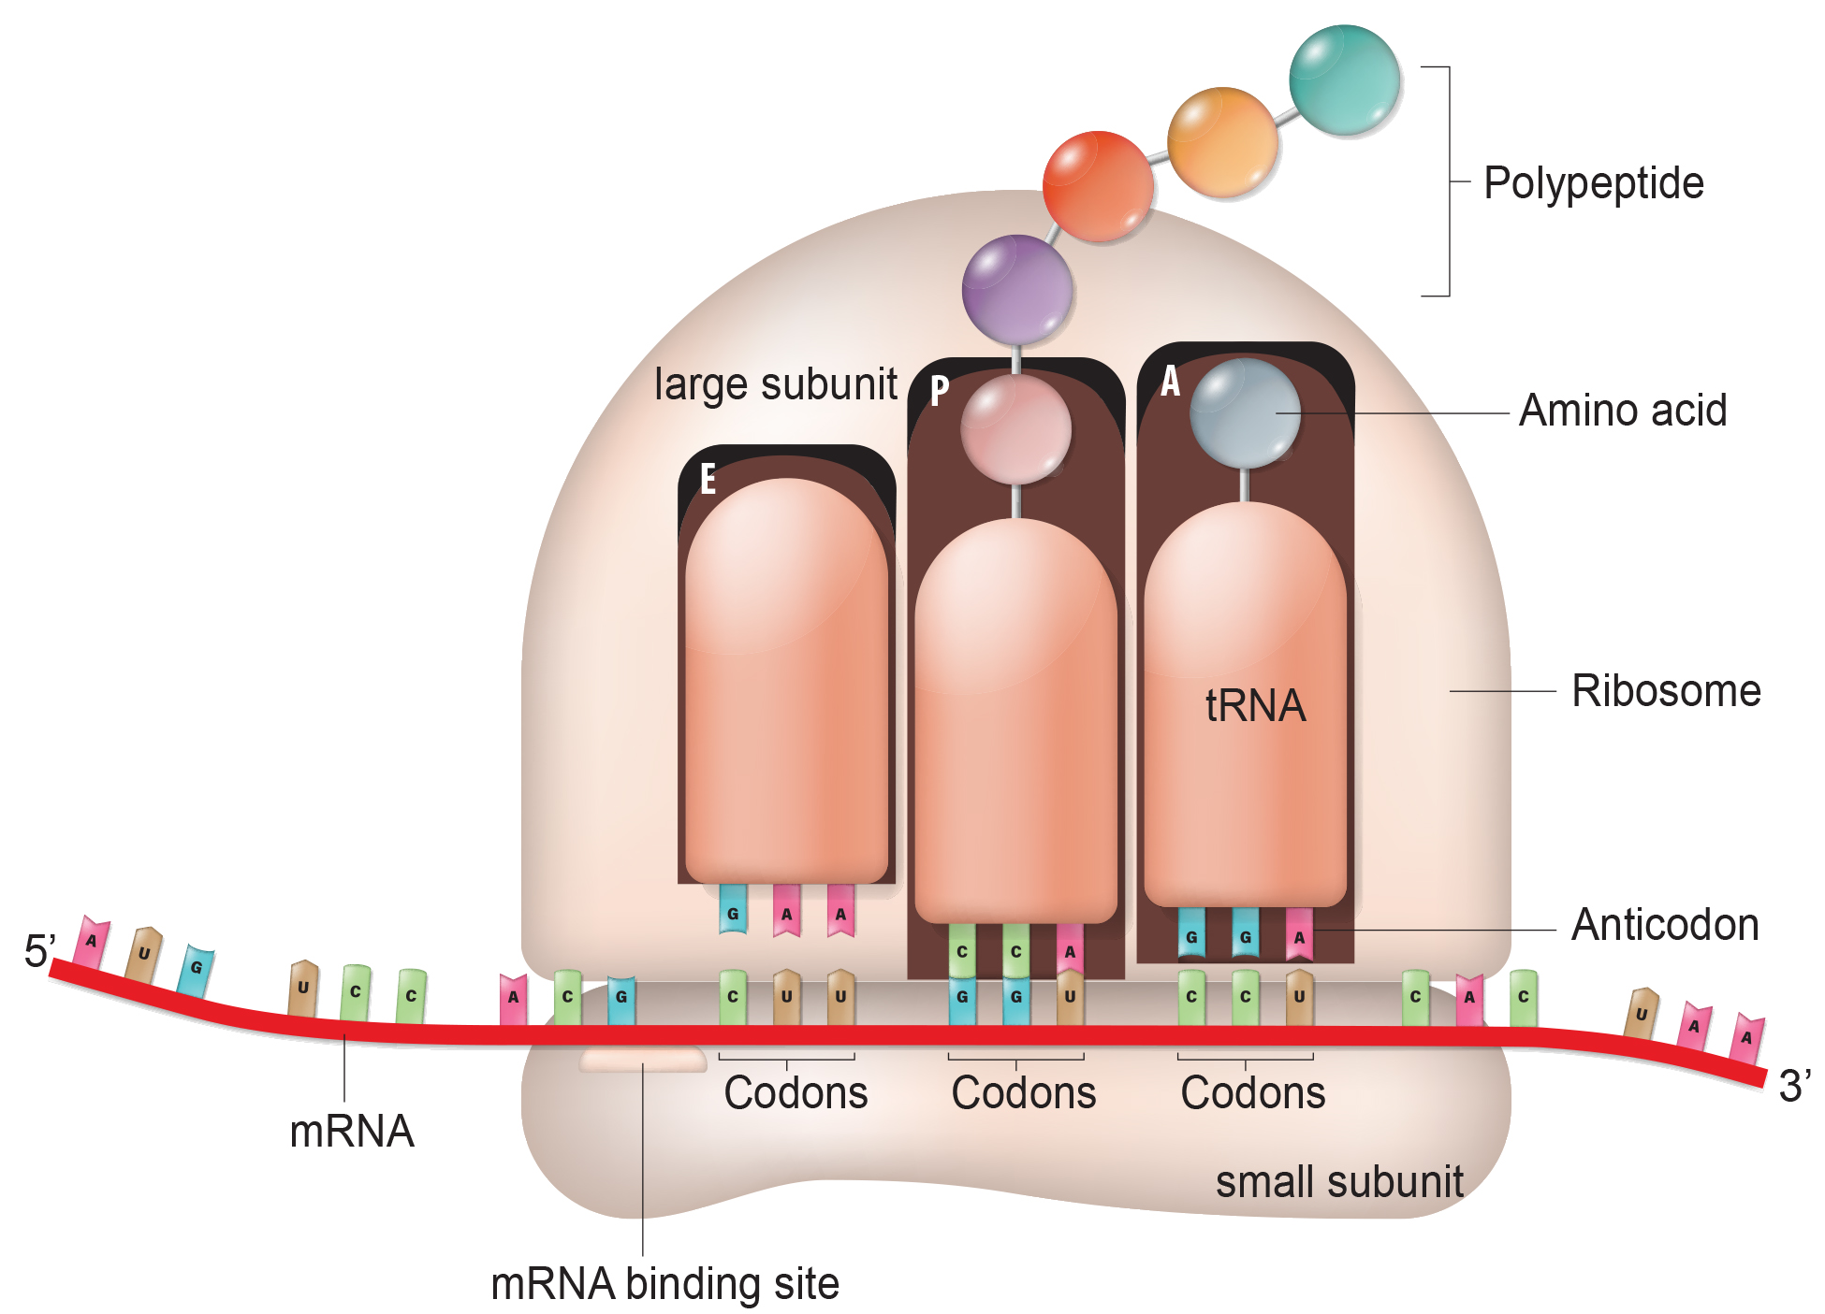
Ribosomes₂
Ribosomes are large protein-RNA complexes with two subunits
mRNA from the nucleus provides the code that ribosomes translate into specific protein sequences.
Cells synthesizing high amounts of proteins, like pancreatic enzyme-producing cells, have high ribosome numbers.
4.2 Figure 9

Slide 16
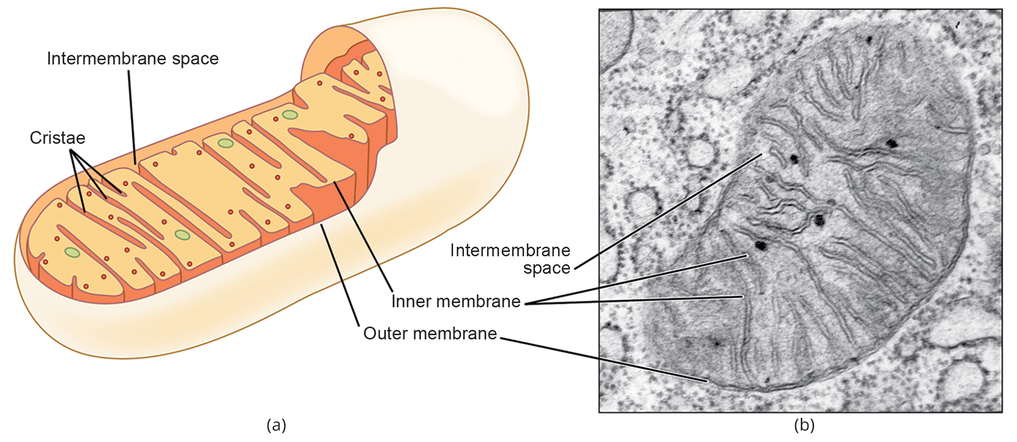
Mitochondria
Mitochondria are the cellular "powerhouses" that produce ATP, the main energy currency, through cellular respiration (from chemical energy stored in molecules like glucose).
Have double membranes with inner folds (cristae), a matrix, and their own ribosomes and DNA for their specialized energy production roles
Muscle cells are rich in mitochondria to meet high energy needs; lack of oxygen leads to lactic acid production instead of ATP.
4.2 Figure 10
OpenStax on Wikimedia Commons. "Mitochondria."

Slide 17
Group Activity
Different tissues contain different amounts of organelles. As a group, make a list of different tissue types that make up a human body. For example, you may list muscle tissue, bone tissue, etc. Now, consider the role of mitochondria in cells.
If you had to guess, which of these tissue types do you think would contain the most mitochondria?
Which might contain the least? Discuss your answers.

Slide 18
Peroxisomes
Peroxisomes are single-membrane organelles that carry out oxidation reactions and detoxification.
Break down fatty acids, amino acids, and hydrogen peroxide (H₂O₂) through oxidation reactions.
Detoxify alcohol in liver cells
Have roles in metabolism, defense, and stress response in plants
  Specialized peroxisomes (glyoxysomes) convert fats to sugars.

Slide 19

Vesicles and Vacuoles
Vesicles and vacuoles are membrane-bound sacs for storage and transport.
Vacuoles are larger.
Vesicles can fuse with other membranes to release their contents, while vacuoles remain separate.
Plant vacuoles contain enzymes that degrade macromolecules.
4.2 Figure 11: Mammary tissue is responsible for producing milk for offspring. Milk is produced inside the cells but must be transported outside the cells; vesicles handle this step.
William Fortunato on Pexels. "Mother and child."

Slide 20
Animal Cells versus Plant Cells
Animal cells have centrosomes and lysosomes, while plant cells lack them.
Plant cells possess a cell wall, chloroplasts, other plastids, and a large central vacuole, which are absent in animal cells.
Both animal and plant cells have a plasma membrane, cytoplasm, nucleus, ribosomes, mitochondria, peroxisomes, and microtubule-organizing centers (MTOCs).

Slide 21
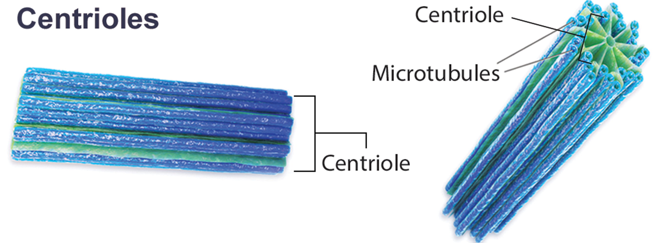
Animal Cells versus Plant Cells: The Centrosome
The centrosome is a microtubule-organizing center found near the nuclei of animal cells.
Contains centrioles of microtubule triplets, organizes microtubules, and assists in separating chromosomes during animal cell division
Are non-essential for cell division, as cells without them and plant cells can still divide
4.2 Figure 12
BruceBlaus on Wikimedia Commons. "Centriole."

Slide 22
Animal Cells versus Plant Cells: Lysosomes
Animal cells have lysosomes which act as the cell's "garbage disposal" using enzymes in an acidic environment to digest wastes, proteins, lipids, nucleic acids, and worn-out organelles.
Plant cells lack lysosomes and instead carry out digestive processes in vacuoles.

Slide 23
Think It Through₂
Why are lysosomes compared to a "garbage disposal"?
Notes:
Originally an On Your Own. This is included here to use as a talking point or for a think-pair-share activity.

Slide 24
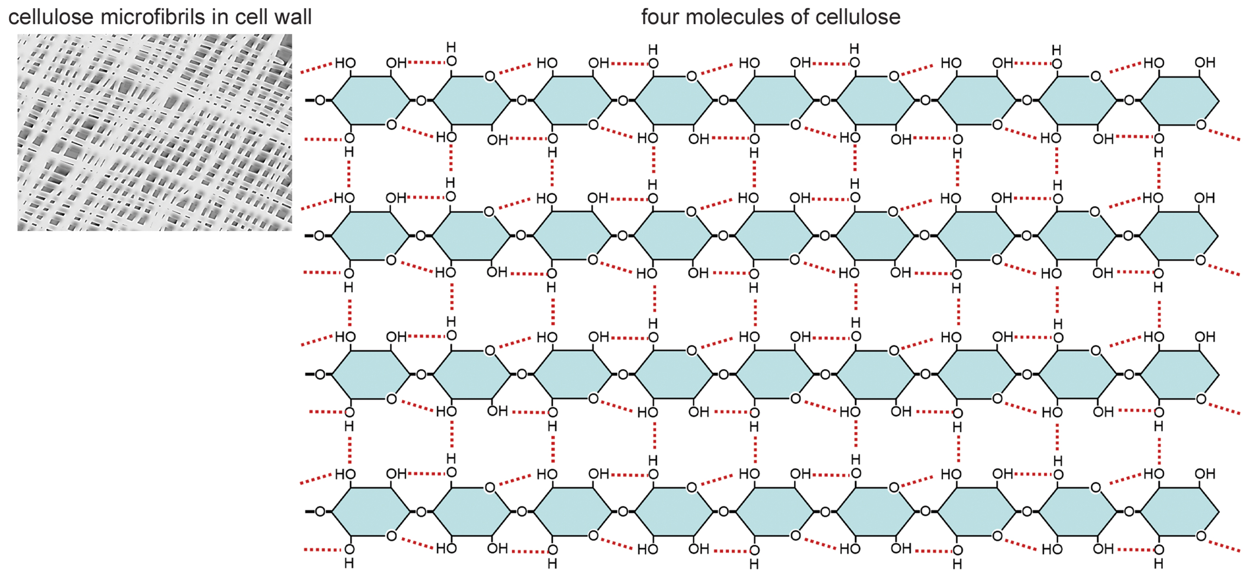
Animal Cells versus Plant Cells: The Cell Wall
Plant cells have a rigid cellulose cell wall exterior to the plasma membrane for structural support and protection.
Main component is cellulose.
Cell walls provide raw vegetables their crunchy texture.
4.2 Figure 13
Eunice Laurent on Wikimedia Commons. "Cellulose."

Slide 25
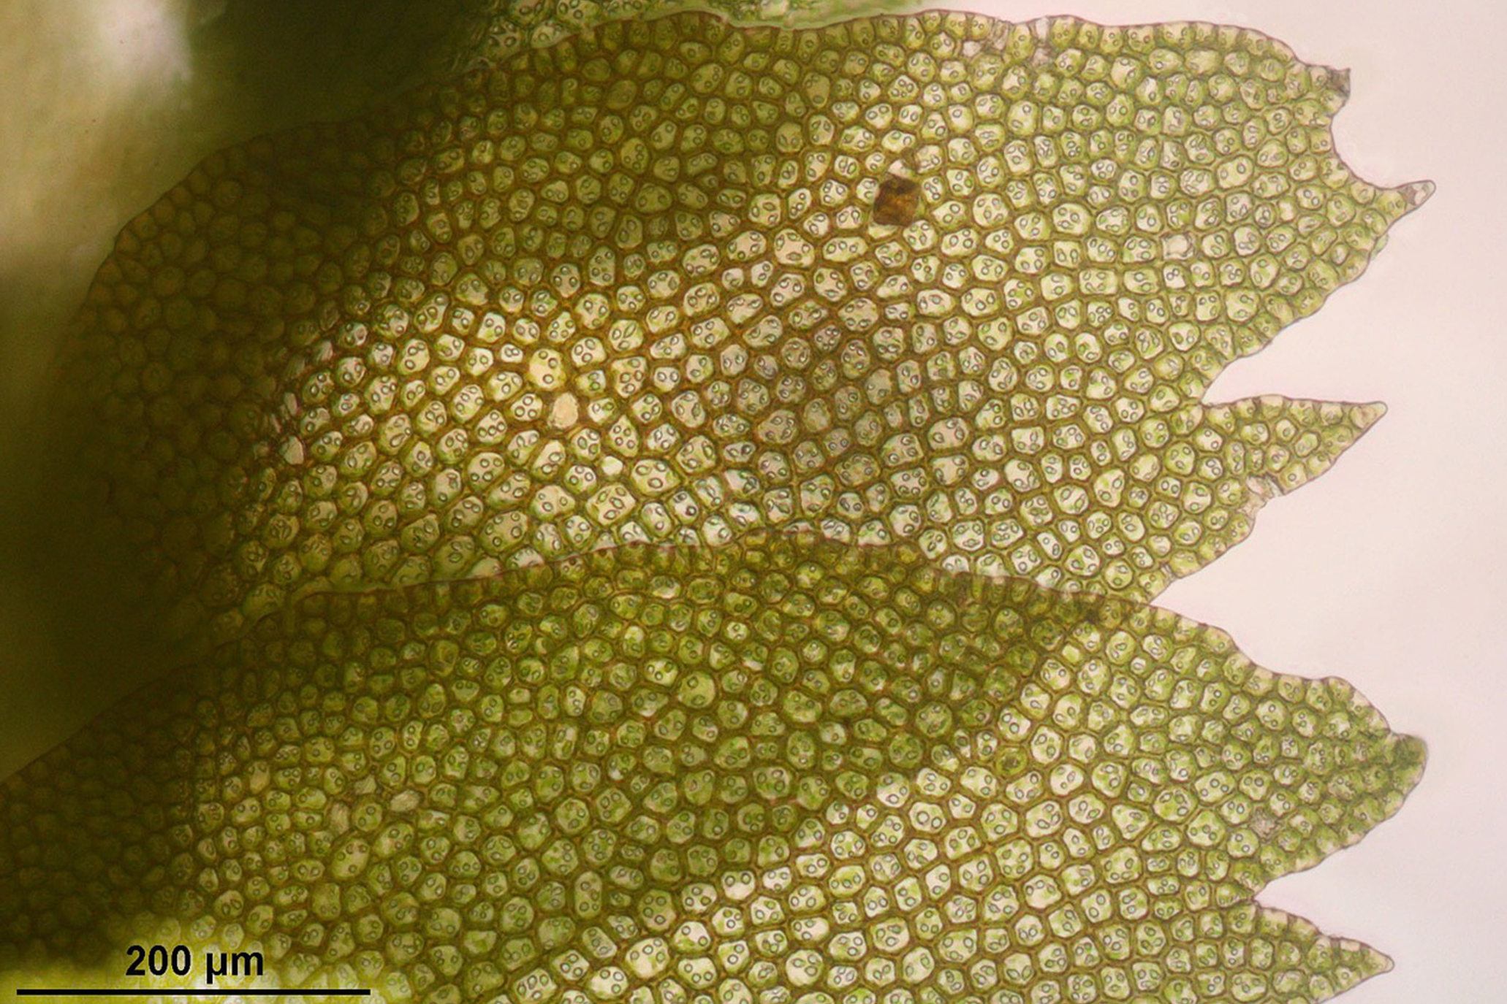
Animal Cells versus Plant Cells: Chloroplasts₁
Chloroplasts perform photosynthesis in plant cells, producing glucose and oxygen from carbon dioxide, water, and sunlight.
Plants are autotrophs that make their own food.
4.2 Figure 14
Wikimedia Images on Pixabay. "Chloroplasts."

Slide 26
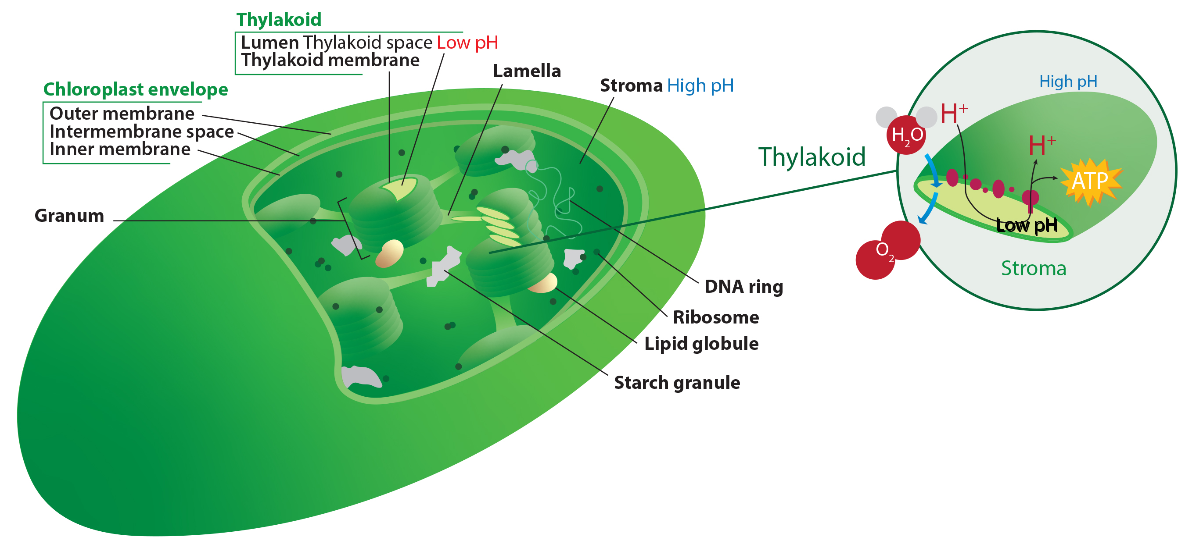
Animal Cells versus Plant Cells: Chloroplasts₂
Chloroplasts contain an inner membrane enclosing a set of interconnected, flattened discs called thylakoids where chlorophyll is located to capture light energy for photosynthesis, with the surrounding fluid known as the stroma.
4.2 Figure 15
Kelvinsong on Wikimedia Commons. "Chloroplast diagram."

Slide 27
Endosymbiotic Theory: The Origin of Mitochondria and Chloroplasts
Mitochondria and chloroplasts originated from an aerobic (uses oxygen for respiration) and an autotrophic (makes its own food) bacteria respectively being engulfed by host cells in an endosymbiotic relationship millions of years ago.
Endosymbiosis involves one organism living inside another in a mutually beneficial way, with ingested bacteria evolving into specialized organelles over time.
Supporting evidence includes similar sizes and presence of DNA and ribosomes in bacteria, mitochondria, and chloroplasts, as well as the endosymbiotic relationships seen in nature today.

Slide 28
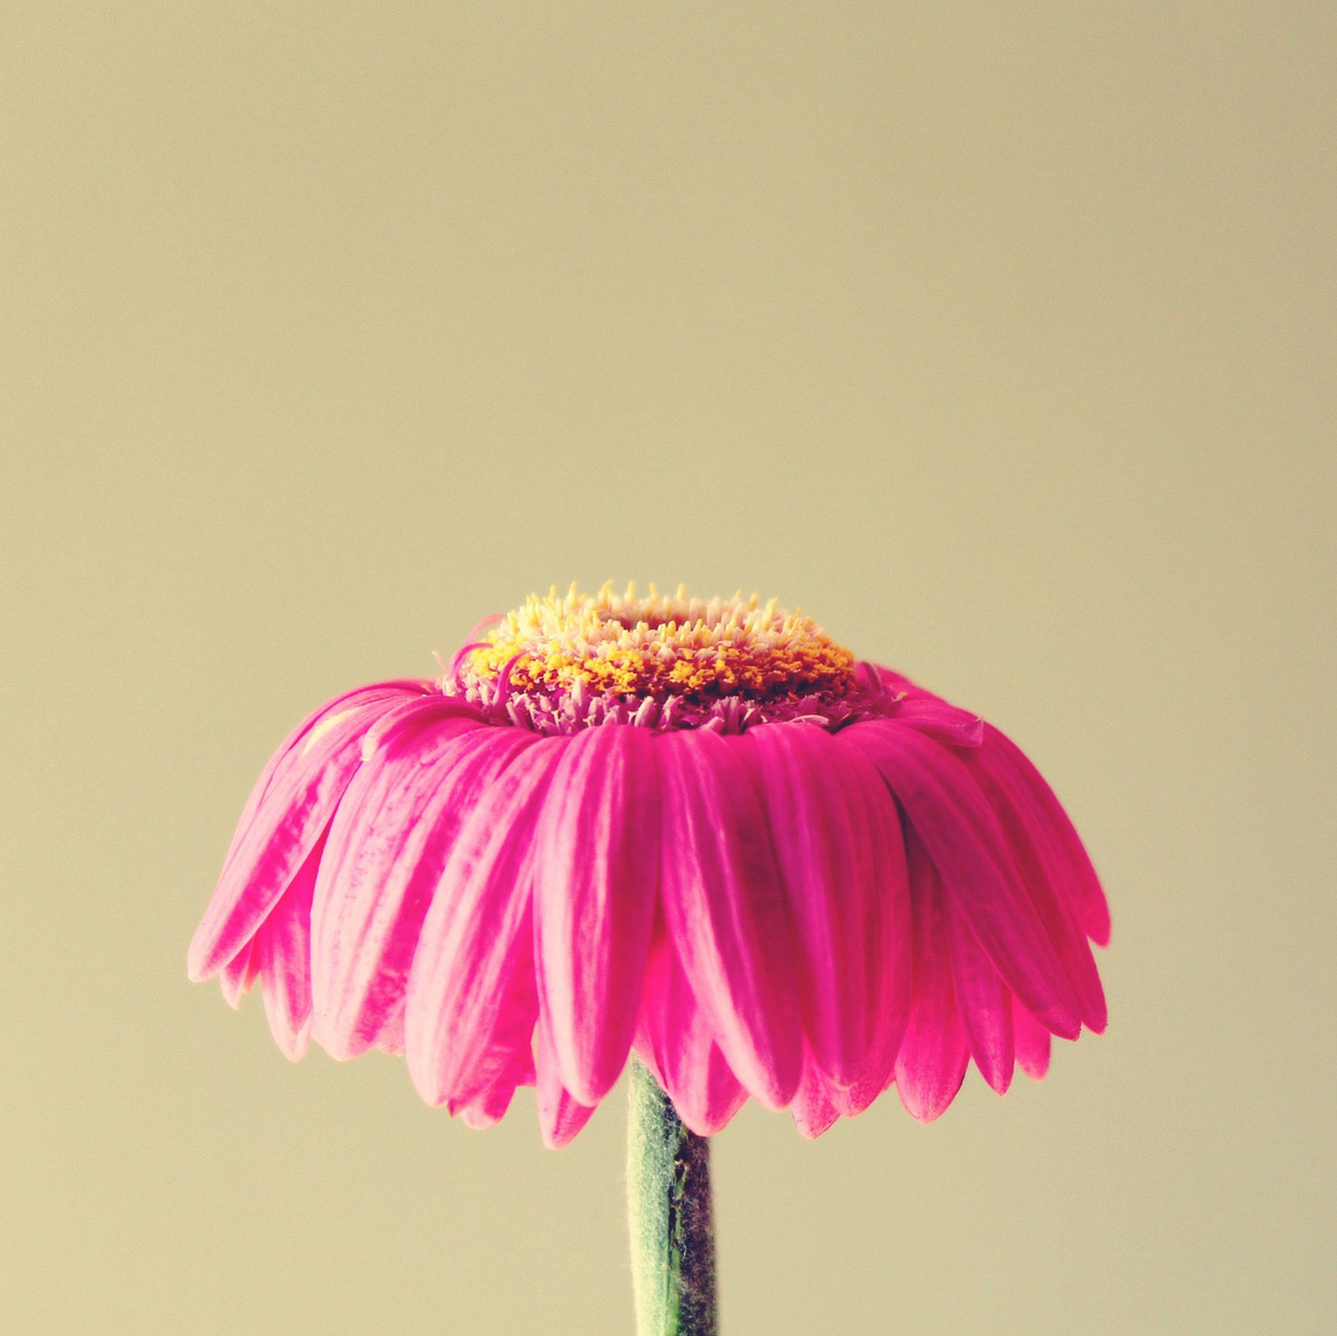
Animal Cells versus Plant Cells: The Central Vacuole
Plant cells have a large central vacuole occupying most of the cell's interior area that regulates water concentration.
Water loss from the vacuole causes wilting due to the loss of support for the cell wall.
The central vacuole allows cell expansion by accommodating more water as the cell grows larger, without requiring the synthesis of additional cytoplasm.
4.2 Figure 16
TanteTati on Pixabay. "Wilted flower."

Slide 29
Summary
Eukaryotic cells are larger than prokaryotes, with a true nucleus, membrane-bound organelles, and linear chromosomes.
Key organelles include the nucleolus for ribosome assembly, ribosomes for protein synthesis, mitochondria for ATP production, and peroxisomes for oxidation reactions.
Vesicles and vacuoles function in storage and transport, with plant vacuoles also degrading macromolecules.
Animal cells have centrosomes with centrioles involved in cell division and lysosomes as digestive organelles.
Plant cells have cellulosic cell walls, chloroplasts for photosynthesis, and a large central vacuole.

Slide 30


End of Hawkes Learning PowerPoint

