Slide 1
Lesson 4.3
The Endomembrane System

Slide 2
Objectives
List the components of the endomembrane system.
Recognize the relationship between the endomembrane system and its functions.
Recognize the relationship between the endoplasmic reticulum and its functions.

Slide 3
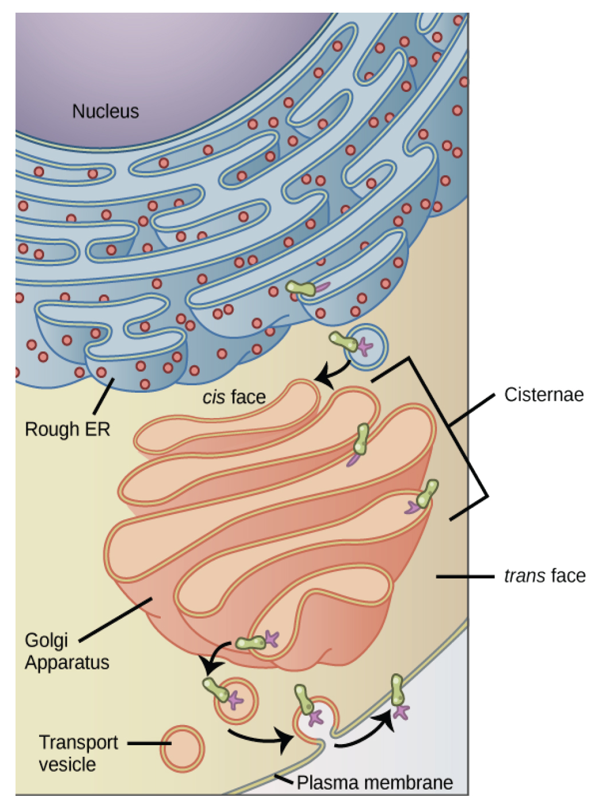
The Endomembrane System
4.3 Figure 1
The endomembrane system is a group of membranes and organelles in eukaryotic cells that work together to modify, package, and transport lipids and proteins.
  Includes the nuclear envelope, lysosomes, vesicles, endoplasmic reticulum, plasma membrane, and Golgi apparatus.
Magnus Manske on Wikimedia Commons. "Endomembrane system."

Slide 4
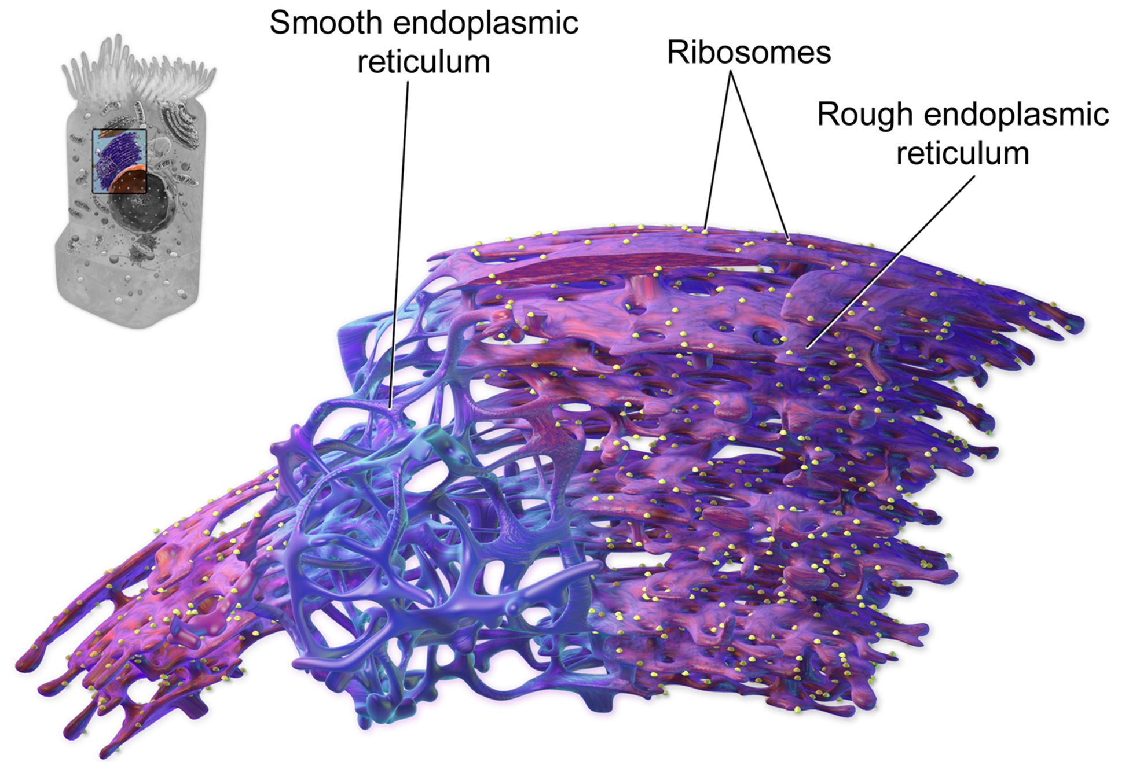
The Endoplasmic Reticulum
The endoplasmic reticulum (ER) is a network of membranous sacs and tubules.
Continuous with the nuclear envelope membrane
Rough ER modifies proteins
Smooth ER synthesizes lipids
4.3 Figure 2
BruceBlaus on Wikimedia Commons. "Endoplasmic reticulum."

Slide 5
Think It Through
Identify two membrane-bound organelles that are not part of the endomembrane system.
Notes:
Originally an On Your Own. This is included here to use as a talking point or for a think-pair-share activity.

Slide 6
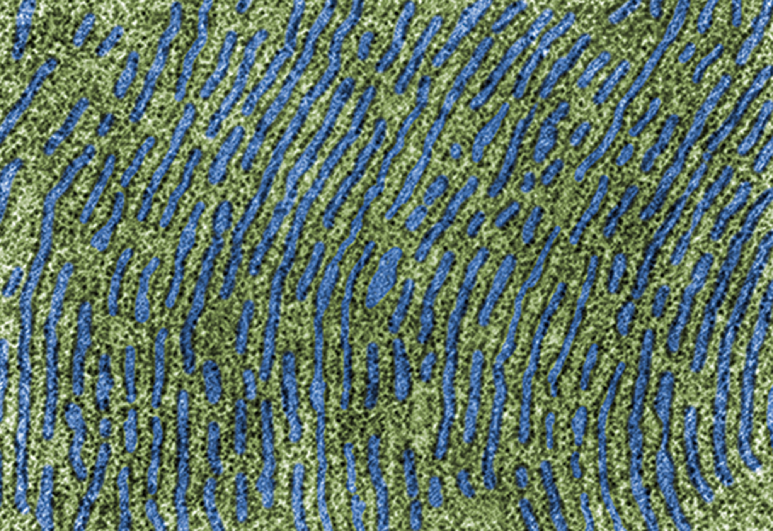
Rough Endoplasmic Reticulum (RER)
The RER has ribosomes attached, giving it a studded appearance.
Modifies proteins by folding and adding side chains which are secreted or incorporated into cellular membranes
Makes phospholipids
4.3 Figure 3: A transmission electron micrograph of the rough endoplasmic reticulum.

Slide 7
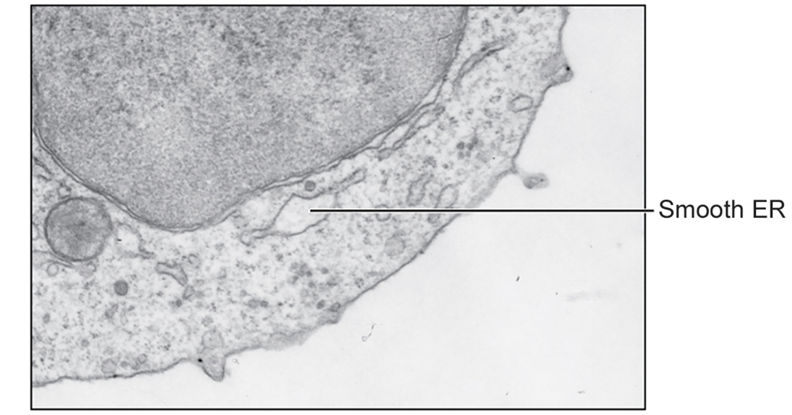
Smooth Endoplasmic Reticulum (SER)
The SER lacks ribosomes on its surface and is continuous with the RER.
Synthesizes carbohydrates, lipids, steroid hormones
Detoxifies medication and poisons
Stores calcium for muscle contraction in muscle cells
4.3 Figure 4
OpenStax on Wikimedia Commons. "Smooth endoplasmic reticulum."

Slide 8
Reflection Question
As a scientist, how might you piece together the general pathway of the endomembrane system? What kinds of experimentation strategies or techniques might you want to use to determine where new proteins are synthesized, processed, and distributed?
Notes:
The reflection question is included here to use as a talking point or for a think-pair-share activity.

Slide 9
Science and You₁
Career: Cardiologist
Medical doctors specializing in diagnosing and treating heart diseases such as heart failure, a leading cause of death
What Is Heart Failure?
When the heart can't pump blood effectively to supply oxygen to organs, caused by improper calcium handling in cardiac muscle cells
How Can a Heart Doctor Help?
Diagnose via tests like ECG, X-ray, and monitoring symptoms
Prescribe medications and recommend lifestyle changes like diet and exercise

Slide 10
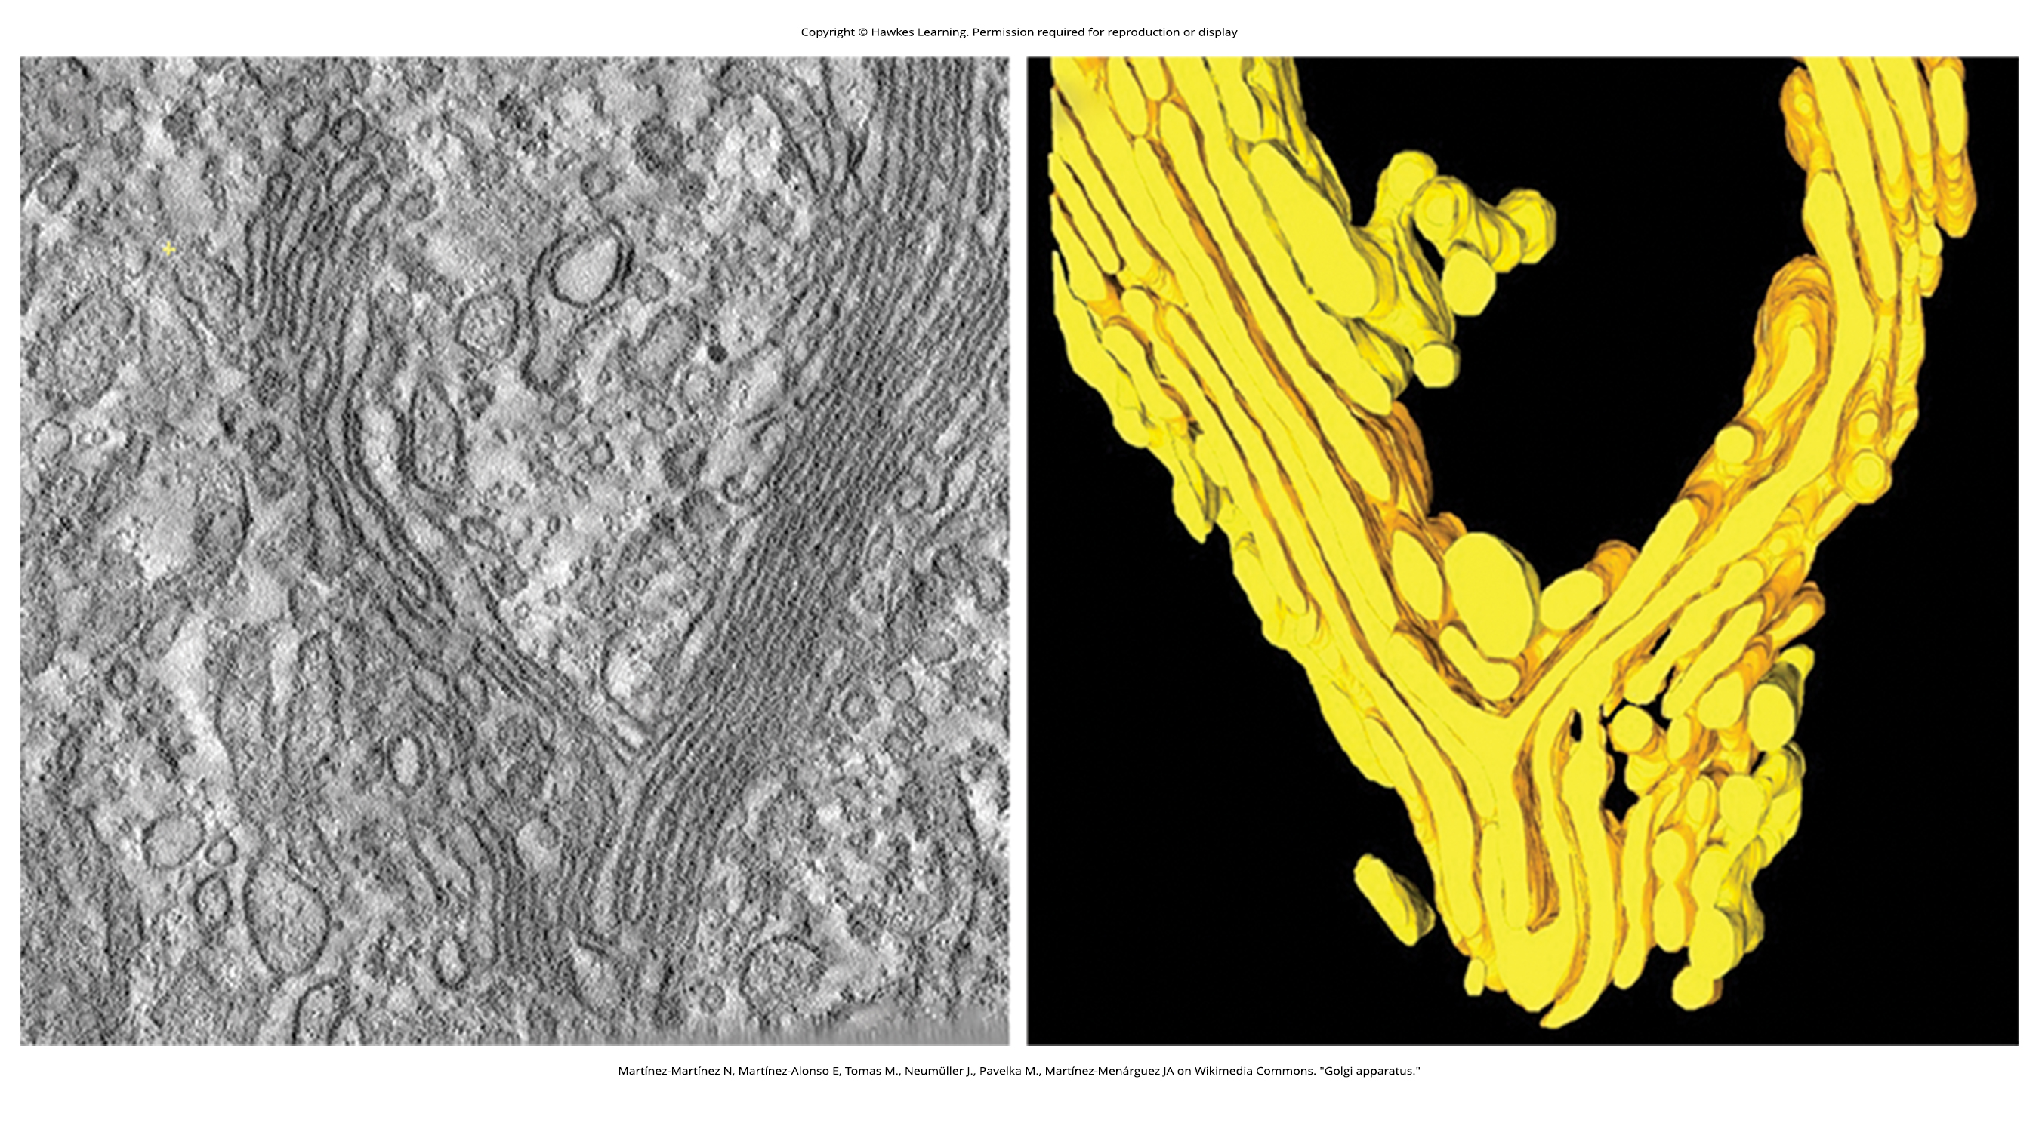
The Golgi Apparatus
The Golgi apparatus is a series of flattened membranes that sort, tag, and package lipids and proteins for distribution.
Modifies them for sorting, by adding a sugar chain
Then tags them with a phosphate group or other molecule to travel the correct destination
Secretory vesicles bud from the trans face of the Golgi
4.3 Figure 5
Martínez-Martínez N, Martínez-Alonso E, Tomas M., Neumüller J., Pavelka M., Martínez-Menárguez JA on Wikimedia Commons. "Golgi apparatus."

Slide 11
Science and You₂
Career: Geneticist
Study genes, inheritance patterns, and their effects on health and disease
Identify mutations causing genetic disorders and develop diagnostic tests
What Causes Lowe Disease?
Mutation in a gene on the X chromosome causing a deficiency in an enzyme in the Golgi apparatus
Males are primarily affected
How Can a Geneticist Help?
Identified the mutated gene’s location
Develop prenatal testing and provide genetic counseling
Notes:
This is included as a relevant application for this topic.

Slide 12
Group Activity
As a group, consider the role of the Golgi apparatus in the manufacturing, processing, and distributing of newly synthesized materials and identify a commercial business, public service, or agency that makes a good analogy. Then, come up with an analogy for the role of the endoplasmic reticulum. Finally, come up with an analogy for vesicles.

Slide 13
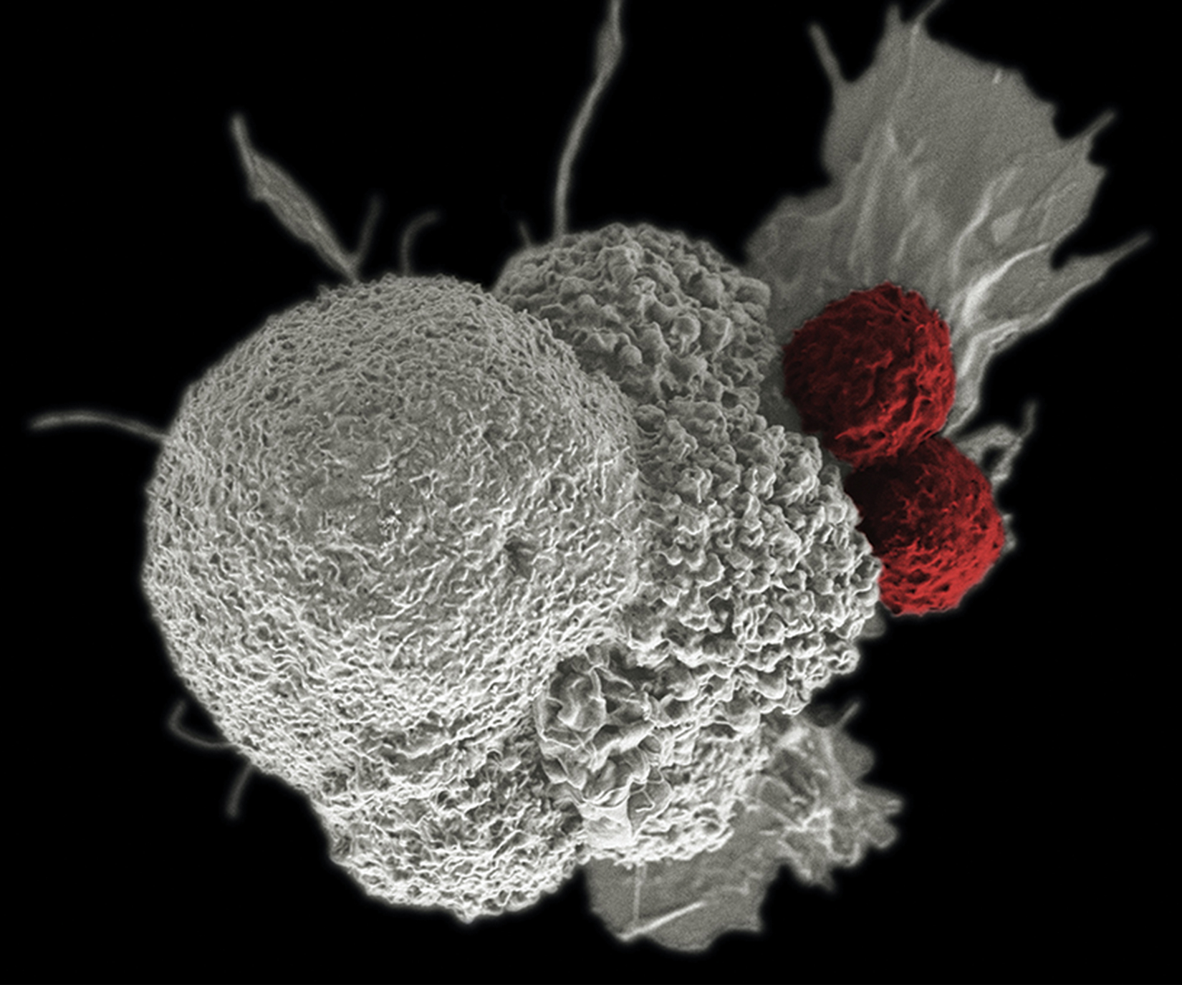
Lysosomes₁
Lysosomes use hydrolytic enzymes to digest macromolecules, recycle organelles, and destroy pathogens.
4.3 Figure 6: Two T cells attack a cancer cell.
National Cancer Institute on Unsplash. "Immune response."

Slide 14
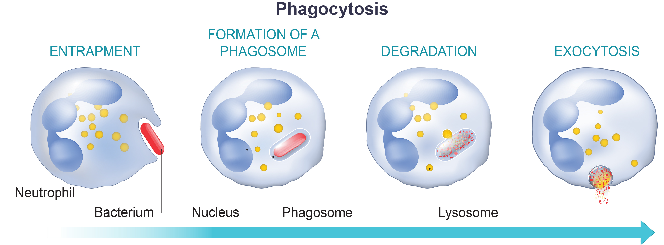
Lysosomes₂
Macrophages, white blood cells, engulf pathogens through phagocytosis and break them down in lysosomes.
4.3 Figure 7

Slide 15
Summary
The endomembrane system includes the nuclear envelope, lysosomes, vesicles, ER, Golgi apparatus, and plasma membrane.
The RER modifies proteins and synthesizes phospholipids, while the SER synthesizes carbohydrates, lipids, steroids, and detoxifies substances.
The Golgi apparatus sorts, tags, packages, and distributes lipids and proteins.
Lysosomes digest macromolecules, recycle organelles, and destroy pathogens.

Slide 16


End of Hawkes Learning PowerPoint

