Slide 1
Lesson 4.4
The Cytoskeleton

Slide 2
Objectives
Compare and contrast cilia and flagella.
Compare the roles of microfilaments, intermediate filaments, and microtubules.
Describe the cytoskeleton.
Summarize the differences among the components of prokaryotic cells, animal cells, and plant cells.

Slide 3
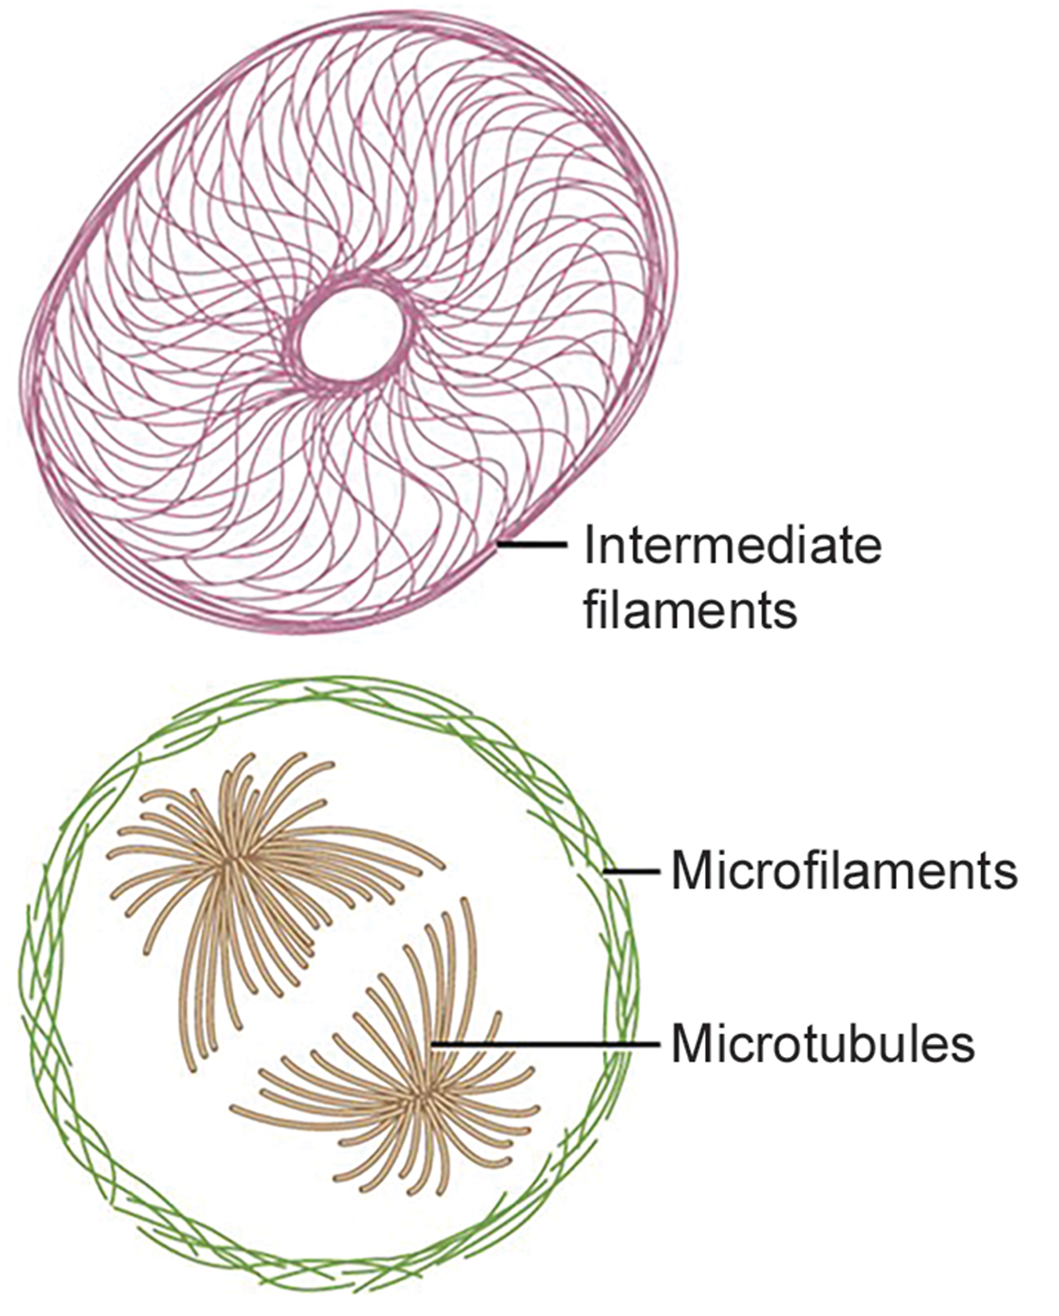
The Cytoskeleton
The cytoskeleton is within the cytoplasm and consists of microfilaments, intermediate filaments, and microtubules.
It maintains cell shape, anchors organelles, allows the movement of cytoplasm and vesicles, and enables cell motility.
4.4 Figure 1
CNX OpenStax on Wikimedia Commons. "Cytoskeleton structure."

Slide 4
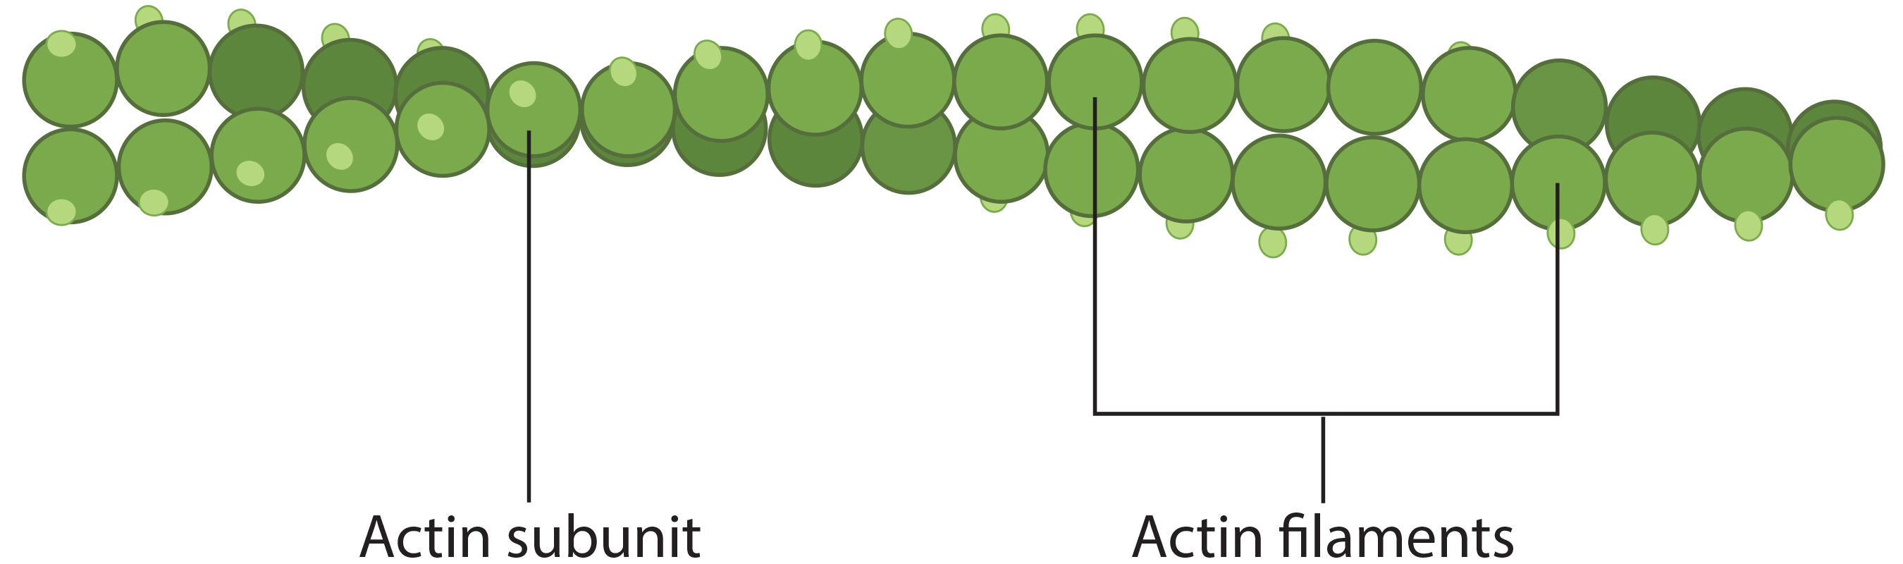
Microfilaments₁
Microfilaments are the narrowest fibers of the cytoskeleton and function in facilitating cellular movement and motility.
Have a diameter of approximately 7 nm
Comprised of two intertwined strands of the globular protein actin, also known as actin filaments
4.4 Figure 2
CNX OpenStax on Wikimedia Commons. "Actin filament." Modified.

Slide 5
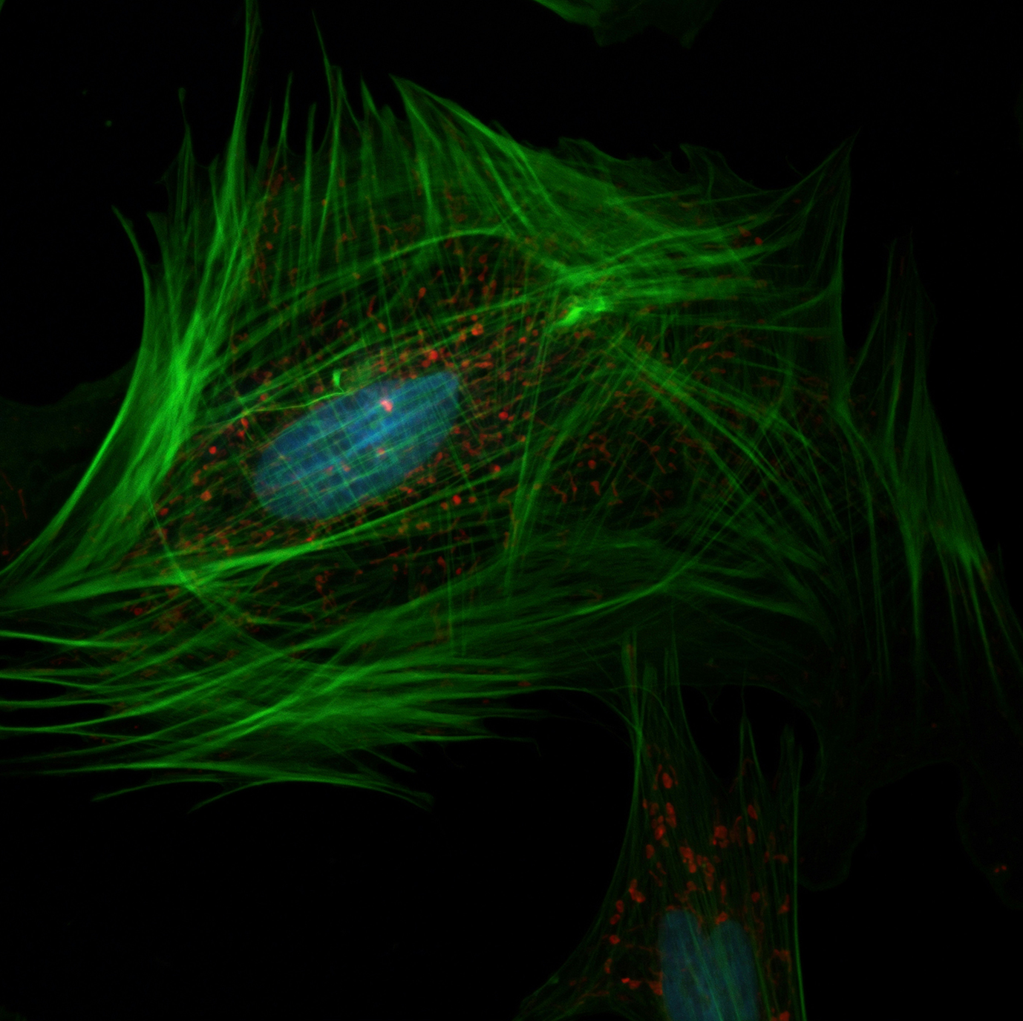
Microfilaments₂
ATP powers actin to assemble its filamentous form, which serves as a track for the movement of a motor protein called myosin.
Allows the movement necessary for cell division, cytoplasmic streaming, and muscle contraction
Microfilaments also provide rigidity and shape for the cell.
Enable cells to change shape and movement by their rapid assembly or disassembly.
White blood cells depend on this to find and phagocytize pathogens.
4.4 Figure 3
National Cancer Institute on Unsplash. "Cytoskeleton in cell."

Slide 6
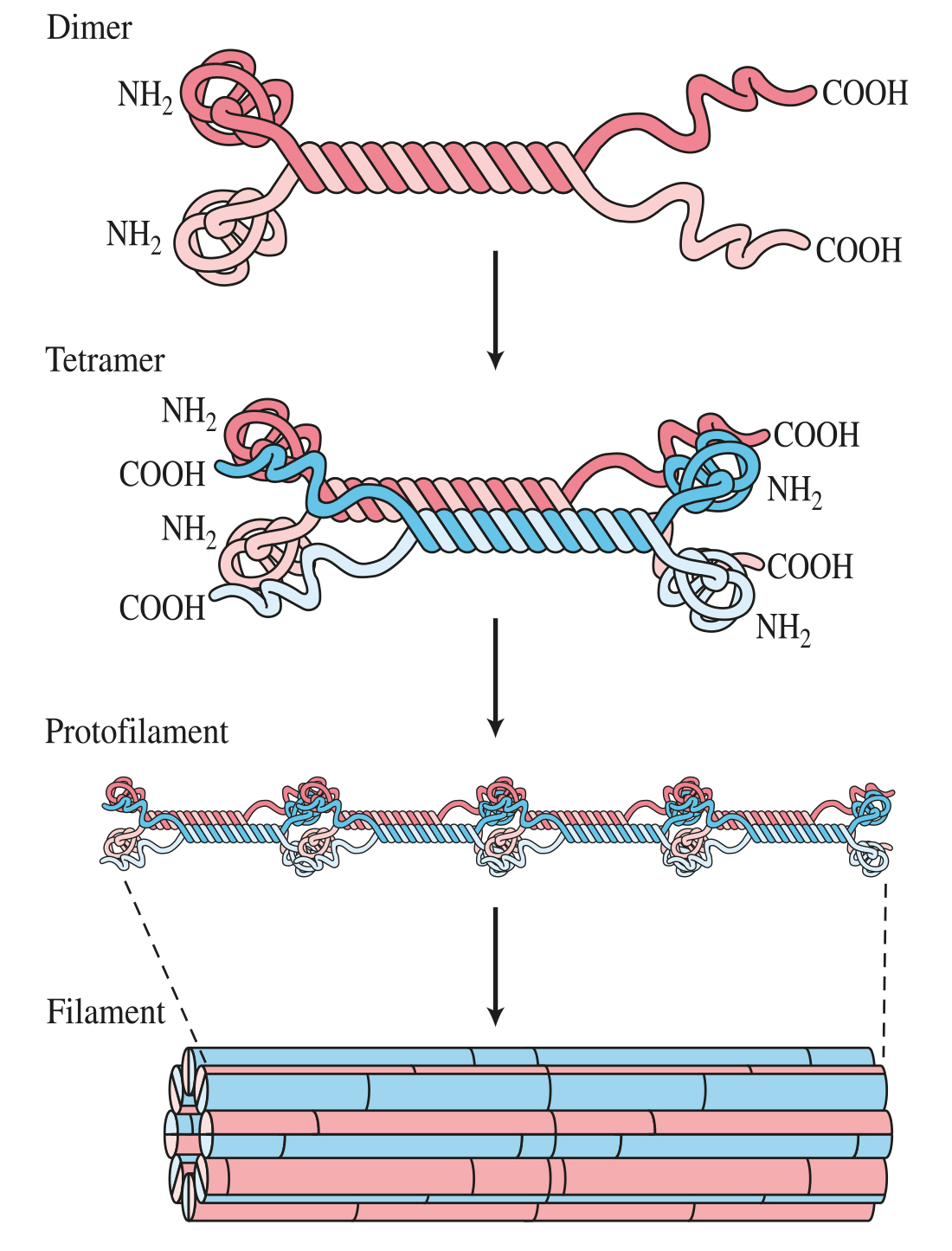
Intermediate Filaments
Intermediate filaments are composed of wound fibrous protein strands with a diameter of 8–10 nm.
Their diameter is between that of microfilaments and microtubules, hence their name.
They comprise various types of fibrous proteins like keratin for hair, nails, and skin.
Intermediate filaments serve a purely structural role.
Bear tension to maintain the cell's shape and form
Anchor organelles like the nucleus in place within the cell
4.4 Figure 4

Slide 7
Reflection Question
The fibrous protein keratin is an intermediate filament that strengthens hair. Slight keratin differences lead to different hair textures. How might the keratin in curly hair differ from that in straight hair?
Notes:
The reflection question is included here to use as a talking point or for a think-pair-share activity.

Slide 8
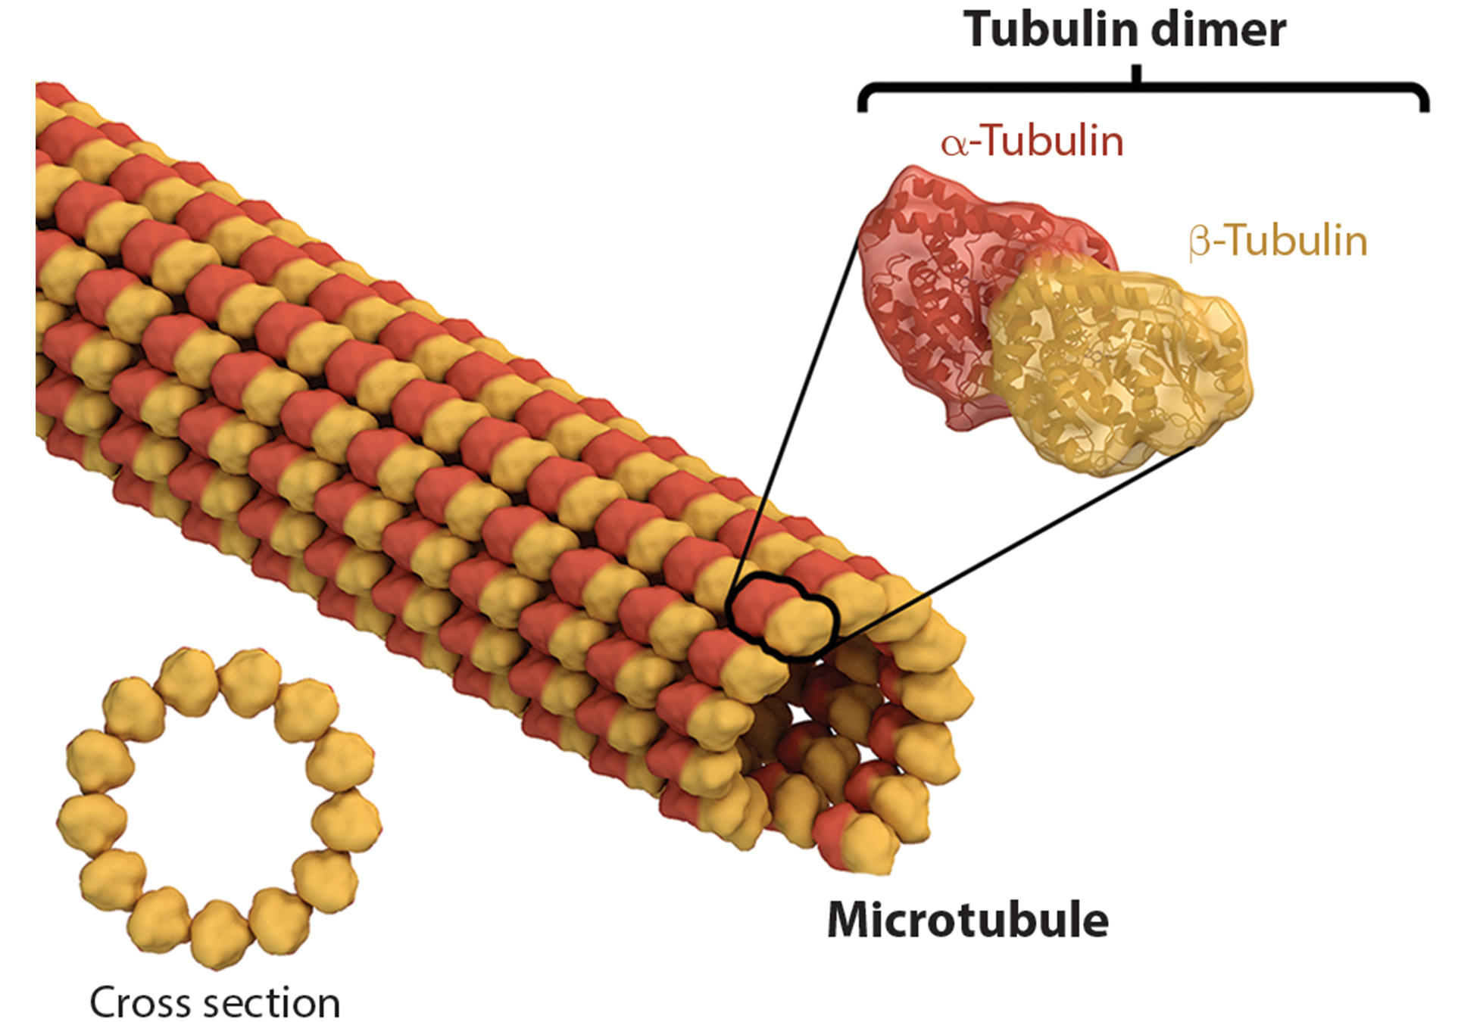
Microtubules
Microtubules are small, hollow tubes that:
Help the cell resist compression
Provide a track along which vesicles move through the cell
Pull replicated chromosomes to opposite ends of a dividing cell
Comprise the structural elements of centrioles, flagella, and cilia
Microtubules are comprised of tubulin dimers.
Have a diameter of 25 nm
4.4 Figure 5: Microtubules are hollow. Their walls consist of 13 polymerized dimers of α-tubulin and β-tubulin.
Thomas Splettstoesser on Wikimedia Commons. "Microtubule."

Slide 9
Think It Through
Describe the capability shared by the microtubules and the microfilaments that allow a cell to change its shape quickly. (Hint: White blood cells depend upon this feature to engulf pathogens.)
Notes:
Originally an On Your Own. This is included here to use as a talking point or for a think-pair-share activity.

Slide 10
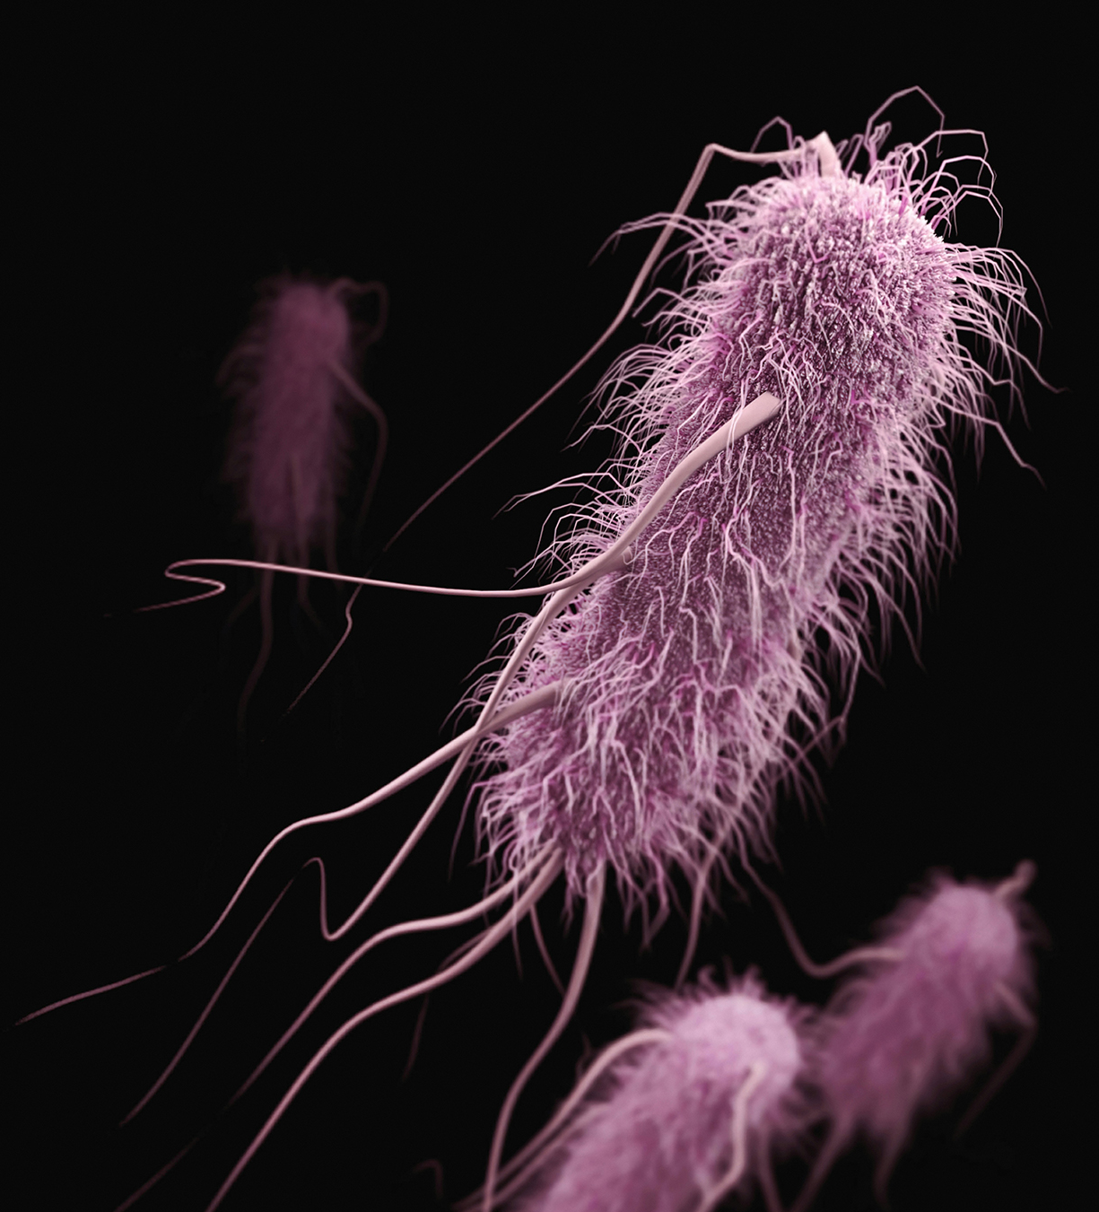
Flagella and Cilia₁
Flagella are long, whip-like structures that extend from the plasma membrane and enable cell movement.
Examples: Sperm, Euglena, and some prokaryotes
Cilia are short, hairlike structures that extend from the plasma membrane and move entire cells or substances along the cell’s outer surface
Found in Fallopian tubes and the respiratory tract
4.4 Figure 6
CDC on Unsplash. "E. coli."

Slide 11
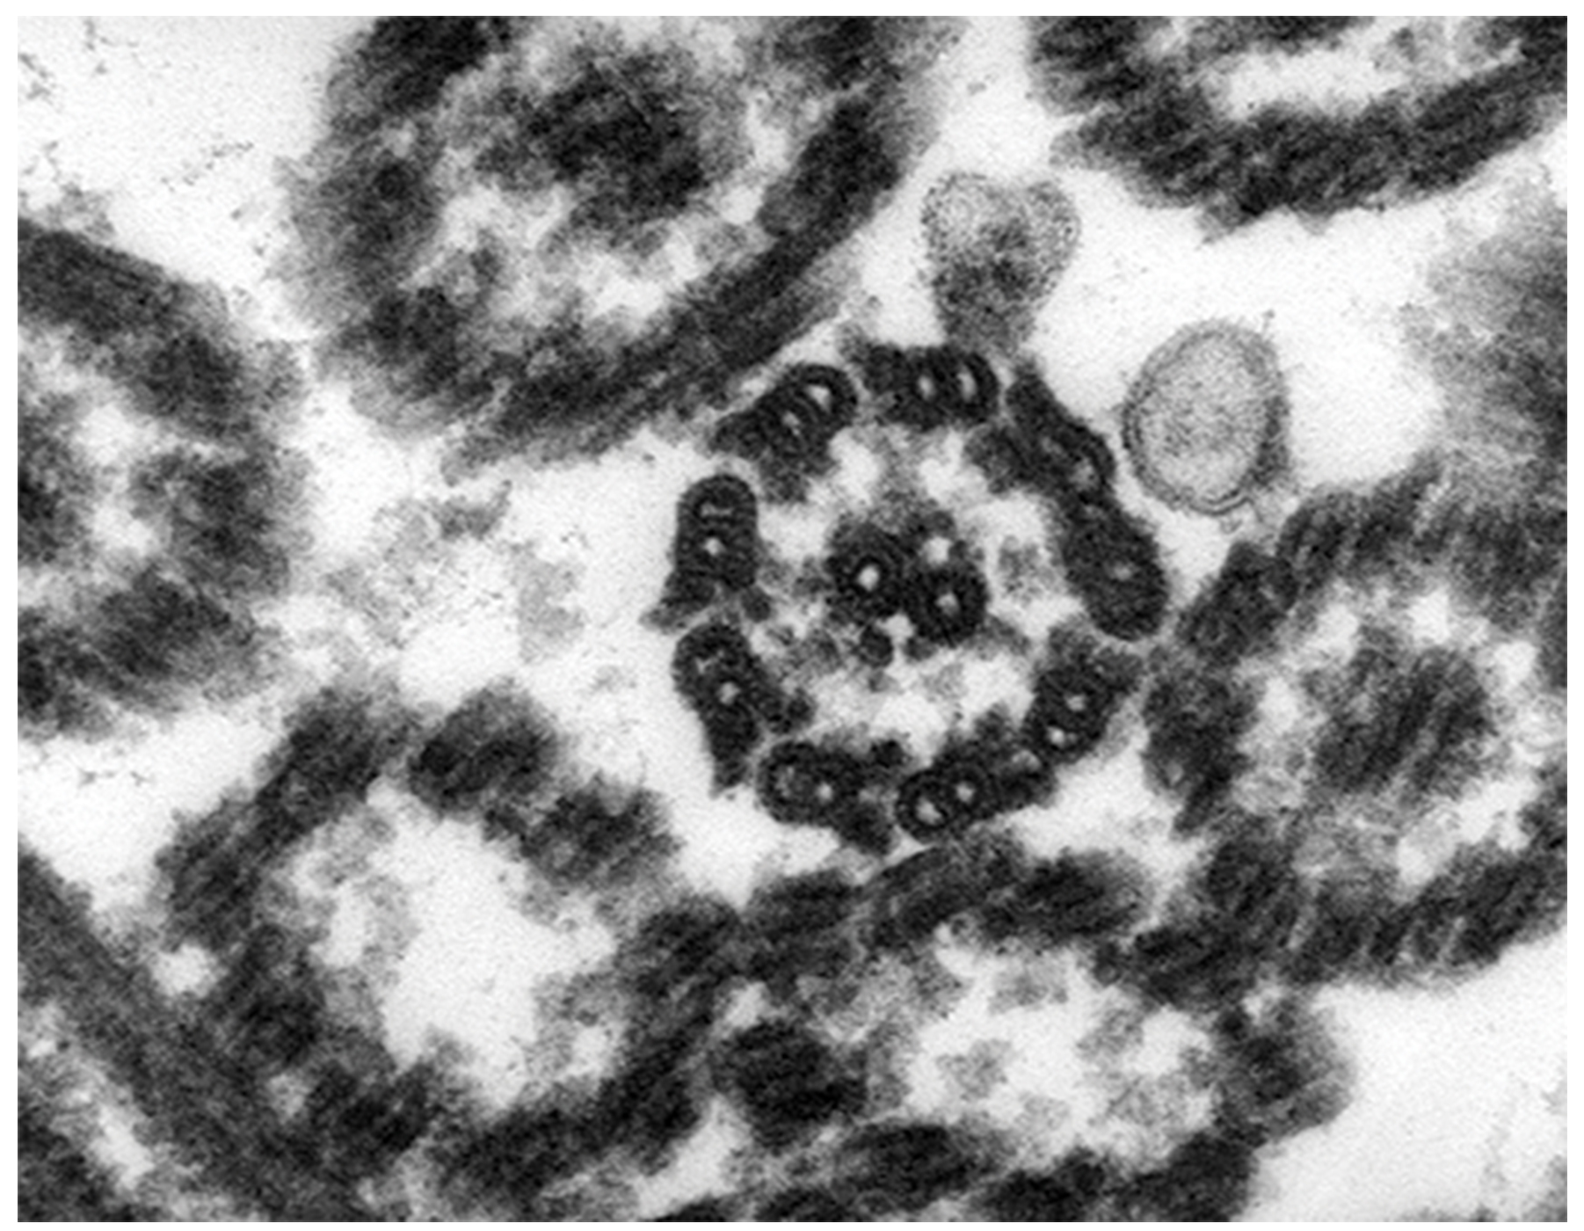
Flagella and Cilia₂
Flagella and cilia have a common "9+2" microtubule arrangement.
This consists of 9 microtubule doublets surrounding 2 central microtubules.
4.4 Figure 7
Darthmouth College on Wikimedia Commons. "Green algae."

Slide 12
Table 1: Components of Prokaryotic and Eukaryotic Cells₁
Cell Component | Function | Present in Prokaryotes? | Present in Animal Cells? | Present in Plant Cells?
plasma membrane | separates cell from external environment; controls passage of organic molecules, ions, water, oxygen, and wastes into and out of cell | yes | yes | yes
cytoplasm | provides turgor pressure to plant cells as fluid inside the central vacuole; site of many metabolic reactions; medium in which organelles are found | yes | yes | yes
nucleolus | darkened area within the nucleus where ribosomal subunits are synthesized | no | yes | yes

Slide 13
Table 1: Components of Prokaryotic and Eukaryotic Cells₂
Cell Component | Function | Present in Prokaryotes? | Present in Animal Cells? | Present in Plant Cells?
nucleus | cell organelle that houses DNA and directs synthesis of ribosomes and proteins | no | yes | yes
ribosomes | protein synthesis | yes | yes | yes
mitochondria | ATP production and cellular respiration | no | yes | yes
peroxisomes | oxidize and break down fatty acids and amino acids; detoxify poisons | no | yes | yes
vesicles and vacuoles | storage and transport; digestive function in plant cells | no | yes | yes

Slide 14
Table 1: Components of Prokaryotic and Eukaryotic Cells₃
Cell Component | Function | Present in Prokaryotes? | Present in Animal Cells? | Present in Plant Cells?
centrosome | unspecified role in cell division in animal cells; microtubule source in animal cells | no | yes | no
lysosomes | digestion of macromolecules; recycling of worn-out organelles | no | yes | some
cell wall | protection, structural support, and maintenance of cell shape | yes, primarily peptidoglycan | no | yes, primarily cellulose
chloroplasts | Photosynthesis | no | no | yes
endoplasmic reticulum | modifies proteins and synthesizes lipids | no | yes | yes
Golgi apparatus | modifies, sorts, tags, packages, and distributes lipids and proteins | no | yes | yes

Slide 15
Table 1: Components of Prokaryotic and Eukaryotic Cells₄
Cell Component | Function | Present in Prokaryotes? | Present in Animal Cells? | Present in Plant Cells?
cytoskeleton | maintains cell's shape, secures organelles in specific positions, allows cytoplasm and vesicles to move within cell, and enables unicellular organisms to move independently | yes | yes | yes
flagella | cellular locomotion | some | some | no, except for some plant sperm cells
Cilia | cellular locomotion, movement of particles along plasma membrane's extracellular surface, and filtration | no | some | no

Slide 16
Summary
Cytoskeleton has three protein elements: microfilaments, intermediate filaments, and microtubules (narrowest to widest).
Microfilaments provide rigidity, shape, and enable movements with myosin.
Intermediate filaments bear tension and anchor organelles.
Microtubules provide resistance to compression, as well as transport vesicles and separate chromosomes.
Microtubules form centrioles, flagella, and cilia.

Slide 17


End of Hawkes Learning PowerPoint

