Slide 1
Lesson 40.1
Asexual and Sexual Reproduction

Slide 2
Objectives
Discuss asexual reproduction methods and their advantages.
Discuss sexual reproduction methods and their advantages.
Discuss internal and external methods of fertilization.
Describe the methods used by animals for development of offspring during gestation.
Describe the anatomical adaptions that occurred in animals to facilitate reproduction.
Describe advantages and disadvantages of asexual and sexual reproduction.

Slide 3
The Reproductive System₁
Reproduction is necessary for the survival of a species.
Asexual reproduction: produces genetically identical clones
Sexual reproduction: combines genetic material to produce genetically different offspring
Producers of sperm are called males; producers of eggs are called females.

Slide 4
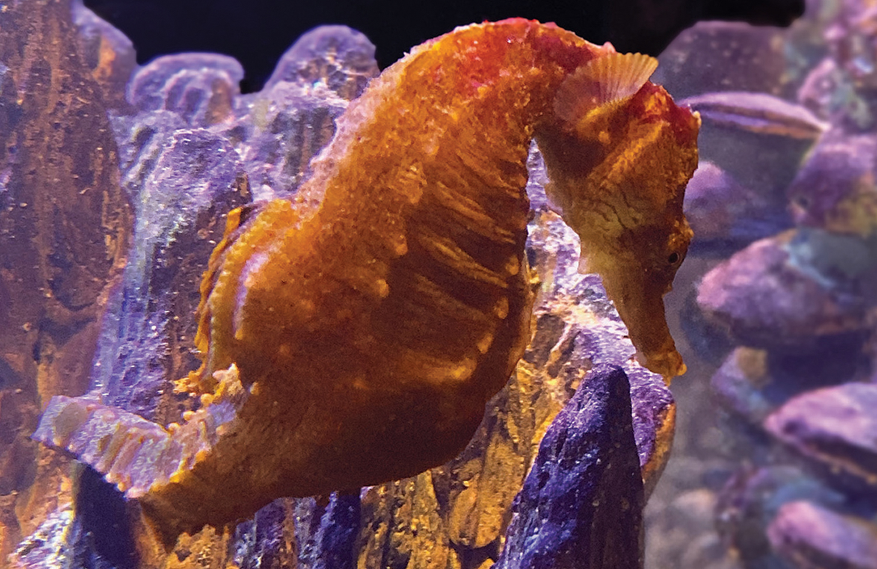
The Reproductive System₂
Parental care and sexual behavior are not universal in kingdom Animalia.
Internal vs. external fertilization
Seahorses: external; female lays eggs in the male's abdominal brood pouch where they are then fertilized
40.1 Figure 1
Betty Wills on Wikimedia Commons. "Orange seahorse."

Slide 5
Asexual Reproduction
Asexual reproduction produces genetically identical offspring (clones) from a single parent.
Advantages: rapid production of large numbers of offspring adapted to stable environments, easier colonization of new habitats since a mate is not needed
Disadvantages: may not survive unstable environments due to a lack of genetic variation

Slide 6
Think It Through₁
List one advantage and one disadvantage of asexual reproduction.
Notes:
Originally an On Your Own. This is included here to use as a talking point or for a think-pair-share activity.

Slide 7
Sexual Reproduction
Sexual reproduction combines genetic material of two individuals, creating genetically diverse offspring.
Potentially advantageous in unpredictable/changing environments
Must have a way to produce two different types of gametes (male and female)
Invertebrates: hermaphroditic individuals (those with male and female reproductive organs)
Vertebrates: presence of both male and female individuals

Slide 8
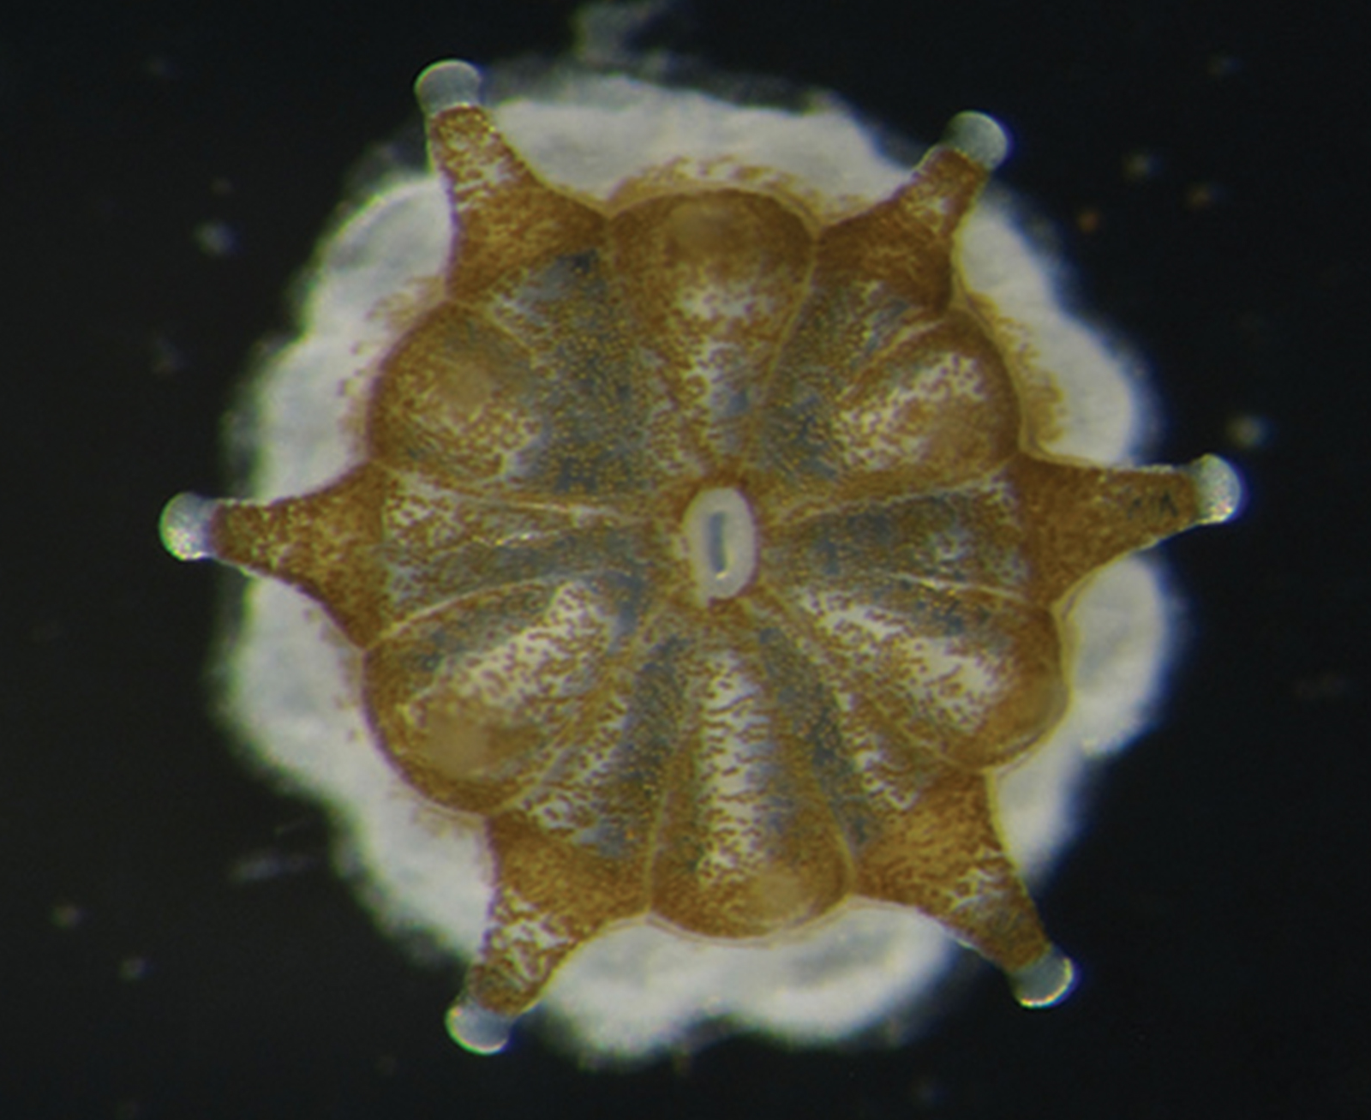
Asexual Reproduction: Fission
Fission (binary fission) is a method of asexual reproduction in various organisms.
An organism splits into two separate organisms after a period of growth.
Some unicellular eukaryotic organisms undergo binary fission through the process of mitosis.
In certain organisms, a part of the individual separates to form a second individual.
40.1 Figure 2: Coral polyps reproduce asexually by fission.
Narrissa Spies on Wikimedia Commons. "Coral polyps."

Slide 9
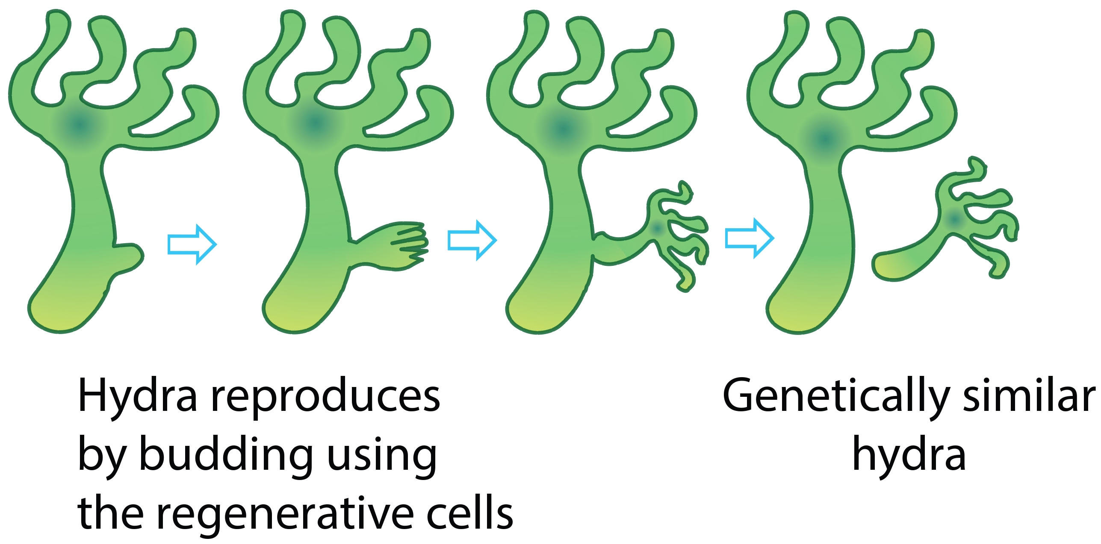
Asexual Reproduction: Budding
Budding: asexual reproduction resulting from outgrowth of a cell or body region
Leads to the separation of the original organism into two distinct individuals
Occurs commonly in some invertebrate animals, such as corals and hydras
Hydras: a bud forms, develops into an adult, and breaks away from the main body
Corals: the bud remains attached, contributing to the growth of a new colony
40.1 Figure 3

Slide 10
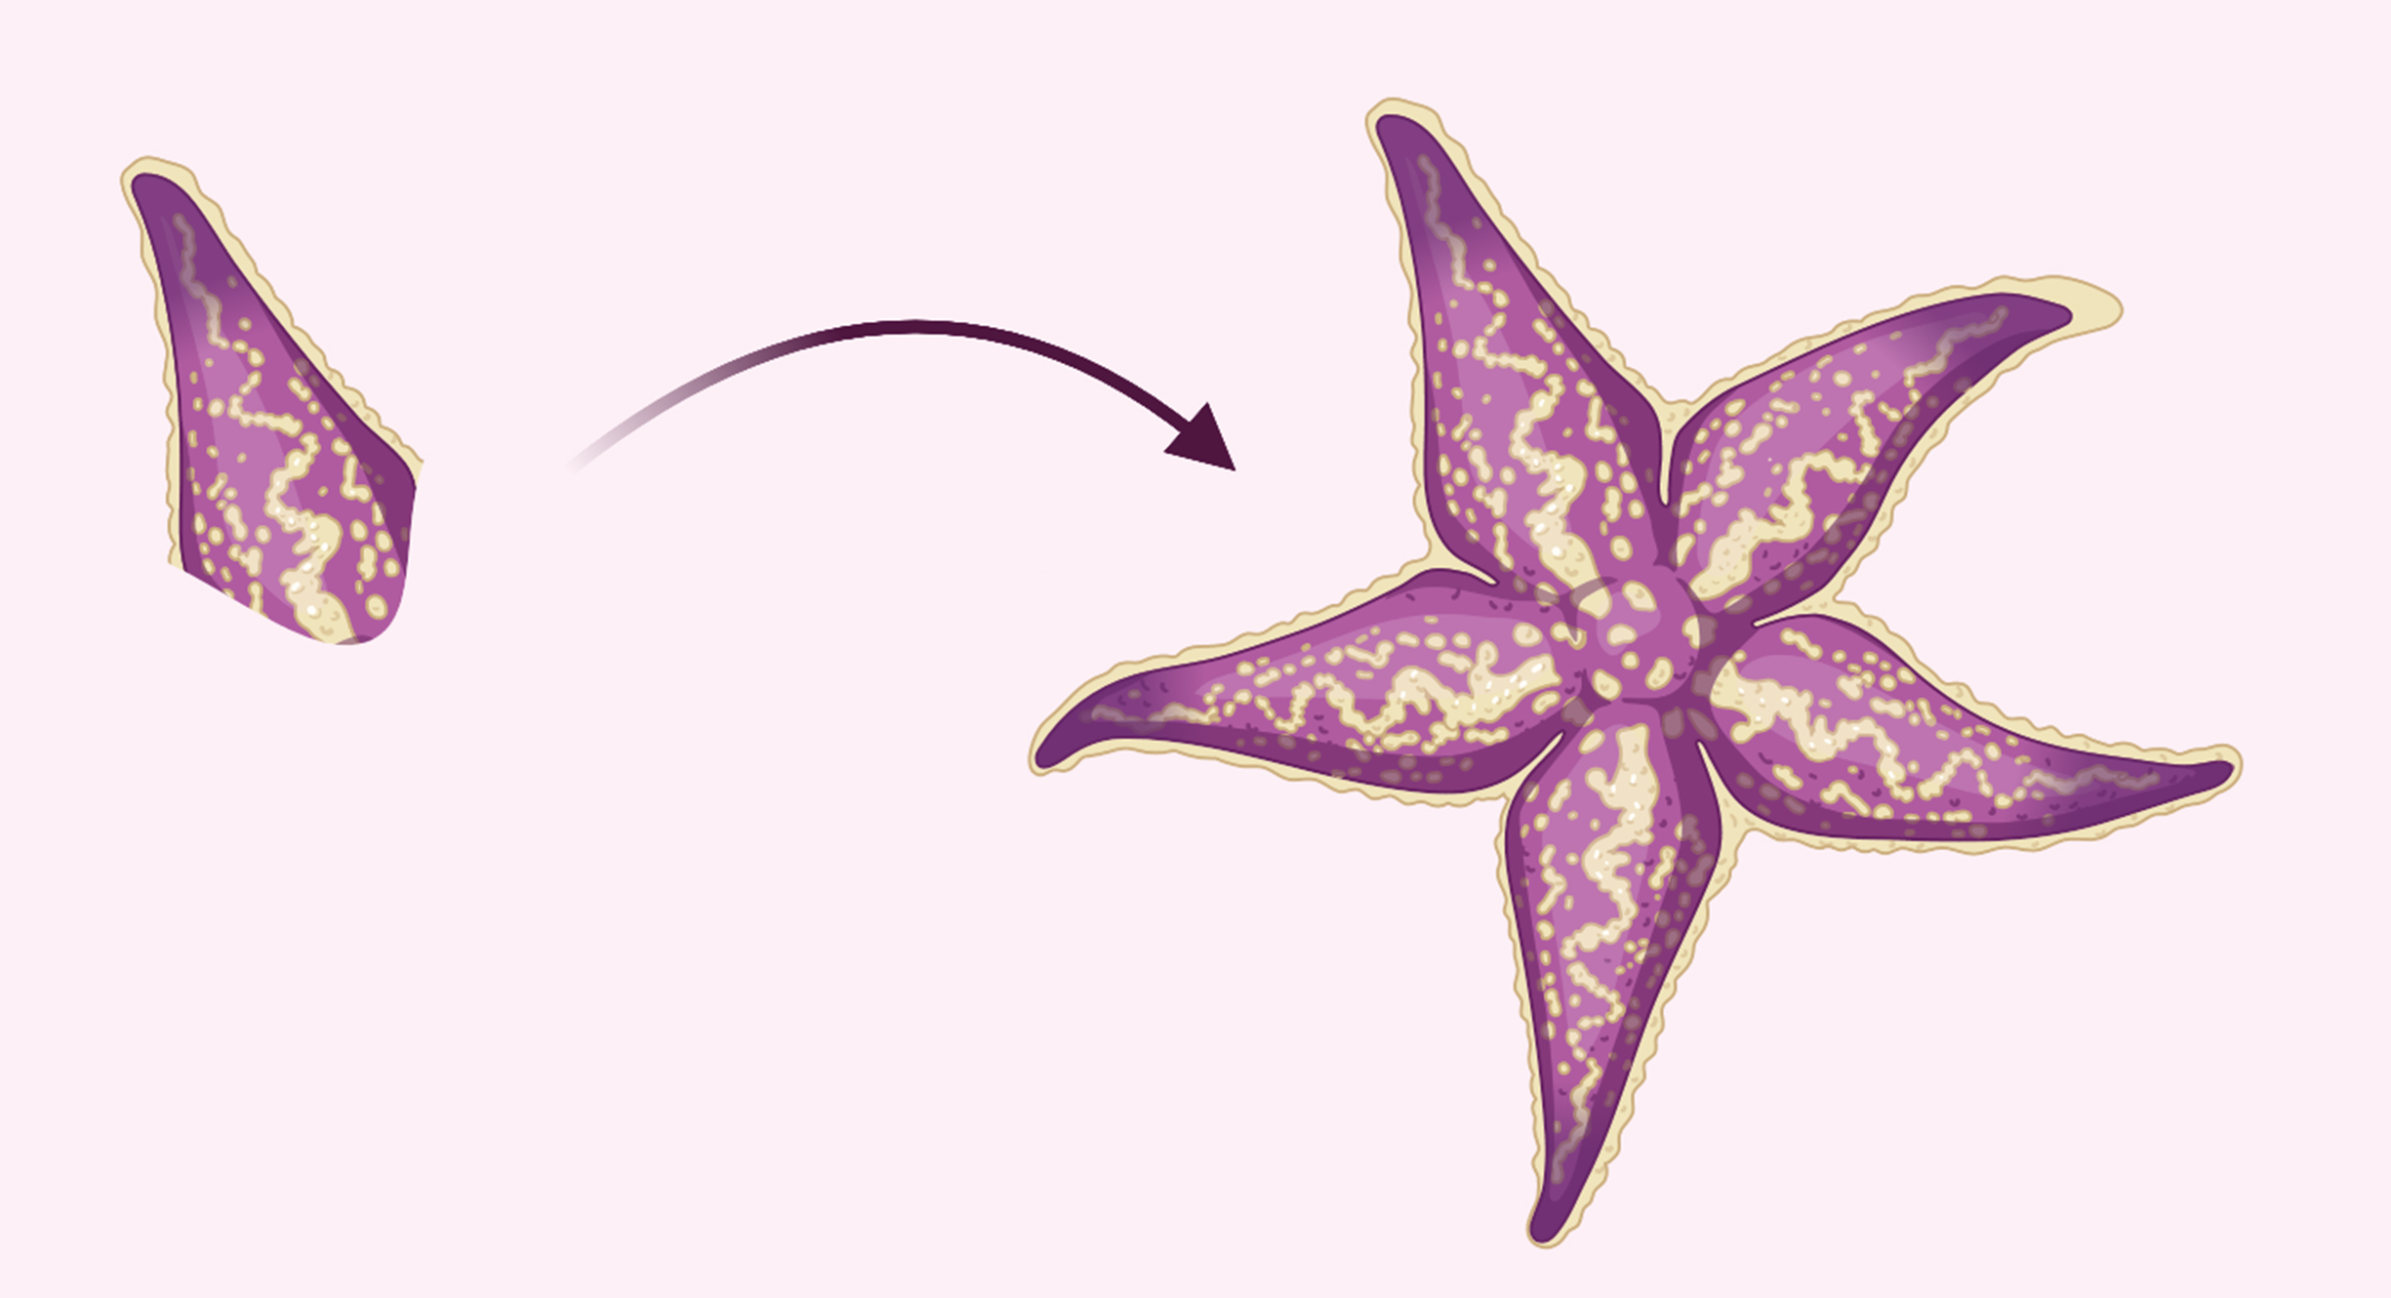
Asexual Reproduction: Fragmentation
Fragmentation involves breaking of the body into two parts with subsequent regeneration.
If the fragmented part is large enough, can regrow into a separate individual
Sea stars: reproduce through fission or fragmentation; a detached arm can regenerate into a new sea star
Occurs in various invertebrates including annelid worms, turbellarians (flatworms), and poriferans (sponges)
Differs from fission in that it typically results in individuals of noticeably different sizes
40.1 Figure 4
HDRB on Wikimedia Commons. "Starfish regeneration."

Slide 11
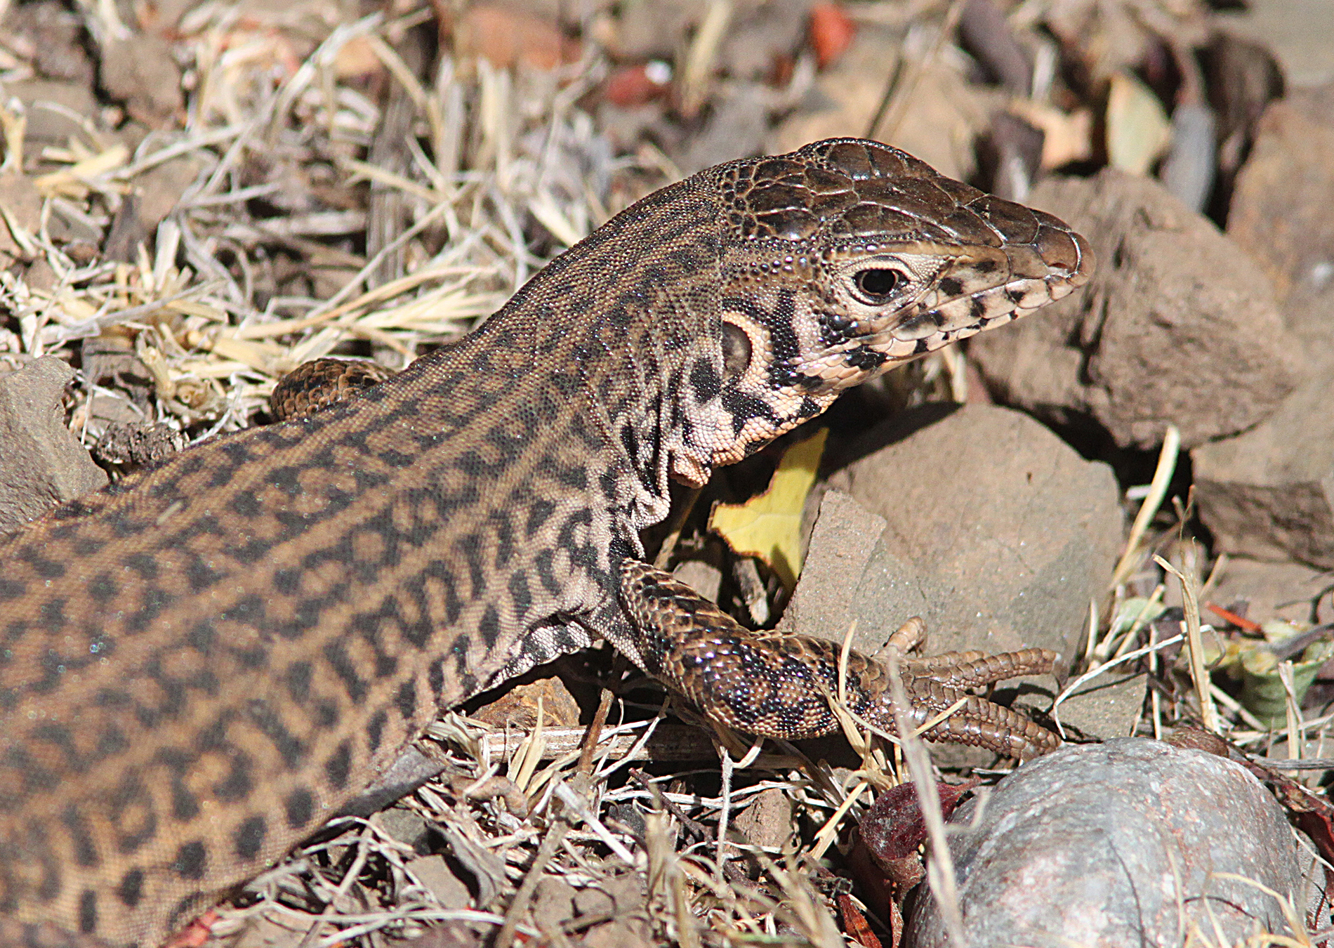
Asexual Reproduction: Parthenogenesis
Parthenogenesis is asexual reproduction where an unfertilized egg develops into a complete individual.
Haploid or diploid offspring, depending on the process and species involved
Common in invertebrates such as water fleas, rotifers, aphids, stick insects, and some ants, wasps, and bees
Bees: produce haploid males (drones), while fertilized eggs become diploid females
Observed in some vertebrates, including certain reptiles, amphibians, and fish species
40.1 Figure 5: Cnemidophorus lizards, such as Cnemidophorus tigris, can reproduce via parthenogenesis.
ALAN SCHMIERER on Wikimedia Commons. "California whiptail."

Slide 12
Think It Through₂
Select the correct type of asexual reproduction for each description.
An individual develops from an unfertilized egg.
One multicellular body breaks up into two and undergoes growth, becoming a viable individual in the process.
A unicellular organism splits into two.
A small part of the body breaks off and becomes an individual.
Notes:
Originally an On Your Own. This is included here to use as a talking point or for a think-pair-share activity.

Slide 13
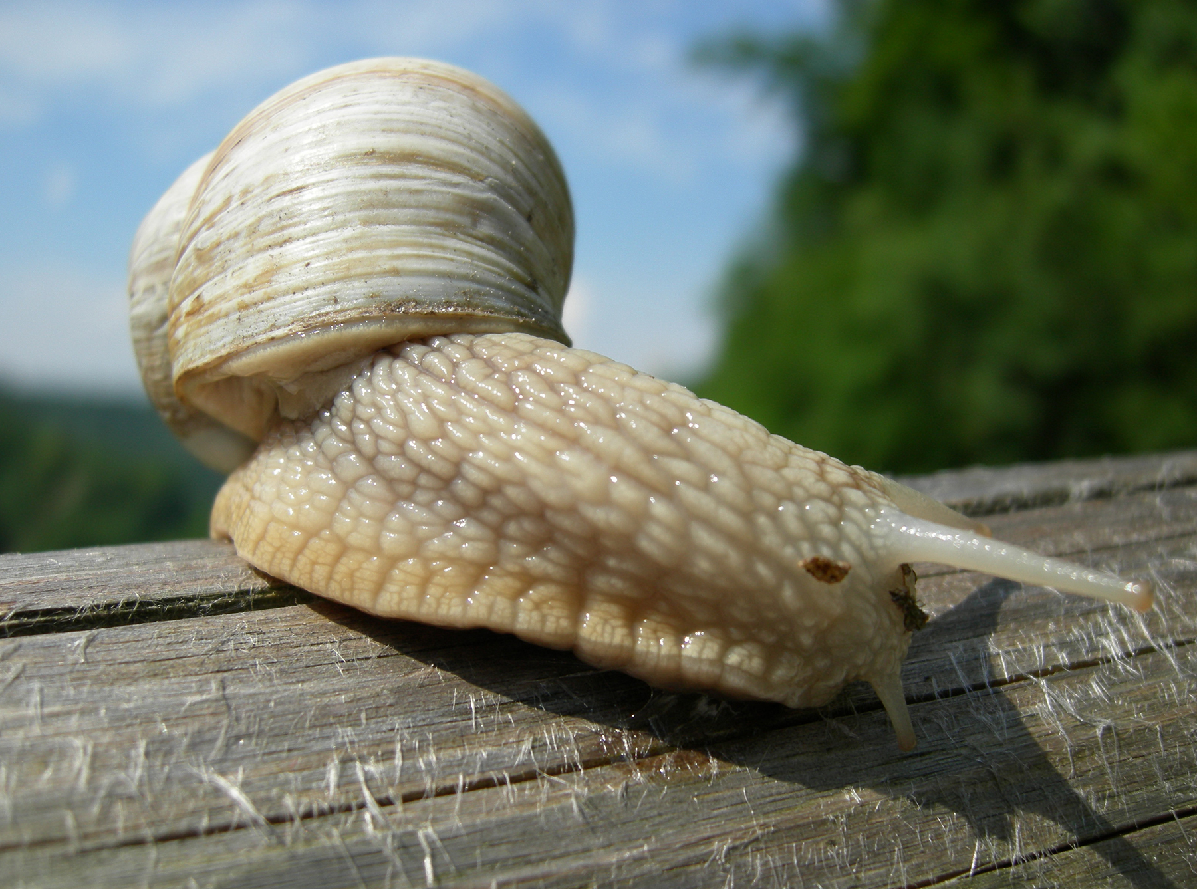
Sexual Reproduction: Hermaphroditism
Hermaphroditism occurs when one individual has both male and female reproductive parts.
Common in invertebrates such as earthworms, slugs, tapeworms, and snails
Includes self-fertilization or mating with another individual, both producing offspring
40.1 Figure 6: Many snails are hermaphrodites. When two individuals mate, they can produce up to one hundred eggs each.
Pinky sl on Wikimedia Commons. "Snail."

Slide 14
Sex Determination₁
Mammalian sex determination is genetically based on X and Y chromosomes.
XX individuals are female; XY individuals are male.
Y chromosome triggers male development.
Avian sex determination relies on Z and W chromosomes.
ZZ individuals are male; ZW individuals are female.
W chromosome plays a key role in determining sex.

Slide 15
Science and You
Chromosomal sex in humans isn't always XX or XY.
Turner syndrome results from an XO genotype, leading to individuals with female characteristics.
Includes reproductive challenges and possible delayed growth
Another example is Klinefelter syndrome, where "males" are genotypically XXY.
May produce nonfunctional sperm
May develop some female characteristics
Notes:
This is included as a relevant application for this topic.

Slide 16
Sex Determination₂
Some species exhibit environmental sex determination, such as temperature-dependent sex determination in reptiles.
Varies across species
Crocodiles: males from moderate temperatures, females from warm temperatures
Sex affected by both genetics and temperature in some species
Some species change sex during their lives, known as protogyny (first female) or protandry (first male).
Oysters: born male, grow, become female, and lay eggs

Slide 17
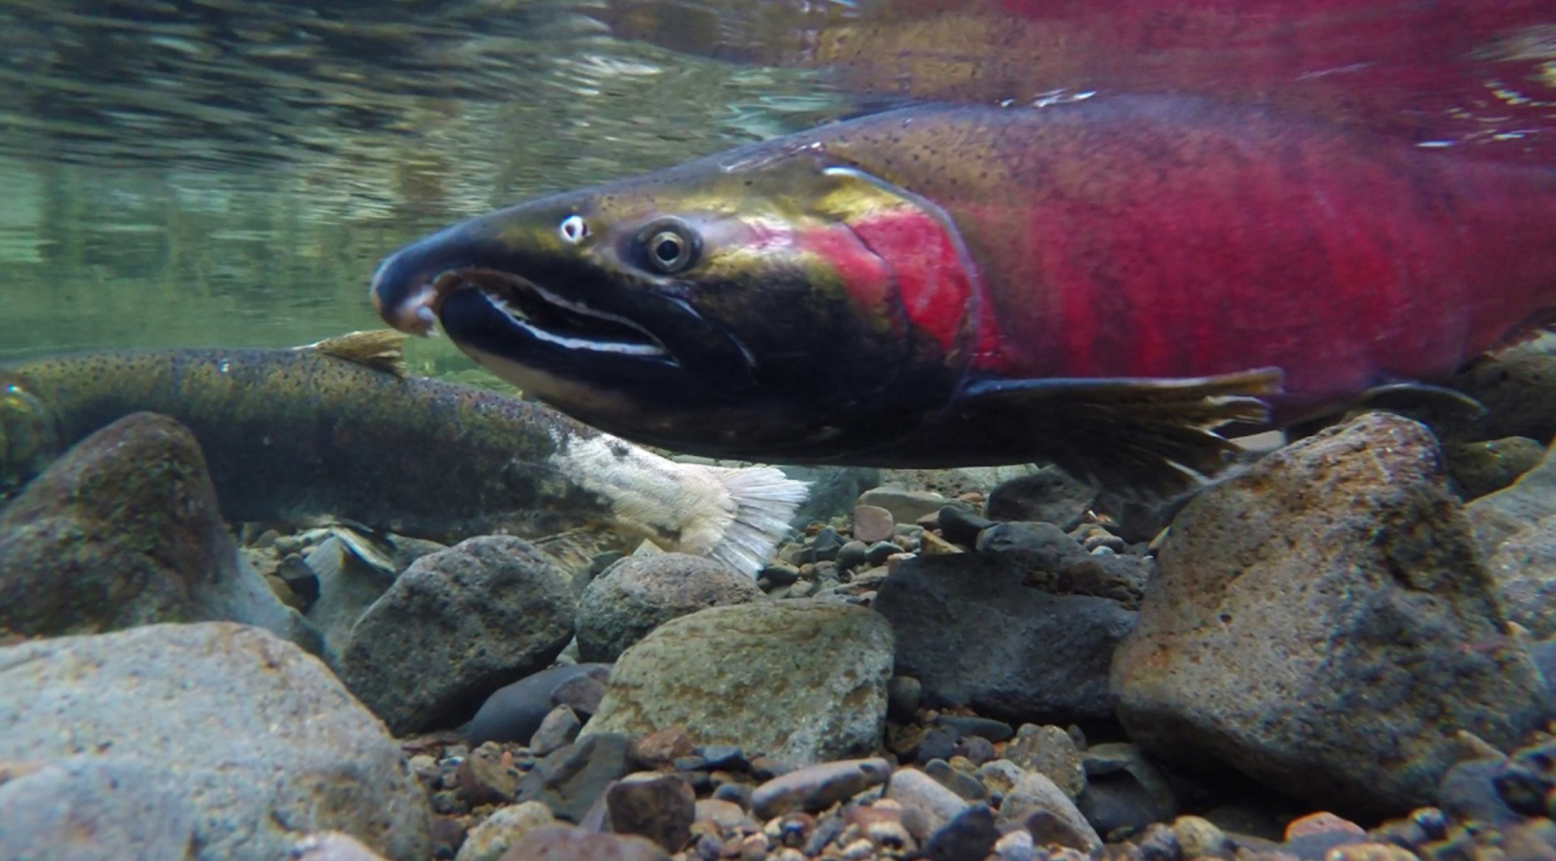
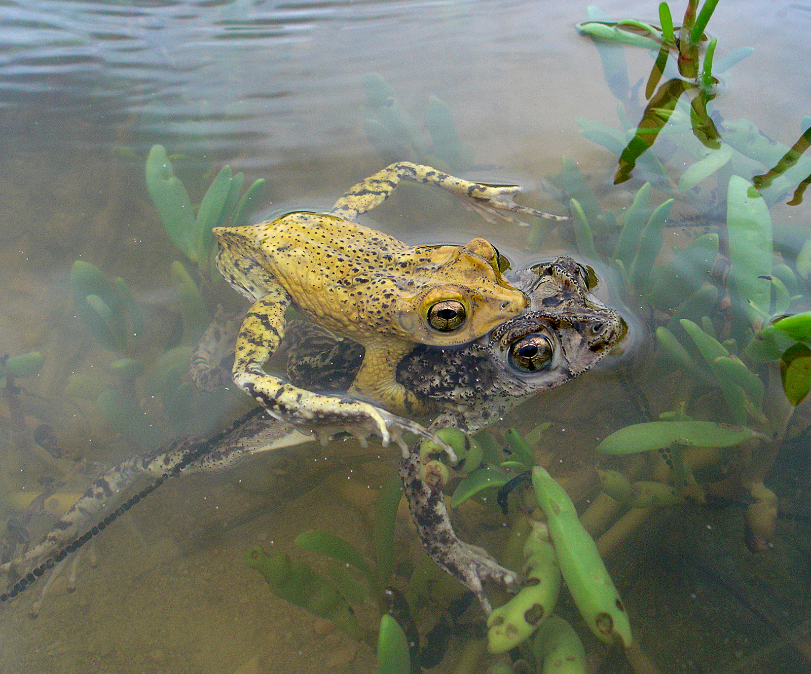
External Fertilization₁
External fertilization typically occurs in aquatic environments where eggs and sperm are released into water.
Mostly during spawning, with synchronized gamete release by males and females
May be triggered by environmental factors
Common in fish, crustaceans, mollusks, squid, echinoderms, toads, and corals
Courtship behavior results in paired external fertilization and increased chances of successful fertilization.
40.1 Figure 7: Salmon reproduce through spawning.
Department of Interior on Wikimedia Commons. "Pacific salmon."
40.1 Figure 8
Jan P. Zegarra on Wikimedia Commons. "Mating frogs."

Slide 18
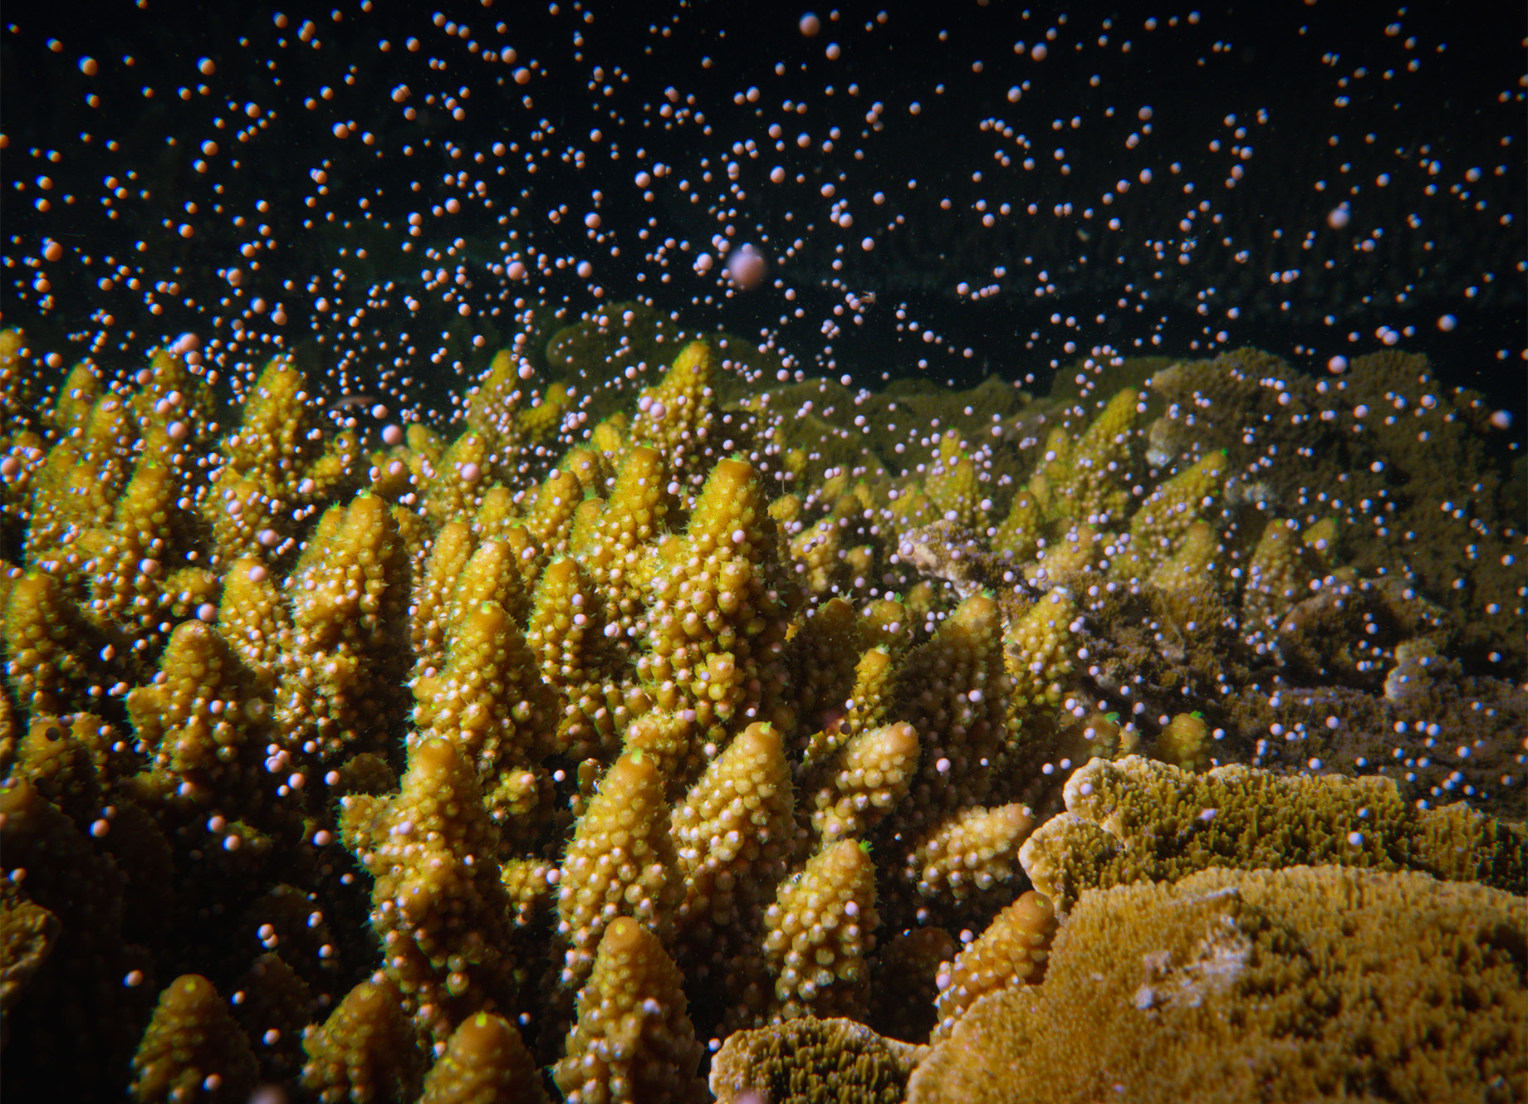
External Fertilization₂
Broadcast spawning results in greater genetic diversity, enhancing species survival in hostile environments.
Sponges: only option; crucial for fertilization and colonization
Risk of predation
Low egg survival rate
40.1 Figure 9: Stony coral (Acropora spp.) reproduce by broadcast spawning. They release their eggs and sperm into the water column, where fertilization and larval development occur.

Slide 19
Internal Fertilization: Oviparity
Internal fertilization occurs mostly in land-based animals and some aquatic species.
Three types: oviparity, ovoviviparity, and viviparity
Oviparity involves laying fertilized eggs outside the female's body, with embryos nourished by egg yolk.
Occurs in most bony fish, reptiles, cartilaginous fish, amphibians, two mammals, and all birds
Reptiles and insects: leathery eggs
Birds and turtles: hard eggs with high levels of calcium carbonate (CaCO₃)

Slide 20
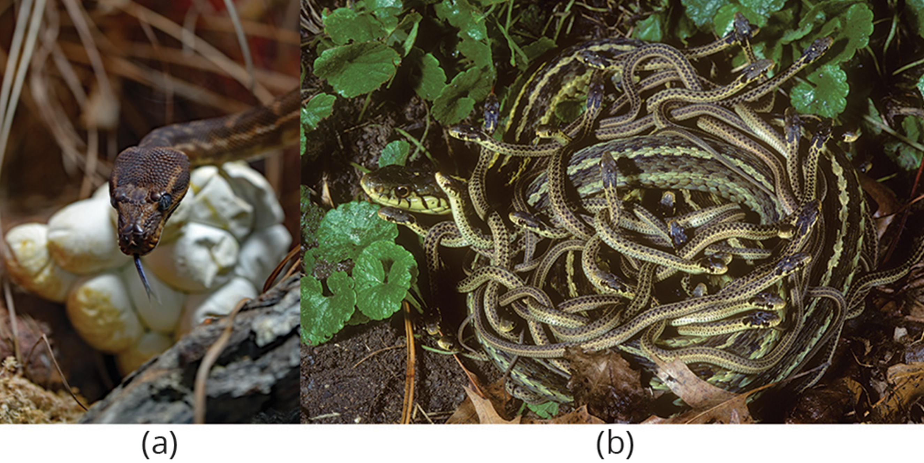
Internal Fertilization: Ovoviviparity
Ovoviviparity retains fertilized eggs in the female, with embryos obtaining nourishment from egg yolk.
Occurs in some bony fish, sharks, lizards, snakes, vipers, and invertebrate animals
40.1 Figure 10: (a) A majority of snake species are oviparous and lay eggs outside of the body. (b) However, some species of snake are ovoviviparous and retain the eggs inside of their body until they hatch, resulting in live birth.
David Clode on Unsplash. "Snake."

Slide 21
Internal Fertilization: Viviparity
Viviparity involves embryo development within the female, nourished by the mother's blood through a placenta.
Occurs in most mammals, some cartilaginous fish, and a few reptiles
Internal fertilization has the advantage of protecting fertilized eggs from dehydration.
Limits predation by keeping embryo isolated
Enhances egg fertilization by a specific male
Produces fewer offspring, but higher survival rate

Slide 22
Table 1: Key Differences in the Three Types of Internal Fertilization
 | Oviparity | Ovoviviparity | Viviparity
Type of Fertilization | internal or external | internal | internal
Laying Eggs | yes | yes | no
Nutrients to the Embryo | from the egg yolk | from the egg yolk | directly from the female
Placental Connection | no | no | yes
Embryo Development | outside of the female's body | inside of the female's body | inside of the female's body

Slide 23
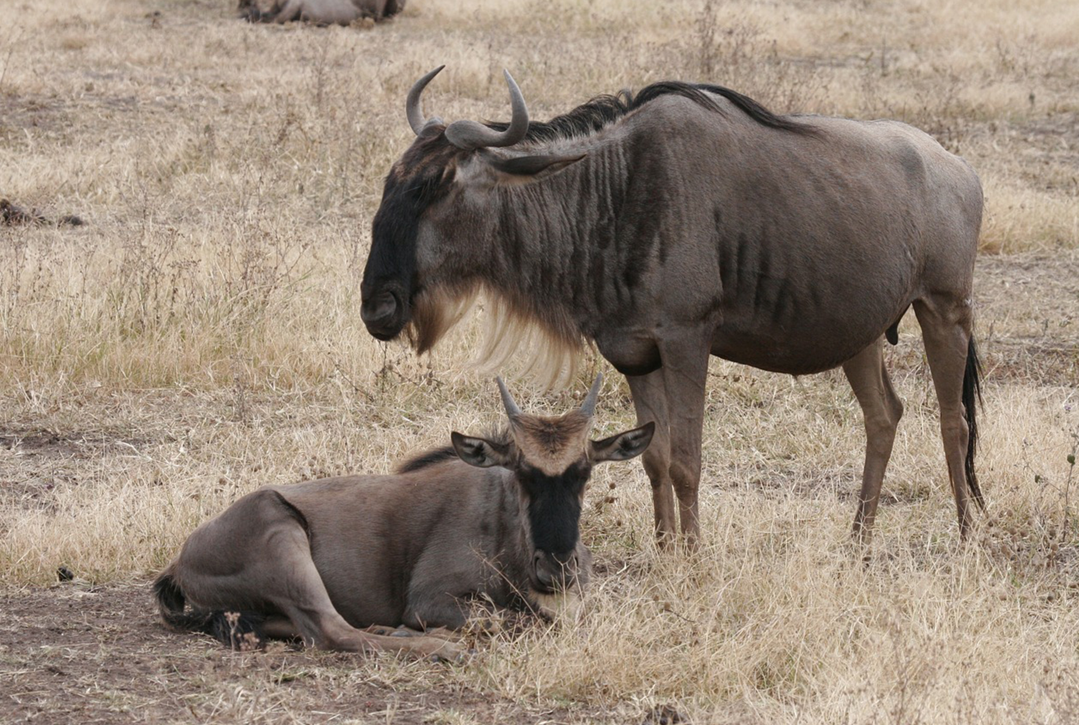
The Evolution of Reproduction
Annelids: produce and store sperm and eggs in their coelom
Release through excretion or by the body splitting open
Gonads: specialized reproductive organs that produce sperm and eggs through meiosis
Insects: complete reproductive systems with separate sexes and specialized structures
Sperm: made in the testes
Eggs: mature in the ovary
Spermatheca: a specialized sac which stores sperm for later use
Fertilization: can be timed for optimal offspring survival conditions
40.1 Figure 11: Wildebeests are seasonal breeders that mate during the dry season, between May and July, and give birth during the wet season, between January and March. The rains that fall on the African plains bring food that is optimal for offspring survival.
carolehenderson on Pixabay. "Wildebeest."

Slide 24
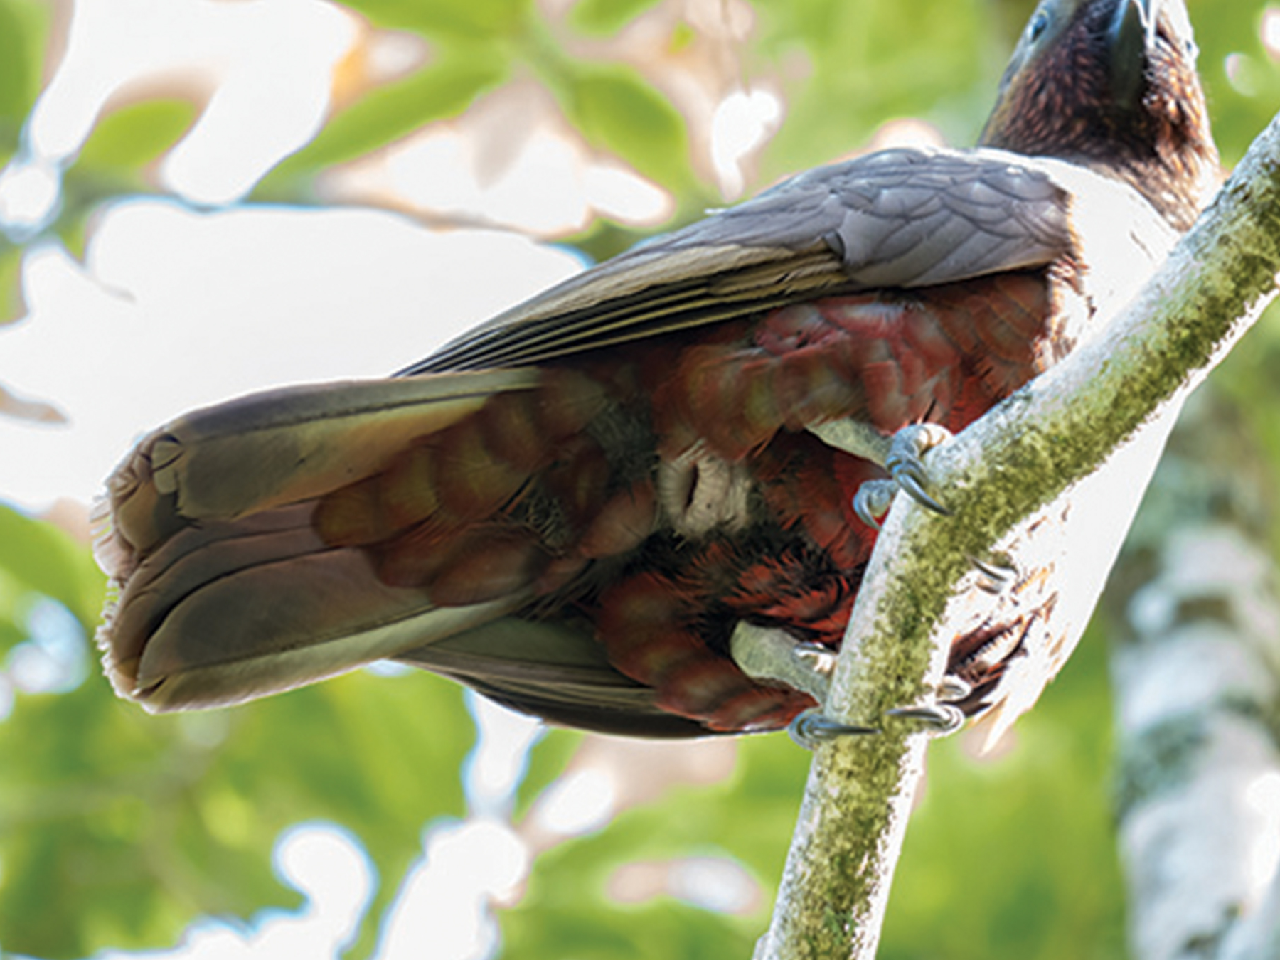
The Evolution of Reproduction₁
Vertebrates evolved similar structures with variations.
Non-mammals have a common body opening: a cloaca (opening for digestive, excretory and reproductive systems).
Mammals have separate openings in the female and a uterus to support developing offspring.
Those that produce many offspring at once have a uterus with two chambers, while those that produce one offspring have a single uterus.
40.1 Figure 12: The bird cloaca, seen here as an opening below the tail, serves the dual purpose of reproduction and excretion.
Judi Lapsley Miller on Wikimedia Commons. "Cloaca."

Slide 25
The Evolution of Reproduction₂
Sperm transfer from male to female varies.
Release of sperm into a watery environment for external fertilization
Joining of the cloaca in birds
Development of a penis for direct delivery into the female's vagina in mammals

Slide 26
Summary
Reproduction can be asexual (genetically identical offspring) or sexual (genetically diverse offspring).
Asexual reproduction occurs through fission, budding, and fragmentation.
Sexual reproduction involves fertilization, the combination of sperm and egg, either internally or externally.
Fertilization methods and subsequent embryo development vary among species.
Animal anatomy has evolved diverse ways to fertilize, hold, or expel eggs and develop offspring.

Slide 27

End of Hawkes Learning PowerPoint

