Slide 1
Lesson 40.2
The Germline and Gametogenesis

Slide 2
Objectives
Describe human male and female reproductive anatomies.
Discuss the human sexual response.
Describe spermatogenesis and oogenesis and discuss their differences and similarities.

Slide 3
The Germline and Gametogenesis
Complex animals evolved specific organs and systems for reproduction.
Reproductive structures in land animals enable mating, internal fertilization, and offspring development.
Essential for the continuation of species and genetic diversity

Slide 4
Human Reproductive Anatomy
Male and female reproductive tissues develop similarly in utero until testosterone release.
Testosterone leads to the development of male sexual organs.
Absence of testosterone leads to the development of female sexual tissues.
Primitive gonads become testes or ovaries.
The penis and clitoris, as well as the scrotum and labia, are homologous structures.

Slide 5
Male Reproductive Anatomy
The scrotum houses the testicles (testes) and provides passage for blood vessels, nerves, and muscles related to testicular function.
Testes are a pair of male reproductive organs that produce sperm and some reproductive hormones.
Approximately 2.5 by 3.8 centimeters in size
Divided into lobules containing seminiferous tubules

Slide 6
Sperm₁
External location of scrotum and penis maintains proper temperature for sperm motility.
Infertility can occur in land mammals if testes do not descend through the abdominal cavity during fetal development.
Sperm mature in seminiferous tubules coiled in the testes.
Sertoli cells protect and promote sperm development.
Interstitial cells of Leydig produce testosterone during adolescence.

Slide 7
Sperm₂
When sperm are nearly mature, they leave the testes and enter the epididymis.
Resembles a comma, lies along the top of the testes
Site of sperm maturation
Sperm leave the epididymis and enter the vas deferens.
Carries the sperm behind the bladder and forms the ejaculatory duct
Partly removed during vasectomy (male sterilization) to prevent fertilization

Slide 8
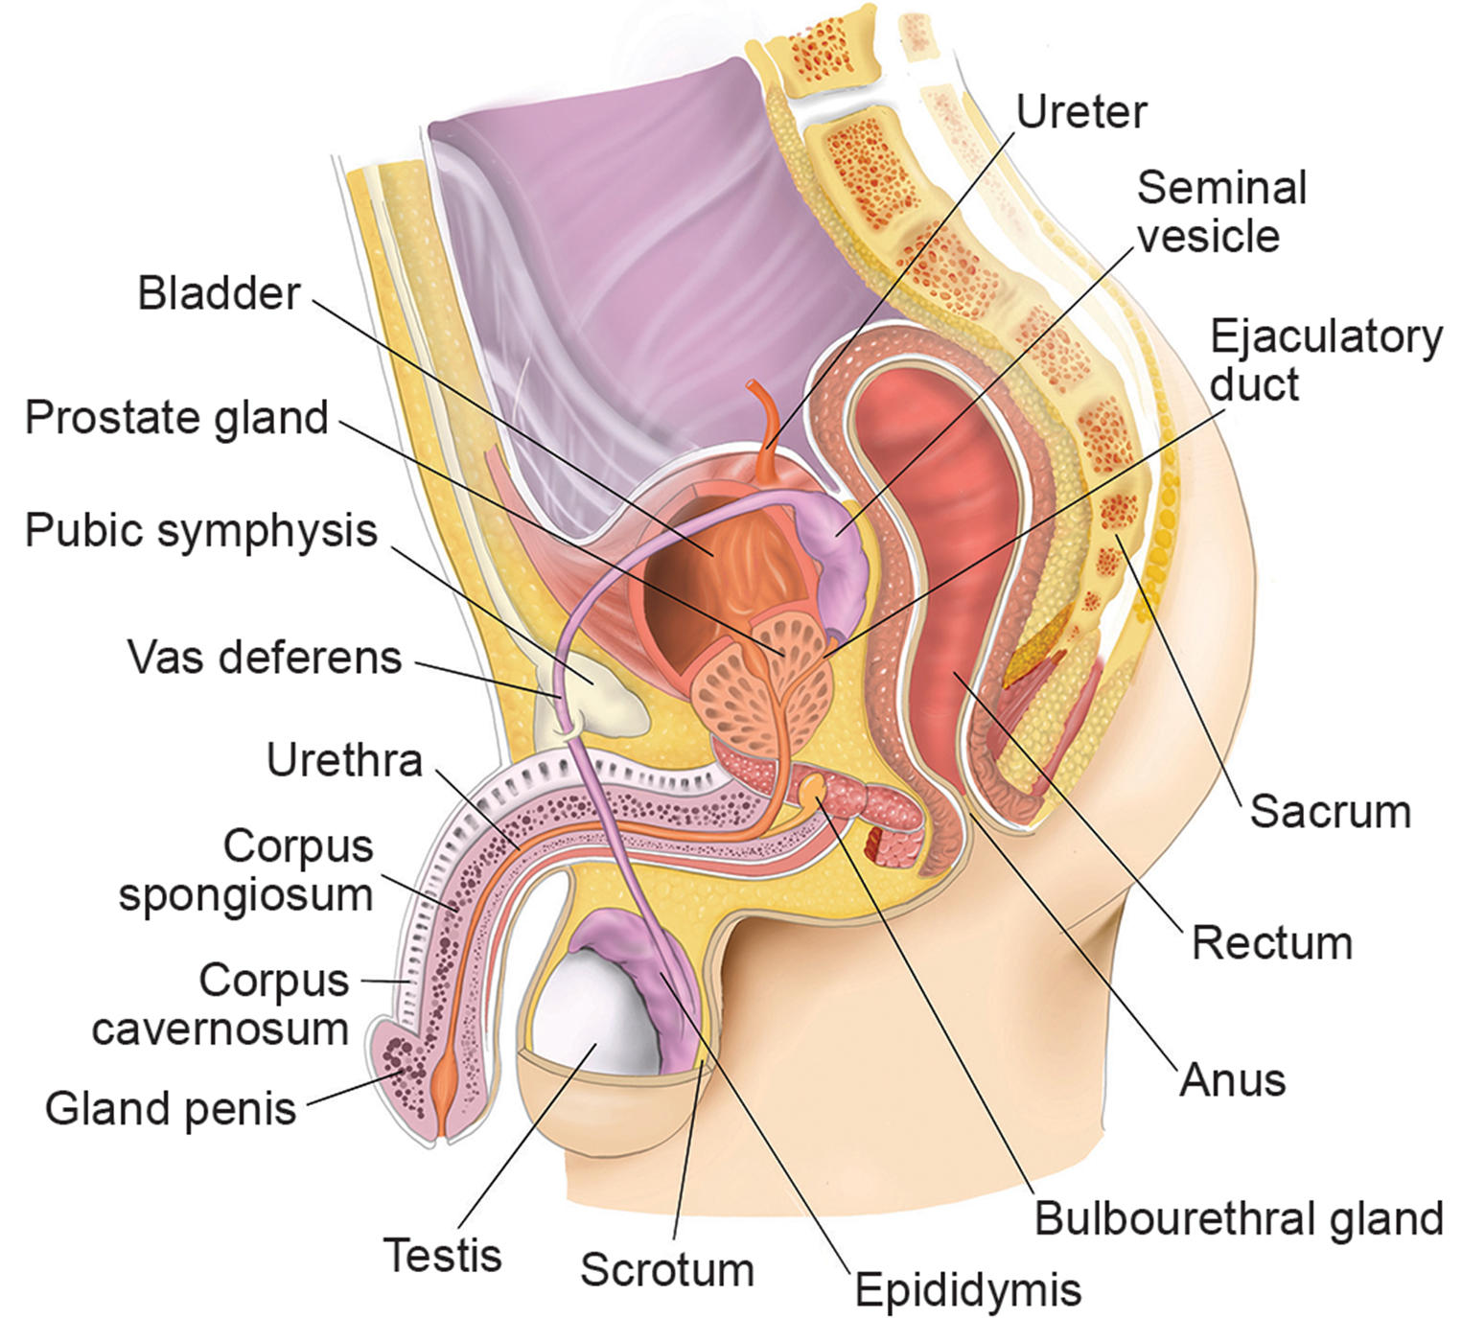
40.2 Figure 1

Slide 9
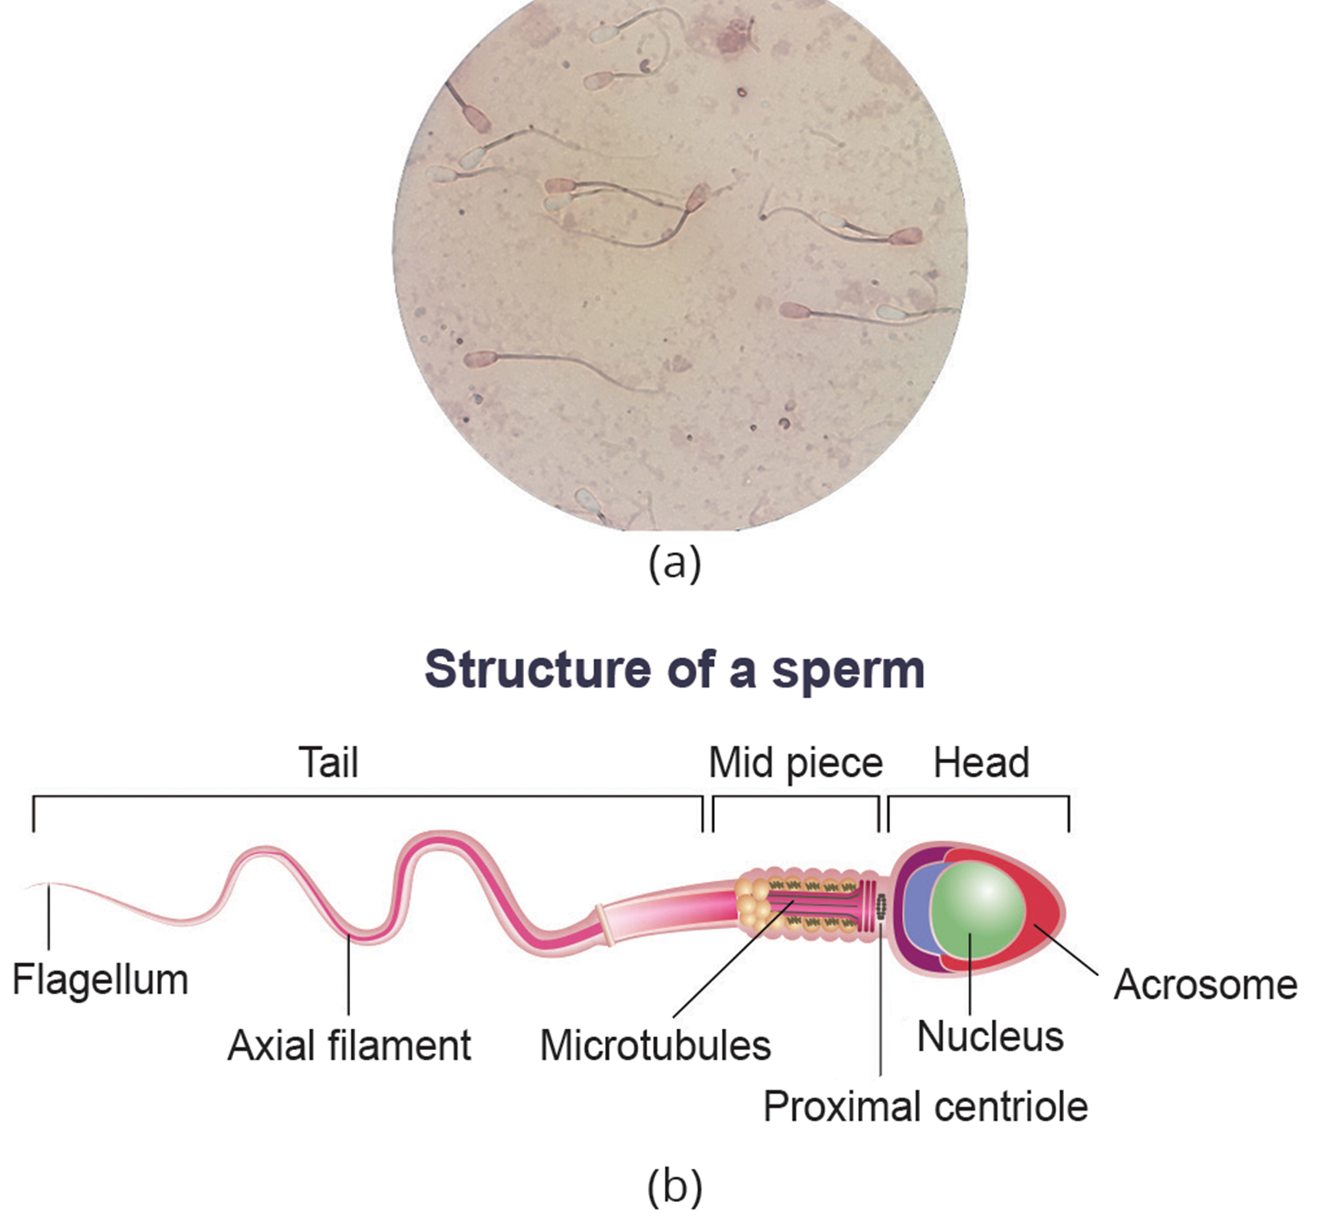
Semen
Semen is a mixture of sperm, spermatic duct secretions, and fluids from accessory glands.
Sperm have a head (with acrosome), neck (with mitochondria), and flagellum (tail).
The acrosome contains enzymes that help the sperm penetrate and fertilize the egg.
An ejaculate contains 2–5 milliliters of fluid with 50–120 million sperm per milliliter.
40.2 Figure 2: (a) This is a magnification of human sperm. (b) This is the anatomy of sperm.
Ghadeer Bustani on Wikimedia Commons. "Sperm viability test."

Slide 10
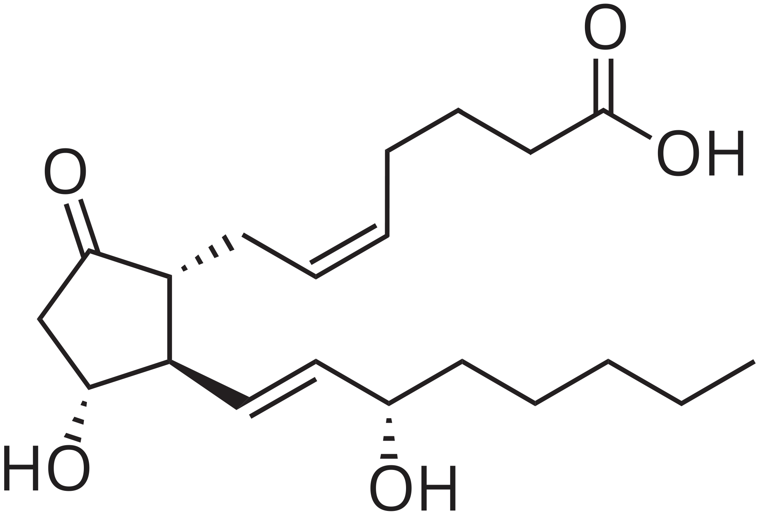
Seminal Vesicles
The seminal vesicles are a pair of glands that lie along the posterior of the urinary bladder.
Produce alkaline fluid to neutralize vaginal acidity
Contains mucus, fructose, a coagulating enzyme, ascorbic acid, and prostaglandins
Account for 60% of semen volume
40.2 Figure 3: Prostaglandin is a local hormone derived from lipids, such as arachidonic acid.
NEUROtiker on Wikimedia Commons. "Prostaglandin chemical structure."

Slide 11
The Penis
The penis drains urine and functions as a copulatory organ during intercourse.
Contains three tubes of erectile tissue: corpus cavernosum (pair of tubes) and corpus spongiosum
Erection: engorgement of erectile tissue with blood
Inserted into vagina during intercourse, culminates in ejaculation
Orgasm: glands/accessory organs contract, then semen expelled through urethra
Becomes flaccid and blood drains from erectile tissue post-intercourse

Slide 12
Prostate and Bulbourethral Glands
The prostate gland surrounds the urethra and produces fluid containing citrate, enzymes, and prostate-specific antigen (PSA).
PSA: proteolytic enzyme that helps liquefy ejaculate minutes after release
Prostate secretions: ~30% of semen volume
The section from the bulbourethral gland (Cowper's gland) neutralizes urethral acidity before ejaculation.
May contain a few sperm, impacting withdrawal methods of contraception

Slide 13
Table 1: A Summary of Male Reproductive Anatomy
Organ | Location | Function
scrotum | external | carry and support testes
penis | external | deliver urine; copulating organ
testes | internal | produce sperm and male hormones
seminal vesicles | internal | contribute to semen production
prostate gland | internal | contribute to semen production
bulbourethral glands | internal | clean urethra at ejaculation

Slide 14
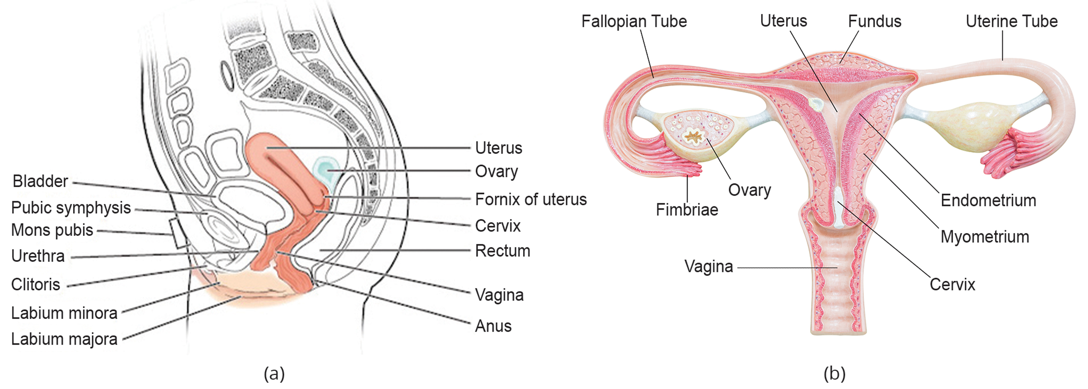
Female Reproductive Anatomy: External₁
Vulva: associated with the vestibule, which includes structures from the groin
Mons pubis: round, fatty area that overlies the pubic symphysis; grows hair during adolescence
Clitoris: structure with erectile tissue; contains sensory nerves and serves as a source of stimulation during intercourse
40.2 Figure 4: The reproductive structures of the human female are shown.

Slide 15
Female Reproductive Anatomy: External₂
Labia majora: pair of elongated folds of tissue that enclose other components of the vulva; grows hair during adolescence
Labia minora: thin folds of tissue central in the labia majora; hairless
Vestibular glands: at sides of the vaginal opening; provide lubrication during intercourse
Breasts: consist of mammary glands and fat; contain ducts to provide a nursing child with nutrients and antibodies

Slide 16
Female Reproductive Anatomy: Internal
Ovaries: consist of a medulla and cortex; produce eggs
Medulla: nerves and blood vessels to supply cortex with nutrients/remove waste
Cortex: follicular cells that surround eggs that develop in utero
Oviducts (fallopian tubes): transport eggs to the uterus
Include fringe of fingerlike fimbriae
Fimbriae: help nonmotile eggs enter the tub and move to the uterus
Ciliated walls made of mostly smooth muscle, which work together to move the egg
Usually the site of fertilization
Severed and sealed during tubal ligation (female sterilization)

Slide 17
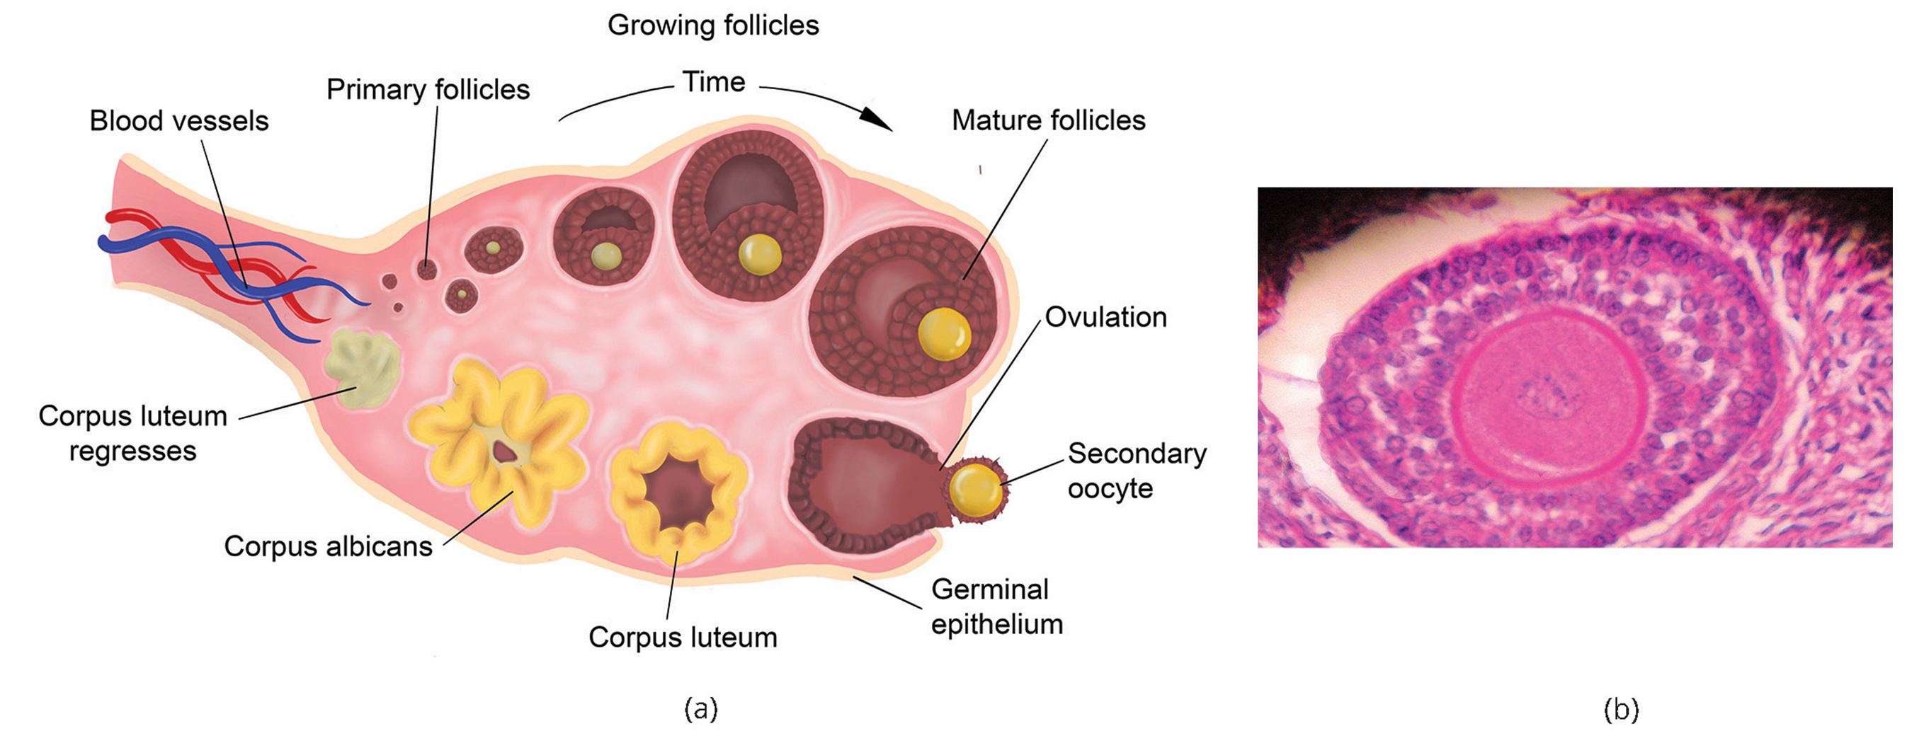
40.2 Figure 5
Jpogi on Wikimedia Commons. "Human ovarian follicle."

Slide 18
The Uterus and Vagina
The uterus supports embryo development during gestation.
Lined with an endometrium rich in blood vessels and mucus glands
Thickest portion made of smooth muscle, which contracts to pass the baby through the vagina
Dismisses and regenerates lining each menstrual period
Cervix: protrudes into top of vagina; functions as birth canal
The vagina is a muscular tube that serves multiple reproductive functions.
Receptacle for penis during intercourse
Vessel for delivery of offspring
Allows menstrual flow to leave the body
Lined by stratified, squamous epithelial cells

Slide 19
Table 2: A Summary of Female Reproductive Anatomy
Organ | Location | Function
clitoris | external | sensory organ
mons pubis | external | fatty area overlying pubic bone
labia majora | external | covers labia minora
labia minora | external | covers vestibule
greater vestibular glands | external | secrete mucus; lubricate vagina
breasts | external | produce and deliver milk
ovaries | internal | carry and develop eggs
oviducts (fallopian tubes) | internal | transport egg to uterus
uterus | internal | support developing embryo
vagina | internal | common tube for intercourse, birth canal, passing menstrual flow

Slide 20
Sexual Response during Intercourse
There are four phases to the sexual response.
In phase one, excitement, vasodilation leads to vasocongestion in erectile tissues in both sexes.
Nipples, clitoris, labia, and penis engorge with blood and enlarge.
Vaginal lubrication occurs.
In phase two, plateau, the outer third of the vaginal wall enlarges with blood, and breathing/heart rate increase.
In phase three, orgasm, there are muscle contractions and ejaculation in males, and uterine and vaginal contractions in females.
In phase four, resolution, the processes from phases one through three reverse and return to their normal state.
Males experience a refractory period.

Slide 21
Gametogenesis
Gametogenesis is the production of sperm and eggs via meiosis.
Meiosis produces haploid cells with half the chromosomes of diploid cells.
Spermatogenesis produces sperm; oogenesis produces eggs.

Slide 22
Spermatogenesis
Spermatogenesis occurs in seminiferous tubules with spermatogonia (stem cells) undergoing mitosis and meiosis.
Primary spermatocytes undergo meiosis to produce haploid spermatids.
Spermatids are called sperm cells after they reach the lumen of the tubule and grow a flagellum.
This process generates four sperm for each spermatocyte.
Stem cells are present at birth in an inactive state.
During adolescence, these cells are activated by gonadotropic hormones.

Slide 23
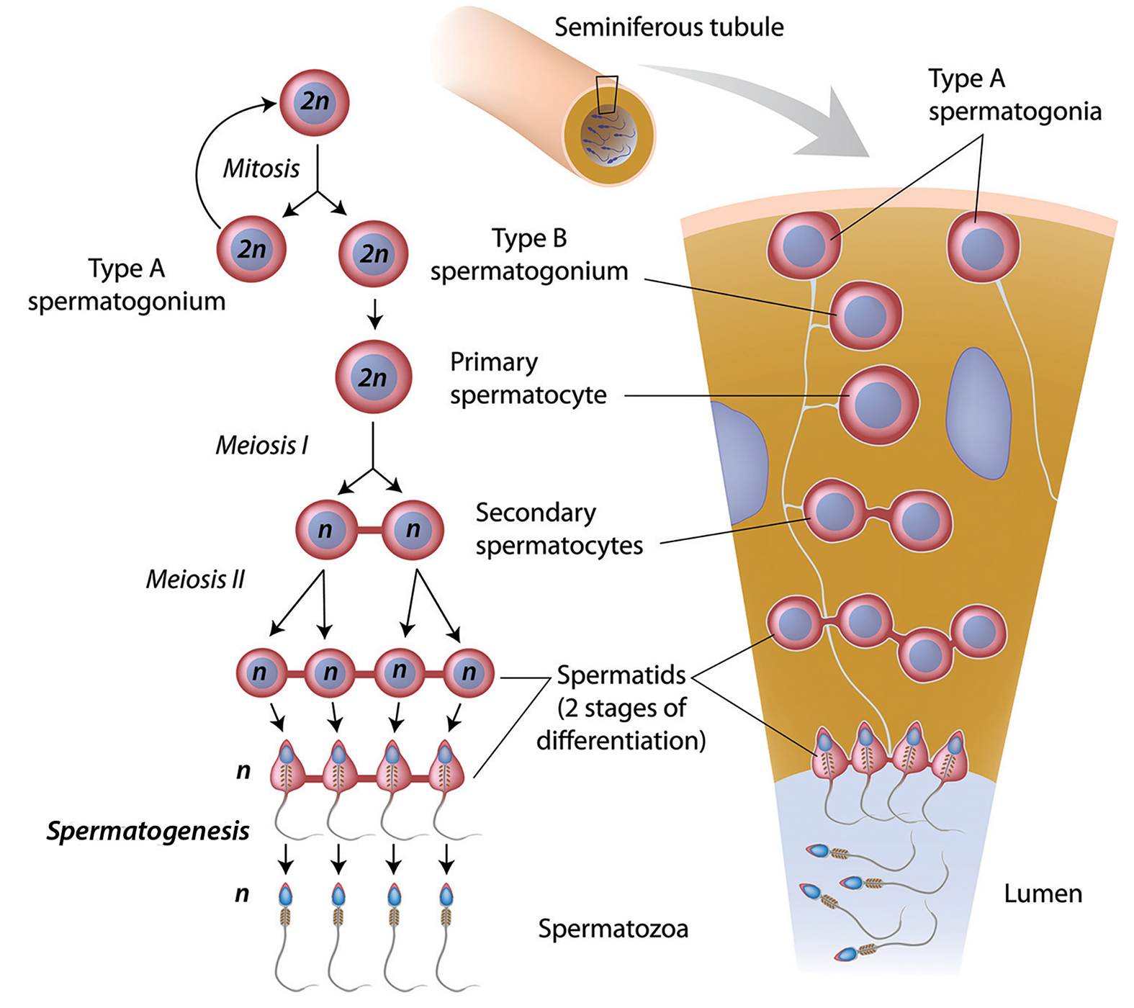
40.2 Figure 6
Jpogi on Wikimedia Commons. "Human ovarian follicle."

Slide 24
Oogenesis
Oogenesis occurs in the ovaries, starting with oogonia undergoing mitosis to increase in number.
Primary oocytes begin meiosis but arrest in prophase I until puberty.
Secondary oocytes result from meiosis I and arrest in metaphase II until fertilization.
Fertilization completes meiosis, producing a fertilized egg and polar bodies.
Meiosis II occurs after fertilization, producing a second polar body and fertilized egg containing all 46 chromosomes.
One functional egg is produced per meiotic process.
Extra chromosomes/chromatids go into polar bodies, which then degenerate and reabsorb in the body.

Slide 25
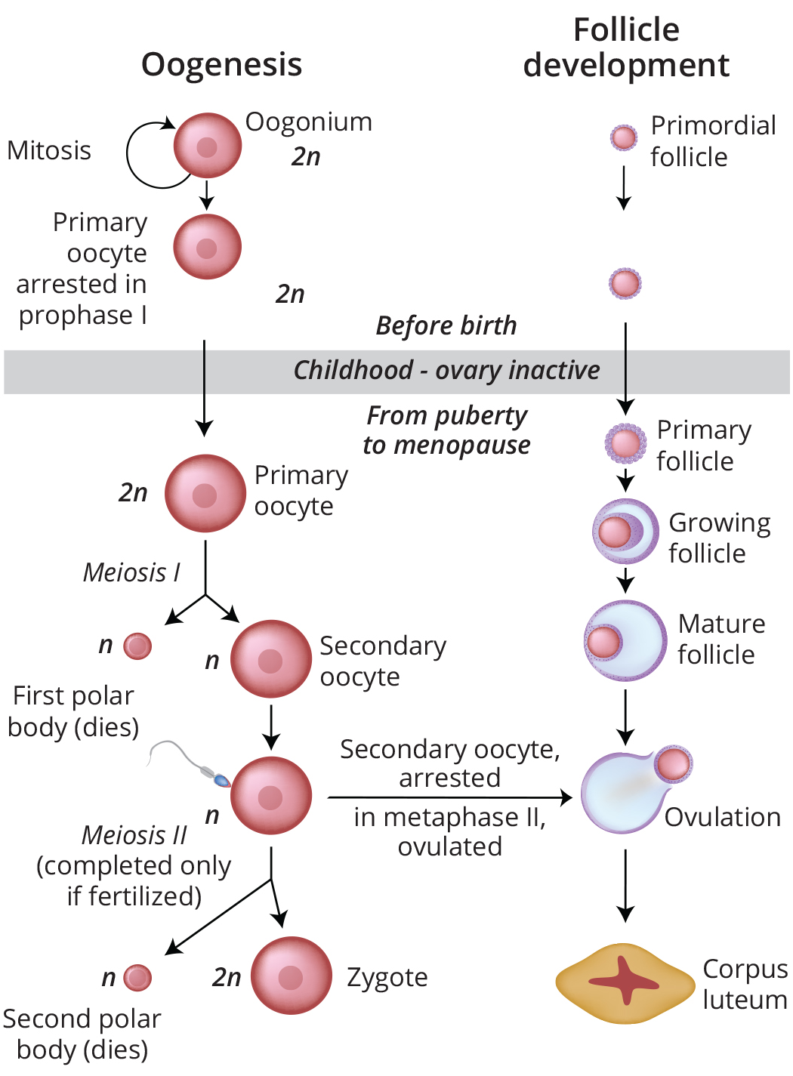
40.2 Figure 7
Jpogi on Wikimedia Commons. "Human ovarian follicle."

Slide 26
Summary
Complex animals evolved specialized reproductive structures.
For land animals, reproductive structures allow males and females to mate, fertilize internally, develop offspring, and support offspring growth.
Gametogenesis, the production of sperm (spermatogenesis) and eggs (oogenesis), produces haploid reproductive cells through meiosis.

Slide 27

End of Hawkes Learning PowerPoint

