Slide 1
Lesson 40.3
Hormonal Control of Reproduction

Slide 2
Objectives
Describe the roles of male and female reproductive hormones.
Discuss the interplay of the ovarian and menstrual cycles.
Describe the process of menopause.

Slide 3
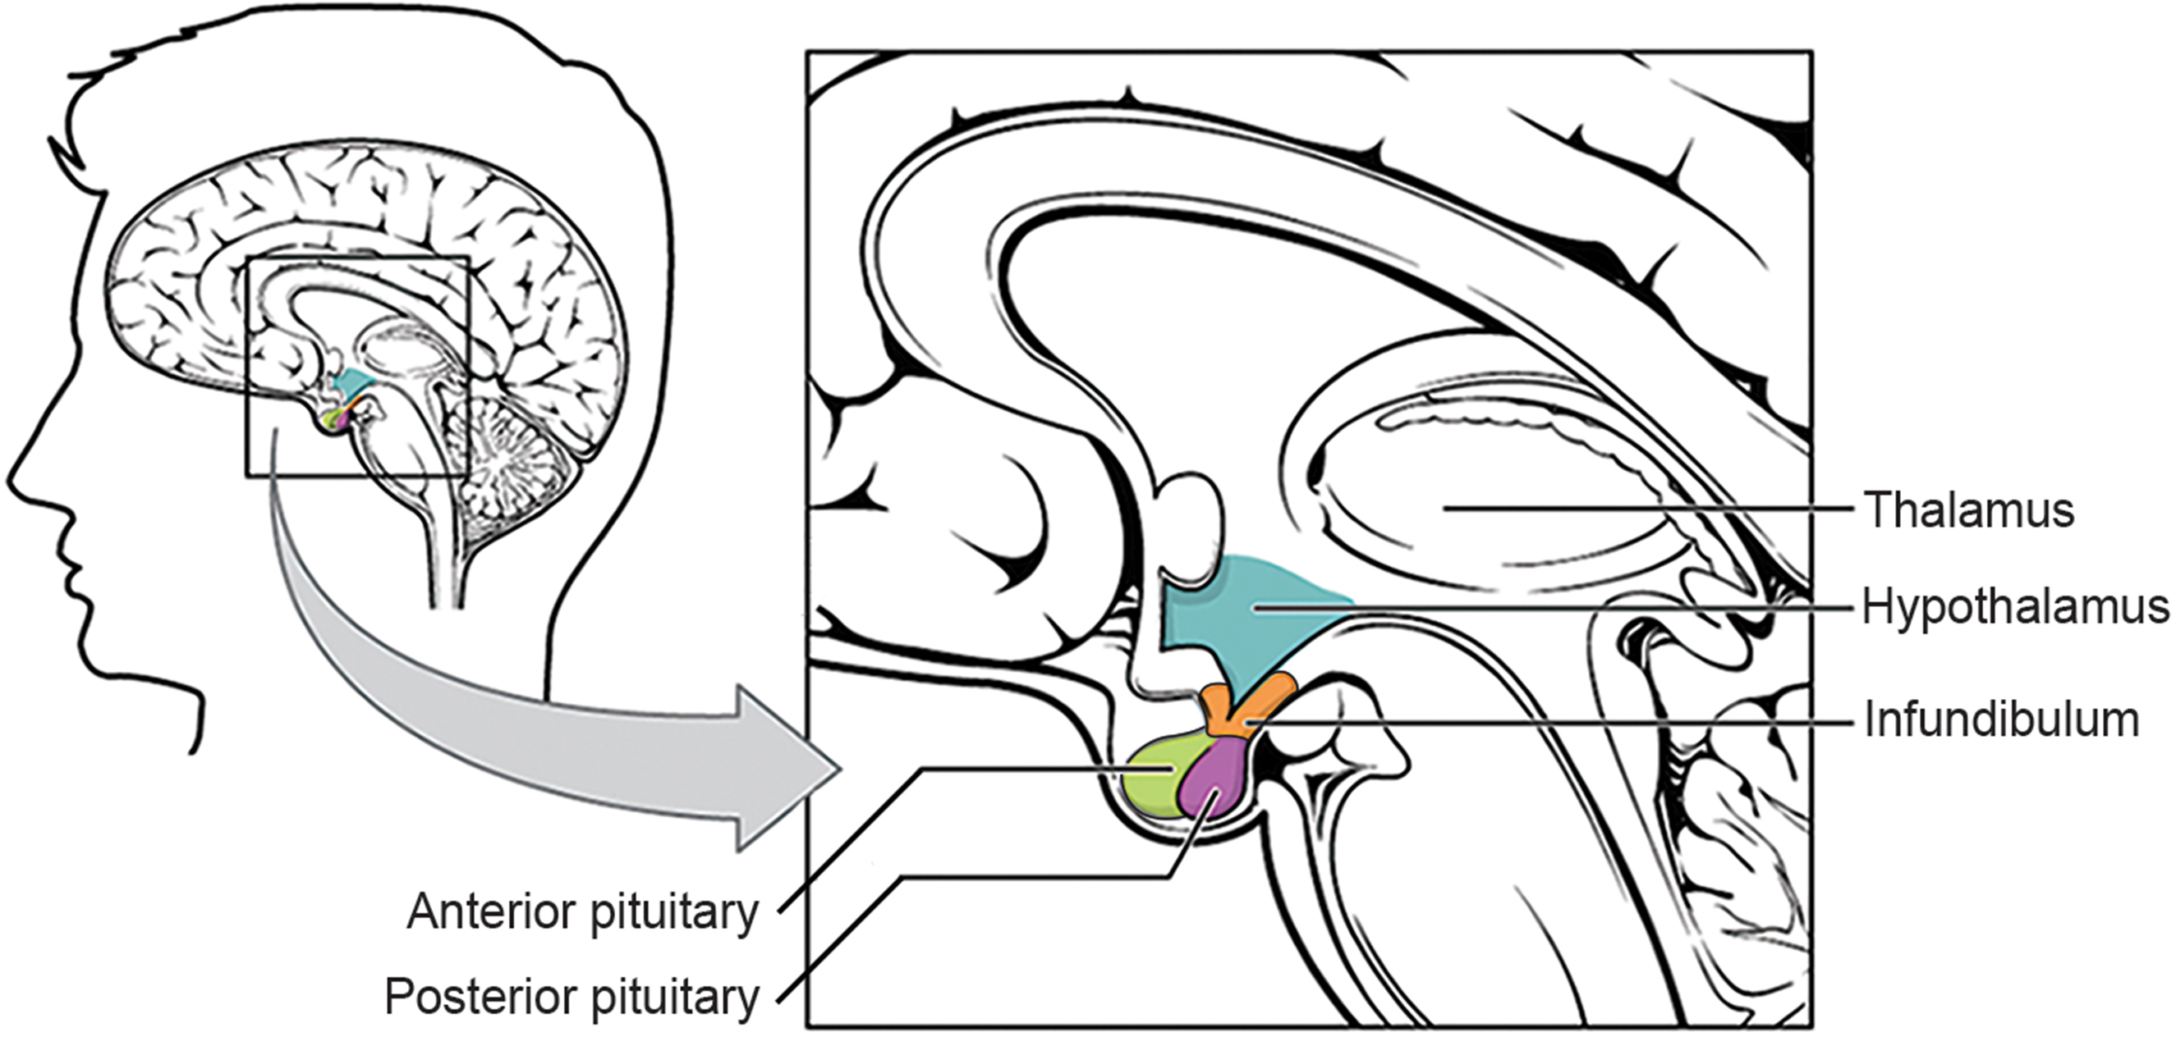
Hormonal Control of Reproduction
The male and female reproductive systems are regulated by interactions between the hypothalamus and anterior pituitary with hormones from reproductive tissues/organs.
The hypothalamus releases gonadotropin-releasing hormone (GnRH) to stimulate the anterior pituitary.
The anterior pituitary releases follicle-stimulating hormone (FSH) and luteinizing hormone (LH) into the blood.
Puberty is necessary to produce GnRH and subsequent hormonal cascades.
FSH and LH play crucial roles in both male and female reproductive systems.
40.3 Figure 1: The hypothalamus, shown here, controls the reproductive cycles of males and females by releasing GnRH to the anterior pituitary.
OpenStax College on Wikimedia Commons. "Hypothalamus-pituitary complex."

Slide 4
Male Hormones
At puberty, the hypothalamus causes the release of FSH and LH into the male system for the first time.
FSH stimulates Sertoli cells in testes to facilitate spermatogenesis using negative feedback.
LH stimulates interstitial cells of Leydig to make/release testosterone into the testes and blood.
Testosterone is responsible for male secondary sexual characteristics and spermatogenesis.
Secondary sexual characteristics include voice deepening, hair growth, and beginnings of the sex drive.

Slide 5
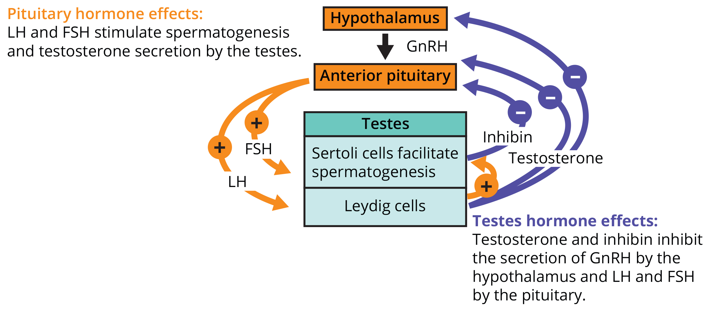
40.3 Figure 2
CNX OpenStax on Wikimedia Commons. "Testes hormone effects." Modified.
Notes:
Hormones control sperm production in a negative feedback system.

Slide 6
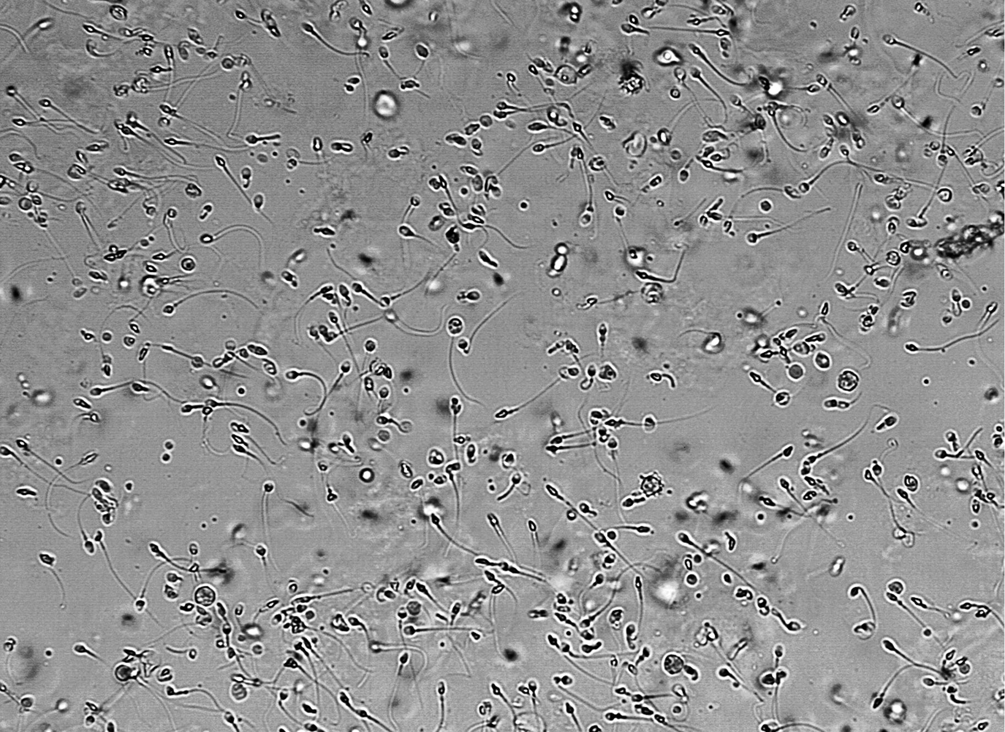
Negative Feedback System in Males
Rising testosterone levels act on hypothalamus and anterior pituitary to inhibit GnRH, FSH, and LH release.
Sertoli cells produce inhibin (released into the blood when sperm count is too high).
Inhibits release of GnRH and FSH; sperm slow down
If sperm count reaches 20 million/mL, Sertoli cells release inhibin to increase sperm.
40.3 Figure 3: This micrograph shows sperm cells.
Doruk Salancı on Wikimedia Commons. "Sperm cells."

Slide 7
Female Hormones
Anterior pituitary hormones release FSH and LH, just like in males.
Additionally, estrogens and progesterone are released from developing follicles.
Estrogens are reproductive hormones in females; they also assist in endometrial regrowth, ovulation, calcium absorption.
Along with estradiol, responsible for secondary sexual characteristics of females (breast development, hip flaring, short bone maturation period)
Progesterone assists in endometrial regrowth and inhibition of FSH and LH release.
FSH stimulates follicle development and ova maturation.
LH induces ovulation and stimulates estradiol and progesterone production.
Estradiol and progesterone (steroid hormones) regulate the menstrual cycle and prepare the body for pregnancy.

Slide 8
Think It Through₁
Compare and contrast the roles of estrogen and progesterone in the female reproductive cycle.
Notes:
Originally an On Your Own. This is included here to use as a talking point or for a think-pair-share activity.

Slide 9
The Ovarian Cycle and the Menstrual Cycle
The ovarian and menstrual cycles occur concurrently over a 22–32-day cycle, averaging 28 days.
Ovarian cycle: preparation of endocrine tissues and release of eggs
Menstrual cycle: preparation and maintenance of the uterine lining

Slide 10
The Follicular Phase
The first half of the ovarian cycle is the follicular phase.
Rising FSH and LH levels stimulate follicle growth and estrogen production.
Progesterone maintains the endometrium to aid pregnancy.
At this stage (the morula), there are 30–60 cells.
If pregnancy does not occur, the lining is sloughed off.
Estrogen levels rise after five days; the menstrual cycle enters the proliferative phase.
Endometrium regrows, replacing blood vessels and glands.

Slide 11
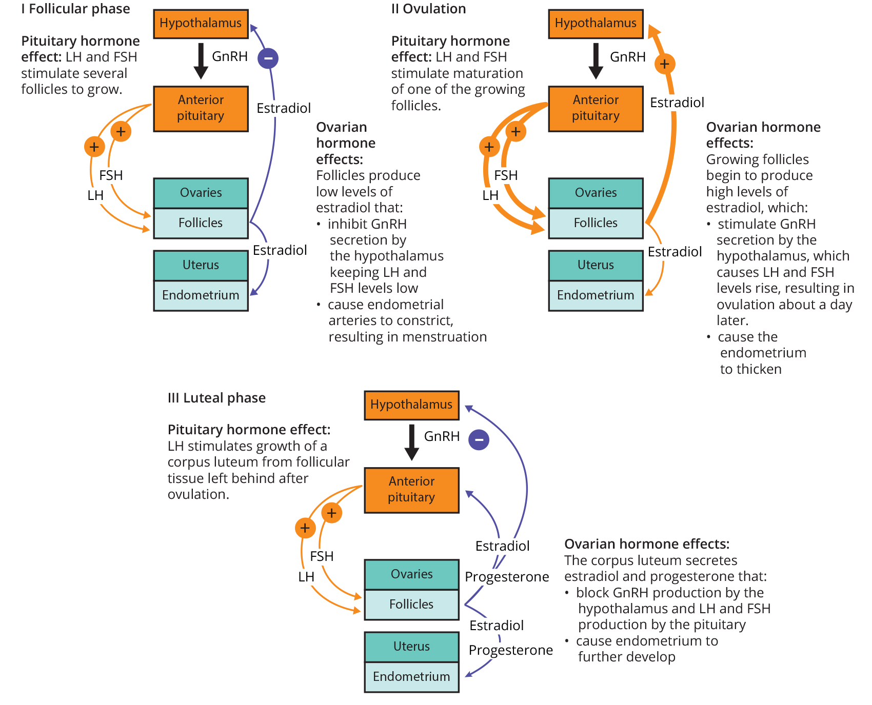
40.3 Figure 4
OpenStax. "Hormonal control of the ovarian and menstrual cycle." Modified.
Notes:
The ovarian and menstrual cycles of female reproduction are regulated by hormones produced by the hypothalamus, pituitary, and ovaries.

Slide 12
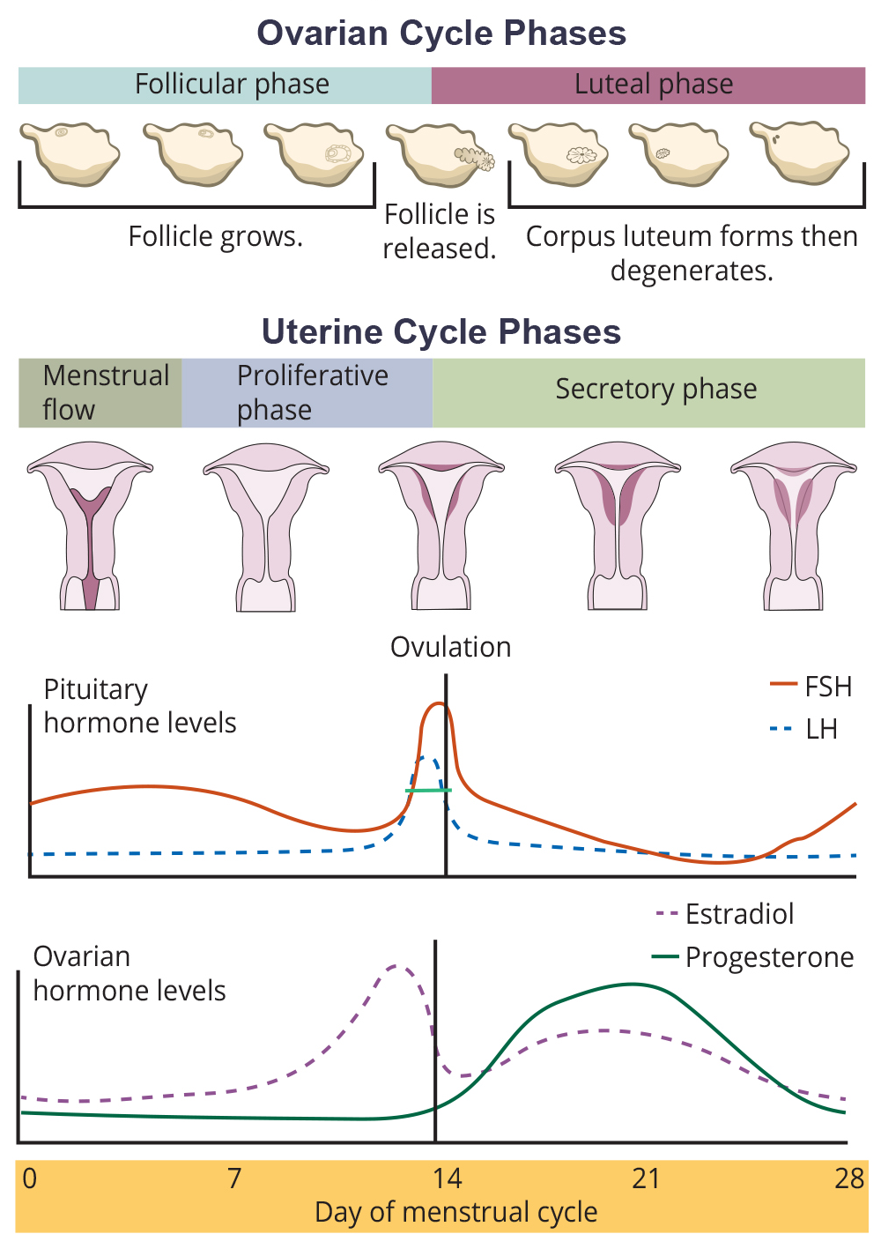
Ovulation
Around day 14 of the cycle, high levels of estrogen cause FSH and LH to rise rapidly, then fall.
This spike in LH causes ovulation, where the most mature follicle ruptures and releases its egg.
Follicles that did not rupture degenerate and lose their eggs; estrogen levels also decrease.
40.3 Figure 5: Rising and falling hormone levels result in progression of the ovarian and menstrual cycles.
Mikael Häggström. "Hormone levels."

Slide 13
The Luteal and Secretory Phases₁
After ovulation, the ovarian cycle enters the luteal phase, and the menstrual cycle enters its secretory phase.
Occur around day 15 to 28
Refer to changes in the ruptured follicle
The follicle cells undergo changes and produce a corpus luteum.
Produces estrogen and progesterone, preparing uterus for implantation
Progesterone: inhibits release of FSH and LH
Prevents further eggs and follicles from developing
Increases estrogen to a steady level for a few days

Slide 14
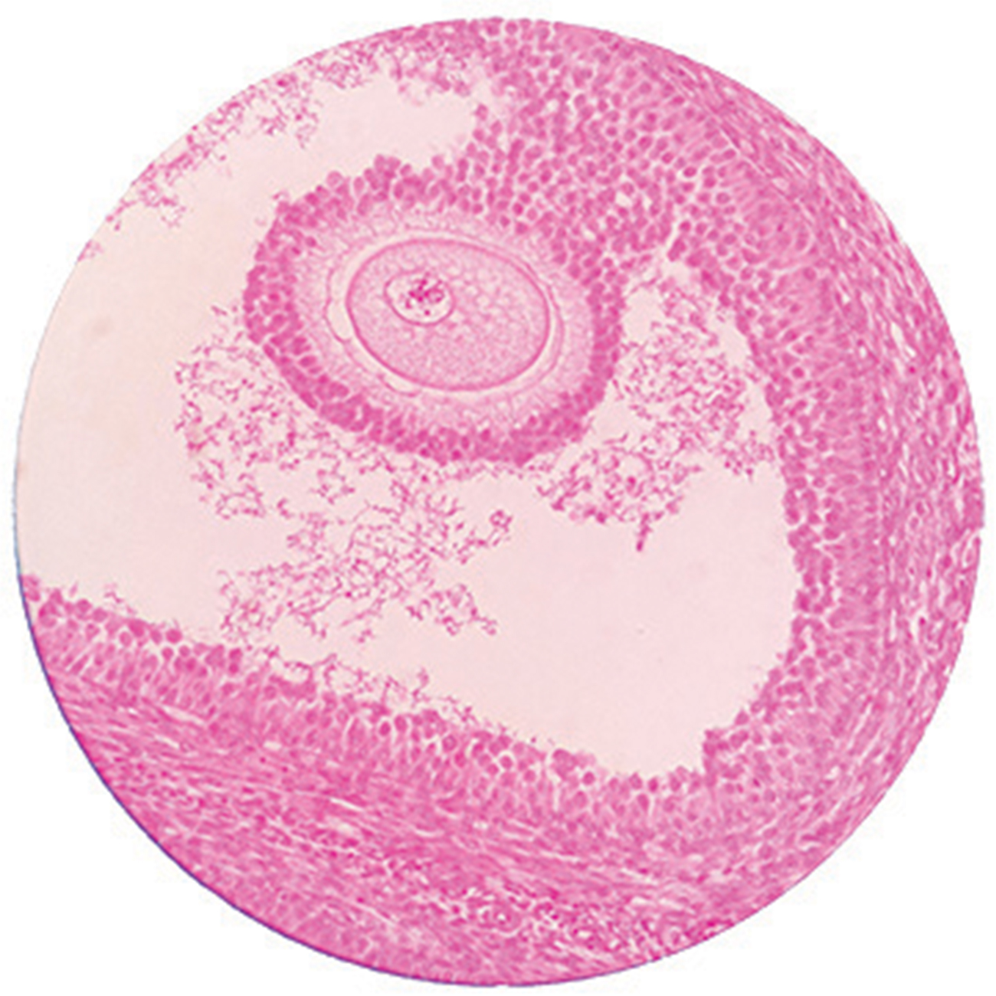
The Luteal and Secretory Phases₂
The corpus luteum degenerates if no fertilized egg is implanted in the uterus.
The endometrium also degenerates as progesterone levels drop.
This initiates the next menstrual cycle.
Decreases in progesterone allow the hypothalamus to send GnRH to the anterior pituitary.
This releases FSH and LH to start the cycle anew.
40.3 Figure 6: This mature egg follicle may rupture and release an egg.

Slide 15
Menopause
Menopause occurs in females in their mid-40s to mid-50s when ovaries lose sensitivity to FSH and LH.
Menstrual periods become irregular and eventually cease.
Eggs and follicles are still in the ovaries, but they do not produce a viable egg without FSH and LH.
Side effects include hot flashes, night sweats, headaches, hair loss, muscle pain, mood swings, and vaginal dryness.
Decreased estrogen levels can lead to bone density loss and increased risk of osteoporosis.
Hormone replacement therapy (HRT) can alleviate symptoms but carries potential risks.
Negative side effects include increased risk of stroke or heart attack, blood clots, cancer, and possible dementia.

Slide 16
Think It Through₂
Explain the hormonal changes that cause menopause. What are the side effects of menopause?
Notes:
Originally an On Your Own. This is included here to use as a talking point or for a think-pair-share activity.

Slide 17
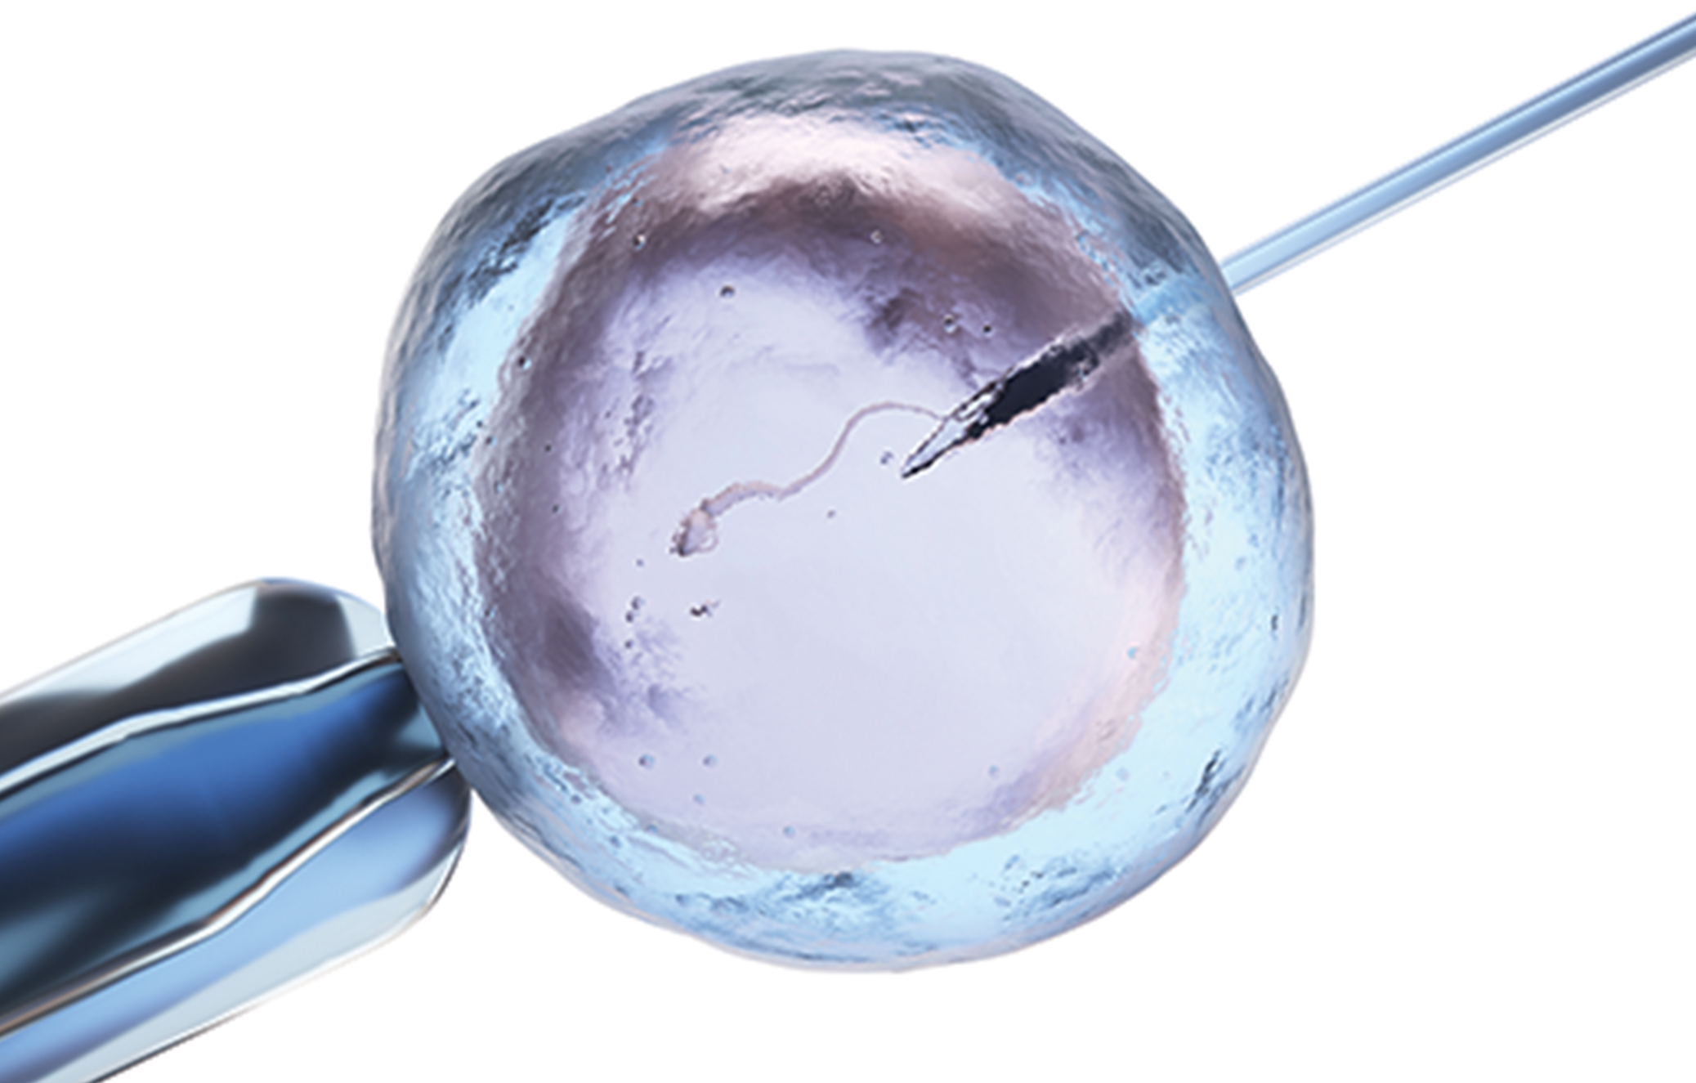
Science and You
Career: Reproductive Endocrinologist
Specializes in treating hormonal disorders related to reproduction and infertility
Addresses issues such as menstrual problems, infertility, and sexual dysfunction
Utilizes fertility drugs, surgery, and assisted reproductive techniques (ART) such as in vitro fertilization
Requires extensive medical training: 4-year OB/GYN residency and 3-year fellowship
Involves written and oral exams in obstetrics, gynecology, and reproductive endocrinology for board certification
40.3 Figure 7: In vitro fertilization, shown here, involves the artificial manipulation of the egg and sperm to begin the fertilization process.
Notes:
This is included as a relevant application for this topic.

Slide 18
Summary
Reproductive cycles are controlled by complex hormonal interactions.
The hypothalamus and anterior pituitary regulate FSH and LH production in both males and females.
Male reproduction is focused on continuous sperm production and testosterone regulation.
Female reproduction involves cyclical changes in ovarian and uterine tissues.
Menopause marks the end of female reproductive capability due to hormonal changes.

Slide 19

End of Hawkes Learning PowerPoint

