Slide 1
Lesson 40.4
Human Pregnancy and Birth

Slide 2
Objectives
Compare the efficacy and duration of various types of contraception.
Discuss causes of infertility and the therapeutic options available.
Identify important terms associated with pregnancy, labor, and birth.
Explain fetal development during the three trimesters of gestation.
Describe labor and delivery.

Slide 3
Human Pregnancy and Birth
Pregnancy begins with fertilization and ends with birth.
Gestation periods vary among animals.
Human gestation lasts 266 days.
Closely related primates have similar gestation periods (237 for chimpanzees, 257 for gorillas, 260 for orangutans).
The longest gestation for a land mammal is the African elephant at 640 days.
The longest gestations for marine mammals are the beluga and sperm whales at 460 days.

Slide 4
Human Gestation
Fertilization occurs when a mature oocyte is fertilized, becoming a zygote.
Zygote travels through the oviduct to the uterus and must implant into the wall within seven days, otherwise it deteriorates and dies.
The blastocyst (outer layers of zygote) grows into the endometrium, and the endometrium closes it into the tissue.
The chorion (layer of the blastocyst) releases β-HCG, maintaining progesterone levels.
β-HCG: beta-human chorionic gonadotropin
Makes its way to the corpus luteum, keeping it active
Used by pregnancy tests

Slide 5
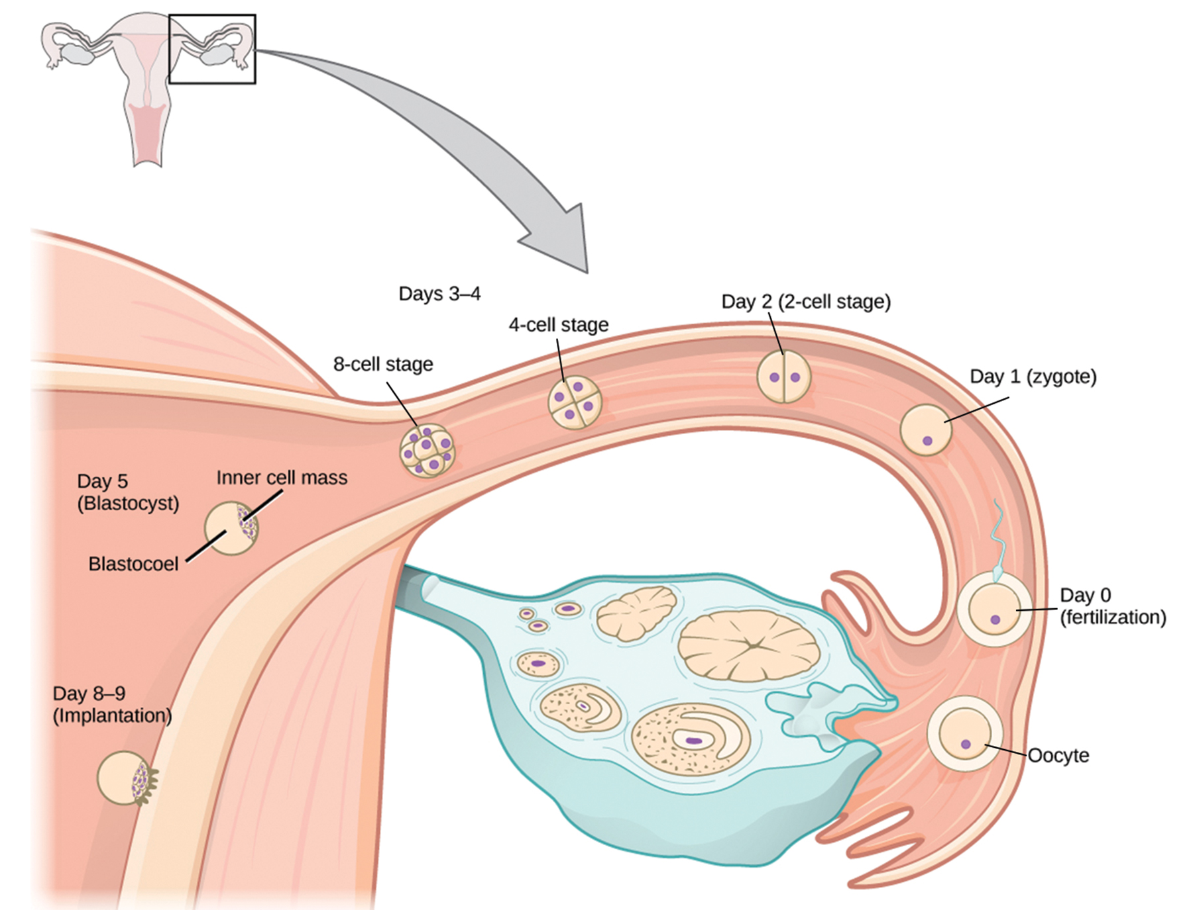
40.4 Figure 1
CNX OpenStax on Wikimedia Commons. "Fertilization."
Notes:
In humans, fertilization occurs soon after the oocyte leaves the ovary. Implantation occurs eight or nine days later.

Slide 6
First Trimester₁
The gestation period is broken into three trimesters.
In the first two to four weeks, nutrition and waste are handled by endometrial lining.
The placenta forms and takes over nutrient and waste management.
Some immunoglobulins (antibodies) pass through the placenta for passive immunity.
Chemicals from the fetus (bilirubin) are processed and eliminated by the liver.

Slide 7
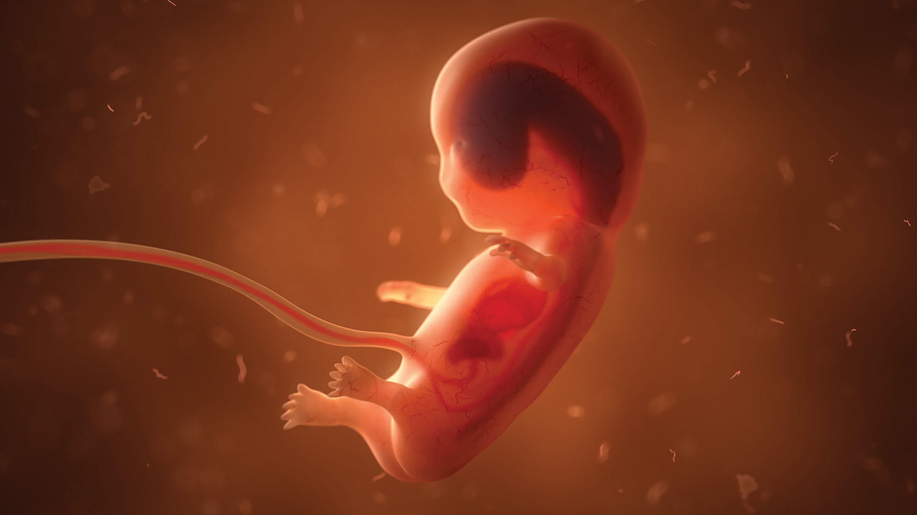
First Trimester₂
Internal organs and body structures begin to develop.
By five weeks, limb buds, eyes, heart, and liver are basically formed.
By eight weeks, the embryo is termed a fetus.
The fetus is about 5 cm (2 inches) in length.
Many organs are developed but are not functioning.
Exposure to toxins is especially dangerous at this stage.
40.4 Figure 2: In early fetal development, major internal organs are developing and somewhat visible through the fetal skin barrier.

Slide 8
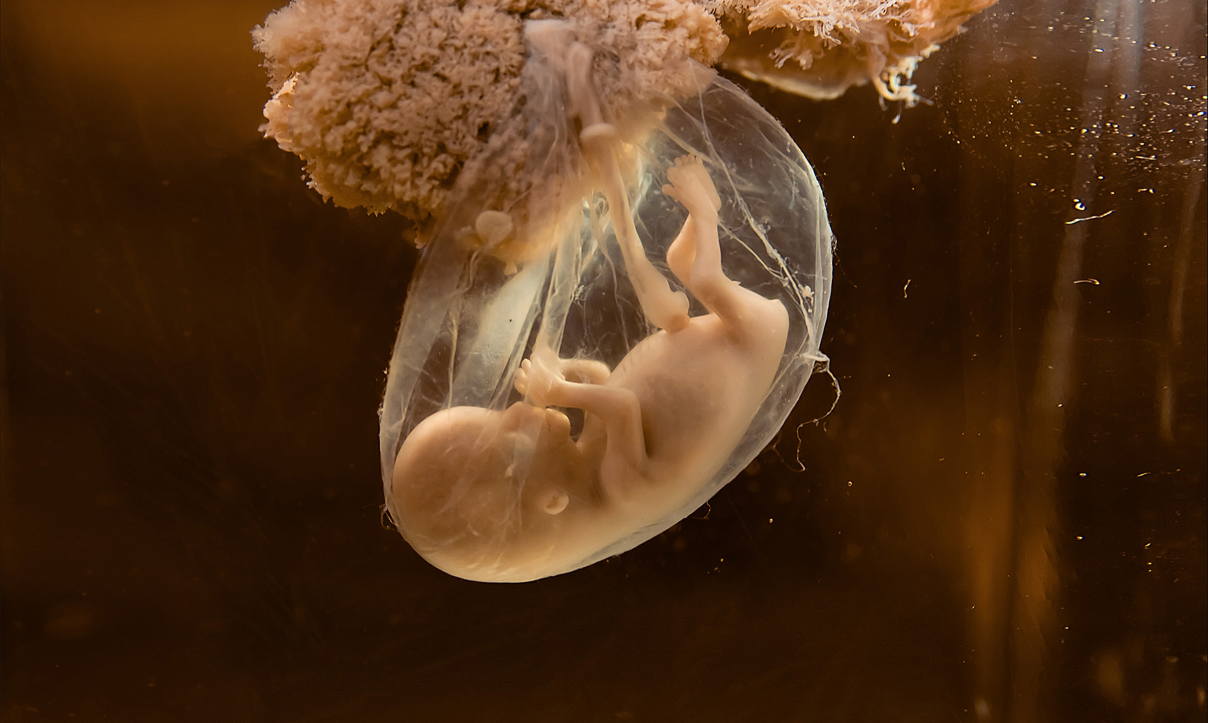
Second Trimester
The fetus grows to about 30 cm (12 inches).
First fetal movements are typically felt.
Organs and structures continue to develop.
The placenta takes over nutrition and waste management, as well as hormone (estrogen and progesterone) production from the corpus luteum.
The corpus luteum degenerates.
The placenta continues this work until delivery.
40.4 Figure 3: During the second trimester, the placenta takes over the functions of nutrition and waste management as the baby develops.

Slide 9
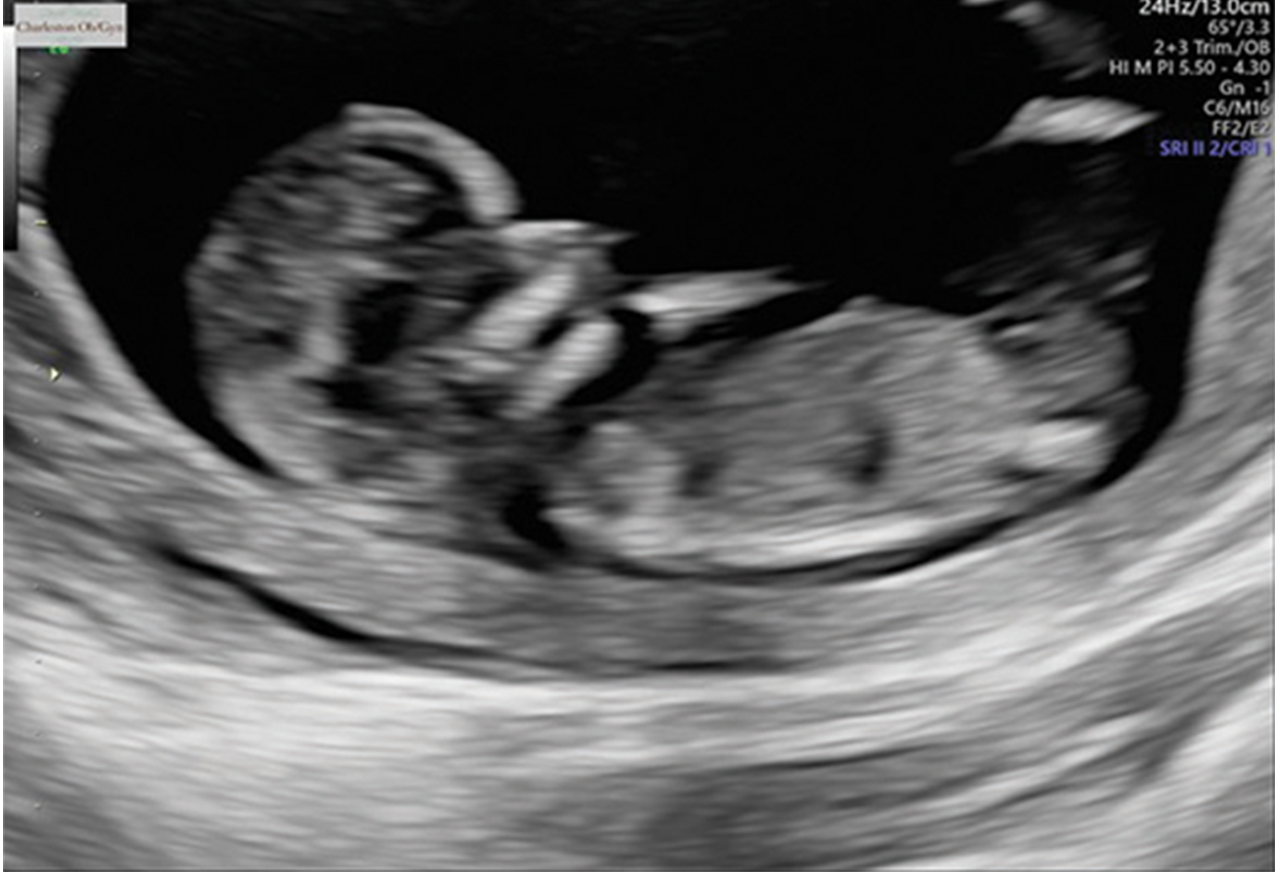
Third Trimester
The fetus reaches 3–4 kg (6.5–8.5 lbs.) and 50 cm (19–20 inches).
Rapid fetal growth occurs.
Organ development continues until birth.
Some systems continue to develop after birth (e.g., the nervous system and liver).
The pregnant female may experience discomfort and physical challenges, such as blood clots and intestinal blockages.
40.4 Figure 4: Ultrasounds are often used to check for normal fetal growth, heart rate, and to determine the sex of the baby.

Slide 10
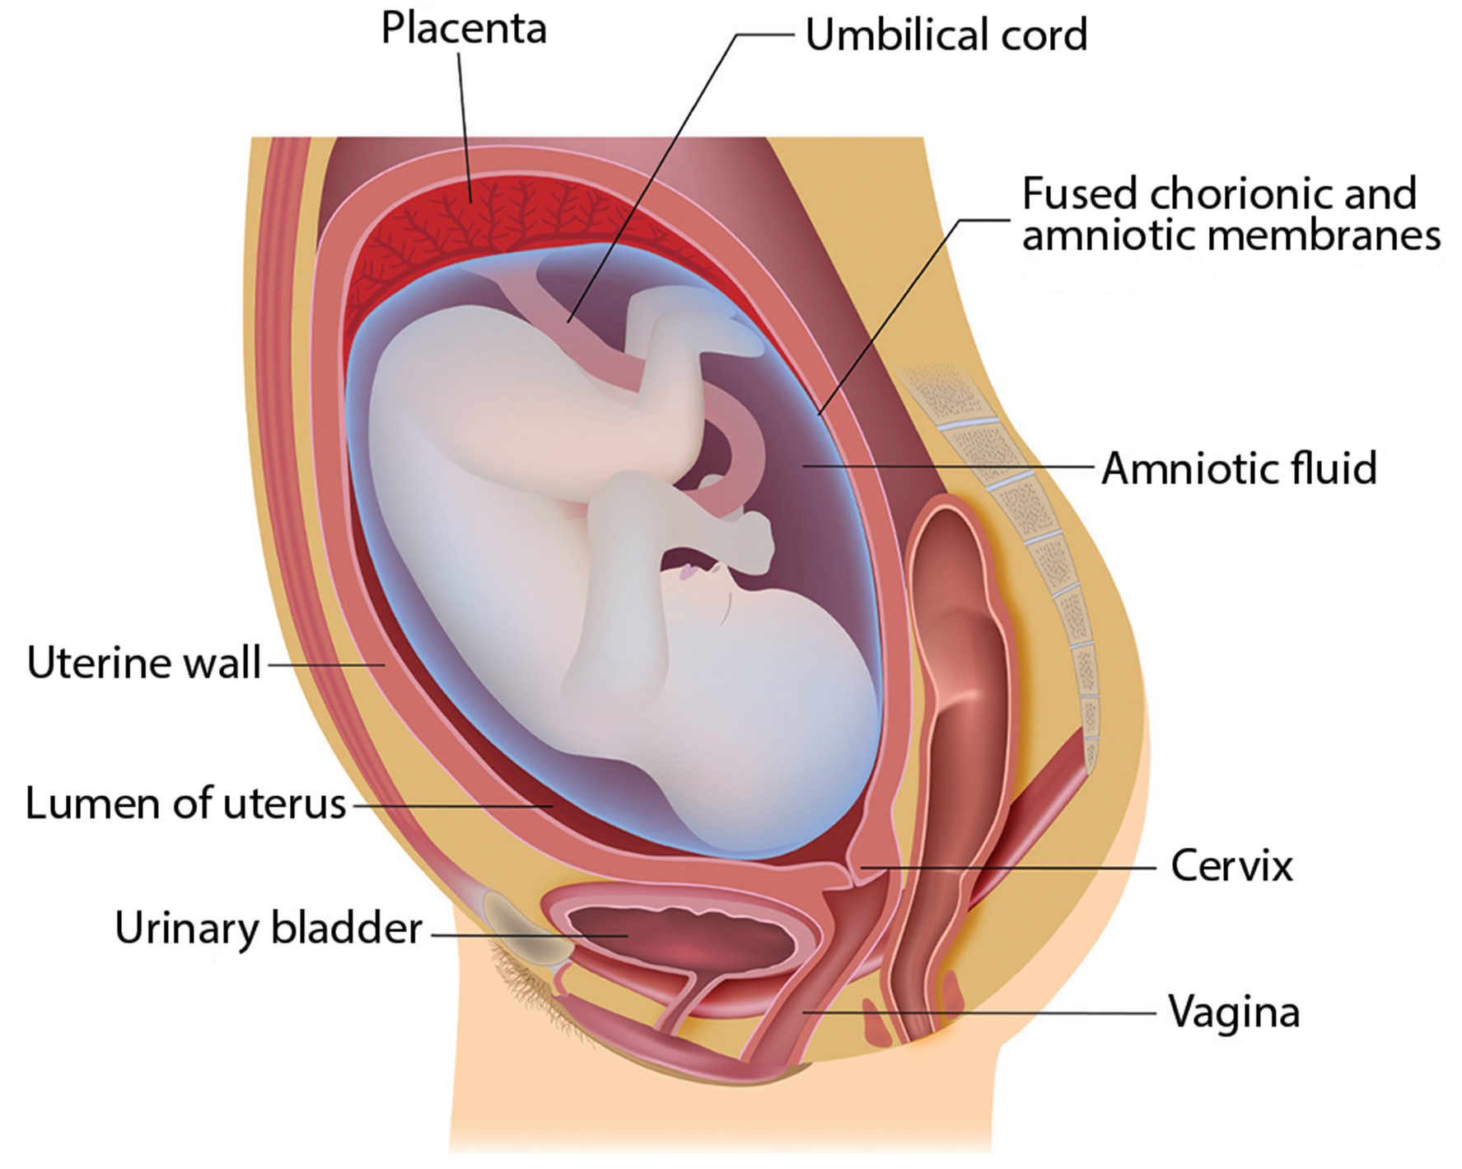
40.4 Figure 5
Notes:
There is rapid fetal growth during the third trimester.

Slide 11
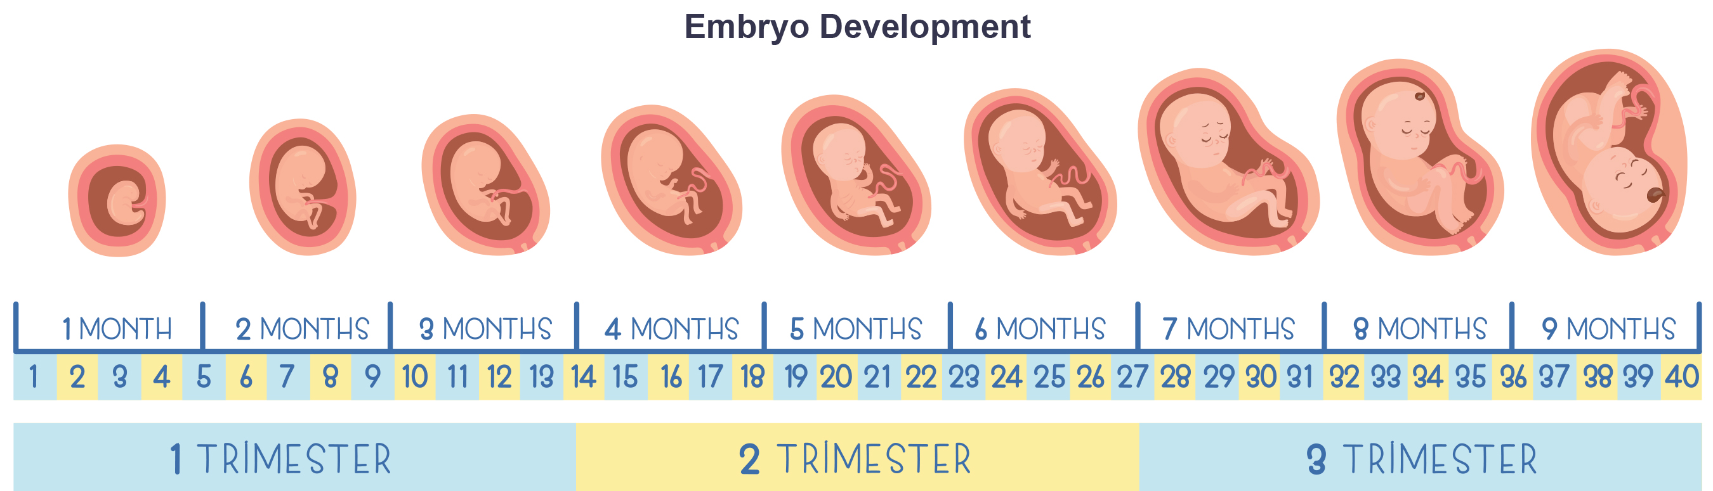
Science and You
The fetus lives in the amniotic sac, surrounded by amniotic fluid.
Practices breathing by inhaling amniotic fluid
Breathing practice stimulates the growth of air sacs and alveoli.
Once the amniotic fluid is removed, the baby can take their first breath.
40.4 Figure 6
Notes:
This is included as a relevant application for this topic.

Slide 12
Labor and Birth
Labor involves expelling the fetus and placenta (parturition).
Triggered by hormones, particularly oxytocin and prostaglandins
The baby reorients to face forward and down, with the crown of the head engaging the cervix.
The cervix stretches, and nerve impulses are sent to the hypothalamus, which signals for oxytocin release from the posterior pituitary.
Oxytocin causes smooth muscle to contract, and the placenta releases prostaglandins into the uterus to increase contractions.
A positive feedback relay occurs between the uterus, hypothalamus, and posterior pituitary to ensure there is enough oxytocin.

Slide 13
Stages of Labor
There are three stages to labor.
Stage one: early, active, transitional labor
Thinning and dilation of cervix, eventually dilating to about 10 cm
Stage two: expulsion of baby from the uterus
Contraction of the uterus and compression of the abdominal muscles to aid delivery
Can use Pitocin (synthetic oxytocin) to restart or maintain labor if labor stops before stage two
Stage three: passage of the placenta after birth

Slide 14
Table 1: Stages of Labor
 | Description | Physical Characteristics
Stage 1 | early, active, and transitional labor | cervix thins and dilates
Stage 2 | baby delivery | delivery of the baby from the birth canal by way of uterine contractions and the female's pushes
Stage 3 | placental delivery | delivery of the placenta and umbilical cord

Slide 15
Cesarian Sections & Breastfeeding
A Cesarean section is a surgical alternative to vaginal delivery.
It can lead to post-surgical complications, but it may be the only way to safely deliver the baby.
Breastfeeding is initiated through hormonal signals.
Signals are sent to the hypothalamus, causing prolactin release from the anterior pituitary.
Prolactin causes the mammary glands to produce milk.
Oxytocin release promotes milk release.
The milk contains nutrients for development and growth as well as antibodies to protect the child from bacterial and viral infections.

Slide 16
Think It Through
Correctly identify which stage of labor each scenario describes.
Cervix is dilated 6 cm.
The female is actively pushing.
The female is holding the baby while delivering the placenta.
Cervix is dilated 3 cm.
Notes:
Originally an On Your Own. This is included here to use as a talking point or for a think-pair-share activity.

Slide 17
Contraception and Birth Control₁
Contraception: preventing the sperm and egg from joining
Used interchangeably with the term birth control
Various methods available with different failure rates
Barrier methods (condoms, cervical caps, diaphragms) to physically block sperm from entering the uterus
Spermicides in the vagina to chemically kill sperm

Slide 18
Table 2: Contraceptive Methods and Their Annual Percent Rate of Error
Method | Examples | Failure Rate in Typical Use Over 12 Months
Barrier | male condom, female condom, sponge, cervical cap, diaphragm, spermicides | 15 to 24%
Hormonal | oral, patch, vaginal ring | 8%
 | injection | 3%
 | implant | less than 1%
Other | natural family planning | 12 to 25%
 | withdrawal | 27%
 | sterilization | less than 1%

Slide 19
Contraception and Birth Control₂
Natural family planning is based on menstrual cycle monitoring, having intercourse only when the egg is not available.
Involves paying attention to changes in body temperature and increases in cervical mucus
The withdrawal method has a high failure rate due to possible sperm in the bulbourethral gland's secretion.

Slide 20
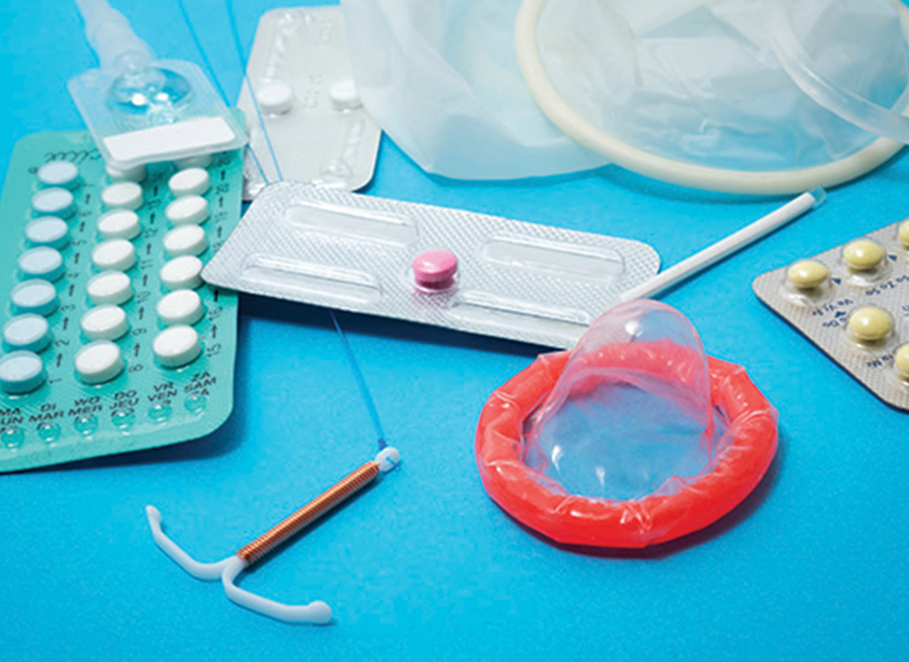
Hormonal Methods
Use synthetic progesterone (and sometimes estrogen) to inhibit FSH or LH release, preventing ovulation
Various administration methods (pills, implants, injections)
Lowest failure rate among hormonal methods: implantation of hormone under the skin
40.4 Figure 7: Pictured are examples of barrier and hormonal contraceptives.
Reproductive Health Supplies Coalition on Unsplash. "Contraceptives."

Slide 21
Sterilization and Long-Term Contraception
A minimal rate of failure is achieved through sterilization methods (vasectomy for males, tubal ligation for females).
Vasectomy and tubal ligation as permanent options
An intrauterine device (IUD) is another low-failure method.
IUDs: inserted in the uterus, establishing inflammation that prevents fertilized eggs from implanting in uterus
IUDs as long-term contraception
Abstinence is the only 100% effective method.

Slide 22
Pregnancy Termination
Can be spontaneous or voluntary
Spontaneous termination: miscarriage; occurs naturally and early in the pregnancy (first few weeks)
Occurs when fetus cannot develop properly
Voluntary termination: abortion; regulated by state laws
State laws: tend to view fetal viability as criteria for allowing or preventing abortion

Slide 23
Infertility
Infertility is the inability to conceive or carry a pregnancy to term.
75% of infertility causes can be identified.
Factors include diseases, hormonal imbalances, stress, toxins, smoking, marijuana use, gonadal injuries, and aging.
Short-term stress affects hormone levels, while long-term stress can delay puberty and cause less frequent menstrual cycles.

Slide 24
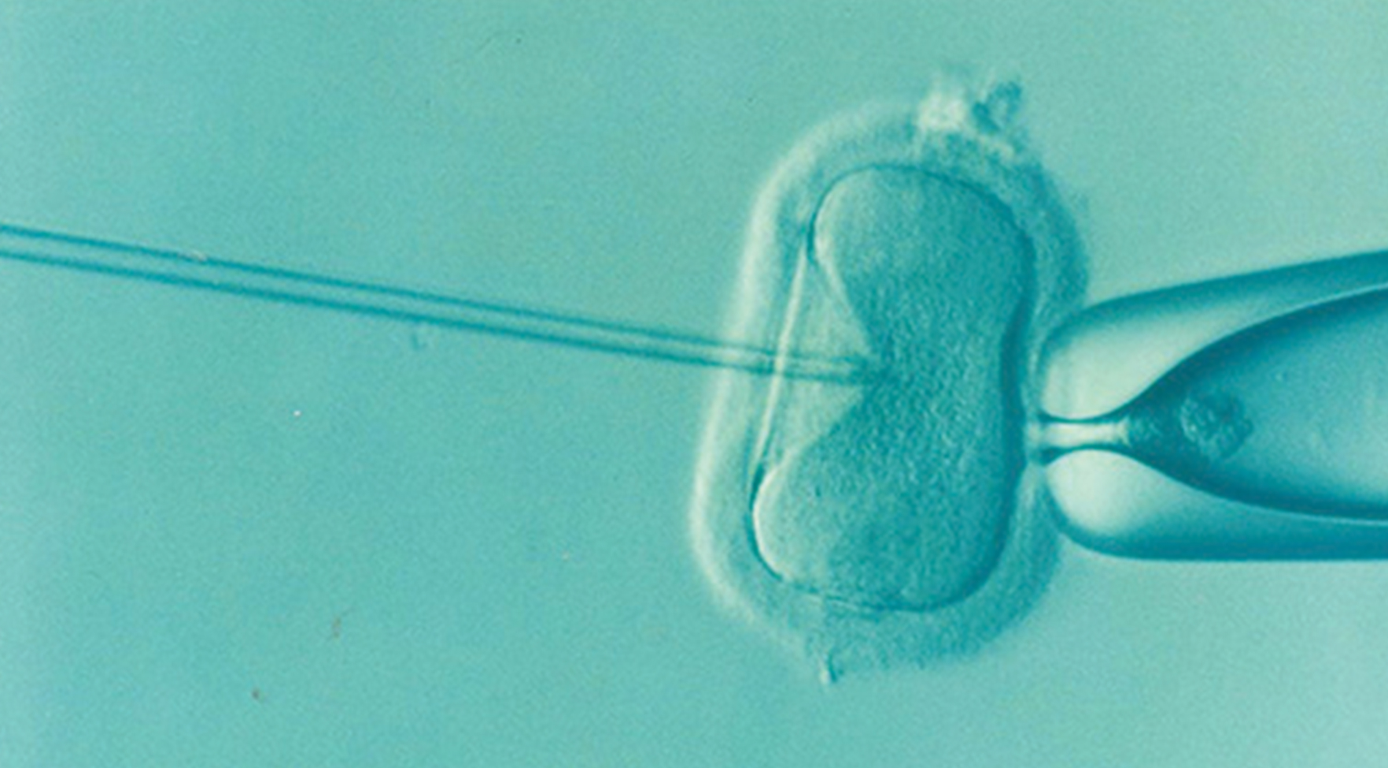
Assisted Reproductive Technologies (ART)
If infertility is identified, several ART are available to aid conception.
In vitro fertilization (IVF) combines egg and sperm outside the body.
Egg: obtained from female after hormonal treatments that prepare the egg for fertilization and the uterus for implantation
Sperm: obtained, combined with the eggs, and supported through several cell divisions to ensure viability
Intracytoplasmic sperm injection (ICSI) injects sperm into an egg.
Useful for cases where simple IVF fails
Multiple births are possible with ART procedures.
40.4 Figure 8: A sperm is inserted into an egg for fertilization during intracytoplasmic sperm injection (ICSI).
DrKontogianniIVF on Pixabay. "Intracytoplasmic sperm injection."

Slide 25
Summary
Human pregnancy progresses through three trimesters of gestation.
First trimester: basic structures of the body
Second trimester: continued development of organs and systems
Third trimester: greatest growth, culminating in labor and delivery
Labor involves three stages driven by hormones: contractions, delivery of the fetus, and expulsion of the placenta.
Various contraception methods are available with different efficacy rates.
Infertility can be addressed through assisted reproductive technologies.

Slide 26

End of Hawkes Learning PowerPoint

