Slide 1
Lesson 40.5
Embryogenesis and Organogenesis

Slide 2
Objectives
Discuss how fertilization occurs.
Explain how the embryo forms from the zygote.
Discuss the role of cleavage and gastrulation in animal development.
Describe the process of organogenesis.
Identify the anatomical axes formed in vertebrates.

Slide 3
Embryogenesis and Organogenesis
The process of a single-celled zygote developing into a multicellular organism involves highly regulated cellular movements and differentiation.
Early stages of embryonic development are crucial for ensuring the organism's fitness.

Slide 4
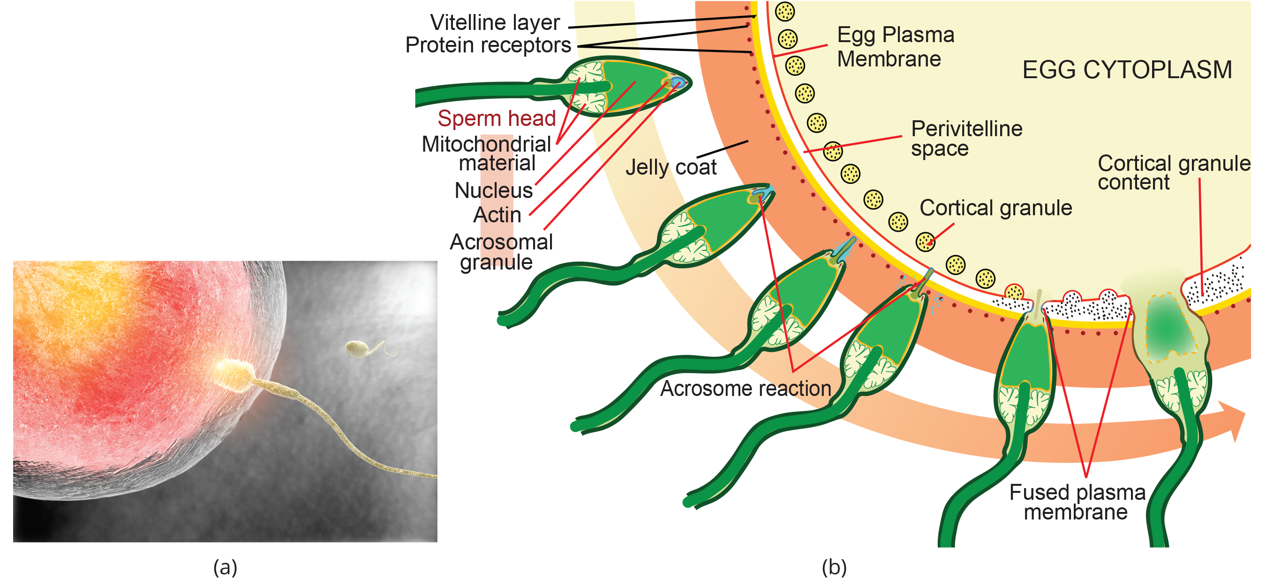
Fertilization
Fertilization is the fusion of gametes (egg and sperm) to form a zygote.
The egg and sperm each contain one set of chromosomes; the fusion ensures a diploid genome in the zygote.
In mammals, the egg is protected by the zona pellucida: a layer of extracellular matrix consisting mainly of glycoproteins.
Acrosomal reactions (a series of biochemical events) in sperm help degrade the zona pellucida, allowing fusion with the egg.
40.5 Figure 1: Fertilization involves acrosomal reactions to help the sperm degrade the glycoprotein matrix protecting the egg.
Clker-Free-Vector-Images on Pixabay. "Fertilization diagram."

Slide 5
Polyspermy
Once acrosomal reactions take place at one location, the egg releases proteins in other locations to prevent other sperm from fusing with the egg.
If this fails, it can result in polyspermy: when multiple sperm fuse with the egg.
An embryo resulting from polyspermy is not genetically viable and dies within a few days.

Slide 6
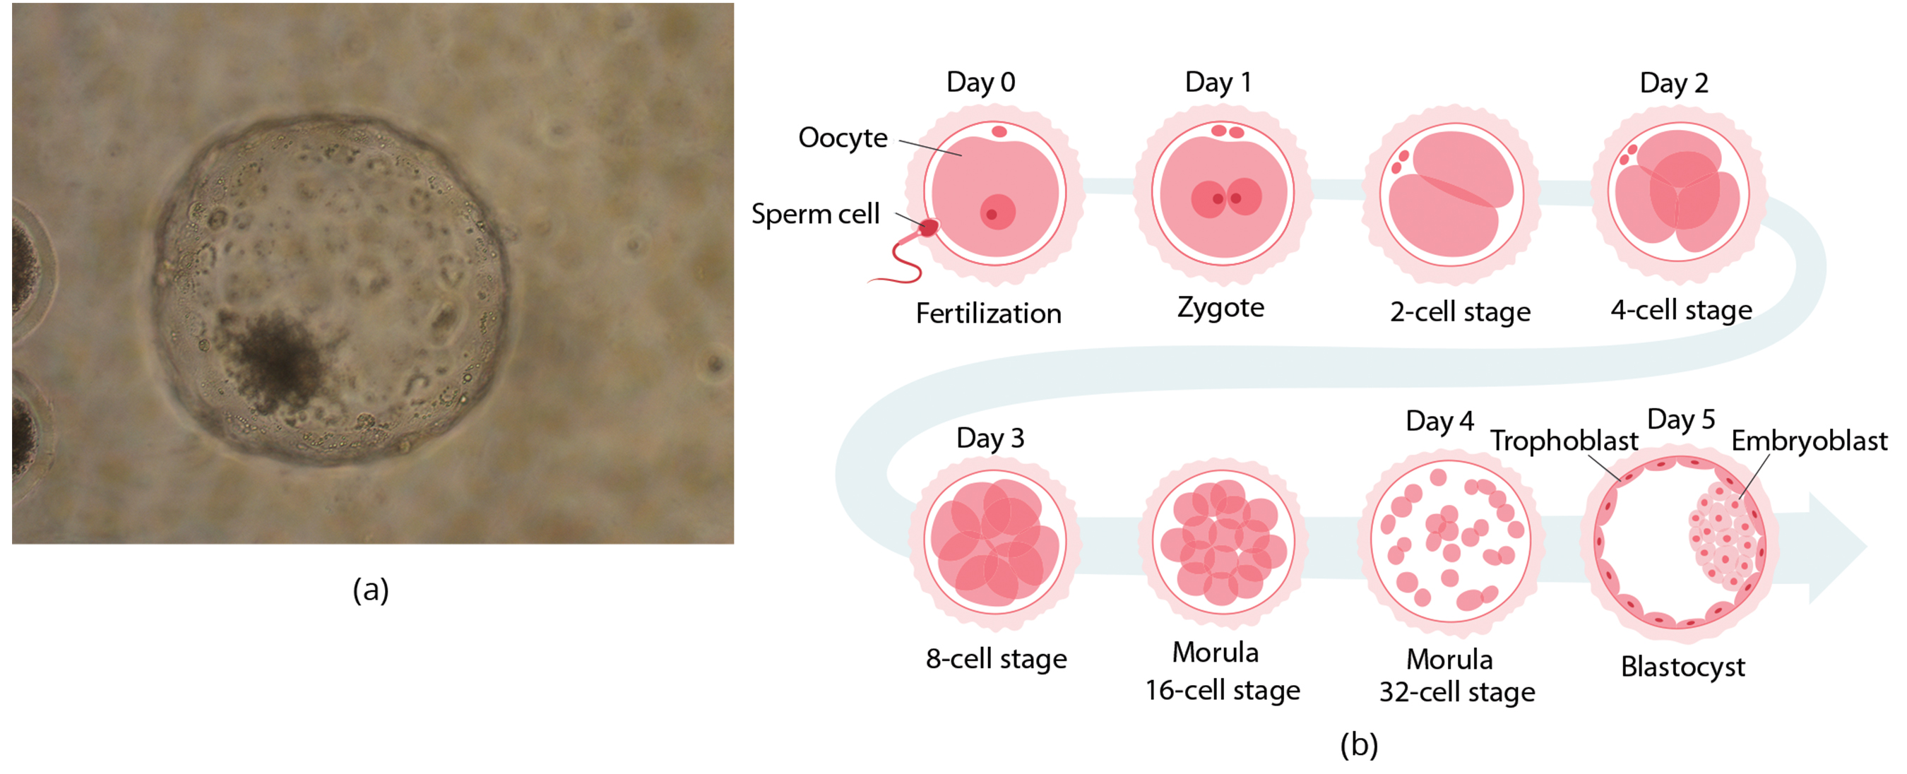
Cleavage and Blastula Stage
Cleavage refers to the rapid cell division of a zygote to form a blastula.
The blastula is a hollow ball of cells surrounding a fluid or yolk-filled cavity.
In mammals, the blastula becomes a blastocyst with an inner cell mass (embryoblast).
The embryoblast extends into the blastocoel, which is surrounded by a trophoblast layer.
Each cell in the blastula is called a blastomere.
Cells divide without an increase in mass during cleavage.
One large single-celled zygote divides into multiple smaller cells.
40.5 Figure 2: (a) A microscopic image of a blastocyst. (b) This is how the zygote changes during cleavage.
Pandal00m on Wikimedia Commons. "Bovine blastocyst."

Slide 7
Cleavage Types
Cleavage can be holoblastic (total) or meroblastic (partial), depending on the amount of yolk in the egg.
Holoblastic: humans; very small amount of yolk since nourishment is mainly provided by the female's body
Meroblastic: birds; a lot of yolk in the egg to nourish embryo during development
Embryoblast cells will differentiate into various cell types, while trophoblast cells contribute to the placenta.

Slide 8
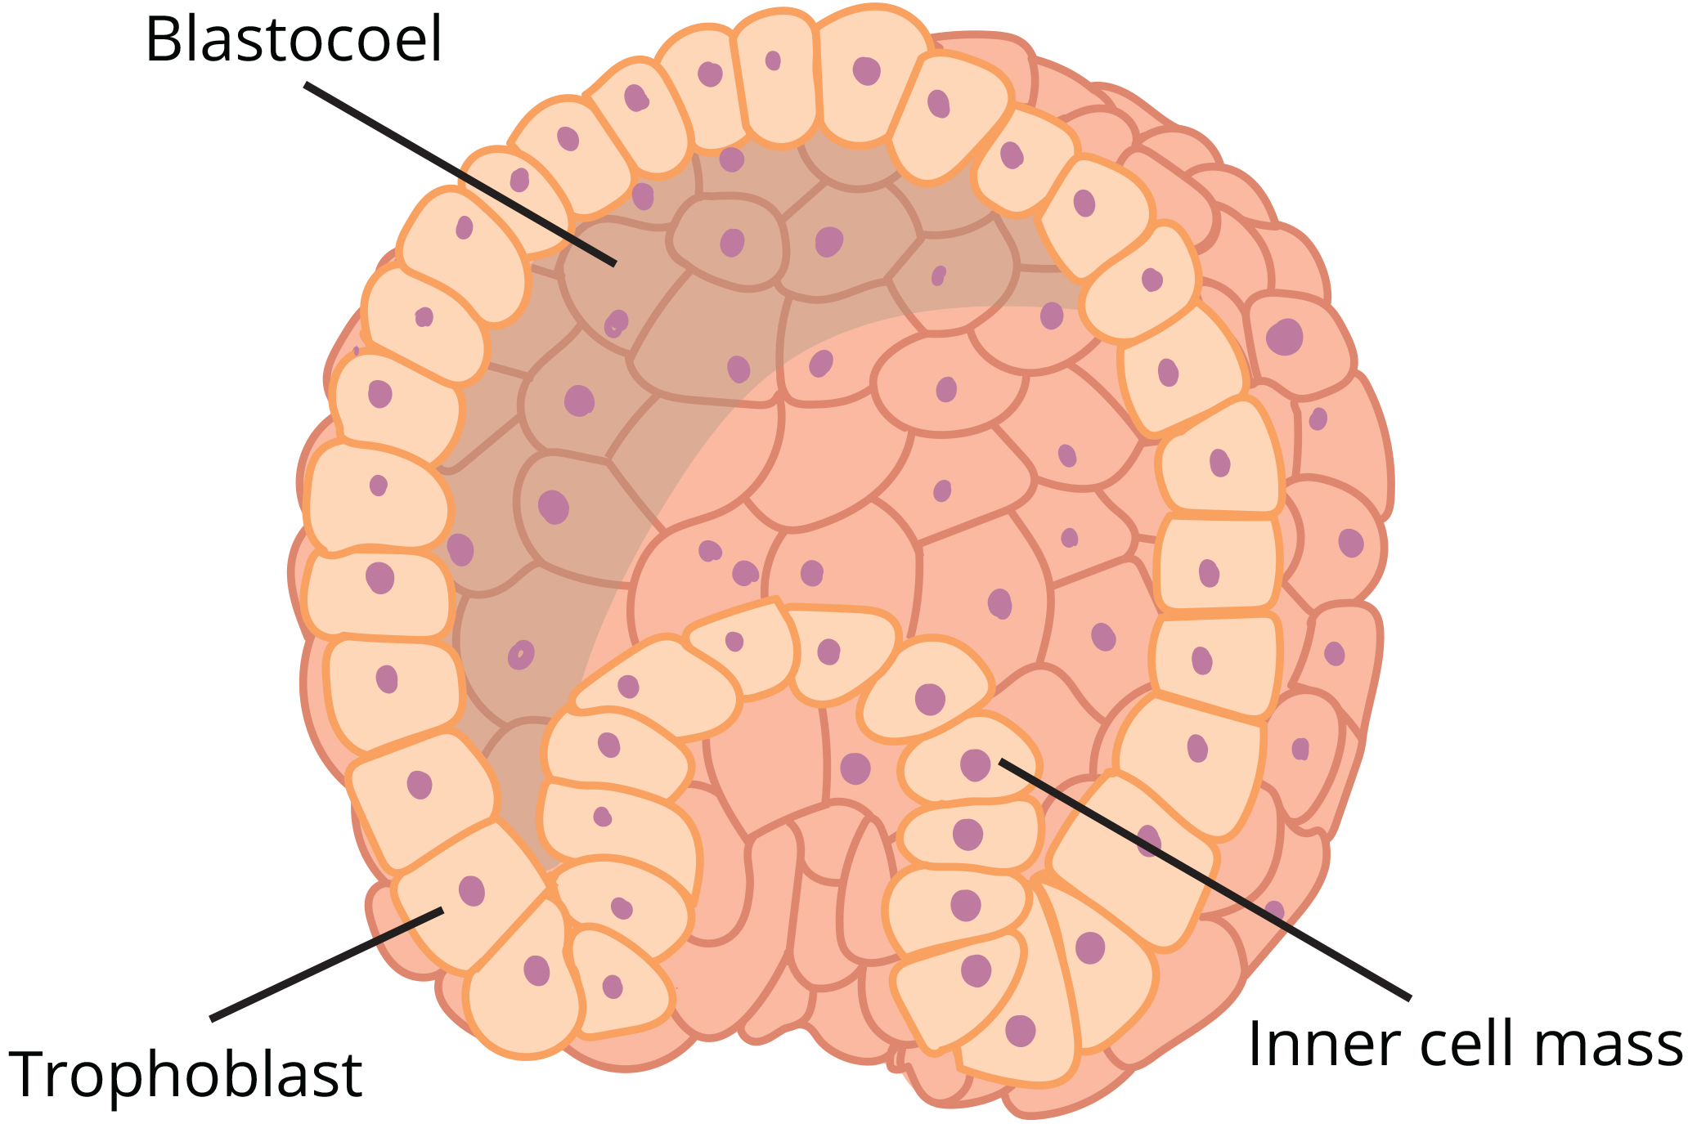
Inner Cell Mass and Trophoblast
In mammals, the blastula forms the blastocyst in the next stage.
Two layers of blastula cells: inner cell mass (embryoblast) and outer layer (trophoblast)
Inner cell mass goes on to form the embryo.
Consists of embryonic stem cells that differentiate into different cell types the organism needs
The trophoblast contributes to the placenta and nourishes the embryo.
40.5 Figure 3: The rearrangement of the cells in the mammalian blastula to two layers—the inner cell mass and the trophoblast—results in the formation of the blastocyst.
OpenStax. "Blastula."

Slide 9
Think It Through
Identify the blastula stage or concept based on the following descriptions.
A partial cleavage when egg yolk is prevalent
The outer blastocyst layer
Also called an embryoblast
A total cleavage when a small amount of yolk is present
Notes:
Originally an On Your Own. This is included here to use as a talking point or for a think-pair-share activity.

Slide 10
Gastrulation
Body plan formation happens after the blastula stage.
Gastrulation is the process where the blastula reorganizes into a three-layered structure.
There are three germ layers:
Ectoderm: nervous system and epidermis
Mesoderm: muscle cells and connective tissue
Endoderm: lining of the digestive system and internal organs

Slide 11
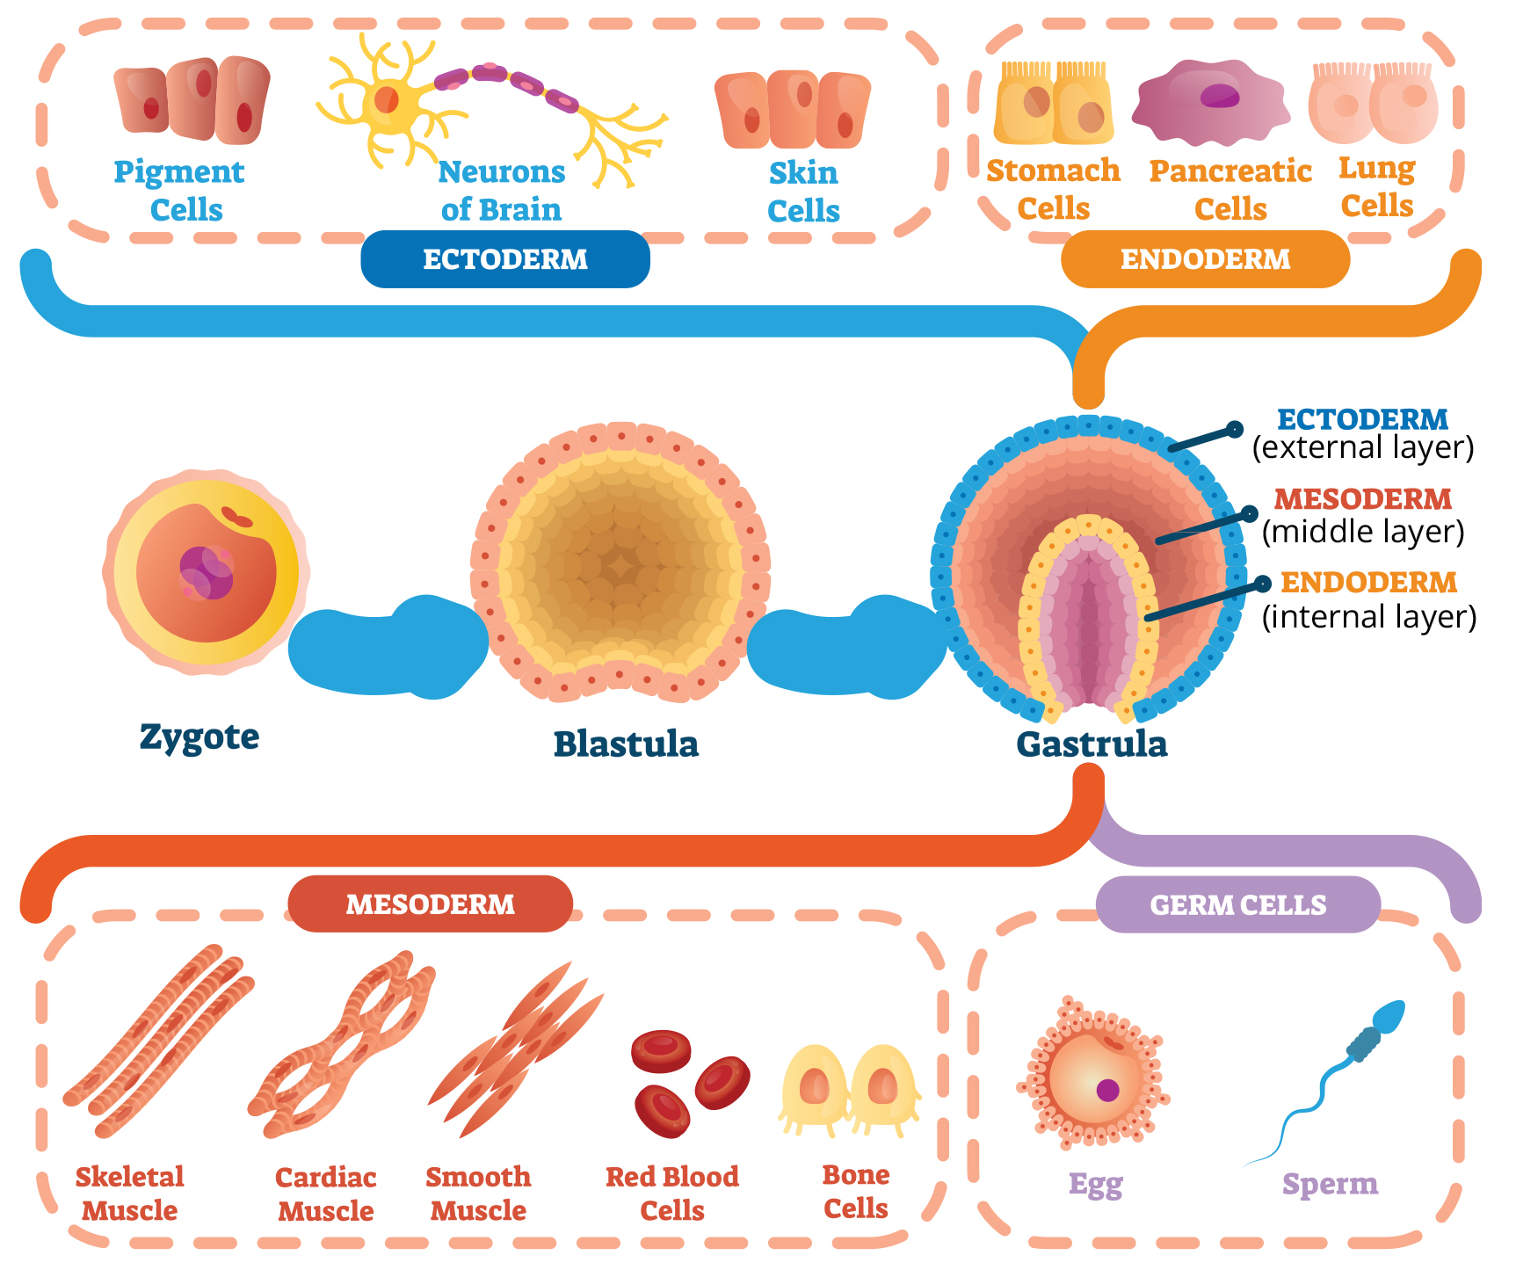
40.5 Figure 4
Notes:
The three germ layers give rise to different cell types in the animal body.

Slide 12
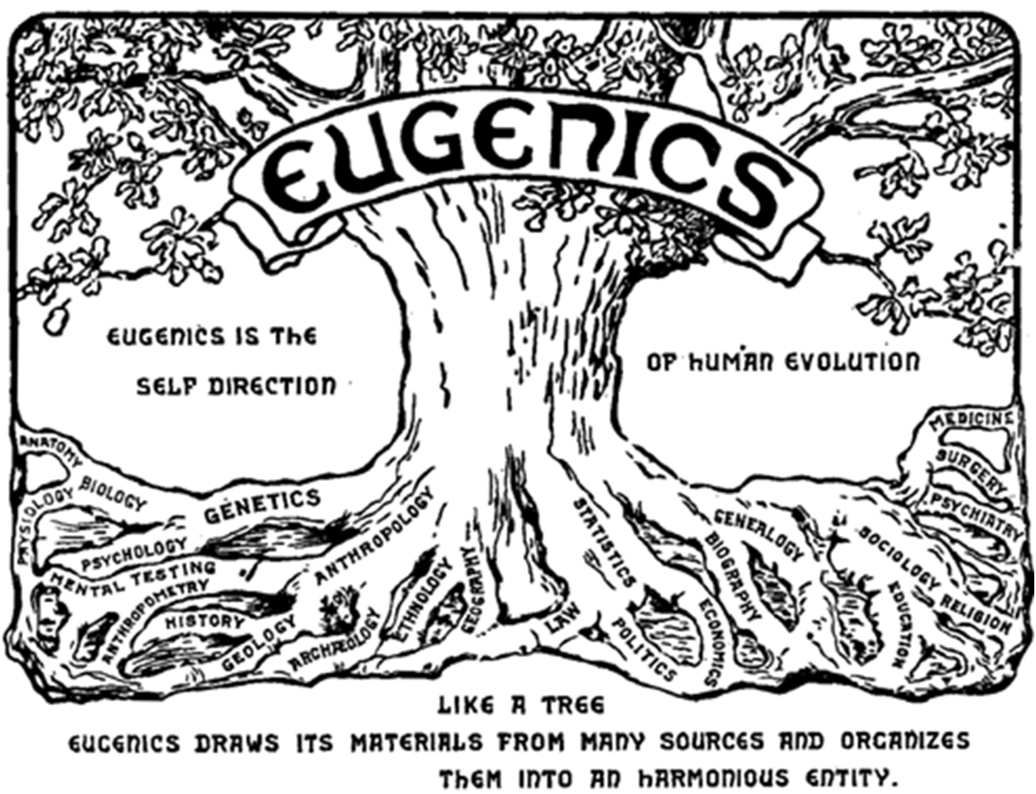
Science and You₁
Are Designer Babies in Our Future?
The genetic engineering of human embryos to select for desirable traits is becoming a reality.
Eugenics: use of information and technology to improve the genetic makeup of the human race
The idea of creating genetically superior humans was prevalent and controversial in the early twentieth century (e.g., Nazi Germany).
Ethical debates still surround the selection of traits like attractiveness, intelligence, and disease resistance.
40.5 Figure 5: This is the logo from the Second International Eugenics Conference in New York City in September of 1921.
Harry H. Laughlin on Wikimedia Commons. "Eugenics logo."
Notes:
This is included as a relevant application for this topic.

Slide 13
Science and You₂
Are Designer Babies in Our Future?
Prenatal genetic diagnosis (PGD) is a procedure that allows for the selection of embryos free from certain genetic diseases.
PGD refers to the diagnosis, selection, and implantation of selected embryos.
Ethical issues arise with the discarding of embryos, sex selection, and selecting for disabilities.
Selecting for disabilities violates the basic medical principle Primum non nocere, or "First, do no harm."
The future of genetic engineering and its regulation remains uncertain and controversial.
Notes:
This is included as a relevant application for this topic.

Slide 14
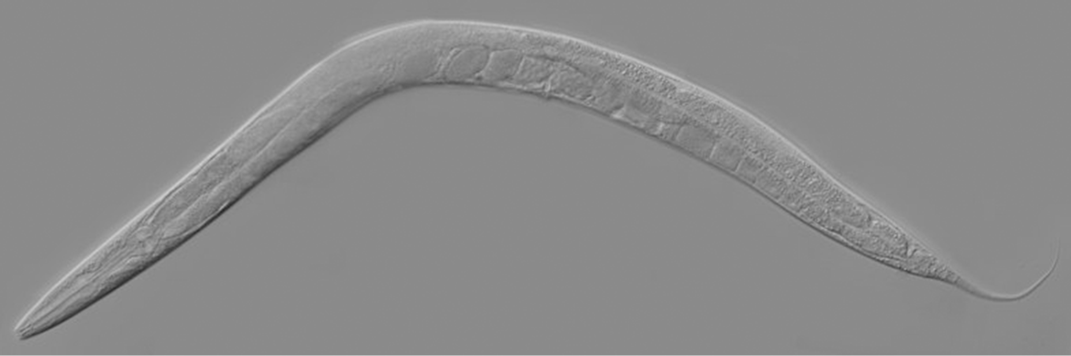
Organogenesis
After gastrulation is organogenesis, where germ layers differentiate into organs.
Involves precise cellular movements and differentiation regulated by signaling pathways
Scientists study model organisms like Drosophila and C. elegans to understand organogenesis.
Drosophila: patterning along their segments helps scientists to study which genes play important roles at different time points in the embryo's development
C. elegans: scientists study the 1,000 somatic cells during their development in the nematode life cycle
40.5 Figure 6: The nematode C. elegans
Zeynep F. Altun on Wikimedia Commons. "C. elegans."

Slide 15
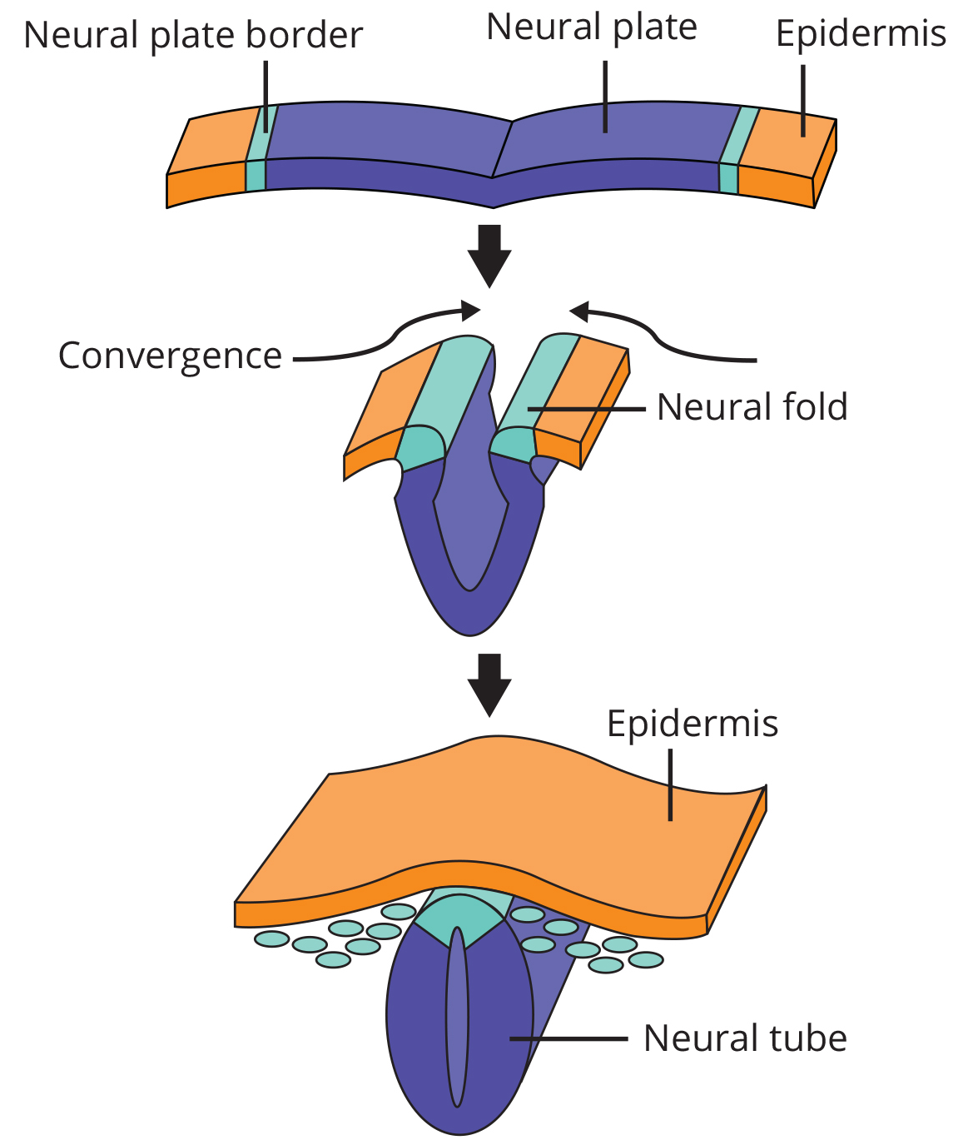
Neural System Formation
In vertebrates, the neural system formation is a key early event in organogenesis.
The ectoderm forms neuronal tissues and epithelial cells.
Growth factors signal cells at the edge of the ectoderm to become epidermis cells.
Remaining cells form the neural plate.
If signaling is disrupted, the entire ectoderm would differentiate into neural tissue.
The neural plate rolls up and forms the neural tube, which later gives rise to the brain and spinal cord.
40.5 Figure 7: The central region of the ectoderm forms the neural tube.
CNX OpenStax on Wikimedia Commons. "Formation of neural tube." Modified.

Slide 16
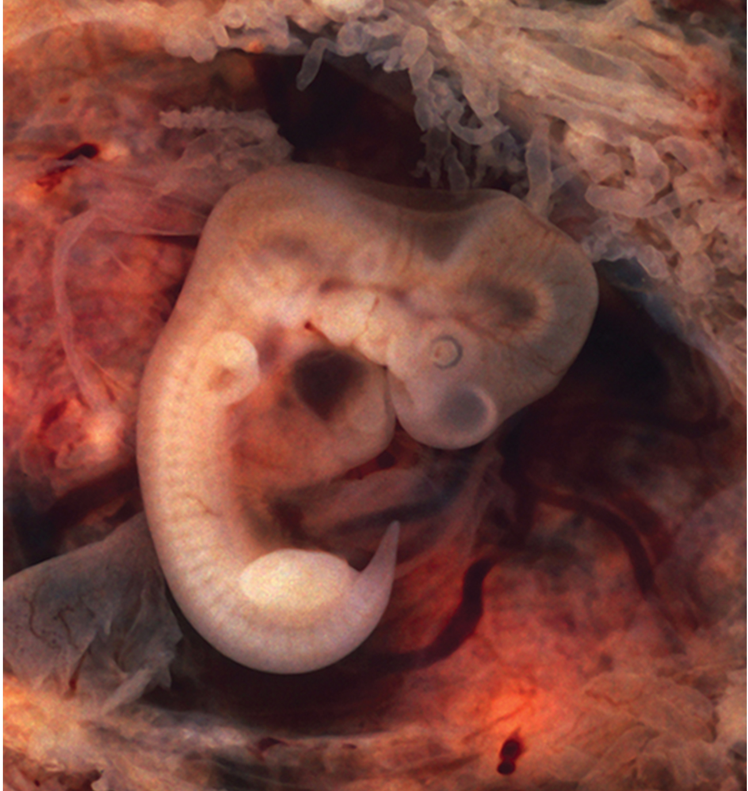
Connective Tissue Formation
The mesoderm develops into the various connective tissues of the body.
A spatial pattern of gene expression reorganizes the mesoderm into a group of somites with spaces between them.
Somites further develop into cells that form the vertebrae and ribs, dermis of the dorsal skin, and skeletal muscles of the back, body wall, and limbs.
The mesoderm also forms the notochord, which forms the central axis of the animal body.
40.5 Figure 8: In this five-week-old human embryo, somites are segments along the length of the body.
Ed Uthman, MD on Wikimedia Commons. "Tubal pregnancy with embryo."

Slide 17
Science and You₃
Proper neural tube closure is crucial in embryonic development.
Can lead to neural tube defects (NTDs)
Example: spina bifida
Results in damage to the spinal cord, impacting the nerves adjacent to the deficit
Symptoms: weakness to total paralysis of the legs, incontinence, and impaired sensation from the lower extremities
Notes:
This is included as a relevant application for this topic.

Slide 18
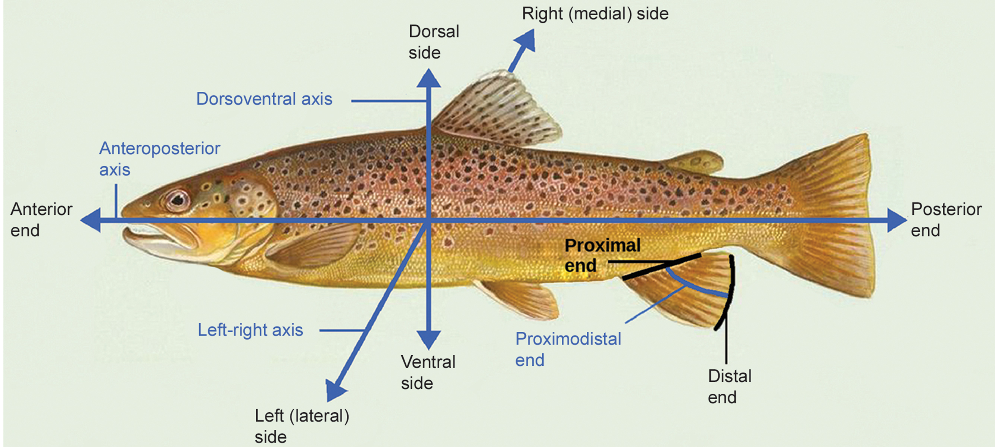
Vertebrate Axis Formation₁
Cells retain their spherical shape as germ layers form, but animal bodies eventually develop the following axes:
Lateral-medial (left-right), dorsal-ventral (back-belly), and anterior-posterior (head-feet)
40.5 Figure 9: Animal bodies have three axes for symmetry: lateral-medial, dorsal-ventral, and anterior-posterior.
NOAA on Wikimedia Commons. "Animal body axes."

Slide 19
Vertebrate Axis Formation₂
Experiments by Spemann and Mangold showed the role of dorsal cells in axis formation.
They took dorsal cells from one embryo and transplanted them into the belly of another embryo.
The latter embryo developed two notochords: one at the dorsal side and one at the belly area.
This suggests dorsal cells were specialized to direct formation of the notochord and define the axis.
These dorsal cells were termed the organizer: a groups of cells that induce neighboring cells to differentiation in specific ways to pattern the embryo.
Pattern: generate a set of organized structures
Researchers identified many genes responsible for axis formation.
Mutations lead to loss of symmetry required for development.

Slide 20
Vertebrate Axis Formation₃
Animal bodies have externally visible symmetry, but internal organs are not symmetrical.
One example is the heart being on the left side and the liver being on the right.
Formation of central left-right axis is important during development.
Internal asymmetry, such as heart placement, is established early and involves specific genes.
Research about these genes is still ongoing.

Slide 21
Summary
Embryogenesis begins with fertilization, ensuring a diploid zygote.
Cleavage forms the blastula and then undergoes gastrulation, which creates the three germ layers:
Ectoderm: nervous system and epidermal skin cells
Mesoderm: muscle cells and connective body tissue
Endoderm: columnar cells and internal organs
Organogenesis involves the differentiation of germ layers into organs.
Ectoderm: formation of the neural system
Mesoderm: somites and the notochord
Vertebrate axis formation is another important developmental stage.

Slide 22

End of Hawkes Learning PowerPoint

