Slide 1
Lesson 41.1
Sensory Processes

Slide 2
Objectives
Describe three important steps in sensory perception.
Explain the concept of just-noticeable difference in sensory perception.
Identify the general and special senses in humans.
Describe the functions of various parts of cellular systems involved in sensory transduction.

Slide 3

Sensory Systems
Bilaterally symmetrical animals possess sensory systems adapted through natural selection.
Bilaterally symmetrical: can be divided into two halves by a central axis
Sensory systems vary among species based on environmental demands.
Example: electrosensitivity (ability to detect electrical fields) in sharks
41.1 Figure 1: This shark uses its senses of sight, vibration (lateral-line system), and smell to hunt, but it also relies on its ability to sense the electric fields of prey.
Oleksandr Sushko on Wikimedia Commons. "Shark."

Slide 4

Sensory Processes
Humans have five special senses: olfaction, gustation, equilibrium, vision, and hearing.
We also have general senses (somatosensation), which respond to stimuli like temperature, pain, pressure, and vibration.
Vestibular sense: sense of spatial orientation and balance
Proprioception: position of bones, joints, and muscles
Kinesthesia: limb movement
Sensory transduction converts stimuli into electrical signals in the nervous system.
41.1 Figure 2: The sense of equilibrium enables an individual to maintain balance when standing or walking.
Loic Leray on Wikimedia Commons. "Tightrope walker."

Slide 5
Sensory Transduction Systems
There are two types of sensory transduction systems:
Type 1: Sensory receptors activate afferent neurons, sending stimulus information to the CNS.
Sensory receptor: a cell or cell process that is specialized to engage with and detect a specific stimulus
Type 2: Free nerve endings respond to multiple stimuli and have low receptor specificity.
Example: pain receptors in your gums/teeth stimulated by temperature changes, chemical stimulation, or pressure

Slide 6

Reception
Reception is the activation of sensory receptors by stimuli (mechanical, chemical, or temperature).
Receptive fields define the spatial area where sensory receptors respond to stimuli.
Can vary; touch requires contact, hearing works at a moderate distance, and vision perceives distant light (e.g., starlight)
41.1 Figure 3: Our visual system can perceive the light from stars, though they may be hundreds of thousands of light-years away.
Joshua Earle on Wikimedia Commons. "Stargazing."

Slide 7
Transduction₁
Sensory systems translate sensory signals to electrical signals at sensory receptors.
Receptor potential: change in electrical potential due to sensory input
Mechanoreceptors have specialized membranes that respond to pressure.
Disturbance by compression or bending opens gated ion channels in the plasma membrane of the sensory neuron, which changes its electrical potential.
In the nervous system, positive change of a neuron's electrical potential (or membrane potential) depolarizes the neuron.

Slide 8
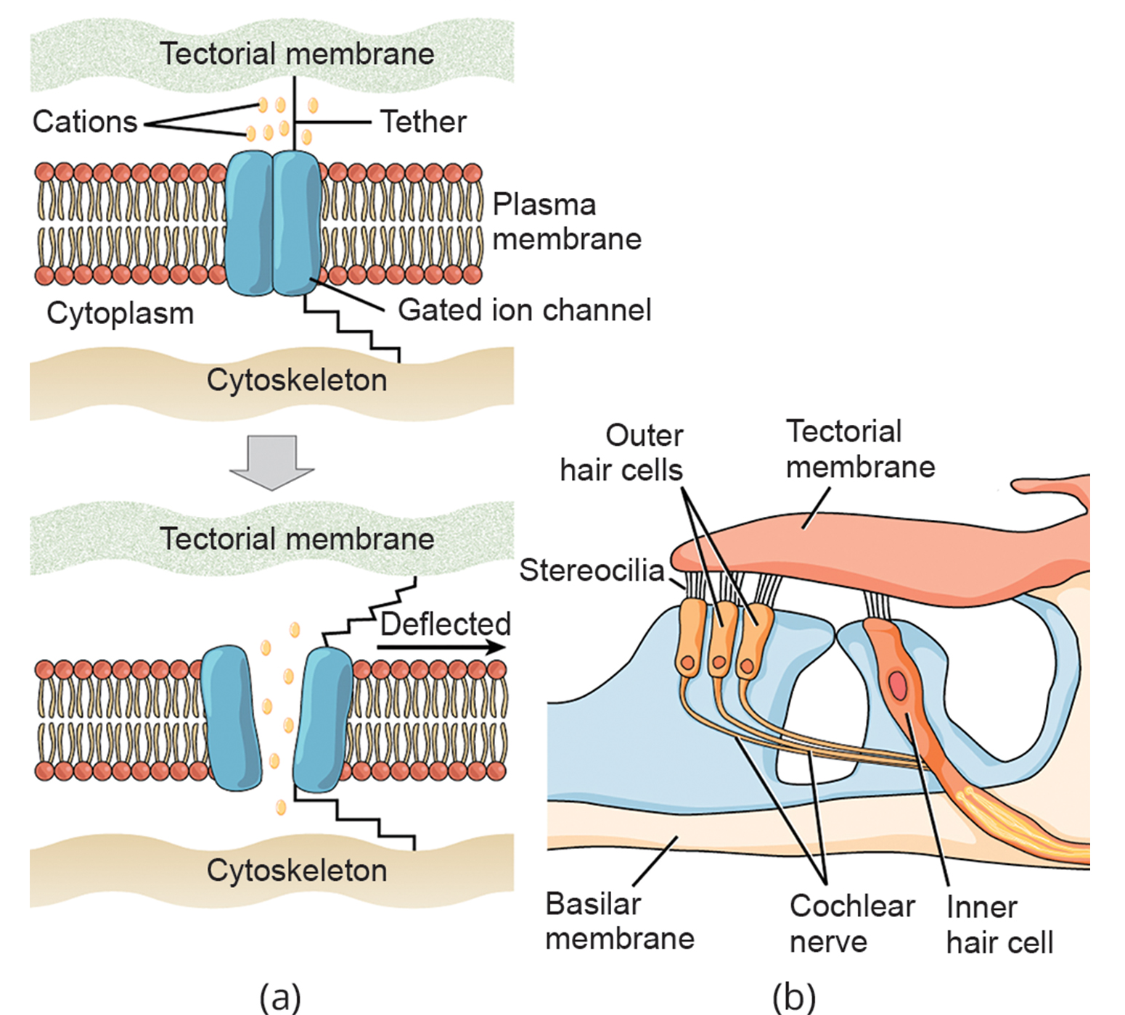
41.1 Figure 4
CNX OpenStax on Wikimedia Commons. "Mechanosensitive ion channels." Modified.
Notes:
(a) Mechanosensitive ion channels are gated ion channels that respond to mechanical deformation of the plasma membrane. (b) Stereocilia in the human ear are connected to mechanosensitive ion channels.

Slide 9
Transduction₂
Receptor potentials are graded; stronger stimuli cause larger changes in membrane potential.
Example: A small amount of stimulus (light pressure) will elicit a small change, while a larger amount (heavier pressure) will elicit a larger change in membrane potential.
If the magnitude of depolarization is sufficient/reaches a threshold, the neuron will fire an action potential.
Action potential: rapid change in a neuron's membrane potential from negative to positive, caused by positive ions flooding the cell
Correct stimuli impinging on sensory receptors typically drive membrane potential positively, except in some systems (e.g., visual).

Slide 10
Receptor Specificity
Sensory receptors for different senses are different from each other.
Specialize according to type of stimulus sensed (receptor specificity)
Example: touch, light, and sound receptors activated by different stimuli

Slide 11

Encoding and Transmission of Sensory Information₁
Sensory systems encode the type, location, duration, and relative intensity of stimuli.
Action potentials on afferent axons encode specific stimuli types, maintaining sense segregation in sensory circuits.
Example: Auditory receptors transmit over their own system, and electrical activity in the axons of said receptors will be interpreted by the brain as a sound.
41.1 Figure 5: The sensation of sound from this concert results from the brain processing information from auditory receptors.
George Webster on Pexels. "Concert."

Slide 12
Encoding and Transmission of Sensory Information₂
Intensity of a stimulus is encoded by the rate of action potentials and the number of receptors activated.
An intense stimulus will produce a more rapid train of action potentials, and reducing the stimulus will likewise slow the rate of action potentials.
CNS integrates sensory information immediately, with the brain further processing signals.

Slide 13
Think It Through
How can the same auditory receptor communicate information about very loud music at a concert or very soft music playing from a speaker?
Notes:
Originally an On Your Own. This is included here to use as a talking point or for a think-pair-share activity.

Slide 14
Perception₁
Perception is the brain's interpretation of sensations.
Relies on activation of sensory receptors
Occurs at higher levels in the nervous system in the brain
Sensory pathways carry action potentials from receptors to specific brain regions.
These neurons are dedicated to particular stimuli and synapse with particular neurons in the brain or spinal cord.

Slide 15
Reflection Question
Do you like the taste of cilantro? To some individuals, cilantro tastes tangy and citrusy; to others, it tastes like soap. How might genetic differences in sensory receptors account for these individual differences in the perception of cilantro's flavor?
Notes:
The reflection question is included here to use as a talking point or for a think-pair-share activity.

Slide 16
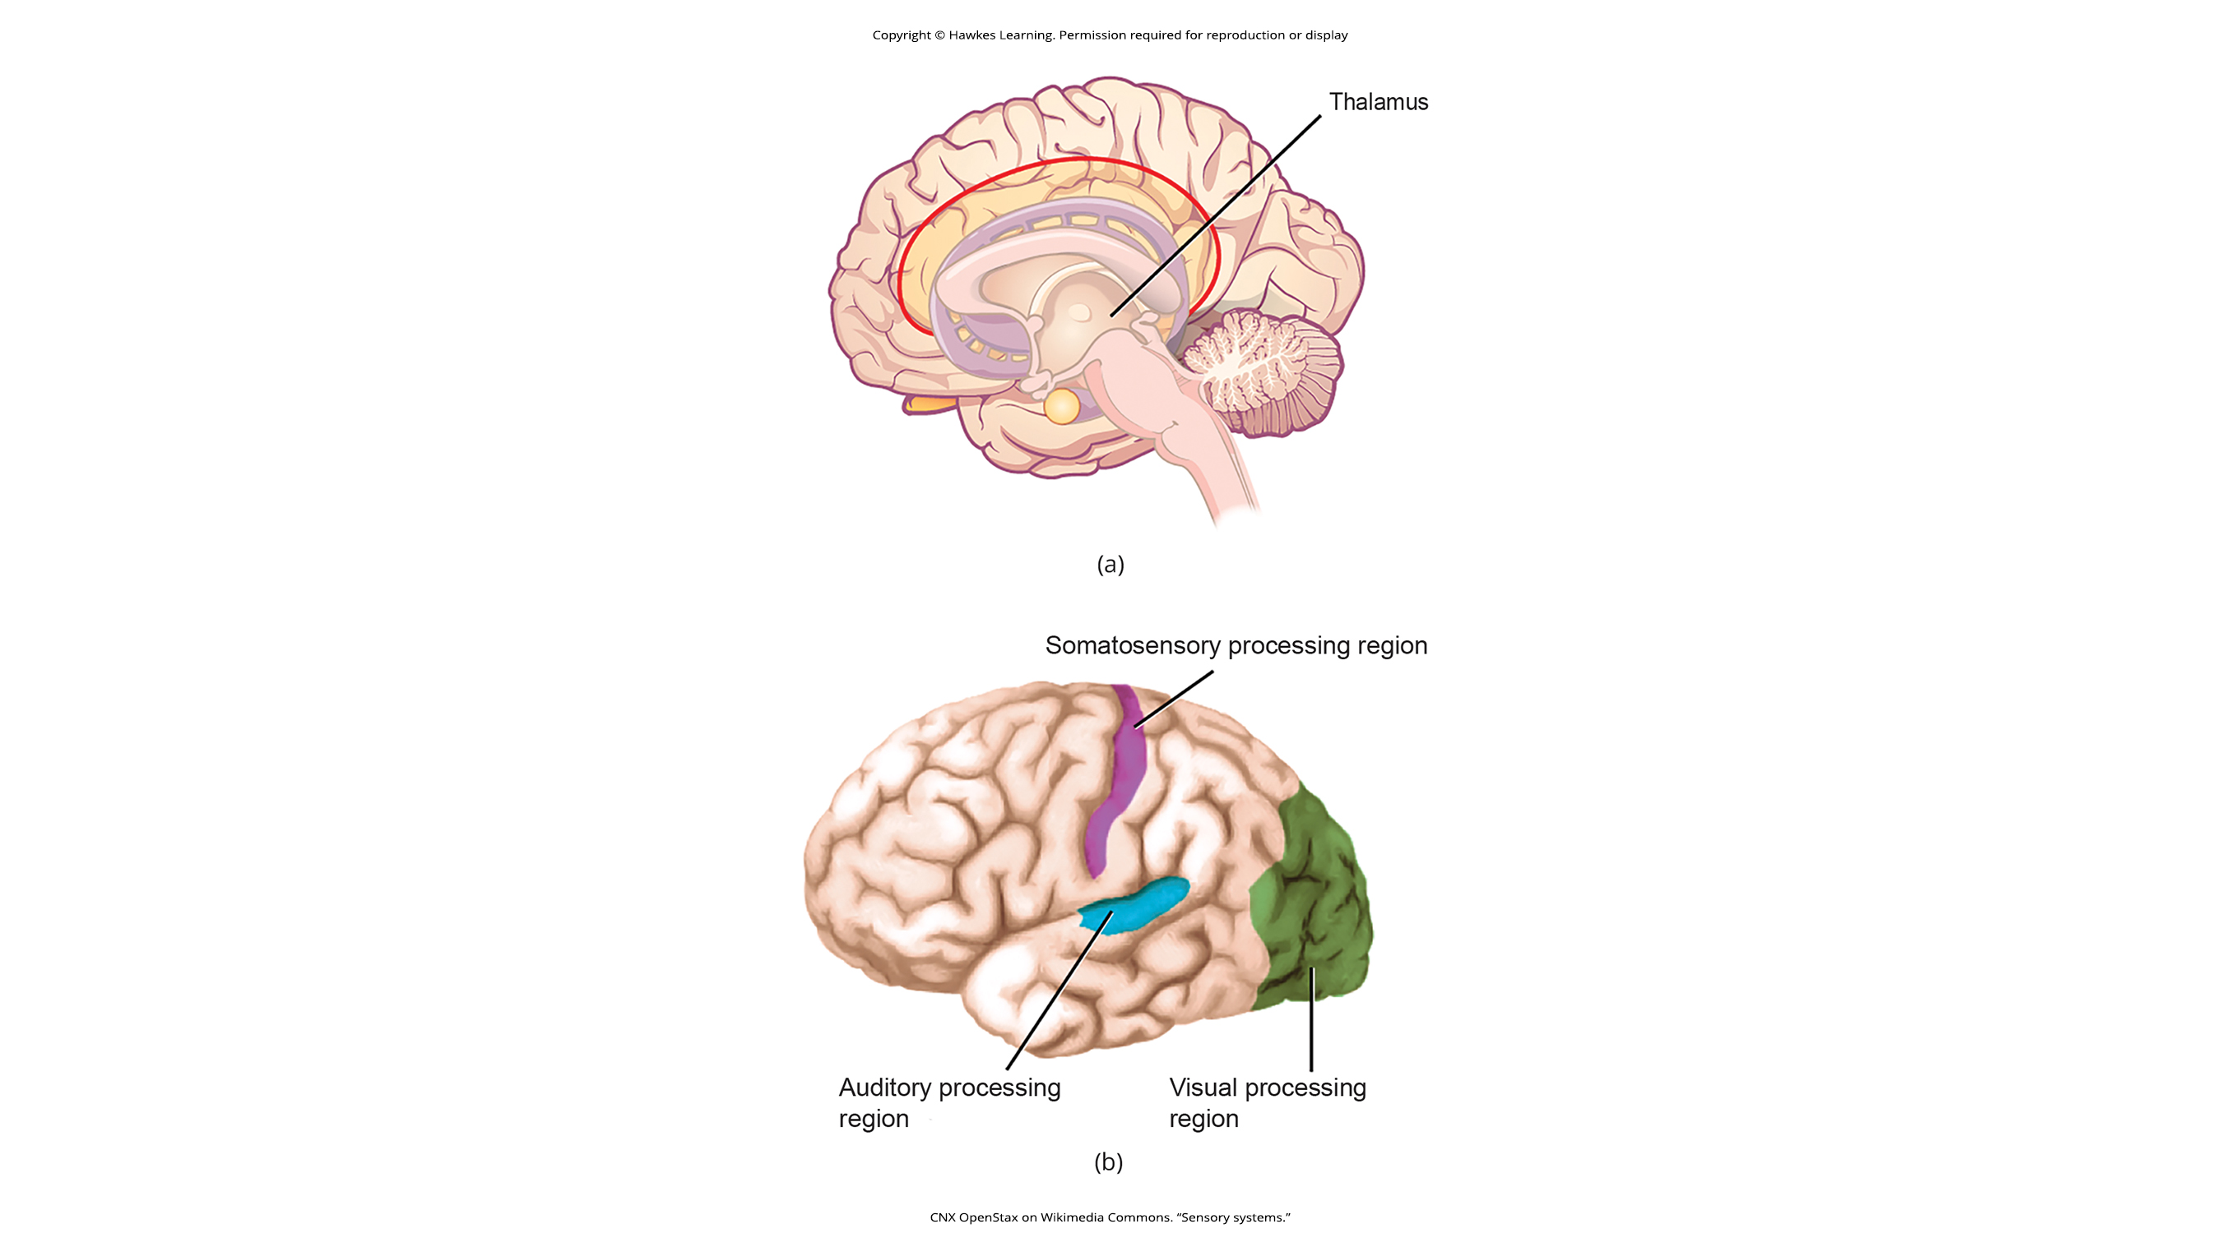
Perception₂
Most sensory signals, except olfactory, route through the thalamus to the cortex.
Thalamus: structure in the forebrain that serves as a clearinghouse and relay station or sensory signals
Neural signal interpretation is mostly similar among individuals of the same species but can vary (e.g., pain tolerance).
41.1 Figure 6: In humans, all sensory signals (except olfaction) are routed from the (a) thalamus to (b) final processing regions in the cortex of the brain.
CNX OpenStax on Wikimedia Commons. "Sensory systems."

Slide 17
Group Activity₁
Just-Noticeable Difference
It is easy to differentiate between a one-pound bag of rice and a two-pound bag of rice; there is a one-pound difference, and one bag is twice as heavy as the other. However, would it be as easy to differentiate between a 20- and a 21-pound bag? The smallest detectible difference between two stimuli is known as the just-noticeable difference (JND). According to Weber's Law, the just-noticeable difference in a stimulus is proportional to the magnitude of the original stimulus. In this activity, you will investigate and test Weber's Law.

Slide 18
Group Activity₂
Just-Noticeable Difference
Question: What is the smallest detectible weight difference between a one-pound bag of rice and a larger bag? What is the smallest detectible difference between a 20-pound bag and a larger bag? In both cases, at what weights are the differences detected?
Background: Research background literature on JND and on Weber's Law, a description of a proposed mathematical relationship between the overall magnitude of the stimulus and the JND. You will be testing the JND of different weights of rice in bags. Choose a convenient increment to be stepped through while testing. For example, you could choose 10% increments between one and two pounds (1.1, 1.2, 1.3, 1.4, and so on) or 20% increments (1.2, 1.4, 1.6, and 1.8).

Slide 19
Group Activity₃
Just-Noticeable Difference
Hypothesis: Develop a hypothesis about the JND in terms of percentage of the whole weight being tested (such as "the JND between the two small bags and between the two large bags is proportionally the same," or "… is not proportionally the same"). So, for the first hypothesis, if the JND between the one-pound bag and a larger bag is 0.2 pounds (that is, 20%; 1.0 pound feels the same as 1.1 pounds, but 1.0 pound feels less than 1.2 pounds), then the JND between the 20-pound bag and a larger bag will also be 20%. (So, 20 pounds feels the same as 22 pounds or 23 pounds, but 20 pounds feels less than 24 pounds.)

Slide 20
Summary
Sensory activation involves converting physical/chemical stimuli into neural signals via sensory receptors.
Perception is the brain's interpretation of sensations.
Humans have special senses (olfaction, gustation, equilibrium, hearing) and general senses (somatosensation).
Sensory receptors are specialized cells or neuron ends in the peripheral nervous system.
Each receptor is modified for specific stimuli and has a defined receptive field.
The fundamental function of sensory systems is translating sensory signals to electrical signals in the nervous system.
Sensory signals (except olfactory) enter the CNS, route through the thalamus, and conduct to specific cortical areas for processing.

Slide 21

End of Hawkes Learning PowerPoint

