Slide 1
Lesson 41.2
Somatosensation

Slide 2
Objectives
Describe four important mechanoreceptors in human skin.
Describe the topographical distribution of somatosensory receptors between glabrous and hairy skin.
Explain why the perception of pain is subjective.

Slide 3
Somatosensation₁
Somatosensation refers to the mixed sensory category encompassing all sensation from the skin, mucus membranes, limbs, and joints.
  Derived from somato- ("of or relating to the human body") and -sensation ("a feeling or perception resulting from a stimulus")
  Also known as the tactile sense or the sense of touch
  Occurs all over the exterior and some of the interior of the body

Slide 4
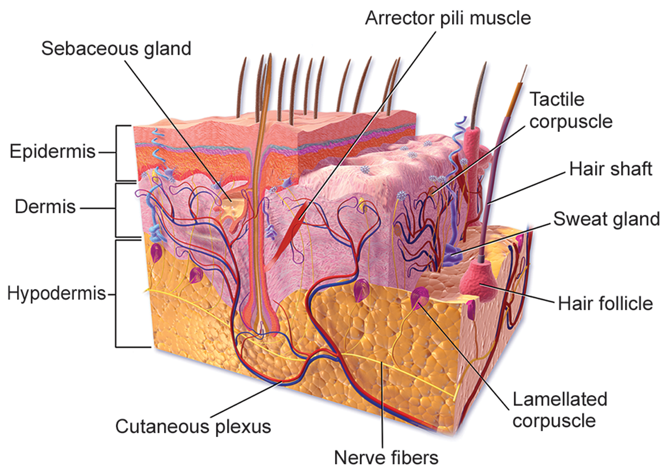
41.2 Figure 1
BruceBlaus on Wikimedia Commons. "Integumentary system."
Notes:
Mammalian skin is composed of two layers: epidermis and dermis. The hypodermis is a subcutaneous tissue that is not strictly a part of the skin.

Slide 5
Somatosensation₂
Epidermis: the outermost skin layer; composed of keratin-filled cells and has no blood supply
  Acts as a barrier to water and pathogens
Dermis: contains blood vessels, sweat glands, hair follicles, lymph vessels, and lipid-secreting sebaceous glands
Hypodermis: fatty layer that contains blood vessels, connective tissue, and the axons of sensory neurons
  Holds about 50% of the body's fat
  Attaches the dermis to the bone and muscle
  Supplies nerves and blood vessels to the dermis

Slide 6
Somatosensory Receptors₁
Sensory receptors are classified into five categories based on the nature of stimuli each class transduces:
Mechanoreceptors, thermoreceptors, proprioceptors, pain receptors, and chemoreceptors
Mechanoreceptors in the skin are encapsulated (surrounded by a capsule) or unencapsulated (includes free nerve endings).
Free nerve ending: unencapsulated dendrite of a sensory neuron
  Most common nerve endings in skin
  Extend into the middle of the epidermis
  Sensitive to painful stimuli, hot and cold, and light touch
  Slow to adjust to a stimulus, so less sensitive to abrupt changes in stimulation

Slide 7
Somatosensory Receptors₂
There are three classes of mechanoreceptors:
Tactile receptors, proprioceptors, and baroreceptors
Mechanoreceptors sense stimuli due to the physical deformation of their plasma membranes.
Contain mechanically gated ion channels that open/close in response to pressure, touch, stretching, and sound
There are four primary tactile mechanoreceptors in human skin:
Merkel's disks, Meissner's corpuscles, Ruffini endings, and Pacinian corpuscles
Two on the surface of the skin, two deeper in the skin
Krause end bulbs: fifth type only found in specialized regions (e.g., mucus membranes of lips and tongue)

Slide 8
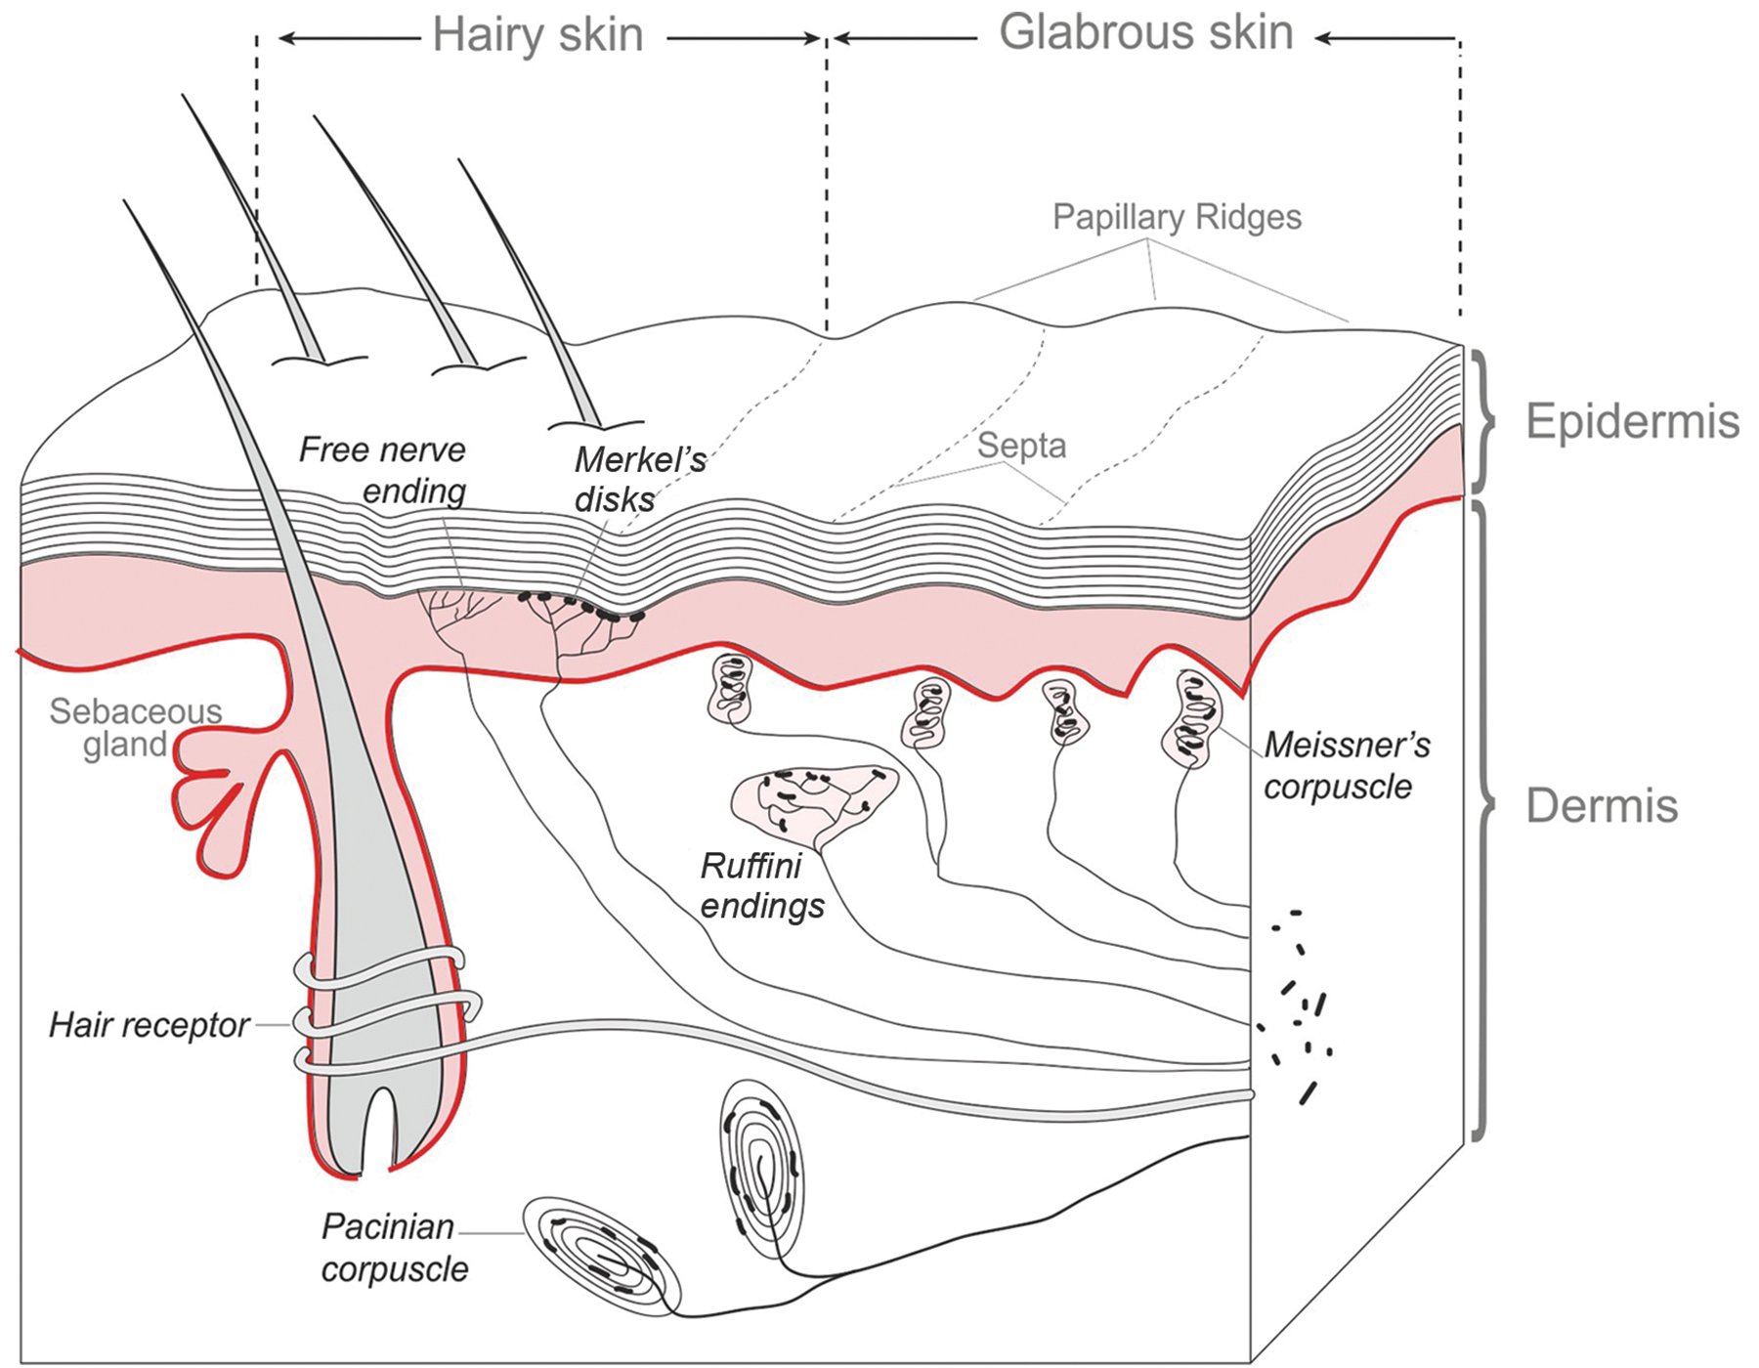
41.2 Figure 2
Thomas.haslwanter on Wikimedia Commons. "Skin receptors."
Notes:
Four of the primary mechanoreceptors in human skin are shown.

Slide 9
Merkel's Disks
Merkel's disks: found in the upper layers of skin near the base of the epidermis
On both hairy skin and glabrous skin (hairless skin on palms and fingers, soles of feet, and lips)
Densely distributed on fingertips and lips
Slow-adapting, unencapsulated nerve endings that respond to light/discriminative touch
  Light touch: light pressure that allows the location of a stimulus to be pinpointed
Have small receptive fields with well-defined borders
Essential for tasks requiring precise touch like typing

Slide 10
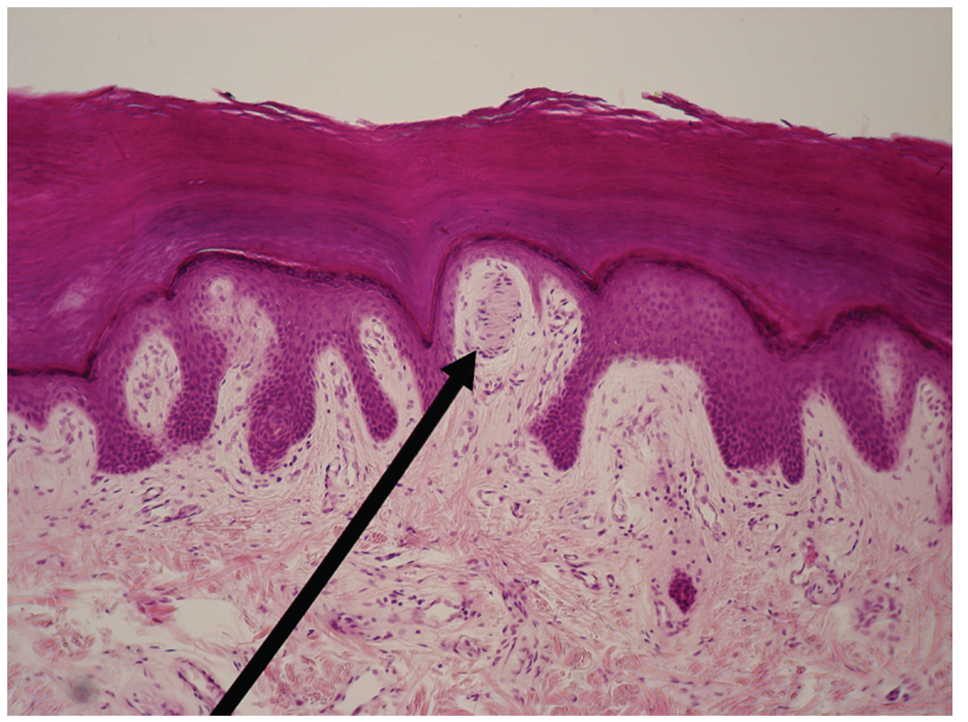
Meissner's Corpuscles
Meissner's corpuscles (tactile corpuscles): found in the upper dermis
Project into the epidermis
Found primarily on glabrous skin (fingertips and eyelids)
Respond to fine touch, pressure, and low-frequency vibrations/flutters
Rapidly adapting, fluid-filled, encapsulated neurons
Have small, well-defined borders, and are responsive to fine details
More abundant in the fingertips than in the palms, like Merkel's disks
41.2 Figure 3: Meissner's corpuscles in the fingertips, such as the one viewed here using bright field light microscopy, allow for finely detailed touch discrimination.
OpenStax Anatomy and Physiology on Wikimedia Commons. "Meissner corpuscle."

Slide 11
Ruffini Endings
Ruffini endings: deeper in the epidermis, near the base
Also called bulbous corpuscles
Found in both glabrous and hairy skin
Slow-adapting, encapsulated mechanoreceptors
Detect skin stretch, joint deformations, and warmth
Provide feedback for gripping and controlling finger position
Contribute to proprioception/kinesthesia, the awareness of body position and movement
Detect warmth with detectors located deeper in the skin than cold detectors
  Why humans detect cold stimuli first

Slide 12
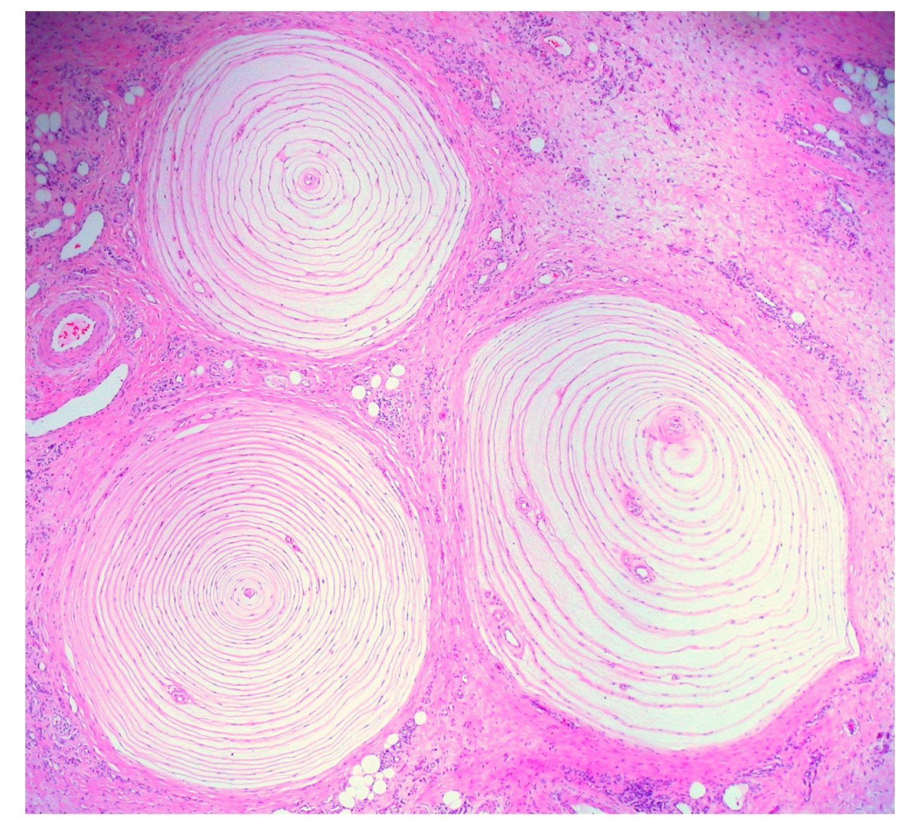
Pacinian Corpuscles
Pacinian corpuscles: deep in the dermis and structurally similar to Meissner's corpuscles
Found in glabrous and hairy skin, bone periosteum, joint capsules, pancreas and other internal organs (viscera), breast, and genitals
Rapidly adapting mechanoreceptors sensing deep transient pressure and high-frequency vibration
Detect pressure and vibration by compression, stimulating internal dendrites
Along with Ruffini endings, fewer in number compared Merkel's disks and Meissner's corpuscles
41.2 Figure 4: Pacinian corpuscles, such as these visualized using bright field light microscopy, detect pressure (touch) and high-frequency vibration.
Ed Uthman on Wikimedia Commons. "Pacinian corpuscles."

Slide 13
Think It Through₁
Which mechanoreceptors detect a cell phone vibrating in your hand?
Notes:
Originally an On Your Own. This is included here to use as a talking point or for a think-pair-share activity.

Slide 14
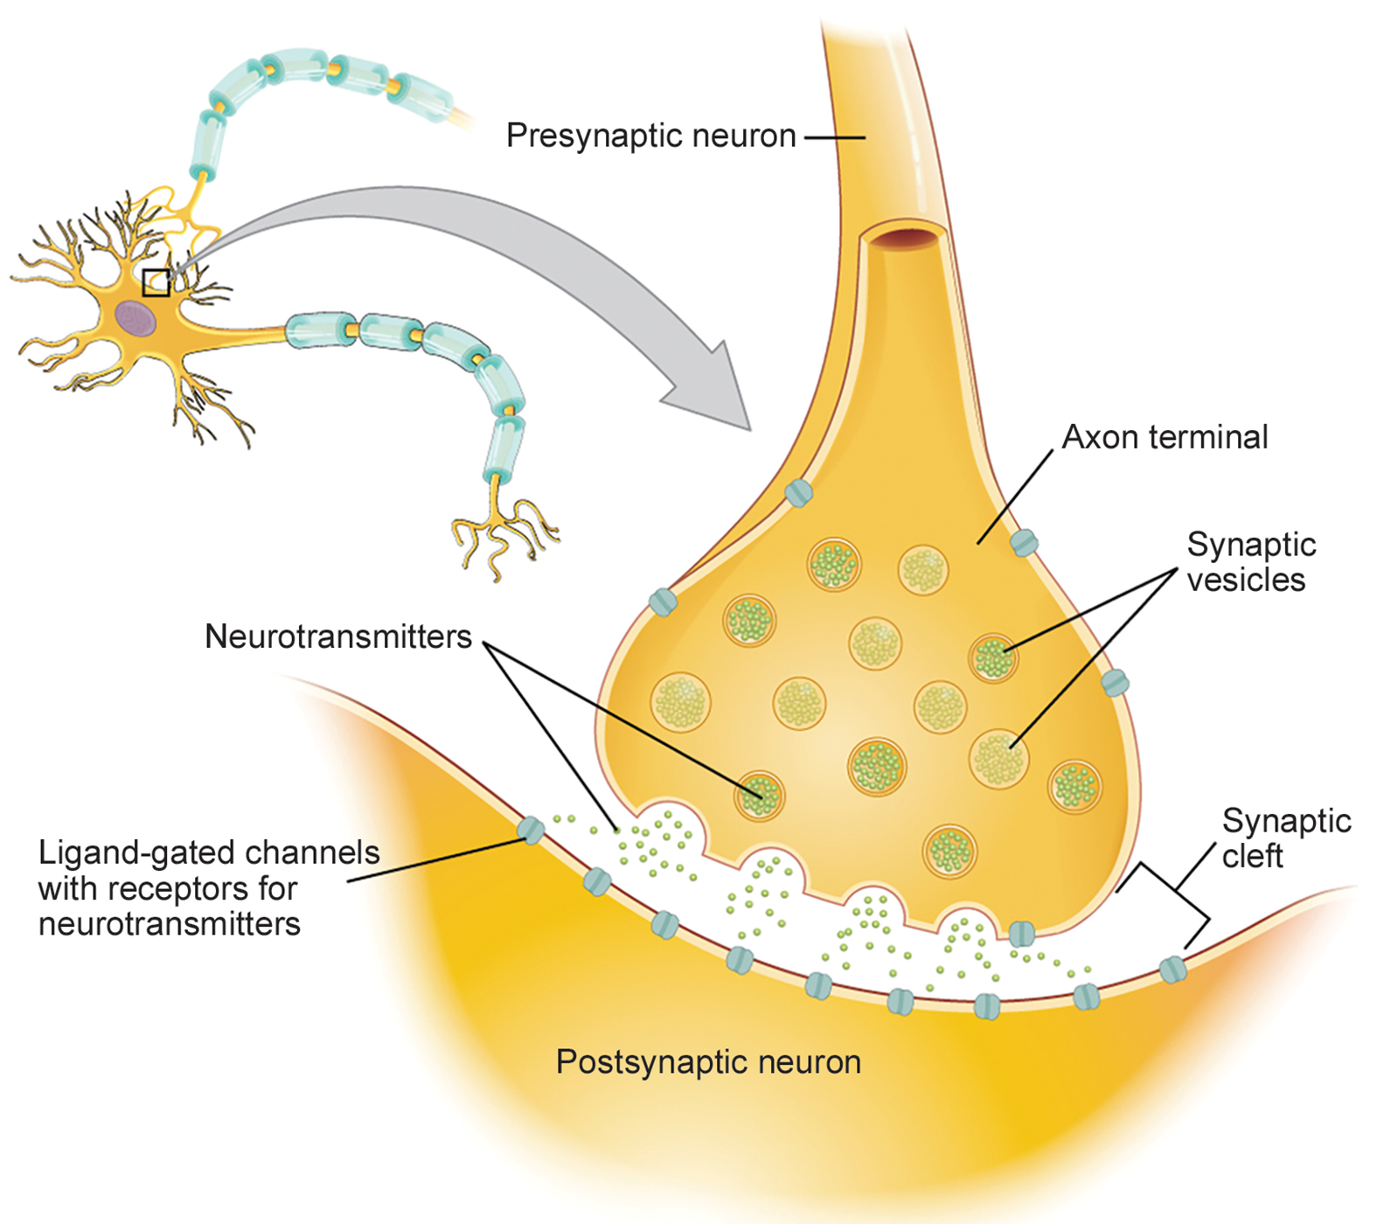
Proprioception
Proprioception involves proprioceptive and kinesthetic signals traveling through myelinated afferent neurons from the spinal cord to the medulla.
Many neurons communicate via neurotransmitters in synaptic clefts (gaps) despite not being connected to each other physically.
Once in the medulla, neurons continue carrying signals to the thalamus.
41.2 Figure 5: A chemical synapse is composed of the presynaptic neuron, synaptic cleft, and postsynaptic neuron.
OpenStax Anatomy and Physiology on Wikimedia Commons. "Chemical synapse."

Slide 15
Muscle Spindles & Golgi Tendon Organs
Muscle spindles are stretch receptors that detect muscle stretch or lengthening.
Golgi tendon organs are tension receptors that detect the force of muscle contraction.
Proprioceptive and kinesthetic signals come from the limbs.
  Unconscious proprioceptive signals run from the spinal cord to the cerebellum (brain region that coordinates muscle contraction) instead of the thalamus, like most other sensory information.

Slide 16
Baroreceptors & Hair Receptors
Baroreceptors: detect pressure changes in organs
Found in the walls of the carotid artery and aorta (blood pressure monitoring) as well as in the lungs (lung expansion)
Hair receptors: found on nerve endings that wrap around the base of hair follicles; different types
Detect slow and rapid hair movement
Differ in sensitivity to movement
Detect skin deflection (movement of skin)
Allow detection of stimuli that have not yet touched skin

Slide 17
Science and You₁
The knee-jerk reflex relies on muscle spindles.
There is a slight stretch in the quadriceps when the patellar ligament is tapped.
Muscle spindles detect stretch and send signals to the spinal cord.
The spinal cord processes the signal and sends it to neurons innervating the hamstrings, causing them to relax.
Simultaneously, neurons innervating the quadriceps receive the signal to contract.
The contraction of the quadriceps and the relaxation of the hamstrings produce the rapid kick.
The entire reflex process, from the hammer tap to the foot kick, typically completes in about 0.02 seconds.
Notes:
This is included as a relevant application for this topic.

Slide 18
Think It Through₂
Identify the mechanoreceptor that best matches each description.
Located deep in the dermis; detects pressure and vibration
Detects pressure change
Located in upper dermis; detects fine touch and pressure
Located deep in epidermis; slow adapting, detects skin stretch and deformations
Located in epidermis; detects fine touch
Notes:
Originally an On Your Own. This is included here to use as a talking point or for a think-pair-share activity.

Slide 19
Integration of Signals from Mechanoreceptors
Different receptors in the skin work together for a refined sense of touch.
Nociceptive receptors detect pain and are near the surface.
Small mechanoreceptors in the upper layers (Merkel's disks and Meissner's corpuscles) localize gentle touch.
Large mechanoreceptors in the lower layers (Pacinian corpuscles and Ruffini endings) respond to deeper touch.
Both primary somatosensory cortex and secondary cortical areas process the stimuli from mechanoreceptors.

Slide 20
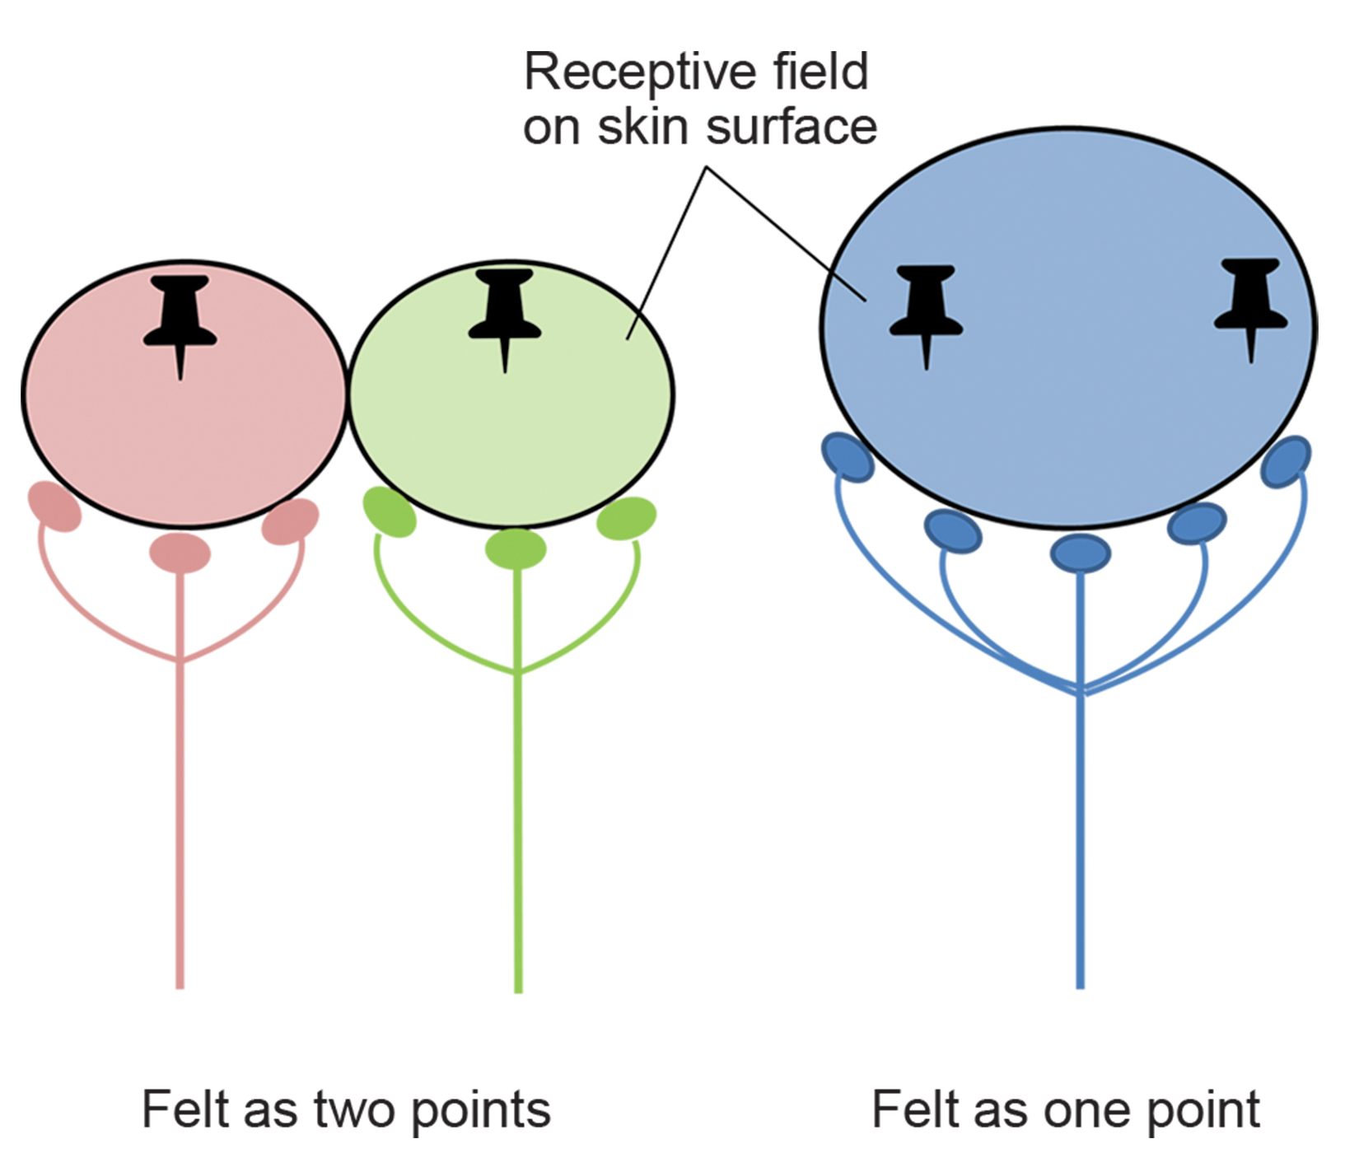
Density of Mechanoreceptors
Touch receptors are denser in glabrous skin compared to hairy skin.
Glabrous skin: more sensitive and thicker than hairy skin
The two-point discrimination test estimates receptor density by testing if two points are felt as one or two separate points.
41.2 Figure 6: The two-point discrimination test can determine the relative size of a neuron's receptive field.

Slide 21
Thermoreception
Thermoreceptors include cold receptors (Krause end bulbs) and warmth receptors (Ruffini endings).
They are located in the dermis, skeletal muscles, liver, and hypothalamus.
Pathways run from the spinal cord, through the thalamus, and to the primary somatosensory cortex.
Temperature information from the face travels through cranial nerves.
Intense temperature stimuli can be perceived as pain since they use the same pathways as pain sensations.

Slide 22
Pain
Nociception (pain) is the neural processing of injurious stimuli in response to tissue damage.
Pain can result from true injury or harmless stimuli mimicking injury (e.g., capsaicins in peppers).
  Peppers taste hot because protein receptors that bind capsaicin open the same calcium channels that are active by warm receptors.
Nociceptive pathways primarily project to the thalamus and are processed in the primary somatosensory cortex.
Some pathways project to the hypothalamus, influencing autonomic nervous system responses.
Pain perception is crucial for survival, prompting avoidance of harmful stimuli.
  Threatening stimuli stimulate the sympathetic branch of the visceral sensory system, reading fight-or-flight.

Slide 23
Science and You₂
"Hot" or "spicy" is not technically a taste!
Only five known taste sensations: sweet, sour, salty, bitter, and umami (savory)
Results from sensations being sent by activated warmth receptors, not taste receptors
Can cause physical pain in excess, since thermoreceptors carry sensations along the same pathway as pain
Notes:
This is included as a relevant application for this topic.

Slide 24
Summary
Somatosensation includes all sensation from the skin, mucus membranes, limbs, and joints.
  Occurs all over the exterior of the body as well as some interior locations
  Various receptor types with different roles, including rapidly adapting free nerve endings and slowly adapting encapsulated receptors like Merkel's disks and Meissner's corpuscles
Receptors like Ruffini endings and Pacinian corpuscles detect different types of touch and vibration.
Proprioception involves muscle spindles and Golgi tendon organs for sensing muscle stretch and force.
Baroreceptors detect pressure changes in organs, contributing to cardiovascular regulation.
Integration of signals from mechanoreceptors results in a refined sense of touch processed by the somatosensory cortex.

Slide 25

End of Hawkes Learning PowerPoint

