Slide 1
Lesson 41.3
Taste and Smell

Slide 2
Objectives
Describe the benefits of enhanced sense of smell or taste in a species.
Explain in what way smell and taste stimuli differ from other sensory stimuli.
Identify the five primary tastes that can be distinguished by humans.
Identify the form and function of the different types of papillae.

Slide 3
Taste and Smell
Gustation (taste) and olfaction (smell) are interconnected senses.
Both involve molecules of the stimuli entering the body and bonding to receptors.
Both senses play crucial roles in survival, helping animals detect food, mates, predators, and environmental chemicals.
Smell allows detection of food, other animals, and environmental chemicals.
Taste helps discriminate between beneficial and harmful foods.

Slide 4
Tastes and Odors₁
The primary tastes detected by humans are sweet, sour, bitter, salty, and umami.
Umami (savoriness) is attributed to the taste of the amino acid L-glutamate.
Identified in 1908 by Japanese scientist Kikunae Ikeda
Monosodium glutamate (MSG) is often used in cooking to enhance the savory taste of some foods.
Adaptive value: savory substances tend to be high in protein

Slide 5
Science and You
A common misconception is that MSG is harmful to your health.
The FDA requires food labels to state if MSG is added, but there is no research supporting MSG being harmful.
MSG is naturally present in foods like soy, tomatoes, and cheese.
Prolonged simmering of tomato sauce releases more MSG, enhancing flavor.
Notes:
This is included as a relevant application for this topic.

Slide 6
Tastes and Odors₂
Odors are airborne molecules detected by our olfactory receptors.
If a substance does not release molecules into the air, it has no smell.
Humans have about 350 olfactory receptor subtypes, detecting around 10,000 odors.
Mice have about 1,300 olfactory receptor types, likely sensing more odors than humans.
Both odors and tastes involve molecules that stimulate specific chemoreceptors.
Flavor perception involves both taste and smell.

Slide 7
Reception and Transduction₁
Odorants (odor molecules) dissolve in the olfactory epithelium (collection of specialized olfactory receptors at the back of the nasal cavity).
Humans have about 12 million olfactory receptors (dendrites of specialized neurons) across hundreds of receptor types.
Olfactory receptors: respond when they bind to certain molecules from the environment; send impulses to the olfactory bulb of the brain
Rabbits: 100 million; dogs: 1 billion; bloodhounds: 4 billion

Slide 8
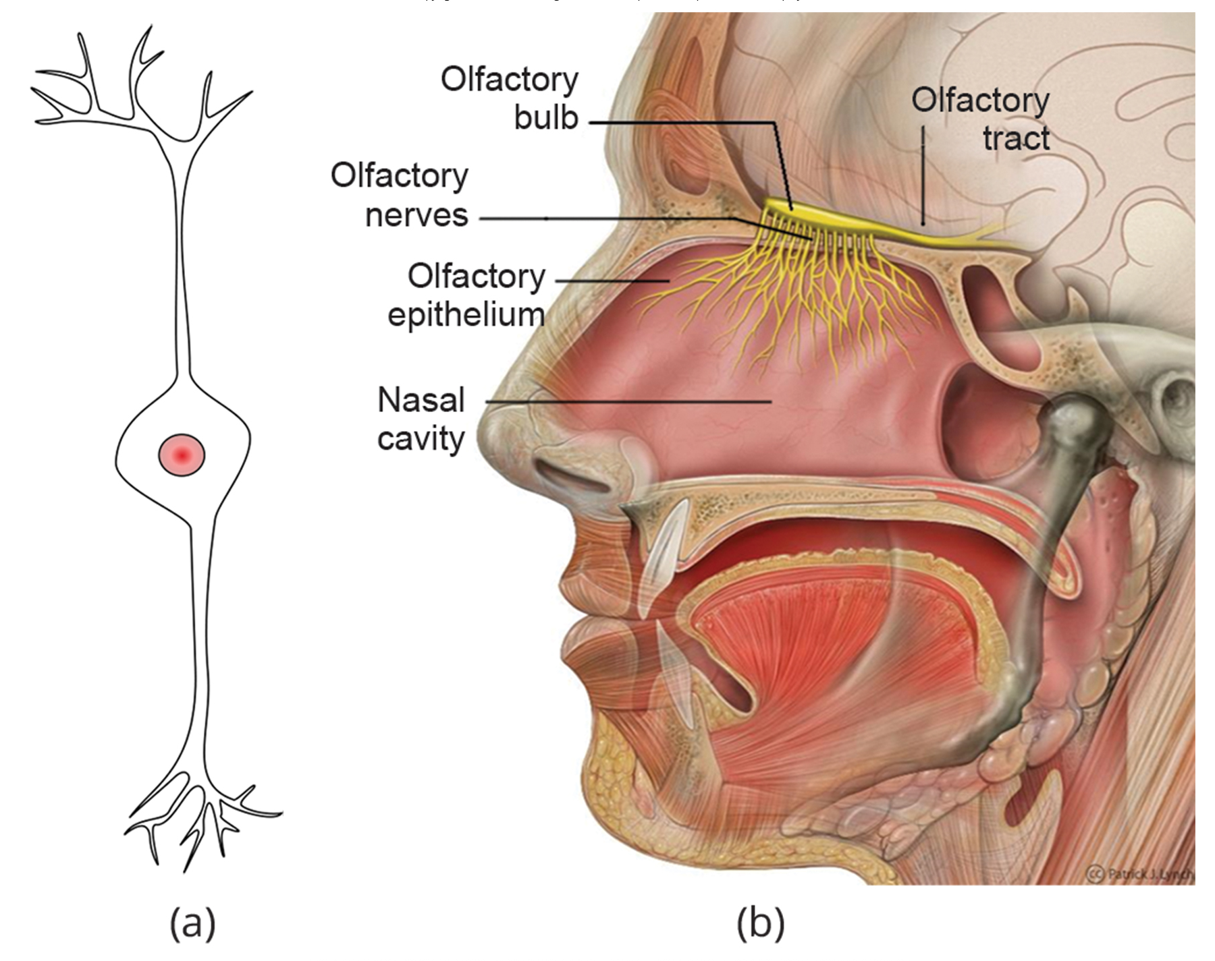
41.3 Figure 1
Juoj8 on Wikimedia Commons. "Bipolar olfactory neurons."
Patrick J. Lynch on Wikimedia Commons. "Olfactory system."
Notes:
In the human olfactory system, (a) bipolar olfactory neurons extend from the (b) olfactory epithelium—located in the upper portion of the nasal cavity and where olfactory receptors are located—to the olfactory bulb.

Slide 9
Reception and Transduction₂
Olfactory neurons are bipolar neurons (neurons with two processes from the cell body) with hairlike cilia containing specific receptors.
The cilia trap odorant molecules.
Sensory receptors on the cilia are proteins; variations in amino acid chains affect the receptors' sensitivity to different odorants.
When an odorant binds with a receptor that recognizes it, the associated sensory neuron is stimulated.
Olfactory stimulation is the only sensory information that reaches the cerebral cortex; other sensations relay through the thalamus.

Slide 10
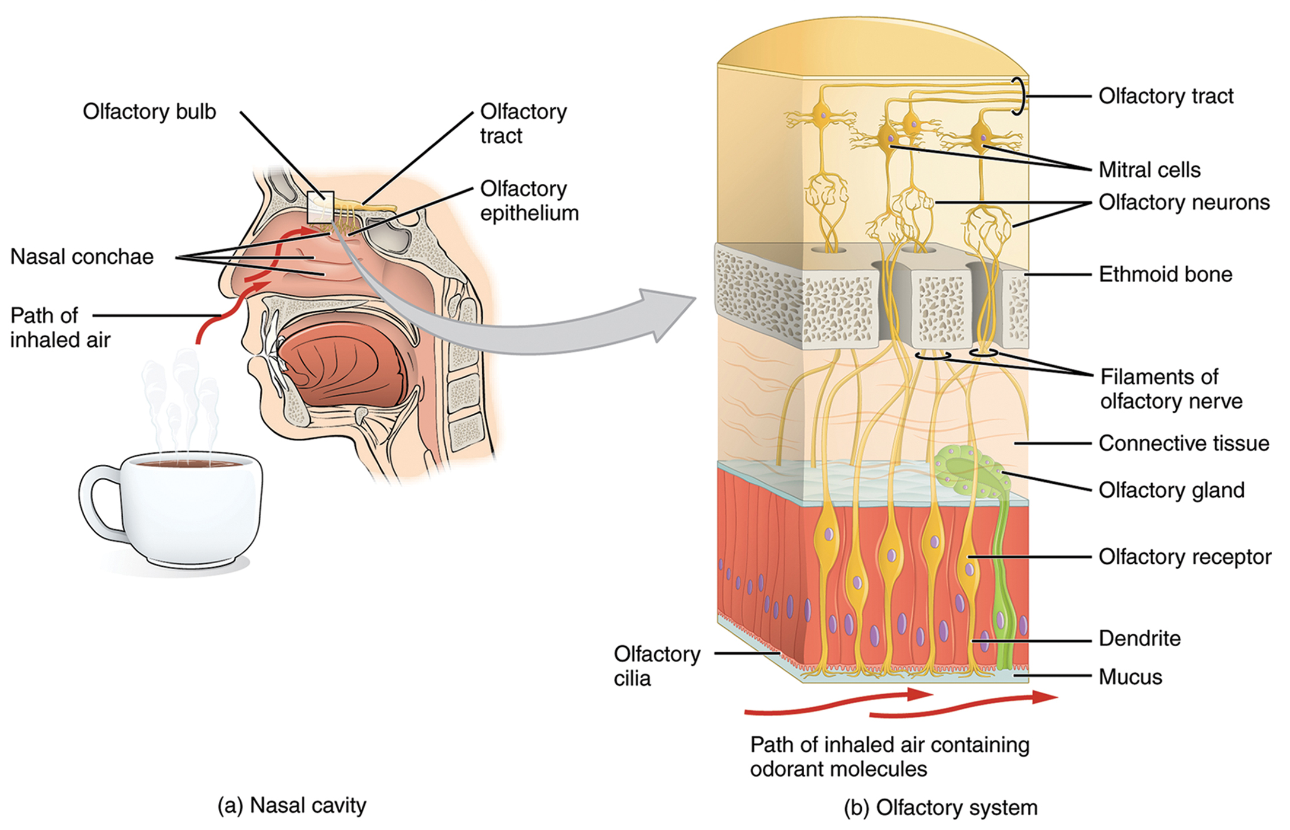
41.3 Figure 2
OpenStax on Wikimedia Commons. "Nasal cavity and olfactory system."
Notes:
As air is inhaled, it flows to the top of the nasal cavity, where the odorants in the air are dissolved in the mucus lining the olfactory epithelium. The dissolved odorants bind to the specific olfactory receptors that recognize them to stimulate the sensory neurons.

Slide 11

Pheromones
Pheromones are chemicals affecting behavior or physiology of animals of the same species.
Play various roles in animal behavior and physiology
Several types released in urine or as glandular secretions
Vomeronasal organ (VNO): olfactory organ present in many vertebrates; sensitive to pheromones
Flehmen response: curling of the upper lip that helps pheromone molecules enter the VNO
Send signals to the amygdala and hypothalamus
41.3 Figure 3: This tiger is exhibiting the flehmen response.
Mathias Appel on Wikimedia Commons. "Tiger."

Slide 12
Buck & Axel's Research
Details of the sense of smell were discovered in the 1990s by Linda B. Buck and Richard Axel.
First to pinpoint the olfactory receptors in the back of the nasal cavity of mice
Buck proposed the way these receptors could detect many different smells: some detect more than one odor, and many odors can be detected by more than one receptor.
Applied in different combinations to create a pattern that can be recognized/remembered
Sometimes called odor coding
Buck and Axel shared the Nobel Prize in medicine for figuring out the way genes code the olfactory receptors.

Slide 13
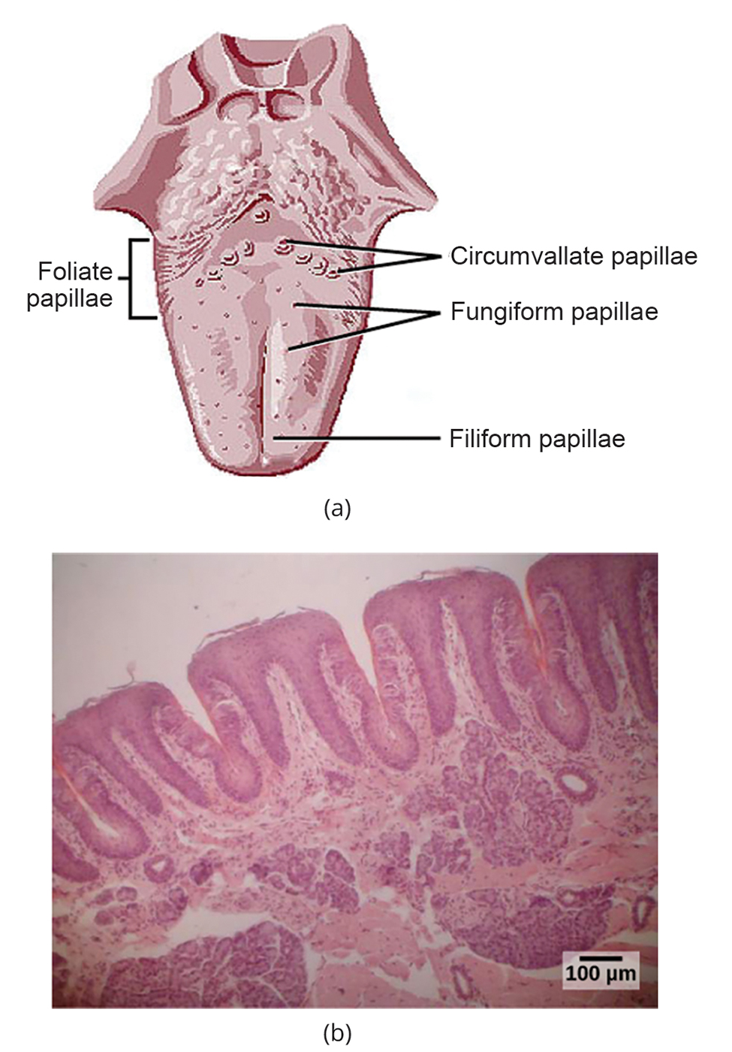
Taste₁
Taste detection (gustation) is similar to odor detection (olfaction); both rely on chemical receptors' stimulation by certain molecules.
Taste buds are clusters of gustatory receptors located in bumps on the tongue called papillae.
Filiform: located across the tongue; tactile; contain no taste cells
Fungiform: located on the front two-thirds of the tongue; contain one to eight taste buds; have receptors for pressure and temperature
Circumvallate: contain up to 250 taste buds; form a "V" near the back margin of the tongue
Foliate: located in parallel folds along the edges and back of the tongue; contain about 1,300 taste buds
41.3 Figure 4: (a) Papillae positions on the tongue. (b) Foliate papillae are prominent protrusions on this light micrograph.
Lesion on Wikimedia Commons. "Papillae of the tongue." Modified.

Slide 14
Taste₂
Taste bud taste cells are replaced every 10–14 days.
Taste cells: elongated cells with microvilli at the tips that extend into the taste bud pore
Food molecules (tastants) dissolve in saliva, and they bind with and stimulate microvilli receptors.
Tastant receptors are found in the outer portion and front of the tongue, outside of the area where filiform papillae are prominent.

Slide 15
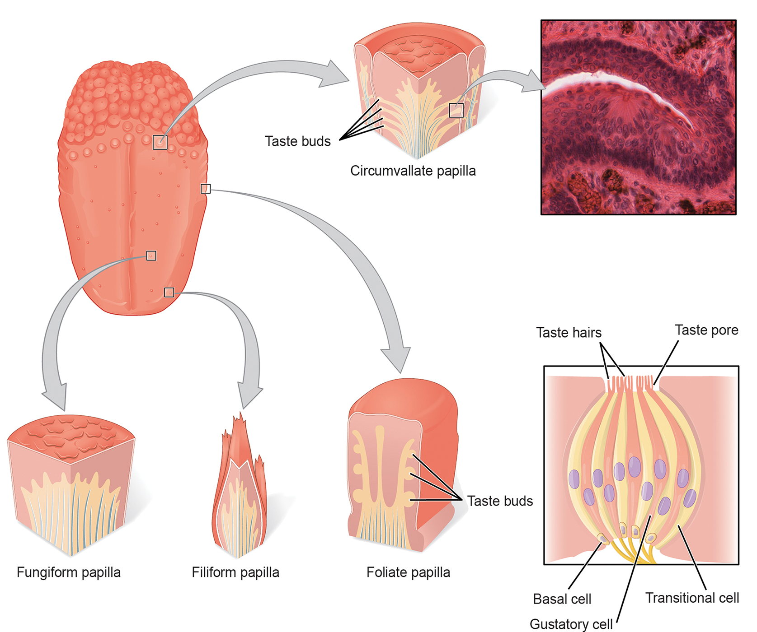
41.3 Figure 5
OpenStax on Wikimedia Commons. "Tongue diagram."
Notes:
Pores in the tongue allow tastants to enter taste pores in the tongue.

Slide 16
Transduction of the Five Primary Tastes
There are five primary tastes in humans, each with its own corresponding receptor type.
Salty tastants containing NaCl provide sodium ions (Na⁺) to excite taste neurons directly.
Sour tastants are acids; binding triggers an increase in hydrogen ions (H⁺), depolarizing taste neurons.
Sweet tastants contain sugar or synthetic sweeteners and require a G protein coupled receptor.
Bitter tastants contain alkaloids like quinine and also require a G protein coupled receptor.
Umami tastants contain glutamate, which also binds to a G protein coupled receptor.

Slide 17
Think It Through₁
For each taste sensation, identify the molecular trigger in the tastant that triggers it.
Sour
Salty
Bitter
Sweet
Umami
Notes:
Originally an On Your Own. This is included here to use as a talking point or for a think-pair-share activity.

Slide 18
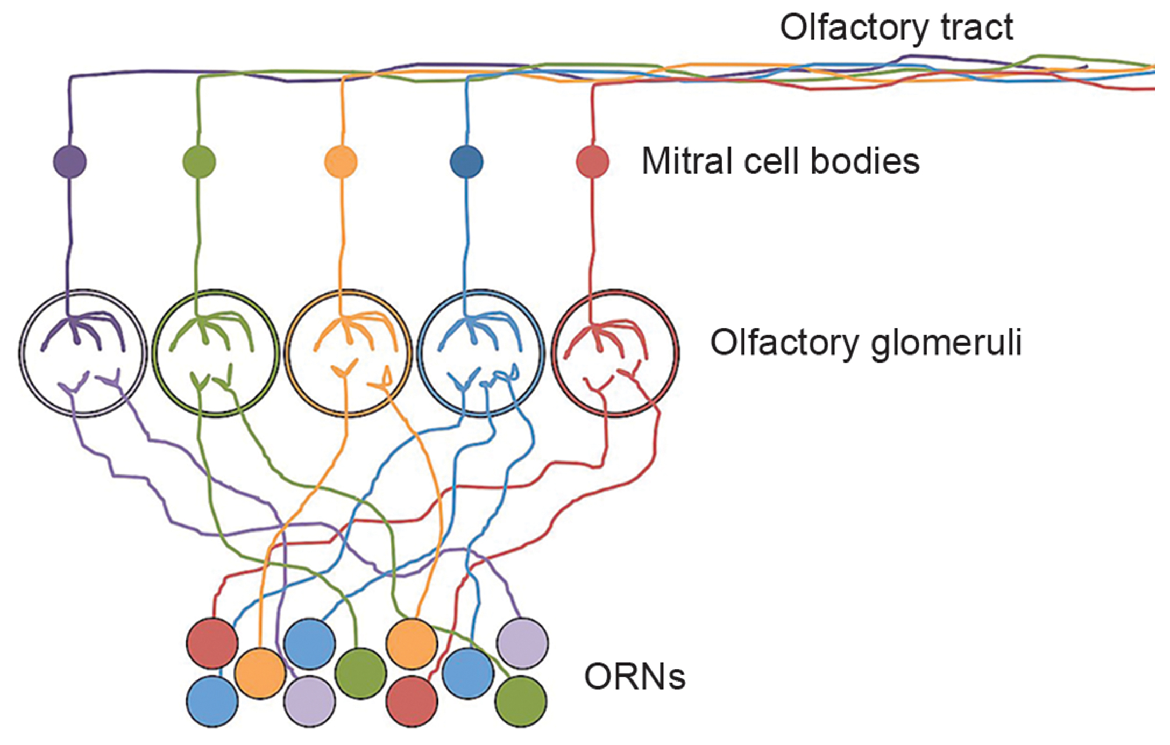
Smell in the Brain
Olfactory neurons project from the olfactory epithelium to the olfactory bulb, forming glomeruli (neural clusters) specific to odorants.
Olfactory signals then travel to the olfactory cortex, frontal cortex, thalamus, and amygdala.
Also travel to a cortical center in the temporal lobe important in spatial, autobiographical, declarative, and episodic memories
Finally processed in areas that deal with memory, emotions, reproduction, and thought
41.3 Figure 6: Olfactory receptor neurons (ORNs) in the olfactory epithelium project axons into the olfactory bulb, which is composed of olfactory glomeruli. Each olfactory glomerulus is specific to one type of odorant.
Noodle brain on Wikimedia Commons. "Olfactory sensory neurons."

Slide 19
Taste in the Brain
Taste signals travel from the tongue, esophagus, and palate to the medulla.
From the medulla, they travel to the thalamus and primary gustatory cortex.
The segregation of taste information occurs in the medulla, thalamus, and cortex.

Slide 20
Think It Through₂
The medulla is the region of the brain responsible for involuntary processes and reflexive responses. Why do taste neurons send the signal to the medulla first?
Notes:
Originally an On Your Own. This is included here to use as a talking point or for a think-pair-share activity.

Slide 21
Summary
Humans have five primary tastes—sweet, sour, bitter, salty, and umami—each with specific receptors.
Tastants dissolve in saliva, stimulating taste cells in taste buds found on three of the four types of papillae.
Humans detect around 10,000 odors with specific olfactory receptors.
Odorants dissolve in nasal mucosa, exciting olfactory sensory cells.
Olfactory signals are processed in the brain areas responsible for memory, emotions, reproduction, and thought.

Slide 22

End of Hawkes Learning PowerPoint

