Slide 1
Lesson 41.4
Hearing and Balance

Slide 2
Objectives
Describe the relationship of amplitude and frequency of a sound wave to attributes of sound.
Identify the structures of the vestibular system that respond to gravity.
Trace the path of sound through the auditory system to the site of transduction of sound.
Identify the different structures involved with the reception of sound.

Slide 3
Hearing and Balance
Audition (hearing) enables detection of environmental sounds, including dangers and social interactions.
The vestibular system, linked to the auditory system, detects movement and balance but is not involved in hearing.
Vestibular information includes linear and angular acceleration and deceleration, balance, and the animal's own movement.

Slide 4
Sound
Sound waves (auditory stimuli) are mechanical pressure waves that travel through a medium (e.g., air or water).
No sound waves exist in a vacuum due to lack of air molecules.
Speed of sound varies based on altitude, medium, and temperature.
  At sea level and 20°C (68°F), sound travels in air at about 343 meters per second.

Slide 5
Frequency
There are four main characteristics of a sound wave: frequency, wavelength, period, and amplitude.
Frequency: number of waves per unit of time
  Heard as pitch in sound
  Measured in cycles per second, or hertz (Hz)
  High-frequency sounds: short wavelengths and high-pitched
  Low-frequency sounds: long wavelengths and low-pitched

Slide 6
Hearing Ranges
Most humans can perceive sounds between 30 and 20,000 Hz.
  Ultrasound: sounds above human range
The ability to hear high frequencies decreases with age.
The following are some animal hearing ranges:
  Dogs: up to 40,000 Hz
  Cats: up to 60,000 Hz
  Bats: up to 100,000 Hz
  Dolphins: up to 150,000 Hz
  American shad: up to 180,000 Hz

Slide 7
Science and You
The "mosquito ringtone" or "teen buzz ringtone":
Refers to a cell phone ringtone which emits a sound at or above 17,400 Hz
Takes advantage of the declining ability to hear high frequencies as one ages
Audible only to individuals younger than their twenties
Notes:
This is included as a relevant application for this topic.

Slide 8
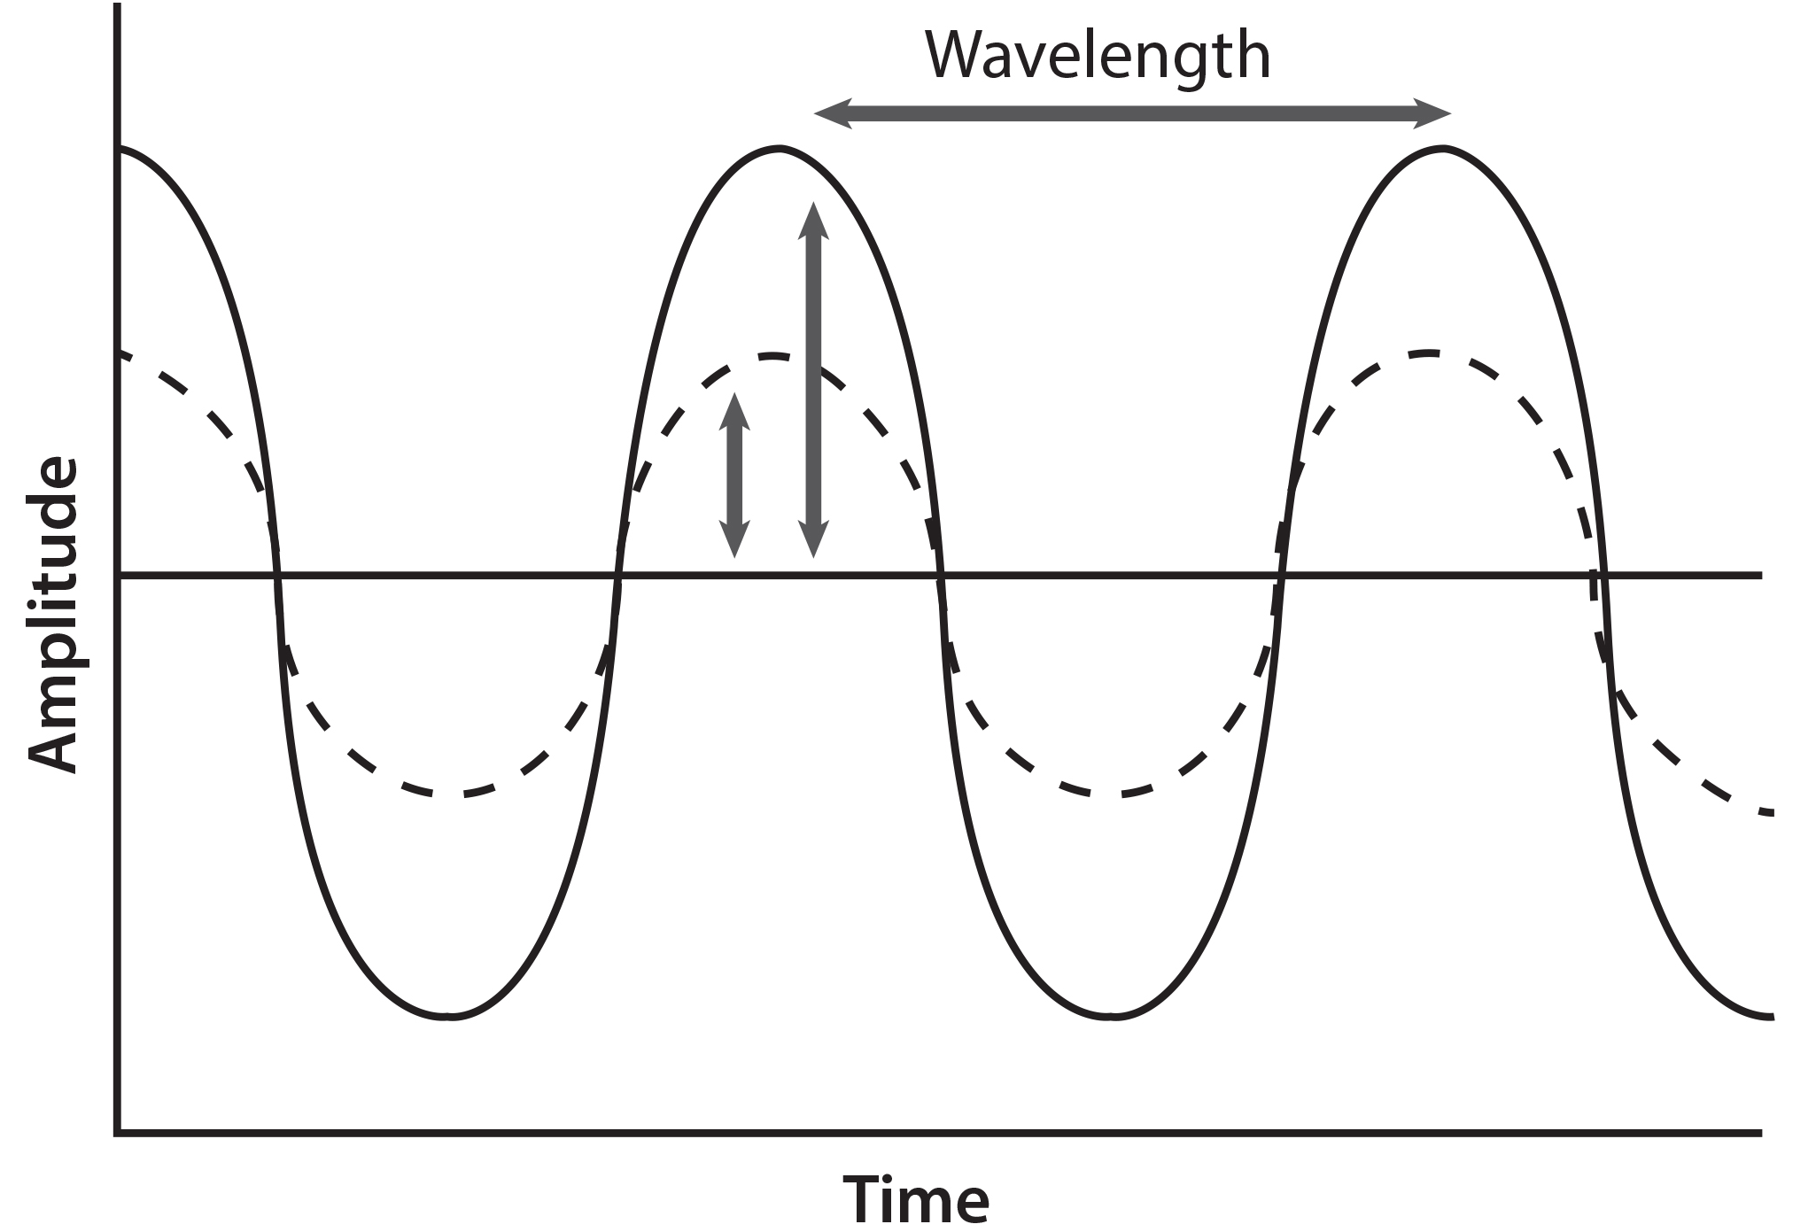
Amplitude
Amplitude: the dimension of a wave from peak to trough
Heard as volume in sound
Measured in decibels (dB)
Higher amplitude = louder sound
0 dB: the softest sound a human can hear
60 dB: volume of normal human speech
41.4 Figure 1: For sound waves, wavelength corresponds to pitch. Amplitude of the wave corresponds to volume. The sound wave shown with a dashed line is softer in volume than the sound wave shown with a solid line.
CNX OpenStax on Wikimedia Commons. "Sound waves."

Slide 9
Reception of Sound
Sound waves are collected by the auricle (external, cartilaginous part of the ear).
  They then travel through the auditory canal and vibrate the tympanum (ear drum), the innermost part of the outer ear.
In the tympanum is the middle ear.
  The middle ear contains the ossicles, which transfer vibrations to the inner ear.

Slide 10
The Ossicles
There are three ossicles:
Malleus: the hammer; attaches to the tympanic membrane and transfers vibrations to the incus
Incus: the anvil; connects the malleus to the stapes
Stapes: the stirrup; transmits vibrations to the oval window of the inner ear
Ossicles amplify sound and are unique to mammals.
Homologous to bones in a fish mouth
Use of a single ossicle (stapes) by frogs, reptiles, and birds

Slide 11
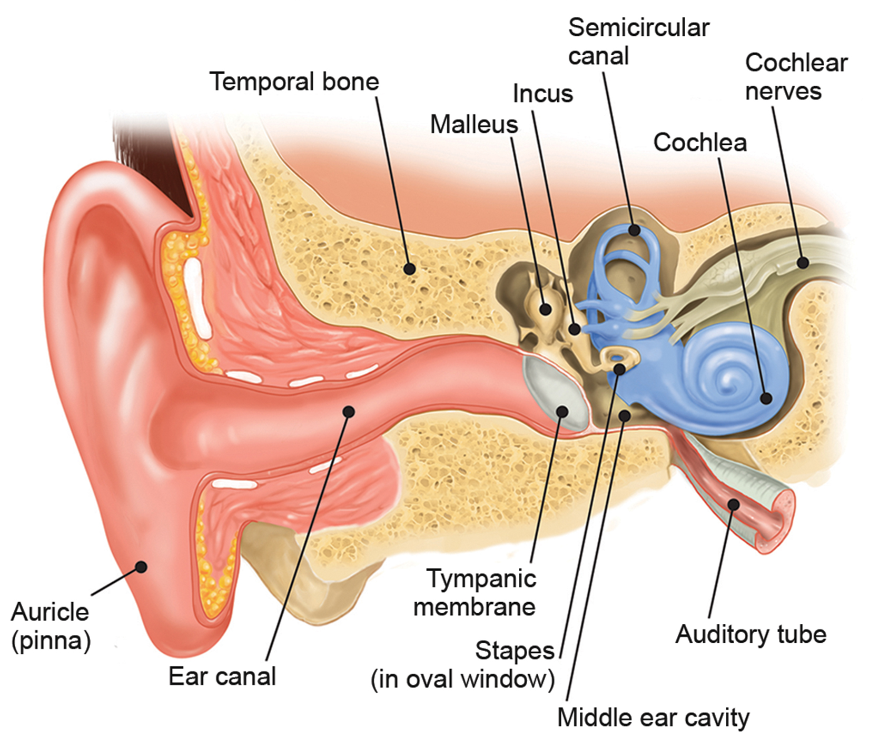
41.4 Figure 2
OpenStax on Wikimedia Commons. "Ear structures."
Notes:
Sound travels through the outer ear to the middle ear, which is bounded on its exterior by the tympanic membrane. The middle ear contains three bones called ossicles that transfer the sound wave to the oval window, the exterior boundary of the inner ear. The organ of Corti, which is the organ of sound transduction, lies inside the cochlea.

Slide 12
Think It Through
How does the reception of sound differ in mammals compared to birds?
Notes:
Originally an On Your Own. This is included here to use as a talking point or for a think-pair-share activity.

Slide 13
Transduction of Sound₁
Vibrating objects (e.g., vocal cords) create sound or pressure waves in the air.
Sound waves travel through air to reach the ear, which then transduces the mechanical stimulus (pressure wave) into an electrical signal (nerve impulse).
Pressure waves strike the tympanum, which then vibrates.
The moving tympanum transmits vibrations to the middle ear ossicles.
  The stapes transmits to the oval window (thin diaphragm, outermost structure of the inner ear).

Slide 14
Transduction of Sound₂
The inner ear is found in the labyrinth: a bony, hollow structure that is the most interior portion of the ear.
The sound wave's energy transfers from the stapes through the oval window and to the fluid of the cochlea.
The oval window's vibrations create pressure waves in the perilymph (fluid) of the cochlea.
  Cochlea: whorled structure that contains receptors for transduction of the mechanical wave to an electrical signal
The basilar membrane in the cochlea is a mechanical analyzer that curls toward the cochlea's center.

Slide 15
Transduction of Sound₃
The basilar membrane is thicker, tauter, and narrower outside of the whorl and thinner, floppier, and broader toward the center of the whorl.
Different regions vibrate according to the sound wave frequency in the fluid of the cochlea.
  When sound waves contact the basilar membrane, it flexes like a wave.
The tectorial membrane is above the basilar membrane.

Slide 16
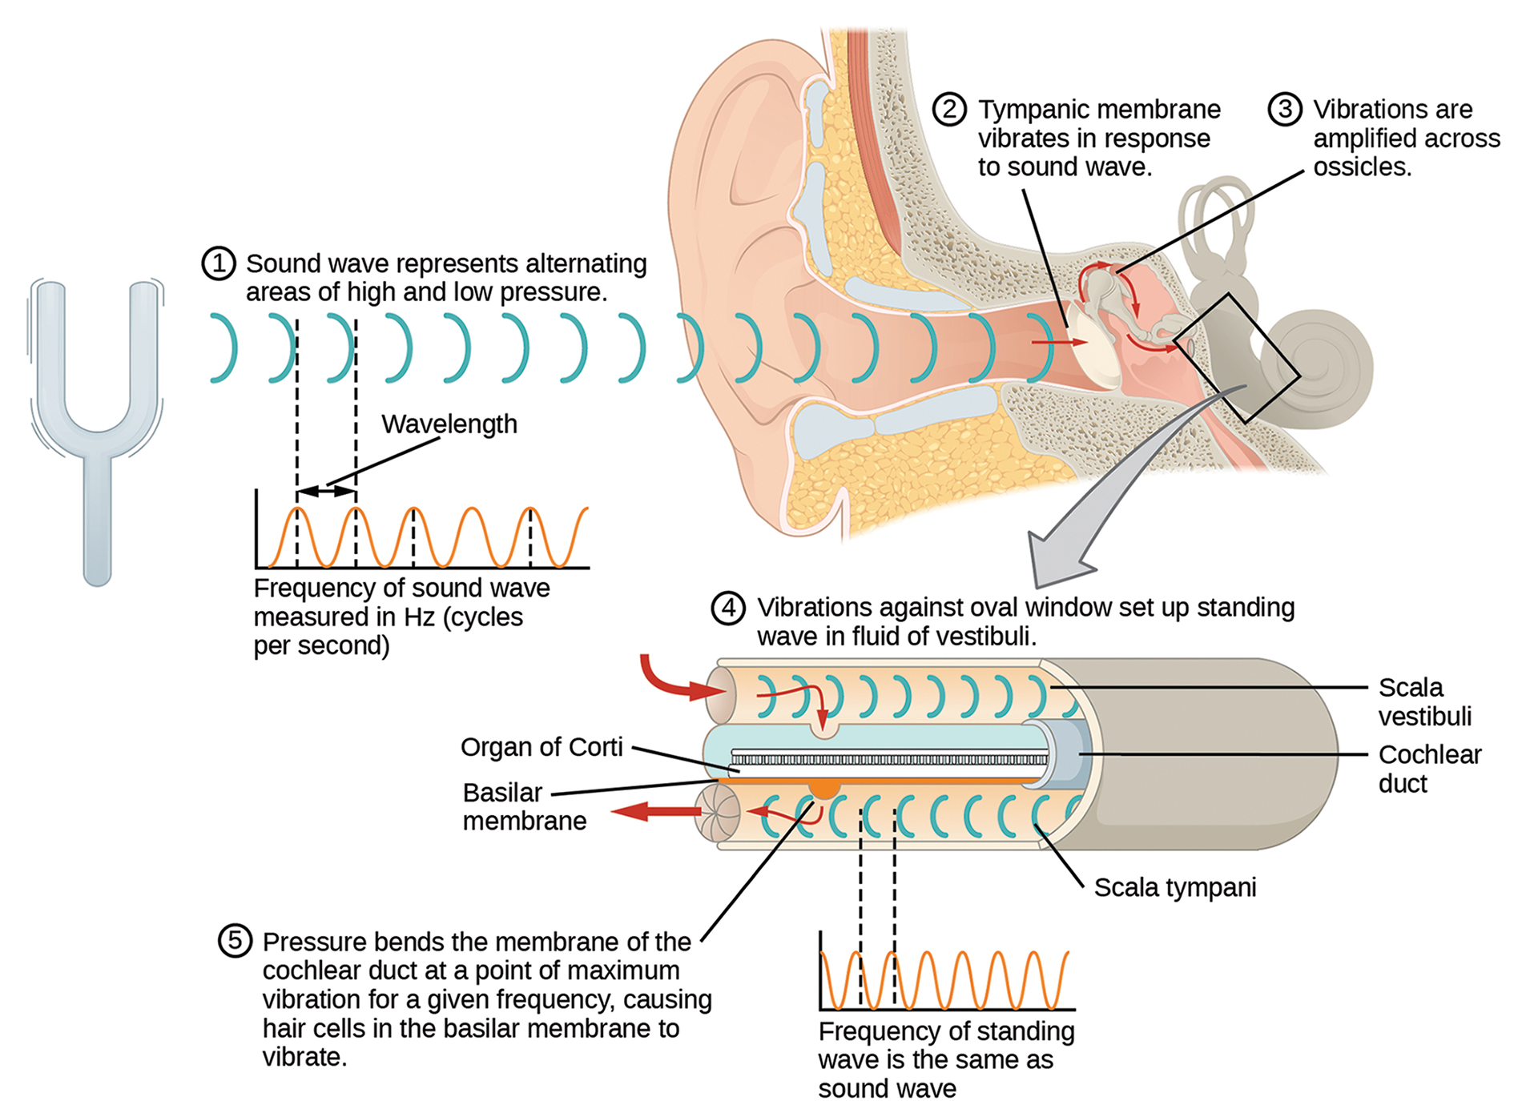
41.4 Figure 3
OpenStax on Wikimedia Commons. "Sound waves and the ear."
Notes:
A sound wave causes the tympanic membrane to vibrate. This vibration is amplified as it moves across the malleus, incus, and stapes. The amplified vibration is picked up by the oval window, causing pressure waves in the fluid of the scala vestibuli and scala tympani. The complexity of the pressure waves is determined by the changes in amplitude and frequency of the sound waves entering the ear.

Slide 17
The Site of Sound Transduction₁
The organ of Corti is a spiral organ that contains hair cells held above basilar membrane.
Inner hair cells: primary auditory receptors; ~3,500 in a single row
Outer hair cells: fine-tune incoming sound waves; ~12,000 in 3–4 rows
Stereocilia: hairlike part of the hair cells that contact or embed in the tectorial membrane
  Mechanoreceptors on hair cells
  Open gated ion channels when bent by vibrations
  Depolarizes hair cell membrane as a result
Intensity of sound determined by number of hair cells are stimulated

Slide 18
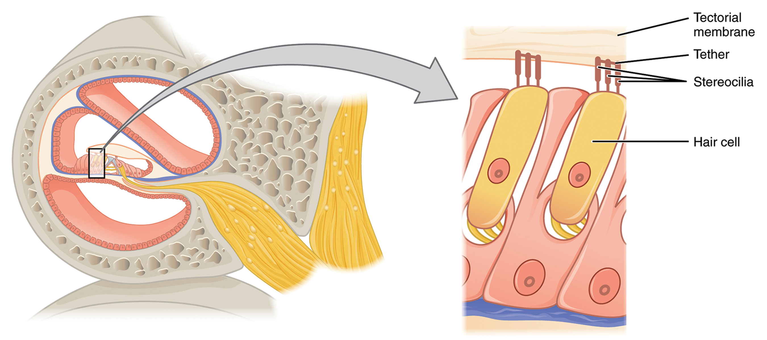
The Site of Sound Transduction₂
Hair cells are arranged in an orderly way on the basilar membrane.
The basilar membrane vibrates in different regions based on sound wave frequency.
Hair cells are most sensitive to specific frequencies.
  Can respond to similar frequencies, but require greater intensity outside optimal range
Adjacent inner hair cells differ in response frequency by about 0.2% (compared to 6% for piano strings).
41.4 Figure 4: The hair cell is a mechanoreceptor with an array of stereocilia emerging from its apical (top) surface.
OpenStax on Wikimedia Commons. "Hair cells."

Slide 19
Place Theory of Pitch Detection
Place theory is a model explaining how pitch detection works in the human ear.
  High frequency sounds selectively vibrate the basilar membrane near the oval window
  Low frequency sounds travel farther along the membrane before causing excitation.
Pitch is determined by the location of stimulated hair cells on the membrane.
Place theory is considered the first step in understanding pitch perception.
  Suggests existence of auditory "sharpening" mechanism for enhanced pitch resolution

Slide 20
The Site of Sound Transduction₃
When sound waves create fluid waves in cochlea, the basilar membrane flexes, which bends the stereocilia attached to the tectorial membrane.
The stereocilia bending triggers action potentials in hair cells, and auditory information travels via bipolar neurons to the brain.
Excitatory neurotransmitters are released when the stereocilia bend, and action potentials are conducted to the central nervous system.
The cochlear branch of the vestibulocochlear cranial nerve transmits hearing information to the brain.
The brain can send signals back to the cochlea, which changes the length of outer hair cells and dampens their response to certain frequencies.

Slide 21
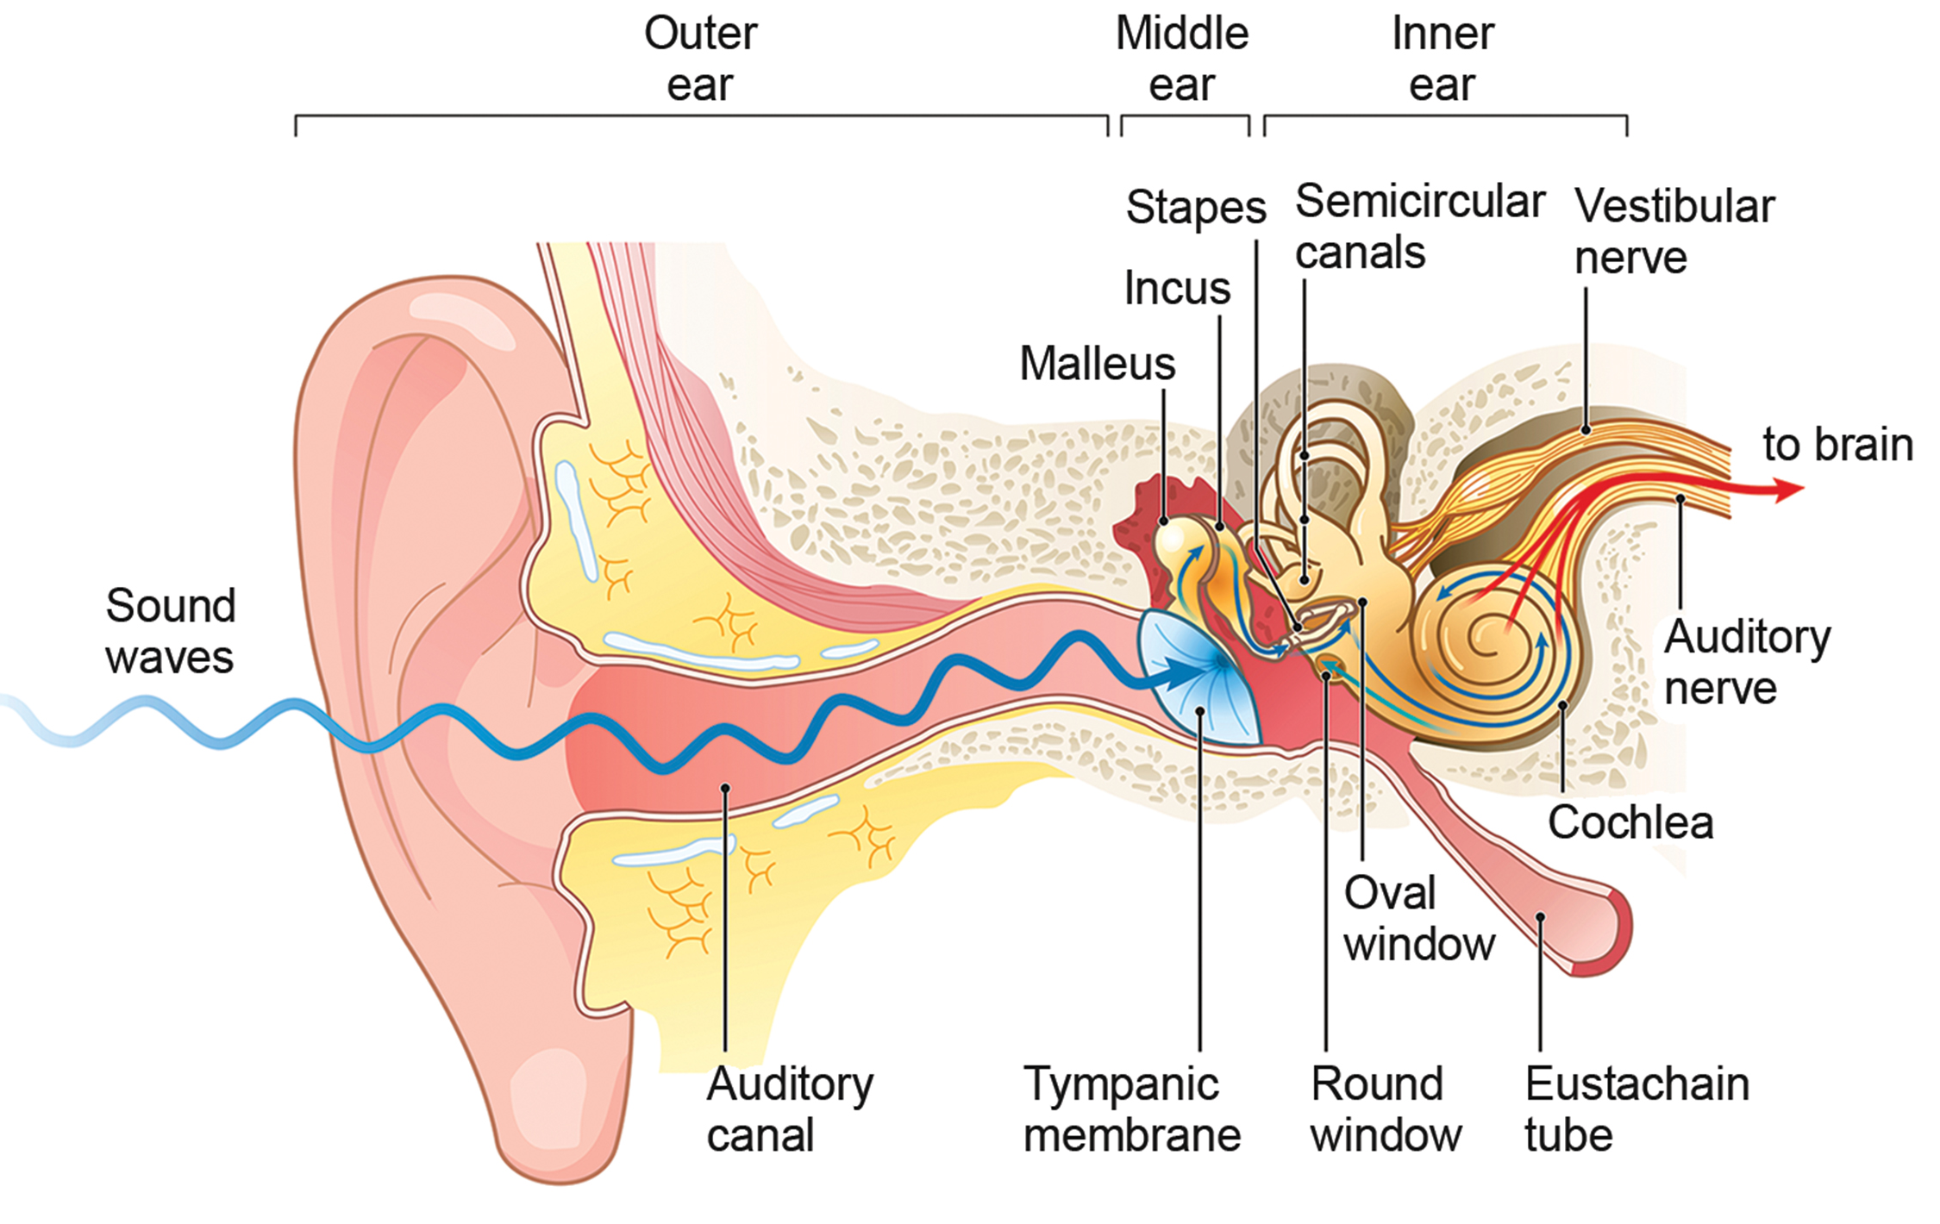
Higher Processing of Sound
Inner hair cells are most important for conveying auditory information to the brain.
Synapse with ~90% of afferent neurons, each hair cell synapsing with 10 or so neurons
Outer hair cells: synapse with 10% of afferent neurons
Bipolar neurons pass through medulla, pons, and midbrain, finally reaching the primary auditory cortex in the temporal lobe.
41.4 Figure 5: Sounds enter the ear and are transmitted from the middle ear to the inner ear. The signal exits the cochlea via the cochlear nerve to the pons and midbrain in the brain stem and is then sent to the auditory cortex in the brain for perception.

Slide 22
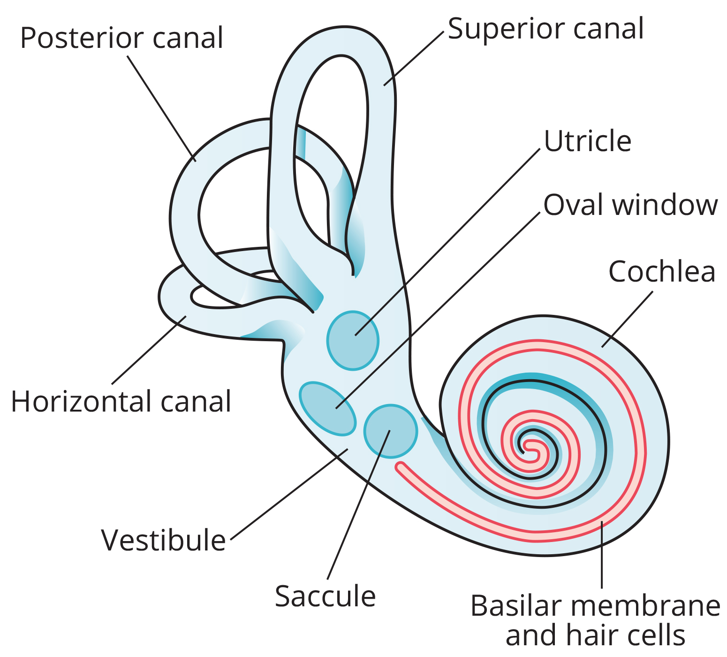
Vestibular Information
Stimuli include linear acceleration (gravity), angular acceleration and angular deceleration.
The vestibular system detects gravity through head position.
  Angular acceleration and deceleration through turning/tilting of the head
The vestibular system has similarities with the auditory system.
  Utilizes hair cells, but excites them differently
  Has vestibular receptor organs that comprise the vestibular labyrinth: utricle, saccule, and three semicircular canals
41.4 Figure 6: The structure of the vestibular labyrinth is shown.
OpenStax. "Vestibular labyrinth." Modified.

Slide 23
Utricle and Saccule
Respond to acceleration in a straight line (gravity)
30,000 hair cells in utricle and 16,000 in saccule
  Stereocilia: project from hair cells into a gelatinous layer
Calcium carbonate crystals embedded into gelatin
  Shifting of crystals due to head tilt, bending stereocilia, which stimulates neurons
Sending of signals to brain to maintain balance
  Dealt with by the vestibular branch of the vestibulocochlear cranial nerve

Slide 24
Reflection Question
Vertigo (a sensation of spinning) is often caused by one or more calcium carbonate (CaCO₃) crystals getting stuck or falling into a different part of the semicircular canals. This cause of vertigo is often treated by a series of head movements. Why do you think mislocated crystals cause dizziness or spinning?
Notes:
The reflection question is included here to use as a talking point or for a think-pair-share activity.

Slide 25
Semicircular Canals
Semicircular canals are fluid-filled tubular loops set at oblique angles, arranged in three spatial planes.
Each base has a swelling that contains a hair cell cluster.
  Hair cells project into the cupula (gelatinous cap) and monitor angular acceleration and deceleration from rotation.
One lies horizontally; the other two lie at 45-degree angles.
  These positions allow the brain to detect three-dimensional acceleration and deceleration.
Canals are not sensitive to velocity itself but rather the changes in velocity.
  Example: moving while holding a glass of water. As you move, the water settles and does not splash. When you start or stop, the water may splash backward or forward.

Slide 26
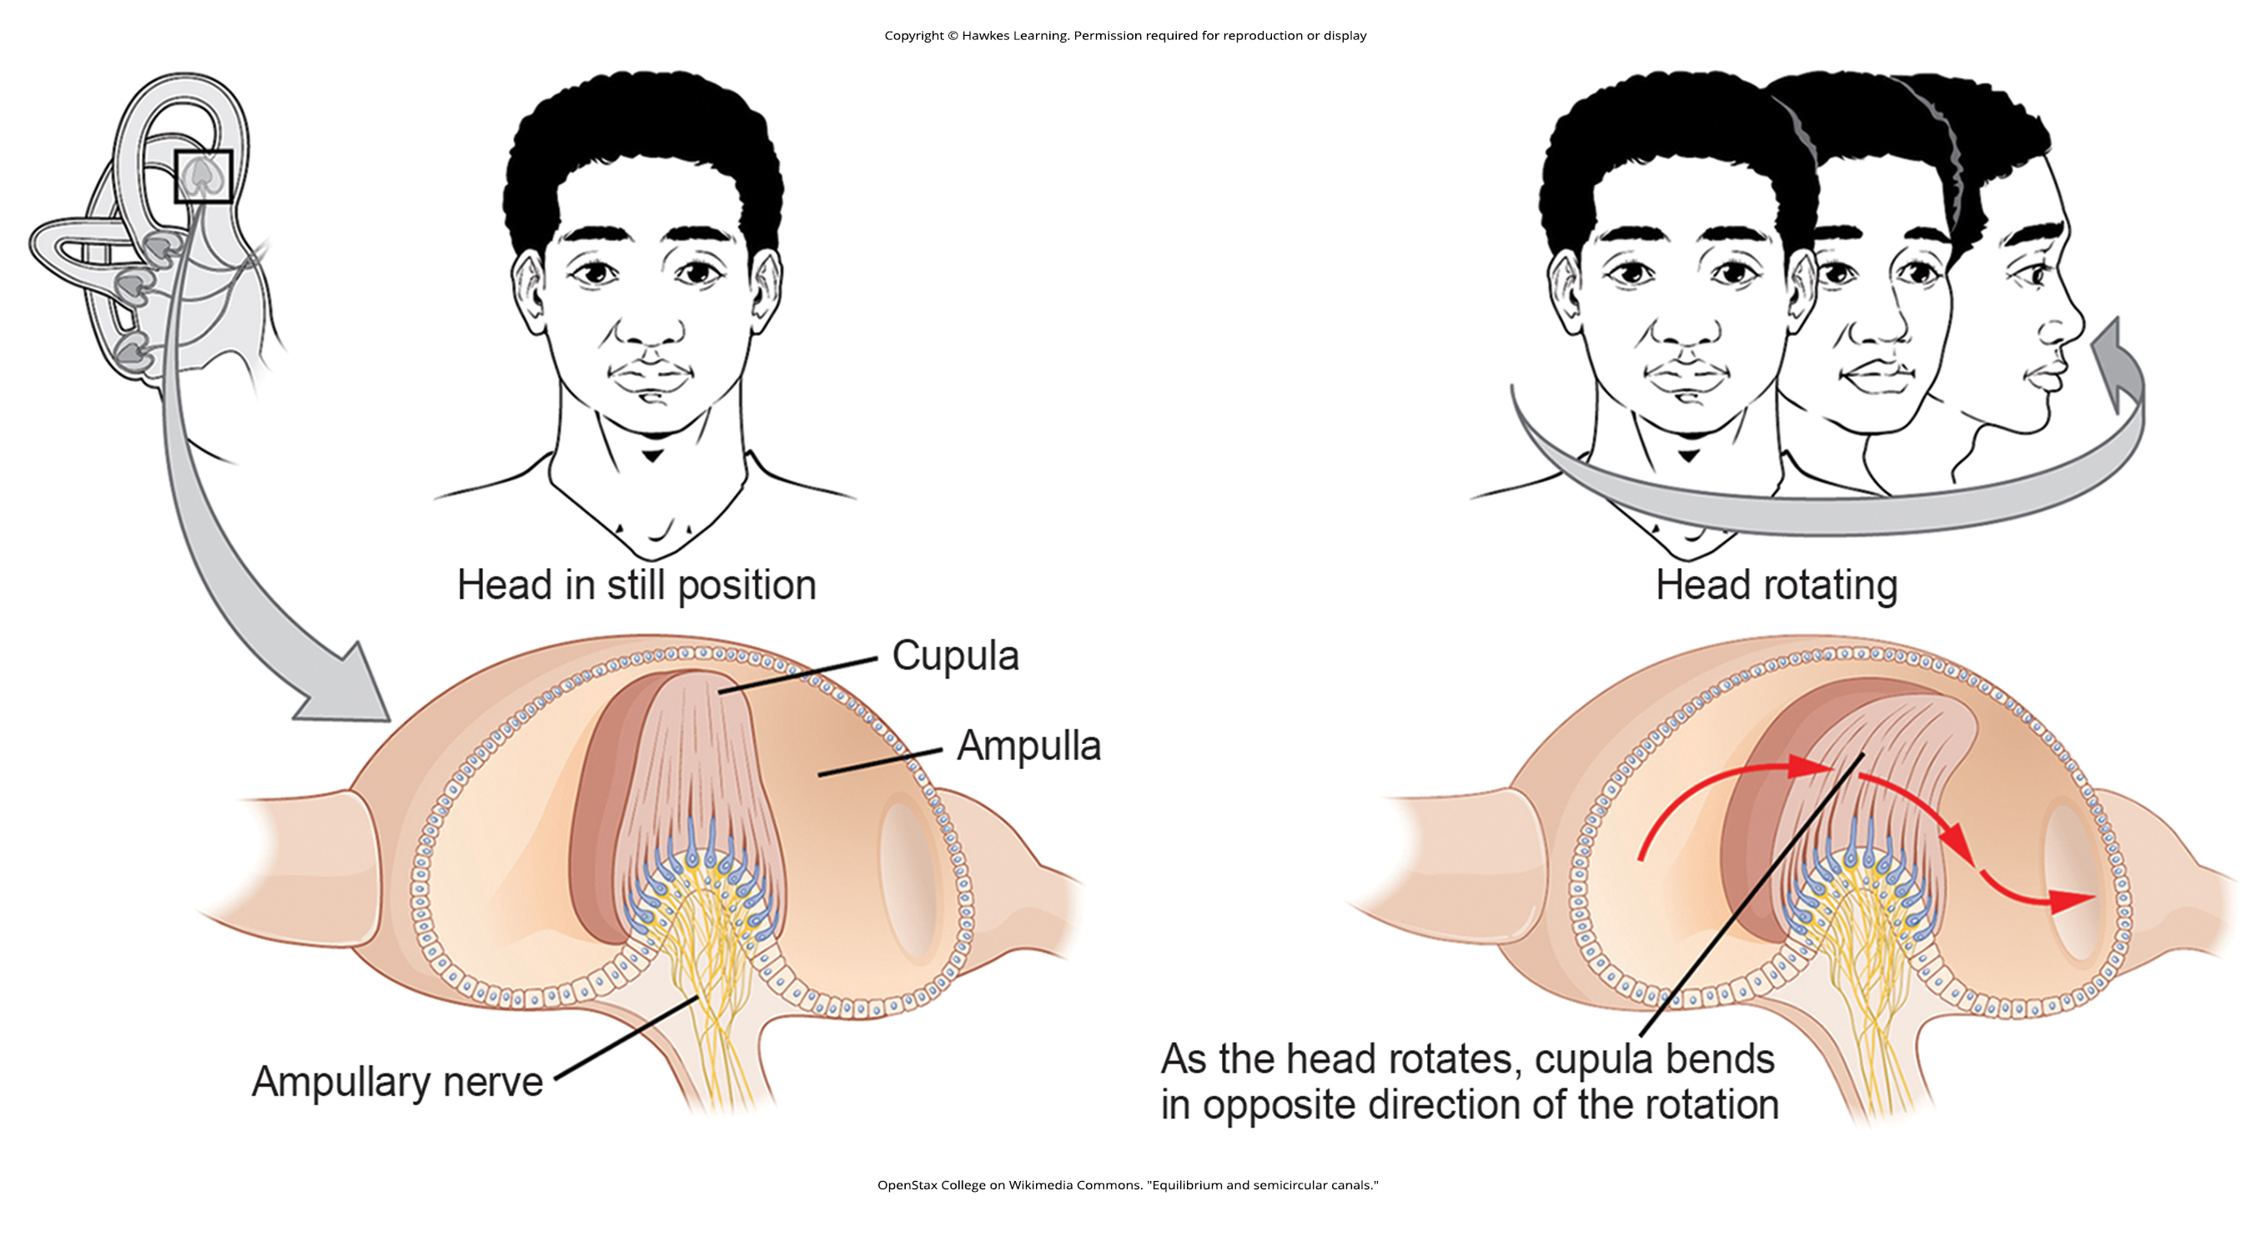
41.4 Figure 7
OpenStax College on Wikimedia Commons. "Equilibrium and semicircular canals."
Notes:
Semicircular canals monitor rotation.

Slide 27
Higher Processing of Vestibular Information
The utricle, saccule, and semicircular canals communicate through bipolar neurons to the cochlear nucleus in the medulla.
Descending projections to the spinal cord
Ascending projections to the pons, thalamus, and cerebellum
  Cerebellum important for coordinated movements
Projections to temporal cortex for dizziness
Projections to autonomic nervous system for motion sickness
Projections to the primary somatosensory cortex for measurements of the external world and self-movement
Projections to certain optic muscles for coordinated eye/head movements

Slide 28
Summary
Hearing is crucial for detecting environmental sounds and social interactions.
The vestibular system, separate from hearing, detects movement and balance.
Sound waves are mechanical pressure waves that travel through air or water.
  Received by the outer ear, amplified by the ossicles, and transduced into electrical signals in the cochlea
Vestibular receptors in the utricle, saccule, and semicircular canals detect head orientation and movement.
Vestibular signals are processed in various brain regions, contributing to balance and coordination.

Slide 29

End of Hawkes Learning PowerPoint

