Slide 1
Lesson 41.5
Vision

Slide 2
Objectives
Discuss visible light compared to the rest of the electromagnetic spectrum.
Explain tonic activity as it is manifested in photoreceptors in the retina.
Trace the path of light through the eye to the point of the optic nerve.
Identify the parts of an eye.

Slide 3
Vision
Vision is the ability to detect light patterns from the environment and interpret them into images.
The visual system evolved to focus on the most important stimuli.
About one-third of the human cerebral cortex is dedicated to analyzing and perceiving visual information.

Slide 4
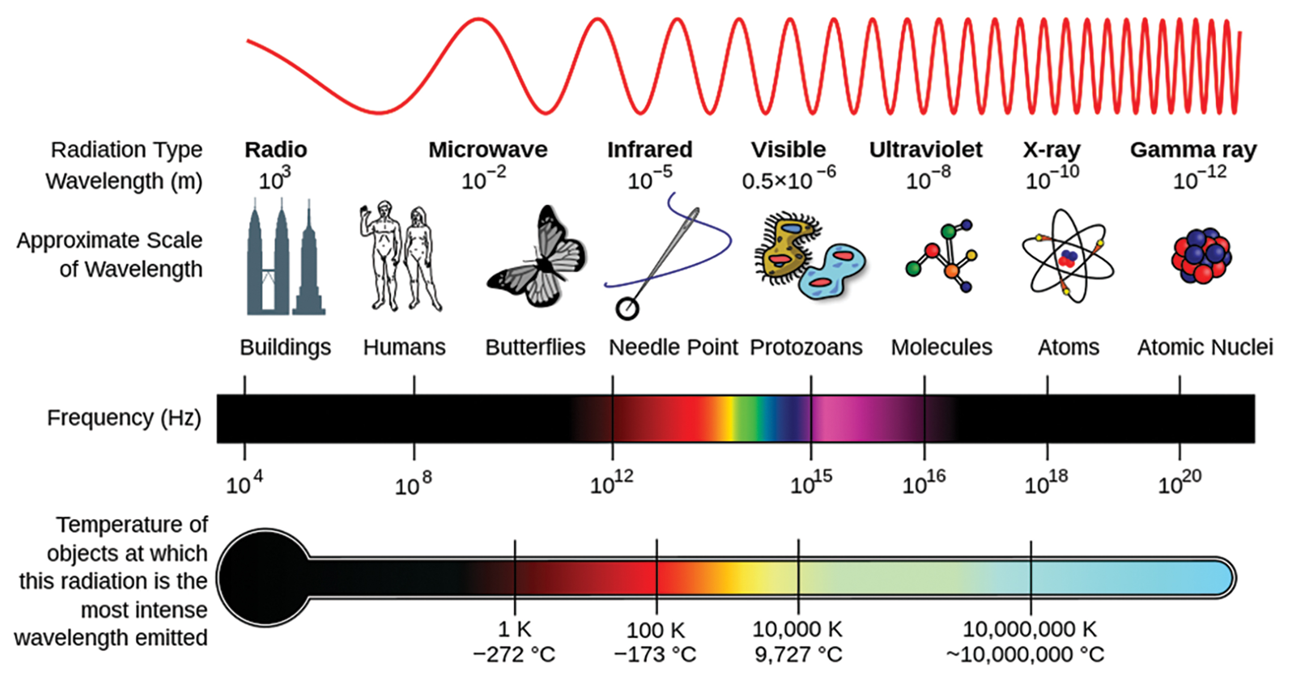
Light
Light travels in electromagnetic waves and does not need a medium.
Can travel in a vacuum, unlike sound (compression waves)
A photon is the fundamental unit of light, a packet of electromagnetic radiation.
Visible light for humans is a small part of the electromagnetic spectrum, ranging from 380 nm to 740 nm.
41.5 Figure 1: In the electromagnetic spectrum, visible light lies between 380 nm and 740 nm.
NASA on Wikimedia Commons. "Electromagnetic spectrum."

Slide 5
Light Waves₁
Wavelength varies inversely with frequency and determines hue.
Longer wavelengths appear red, and shorter wavelengths appear violet.
Wavelength is expressed in nanometers (nm).
Humans perceive light between 380 and 740 nm, though other animals can detect outside human range.
Wave amplitude is perceived as luminous intensity (brightness).
Amplitude is measured in candelas—one candela is approximately the intensity of a common candle.

Slide 6
Light Waves₂
Light waves travel 299,792,458 km/second in a vacuum.
Media can slow light wave speed.
Long waves appear red, medium appear green, and short appear blue.
"White light" is stimulated by the three-color receptors in the human eye.
The color of an object is the color that object reflects.

Slide 7
Anatomy of the Eye₁
Photoreceptive cells (rods and cones) are located in the retina on the inner surface at the back of the eye.
Light passes through the cornea and lens, both of which refract light to focus the image on the retina.
Cornea: front transparent layer of the eye
Lens: transparent convex structure behind the cornea
The iris controls the amount of light entering the eye by adjusting the size of the pupil.

Slide 8
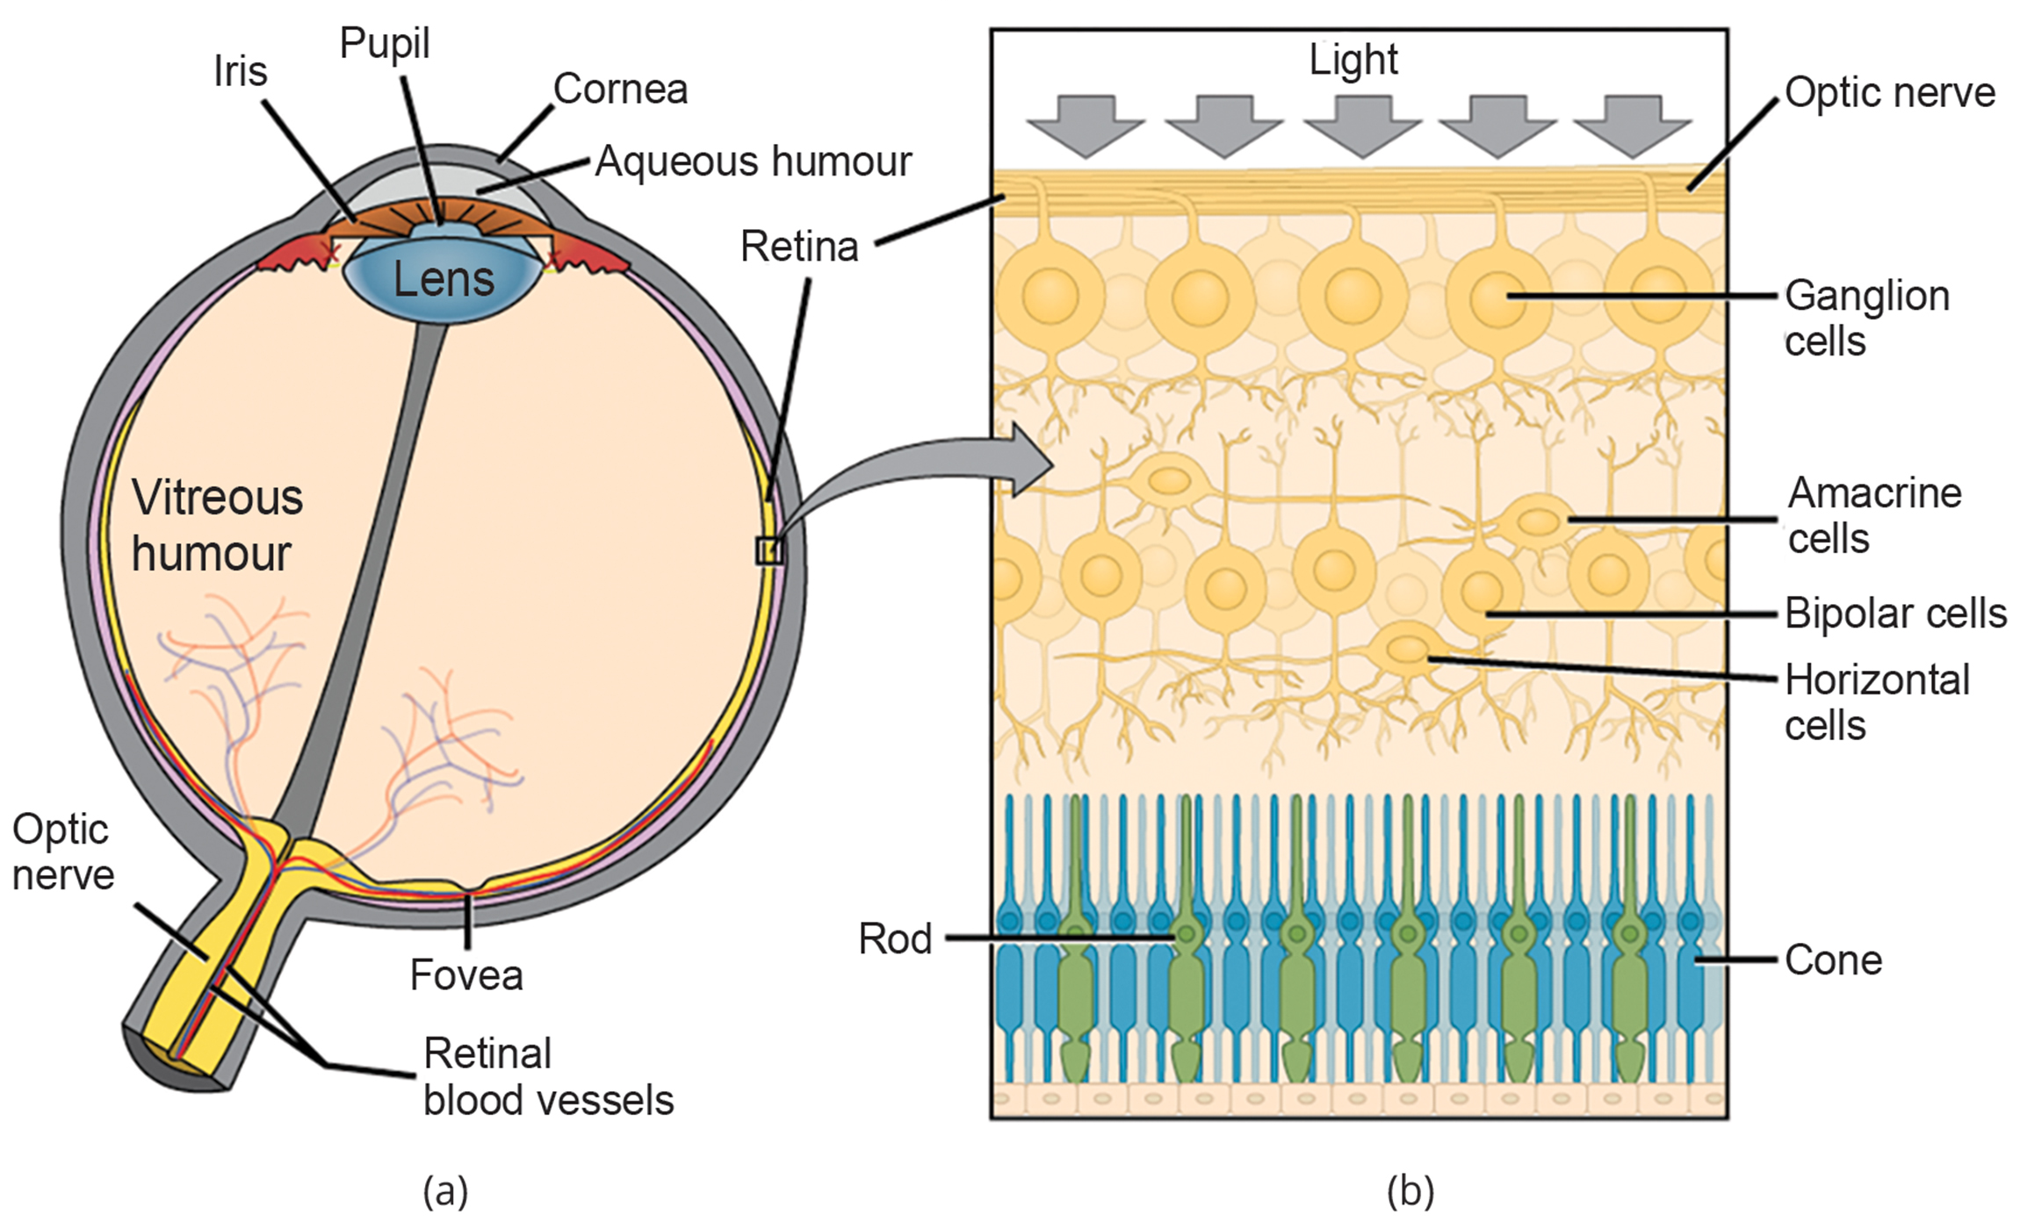
41.5 Figure 2
OpenStax. "Structure of the eye." Modified.
Notes:
(a) The human eye is shown in cross section. (b) A blowup shows the layers of the retina.

Slide 9
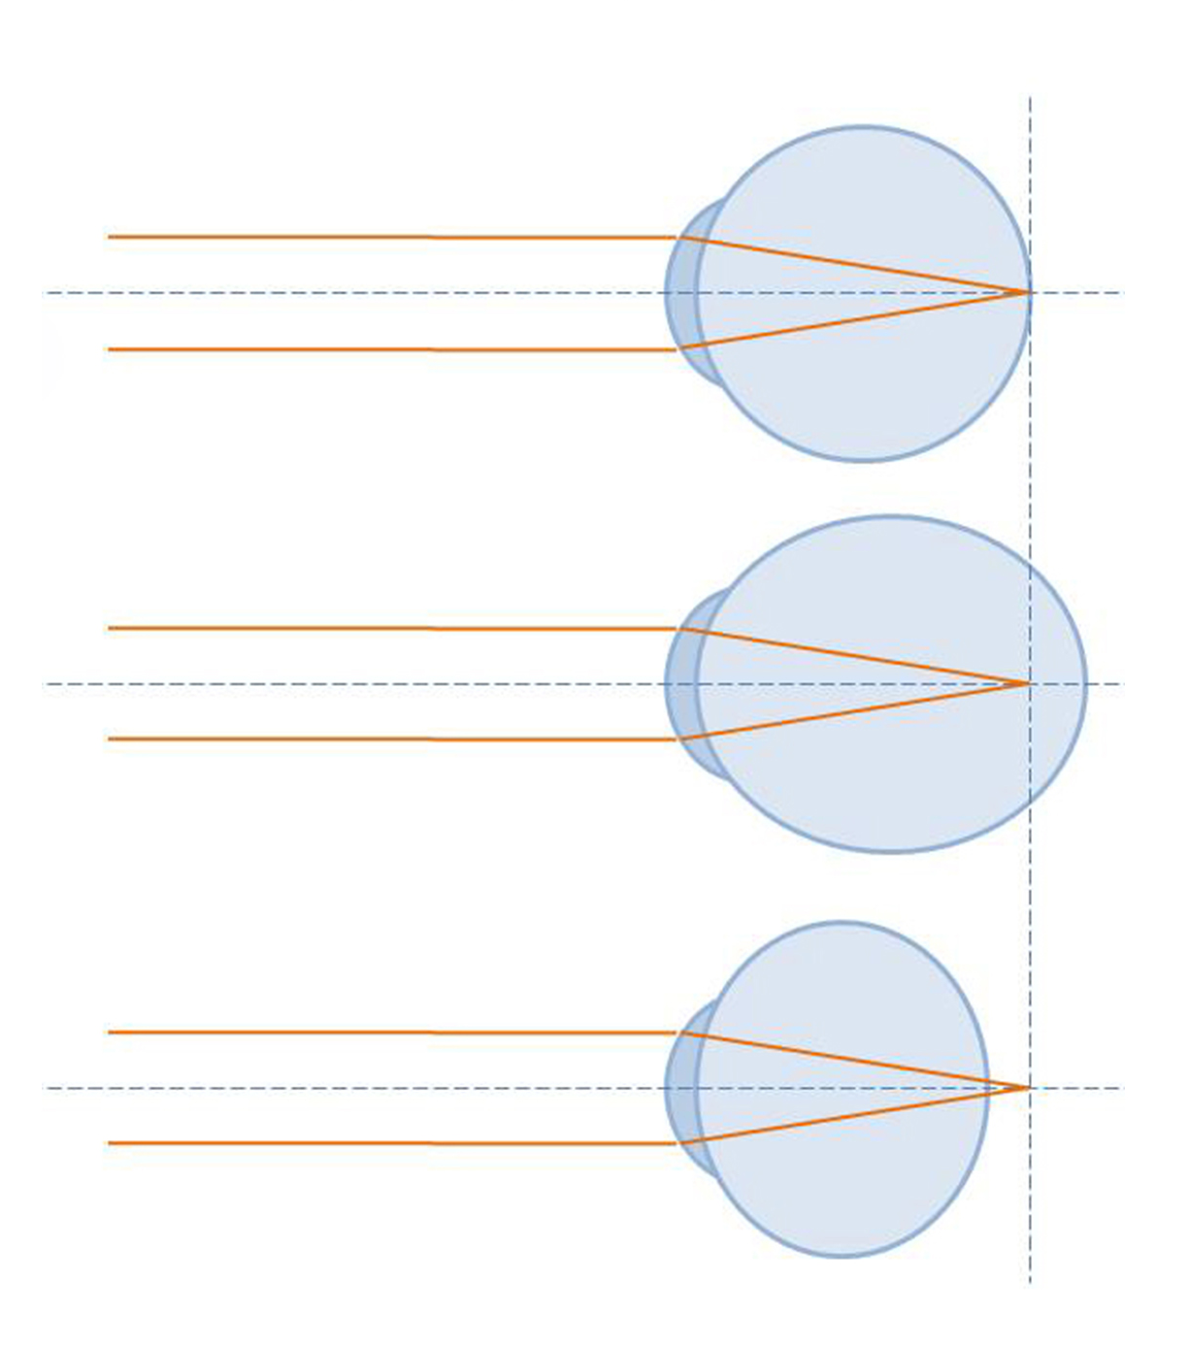
Anatomy of the Eye₂
The lens focuses light on the retina and fovea centralis.
The lens focuses and refocuses light as the eye takes in near and far objects.
It is also operated by muscles that stretch it flat or allow it to thicken.
Its flexibility decreases with age, leading to presbyopia.
Presbyopia: a form of farsightedness; occurs because the image focuses behind the retina
Hyperopia: another form of farsightedness; caused by an eyeball being too short
Myopia: nearsightedness; caused by an eyeball being elongated; the image focuses in front of the retina
41.5 Figure 2: The shape of the eyeball affects where light focuses in relation to the retina.
Philos2000 on Wikimedia Commons. "Refractive errors."

Slide 10
Reflection Question₁
How do you think eyeglasses work to correct refractive errors such as myopia and hyperopia?
Notes:
The reflection question is included here to use as a talking point or for a think-pair-share activity.

Slide 11
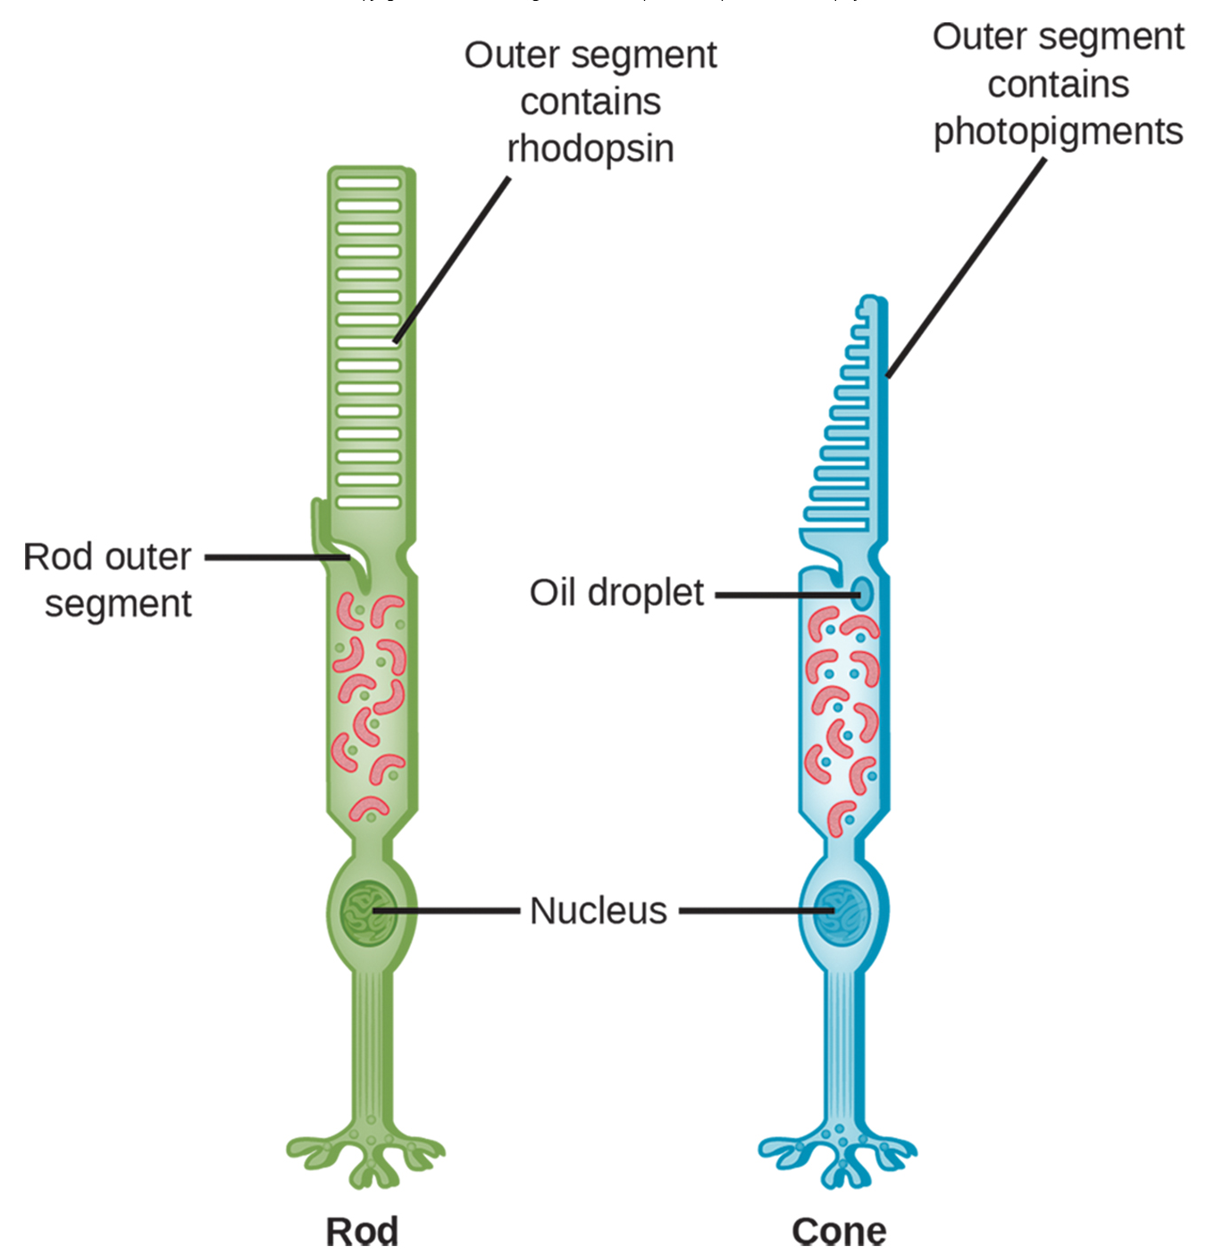
Anatomy of the Eye₃
There are two types of photoreceptors in the retina:
Rods detect dim light and are used for peripheral and nighttime vision.
Strongly photosensitive and located in the outer edges of the retina
Cones detect bright light and are used for daytime, color vision.
Weakly photosensitive and located near the center of the retina
The fovea centralis (fovea) is the region on the center back of the eye responsible for acute vision.
Has a high density of cones, which far outnumber rods in the fovea
41.5 Figure 4
Piotr Sliwa on Wikimedia Commons. "Rods and cones." Modified.

Slide 12
Transduction of Light₁
Rods and cones contain photopigments that convert light into neural signals.
Rhodopsin is the main photopigment in vertebrates.
Rhodopsin has two parts: opsin (membrane protein) and retinal (molecule that absorbs light).
When light hits photoreceptors, the retinal undergoes a shape change from a bent (cis) form to its linear (trans) isomer.
This cascade results in the closure of Na⁺ channels, leading to hyperpolarization of the photoreceptor.

Slide 13
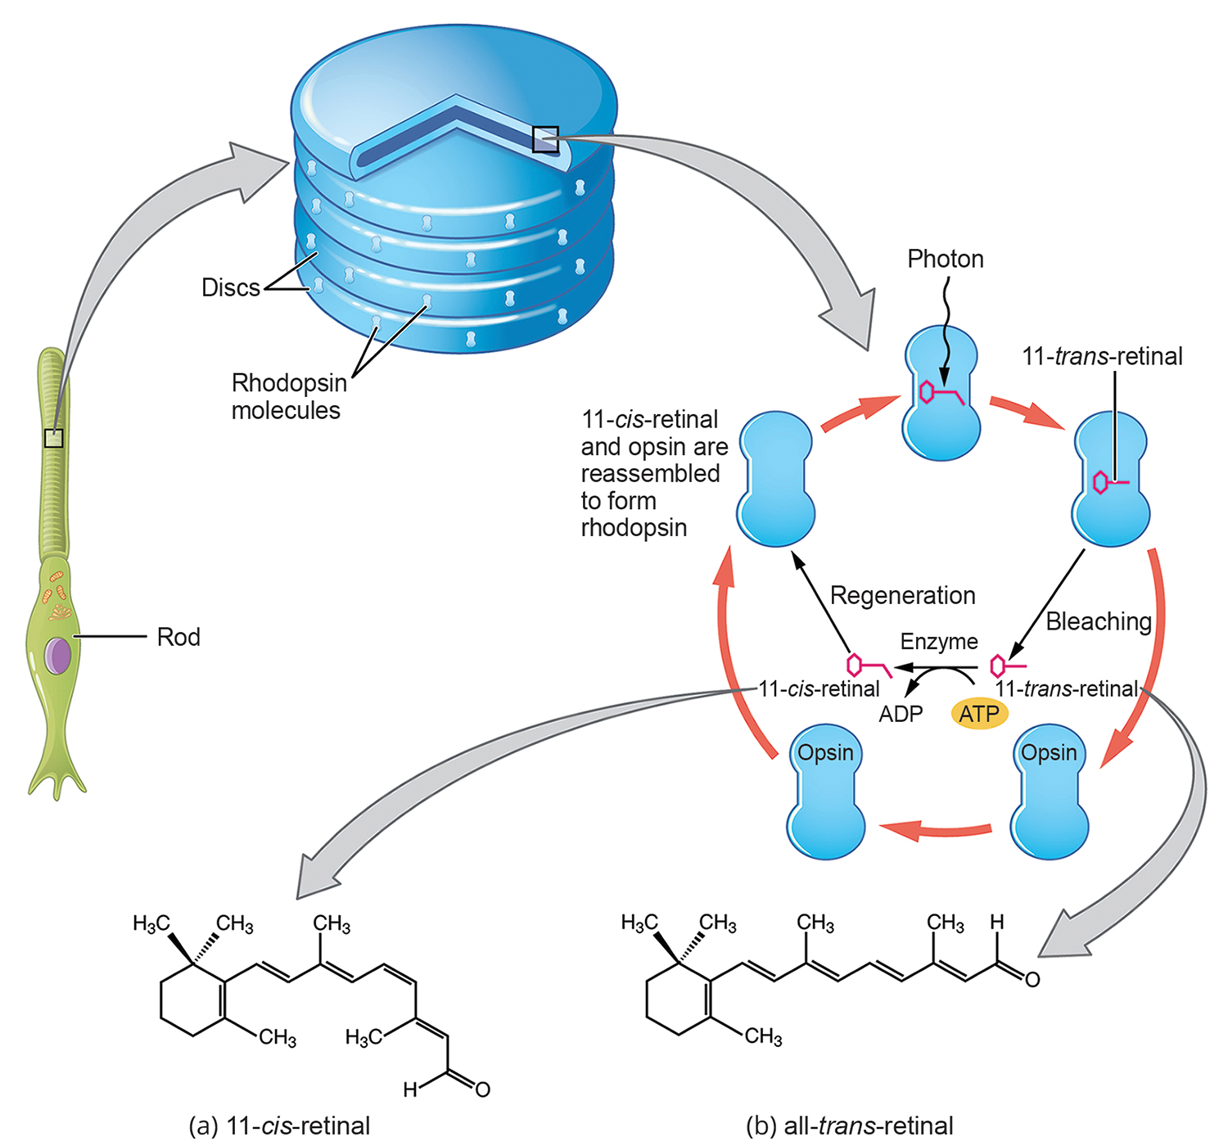
41.5 Figure 5
OpenStax College on Wikimedia Commons. "Retinal isomers."
Notes:
Rhodopsin, the photoreceptor in vertebrates, has two parts: the trans-membrane protein opsin and retinal. When light strikes retinal, it changes shape from (a) cis to (b) trans form.

Slide 14
Transduction of Light₂
Rhodopsin activation initiates a cascade of events, ending with the closing of Na⁺ channels in the photoreceptor membrane.
Without light, Na⁺ channels are bound by cyclic GMP (cGMP) and continually flow into photoreceptors, keeping them depolarized.
Depolarized photoreceptors signal to bipolar cells through the release of glutamate.
With light, rhodopsin activates transducin, activating phosphodiesterase.
Phosphodiesterase convers cGMP to GMP, and GMP dissociates from the Na⁺ channels, closing them.
Closed Na⁺ channels stop the flow of positive charge.
Photoreceptors become hyperpolarized in response to light, unlike other sensory neurons which become depolarized.
Hyperpolarized photoreceptors stop releasing the neurotransmitter glutamate.

Slide 15
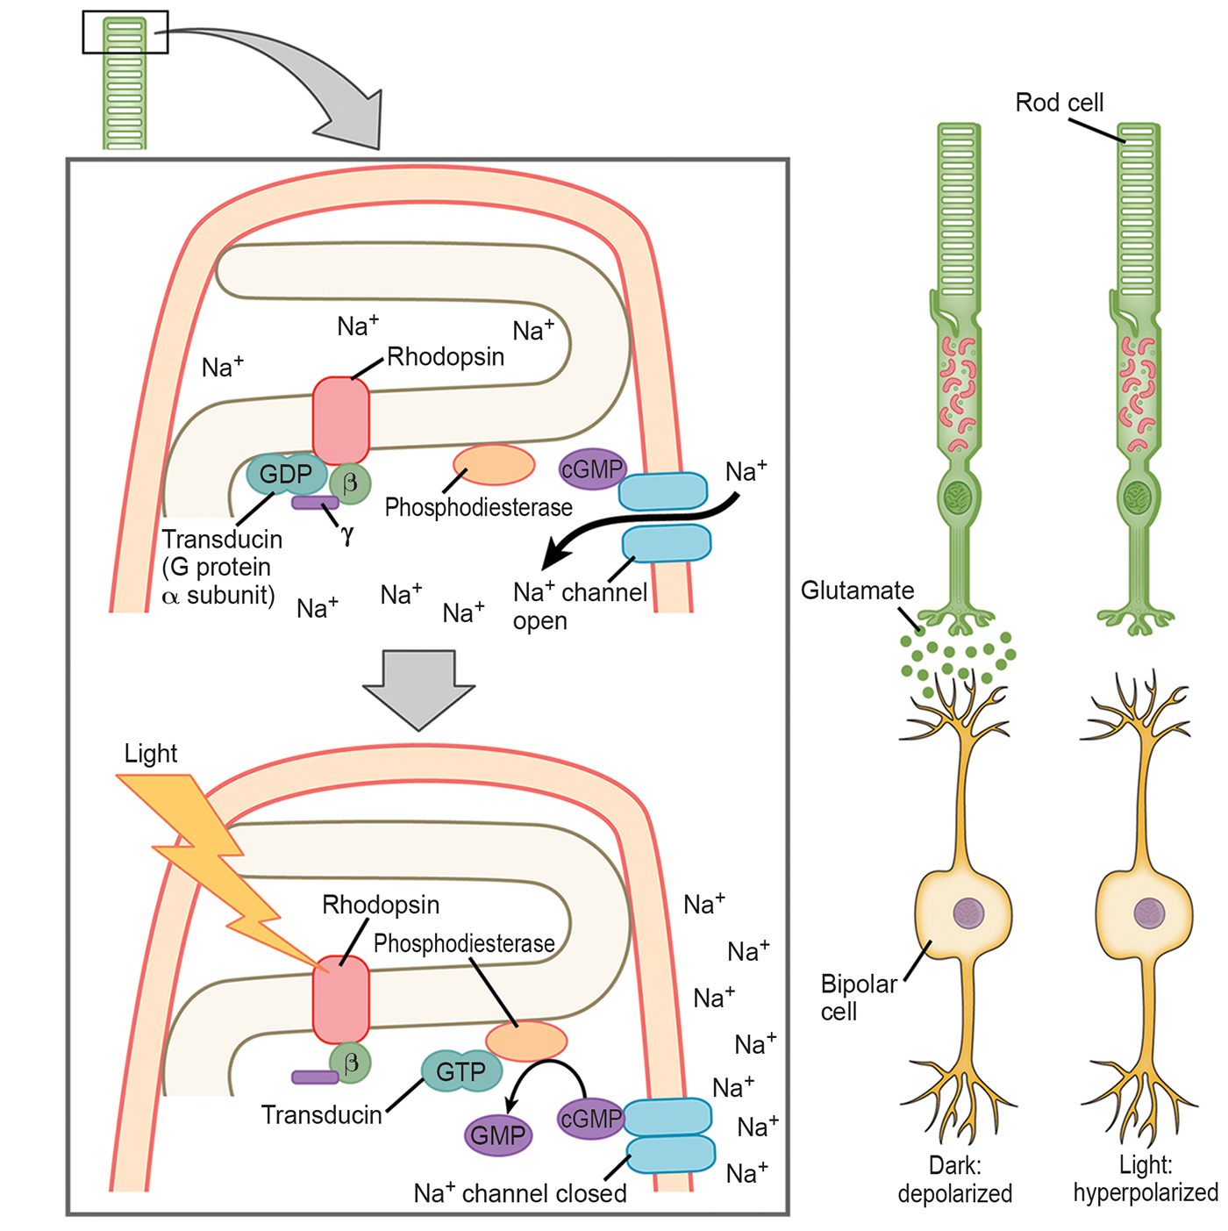
41.5 Figure 6
CNX OpenStax on Wikimedia Commons. "Rhodopsin." Modified.
Notes:
When light strikes rhodopsin, the G protein transducin is activated, which, in turn, activates phosphodiesterase. Phosphodiesterase converts cGMP to GMP, thereby closing sodium channels. As a result, the membrane becomes hyperpolarized. The hyperpolarized photoreceptor does not release glutamate to the bipolar cell.

Slide 16
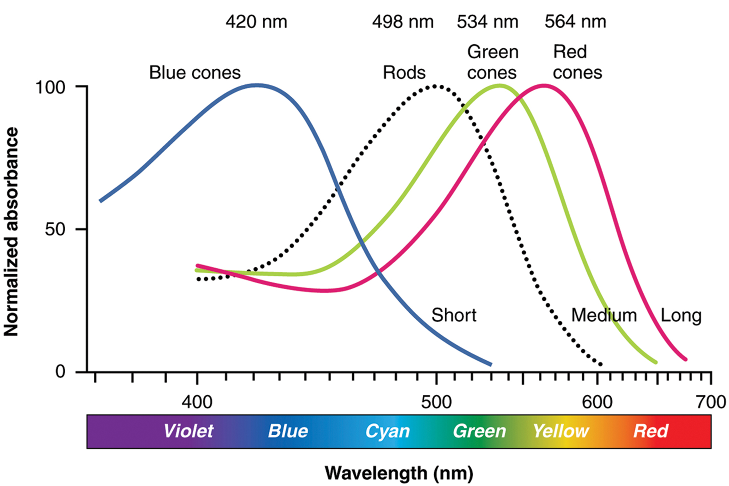
Trichromatic Coding₁
There are three types of cones: S cones (short, blue), M cones (medium, green), and L cones (long, red).
Each type of cone is most responsive to a different wavelength.
Color perception results from the ratio of activity among the three types of cones.
With one type of cone, color vision is not possible.
With dichromatic (two-cone) vision, there are limitations.
A trichromatic system results in full color vision.
41.5 Figure 7: Human rod cells and the different types of cone cells each have an optimal wavelength. However, there is considerable overlap in the wavelengths of light detected.
OpenStax College on Wikimedia Commons. "Color sensitivity."

Slide 17
Science and You
Color blindness is the decreased ability to see colors or distinguish between colors.
This occurs when an individual has one or more faulty or absent cones.
Red-green color blindness is the most common.
Blue-yellow color blindness causes difficulty distinguishing between blue and green and between yellow and red.
Most color blindness is caused by recessive alleles on the X chromosome, affecting mostly males.
Notes:
This is included as a relevant application for this topic.

Slide 18
Trichromatic Coding₂
The color we perceive results from the ratio of activity of the three cone types.
The visual spectrum runs from long-wavelength light to short:
Red (700 nm)
Orange (600 nm)
Yellow (565 nm)
Green (497 nm)
Blue (470 nm)
Indigo (450 nm)
Purple (425 nm)
Humans can distinguish about 500 levels of brightness, 200 hues, 20 steps of saturation—2 million distinct colors.

Slide 19
Retinal Processing₁
Visual signals travel from photoreceptors to bipolar cells and then to ganglion cells.
Processing occurs in the retina before information is sent to the brain.
Photoreceptors in the retina undergo tonic activity; they are always slightly active even when not stimulated.
In neurons that exhibit tonic activity, absence of stimuli maintains a baseline firing rage, while some stimuli increase their baseline firing rate, and others decrease it.

Slide 20
Retinal Processing₂
Bipolar cells can be ON or OFF types, responding differently to light exposure.
ON are inhibited by constant stimulation from photoreceptors during the dark.
Do not stimulate ganglion cells
OFF are activated by this constant stimulation.
Do stimulate ganglion cells
Exposure of the retina to light hyperpolarizes the rods and cones, stopping them from signaling bipolar cells.
This removes the inhibition of ON cells and stops the stimulation of OFF cells.

Slide 21
Retinal Processing₃
Ganglion cells send action potentials along the optic nerve to the brain.
Tells the brain that the light is on
The visual system relies on retinal activity changes to encode visual signals for the brain.
Horizontal cells and amacrine cells modulate information flow and enhance image contrast.
Inhibits more distant photoreceptors and bipolar cells when stimulated
Lateral inhibition by horizontal cells sharpens edges and enhances contrast.
Amacrine cells make connections with bipolar and ganglion cells.
Distribute information from one bipolar cell to many ganglion cells to modify activity/responsiveness in these cells

Slide 22
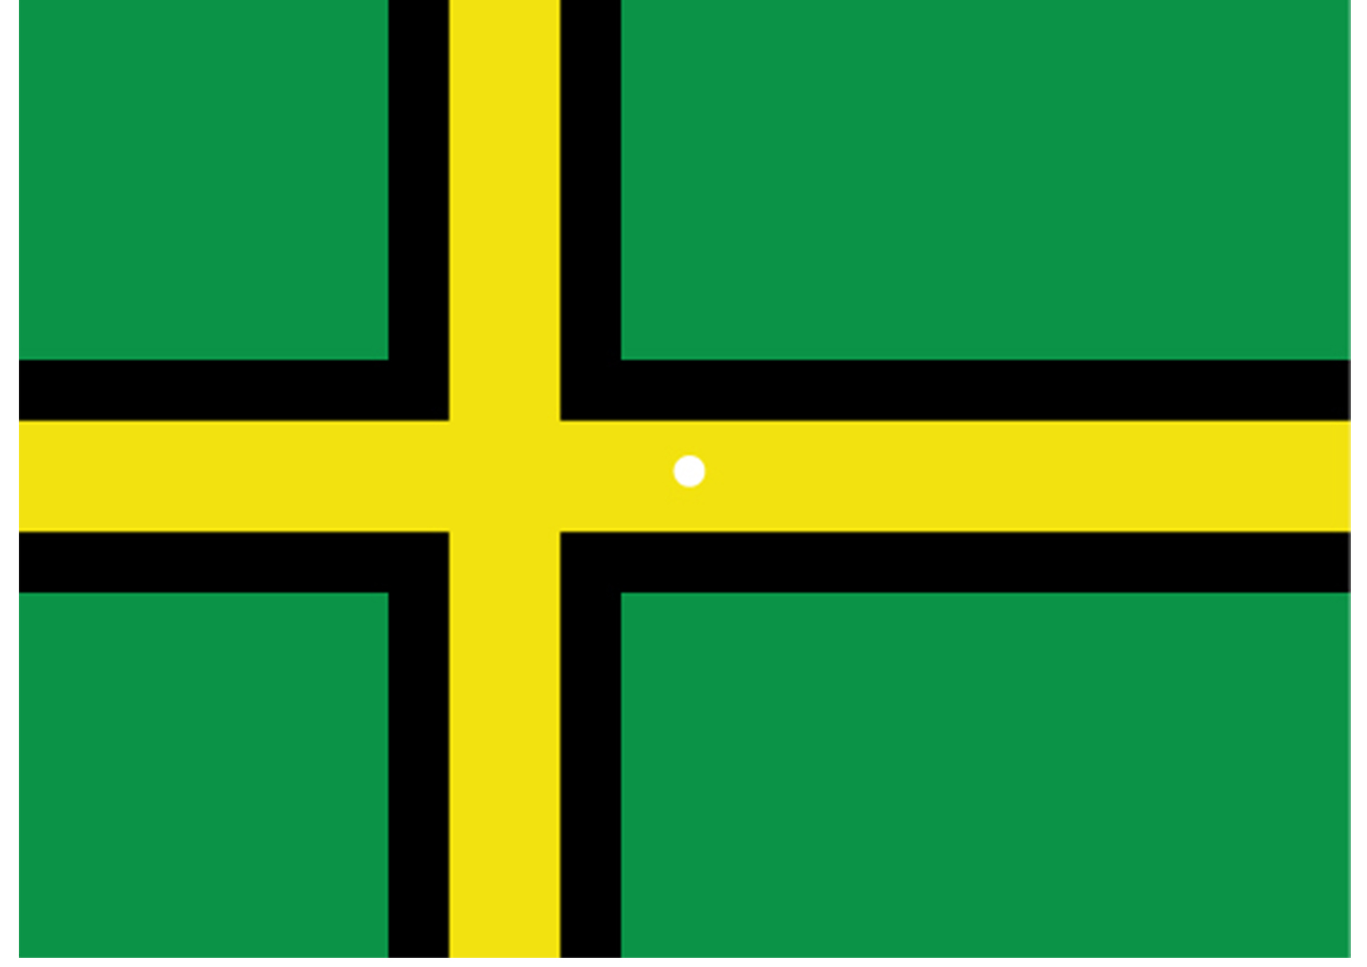
Opponent Process Theory
Opponent process theory:
Retinal ganglion cells that respond to green, black, and yellow increased their firing dramatically.
When your gaze shifted to the neutral white ground, the ganglion cells decreased their activity and the brain thought they were responding to the "opponent" colors red, white, and blue.
41.5 Figure 8: View this flag to understand how retinal processing works. Stare at the center of the flag (indicated by the white dot) for 45 seconds, and then quickly look at a white background, noticing how colors appear.
CNX OpenStax on Wikimedia Commons. "Inverted color."

Slide 23
Higher Processing₁
Myelinated axons of ganglion cells make up optic nerves.
Different axons carry different qualities of the visual signal.
Some constitute the magnocellular (big cell) pathway, which carries information about form, movement, and brightness.
Others constitute the parvocellular (small cell) pathway, which carries information about color and fine detail.
The optic chiasma allows for coordination of information from both eyes.

Slide 24
Higher Processing₂
Visual information is processed in several places in the brain, each route reflecting complexity and importance.
One route goes to the thalamus.
Serves as routing station for incoming sensory impulses except olfaction
Then sent to the primary visual cortex
From the visual cortex, the signals can take one of two directions.
One stream to the parietal lobe ("where" information)
A second stream to the temporal lobe ("what" information)

Slide 25
Reflection Question₂
Why do you think it is important for some visual information to cross to the opposite side of the brain at the optic chiasma?
Notes:
The reflection question is included here to use as a talking point or for a think-pair-share activity.

Slide 26
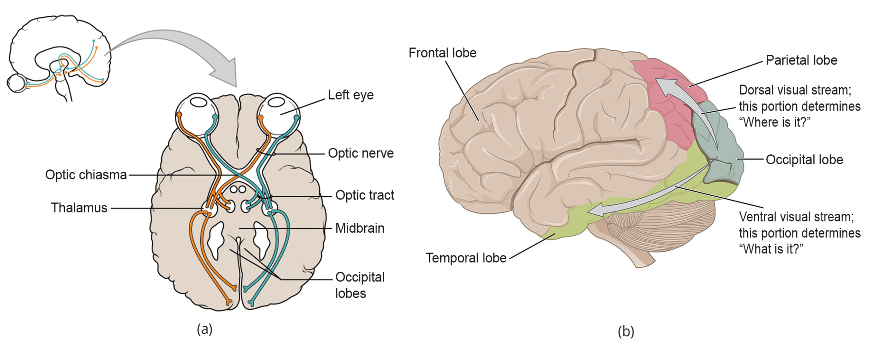
41.5 Figure 9
OpenStax on Wikimedia Commons. "Optic nerve and tract."
OpenStax College on Wikimedia Commons. "Visual streams."
Notes:
a) Some visual pathways continue directly to the back of the brain, whereas other information crosses at the optic chiasma. (b) Visual signals from the occipital lobe are split into two streams: the dorsal visual stream that carries the magnocellular ("where") information to the parietal lobe, and the ventral visual stream that carries the parvocellular ("what") information to the temporal lobe.

Slide 27
Higher Processing₃
Another route is the pathway from the retina to the superior colliculus in the midbrain.
Coordination of eye movements and integration of auditory information
Final pathway is from the retina to the suprachiasmatic nucleus (SCN) of the hypothalamus.
SCN: cluster of cells; body's internal clock
Controls circadian (day-long) cycle
Sends information to the pineal gland (important to sleep/wake and annual cycles)

Slide 28
Summary
Vision involves the detection and interpretation of light, which travels in waves.
The retina contains photoreceptors (rods and cones) that convert light into neural signals.
Cones have three forms: L, M, and S.
Cones are found in the fovea centralis, while rods are found in the peripheral regions.
Visual signals travel from the eye over the axons of retinal ganglion cells.
Ganglion cells can carry information on form, movement, depth, and brightness, or they carry information on color and fine detail.
Visual information is sent to the superior colliculi in the midbrain and also to the SCN, which plays a role in the circadian cycle.

Slide 29

End of Hawkes Learning PowerPoint

