Slide 1
Lesson 42.1
Neurons and Glial Cells

Slide 2
Objectives
List and describe the functions of the structural components of a neuron and glial cells.
List and describe the four main types of neurons.
Compare the functions of different types of glial cells.

Slide 3
Nervous System As Control Center
The nervous system is an organism’s control center.
It processes sensory information from both outside and inside the body.
It controls all behaviors.
Examples of functions or actions that the nervous system controls include:
Complicated actions like a high jump
Reading a book
Breathing
Regulation of body temperature
Eating
Finding a mate

Slide 4

42.1 Figure 1
Scott Ray on Wikimedia Commons. "High jump."
Notes:
42.1 Figure 1: An athlete's nervous system is hard at work during the planning and execution of a movement as precise as a high jump. Parts of the nervous system are involved in determining how hard to push off and when to turn as well as controlling the muscles throughout the body that make this complicated movement possible without knocking the bar down—all in just a few seconds.

Slide 5
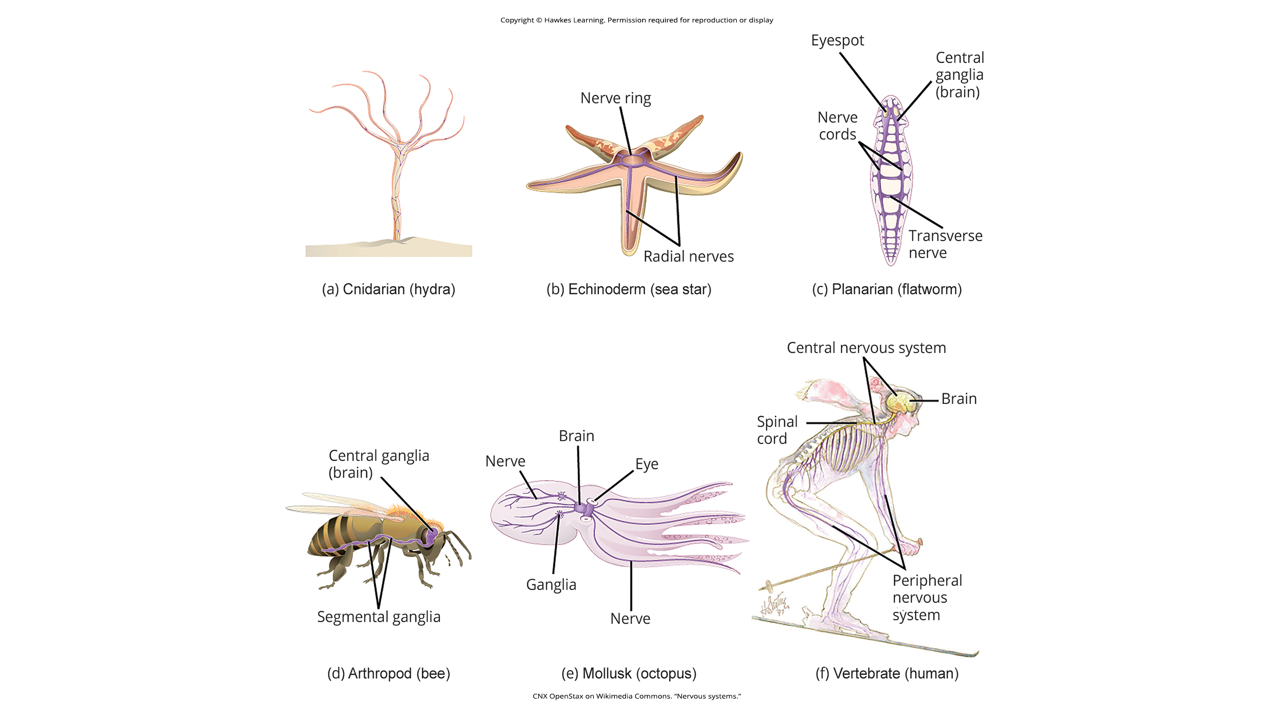
Variations in Animal Nervous Systems₁
Sea sponges lack true nervous systems.
Jellyfish and hydra each lack a true brain, having a "nerve net" (a system of separate but connected nerve cells) instead.
Echinoderms (including sea stars) have nerve cells that are bundled into fibers called nerves.
42.1 Figure 2 (a) and (b)
CNX OpenStax on Wikimedia Commons. “Nervous systems.”

Slide 6
Variations in Animal Nervous Systems₂
Flatworms (Platyhelminthes) each have both a central nervous system (CNS) and a peripheral nervous system (PNS).
The CNS contains a "brain" and 2 nerve cords.
The PNS is a system of nerves extending throughout the body.
42.1 Figure 2 (c)
CNX OpenStax on Wikimedia Commons. “Nervous systems.”

Slide 7
Variations in Animal Nervous Systems₃
Insects each have a more complex but decentralized nervous system with"
A brain
A ventral nerve cord
Ganglia (clusters of connected neurons) that can control movements and behaviors without brain input
42.1 Figure 2 (d)
CNX OpenStax on Wikimedia Commons. “Nervous systems.”

Slide 8
Variations in Animal Nervous Systems₄
42.1 Figure 2 (e)
An octopus has neurons organized into specialized lobes and eyes that are structurally like vertebrate species.
CNX OpenStax on Wikimedia Commons. “Nervous systems.”

Slide 9
Variations in Animal Nervous Systems₅
Vertebrate nervous systems are:
More complex
Centralized
Specialized
Vertebrate nervous systems share a basic structure:
A CNS containing a brain and spinal cord
A PNS made up of peripheral sensory and motor nerves
42.1 Figure 2 (f)
CNX OpenStax on Wikimedia Commons. “Nervous systems.”

Slide 10
Comparing Invertebrate to Vertebrate Nervous Systems
They are located in different parts of the body.
Invertebrate nerve cords are located ventrally (on the body’s front).
Vertebrate spinal cords are located dorsally (on the body’s back).
What accounts for this difference?
Did these evolve separately?
Did the invertebrate body plan arrangement "flip" during the evolution of vertebrates?

Slide 11
Composition of the Nervous System
The nervous system is made of up neurons and glia.
Neurons are specialized cells that can receive and transmit chemical or electrical signals.
A neuron can be compared to an electrical wire in that it transmits a signal from one place to another.
There are 4 major types of neurons.
Glia are cells that provide support functions for neurons, which includes information processing complementary to that of neurons.
Glia can be compared to electric company workers who make sure wires go to the right places, maintain the wires, and remove broken wires.
Some glia may participate in some signaling functions.

Slide 12
Animals Differ in Neuron Number
Different animals have different numbers of neurons.
A common lab fly (Drosophila melanogaster): 100,000 neurons
A lobster: 100,000 neurons
A mouse: 75 million neurons
An octopus: 300 million neurons
A human brain: 86 billion neurons
Despite variation in numbers, these animals’ nervous systems control similar behaviors:
Basic reflexes
Finding food
Courting mates

Slide 13
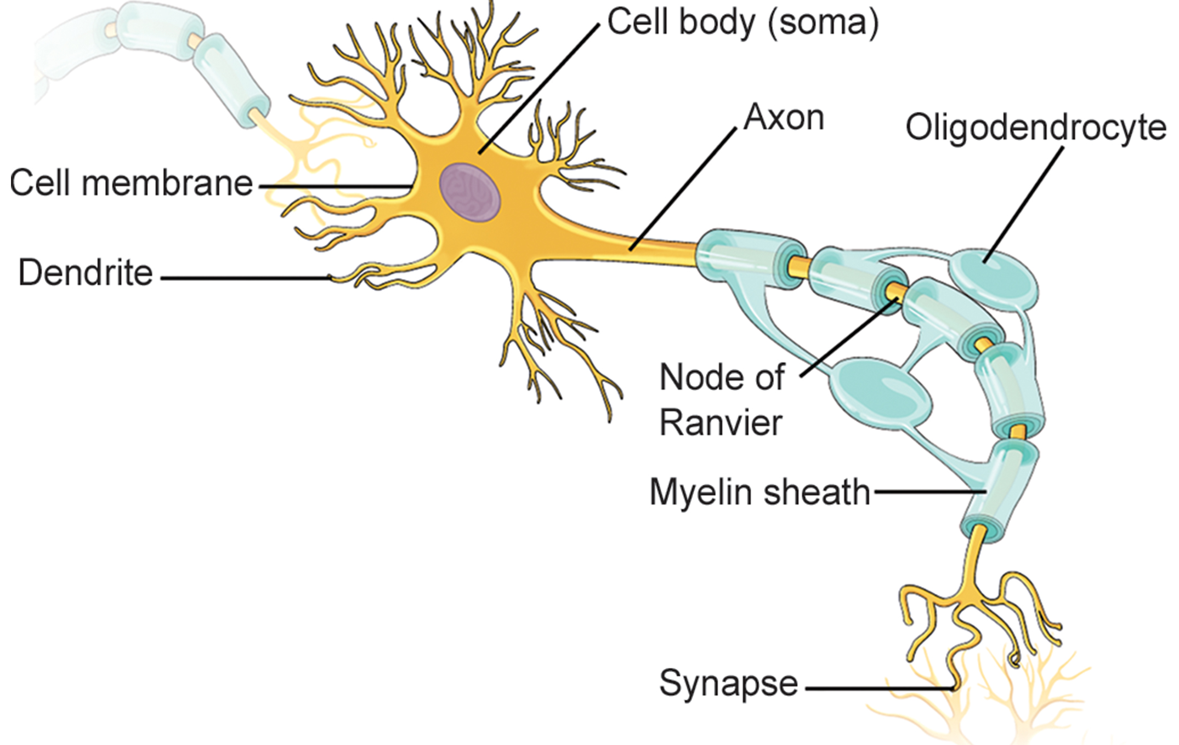
Neuron Structure
Each neuron has
A cell body
Dendrites
An axon
42.1 Figure 3
OpenStax. "Neuron structure."

Slide 14
Neuron Structure: The Cell Body
A cell body (or soma) contains:
A nucleus
The smooth and rough ER
The Golgi apparatus
Mitochondria
Other cellular components

Slide 15
Neuron Structure: Dendrites
Dendrites are treelike structures extending away from the cell body to receive messages from other neurons at specialized junctions called synapses.
Some neurons have multiple dendrites.
Other neurons lack dendrites.
Dendrites can have dendritic spines, small protrusions to further increase surface area for synaptic connections.

Slide 16
Neuron Structure: The Axon
The axon hillock integrates signals from multiple synapses and joins the cell body to the axon.
An axon is a tubelike structure that propagates the integrated signal to specialized endings called axon terminals which synapse with other neurons, muscle, or target organs.
Neurons usually have 1 or 2 axons.
Some neurons (like retinal amacrine cells) lack axons.
Myelin covers some axons to insulate them, minimizing loss of electrical signal as it travels down the axon and greatly increasing the speed of conduction.
Myelin is produced by glial cells.
Nodes of Ranvier are gaps in the myelin sheath where the signal is "recharged."

Slide 17
Neuronal Connections₁
A single neuron does not act alone.
Neuronal communication depends on connections that neurons make with each other and with other cells (like muscle cells).
A dendrite from a single neuron may receive synaptic contact from many other neurons.

Slide 18
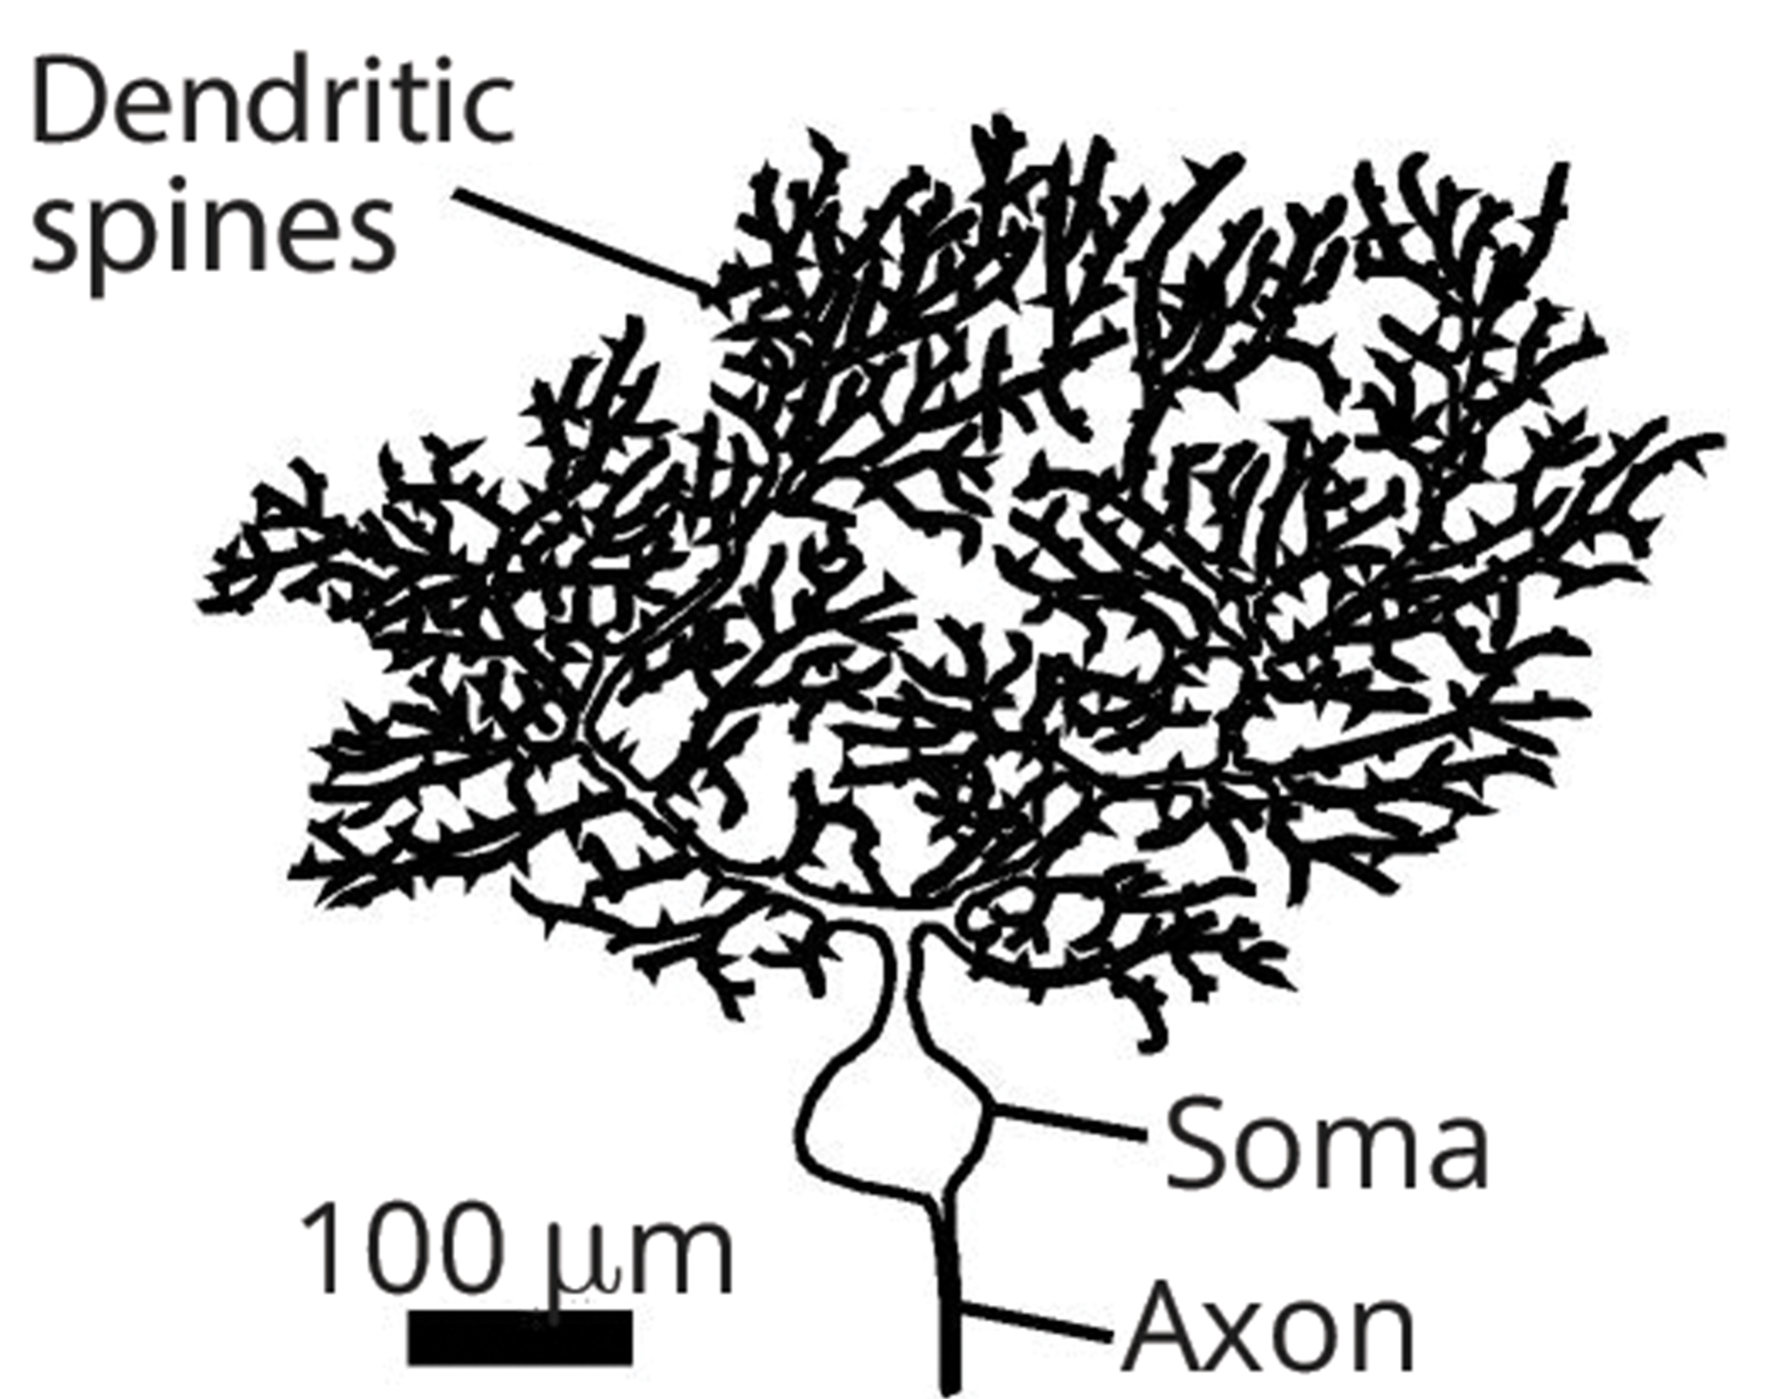
Neuronal Connections₂
Dendrites from a Purkinje cell in the cerebellum may receive contact with up to 200,000 other neurons.
42.1 Figure 4
Synapse on Wikimedia Commons. "Purkinje cell."
Notes:
.

Slide 19
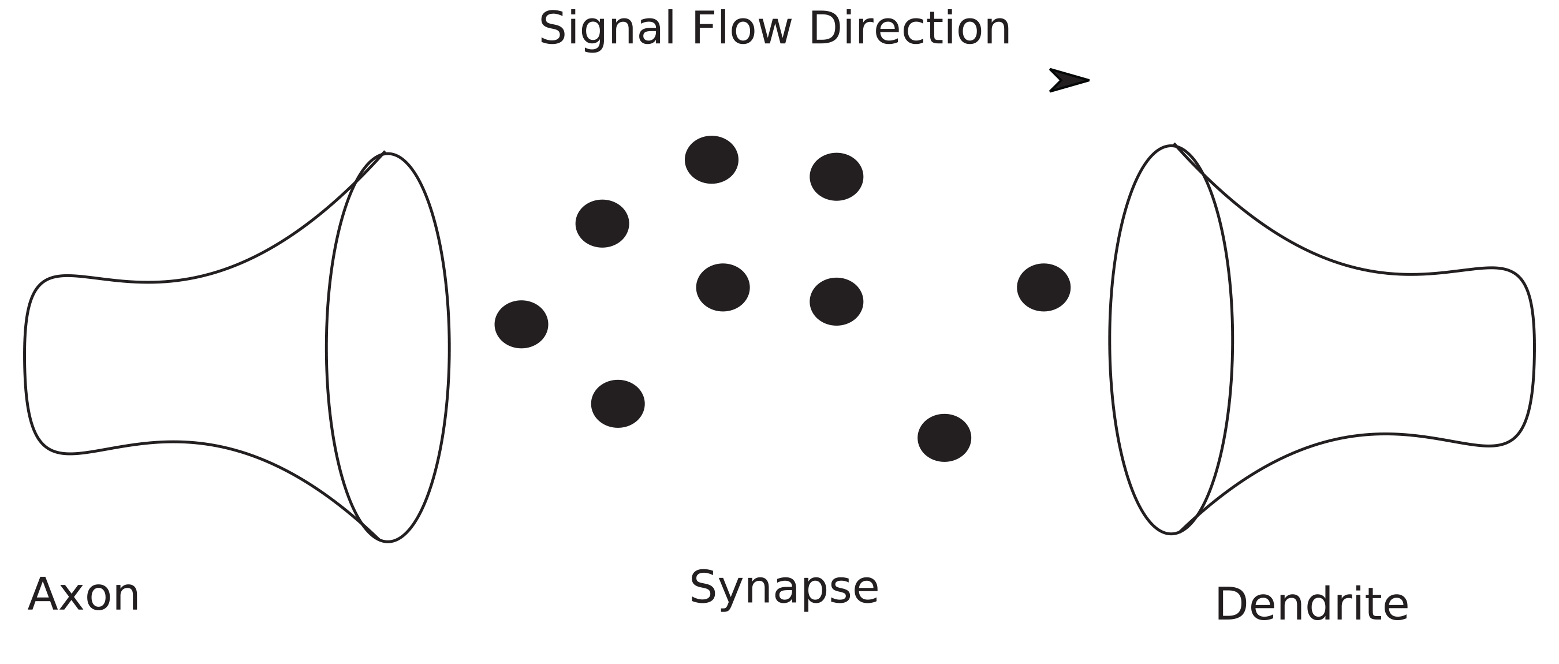
Neuronal Connections₃
Neuronal connection occurs between the axon of one neuron and the dendrite of another.
42.1 Figure 5
Whiteknight on Wikimedia Commons. "Basic synpase."

Slide 20
Think It Through₁
Which of the following statements is false about nerve cells?
The soma is the cell body of a nerve cell.
The myelin sheath provides an insulating layer to the dendrites.
Axons carry the signal from the soma to the target.
Dendrites receive and communicate the signal to the soma.
Notes:
Originally an On Your Own. This is included here to use as a talking point or for a think-pair-share activity.

Slide 21
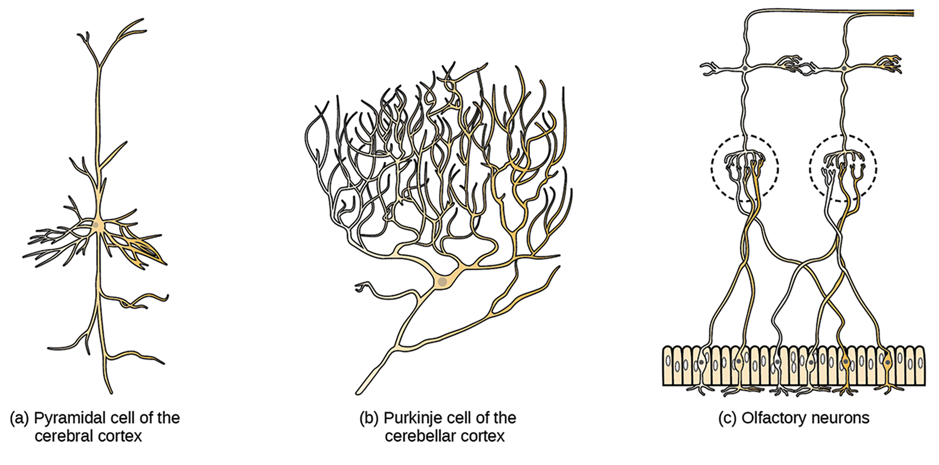
Neuron Differences in Structure and Function
There is amazing diversity in neuron shapes and sizes found:
In different parts of the nervous system
Across species
42.1 Figure 6
OpenStax. "Neuron diversity."

Slide 22
Types of Neurons
There are 4 basic types of neurons:
Unipolar
Bipolar
Multipolar
Pseudounipolar

Slide 23
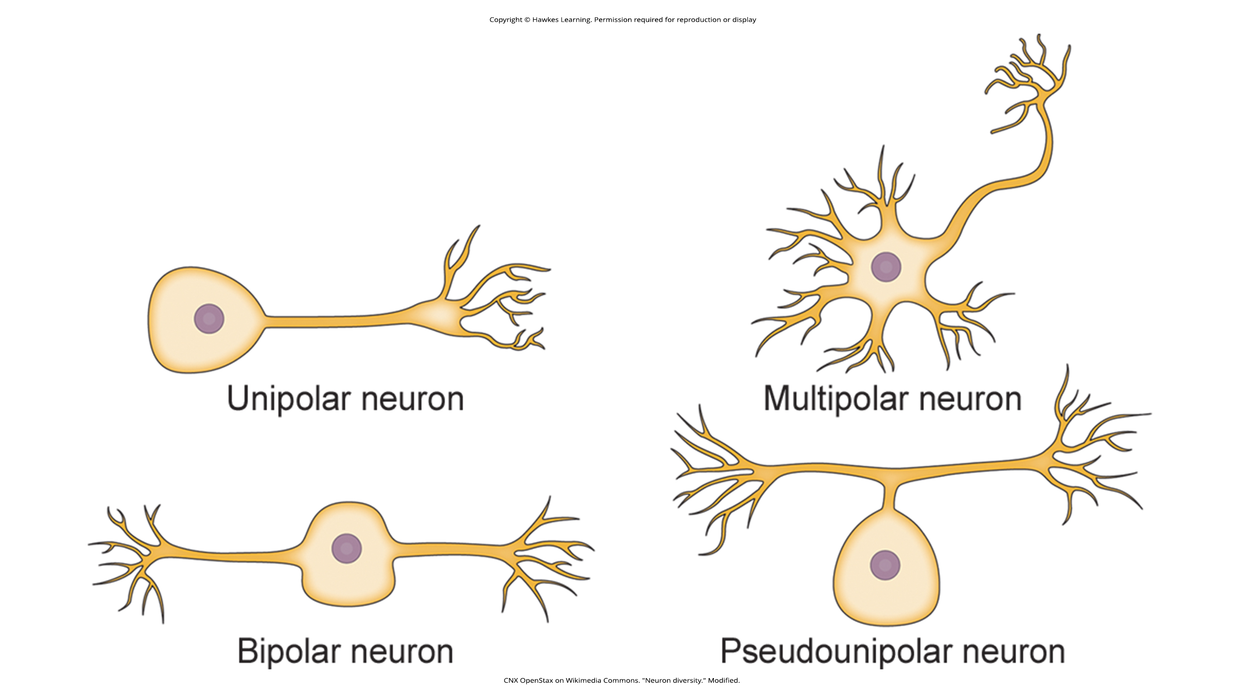
Types of Neurons: Unipolar Neurons
A unipolar neuron has only 1 structure that extends away from the soma.
These are found in insects where they stimulate muscles or glands.
These are NOT found in vertebrates.
42.1 Figure 7
CNX OpenStax on Wikimedia Commons. "Neuron diversity." Modified.

Slide 24
Types of Neurons: Bipolar Neurons
A bipolar neuron has 1 axon and 1 dendrite extending away from the soma.
An example is a retinal bipolar cell, which receives signals from photoreceptor cells sensitive to light and transmits these signals to ganglion cells that carry the signal to the brain.
42.1 Figure 7
CNX OpenStax on Wikimedia Commons. "Neuron diversity." Modified.

Slide 25
Types of Neurons: Multipolar Neurons
A multipolar neuron has 1 axon and multiple dendrites.
This is the most common type of neuron.
These can be found in the CNS.
42.1 Figure 7
CNX OpenStax on Wikimedia Commons. "Neuron diversity." Modified.

Slide 26
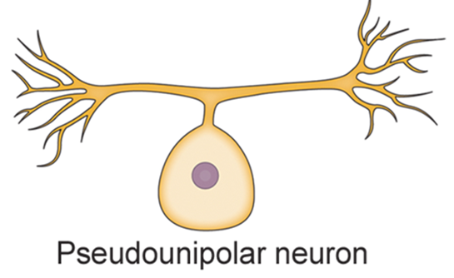
Types of Neurons: Pseudounipolar Neurons₁
A pseudounipolar neuron shares characteristics with both unipolar and bipolar cells.
It has a single process extending from the soma (like a unipolar cell).
The process branches into 2 structures (like a bipolar cell).
42.1 Figure 7
CNX OpenStax on Wikimedia Commons. "Neuron diversity." Modified.

Slide 27
Types of Neurons: Pseudounipolar Neurons₂
Most sensory neurons are pseudounipolar with an axon branching into 2 extensions:
One is connected to dendrites that receive sensory information.
The other transmits information to the spinal cord.

Slide 28
Science and You
Neurogenesis
Neurogenesis is the birth of new neurons
While scientists once believed that neurogenesis did not occur after birth, they now know that neurogenesis occurs in adults
In mammals, ~ 1,000 new neurons develop in the hippocampus (a brain structure involved in learning and memory) daily
Exercise and some antidepressants promote neurogenesis
Stress limits neurogenesis
New neurons can be identified by the incorporation BrdU into newly synthesized DNA and fluorescent labeling
Notes:
This is included as a relevant application for this topic.

Slide 29
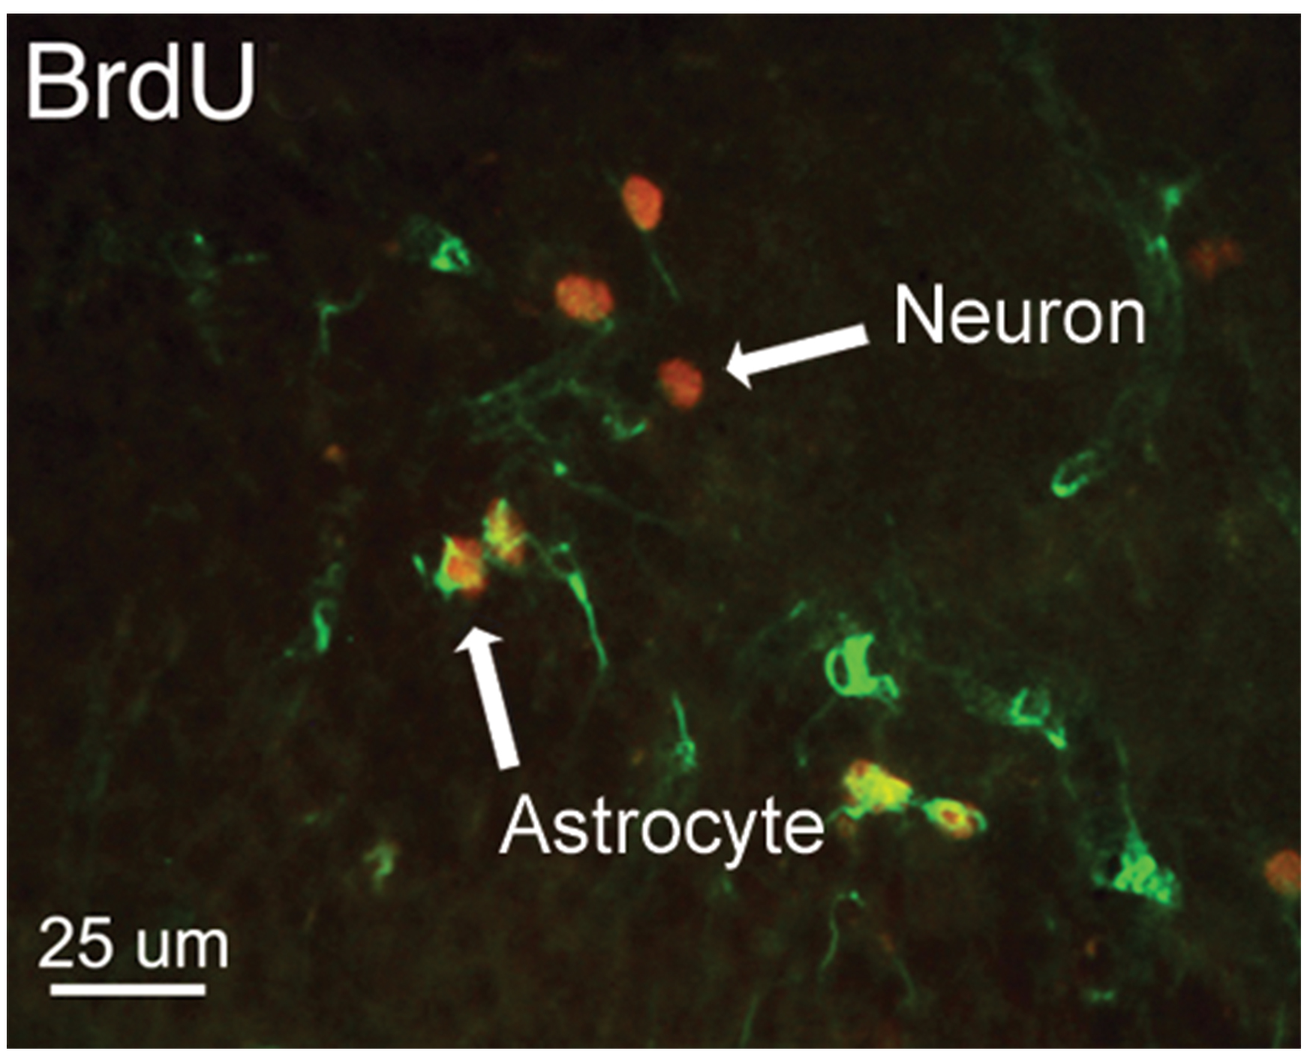
42.1 Figure 8
Maryam Faiz , Laia Acarin , Bernardo Castellano and Berta Gonzalez on Wikimedia Commons. "BrdU in DNA."
Notes:
42.1 Figure 8: This micrograph shows fluorescently labeled new neurons in a rat's hippocampus. Cells that are actively dividing have bromodeoxyuridine (BrdU) incorporated into their DNA and are labeled in red (neurons). Cells that express glial fibrillary acidic protein (GFAP) are labeled in green. Astrocytes, but not neurons, express GFAP. Thus, cells that are labeled both red and green are actively dividing astrocytes, whereas cells labeled red only are actively dividing neurons.

Slide 30
The Roles of Glia
The number of glial cells in the brain is more than 10X that of neurons.
Neurons cannot function without the roles carried out by glia:
Glia guide developing neurons to their destinations.
Glia buffer ions and chemicals that would otherwise harm neurons.
Glia provide myelin sheaths around axons.
Glia respond to nerve activity and modulate communication between nerve cells.
Most brain tumors are caused by mutations in glia.

Slide 31
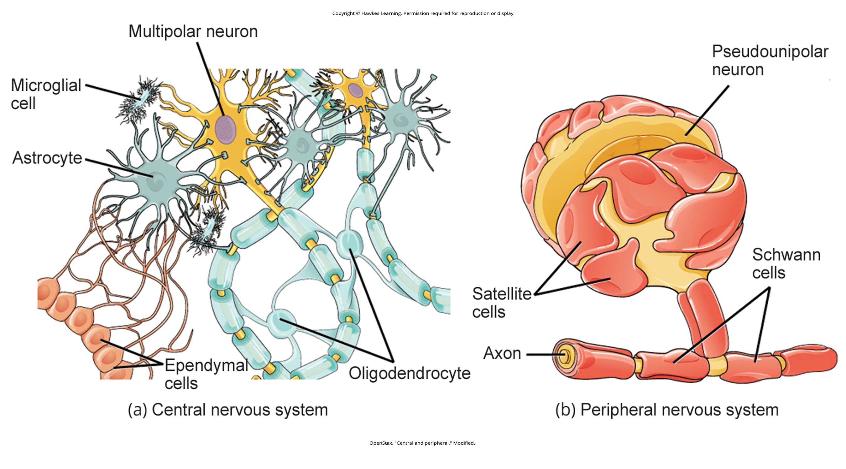
Types of Glia in the Central Nervous System
The types of glia found in the CNS are:
Astrocytes
Oligodendrocytes
Microglia
Radial glia
Ependymal cells
42.1 Figure 9 (a)
OpenStax. "Central and peripheral." Modified.

Slide 32
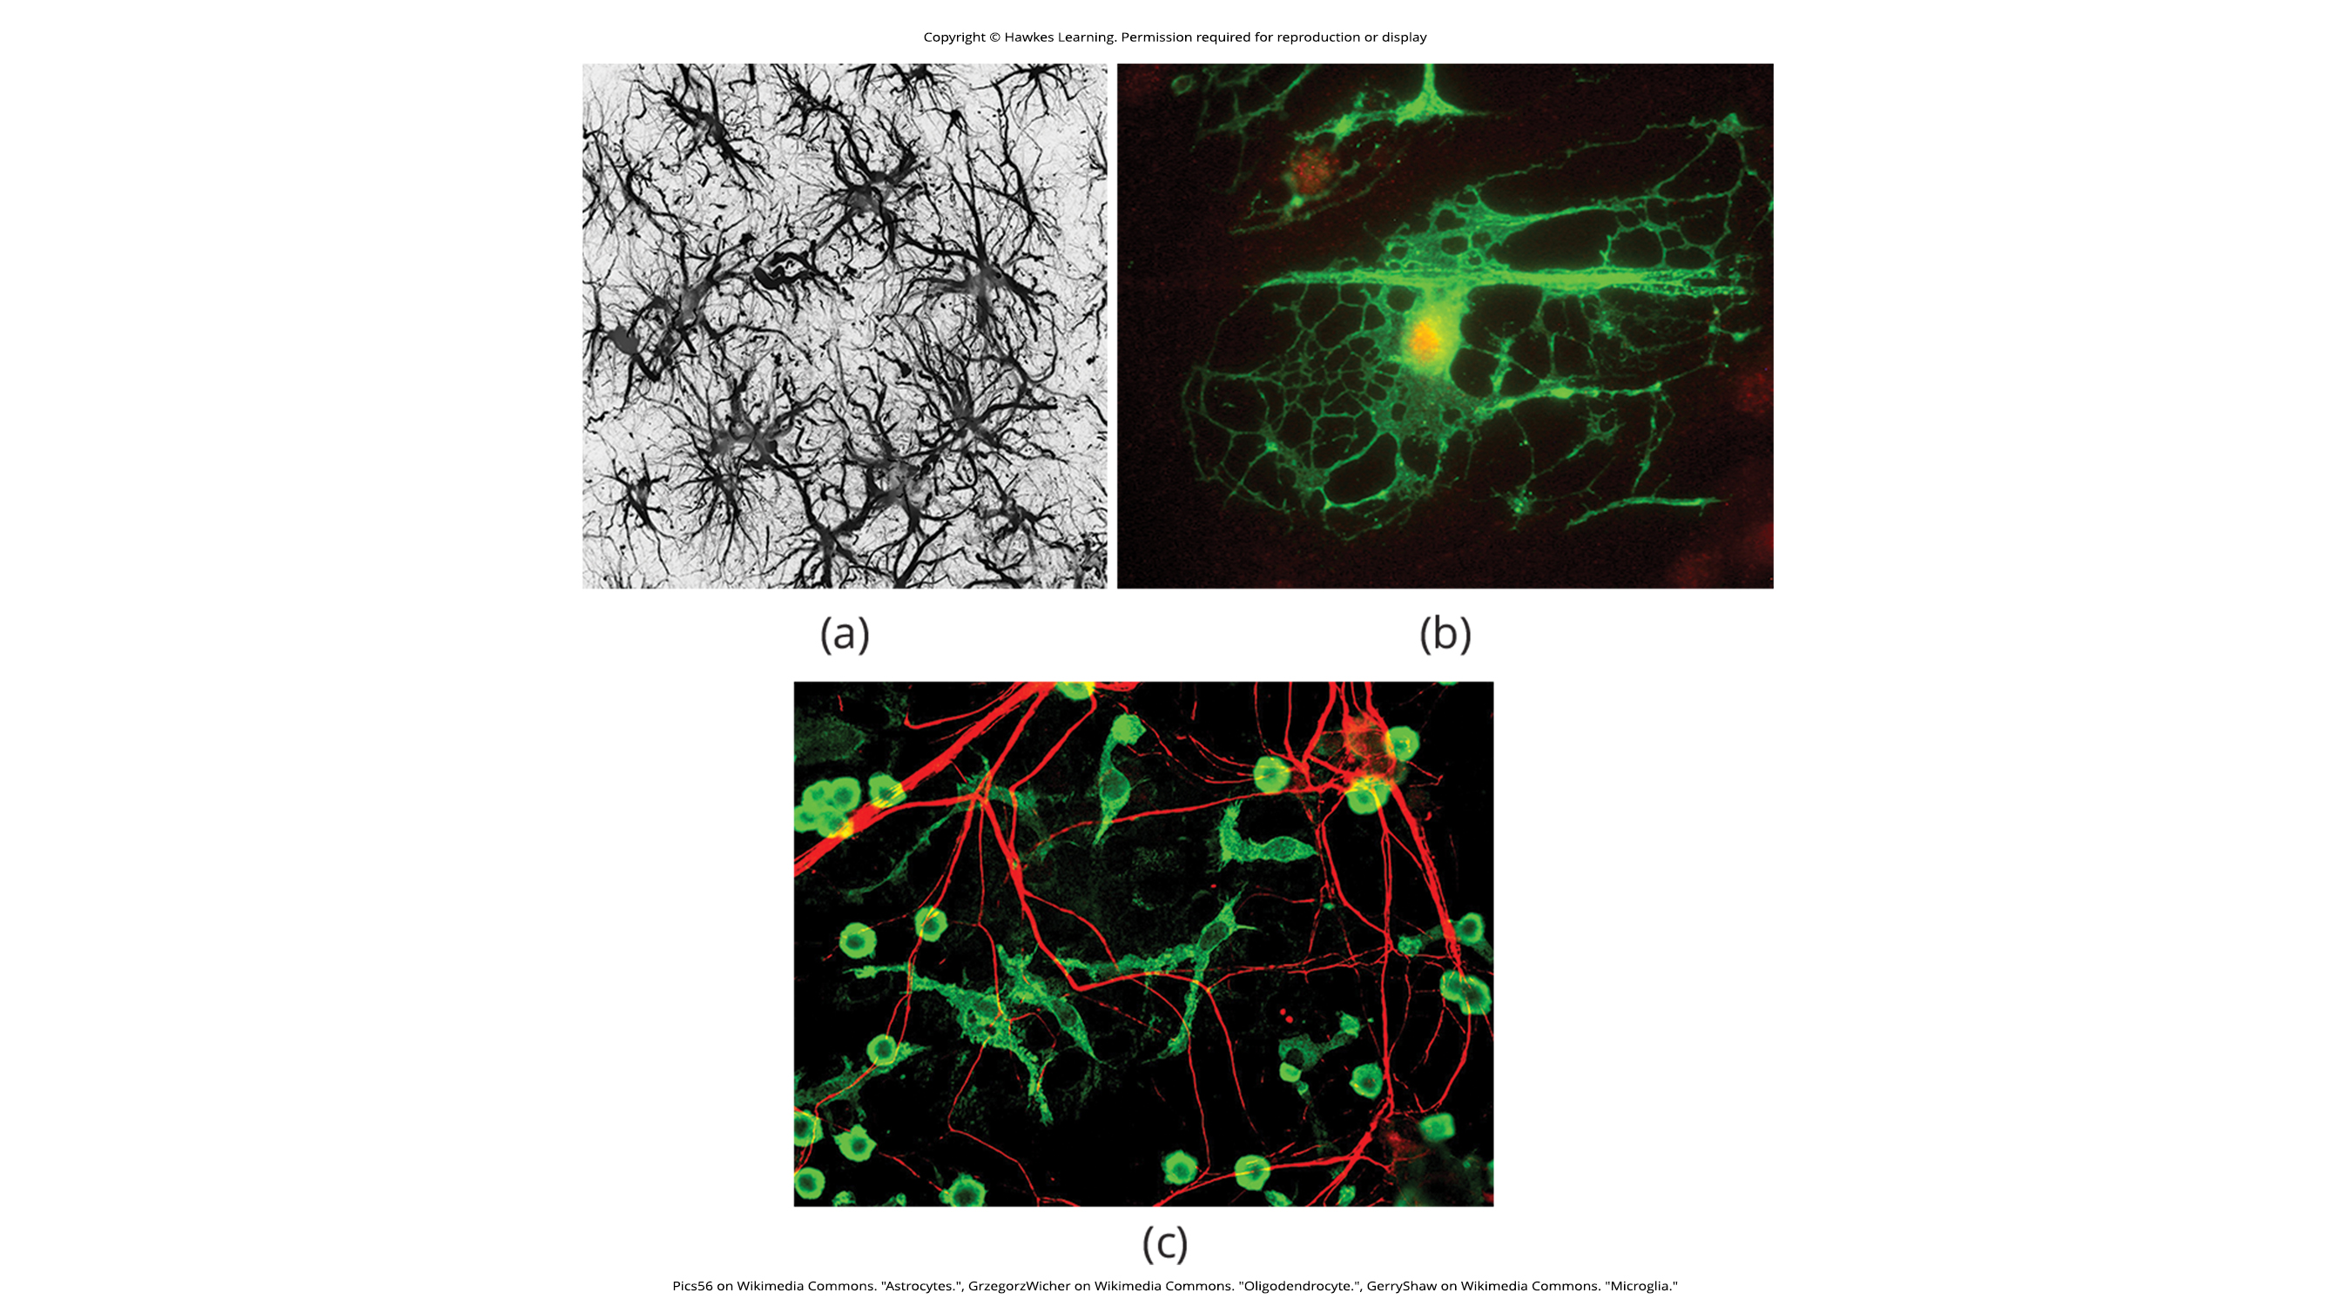
Types of Glia in the CNS: Astrocytes
Astrocytes each contact both capillaries and neurons.
They provide nutrients and other substances to neurons.
They regulate concentrations of ions and chemicals in the extracellular fluid.
They provide structural support for synapses.
They compose the blood-brain barrier which blocks the entrance of toxic substances into the brain.
They become active in response to nerve activity, transmit calcium waves between astrocytes, and modulate the activity of surrounding synapses.
42.1 Figure 10 (a)
Pics56 on Wikimedia Commons. "Astrocytes."

Slide 33
Types of Glia in the CNS: Oligodendrocytes
Oligodendrocytes form myelin sheaths around axons in the CNS.
One axon can be myelinated by several oligodendrocytes.
One oligodendrocyte can provide myelin for multiple neurons.
42.1 Figure 10 (b)
GrzegorzWicher on Wikimedia Commons. "Oligodendrocyte."

Slide 34
Types of Glia in the CNS: Microglia
Microglia scavenge and degrade dead cells and protect the brain from invading microorganisms.
42.1 Figure 10 (c)
GerryShaw on Wikimedia Commons. "Microglia."

Slide 35
Types of Glia in the CNS: Radial Glia and Ependymal Cells
Radial glia serve as scaffolds to support developing neurons as they migrate to their end destinations.
Ependymal cells line fluid-filled ventricles of the brain and the central canal of the spinal cord.
They produce cerebrospinal fluid (CSF), a clear watery liquid found around the brain and spinal cord that acts as a cushion.
These are concentrated in the choroid plexus, a network of blood vessels and cells in each ventricle that produces CSF.
These cells can also help move fluid between the brain and spinal cord.

Slide 36
Types of Glia in the Peripheral Nervous System
The types of glia found in the PNS are:
Satellite cells
Satellite glia provide nutrients and structural support for neurons in the PNS.
Schwann cells
A single Schwann cell provides myelin for a single axon in the PNS since it entirely surrounds the axon.
Each axon is typically surrounded by multiple Schwann cells.
42.1 Figure 9 (b)
OpenStax. "Central and peripheral." Modified.

Slide 37
Think It Through₂
A neuron in your forearm is missing the myelin coat that is normally found wrapped around it.
Which glial cell is likely not performing its role?
astrocyte
macrophage
Schwann cell
oligodendrocyte
Notes:
Originally an On Your Own. This is included here to use as a talking point or for a think-pair-share activity.

Slide 38
Summary
The nervous system is made up of neurons and glia
Neurons are specialized cells that can send electrical and chemical signals.
Most neurons contain dendrites (which receive these signals) and axons (which send signals to other neurons or tissues).
There are 4 main types of neurons: unipolar, bipolar, multipolar, and pseudounipolar.
Glia are non-neuronal cells in the nervous system that support neuronal development and signaling.
There are several types of glia that serve different functions.

Slide 39


End of Hawkes Learning PowerPoint

