Slide 1
Lesson 42.2
Communication between Neurons

Slide 2
Objectives
Describe the basis of the resting membrane potential.
Explain the stages of an action potential and how action potentials are propagated.
Explain the similarities and differences between chemical and electrical synapses.
Describe long-term potentiation and long-term depression.

Slide 3
Neuronal Communication
All nervous system functions require neurons to communicate with one another.
While humans use words and body language, neurons use electrical and chemical signals.
One neuron usually receives and synthesizes messages from multiple other neurons before "making the decision" to send the message to other neurons.

Slide 4
Nerve Impulse Transmission Within a Neuron
Neurons must be able to send and receive signals.
This is possible because each neuron has a charged cellular membrane (a difference in voltage between the inside and outside).
The charge of the membrane can change in response to neurotransmitter molecules released from other neurons and environmental stimuli.
Changes in membrane charge occur relative to the baseline or "resting" membrane charge.

Slide 5
The Role of Ion Channels in Determining Membrane Potential
Ion channels, special membrane-spanning proteins, are required for the entry or exit of charged molecules and ions because a neuron’s lipid bilayer is impermeable to charged substances.
Ion channels have different configurations:
  Open
  Closed
  Inactive
Ion channels that need to be activated to open are sensitive to the environment and change their shape.
  Voltage-gated ion channels respond to voltage changes and regulate relative concentrations of different ions inside and outside the cell.
  Ligand-gated ion channels open when bound to a particular molecule (ligand).
Membrane potential is the difference in total charge between the inside and outside of the cell.

Slide 6
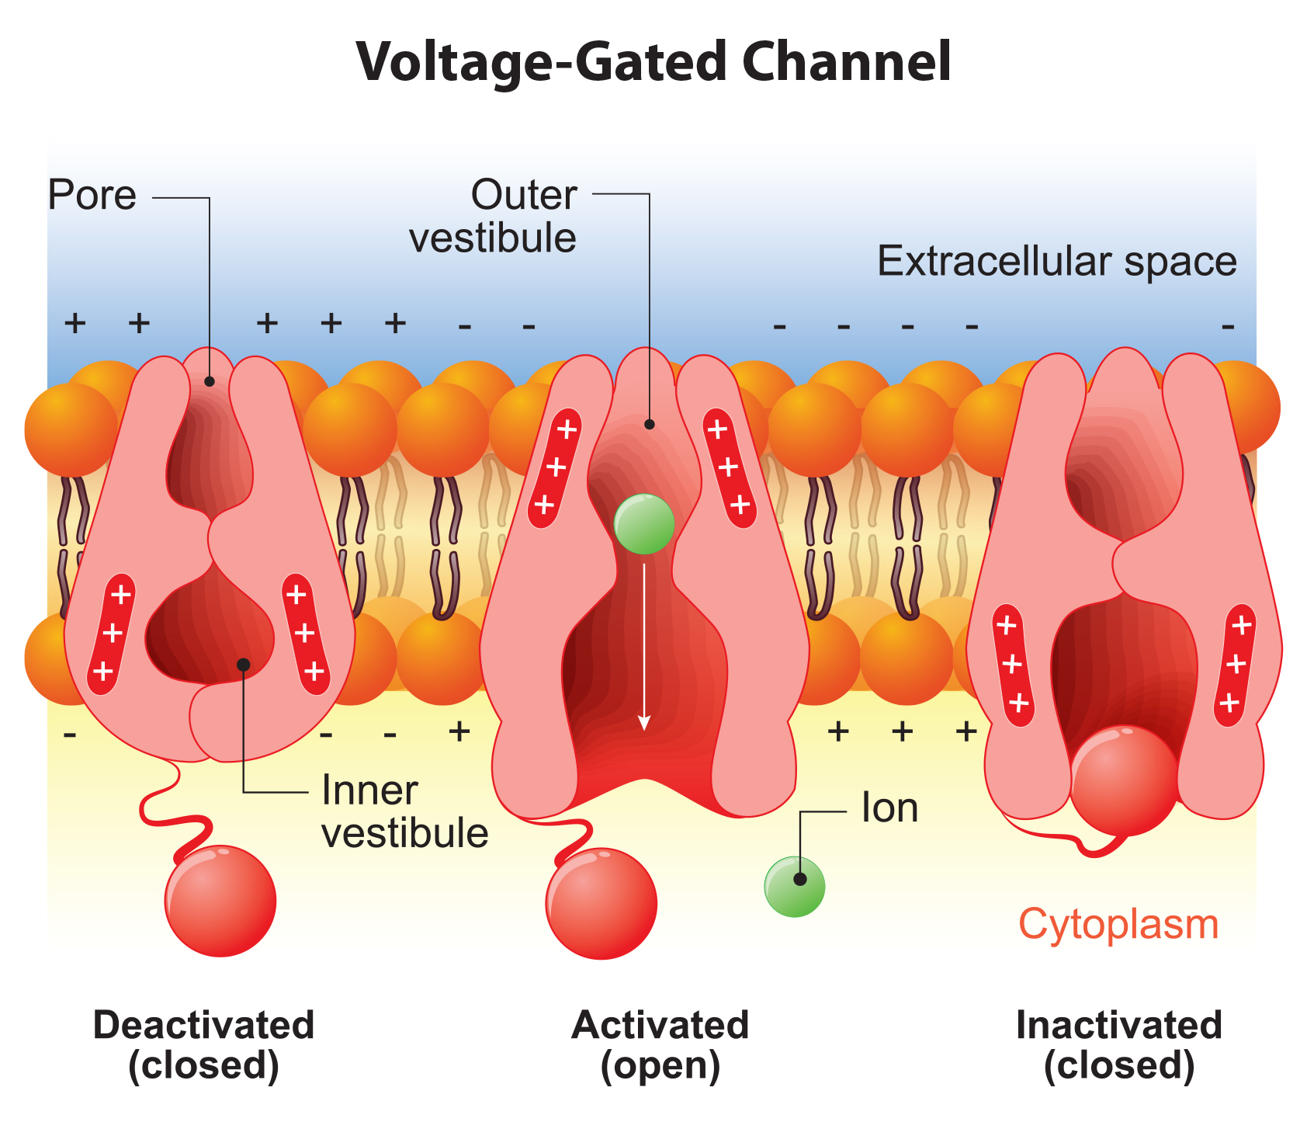
42.2 Figure 1
Notes:
42.2 Figure 1: Voltage-gated ion channels open in response to changes in membrane voltage. After activation, they become inactivated for a brief period and will no longer open in response to a signal during that period.

Slide 7
Resting Membrane Potential
The resting membrane potential (the membrane potential of a resting neuron) is ~-70 mV.
  The inside of the cell is ~70 mV more negative than the outside.
  This is due to differences in ion concentrations inside and outside of the cell resulting from the impermeability of the membrane to ions.

Slide 8
Table 1: Ion Concentration Inside and Outside Neurons
Ion | Extracellular Concentration (mM) | Intracellular Concentration (mM) | Ratio Outside/Inside
Na⁺ | 145 | 12 | 12
K⁺ | 4 | 155 | 0.026
Cl⁻ | 120 | 4 | 30
Organic anions (A⁻) | – | 100 | –

Slide 9
Resting Membrane Potential: K⁺, Na⁺, and Cl⁻
The difference in the number of positively charged potassium ions (K⁺) inside and outside the cell dominates the resting potential.
  The [K⁺] inside the cell is higher than outside the cell.
  The [Na⁺] outside the cell is higher than inside the cell.
The negative charge within the cell results from the cell membrane being more permeable to K⁺ movement than Na⁺ movement.
  There are far more K⁺ leakage channels (allowing diffusion down its concentration gradient) than Na⁺ leakage channels, so K⁺ leaks out much faster than Na⁺ leaks in.
The sodium-potassium pump helps to maintain the resting potential, bringing in 2 K⁺ and removing 3 Na⁺ per ATP used.
Chloride ions (Cl⁻) are repelled by the negatively charged cytoplasmic proteins and thus accumulate outside the cell.

Slide 10
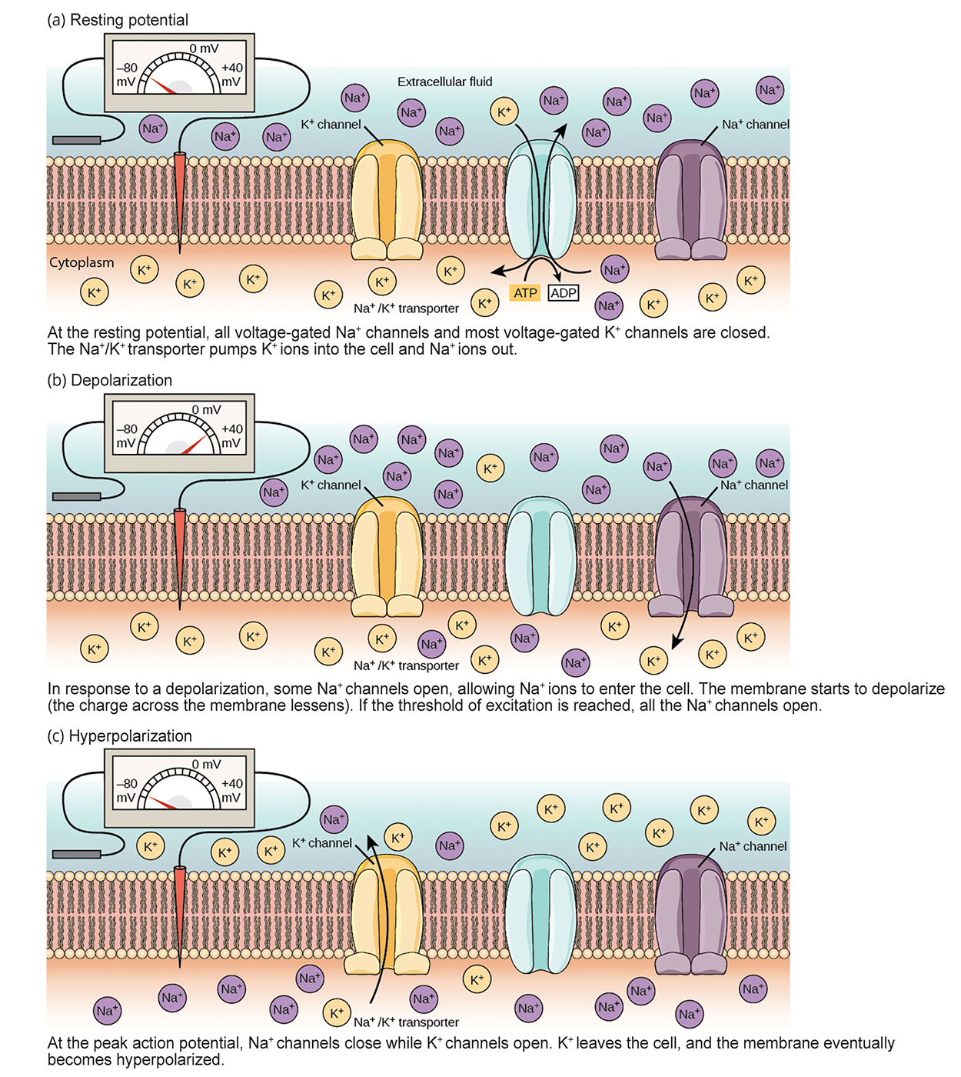
42.2 Figure 2
CNX OpenStax on Wikimedia Commons. "Nerve impulse across a cell and voltage-gated channel response."
Notes:
42.2 Figure 2: The (a) resting membrane potential is a result of different concentrations of Na+ and K+ ions inside and outside the cell. A nerve impulse causes Na+ to enter the cell, resulting in (b) depolarization. At the peak action potential, K+ channels open and the cell becomes (c) hyperpolarized.

Slide 11
Nervous System Signal Transmission
Transmission of a signal between neurons is carried by a chemical neurotransmitter.
Transmission of a signal within a neuron from dendrite to axon terminal is carried by a brief reversal of the resting membrane potential called an action potential.

Slide 12
Generation of an Action Potential: Depolarization
When a neurotransmitter binds to receptors on a neuron’s dendrites, ion channels open.
At excitatory synapses, positive ions enter the neuron, causing depolarization — a decrease in the voltage difference between the inside and outside of the neuron.
If enough depolarization occurs to reach the threshold potential (-55 mV), all voltage gated Na⁺ channels in the axon hillock open, allowing more positive ions to enter until the neuron depolarizes to about +40 mV.
Action potentials are "all or nothing" — once the threshold potential is reached, the neuron always completely depolarizes.

Slide 13
Conclusion of an Action Potential: Resetting Back to Resting Potential
Once depolarization is done, the cell must "reset" to resting potential.
The Na⁺ channels close and cannot be opened, beginning the refractory period during which it cannot produce another action potential.
The voltage-gated K⁺ channels open and K⁺ leaves the cell, allowing the membrane potential to become more negative .
  Hyperpolarization (the membrane potential becomes more negative than the cell’s normal resting potential) occurs as a result of K⁺ leaving the cell.
At this point, Na⁺ channels return to their resting state and reopen again if the threshold potential is reached.
The sodium-potassium pump actively brings K⁺ ions in and pumps Na⁺ ions out of the cell to return the cell from its hyperpolarized state to its resting potential.

Slide 14
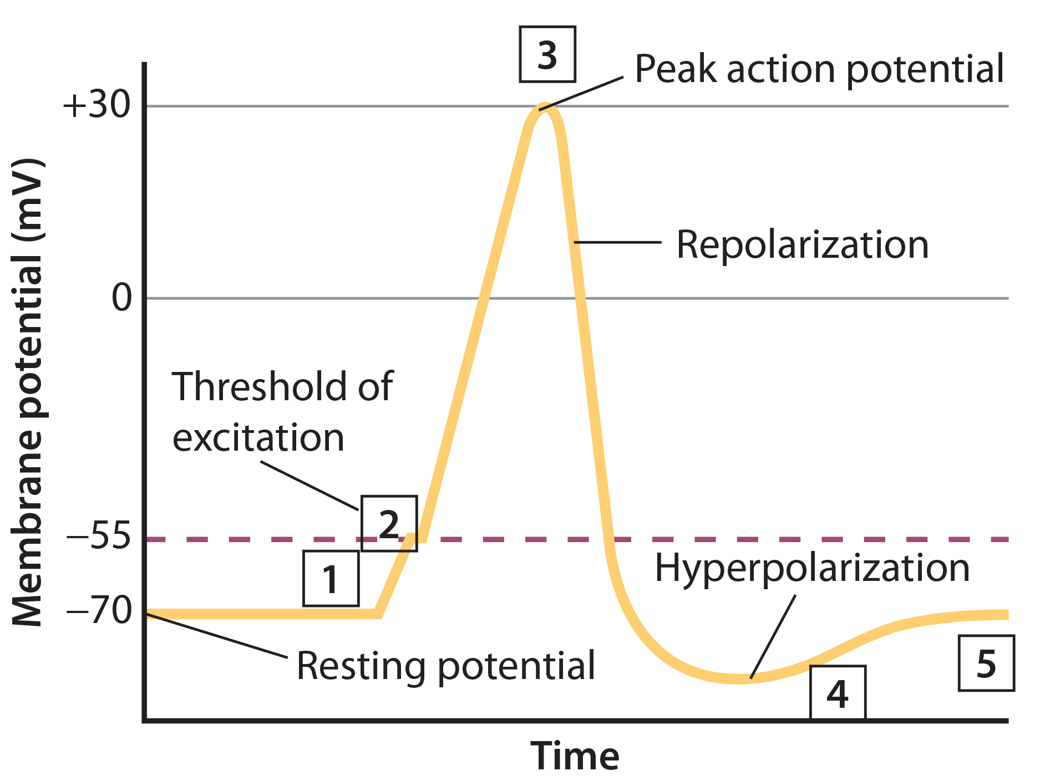
42.2 Figure 3
CNX OpenStax on Wikimedia Commons. "Action potential steps."
Notes:
42.2 Figure 3: The formation of an action potential can be divided into five steps. (1) A stimulus from a sensory cell or another neuron causes the target cell to depolarize toward the threshold potential. (2) If the threshold of excitation is reached, all Na+ channels open, and the membrane depolarizes. (3) At the peak action potential, K+ channels open, and K+ begins to leave the cell. At the same time, Na+ channels close. (4) The membrane becomes hyperpolarized as K+ ions continue to leave the cell. The hyperpolarized membrane is in a refractory period and cannot fire. (5) The K+ channels close, and the Na+/K+ transporter restores the resting potential.

Slide 15
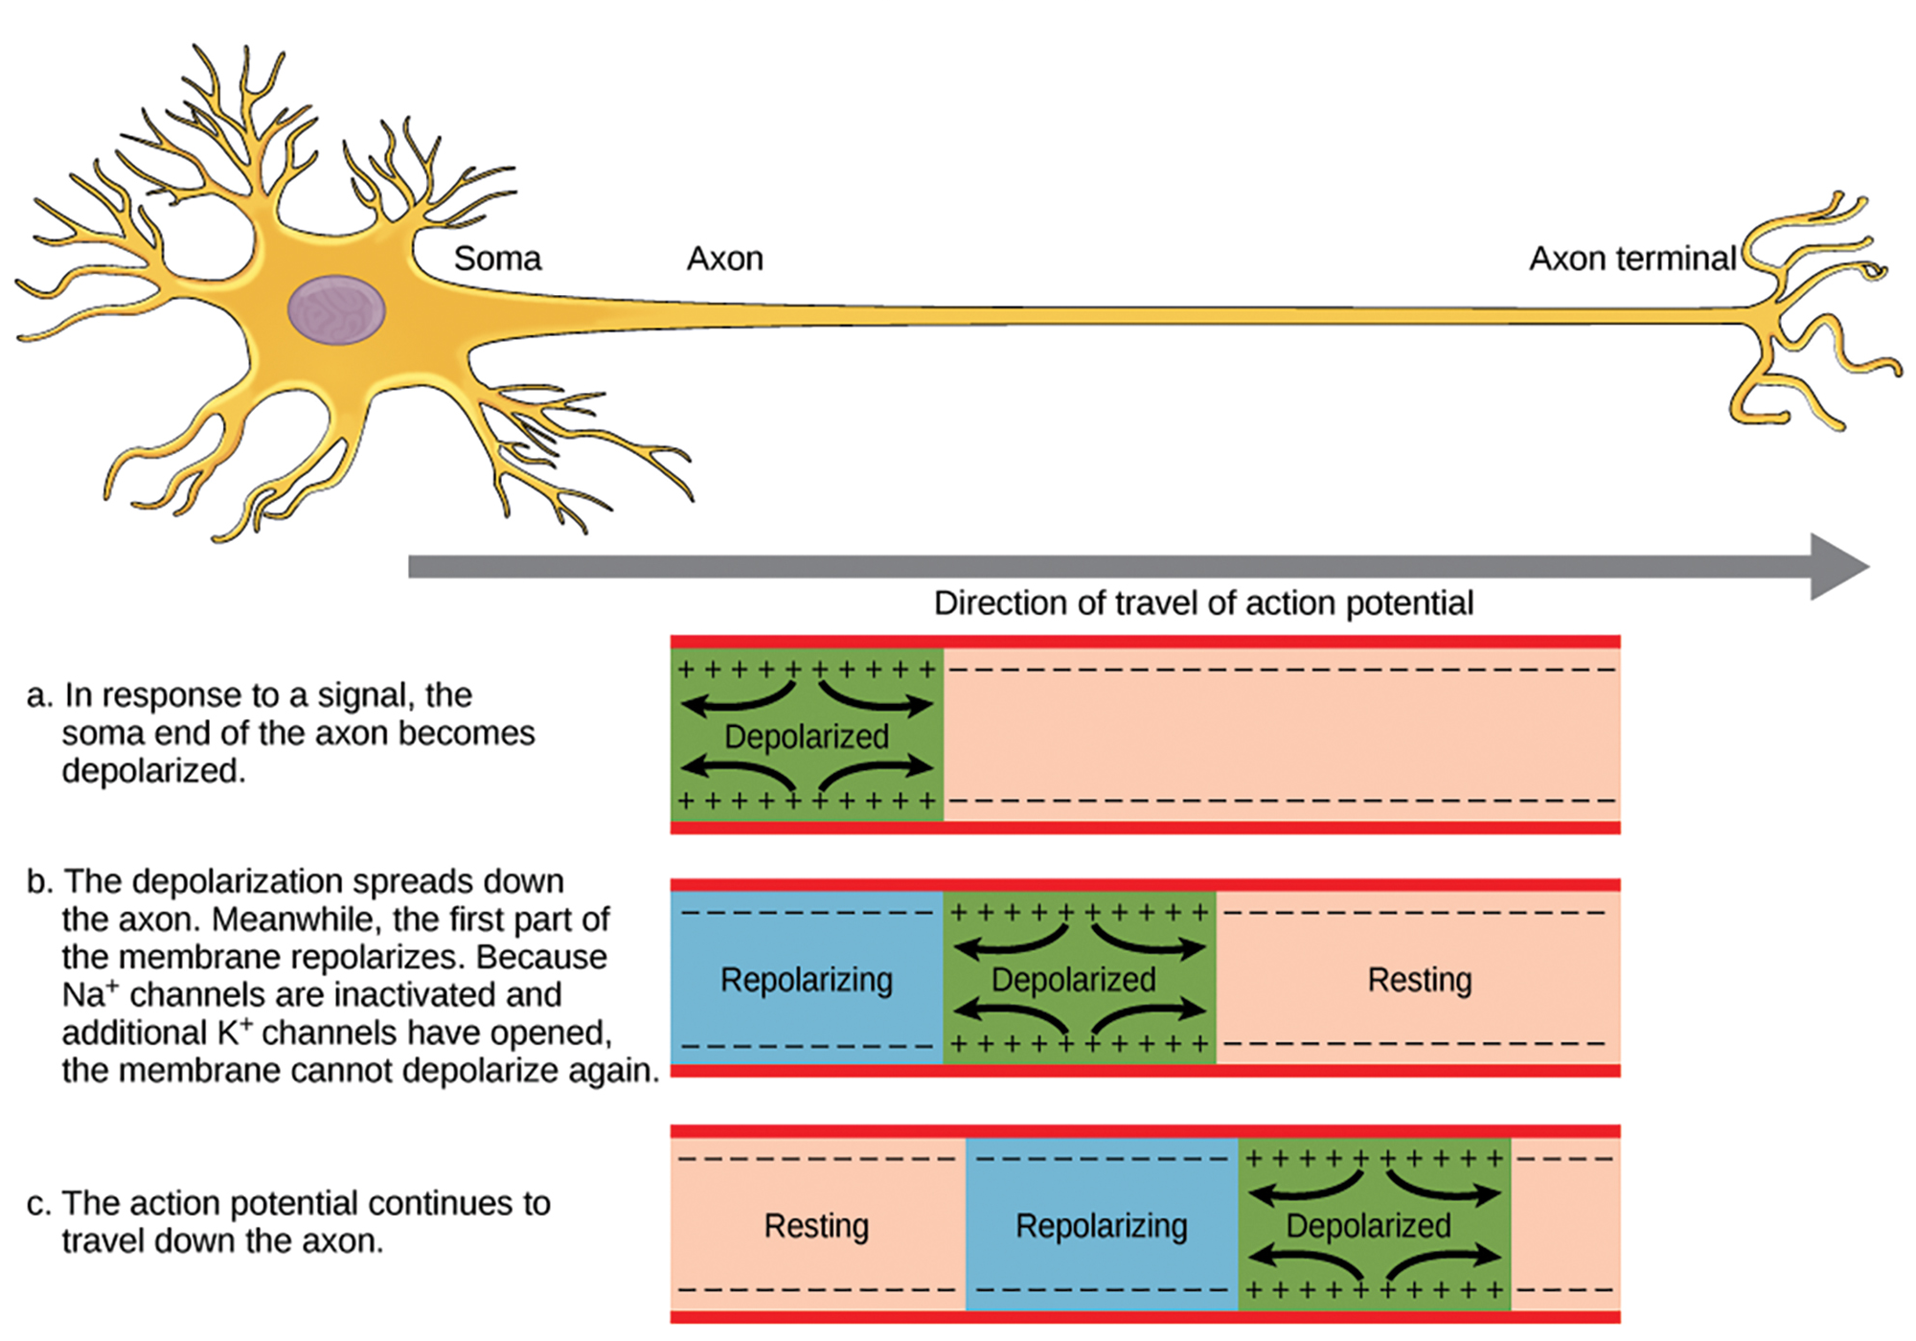
42.2 Figure 4
CNX OpenStax on Wikimedia Commons. "Action potential."
Notes:
42.2 Figure 4: The action potential is conducted down the axon as the axon membrane depolarizes then repolarizes.

Slide 16
Think It Through₁
Potassium channel blockers—such as amiodarone and procainamide, which are used to treat abnormal electrical activity in the heart (cardiac dysrhythmia)—impede the movement of K⁺ through voltage-gated K⁺ channels.
Which part of the action potential (Figure 3) would you expect potassium channels to affect?
Notes:
Originally an On Your Own. This is included here to use as a talking point or for a think-pair-share activity.

Slide 17
Myelin’s Role in the Propagation of the Action Potential₁
For an action potential to communicate with another neuron, it must reach axon terminals to initiate neurotransmitter release.
The speed of conduction of the action potential along an axon is influenced by the axon’s:
  Diameter
  Resistance to current leakage
Myelin acts as an insulator to prevent current leakage, increasing the speed of action potential conduction.
  In demyelinating diseases like multiple sclerosis (MS), action potential conduction slows.

Slide 18
Myelin’s Role in the Propagation of the Action Potential₂
The nodes of Ranvier are 1 μM gaps in the myelin sheath that contain voltage-gated Na⁺ and K⁺ channels.
  Ion flow through these channels (especially the Na+ channels) regenerates the action potential repeatedly.
  Saltatory conduction is the "jumping" of the action potential from one node to next.
  If the nodes of Ranvier were not present, the action potential would propagate very slowly since the Na⁺ and K⁺ channels would have to continuously regenerate action potential at every point (instead of at specific points) along the axon.
  Nodes of Ranvier save energy since the channels only need to be present at the nodes (not along the entire axon).

Slide 19
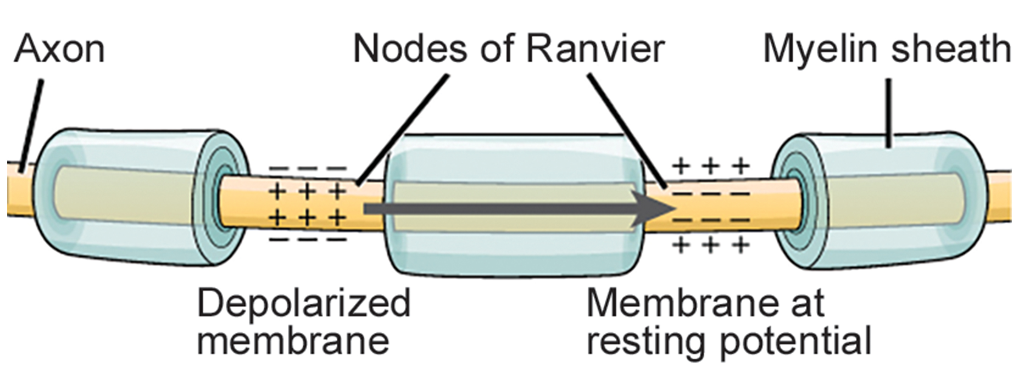
42.2 Figure 5
CNX OpenStax on Wikimedia Commons. "Nodes of Ranvier."
Notes:
42.2 Figure 5: Nodes of Ranvier are gaps in myelin coverage along axons. Nodes contain voltage-gated K+ and Na+ channels. Action potentials travel down the axon by jumping from one node to the next.

Slide 20
Synaptic Transmission
The synapse ("gap") is where transmission from one neuron to the next occurs.
  These usually occur between the axon terminals of one neuron and the dendritic spines on the next.
  Synapses may also occur:
    Dendrite-to-dendrite
    Axon-to-axon
    Axon-to-cell body
  There are 2 types of synapses:
    Chemical
    Electrical
With respect to a particular synapse:
  The presynaptic neuron transmits the signal.
  The postsynaptic neuron receives the signal.
A single neuron can be both presynaptic and postsynaptic.

Slide 21
A Chemical Synapse: Presynaptic Neuron
When an action potential reaches an axon terminal,
It depolarizes the membrane and opens voltage-gated Na⁺ channels.
Na⁺ ions enter the cell, further depolarizing the presynaptic membrane.
This causes voltage-gated Ca²⁺ channels to open.
Ca²⁺ ions initiate a signaling cascade, resulting in the fusion of one or more membrane-bound synaptic vesicles containing neurotransmitter molecules with the presynaptic membrane.
  This results in neurotransmitter being released into the synaptic cleft, the extracellular space between the presynaptic and postsynaptic membranes.
  Ca²⁺ channel blockers are drugs that impair synaptic transmission and can be used to treat chronic pain.

Slide 22
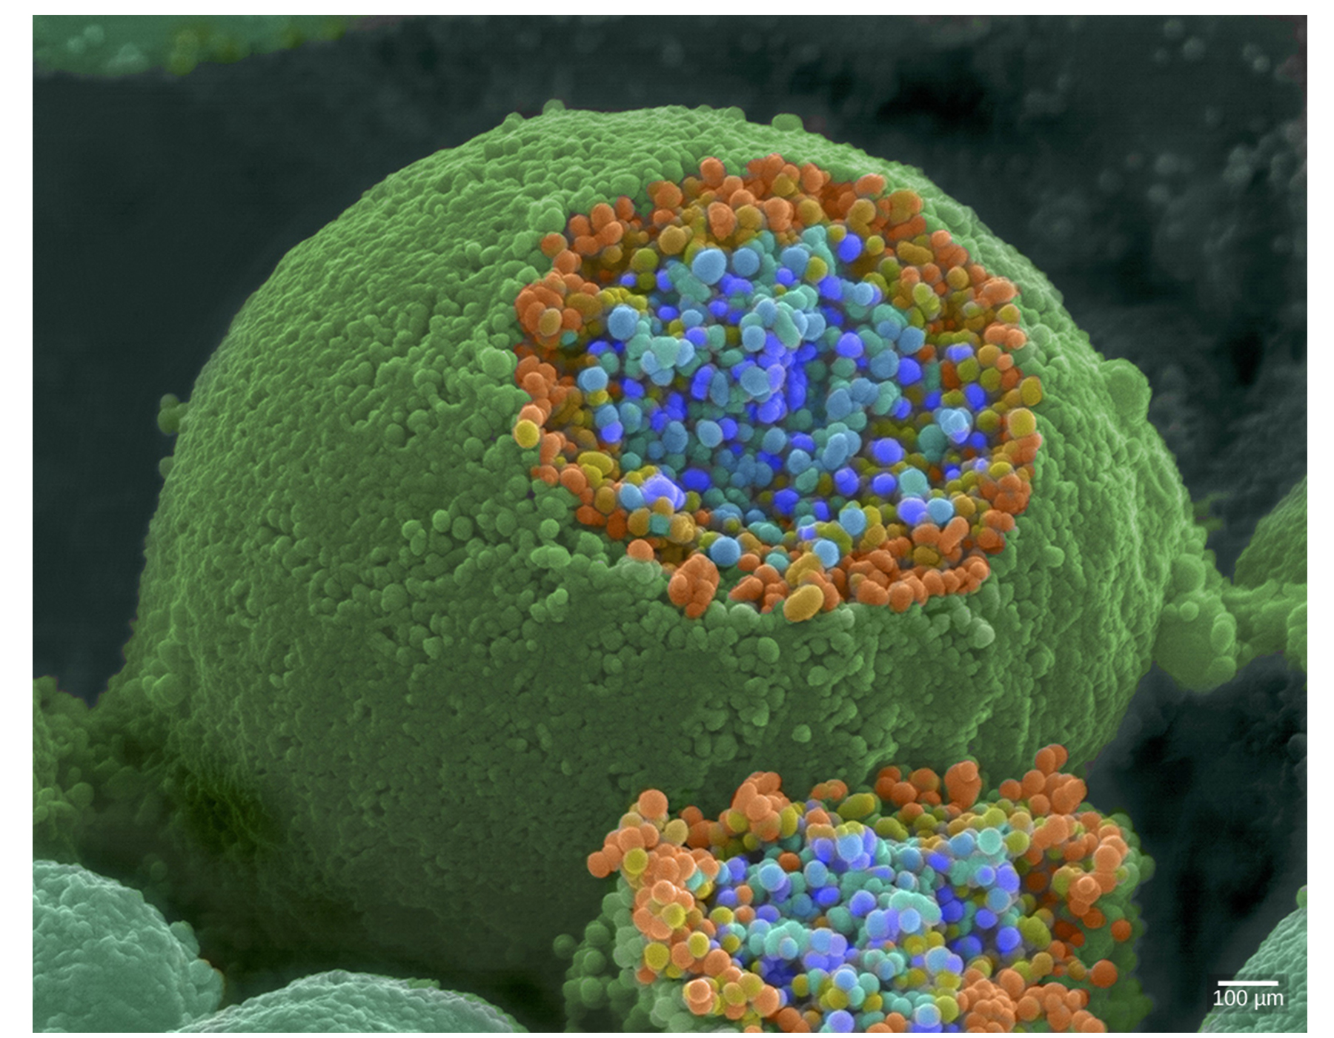
42.2 Figure 6
Tina Carvalho, NIH-NIGMS on Wikimedia Commons. "Axon terminal." Modified.
Notes:
42.2 Figure 6: This pseudocolored image, taken with a scanning electron microscope, shows an axon terminal that was broken open to reveal synaptic vesicles (blue and orange spheres) inside the neuron.

Slide 23
A Chemical Synapse: Postsynaptic Neuron₁
The neurotransmitter diffuses across the synaptic cleft to bind to receptor proteins on the postsynaptic membrane.
Specific neurotransmitter binding causes ligand-gated channels on the post-synaptic membrane to open.

Slide 24
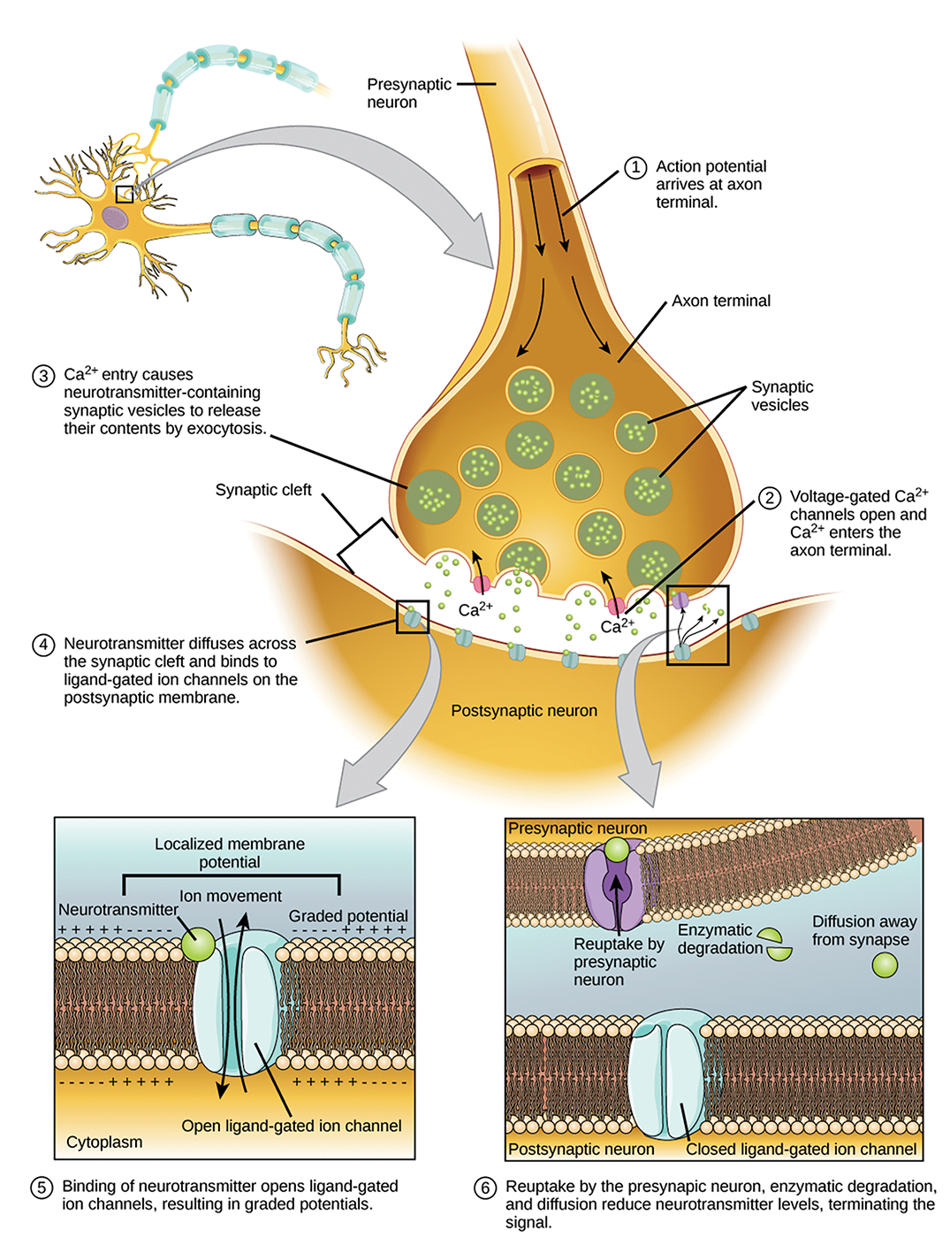
42.2 Figure 7
CNX OpenStax on Wikimedia Commons. "Communication at chemical synapse."
Notes:
42.2 Figure 7: Communication at chemical synapses requires the release of neurotransmitters. When the presynaptic membrane is depolarized, voltage-gated Ca2+ channels open and allow Ca2+ to enter the cell. The calcium entry causes synaptic vesicles to fuse with the membrane and release neurotransmitter molecules into the synaptic cleft. The neurotransmitter diffuses across the synaptic cleft and binds to ligand-gated ion channels (ion channels that open in response to the binding of a particular molecule, in this case the neurotransmitter) in the postsynaptic membrane, resulting in a localized depolarization or hyperpolarization of the postsynaptic neuron.

Slide 25
A Chemical Synapse: Postsynaptic Neuron₂
Neurotransmitters may have either excitatory or inhibitory effects on the postsynaptic neuron.
Acetylcholine causes postsynaptic Na⁺ channels to open, allowing Na⁺ in, causing postsynaptic neuron depolarization.
  This depolarization is called an excitatory postsynaptic potential and makes the postsynaptic neuron more likely to fire an action potential.
Gamma-aminobutyric acid (GABA) causes Cl⁻ channels to open, allowing Cl⁻ in, causing postsynaptic neuron hyperpolarization.
  This hyperpolarization is called an inhibitory postsynaptic potential and makes the postsynaptic neuron less likely to fire an action potential.

Slide 26
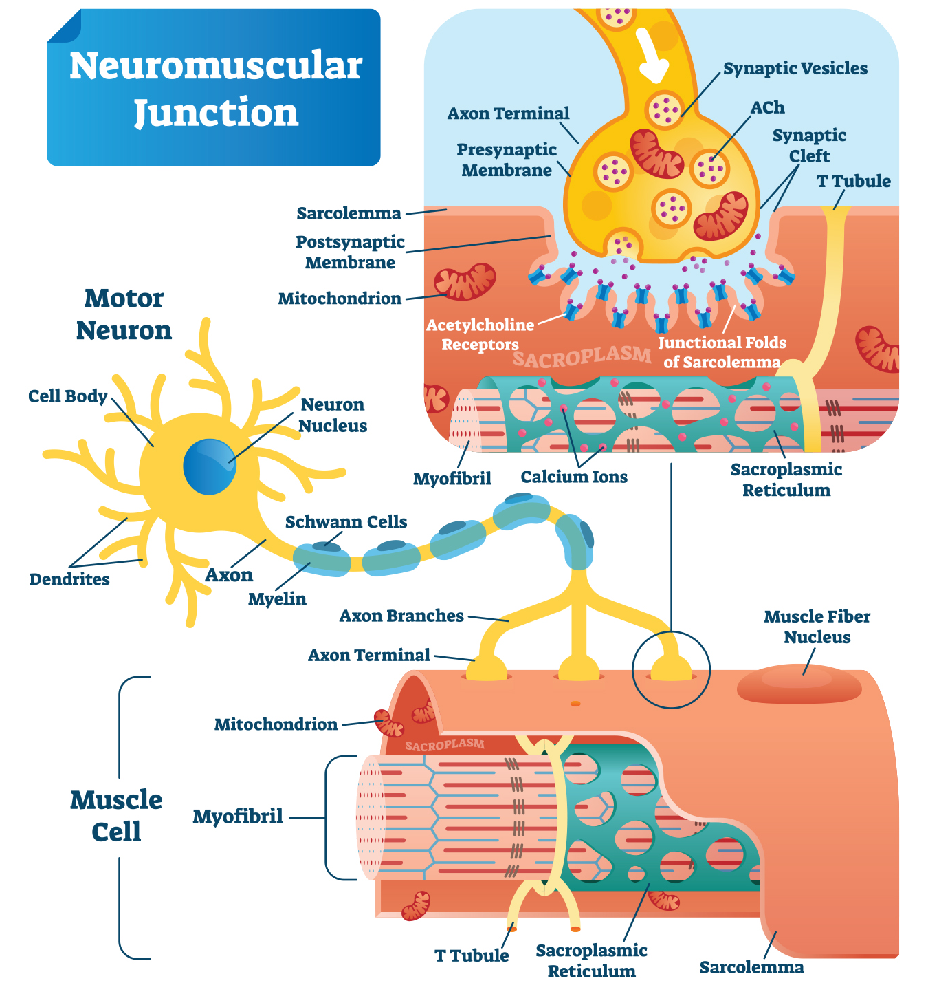
42.2 Figure 8
Notes:
42.2 Figure 8: At the neuromuscular junction, acetylcholine is released and binds to receptors on the muscle cell, causing sodium ion channels to open and the postsynaptic muscle cell to depolarize.

Slide 27
Table 2: Neurotransmitter Function and Location
Neurotransmitter | Example | Location
Acetylcholine | – | CNS and/or PNS
Biogenic amine | dopamine, serotonin, norepinephrine | CNS and/or PNS
Amino acid | glycine, glutamate, aspartate, gamma-aminobutyric acid (GABA) | CNS
Neuropeptide | substance P, endorphins | CNS and/or PNS

Slide 28
Conclusion of Neurotransmission
Once neurotransmission has occurred, the neurotransmitter is removed from the cleft through one of the following:
  The neurotransmitter diffuses away from the synaptic cleft.
  The neurotransmitter is degraded by enzymes in the synaptic cleft.
  The neurotransmitter is recycled (by reuptake) by the presynaptic neuron.
This allows the postsynaptic membrane to "reset" and be ready for another signal.

Slide 29
Drug Action at the Synaptic Cleft
Some drugs act within the synaptic cleft at the step of neurotransmitter removal.
Some drugs to treat Alzheimer’s disease work by inhibiting acetylcholinesterase, the enzyme that degrades acetylcholine, which
  Allows acetylcholine to stay in the cleft
  Allows acetylcholine to continually bind and unbind to postsynaptic receptors
  Increases neurotransmission at synapses that release acetylcholine

Slide 30
Science and You₁
Addictive substances often interact with neurotransmitter receptors at synapses.
Nicotine (in tobacco)
  Activates acetylcholine receptors
  Increases alertness and concentration
  Increases the release of mood-regulating neurotransmitters—dopamine (involved in the reward pathway) and serotonin
  Leads to both an increase in number of acetylcholine receptors as well as their desensitization
Nicotine addiction
  Requires more and more nicotine over time to experience the same pleasurable effects
  Leads to withdrawal symptoms (6–12 weeks) when quitting nicotine as a result of the changes in the brain
Notes:
This is included as a relevant application for this topic.

Slide 31
Electrical Synapses
Electrical synapses are fewer in number but found in all nervous systems where they play important roles.
In an electrical synapse, gap junctions (channel proteins):
  Physically connect the presynaptic and postsynaptic membranes
  Allow current and other small molecules (ATP, intracellular messengers) to pass through

Slide 32
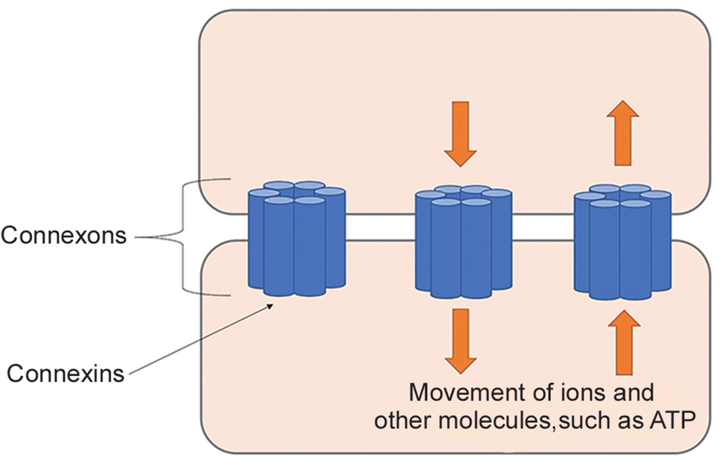
42.2 Figure 9
Lu.qianhe on Wikimedia Commons. "Gap junctions."
Notes:
42.2 Figure 9: Gap junctions, made of a protein called connexin, facilitate the movement of ions between two cells. This is called an electrical synapse.

Slide 33
Key Differences Between Chemical and Electrical Synapses
Chemical synapses are slower than electrical synapses.
  Because chemical synapses rely on neurotransmitter release from synaptic vesicles, there is ~1 millisecond delay between when the action potential reaches the presynaptic terminal and when the postsynaptic ion channels open.
  Signaling in electrical synapses is virtually instantaneous (which is important for key reflexes).
Signaling is unidirectional in chemical synapses but sometimes bidirectional in electrical synapses.
Electrical synapses are more reliable and less likely to be blocked than chemical synapses.
Electrical synapses are important for synchronizing the activity of a group of neurons.
  Electrical synapses in the thalamus are thought to regulate slow-wave sleep (the deepest phase of non-REM).

Slide 34
Think It Through₂
Identify whether the synapse is chemical or electrical based on the description provided.
Involves neurotransmitter release
Involves movement of ions
Involves specialized channels called gap junctions
Involves specialized channels called voltage-gated channels
Notes:
Originally an On Your Own. This is included here to use as a talking point or for a think-pair-share activity.

Slide 35
Signal Summation
Summation is the process by which multiple simultaneous presynaptic inputs (both EPSPs and IPSPs) are considered together by a single postsynaptic neuron to determine if the net change in postsynaptic membrane voltage has reached the threshold of excitation (threshold potential) for firing an action potential.
A single EPSP is often not strong enough to reach the threshold of excitation.
Summation occurs at the axon hillock.
This prevents random "noise" in the system from being considered as important.

Slide 36
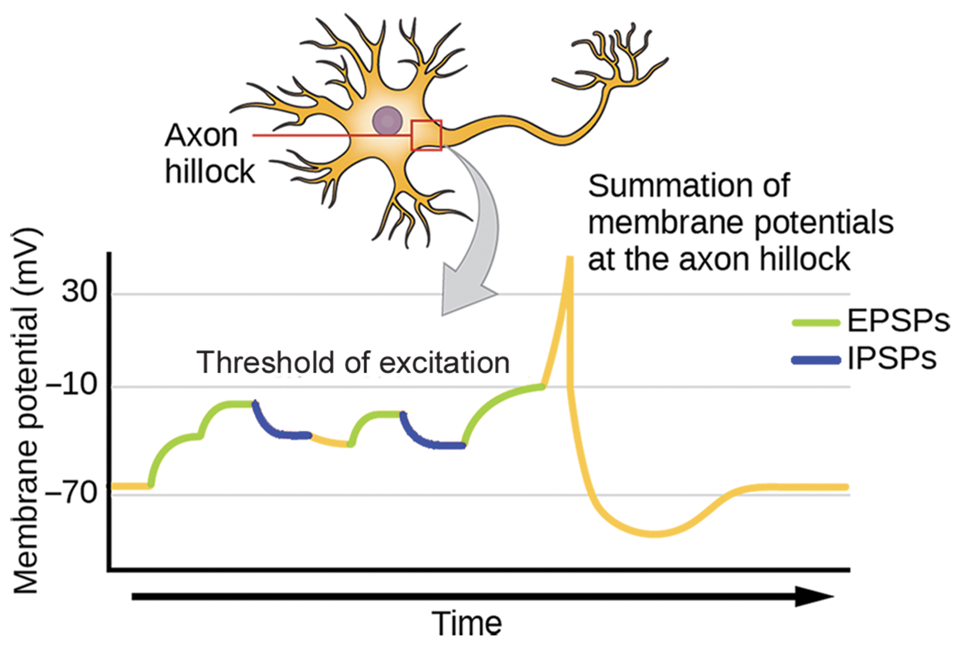
42.2 Figure 10
CNX OpenStax on Wikimedia Commons. "Neuron excitation."
Notes:
42.2 Figure 10: A single neuron can receive both excitatory and inhibitory inputs from multiple neurons, resulting in local membrane depolarization (EPSP input) and hyperpolarization (IPSP input). All these inputs are added together at the axon hillock. If the EPSPs are strong enough to overcome the IPSPs and reach the threshold of excitation, the neuron will fire.

Slide 37
Science and You₂
Brain-Computer Interface
Amyotrophic lateral sclerosis (ALS, Lou Gehrig’s Disease) causes the degeneration of motor neurons that control voluntary movements (speech, breathing, swallowing), leading to paralysis
Brain-Computer Interface (BCI) allows paralyzed patients (like those with ALS) to control a computer using only their thoughts
  Some forms of BCI use electroencephalogram (EEG) recordings from electrodes taped to the skull
  Other forms of BCI require implanting a postage-stamp-sized electrode array in the arm and hand area of the motor cortex in the brain (an invasive surgery)
    While this involves extensive training of and concentration by the patient, BCI allows thinking about moving the hand or arm to result in computer interpretation and responses by an adaptive technology (like a wheelchair or a robotic arm)
Notes:
This is included as a relevant application for this topic.

Slide 38
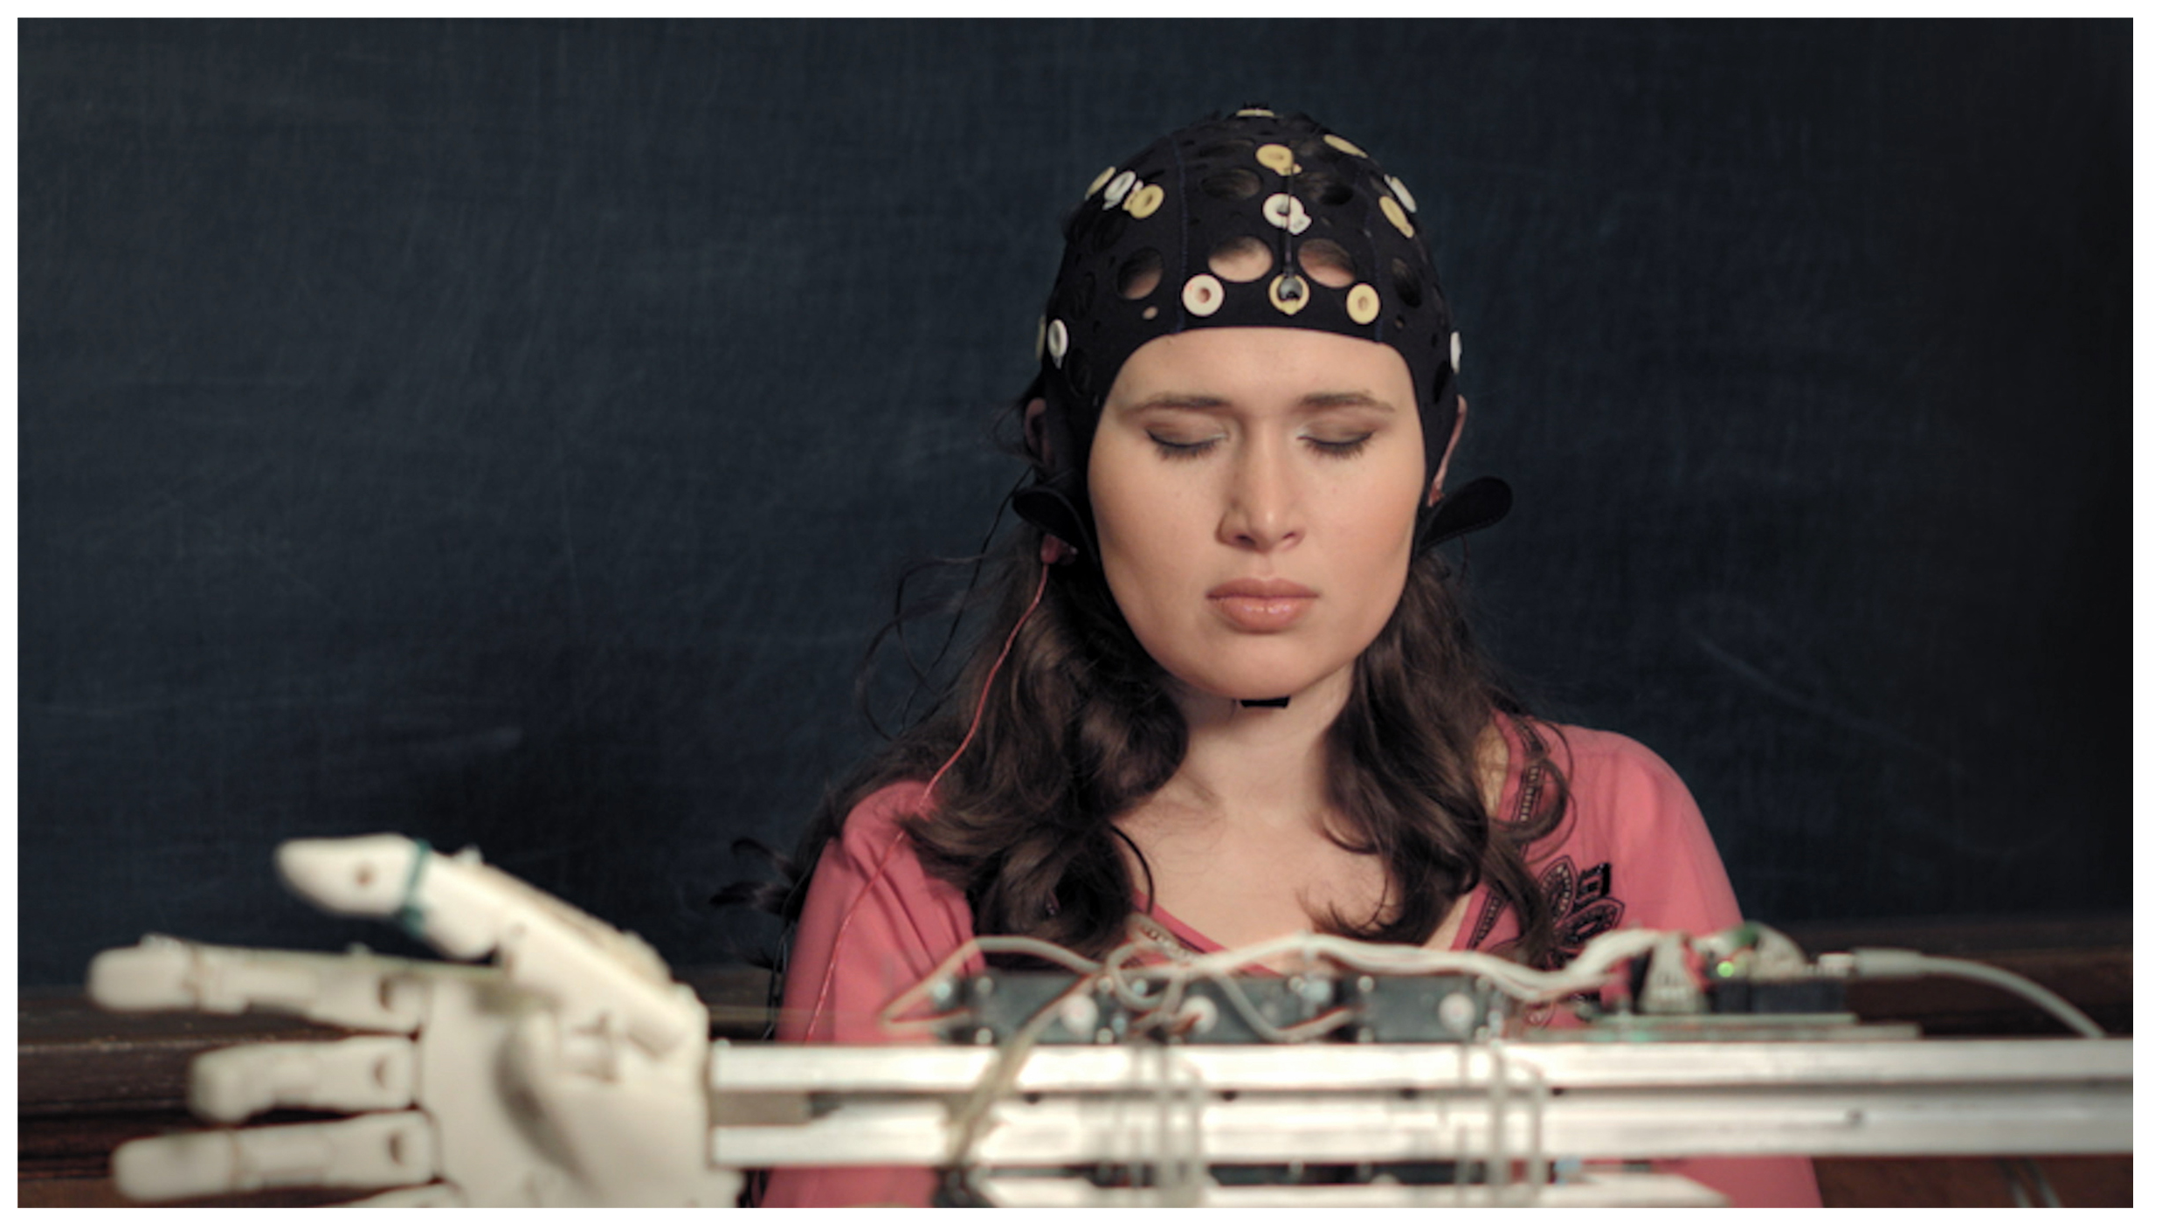
42.2 Figure 11
Adindva1 on Wikimedia Commons. "Brain-computer interface technology."
Notes:
42.2 Figure 11: With brain-computer interface technology, neural signals from a paralyzed patient are collected, decoded, and then fed to a tool, such as a computer, a wheelchair, or a robotic arm.

Slide 39
Synaptic Plasticity
Synaptic plasticity refers to the ability to
  Strengthen or weaken synapses
  Break synapses
  Form new synapses
Synaptic plasticity is required for
  A functioning nervous system
  Learning and memory
The two processes important for synaptic plasticity in the hippocampus (region important in memory storage) include:
  Long-term potentiation (LTP)
  Long-term depression (LTD)

Slide 40
Synaptic Plasticity: Long-Term Potentiation (LTP)
Long-term potentiation (LTP) is the persistent strengthening of a synaptic connection.
It results from frequent activity at a particular synapse, strengthening the connection between the neurons.
  Frequent presynaptic inputs leading to postsynaptic depolarization can remove the blocking effect of Mg²⁺ on NMDA glutamate receptors, allowing Ca²⁺ entry.
  Ca²⁺ entry into the postsynaptic neuron causes a shift from NMDA to AMPA glutamate receptors, which are not blocked by Mg²⁺.
  This leads to a larger excitatory effect by subsequent glutamate binding to the postsynaptic neuron.

Slide 41
Synaptic Plasticity: Long-Term Depression (LTD)
Long-term depression (LTD) is the reverse of LTP and is a long-term weakening of a synaptic connection.
It results from inactivity at a particular synapse, decreasing the connection between the neurons.
  Low Ca²⁺ entry into the postsynaptic neuron through NMDA receptors results in removal of AMPA glutamate receptors.
  This results in making the postsynaptic neuron’s membrane less responsive to glutamate.
  This allows for the weakening and pruning of unused synapses and the loss of unimportant connections, allowing for the strengthening of synapses by LTP.

Slide 42
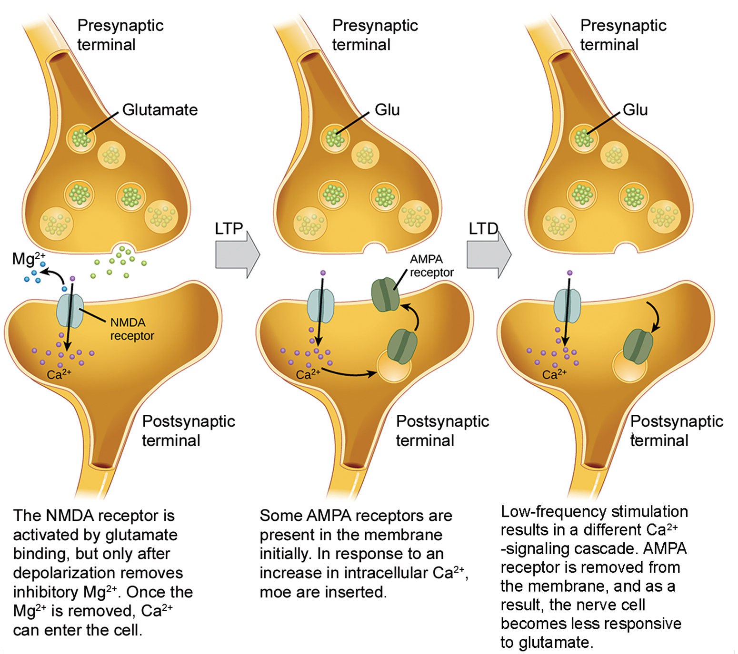
42.2 Figure 12
CNX OpenStax on Wikimedia Commons. "Calcium initiate LTP or LTD."
Notes:
42.2 Figure 12: Calcium entry through postsynaptic NMDA receptors can initiate two different forms of synaptic plasticity: long-term potentiation (LTP) and long-term depression (LTD). LTP arises when a single synapse is repeatedly stimulated. This stimulation triggers a calcium-dependent cellular cascade, which results in the insertion of more AMPA receptors into the postsynaptic membrane. The next time glutamate is released from the presynaptic cell, it will bind to both NMDA and the newly inserted AMPA receptors, thus depolarizing the membrane more efficiently. LTD occurs when few glutamate molecules bind to NMDA receptors at a synapse (due to a low firing rate of the presynaptic neuron). The calcium that does flow through NMDA receptors initiates a different calcium-dependent cascade, which results in the removal of AMPA receptors. This makes the postsynaptic neuron less responsive to glutamate released from the presynaptic neuron.

Slide 43
Summary
Neurons have charged membranes due to differences in ion concentrations inside and outside of the cell
  Voltage-gated ion channels control ion movement across membranes
An action potential is fired when a neuronal membrane is depolarized to the threshold of excitation
  The action potential is propagated through a myelinated axon to axon terminals
In a chemical synapse, an action potential causes neurotransmitter release into the synaptic cleft
  Neurotransmitter binding to postsynaptic receptors can cause excitatory postsynaptic potentials by depolarizing the postsynaptic membrane OR inhibitory postsynaptic potentials by hyperpolarizing the postsynaptic membrane
In an electrical synapse, the action potential is communicated direction through gap junctions that connect the presynaptic and postsynaptic membranes
Synapses can be strengthened by long-term potentiation or weakened by long-term depression

Slide 44


End of Hawkes Learning PowerPoint

