Slide 1
Lesson 42.3
The Central Nervous System

Slide 2
Objectives
Identify the spinal cord, cerebral lobes, and other brain areas.
Describe the basic functions of the spinal cord, cerebral lobes, and other brain areas.

Slide 3
Central Nervous System (CNS) Structure₁
The central nervous system (CNS) is made up of:
The brain
The spinal cord

Slide 4
Central Nervous System (CNS) Structure₂
The CNS is covered with 3 layers of protective layers called meninges.
The outermost is the dura mater, a thick protective layer with veinlike structures to carry blood from the brain back to the heart.
The middle layer is the arachnoid mater, which consists of thin elastic fibers that connect the outermost and innermost layers.
The innermost layer is the pia mater, which directly contacts and covers the brain and spinal cord like plastic wrap.
Cerebrospinal fluid (CSF):
Fills the space between the arachnoid and pia maters
Is produced by choroid plexus tissue in fluid-filled CNS compartments called ventricles
Serves as a cushion for the brain, which floats in it
Circulates chemical substances throughout the brain and into the spinal cord

Slide 5
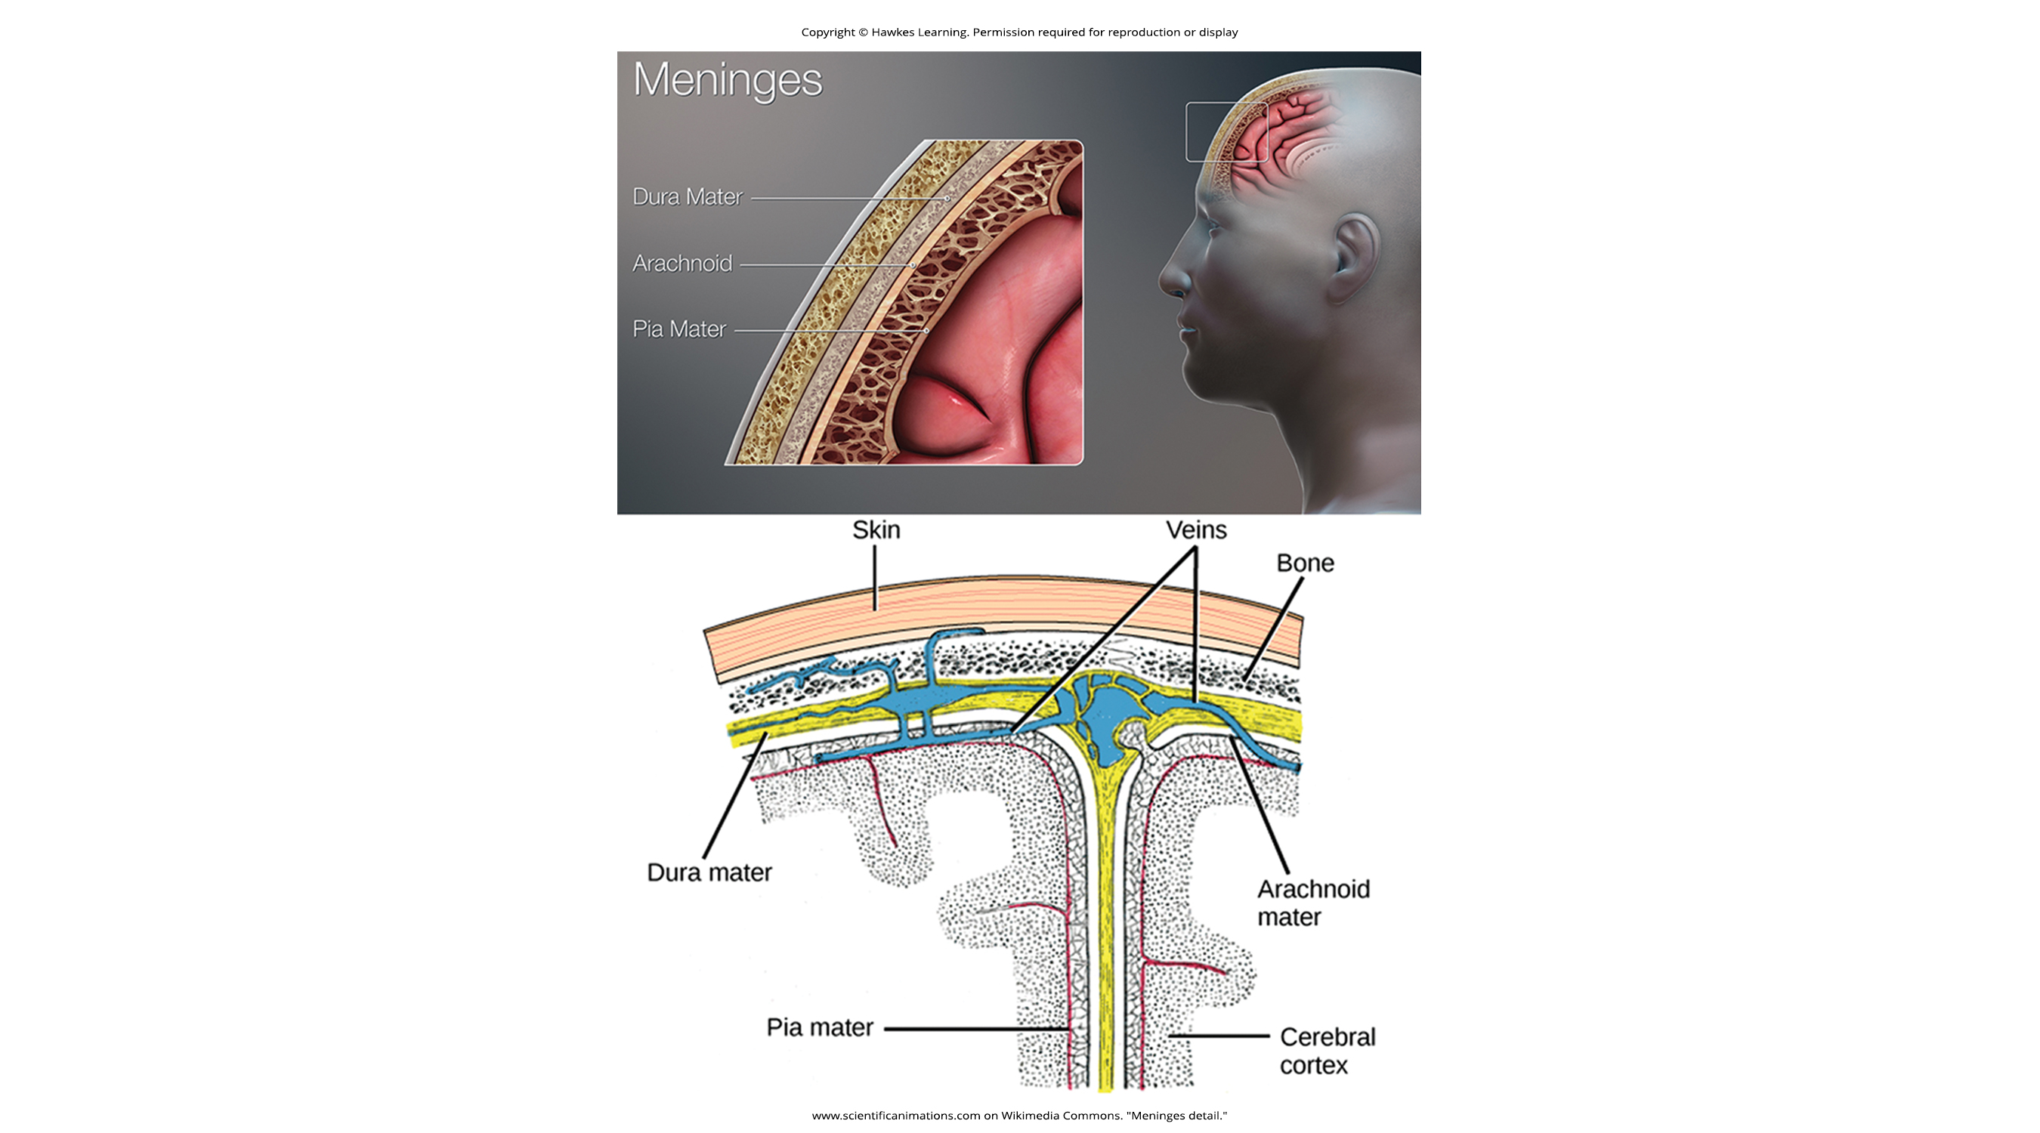
42.3 Figure 1
www.scientificanimations.com on Wikimedia Commons. "Meninges detail."
Notes:
42.3 Figure 1: The cerebral cortex is covered by three layers of meninges: the dura mater, arachnoid mater, and pia mater.

Slide 6
Central Nervous System (CNS) Structure₃
While the entire brain contains only 8.5 Tbsp of CSF, the ventricles constantly produce it.
If a ventricle is blocked, hydrocephalus (swelling) may occur, resulting in seizures, cognitive problems, and even death if a shunt is not inserted to remove fluid and pressure.

Slide 7
Brain Structure
The brain is contained the cranial cavity of the skull.
The brain includes:
The cerebral cortex
The basal ganglia
The thalamus
The hypothalamus
The limbic system
The cerebellum

Slide 8
Brain Sectioning
The brain can be sectioned to view internal structure in 3 different ways:
A coronal section cuts the brain from front to back.
A sagittal section cutes the brain left to right.
A horizontal section cuts the brain top to bottom.

Slide 9
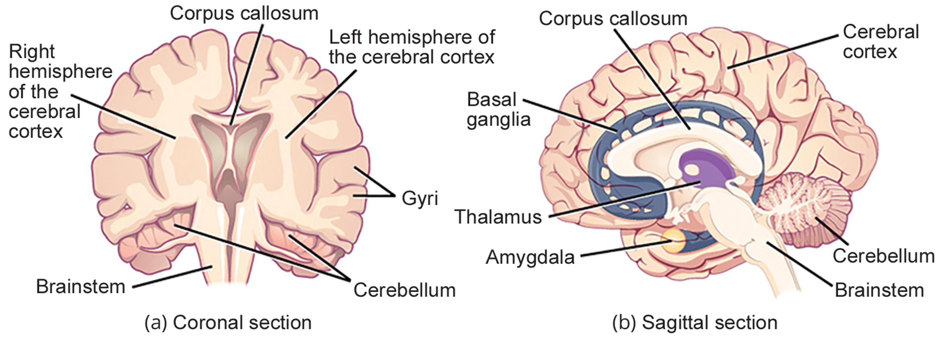
42.3 Figure 2
CNX OpenStax on Wikimedia Commons. "Coronal and saggital sections of the brain." Modified.
Notes:
42.3 Figure 2: These illustrations show the (a) coronal and (b) sagittal sections of the human brain.

Slide 10
Brain Structure: Cerebral Cortex₁
The cerebral cortex (the outermost part of the brain) is a thick piece of nervous system tissue folded into:
Gyri: hills
Sulci: valleys
The right and left hemispheres are separated by a large sulcus.
The corpus callosum is a thick fiber bundle that connects the 2 hemispheres and allows for information transfer between them.

Slide 11
Brain Structure: Cerebral Cortex—Insights From Treating Epilepsy
Various types of brain surgeries for treating epilepsy have revealed information about the cerebral cortex.
Epilepsy patients (especially children) who have an entire hemisphere removed have some deficits but surprisingly few problems.
This suggests that, while there are some functions localized to 1 hemisphere, the 2 hemispheres are mostly redundant.
When the corpus callosum of epilepsy patients is cut instead, the condition of split-brain results.
When an object is presented to a patient’s left visual field, they may be unable to name the object (and may not be able to see it).
The visual input from the left field enters the right hemisphere, but cannot signal the speech center in the brain’s left side.

Slide 12
Brain Structure: Cerebral Cortex—Techniques for Determining Functions of Brain Areas₁
Scientists use various techniques to determine what brain areas are involved in different functions.
They examine patients with injuries or diseases affecting specific brain areas to see how they are related to functional deficits.
They conduct animal studies stimulating brain areas to see any behavioral changes.
They use transcranial magnetic stimulation (TMS) to temporarily deactivate parts of the cortex using strong magnets.
They use functional magnetic resonance imaging (fMRI) to look at changes in oxygenated blood flow in particular brain regions that correlate with specific behavioral tasks.

Slide 13
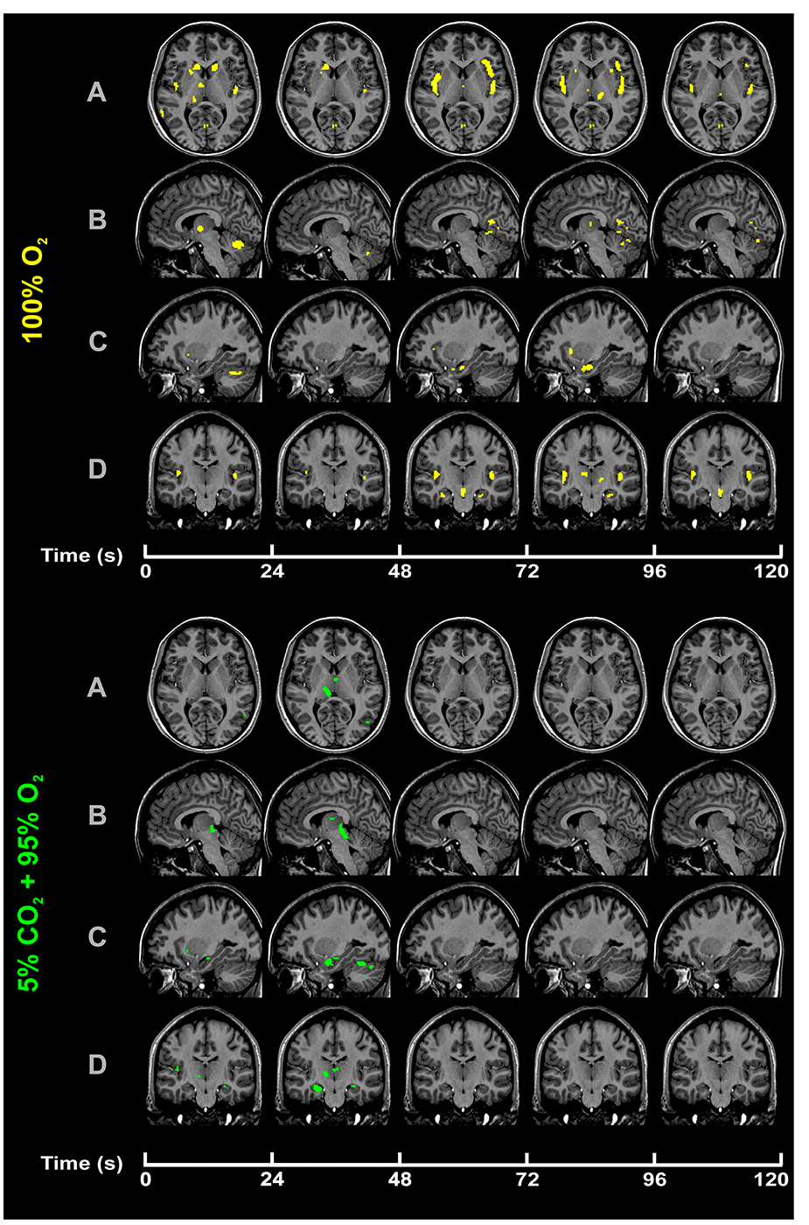
42.3 Figure 3
Macey et al., 2007 on Wikimedia Commons. "fMRI."
Notes:
42.3 Figure 3: Functional magnetic resonance imaging (fMRI) is a widely used technique to help visualize brain abnormalities and to help diagnose a variety of brain disorders. In this study, scientists assessed brain metabolism at different levels of oxygen intake.

Slide 14
Brain Structure: Cerebral Cortex—Techniques for Determining Functions of Brain Areas₂
From various techniques, scientists have shown that:
Any given brain area can be involved in >1 behavior or process.
Any given behavior or process generally involves neurons in multiple brain areas.

Slide 15
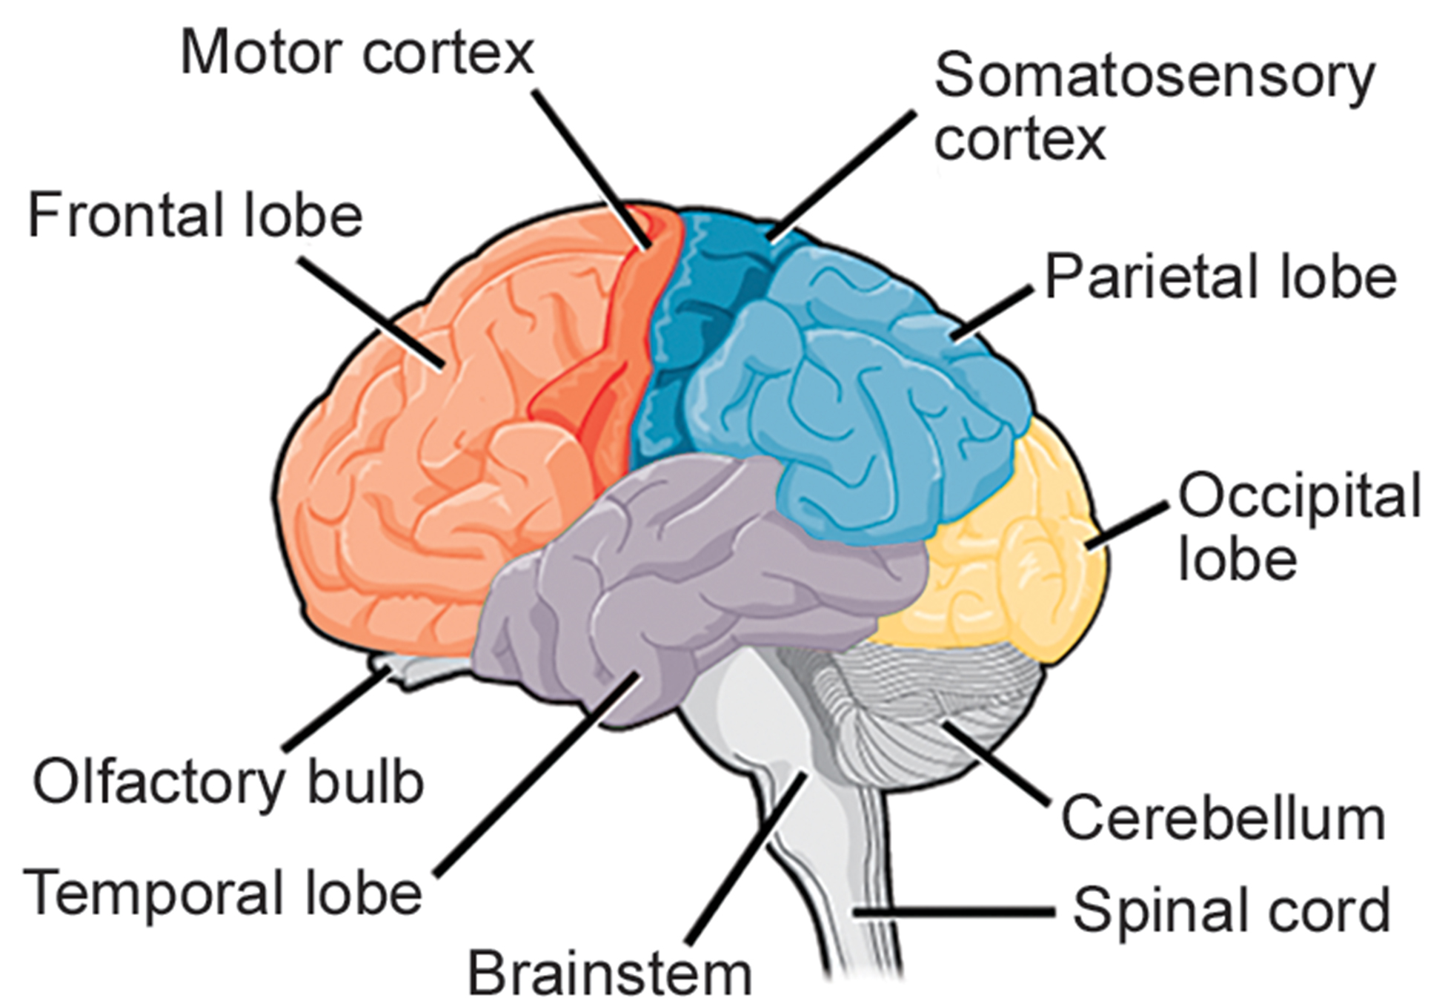
Brain Structure: Cerebral Cortex₂
Each mammalian cortical hemisphere contains 4 functionally and spatially defined lobes (regions):
Frontal lobe
Parietal lobe
Temporal lobe
Occipital lobe
42.3 Figure 4
CNX OpenStax on Wikimedia Commons. "Parts of the brain."

Slide 16
Brain Structure: Cerebral Cortex—Frontal Lobe
The frontal lobe:
Is located at the front of the brain over the eyes
Contains the olfactory bulb, which processes smells
Contains the motor cortex, which is important for planning and implementing movement
Different areas within the motor cortex map to specific muscle groups which largely reflects their distribution (for example, neurons controlling finger movement are next to those controlling hand movement)
Controls cognitive functions like maintaining attention, speech, and decision-making
Is involved in personality, socialization, and assessing risk

Slide 17
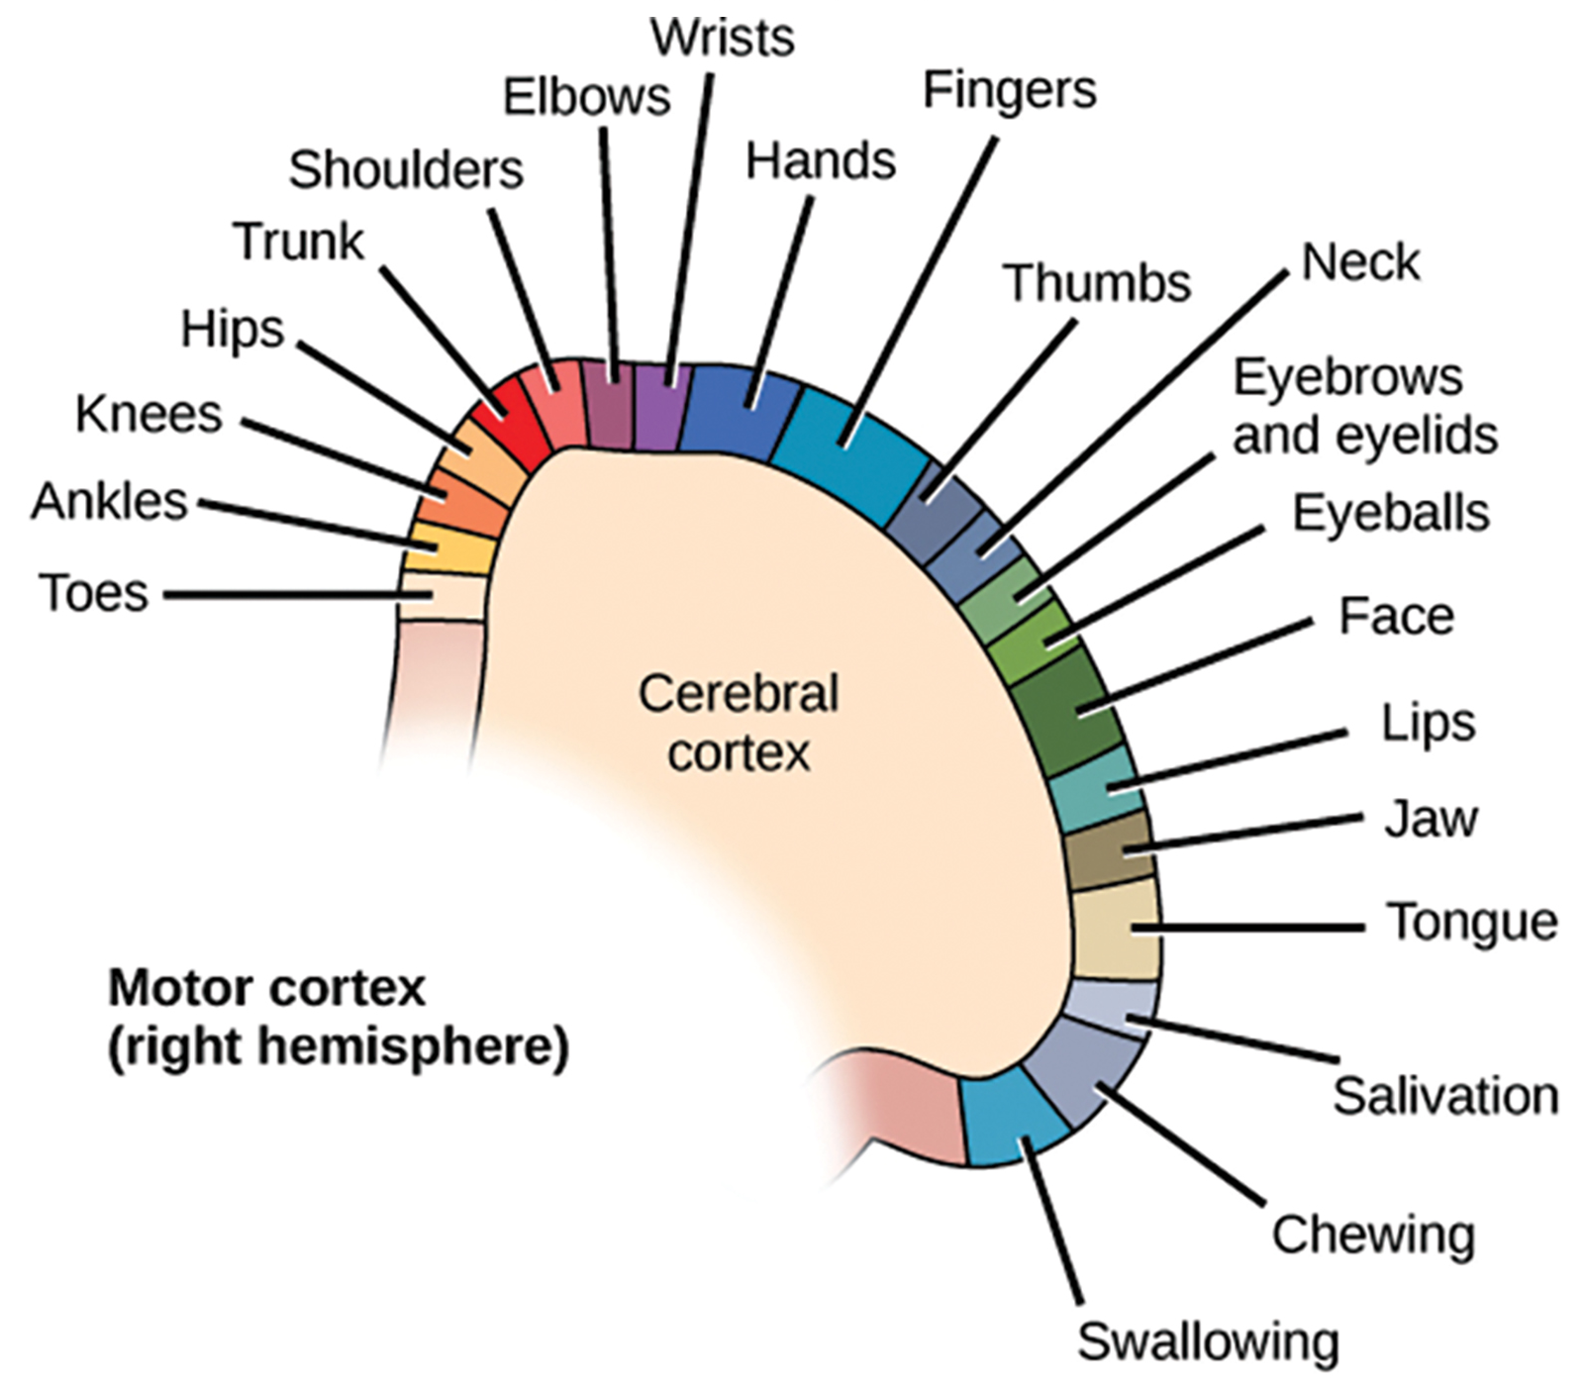
42.3 Figure 5
CNX OpenStax on Wikimedia Commons. "Motor cortex controls."
Notes:
42.3 Figure 5: Different parts of the motor cortex control different muscle groups. Muscle groups that are neighbors in the body are generally controlled by neighboring regions of the motor cortex as well. For example, the neurons that control finger movement are near the neurons that control hand movement.

Slide 18
Brain Structure: Cerebral Cortex—Parietal Lobe
The parietal lobe:
Is located at the top of the brain
Is involved in speech and reading
Has 2 main functions
Processing somatosensation, touch sensations like pressure, pain, heat, and cold
Processing proprioception, the sense of how body parts are oriented in space
Contains a somatosensory map of the body similar to the motor cortex

Slide 19
Brain Structure: Cerebral Cortex—Occipital Lobe
The occipital lobe:
Is located at the back of the brain
Is primarily involved in vision—seeing, recognizing, and identifying the visual world

Slide 20
Brain Structure: Cerebral Cortex—Temporal Lobe
The temporal lobe:
Is located at the based of the brain, by your ears
Is primarily involved in processing and interpreting sounds
Contains the hippocampus, a structure that processes memory formation
The role of the hippocampus in memory was determined in part by studying H.M., an epileptic patient who had both sides of his hippocampus removed, resulting in the elimination of seizures along with the inability to form new memories.

Slide 21
Think It Through₁
Which of the following regions in the cerebral cortex regulates vision?
Temporal
Occipital
Parietal
Frontal
Notes:
Originally an On Your Own. This is included here to use as a talking point or for a think-pair-share activity.

Slide 22
Evolution Connection
The Cerebral Cortex
Compared to other vertebrates, mammals have very large brains for their body sizes.
The increase in brain-to-body ratio is especially pronounced in apes, whales, and dolphins.
Despite this trend, it does not tell the whole story.
There is a relationship between the relatively high surface area of the cortex and the intelligence and complex social behaviors of some mammals.
This increased surface area is due, at least in part, to increased folding of the cortical sheet.
A rat cortex shows few sulci and gyri.
Chimps, humans, and dolphins have many more sulci and gyri.

Slide 23
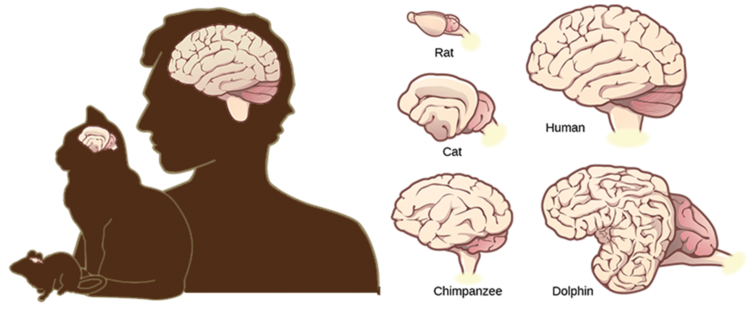
42.3 Figure 6
CNX OpenStax on Wikimedia Commons. "Brain to body ratio for animals." Modified.
Notes:
42.3 Figure 6: Mammals have larger brain-to-body ratios than other vertebrates. Within mammals, increased cortical folding and surface area is correlated with complex behavior.

Slide 24
Brain Structure: Basal Ganglia
The basal ganglia (or basal nuclei):
Are interconnected brain areas
Play important roles in movement control and posture
Damage to the basal ganglia (which occurs in Parkinson’s disease) leads to motor impairments like a shuffling gait.
Regulate motivation
When a wasp sting caused bilateral basal ganglia damage in a 25-year-old businessman, he began spending all of his days in bed, but he could engage when externally stimulated.

Slide 25
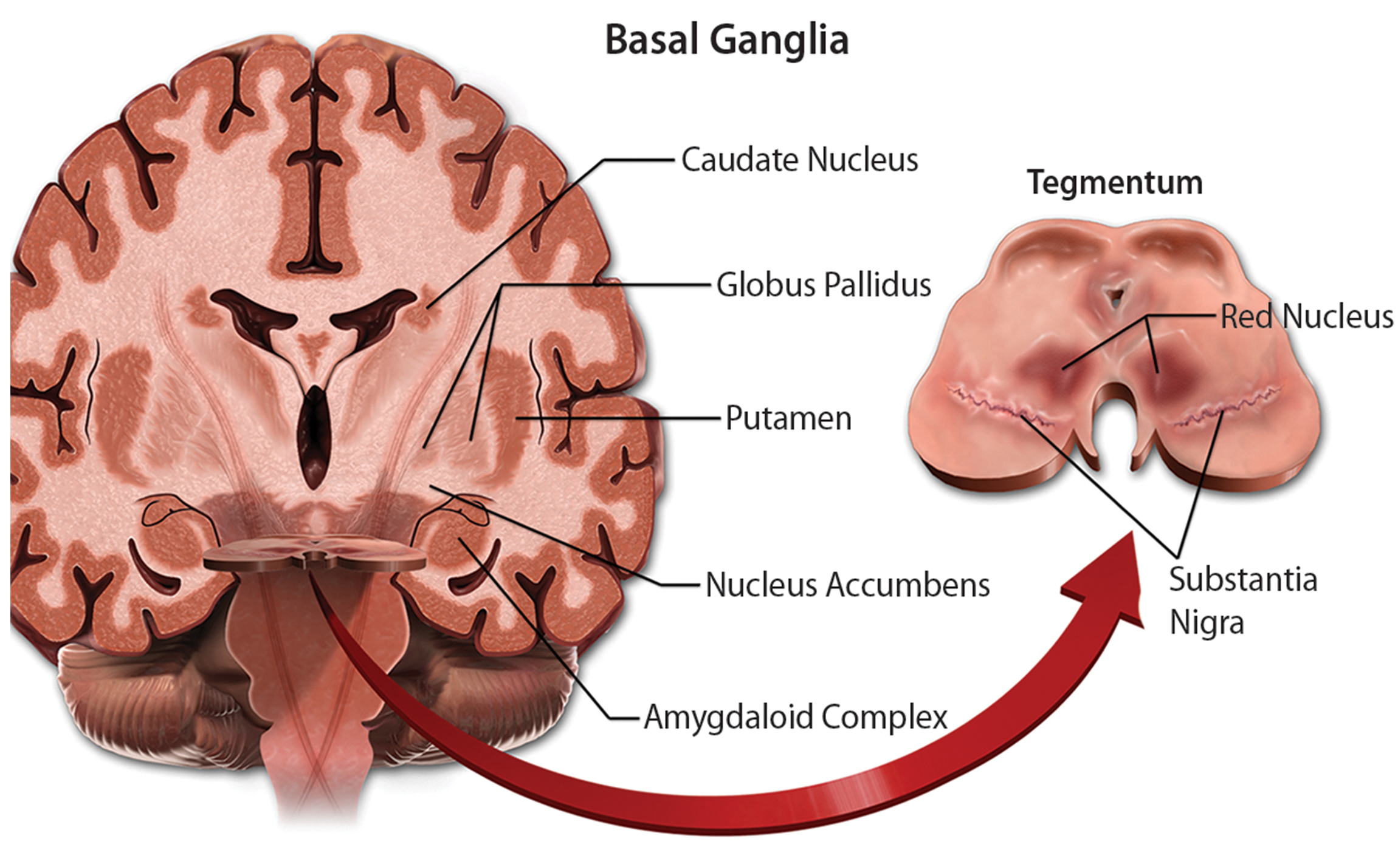
42.3 Figure 7
BruceBlaus on Wikimedia Commons. "Basal ganglia."
Notes:
42.3 Figure 7: The basal ganglia is a brain region important to the regulation of movement. Loss of a subtype of neurons in the substantia nigra—a region inside the basal ganglia—results in the onset of Parkinson's disease.

Slide 26
Brain Structure: Thalamus
The thalamus:
Acts as a gateway to and from the cortex
Receives sensory and motor inputs from the body and receives feedback from the cortex
This feedback mechanism can modulate conscious awareness of sensory and motor inputs depending on the attention and arousal state of the animal.
Helps regulate consciousness, arousal, and sleep states
Fatal familial insomnia, a rare genetic disorder, causes degeneration of thalamic neurons and glia, preventing patients from being able to sleep and eventually resulting in death.

Slide 27
Brain Structure: Hypothalamus
The hypothalamus:
Is located below the thalamus
Controls the endocrine system by sending signals to the pituitary gland, a pea-sized endocrine gland that releases several different hormones that affect other glands and other cells
The hypothalamus thus regulates important behaviors controlled by these hormones.
Is the body’s thermostat
The hypothalamus ensures that food and water intake, energy expenditure, and body temperature are all kept at appropriate levels.
Regulates circadian rhythms (sleep cycles)

Slide 28
Brain Structure: Limbic System
The limbic system:
Is a connected set of structures that regulates emotion and behaviors related to fear and motivation
Plays a role in memory formation
Includes parts of
The thalamus
The hypothalamus
The hippocampus
Contains the amygdala, a temporal lobe structure
The 2 amygdalae are important for the sensation of fear and for recognizing fearful faces.
Contains the cingulate gyrus, which helps regulate emotions and pain

Slide 29
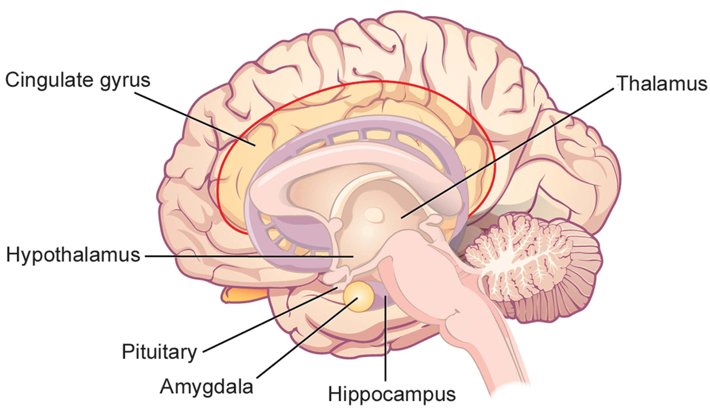
42.3 Figure 8
CNX OpenStax on Wikimedia Commons. "Limbic system."
Notes:
42.3 Figure 8: The limbic system regulates emotion and other behaviors. It includes parts of the cerebral cortex located near the center of the brain, including the cingulate gyrus and the hippocampus as well as the thalamus, hypothalamus, and amygdala.

Slide 30
Brain Structure: Cerebellum
The cerebellum:
Sits at the base of the brain, on top of the brain stem
Controls balance
Aids in coordinating movement
Aids in learning new motor tasks

Slide 31
Connecting the Brain to the Spinal Cord: The Brain Stem
The brainstem:
Consists of:
The midbrain
The medulla oblongata
The pons
Connects the rest of the brain with the spinal cord via motor and sensory neurons that extend through it
Ascending and descending neural pathways cross here, allowing the left hemisphere of the cerebrum to control the body’s right side, and vice versa.
Coordinates motor control signals sent from the brain to the body
Controls alertness, arousal, breathing, blood pressure, digestion, heart rate, swallowing, walking, and the integration of sensory and motor information

Slide 32
Think It Through₂
Identify the brain region associated with the function described.
Coordination of motor signals from cerebral cortex to muscles
Control of endocrine system
Gateway to and from cortical areas
Learning new motor tasks
Control of posture and movement
Experience and regulation of fear, emotion, and pain
Notes:
Originally an On Your Own. This is included here to use as a talking point or for a think-pair-share activity.

Slide 33
The Spinal Cord₁
The spinal cord:
Is a thick bundle of nerve tissue extending down the body through the spinal column that carries information
From the body to the brain
From the brain to the body
Is contained within the vertebrate column bones
Can communicate signals to and from the body through its connections with the spinal nerves of the PNS

Slide 34
The Spinal Cord₂
The spinal cord:
In cross sections it looks like a white oval containing a gray butterfly.
"White matter" is made of myelinated axons.
"Gray matter" is made of neuron and glial cell bodies and interneurons (neurons that connect 2 neurons located in different parts of the body).
The dorsal spinal cord’s axons and cell bodies mostly convey sensory information from the body to the brain.
The ventral spinal cord’s axons and cell bodies mostly transmit signals controlling movement from the brain to the body.

Slide 35
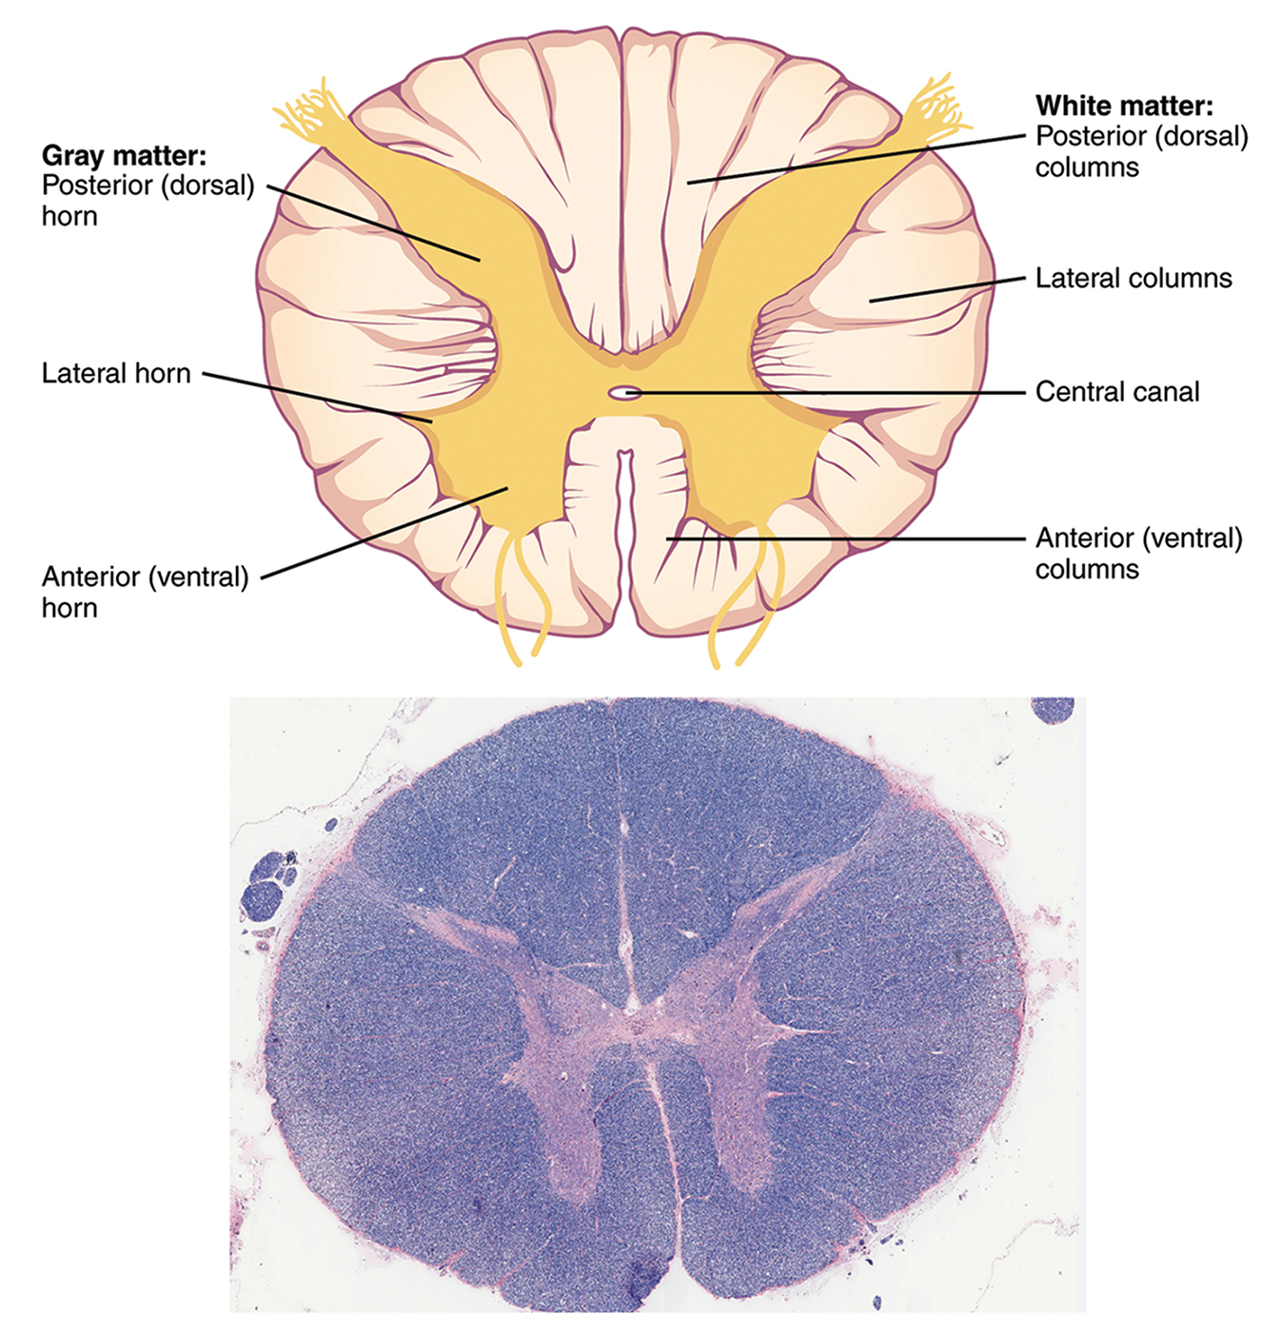
42.3 Figure 9
OpenStax on Wikimedia Commons. "Spinal cord cross section."
Notes:
42.3 Figure 9: Both cross sections of the spinal cord show gray matter (containing cell bodies and interneurons) and white matter (containing axons).

Slide 36
The Spinal Cord: Motor Reflexes
The spinal cord also controls motor reflexes, which are very quick unconscious movements that involve only local synaptic connections (and do not involve the brain).
Examples:
Automatically removing a hand from a hot object
Knee jerk reflex during a routine physical
While a reflex only involves 1 or 2 local synapses, synapses with interneurons in the spinal column transmit information to the brain to convey what happened.

Slide 37
Spinal Cord Injuries
There are about 18,000 spinal cord injuries in the U.S. annually.
Spinal cord injury can lead to paralysis, with the extent depending on:
The injury’s location
Injury at the neck can lead to paralysis from the neck down.
Injury of the spinal column further down may limit paralysis to the legs.
Whether the spinal cord was completed cut
Spinal cord injuries are difficult to treat because spinal nerves do not regenerate
Research suggests that stem cell transplants may reconnect severed nerves.
Inflammation following injury worsens nerve damage, so researchers are looking for how to prevent inflammation.
Induced hypothermia through injection of cold saline may prevent swelling.

Slide 38
Summary
The central nervous system contains the brain and the spinal cord which are covered and protected by 3 meninges.
The mammalian brain contains structurally and functionally defined regions including:
The cortex: the frontal, temporal, occipital, and parietal lobes
The basal ganglia
The thalamus
The hypothalamus
The limbic system
The cerebellum
The brainstem
While some functions are localized to one brain structure, complex functions (like language and sleep) involve multiple brain regions.
The spinal cord connects the brain with the rest of the body, transmits sensory and motor input and controls motor reflexes.

Slide 39


End of Hawkes Learning PowerPoint

