Slide 1
Lesson 42.4
The Peripheral Nervous System

Slide 2
Objectives
Describe the organization and functions of the sympathetic and parasympathetic nervous systems.
Describe the organization and function of the sensory-somatic nervous system.

Slide 3
Peripheral Nervous System (PNS) Structure and Function
The peripheral nervous system (PNS):
Connects the CNS to the rest of the body
If the CNS is like the power plant of the nervous system, creating signals that control body functions, then the PNS is like the wires that go to individual houses.
The PNS can be broken into:
The autonomic nervous system
Controls bodily functions without conscious control
The sensory-somatic nervous system
Transmits sensory information from the skin, muscles, and sensory organs to the CNS
Sends motor commands from the CNS to the muscles

Slide 4
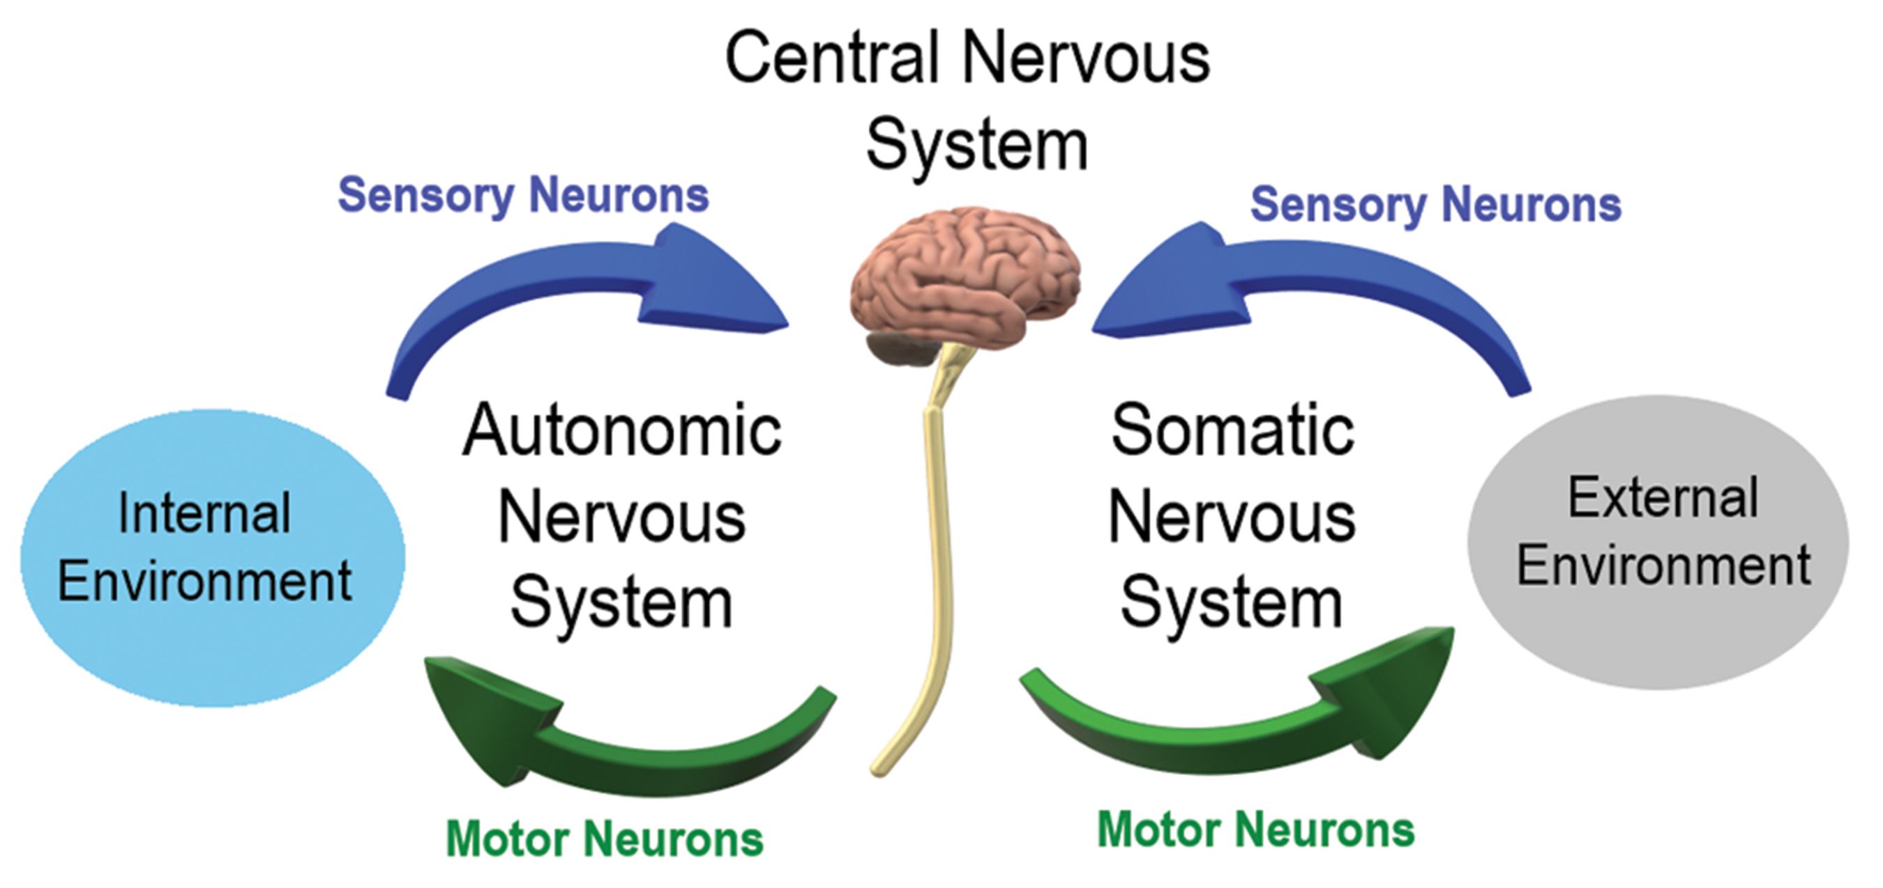
42.4 Figure 1
Christinelmiller on Wikimedia Commons. "Autonomic and somatic nervous system."
Notes:
42.4 Figure 1: This diagram shows the interplay between the central and peripheral nervous systems. The central nervous system—the brain and spinal cord—experience the environment via sensory neurons and act on the environment via motor neurons.

Slide 5
The Autonomic Nervous System₁
The autonomic nervous system:
Serves as the relay between the CNS and the internal organs
Controls the lungs, heart, smooth muscle, and exocrine and endocrine glands largely without conscious control through continuously monitoring conditions and implementing needed changes
Signaling to target tissue involves 2 synapses.
A preganglionic neuron originating in the CNS synapses to a neuron in a ganglion.
The postganglionic neuron is the PNS neuron in the ganglion that then synapses on the target organ.
NOTE: A ganglion (plural ganglia) is a collection of neuron cell bodies that act as a synaptic relay station.

Slide 6
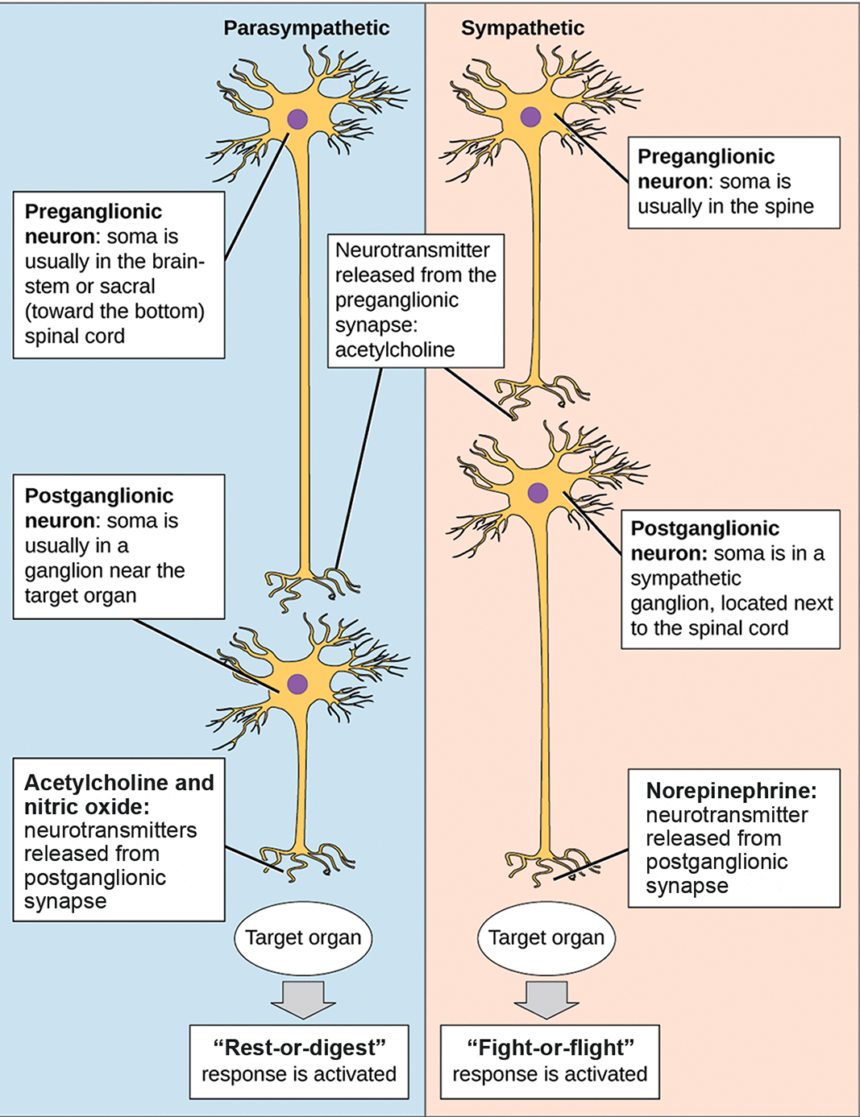
The Autonomic Nervous System₂
The 2 divisions of the autonomic nervous system have opposing effects:
The sympathetic nervous system
The parasympathetic nervous system
42.4 Figure 2
OpenStax. "Autonomic nervous system." Modified.

Slide 7
The Autonomic Nervous System: The Sympathetic Nervous System₁
The sympathetic nervous system is responsible for the "fight-or-flight" response that occurs when an animal encounters danger (like a surprise encountering of a snake).
Examples of functions controlled by the sympathetic nervous system include:
An accelerated heart rate
Inhibited digestion
These functions prepare an organism’s body for physical strain needed to escape danger or fend off a predator.

Slide 8
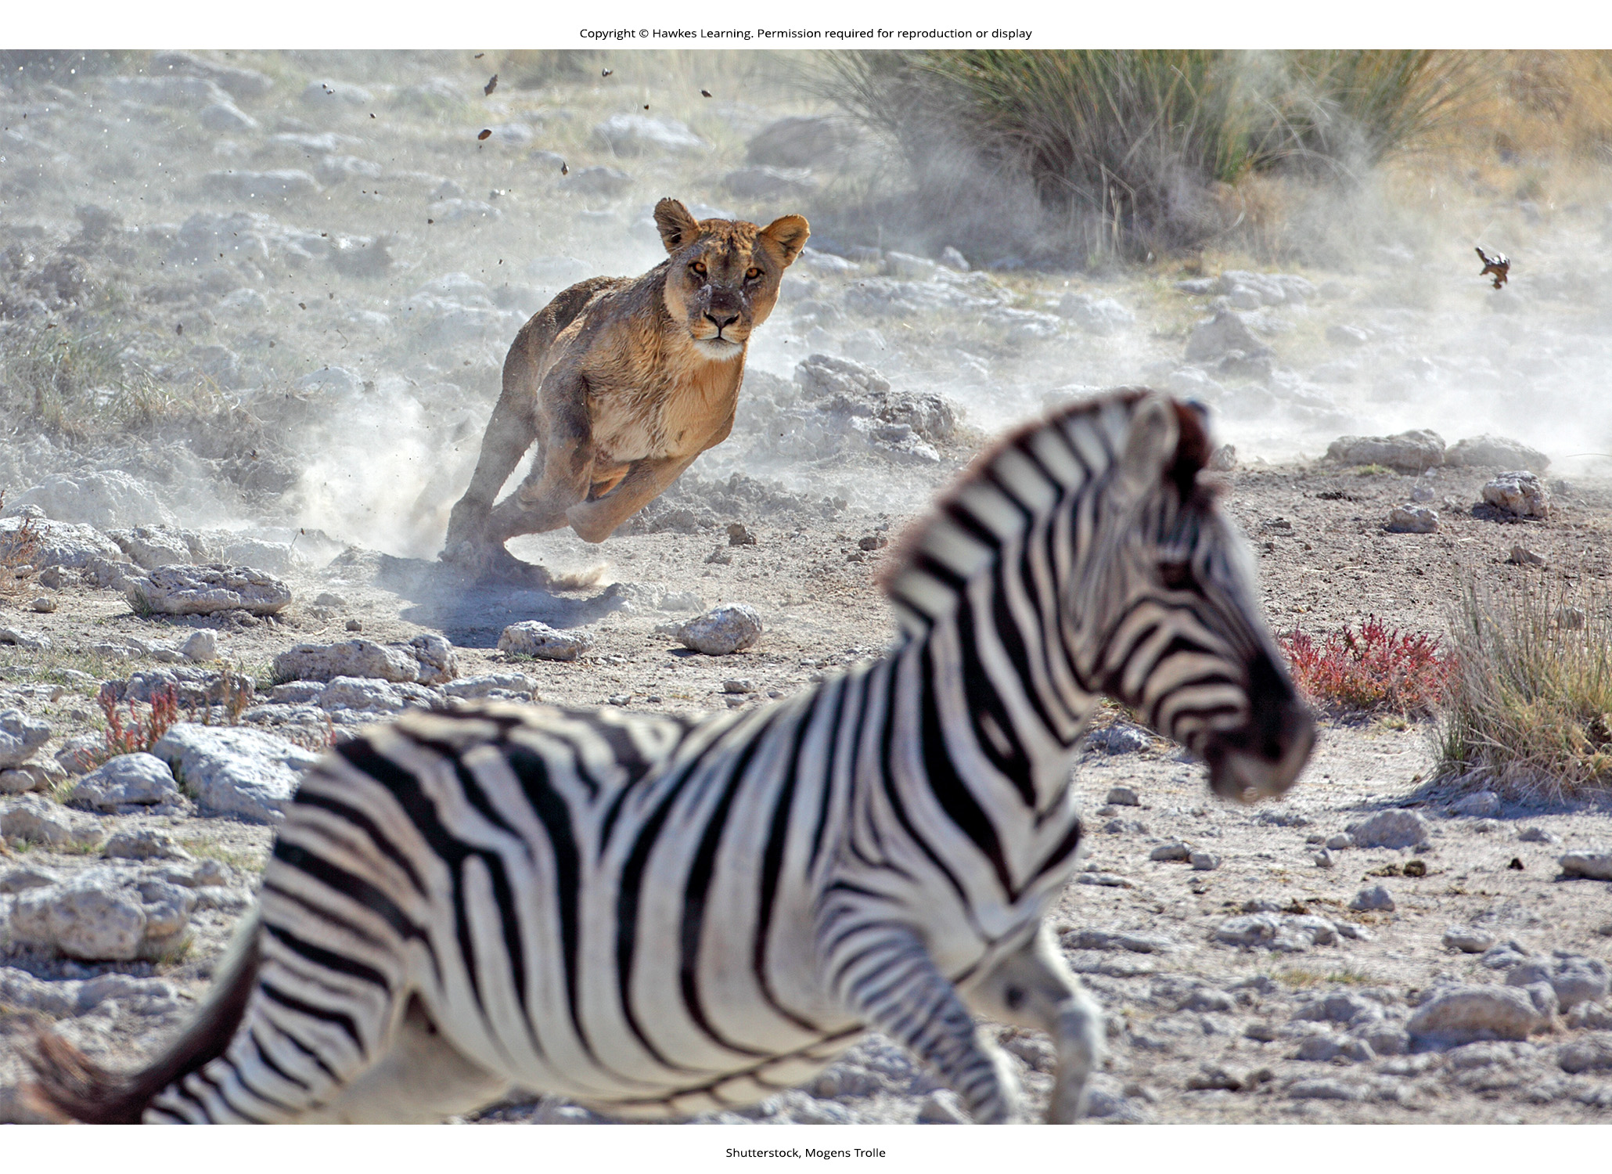
42.4 Figure 3
Notes:
42.4 Figure 3: As soon as this zebra notices the lion, its sympathetic "fight-or-flight" response is activated, increasing its heart rate and facilitating blood flow to its muscles to allow it to escape.

Slide 9
The Autonomic Nervous System: The Sympathetic Nervous System₂
Most preganglionic neurons in the sympathetic nervous system originate in the spinal cord.
Their axons release acetylcholine on postganglionic neurons, activating these neurons, within sympathetic ganglia.
The postganglionic neurons then release norepinephrine onto target organs.

Slide 10
The Autonomic Nervous System: The Sympathetic Nervous System₃
The resulting effects are pervasive:
A single preganglionic neuron synapses on multiple postganglionic neurons, amplifying the effect.
The adrenal gland also releases norepinephrine and epinephrine into the bloodstream, resulting in:
Dilating the trachea and bronchi for easier breathing
Increasing the heart rate
Moving blood from the skin the heart, muscles, and brain for running and thinking
LTP may also be increased, allowing the animal to remember the danger and avoid it in the future.

Slide 11
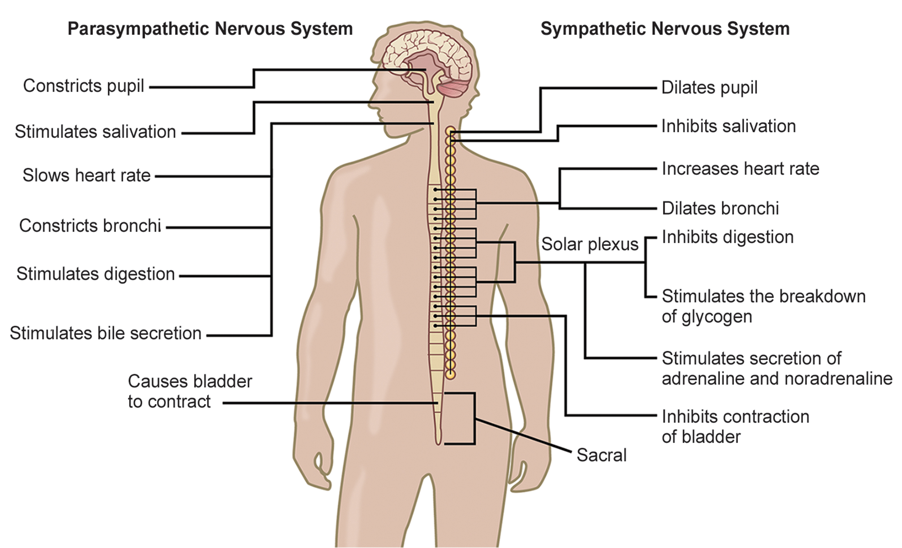
42.4 Figure 4
CNX OpenStax on Wikimedia Commons. "Organs controlled by the parasympathetic and sympathetic nervous system."
Notes:
42.4 Figure 4: The sympathetic and parasympathetic nervous systems often have opposing effects on target organs.

Slide 12
The Autonomic Nervous System: The Parasympathetic Nervous System₁
The parasympathetic nervous system allows an animal to "rest and digest" (as during a restful situation like a picnic).
Parasympathetic preganglionic neurons have cell bodies located in:
The brainstem
The sacral (bottom) spinal cord

Slide 13
The Autonomic Nervous System: The Parasympathetic Nervous System₂
The axons of the preganglionic neurons release acetylcholine on the postganglionic neurons, which are located very near the target organs.
Most postganglionic neurons release acetylcholine onto target organs, although some release nitric oxide (NO).
The acetylcholine leads to:
Slowing down of the heart rate
Lowering blood pressure
Stimulation of digestion
The parasympathetic nervous system resets organ function after sympathetic nervous system activation.

Slide 14
Think It Through₁
Which of the following statements is false about the autonomic nervous system?
The parasympathetic pathway is responsible for resting the body, while the sympathetic pathway is responsible for preparing for an emergency.
Most preganglionic neurons in the sympathetic pathway originate in the spinal cord.
Slowing of the heartbeat is a parasympathetic response.
Parasympathetic neurons are responsible for releasing norepinephrine on the target organ, while sympathetic neurons are responsible for releasing acetylcholine.
Notes:
Originally an On Your Own. This is included here to use as a talking point or for a think-pair-share activity.

Slide 15
The Sensory-Somatic Nervous System
The sensory-somatic nervous system:
Is made up of cranial and spinal nerves
Contains both sensory and motor neurons
Sensory neurons transmit sensory information from the skin, skeletal muscle, and sensory organs to the CNS.
Motor neuron transmit messages about desired movement form the CNS to the muscles to make them contract.
Provides an animal the ability to process information about its environment (what it sees, feels, hears, etc.) and control motor movements
Involves only 1 synapse–1 ending of the neuron is at the organ and the other direct contacts a CNS neuron
NOTE that this is different from the autonomic nervous system.
Mainly used acetylcholine as the neurotransmitter released at its synapses.

Slide 16
The Sensory-Somatic Nervous System: Cranial Nerves
Humans have 12 cranial nerves emerging from or entering the skull (cranium).
Some transmit only sensory information.
The olfactory nerve transmits information about smells from the nose to the brainstem.
Others transmit solely motor information.
The oculomotor nerve controls the opening and closing of the eyelid and some eye movements.
Others contain a mix of sensory and motor fibers.
The glossopharyngeal nerve has a role in both taste (sensory) and swallowing (motor).

Slide 17
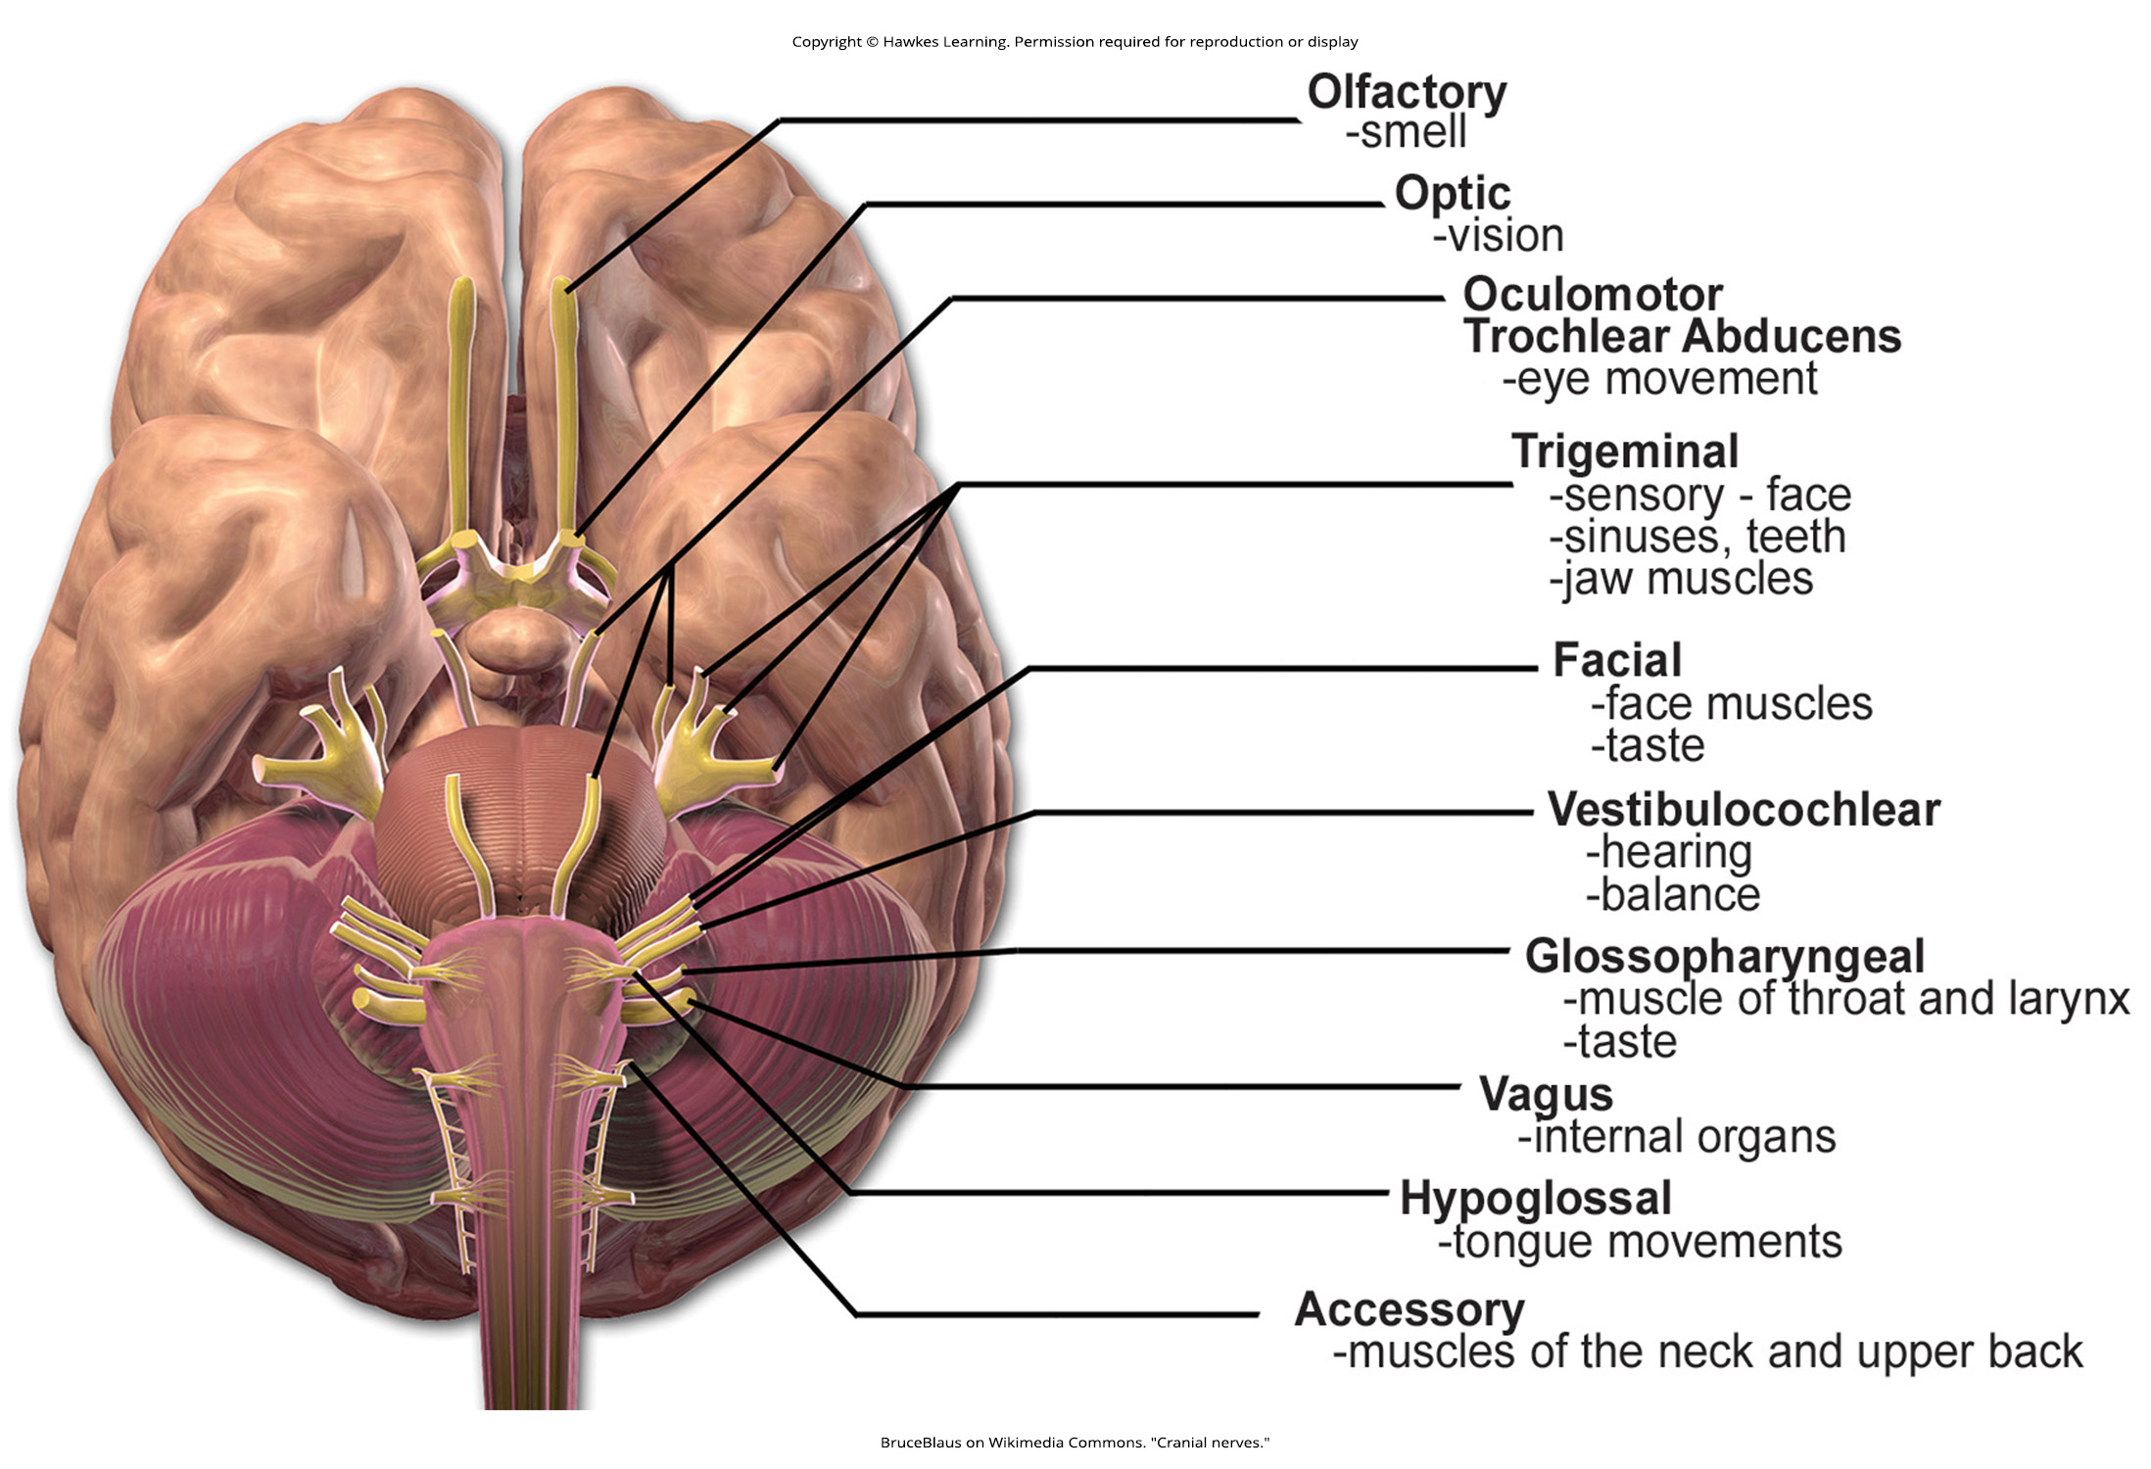
42.4 Figure 5
BruceBlaus on Wikimedia Commons. "Cranial nerves."
Notes:
42.4 Figure 5: The human brain contains 12 cranial nerves that receive sensory input and control motor output for the head and neck.

Slide 18
The Sensory-Somatic Nervous System: Spinal Nerves₁
Spinal nerves:
Emerge from the vertebral column
Transmit sensory and motor information between the spinal cord and the rest of the body
There are 31 spinal nerves containing both sensory and motor axons in humans.

Slide 19
The Sensory-Somatic Nervous System: Spinal Nerves₂
The sensory neuron cell bodies are grouped into dorsal root ganglia.
Each sensory neuron has:
A projection with a sensory receptor ending in skin, muscle, or sensory organs
Another projection that synapses with a neuron in the dorsal spinal cord
Motor neurons have cell bodies in the ventral gray matter of the spinal cord that project to muscle through the ventral root.
These neurons are usually stimulated by interneurons within the spinal cord.
These neurons are sometimes directly stimulated by sensory neurons.

Slide 20
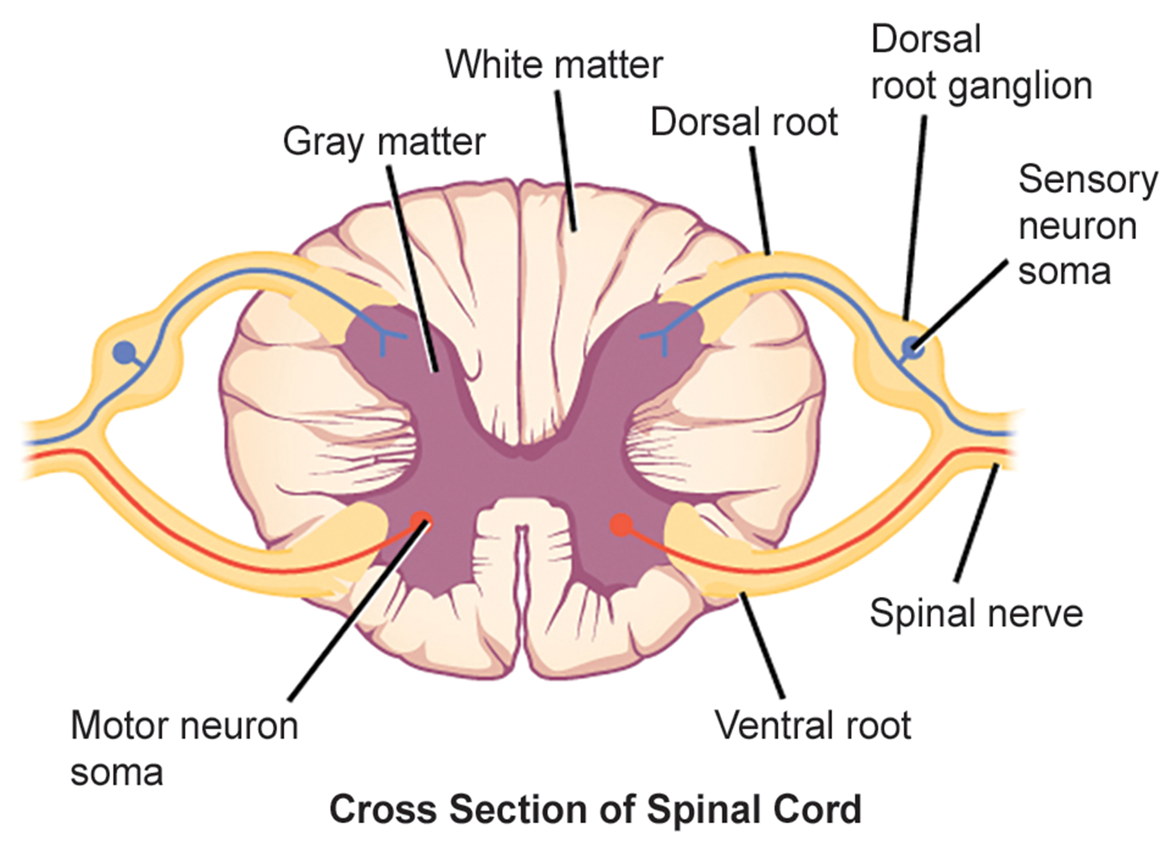
42.4 Figure 6
Notes:
42.4 Figure 6: Spinal nerves contain both sensory and motor axons. The somas of sensory neurons are in the dorsal root ganglia. The somas of motor neurons are found in the ventral portion of the gray matter of the spinal cord.

Slide 21
Think It Through₂
Which of the following is not the name of a cranial nerve?
oculomotor
trigeminal
vulgaris
vestibulocochlear
Notes:
Originally an On Your Own. This is included here to use as a talking point or for a think-pair-share activity.

Slide 22
Summary
The peripheral nervous system contains:
The autonomic nervous system
The sensory-somatic nervous system
The autonomic nervous system provides unconscious control over visceral functions and has 2 divisions:
The sympathetic nervous system, which is activated during stressful situations to prepare an animal for "fight-or-flight"
The parasympathetic nervous system, which is is active during restful periods ("rest-and-digest")
The sensory-somatic nervous system is made of cranial and spinal nerves that transmit:
Sensory information from the skin and muscle to the CNS
Motor commands from the CNS to muscles

Slide 23


End of Hawkes Learning PowerPoint

