Slide 1
Lesson 42.5
Nervous System Disorders

Slide 2
Objectives
Describe the symptoms, potential causes, and treatment of nervous system disorders.

Slide 3
Nervous System Disorders
Nervous system disorders can be categorized as:
Neurodegenerative disorders
Neurodevelopmental disorders
Mental illnesses
Other neurological disorders

Slide 4
Neurodegenerative Disorders
Neurodegenerative disorders are illnesses characterized by a loss of nervous system functioning that are usually caused by neuronal death.
These worsen over time as more neurons die.
The symptoms are related to the location where neuronal death occurs.
Spinocerebellar ataxia leads to neuronal death in the cerebellum, which causes problems with balance and walking.
Examples include Huntington’s disease, amyotrophic lateral sclerosis (ALS), Alzheimer’s disease, and Parkinson’s disease

Slide 5
Neurodegenerative Disorders: Alzheimer’s Disease–Prevalence Statistics
Alzheimer’s disease:
Is the most common cause of dementia in the elderly
Affected 5.8 million Americans in 2020, costing them $305 billion
Affects 1 in 9 people over 65 years of age
Is projected to affect up to 14 million Americans in 2060

Slide 6
Neurodegenerative Disorders: Alzheimer’s Disease–Symptoms
Alzheimer’s disease symptoms include:
Disruptive memory loss
Confusion about time or place
Difficulty planning or executing tasks
Poor judgment
Personality changes
Problems smelling certain scents (early warning sign)
These symptoms are also common in those aging normally, so it is their severity and longevity that distinguishes Alzheimer’s.

Slide 7
Neurodegenerative Disorders: Alzheimer’s Disease–Changes to the Brain
Alzheimer’s disease is named for Alois Alzheimer, a German psychiatrist who published a report in 1911 about a woman suffering from the disease.
Upon examining her brain after death, he found abnormal clumps, now called amyloid plaques, and neurofibrillary tangles.
Today, common structural changes seen in the postmortem analyses of the brains of Alzheimer’s patients include:
Amyloid plaques
Neurofibrillary tangles
Overall shrinkage of brain volume
Loss of neurons in the hippocampus (in advanced cases)

Slide 8
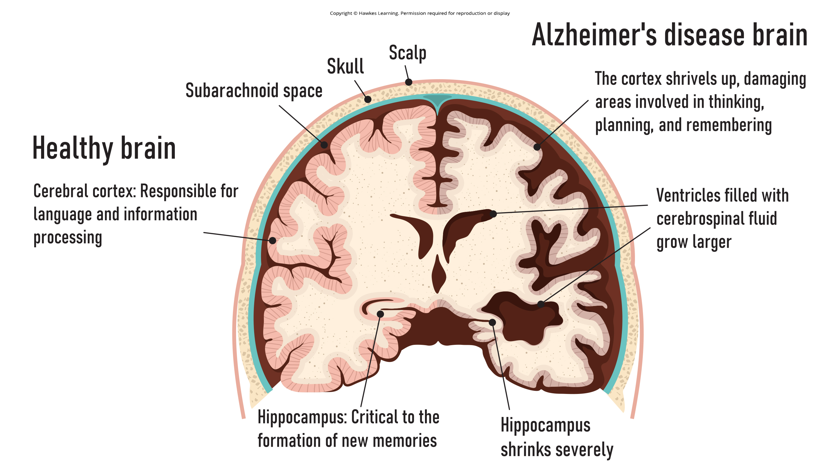
42.5 Figure 1
Notes:
42.5 Figure 1: Compared to a healthy brain (left), the brain from a patient with Alzheimer's disease (right) shows dramatic neurodegeneration, particularly within the ventricles and hippocampus.

Slide 9
Neurodegenerative Disorders: Alzheimer’s Disease–Genetics
One form of Alzheimer’s is caused by mutations in 1 of 3 known genes.
This affects <5% of Alzheimer’s patients.
This causes dementia beginning between 30–60 of age.
The more prevalent late-onset form also has a genetic component
The apolipoprotein epsilon (APOE) gene has a variant (ε4) that increases the likelihood of getting the disease.
There are also many other genes implicated.

Slide 10
Neurodegenerative Disorders: Alzheimer’s Disease–Treatment and Prevention
There is no cure for Alzheimer’s disease, so current treatments focus on disease management.
Because the activity of cholinergic neurons (ones that use acetylcholine) decreases in Alzheimer’s disease, several drugs increase acetylcholine neurotransmission, often by inhibiting acetylcholinesterase breakdown of the neurotransmitter in the synaptic cleft.
Behavioral therapies include psychotherapy, sensory therapy, and cognitive exercises.
Research into prevention is prevalent.
Smoking, obesity, and cardiovascular problems are risk factors, so treating those may help to prevent the disease.
Remaining intellectually active by playing games, reading, playing musical instruments, and being socially active reduce the risk of developing the disease.

Slide 11
Think It Through₁
Which of the following is false about Alzheimer's disease?
There is currently no cure for the disease.
The disease was discovered in the early twentieth century.
An initial symptom is an observable tremor in the affected individual's hand.
It is associated with the presence of amyloid plaque and neurofibrillary tangles in the brain.
Notes:
Originally an On Your Own. This is included here to use as a talking point or for a think-pair-share activity.

Slide 12
Neurodegenerative Disorders: Parkinson’s Disease–Prevalence Statistics
Parkinson’s disease:
Was first characterized by James Parkinson in 1817
Is diagnosed in 50,000–60,000 people annually in the United States

Slide 13
Neurodegenerative Disorders: Parkinson’s Disease–Symptoms
Parkinson’s disease:
Causes the loss of dopamine neurons in the substantia nigra, a midbrain structure regulating movement, leading to the disease’s many symptoms
Parkinson’s disease symptoms include:
Tremors (shaking of fingers or a limb)
Slowed movement
Speech changes
Balance and posture problems
Rigid muscles
A slow, hunched, shuffling walk
Psychological symptoms (dementia or emotional problems)

Slide 14
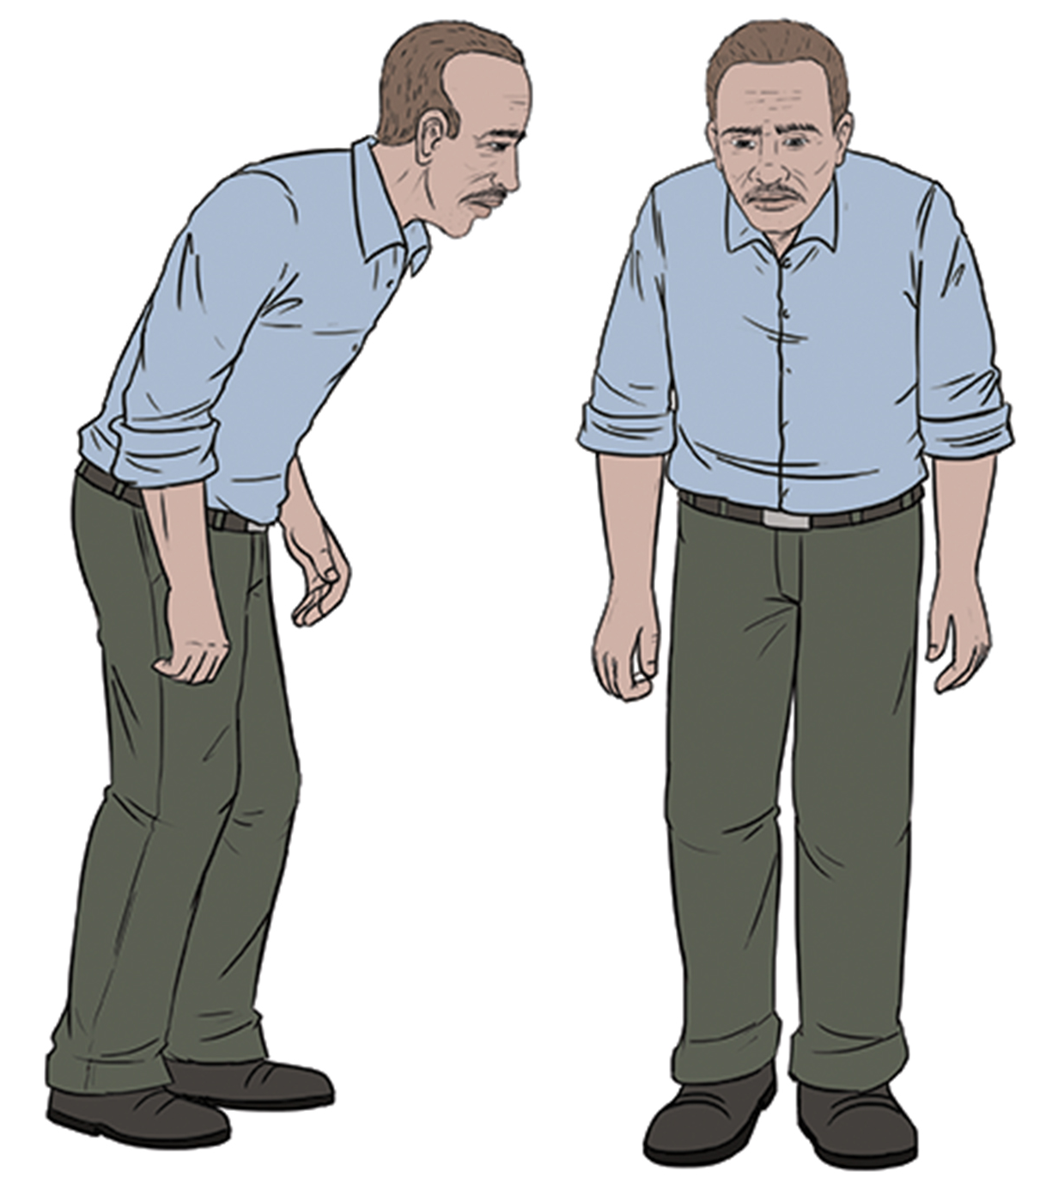
42.5 Figure 2
OpenStax. "Parkinson's patient." Modified.
Notes:
42.5 Figure 2: Parkinson's patients often have a characteristic hunched walk.

Slide 15
Neurodegenerative Disorders: Parkinson’s Disease–Possible Causes
Some patients have a form of the disease caused by a single mutation.
For most patients, the exact causes of the disease are unknown.
The disease likely results from a combination of genetic and environmental factors.
Postmortem analysis of brains from Parkinson’s patients show the presence of Lewy bodies (abnormal protein clumps) in dopaminergic neurons.
The prevalence of Lewy bodies often correlates with disease severity.

Slide 16
Neurodegenerative Disorders: Parkinson’s Disease–Treatment and Prevention
There is no cure for Parkinson’s disease, so current treatments focus on disease management.
L-DOPA, a chemical that is converted into dopamine by neurons in the brain, is commonly prescribed.
This conversion increases the overall level of dopamine transmission to help compensate for the loss of dopaminergic neurons in the substantia nigra.
Other drugs inhibit the enzyme that breaks down dopamine.

Slide 17
Neurodevelopmental Disorders
Neurodevelopmental disorders occur when the development of the nervous system occurs.
There are several classes:
Some (example: Down syndrome) cause intellectual deficits.
Others affect communication, learning, or the motor system.
Some (examples: autism spectrum disorder, attention-deficit/hyperactivity disorder) have complex symptoms.

Slide 18
Neurodevelopmental Disorders: ASD–Prevalence Statistics
Autism spectrum disorder (ASD)
Differs in severity from person to person
Is estimated to be found in 1 in 44 children (2018)
Is 4X more prevalent in males than females

Slide 19
Neurodevelopmental Disorders: ASD–Symptoms
ASD symptoms include:
Impaired social skills
Difficulty making and maintaining eye contact
Difficulty reading social cues
Problems feeling empathy or others
Repetitive motor behaviors (rocking back and forth)
Preoccupation with specific subjects
Strict adherence to certain rituals
Use of unusual language
Epilepsy (in up to 30% of patients)
Intellectual disability (in some forms like Fragile X)
Because it is a spectrum disorder, many ASD patients are very functional with good-to-excellent language skills and do not feel they have a disorder.

Slide 20
Neurodevelopmental Disorders: ASD–Possible Causes
Some forms of ASD are clearly genetic:
Fragile X
Rett syndrome
Beyond these, the causes of ASD are largely unknown.
Variants of several genes correlate to the presence of ASD, but many different mutations in different genes may be required for disease development.
ASD is thought to be a disease of atypical wiring.
The brains of some ASD patients lack the same level of synaptic pruning as in unaffected people.
While a research paper from the 1990s linked autism to a common vaccine, the paper was later retracted.
There is NO connection between vaccines and autism.

Slide 21
Neurodevelopmental Disorders: ASD–Treatment
Treatment for autism usually combines:
Behavioral therapies and interventions
Medications to treat other disorders common to people with autism
Depression
Anxiety
Obsessive-compulsive disorder
While early interventions can help mitigate the disease’s effects, there is currently no cure.

Slide 22
Neurodevelopmental Disorders: ADHD–Prevalence Statistics
Attention-deficit/hyperactivity disorder (ADHD)
Affects ~3–5% of children and adults
Is more prevalent in males than females

Slide 23
Neurodevelopmental Disorders: ADHD–Symptoms₁
ADHD symptoms include:
Inattention (lack of focus)
Executive functioning difficulties
Impulsivity
Hyperactivity beyond what is developmentally normal
Some patients who lack the hyperactive symptoms are diagnosed with attention deficit disorder (ADD), a subtype of ADHD.

Slide 24
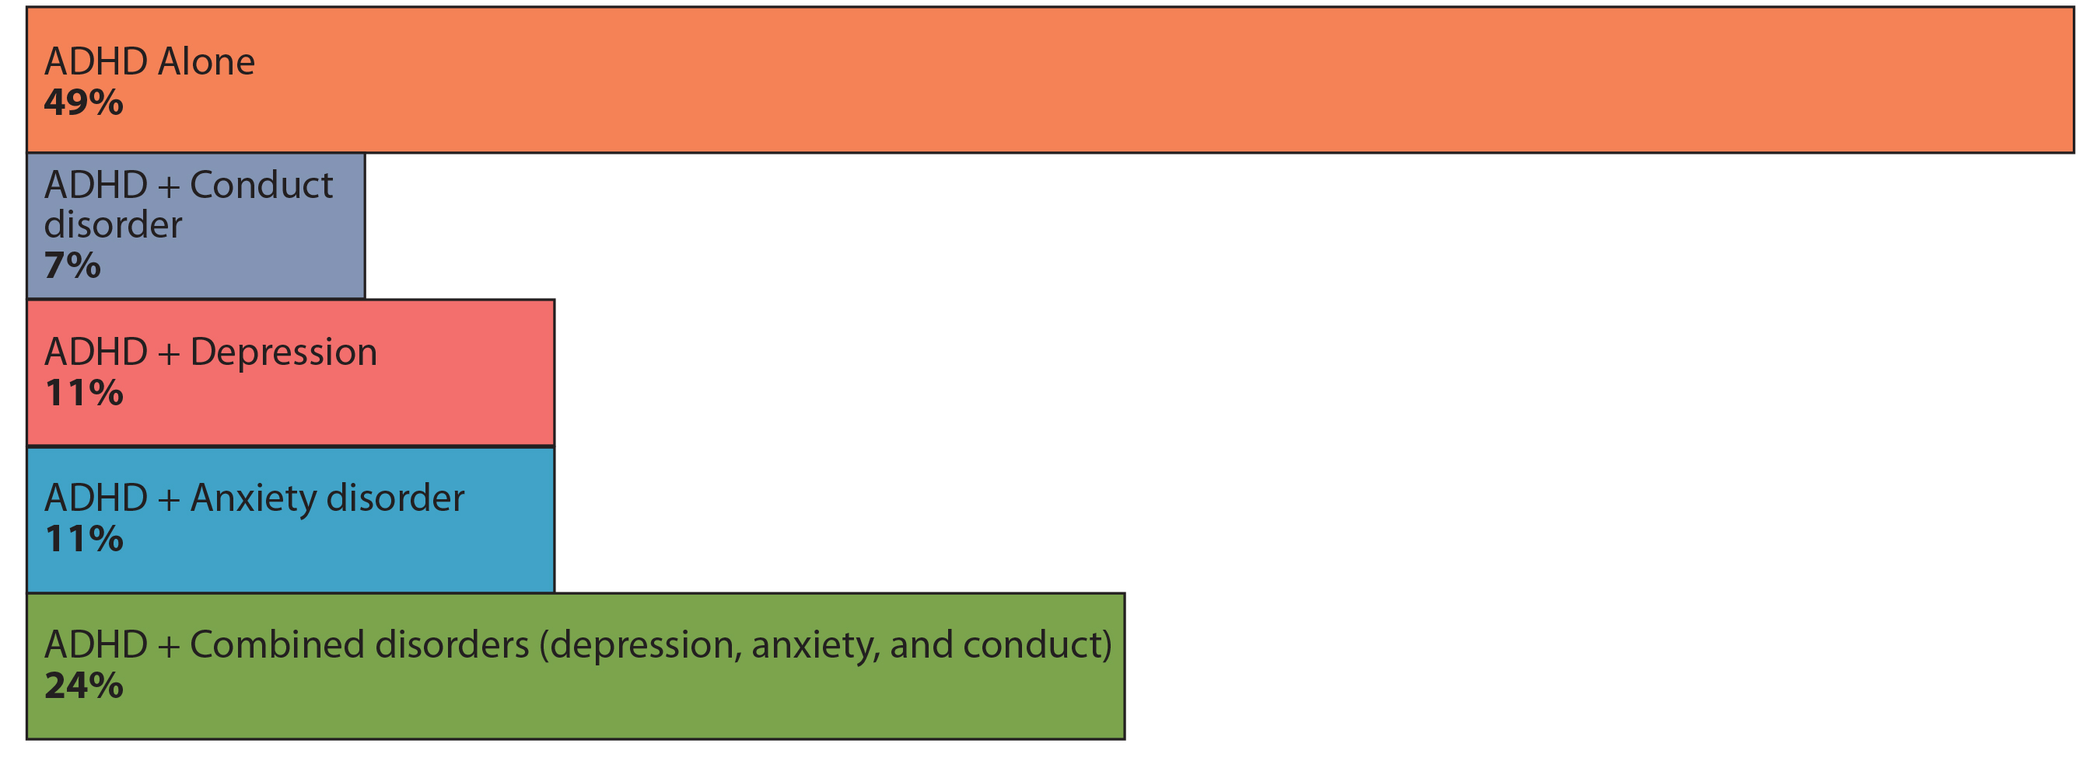
Neurodevelopmental Disorders: ADHD–Symptoms₂
Many people with ADHD show comorbidity, meaning that they develop secondary disorders like obsessive-compulsive disorder (OCD) along with ADHD.
42.5 Figure 3
CNX OpenStax on Wikimedia Commons. “ADHD chart.” Modified.

Slide 25
Neurodevelopmental Disorders: ADHD–Possible Causes and Treatment
The cause of ADHD is unknown.
Research suggests a delay and dysfunction in the development of the prefrontal cortex and disturbances in neurotransmission.
Studies of twins suggest a strong genetic component.
While several candidate genes have been identified, no definitive links have been discovered.
Environmental factors (including pesticide exposure) may contribute to ADHD development.
Treatment for ADHD includes:
Behavioral therapies
Prescription of stimulant medications, which cause calming in these patients

Slide 26
Mental Illnesses₁
Mental illnesses are nervous system disorders that result in problems with thinking, mood, or relating to others.
These affect a person’s quality of life and make performing daily tasks difficult.
It is estimated that 52.9 million Americans (1 in 5 people) have a mental illness (2020).

Slide 27
Mental Illnesses₂
There are several types of mental disorders:
Schizophrenia
Major depression
Bipolar disorder
Anxiety disorders and phobias
Post-traumatic stress disorders
Obsessive-compulsive disorder (OCD)
The APA published the Diagnostic and Statistical Manual of Mental Disorders (DSM) which describes the symptoms required for diagnosis.
Each revision updates the symptoms and classifications.

Slide 28
Science and You
Career: Neurologist
Neurologists:
Are physicians who specialize in (diagnose and treat) nervous system disorders
Are medical doctors who have attended college and medical school and have completed a 3–4 year neurology residency
Take full medical histories and perform complete physical exams to determine what areas of the nervous system may be damaged in patients
Use the techniques of electroencephalography (EEG) and computerized topography (CT) for diagnosis
May prescribe medications for treatment or refer a patient to a neurosurgeon for surgery
Notes:
This is included as a relevant application for this topic.

Slide 29
Mental Illnesses: Schizophrenia–Prevalence Statistics and Symptoms
Schizophrenia:
Affects ~1% of people in the United States
Symptoms include:
The inability to differentiate between reality and imagination
Inappropriate and unregulated emotional responses
Difficulty thinking
Problems with social situations
Hallucinations and delusions
Hearing voices
“Negative” symptoms like a flattened emotional state, loss of pleasure, and loss of basic drives

Slide 30
Mental Illnesses: Schizophrenia–Diagnosis, Possible Causes, and Treatment
Most schizophrenics are diagnosed in their late adolescence or early 20s.
Schizophrenia may be caused by malfunctioning dopaminergic neurons and/or glutamate signaling.
Treatment usually requires antipsychotic medications that block dopamine receptors, thereby decreasing dopamine neurotransmission in the brain.
Treatment may cause Parkinson’s-like symptoms in some patients.
There is no cure, most patients must remain medicated for the rest of their lives.

Slide 31
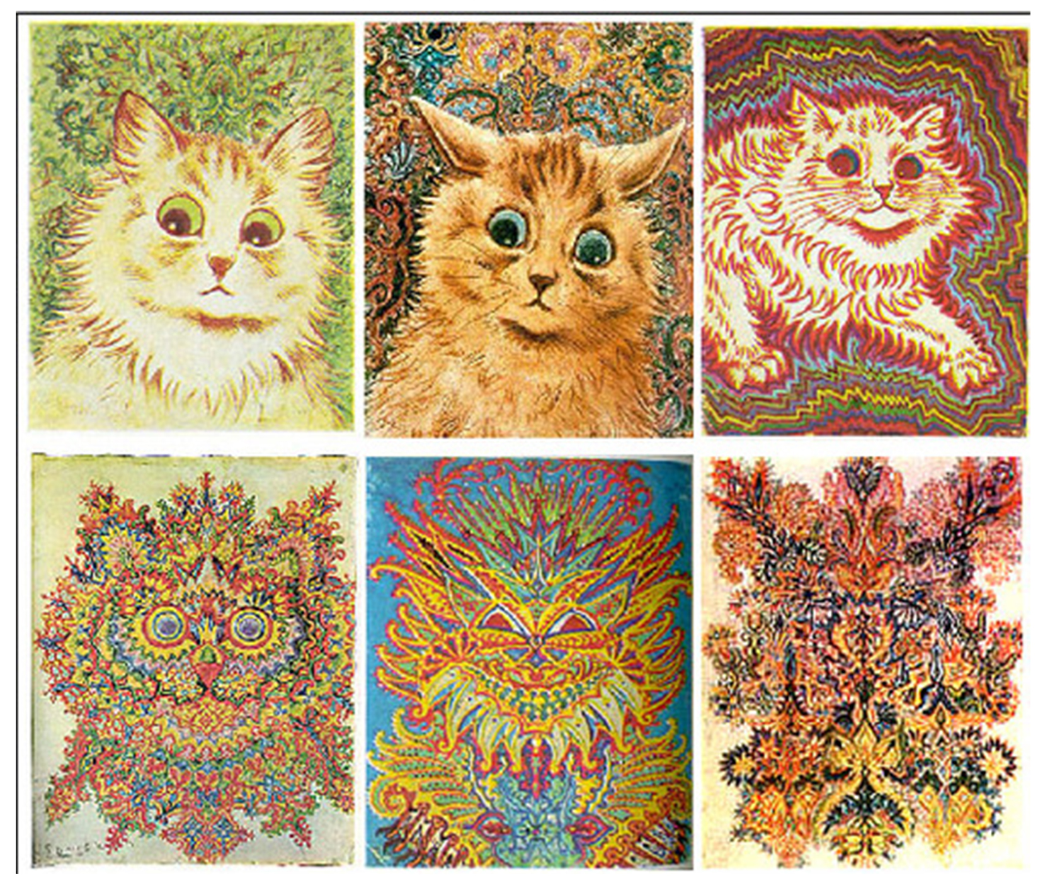
42.5 Figure 4
Louis Wain on Wikimedia Commons. "Schizophrenia drawings."
Notes:
42.5 Figure 4: English artist Louis William Wain (1860–1939) is alleged to have suffered from schizophrenia, though his diagnosis was never clinically validated. These images of cats were drawn over many years and may reflect a change in Wain's mental health over time.

Slide 32
Mental Illnesses: Depression–Prevalence Statistics, Diagnosis, and Symptoms
Major depression:
Affects ~8.4% of adults in the United States
Is one of the most common mental disorders
To be diagnosed with a major depressive disorder, a person must have experienced a severely depressed mood lasting longer than 2 weeks along with other symptoms, including:
A loss of enjoyment in activities that were previously enjoyed
Changes in appetite and sleep schedules
Difficulty concentrating
Feelings of worthlessness
Suicidal thoughts

Slide 33
Mental Illnesses: Depression–Possible Causes
While exact causes are unknown, major depression is likely caused by both genetic and environmental risk factors.
The "classic monoamine hypothesis" suggests that depression is caused by low brain levels of norepinephrine, dopamine, and/or serotonin (monoamine neurotransmitters).
While some antidepressants increase monoamine availability within a few hours, clinical results are not seen for weeks.
These monoamine-based antidepressants induce physical changes in neurons that alter their response to monoamines.
Not all patients taking these antidepressants respond.
The "glutamate" hypothesis suggests that depression is caused by a dysfunction in glutamate signaling, leading to a glutamate excess.
Because glutamate is involved in synapse formation (LTP and LTD), this explains why neural plasticity is disrupted during depression.

Slide 34
Mental Illnesses: Depression–Treatments
Treatments for depression include:
Psychotherapy
Electroconvulsive therapy
Deep-brain stimulation
Prescription medications
Monoamine oxidase inhibitors (MAO) block the enzyme that degrades many neurotransmitters, resulting in increased transmitters in the synaptic cleft.
Selective serotonin reuptake inhibitors (SSRIs) block the reuptake of serotonin into the presynaptic neuron, resulting in increased serotonin in the synaptic cleft.
Norepinephrine-dopamine reuptake inhibitors and norepinephrine-serotonin reuptake inhibitors work similarly.

Slide 35
Think It Through₂
Identify the appropriate neurodegenerative or neurodevelopmental disorder based on the salient symptom described.
Loss of memory
Loss of memory
Difficulty focusing on a task
Tremor and gait abnormalities
Notes:
Originally an On Your Own. This is included here to use as a talking point or for a think-pair-share activity.

Slide 36
Other Neurological Disorders
Other neurological disorders that cannot be placed into other categories include:
Chronic pain conditions
Cancers of the nervous system
Epilepsy disorders
Stroke

Slide 37
Other Neurological Disorders: Epilepsy
Epilepsy:
Affects ~1.2% of people in the United States (2015)
Comes in several different types
Is characterized by recurrent seizures
Can be a symptom of brain injury, disease, or other illness
Those with an intellectual disability or ASD can experience seizures.
Often has no identified cause
Likely results from a combination of genetic and environmental factors
Is controlled by anticonvulsant medications (to limit seizures)
May require brains surgery in very severe cases to remove the brain area where seizures originate

Slide 38
Other Neurological Disorders: Stroke–Prevalence Statistics
Strokes are the 3rd most common cause of death in the United States.
On average, 1 person experiences a stroke every 40 seconds in the United States.
~75% of strokes occur in people older than 65 years of age.
Risk factors for stroke include:
High blood pressure
Diabetes
High cholesterol
A family history of stroke
Smoking (which doubles the risk of stroke)

Slide 39
Other Neurological Disorders: Stroke–Causes and Symptoms
A stroke results when blood fails to reach a portion of the brain for a long enough time to cause damage (neuronal death).
Stroke is often caused by:
Blood clots
Bursting of a weak blood vessel
Symptoms may include (depending on the brain area affected):
Headache
Muscle weakness or paralysis
Speech disturbances
Sensory problems
Memory loss
Confusion

Slide 40
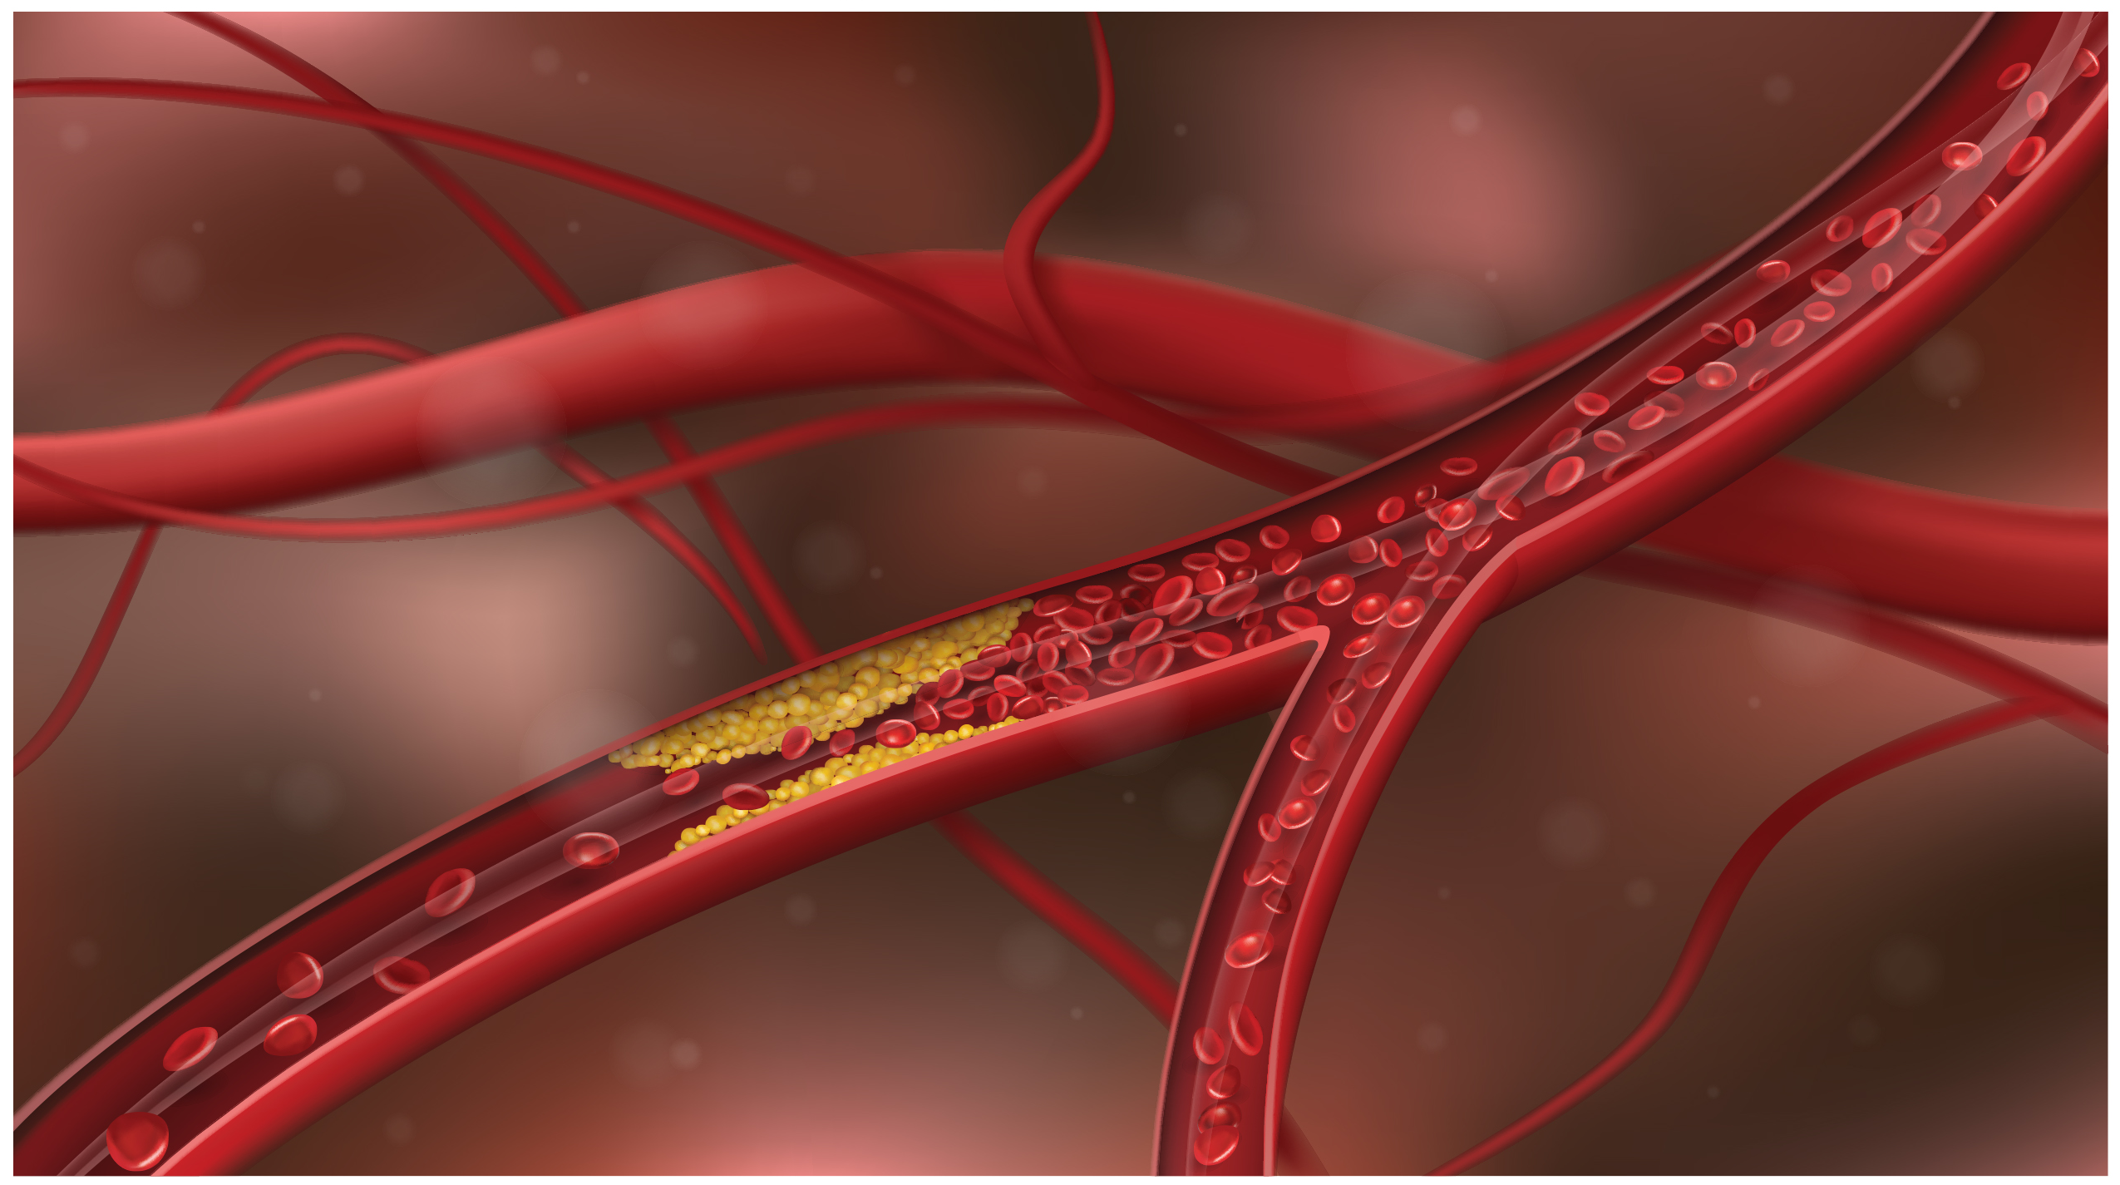
42.5 Figure 5
Notes:
42.5 Figure 5: The narrowing of blood vessels due to the deposition of cholesterol can prevent blood flow and result in blockage of the artery. If this blocked blood vessel is in the brain, it can result in a stroke.

Slide 41
Other Neurological Disorders: Stroke–Treatment
A stroke is a medical emergency.
Immediate (within 3 hours) administration of drug(s) to dissolve any clots is important.
These drugs do not work if:
The stroke was caused by a burst blood vessel, or the stroke occurred more than 3 hours ago
Subsequent treatment includes:
Blood pressure medication (to prevent future strokes)
Physical therapy (which may be intense)

Slide 42
Reflection Question
What are some behaviors that can lower the onset of a stroke?
Notes:
The reflection question is included here to use as a talking point or for a think-pair-share activity.

Slide 43
Summary
Some general themes emerge from studying nervous system disorders.
The causes for most disorders are not fully understood, at least for all patients.
The causes often likely involve a combination of nature (genetics) and nurture (environmental factors including emotional trauma, stress, hazardous chemical exposure).
Treatment options are lacking and often only address symptoms, not causes.

Slide 44


End of Hawkes Learning PowerPoint

