Slide 1
Lesson 43.1
Skeletal Systems

Slide 2
Objectives
Discuss the different types of skeletal systems.
Explain the role of the human skeletal system.
Compare and contrast different skeletal systems.

Slide 3
Musculoskeletal System
The musculoskeletal system is a combination of:
The skeletal system, which:
  Is composed of bones
  Protects the body’s internal organs
  Supports the weight of the body
The muscular system, which:
  Contracts and pulls on bones
  Allows for diverse movements

Slide 4
Musculoskeletal System: Injury and Disease
Injury or disease affecting the musculoskeletal system can be debilitating.
Malnutrition causes the most common musculoskeletal diseases worldwide.
Ailments affecting joints (such as arthritis) can make movement difficult and impair mobility.
In severe cases of joint damage, joint replacement surgery may be needed.
  Joint replacement of the hips and knees is the most common.
  Joint replacement for shoulders, elbows, and fingers are also available.
Prostheses have improved but still have limited durability.
  New materials (such as carbon fiber) may make them more durable.

Slide 5
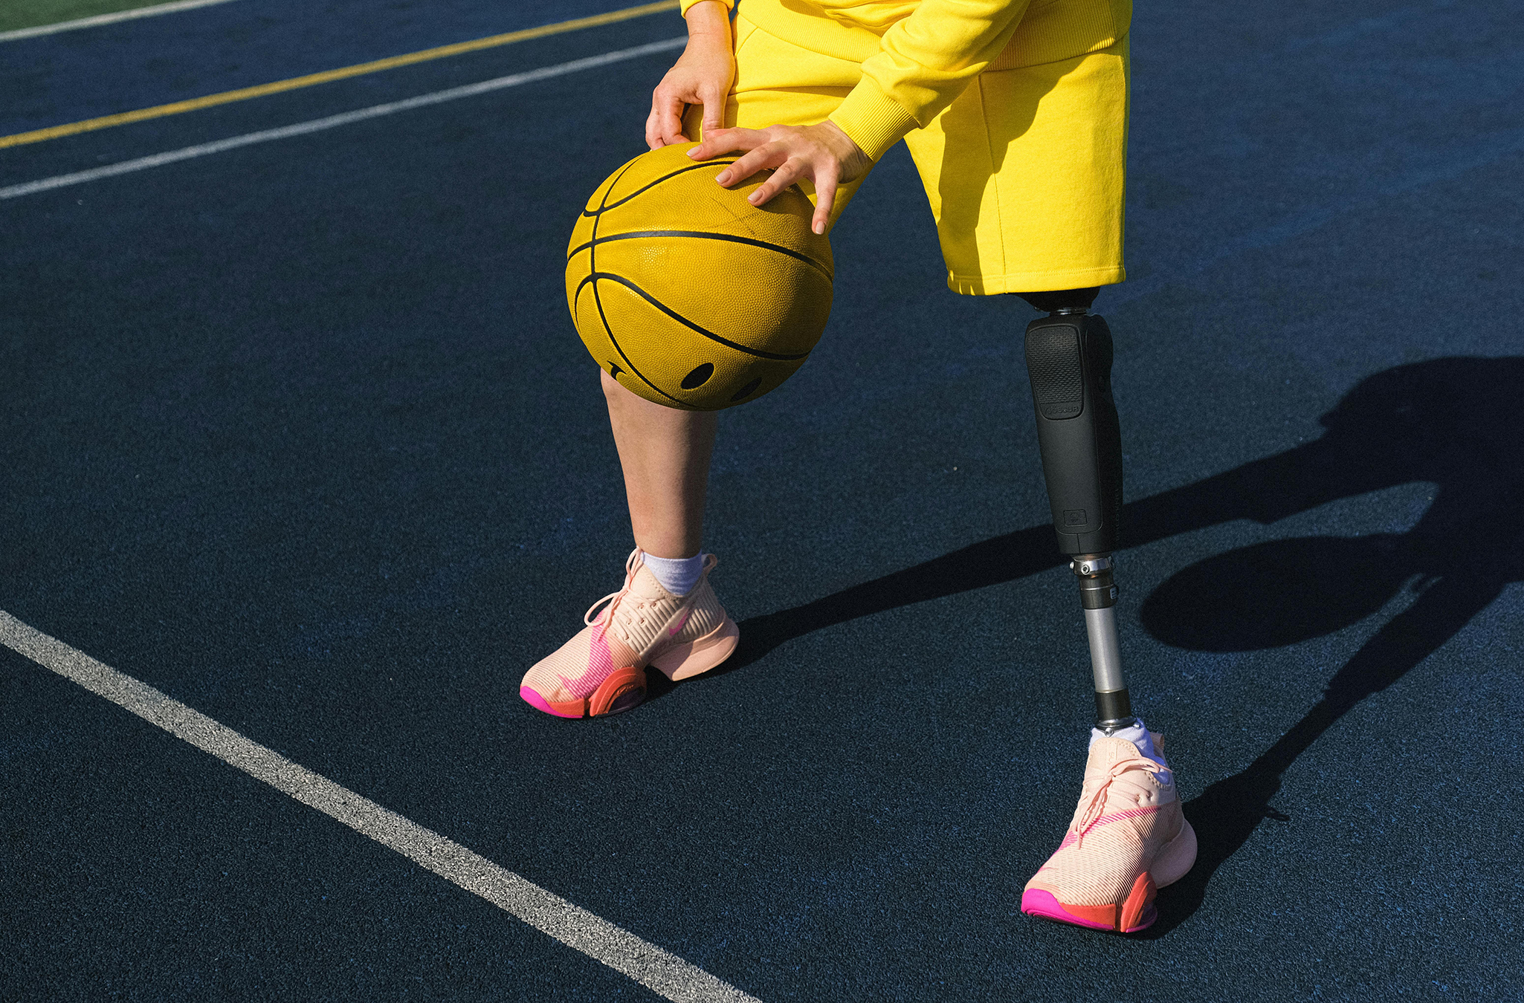
43.1 Figure 1
Anna Shvets on Pexels. "Prosthetic leg."
Notes:
43.1 Figure 1: Improvements in the design of prostheses have allowed for a wider range of activities in recipients.

Slide 6
Skeletal System Functions and Designs
The skeletal system has 3 functions:
  Support the body
  Protect internal organs
  Allow for movement of the organism
There are 3 different skeleton designs that fulfill these functions:
  Hydrostatic skeleton
  Exoskeleton
  Endoskeleton

Slide 7
Skeletal System Design: Hydrostatic Skeleton
A hydrostatic skeleton is one formed by a fluid-filled compartment within the body called the coelom.
The organs of the coelom are supported by aqueous fluid and resist external compression.
The coelom is under hydrostatic pressure because of the fluid and supports other organs.
The muscles surrounding the coelom allow movement, contracting to change the shape of the coelom.
  The pressure of the fluid in the coelom produces movement.
  Example: earthworm movement by peristalsis (waves of muscular contractions) of the body wall’s skeletal muscle
Soft-bodied animals including sea anemones, earthworms, jellyfish, and other invertebrates have hydrostatic skeletons.
This is not an efficient skeleton for larger terrestrial animals.
  If it were to get too large, it would collapse under the weight of its fluid.

Slide 8
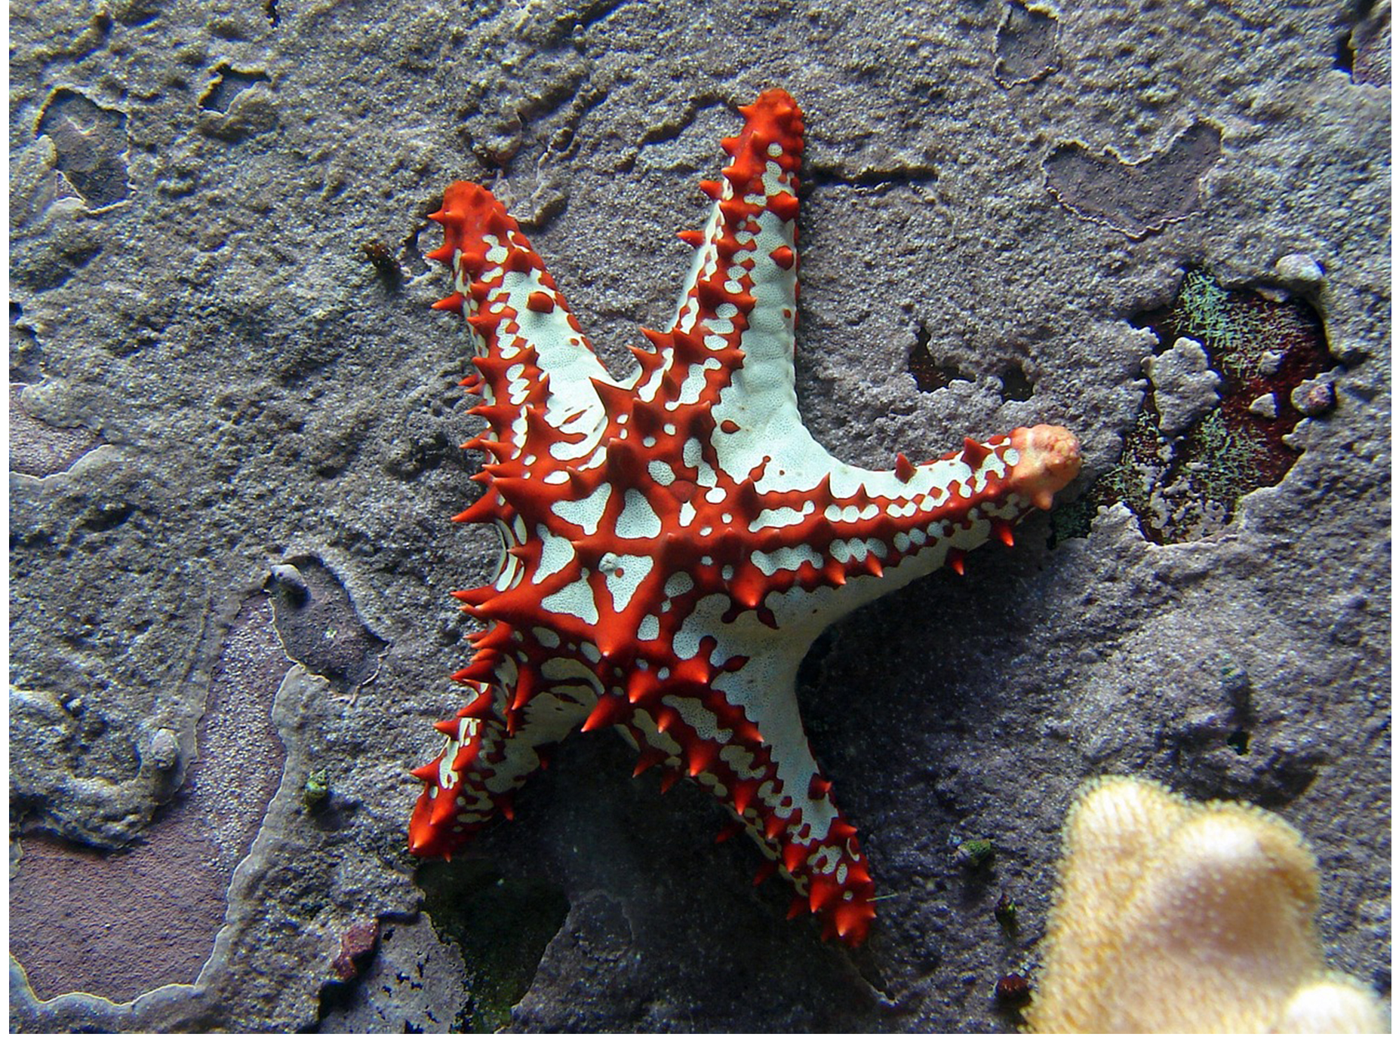
43.1 Figure 2
dmkoch on Pixabay. "Sea star skeleton."
Notes:
43.1 Figure 2: The skeleton of the red-knobbed sea star (Protoreaster linckii) is an example of a hydrostatic skeleton.

Slide 9
Group Activity
Working in pairs, come up with three different animals that you suspect operate by way of a hydrostatic skeleton. Then, do a quick internet search and check your list. How many did you get correct? Pick one of these animals to research further.
Use the internet or other resources to learn how this animal can move around with its hydrostatic skeleton.
Share your animal's method of locomotion with the class.

Slide 10
Skeletal System Design: Exoskeleton₁
An exoskeleton:
Is an external skeleton that consists of a hard covering on an organism’s surface
Provides defense against predators
Supports the body
Allows for movement through the contraction of attached muscles
  These muscle must cross joints (points where two skeletal segments join) inside the exoskeleton.
  Muscle shortening changes the relationship between the 2 exoskeleton segments.

Slide 11
Skeletal System Design: Exoskeleton₂
Examples of animals with exoskeletons include the shells of crabs and insects.
Arthropods (such as crabs and lobsters) have exoskeletons that are 30–50% chitin, a strong and flexible modified glucose polysaccharide.
  Chitin is secreted by epidermal cells that line the body’s surface.
  The exoskeleton is strengthened by CaCO₃ in organisms such as the lobster.
  The exoskeleton does not grow, so an organism periodically sheds its exoskeleton and secretes a new one as it grows larger.

Slide 12
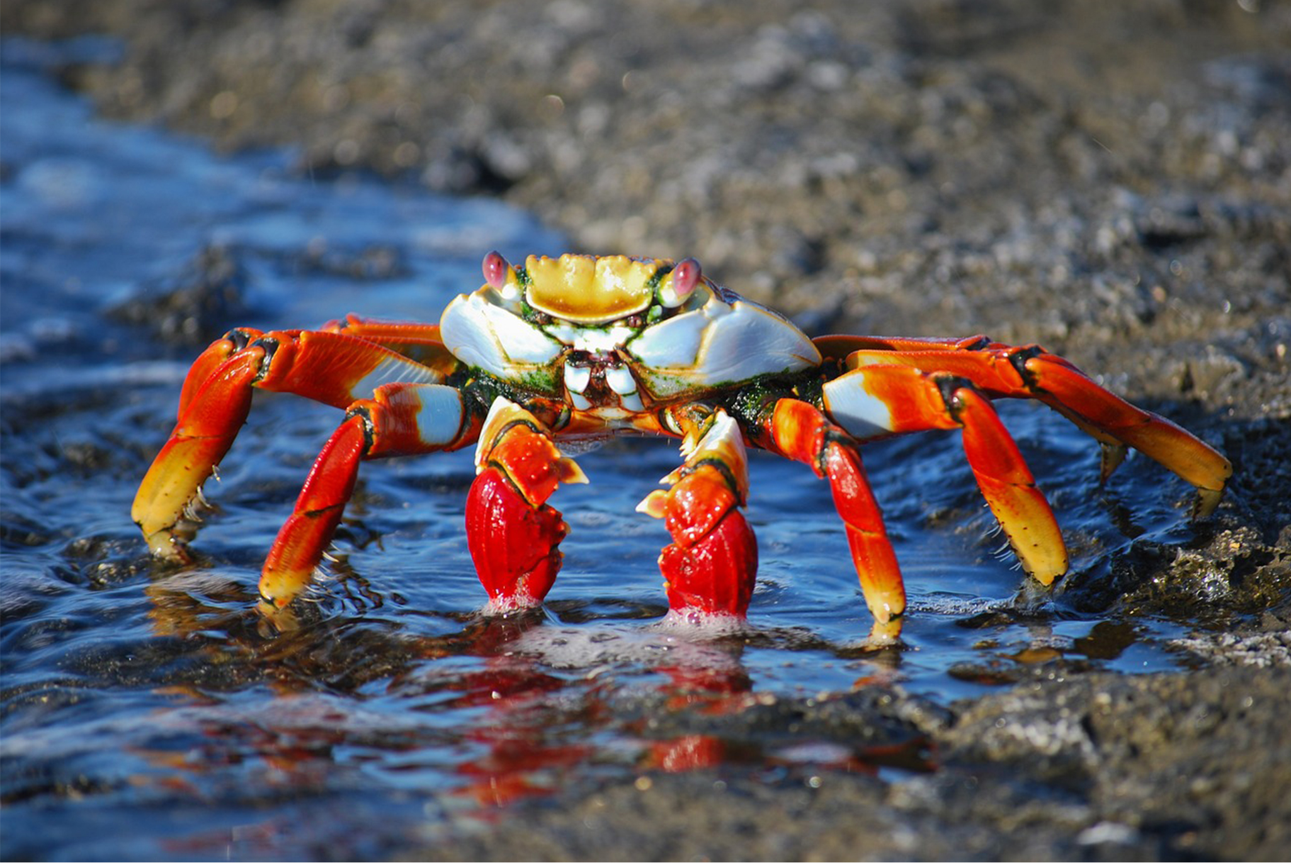
43.1 Figure 3
Kirkby on Pixabay. "Sally lightfoot crab."
Notes:
43.1 Figure 3: Muscles attached to the exoskeleton of the Sally Lightfoot crab (Grapsus grapsus) allow the crab to move.

Slide 13
Skeletal System Design: Endoskeleton
An endoskeleton:
Is a skeleton that consists of hard, mineralized structures located within the soft tissue (muscle and fat) of an organism
Provides support for the body
Protects internal organs
Allows for movement through contraction of muscles attached to the skeleton
Examples of endoskeletons include:
The spicules of sponges (a primitive endoskeleton), although sponges have no true tissues
The vertebral skeletons, whose bones are composed of tissues

Slide 14
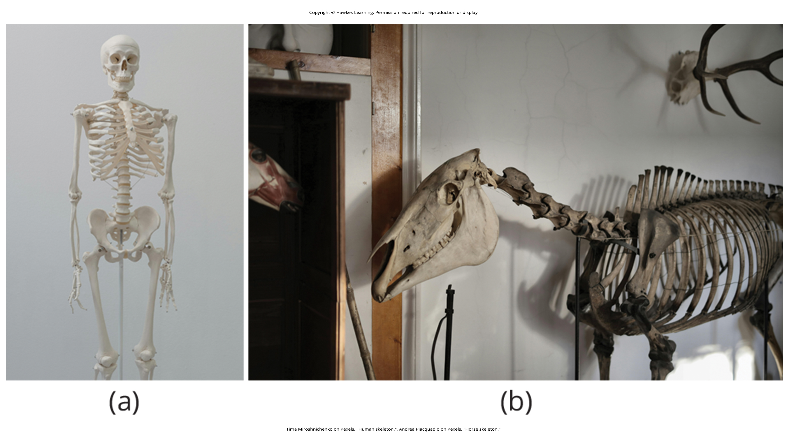
43.1 Figure 4
Tima Miroshnichenko on Pexels. "Human skeleton."
Andrea Piacquadio on Pexels. "Horse skeleton."
Notes:
43.1 Figure 4: The skeletons of (a) humans and (b) horses are examples of endoskeletons.

Slide 15
The Human Endoskeleton₁
The adult human endoskeleton:
Consists of 206 bones
Has 5 main functions:
  Providing support to the body
  Storing mineral and lipids
  Producing blood cells
  Protecting internal organs
  Allowing for movement

Slide 16
The Human Endoskeleton₂
The adult human endoskeleton is divided into 2 parts:
The axial skeleton:
  Skull
  Vertebral column
  Rib cage
The appendicular skeleton
  Shoulders
  Limb bones
  Pectoral girdle
  Pelvic girdle

Slide 17
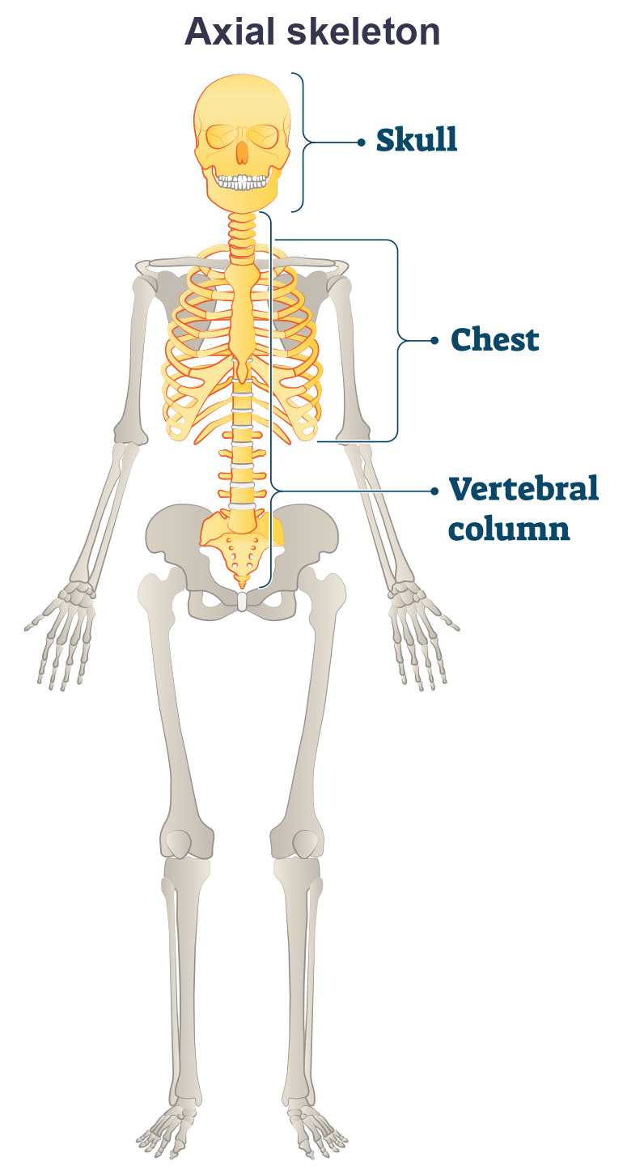
The Human Endoskeleton: Axial Skeleton Structure
The axial skeleton:
Forms the central axis of the body
Includes:
  Bones of the skull
  Ossicles (small bones) of the middle ear
  Hyoid bone of the throat
  Vertebral column
  Thoracic cage (rib cage)
43.1 Figure 5

Slide 18
The Human Endoskeleton: Axial Skeleton Function
The axial skeleton functions to:
Provide support and protection for
  The brain
  The spinal cord
  The organs in the ventral body cavity (which contains the lungs, heart, stomach, and intestines)
Provide a surface for the attachment of muscles that move the head, neck, and trunk, which also help to
  Perform respiratory movements
  Stabilize parts of the appendicular skeleton

Slide 19
The Axial Skeleton: The Skull
The skull:
Supports structures of the face
Protects the brain
Consists of 22 bones, divided into 2 categories:
  Cranial bones
  Facial bones

Slide 20
The Axial Skeleton: The Skull’s Cranial Bones
The cranial bones:
Are 8 bones that form the cranial cavity, which enclose the brain and serve as attachment sites for the muscles of the head and neck
  1 frontal bone
  2 parietal bones
  2 temporal bones
  1 occipital bone
  1 sphenoid bone
  1 ethmoid bone
While the bones develop separately in the embryo and fetus, they are tightly fused with connective tissue in an adult and do not move.

Slide 21
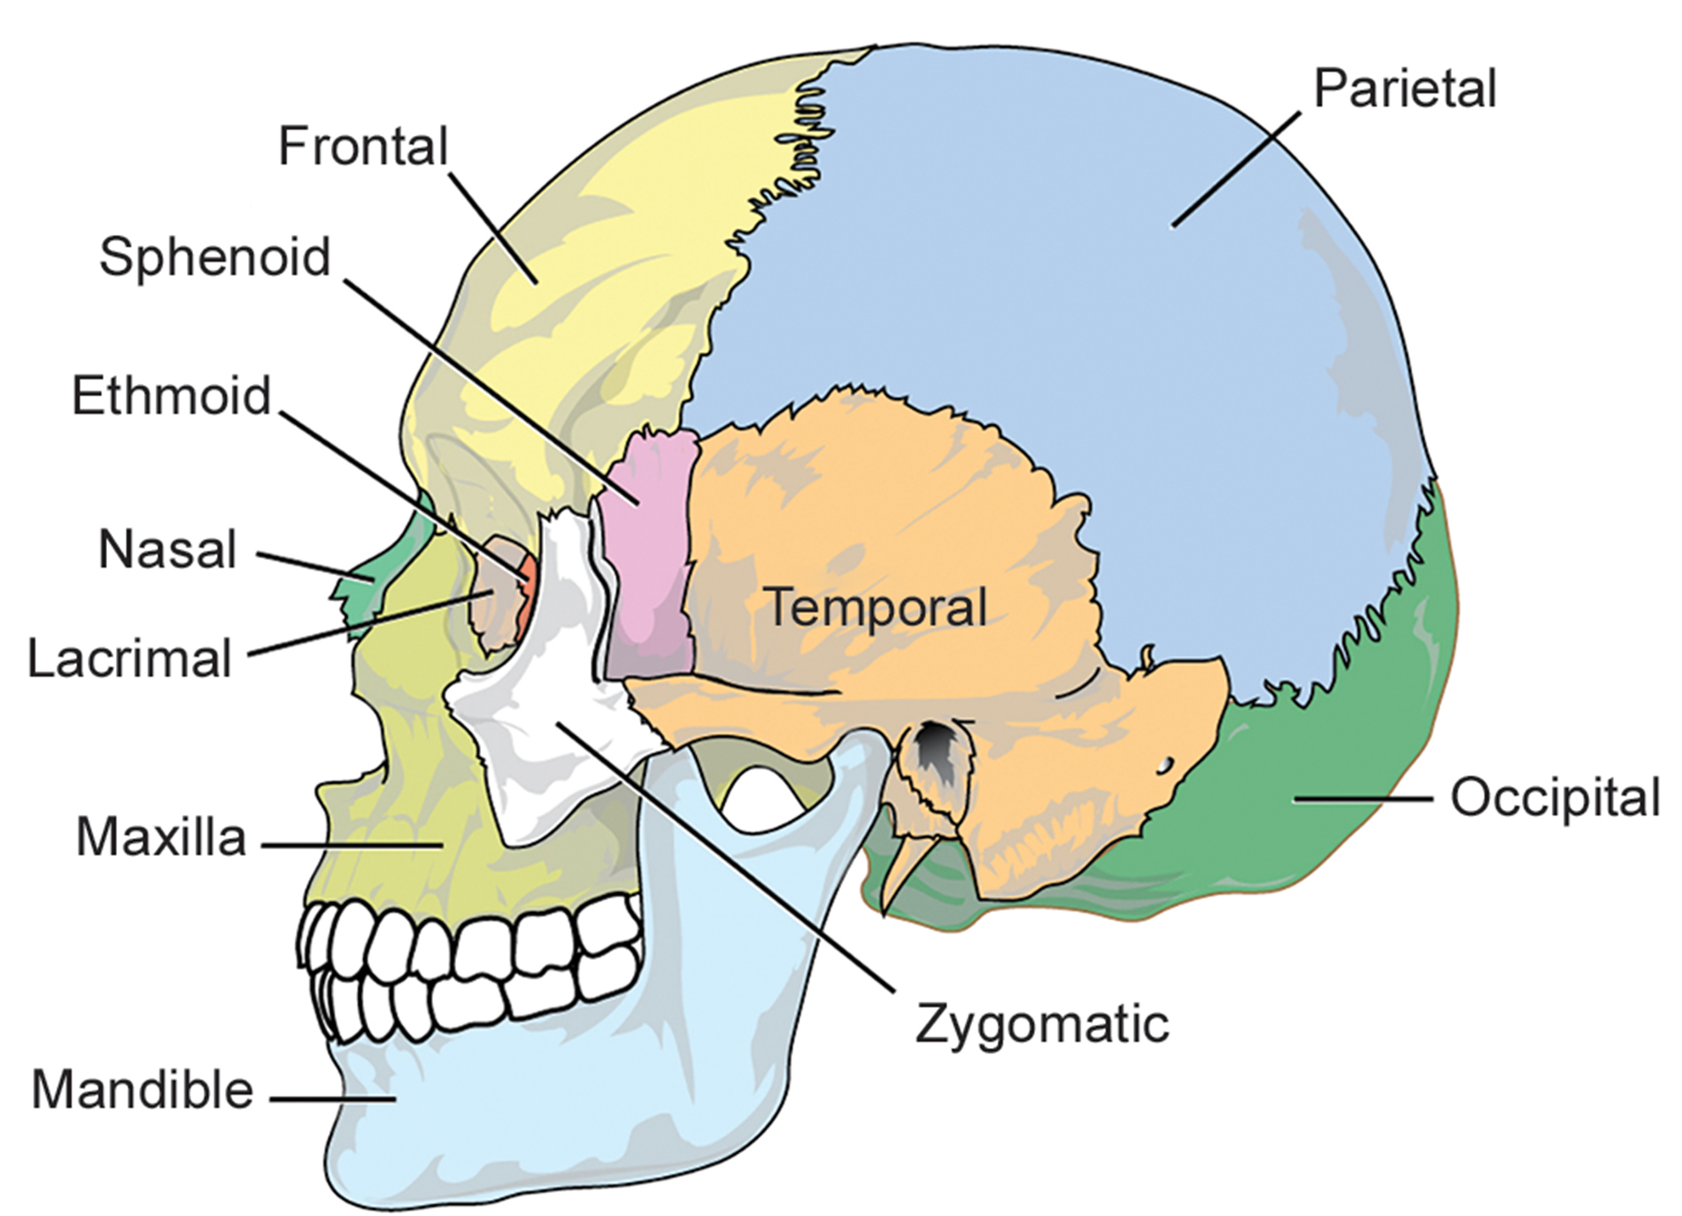
43.1 Figure 6
Mariana Ruiz Villarreal on Wikimedia Commons. "Skull bones."
Notes:
43.1 Figure 6: The bones of the skull support the structures of the face and protect the brain.

Slide 22
The Axial Skeleton: The Auditory Ossicles
The auditory ossicles of the middle ear:
Transmit sounds from the air as vibrations to the fluid-filled cochlea in the inner ear where vibrations are converted to nerve impulses
Consist of 3 bones each:
  The malleus
  The incus
  The stapes
Are the smallest bones in the body
Are unique to mammals
Are not considered as part of the skull but are found within it

Slide 23
The Axial Skeleton: The Skull’s Facial Bones
The facial bones:
Form the face
Provide cavities for sense organs (eyes, mouth, and nose)
Protect the entrances to the digestive and respiratory tracts
Serve as attachment points for facial muscles
Are 14 bones that include:
  2 nasal bones
  2 maxillary bones
  2 zygomatic bones
  2 palatine bones
  2 lacrimal bones
  2 inferior nasal conchae
  The vomer
  The mandible

Slide 24
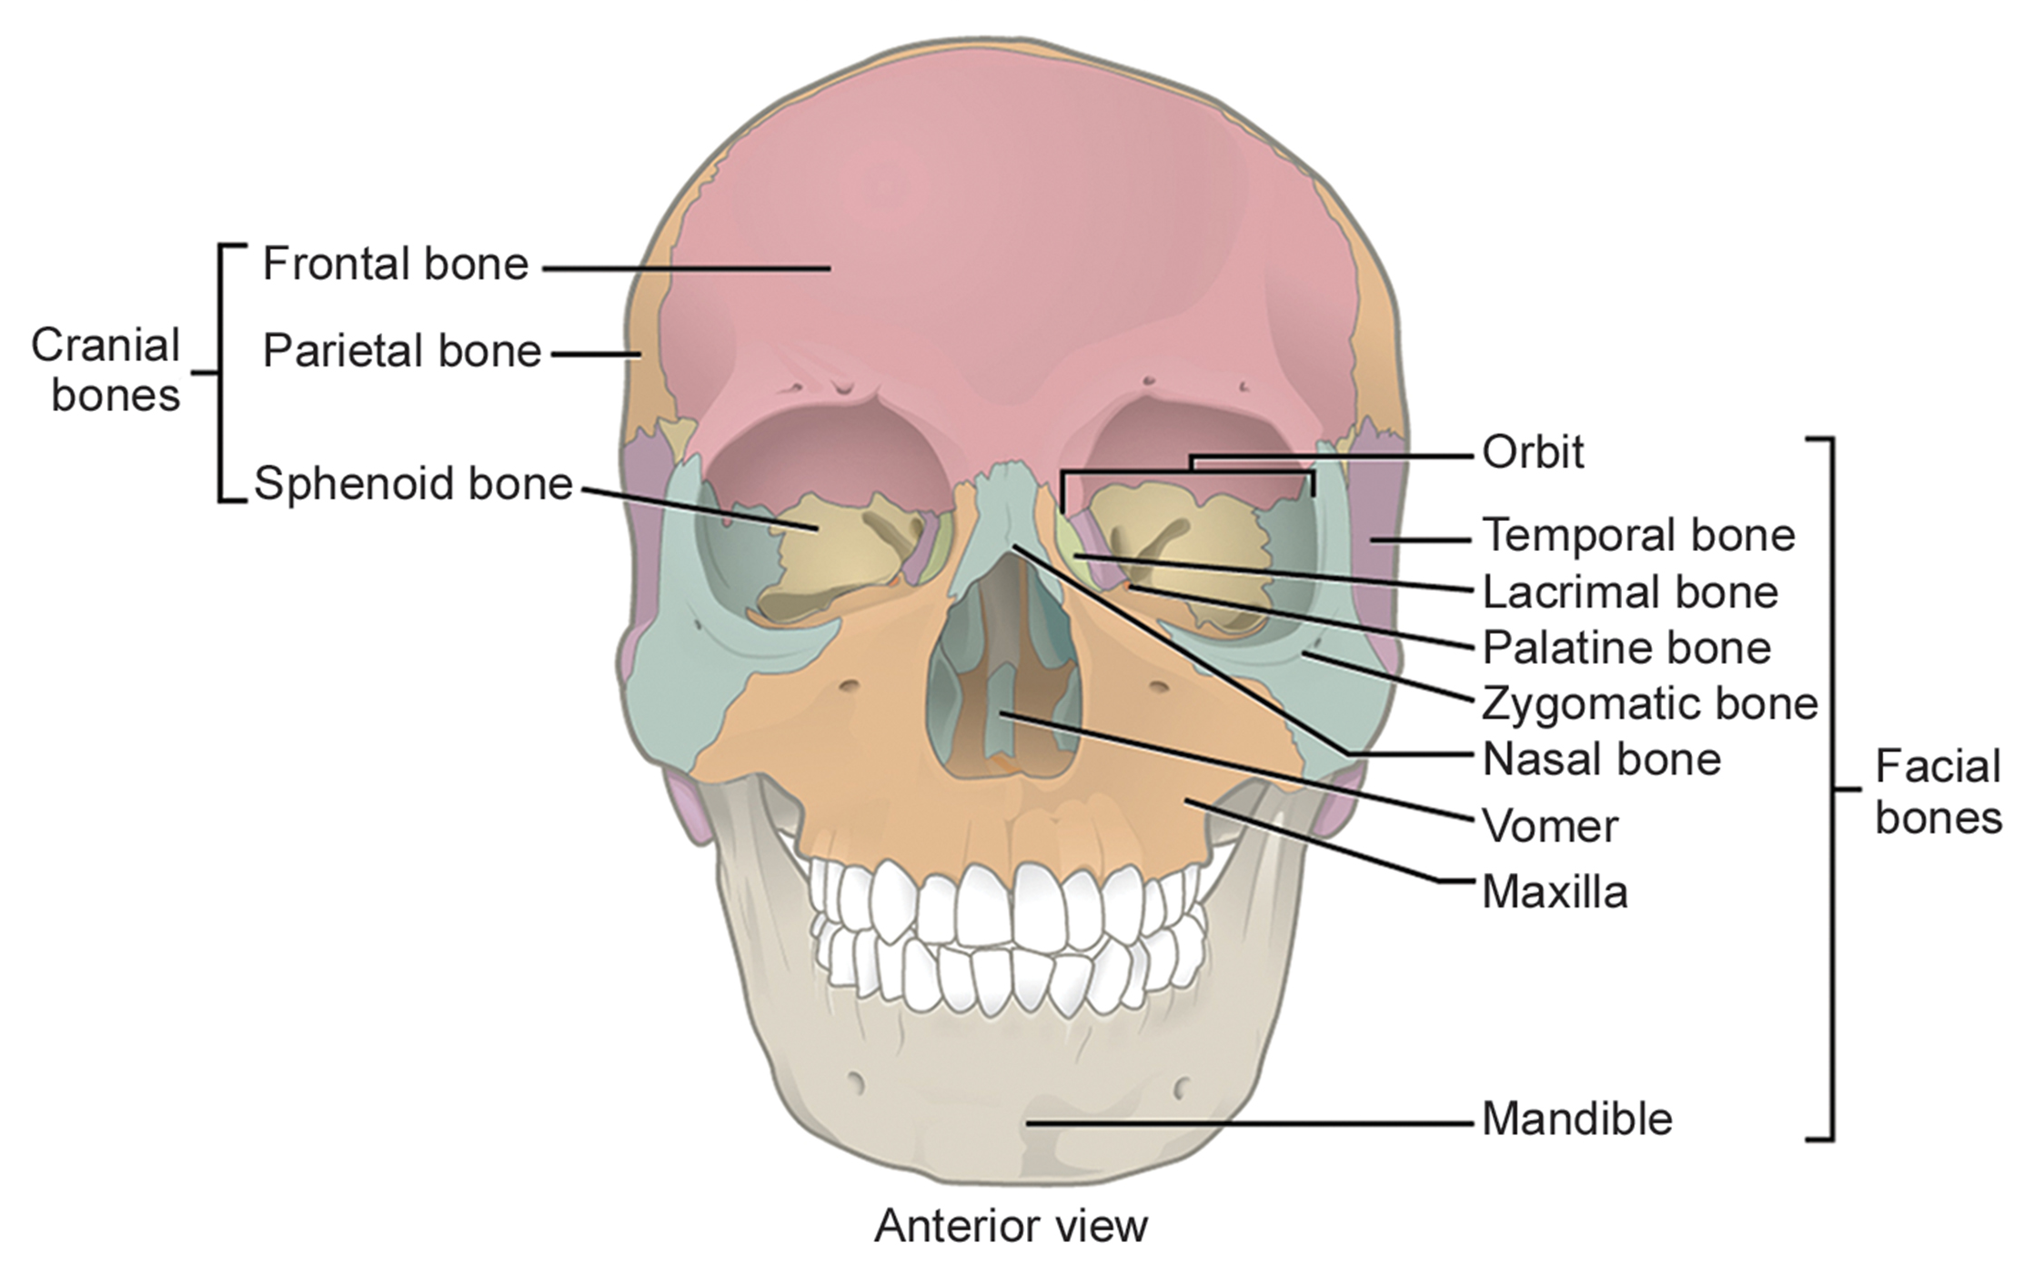
43.1 Figure 7
OpenStax. "Cranial and facial bones."
Notes:
43.1 Figure 7: The cranial bones, including the frontal, parietal, and sphenoid bones, cover the top of the head. The facial bones of the skull form the face and provide cavities for the eyes, nose, and mouth.

Slide 25
The Axial Skeleton: The Hyoid Bone and the Mandible
The hyoid bone:
Lies below the mandible in front of the neck
Acts as a movable base for the tongue
Is connected to muscles of:
  The jaw
  The larynx (voice box)
  The tongue
Is part of the axial skeleton, but not part of the skull
The mandible:
Articulates (connects via a joint) with the base of the skull
Controls the opening to the airway and gut
Brings the surfaces of the mandibular (lower) teeth in contact with the maxillary (upper) teeth

Slide 26
Think It Through₁
Identify the most accurate statement from the following choices.
The zygomatic bone is a facial bone.
The frontal bone lies below the mandible in the front of the neck.
Fifteen facial bones form the face.
The smallest bones in the body are found in the orbital socket.
Notes:
Originally an On Your Own. This is included here to use as a talking point or for a think-pair-share activity.

Slide 27
The Axial Skeleton: The Vertebral Column₁
The vertebral column (or spinal column):
Surrounds and protects the spinal cord
Supports the head
Acts as an attachment point for the ribs and muscles of the back and neck
Is made up of 26 bones in adults:
  24 vertebrae:
    7 cervical
    12 thoracic
    5 lumbar
  The sacrum: composed of 5 vertebrae that fuse
  The coccyx: composed of 3–4 vertebrae that fuse
    Around age 70, the sacrum and coccyx may fuse.

Slide 28
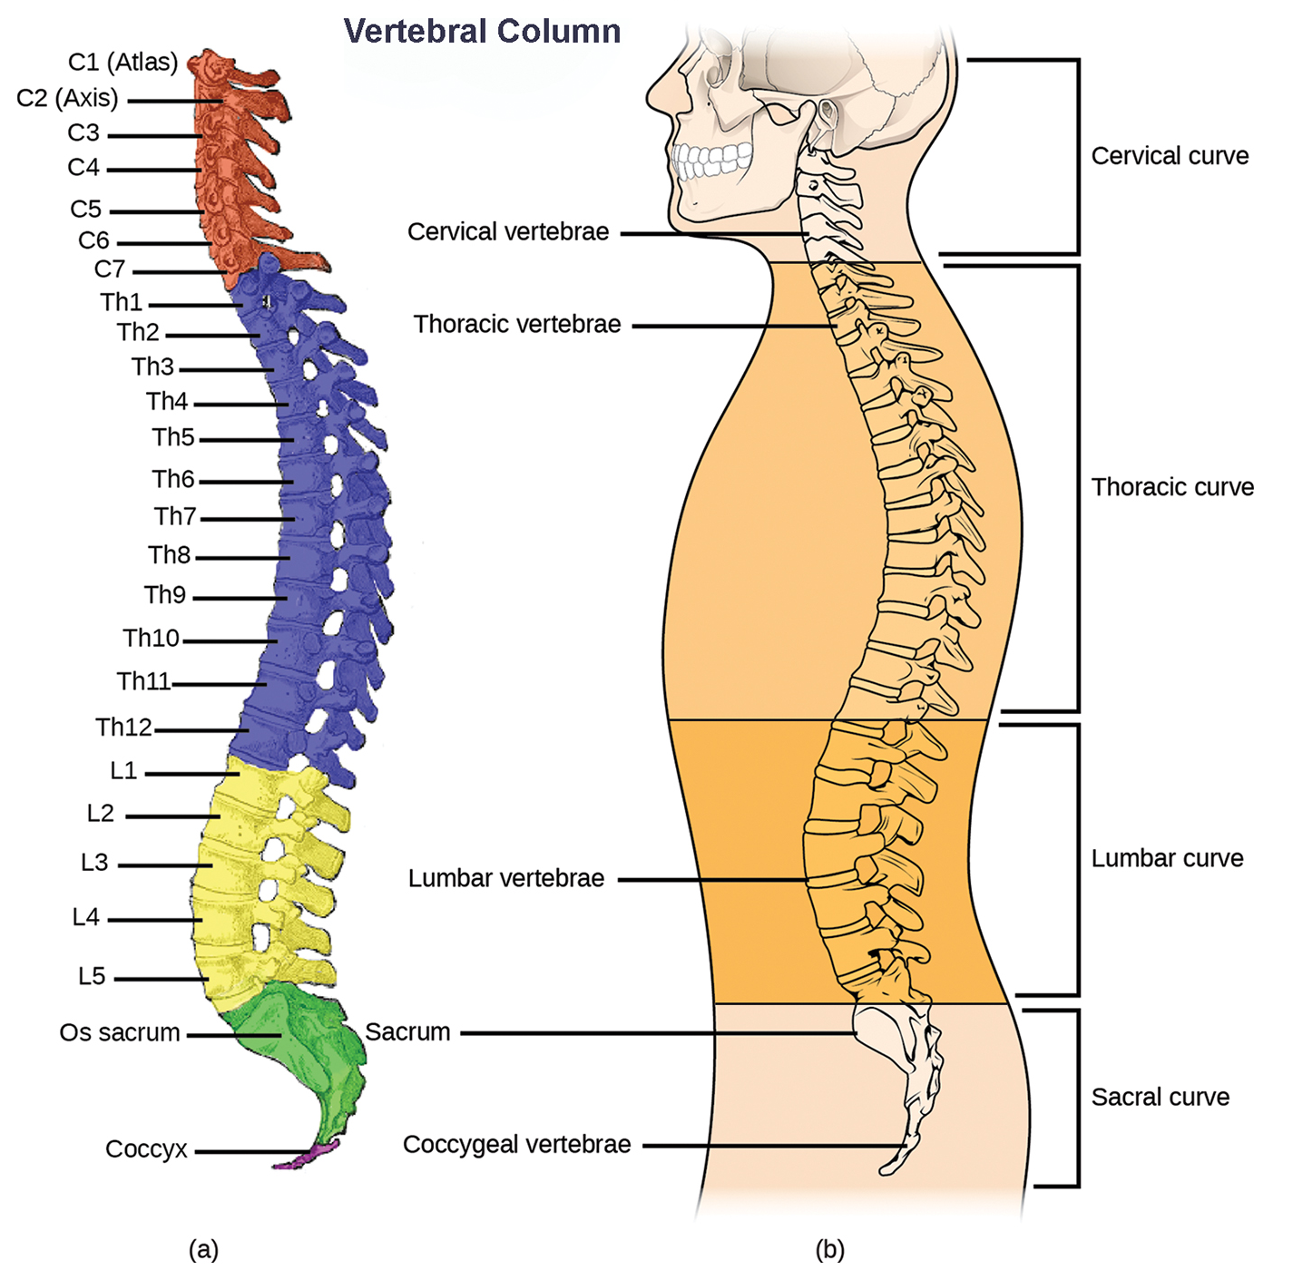
43.1 Figure 8
Uwe Gille on Wikimedia Commons. “Vertebral column.” Modified.
NCI, NIH. “Spinal column.” Modified.
Notes:
43.1 Figure 8: (a) The vertebral column consists of 7 cervical vertebrae (C1–7), 12 thoracic vertebrae (Th1–12), 5 lumbar vertebrae (L1–5), the os sacrum, and the coccyx. (b) Spinal curves increase the strength and flexibility of the spine.

Slide 29
The Axial Skeleton: The Vertebral Column₂
Each vertebral body has:
  A large hole in the center through which nerves of the spinal cord pass
  A notch on each side through which spinal nerves serving the body at that level can exit the spinal cord
The vertebral column is curved and ~ 71 cm (28 in.) long in adult male humans.
The names of the spinal curves refer to the spinal region in which they occur.
  The thoracic and sacral curves are concave (curve inwards from the front of the body).
  The cervical and lumbar curves are convex (curve outwards from the front of the body).
  The curvature increases strength and flexibility, allowing it to absorb shock.

Slide 30

43.1 Figure 9
Isiwal on Wikimedia Commons. "Pole vault."
Notes:
43.1 Figure 9: The sport of pole vaulting displays the strength, flexibility, and shock-absorbing abilities of the human vertebral column.

Slide 31
The Axial Skeleton: The Vertebral Column₃
Intervertebral discs:
Are composed of fibrous cartilage
Lie between adjacent vertebral bodies from the second cervical vertebra to the sacrum
Each is part of a joint that allows for some movement of the spine
Each acts as a cushion to absorb shocks from movements such as walking and running
Act as ligaments to bind vertebrae together
Each contains the nucleus pulposus (the inner part) that hardens and becomes less elastic as people age, diminishing the ability to absorb shock

Slide 32
The Axial Skeleton: The Thoracic Cage₁
The thoracic cage (the rib cage):
Is the skeleton of the chest
Consists of the ribs, sternum, thoracic vertebrae, and costal cartilages
Encloses and protects the organs of the thoracic cavity (including the heart and lungs)
Provides support for the shoulder girdles and upper limbs
Serves as the attachment point for the diaphragm, muscles of the back, chest, neck, and shoulders
Changes volume to enable breathing

Slide 33
The Axial Skeleton: The Thoracic Cage₂
The sternum (the breastbone):
Is a long, flat bone located on the anterior (front) of the chest
Is formed from 3 bones that fuse in adults
The ribs:
Are 12 pairs of long, curved bones that attach to the thoracic vertebrae and curve toward the front of the body, forming the rib cage
Costal cartilages connect the anterior ends of the ribs to the sternum, with the exception of rib pairs 11 and 12, which are free-floating.

Slide 34
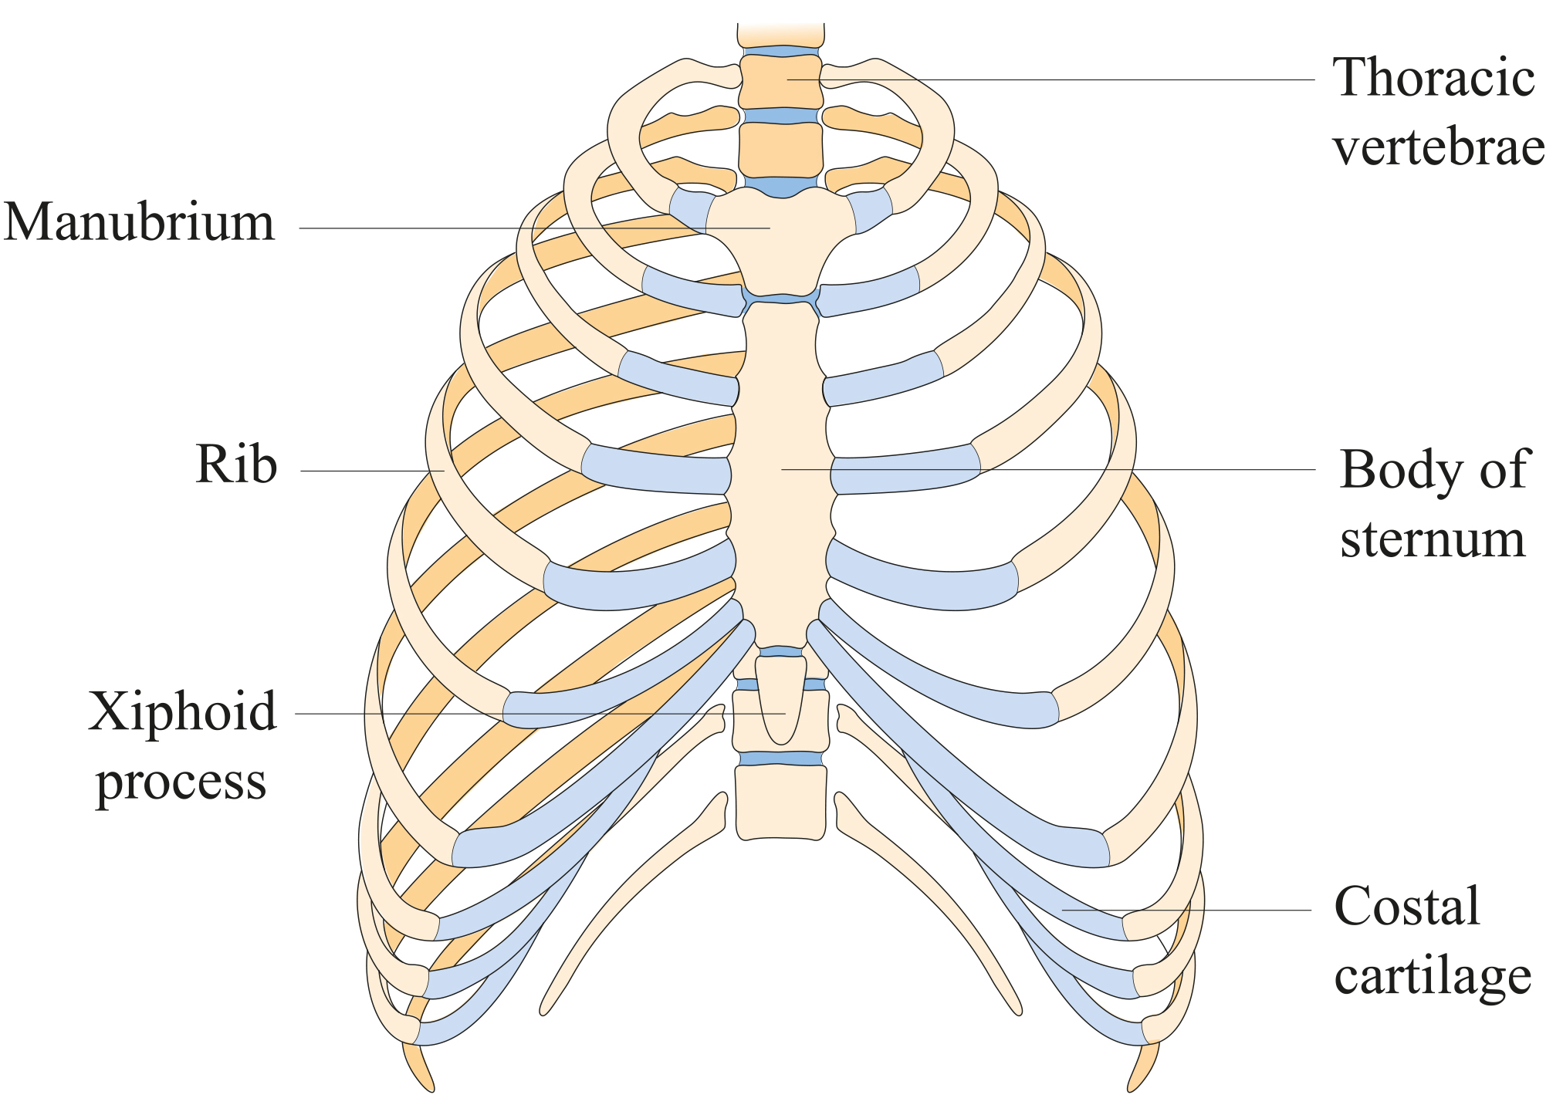
43.1 Figure 10
Notes:
43.1 Figure 10: The thoracic cage, or rib cage, protects the heart and the lungs.

Slide 35
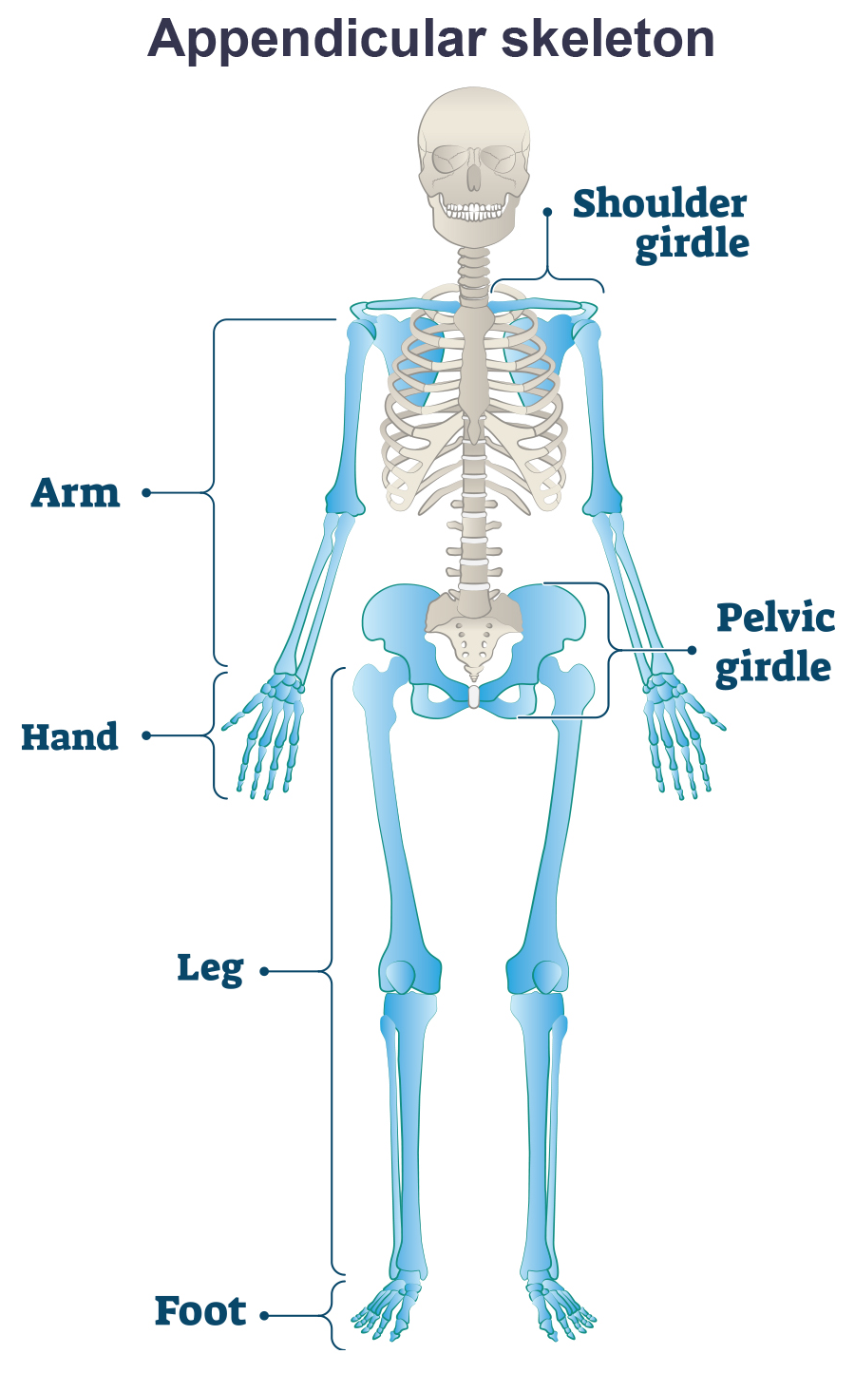
The Human Endoskeleton: Appendicular Skeleton Structure
The appendicular skeleton is composed of the bones of:
The pectoral (shoulder) girdle, which attaches the upper limbs to the body
The upper limbs, which grasp and manipulate objects
The pelvic girdle, which attaches the lower limbs to the body
The lower limbs, which permit locomotion
43.1 Figure 11

Slide 36
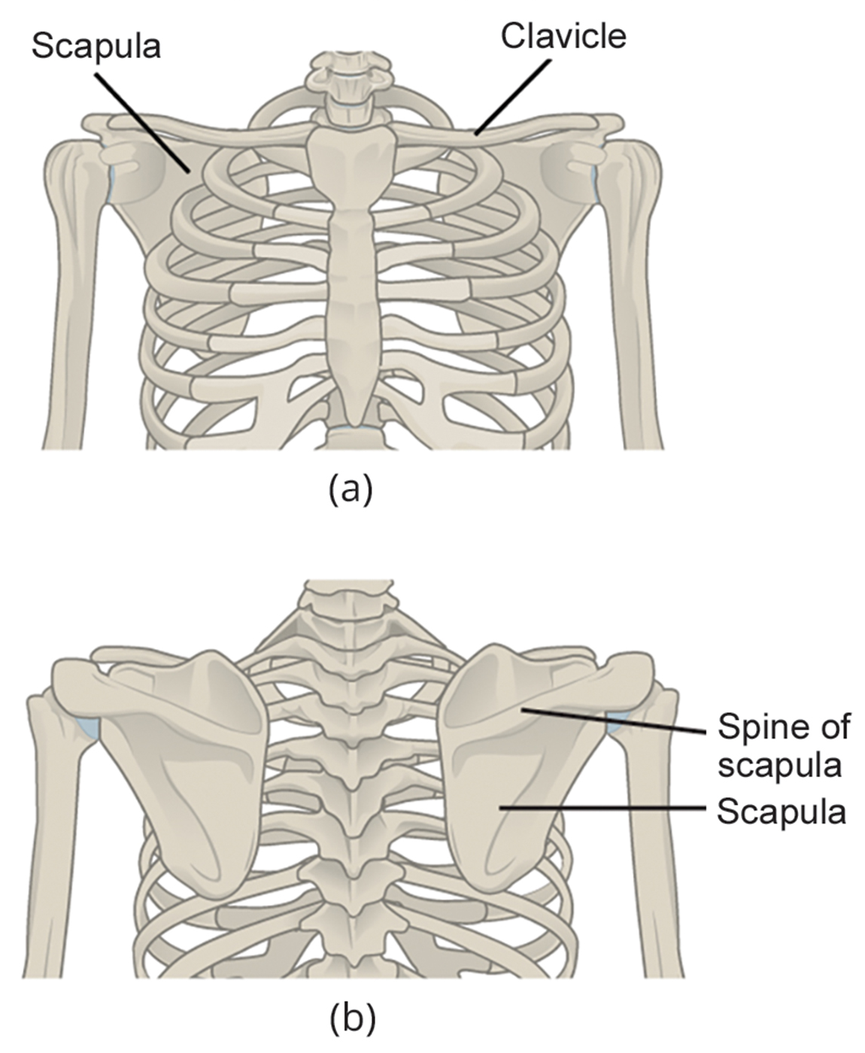
The Appendicular Skeleton: The Pectoral Girdle₁
The pectoral girdle bones:
Provide points of attachment of the upper limbs to the axial skeleton
Consist of:
  The clavicle (or collarbone) in the interior
  The scapulae (or shoulder blades) in the posterior
43.1 Figure 12
OpenStax. "Pectoral girdle." Modified.

Slide 37
The Appendicular Skeleton: The Pectoral Girdle₂
The clavicles:
Are S-shaped bones that position the arms on the body
Lie horizontally across the front of the chest, just above the first rib
Are fairly fragile and susceptible to fractures
  During a fall with outstretched arms, the force is transmitted to the clavicles, which could result in breakage.
Each articulate with the sternum and the scapula

Slide 38
Think It Through₂
The most common bone to fracture in the human body is the clavicle. Based on your reading, explain why.
Notes:
Originally an On Your Own. This is included here to use as a talking point or for a think-pair-share activity.

Slide 39
The Appendicular Skeleton: The Pectoral Girdle₃
The scapulae:
Are flat, triangular bones that are located at the back of the pectoral girdle
Support the muscles crossing the shoulder joint
Each include a ridge, called a spine, that can be easily felt through the skin
  The spine provides a broad area for the attachment of several different muscles to bone.

Slide 40
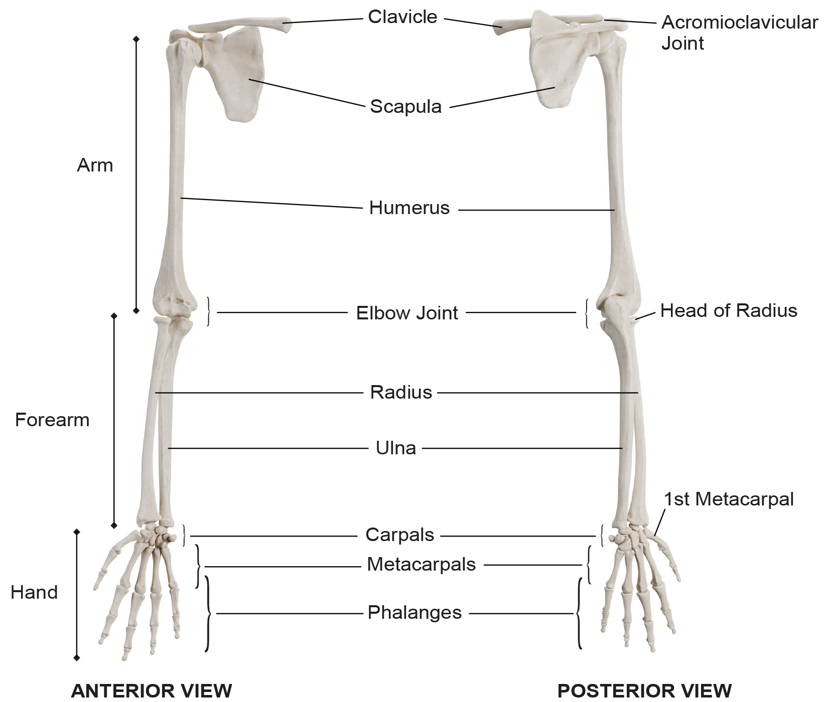
The Appendicular Skeleton: The Upper Limbs₁
Each upper limb contains 30 bones in 3 regions:
The arm (shoulder to elbow):
  The humerus
The forearm:
  The radius
  The ulna
The wrist and hand:
  8 carpals
  5 metacarpals
  14 bones of the phalanges
43.1 Figure 13
DrJanaOfficial on Wikimedia Commons. "Upper limb bones."

Slide 41
The Appendicular Skeleton: The Upper Limbs₂
An articulation is any place where 2 bones are joined.
The humerus:
  Is the largest and longest bone of the upper limb
  Is the only bone of the upper arm
  Articulates with the scapula at the shoulder
  Articulates with the forearm at the elbow

Slide 42
The Appendicular Skeleton: The Upper Limbs₃
The forearm extends from the elbow to the wrist and consists of:
The radius, which:
  Is located along the lateral (thumb) side
  Articulates with the humerus at the elbow
The ulna, which:
  Is located on the medial side (pinky-finger side) of the forearm
  Is longer than the radius
  Articulates with the humerus at the elbow
Both the radius and ulna also articulate with the carpal bones and each other, giving vertebrates a variable degree of wrist rotation

Slide 43
The Appendicular Skeleton: The Upper Limbs₄
The hand includes:
The 8 bones of the carpus (wrist)
The 5 bones of the metacarpus (palm)
The 14 bones of the phalanges (digits)
  Each digit consists of 3 phalanges, except the thumb which has only 2
    Distal
    Middle
    Proximal

Slide 44
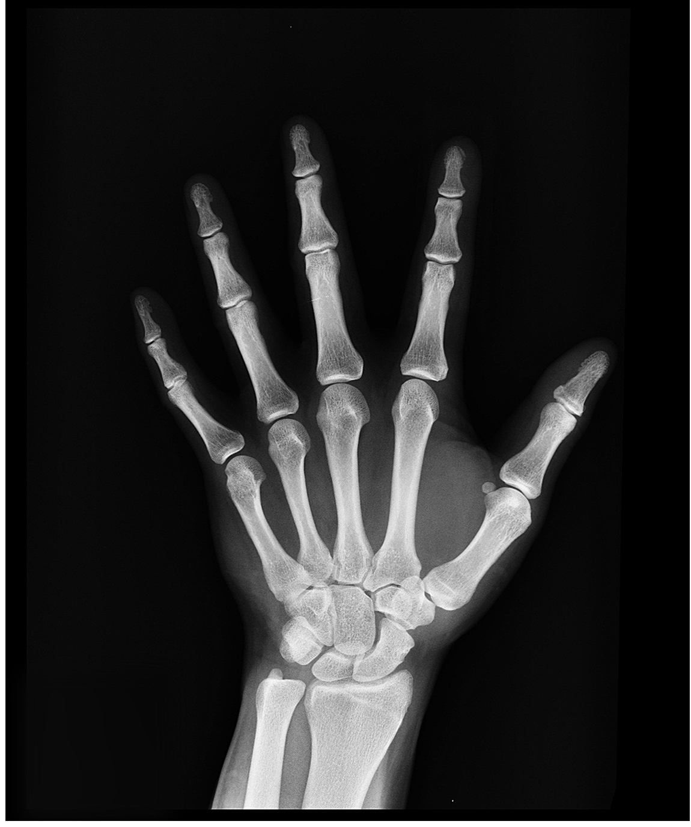
43.1 Figure 14
Pixabay on Pexels. "Hand X-ray."
Notes:
43.1 Figure 14: X-rays are helpful for examining bones and their structure. In this image, each finger consists of three phalanges, except for the thumb, which has only two.

Slide 45
The Appendicular Skeleton: The Pelvic Girdle₁
The pelvic girdle:
Is attached to the lower limbs of the axial skeleton
Is responsible for bearing the body’s weight and locomotion
Is securely attached to the axial skeleton by strong ligaments (connective tissue that attaches bone to bone)
Has deep sockets with robust ligaments to securely attached the femur to the body
Is further strengthened by 2 large hip bones (coxal bones), which are each formed by the fusion of 3 bones:
  The ilium
  The ischium
  The pubis
Is joined together:
  By a joint called the pubic symphysis at the body’s anterior
  With the bones of the sacrum at the body’s posterior

Slide 46
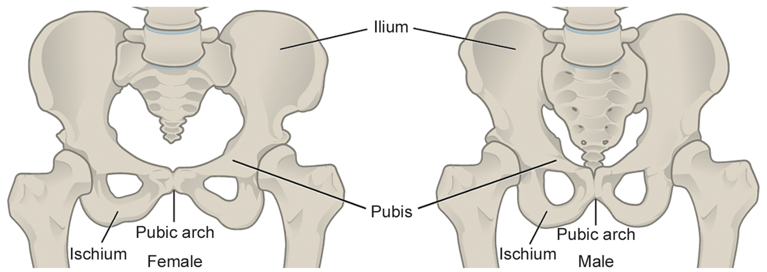
The Appendicular Skeleton: The Pelvic Girdle₂
The female pelvis is slightly different than the male’s, likely due to evolution selecting for females having a wider public angle and a pelvic canal with a larger diameter.
These pelvic characteristics are associated with easier childbirth and more successful reproduction.
43.1 Figure 15
OpenStax. "Pelvic girdle." Modified.

Slide 47
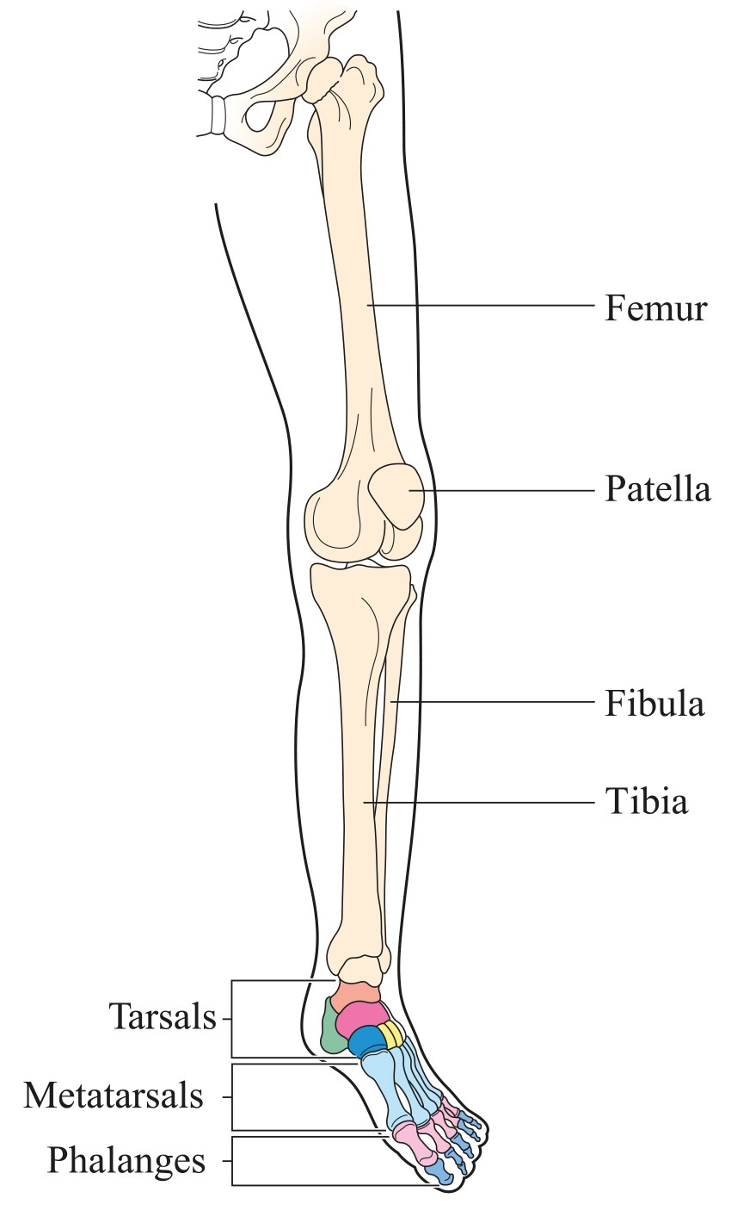
The Appendicular Skeleton: The Lower Limbs₁
Each lower limb consists of 3 regions:
The thigh:
The leg
The foot
The bones include:
The femur (thigh bone)
The patella (kneecap)
The tibia and fibula (leg bones)
The tarsals (ankle bones)
The metatarsals and phalanges (foot bones)
These bones are thicker and stronger than those of the upper limbs because they must support:
The body’s weight
Forces from locomotion
43.1 Figure 16

Slide 48
The Appendicular Skeleton: The Lower Limbs₂
The femur (thighbone) is the longest, heaviest, and strongest bone in the body.
The femur and pelvis form the hip joint at the proximal end.
The femur, tibia, and patella form the knee joint at the distal end.
The patella (kneecap) is a triangular bone that lies in front of the knee joint.
It is embedded in the tendon of the quadriceps muscle.
It improves knee extension by reducing friction.

Slide 49
The Appendicular Skeleton: The Lower Limbs₃
The tibia (shinbone) is a large leg bone located directly below the knee.
It articulates with the femur at its proximal end and with the fibula and tarsal bones at its distal end.
It is the second largest bone in the human body.
It transmits the body’s weight from the femur to the foot.
The fibula (calf bone) parallels and articulates with the tibia.
It does not articulate with the femur and does not bear weight.
It acts as a site for muscle attachment.
It forms the lateral (outside) part of the ankle joint.

Slide 50
The Appendicular Skeleton: The Lower Limbs₄
The tarsals are the 7 bones of the ankle.
  The ankle transmits body weight from the tibia and fibula to the foot.
The metatarsals are the 5 bones of the foot.
The phalanges are the 14 bones of the toes.
  Each toe consists of 3 phalanges, except the big toe that has only 2.
Variations exist in other species.
  The horse’s metacarpals and metatarsals are oriented vertically and do not make contact with the substrate.

Slide 51
Science and You
How Do Human Lower Limb Bones Compare to Some of Our Closest Living Relatives?
One difference is that, compared with other great apes, humans have different angles in their leg bones.
These angles enable us to walk upright.
In humans, the angle of the femur toward the knee is an inward sloping angle.
  That angle positions our feet so we can walk without swaying.
Great apes have thighs that either angle more up and down or even angle outward, which is why apes tend to sway when they walk upright.
Notes:
This is included as a relevant application for this topic.

Slide 52
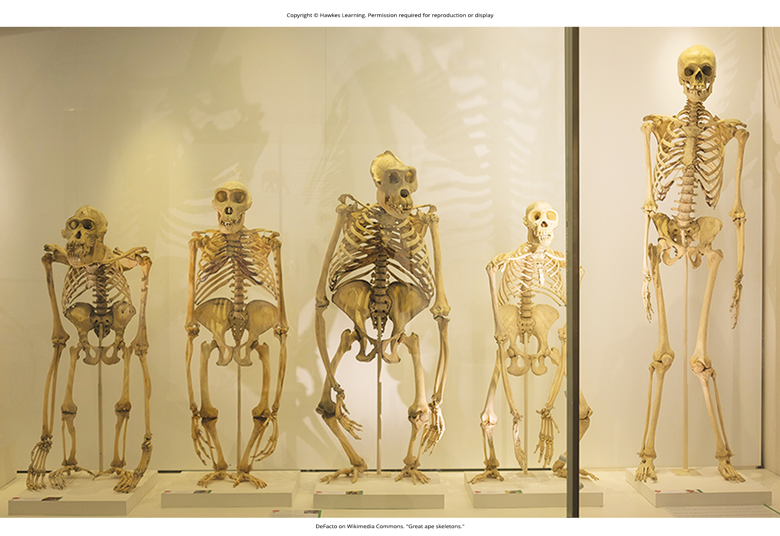
43.1 Figure 17
DeFacto on Wikimedia Commons. "Great ape skeletons."
Notes:
43.1 Figure 17: Unlike other great apes, human femurs angle inward toward the knee, as seen in this image. However, notice that the feet position of the human skeleton is a wide-leg stance and not a natural walking position. A natural walking position would show the feet closer inward. These are great ape skeletons from the Museum of Zoology, University of Cambridge. From left to right: Bornean orangutan, western gorilla, western gorilla, chimpanzee, human.

Slide 53
Evolution Connection
Evolution of Body Design for Locomotion on Land
Ancestral vertebrates evolved in water and adapted to land with significant body design changes.
Axial Skeleton:
  Gravity required stronger, ossified limbs and a firmer vertebral column.
  Vertebrae adapted for vertical motion to reduce strain and support weight.
  The pectoral girdle detached from the head to minimize jarring.
  Neck vertebrae evolved for independent head movement.
Appendicular Skeleton:
  Shoulders attached to the pectoral girdle through muscles and connective tissue to reduce skull jarring.
  Early tetrapods moved inefficiently with limbs splayed out.
  Later tetrapods positioned limbs under their bodies for efficient forward movement.
    Limbs moved in 1 plane, swinging like a pendulum for efficiency.

Slide 54
Summary
There are 3 types of skeleton designs:
  A hydrostatic skeleton is a fluid-filled compartment under pressure.
  An exoskeleton is a hard external structure.
  An endoskeleton is an internal mineralized skeleton.
The human skeleton is an endoskeleton.
  Its axial skeleton includes:
    The bones of the skull (8 cranial and 14 facial bones)
    6 bones of the ossicles of the middle ear
    The hyoid bone
    The vertebral column (26 bones) protecting the spinal cord
    The thoracic cage (sternum, ribs, thoracic vertebrae, costal cartilages)
  Its appendicular skeleton includes:
    The pectoral girdle (clavicles and scapulae)
    The upper limb (30 bones in each within the arm, forearm, and hand)
    The pelvic girdle
    The lower limb (bones of the thigh, leg, and foot)

Slide 55

End of Hawkes Learning PowerPoint

