Slide 1
Lesson 43.2
The Structure and Function of Bones

Slide 2
Objectives
Classify the different types of bones in the skeleton.
Explain the role of the different cell types in bone.
Explain how bone forms during development.
Understand the 4 stages of bone remodeling and repair.

Slide 3
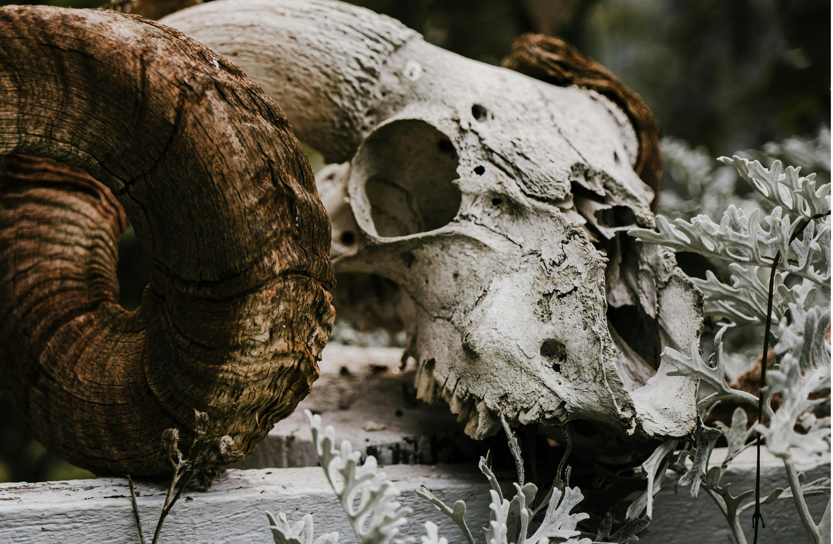
The Structure and Function of Bones₁
Bone, or osseous tissue, is a connective tissue that makes up the endoskeleton.
Contains specialized cells, a matrix of mineral salts (like calcium phosphate), and collagen fibers
Calcification is the process through which mineral salts are deposited on the collagen fibers to crystallize and harden the tissue.
43.2 Figure 1
Rachel Claire on Pexels. "Skull."

Slide 4
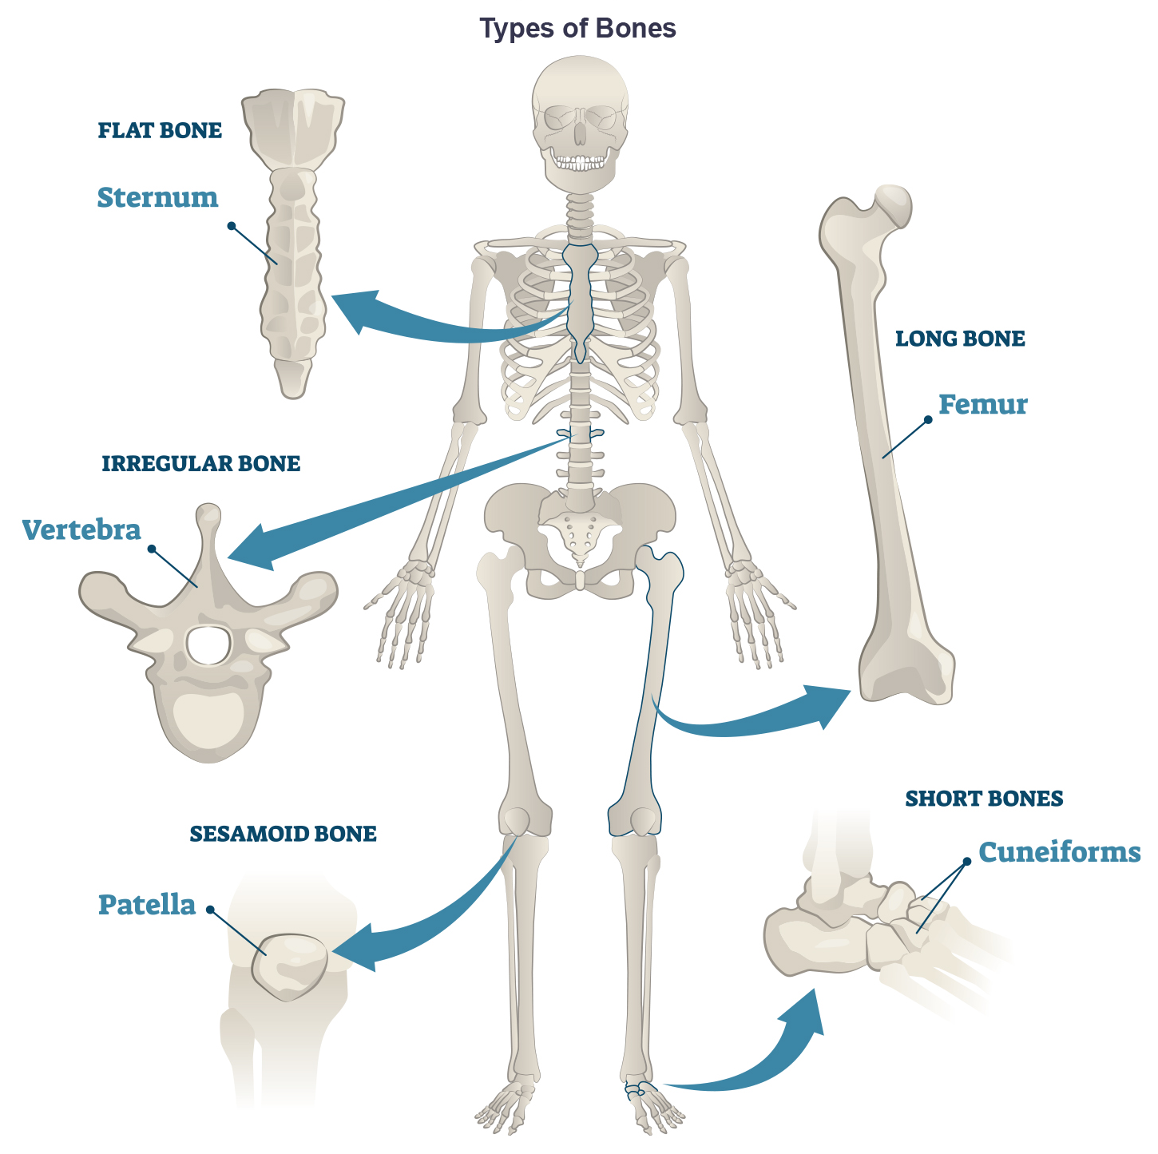
43.2 Figure 2
Notes:
Shown are different types of bones: flat, irregular, long, short, and sesamoid.

Slide 5
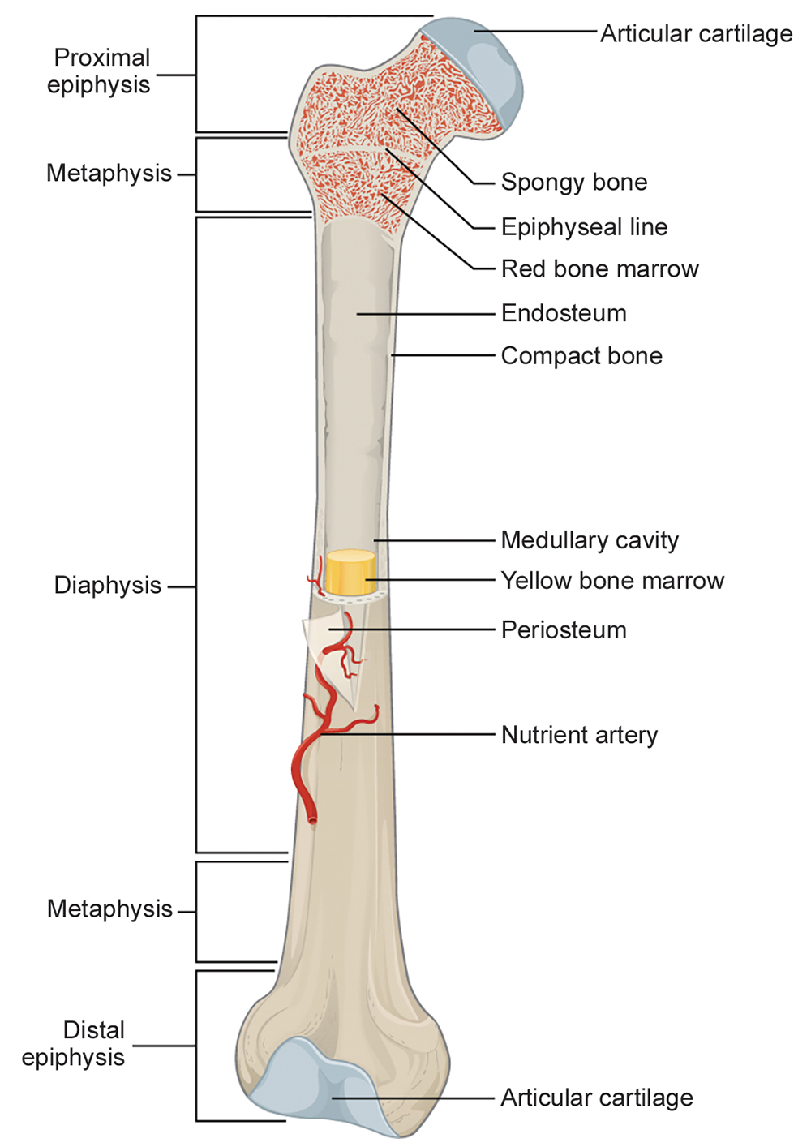
The Structure and Function of Bones₂
Long bones are longer than they are wide with a shaft at two ends.
Diaphysis contains bone marrow in a marrow cavity.
The rounded ends or epiphyses, are covered with articular cartilage and are filled with red bone marrow (produces blood cells).
Majority of limb bones are long bones.
43.2 Figure 3
OpenStax Anatomy and Physiology on Wikimedia Commons. "Long bone anatomy."

Slide 6
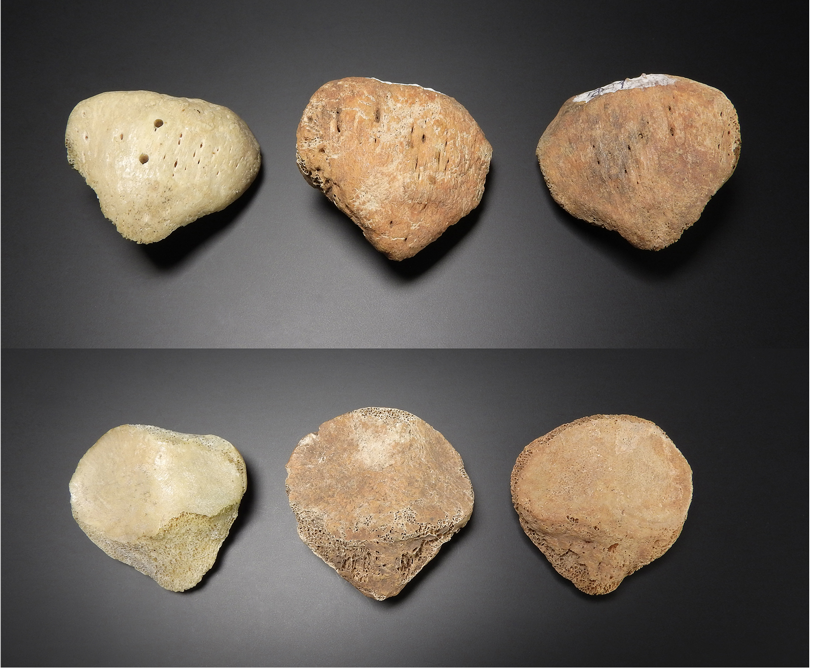
The Structure and Function of Bones₃
Short bones, or cuboidal ones, are the same width and length, such as the bones of the wrist and ankle.
Flat bones are thin, relatively broad bones that protect organs and provide broad surfaces for muscle attachment.
Irregular bones have complex shapes and may have short, flat, notched, or rigid surfaces, such as vertebrae.
Sesamoid bones are small, flat bones shaped like a sesame seed, such as the patellae.
Sutural bones are small, flat, irregularly shaped bones found between the flat bones of the skull.
43.2 Figure 4: Patellae
MAKY.OREL on Wikimedia Commons. "Patella bones."

Slide 7
Bone Tissue
Bones are organs as they contain several types of tissues:
Blood
Connective tissue
Nerves
Bone tissue: compact or spongy

Slide 8
Compact Bone Tissue
Compact bone (cortical bone) forms the external layer of bones and surrounds the bone marrow.
Provides strength and protection
Osteons are cylindrical structure that contain a mineral matrix of living osteocytes connected by canaliculi which transport blood.
Consist of lamellae: layers of compact matrix that surround the Haversian canal.
  Haversian canal (osteonic canal) contains the bone’s blood vessels and nerve fibers.
Osteons align in the same direction to help the bone resist bending or fracturing.

Slide 9
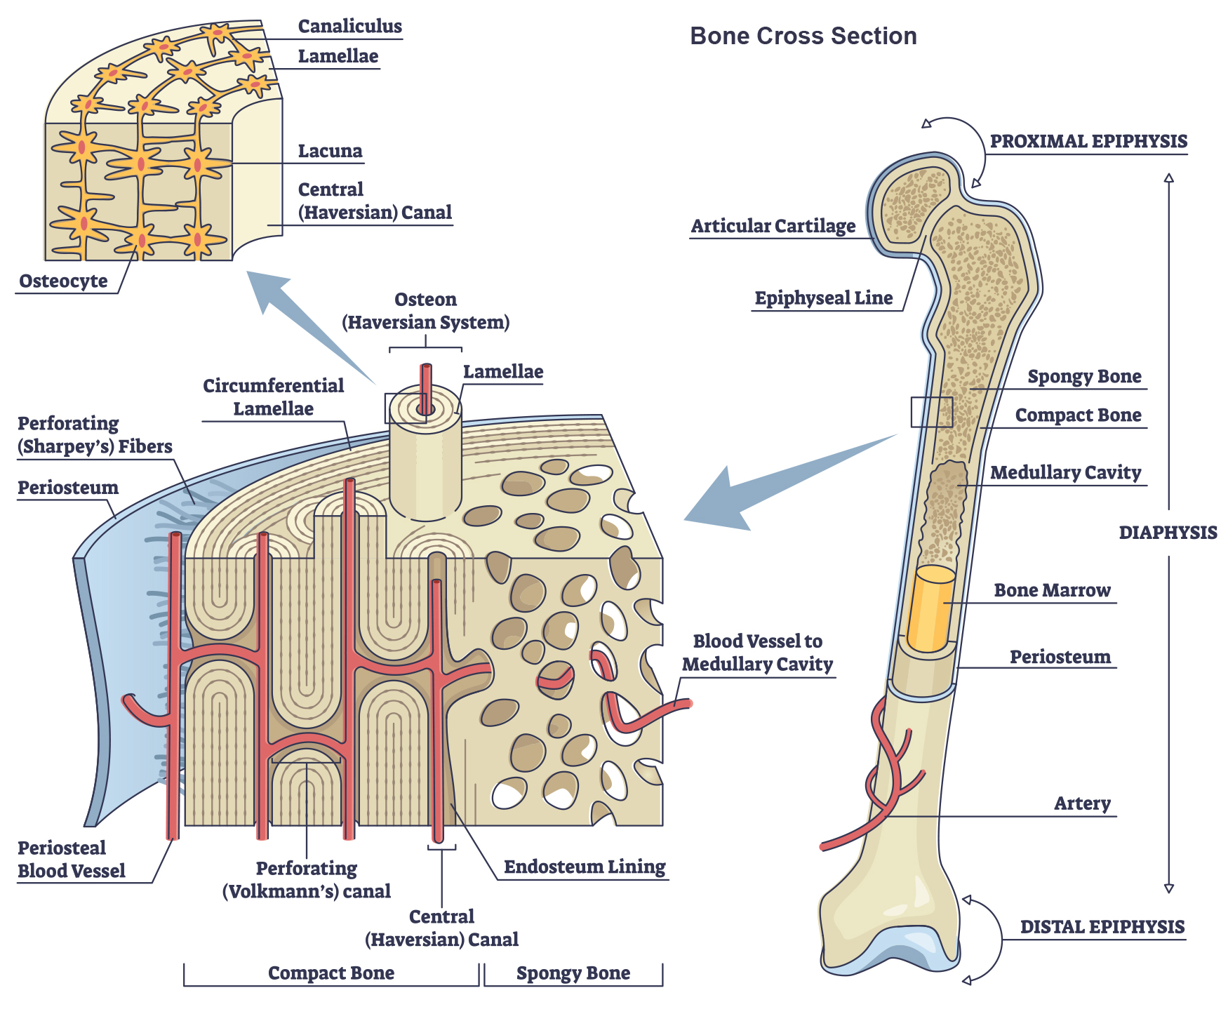
43.2 Figure 5
Notes:
Compact bone tissue consists of osteons, aligned parallel to the long axis of the bone, and the Haversian canal that contains the bone's blood vessels and nerve fibers. The inner layer of bones consists of spongy bone tissue. The small dark ovals in the osteon represent the living osteocytes.

Slide 10
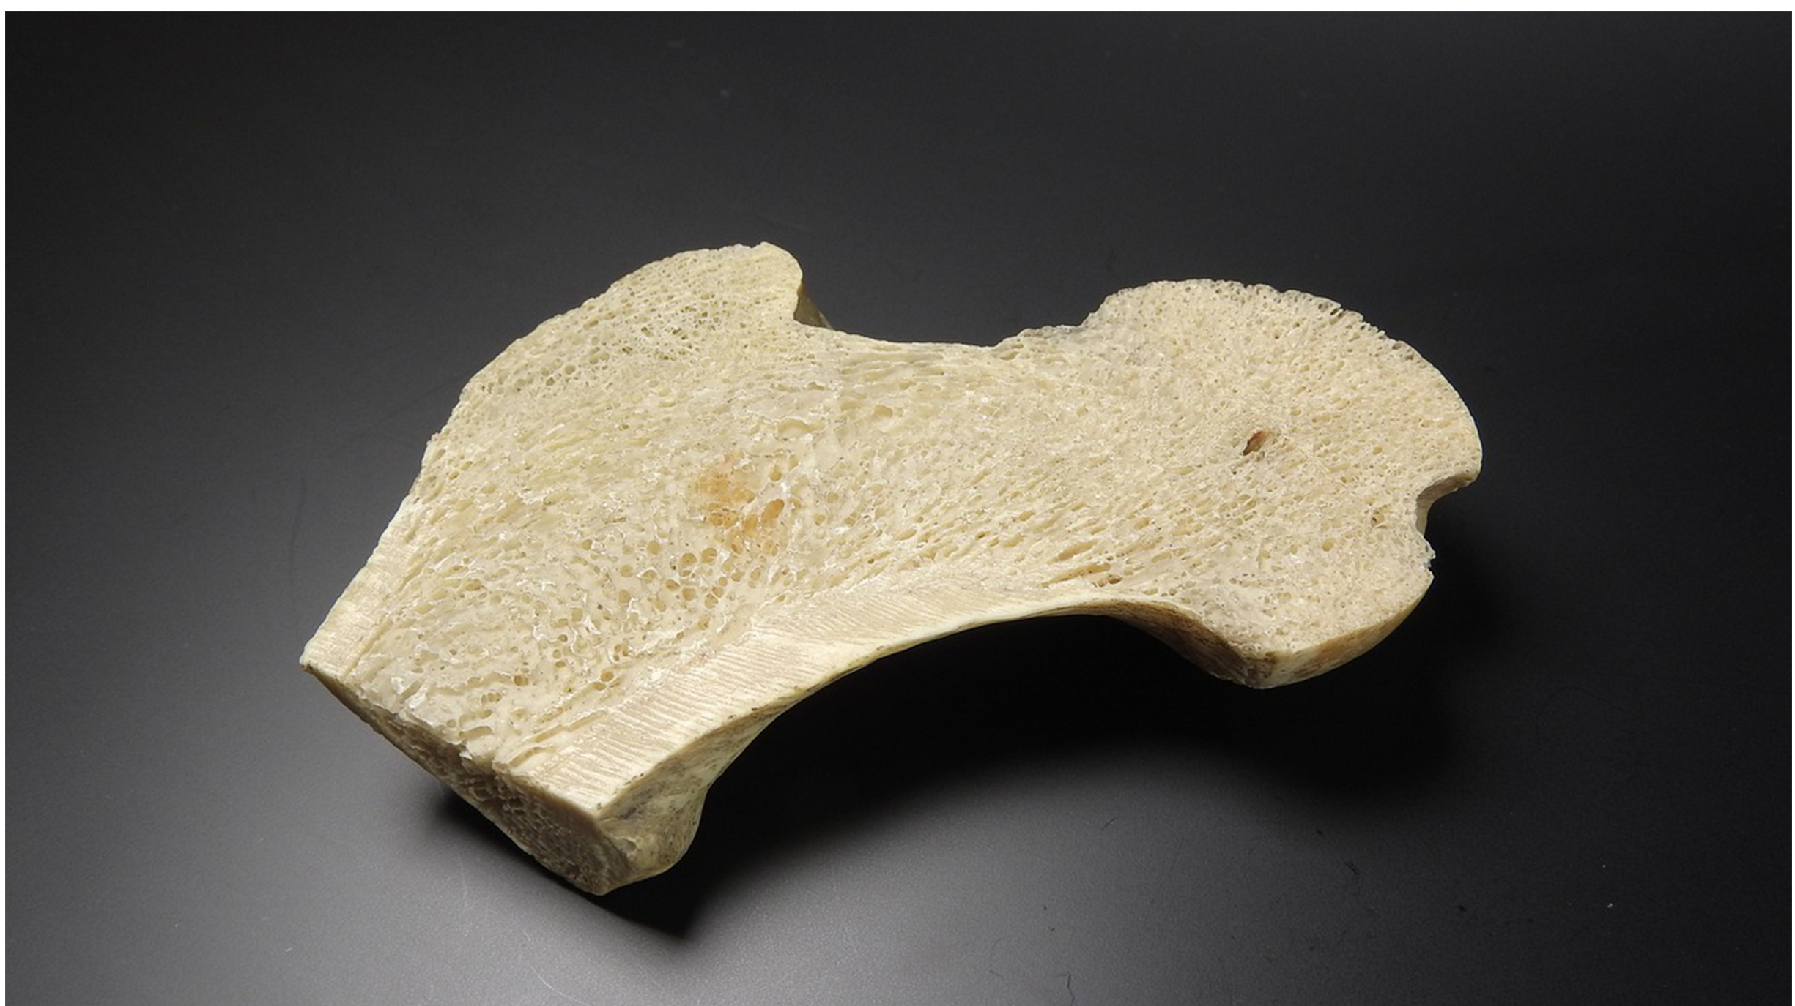
Spongy Bone Tissue
Spongy bone tissue (cancellous bone) forms the inner layer of all bones.
Consist of trabeculae which are lamellae arranged as rods or plates
  Red bone marrow is found between the trabeculae.
    Deliver nutrients, removes waste, and may form blood cells
Reduces bone density and allows long bones to compress under stress, such as the femur and neck bones
43.2 Figure 6
MAKY_OREL on Pixabay. "Spongy bone."

Slide 11
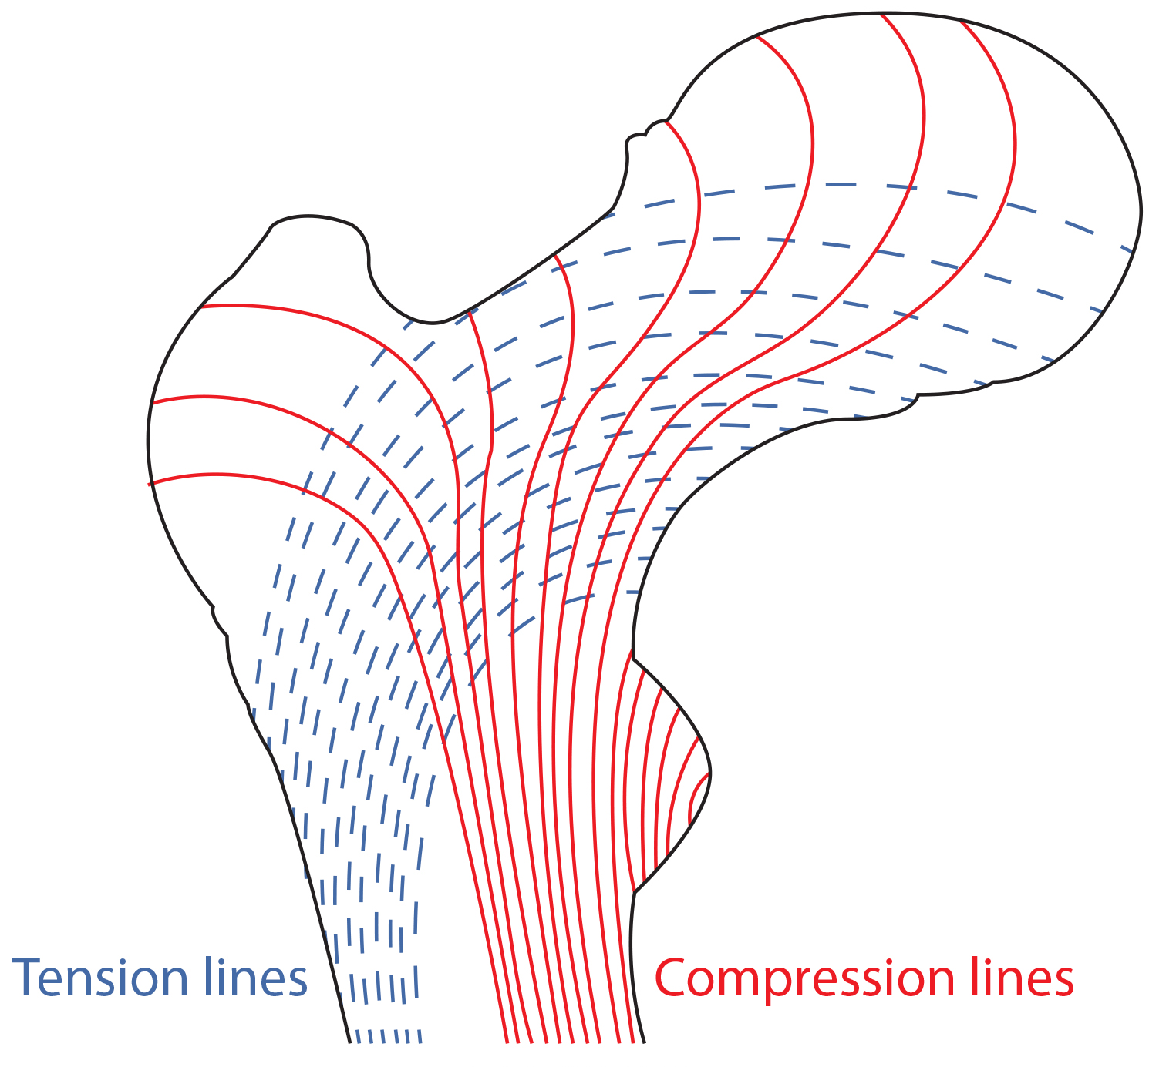
43.2 Figure 7
OpenStax. "Trabeculae in spongy bone."
Notes:
Trabeculae in spongy bone are arranged such that one side of the bone bears tension and the other withstands compression.

Slide 12
Cell Types in Bones
Bones consist of four types of cells:
Osteoblasts are bone cells responsible for bone formation, synthesizing and secreting the organic and inorganic parts of the extracellular matrix of bones.
Osteoclasts are large bone cells with up to 50 nuclei that remove bone structure by releasing lysosomal enzymes and acids.
  Releases minerals into the blood stream, such as calcium
Osteocytes are mature bone cells and the main cell type found in bony connective tissue.
Osteoprogenitor cells are squamous stem cells that produce daughter cells that differentiate into osteoblasts and help repair fractures.

Slide 13
Think It Through
Which type of bone cell (osteoblasts, osteoclasts, or osteocytes) matches each description?
These cells maintain normal bone structure by recycling the mineral salts in the bony matrix.
These cells remove bone tissue by releasing lysosomal enzymes and acids that dissolve the bony matrix.
These bone cells are responsible for bone formation.
Notes:
Originally an On Your Own. This is included here to use as a talking point or for a think-pair-share activity.

Slide 14
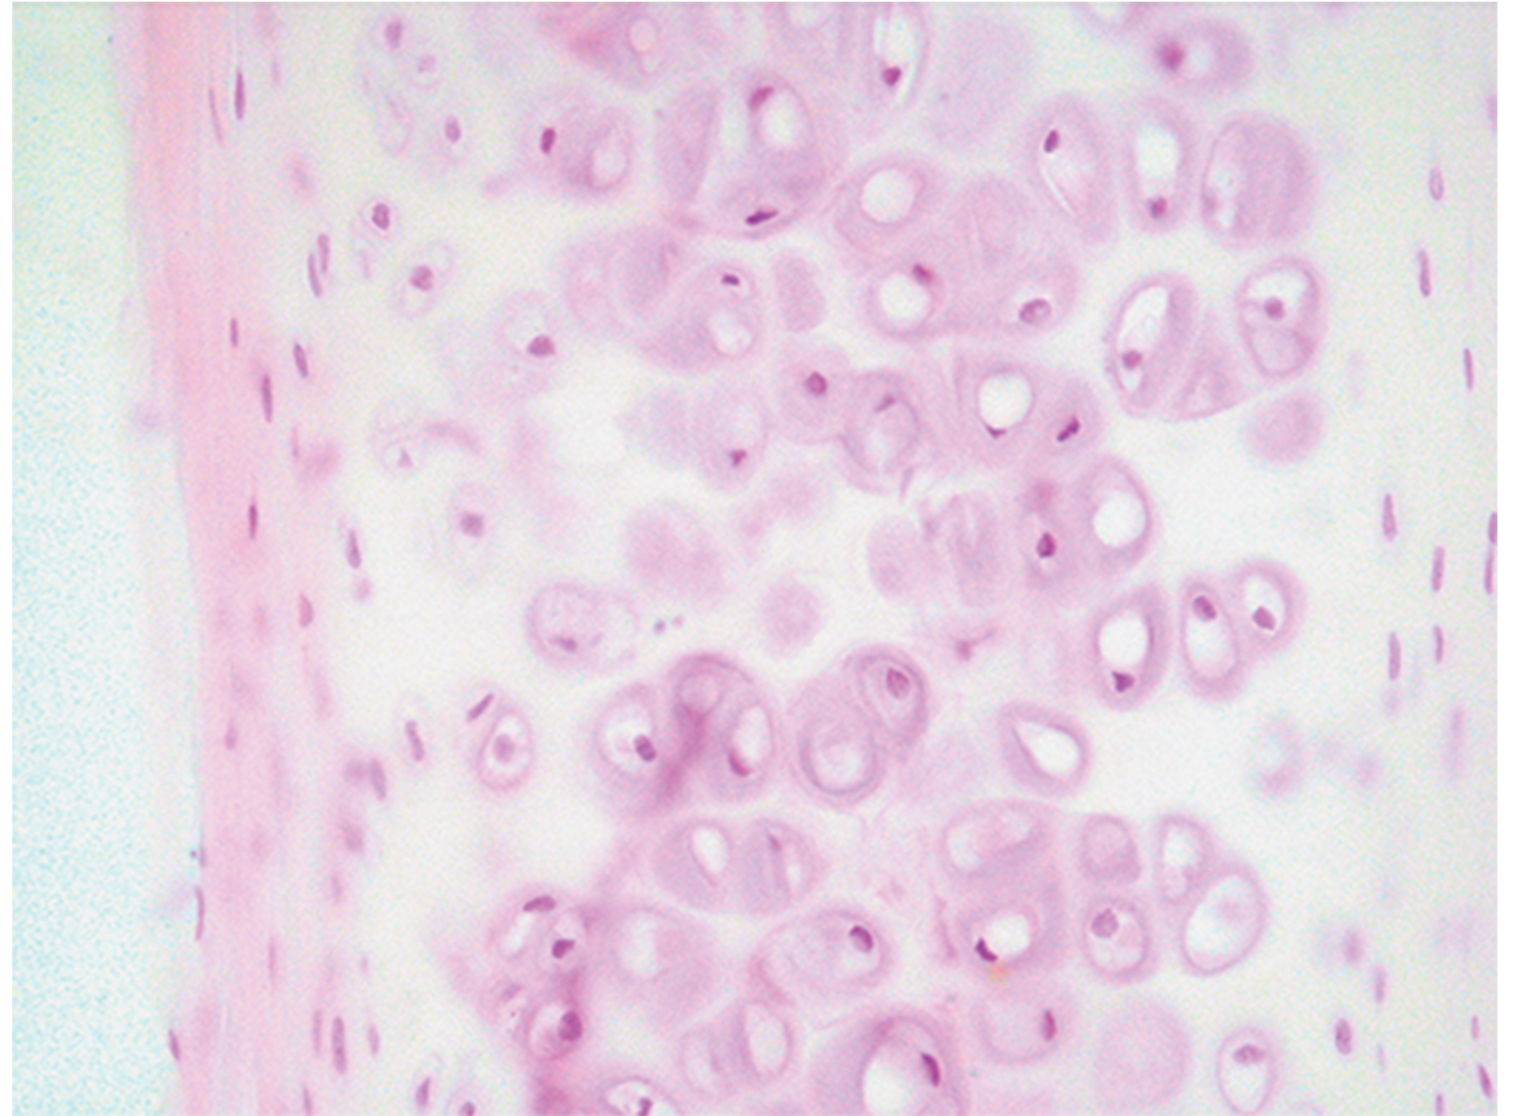
Development of Bone
Ossification, or osteogenesis, is the process of bone formation by osteoblasts.
Distinct from calcification
Begins 6 weeks after fertilization in an embryo
Intramembranous ossification: development of bone from fibrous membranes
Endochondral ossification: development of bone from hyaline cartilage
43.2 Figure 8: This microscope slide shows human hyaline cartilage with chondrocytes (cartilage cells) in lacunae.
Echinaceapallida on Wikimedia Commons. "Hyaline cartilage."

Slide 15
Intramembranous Ossification
Intramembranous ossification is the process of bone development from fibrous membranes.
It occurs in the flat bones of the skull, mandible, and clavicles.
Mesenchymal cells (stem cell) differentiate into osteoblasts which secrete the extracellular matrix and deposit calcium which hardens.
The osteoid continues to form around blood vessels, forming blood vessels.
Connective tissue differentiates into red bone marrow.

Slide 16
Endochondral Ossification₁
Endochondral ossification is the process of bone development from hyaline cartilage.
All bones other than flat bones of the skull, the mandible, and clavicles are formed this way.
In long bones, chondrocytes form a template of the hyaline cartilage diaphysis that begins to calcify.
Calcification leads to the death of chondrocytes (cartilage cells) creating cavities in the diaphysis cartilage that are filled by blood vessels.
Osteoclasts break down some of the spongy bone to create a marrow cavity in the center of the diaphysis.
Irregular connective tissue forms a sheath around bones and the periosteum assists in attaching the bone to surrounding tissues, tendons, and ligaments.

Slide 17
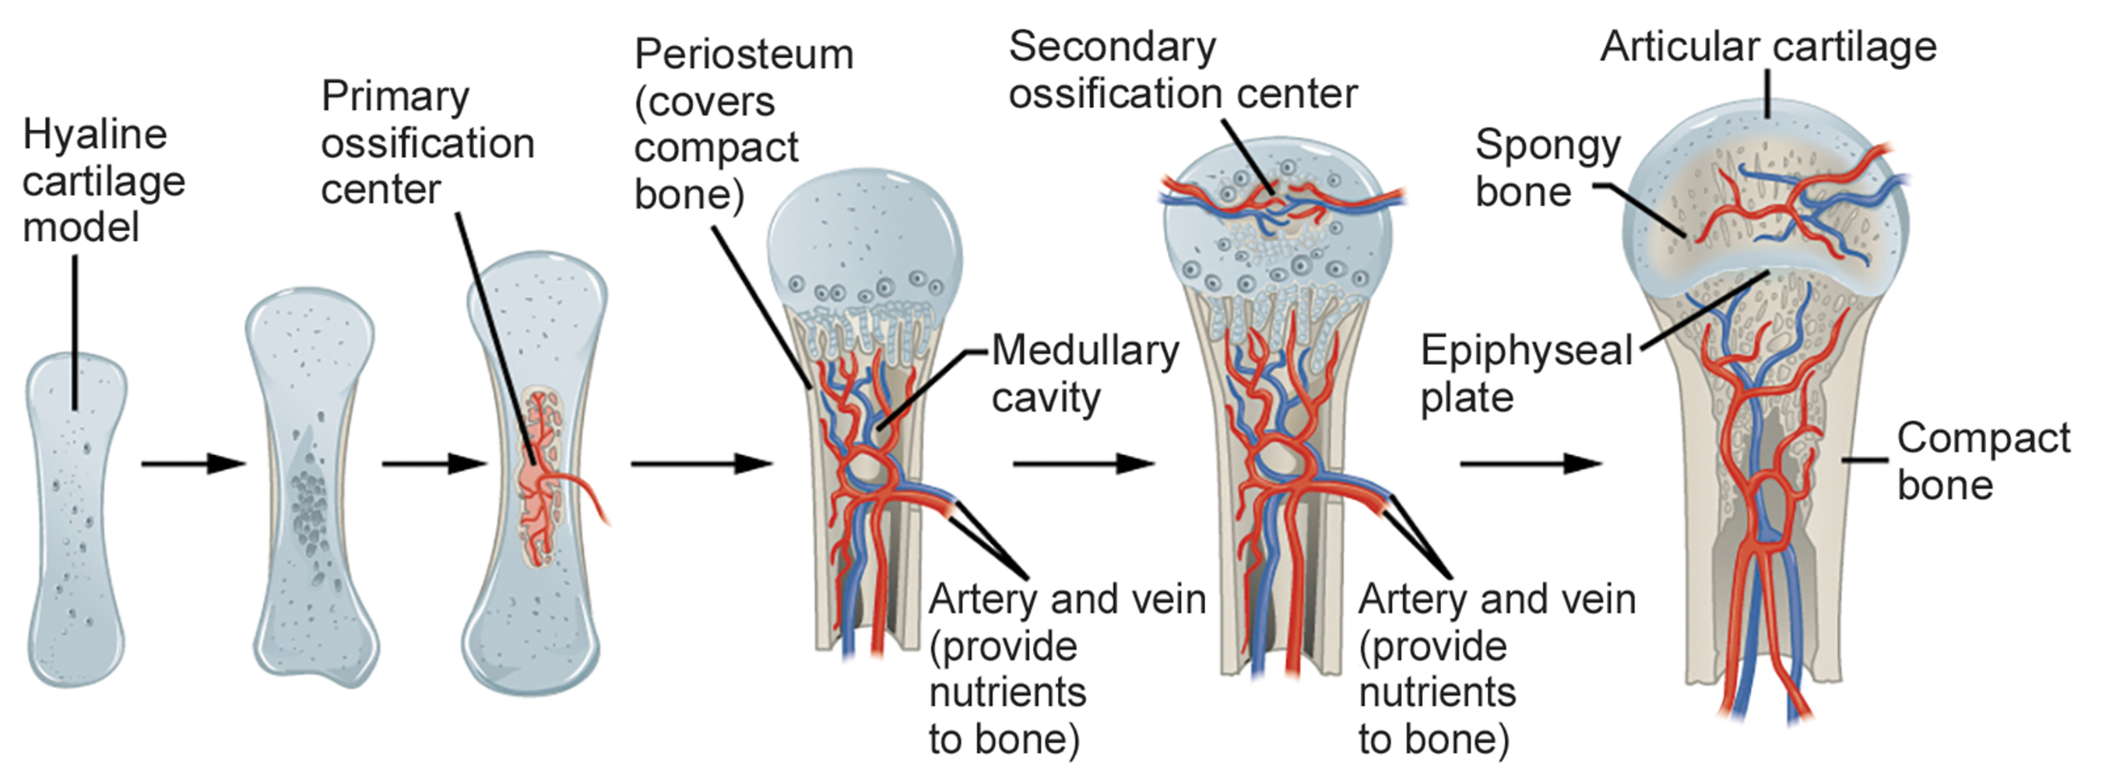
Endochondral Ossification₂
In the last stage, the centers of the epiphyses begin to calcify.
Secondary ossification centers form in the epiphyses as blood vessels and osteoblasts convert hyaline cartilage into spongy bone.
Hyaline cartilage persists at the epiphyseal plate (growth plate, the region between the diaphysis and epiphysis) until adolescence.
43.2 Figure 9
CNX OpenStax on Wikimedia Commons. "Endochondral ossification."

Slide 18
Growth of Bone
Until adolescence, long bones continue to lengthen, due to the addition of bone tissue at the epiphyseal plate and widen through appositional growth in which new bone is laid down.
Lengthening of Long Bones
Chondrocytes at the epiphyseal plate divide and one cell remains near the epiphysis.
  Other cell are pushed from the epiphysis, mature and are destroyed by calcification, replacing cartilage with bone on the diaphyseal side of the plate, resulting in lengthening.
During epiphyseal plate closure cartilage cells stop dividing and all the cartilage is replaced by bone.

Slide 19
Thickening of Long Bones
Appositional growth is the increase in the diameter of bones by the addition of bony tissue at the surface of bones.
Osteoblasts secrete bone matrix and osteoclasts on the inner surface break down bone.
The osteoblasts differentiate into osteocytes.
A balance between these processes allows the bone to thicken without becoming too heavy.

Slide 20
Bone Remodeling and Repair₁
Bone renewal occurs from birth through adulthood.
Bone remodeling is the replacement of old bone tissue by new bone tissue.
  Includes bone deposition by osteoblasts and bone resorption by osteoclasts
Bone growth requires vitamins D, C, and A and calcium phosphorus, and magnesium.
Parathyroid hormone, growth hormone, and calcitonin are required for bone growth and maintenance.

Slide 21
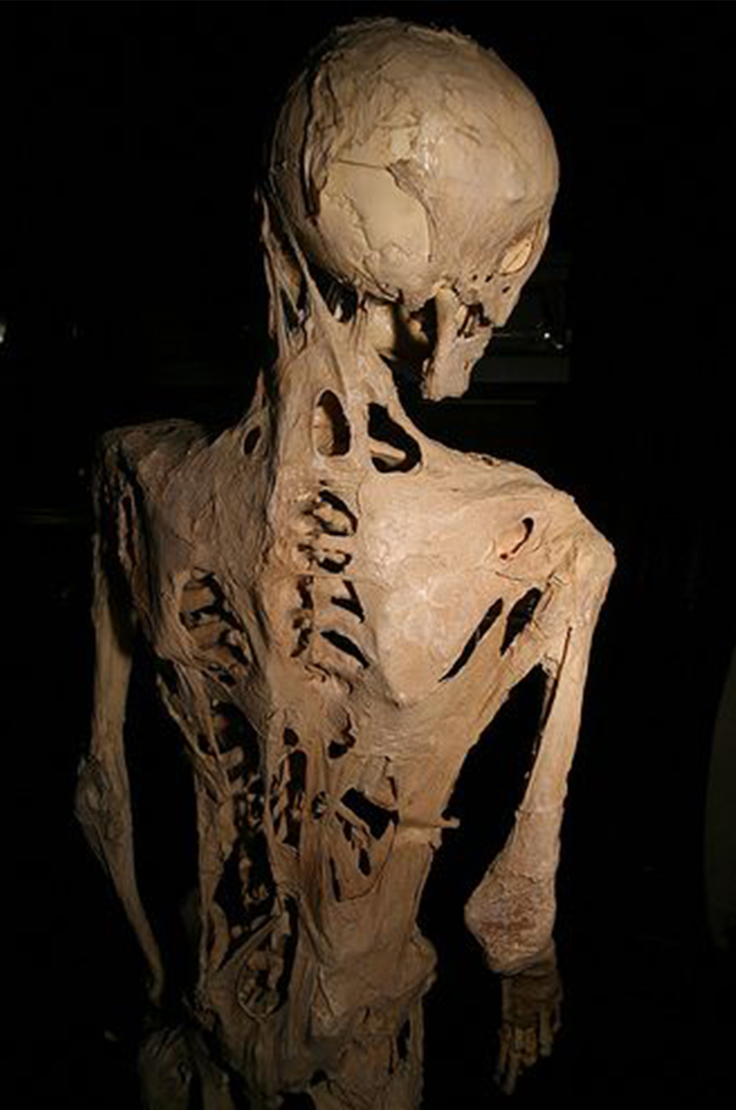
Science and You
Bone tissue undergoes constant remodeling throughout our lives. Abnormal bone remodeling can cause serious health consequences.
One example is fibrodysplasia ossificans progressiva (FOP)—a very rare genetic disorder involving the abnormal growth of bone tissue.
Replaces damaged soft tissue with bone tissue
Causes slow loss of mobility as joints lock into place
43.2 Figure 10
Joh-co on Wikimedia Commons. "Fibrodysplasia ossificans progressiva."
Notes:
This is included as a relevant application for this topic.

Slide 22
Bone Remodeling and Repair₂
5-7% of bone mass is recycled every week, with certain areas replaced at higher rates.
Bone remodeling allows bones to adapt to stresses, becoming thicker and stronger.
Fractured or broken bone undergoes repair in four stages:
Blood clotting occurs at broken blood vessels, and bone cells deprived of nutrients begin to die.
Capillaries grow into the area and phagocytic cells clear away dead cells. Fibroblasts and osteoblasts enter the area and being to reform bone creating a fibrocartilaginous callus.
The fibrocartilaginous callus is converted to a bony callus of spongy bone.
The bony callus is remodeled by osteoclasts and osteoblasts and compact bone is added.

Slide 23
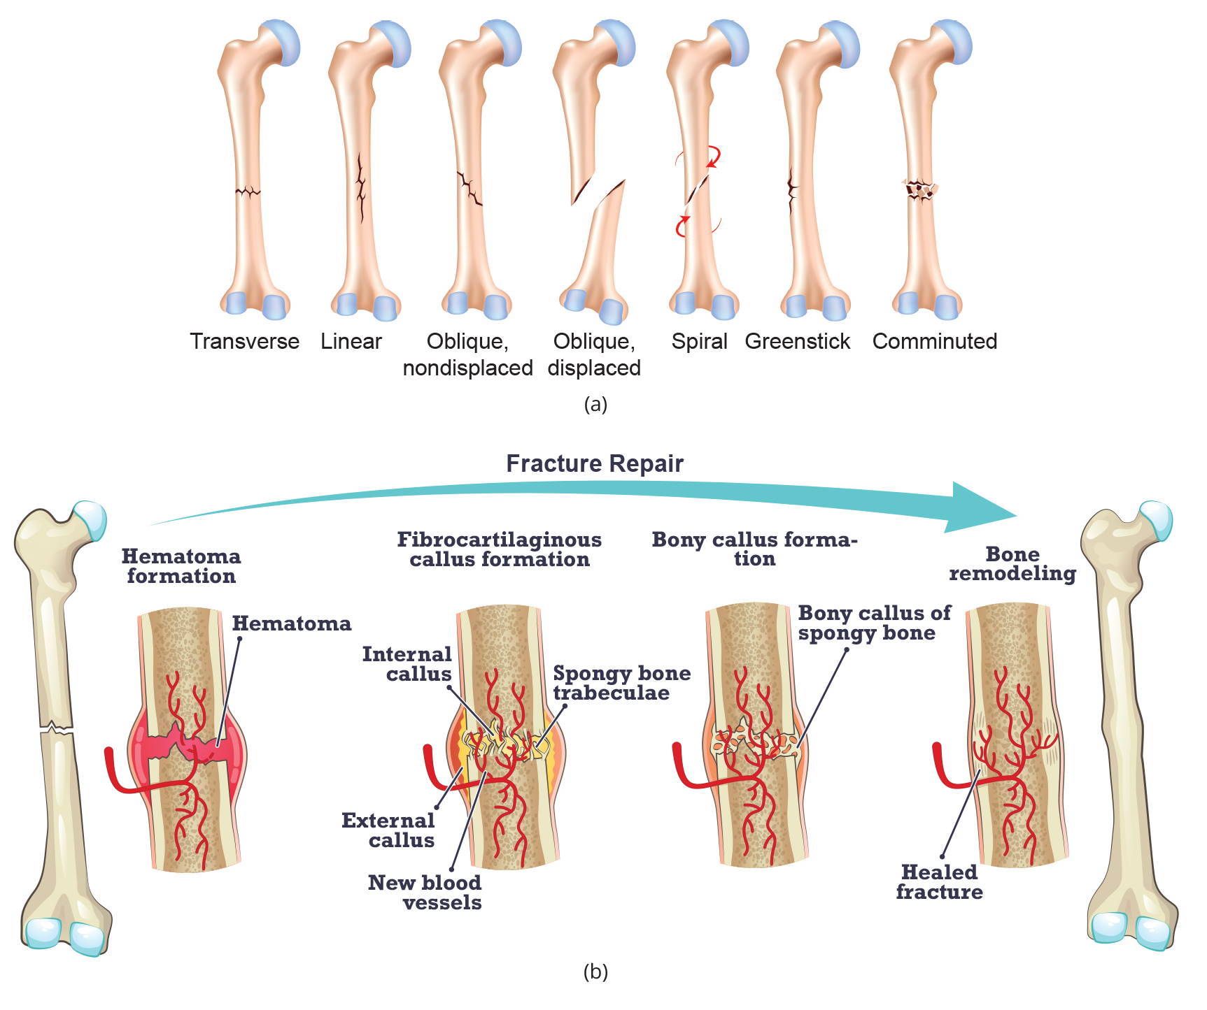
43.2 Figure 11
Notes:
(a) Bones can fracture in many different ways, depending on the nature of the injury and the break. (b) Bones can heal fractures through four main stages: hematoma formation, fibrocartilaginous callus formation, bony callus formation, and bone remodeling.

Slide 24
Group Activity
Scientific Method: Decalcification of Bones
Question: What effect does the removal of calcium and collagen have on bone structure?
Background: Conduct a literature search on the role of calcium and collagen in maintaining bone structure. Conduct a literature search on diseases in which bone structure is compromised.
Hypothesis: Develop a hypothesis that states predictions of the flexibility, strength, and mass of bones that have had the calcium and collagen components removed. Develop a hypothesis regarding the attempt to add calcium back to decalcified bones.

Slide 25
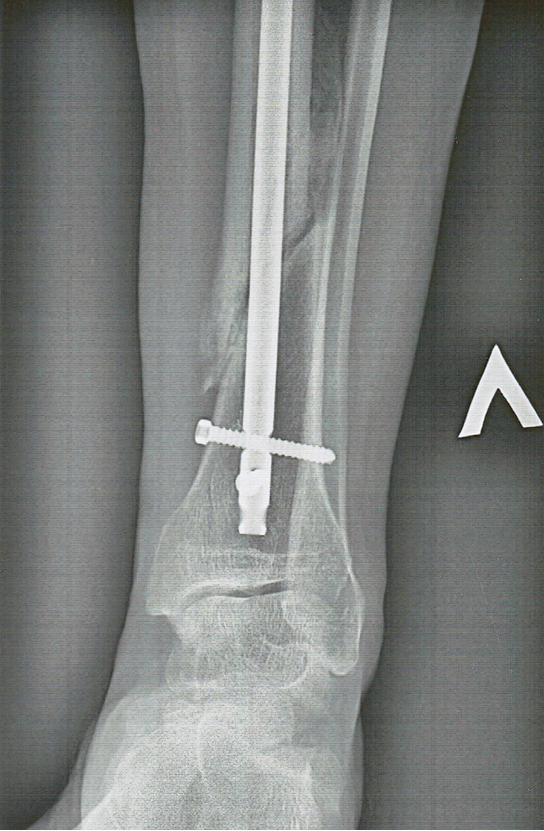
43.2 Figure 12
NiaPol on Wikimedia Commons. "Pin in bone fracture."
Notes:
This tibia bone has been set with a metal pin, and a callus has begun to form in the lower half.

Slide 26
Summary
Bone tissue consists of specialized cells, mineral salts, and collagen fibers, with the skeleton divided into long, short, flat, and irregular bones.
Bone structure includes compact bone (made of osteons) on the outside and spongy bone (made of trabeculae) on the inside, with four types of cells: osteocytes, osteoclasts, osteoprogenitor cells, and osteoblasts.
Bone formation occurs through two processes: intramembranous ossification (from fibrous membranes) and endochondral ossification (from hyaline cartilage).
Bone growth involves lengthening of long bones through chondrocyte division and cartilage replacement, as well as appositional growth to increase bone diameter.
Bone remodeling is a continuous process involving bone deposition by osteoblasts and resorption by osteoclasts, while bone repair occurs in four stages over several months.

Slide 27

End of Hawkes Learning PowerPoint

