Slide 1
Lesson 43.3
Joint and Skeletal Movement

Slide 2
Objectives
Classify the different types of joints on the basis of structure.
Explain the role of joints in skeletal movement.

Slide 3
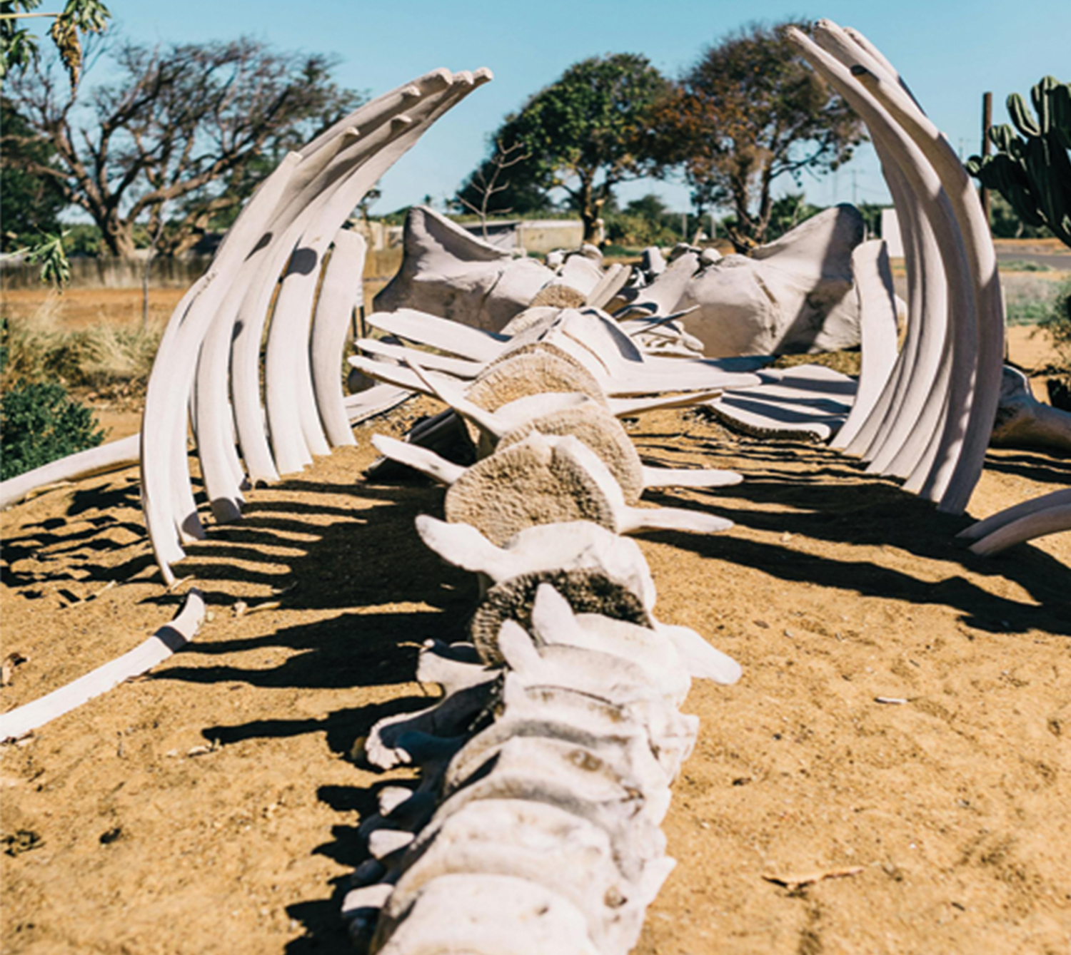
Joints and Skeletal Movement
A joint, or articulation, is the point at which two or more bones meet.
Responsible for movement and stability
43.3 Figure 1
Rachel Claire on Pexels. "Whale skeleton."

Slide 4
Classification of Joints on the Basis of Structure
Two ways to classify joints — based on structure or function.
Structural classification divides joints into:
Bony
Fibrous
Cartilaginous
Synovial

Slide 5
Fibrous Joints
Fibrous joints are held together by fibrous connective tissue.
No space between joints, so there is little to no movement in the joint.
Three types of fibrous joints:
Sutures
Syndesmoses
Gomphoses

Slide 6
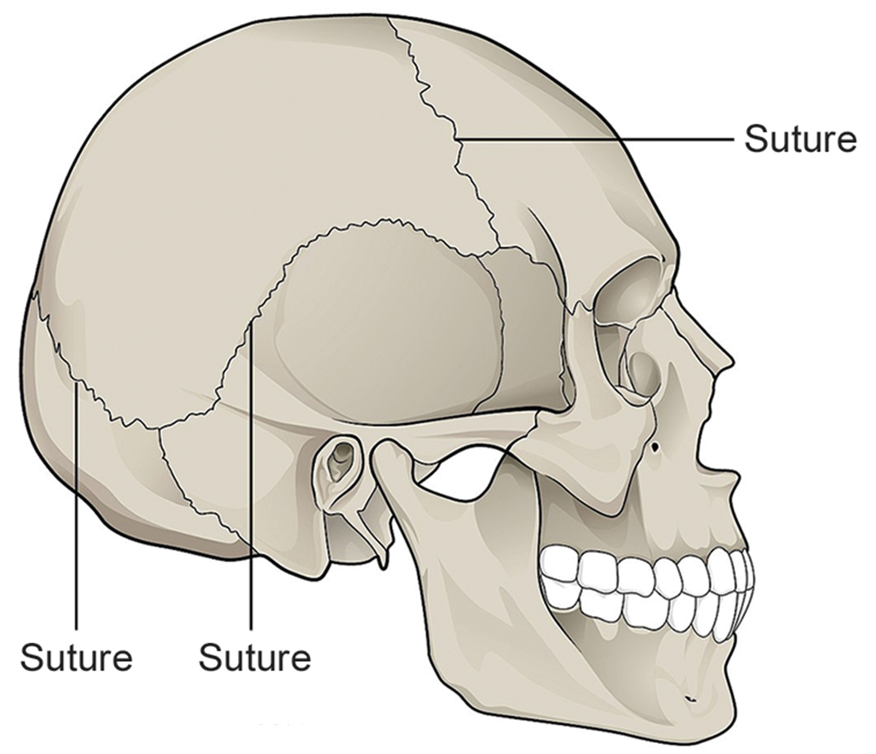
Sutures
Sutures are only found in the skull and possess short fibers of connective tissue that hold the skull bones tightly in place.
43.3 Figure 2
OpenStax College on Wikimedia Commons. "Skull sutures."

Slide 7
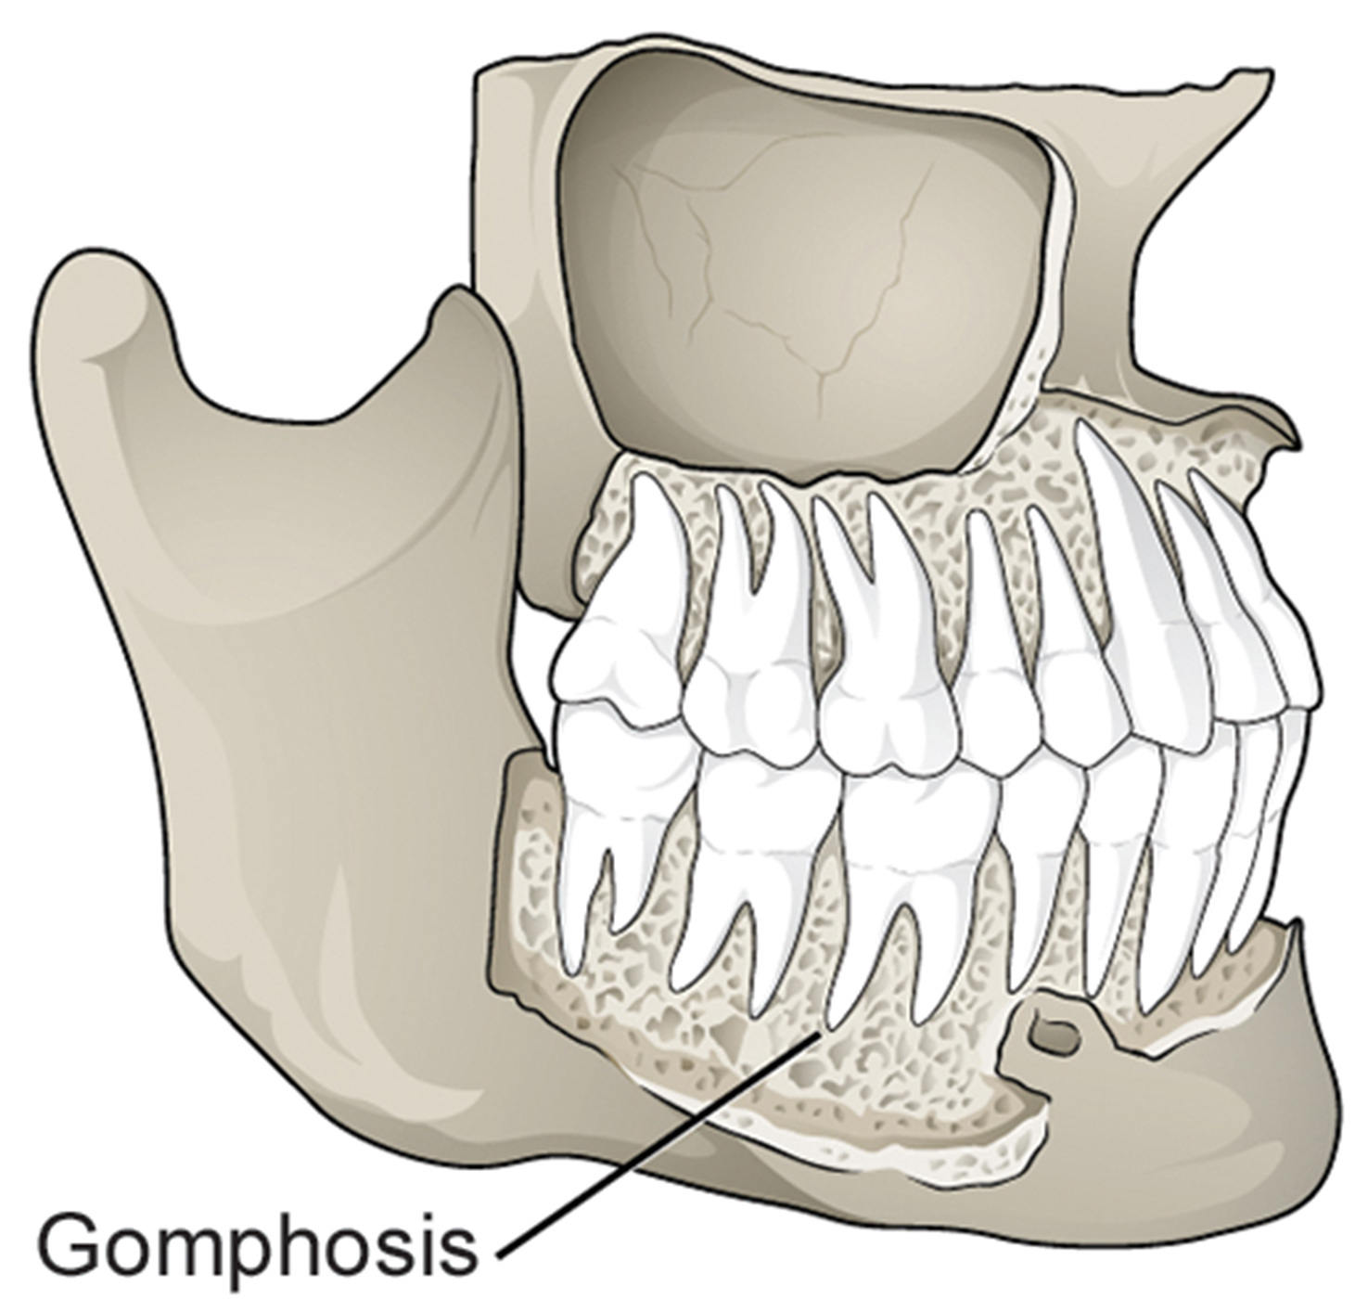
Syndesmoses and Gomphoses
Syndesmoses are joints in which the bones are connected by a band of connective tissue, allowing for more movement than a suture.
Amount of movement depends on length of the connective tissue
Gomphoses occur between teeth and their sockets.
Connected to the socket by a connective tissue referred to as the periodontal ligament
43.3 Figure 3
CNX OpenStax on Wikimedia Commons. "Gomphoses."

Slide 8
Cartilaginous Joints
Cartilaginous joints are joints in which the bones are connected by cartilage and have very little movement.
Two types:
Synchondrosis: the bones are joined by hyaline cartilage
Found in the epiphyseal plates of growing bones
Symphyses: hyaline cartilage covers the end of the bone, but connection between the bones occurs through fibrocartilage

Slide 9
Evolution Connection
How "Softer Skulls" Allow for Bigger Brains
Human infants have flexible suture joints in their skulls that remain unfused for about two years.
Chimpanzees' skull sutures close after three months.
This delayed closure allows for significant brain growth in human infants during the first few years of life.
While making the infant's skull more vulnerable, this adaptation enables humans to develop much larger brains relative to other species.

Slide 10
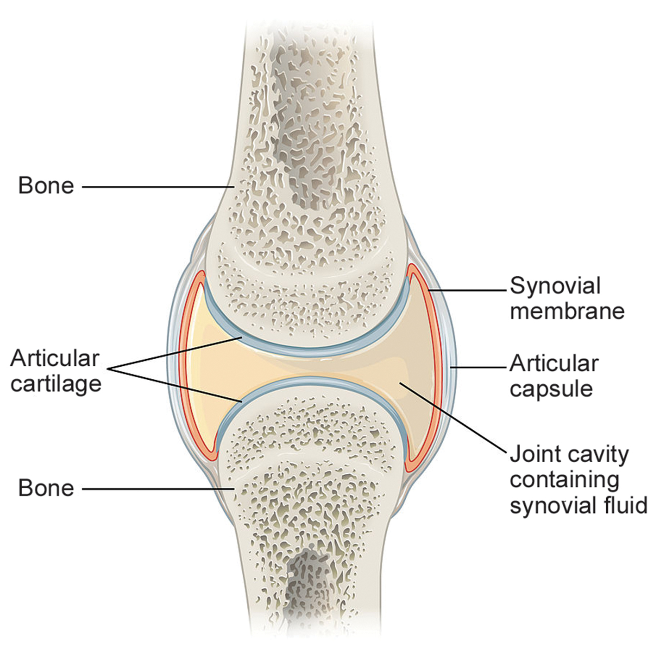
Synovial Joints
Synovial joints are the only joints that have a spaced between adjoining bones.
The cavity is filled with synovial fluid which lubricates the joint, reducing friction, and allowing for greater movement.
Bones are covered in articular cartilage (hyaline cartilage).
The joint is surrounded by an articular capsule, allowing for movement in the joint without dislocation.
Examples include knees, elbows, and shoulders.
43.3 Figure 4
OpenStax College on Wikimedia Commons. "Synovial joints."

Slide 11
Classification of Joints on the Basis of Function
Functional classification divides joints into three categories:
Synarthroses: a joint that is immovable, including sutures, gomphoses, and synchondroses
Amphiarthroses: joints that allow slight movement, including syndesmoses and symphyses
Diarthroses: joints that allow for free movement of the joint, such as synovial joints

Slide 12
Think It Through₁
Describe three ways synovial joints differ from other joint types. Consider aspects of the joint's structure, relative strength, and freedom of movement.
Notes:
Originally an On Your Own. This is included here to use as a talking point or for a think-pair-share activity.

Slide 13
Movement at Synovial Joints₁
The movement of synovial joints can be classified as one of four different types:
Gliding
Angular
Rotational
Special movement
Gliding movements occur as a relatively flat bones move past each other, such as the carpal and tarsal bones.

Slide 14
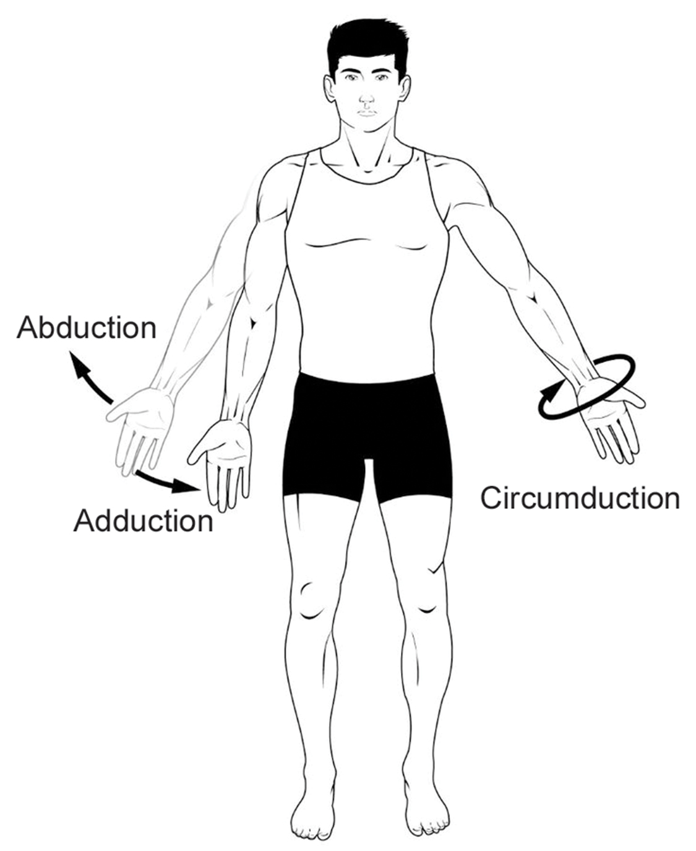
Movement at Synovial Joints₂
Angular movements are produced when the angle between the bones of a joint changes, including:
Flexion: bending that occurs when the angle between the bones decreases
Extension: when the angle between the bones of a joint increase
Extension past the regular anatomical position is referred to as hyperextension.
Abduction: when a bone moves away from the midline of the body
Adduction: movement of a bone toward the midline of the body
Circumduction: movement of a limb in a circular motion, such as moving the arm in a circular motion
43.3 Figure 5
Connexions on Wikimedia Commons. "Abduction, adduction, and circumduction."

Slide 15
Movement at Synovial Joints₃
Rotational movement: movement of a bone as it rotates around its longitudinal axis
Medial rotation: rotation toward the midline of the body
Lateral rotation: rotation away from the midline of the body

Slide 16
Movement at Synovial Joints: Special Movements₁
Special movements are those that do not fit other classifications.
Inversion: soles of the feet moving inward, toward the midline of the body
Eversion: movement of the sole of the foot outward, away from the midline of the body
Protraction: anterior (forward) movement of a bone in the horizontal plane
Retraction: joint moves back into position after protraction
Protraction and retraction can be seen in the movement of the mandible as the jaw is thrust outwards and then back inwards.
Elevation: movement of a bone upward, such as when the shoulders are shrugged, lifting the scapulae
Depression: movement downward of a bone, such as after the shoulders are shrugged and the scapulae return to their normal position from an elevated position

Slide 17
Movement at Synovial Joints: Special Movements₂
Dorsiflexion: bending at the ankle such that the toes are lifted toward the knee
Plantar flexion: bending at the ankle when the heel is lifted, such as when standing on your toes
Supination: movement of the radius and ulna bones of the forearm so that the palm faces forward
Pronation: opposite movement, in which the palm faces backward
Opposition: movement of the thumb toward the fingers of the same hand, making it possible to grasp and hold objects

Slide 18
Think It Through₂
For each scenario of body movement, describe the movement type as either gliding, angular, rotational, or special.
The movement within the hip joint when abducting the leg away from the body
The mandible's movement when thrusting the bottom jaw outward
The neck's movement when shaking the head from side to side, as in shaking the head "no"
The sliding movement of carpal bones when bending the wrist
Notes:
Originally an On Your Own. This is included here to use as a talking point or for a think-pair-share activity.

Slide 19
Group Activity
Working with a partner, make a list of ten types of movements that synovial joints can allow. (For example, your list may include things like extension, adduction, or elevation.) For each movement type on your list, demonstrate the movement. Use a new joint each time.

Slide 20
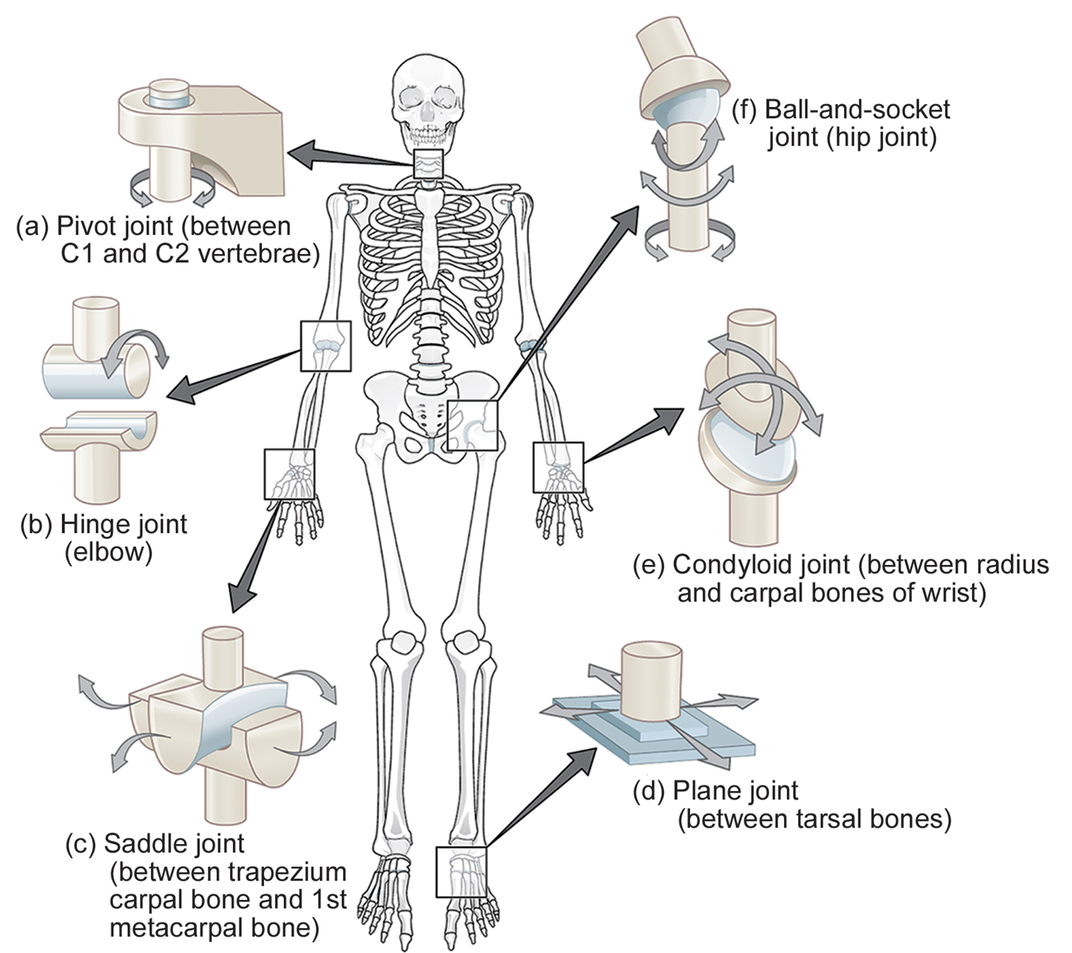
Types of Synovial Joints
Classified into six categories based on shape and structure of the joint.
Planar
Hinge
Pivot
Condyloid
Saddle
Ball-and-socket
43.3 Figure 6
OpenStax College on Wikimedia Commons. "Types of joints."

Slide 21
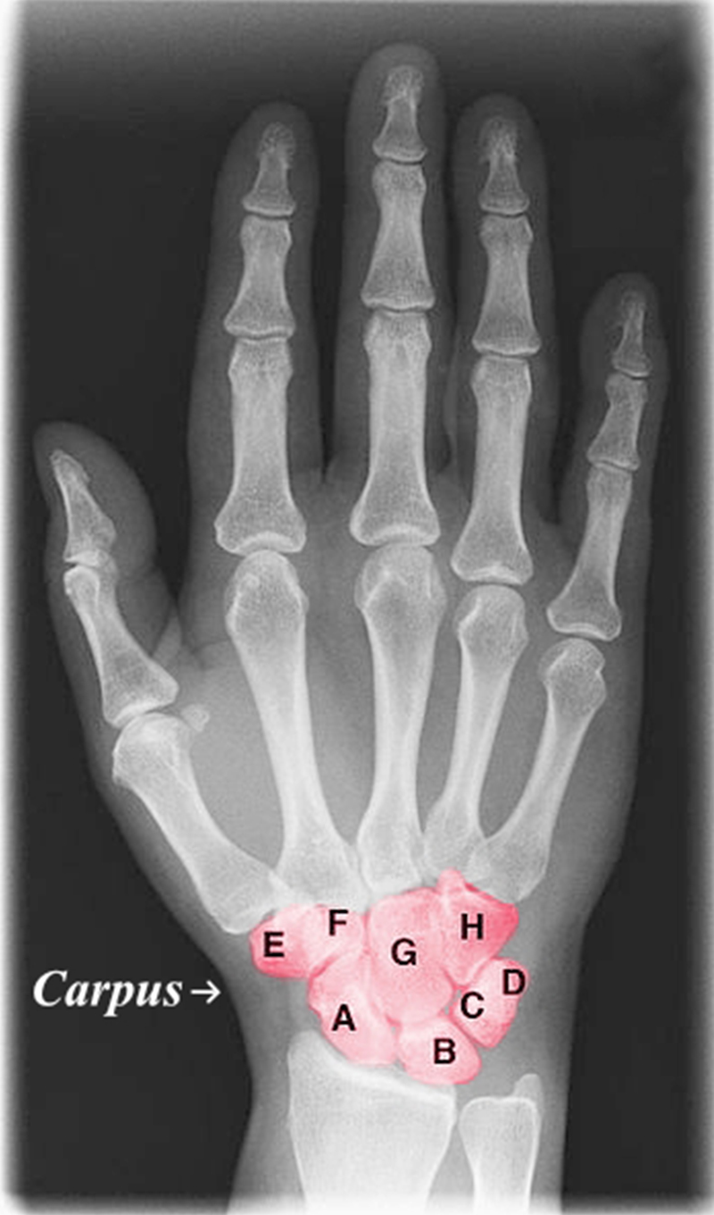
Planar Joints
Planar joints have bones with articulating surfaces that are flat or have slightly curved faces.
Allow for gliding movements (gliding joints)
Found in carpal bones in the hand, tarsal bones of the foot, and between vertebrae
43.3 Figure 7
Dr. Jochen Lengerke on Wikimedia Commons. "Carpal bone joints."

Slide 22
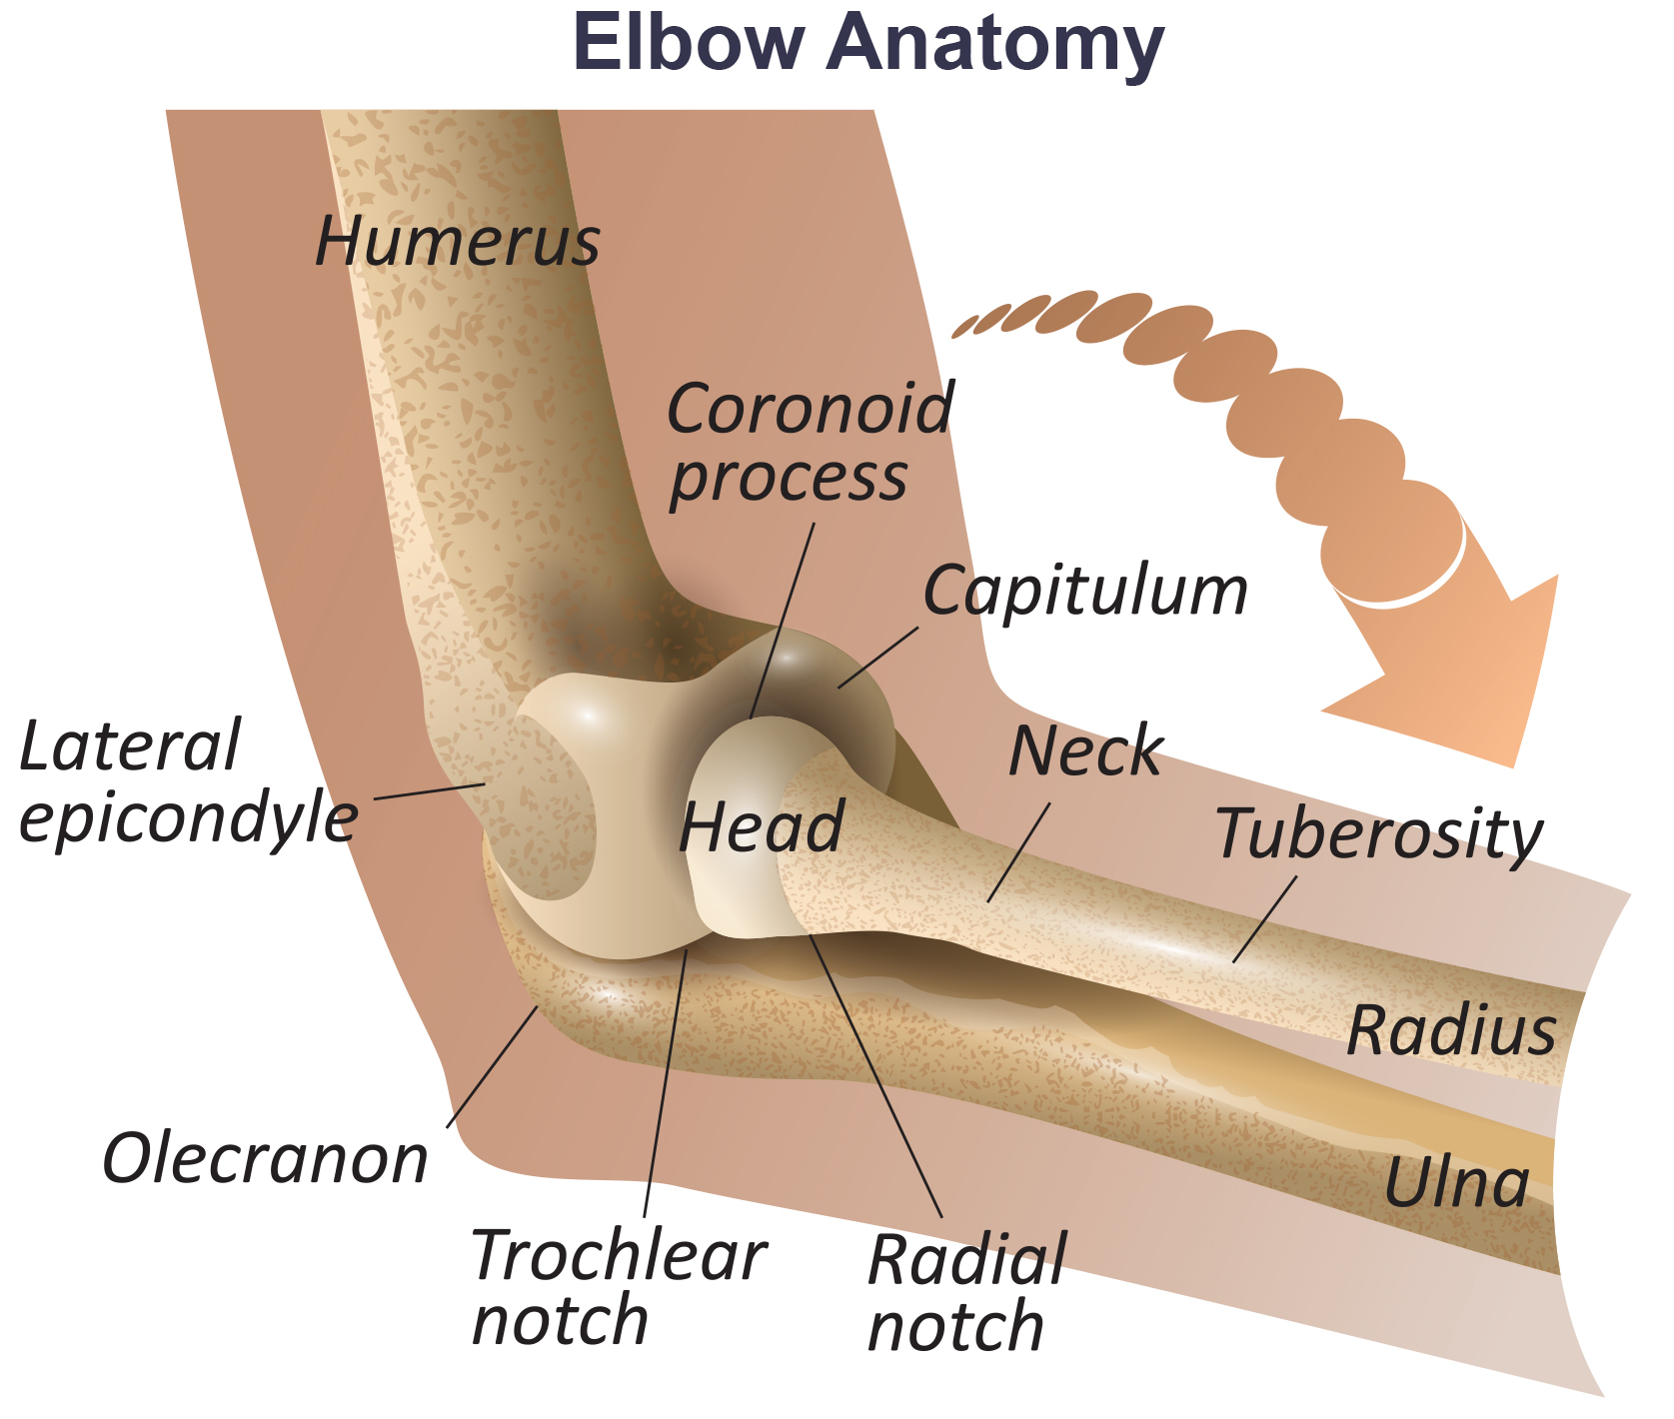
Hinge Joints
Hinge joints: slightly rounded end of one bone fits into the slightly hollow end of the other bone
One bone moves while the other remains stationary.
43.3 Figure 8

Slide 23
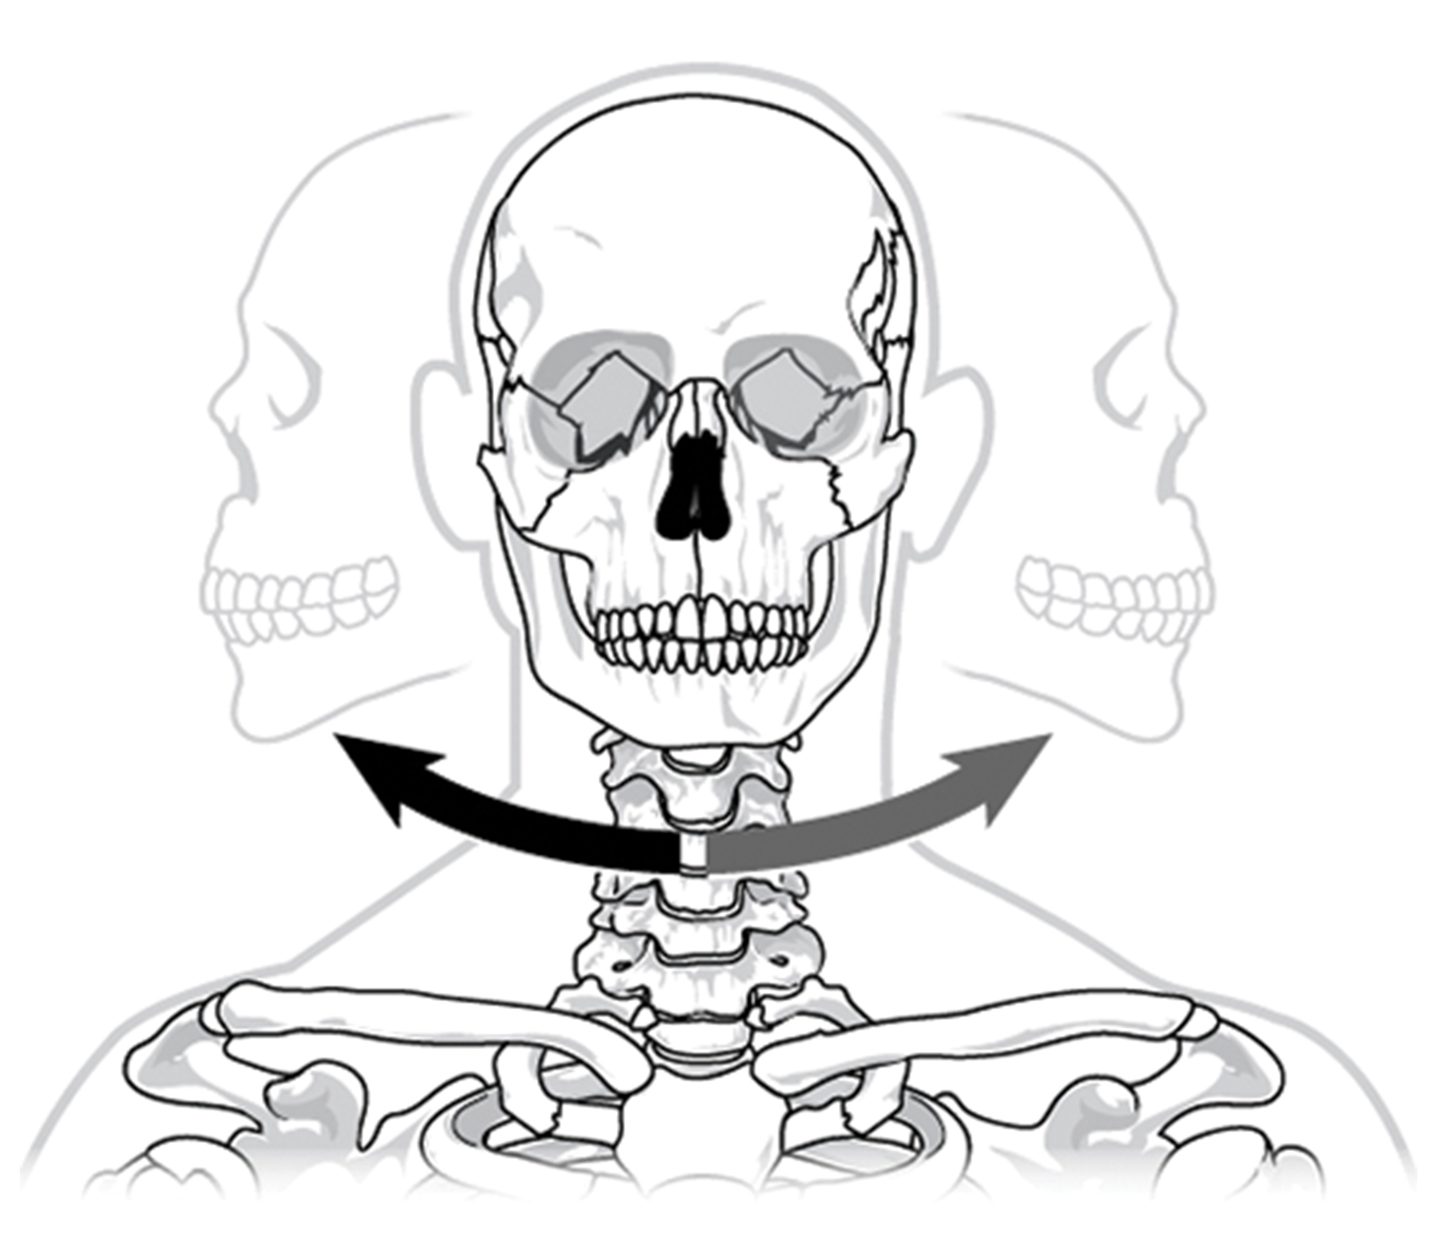
Pivot Joints
Pivot joints consist of the rounded end of one bone fitting into a ring formed by the other bone.
Allow for rotational movement
Example: first and second vertebrae of the neck allow the head to move back and forth
43.3 Figure 9
OpenStax. "Pivot joint."

Slide 24
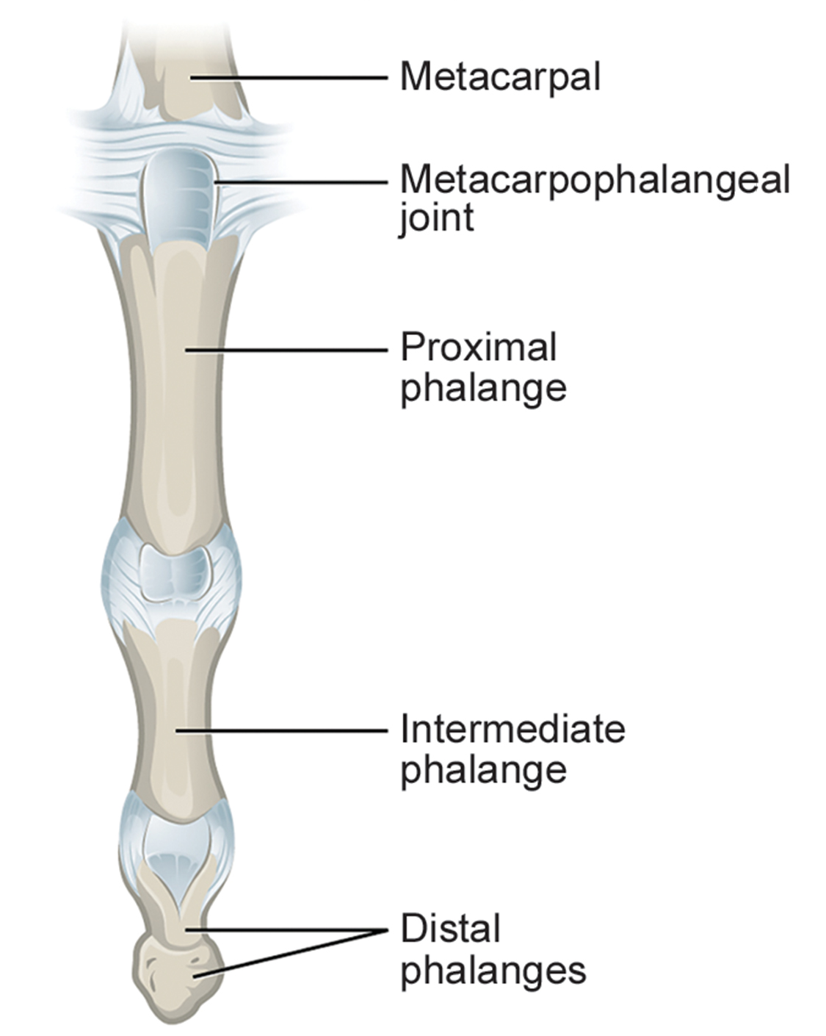
Condyloid Joints
Condyloid joints (ellipsoidal joint) consist of an oval-shaped end of one bone fitting into a similarly oval-shaped hollow of another bone.
Allow for angular movement along two axes
Example: joints of the writs and fingers
43.3 Figure 10
Henry Gray on Wikimedia Commons. "Metacarpophalangeal joints." Modified.

Slide 25
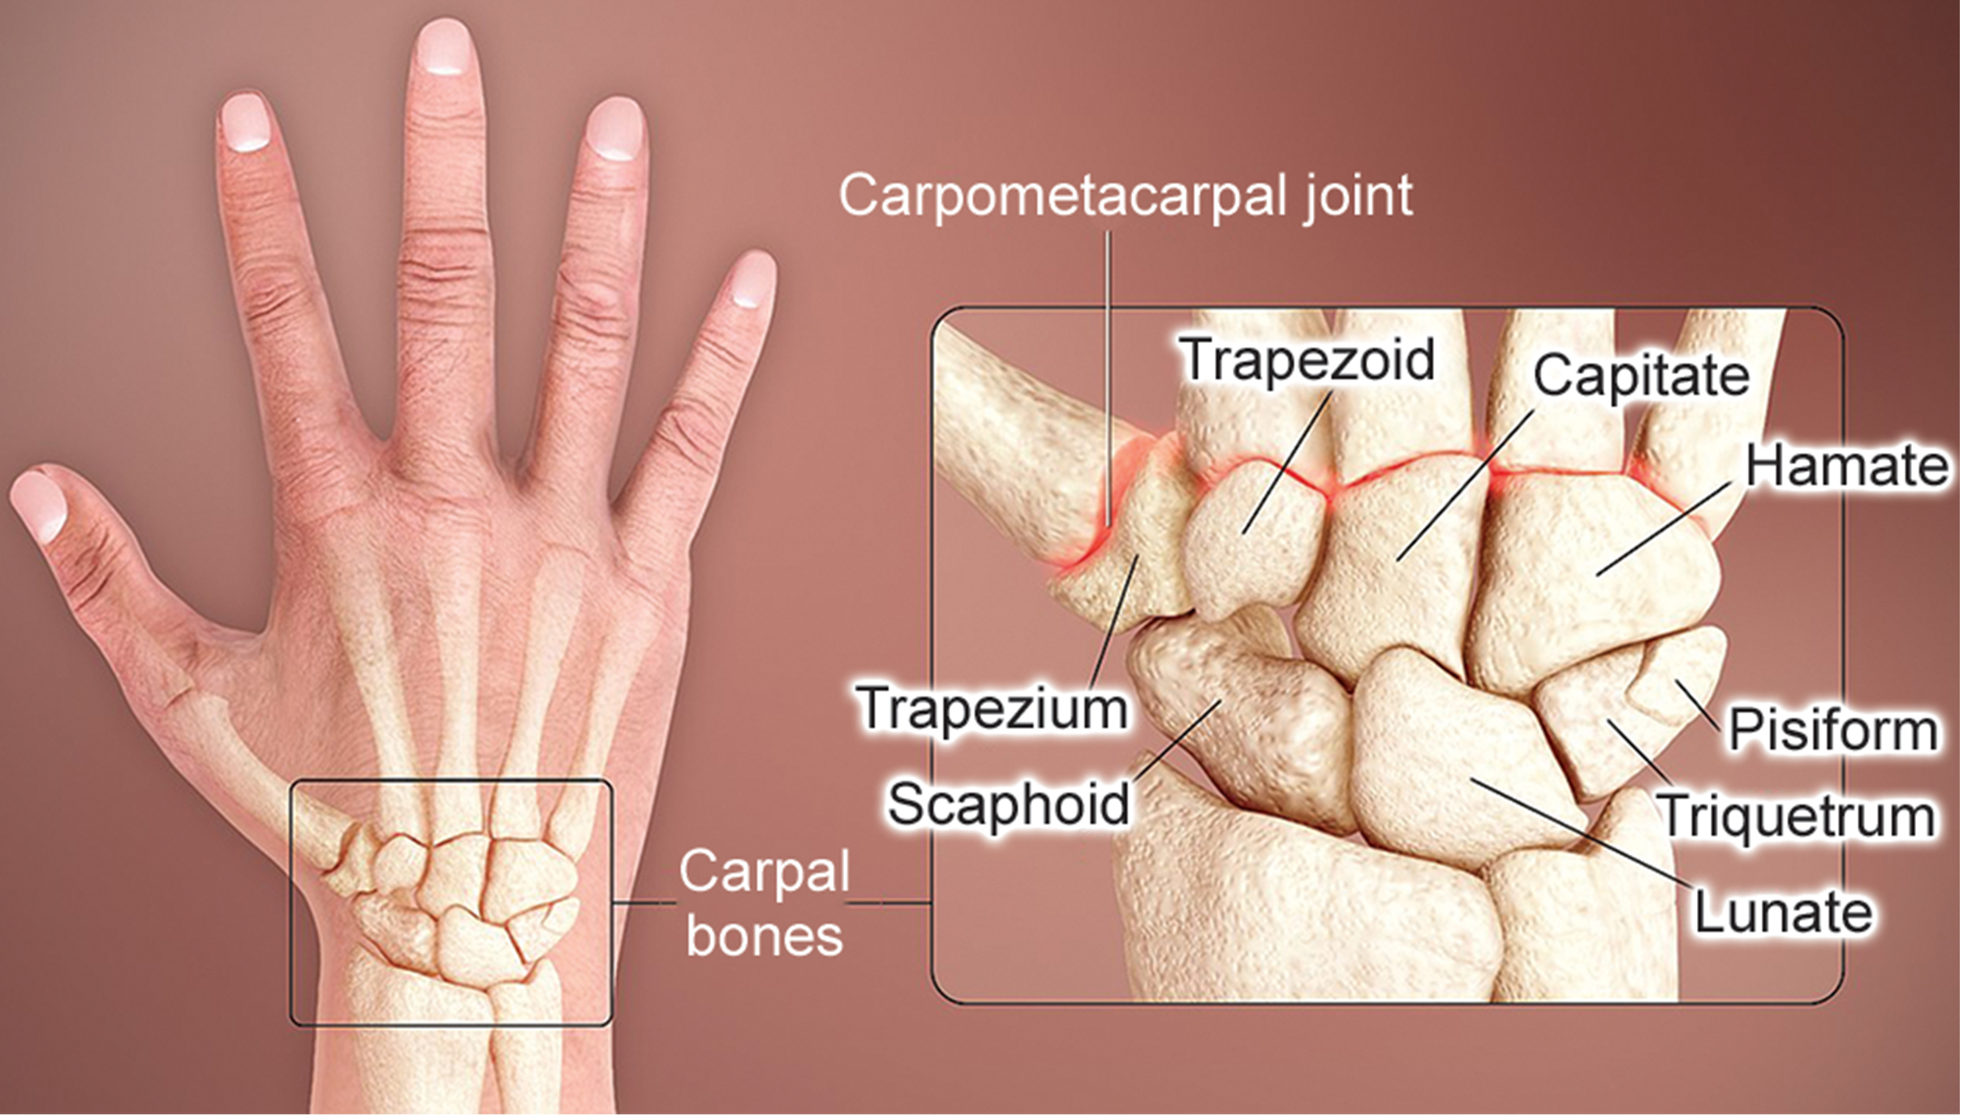
Saddle Joints
Saddle joints are so named because the ends of each bone resemble a saddle, with concave (rounded inward) and convex (rounded outward) portions that fit together.
Allow angular movements with a greater range of motion than condyloid joints
43.3 Figure 11
www.scientificanimations.com on Wikimedia Commons. "Human wrist diagram."

Slide 26
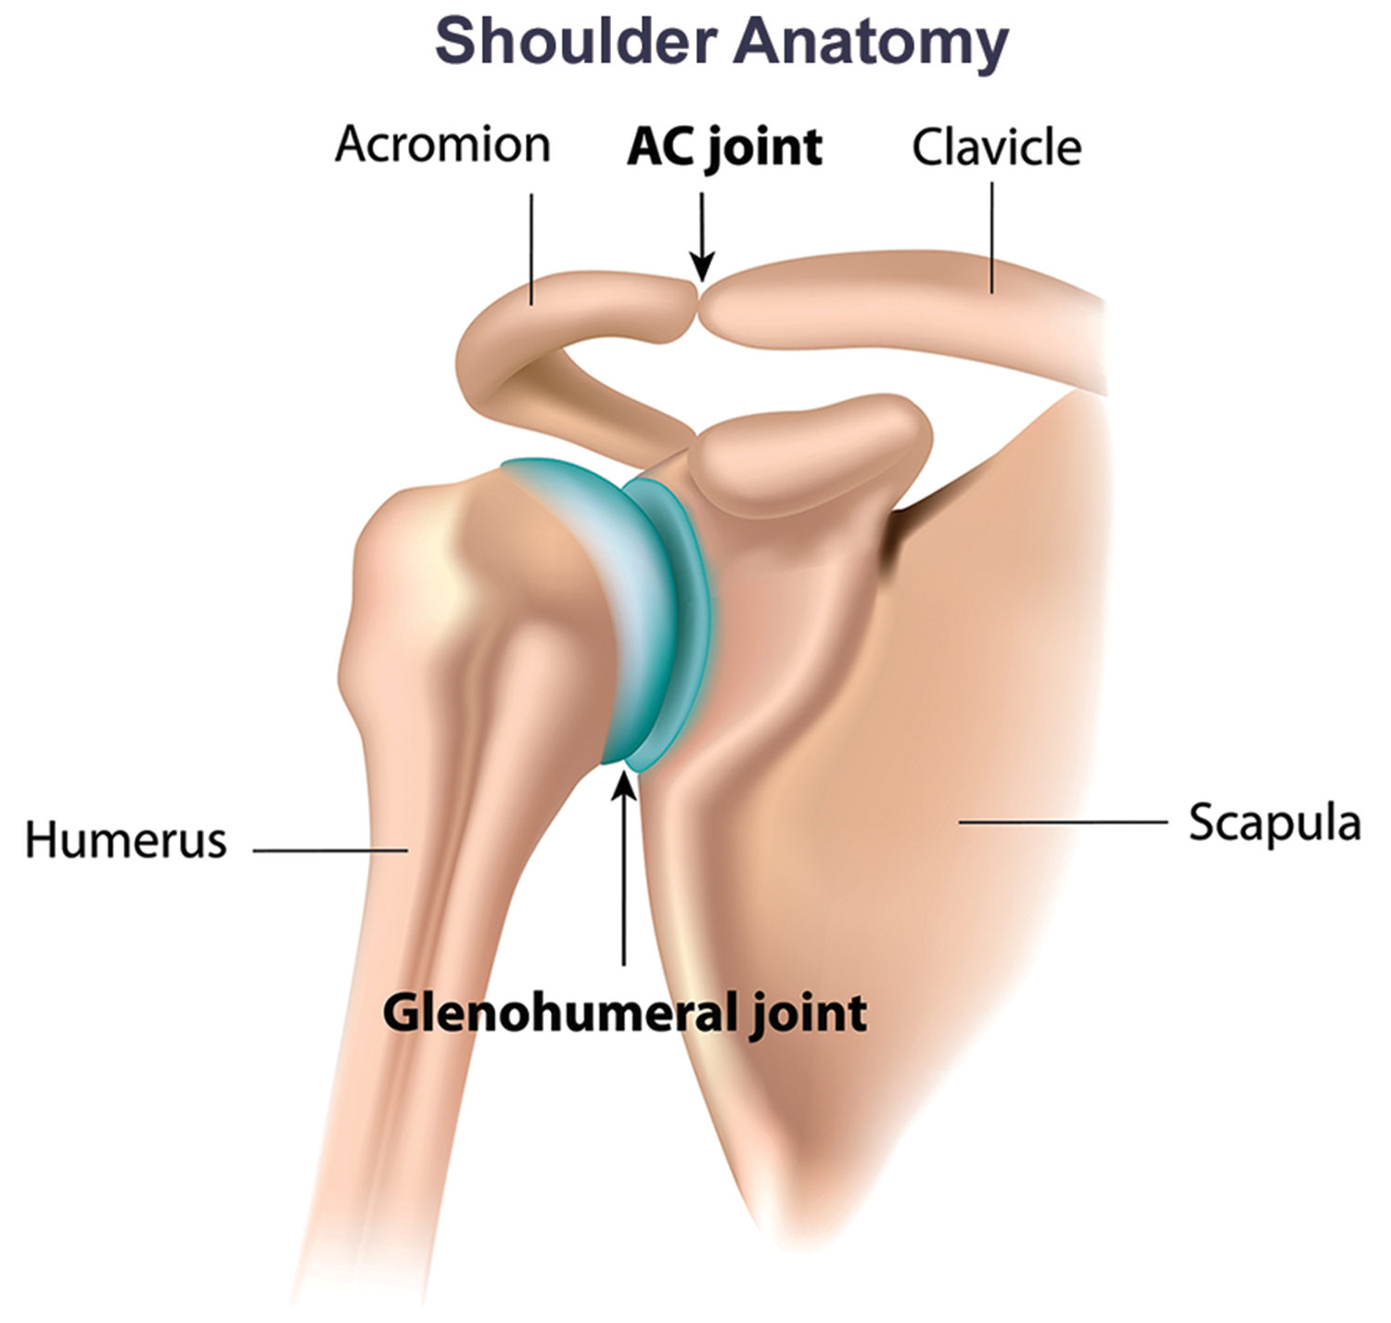
Ball-and-Socket Joints
Ball-and-socket joints possess a rounded, ball-like end of one bone fitting into a cuplike socket of another bone.
Allow for the greatest range of motion, as all movement types are possible in all directions
Examples: shoulder and hip joints
43.3 Figure 12

Slide 27
Science and You
Is There Such a Thing as a Joint Doctor?
Rheumatologists are medical doctors who specialize in the diagnosis and treatment of disorders of the joints, muscles, and bones.
What Is Rheumatoid Arthritis?
Rheumatoid arthritis (RA) is an inflammatory disorder that primarily affects the synovial joints of the hands, feet, and cervical spine.
Common in females aged 40-50.
Diagnosis involves assessing symptoms, imaging (X-rays, MRI, arthrography), and blood tests.
There's no cure, but treatment options include rest, exercise, medications (anti-inflammatories, pain relievers, corticosteroids), and surgery in severe cases.
Arthrography, a specialized imaging technique using contrast agents, allows early detection of joint cartilage degeneration.
Notes:
This is included as a relevant application for this topic.

Slide 28
Summary
Joints are structurally classified as bony, fibrous, cartilaginous, or synovial.
Fibrous joints include sutures, syndesmoses, and gomphoses; cartilaginous joints include synchondroses and symphyses.
Functionally, joints are classified as synarthroses, amphiarthroses, or diarthroses.
Synovial joint movements are categorized as gliding, angular, rotational, or special.
Special movements include inversion, eversion, protraction, retraction, elevation, depression, dorsiflexion, plantar flexion, supination, pronation, and opposition.
Synovial joints are further classified into six types based on shape and structure: planar, hinge, pivot, condyloid, saddle, and ball-and-socket.

Slide 29

End of Hawkes Learning PowerPoint

