Slide 1
Lesson 43.4
Muscle Contraction and Locomotion

Slide 2
Objectives
Classify the different types of muscle tissue .
Explain the role of muscles in locomotion.
Understand the structure of a muscle fiber.

Slide 3
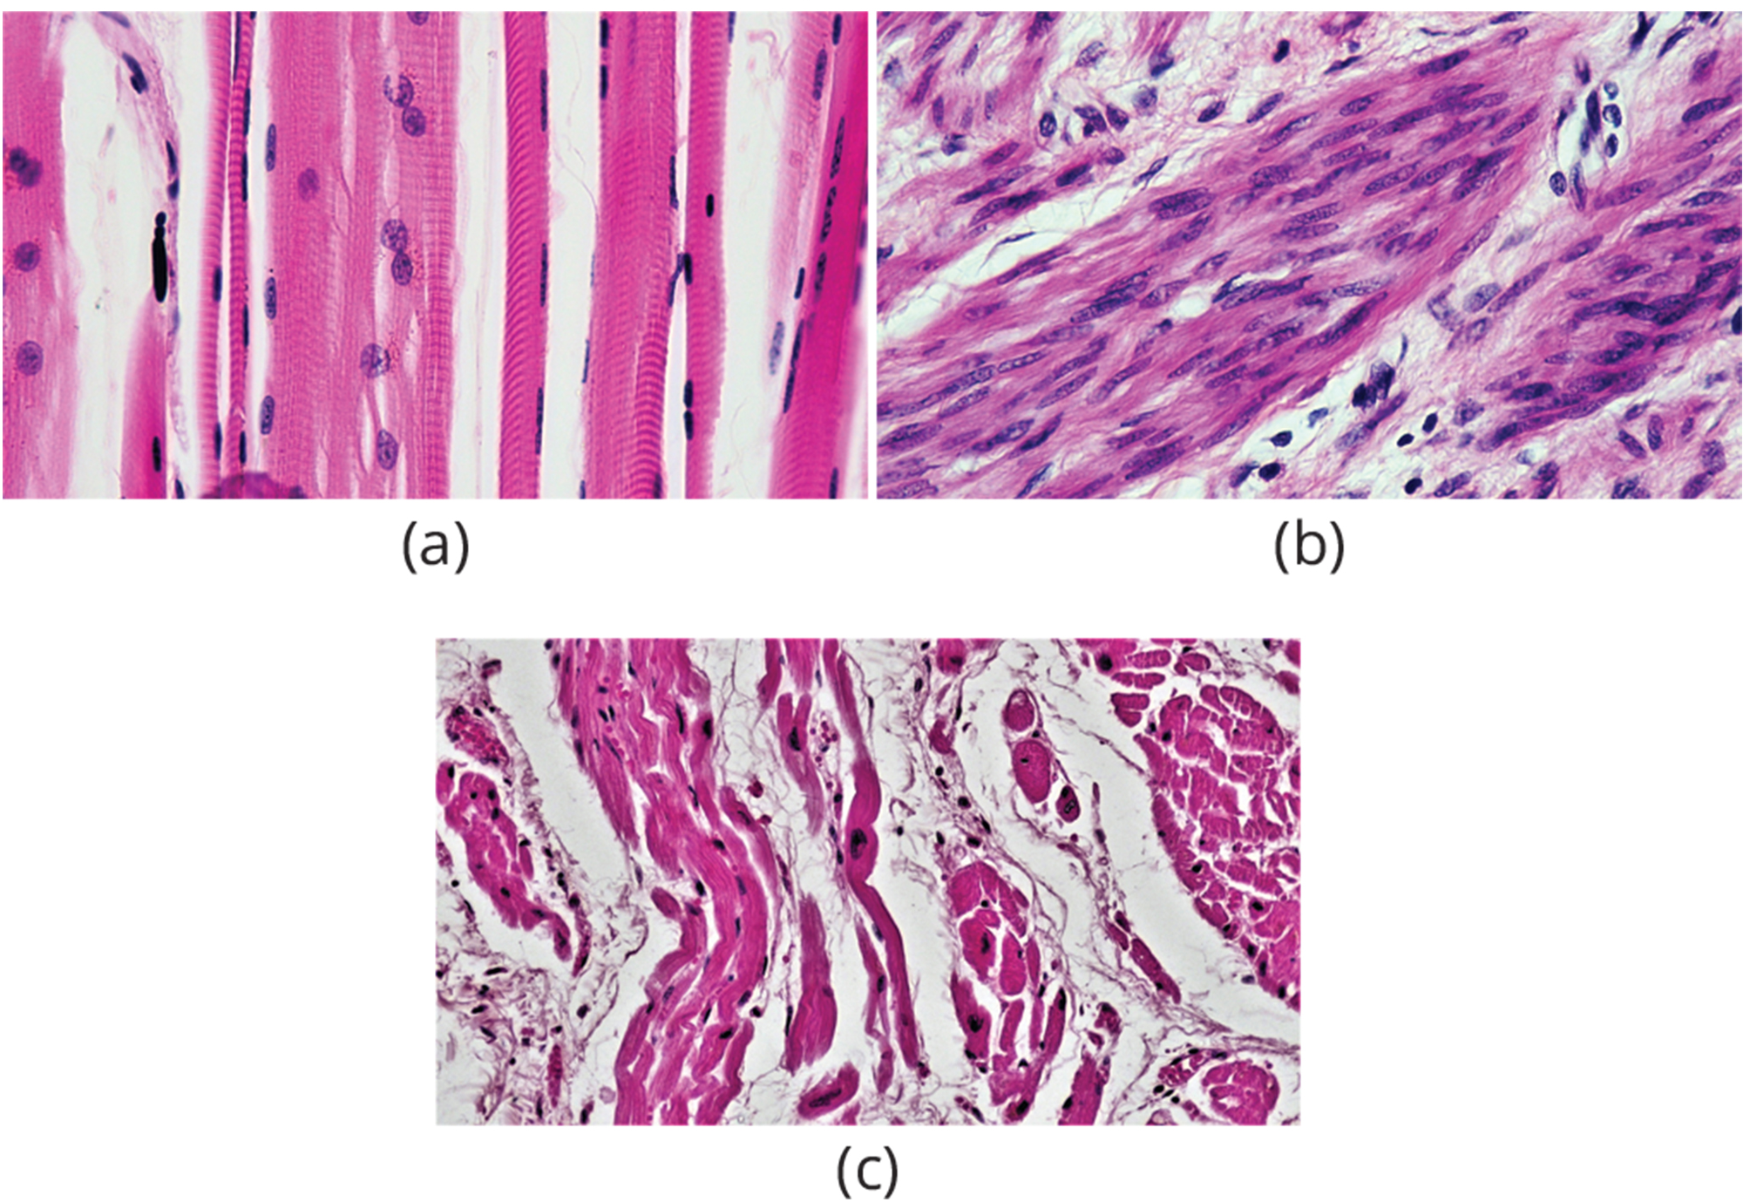
Muscle Contraction and Locomotion
Body contains three types of muscle tissue:
Skeletal
Cardiac
Smooth
43.4 Figure 4: (a) skeletal, (b) smooth, and (c) cardiac muscle
Berkshire Community College Bioscience Image Library on Wikimedia Commons. "Skeletal, smooth, and cardiac muscle."

Slide 4
Skeletal Muscle Tissue
Skeletal muscle tissue forms skeletal muscles, which attach to bones or skin and control locomotion and any movement that can be consciously controlled.
Are voluntary muscle controlled by thought
Have a cylindrical and striated appearance under a microscope due to actin and myosin
Actin: globular protein that interacts with myosin for muscle contraction
Cells contain multiple nuclei

Slide 5
Reflection Question₁
Based on what you know, which type of muscle tissue do you think makes up the highest percentage of muscle in the human body?
Which might make up the lowest percentage? Explain your answer.
Notes:
The reflection question is included here to use as a talking point or for a think-pair-share activity.

Slide 6
Skeletal Muscle Fiber Structure₁
Each skeletal muscle fiber is a skeletal muscle cell.
Cells have large diameters up to 100 μm and lengths of up to 30 cm.
Plasma membrane is known called a sarcolemma, which conducts the action potential that triggers muscle contraction.
Within each are myofibrils: long cylindrical structures that lie parallel to the muscle fiber and attach to the sarcolemma.

Slide 7
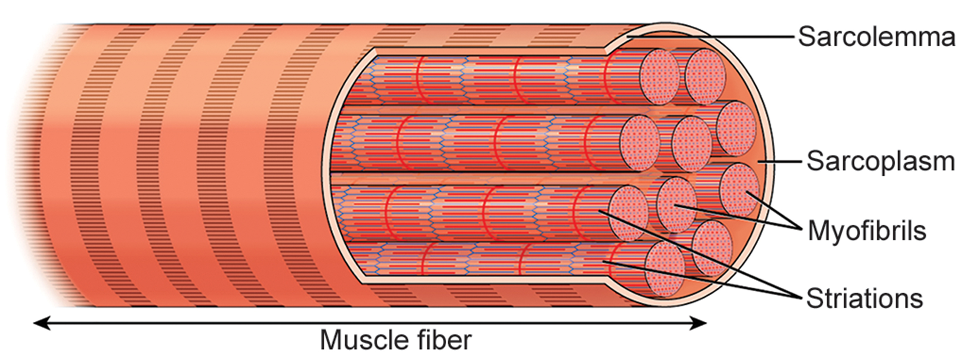
43.4 Figure 2
CNX OpenStax on Wikimedia Commons. "Skeletal muscle cell."
Notes:
A skeletal muscle cell is surrounded by a plasma membrane called the sarcolemma with a cytoplasm called the sarcoplasm. A muscle fiber is composed of many myofibrils, packaged into orderly units.

Slide 8
Skeletal Muscle Fiber Structure₂
Repeating bands of actin and myosin give the tissue its striated appearance.
A bands = dark regions
I bands = light regions
Each has a dense line running vertically called a Z disc, or line
Z discs mark the border of units called sarcomeres (space between two consecutive Z discs).

Slide 9
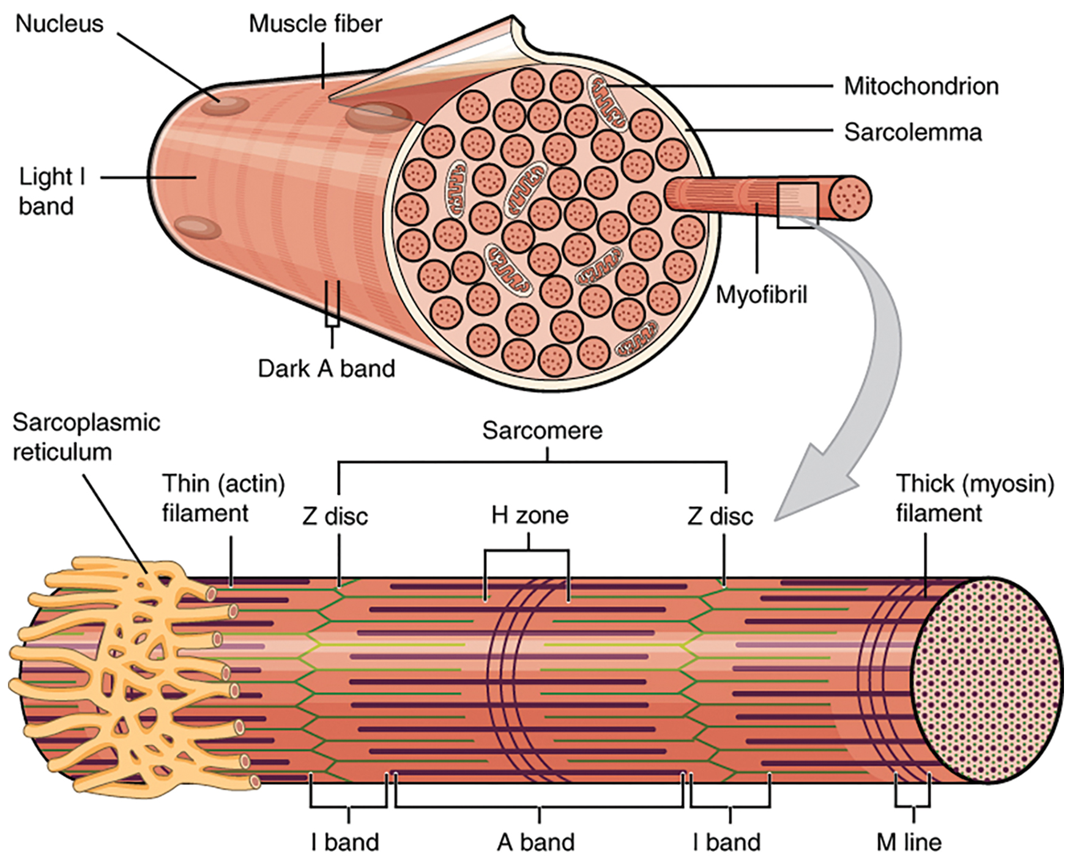
43.4 Figure 3
OpenStax on Wikimedia Commons. "Myofibril diagram."
Notes:
Each myofibril is made up of contractile units called sarcomeres. A sarcomere is the region from one Z disc to the next Z disc. Many sarcomeres are present in a myofibril, resulting in the striation pattern characteristic of skeletal muscle.

Slide 10
Skeletal Muscle Fiber Structure₃
Myofibrils are composed of myofilaments (thick or thin filaments).
Thick filaments are composed of myosin (linear tail with globular heads) and occur in the A band only.
H band is the area of the A band with only thick filaments.
The vertical line in the middle of the H band is the M line at which accessory proteins hold together thick filaments.
Thin filaments are composed of actin (composed of tropomyosin and troponin) and attach to alpha-actinin in the Z disc and occur across the length of the I band and partway into the A band.
Strands of tropomyosin block the binding sites and prevent actin-myosin interactions when the muscles are at rest.
Troponin consists of three globular subunits that each bind to tropomyosin, actin, or Ca²⁺ ions.

Slide 11
Sliding Filament Model of Contraction
For a muscle cell to contract, the sarcomere must shorten.
Thick and thin filaments slide by one another causing the sarcomere to shorten.
The mechanism of contraction is the binding of myosin to actin, forming cross-bridges that generate filament movement.
During contraction the H and I bands shorten.
The A band does not shorten but A bands move closer together during contraction.

Slide 12
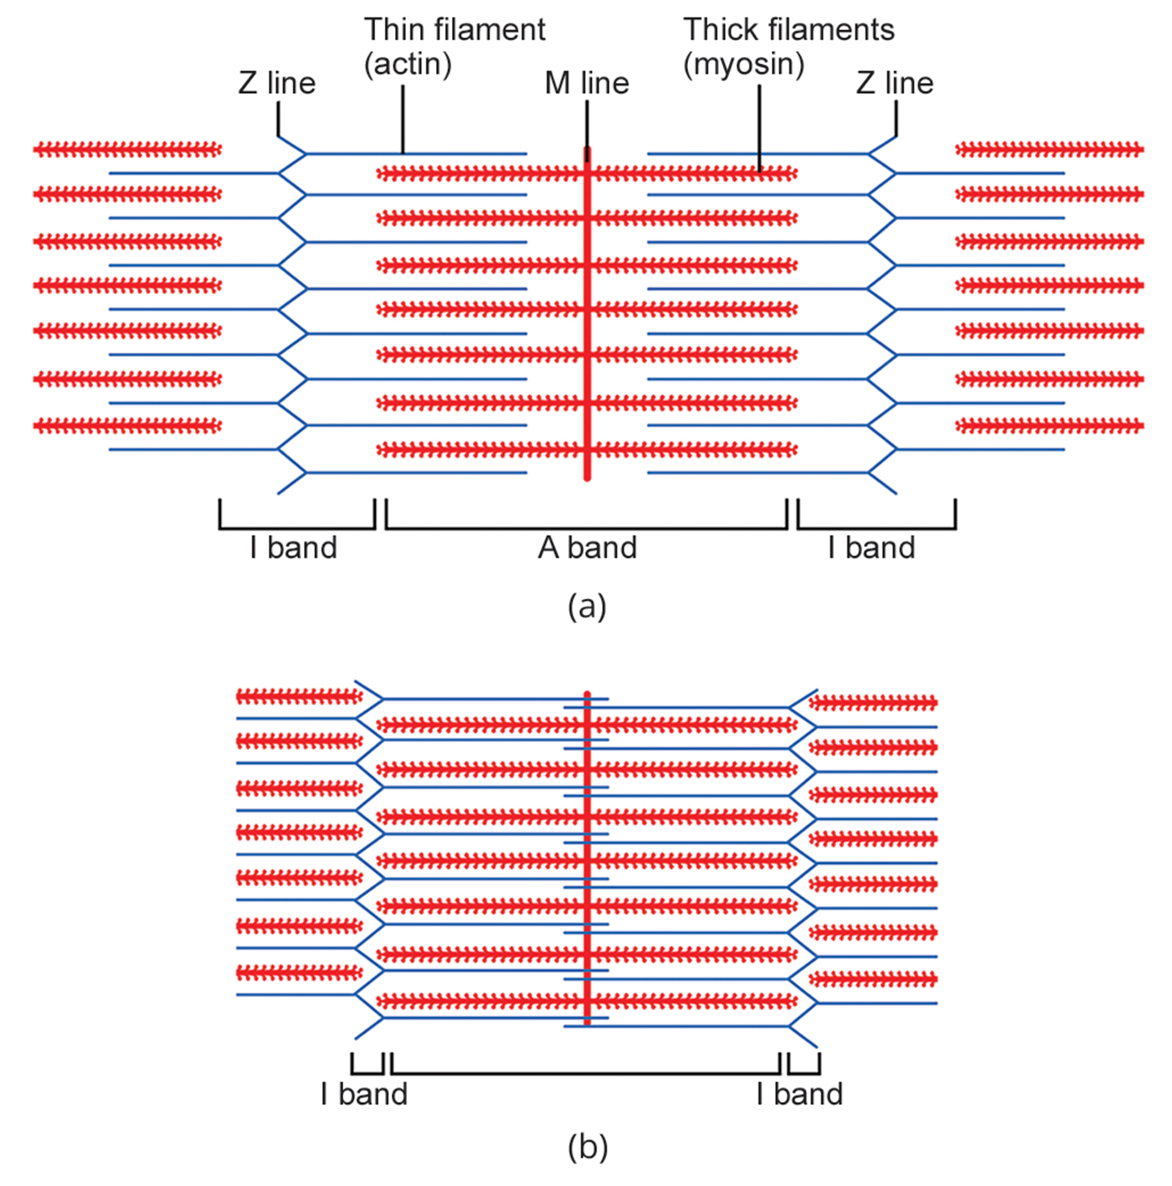
43.4 Figure 4
OpenStax. "Actin and myosin." Modified.
Notes:
When a (a) sarcomere (b) contracts, the Z lines move closer together and the I band gets smaller. The A band stays the same width, and, at full contraction, the thin filaments overlap.

Slide 13
Reflection Question₂
Even with exercise, humans generally don't make new muscle cells. The appearance of bulging muscles is caused by muscle cells getting bulkier, not by an increase in muscle cells.
Why do you think muscle cells grow bigger?
Consider the different proteins and components of muscle cells. Then, use your knowledge to make an educated guess. Finally, discuss your ideas with your classmates.
Notes:
The reflection question is included here to use as a talking point or for a think-pair-share activity.

Slide 14
ATP and Muscle Contraction
ATP powers muscle contraction.
ATP binding causes myosin to release actin; ATP is then hydrolyzed by myosin's ATPase enzyme into ADP and P_{i}.
Energy from ATP hydrolysis changes the myosin head angle to a "cocked" position, storing potential energy.
When actin-binding sites are uncovered, myosin forms a cross-bridge with actin and releases P_{i}, triggering a conformational change.
This change results in the power stroke, where myosin pulls actin about 10 nm toward the M line, causing sarcomere shortening and muscle contraction.
After the power stroke, ADP is released, and actin and myosin are still bound together.

Slide 15
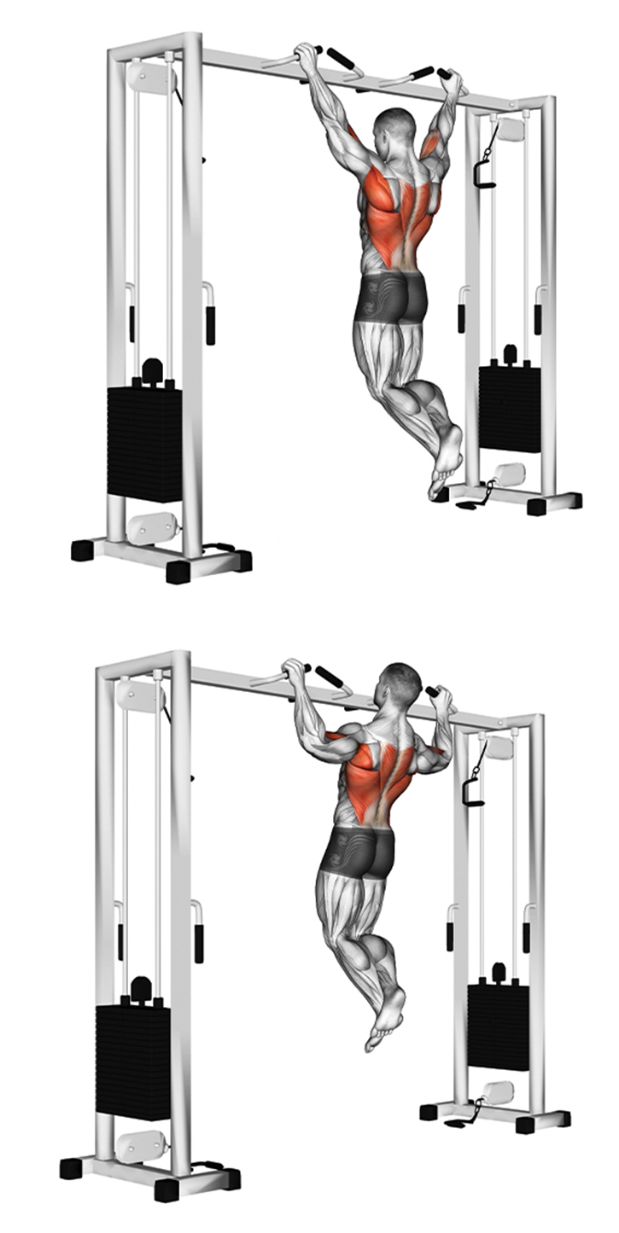
43.4 Figure 5
Notes:
As the sarcomeres shorten, the muscle contracts, enabling movement.

Slide 16
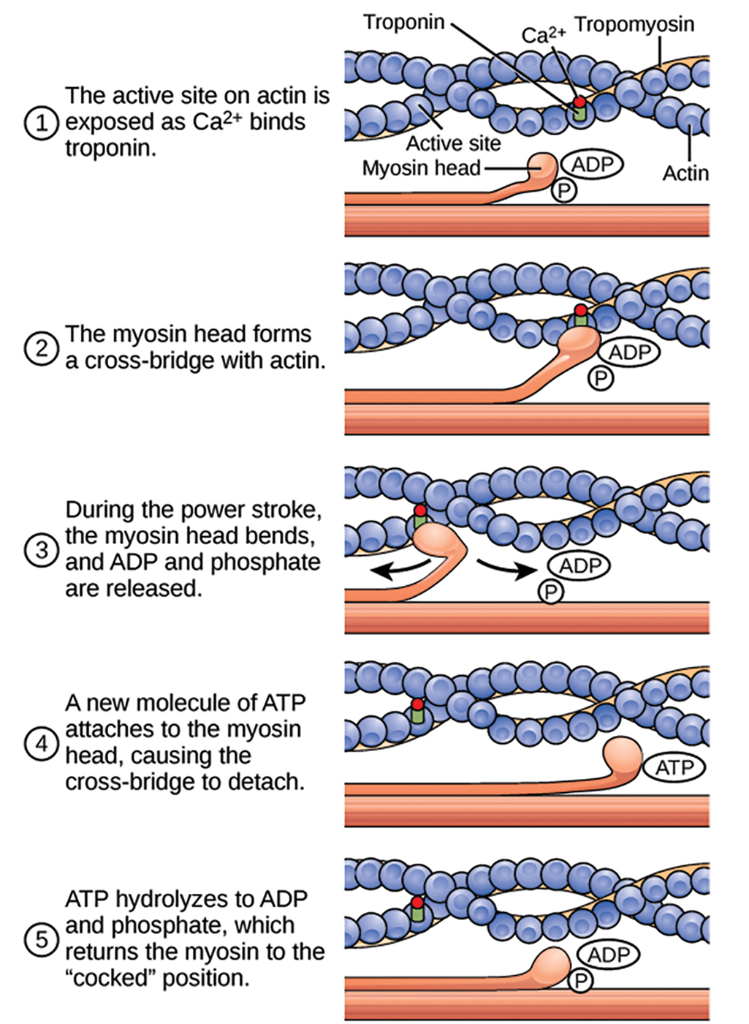
43.4 Figure 6
OpenStax. "Muscle contraction."
Notes:
The cross-bridge muscle contraction cycle, which is triggered by Ca2+ binding to the actin active site, is shown. With each contraction cycle, actin moves relative to myosin.

Slide 17
Regulatory Proteins
In resting muscles, tropomyosin blocks myosin-binding sites on actin, preventing contraction.
Troponin binds to tropomyosin and calcium ions, helping position tropomyosin on actin.
Muscle contraction is triggered when calcium ions bind to troponin, causing tropomyosin to move and expose myosin-binding sites on actin.
Cross-bridge cycling continues until calcium ions and ATP are depleted, at which point tropomyosin covers the binding sites again, ending contraction.

Slide 18
Think It Through₁
Provide the name of the structure(s) matching each description involved in muscle contraction.
These charged particles bind to troponin and cause a conformational change that results in the exposure of the actin-binding site.
The hydrolysis of this molecule provides the energy needed to return myosin to its "cocked" position after a power stroke.
This protein connects to actin by way of a reversible cross-bridge.
Troponin binds to this molecule and helps position it on the actin molecule.
Notes:
Originally an On Your Own. This is included here to use as a talking point or for a think-pair-share activity.

Slide 19
Excitation-Contraction Coupling₁
Excitation-contraction coupling links the action potential in the sarcolemma to muscle contraction initiation.
A signal from a motor neuron triggers calcium release from the sarcoplasmic reticulum into the sarcoplasm.
Each skeletal muscle fiber is controlled by a motor neuron that conducts signals from the brain or spinal cord.
The motor end plate is the area of the sarcolemma that interacts with the neuron's synaptic terminal, separated by the synaptic cleft.
Electrical signals travel along the neuron's axon, which branches through the muscle and connects to individual muscle fibers to form a neuromuscular junction.
Cells create an electrical gradient across their membranes through an unequal distribution of ions, which is essential for electrical communication.

Slide 20
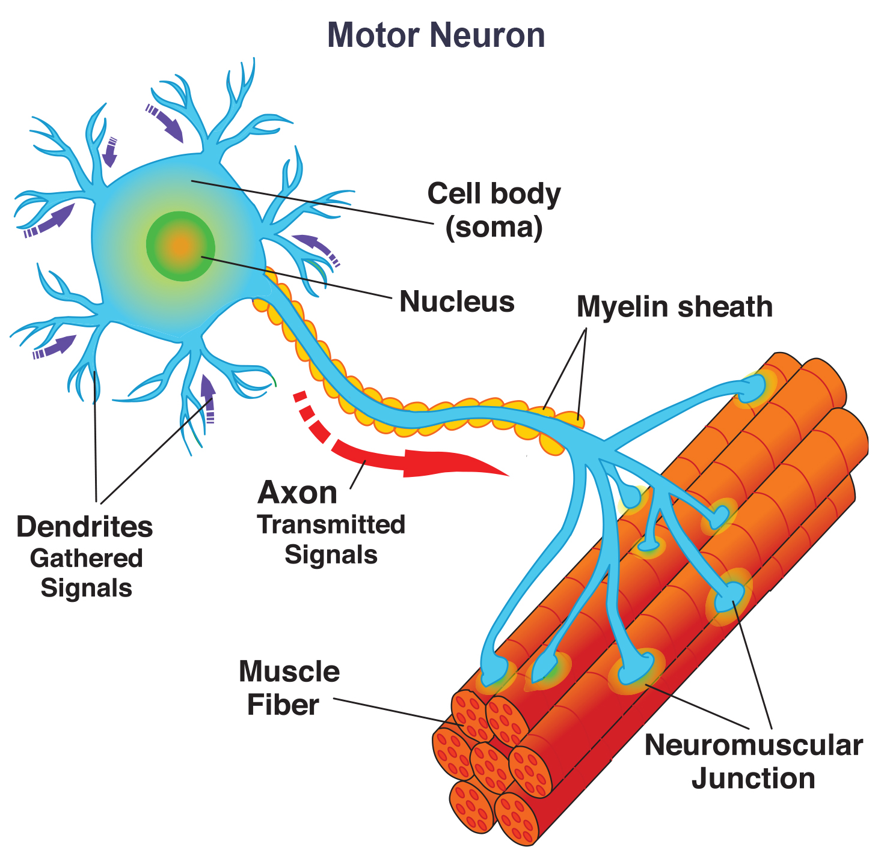
43.4 Figure 7
Notes:
The axon of a motor neuron branches, with each branch forming a neuromuscular junction on a muscle fiber.

Slide 21
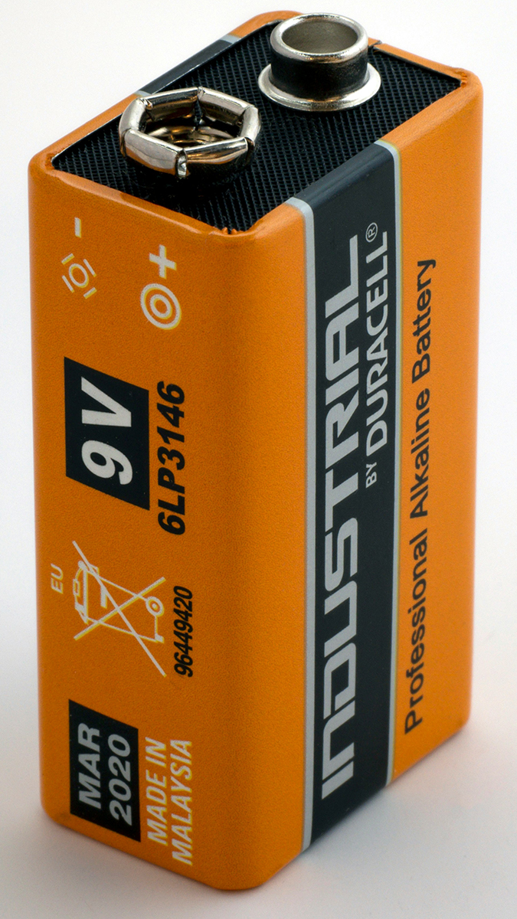
Think It Through₂
What is meant by a "charge gradient" across a cell membrane?
How is a charge gradient a form of potential energy?
43.4 Figure 8
Brett Jordan on Unsplash. "Battery."
Notes:
Originally an On Your Own. This is included here to use as a talking point or for a think-pair-share activity.

Slide 22
Excitation-Contraction Coupling₂
The sodium-potassium pump maintains cell membrane charge gradients using ATP to move K⁺ in and Na⁺ out.
K⁺ can leave the cell through mostly open channels, while Na⁺ channels are rarely open, creating a concentration gradient.
This results in a negative charge inside the cell, establishing the resting membrane potential of about -70 mV.
Action potentials occur when Na⁺ channels open, allowing Na⁺ to enter the cell and change the membrane voltage.
Neurotransmitters released from neuron axon terminals into the synaptic cleft facilitate nerve-muscle communication.
At the motor end plate, neurotransmitters bind to receptors (sodium channels), allowing for a Na⁺ influx and signal propagation.

Slide 23
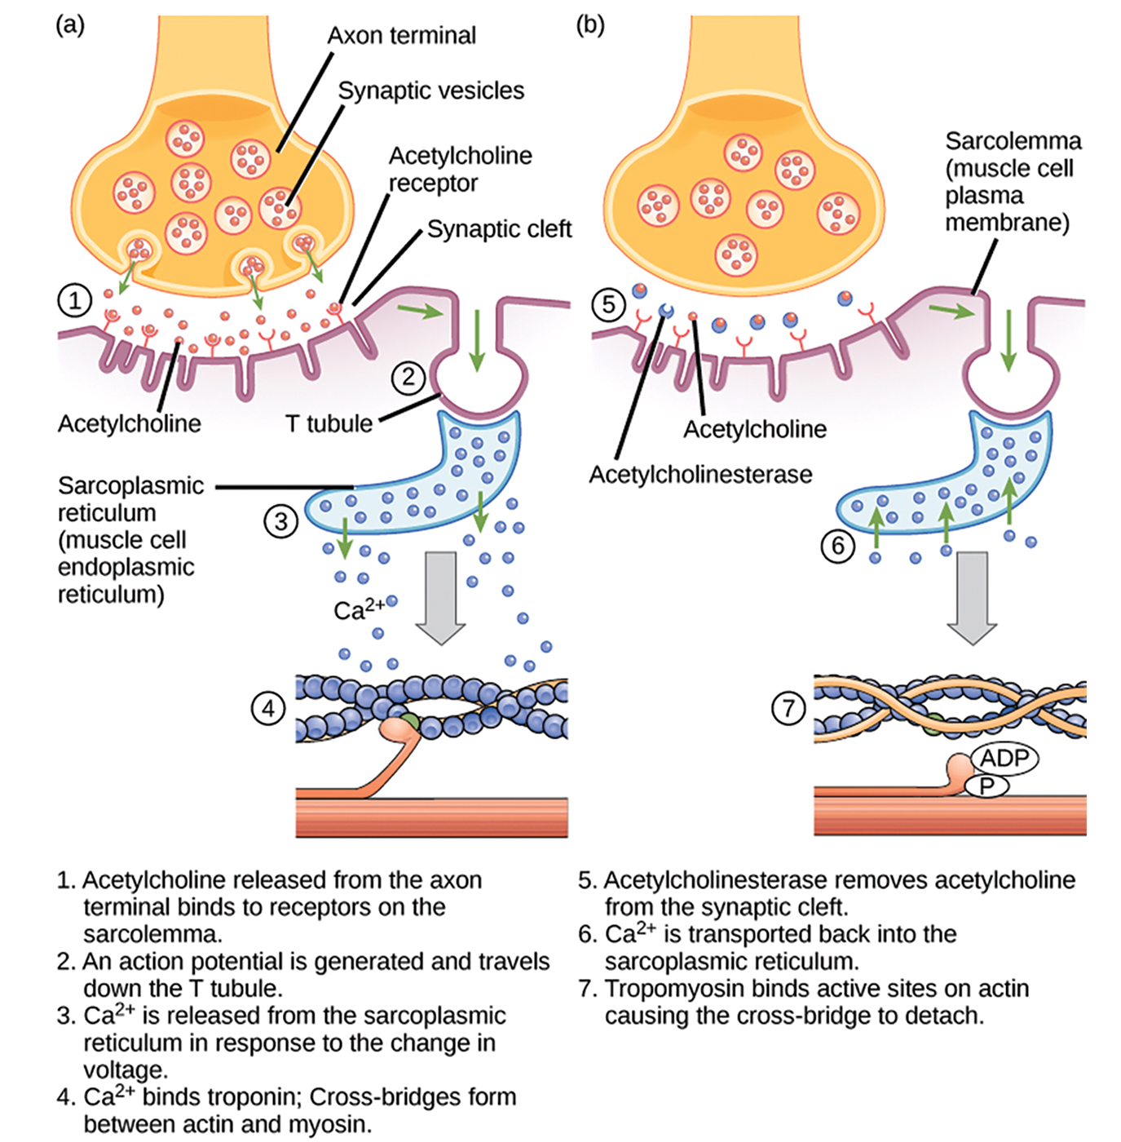
43.4 Figure 9
CNX OpenStax on Wikimedia Commons. "Excitation-contraction coupling."
Notes:
This diagram shows excitation-contraction coupling in a skeletal muscle contraction. The sarcoplasmic reticulum is a specialized endoplasmic reticulum that stores the Ca2+ needed for muscle contraction.

Slide 24
Think It Through₃
The nerve gas sarin irreversibly inhibits acetylcholinesterase. What effect would sarin have on muscle contraction?
Notes:
Originally an On Your Own. This is included here to use as a talking point or for a think-pair-share activity.

Slide 25
Excitation-Contraction Coupling₃
Acetylcholine (ACh) is a neurotransmitter released by motor neurons when an action potential triggers calcium influx in the synaptic terminal.
ACh binds to receptors on the motor end plate, opening ion channels and allowing Na⁺ influx, causing depolarization.
This depolarization spreads along the sarcolemma, creating an action potential and triggering Ca²⁺ release within the muscle cell.
Acetylcholinesterase (AChE) breaks down ACh in the synaptic cleft to prevent prolonged muscle contraction.
After depolarization, the membrane repolarizes as sodium channels close, and the sodium-potassium pump restores ion balance.
The refractory period follows, during which the cell cannot generate another action potential, allowing ion channels to reset.

Slide 26
Science and You
Botulinum toxin is a potent neurotoxin made by the bacteria Clostridium botulinum. The toxin is responsible for a dangerous food poisoning known as botulism. Botulinum toxin injections serve cosmetic purposes, under the name Botox, when used in minute amounts.
How does Botox work?
The answer is that Botox causes muscle paralysis. The botulinum toxin blocks the release of acetylcholine from motor neurons. Without adequate acetylcholine, no message passes from motor neuron to muscle cell to trigger muscle contraction, resulting in localized paralysis. For example, injection of Botox into the face paralyzes underlying facial muscles to reduce the appearance of wrinkles.
Notes:
This is included as a relevant application for this topic.

Slide 27
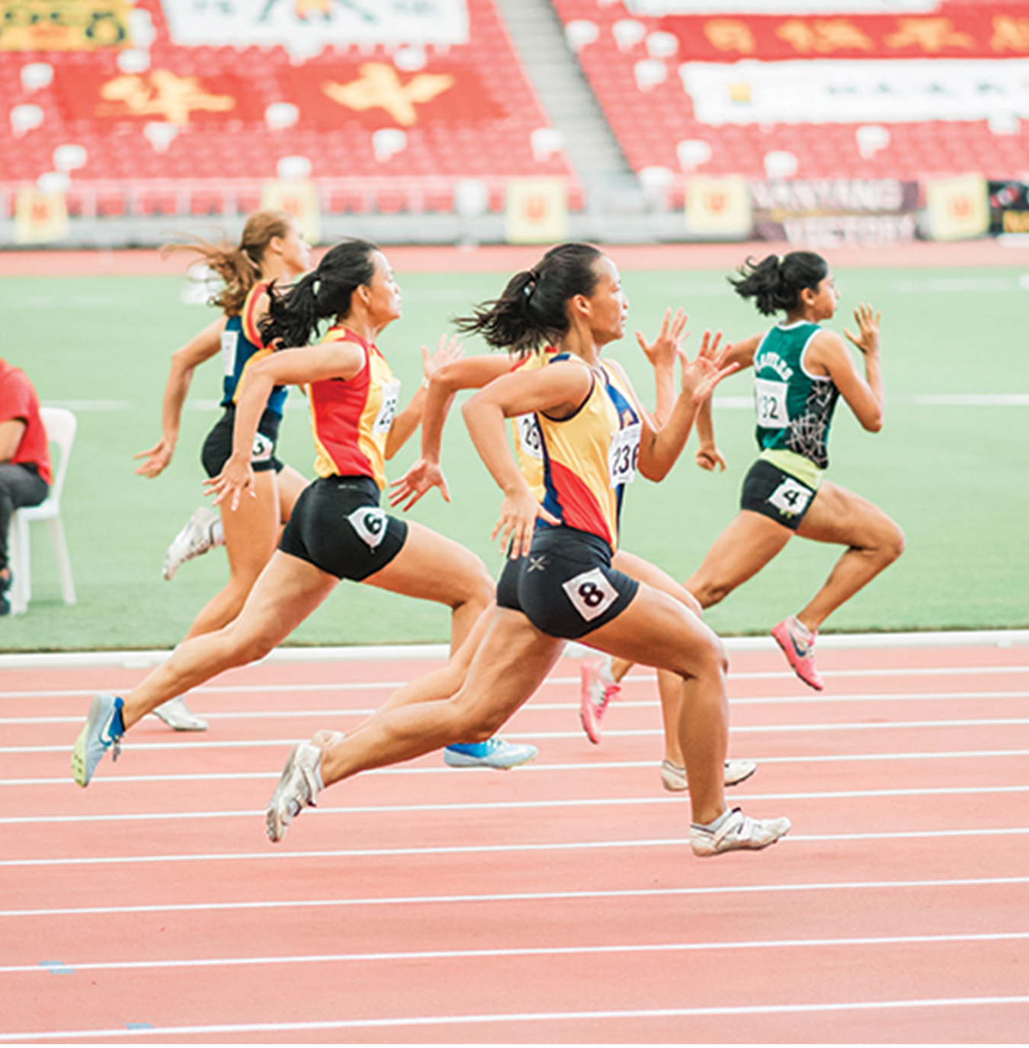
Control of Muscle Tension₁
A signal from a neuron initiates the formation of actin-myosin cross-bridges, leading to the sarcomere shortening that causes muscle contraction.
The pull exerted by a muscle is called tension, and the amount of force created by this tension can vary.
The number of cross-bridges formed between actin and myosin determines the amount of tension a muscle fiber can produce, with more cross-bridges resulting in greater tension.
43.4 Figure 10
Jonathan Chng on Unsplash. "Runners."

Slide 28
Control of Muscle Tension₂
Maximal muscle tension occurs when thick and thin filaments overlap optimally in the sarcomere; stretching or shortening beyond this point reduces tension.
Force production primarily depends on the number of stimulated muscle fibers within a muscle.
Motor units (a neuron and its innervated muscle fibers) are recruited based on the force required for a task.
Increasing the frequency of action potentials can slightly increase force by flooding tropomyosin with calcium.

Slide 29
Summary
The body contains three types of muscle tissue: skeletal muscle, cardiac muscle, and smooth muscle.
Skeletal muscle tissue is composed of sarcomeres, the functional units of muscle tissue.
Muscle contraction occurs when sarcomeres shorten, as thick and thin filaments slide past each other, which is called the sliding filament model of muscle contraction.
ATP provides the energy for cross-bridge formation and filament sliding.
Regulatory proteins, such as troponin and tropomyosin, control cross-bridge formation.
Excitation-contraction coupling transduces the electrical signal of the neuron, via acetylcholine, to an electrical signal on the muscle membrane, which initiates force production.
The number of muscle fibers contracting determines how much force the whole muscle produces.

Slide 30

End of Hawkes Learning PowerPoint

