Slide 1
Lesson 44.1
The Scope of Ecology

Slide 2
Objectives
Define ecology and the four basic levels of ecological research.
Describe examples of the ways in which ecology requires the integration of different scientific disciplines.
Distinguish between abiotic and biotic components of the environment.
Recognize the relationship between abiotic and biotic components of the environment.

Slide 3
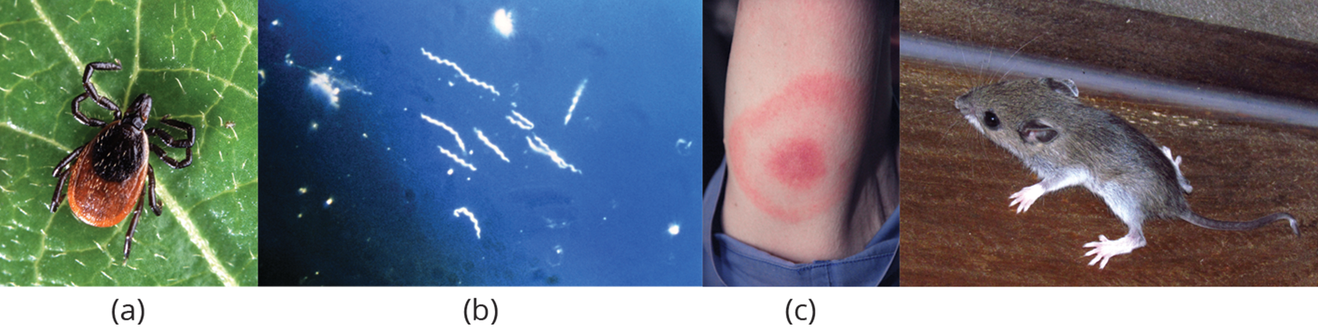
Ecology and the Biosphere
Humans are part of the ecological landscape, and human health is connected to the natural world.
Example: Lyme disease is a connection between our health and the natural world.
  Lyme disease is transmitted by deer ticks, with infection probability depending on host species.
  Understanding ecological factors helps in comprehending disease transmission and prevention.
44.1 Figure 1: The (a) deer tick carries the (b) Borrelia burgdorferi spirochete (spiral-shaped bacterium) that produces Lyme disease in humans, often evident in (c) a symptomatic bull's eye rash. The (d) white-footed mouse is one well-known host to deer ticks carrying the Lyme disease bacterium.
PD-USGov-USDA-ARS on Wikimedia Commons. "Deer tick."
PD-USGov-HHS-CDC on Wikimedia Commons. "Borrelia burgdorferi."
CDC / James Gathany on Wikimedia Commons. "Lyme disease rash."
D. Gordon E. Robertson on Wikimedia Commons. "White-footed mouse."

Slide 4
The Scope of Ecology
Ecology is the study of interactions between living organisms and their environment.
A core goal is to understand the distribution and abundance of living organisms.
  Involves integrating various scientific disciplines, including mathematics, statistics, biochemistry, and climatology

Slide 5
Levels of Ecological Study
Ecology is divided into four general levels: organismal, population, community, and ecosystem.
These levels sometimes overlap and collectively make up the biosphere: collection of all ecosystems on Earth.
Each level focuses on different aspects of ecological interactions and processes.

Slide 6
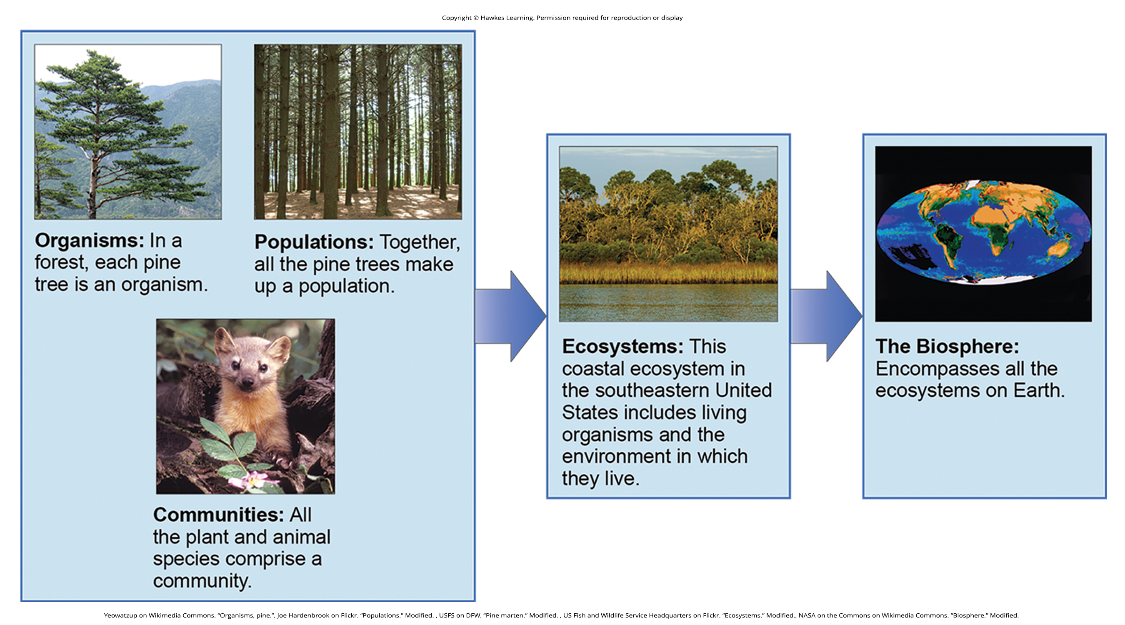
44.1 Figure 2
US Fish and Wildlife Service Headquarters on Flickr. "Ecosystems." Modified.
NASA on the Commons on Wikimedia Commons. "Biosphere." Modified.
Yeowatzup on Wikimedia Commons. "Organisms, pine."
USFS on DFW. "Pine marten." Modified.
Joe Hardenbrook on Flickr. "Populations." Modified.
Notes:
Figure 2: Ecologists study within several biological levels of organization.

Slide 7
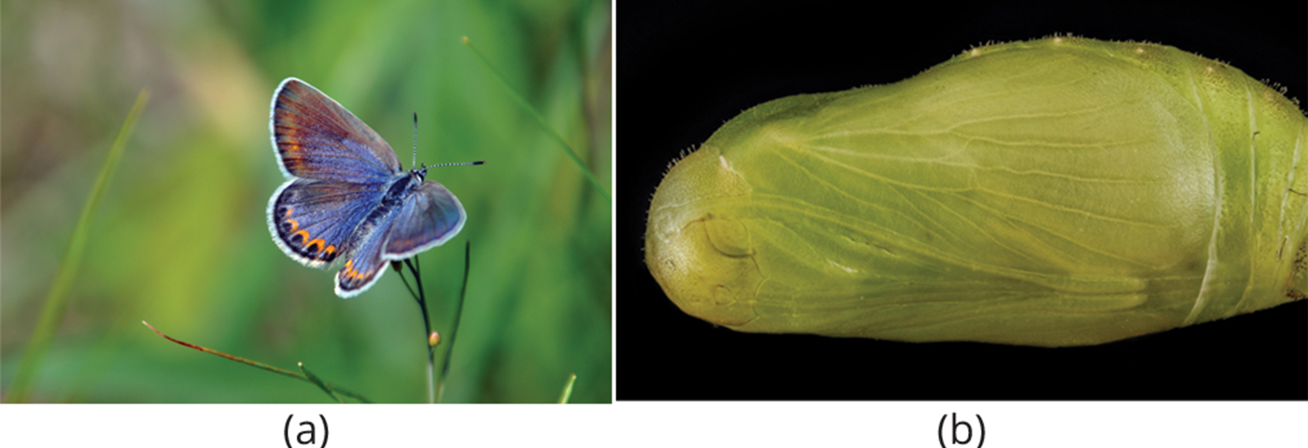
Organismal Ecology₁
The organismal level focuses on adaptations that enable individuals to live in specific habitats.
Can be morphological, physiological, or behavioral
Example: Karner blue butterfly's specialization on wild lupine for egg-laying and larval development
  Completely dependent on wild lupine plants for survival
44.1 Figure 3: (a) Karner blue butterfly (Lycaeides melissa samuelis) and (b) the pupate form of the butterfly
USFWSmidwest on Wikimedia Commons. "Karner blue butterfly."
Sam Droege on Wikimedia Commons. "Karner blue butterfly pupa."

Slide 8
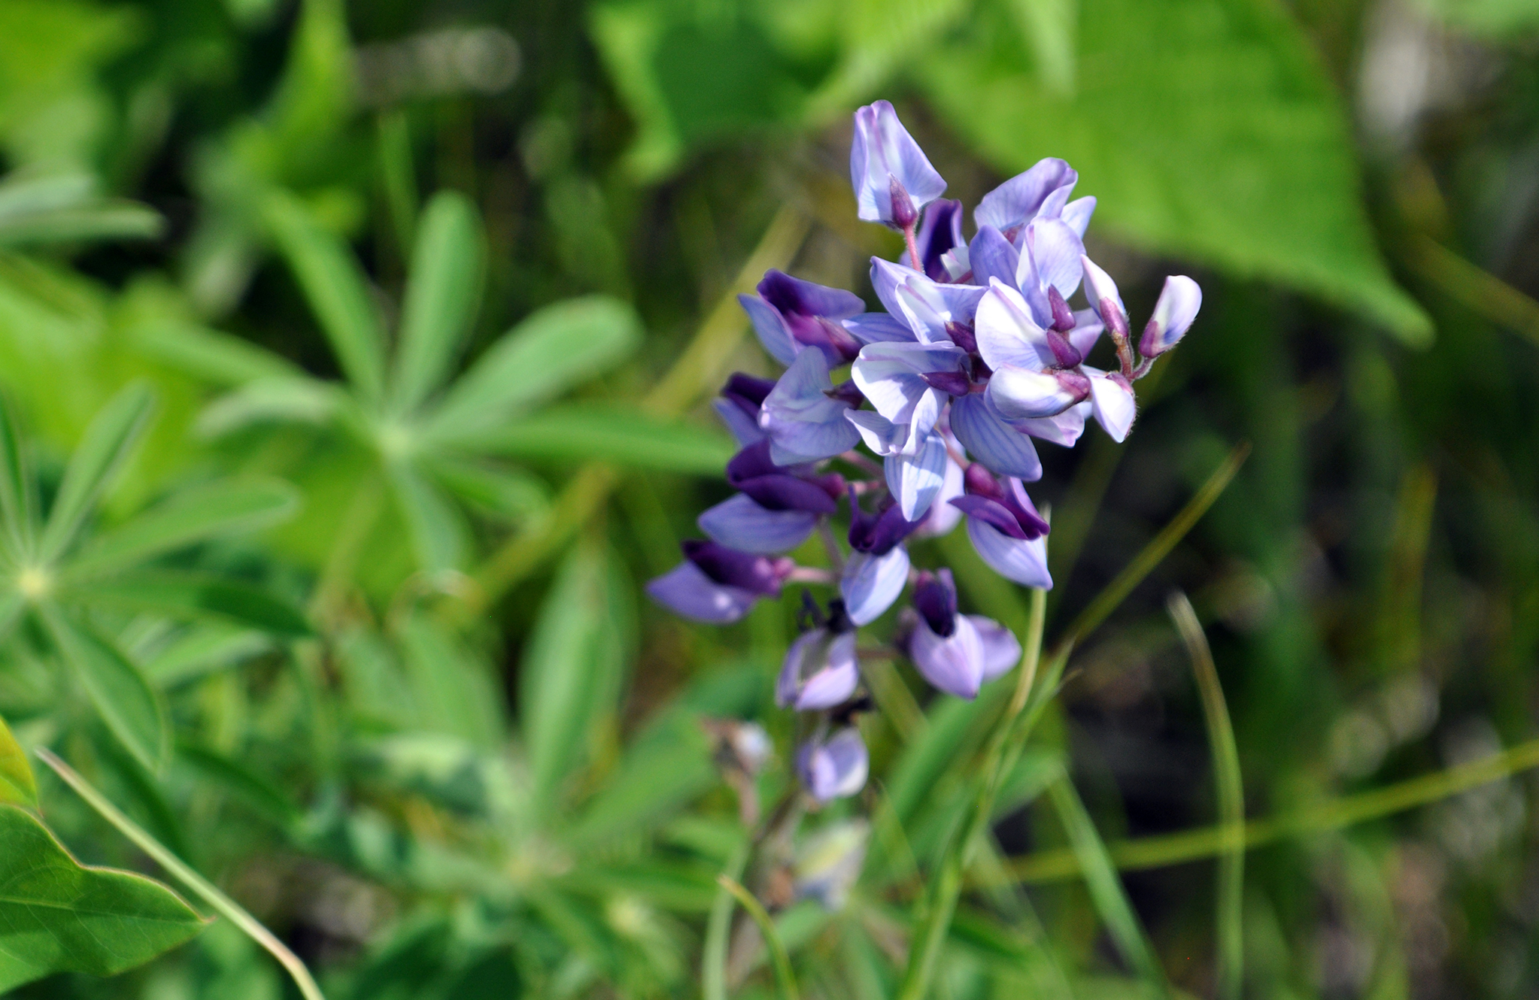
Organismal Ecology₂
The first instar (stage 1 of larval development) caterpillars spend four to six weeks feeding on wild lupine as they grow.
The caterpillars pupate and undergo metamorphosis to emerge as butterflies after four weeks.
The adult butterflies continue to feed on wild lupine flowers as well as other plants.
An organismal ecologist might ask questions about egg-laying requirements, flight temperature, and larval behavior.
44.1 Figure 4: The wild lupine (Lupinus perennis) is the only known host plant for the Karner blue butterfly.
USFWSmidwest on Wikimedia Commons. "Wild lupine."

Slide 9
Population Ecology₁
A population is a group of interbreeding organisms of the same species living in a defined area at the same time.
Identified in part by where the population lives
May have natural boundaries (rivers, mountains, deserts) or artificial boundaries (mowed grass, manmade structures, roads)
Focuses on the number of individuals in an area and how/why population size changes over time

Slide 10
Population Ecology₂
One example is counting and studying Karner blue butterflies as an endangered species.
  Highly influenced by distribution and abundance of wild lupine and the biophysical environment
  Might ask questions about factors leading to decline of wild lupine and how these affect Karner blue butterflies
Ecologists know that wild lupine thrives in open areas.
  Removal of trees by intermittent wildfires
  Can use mathematical models to understand how human suppression of wildfires has led to decline in wild lupine

Slide 11
Community Ecology₁
Investigates different species within an area and their interactions
Studies both conspecific (same species) and heterospecific (different species) interactions
  Conspecific: competition among members of the same species for a limited resource
  Heterospecific: processes like predation, parasitism, and mutualism
  Can have regulating effects on population size and impact ecological and evolutionary processes affecting diversity

Slide 12
Think It Through₁
Identify the vocabulary term associated with each description.
Members of different species living in the same geographical area
Members of same species living in the same geographical area
Notes:
Originally an On Your Own. This is included here to use as a talking point or for a think-pair-share activity.

Slide 13
Community Ecology₂
One example is the mutualistic relationship between Karner blue butterfly larvae and ants.
Mutualism: form of long-term relationship that coevolved between two species and from which each species benefits
Increased survival rates in larvae when ants protect them from predation (tending)
Less time spent in each life stage when being tended
Secretion of ant-like pheromones and a carbohydrate-rich substance to attract and provide energy to the ants
Beneficial for both species, though the ants may be partially opportunistic

Slide 14
Ecosystem Ecology₁
An extension of organismal, population, and community ecology
Examines both biotic (living things) and abiotic (nonliving things) factors influencing ecosystem dynamics
  Abiotic: air, water, and soil
Studies nutrient and energy storage and movement within the ecosystem

Slide 15
Think It Through₂
Identify the following ecosystem components as either biotic or abiotic.
Grass
Water
Elephants
Humans
Sand
Notes:
Originally an On Your Own. This is included here to use as a talking point or for a think-pair-share activity.

Slide 16
Ecosystem Ecology₂
One example is nutrient availability in oak-pine barren habitats of Karner blue butterflies.
Characterized by natural disturbance and nutrient-poor soils low in nitrogen (N)
Nutrient availability important to distribution of plants that live in the habitat
Ecosystem ecologists ask questions about the importance of limited resources and the movement of resources through the ecosystem.

Slide 17
Group Activity
In a group of 3–4 students, discuss why it is important to approach the study of ecology from multiple levels—ranging from the organism to the ecosystem.

Slide 18
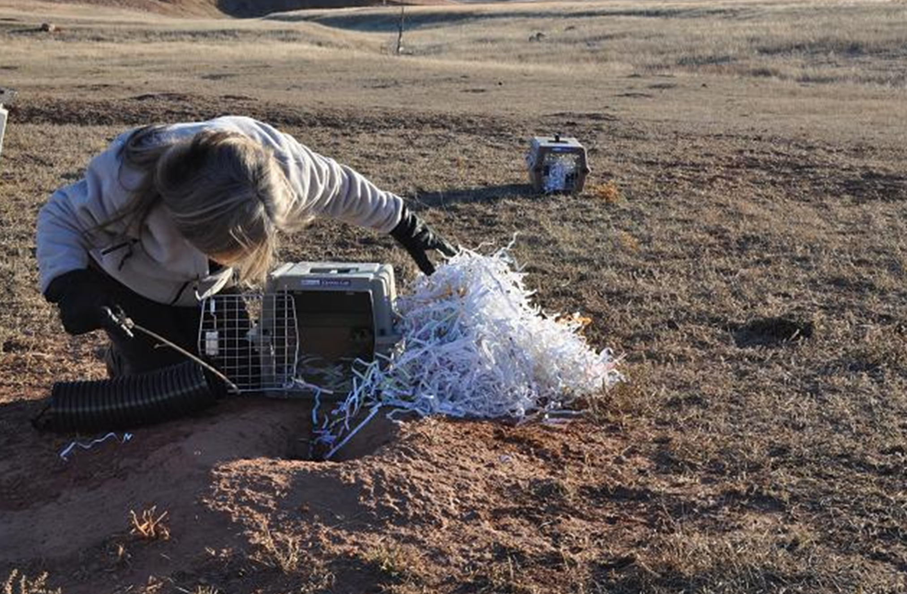
Science and You
Career: Ecologist
Ecologists contribute to various aspects of human society, including food, shelter, and health care.
Work environments include laboratories and natural settings.
Career paths include resource management, education, and policy advising.
Educational requirements typically include an undergraduate degree in natural sciences, often followed by specialized training or advanced degrees.
44.1 Figure 5: This landscape ecologist is releasing a black-footed ferret into its native habitat as part of a study.
USFWS Mountain-Prairie on Wikimedia Commons. "Ferret release."
Notes:
This is included as a relevant application for this topic.

Slide 19
Summary
Ecology encompasses the study of organisms, populations, communities, and ecosystems.
  Organismal: study individual organisms and how they interact with the environment
  Population: explore how a population changes over time
  Community: explore the ways in which a population interacts with other species in the community
  Ecosystem: examine living species (biotic) and nonliving portions (abiotic) of an ecosystem

Slide 20

End of Hawkes Learning PowerPoint

