Slide 1
Lesson 44.2
Biogeography

Slide 2
Objectives
Define biogeography.
List and describe abiotic factors that affect the global distribution of plant and animal species.
Compare the impact of abiotic forces on aquatic and terrestrial environments.
Summarize the effects of abiotic factors on net primary productivity.
Understand animal adaptations in relation to the biogeography of their habitat.

Slide 3
The Biosphere
The biosphere includes all parts of Earth inhabited by life, extending into the atmosphere and ocean depths.
The biosphere is a small part of the universe despite appearing vast to humans.
Abiotic factors, such as climate, play a significant role in determining where life exists.
Biomes are large areas of land with similar climate, flora, and fauna influenced by abiotic factors.

Slide 4
Biogeography
Biogeography is the study of the geographic distribution of living organisms and the abiotic factors influencing them.
Temperature and rainfall are major abiotic factors that vary with latitude and elevation.
Changes in abiotic factors lead to shifts in the composition of plant and animal communities.
Different ecosystems exist at the same latitude partly due to abiotic factors (e.g., jet streams, the Gulf Stream, ocean currents).

Slide 5
Types of Biomes
Tropical wet forests: near the equator, characterized by broad-leaved evergreen trees
Deserts: found around 30 degrees latitude, with low precipitation and high insolation
Grasslands: characterized by grasses and few trees
Deciduous temperate forests: found in regions with seasonal changes, losing leaves in winter
Boreal forests and taiga: located in subarctic regions with coniferous trees
Arctic tundra: found at northern latitudes with low temperatures and short growing seasons

Slide 6
Reflection Question
The tropics near the equator have more species than environments towards the pole of the Earth. Can you think of why that might be?
Notes:
The reflection question is included here to use as a talking point or for a think-pair-share activity.

Slide 7
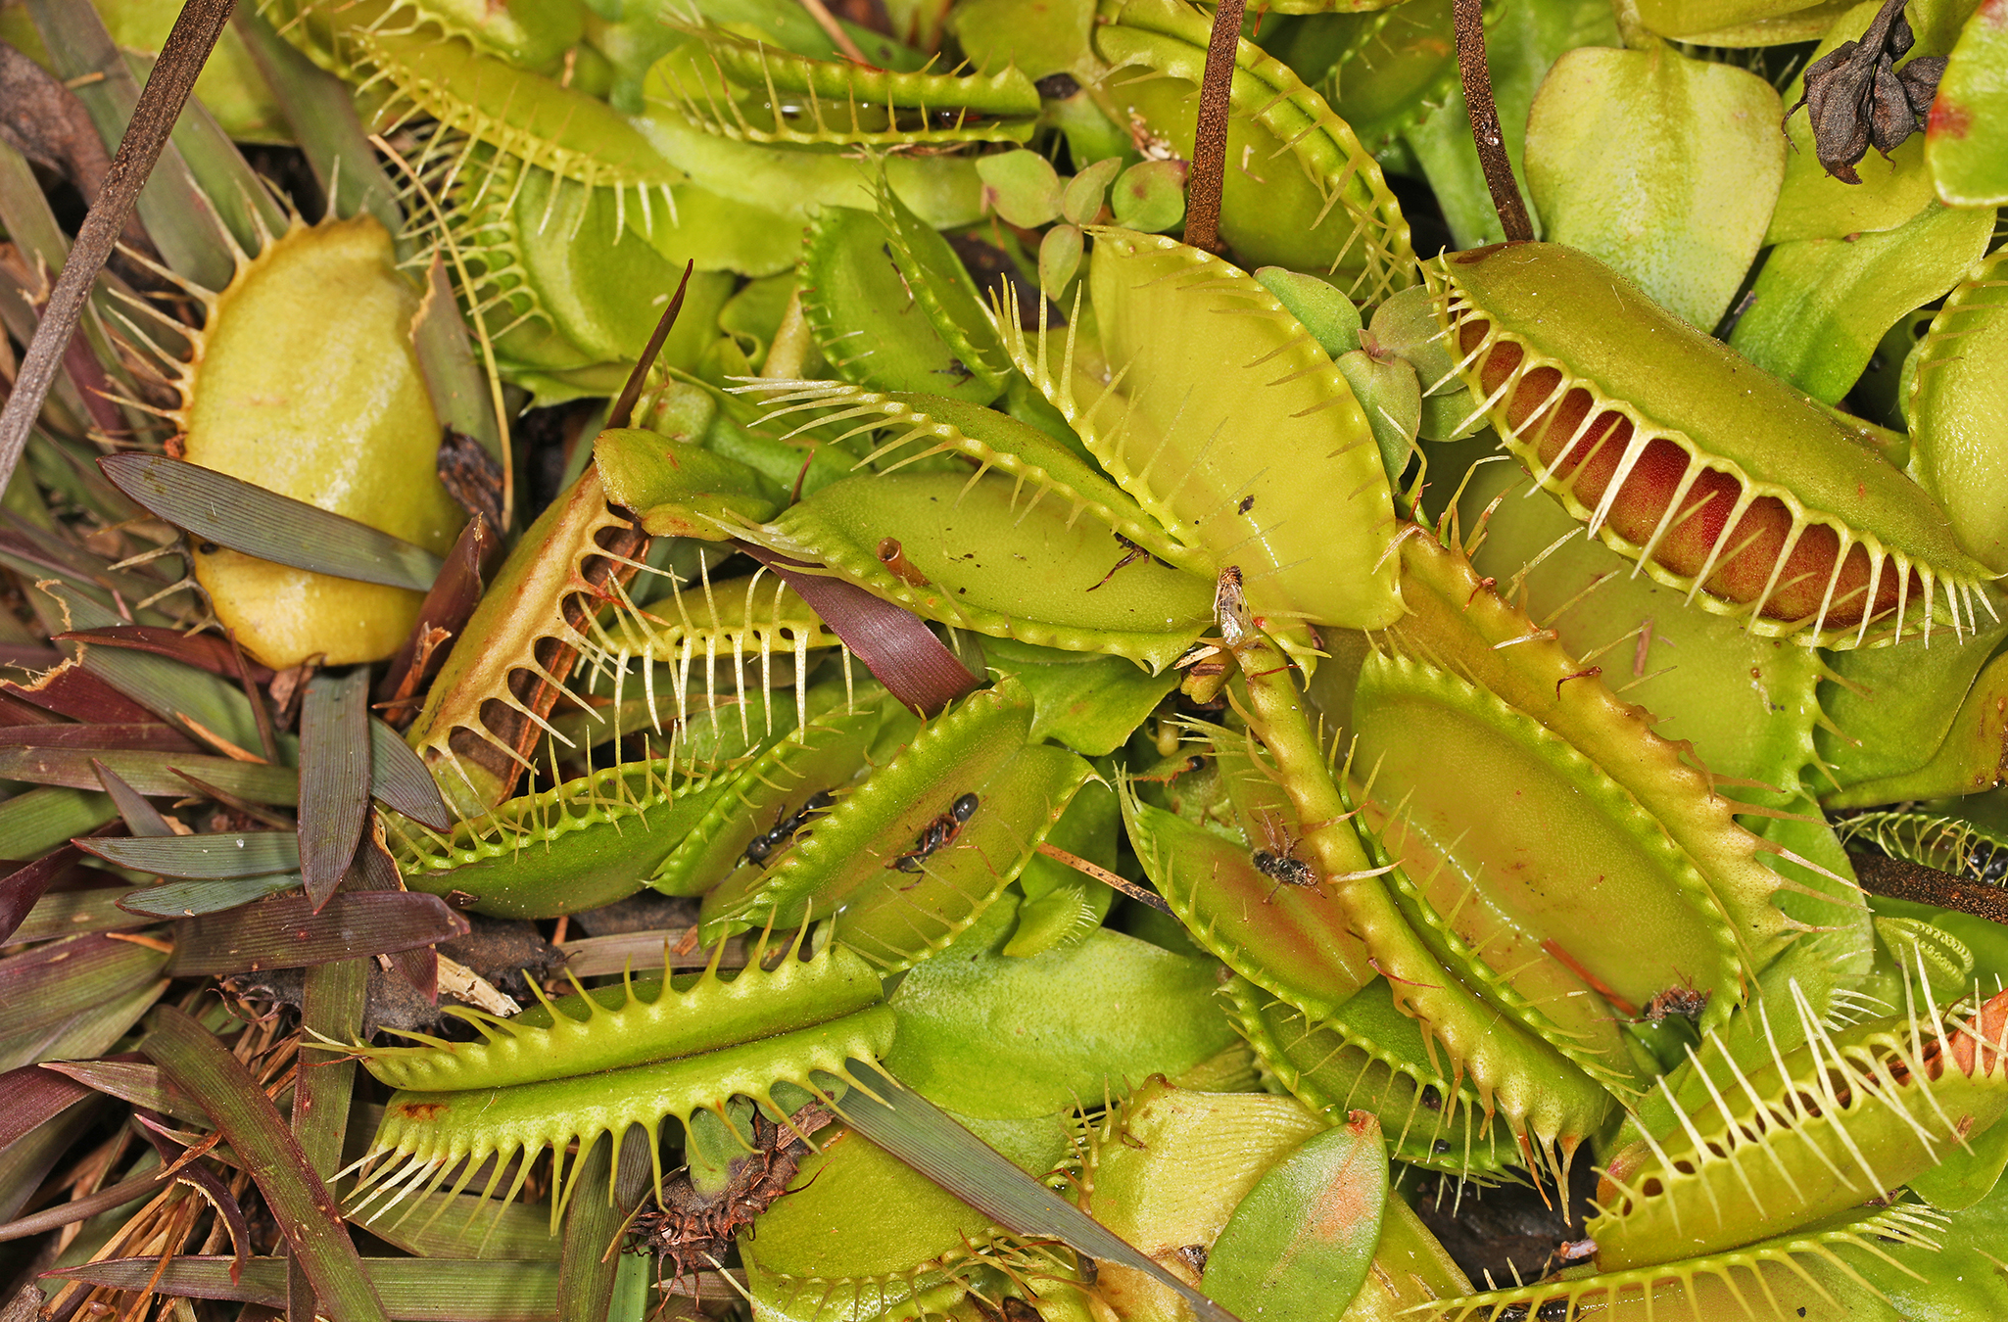
Endemic Species
Endemic species are found only in specific geographic areas, while generalist species live in a wide variety of geographic regions.
Example: Venus flytrap (Dionaea muscipula) endemic to a small area in North and South Carolina
Example: racoon (Procyon spp.) native to most of North and Central America
44.2 Figure 1: Venus flytraps are endemic to North and South Carolina in the United States.
Judy Gallagher on Wikimedia Commons. "Venus flytrap."

Slide 8
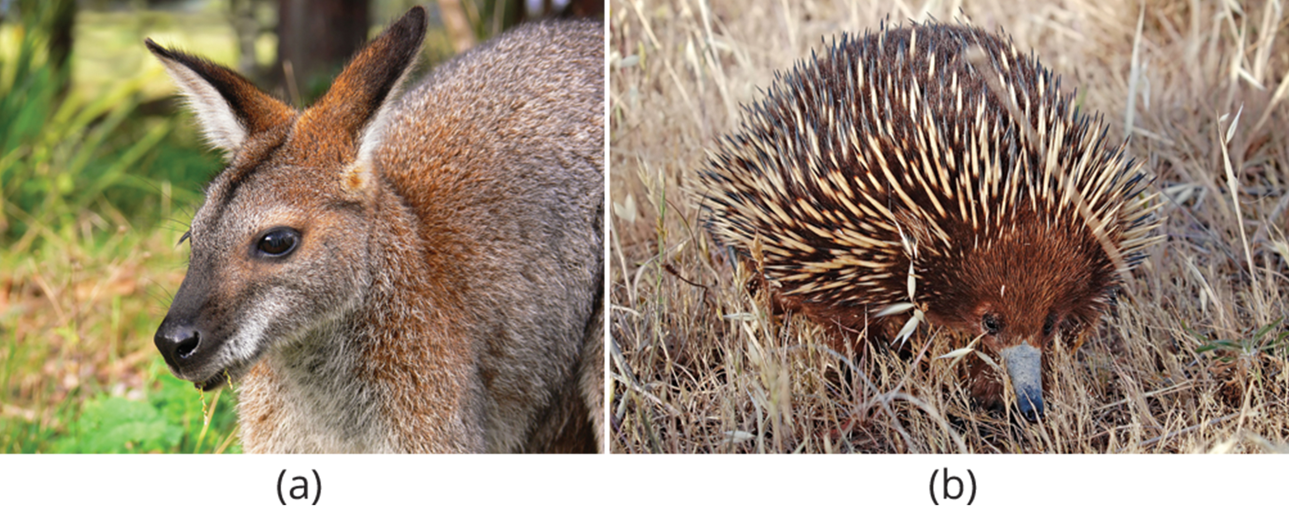
Species Distribution Patterns₁
Species distribution patterns are based on long-term biotic and abiotic factors.
Early biogeography was linked to evolutionary thinking in the nineteenth century.
Some of the most distinctive assemblages of plants and animals occur in regions that have been physically separated for millions of years.
Example: Approximately three-quarters of living plant and animal species live solely in Australia.
44.2 Figure 2: In Australia, the (a) wallaby (Wallabia bicolor), a medium-sized member of the kangaroo family, is a pouched mammal, or marsupial. The (b) echidna (Tachyglossus aculeatus) is an egg-laying mammal.
benjamint on Wikimedia Commons. "Wallaby."
Fir0002 on Wikimedia Commons. "Echidna."

Slide 9
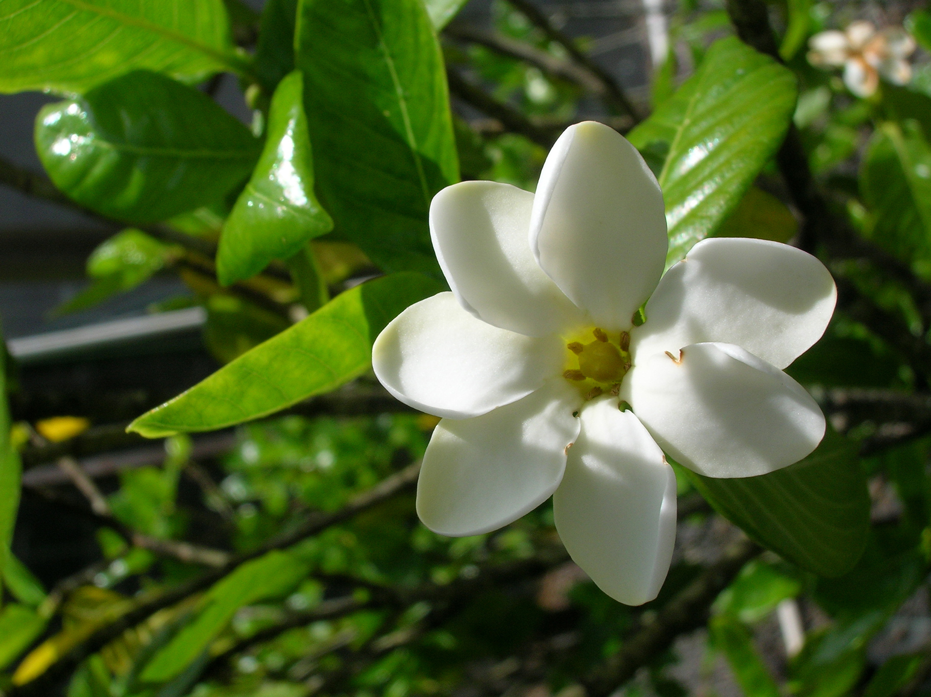
Species Distribution Patterns₂
Unique distribution patterns may reveal where species are absent.
Example: Hawaii lacks native reptiles and amphibians, but it does have a few native butterflies and one terrestrial animal.
Example: New Guinea lacks placental mammals.
Endemic species are found in specific regions, while generalists inhabit multiple areas.
Isolated land masses often have many endemic species, like Madagascar and Australia.
Endemic to Hawaii, the forest gardenia (Gardenia brighamii) is endangered, with only 15-20 trees thought to exist.
44.2 Figure 3: Listed as federally endangered, the forest gardenia is a small tree with distinctive flowers. It is found only in five of the Hawaiian Islands in small populations consisting of a few individual specimens.
Forest & Kim Starr on Wikimedia Commons. "Gardenia."

Slide 10
Think It Through₁
Why do islands have a higher number of endemic species compared to the mainland?
Notes:
Originally an On Your Own. This is included here to use as a talking point or for a think-pair-share activity.

Slide 11
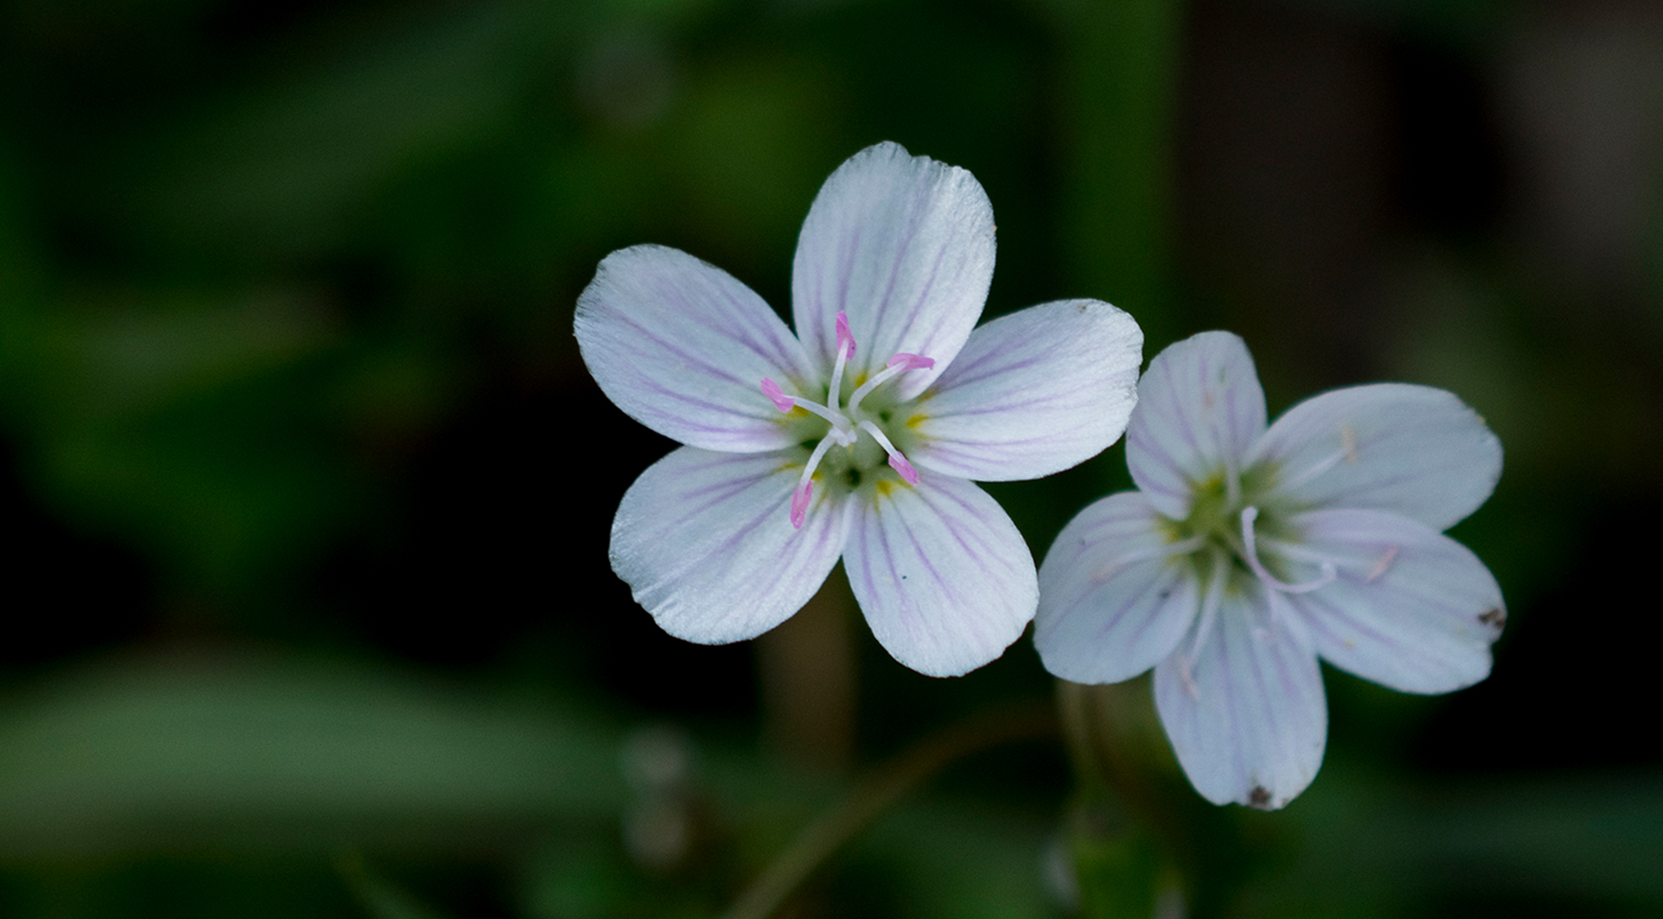
Energy Sources
Energy from the sun is captured by photosynthetic organisms, providing chemical energy for life.
Light availability influences photosynthetic adaptations in plants.
Example: The spring beauty (Claytonia virginica) is a short-lived (ephemeral) plant that finishes its life cycle before canopy trees develop leaves.
44.2 Figure 4: The spring beauty (Claytonia virginica) is an ephemeral spring plant that flowers early in the spring to avoid competing with larger forest trees for sunlight.
Andrew Weitzel on Wikimedia Commons. "Spring beauty."

Slide 12
Light Availability in Aquatic Ecosystems
In aquatic systems, light availability is limited by water, plants, suspended particles, and resident microorganisms.
Light penetration in water is limited, affecting photosynthesis in aquatic plants.
Adaptations like floating leaves in water lilies allow survival in low-light conditions.
Some organisms, like those near hydrothermal vents, extract energy from inorganic chemicals since there is no light for photosynthesis.

Slide 13
Availability of Nutrients in Oceans
Nutrient availability is also an important factor that affects photosynthesis.
Nutrients in oceans often settle at the bottom when organisms die.
Ocean upwelling brings these nutrients to the surface, supporting marine life.
Ocean upwelling is the rising of deep waters that occurs when prevailing winds blow along surface waters near a coastline.
As the wind pushes water offshore, water from the bottom of the ocean moves up to replace, bringing nutrients with it.

Slide 14
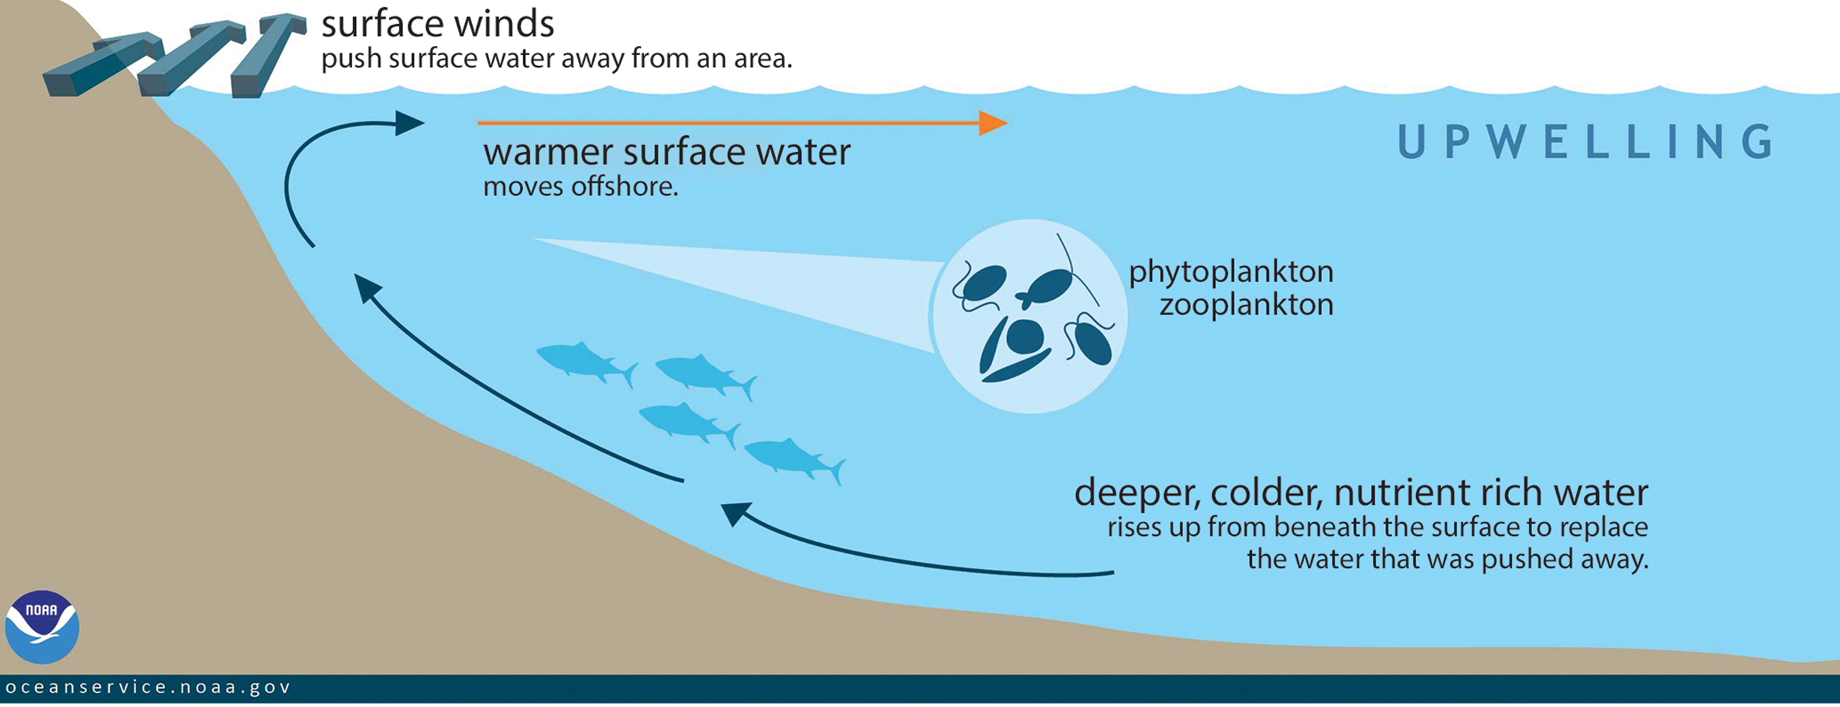
44.2 Figure 5
NOAA on Wikimedia Commons. "Ocean upwelling."
Notes:
Ocean upwelling is an important process that recycles nutrients and energy in the ocean. As wind pushes offshore, it causes water from the ocean bottom to move to the surface, bringing up nutrients from the ocean depths.

Slide 15
Availability of Nutrients in Freshwater Systems
Nutrients in lakes are recycled twice a year through spring-and-fall turnovers.
Spring-and-fall-turnovers: seasonal processes that recycle nutrients and oxygen (O₂) from the bottom of a lake to the top
Caused by formation of a thermocline: layers of water with temperatures significantly different from those above and below it

Slide 16
Spring-and-Fall Turnovers₁
Seasonal temperature changes drive the turnover process.
Winter: Surface ice insulates slightly warmer water under the ice, and water at the bottom of the lake is warmer yet (4°C to 5°C).
Water is densest at about 4°C; therefore, the deepest water is the densest.
Deepest water is also poor in oxygen because of organic material decomposition, which uses available oxygen.
In decomposition, organic material is broken down by bacteria and other decomposers; organisms use oxygen to extract energy, producing carbon dioxide as waste.

Slide 17
Spring-and-Fall Turnovers₂
Spring: Melting surface ice causes dense surface water to sink, mixing nutrients and oxygen.
Water at the bottom is displaced by the heavier, denser surface water and rises to the top.
This is called the spring turnover.
Summer: The water stratifies (forms layers), with the warmest water at the surface.

Slide 18
Spring-and-Fall Turnovers₃
Fall: The cooling surface water sinks, causing another nutrient and oxygen turnover.
This is called the fall turnover.
The heavy, cold water sinks and displaces the water at the bottom.
Oxygen-rich water from the surface moves to the bottom of the lake, while nutrients from the bottom rise to the surface.

Slide 19
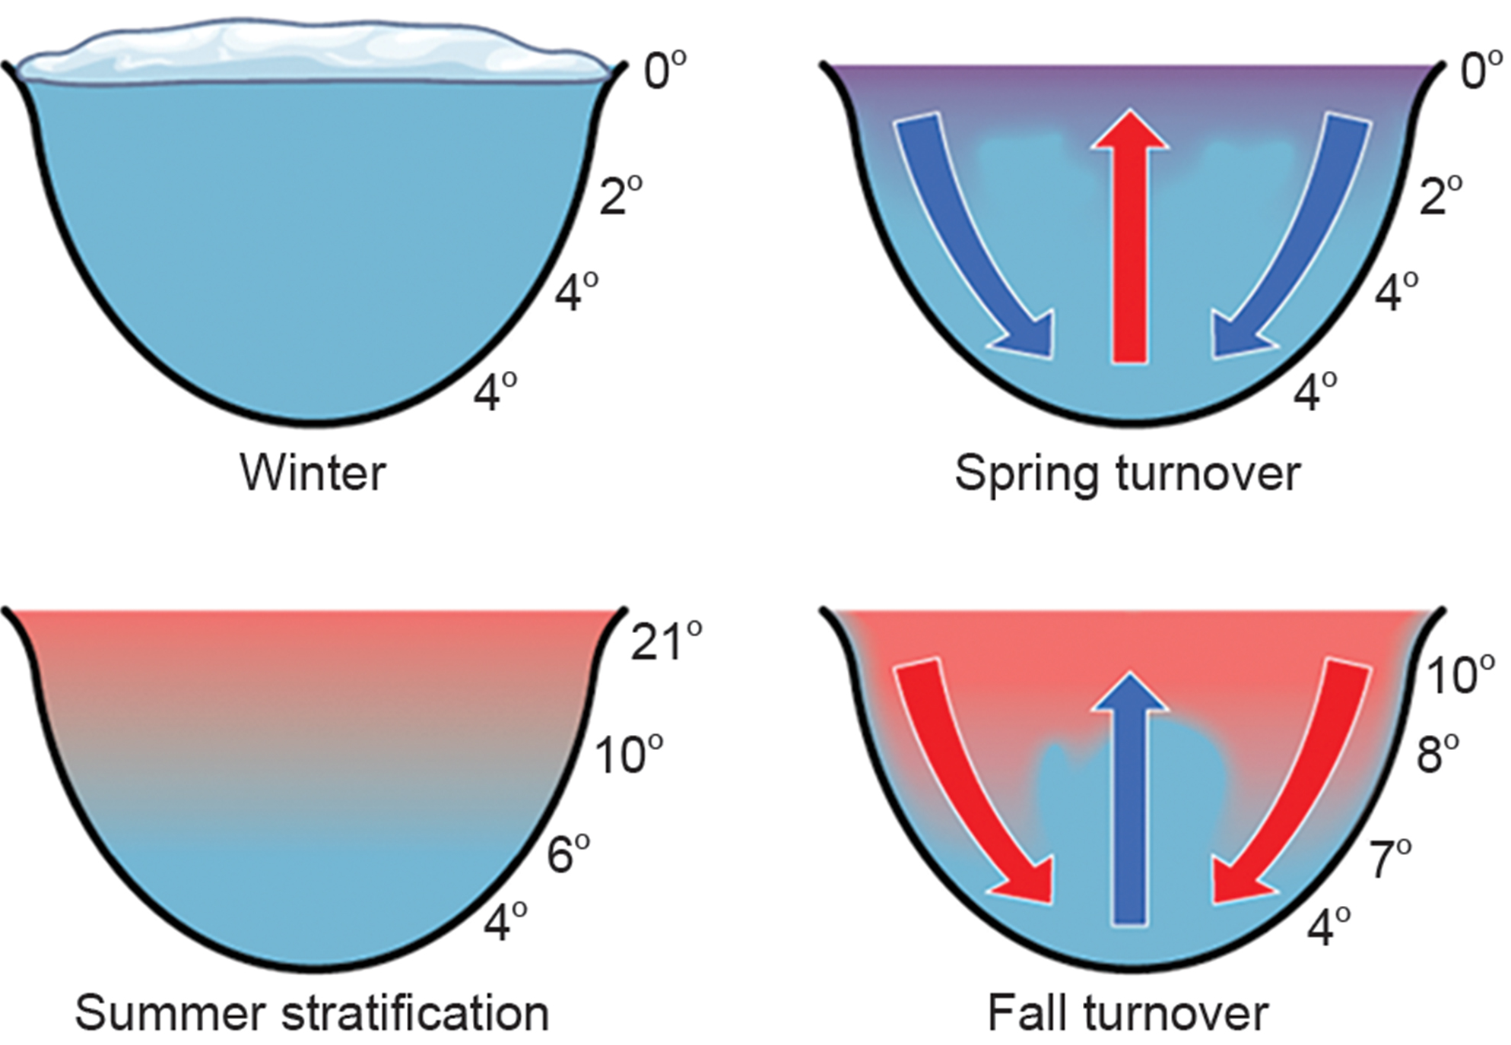
44.2 Figure 6
CNX OpenStax on Wikimedia Commons. "Spring/fall turnover."
Notes:
The spring-and-fall turnovers are important processes in freshwater lakes that act to move the nutrients and oxygen at the bottom of deep lakes to the top. Turnover occurs because water has a maximum density at 4°C. Surface water temperature changes as the seasons progress, and denser water sinks.

Slide 20
Think It Through₂
How might turnover in tropical lakes differ from turnover in lakes that exist in temperate regions? Think of the variation, or lack of variation, in seasonal temperature change.
Notes:
Originally an On Your Own. This is included here to use as a talking point or for a think-pair-share activity.

Slide 21
Temperature
Temperature influences the physiology of organisms as well as the density and state of water.
Few can survive at temperatures below 0°C or above 45°C due to metabolic constraints.
Enzymes are most efficient within a specific range of temperatures, with degradation occurring at higher temperatures.
Organisms must maintain an internal temperature or inhabit an environment that will keep their body within a reasonable temperature to support metabolism.
Some animals adapt to temperature changes through migration, hibernation, or reptilian torpor.
Extremophiles, like certain Archaea, thrive in extreme temperatures.

Slide 22
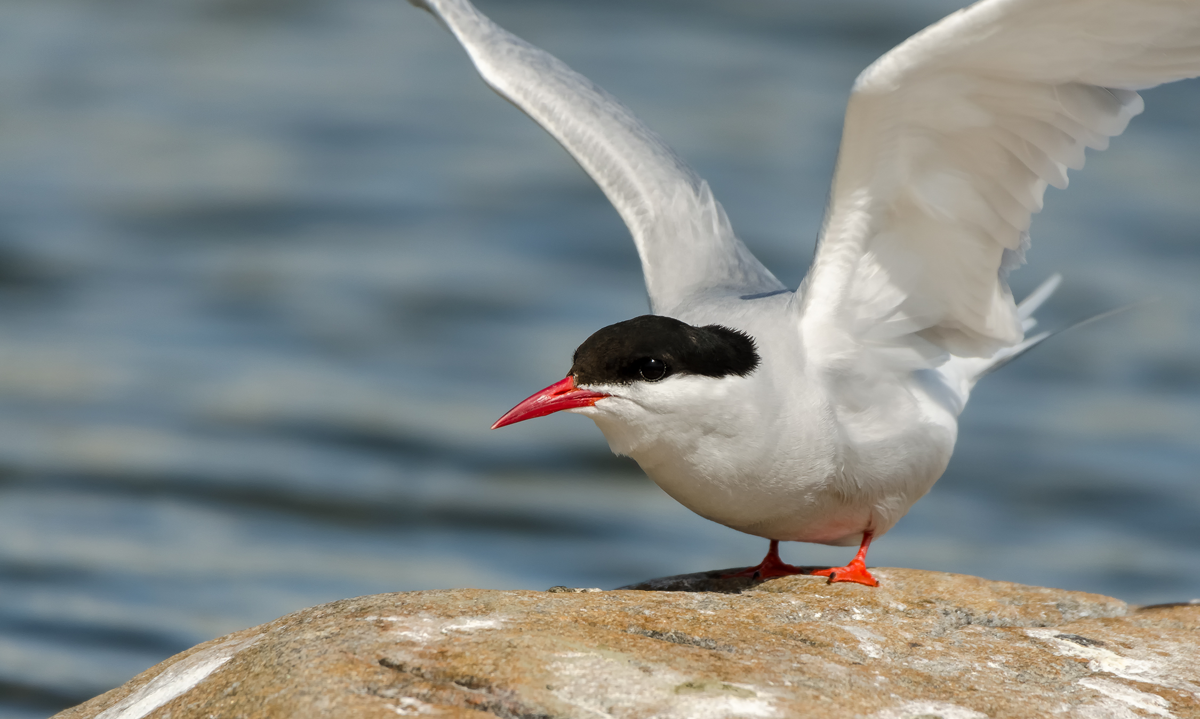
Migration
Animals faced with temperature fluctuations may respond with adaptations, such as migration, to survive.
Migration (regular movement from one place to another) is an adaptation to survive temperature changes, find food, or mates.
Example: The Arctic tern (Sterna paradisaea) makes a 40,000 km round-trip flight between its feeding grounds in the south and its breeding grounds in the Artic Ocean.
Not all animals who can migrate do; it is energy-intensive and carries risks.
44.2 Figure 7: Arctic terns (Sterna paradisaea) migrate long distances to complete their breeding cycles.
Kristian Pikner on Wikimedia Commons. "Arctic tern."

Slide 23
Hibernation, Estivation, and Torpor
Some animals hibernate or estivate to survive hostile temperatures.
Hibernation allows survival during cold periods by lowering metabolic rates.
Estivation enables survival in hot, dry climates.
Animals hibernating or estivating undergo torpor: a state of reduced metabolism.
Allows the animal to wait until its environment better supports its survival
Some amphibians (e.g., the wood frog, Rana sylvatica) use antifreeze-like chemicals in their cells to prevent cell damage during freezing.

Slide 24
Water Retention Adaptations in Plants
Terrestrial organisms have evolved adaptations to retain water.
Plants have adaptations like leaf hairs and waxy cuticles to reduce the rate of water loss via:
Transpiration: release of water vapor across the stomata in the leaf surface
Convection: transfer of heat from one region to another through a fluid

Slide 25
Water Retention Adaptations in Freshwater Organisms
Freshwater organisms face osmotic pressure from lower solute concentrations in the water they live in.
They have evolved adaptations to remove excess water and ensure the solute concentration in their cells remains similar to that in the surrounding fluid.
Example: Freshwater fish excrete highly dilute urine to remove extra water.

Slide 26
Water Retention Adaptations in Marine Organisms
Marine (saltwater) organisms are surrounded by water with a higher solute concentration, meaning they are in danger of losing water due to osmosis.
They have morphological and physiological adaptations to retain water and release solutes.
Example: Marine iguanas (Amblyrhynchus cristatus) sneeze out water vapor high in salt to maintain solute concentrations while swimming and eating.

Slide 27
Inorganic Nutrients and Soil
Inorganic nutrients: important in determining distribution and abundance of living things
Examples: nitrogen and phosphorus
Obtained by plants from the soil when water moves into the plants through the roots
Obtained by animals from their food
Plant distribution affected by soil structure, pH, and nutrient content
Animal distribution related to distribution of what they eat

Slide 28
Other Aquatic Factors
Some abiotic factors are important in aquatic ecosystems and terrestrial environments.
Terrestrial animals get oxygen from the air they breathe.
Oxygen availability can be an issue for those at high elevations.
Cold water holds more dissolved oxygen than warmer water, and fast-moving water is typically more oxygen-rich.
Salinity, currents, and tides also impact aquatic ecosystems.

Slide 29
Other Terrestrial Factors: Wind
Wind is an important terrestrial factor.
Wind affects evaporation, transpiration, and convective heat loss from the surface of all organisms.
It can physically move soil, water, and organisms, impacting ecosystems.

Slide 30
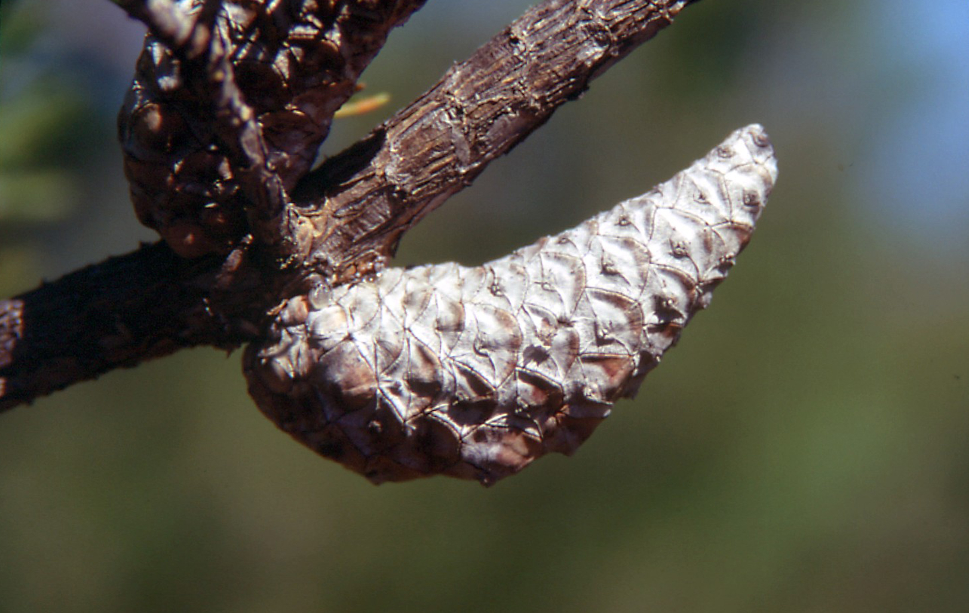
Other Terrestrial Factors: Fire
Fire is another terrestrial factor that can be an agent of disturbance in ecosystems.
Some organisms are adapted to fire and require high heat to complete part of their life cycle.
Example: The jack pine (Pinus banksiana) requires heat from fire for its seed cones to open.
By burning pine needles, fire adds nitrogen to the soil and reduces competition by clearing undergrowth.
44.2 Figure 8: The mature cones of the jack pine (Pinus banksiana) open only when exposed to high temperatures, such as during a forest fire. A fire is likely to kill most vegetation, so a seedling that germinates after a fire is more likely to receive ample sunlight than one that germinates under normal conditions.
USDA-NRCS PLANTS Database on Wikimedia Commons. "Jack pine cone."

Slide 31
Net Primary Productivity
Temperature and moisture significantly impact primary productivity (plant production) and net primary productivity.
Net primary productivity is the estimation of all organic matter available as food.
Calculated as total amount of carbon (C) fixed per year minus amount oxidized during cellular respiration
Estimated by measuring aboveground biomass (total mass of living plants, excluding roots)
Important variable when considering biome differences; productive biomes = higher level of aboveground biomass

Slide 32
Annual Biomass Production
Annual biomass production is linked to abiotic components of the environment.
Warm, wet climates support high biomass, photosynthesis, and optimized net primary productivity.
Photosynthesis proceeds at a high rate, enzymes work efficiently, and stomata remain open without risk of transpiration, which leads to maximal carbon dioxide moving into the plant.
Aboveground biomass produces important resources, like habitat and food.
Cold, dry environments have lower photosynthetic rates and less biomass.
Animal communities are also affected by the decrease in available food.

Slide 33
Summary
Biogeography studies the distribution of organisms and the abiotic factors affecting them.
Endemic species are limited to specific areas, while generalists are widespread.
Nutrient recycling processes like ocean upwellings and spring-and-fall turnovers are crucial.
Temperature, water, nutrients, and soil structure influence organism distribution.
Net primary productivity is a key measure of biome biomass and ecological health.

Slide 34

End of Hawkes Learning PowerPoint

