Slide 1
Lesson 44.3
Terrestrial Biomes

Slide 2
Objectives
Identify the two major abiotic factors that determine terrestrial biomes.
Recognize distinguishing characteristics of each of the eight major terrestrial biomes.

Slide 3
Terrestrial Biomes
Biomes are classified into two major groups: terrestrial and aquatic.
Terrestrial: land-based ecosystems characterized by specific temperatures and precipitation patterns
Eight major types: tropical wet forests, savannas, subtropical deserts, chaparral, temperate grasslands, temperate forests, boreal forests, and Arctic tundra
Abiotic factors like temperature variation and precipitation play crucial roles in biome distribution and vegetation.
Shows similar biomes can occur in geographically distinct areas with comparable climates

Slide 4
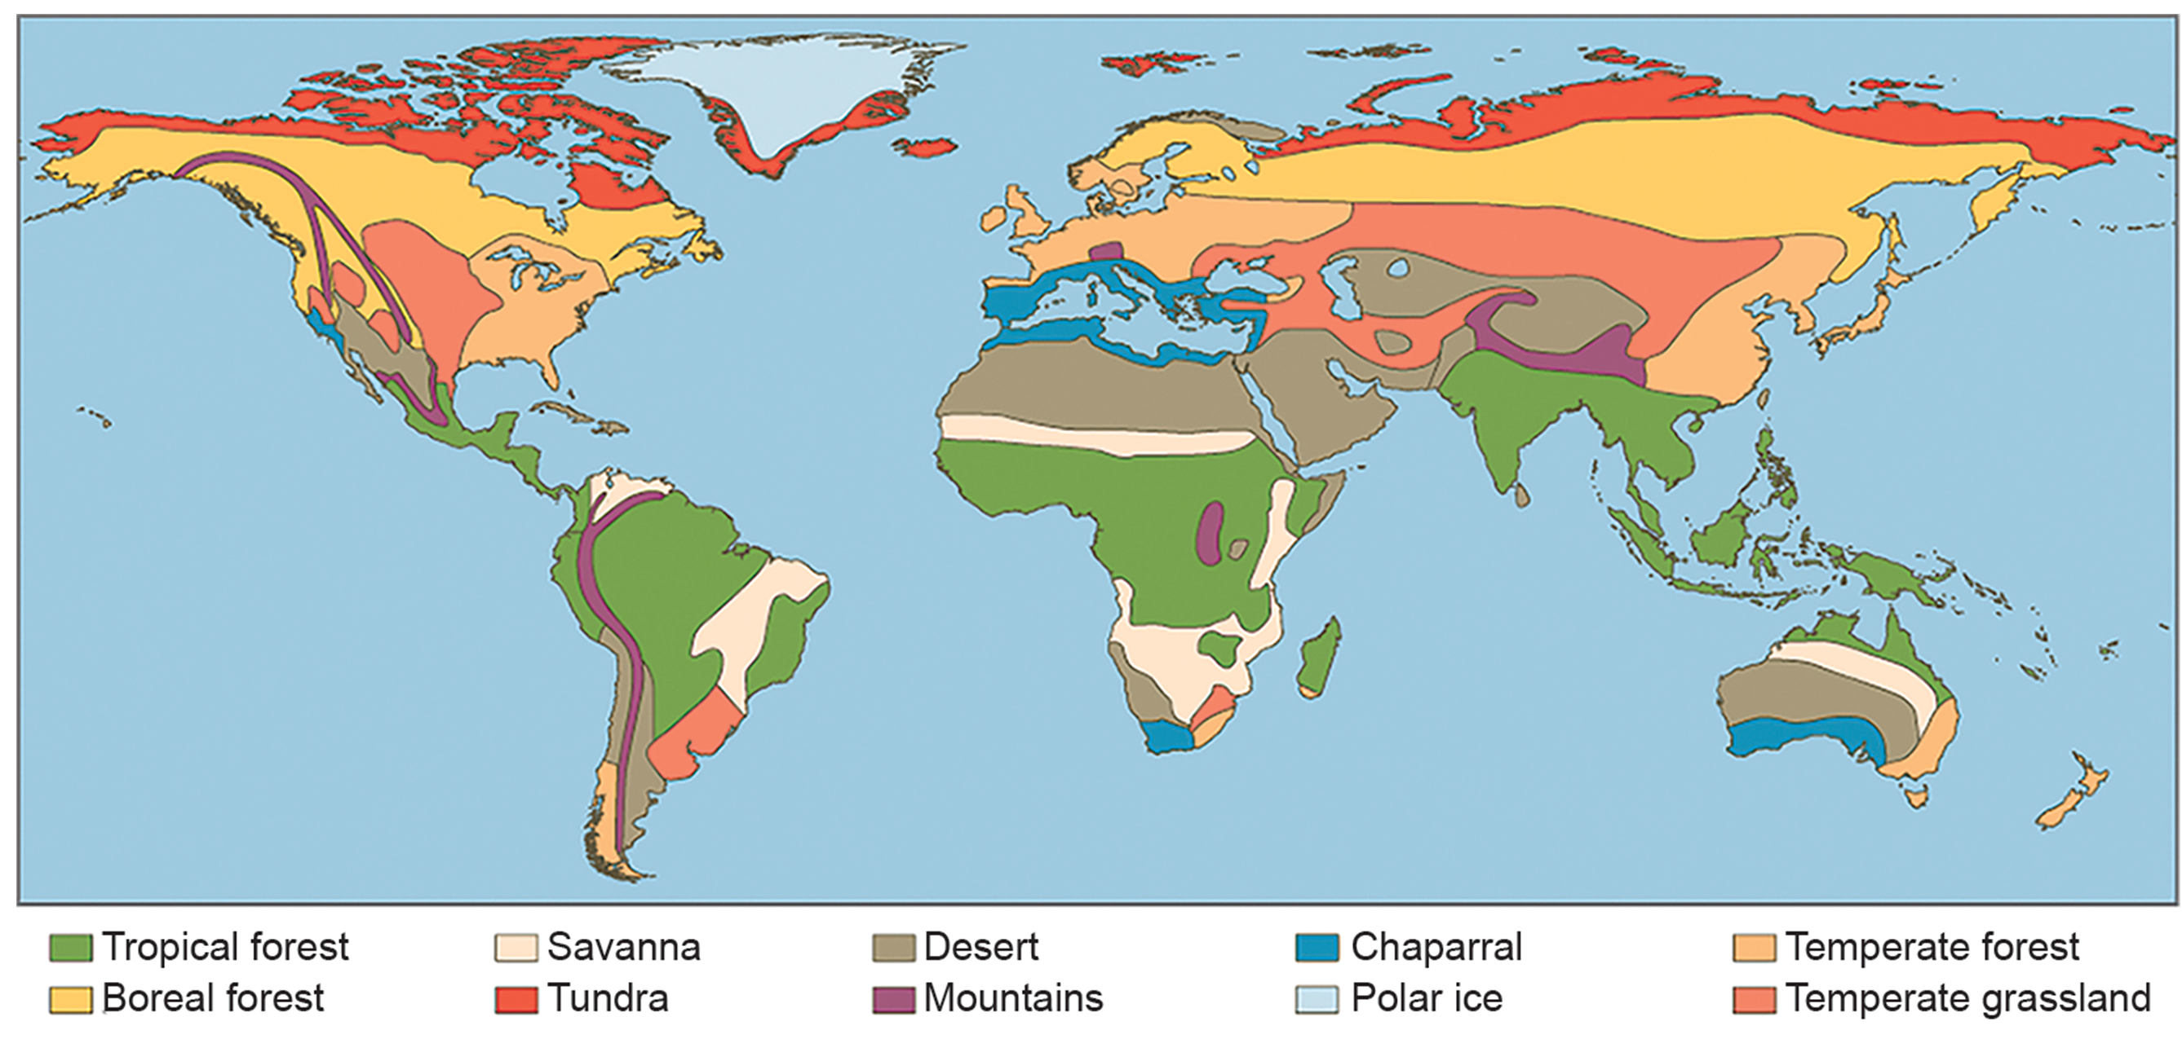
44.3 Figure 1
CNX OpenStax on Wikimedia Commons. "Biomes."
Notes:
Each of the world's major biomes, shown in this image, is distinguished by characteristic temperatures and amounts of precipitation. Polar ice and mountains are also shown.

Slide 5
Tropical Wet Forests
Tropical wet forests (tropical rainforests):
Found in regions located in and around the equator.
Characterized by broad-leaved plants and year-round plant growth
Stable temperature range compared to other biomes: 20°C to 34°C (68°F to 93°F)

Slide 6
Sunlight in Tropical Wet Forests
Constant daily sunlight (11–12 hours) year-round, unlike other biomes with seasonal variations
Provides more solar radiation and longer period for plant growth
Contributes to lack of seasonality in plant growth patterns

Slide 7
Rainfall in Tropical Wet Forests
Annual rainfall: 125–660 cm (50–200 in) with monthly variations
Wet months: more than 30 cm (11–12 in)
Dry periods: fewer than 10 cm (3.5 in)
Can exceed annual rainfall of other biomes (e.g., deserts)

Slide 8
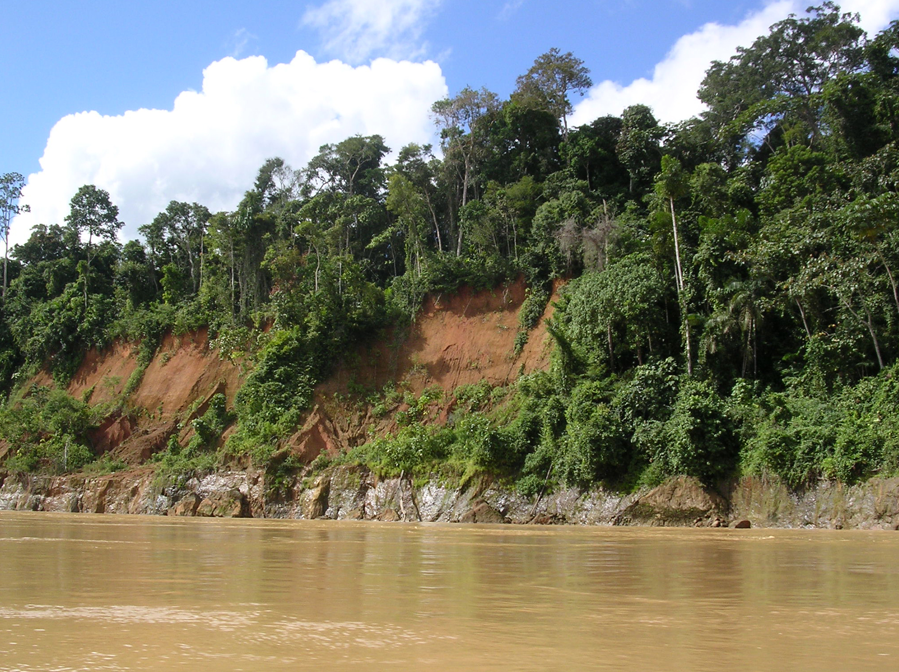
Net Primary Productivity in Tropical Wet Forests
High due to ideal temperature and precipitation conditions for plant growth
Supports extensive biomass and high species diversity
Have more species of trees than any other biome
100–300 species of trees in 2.5 acres of South American Amazonian rainforest
44.3 Figure 2: Tropical wet forests, such as these forests along the Madre de Dios River, Peru, (near the Amazon River) have high species diversity.
Roosevelt Garcia on Wikimedia Commons. "Tropical wet forests."

Slide 9
Layers within Tropical Wet Forests
Complex vertical structure with distinct layers:
Forest floor: sparse layer of plants and decaying plant matter
Understory: plants beneath the canopy
Canopy: uppermost overhead layer of branches and leaves

Slide 10
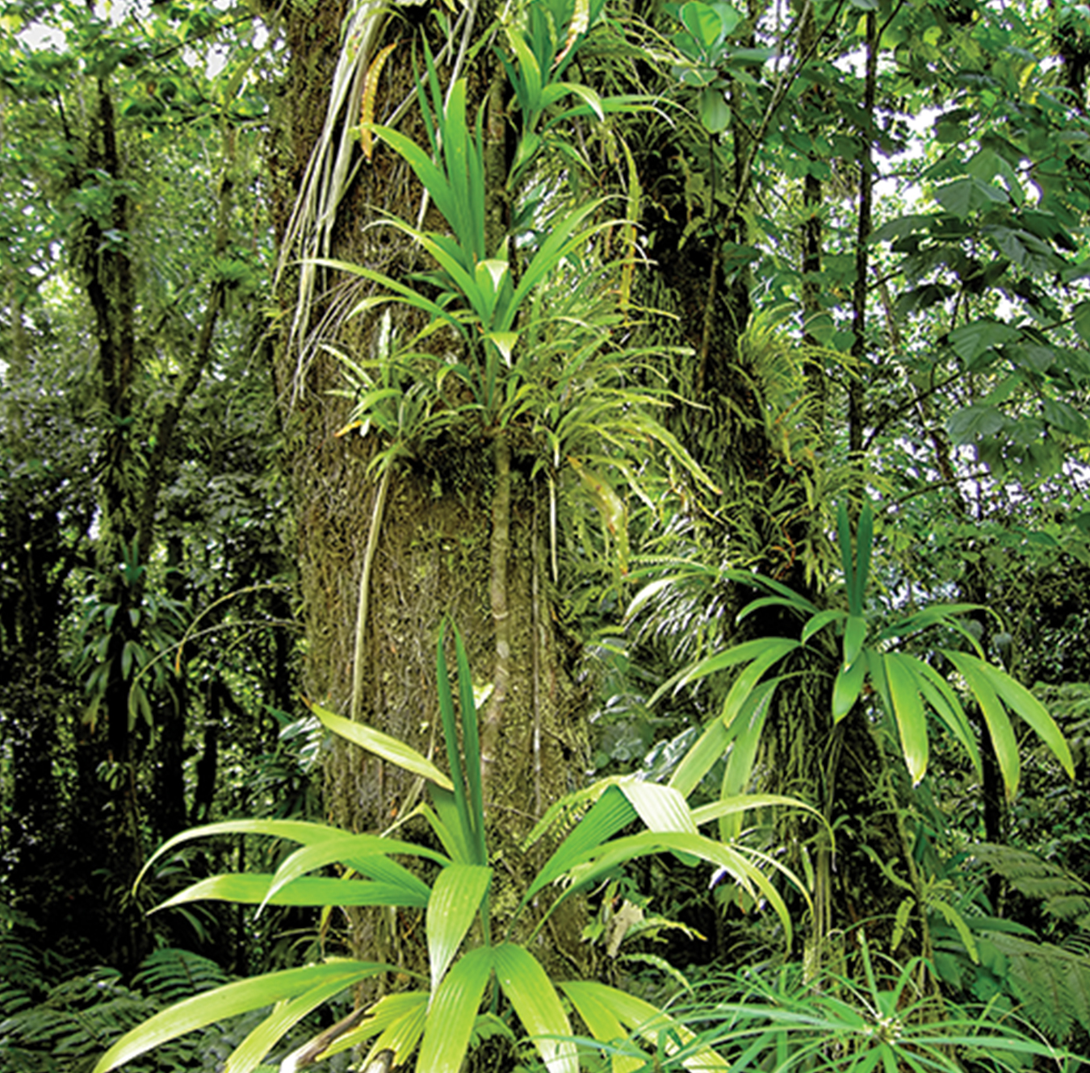
Epiphytes
Epiphytes: plants that grow on other plants without harming them
Common in tropical wet forests
Contribute to the biome's structural complexity and biodiversity
44.3 Figure 3: Epiphytes are plants that grow on other plants or trees without harming the latter.
Hans Hillewaert on Wikimedia Commons. "Epiphytes."

Slide 11
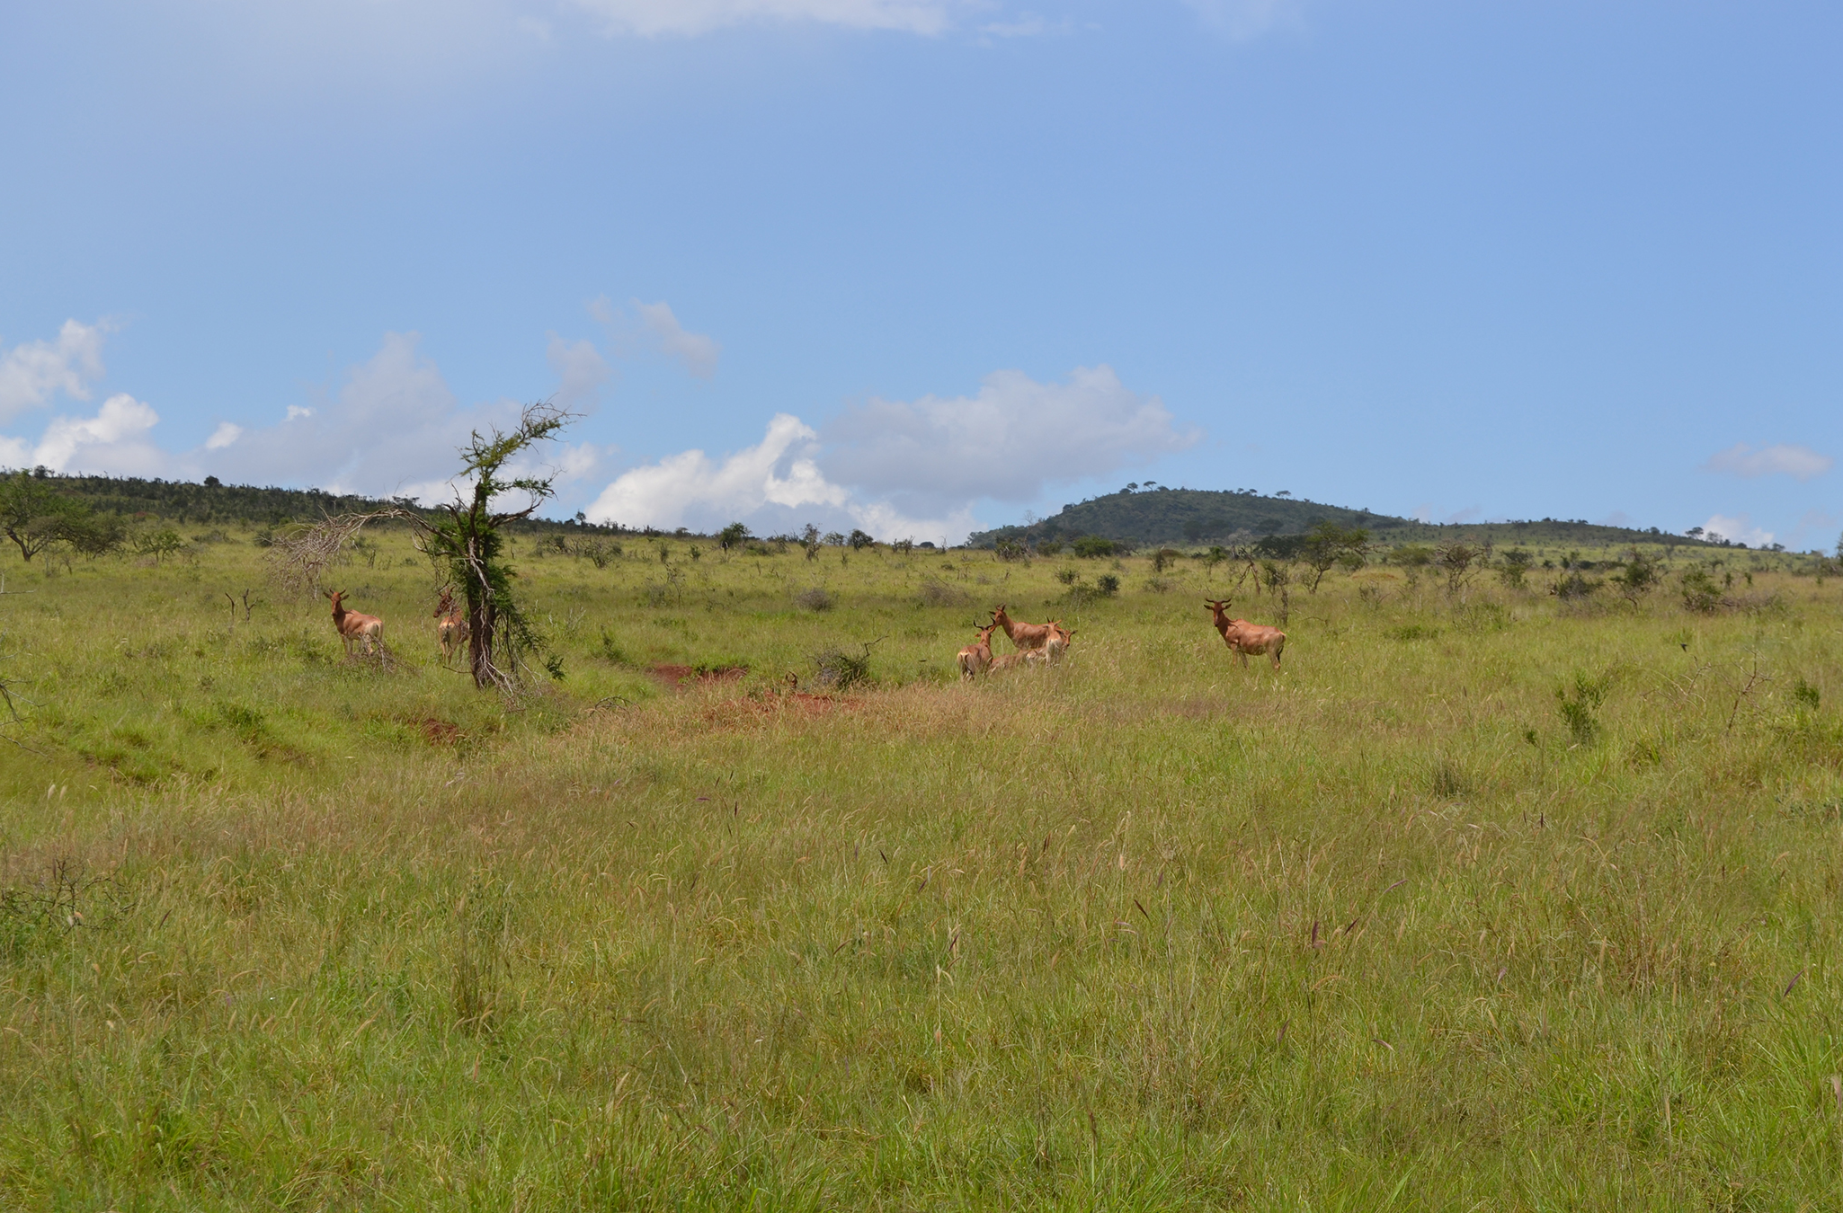
Savannas
Savannas are grasslands with scattered trees.
Found in Africa, South America, and northern Australia
Have a hot climate with average temperatures of 24°C to 29°C (75°F to 84°F)
Annual rainfall: 10–40 cm (3.9–15.7 in)
Have an extensive dry season, which limits tree growth compared to other biomes
Characterized by grasses and forbs (herbaceous flowering plants) instead
Adaptations to fire disturbances with well-developed root systems
44.3 Figure 4: Savannas, like this one in Taita Hills Wildlife Sanctuary in Kenya, are dominated by grasses.
CT Cooper on Wikimedia Commons. "Savanna."

Slide 12
Subtropical Deserts
Subtropical deserts:
Located between 15° and 30° north and south latitude
Centered on the Tropics of Cancer and Capricorn
Extremely dry with high evaporation rates
Large temperature fluctuations between day and night (above 60°C/140°F in the day and around 0°C/32°F at night)
Due to lack of atmospheric water
Characterized by low annual precipitation of less than 30 cm (12 in)
Unpredictable rainfall patterns

Slide 13
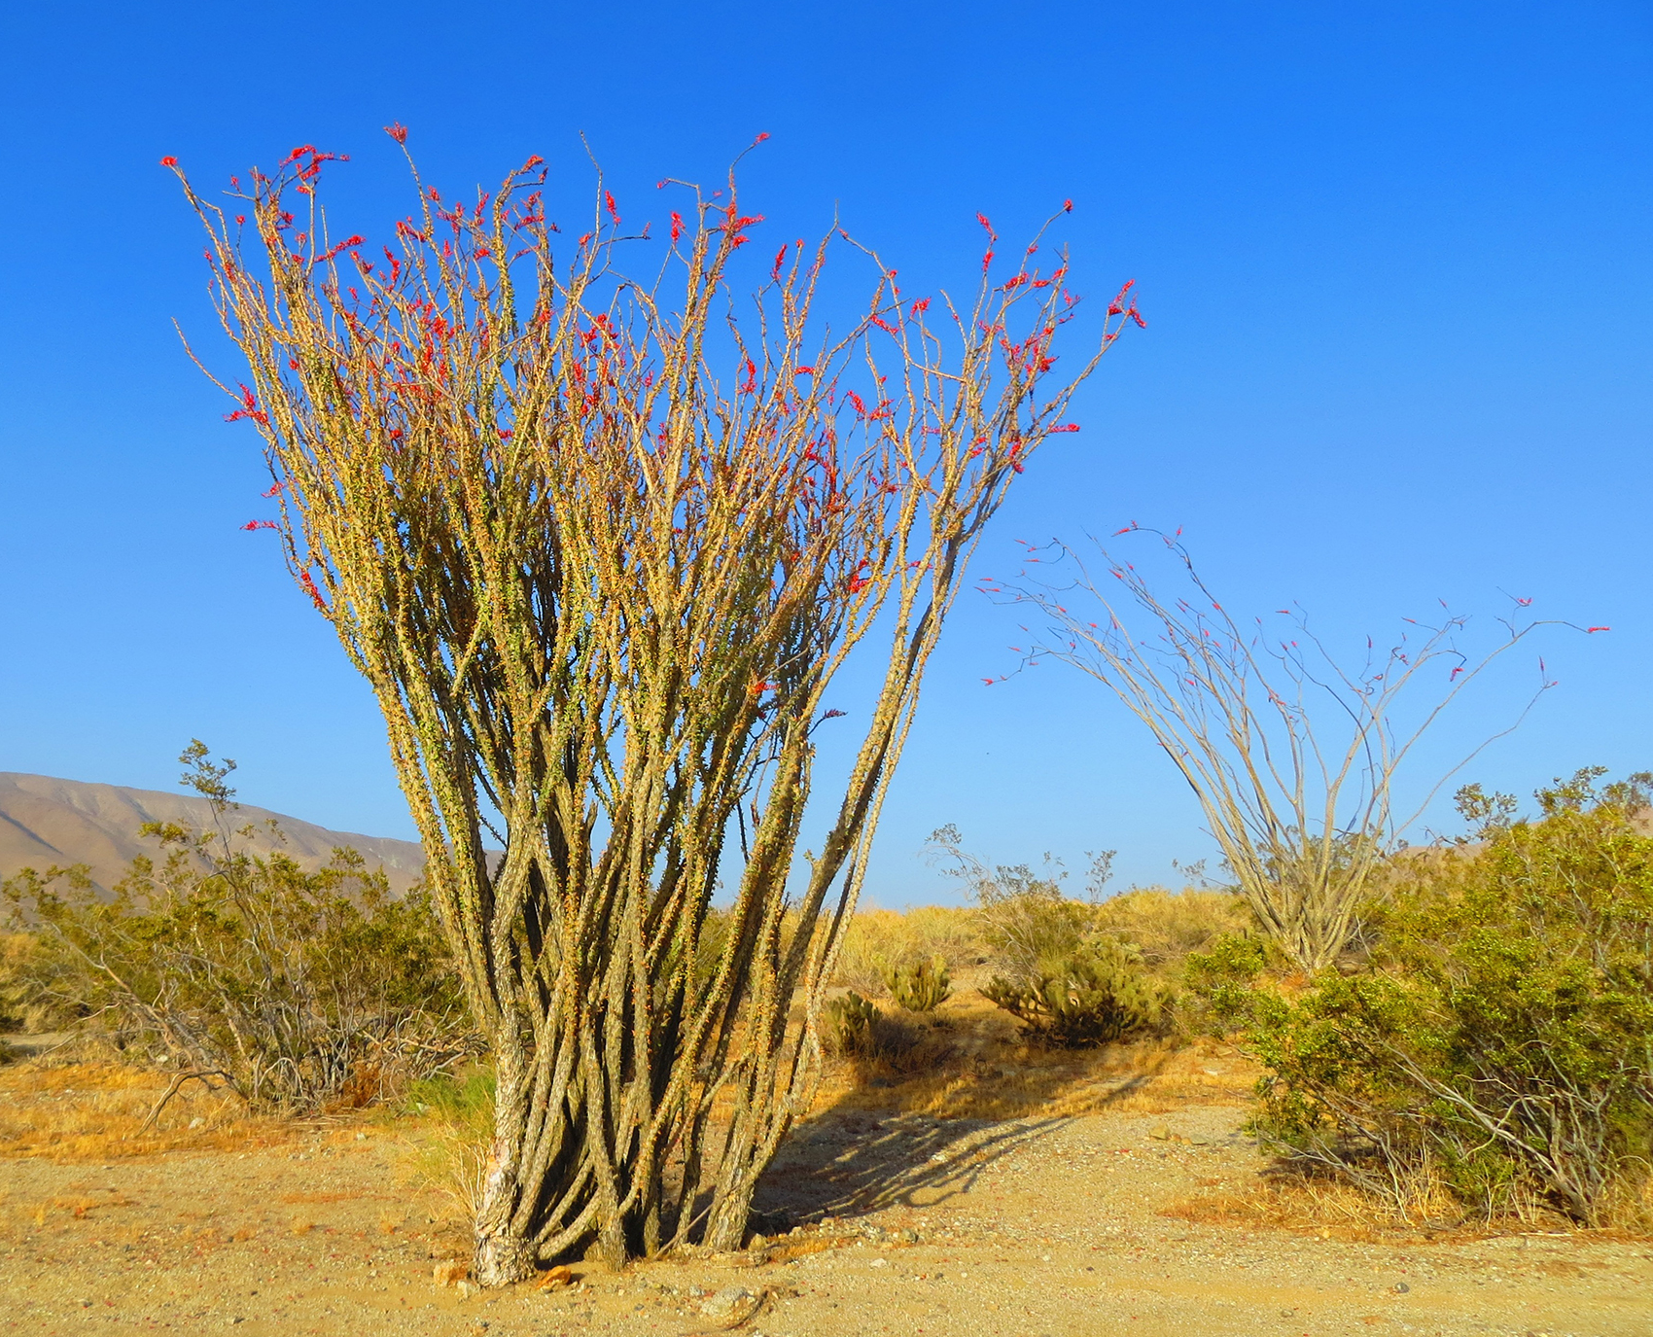
Plant Adaptations in Subtropical Deserts
These dry deserts lack perennial vegetation; instead, many plants grow quickly, reproduce during rainfall, and die.
Characterized by several adaptations that conserve water (deep roots, reduced foliage, water-storing stems)
44.3 Figure 5: To reduce water loss, many desert plants have tiny leaves or no leaves at all. The leaves of ocotillo (Fouquieria splendens), shown here in the Anza Borrego Desert State Park in California, appear only after rainfall and are then shed.
DiverDave on Wikimedia Commons. "Desert plant."

Slide 14
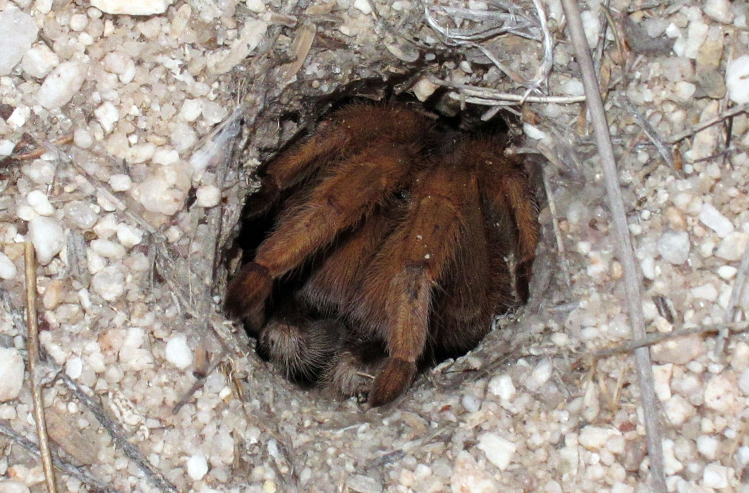
Animal Adaptations in Subtropical Deserts
Adaptations in desert animals include:
Nocturnal behavior
burrowing
44.3 Figure 6: Burrowing is a behavioral adaptation that allows fauna to survive the harsh conditions in the desert. This blonde tarantula is seen inside its burrow.
Michael Wifall on Flickr. "Burrowing tarantula."

Slide 15
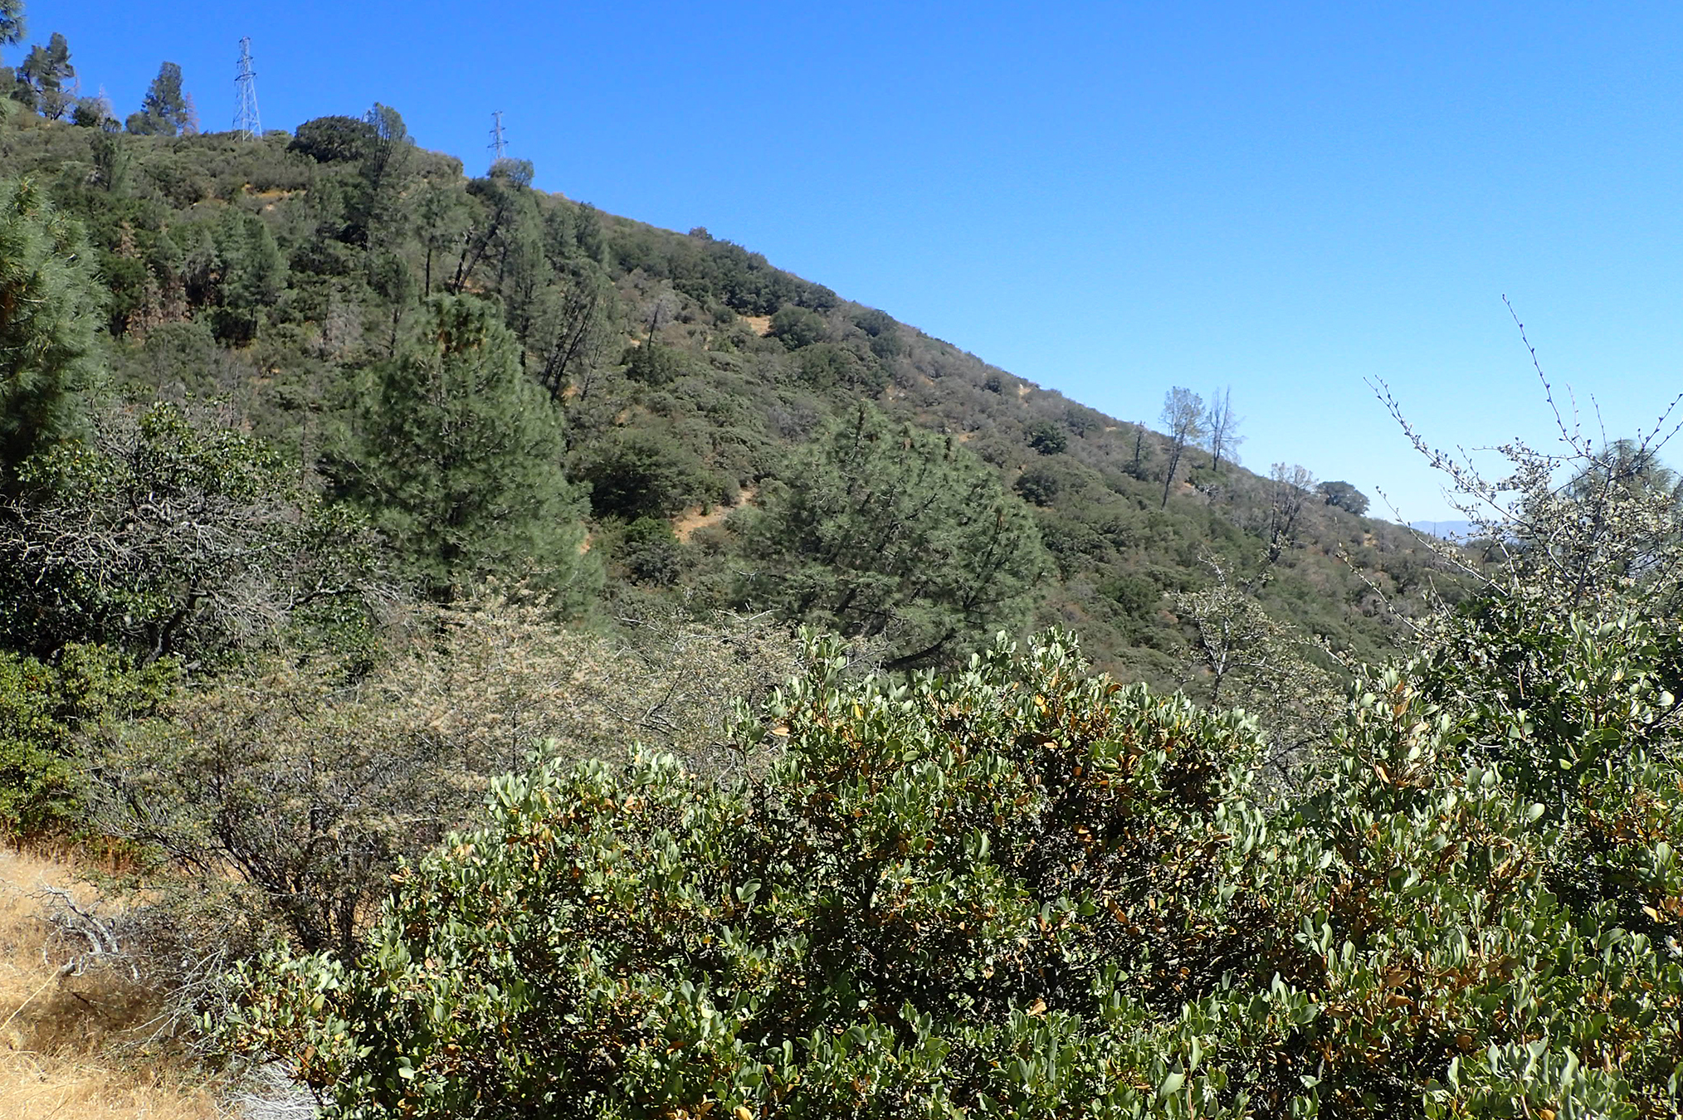
Chaparral
Chaparral (scrub forest):
Found in California, Mediterranean region, and southern Australia
Annual rainfall: 65–75 cm (25.6–29.5 in), mostly in winter
Dominated by shrubs adapted to periodic fires
In some plants, production of seeds that only germinate after fires
Ashes rich in nutrients (like nitrogen) to promote fertilization and plant growth
44.3 Figure 7: The chaparral is dominated by shrubs.
Krzysztof Ziarnek, Kenraiz on Wikimedia Commons. "Chaparral."

Slide 16
Temperate Grasslands
Temperate grasslands:
Also known as prairies (in central North America) and steppes (in Europe and Asia)
Have pronounced annual temperature fluctuations, which produce specific plant growing seasons
Can grow during spring, summer, and fall, but winter is too cold with little available water

Slide 17
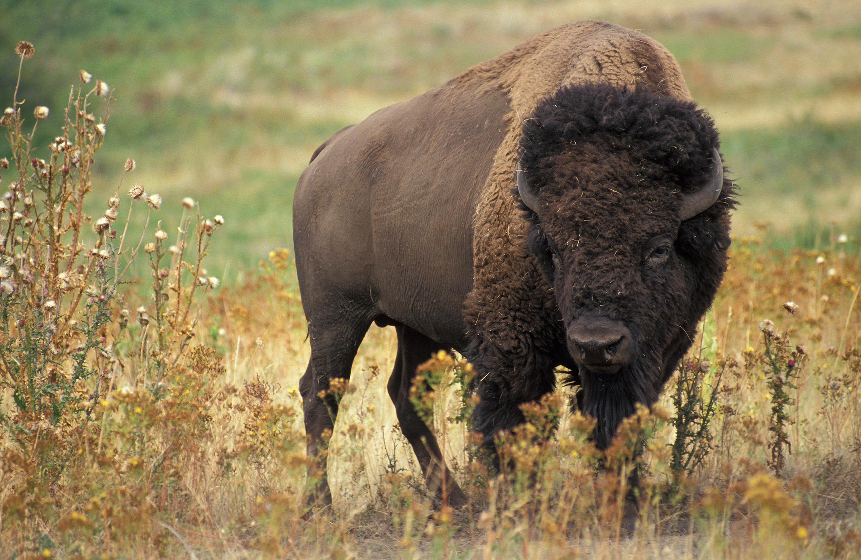
Rainfall in Temperate Grasslands
Annual precipitation: 25–75 cm (9.8–29.5 in)
Few trees except for those along rivers or streams
Mostly grasses dense enough to sustain grazing animals
Dense root systems contribute to fertile soils, packed with roots and rhizomes (underground stems)
Act to anchor plants and replenish organic material (humus)
44.3 Figure 8: The American bison (Bison bison), more commonly called the buffalo, is a grazing mammal that once populated American prairies in huge numbers.
Jack Dykinga on Wikimedia Commons. "Bison."

Slide 18
Fires in Temperate Grasslands
Fires are a natural disturbance to temperate grasslands, often caused by lightning.
Suppression can convert vegetation to scrub and sometimes dense forests with drought-tolerant trees.
Restoration requires the use of controlled burns to suppress tree growth and maintain grasses.

Slide 19
Reflection Question
Homo sapiens evolved as a species a few hundred thousand years ago. Which biome(s) do you think would suit the early human? Which biome(s) would not?
Notes:
The reflection question is included here to use as a talking point or for a think-pair-share activity.

Slide 20
Temperate Forests
Temperate forests:
Most common biome in eastern North America, western Europe, eastern Asia, Chile, and New Zealand
Found in mid-latitude regions
Temperature range: −30°C to 30°C (−22°F to 86°F)
Defined growing seasons due to cold winters

Slide 21
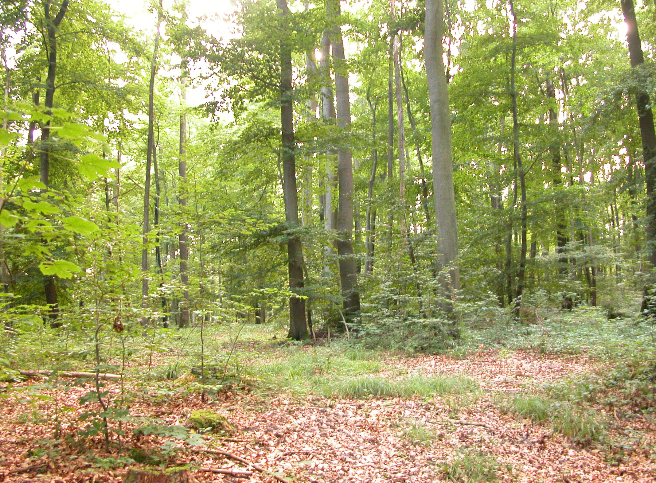
Rainfall in Temperate Forests
Relatively constant throughout the year
Annual precipitation: 75–150 cm (29.5–59 in)
Supports growth of deciduous trees
Lose leaves each fall, remain leafless in winter
No photosynthesis during winter
New leaves in the spring with rising temperatures
Net primary productivity less than tropical wet forests
44.3 Figure 9: Deciduous trees are the dominant plant in the temperate forest.
Oliver Herold on Wikimedia Commons. "Deciduous trees."

Slide 22
Trees in Temperate Forests
Dominated by deciduous species
Lose leaves in fall, dormant in winter
More open than tropical forests because trees do not grow as tall as those in tropical wet forests
Contribute to rich soil through leaf litter decomposition
Also protects soil from erosion, insulates the ground, and provides habitats for invertebrates

Slide 23
Boreal Forests
Boreal forest (taiga or coniferous forest):
Located south of the Arctic Circle across Canada, Alaska, Russia, and northern Europe
Cold, dry winters and short, cool, wet summers
Annual precipitation: 40–100 cm (15.7–39 in), often as snow
Little precipitation due to cold temperatures

Slide 24
Trees in Boreal Forests
Dominated by cold-tolerant, evergreen conifers (e.g., pines, spruce, fir) due to cold, long winters
Retain nitrogen-rich needles year-round
Adapted to photosynthesize earlier in spring
Acidic soils with little available nitrogen

Slide 25
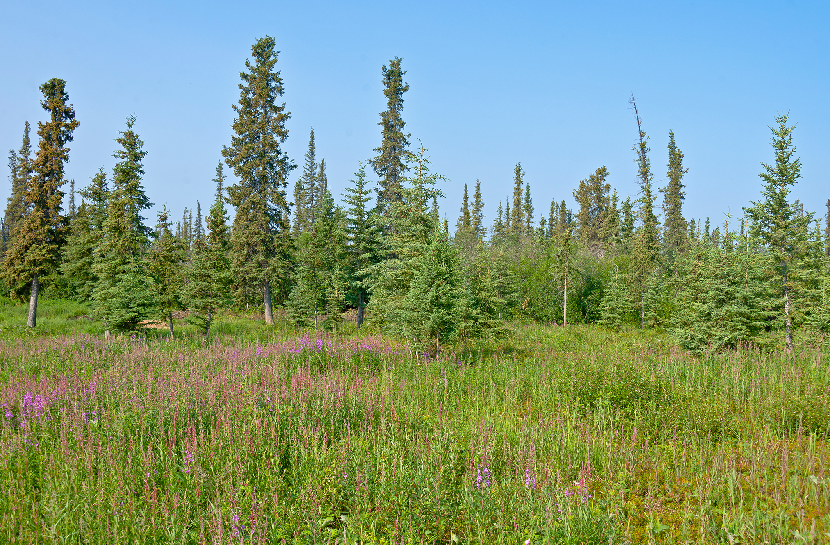
Net Primary Productivity in Boreal Forests
Lower than temperate and tropical wet forests
High aboveground biomass due to long-lived, slow-growing trees
Lack elements of a layered forest; only have a tree layer and a ground layer
Slower nutrient cycling due to slow decomposition of conifer needles
44.3 Figure 10: The boreal forest (taiga) has low-lying plants and coniferous trees.
Daniel Case on Wikimedia Commons. "Boreal forest."

Slide 26
Think It Through
Identify the biome for each of the following descriptions.
This biome is found in equatorial regions.
Most of the rain occurs in winter.
This biome sees very low temperatures with a short growing season.
In this biome, there is a predominance of coniferous plants.
This biome is also called prairies or steppes.
Flora and fauna in this biome exhibit several adaptations to conserve water.
Deciduous trees predominate in this biome.
Notes:
Originally an On Your Own. This is included here to use as a talking point or for a think-pair-share activity.

Slide 27
Arctic Tundra
Arctic tundra:
North of the subarctic boreal forest
Located in Arctic regions of the northern hemisphere
Average winter temperature: −34°C (−29.2°F)
Average summer temperature: 3°C to 12°C (37°F to 52°F)
Very short growing season (10–12 weeks)
Almost 24 hours of daylight during growing season
Supports rapid plant growth during short summer

Slide 28
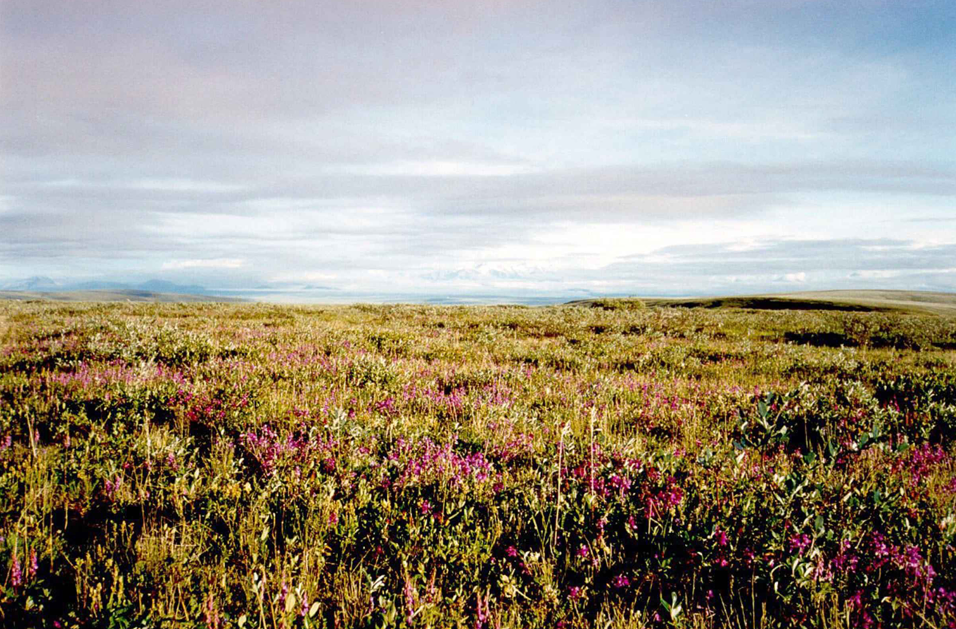
Plants in the Arctic Tundra
Generally low to the ground
Little species diversity, low net primary productivity, and low aboveground biomass
Permafrost: perennially frozen soil layer
Inhibits deep root penetration
Slows organic matter decay and nutrient release
Affects soil structure and plant growth
During growing season, abundant with plants or lichens
44.3 Figure 11: Low-growing plants, such as shrub willow, dominate the tundra landscape, shown here in the Arctic National Wildlife Refuge.
U.S. Fish and Wildlife Service on Wikimedia Commons. "Tundra."

Slide 29
Summary
Earth has both terrestrial and aquatic biomes.
Eight major terrestrial biomes with distinct characteristics: tropical wet forests, savannas, subtropical deserts, chaparral, temperate grasslands, temperate forests, boreal forests, and Arctic tundra
Temperature and precipitation are key factors in shaping biome composition.
Biome productivity varies based on climate conditions.
Complex interactions between abiotic factors and living organisms define each biome's unique ecosystem.

Slide 30

End of Hawkes Learning PowerPoint

