Slide 1
Lesson 44.4
Aquatic Biomes

Slide 2
Objectives
Describe the effects of abiotic factors on the composition of plant and animal communities in aquatic biomes.
Compare and contrast the characteristics of the ocean zones.
Summarize the characteristics of standing water and flowing water freshwater biomes.
Understand coral reefs.

Slide 3
Abiotic Factors Influencing Aquatic Biomes
Aquatic biomes are influenced by a series of abiotic factors.
Water absorbs light, creating depth-based light gradients.
Thermal properties of water affect energy storage and distribution.
Stratification due to density differences is crucial in freshwater systems.
Large-scale water movements (currents) are significant in marine systems.

Slide 4
Abiotic Factors and Ocean Zones
The ocean is categorized by several areas or zones defined by abiotic factors.
Pelagic realm: open water areas of the ocean
Benthic realm: ocean bottom from shoreline to deepest parts
Photic zone: area where light penetrates (up to 200 m depth)
Aphotic zone: area below 200 m where light cannot penetrate
Challenger Deep: deepest known point in the ocean (about 11,000 m)
These zones pertain to freshwater lakes as well.

Slide 5
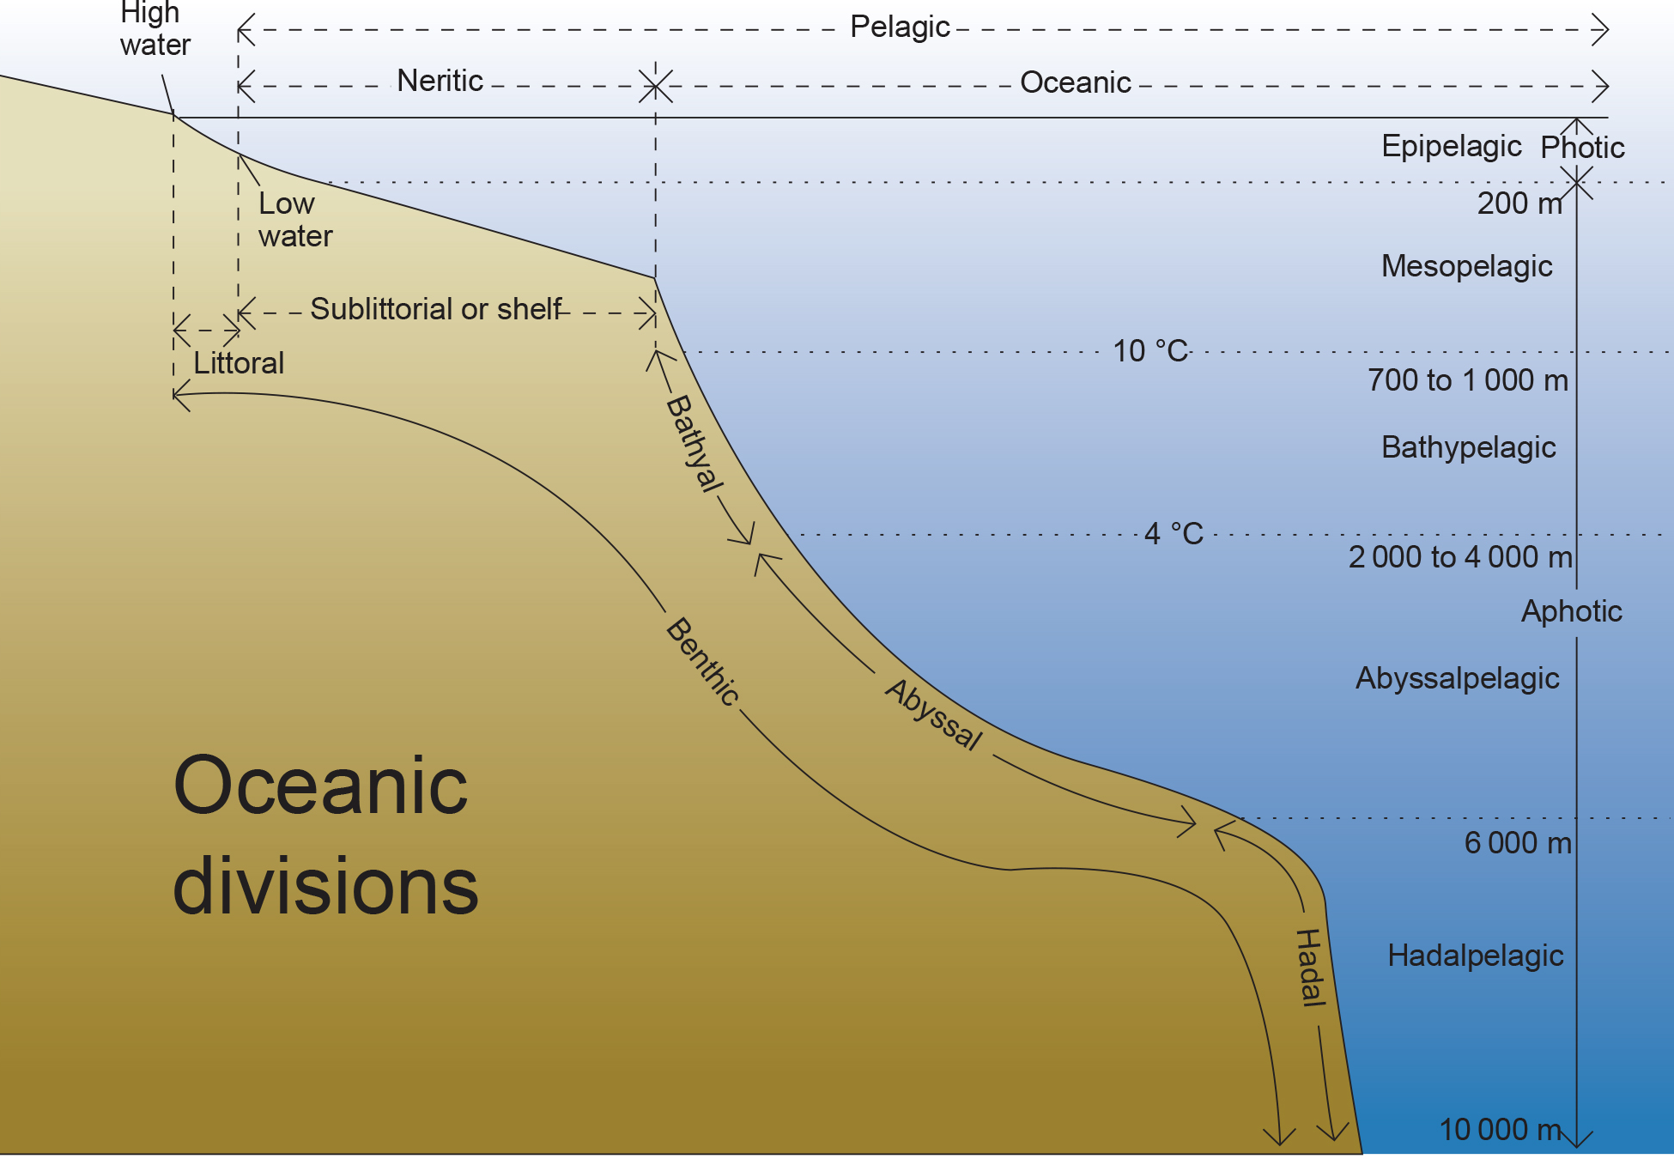
44.4 Figure 1
Chris huh on Wikimedia Commons. "Oceanic divisions."
Notes:
The ocean is divided into different zones based on water depth and distance from the shoreline.

Slide 6
Marine Biomes
Ocean: largest marine biome, continuous body of salt water
Coral reefs: underwater structures formed by marine invertebrates
Estuaries: coastal areas where salt and fresh water mix

Slide 7
Ocean
The ocean's physical diversity has significant influence on plants, animals, and other organisms.
Divided into zones based on light penetration and other abiotic factors
Each with distinct species adapted to specific conditions

Slide 8
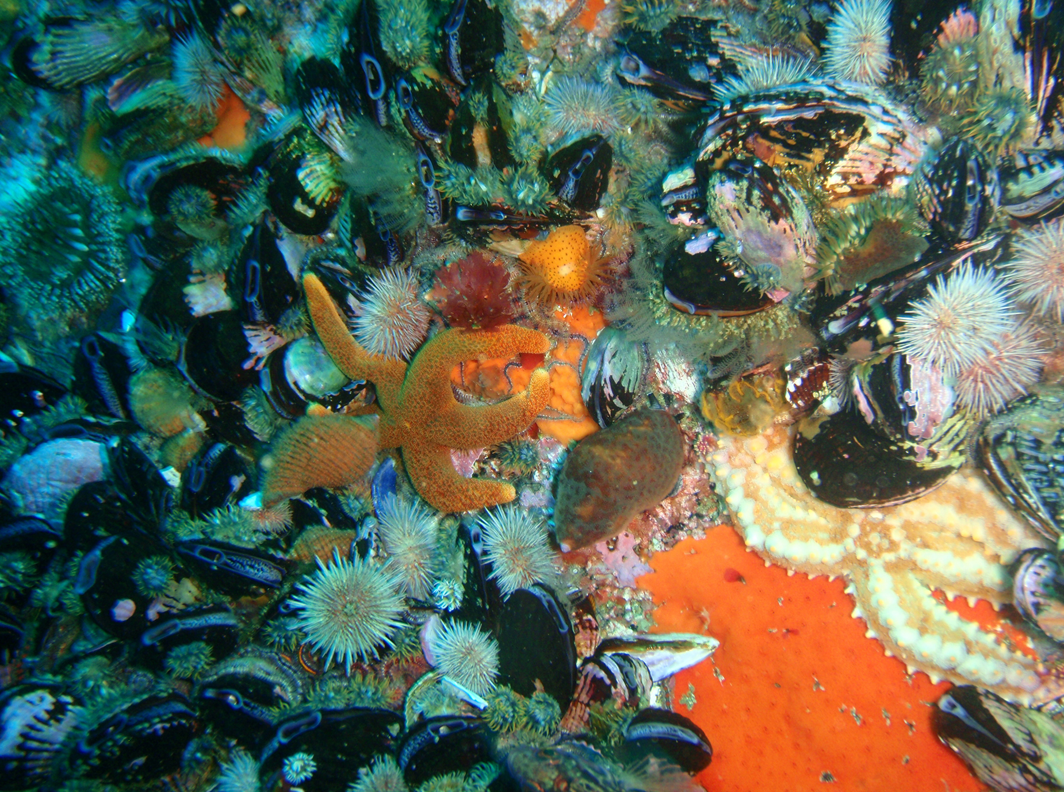
Intertidal Zone
Intertidal zone:
Area between high and low tide marks
Region closest to land
Highly variable environment due to tidal fluctuations
Low tide: organisms exposed to air and sunlight
High tide: organisms mostly underwater
Adapted to being dry for periods of time and to withstand damage from waves
Few algae and plants due to constant water movement
44.4 Figure 2: Sea urchins, mussel shells, and starfish are often found in the intertidal zone.
Peter Southwood on Wikimedia Commons. "Intertidal organisms."

Slide 9
Neritic Zone
Neritic zone:
Extends from intertidal zone to edge of continental shelf (about 200 m depth)
Continental shelf: underwater landmass that extends from a continent
Can be penetrated by light, so photosynthesis occurs
Well-oxygenated, low-pressure, stable temperature water
Diverse marine life (phytoplankton, Sargassum, zooplankton, protists)
Sargassum: type of free-floating seaweed
Base of the food chain for many of the world's fisheries

Slide 10
Pelagic Realm
Pelagic realm (oceanic zone):
Open ocean area beyond the neritic zone
Exhibits thermal stratification: where warm and cold waters mix due to ocean currents
Supports plankton (base of the food chain), whales, and dolphins
Relatively less productive due to nutrient scarcity
Lack of process to bring nutrients from dead protists and animals from the bottom to the top
Exceptions: oceanic upwellings in the Humboldt Current in South America

Slide 11
Benthic Realm
Benthic realm:
Deep-water region beyond the continental shelf
Composed of sand, silt, and dead organisms
Temperature decreases with depth but remains above freezing
Nutrient-rich due to organic matter falling from upper layers

Slide 12
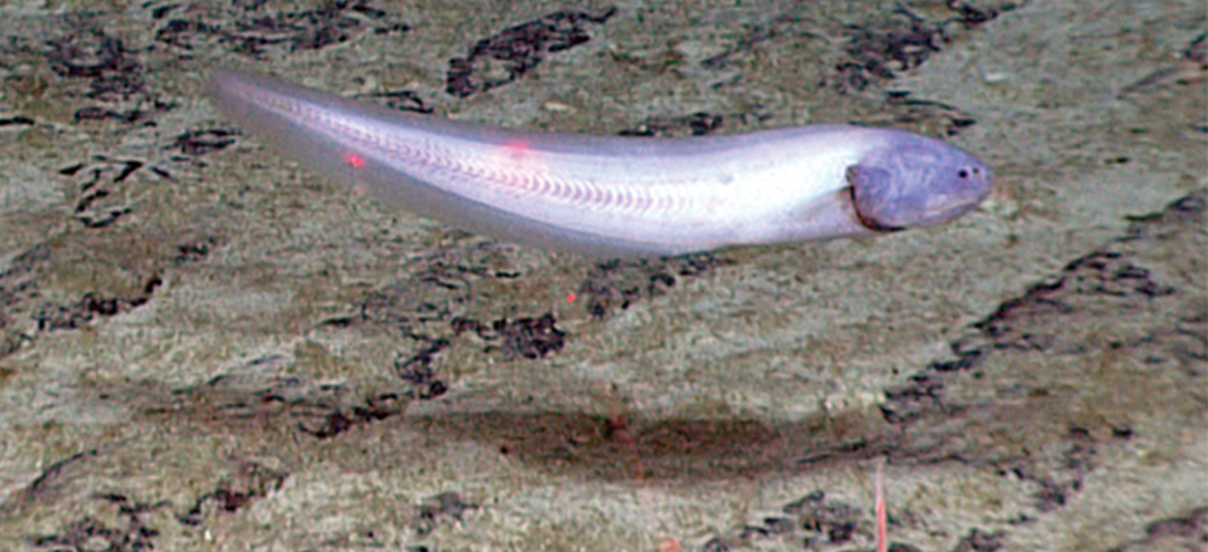
Abyssal Zone
Abyssal zone:
Deepest part of the ocean (4,000 m or greater)
Characterized by very cold temperatures, high pressure, and complete darkness
Varied oxygen levels, with some areas completely depleted
Adaptations in organisms like slow metabolism and bioluminescence (ability to produce light)
Presence of hydrothermal vents
Support chemosynthetic bacteria-based ecosystems
44.4 Figure 3: This cusk eel (Bassozetus sp.) was observed by a National Oceanic and Atmospheric Administration (NOAA) expedition.
NOAA Okeanos Explorer on Wikimedia Commons. "Cusk eel."

Slide 13
Reflection Question
What are some evolutionary or behavioral adaptations that fish living in the abyssal zone might need to have to survive the harsh conditions near the bottom of the ocean?
Notes:
The reflection question is included here to use as a talking point or for a think-pair-share activity.

Slide 14
Coral Reefs₁
Coral reefs: ocean ridges formed by marine invertebrates
Comprised mostly of cnidarians and mollusks in warm, shallow waters of the photic zone
Found within 30° north and south of the equator
Great Barrier Reef: best-known and largest reef system in the world
Located off the northeastern coast of Australia
Other types include:
Fringing islands: directly adjacent to land
Atolls: circular reef systems surrounding a former landmass that is now underwater

Slide 15
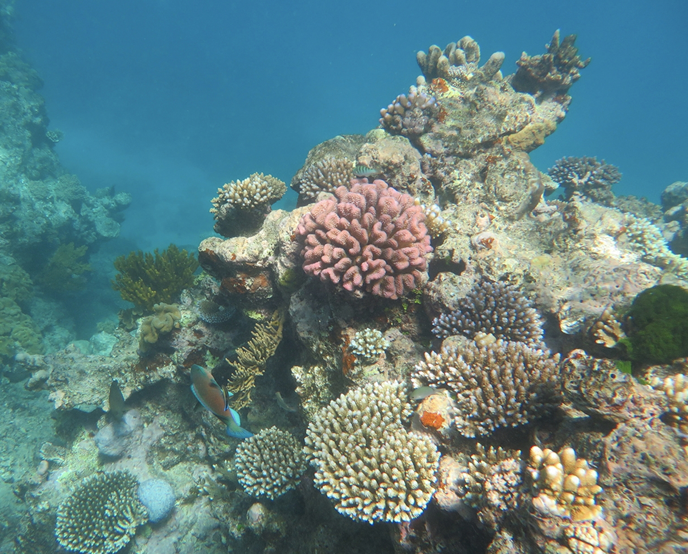
Coral Reefs₂
The coral organisms are colonies of saltwater polyps that secrete calcium carbonate (CaCO₃) skeletons.
Members of phylum Cnidaria
Underwater reef formed by calcium-rich skeletons
44.4 Figure 4: Coral reefs are formed by the calcium carbonate skeletons of coral organisms, which are marine invertebrates in the phylum Cnidaria.
Rebecca Jackson on Wikimedia Commons. "Coral reef."

Slide 16
Coral Reefs₃
Corals in shallower waters have a mutualistic relationship with zooxanthellae.
Zooxanthellae: photosynthetic unicellular algae
Provides corals with their required nutrition and energy
Not provided by the water they live in
Corals in deeper waters do not have this relationship; instead, they attain nutrients from cnidocytes (stinging cells) on their tentacles.

Slide 17
Species in Coral Reefs
An estimated over 4,000 fish species live in the coral reefs.
Feed on seaweed, algae, or cryptofauna: invertebrates that conceal themselves within crevices of the calcium carbonate skeletons of the coral reefs
Some fish species inhabit the coral reef boundaries, including:
Predator species: consume other organisms via hunting
Herbivore species: primarily feed on plants
Planktivores: consume planktonic organisms, such as bacteria, archaea, algae, and protists in the pelagic zone

Slide 18
Global Decline of Coral Reefs₁
Coral reefs take thousands of years to build.
Climate change and human activity pose significant threats to coral reefs.
Rising ocean temperatures cause coral bleaching: excessive warmth causing the reefs to lose their food-producing algae.
Reefs lose their coloration if loss of the zooxanthellae is prolonged.
Increasing atmospheric CO₂ leads to ocean acidification.
Acidification interferes with coral calcification processes.

Slide 19
Global Decline of Coral Reefs₂
Human population growth increases sediment and agricultural chemicals, which causes clear waters to become cloudy.
Overfishing of popular fish disrupts the ecological balance.
Rise in global temperature is very significant to coral reefs.
Species can become extinct before evolution offers new adaptations.
Many scientists believe global warming may be irreversible for many coral reefs.

Slide 20
Estuaries: Where the Ocean Meets Fresh Water
Estuaries: biomes that occur where a source of fresh water meets the ocean
Characterized by brackish (diluted) water
Form protected areas where young crustacean, mollusks, and fish offspring begin their lives
Salinity based on rate of freshwater flow, which depends on seasonal rainfall
Experience daily tidal fluctuations

Slide 21
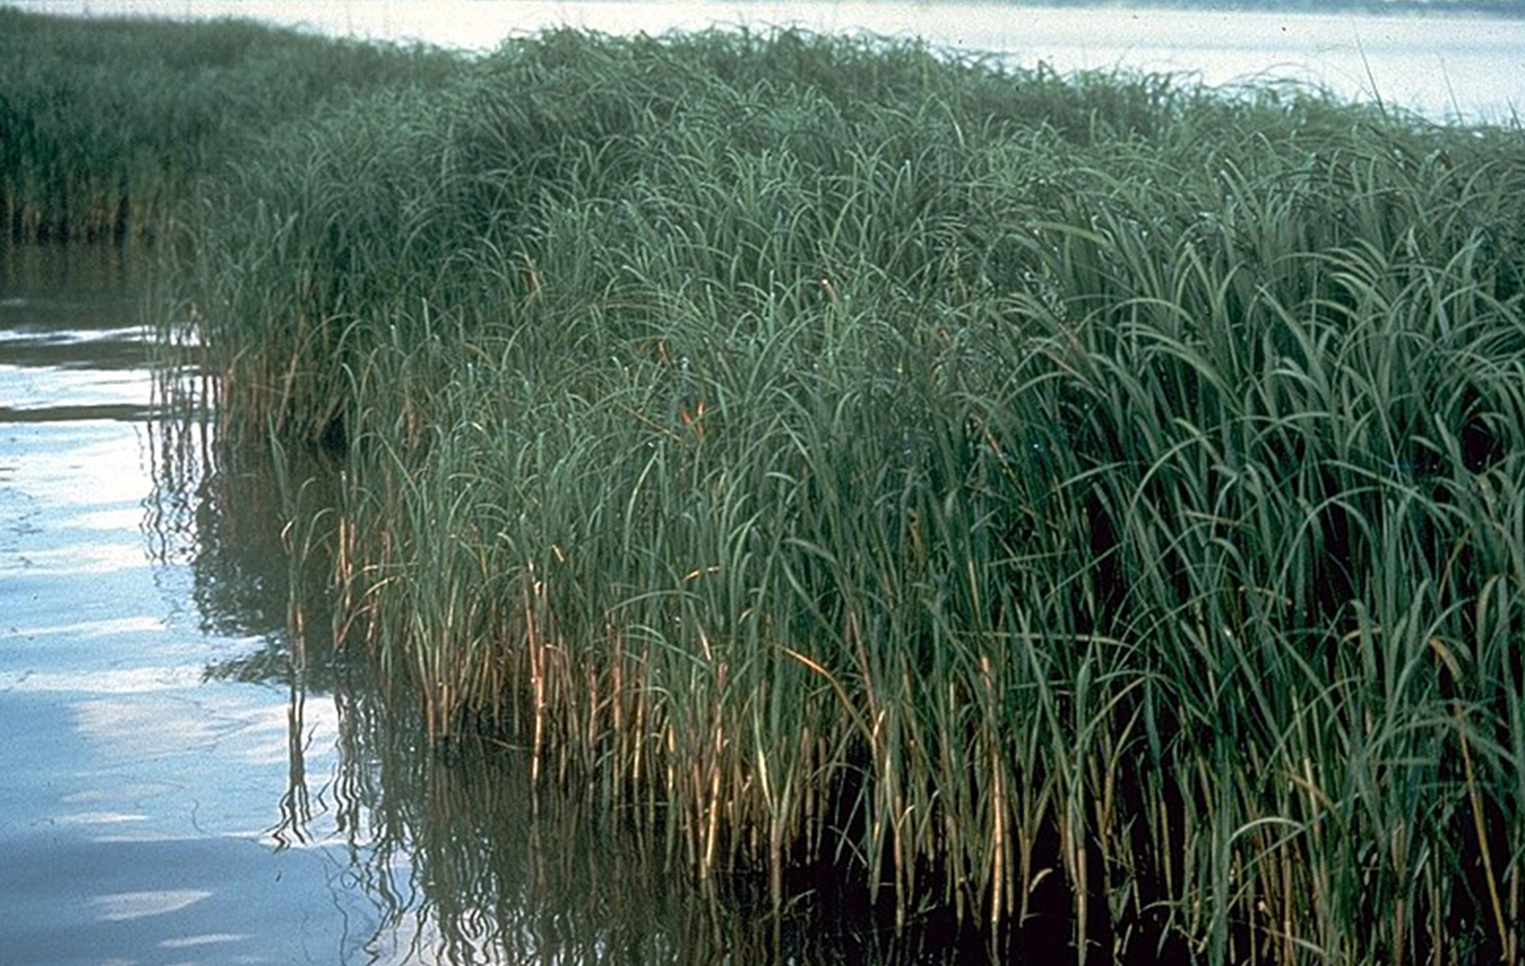
Salinity in Estuaries
The variation in salinity poses physiological challenges for estuarine inhabitants.
Plants (halophytes) and animals have adaptations to cope with salinity changes.
Halophytes: plants that can tolerate salty conditions
Plants: have filters in the roots to remove salt from the water the plant absorbs
Animals: may switch between aerobic and anaerobic respiration based on conditions
44.4 Figure 5: The marshgrass Spartina alterniflora is a halophyte (salt-tolerant plant) that thrives in brackish coastal estuaries.
USDA-NRCS PLANTS Database on Wikimedia Commons. "Spartina alterniflora."

Slide 22
Freshwater Biomes
Include lakes, ponds, rivers, streams, and wetlands
Provide essential ecosystem services (benefits humans obtain from ecosystems), such as:
Aquatic resources for drinking water
Crop irrigation
Sanitation
Industry
Connected to terrestrial biomes through abiotic and biotic factors

Slide 23
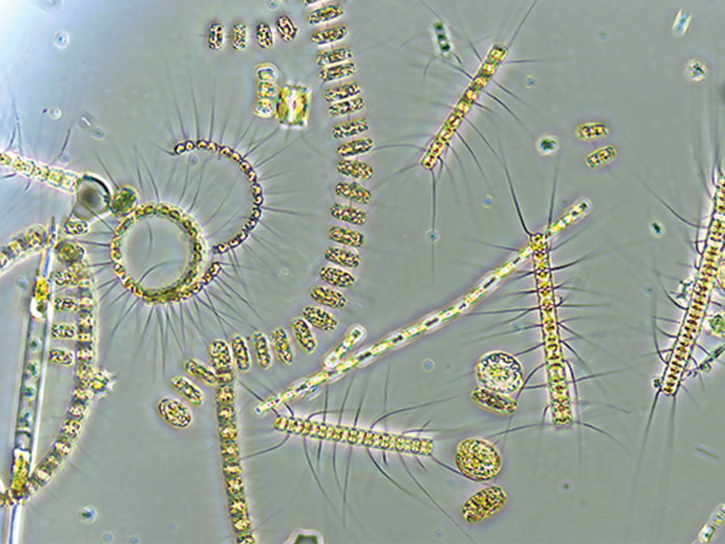
Lakes and Ponds
Range in size from a few square meters to thousands of square kilometers
Temperature important abiotic factor
Experience thermal stratification in summer
Support phytoplankton in the photic zone, forming the base of the food web in lakes and ponds
Breakdown of dead organisms by bacteria in the aphotic zone
44.4 Figure 6: Phytoplankton, found in lakes and ponds, are a critical component of the ecosystem.
University of Rhode Island/Stephanie Anderson on Wikimedia Commons. "Phytoplankton."

Slide 24
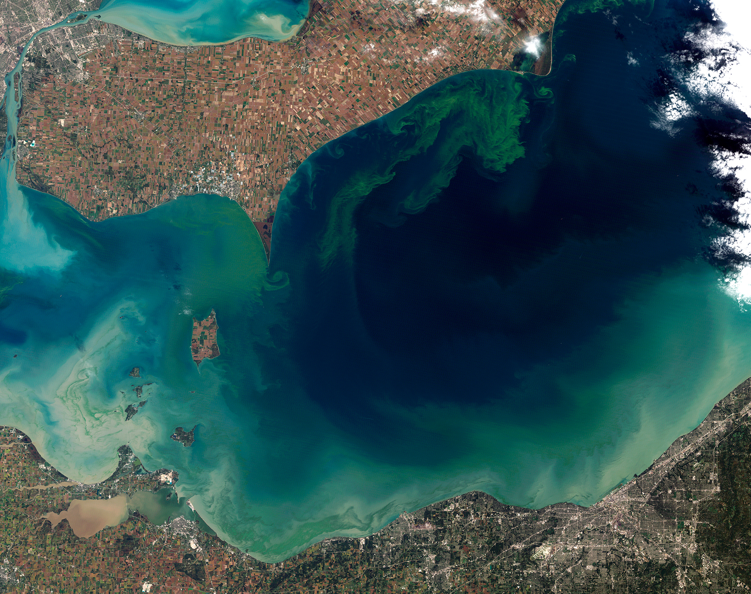
Nitrogen and Phosphorus in Lakes and Ponds
Nitrogen (N) and phosphorus (P) are essential limiting nutrients for algae and plant growth.
They are determining factors in the amount of phytoplankton growth that takes place.
Excess input can lead to algal blooms: a large accumulation of algae.
Algal blooms can cause oxygen (O) depletion and create dead zones.
Phosphorus control and storm water runoff pose environmental challenges in areas like Lake Erie and the Gulf of Mexico.
44.4 Figure 7: The uncontrolled growth of algae in Lake Erie has resulted in an algal bloom.
Jesse Allen and Robert Simmon on Wikimedia Commons. "Algae bloom in Lake Erie."

Slide 25
Rivers and Streams
Continuously moving bodies of water that carry large amounts of water from the source (headwater) to a lake or ocean
Largest rivers:
Nile River in Africa
Amazon River in South America
Mississippi River in North America

Slide 26
Abiotic Features of Rivers and Streams
Abiotic features vary from source to mouth.
Streams begin at a point of origin called source water.
Typically cold, low in nutrients, and clear
The channel (width of the river or stream) width increases from source to mouth.
The current is often faster at the source than any other point in the river or stream.

Slide 27
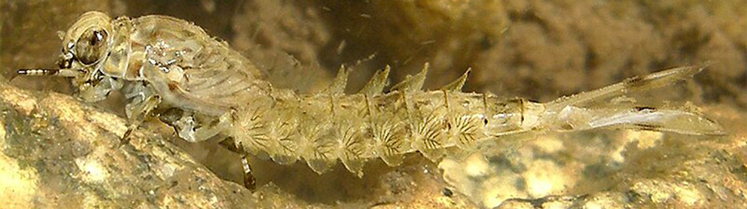
Fast-Moving Water in Rivers and Streams
Results in minimal silt accumulation at the bottom of the river or stream
Clear water with little debris
Photosynthesis mainly from algae on rocks
Energy from leaves and other organic material from downstream trees and border plants
Plant and animal adaptations to fast-moving water:
Mayfly nymphs (larvae): flattened bodies and legs with modified claws to cling to rocks
Freshwater trout: important predator in fast-moving rivers and streams
44.4 Figure 8: A mayfly nymph has a flattened body and claws to cling to rocks in a river.
Thom Quine on Wikimedia Commons. "Mayfly nymph."

Slide 28
Slow-Moving Water in Rivers and Streams
Caused by gradient decrease and volume increase as tributaries unite
Increased sedimentation and higher phytoplankton content
Warmer water, but not as clear
Worms (phylum Annelida) and insects (phylum Arthropoda) in the mud
Vertebrate predators: waterfowl, frogs, fishes
Find food using taste or chemical cues instead of vision due to murky waters

Slide 29
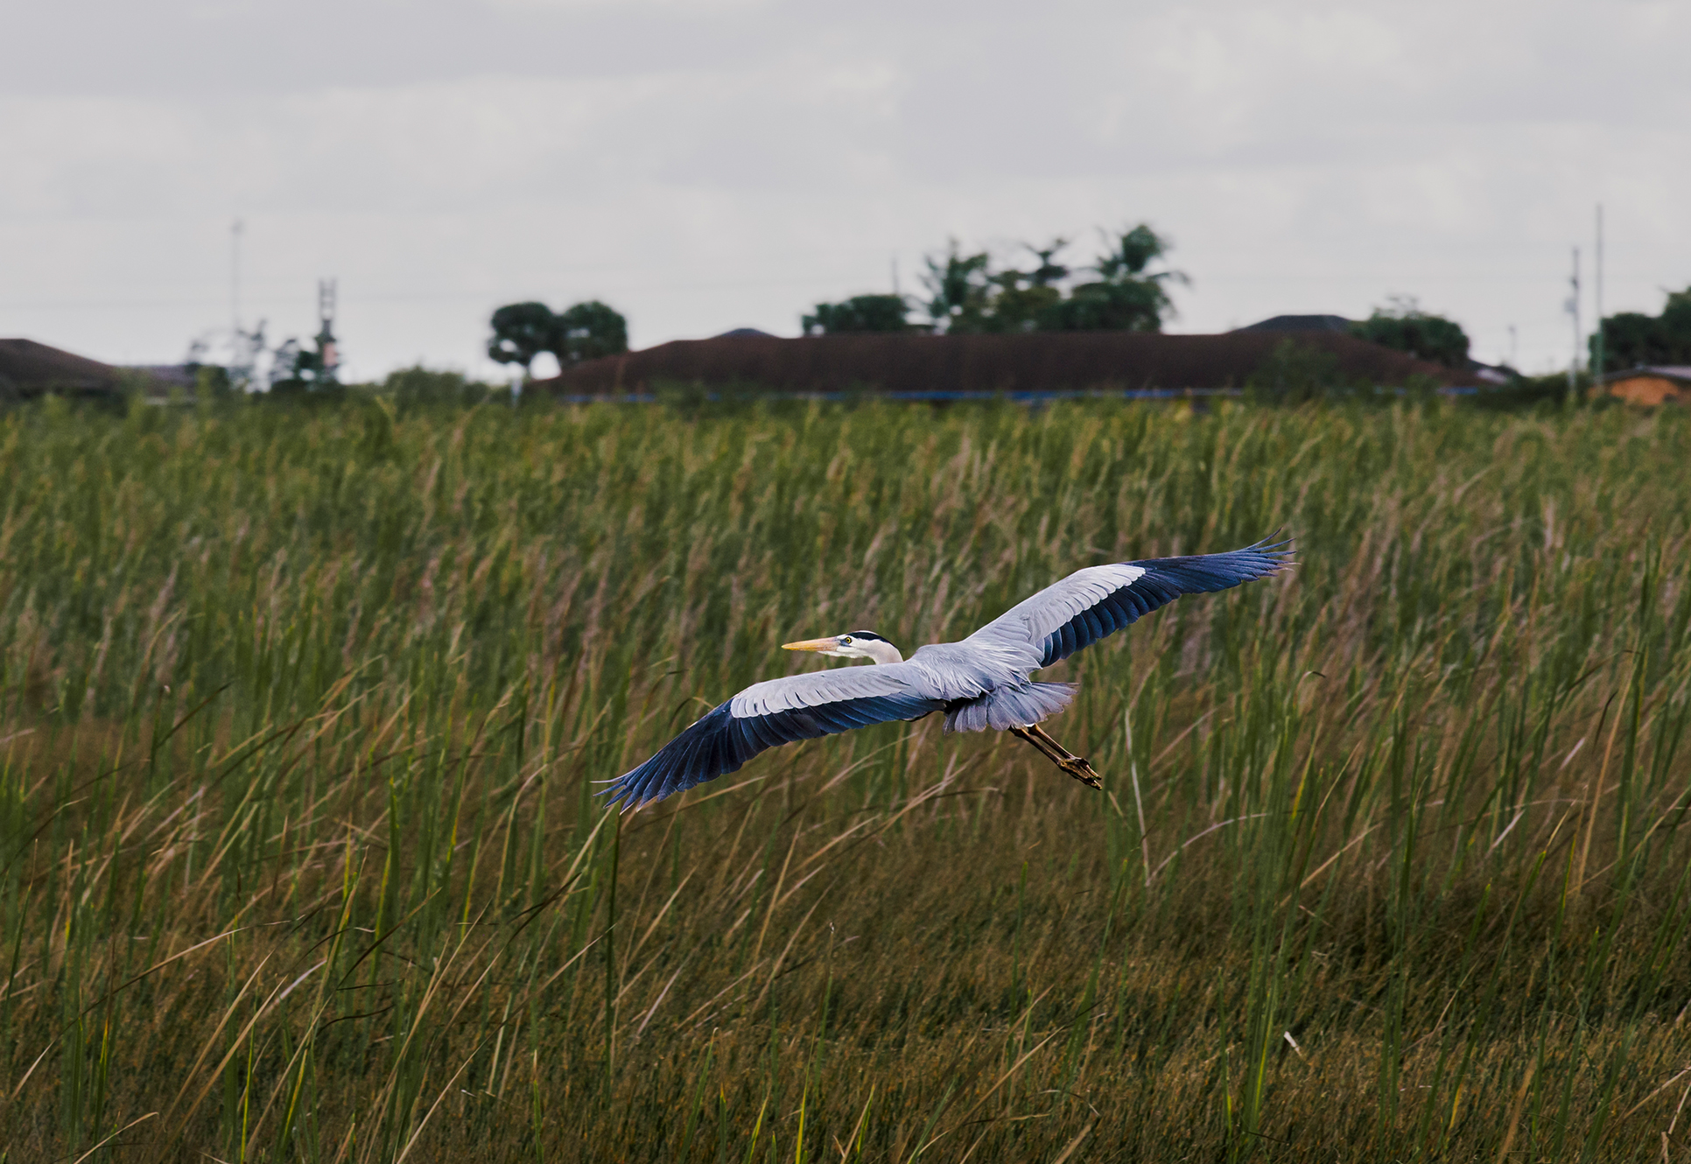
Wetlands
Shallow bodies of water with saturated soil
Wetland plants: rooted in the soil but have leaves, stems, and flowers extending above the surface
Include marshes, swamps, bogs, mudflats, and salt marshes
Characterized by:
Hydrology: how water is distributed and moves
Hydrophytic vegetation: can survive in or near water
Hydric soils: permanently or seasonally saturated with water
44.4 Figure 9: Located in southern Florida, Everglades National Park is a vast array of wetland environments, including sawgrass marshes, cypress swamps, and estuarine mangrove forests. Here, a great blue heron (Ardea herodias) flies over long grass.
Matthew T Rader on Wikimedia Commons. "Great blue heron."

Slide 30
Water Flow in Wetlands
Freshwater marshes and swamps have slow, steady water flow.
Bogs have low or nonexistent water flow.
Develop in depressions with clay bottoms and poor percolation (movement of water through pores in the soil or rocks)
Have stagnant (not flowing), oxygen-depleted, and acidic water
Limits available nitrogen for plants because of lower water pH
Bog plants: include sundews, pitcher plants, and Venus flytraps; extract nitrogen from insects
Have low net primary productivity due to low levels of nitrogen and oxygen in water

Slide 31
Summary
Aquatic ecosystems include saltwater and freshwater biomes.
Sunlight, density, and temperature are crucial in structuring aquatic systems.
Oceans have distinct zones based on depth and light penetration.
Coral reefs contain a wide variety of species in their marine ecosystems.
Estuaries are found where rivers meet the ocean.
Freshwater biomes include lakes, ponds, rivers, streams, and wetlands.
Bogs are a type of wetland characterized by standing water, lower pH, and lack of nitrogen.

Slide 32


End of Hawkes Learning PowerPoint
End of Hawkes Learning PowerPoint

