Slide 1
Lesson 44.5
Climate and Climate Change

Slide 2
Objectives
Define global climate change.
Summarize the effects of past events and the Industrial Revolution on the global climate.
Describe three natural factors affecting long-term global climate.
List two or more greenhouse gases and describe their role in the greenhouse effect.

Slide 3
Climate and Climate Change
Climate affects all biomes and shapes their environments.
Scientists have observed significant changes in climate over the last 60 years.
Global climate change refers to altered global weather patterns, particularly a worldwide increase in temperature, and resulting climate changes.
Rising levels of atmospheric carbon dioxide (CO₂) are largely responsible for global climate change.

Slide 4
Climate and Weather
A common misconception is that a specific weather event in a particular region indicates global climate change.
Climate refers to long-term, predictable atmospheric conditions of a specific area.
Characterized by consistent seasonal temperature and rainfall ranges
Weather refers to short-term atmospheric conditions, usually forecasted over 48-hour cycles.
Planning events based on climate is more reliable than planning based on specific weather predictions.

Slide 5
Group Activity₁
In groups of two or three, discuss what the climate might be for your hometown. What sorts of temperature patterns are typical of your location? How often does it rain in a given season?

Slide 6
Think It Through
What is the difference between weather and climate?
Notes:
Originally an On Your Own. This is included here to use as a talking point or for a think-pair-share activity.

Slide 7
Global Climate Change
Climate change can be studied through:
Evidence of current and past global climate change
Drivers of global climate change
Documented results of global climate change
Separating these aspects helps in understanding media reports on global climate change.
Accurate interpretation of data is crucial for comprehending global climate change.

Slide 8
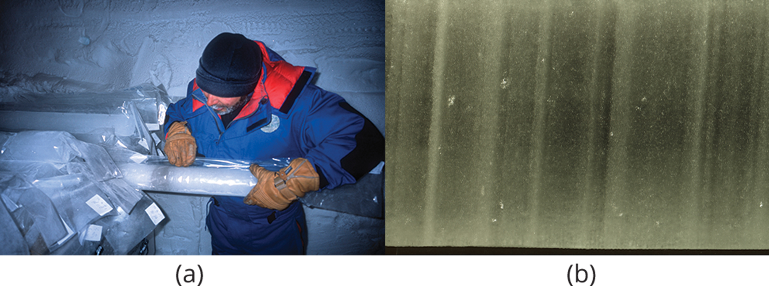
Evidence for Global Climate Change
Scientists use indirect methods to measure past climate conditions.
Antarctic ice cores provide key evidence for historical climate data.
Samples of polar ice via drills that reach thousands of meters into ice sheets or mountain glaciers
Like traveling through time: the deeper the sample, the earlier the time period
Can reveal data about temperature and carbon dioxide
Have been used to estimate the Earth's temperature over the past 400,000 years
44.5 Figure 1: (a) Scientists drill for ice cores in polar regions. (b) The ice contains air bubbles and biological substances that provide important information for researchers.
Dargaud on Wikimedia Commons. "Ice cores."
National Ice Core Laboratory on Wikimedia Commons. "Layers in ice core."

Slide 9
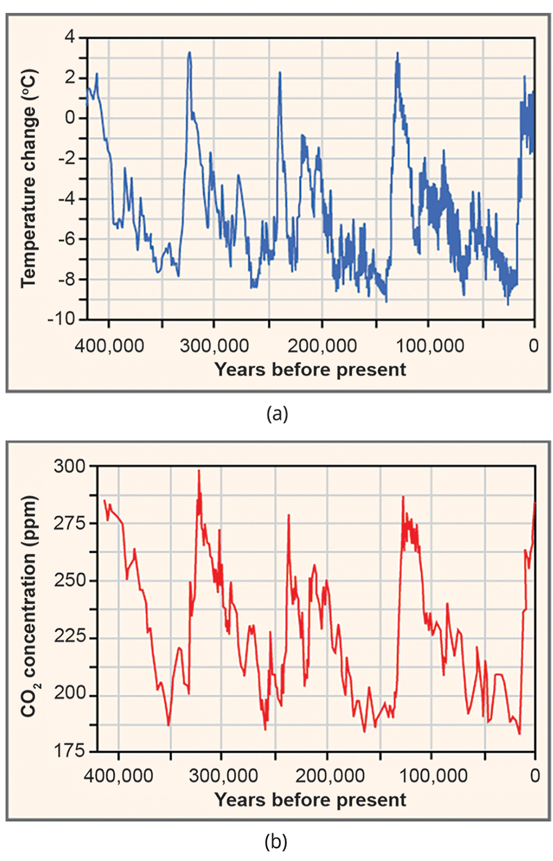
Earth's Average Temperature
Historical data shows Earth's temperature fluctuating between cooler and warmer periods over the last 400,000 years.
Long-term average temperatures provide a baseline for comparing current changes.
Pre-1800s data shows natural cycles of temperature variations.
Earth had been as much as 9°C cooler and about 3°C warmer than its average long-term temperature.
These changes align with increased carbon dioxide levels in the atmosphere.
44.5 Figure 2: (a) This graph displays average temperature changes over the past 400,000 years. (b) This graph displays CO₂ concentrations.
CNX OpenStax on Wikimedia Commons. "Ice at the Russian Vostok station."

Slide 10
Temperature Anomalies
Two significant temperature anomalies (irregularities) have occurred in the last 2,000 years: Medieval Climate Anomaly (Medieval Warm Period) and the Little Ice Age.
A third aligns with the Industrial Era.
The Medieval Climate Anomaly saw slightly warmer conditions from 900 to 1300 CE.
Freed seas of ice
Enabled Vikings to colonize Greenland

Slide 11
The Little Ice Age
Little Ice Age: cold period between 1550 and 1850 CE
Characterized by cooler temperatures (little less than 1°C) in North America, Europe, and possible other areas
Resulted in exceptionally harsh winters with much snow and frost

Slide 12
Group Activity₂
As a group, examine Figure 3. The first image shows average CO₂ concentrations in the troposphere (the lowest level of the atmosphere) across Earth during the year 2011 (top), as well average global CO₂ concentrations in the troposphere in May (left) and October (right) of that year. Note the change in the distribution of CO₂ between May and October. The bottom graph shows the annual mean global tropospheric and surface CO₂ concentrations from 1998 to 2012.
After examining the figure with your group, answer the four questions on the next slide.

Slide 13
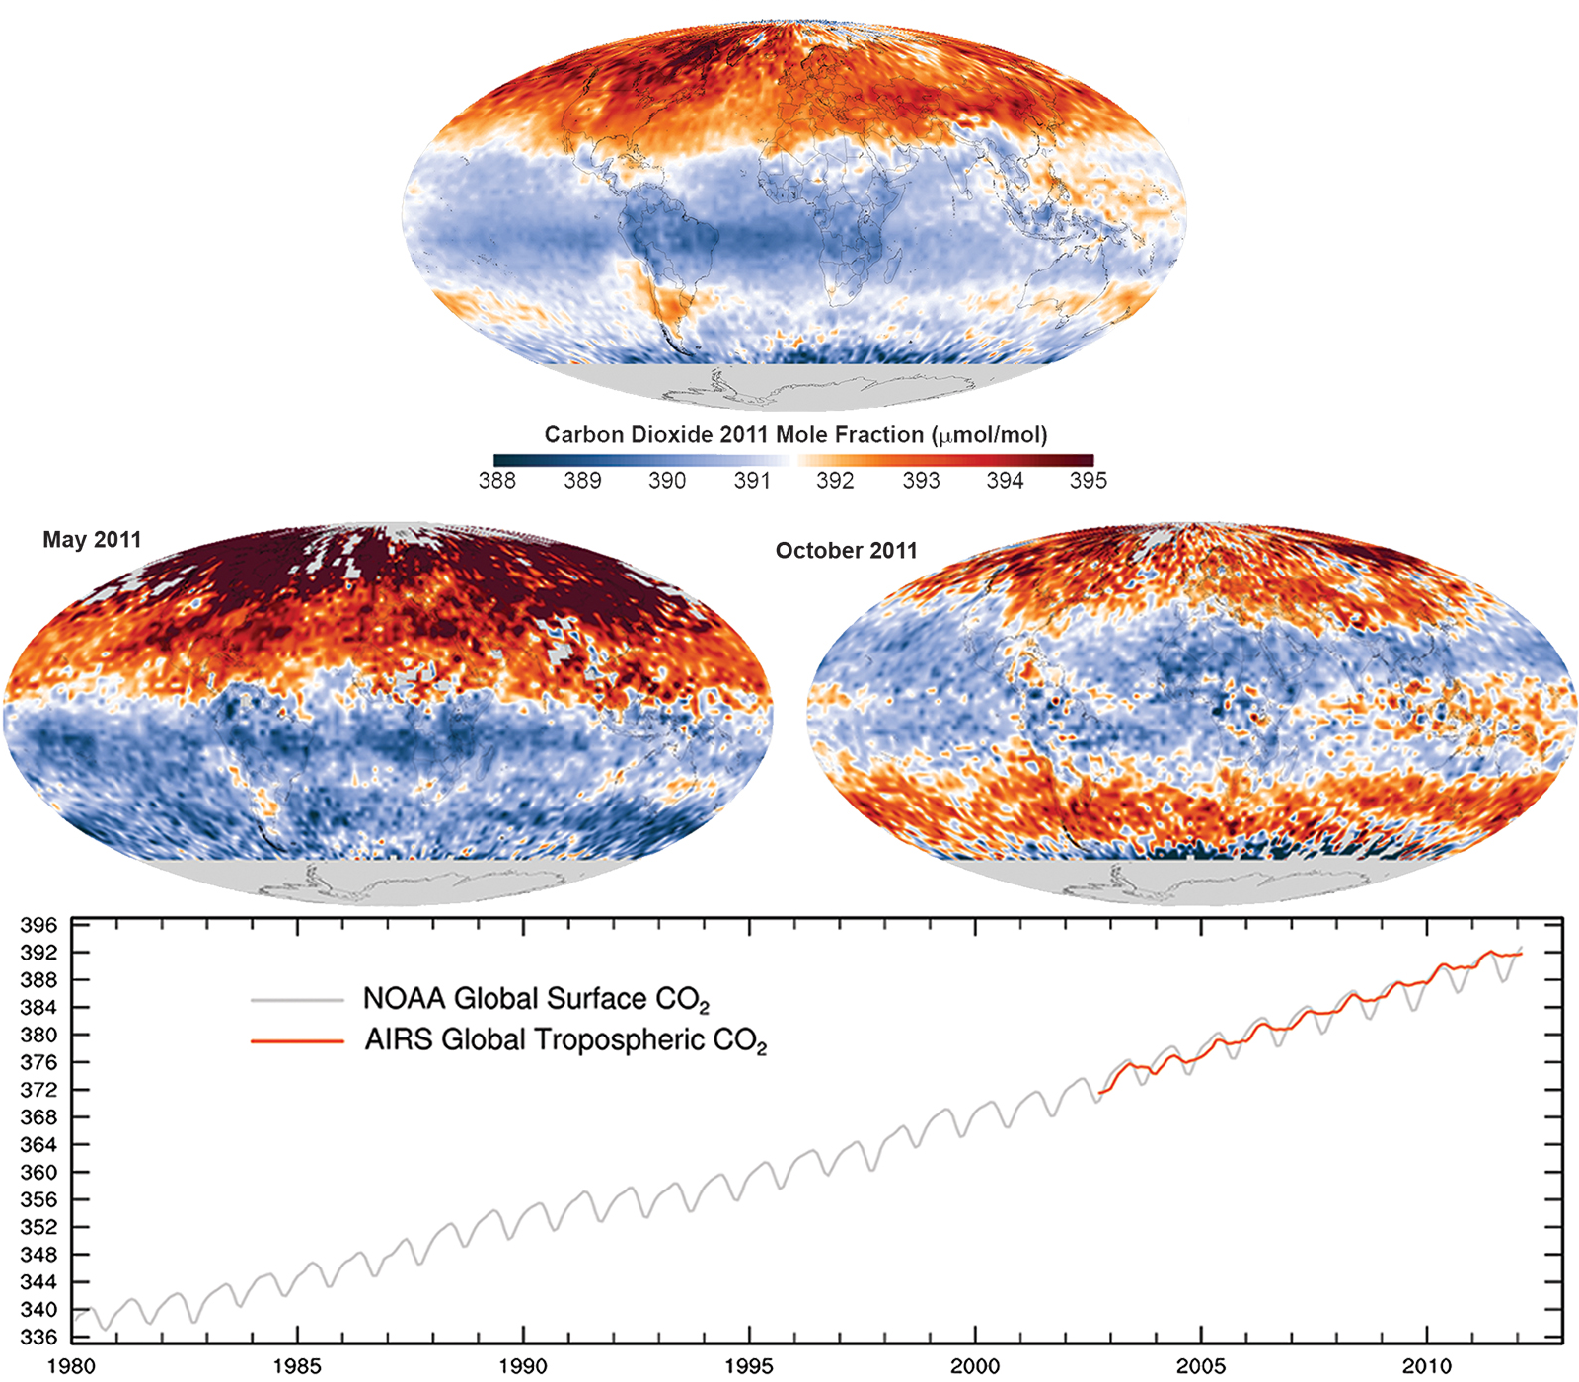
44.5 Figure 3
Giorgiogp2 on Wikimedia Commons. "Carbon dioxide concentrations."
Notes:
The top image displays the average global tropospheric CO₂ across Earth for all of 2011, in May of 2011, and in October of 2011. The bottom graph displays the annual mean carbon dioxide concentration at the surface, in the troposphere, and at Earth's surface between 1980 and 2012.

Slide 14
Group Activity₃
How does the average CO₂ in 1995 compare to that in 2010?
Consider the change in the distribution of CO₂ between May and October of 2011. What do you think causes such seasonal fluctuations in the concentration of CO₂ in the atmosphere?
What do you think will happen to the concentration of CO₂ in the atmosphere in the next 50 years? Explain the reasons for your predictions.
What are some negative effects of the rise in CO₂? Are there any positive effects?

Slide 15
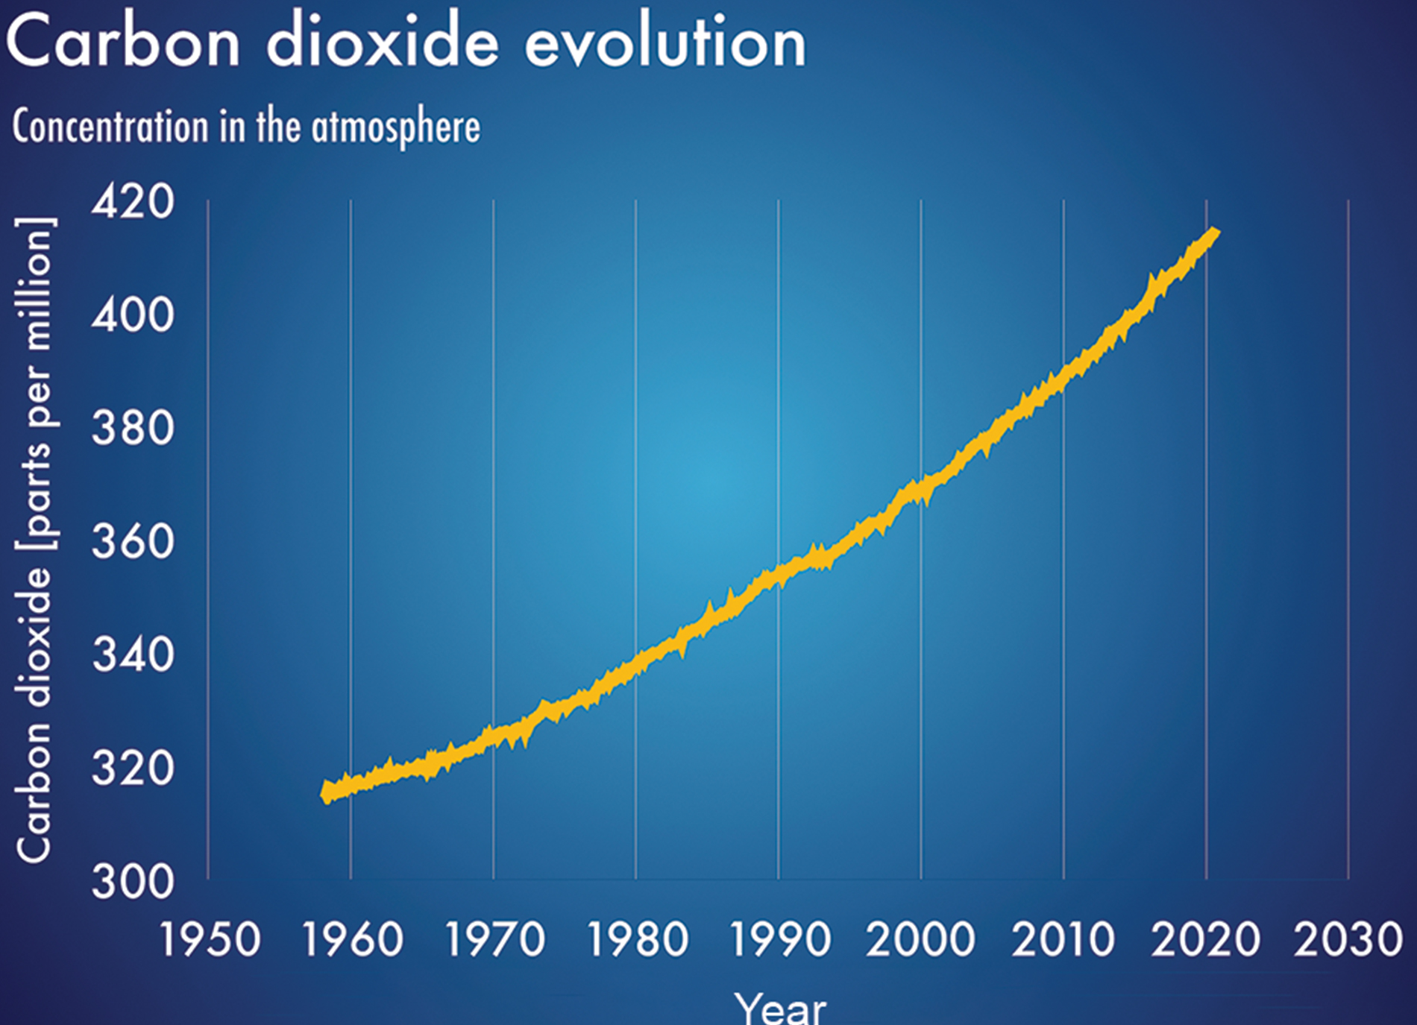
The Industrial Revolution
Industrial Revolution:
Began around 1750, marking significant changes in human society
Improved living standards in Europe and the United States due to advances in agriculture and technology
New technologies powered by fossil fuels, especially coal, releasing CO₂
Led to the Industrial Era, which led to a sharp rise in atmospheric carbon dioxide levels
44.5 Figure 4: The atmospheric concentration of CO₂ has risen steadily since the beginning of industrialization.

Slide 16
Current and Past Drivers of Global Climate Change
Scientists must use indirect evidence to determine the drivers for climate change.
Includes data from ice cores, boreholes (narrow shaft bored into the ground), tree rings, glacier lengths, pollen remains, and ocean sediments
Shows a correlation between temperature changes and drivers of climate change
Milankovitch cycles: describe the effects of slight changes in Earth's orbit on climate
Length ranges between 19,000 and 100,000 years
One of three primary drivers of climate change

Slide 17
Solar Intensity
Solar intensity: amount of energy emitted by the sun
Second natural driver of climate change
Direct relationship between solar intensity and Earth's temperature
Changes in intensity proposed as one of several explanations for the Little Ice Age

Slide 18
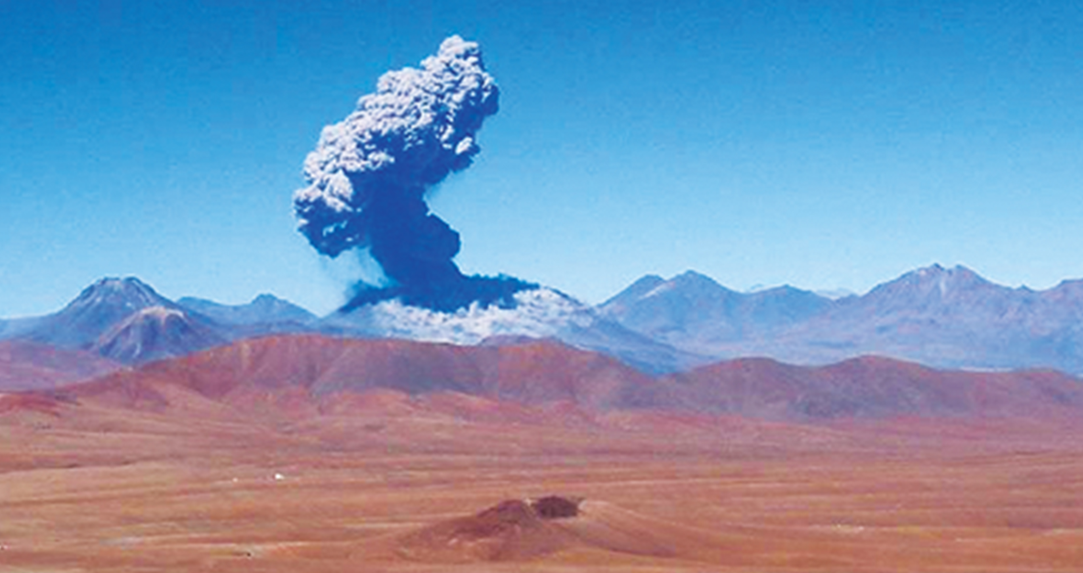
Volcanic Eruptions
Volcanic eruptions release gases and particles that can cool the climate.
Third natural driver of climate change
Can cause short-term climate changes due to solids and gases released at eruption
Can include carbon dioxide, water vapor, sulfur dioxide, hydrogen sulfide, hydrogen, and carbon monoxide
Haze-effect cooling: occurs when dust, ash, or other particles block out sunlight and trigger lower global temperatures
Usually extends for one or more years before dissipating
Produced lowest average winter temperatures on record in 1783 and 1784
44.5 Figure 5: Volcanic eruptions, such as this 2006 eruption of the Lascar volcano, can result in the release of greenhouse gases into the atmosphere.
Neil on Wikimedia Commons. "Volcanic eruption."

Slide 19
Greenhouse Gases
Greenhouse gases trap heat in the atmosphere, warming the Earth.
Probably the most significant driver of climate change
Include carbon dioxide, methane (CH₄), water vapor, nitrous oxide (NO), and ozone (O₃)
Reflect much of the thermal energy from radiation back to Earth's surface
The greenhouse effect is the warming of Earth due to carbon dioxide and other greenhouse gases in the atmosphere.
Result of greenhouse gases absorbing and emitting radiation

Slide 20
Atmospheric Concentrations of Carbon Dioxide
There is a relationship between atmospheric concentrations of carbon dioxide and temperature.
Atmospheric CO₂ levels have increased from 280 ppm in 1950 to 419 ppm in 2022.
Historical data shows CO₂ levels cycling between 180 and 300 ppm.
The rapid increase in CO₂ levels is unprecedented in Earth's history.
This increase correlates with industrial activities and fossil fuel combustion.

Slide 21
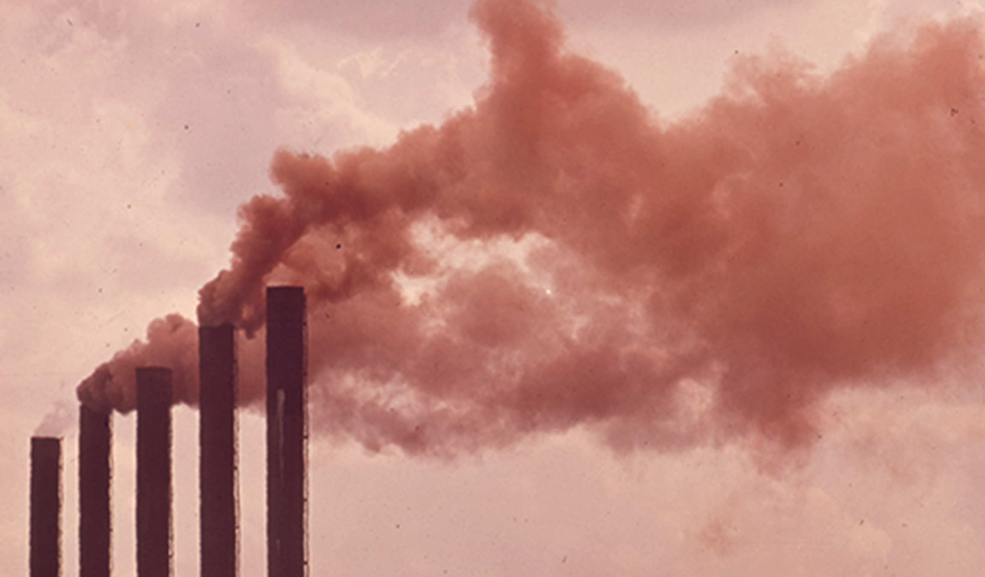
Human Activity and Greenhouse Gases
Burning fossil fuels is the primary source of human-induced CO₂ emissions.
Deforestation and land clearing also contribute to CO₂ emissions.
Methane is released from agriculture, landfills, and natural gas fields.
Produced when bacteria break down organic matter under anaerobic conditions
44.5 Figure 6: The burning of fossil fuels in industry and by vehicles releases carbon dioxide and other greenhouse gases into the atmosphere.
U.S. National Archives and Records Administration on Wikimedia Commons. "Burning fossil fuels."

Slide 22
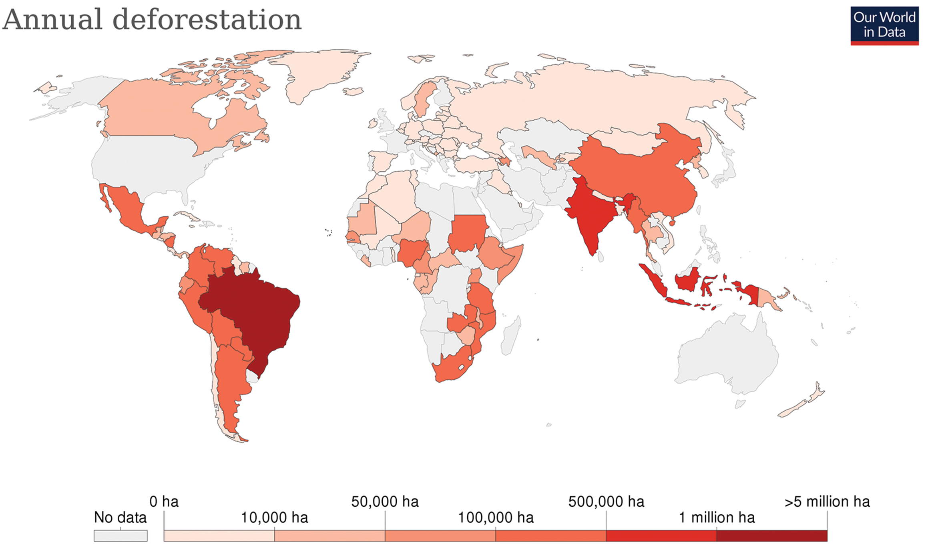
44.5 Figure 7
Hannah Ritchie and Max Roser on Wikimedia Commons. "Annual deforestation."
Notes:
Deforestation affects climate change significantly. Shown here is an estimate of global deforestation.

Slide 23
Clathrates
Clathrate melting is another source of methane.
Clathrates are frozen chunks of ice and methane found at the bottom of the ocean.
As ocean water's temperature increases, the rate at which clathrates melt also increases, which releases more methane.
Leads to increased levels of methane in the atmosphere
Example of the positive feedback loop leading to the increase in global temperatures

Slide 24
Documented Results of Climate Change: Past and Present
Geological evidence shows past climate change events.
Modern-day climate change is evidenced by retreating glaciers and rising sea levels.
Changes in climate can negatively impact organisms.

Slide 25
Geological Climate Change
The Permian extinction event (about 251 MYA) was associated with global warming.
One of three warmest periods in Earth's geologic history
Extinction of approximately 70% of terrestrial and 84% of marine species
Organisms adapted to specific climatic conditions struggled to survive the climate change.

Slide 26
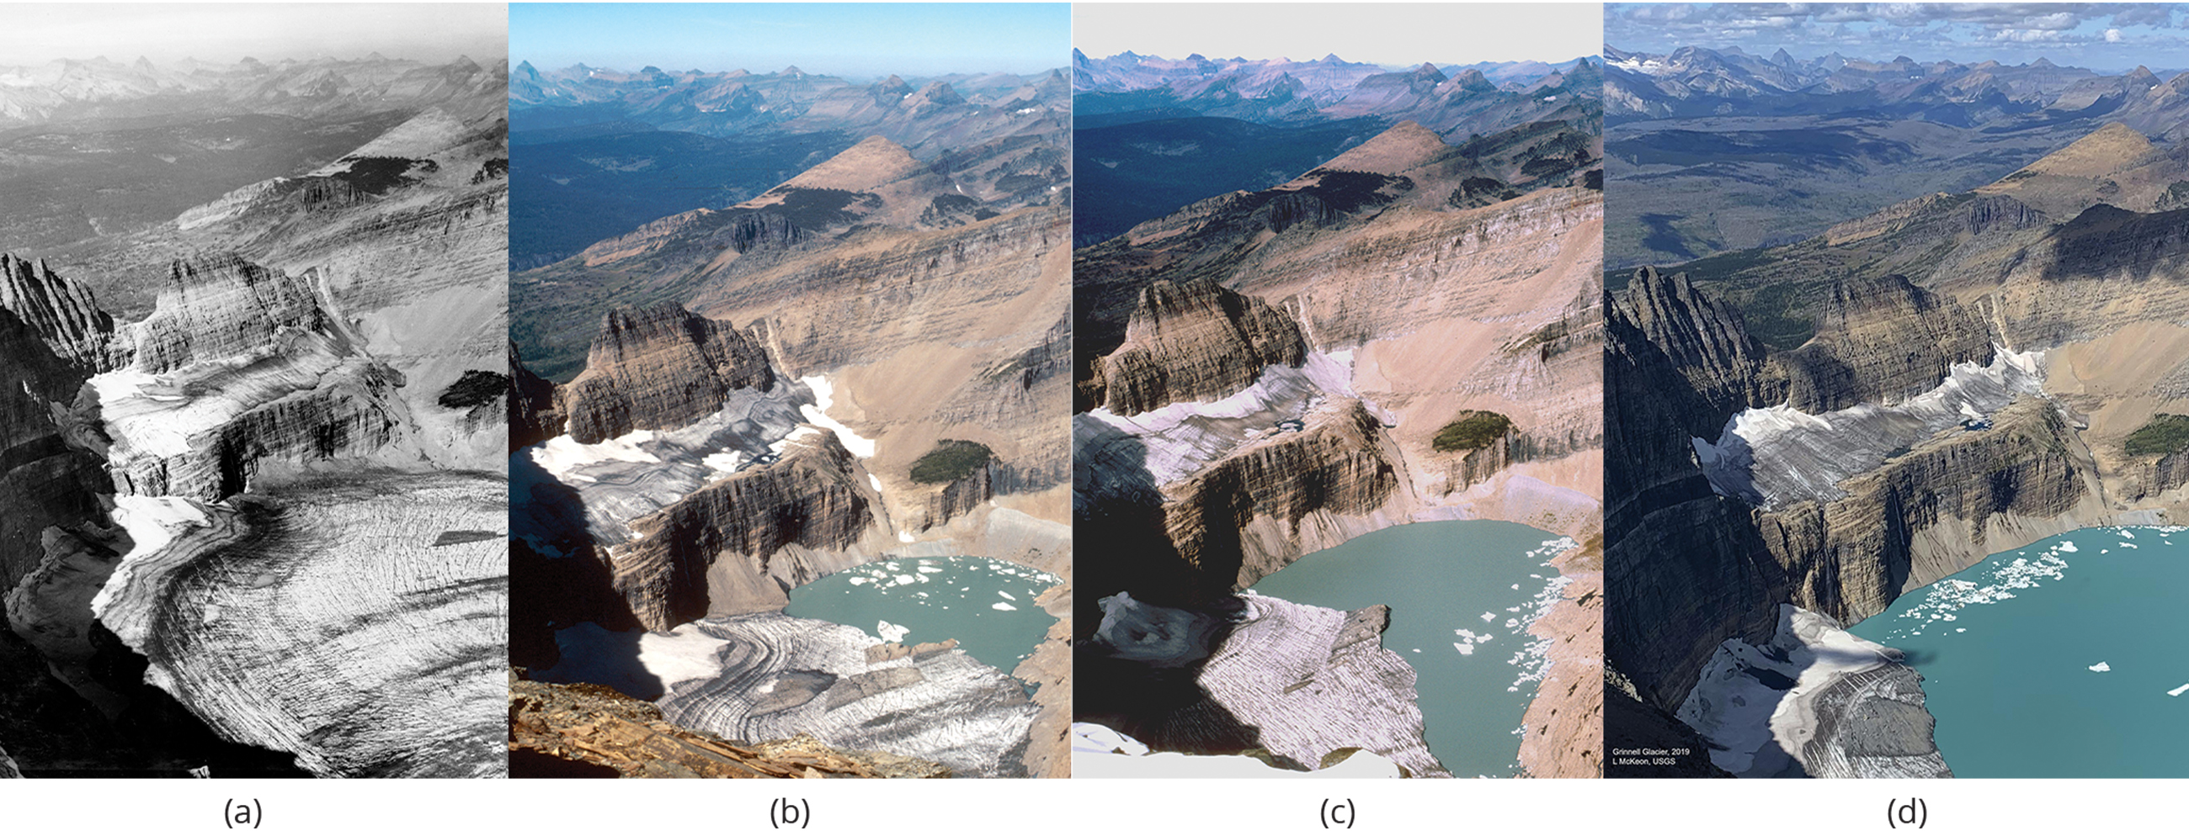
Present Climate Change
Glacier recession (retreat of glaciers) is observed in areas like Glacier National Park in Montana.
150 glaciers in 1850 down to 24 glaciers greater than 25 acres in size in 2010
Grinnell Glacier: shrank by 40% between 1966 and 2005
Ice sheets in Greenland and Antarctica are losing mass.
Greenland: 150–250 km³ of ice lost per year between 2002 and 2006
Arctic Sea: size and thickness of ice decreasing
44.5 Figure 8: The effect of global warming can be seen in the continuing retreat of Grinnell Glacier via images taken in (a) 1938, (b) 1981, (c) 1998, and (d) 2019.
T.J. Hileman (Glacier National Park Archives) on Wikimedia Commons. "Grinnell glacier in 1938."
Carl Key (USGS) on Wikimedia Commons. "Grinnell glacier in 1981."
Dan Fagre (USGS) on Wikimedia Commons. "Grinnell glacier in 1998."
Lisa McKeon, USGS Northern Rocky Mountain Science Center on Wikimedia Commons. "Grinnell glacier in 2019."

Slide 27
Global Sea Level
Sea levels are rising at an accelerated rate due to melting ice and thermal expansion.
The rate of sea level rise has increased from 1.8 mm/year to 2.9–3.4 mm/year from 1993 to 2010.
Temperature and amount of water in rivers, lakes, glaciers, polar ice caps, and sea ice affect the volume of water in the ocean.
As glaciers/ice caps melt, previously frozen water becomes liquid and contributes to the sea level.

Slide 28
Temperature Changes
Temperature and precipitation play roles in determining geographic distribution and phenology of plants and animals.
Phenology is the study of the effects of climatic conditions on the timing of period life cycle events.
In Great Britain, 385 plant species are flowering 4.5 days sooner than recorded in the last 40 years.
Could have impacts on pollination and pollinators

Slide 29
Reflection Question
Current models of climate change predict significant impacts on flora and fauna within our lifetime. What are some actionable changes that we should make at the (1) individual and (2) policy level to limit (or arrest) the damage being caused by climate change?
Notes:
The reflection question is included here to use as a talking point or for a think-pair-share activity.

Slide 30
Summary
Earth's climate has undergone periodic cycles of temperature changes.
The Medieval Climate Anomaly (warmer period) and Little Ice Age (colder period) were natural climate variations.
Natural drivers of climate change include Milankovitch cycles, changes in solar activity, and volcanic eruptions.
Greenhouse gases, especially CO₂, are major drivers of current climate change.
Modern-day climate change is associated with melting glaciers and polar ice sheets, resulting in an increase in the sea level.
Plants and animals are also affected when the timing of seasonal events (flowering, pollination) is affected by global warming.

Slide 31

End of Hawkes Learning PowerPoint

