Slide 1
Lesson 45.1
Population Demography

Slide 2
Objectives
Describe how ecologists measure population size and density.
Describe the three types of survivorship curves and relate them to specific populations.
Describe three different patterns of population distribution.
Calculate mortality rates.

Slide 3

Population and Community Ecology
Asian carp:
A group of species including silver, black, grass, and big head carp
Farmed and eaten in China for over 1,000 years
Invasive species to the United States
  Considered dangerous because it disrupts community structure and composition to the point of threatening native species
45.1 Figure 1: The photograph on the left shows Asian carp jumping out of the water in response to electrofishing. The Asian carp in the photograph on the right were harvested from the Little Calumet River in Illinois.
U.S. Army Corps of Engineers Nashville District on Wikimedia Commons. "Asian carp jumping."
U.S. Government Accountability Office on Wikimedia Commons. "Asian carp removed from river."

Slide 4
Population Demography
Population: all the individuals of a particular species that live in a specific area and have the potential to interact with each other
Fluctuate based on seasonal/yearly changes in the environment, natural disasters, and competition for resources between and within species
Demography: statistical study of population changes over time, including birth rates, death rates, and life expectancy
Uses mathematical tools to investigate how populations respond to changes in biotic (living) and abiotic (nonliving) factors
  Many originally developed to study human populations but applicable to all living populations
Life tables: detail the life expectancy of individuals within a population
  Initially developed by life insurance companies to set insurance rates

Slide 5
Population Size and Density
The study of any population begins by determining two main characteristics:
  Population size (N): total number of individuals in a population
  Population density: number of individuals per unit area or volume
Larger populations may be more genetically diverse and adaptable.
Lower density populations may face challenges in finding mates.
Smaller organisms tend to have higher population densities than larger ones.

Slide 6
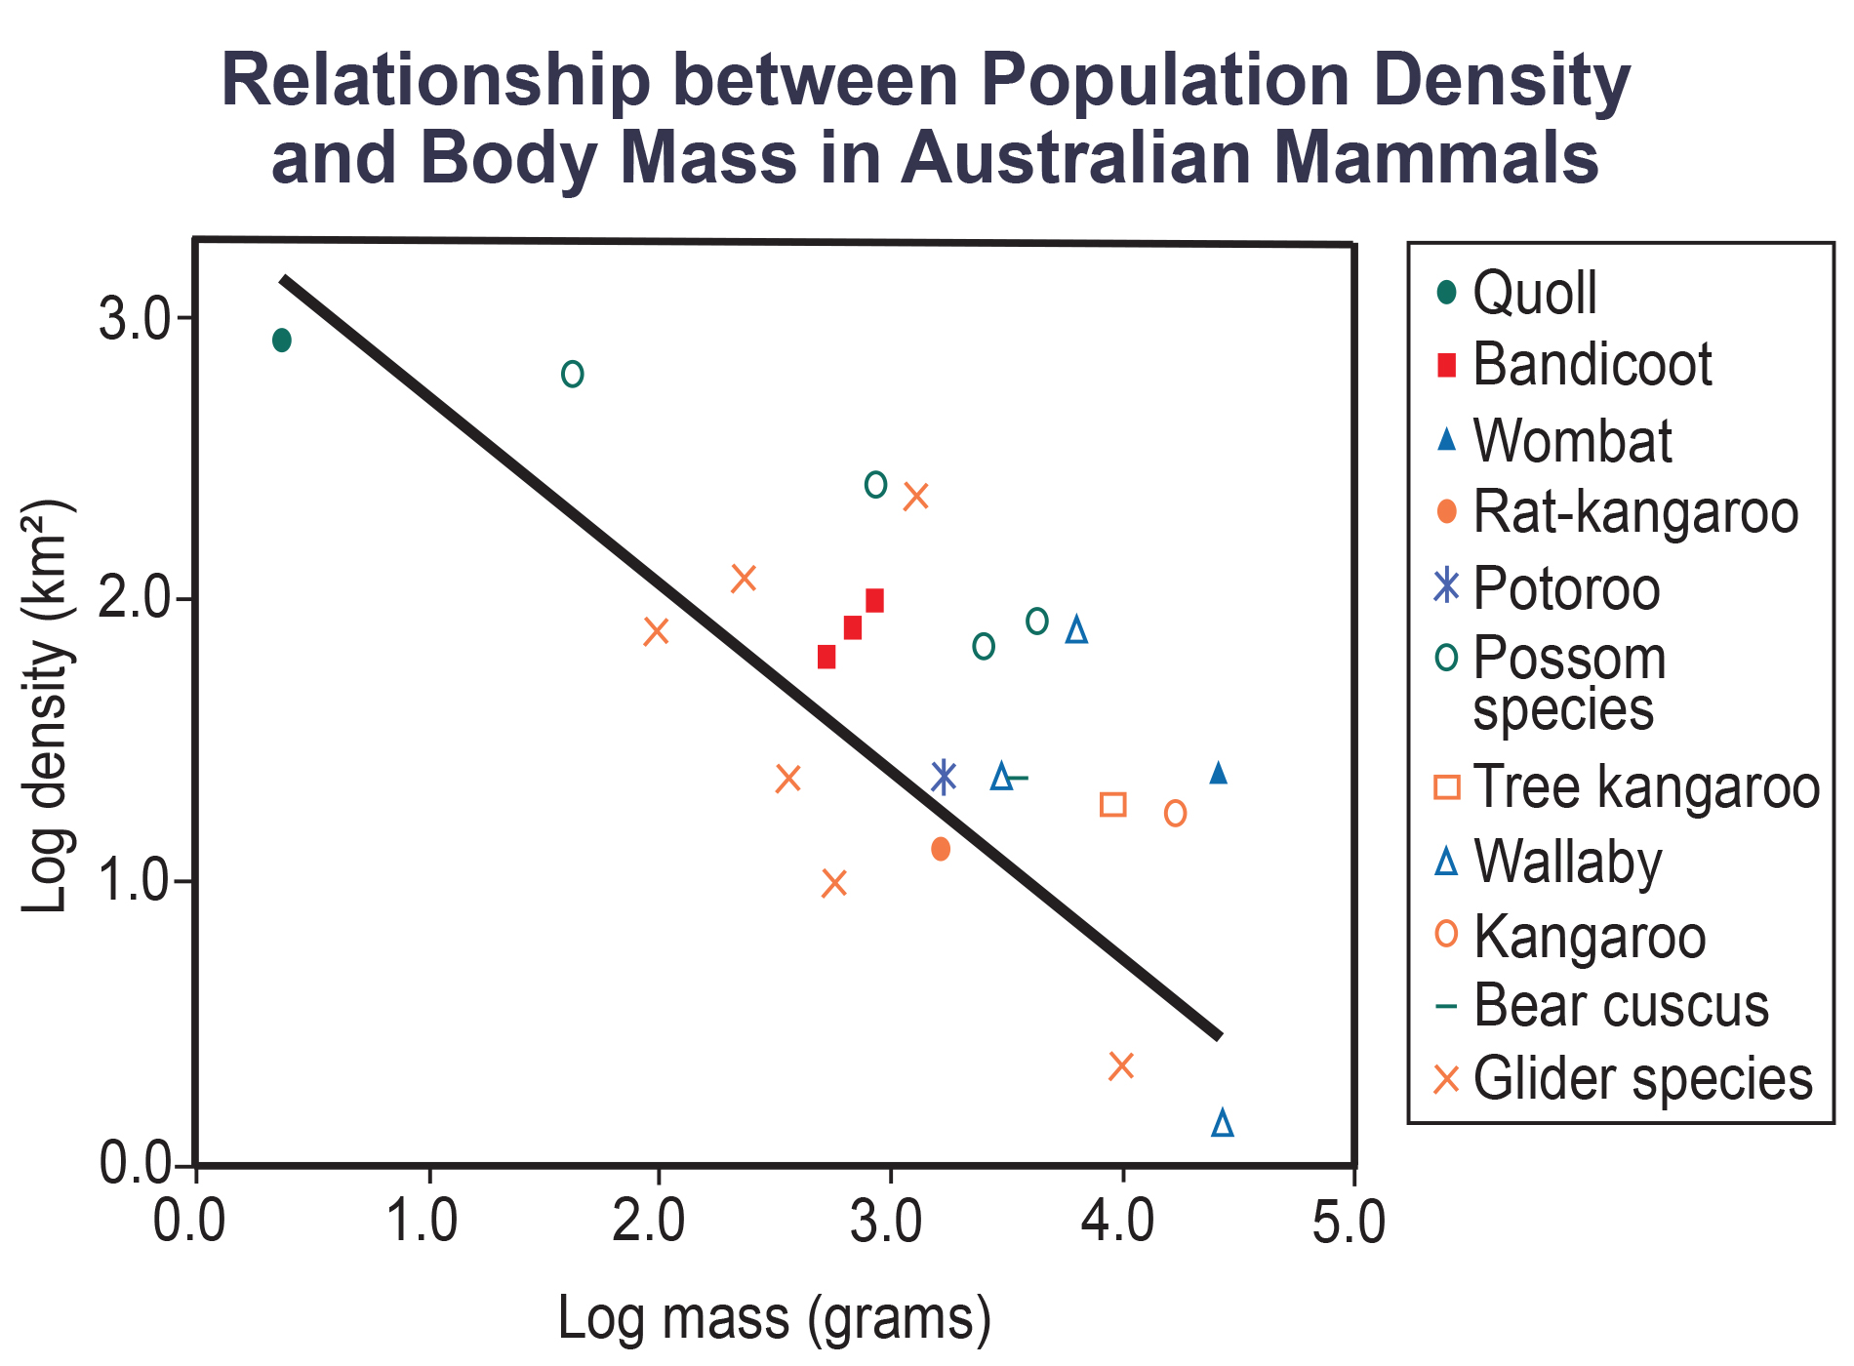
45.1 Figure 2
CNX OpenStax on Wikimedia Commons. "Relationship between population and body mass in Australian mammals."
Notes:
Australian mammals show a typical inverse relationship between population density and body size.

Slide 7
Think It Through₁
As Figure 2 shows, population density typically decreases with increasing body size. Why do you think this is the case?
Notes:
Originally an On Your Own. This is included here to use as a talking point or for a think-pair-share activity.

Slide 8
Population Research Methods
Counting individuals is the most accurate method but often impractical for large habitats.
Scientists sample representative portions of habitats to infer population sizes and densities.
Some examples include:
  Quadrats
  Mark and recapture

Slide 9
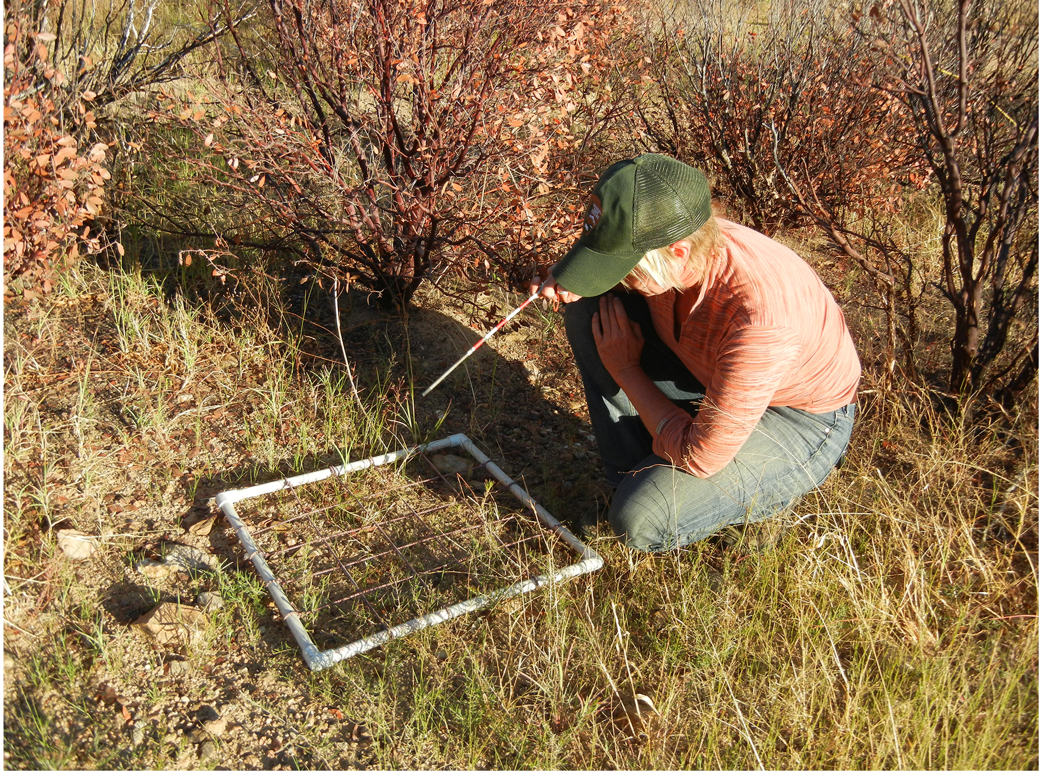
Quadrats
Quadrat: way of marking off square areas within a habitat
Used for immobile or slow-moving organisms
Multiple samples taken at random locations
Relation of size and number to organism size and expected density
  Example: daffodils (smaller quadrat) vs. giant redwoods (larger quadrat)
Data used to estimate total population size and density
45.1 Figure 3: A scientist uses a quadrat to measure population size and density.
SonoranDesertNPS on Wikimedia Commons. "Quadrat."

Slide 10
Group Activity₁
As a group, use a 1 m² quadrat and count the number of individuals of your choice in a particular location. Quadrats can be constructed from items such as string, meter sticks, or PVC pipe. Repeat this process three times in different areas and calculate the average of the three quadrat counts. The average count represents the population density of individuals per 1 m². This can be completed inside using nonliving objects in place of organisms, or it can be completed outside using living organisms, such as flowers, ants, etc.

Slide 11
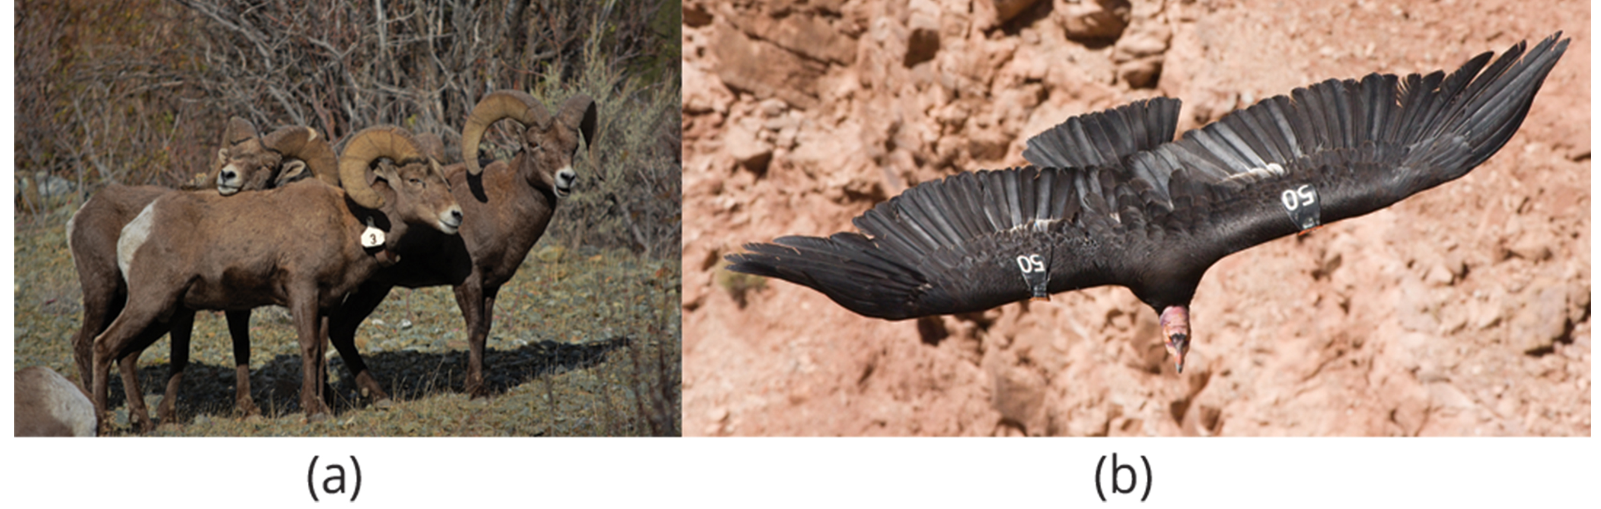
Mark and Recapture₁
Mark and recapture: marking a sample of captured animals and releasing them back into the environment
Used for mobile organisms (e.g., mammals, birds, fish)
Process:
  Capture and mark a sample of individuals
  Release marked individuals back into the population
  Allow time for mixing with unmarked individuals
  Capture a new sample, including both marked and unmarked individuals
45.1 Figure 4: Mark and recapture is used to measure the population size of mobile animals, such as (a) bighorn sheep and (b) the California condor.
Bureau of Land Management Oregon and Washington on Wikimedia Commons. "Bighorn sheep."
Christian Mehlführer on Wikimedia Commons. "Californian condor."

Slide 12
Mark and Recapture₂
In the second catch, the sample size is the sum of the number of marked and unmarked individuals.
  Multiply sample size by ratio of number of individuals marked in the first catch to the number of marked individuals in the second catch to estimate total size.
This method assumes the larger the population, the lower the percentage of tagged organisms recaptured.
This is the equation for estimating population size

Slide 13
Limitations to Mark and Recapture
Some animals may learn to avoid recapture, inflating population estimates.
Some animals may prefer to be recaptured, underestimating population size.
Marking techniques may harm some species, reducing survival rates.

Slide 14
Think It Through₂
Sixty goats are captured, tagged, and released back into their environment. One year later, 120 are captured, and 30 are already marked. Given this data, estimate the population size for these goats.
Notes:
Originally an On Your Own. This is included here to use as a talking point or for a think-pair-share activity.

Slide 15
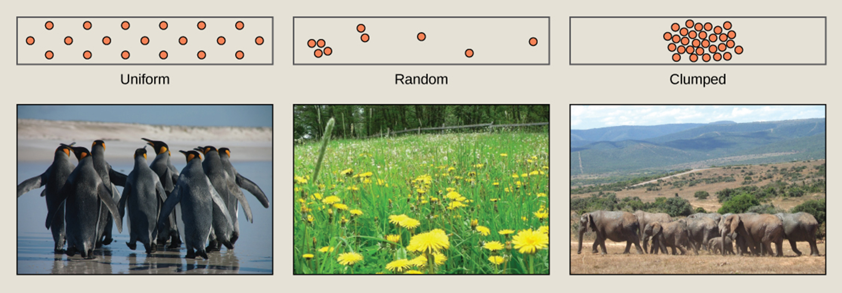
Species Distribution
Information about a population can be gathered by looking at the distribution of individuals.
Species dispersion patterns: the spatial relationship of individuals within a population
  Show whether members of a species live close or far apart
  Three types: uniform, random, and clumped
45.1 Figure 5: Species may have uniform, random, or clumped distribution.
Ben Tubby on Wikimedia Commons. "Penguins." Modified.
Rosendahl on Wikimedia Commons. "Dandelion field." Modified.
Rebecca Wood on Flickr. "Elephants."

Slide 16
Examples of Dispersion Patterns
Uniform dispersion: seen in plants that secrete substances that inhibit the growth of nearby individuals (Salvia leucophylla)
  Also seen in animals that maintain a defined territory (penguins)
Random dispersion: occurs in plants that have wind-dispersed seeds that germinate where they fall (dandelions)
Clumped dispersion: seen in plants that drop their seeds to the ground (oak trees)
  Also seen in animals that live in groups (elephants)
  May be a function of habitat heterogeneity (habitat broken into patches suitable for a specific population and those that are not)

Slide 17
Demography
Scientists must use demography to study dynamics of a population.
Statistical study of population changes over time
Analyzes factors such as birth rates, death rates, and life expectancies
Influenced by population characteristics like size, density, and distribution
  Large population size: higher birth rate, higher death rate
  High population density: more potential reproductive encounters, increased birth rate
  Female-based sex ratio: increase birth rates
  Age structure: proportion of population members at specific age ranges; can also increase birth rates

Slide 18
Reflection Question
The birth rate in the United States has been declining for over a decade, but life expectancy has continuously increased. How do you think this will affect the population?
Notes:
The reflection question is included here to use as a talking point or for a think-pair-share activity.

Slide 19
Group Activity₂
Form a group of three or four. Choose a species you would like to study as a group. Research the population changes of this species over the last 50 years. What factors do you think have affected the population?

Slide 20
Demographic Characteristics of a Population
Can influence how the population grows or declines over time
  Increase in population if birth rates exceed death rates
  Decrease in population if death rates exceed birth rates
  Local resources, reproduction, and overall health impacted by length of time individuals remain in a population

Slide 21
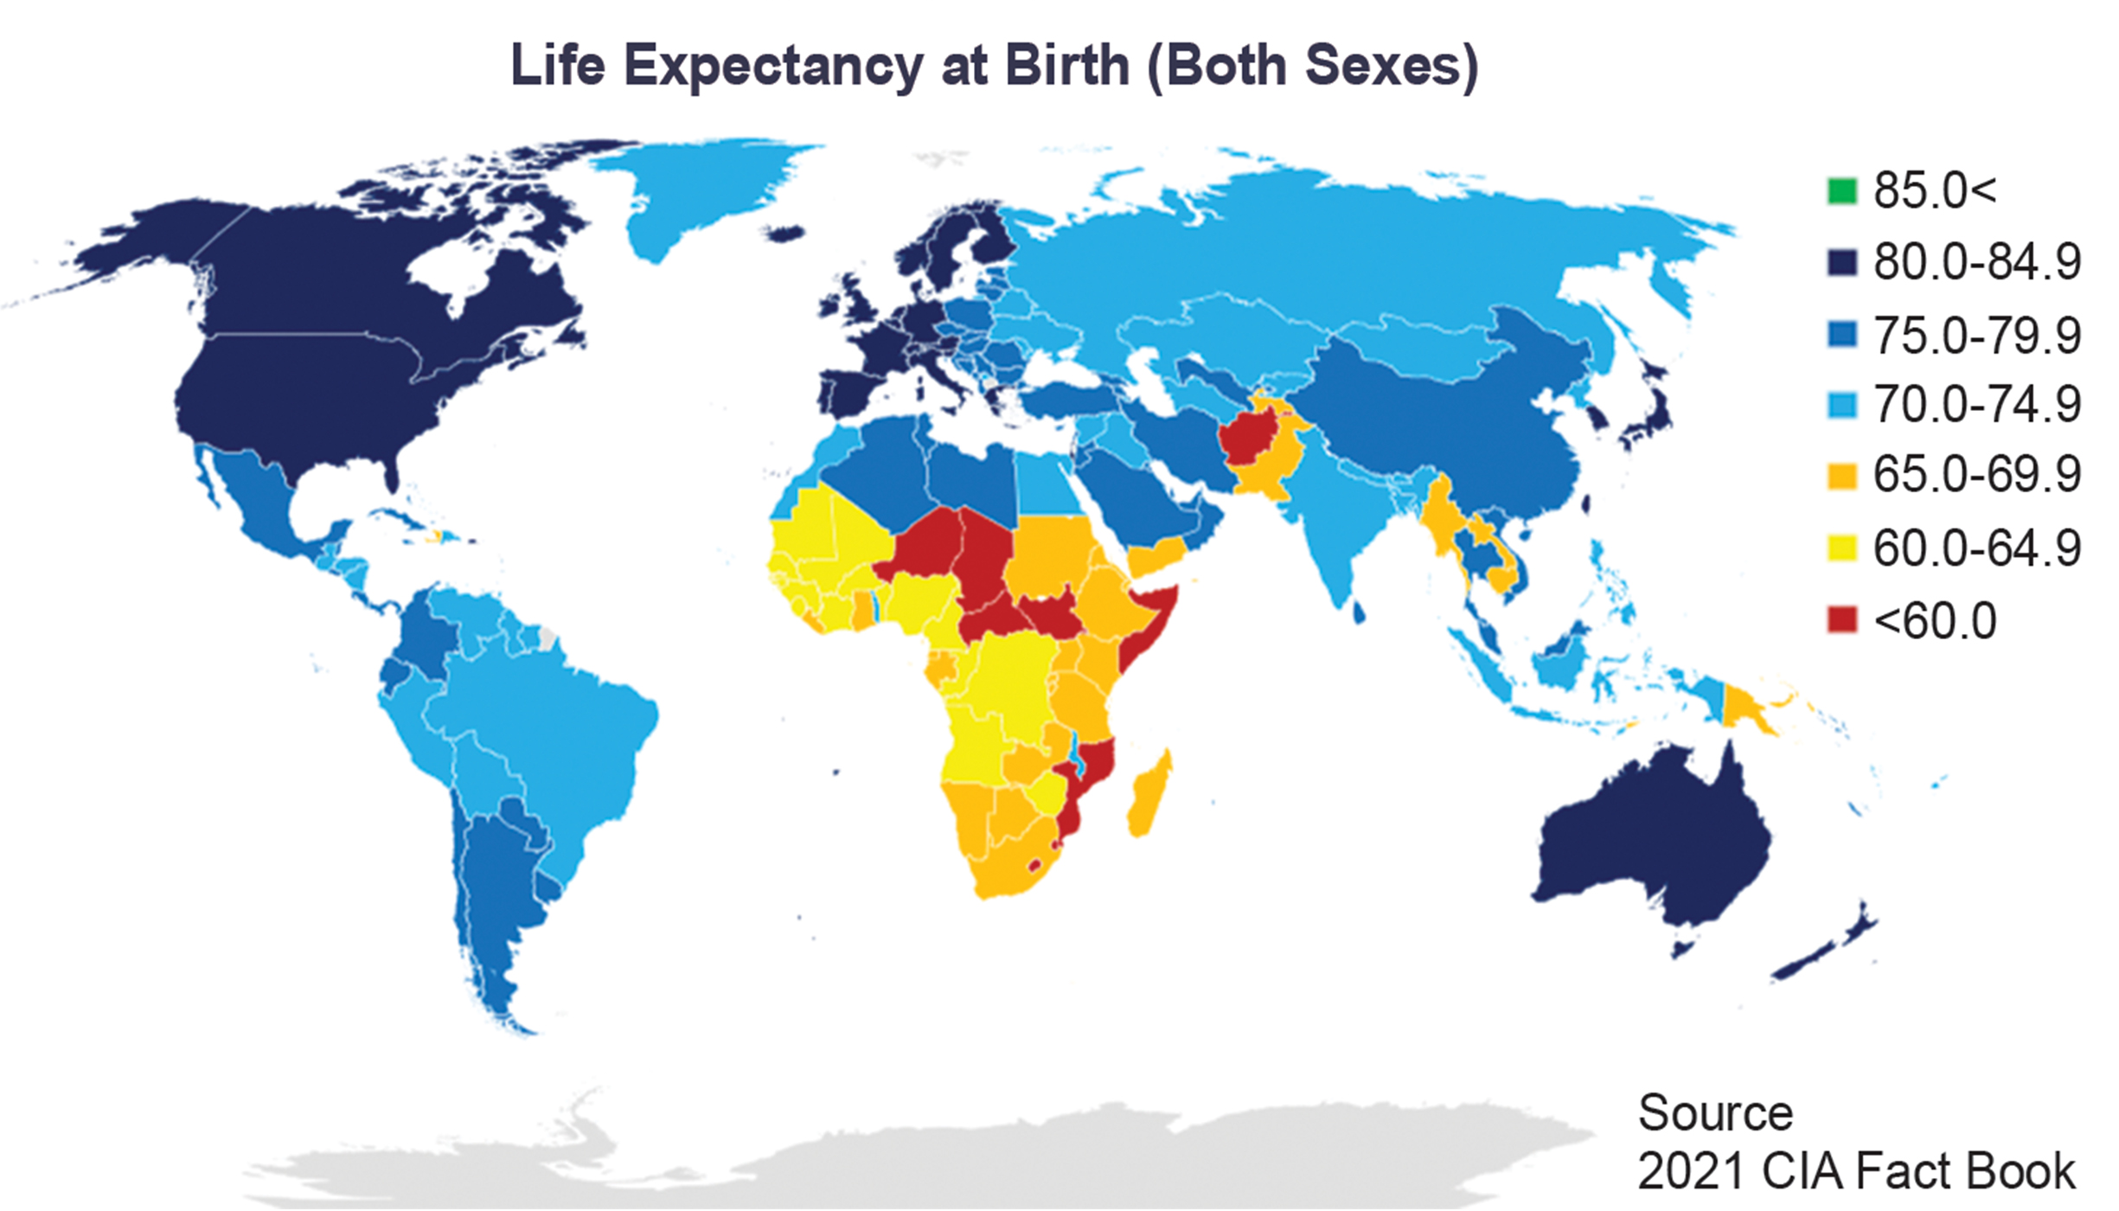
45.1 Figure 6
CIA Factbook on Wikimedia Commons. "Life expectancy at birth."
Notes:
This map depicts worldwide human life expectancy at birth. Life expectancy is not equal throughout populations in the world due, in part, to differences in local resources and health care.

Slide 22
Life Tables₁
Provide detailed information about an organism's life history
Divide population into age groups and sexes
Modeled after actuarial tables used in insurance
May include mortality rate: probability of individuals dying before their next birthday
  Also, percentage of surviving individuals dying at an age interval and life expectancy at each interval
The equation for mortality rate:

Slide 23
Life Tables₂
Table 1 is from a study of Dall sheep, divided into age intervals (Column A).
Mortality rate (Column D) is based on the number in Column B divided by Column C, multiplied by 1,000.
According to Column D, a high death rate occurred when sheep were between 6 and 12 months old and increased between 8 to 12 years old.
  Indicates that sheep in this population could be expected to live another 7.7 years if they make it to age 1 (Column E)

Slide 24
Table 1: Life Table of Dall Sheep (Deevey, 1947)₁
Column A: Age Interval (Years) | Column B: Number Dying in Age Interval Out of 1,000 Born | Column C: Number Surviving at Beginning of Age Interval Out of 1,000 Born | Column D: Mortality Rate per 1,000 Alive at Beginning of Age Interval | Column E: Life Expectancy or Mean Lifetime Remaining to Those Attaining Age Interval
0–0.5 | 54 | 1,000 | 54.0 | 7.06
0.5–1 | 145 | 946 | 153.3 | ―
1–2 | 12 | 801 | 15.0 | 7.7
2–3 | 13 | 789 | 16.5 | 6.8
3–4 | 12 | 776 | 15.5 | 5.9
4–5 | 30 | 764 | 39.3 | 5.0
5–6 | 46 | 734 | 62.7 | 4.2
6–7 | 48 | 688 | 69.8 | 3.4
7–8 | 69 | 640 | 107.8 | 2.6
8–9 | 132 | 571 | 231.2 | 1.9
9–10 | 187 | 439 | 426.0 | 1.3
10–11 | 156 | 252 | 619.0 | 0.9
11–12 | 90 | 96 | 937.5 | 0.6
12–13 | 3 | 6 | 500.0 | 1.2
13–14 | 3 | 3 | 1,000.0 | 0.7

Slide 25
Survivorship Curves
Survivorship curve: a graph of the number of individuals surviving at each age interval plotted versus age
Three main types of survivorship curves:
  Type I: high early survival, death mainly in older individuals, small numbers of offspring at a time, high amount of parental care (e.g., humans)
  Type II: constant mortality rate across all age groups, relatively few offspring, significant parental care (e.g., birds)
  Type III: high early mortality, lower mortality in survivors, large number of offspring, little parental care, vulnerable to predation, strength in numbers (e.g., trees, marine invertebrates)

Slide 26
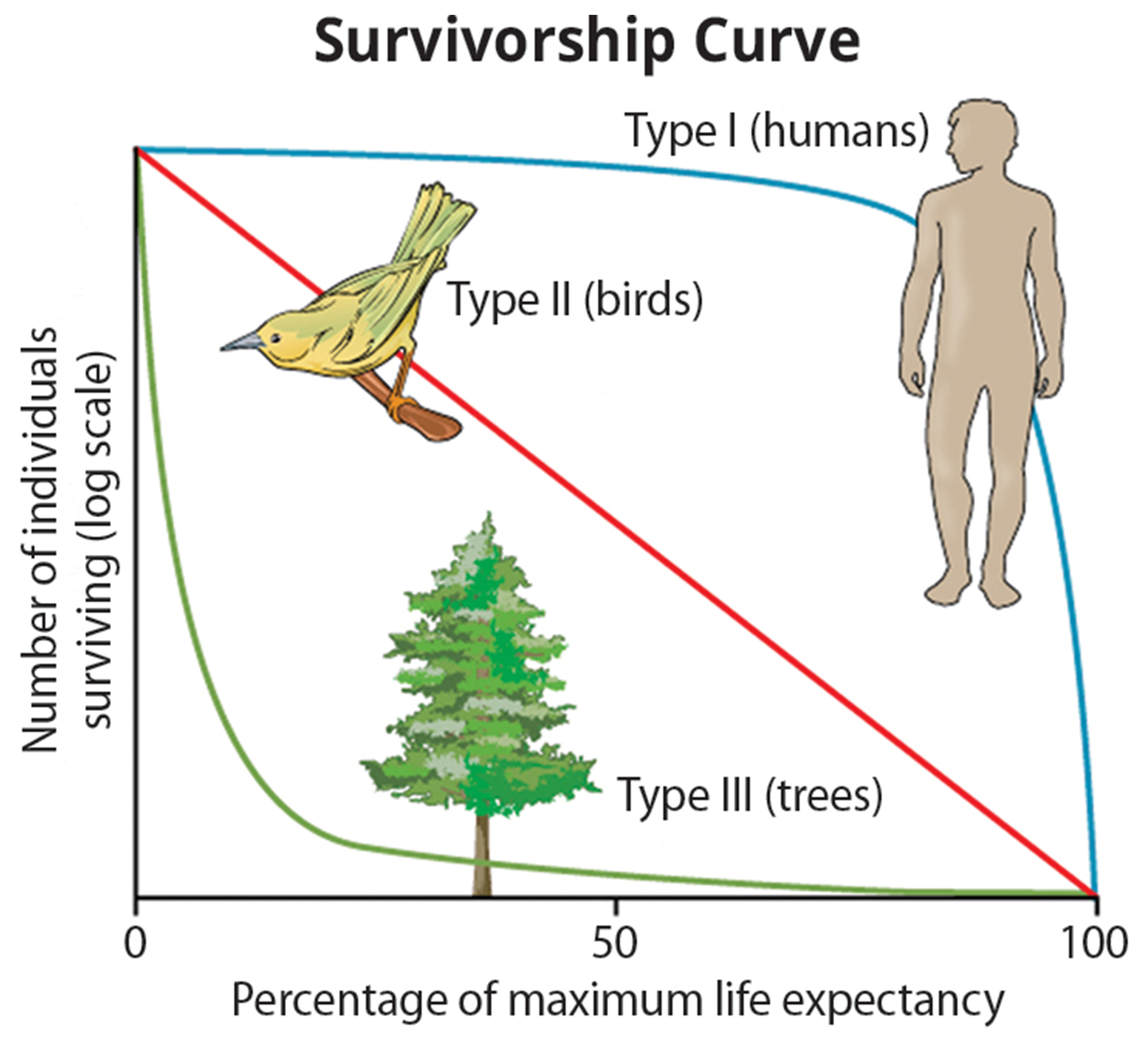
45.1 Figure 7
CNX OpenStax on Wikimedia Commons. "Survivorship curves." Modified.
Notes:
Survivorship curves show the distribution of individuals in a population according to age. Humans and most mammals have a Type I survivorship curve because death primarily occurs in the older years. Birds have a Type II survivorship curve, as death at any age is equally probable. Trees have a Type III survivorship curve because very few survive the younger years, but after a certain age, individuals are much more likely to survive.

Slide 27
Think It Through₃
Provide the correct term for each definition.
Spatial relationship between members of a population within a habitat at a particular point in time
Marked off square area within a habitat
Details the life expectancy of individuals within a population
Number of individuals within a specific area or volume
Statistical study of population dynamics
Notes:
Originally an On Your Own. This is included here to use as a talking point or for a think-pair-share activity.

Slide 28
Summary
Populations are individuals of a species that live in a particular habitat and potentially interact.
Ecologists measure characteristics of populations:
  Population size
  Density
  Dispersion pattern
  Age structure
  Sex ratio
Life tables help calculate life expectancies of population members.
Survivorship curves show the number of surviving individuals at each age interval versus time.

Slide 29

End of Hawkes Learning PowerPoint

