Slide 1
Lesson 45.2
Life Histories and Natural Selection

Slide 2
Objectives
Describe how life history patterns are influenced by natural selection.
Describe how natural selection and environmental adaptation leads to the evolution of particular life-history patterns.
Explain different life history patterns and how different reproductive strategies affect species' survival.

Slide 3
Life Histories and Natural Selection
Life history describes a species' series of events over its lifetime.
Includes allocation of resources for growth, maintenance, and reproduction
Affects mortality rates and survivorship curves
Genetically determined and shaped by environment and natural selection

Slide 4
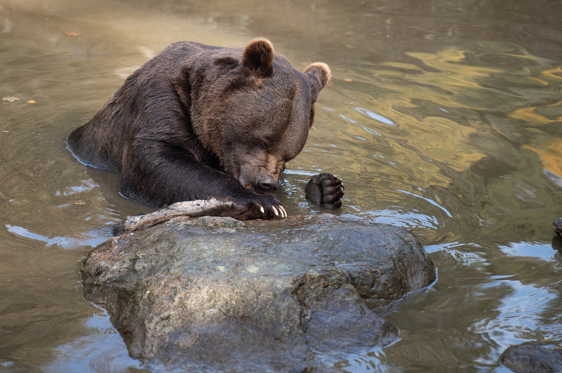
Life History Patterns and Energy Budgets
All organisms require energy for growth, maintenance, and reproduction, but energy is often a limiting factor for survival.
Example: Plants use photosynthesis for energy but must allocate it for growth, health, and reproduction.
An energy budget is a species' balance of their energy intake with their usage (metabolism, reproduction, parental care, and energy storage).
45.2 Figure 1: To balance their energy intake with energy use in hibernation, bears prepare for winter by storing up large amounts of energy reserves in the form of body fat.
Miller_Eszter on Pixabay. "Bear."

Slide 5
Parental Care and Fecundity
Fecundity: potential reproductive capacity of an individual within a population
Describes how many offspring could be produced if an individual has as many offspring as possible
In animals, inversely related to amount of parental care given

Slide 6
High vs. Low Fecundity
High fecundity species (e.g., marine invertebrates):
Produce many offspring
Provide little parental care
Self-sufficient offspring early on
Maximize evolutionary fitness (capacity of a species to survive and reproduce)
Low fecundity species (e.g., mammals):
Produce few offspring
Provide extensive parental care
Helpless offspring at birth

Slide 7

Plants with Low Fecundity
Produce few energy-rich seeds (e.g., coconuts, chestnuts)
Have a good chance of germination
Contrasts with high fecundity plants (e.g., orchids) that produce many small, energy-poor seeds
45.2 Figure 2: This wild orchid produces millions of seeds. The energy tradeoff for such high seed production is that the orchid makes some of the smallest and most energy-poor seeds of any plant.
Michelle_Maria on Pixabay. "Orchid."

Slide 8
Early versus Late Reproduction
The timing of reproduction in a life history affects species survival.
Early reproduction:
Greater chance of producing offspring
May compromise growth and health
Late reproduction:
Higher fecundity or better parental care
Risk of not surviving to reproductive age
Examples: guppies (early) vs. bluegill or shark (late)
Key to understanding evolution of a species
Variations in energy budgeting across species

Slide 9
Think It Through₁
What are the advantages and disadvantages of early reproduction?
Notes:
Originally an On Your Own. This is included here to use as a talking point or for a think-pair-share activity.

Slide 10
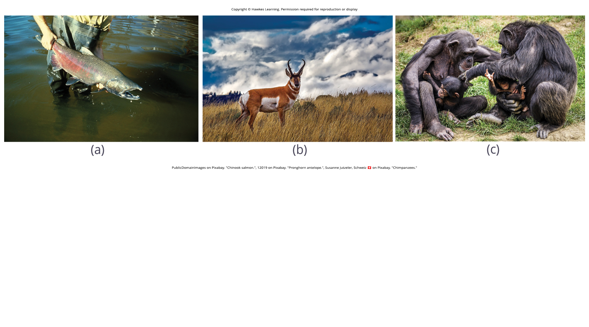
Semelparity
Semelparity: when a species reproduces once in a lifetime and then dies
Uses most of the species' resources for a single reproductive event, sacrificing their health
Examples: bamboo, Chinook salmon
45.2 Figure 3: (a) The Chinook salmon mates once and dies.
PublicDomainImages on Pixabay. "Chinook salmon."

Slide 11
Iteroparity
Iteroparity: when a species reproduces repeatedly during their lives
Occurs once per year or continuously, depending on the species
Must balance energy between reproduction and survival across multiple seasons
Examples: pronghorn antelope, primates
45.2 Figure 3: (b) The pronghorn antelope mates during specific times of the year during its reproductive life. Primates, such as humans and (c) chimpanzees, may mate on any day, independent of ovulation.
12019 on Pixabay. "Pronghorn antelope."
Susanne Jutzeler, Schweiz 🇨🇭 on Pixabay. "Chimpanzees."

Slide 12
Group Activity₁
In groups of three or four, investigate another species besides the ones mentioned that exhibits semelparity and another that exhibits iteroparity. Compare and contrast these species. What are some reasons why semelparity may be advantageous to one species while iteroparity is advantageous to the other?

Slide 13
Energy Budgets, Reproductive Costs, and Sexual Selection in Drosophila₁
Studies on fruit flies show reproduction reduces male life span and sperm production.
Males maximize reproductive chances by selecting optimal mates.
1981 study: Males with virgin females had shorter life spans than those with inseminated females.
2006 study: Males select larger, more fecund females, especially when sperm supplies are low.

Slide 14
Energy Budgets, Reproductive Costs, and Sexual Selection in Drosophila₂
Resource-depleted males prioritize mating with larger females to maximize offspring.
Mate selection changes based on physiological state and resource availability.
Behavioral biology studies the effects of energy budgets on reproductive strategies.
Energy tradeoffs influence mating behavior and evolutionary fitness.

Slide 15
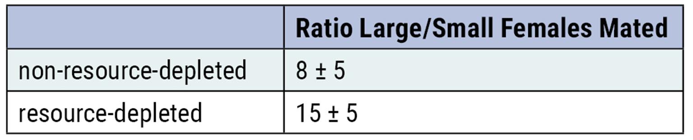
45.2 Figure 4
Notes:
Male fruit flies that had previously mated (resource-depleted) picked larger, more fecund females more often than those that had not mated (non-resource-depleted). This change in behavior causes an increase in the efficiency of a limited reproductive resource: sperm.

Slide 16
Life Histories of K-Selected and r-Selected Species
K-selected and r-selected species represent two ends of a continuum.
Concept based on reproductive strategies, habitat, and behavior
Considers resource limitations and competition
Plays a key role in life histories

Slide 17
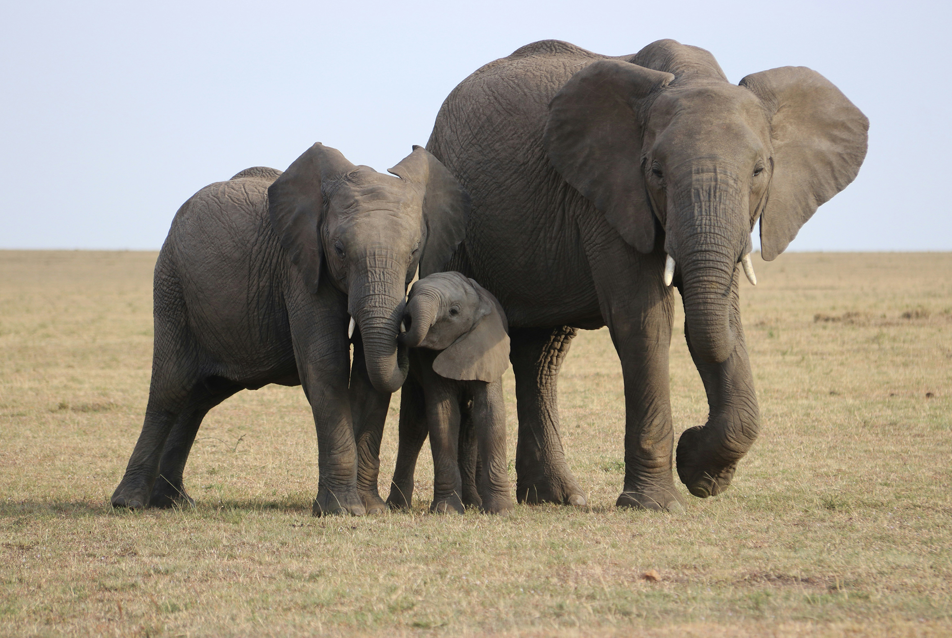
K-Selected Species
K-selected species: selected by stable, predictable environments
Few, large offspring that are relatively helpless at birth
High level of parental care
Long gestation period
Population size close to carrying capacity
High intraspecific competition
Examples: primates, elephants, wolves, oak trees
45.2 Figure 5: Elephants are considered K-selected species as they live long, mature late, and provide long-term parental care to a few offspring.
David Heiling on Unsplash. "Elephants."

Slide 18
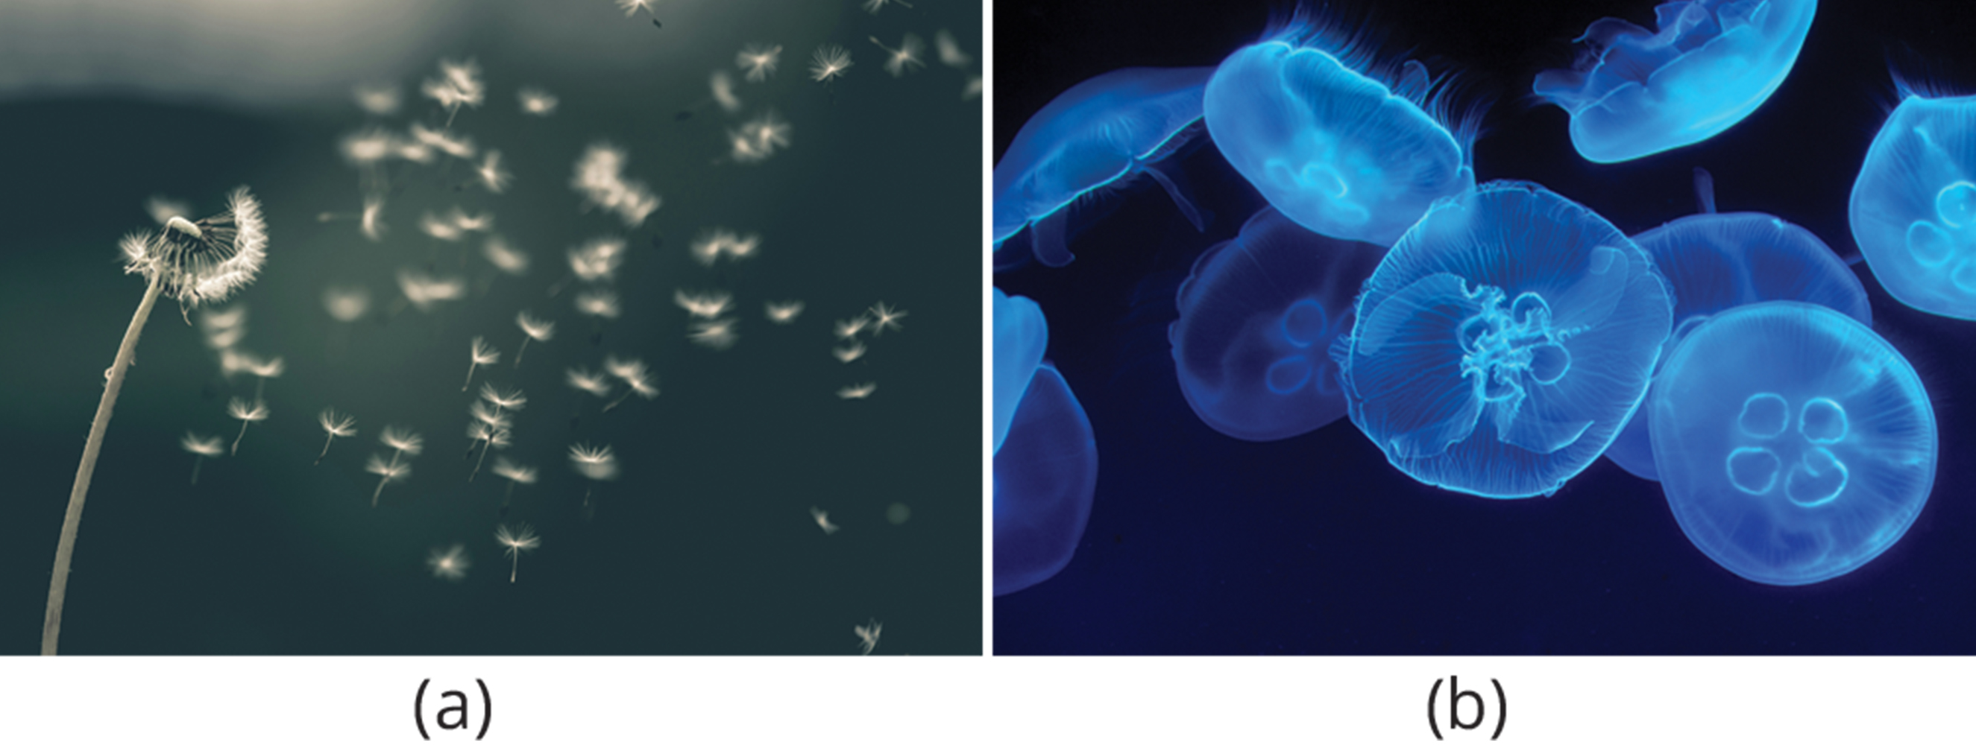
r-Selected Species
r-selected species: employed in unpredictable or changing environments
Large number of small offspring
Little to no parental care
Offspring relatively mature and self-sufficient at birth
Examples: jellyfish, dandelions
45.2 Figure 6: (a) Dandelions and (b) jellyfish are both considered r-selected species as they mature early, have short lifespans, and produce many offspring that receive no parental care.
Saad Chaudhry on Unsplash. "Dandelion."
Marat Gilyadzinov on Unsplash. "Jellyfish."

Slide 19
Table 1: Characteristics of K-Selected and r-Selected Species
Characteristics of K-Selected Species | Characteristics of r-Selected Species
mature late | mature early
greater longevity | lower longevity
increased parental care | decreased parental care
increased competition | decreased competition
fewer offspring | more offspring
larger offspring | smaller offspring

Slide 20
Think It Through₂
For each description, identify each species' reproductive strategy as either "K-selected" or "r-selected."
Mother orcas (Orcinus orca) give birth to one offspring every three to ten years. They nurse each baby for up to two years.
Coconut palms (Cocos nucifera) produce large fruits with very high energy contents.
Barnacles are hermaphroditic and reproduce with neighboring barnacles to produce up to 500 million zygotes each year. They provide no parental care for their offspring.
E. coli are bacteria and can carry out binary fission every 20 minutes under ideal conditions.
Notes:
Originally an On Your Own. This is included here to use as a talking point or for a think-pair-share activity.

Slide 21
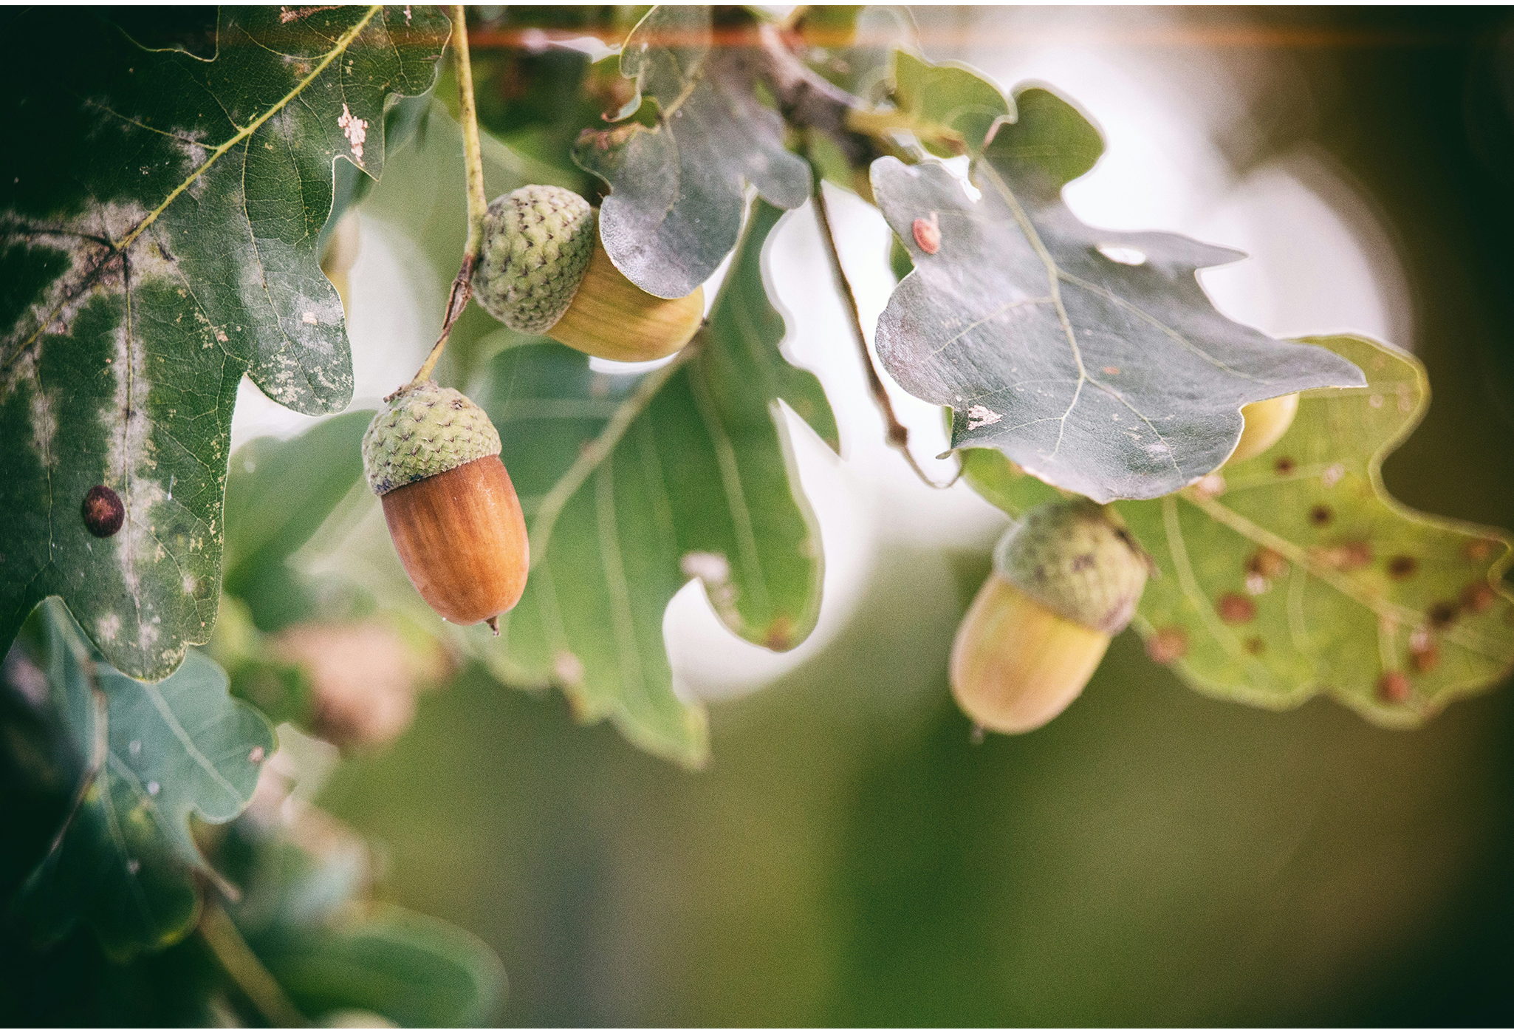
Categorization of K-Selected vs. r-Selected Species
Categorization is not a strict classification but a continuum.
Some species show characteristics of both.
Example: Oak trees grow slowly and take 20 years to produce seeds, meaning they devote much energy to growth (K-selected) and produce many energy-rich seeds (r-selected).
This framework is useful for initial analyses of species' life histories.
45.2 Figure 7: Oak trees have characteristics of both K-selected and r-selected species. They have a long lifespan and take a long time to mature (K-selection) but produce many offspring, the majority of which will not survive (r-selection).
Denny Müller on Unsplash. "Oak tree."

Slide 22
Group Activity₂
Rather than thinking of K-selected and r-selected as distinct categories, the terms describe two ends of a spectrum ranging from most K-selected to most r-selected. As a group, draw a scale from 1–10. Assign K-selected at one extreme (#1), and assign r-selected at the other extreme (#10). Then, work together to come up with four example species to illustrate your continuum. Include an example species at both extreme ends of the continuum (1 and 10). Then, provide example species that lie along the middle.

Slide 23
Modern Theories of Life History
r- and K-selection theory has been reconsidered after being accepted for decades.
Limitations of the theory:
Failed to confirm predictions for many species
Ignored age-specific mortality
New demographic-based models:
Incorporate ecological concepts from r- and K-selection theory
Population age structure
Mortality factors

Slide 24
Summary
Life history strategies involve energy allocation for growth, maintenance, and reproduction.
Strategies evolve through natural selection for environmental adaptation.
There is an inverse relationship between fecundity and parental care.
Reproductive timing affects survival and fitness.
r- and K-selection theory provides a framework for understanding life history patterns.
Modern models incorporate more complex demographic factors.

Slide 25

End of Hawkes Learning PowerPoint

