Slide 1
Lesson 45.3
Population Growth and Regulation

Slide 2
Objectives
Explain the characteristics of and differences between exponential and logistic growth patterns.
Give examples of exponential and logistic growth in natural populations.
Give examples of how the carrying capacity of a habitat may change.
Compare and contrast density-dependent growth regulation and density-independent growth regulation, giving examples.
Explain how humans have expanded the carrying capacity of their habitat.

Slide 3
Population Growth and Regulation
Population ecologists use mathematical models to describe and predict population dynamics.
These models are continuously refined to improve their predictive ability.
Long-accepted models may be modified or abandoned if they lack accuracy.

Slide 4
Exponential Growth
Exponential growth: accelerating pattern of increasing population size
Concept introduced by Thomas Malthus in 1798
Occurs when resources are abundant
  If depleted, growth slows (logistic growth) or crashes (Malthusian catastrophe)

Slide 5
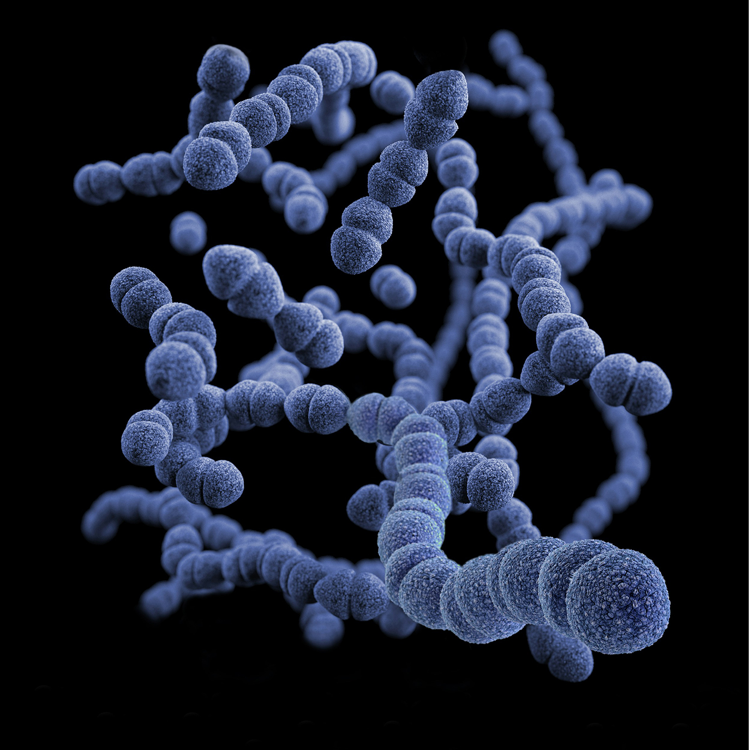
Bacteria and Exponential Growth₁
Bacteria demonstrate exponential growth under ideal conditions.
Example: 1,000 bacteria doubling every hour can reach 16 billion in 24 hours.
  Demonstrates population growth rate: when the number of organisms added in each reproductive generation increases at a greater and greater rate
When population size (N) is plotted over time, it produces a J-shaped growth curve.
45.3 Figure 1: This image shows a computer-generated depiction of Streptococcus pneumoniae bacteria that was created based on scanning electron microscopic (SEM) imagery. Some cells in this image are depicted halfway through the binary fission process.
CDC on Unsplash. "Strep bacteria."

Slide 6
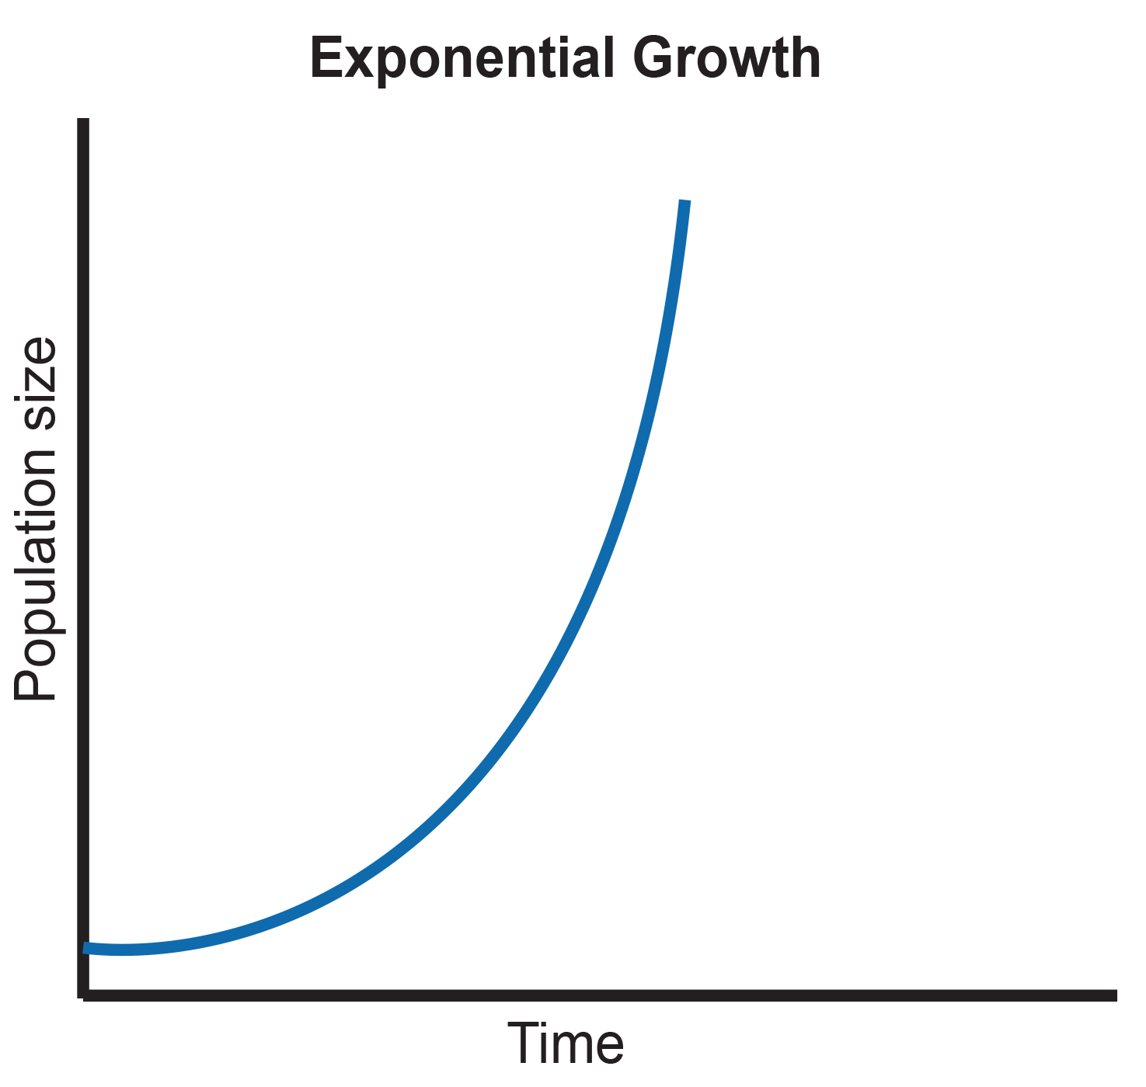
45.3 Figure 2
CNX OpenStax on Wikimedia Commons. "Exponential growth." Modified.
Notes:
When resources are unlimited, populations exhibit exponential growth, resulting in a J-shaped curve.

Slide 7
Bacteria and Exponential Growth₂
Resources are limited in the real world, so bacteria aren't always reproducing.
Some will die and not reproduce, which lowers the growth rate.
To calculate the growth rate of a population, the death rate (D) (number that die during a time interval) is subtracted from the birth rate (B) (number that are born during a time interval).
This is the formula:

Slide 8
Birth Rate and Death Rate
Birth rate is usually expressed per capita (b).
  Equal to total number of births in a population (B) divided by total number of individuals (N) in the population
  B (birth rate) = bN
The per capita death rate is calculated similarly.
  Equal to total number of deaths in a population (D) divided by N
  D (death rate) = dN
Instantaneous growth rate (population at a particular point in time) is calculated by:
dN/dT is change in number of individuals relative to change in time.

Slide 9
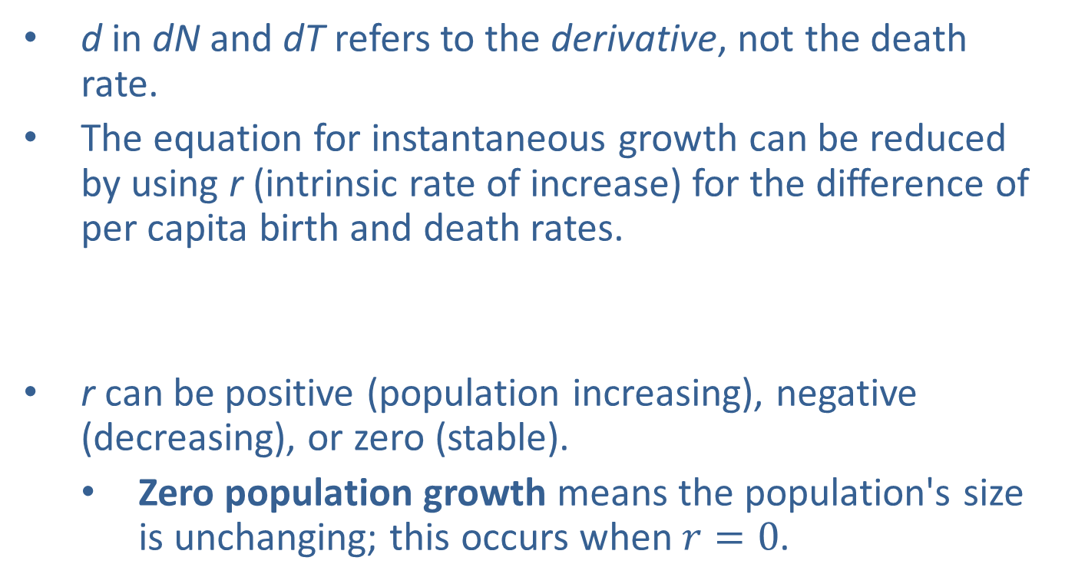
Intrinsic Rate of Increase
d in dN and dT refers to the derivative, not the death rate.
The equation for instantaneous growth can be reduced by using r (intrinsic rate of increase) for the difference of per capita birth and death rates.
r can be positive (population increasing), negative (decreasing), or zero (stable).
  Zero population growth means the population's size is unchanging; this occurs when $r=0$.

Slide 10
Biotic Potential
Another form of the formula represents different species' inherent differences in their intrinsic rate of increase, even under ideal conditions.
  Example: Bacteria can reproduce more rapidly and have a higher r than humans.
Biotic potential (r_{max}) is the maximal growth rate for a species.
This changes the equation to:

Slide 11
Logistic Growth
Exponential growth is only possible when unlimited resources exist; this is not the case in the real world.
Darwin's "struggle for existence": individuals will compete (with members of their own or other species) for limited resources
  If successful, pass on their traits (natural selection)
Logistic growth model: developed by population ecologists to model the reality of limited resources

Slide 12
Carrying Capacity and the Logistic Model
Growth rate slows as population size approaches carrying capacity.
Carrying capacity (K) is the maximum population size an environment can support.
This is the equation to calculate logistic growth:

Slide 13
Think It Through₁
Use the term carrying capacity to explain why exponential growth cannot continue indefinitely.
Notes:
Originally an On Your Own. This is included here to use as a talking point or for a think-pair-share activity.

Slide 14
Relation of N to K
When N is small, the population is growing exponentially and is not influenced by carrying capacity.
When N is large, population growth will be slowed greatly or stopped.
If N exceeds K, population may decline until it stabilizes around K.

Slide 15
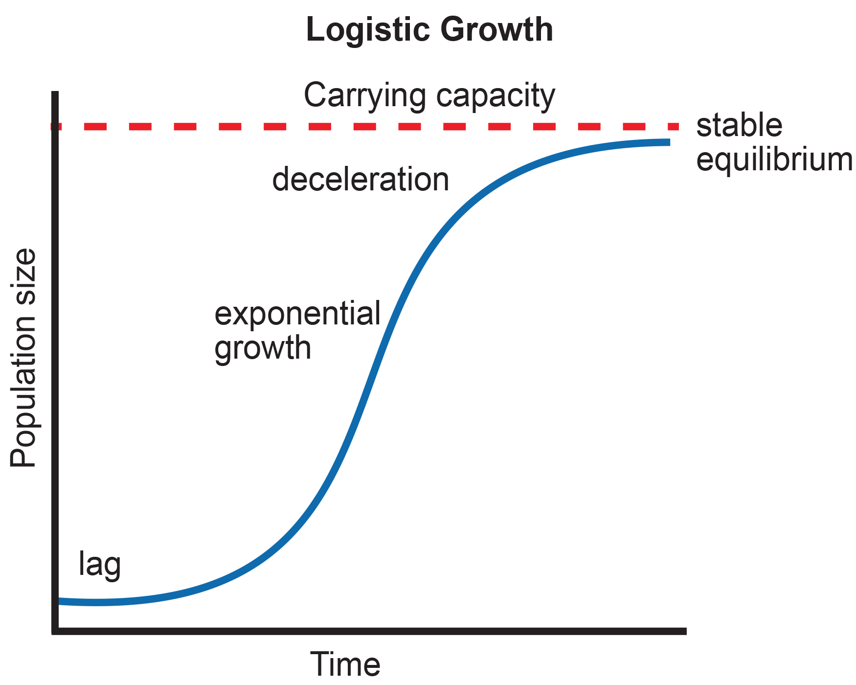
S-Shaped Growth Curve
S-shaped curve (logistic growth) reflects real-world population dynamics.
Lag phase: slow growth, which occurs as populations settle into their environments
Exponential growth: rapid growth due to more resources
Deceleration: decreasing growth due to limited resources
Stable equilibrium: growth levels off at the carrying capacity with little change in population size
45.3 Figure 3: When resources are limited, populations exhibit logistic growth. In logistic growth, population expansion decreases as resources become scarce, and it levels off when the carrying capacity of the environment is reached, resulting in an S-shaped curve.
CNX OpenStax on Wikimedia Commons. "Logisitic growth." Modified.

Slide 16
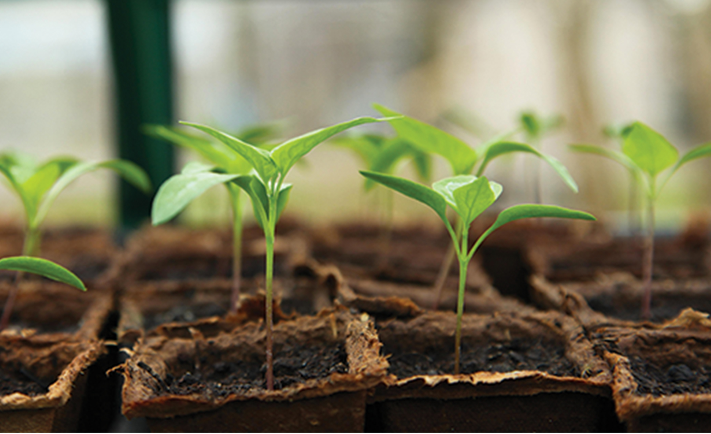
Role of Intraspecific Competition
The logistic model assumes individuals will have equal access to resources and equal chance of survival.
Plants: water, sunlight, nutrients, space to grow
Animals: food, water, shelter, nesting space, mates
Phenotypic (expressed traits) variation within a population means that some will be better adapted than others.
Intraspecific competition: competition among members of the same species for resources
  Affects populations near carrying capacity more than those well below it
  Intensifies as population size increases
45.3 Figure 4: The availability of vital resources determines the growth for each of these seedlings. Those resources are water, sunlight, nutrients, and space to grow.
J Garget on Pixabay. "Seedlings."

Slide 17
Examples of Logistic Growth
Yeast in a test tube, sheep, and harbor seals show logistic growth patterns.
Population size oscillates around carrying capacity due to environmental factors.
  A logistic model best fits real-world data despite fluctuations.

Slide 18
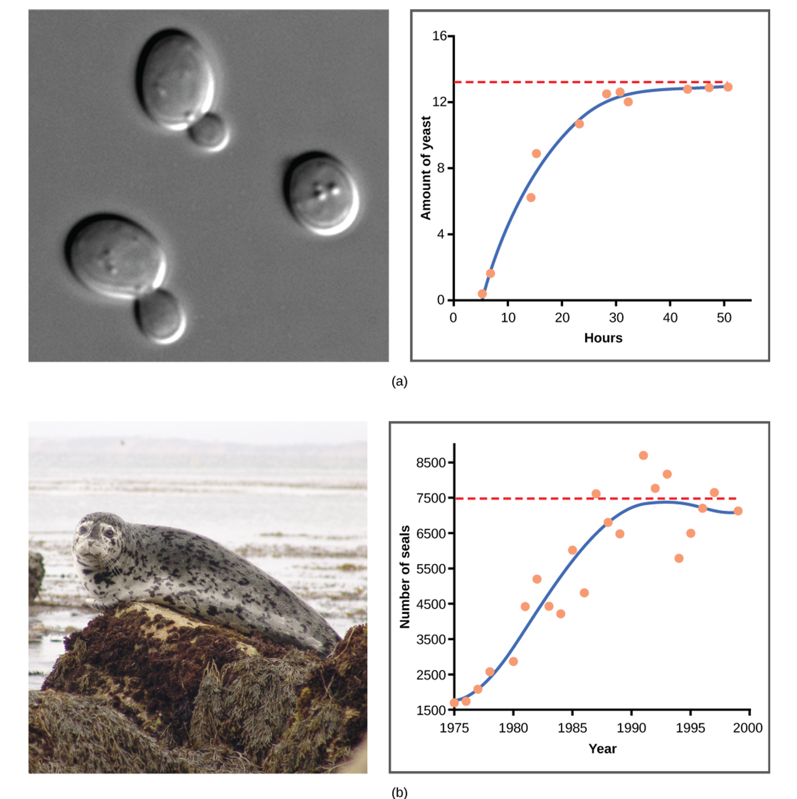
45.3 Figure 5
CNX OpenStax on Wikimedia Commons. "Population growths."
Notes:
(a) Yeast grown in ideal conditions in a test tube closely conform to a logistic growth model. Note the data points representing the actual population size of the yeast at different time points lie very close to the logistic curve. While (b) the size of a natural population of seals shows real-world fluctuation above and below the seals' carrying capacity, population size over time is best modeled by a logistic growth curve.

Slide 19
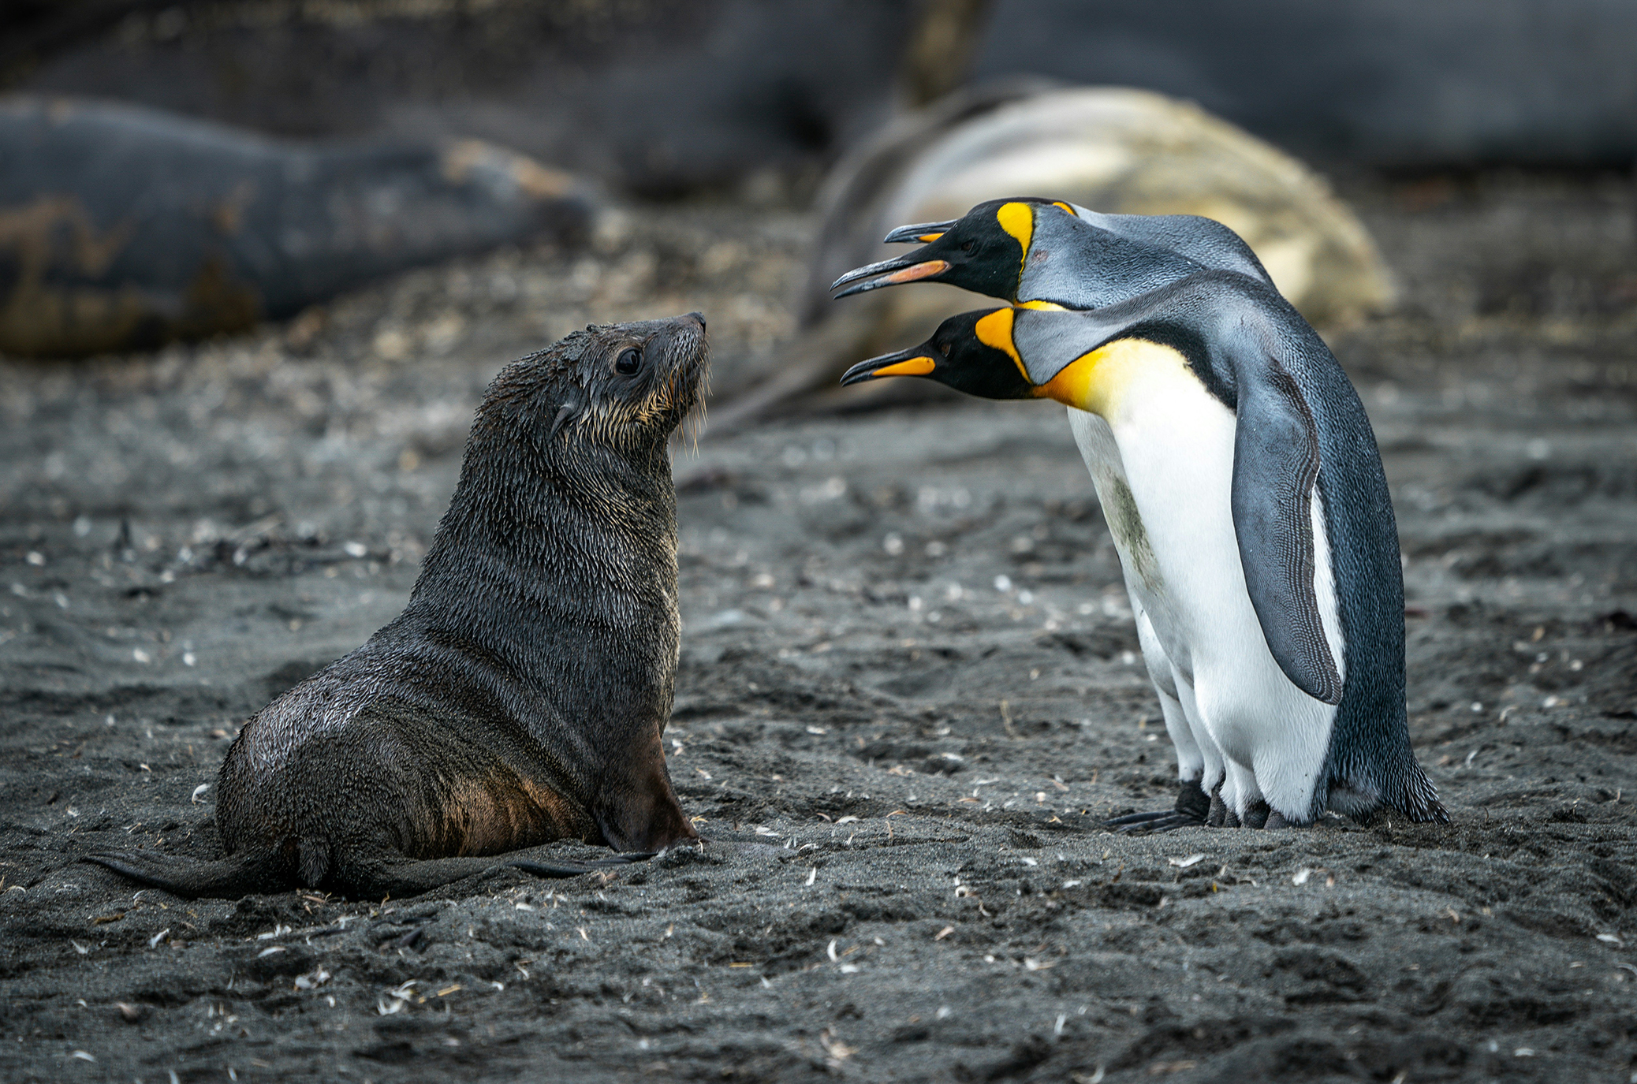
Population Dynamics
Though useful, the logistic model is a simplification of real-world population dynamics.
The carrying capacity can vary annually due to temperature changes and natural events.
Interspecific competition (competition between species that share an environment and compete for the same resources) also affects population growth.
45.3 Figure 6: Emperor penguins and seals often share an environment. As a result, these species sometimes compete for the same resources.
Rod Long on Unsplash. "Seal and penguin."

Slide 20
Regulating Population Growth
Nature regulates population growth in many ways:
Density-dependent regulation factors: density of the population at a given time affects growth rate and mortality
Density-independent regulation factors: influence mortality in a population regardless of population density

Slide 21
Density-Dependent Regulation
Most are biotic and include predation, interspecific and intraspecific competition, waste accumulation, and diseases.
The denser a population is, the lower its birth rate and greater its mortality rate.
Higher population density of predators increases competition and mortality rate, lowering the rate of growth.
Decreased growth rate from competition helps return the population size to one that's sustainable with the resources available.

Slide 22
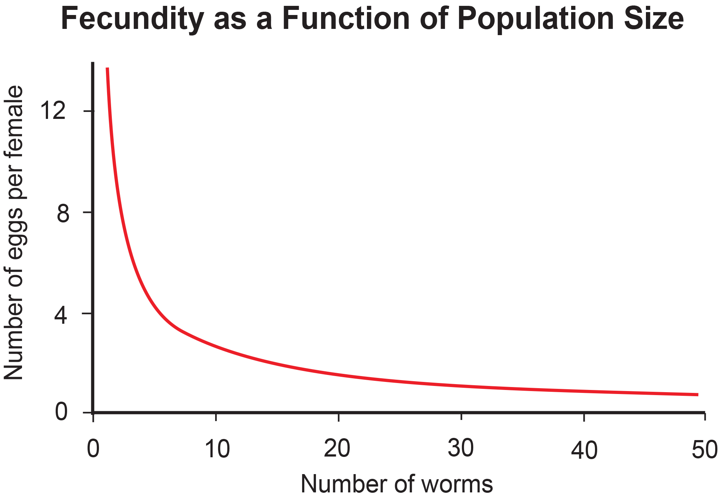
Example of Density-Dependent Regulation
Giant intestinal roundworms (Ascaris lumbricoides) produce fewer eggs at higher densities (Croll et al., 1982).
Roundworm fecundity decreases with population density.
One explanation is that females would be smaller in dense populations and those smaller females would produce fewer eggs.
  Tested and disproved (Walker et al., 2009)
  Actual cause still unclear
45.3 Figure 7: In this population of roundworms, fecundity (number of eggs) decreases with population density (Croll et al., 1982).
CNX OpenStax on Wikimedia Commons. "Fecundity."

Slide 23
Reflection Question
What do you think are the most significant factors regulating the growth of animal and/or plant populations in your local ecosystem today?
Notes:
The reflection question is included here to use as a talking point or for a think-pair-share activity.

Slide 24
Density-Independent Regulation and Interaction with Density-Dependent Factors
Abiotic factors affect mortality regardless of density.
  Include weather, natural disasters, and pollution
Interaction between density-dependent and independent factors complicates population regulation.
Dense populations recover differently from environmental impacts than sparse ones.

Slide 25
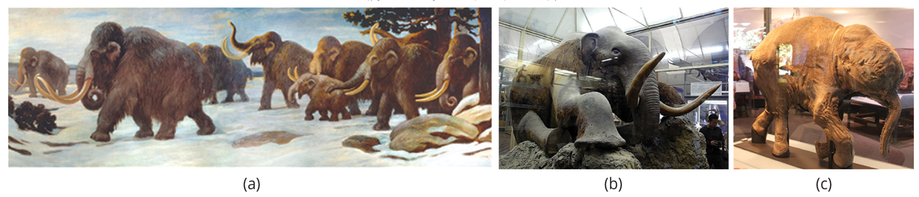
Why Did the Woolly Mammoth Go Extinct?₁
Mammoths began to go extinct when they shared the Earth with humans.
Survived in island populations as recently as 1700 BCE
Found frozen in Siberian ice and other regions of the north
98–99% identical to modern elephants
45.3 Figure 8: (a) The full-scale model of a mammoth is located at the Royal BC Museum, Victoria, British Columbia. (b) Pictured here is a fossilized skeleton of a mammoth. (c) This is a one-month-old baby mammoth, named Lyuba, that was discovered in Siberia in 2007.
Charles R. Knight on Wikimedia Commons. "Mammoths." Modified.
Tanapon on Flickr. "Mammoth." Modified.
Matt Howry on Wikimedia Commons. "Mammoths." Modified.

Slide 26
Why Did the Woolly Mammoth Go Extinct?₂
Commonly thought that climate change and human hunting contributed to extinction.
2008 study: Range reduction and human migration affected mammoth populations (Nogués-Bravo et al., 2008).
2012 study: No single factor was exclusively responsible (MacDonald et al., 2012).
The migration of humans across the Bering Strait 20,00 years ago was another important factor.

Slide 27
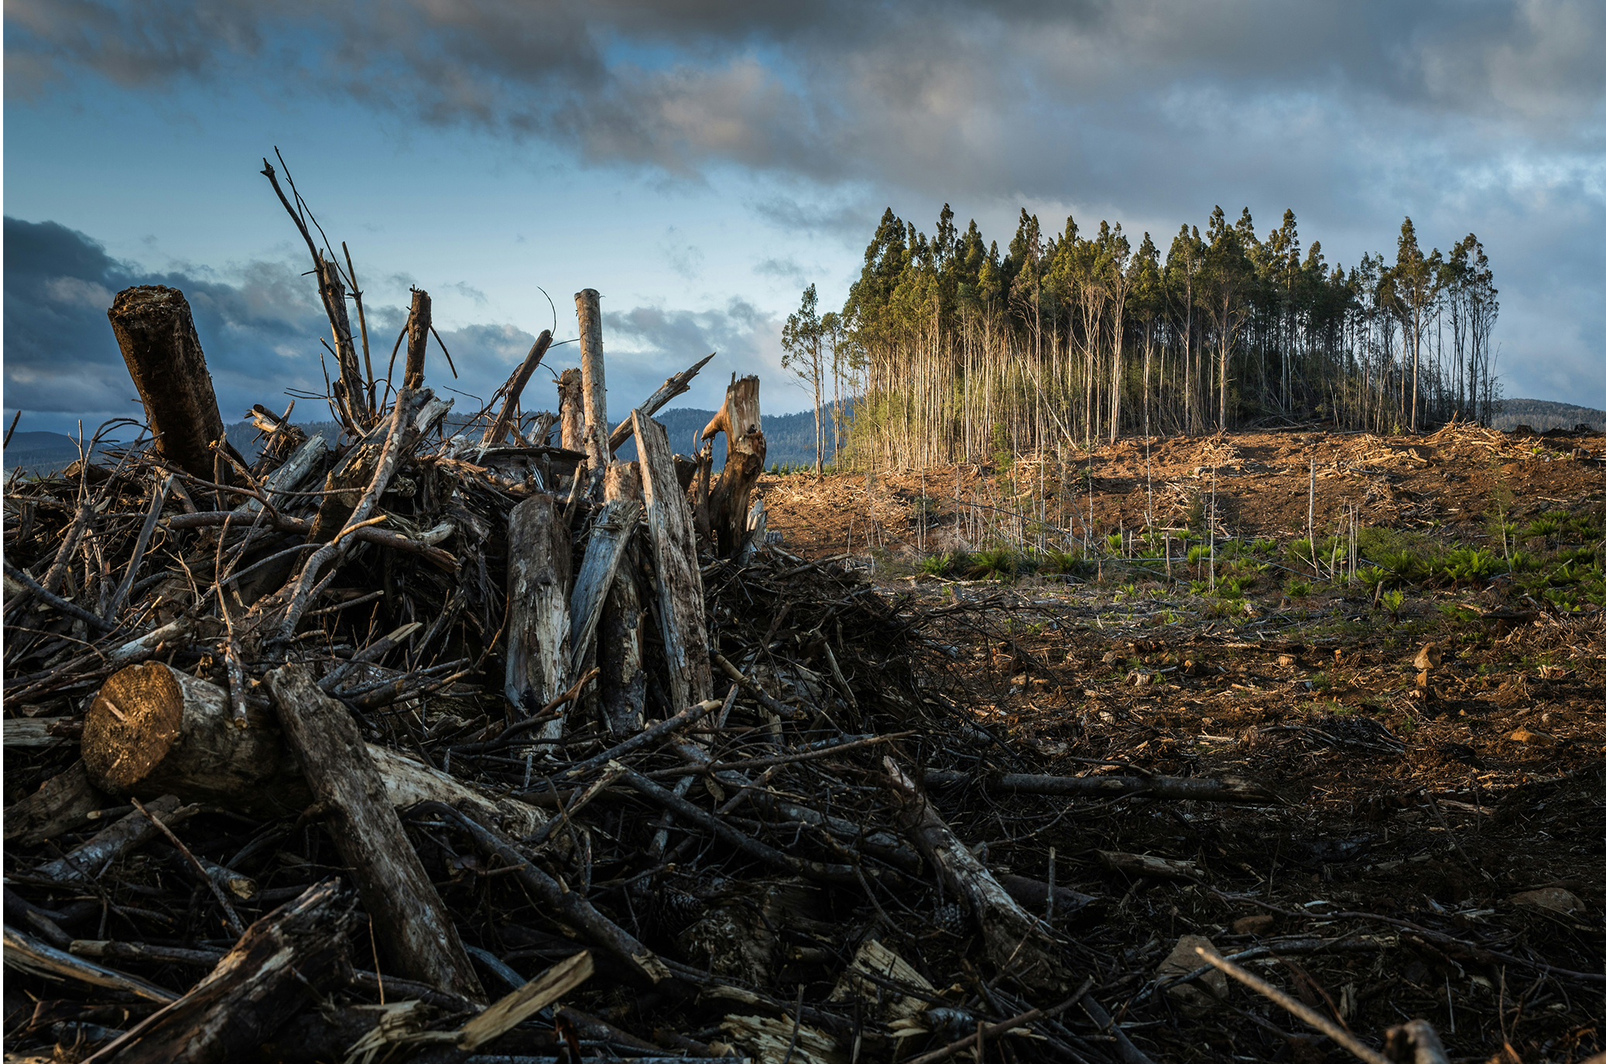
Human Population Growth
Population dynamics can be applied to human population growth.
Human population growth raises concerns about environmental sustainability.
  Long-term potential risks of famine, disease, and large-scale death
Technological advances have increased Earth's carrying capacity.
Environmental changes from human activities threaten ecosystems.
  Include the depletion of the ozone layer, acid rain erosion, and global climate change damage
45.3 Figure 9: Human activities alter ecosystems to the point where some may be in danger of collapse.
Matt Palmer on Unsplash. "Deforestation."

Slide 28
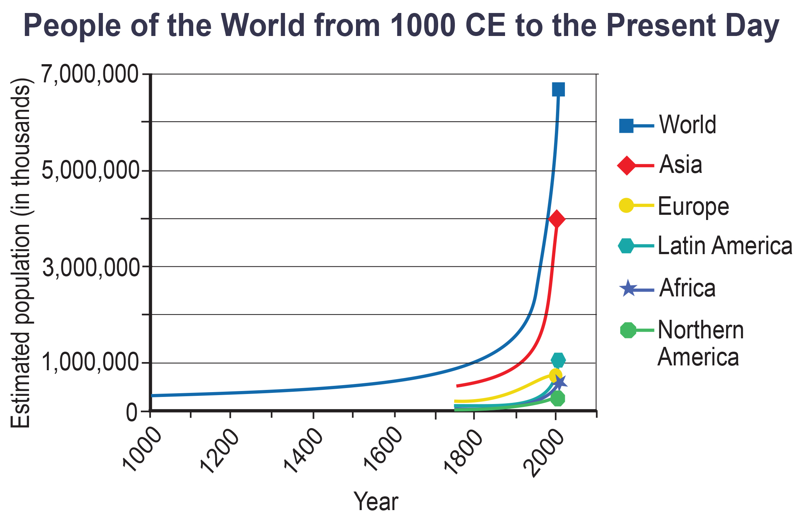
Exponential Growth in the Human Population₁
Human population grows exponentially despite low biotic potential.
To reach this potential, all females would have to become pregnant every nine months or so and resources would have to support this growth.
45.3 Figure 10: Human population growth since 1000 CE is exponential (first line from the left). Notice that while the population in Asia (second line from left), which has many economically underdeveloped countries, is increasing exponentially, the population in Europe (third line from left), where most of the countries are economically developed, is growing much more slowly.
CNX OpenStax on Wikimedia Commons. "Human population growth." Modified.

Slide 29
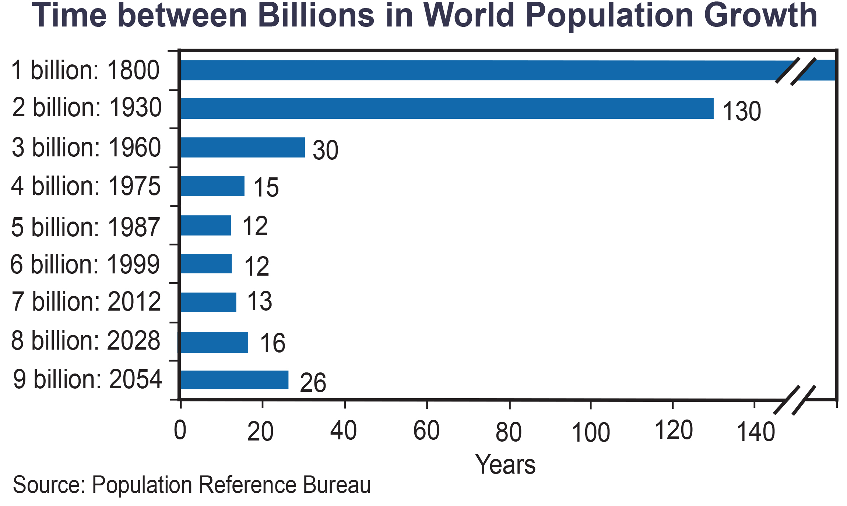
Exponential Growth in the Human Population₂
Exponential growth reduces time to add specific numbers of humans to the Earth.
130 years to add 1 billion humans in 1930, but only 27 years to add 2 billion between 1975 and 1999
Technological limits may slow growth, but overpopulation threats remain.
45.3 Figure 11: The time between the addition of each billion human beings to Earth decreases over time. In the graph, the slashes on the horizontal axis and in the bar for the first 1 billion individuals (1800) represent a gap in time on the axis (in this case, the entire length of time between when humans first arose and when the first 1 billion was reached in the year 1800).
Ryan T. Cragun on Wikimedia Commons. "World population growth."

Slide 30
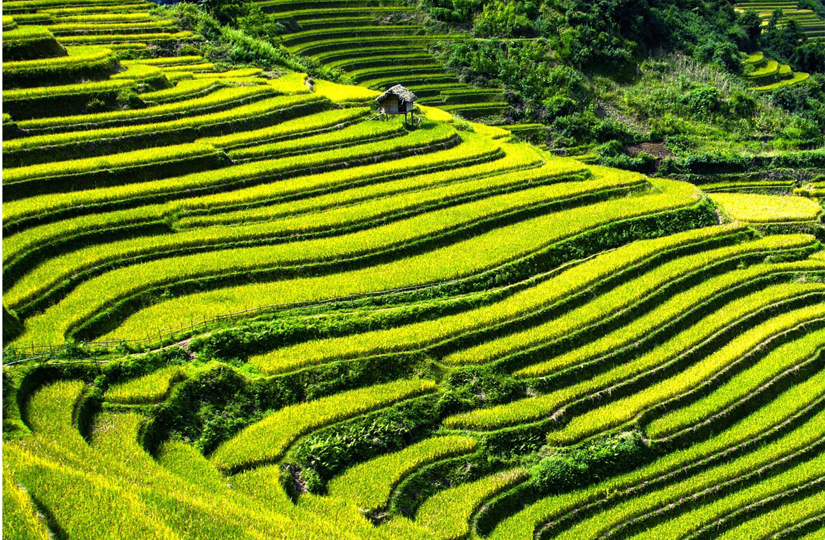
Overcoming Density-Dependent Regulation
Humans alter environments to increase carrying capacity.
  Major factor for human population growth and overcoming density-dependent regulation
  Related to human intelligence, society, and communication
Innovations in agriculture, shelter, and technology help humans drive population growth.
Communication and societal structures support sustained growth.
45.3 Figure 12: The development of agriculture, such as these rice terraces, is one way humans have adapted to overcome density-dependent growth regulations.
PublicDomainPictures on Pixabay. "Rice fields."

Slide 31
Migration and Public Health
Migration and public health and other factors in human population growth.
Since their start in Africa, humans have migrated to other inhabitable land on Earth.
Public health advances have reduced disease impact on population growth.
Vaccines, antibiotics, and sanitation improve survival rates.
  Example: The SARS-CoV-2 virus resulted in 6.5 million deaths between 2020 and 2022, but the rapid production of the COVID-19 vaccine blunted global mortality.

Slide 32
Age Structure, Population Growth, and Economic Development
Age structure: the proportion of a population at different age ranges
Allows for better prediction of population growth
Helps associate growth with economic development
Pyramidal shape: rapid growth (many young individuals of or around reproductive age)
  Most observed in underdeveloped countries
Conical shape: slow or zero growth (more older individuals)

Slide 33
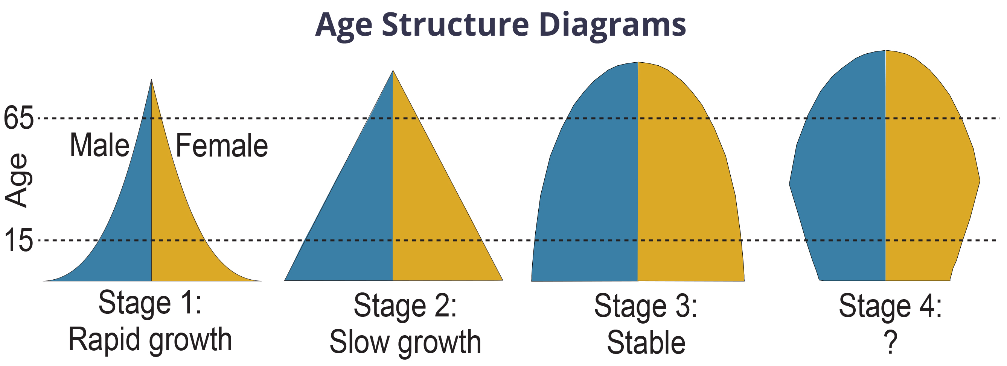
Think It Through₂
Age structure diagrams for rapidly growing, slow-growing, and stable populations are shown in stages 1 through 3. What type of population change do you think stage 4 represents?
Figure 13: Typical age structure diagrams are shown. The rapid growth diagram narrows to a point, indicating that the number of individuals decreases rapidly with age. In the slow growth model, the number of individuals decreases steadily with age. Stable population diagrams are rounded on the top, showing that the number of individuals per age group decreases gradually and then increases for the older part of the population.
CNX OpenStax on Wikimedia Commons. "Age structure diagrams." Modified.
Notes:
Originally an On Your Own. This is included here to use as a talking point or for a think-pair-share activity.

Slide 34
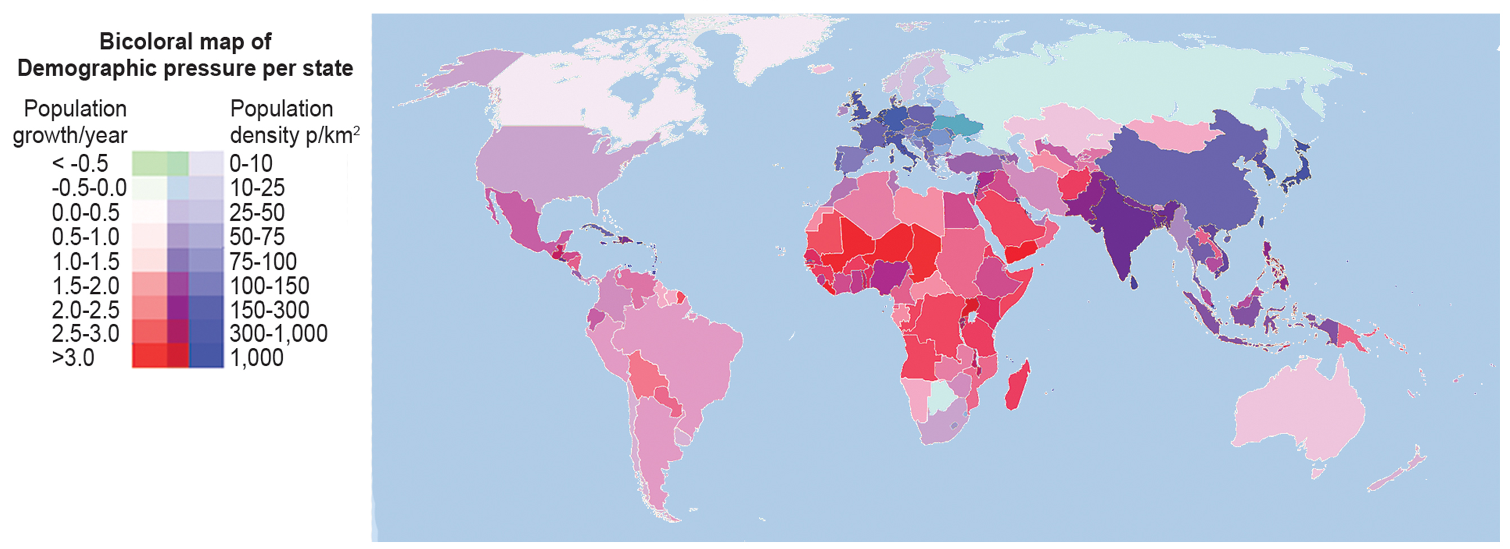
45.3 Figure 14
PoliticalMapsOfTheWorld on Wikimedia Commons. "World populations."
Notes:
A 2018 bicoloral map of the world, with colors to highlight the population density (blue, as in some European countries) and population growth (red, as in some African countries) of each country or territory. Blue countries have a high population density, red countries a high population growth, and purple countries, therefore, have both high population density and population growth.

Slide 35
Long-Term Consequences of Exponential Human Population Growth
Many dire predictions have been made about the "population explosion."
Dr. Paul R. Ehrlich wrote in The Population Bomb (1968):
  "The battle to feed all of humanity is over. In the 1970s hundreds of millions of people will starve to death in spite of any crash programs embarked upon now. At this late date nothing can prevent a substantial increase in the world death rate."
Many experts view this as incorrect; even so, unchecked growth cannot continue indefinitely.

Slide 36
Policies that Influence Population
Several nations have implemented policies to influence population growth.
China: one-child policy to control population growth
  Now being phased out
India: encouraging family planning
Japan, Spain, Russia, Iran, and others: increase population growth after dip in birth rates
The UN estimates that future population growth may vary between 6 billion to 16 billion by 2100.

Slide 37
Endangerment of Natural Environment
Population growth threatens natural habitats.
Many countries have made efforts to reduce human impact on climate change.
  Reducing carbon dioxide emissions
  Not implemented in every country
There is constant debate over the human role in climate change, which leads to uncertainty about our ability to curb growth and protect the environment.

Slide 38
Summary
Populations grow exponentially with unlimited resources.
Logistic growth occurs when resources are limited.
Human population growing exponentially but below biotic potential.
Long-term consequences of growth remain uncertain.

Slide 39

End of Hawkes Learning PowerPoint

