Slide 1
Lesson 45.4
Community Ecology

Slide 2
Objectives
Describe community structure and succession.
Describe the competitive exclusion principle.
Discuss the predator-prey cycle.
Give examples of defenses against predation and herbivory.
Give examples of symbiotic relationships between species.

Slide 3
Community Ecology
Numerous species share habitats; populations hardly live in isolation from other species.
These species that share habitats form a community.
Species diversity: the number and relative abundance of species in an area
Community ecology focuses on species interactions and competition for resources.

Slide 4
Predation
Predation is the consumption of prey by its predators.
Example of species interaction
Populations of predators and prey often vary in cycles.
Example: lynx (predator) and snowshoe hare (prey) population cycles

Slide 5
The Predator-Prey Cycle
The predator-prey cycle lasts approximately 10 years based on nearly 200-year-old trapping data.
Predator population lags 1–2 years behind prey population.
As the hare numbers increase, so eventually do the lynx numbers.
As the hare numbers decrease, so eventually do the lynx numbers.

Slide 6
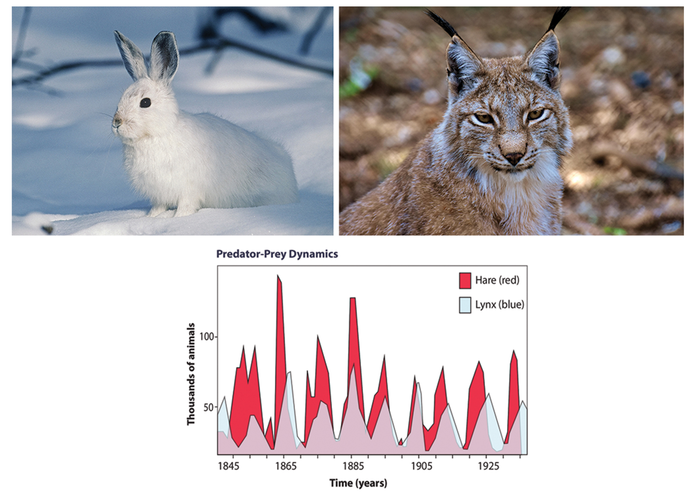
45.4 Figure 1
12019 on Pixabay. "Arctic rabbit."
Alexas_Fotos on Pixabay. "Lynx."
Notes:
The cycling of lynx and snowshoe hare populations in Northern Ontario is an example of predator-prey dynamics.

Slide 7
Reflection Question₁
Think about the organisms that are common where you live. What is another example of this predator-prey cycle in your area?
Notes:
The reflection question is included here to use as a talking point or for a think-pair-share activity.

Slide 8
Other Effects on Population Cycling
Recent studies suggest density-dependent factors (in addition to predation) also play a role in population cycling.
May be inherent in prey populations due to density-dependent effects (lower fecundity)
Direct relation between hare population and lynx population, since hares are the lynx's food source
The complexity of species interactions leads to more sophisticated ecological models.

Slide 9
Herbivory
Herbivory is the consumption of plants by insects and other animals.
An interspecific (between species) relationship that affects populations
Plants have developed defense mechanisms against herbivory.
Some plants have mutualistic relationships with herbivores for seed distribution.

Slide 10
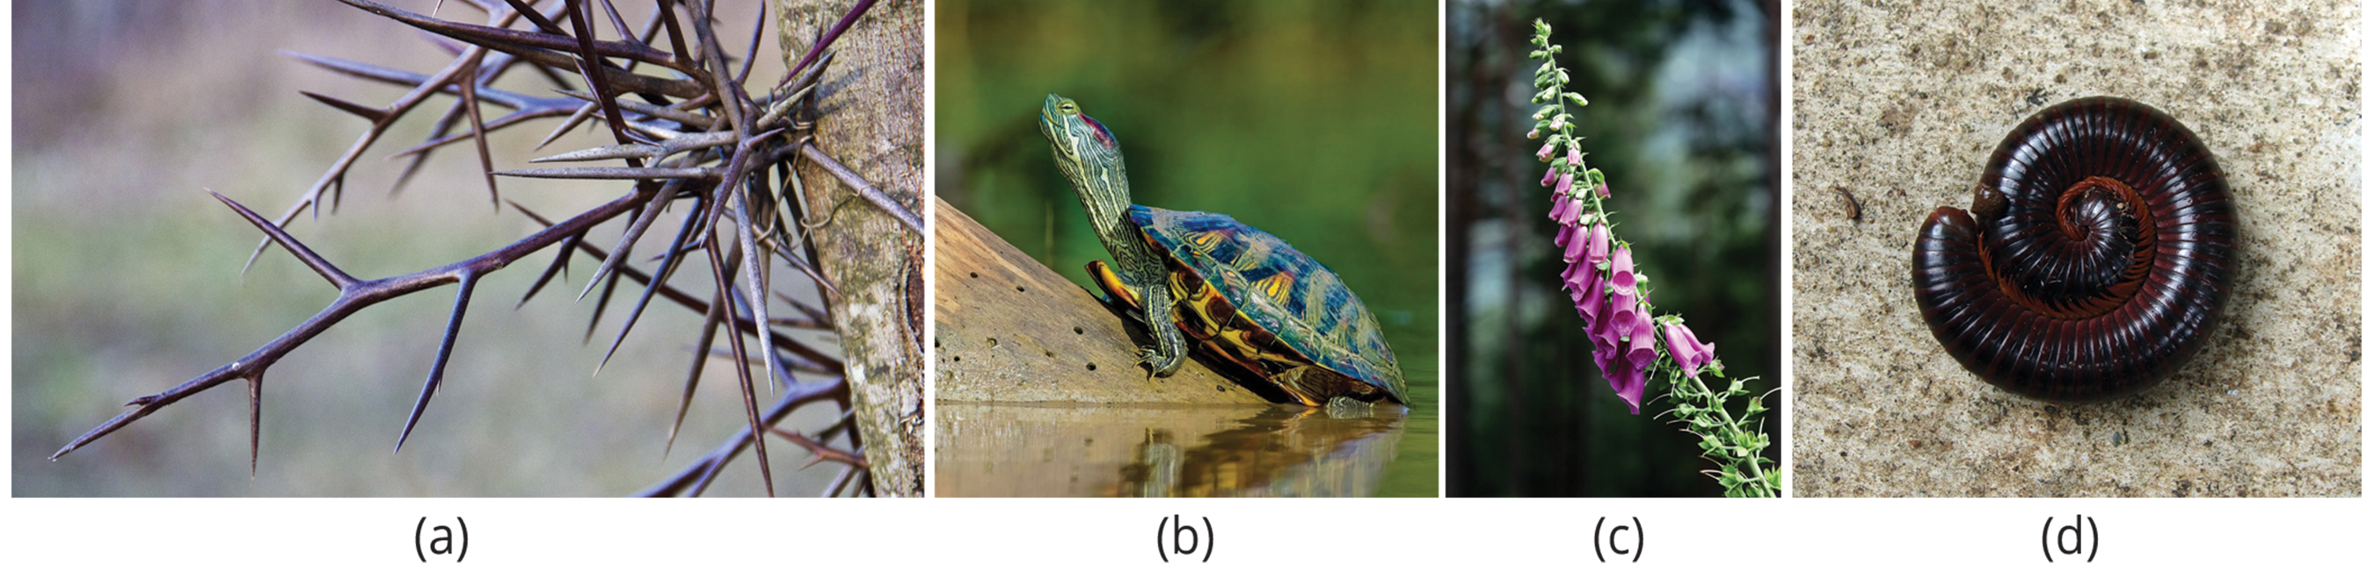
Defense Mechanisms against Predation and Herbivory
Species evolved numerous ways to escape predation and herbivory.
Mechanical defenses: cause physical pain to the predator or prevent the predator from eating the prey (e.g., thorns, hard shells)
Chemical defenses: extremely toxic substances that plants or animals produce (e.g., death-causing chemicals)
45.4 Figure 2: The (a) honey locust tree (Gleditsia triacanthos) uses thorns, and the (b) red-eared slider (Trachemys scripta) uses its shell. (c) Foxglove (Digitalis spp.) uses toxins produced by the plant. (d) The North American millipede (Narceus americanus), when threatened, curls into a defensive ball and produces a noxious substance.
SparrowsHome on Pixabay. "Honey locust tree."
22537878 on Pixabay. "Red-eared slider."
GabrieleLeonardy on Pixabay. "Foxglove."
Bishnu Sarangi on Pixabay. "Millipede."

Slide 11
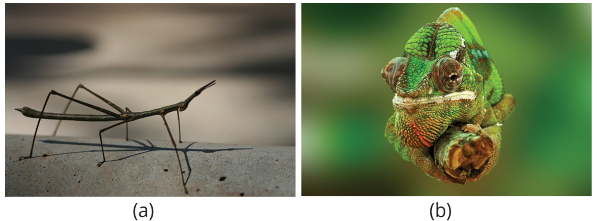
Physical & Behavioral Defenses
Physical: includes body shape and coloration
Camouflage: avoiding detection by blending in with the background
Example: chameleons changing their coloration to match surroundings
Behavioral: used to avoid or confuse predators
Includes playing dead, traveling in large groups
45.4 Figure 3: (a) The tropical walking stick and (b) the chameleon use body shape and/or coloration to prevent detection by predators.
Rebekah2brazil on Pixabay. "Walking stick."
FrankWinkler on Pixabay. "Chameleon."

Slide 12
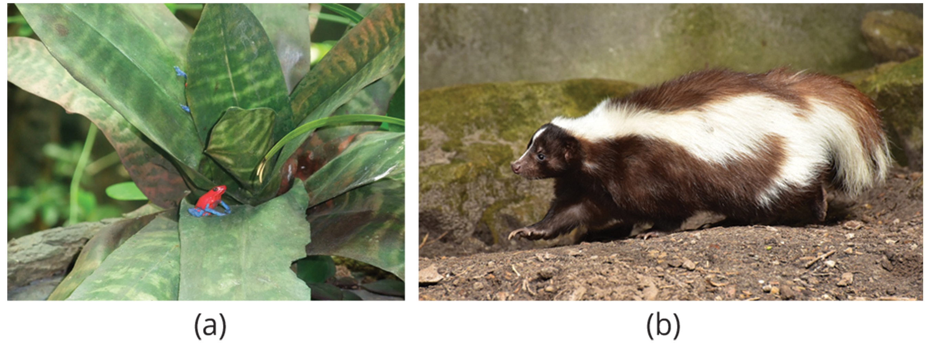
Coloration
Some use coloration as a way to warn predators that they're not good to eat.
Aposematic coloration (warning coloration): indicates that an organism is toxic or unpalatable
Example: bright colors in species like the cinnabar moth caterpillar
45.4 Figure 4: (a) The strawberry poison dart frog (Oophaga pumilio) uses aposematic coloration to warn predators that it is toxic, while the (b) striped skunk (Mephitis mephitis) uses aposematic coloration to warn predators of the unpleasant odor it produces.
kham_me on Pixabay. "Strawberry poison dart frog."
sipa on Pixabay. "Striped skunk."

Slide 13
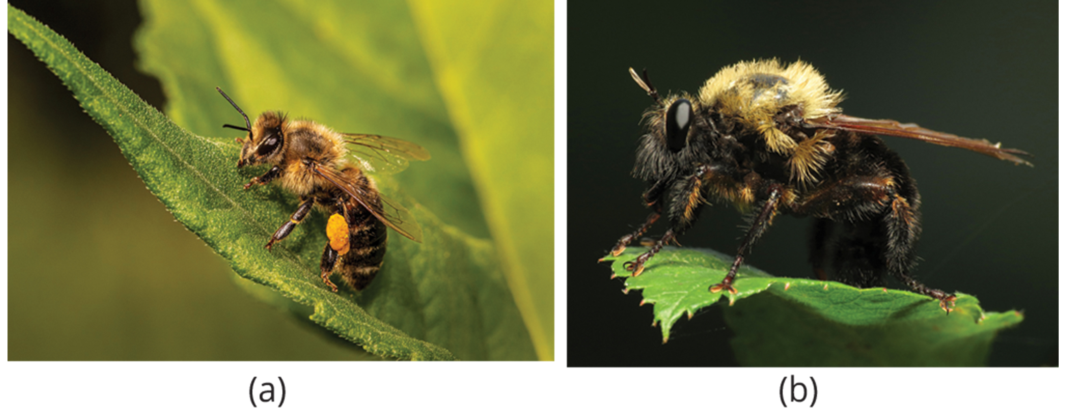
Batesian Mimicry
Nontoxic species evolved mechanisms to mimic coloration even though they may be safe to eat.
Batesian mimicry: when a harmless species mimics the warning coloration of a harmful species
Protects the harmless species without having the same level of defenses as the species they mimic
Example: insects mimicking wasps or bees
45.4 Figure 5: Batesian mimicry occurs when a harmless species mimics the coloration of a harmful species, as seen with the (a) bumblebee and (b) beelike robber fly.
Erik_Karits on Pixabay. "Bumblebee."
Katja Schulz on Wikimedia Commons. "Robber fly."

Slide 14
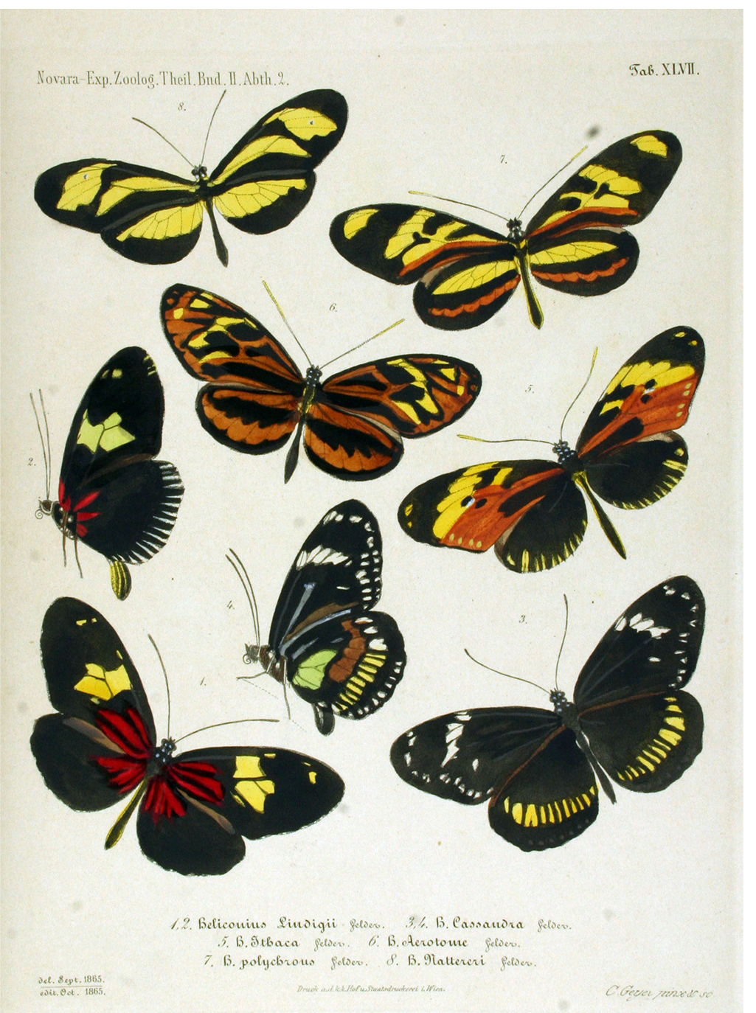
Müllerian Mimicry
Müllerian mimicry: when multiple species share the same warning coloration, but all have defenses
More efficient in educating local predators
Example: foul-tasting butterflies with similar coloration
45.4 Figure 6: Several unpleasant-tasting Heliconius butterfly species share a similar color pattern, an example of Müllerian mimicry.
Felder on Wikimedia Commons. "Butterfly species."

Slide 15
Emsleyan/Mertensian Mimicry
Emsleyan/Mertensian mimicry: when deadly prey mimics a less dangerous one
Rare and complex form of mimicry
Example: venomous coral snake mimicking nonvenomous milk snake
Relies on the fact that eating the milk snake will be unpleasant but not fatal, so prey learns not to eat it

Slide 16
Group Activity₁
In groups, find examples of each of the three types of mimicry. Share your examples with the rest of the class.

Slide 17
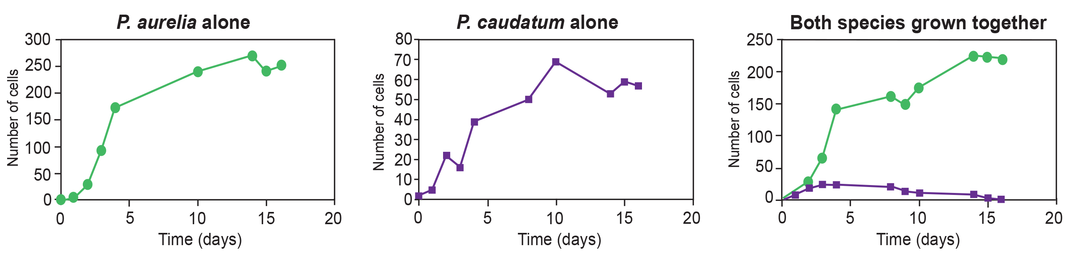
Competitive Exclusion Principle
Each species has an ecological niche, or role, in the ecosystem.
Includes where it lives, how it acquires resources, and other species with which it interacts
Competitive exclusion principle: two species cannot occupy the same niche in a habitat
Cannot coexist in a community if they are competing for all the same resources and performing all the same functions
Example: Paramecium aurelia and Paramecium caudatum
Can be avoided if species evolve to use different resources or occupy different microniches
Resource partitioning: allows species to coexist by minimizing direct competition
45.4 Figure 7: Paramecium aurelia and Paramecium caudatum grow well individually, but when they compete for the same resources, P. aurelia outcompetes P. caudatum.
CNX OpenStax on Wikimedia Commons. "Competitive exclusion principle." Modified.

Slide 18
Symbiosis
Symbioses: close interactions between individuals of different species over an extended period
Impact abundance and distribution of associating populations
Sometimes restricted to only those species that are mutualistic, where both individuals benefit

Slide 19
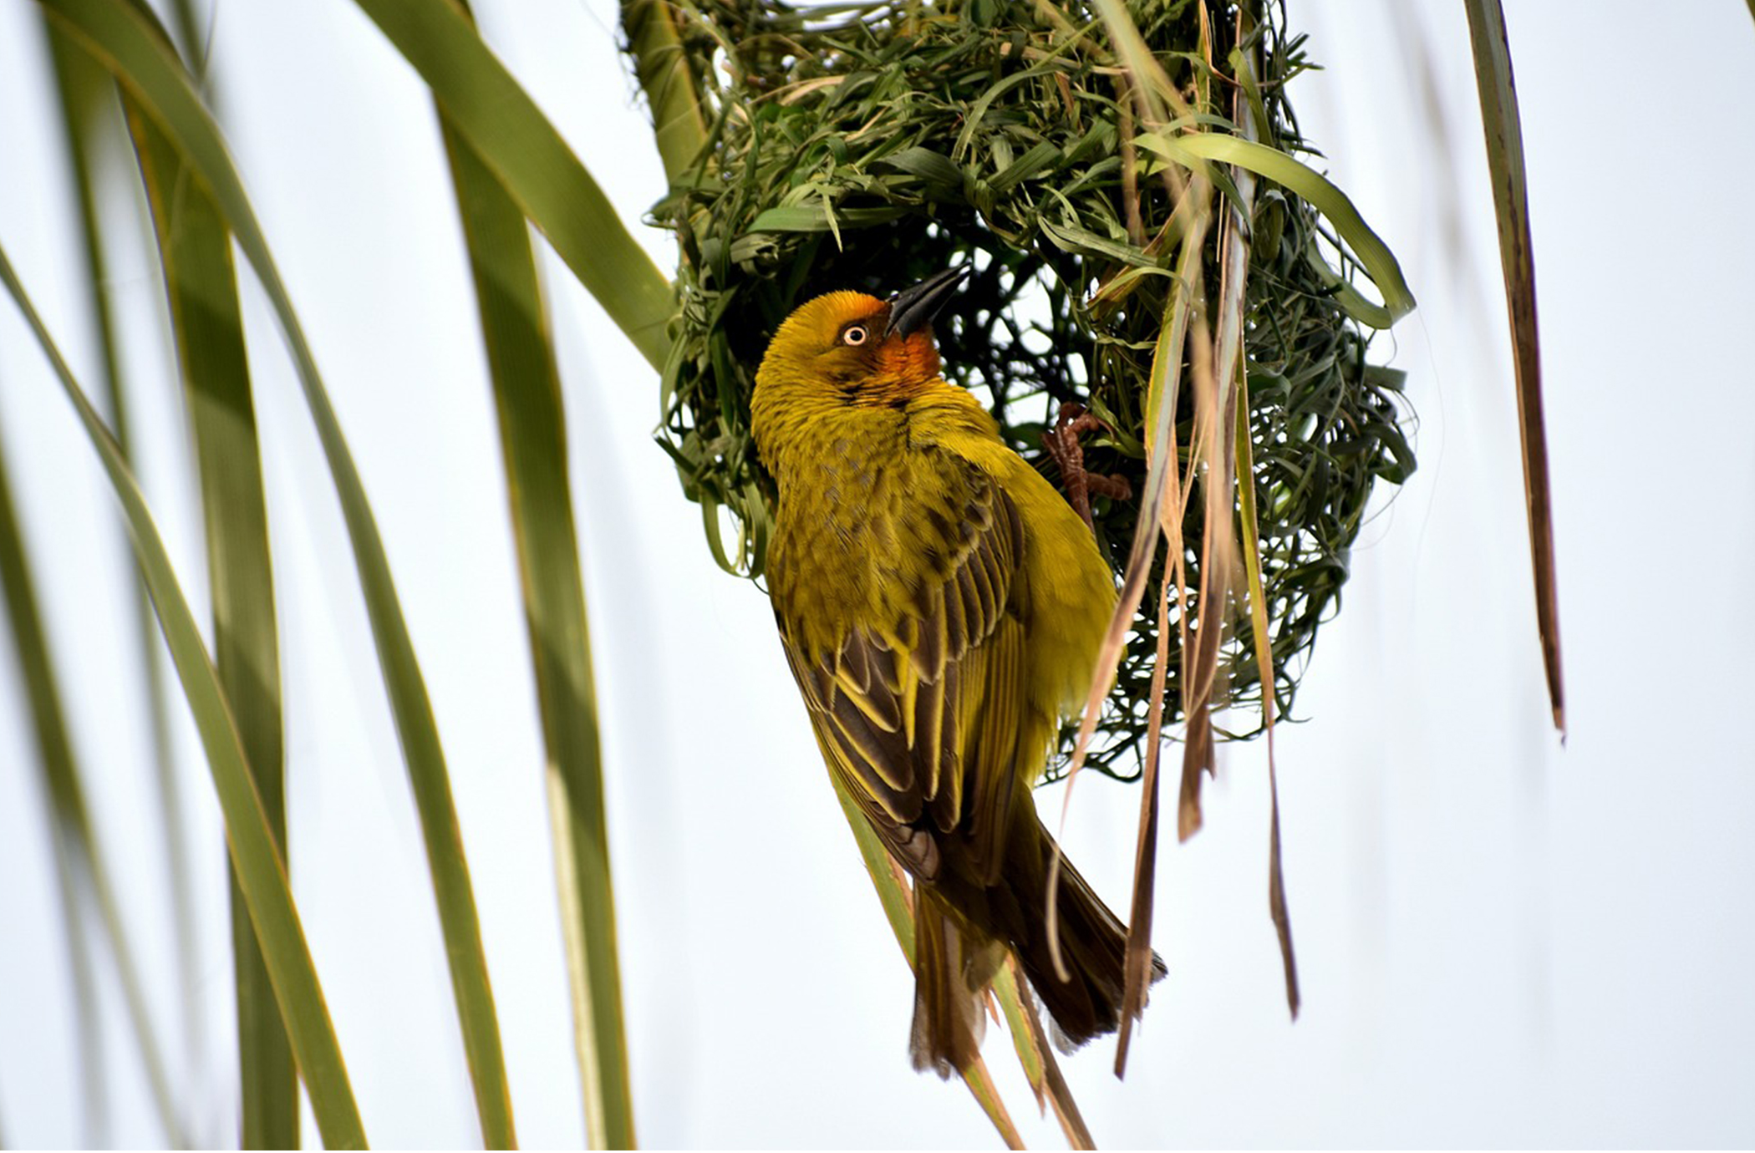
Commensalism
Commensalism: when one species benefits while the other is unaffected
Examples: birds nesting in trees and pilot fish feeding on sharks' leftover meals
45.4 Figure 8: The southern masked-weaver bird is starting to make a nest in a tree in Zambezi Valley, Zambia. This is an example of a commensal relationship, in which one species (the bird) benefits, while the other (the tree) neither benefits nor is harmed.
Peter Holmes on Pixabay. "Southern masked weaver."

Slide 20
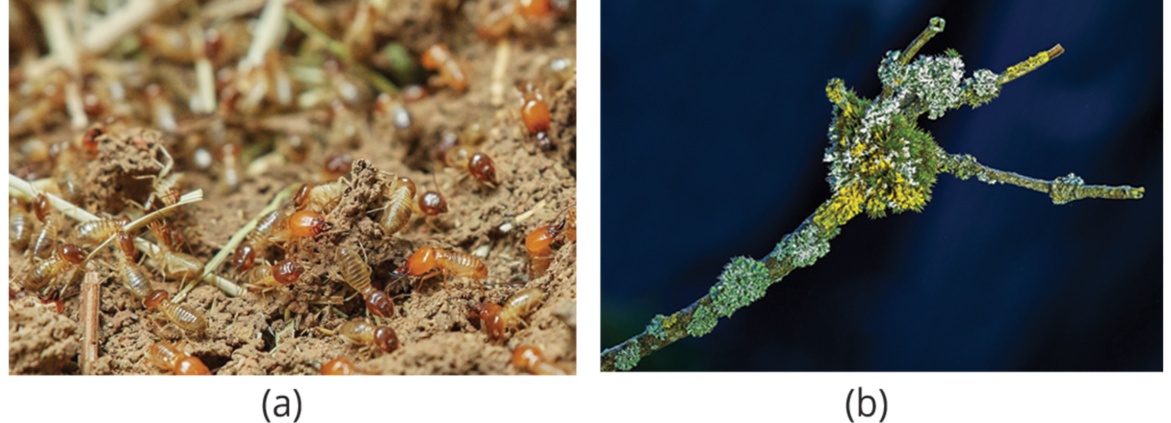
Mutualism
Mutualism: when two species benefit from their interaction
Believed to be the only true example of symbiosis
Examples: termites and gut protozoa, lichens (fungi and algae/bacteria)
45.4 Figure 9: (a) Termites form a mutualistic relationship with symbiotic protozoa in their guts, which allows both organisms to obtain energy from the cellulose the termite consumes. (b) Lichen is a fungus that has symbiotic photosynthetic algae living inside its cells.
RoyBuri on Pixabay. "Termites."
adege on Pixabay. "Lichen."

Slide 21
Reflection Question₂
Do humans form mutualistic relationships with other species? How would each species benefit in those relationships?
Notes:
The reflection question is included here to use as a talking point or for a think-pair-share activity.

Slide 22
Parasitism
Parasitism: where the parasite benefits, but the host is harmed
Parasite: organism that lives in or on another living organism and/or derives nutrients from it
Host: weakened by the parasite since the parasite siphons resources from it
Unlikely to be killed, since parasite would have to find new host
Examples: tapeworms, Plasmodium falciparum

Slide 23
Reproductive Cycles of Parasites
Often complex, sometimes requiring more than one host species
Example: tapeworm life cycle involving humans and other vertebrates
Lives inside the host's intestine for years, benefiting from the host's food
Moves from species to species in a cycle, requiring two hosts to complete its life cycle
Have eggs that can be ingested by other vertebrates through feces and larvae that can be ingested further
Example: Plasmodium falciparum
Protozoa causing malaria that lives in the human liver and red blood cells
Reproduces asexually in the guts of mosquitoes
Spread from human to human by mosquitoes

Slide 24
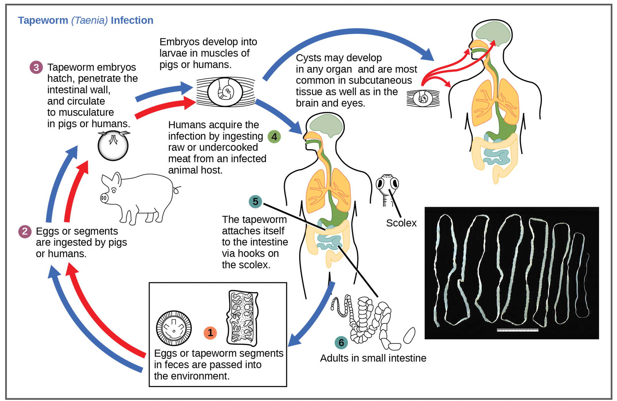
45.4 Figure 10
CDC. "Tapeworm life cycle."
Notes:
This diagram shows the life cycle of a pork tapeworm (Taenia solium), a human parasite.

Slide 25
Characteristics of Communities
Communities are complex entities defined by:
Structure (diversity and density of species)
Dynamics (changes over time)
Understanding these aspects helps with ecosystem management.

Slide 26
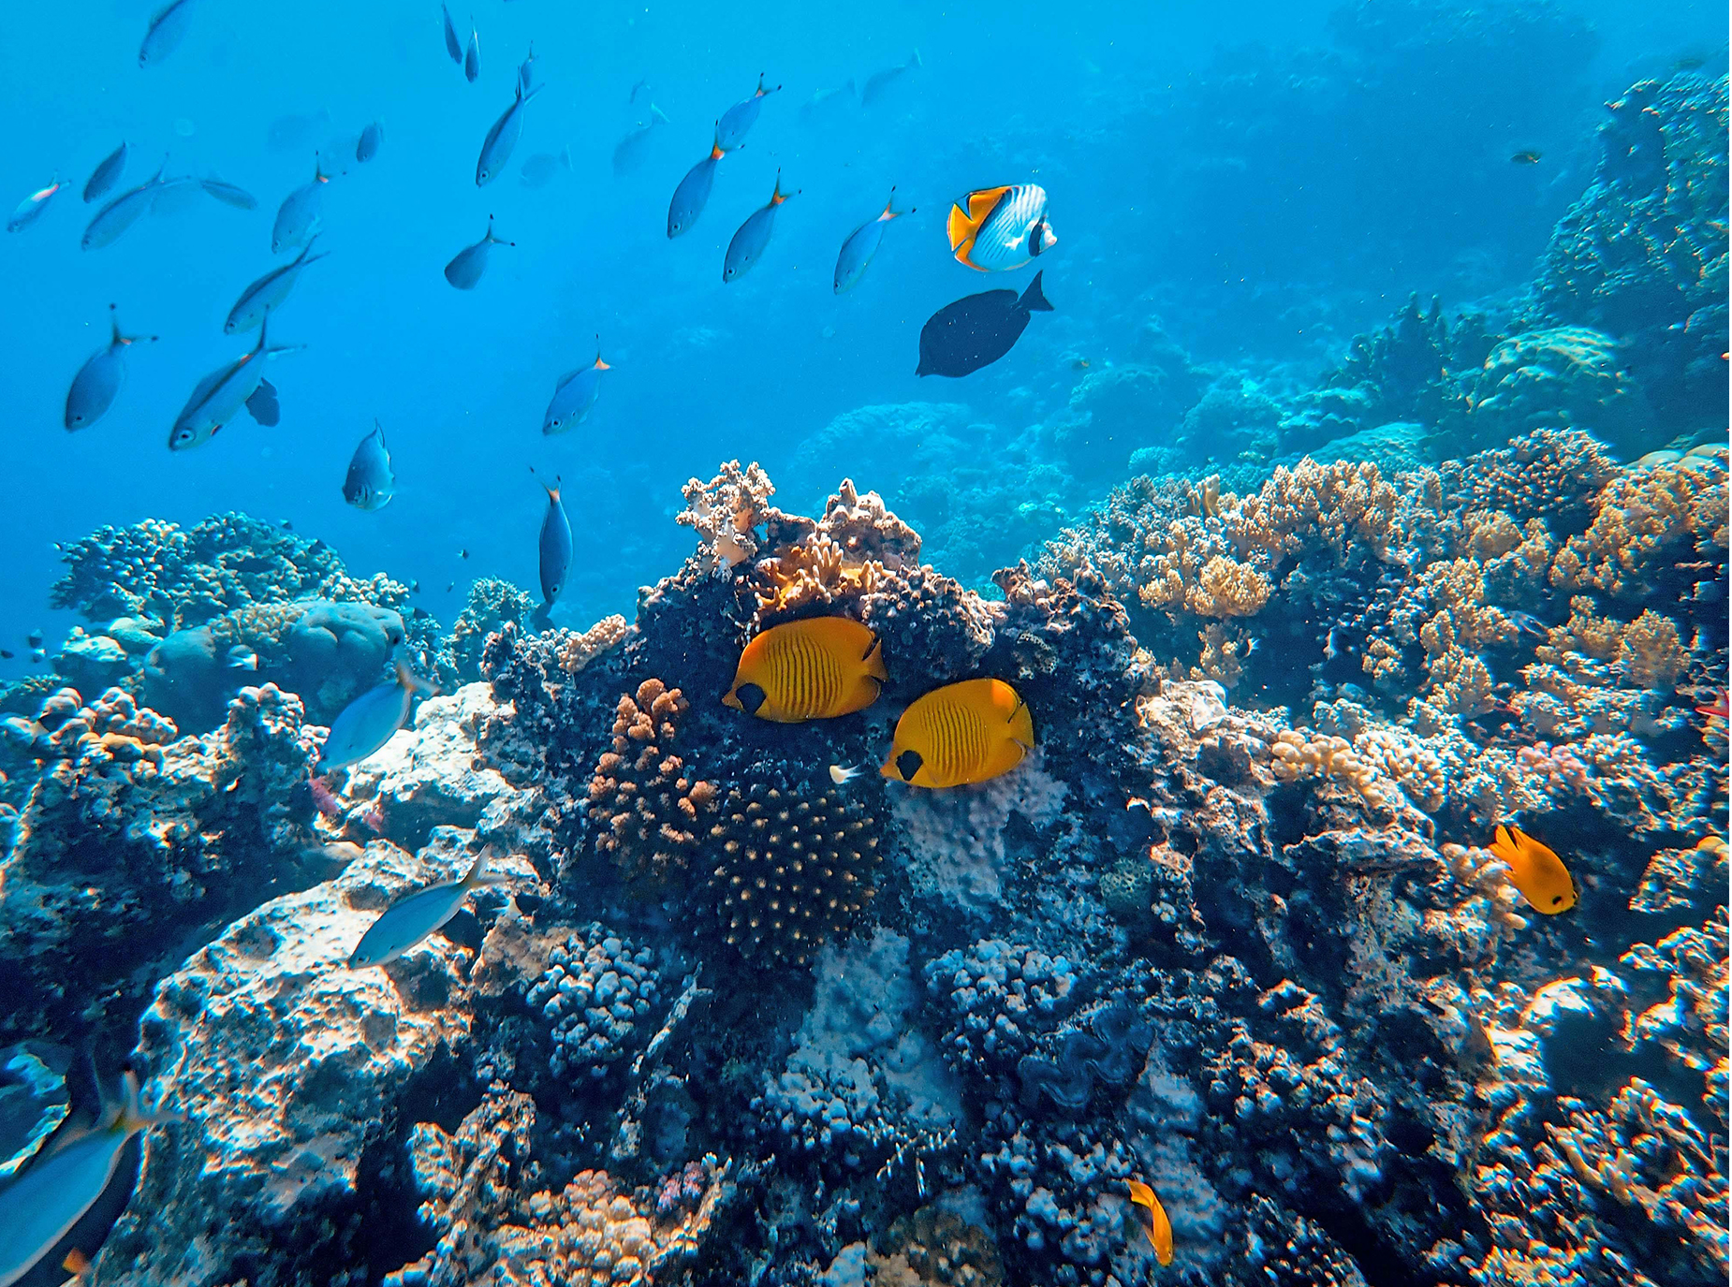
Foundation Species
Foundation species: the "base" or "bedrock" of a community, having the greatest influence on its overall structure
Usually primary producers: organisms that bring most of the energy into the community
May physically modify the environment
Examples: kelp in kelp forests, corals in coral reefs
45.4 Figure 11: Corals are the foundation species of coral reef ecosystems.
Francesco Ungaro on Pexels. "Coral reef."

Slide 27
Biodiversity and Species Richness
Biodiversity: measure of a community's biological complexity
Measured by the number of different species in a particular area (species richness) and their relative abundance (species evenness)
Could be a habitat, biome, or entire biosphere
Factors influencing species richness: latitude, climate, productivity, island biogeography, relative species abundance

Slide 28
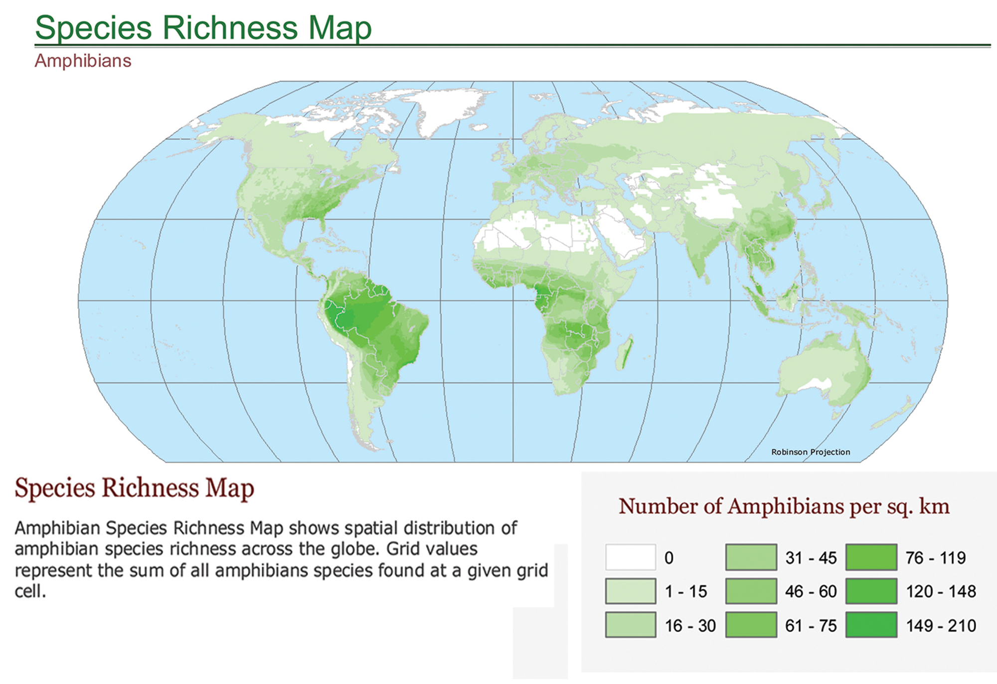
45.4 Figure 12
SEDACMaps on Wikimedia Commons. "Species richness map."
Notes:
Species richness of amphibians varies across the globe, with the most diversity found near the equator.

Slide 29
Island Biogeography and Relative Species Abundance
Island biogeography: attempts to explain the relatively high species richness in isolated island chains
Example: the Galápagos Islands
Relative species abundance: number of individuals in a species compared to total number of individuals
Foundation species: highest relative abundance

Slide 30
Group Activity₂
As a group, identify as many different plant and animal species as you can in the outdoor space nearest to you. Define the biodiversity of this habitat. Does it have a high species richness? Are some species more abundant than others?
Draw your own map of the area. Label where different species live and how abundant they are.

Slide 31
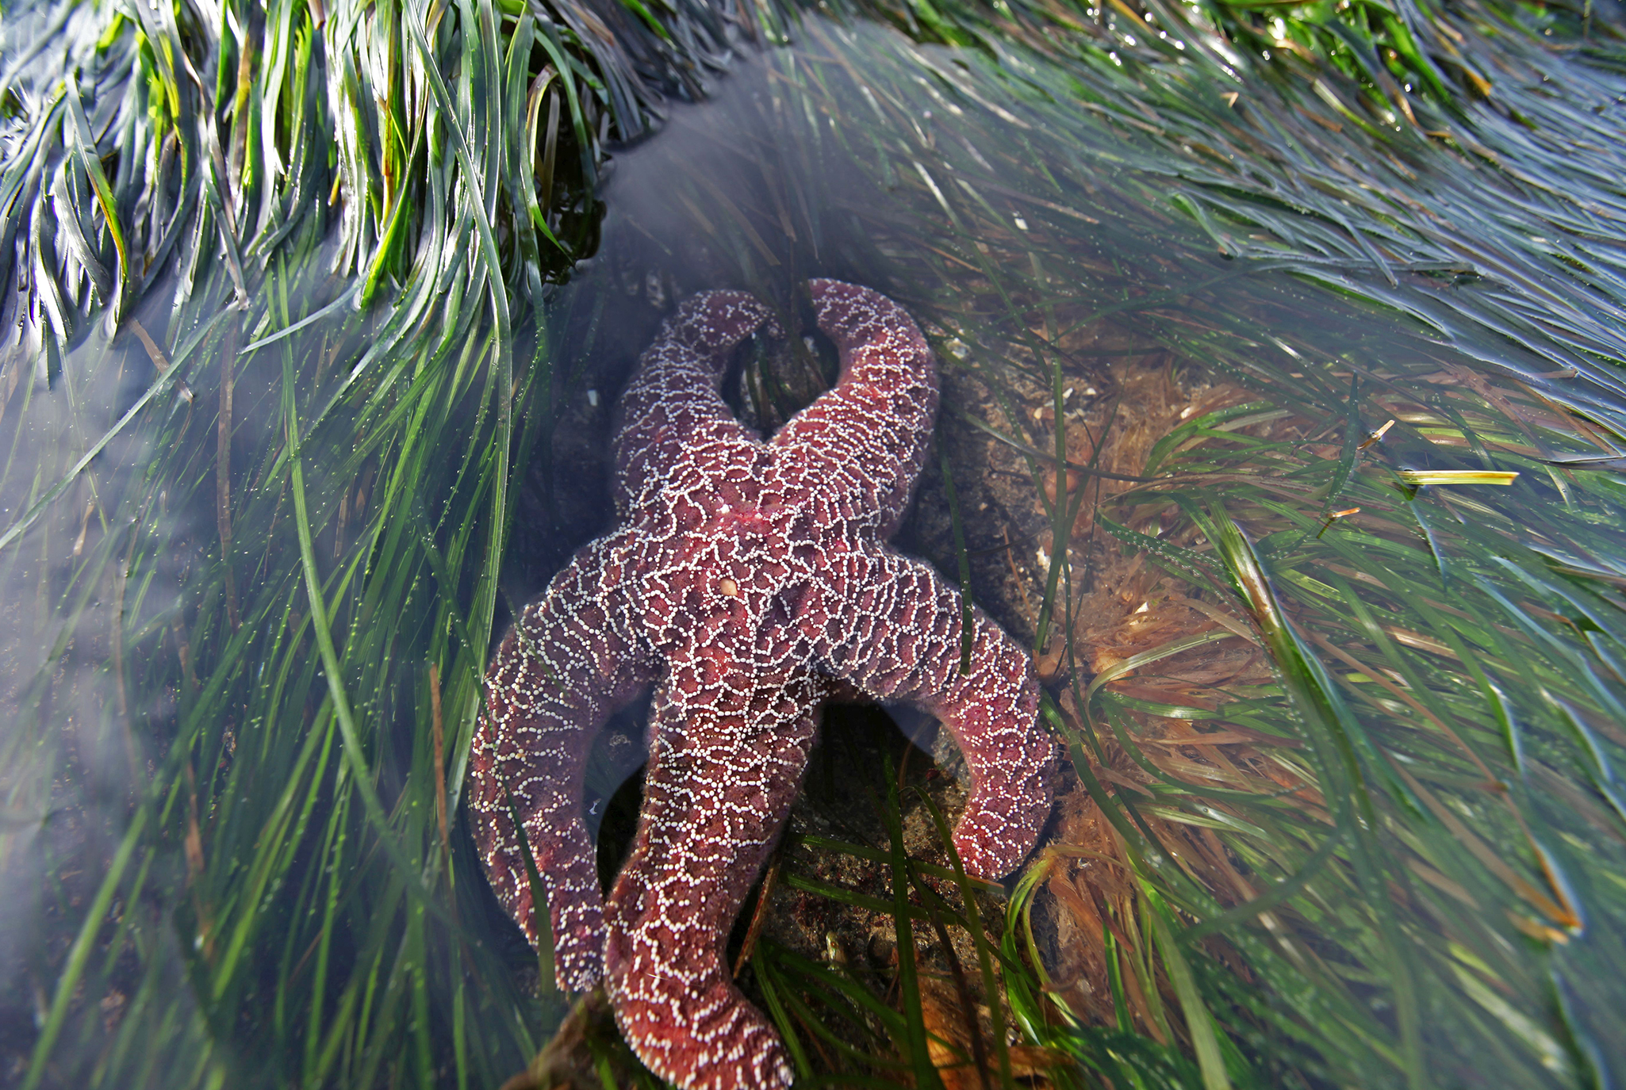
Keystone Species
Keystone species: key in maintaining biodiversity in an ecosystem and upholding an ecological community's structure
Can significantly alter species composition and reduce biodiversity when removed
Examples: intertidal sea star (Pisaster ochraceus), banded tetra fish
45.4 Figure 13: The Pisaster ochraceus sea star is a keystone species.
USFWS - Pacific Region on Wikimedia Commons. "Ochre star."

Slide 32
Think It Through
Intertidal sea stars (P. ochraceus) are found in kelp forest ecosystems along the coast of the northwestern United States. In these ecosystems, sea stars compete with sea urchins for access to kelp. Over the last 20 years, populations of sea stars have dramatically declined in many of these ecosystems. Make two predictions for how this decline could affect these ecosystems.
Notes:
Originally an On Your Own. This is included here to use as a talking point or for a think-pair-share activity.

Slide 33
Science and You
Invasive Species
Non-native organisms threatening ecosystem balance
Example: Asian carp in the United States
Introduced in the 1970s, now colonize many U.S. waterways
May outcompete native species, alter food webs, and cause physical harm
Efforts to prevent the spread of Asian carp: electric barriers, legal action
Illustrates intersection of ecology, fisheries management, and politics
Notes:
This is included as a relevant application for this topic.

Slide 34
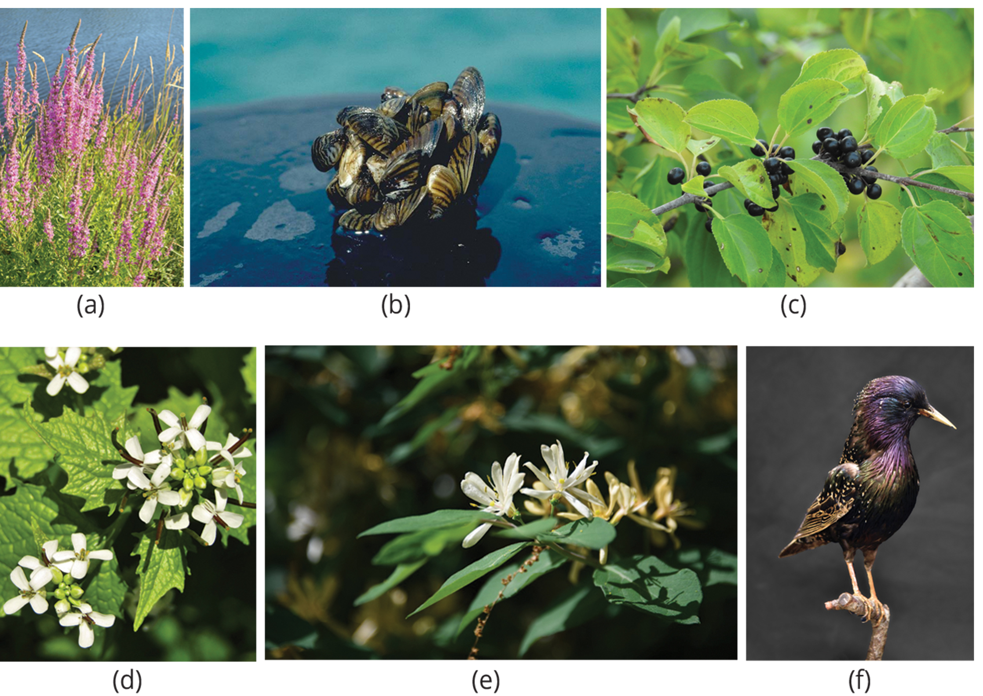
45.4 Figure 14
ecoperc on Pixabay. "Purple loosestrife."
NOAA, Great Lakes Environmental Research Laboratory on Wikimedia Commons. "Zebra mussels."
Robert Flogaus-Faust on Wikimedia Commons. "Buckthorn."
Schwester M. Jutta on Pixabay. "Garlic mustard."
eliza28diamonds on Pixabay. "Honeysuckle."
Wild0ne on Pixabay. "European starling."
Notes:
In the United States, invasive species like (a) purple loosestrife (Lythrum salicaria) and the (b) zebra mussel (Dreissena polymorpha) threaten certain aquatic ecosystems. Some forests are threatened by the spread of (c) common buckthorn (Rhamnus cathartica), (d) garlic mustard (Alliaria petiolata), and (e) honeysuckle (Lonicera sp.). The (f) European starling (Sturnus vulgaris) may compete with native bird species for nest holes.

Slide 35
Community Dynamics
Community dynamics: changes in community structure and composition over time
Can be induced by environmental disturbances (volcanoes, earthquakes, storms, fires, climate change)
May or may not return to equilibrium state after disturbance
Succession: sequential appearance and disappearance of species in a community over time
Primary succession: living things colonizing newly exposed or newly formed land
Secondary succession: part of an ecosystem is disturbed, and remnants of the previous community remain

Slide 36
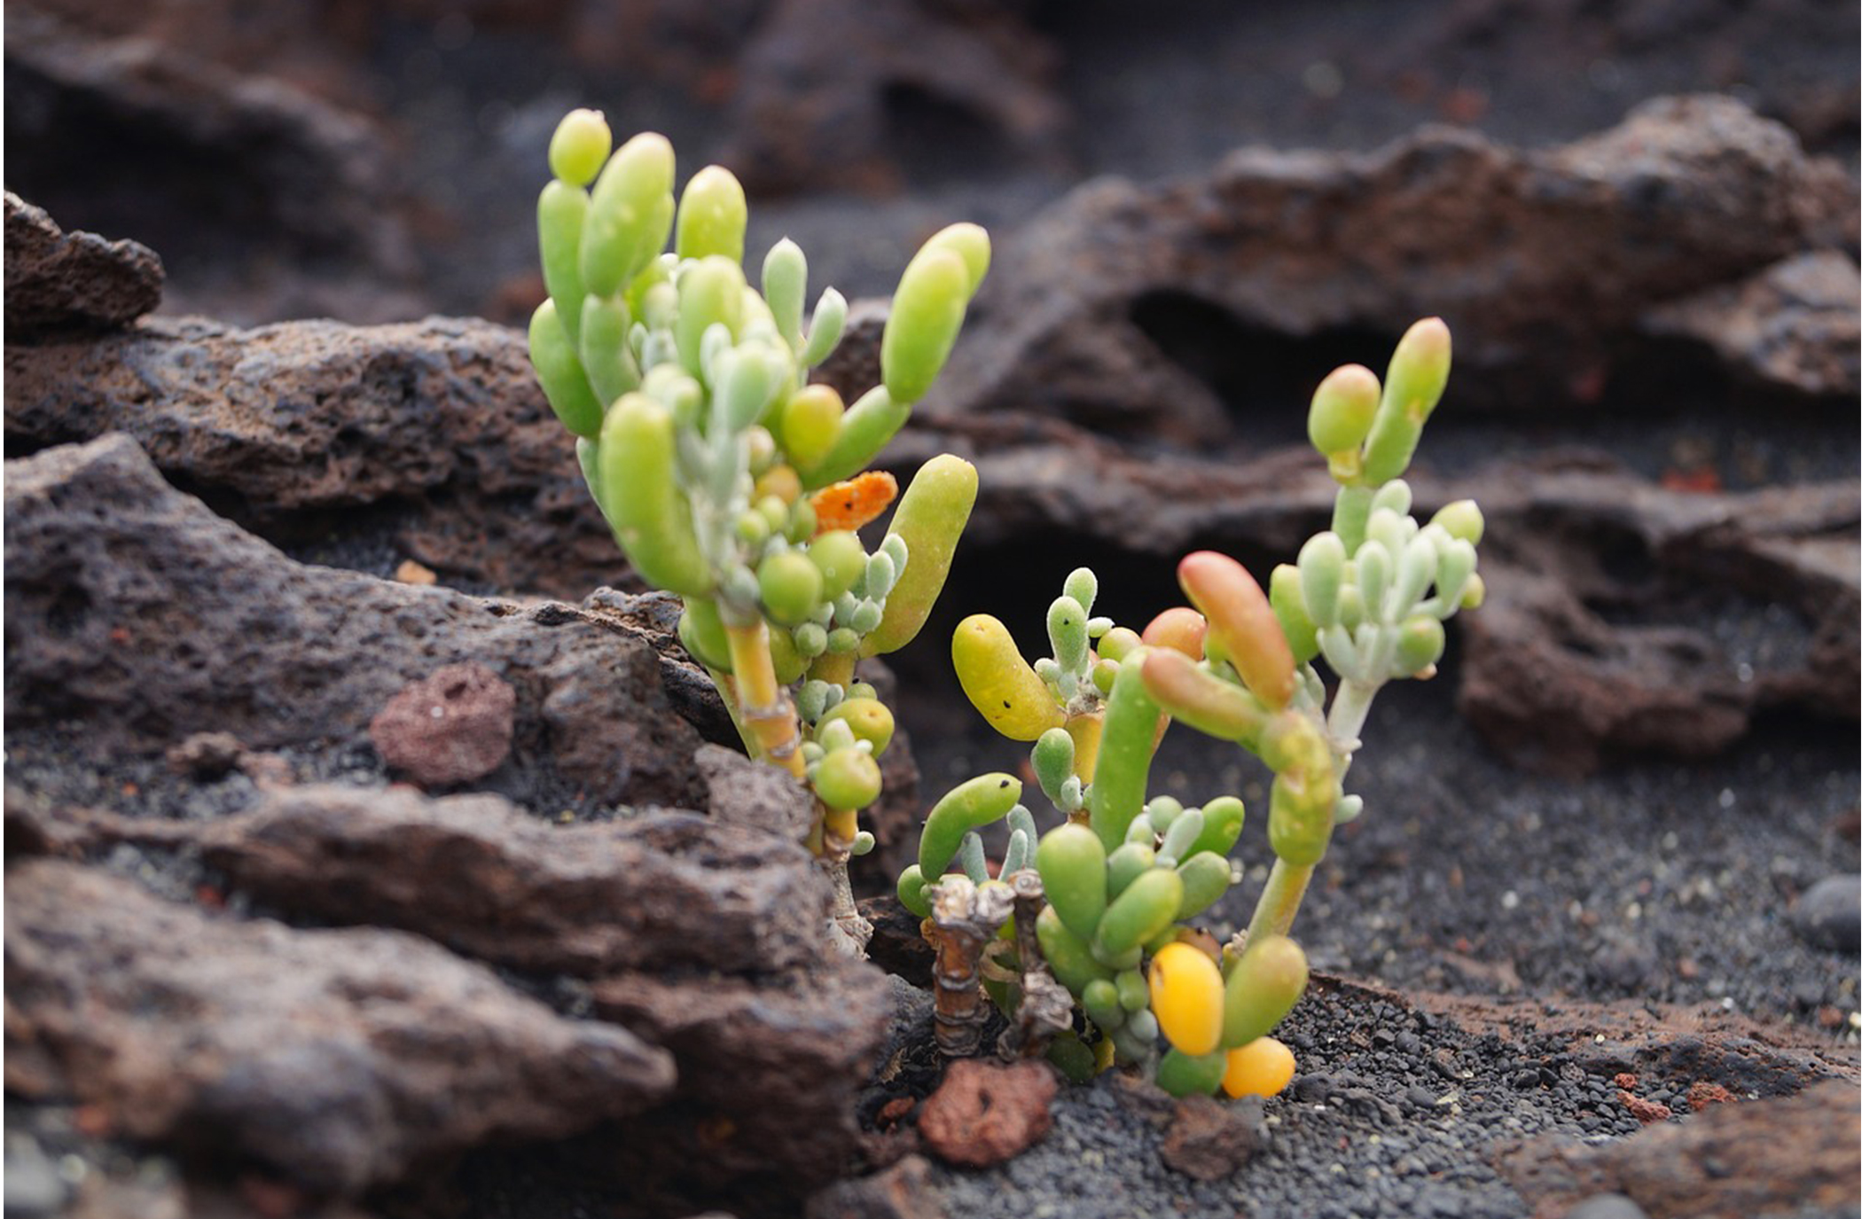
Primary Succession and Pioneer Species
Primary succession: occurs on newly exposed or formed land
Example: volcanoes on the Big Island of Hawaii continuously erupting, forming new land
Breakdown of substrate by weathering and other natural forces enough to establish pioneer species
Pioneer species: hearty plants and lichens with few soil requirements that colonize new areas
Further breakdown of mineral-rich lava by pioneer species to make better soil for less hardy species
Production of ever-growing layer of decomposing organic material as pioneer species grow and die
Gradually leads to more complex ecosystems
45.4 Figure 15: During primary succession in lava on Maui, Hawaii, succulent plants are the pioneer species.
Widling on Pixabay. "Succulent plants."

Slide 37
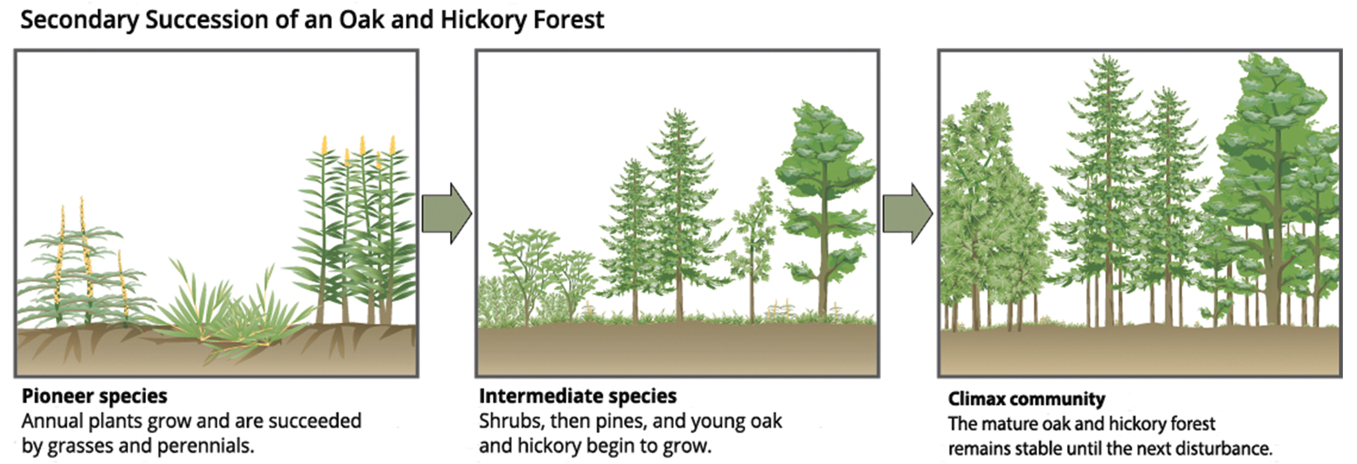
Secondary Succession
Secondary succession: occurs when part of an ecosystem is disturbed
Example: forest recovery after wildfire
Progresses through stages: annual plants, grasses, shrubs, trees
Intermediate species: shrubs and small pine, oak, and hickory trees
Eventually reaches climax community resembling pre-disturbance state
Climax community: a community's equilibrium state, which remains stable until the next disturbance
45.4 Figure 16: Secondary succession is shown in an oak and hickory forest after a forest fire.
CNX OpenStax on Wikimedia Commons. "Secondary succession."

Slide 38
Summary
Communities include all species in a given area; the variety of these species is called species richness.
Organisms develop defenses against predation and herbivory, including mechanical defenses, warning coloration, and mimicry.
The competitive exclusion principle states that two species cannot coexist in the same habitat if they are fighting for the same resources.
Species may form symbiotic relationships, such as commensalism and mutualism.
Community structure is described by its foundation and keystone species.
Succession (primary, secondary) is a response to environmental disturbances.

Slide 39

End of Hawkes Learning PowerPoint

