Slide 1
Lesson 45.5
Behavioral Biology

Slide 2
Objectives
Compare innate and learned behavior.
Discuss how movement and migration behaviors are a result of natural selection.
Discuss the different ways members of a population communicate with each other.
Give examples of how species use energy for mating displays and other courtship behaviors.
Differentiate between various mating systems.

Slide 3
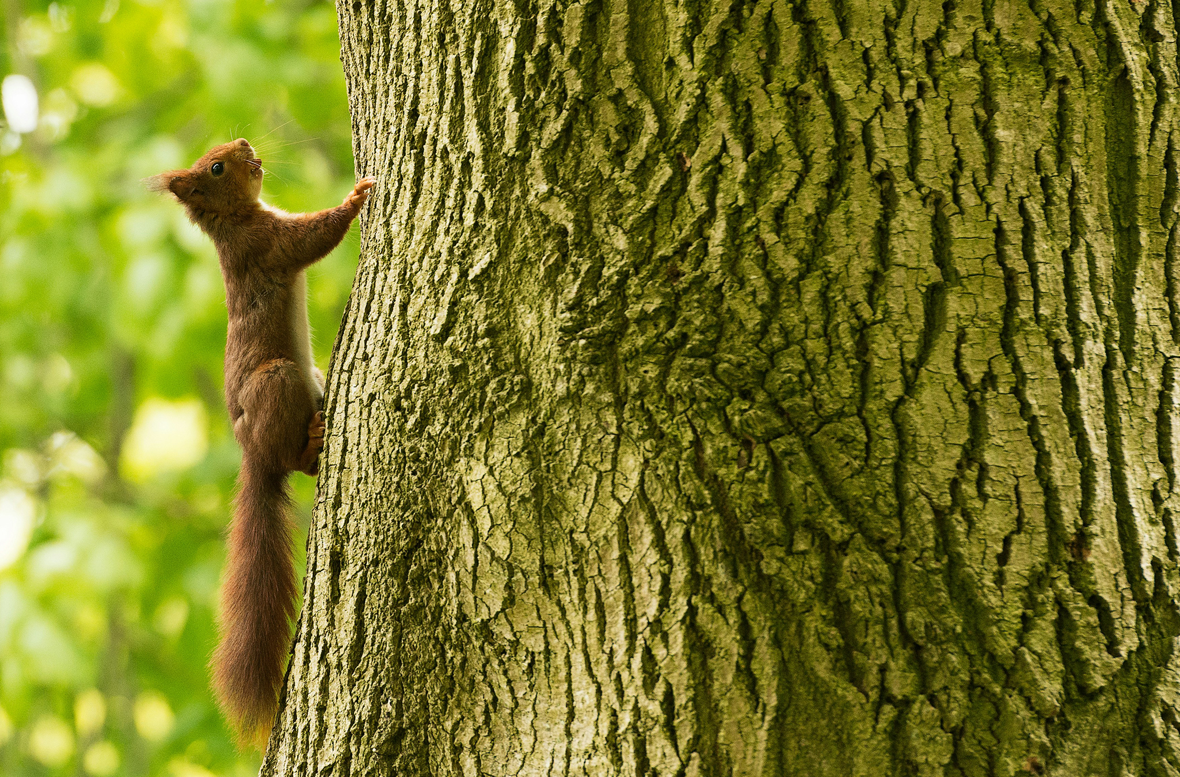
Behavioral Biology
Behavior is the change in activity of an organism in response to a stimulus.
Behavioral biology: study of biological and evolutionary bases for animal behavior
Draws from ethology, comparative psychology, and neurobiology
Examines how behaviors evolve through natural selection
Aims to distinguish innate (genetic) from learned (environmental) behaviors
45.5 Figure 1: This squirrel darts up a tree when alerted to danger. This stimulus-inspired action is part of the animal's behavior.
Vincent van Zalinge on Unsplash. "Squirrel."

Slide 4
Innate and Learned Behaviors
Innate behaviors: genetically programmed, independent of environment
Also called instinct
No risk of an incorrect behavior being learned since they are "hardwired"
Learned behaviors: acquired through experience
More flexible but riskier
Can be altered according to environmental changes

Slide 5
Innate Behaviors: Movement and Migration
Innate/instinctual behaviors rely on stimuli-response mechanisms.
Reflex action: involuntary and rapid response to a stimulus
Example: the "knee-jerk" reflex
Includes kinesis, taxis, and fixed action patterns

Slide 6
Kinesis
Kinesis: undirected movement in response to a stimulus
Helps organisms randomly find more favorable environments
Orthokinesis: change in movement speed in response to a stimulus
Example: woodlice increasing their movement speed when exposed to high or low temperatures
Klinokinesis: increase in turning behaviors
Example: E. coli

Slide 7
Taxis
Taxis: directed movement towards or away from a stimulus
Can be in response to light (phototaxis), chemicals (chemotaxis), or gravity (geotaxis)
Can be positive (towards) or negative (away from) the stimulus
Example: positive chemotaxis in Tetrahymena thermophila in response to a chemoattractant gradient

Slide 8
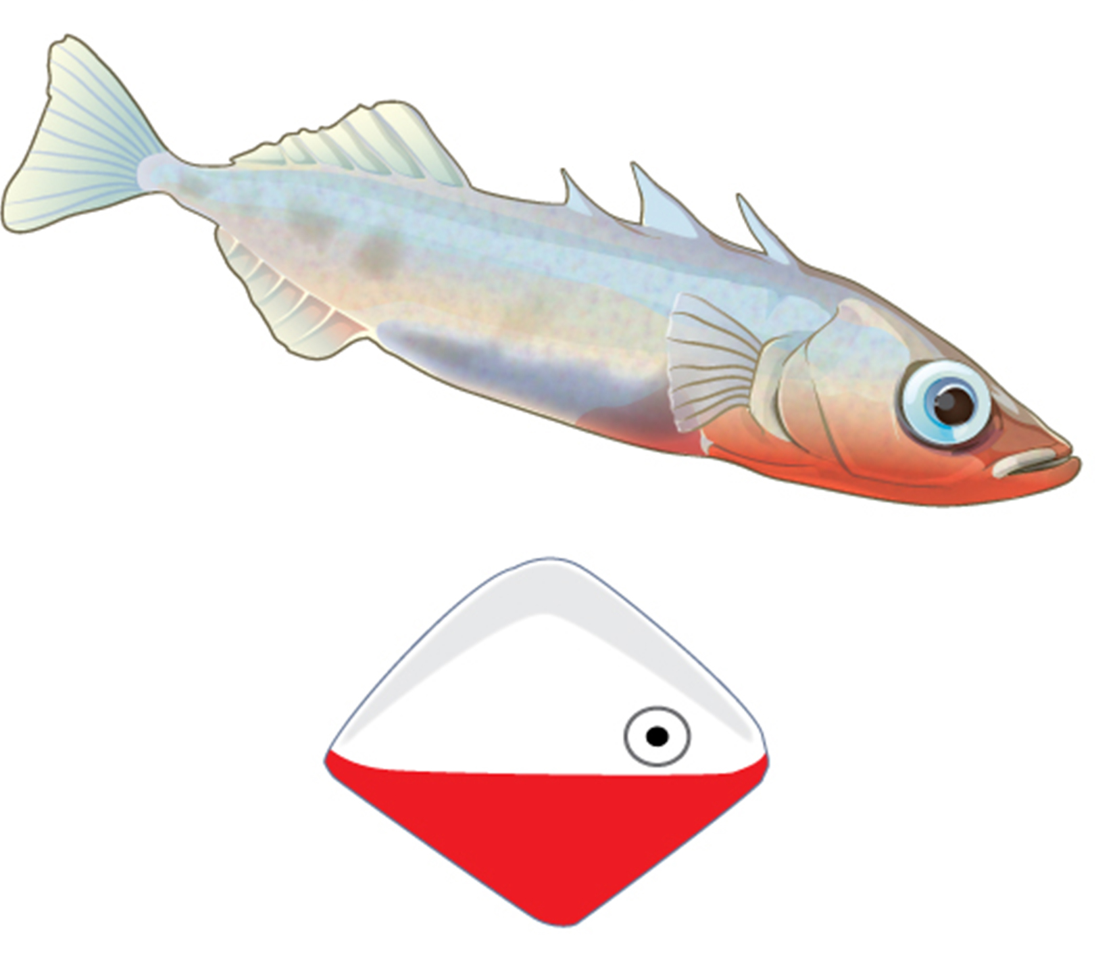
Fixed Action Patterns
Fixed action pattern: sequence of behaviors triggered by a stimulus so that, even when it's removed, the pattern goes on to completion
Example: aggressive response of male stickleback fish to red-colored objects
45.5 Figure 2: Male three-spined stickleback fish exhibit a fixed action pattern. During mating season, the males, which develop a bright red belly, react strongly to red-bottomed objects that in no way resemble fish.
CNX OpenStax on Wikimedia Commons. "Stickleback."

Slide 9
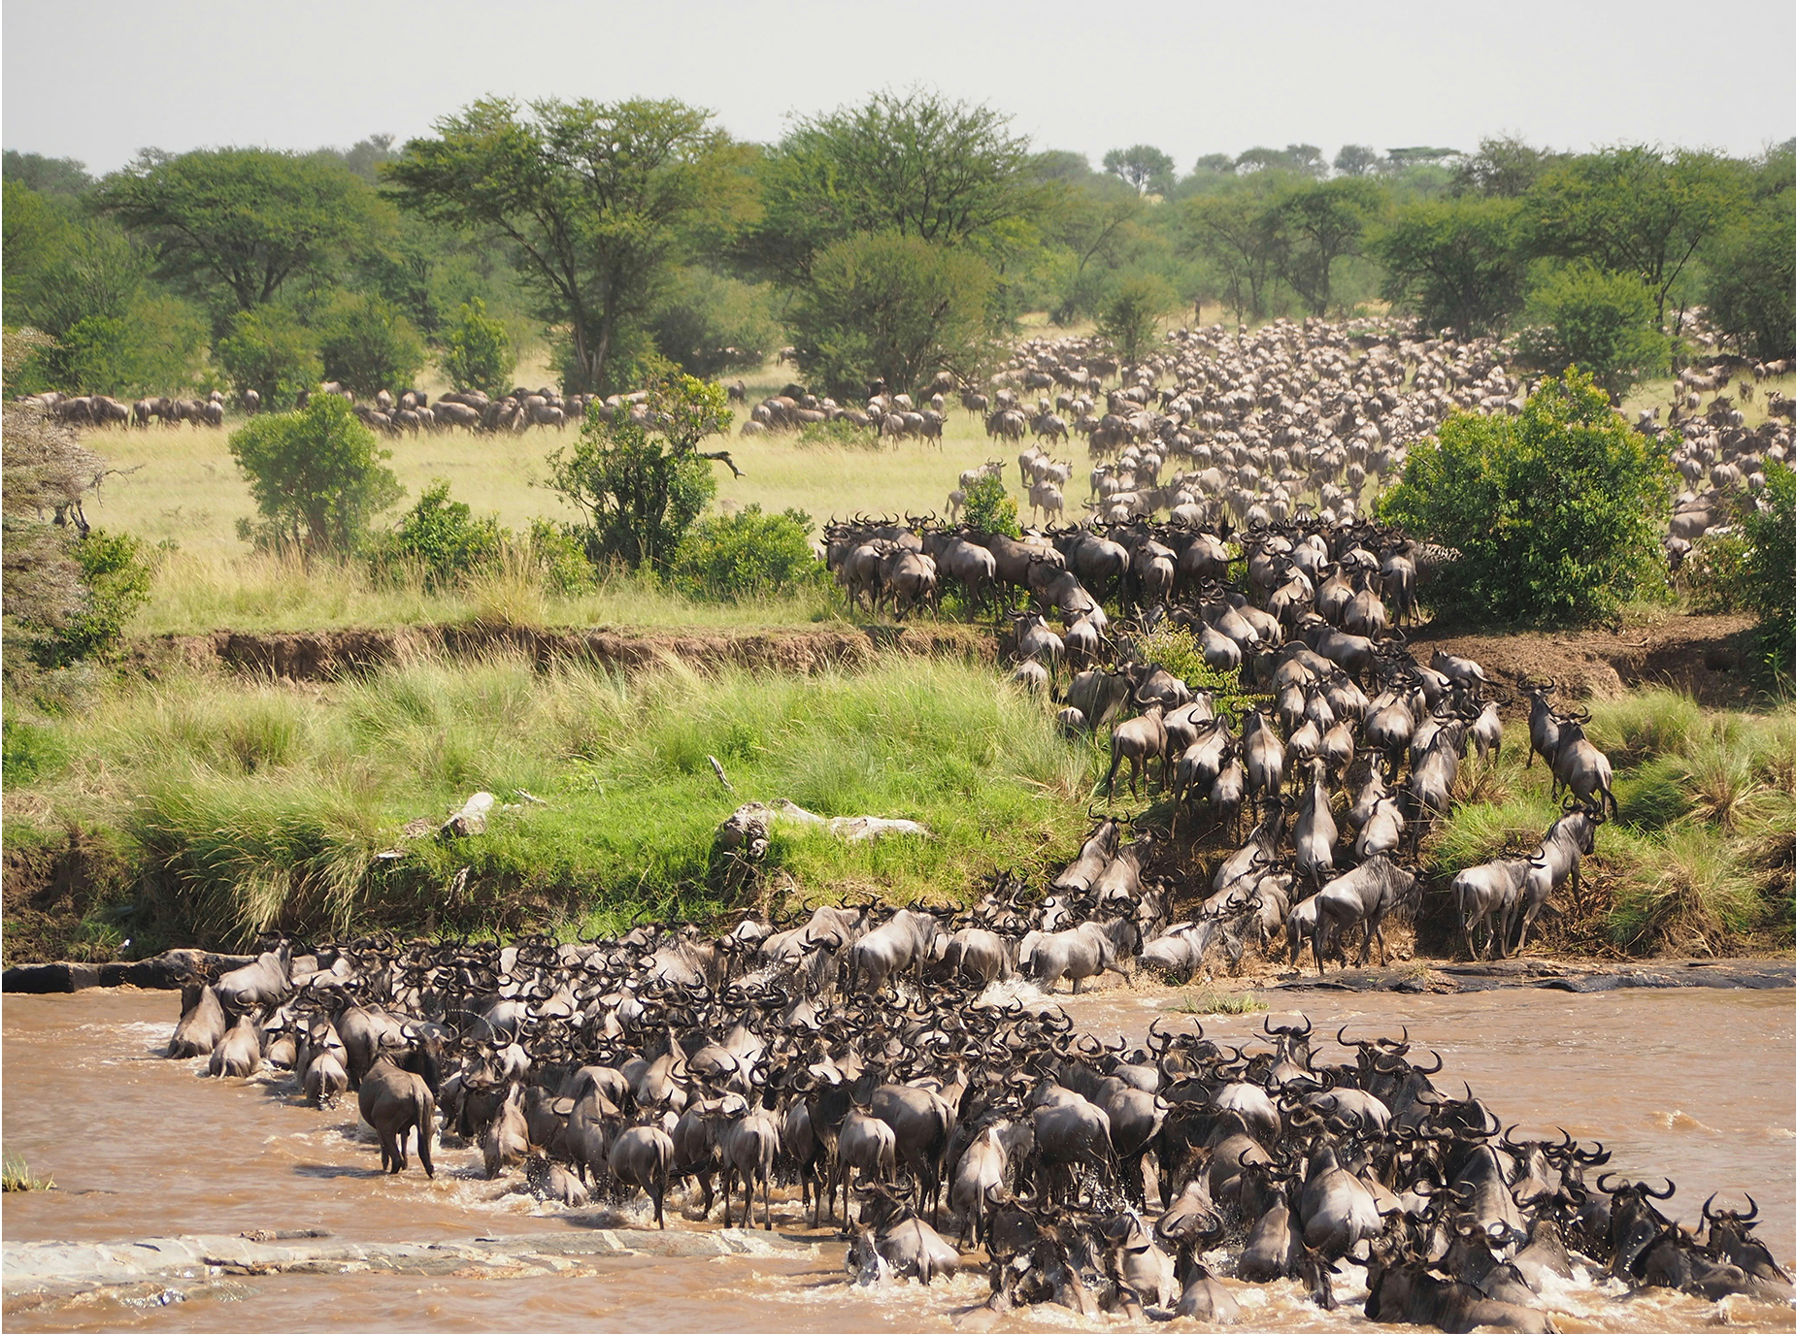
Migration
Migration: long-range seasonal movement of animals
Adaptive response to variation in resource availability
Found in many major animal groups (birds, fish, mammals, etc.)
Can involve incredible feats of endurance and navigation
Example: wildebeests migrating 1,800 miles annually in search of new grasslands
45.5 Figure 3: Wildebeests migrate in a clockwise fashion over 1,800 miles each year in search of rain-ripened grass.
Jorge Tung on Unsplash. "Wildebeests."

Slide 10
Types of Migration
Migration is thought to be innate, but there are different levels:
Obligate: always migrate
Facultative: optional migration based on conditions
Incomplete: only part of population migrates

Slide 11
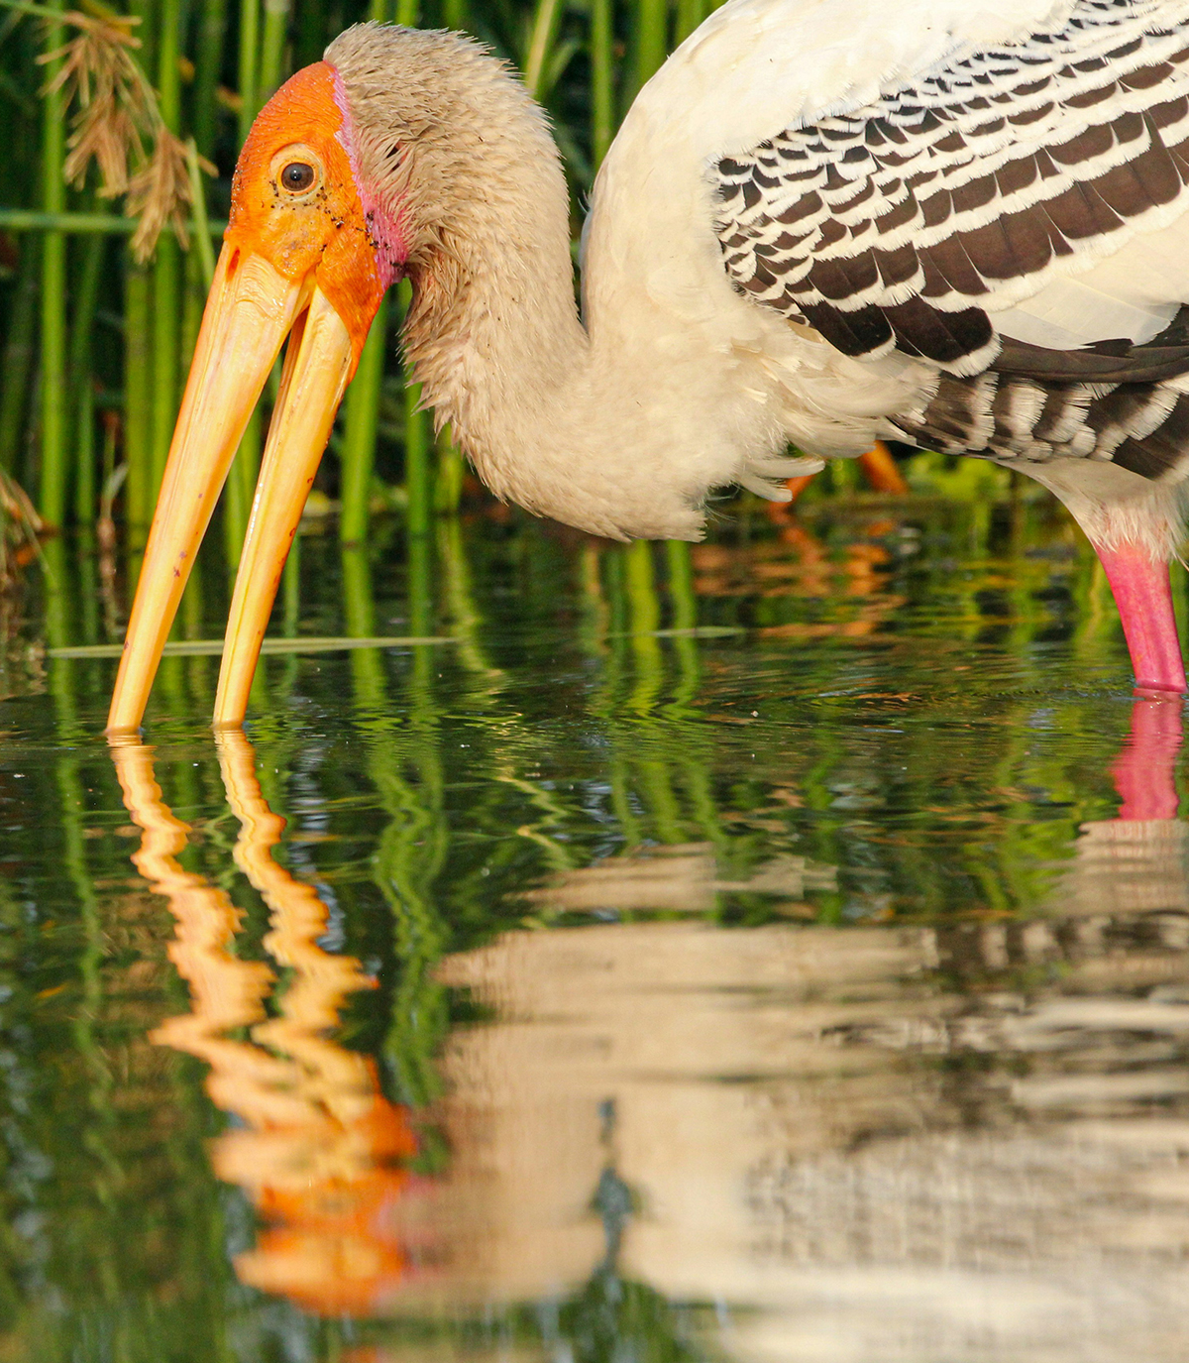
Foraging
Foraging: act of searching for and exploiting food resources
Optimal foraging behaviors: maximize energy gain and minimize expenditure
Favored by natural selection
Example: specialized beak of painted stork for searching marshland for crabs and other food
45.5 Figure 4: The stork uses its long beak to forage.
Omkar Rane on Unsplash. "Stork."

Slide 12
Innate Behaviors: Living in Groups
All animals, those living in groups and those living alone, must mate.
Mating: involves one animal signaling another to communicate the desire to mate
Mating rituals: types of energy-intensive behaviors or displays associated with mating
Other behaviors are classified as selfish, altruistic, or cooperative based on who benefits.
Involve some form of communication between individuals

Slide 13
Signals
Animals communicate with each other using stimuli known as signals.
Can be visual (courtship and aggressive displays), chemical (pheromones), auditory (sound), or tactile (touch)
May be innate, learned, or a combination
Different from human language communication
Example: three-spined stickleback aggressively responding to the visual signal of a red region on another fish

Slide 14
Pheromones
Pheromones: secreted chemical signals that elicit specific behaviors in others of the same species
Common in social insects for various functions
Used by many species to attract the opposite sex, sound alarms, mark food trails, and elicit complex behaviors
May play a role in human behavior (axillary steroids) and physiology

Slide 15
Songs
Songs are an example of an aural signal, or one that needs to be heard.
Examples:
In birds, used to identify the species and to attract mates
In whales, low frequency that travels long distances underwater
In dolphins, used for communication with each other and other species of dolphins
In crickets, chirping sounds to attract a mate, repel other males, and announce a successful mating

Slide 16
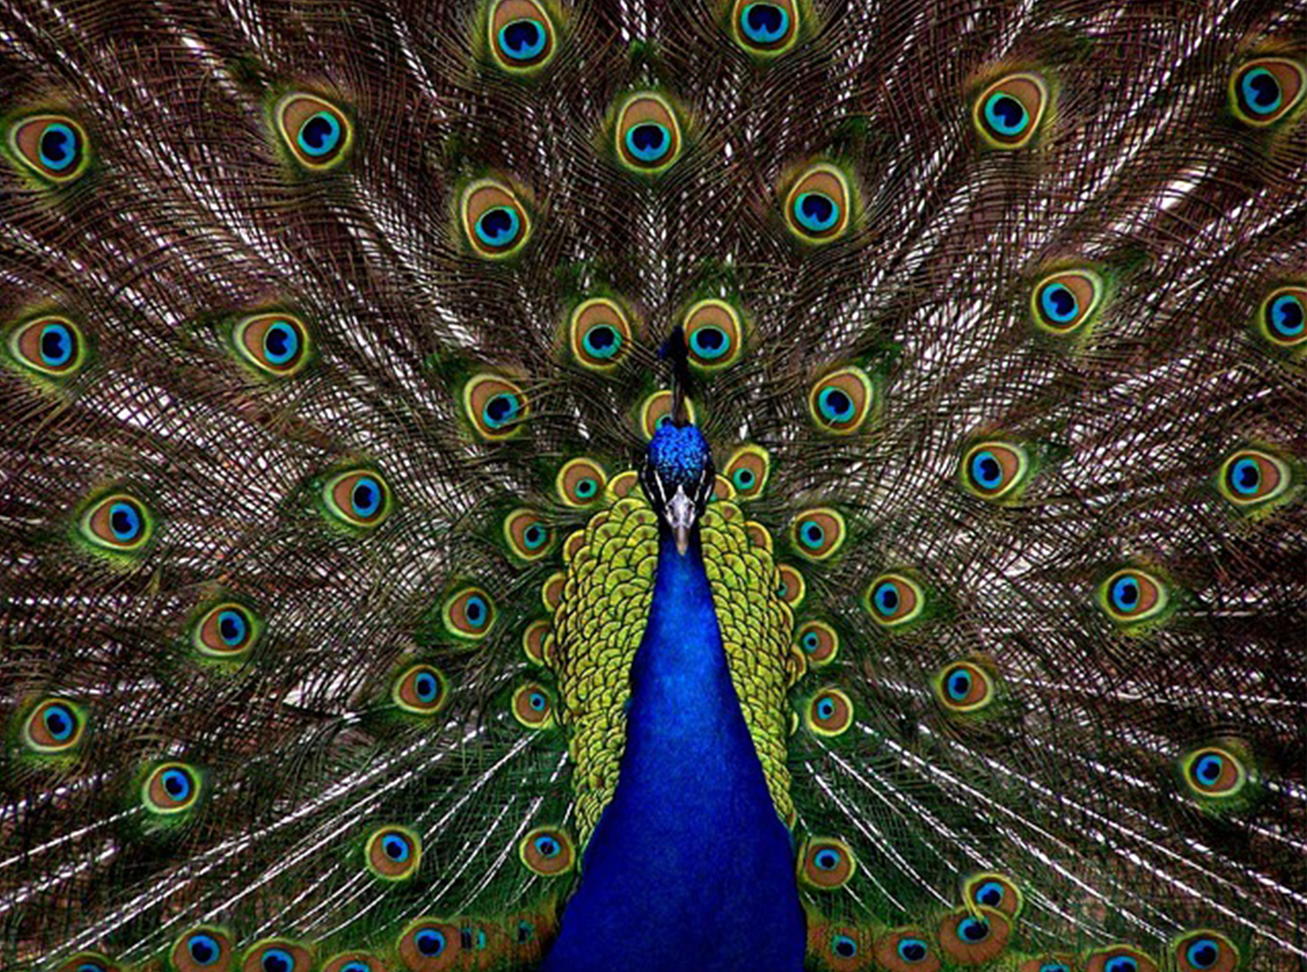
Courtship Displays
Courtship displays are ritualized visual behaviors to attract mates.
Often involve a series of steps between males and females
If incorrect or proper response not given, can lead to abandonment of mating attempt
Example: elaborate tail displays of peacocks
45.5 Figure 5: This peacock's courtship display is designed to attract potential mates.
PublicDomainPictures on Pixabay. "Peacock."

Slide 17
Reflection Question₁
What are some examples of human courtship displays? What about aggressive displays?
Notes:
The reflection question is included here to use as a talking point or for a think-pair-share activity.

Slide 18
Aggressive Displays
Aggressive displays are visual signals of aggression or willingness to fight.
May serve to reduce actual fighting between conspecifics (members of the same species)
Allow assessment of opponent's fighting ability
May involve bluffing or exaggeration of fighting prowess

Slide 19
Distraction Displays & Touch
Distraction displays are designed to attract a predator away from the nest.
Seen in birds and some fish
Example of altruistic behavior benefiting the young
Many animals also communicate through touch.
Tactile communication common in primates
Include behaviors like grooming, embracing, lip contact, greeting ceremonies, and others

Slide 20
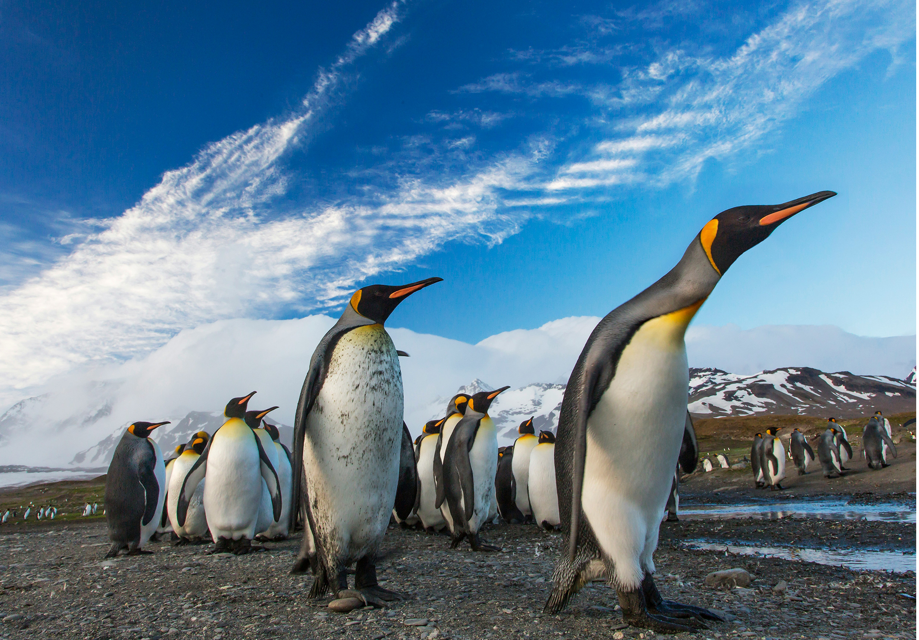
Altruistic Behaviors
Altruistic behaviors are actions that lower individual fitness but increase the fitness of others
Examples: worker bees, meerkat sentries, and food sharing in wolves
One explanation for altruistic behavior is that natural selection acts at the gene level rather than the whole organism.
Individuals sacrificing their own survival to benefit a relative ("selfish gene")
Example: penguins migrating in harsh conditions to feed their young
45.5 Figure 6: Emperor penguins migrate miles to make sure their young are fed.
Ian Parker on Unsplash. "Penguins."

Slide 21
An Extreme Example: Eusocial Insects₁
Eusocial insects are highly social insects with a division of labor in their large colonies (ants, bees, and wasps).
Most individuals are sterile workers caring for the queen's offspring to the point of sacrificing their own lives.
This extreme altruism is thought to be related to the unique genetic systems of these insects.
In bees, all workers are offspring of the queen (50% of her genetics), and the sisters share 75%.
Helping the queen ensures the bees' genes are passed on.

Slide 22
An Extreme Example: Eusocial Insects₂
Lowering of individual fitness (direct ability to survive and reproduce) to enhance reproductive fitness
Inclusive fitness: organism's total ability to pass on its genes to the next generation
Kin selection: selection for behaviors that enhance the reproductive ability of one's relatives
Can explain seemingly altruistic behaviors (birds providing food to sibling's offspring)

Slide 23
Altruistic Behavior in Unrelated Individuals
Defies the "selfish gene" explanation
Occurs in some species, like reciprocal grooming in primates
Explained by reciprocal altruism: mutual benefit over time
Requires repeated interactions and punishment of cheaters (those that never "give back")

Slide 24
Are Altruistic Behaviors Truly Altruistic?
Many seemingly altruistic behaviors have selfish components.
Game theory reveals hidden benefits to apparently selfless acts.
The terms selfish and altruism may not apply well to instinctual animal behaviors since they describe human behaviors.
Behaviors that increase inclusive fitness are favored by natural selection.

Slide 25
Group Activity
For part one, work in small groups. Pick one movie that contains altruistic behaviors or decision-making. Be sure to choose a film that all group members have seen. Consider a significant altruistic behavior or decision made during the movie's plot. As a group, brainstorm ways that this altruistic behavior may not be "pure altruism" and write them down. If your group concludes that the film depicts an act of "true altruism," then write that down instead.
For part two, your group will partner with a second group and take turns briefly sharing your movie analyses. Challenge each other to identify any aspects of "non-altruistic" behavior that may have been missed.

Slide 26
Reflection Question₂
So far, we've discussed behaviors directed towards members of the same species. Seemingly altruistic behaviors can also occur between members of different species. Experience this account of dolphins helping a human. Do you think this is an example of true altruism, or do you have another explanation for why the dolphins exhibited this behavior?
Notes:
The reflection question is included here to use as a talking point or for a think-pair-share activity.

Slide 27
Finding Sex Partners
Two types of selection:
Intersexual selection: individuals of one sex choose mates of the other sex
Often complex since mate selection may be based on visual, aural, tactile, and chemical cues
Example: when female peacocks choose to mate with the male with the brightest plumage
Leads to traits that may not enhance survival but appear attractive
Intrasexual selection: competition for mates between species members of the same sex
Involves mating displays and aggressive mating rituals
Example: rams butting heads
Uses up energy but results in healthiest, strongest, and/or most dominant individuals for mating

Slide 28
Monogamous Mating
Monogamous mating: one male mates with one female for at least one breeding season
Can involve lifelong pair bonds in some species (e.g. wolves)
"Mate-guarding hypothesis": males stay with the female to prevent other males from mating with her
Advantageous when mates are scarce
"Male-assistance hypothesis": males that help guard and rear their young will have more and healthier offspring
Common in birds where both parents provide significant care
"Female-enforcement hypothesis": female ensures that the male does not have other offspring that might compete with her own
Actively interferes with the male's signaling

Slide 29
Polygynous Mating₁
Polygynous mating: one male mates with multiple females
Involves female providing the most parental care since single male has too many offspring
Resource-based polygyny: males compete for resource-rich territories and then mate with females that enter the territory
Example: yellow-rumped honeyguide males defending beehives because the females feed on the wax

Slide 30
Polygynous Mating₂
Harem mating: alpha male dominates the mating within the group
Example: elephant seals
Lek system: communal courting area where several males perform elaborate displays for females, and the females chose their mate from the group
Example: several bird species, including the sage grouse and prairie chicken

Slide 31
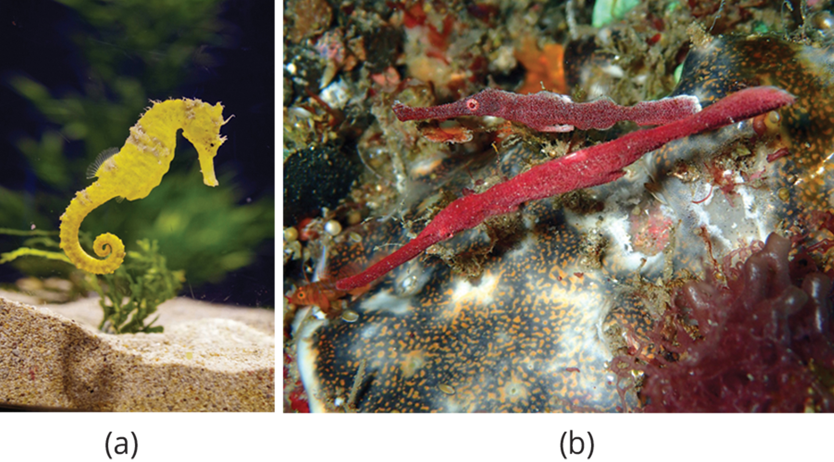
Polyandrous Mating
Polyandrous mating: one female mates with many males
Rarest mating system among animals
Example: pipefish and seahorses where males care for eggs
Allows females to produce more offspring than they could care for alone
45.5 Figure 7: Polyandrous mating, in which one female mates with many males, occurs in the (a) seahorse and the (b) pipefish.
Valkyrie Pierce on Unsplash. "Seahorse."
Kevin Mc Loughlin on Pixabay. "Pipefish."

Slide 32
Simple Learned Behaviors
Modified by experience unlike innate behaviors
Can have instinctive components
Allow adaptation to environmental changes
Include habituation and imprinting
Important in maturation and development of young animals

Slide 33
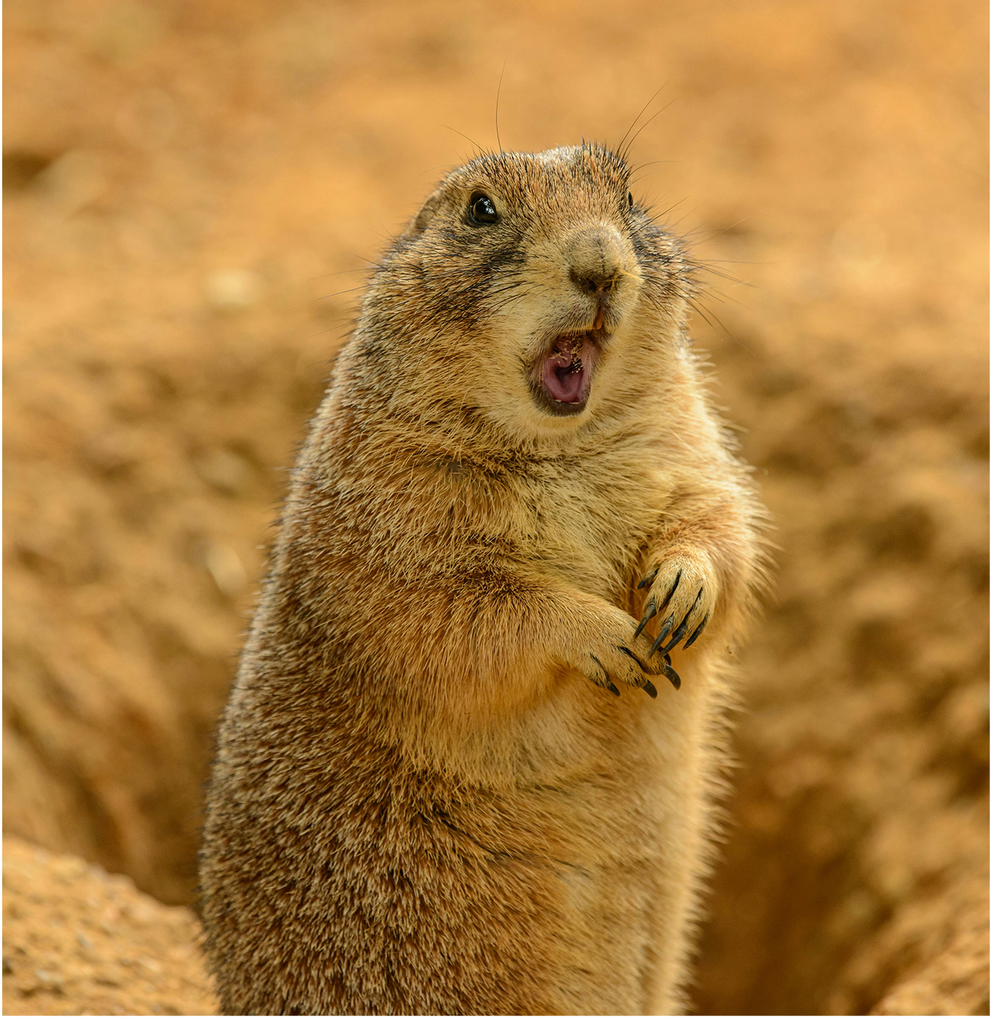
Habituation
Habituation: an animal stops responding to a stimulus after a period of repeated exposure
Form of nonassociative learning, since stimulus is not associated with any punishment or reward
Example: prairie dogs habituating to the sound of human footsteps
45.5 Figure 8: Prairie dogs sound the alarm when alerted to a predator; though in captivity, they become habituated to human footsteps when no harm comes from the sound.
Petr Ganaj on Pexels. "Prairie dog."

Slide 34
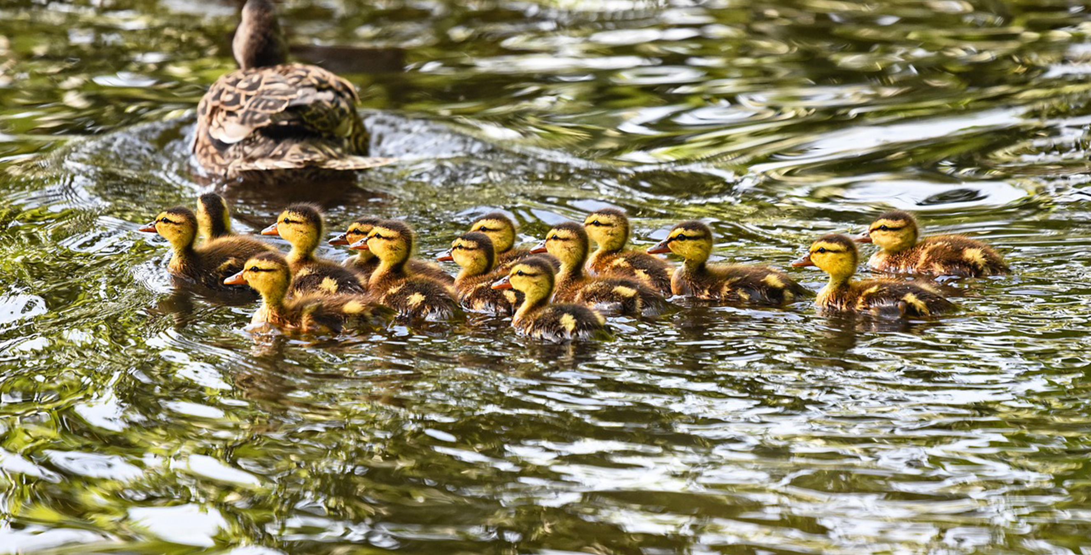
Imprinting
Imprinting: rapid learning at a specific age or life stage, independent of the species involved
Another form of nonassociative learning
Critical for survival in some species
Example: ducklings following their mother
Can occur on inappropriate objects/individuals if exposed at critical period
Example: ducklings following a human instead of their mother if they see the human first
45.5 Figure 9: The attachment of ducklings to their mother is an example of imprinting.
MabelAmber on Pixabay. "Ducklings."

Slide 35
Conditioned Behavior
Conditioned behavior: a stimulus becomes associated with a consequence
Type of associative learning
Two main types: classical and operant

Slide 36
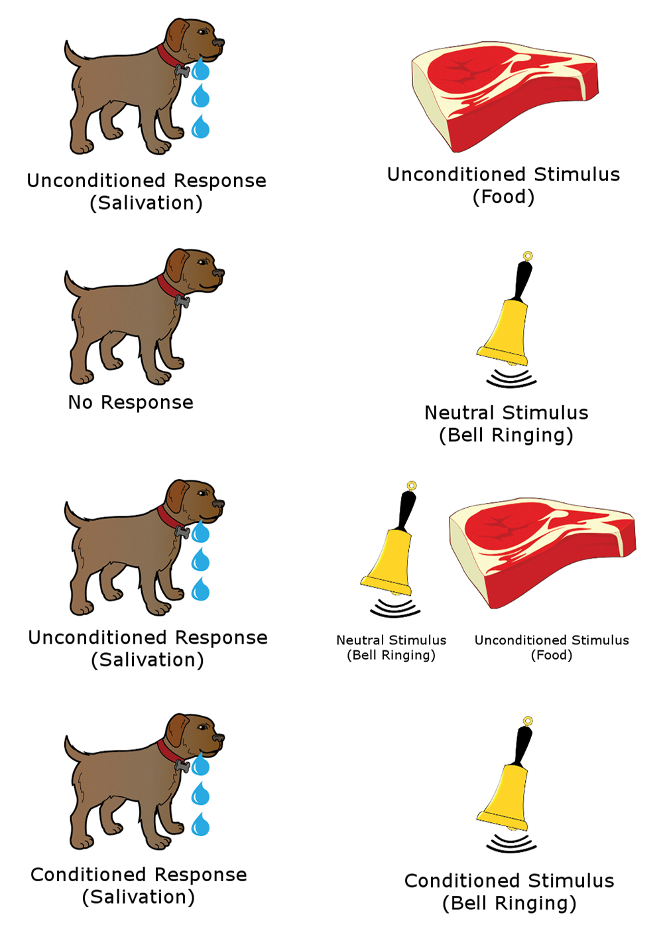
Classical Conditioning₁
Classical conditioning: a response is associated with a stimulus that it had previously not been associated with (conditioned stimulus)
Unconditioned response: response to the original, unconditioned stimulus
After repeated pairings, neutral stimulus alone eliciting a response
Famous example: Pavlov's experiments with dogs
45.5 Figure 10: In the classic Pavlovian response, the dog becomes conditioned to associate the ringing of the bell with food.
Salehi.s on Wikimedia Commons. "Classical conditioning."

Slide 37
Classical Conditioning₂
Conditioned response may differ slightly from unconditioned response.
Some conditioning can occur in a single pairing.
Classical conditioning is a major tenet of behaviorism in psychology.
Proposed that all behaviors could be explained by conditioning

Slide 38
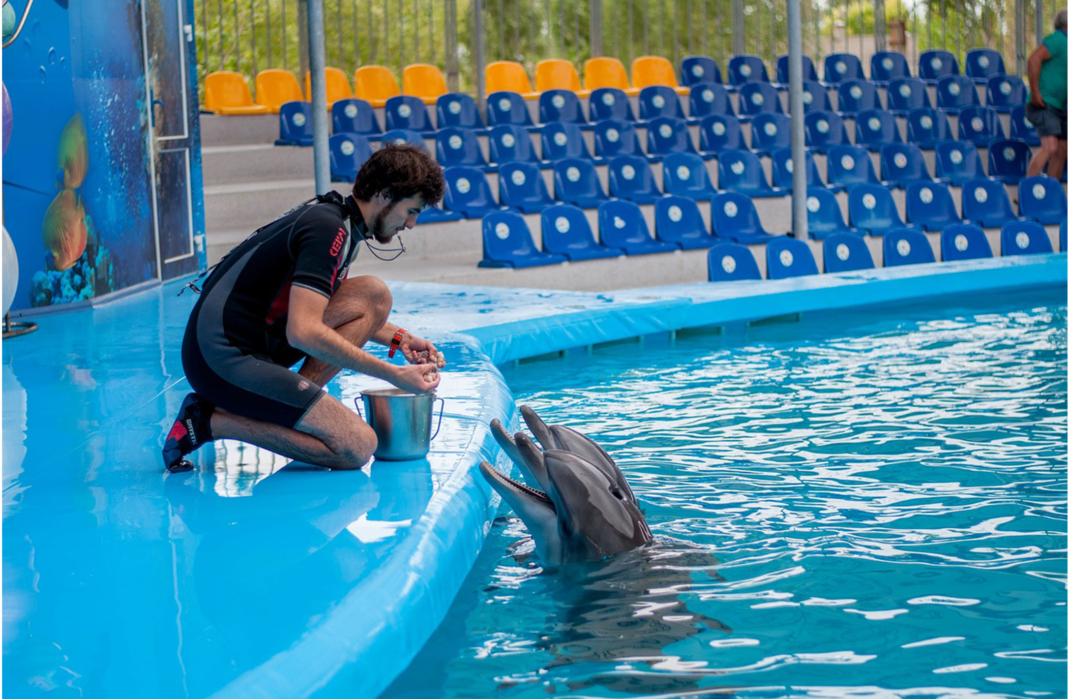
Operant Conditioning₁
Operant conditioning: conditioned behavior is gradually modified by its consequences as the animal responds to the stimulus
Studied extensively by B. F. Skinner using "Skinner boxes" with rats
Basis for most animal training techniques
Continually modified by positive (reward) or negative (punishment) reinforcement
Associates type of behavior with the punishment or reward
Example: dolphins performing tricks
45.5 Figure 11: The training of dolphins by rewarding them with food is an example of positive reinforcement operant conditioning.
vladimir1973 on Pixabay. "Dolphin and trainer."

Slide 39
Operant Conditioning₂
B. F. Skinner believed an animal could be taught to perform any trick with the right conditioning.
Other research determined that conditioning can be overridden or disrupted by innate behaviors ("instinctual drift").
Example: Keller and Marian Breland's trained raccoons to deposit coins in a toy bank in exchange for food.
Initially successful, but eventually raccoons started dipping the coins in the bank and rubbing the coins between their paws.
Racoons exhibit this behavior with their food, so the coin experiment triggered a fixed action pattern in them.
Highlighted complexity of animal behavior beyond simple conditioning

Slide 40
Cognitive Learning
Cognitive learning: the manipulation of information using the mind
Once thought unique to humans, now recognized in many species
Example: birds, dolphins, whales, and primates imitating behavior of others, taking instruction, and engaging in reasoning or apparent thought
Involves reasoning, problem-solving, and abstract thought
Enhanced by multiple sensory inputs and past experiences

Slide 41
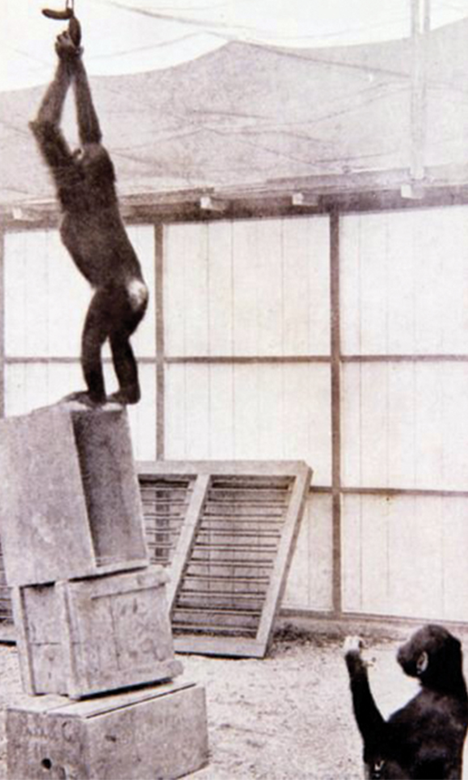
Cognitive Learning and Primates
Classic studies by Wolfgang Köhler with chimpanzees
Demonstrated abstract problem-solving (stacking boxes to reach food)
Implies ability to mentally visualize solutions before acting
Indicative of higher cognitive abilities in primates
45.5 Figure 12: Wolfgang Köhler's work with chimpanzees suggested they could visualize the result of stacking the boxes before they had performed the action.
Kurt.Köhler on Wikimedia Commons. "Chimpanzees."

Slide 42
Think It Through
This video shows a wild crow using water displacement to reach a piece of food in a graduated cylinder. Is this kind of behavior more akin to cognitive learning or to operant conditioning?
Notes:
Originally an On Your Own. This is included here to use as a talking point or for a think-pair-share activity.

Slide 43
Cognitive Learning and Rats
Early maze experiments by H. C. Blodgett in the 1920s showed cognitive abilities in rats.
Group I rats ran in one trial per day and had food available each day after completion.
Learned quickly and figured out the maze in seven days
Group II rats were not fed for the first six days and then food was provided on subsequent runs.
Learned slowly for the six days and did not catch up to Group I until food was given
Group III rats had food available on the third day and every day after.
Did not learn much during three days without food but caught up once food was given

Slide 44
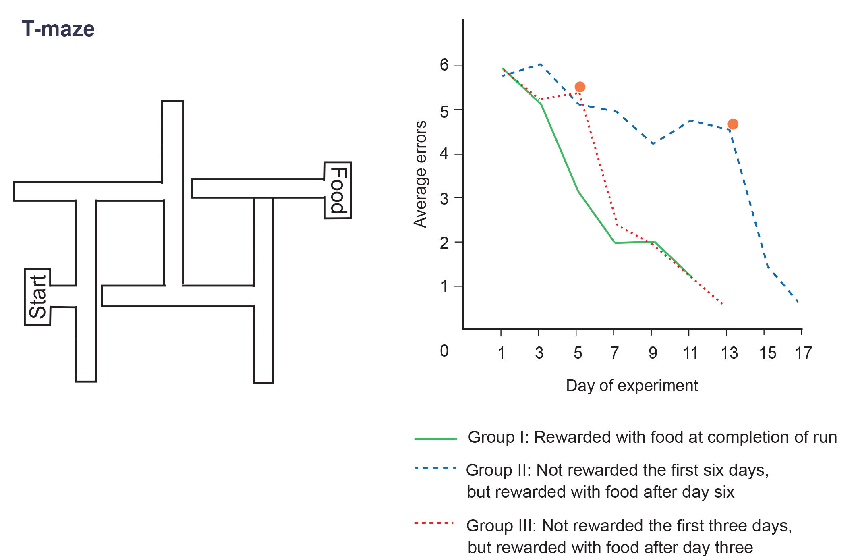
45.5 Figure 13
CNX OpenStax on Wikimedia Commons. "T-maze."
Notes:
Group I rats (the green solid line) found food at the end of each trial, Group II (the blue dashed line) did not find food for the first six days, and Group III (the red dotted line) did not find food during runs on the first three days. Notice that rats given food earlier learned faster and eventually caught up to the control group. The orange dots on the Group II and Group III lines show the days when food rewards were added to the mazes.

Slide 45
Cognitive Maps
E. C. Tolman demonstrated a decade later that Blodgett's rats formed "cognitive maps" of mazes rather than just conditioned responses.
Cognitive maps: mental representations of spatial environments
Demonstrated that cognitive learning is not limited to humans
Led to discovery of specialized place cells in mammalian brains that are responsible for cognitive map creation

Slide 46
Sociobiology₁
Sociobiology aims to understand social behaviors in terms of evolution.
Popularized by E. O. Wilson in the 1970s
Defined it as "the extension of population biology and evolutionary theory to social organization" (Wilson, 2004)
Argues animal and human behavior can be partly explained in terms of genetics and natural selection
Controversial, especially when applied to human behavior
Criticized by Stephen Jay Gould for ignoring the environmental effects on behavior
Example of "nature versus nurture" debate

Slide 47
Sociobiology₂
Not the same as "biological determinism," though some have associated the two
Biological determinism: the belief that all behaviors are hardwired into our genes
Undisputed that certain behaviors can be inherited, and that natural selection plays a role
Controversial in application to human behavior
Remains an active area of research and debate in behavioral biology

Slide 48
Reflection Question₃
What do you think about sociobiology? Do you think that animal and human behavior has a genetic component and that some behaviors can be explained in terms of natural selection? Explain why or why not.
Notes:
The reflection question is included here to use as a talking point or for a think-pair-share activity.

Slide 49
Summary
Behaviors are responses to stimuli.
Can be innate (genetically programmed) or learned (environmentally influenced)
Innate behaviors include mating systems and communication methods.
Learned behaviors include habituation, imprinting, conditioning, and cognitive learning.

Slide 50

End of Hawkes Learning PowerPoint

