Slide 1
Lesson 46.1
Ecosystem Ecology

Slide 2
Objectives
Explain the basics of ecosystems and ways they retain or lose stability.
Explain the methods that ecologists use to study ecosystem structure and dynamics.
Differentiate between food chains and food webs and recognize the importance of each.
Identify the different methods of ecosystem modeling.

Slide 3
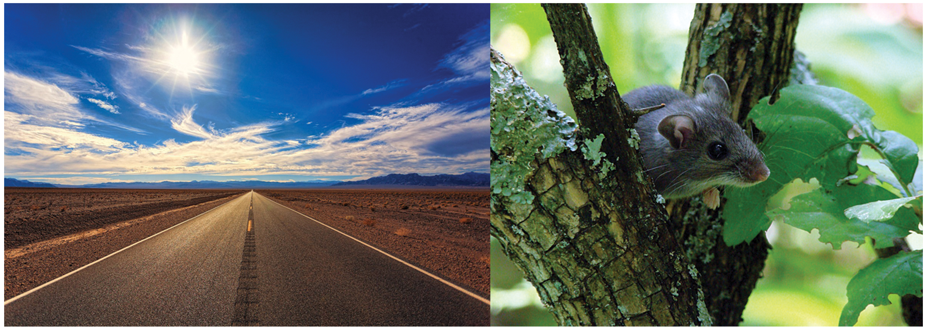
Ecosystems
In 1993, a rare lung disease with a high fatality rate struck the southwestern United States, primarily affecting Native Americans.
The Centers for Disease Control and Prevention (CDC) was called in to investigate the unknown disease.
The cause was identified as the Sin Nombre hantavirus within a few weeks.
Navajo healers had observed a connection between rainfall, mice populations, and disease outbreaks, highlighting the importance of understanding ecosystem dynamics and traditional knowledge.
From their insights, scientists were able to characterize the disease and implement health measures.
46.1 Figure 1: In the southwestern United States, rainy weather causes an increase in production of pinyon nuts, causing the deer mouse population to explode. Deer mice may carry a virus called Sin Nombre that causes respiratory disease in humans and has a high fatality rate.
USFWS Mountain-Prairie on Wikimedia Commons. "Deer mouse."

Slide 4
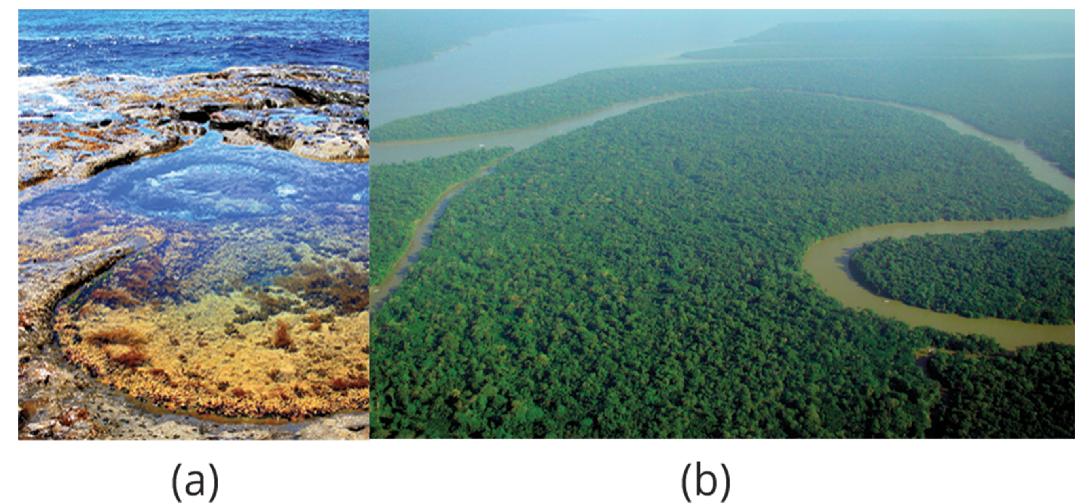
Ecosystem Ecology₁
Life in an ecosystem is often about competition for limited resources including organic material, sunlight, and mineral nutrients.
Critical factors influencing community dynamics include a habitats latitude, amount of rainfall, topography (elevation), and available species.
An ecosystem is a community of living organisms and all the abiotic (nonliving) features of the environment with which they interact.
46.1 Figure 2: (a) A tidal pool on Pebbly Beach, New South Wales, is a small ecosystem, while (b) the Amazon rainforest in Brazil is a large ecosystem.
Merbabu on Wikimedia Commons. "Tida pool."
lubasi on Wikimedia Commons. "Amazon rainforest."

Slide 5
Ecosystem Ecology₂
There are three categories of ecosystems: fresh water, ocean, and terrestrial.
Ocean ecosystems are the most abundant, making up 70% of the Earth's surface and including:
Shallow ocean: including coral reef ecosystems
Deep ocean water: including diverse marine organisms
Deep ocean surfaces: including plankton and krill
Freshwater ecosystems are the rarest, occurring on only 1.8% of Earth's surface and including lakes, rivers, streams, and springs.
Terrestrial ecosystems are grouped into biomes such as tropical rain forests, deserts, coniferous forests, deciduous forests, and tundra.

Slide 6
Think It Through₁
Classify each ecosystem as saltwater, freshwater, or terrestrial.
Arctic Ocean
Mississippi River
Atlantic Ocean
Sahara Desert
Yellowstone National Park
Lake Superior
Notes:
Originally an On Your Own. This is included here to use as a talking point or for a think-pair-share activity.

Slide 7
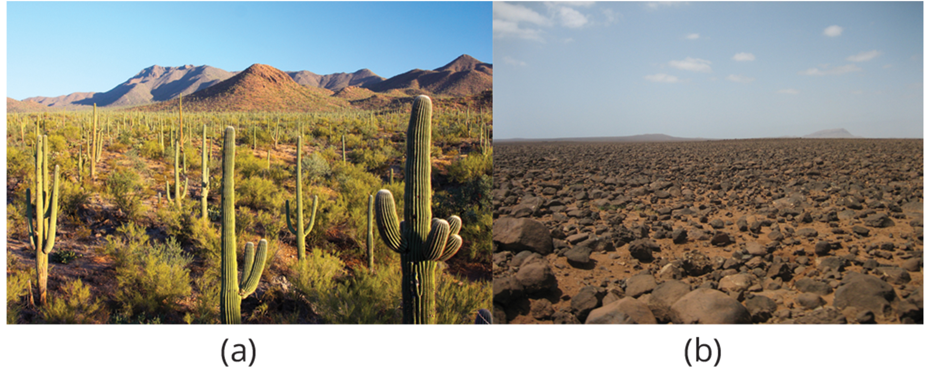
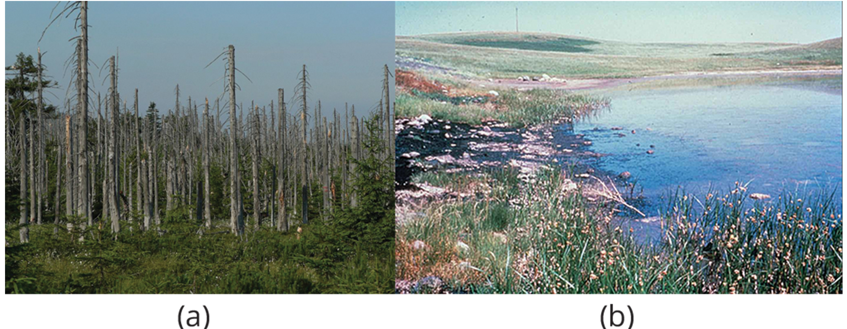
Ecosystem Ecology₃
Ecosystems are routinely exposed to various disturbances (natural and man made) in the environment that affect their compositions:
Yearly variations in rainfall and temperature
Slower processes of plant growth
Human agricultural practices
Air pollution
Acid rain
Global deforestation
Overfishing
Eutrophication
Oil spills
Waste dumping
46.1 Figure 3: Desert ecosystems, like all ecosystems, can vary greatly. The desert in (a) Saguaro National Park, Arizona, has abundant plant life, while the rocky desert of (b) Boa Vista island, Cape Verde, Africa, is devoid of plant life.
Joe Parks on Wikimedia Commons. "Saguaro National Park."
46.1 Figure 4: Environmental disturbances are of great interest to conservation biologists. For example, (a) acid rain results in loss of trees. (b) Oil spills significantly affect the health of an ecosystem.
Lovecz on Wikimedia Commons. "Acid rain effects."
U.S. Fish and Wildlife Service. "Oil spill."

Slide 8
Ecosystem Ecology₄
Equilibrium is the steady state of an ecosystem where all organisms are in balance with their environment and with each other.
Two parameters measure changes in ecosystems:
Resistance is the ability of an ecosystem to remain at equilibrium despite disturbances.
Resistance is the ability of an ecosystem to remain at equilibrium despite disturbances.

Slide 9
Food Chains and Food Webs₁
In ecology, a food chain is a linear sequence of organisms through which nutrients and energy pass; primary producers, primary consumers, and higher-level consumers are used to describe ecosystem structure and dynamics.
Each organism in a food chain occupies a position known as a trophic level.
Primary producers are photosynthetic organisms (plants and/or phytoplankton).
Primary consumers eat primary producers (herbivores).
Secondary consumers (often carnivores) eat primary consumers.
Tertiary consumers (carnivores) eat other carnivores.
An apex consumer is the organism at the top of the food chain.

Slide 10
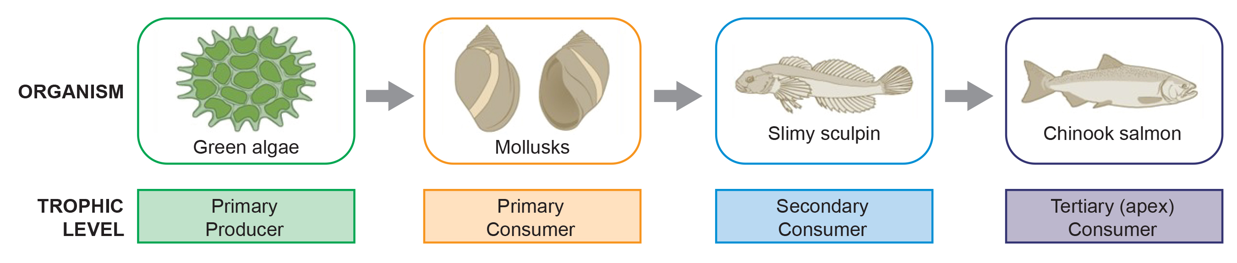
46.1 Figure 5
CNX OpenStax on Wikimedia Commons. "Trophic levels." Modified.
Notes:
These are the trophic levels of a food chain in Lake Ontario at the United States-Canada border. Energy and nutrients flow from photosynthetic green algae at the bottom of the food chain up to the top of the food chain: the Chinook salmon.

Slide 11
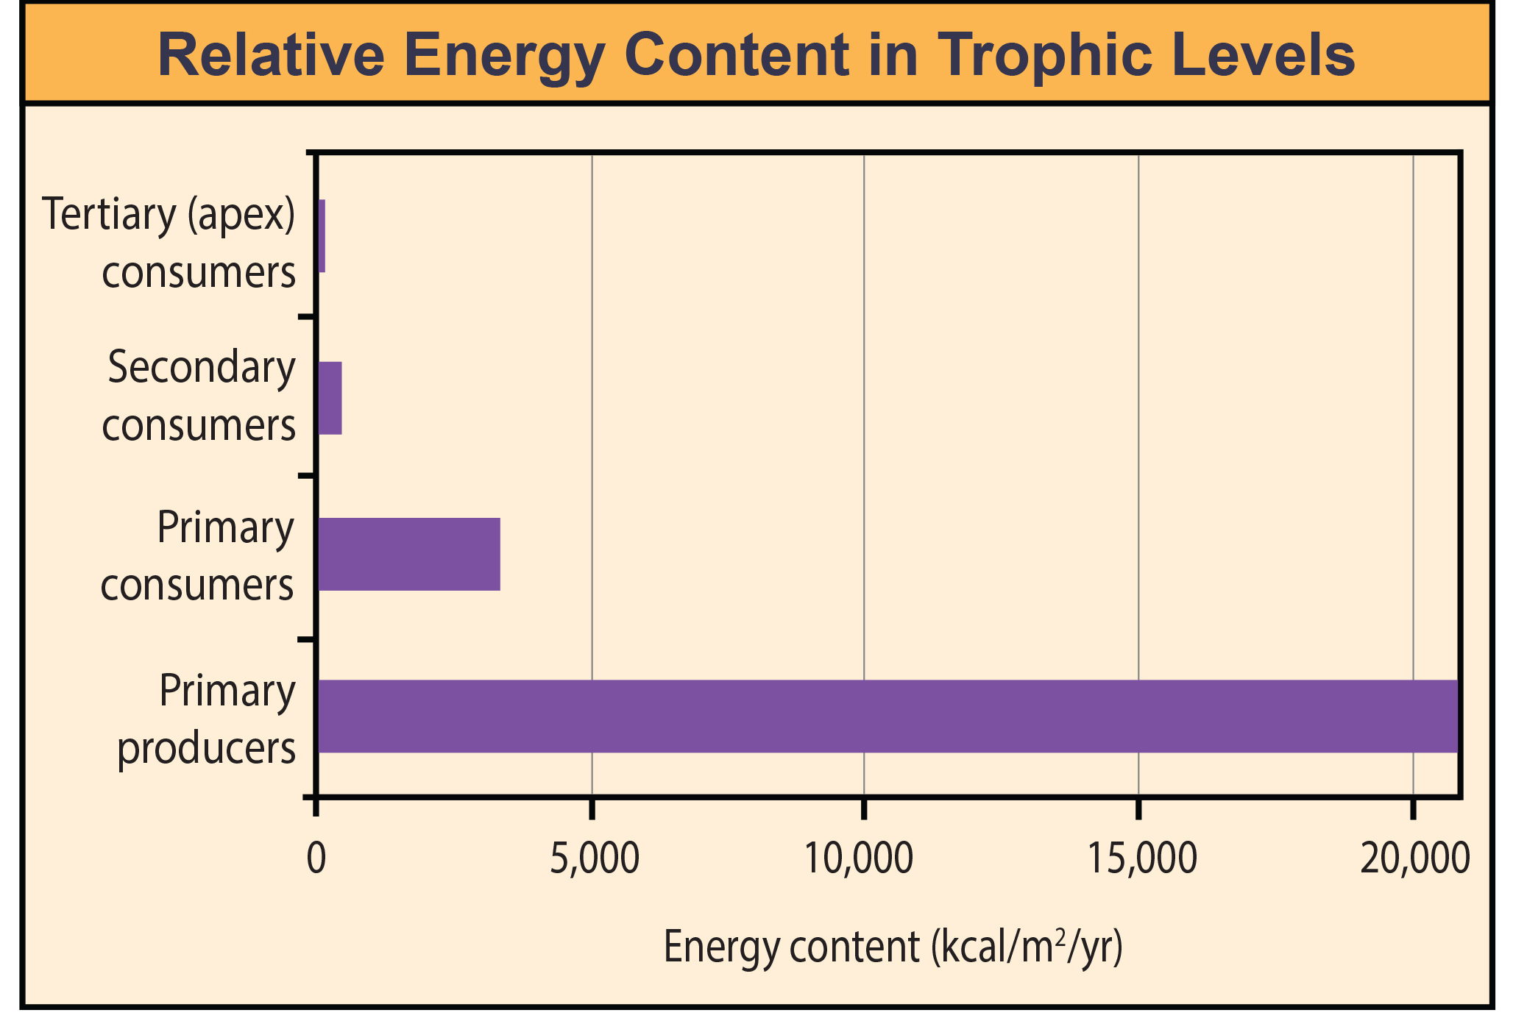
Food Chains and Food Webs₂
Energy is lost as heat between each trophic level due to the second law of thermodynamics.
After a limited number of trophic energy transfers, the amount of energy remaining in the food chain may not be great enough to support viable populations at yet a higher trophic level.
46.1 Figure 6: The relative energy in trophic levels in a Silver Springs, Florida, ecosystem is shown. Each trophic level has less energy available and supports fewer organisms at the next level.
CNX OpenStax on Wikimedia Commons. "Energy in trophic levels."

Slide 12
Food Chains and Food Webs₃
A food web is a graphic representation of a holistic, nonlinear web of primary producers, primary consumers, and higher-level consumers used to describe ecosystem structure and dynamics.
Considers that:
Some organisms can feed on species from more than one trophic level
Some organisms can be eaten by species from multiple trophic levels

Slide 13
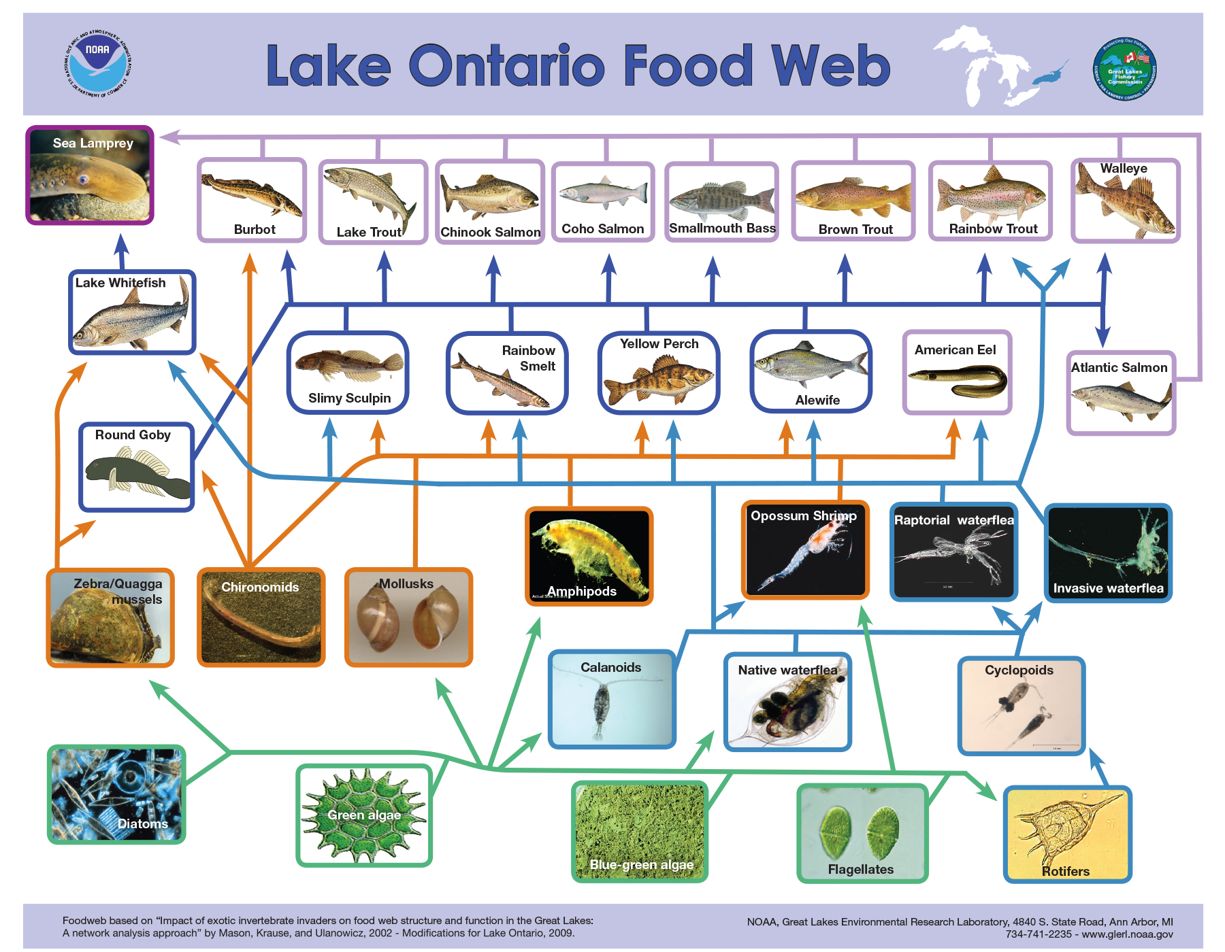
46.1 Figure 7A
National Oceanic and Atmospheric Administration. "Food web."
Notes:
This food web shows the interactions between organisms across trophic levels in the Lake Ontario ecosystem. Primary producers are outlined in the bottom row (green), primary consumers in the row above the bottom (orange), secondary consumers in the row below the top row (blue), and tertiary (apex) consumers in the top row (purple). Arrows point from an organism that is consumed to the organism that consumes it. Notice how some lines point to more than one trophic level. For example, the opossum shrimp eats both primary producers and primary consumers.

Slide 14
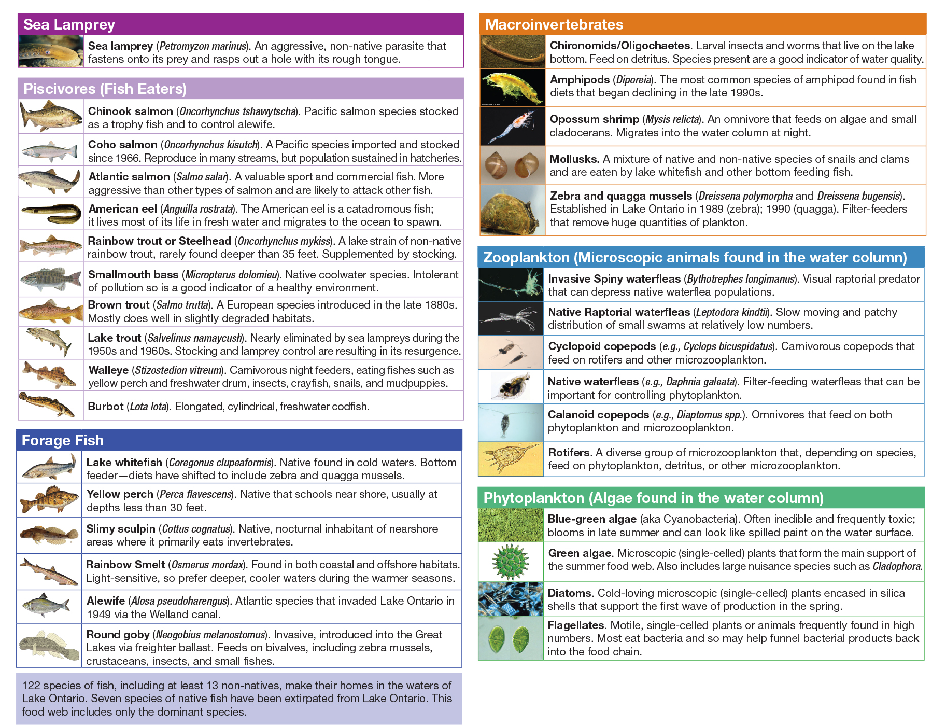
46.1 Figure 7B
National Oceanic and Atmospheric Administration. "Food web."
Notes:
This food web shows the interactions between organisms across trophic levels in the Lake Ontario ecosystem. Primary producers are outlined in the bottom row (green), primary consumers in the row above the bottom (orange), secondary consumers in the row below the top row (blue), and tertiary (apex) consumers in the top row (purple).

Slide 15
Group Activity₁
Visit this website to access photos taken from a trail camera in Gorongosa National Park.
Navigate through the photos of each species and predict the trophic level (producer, primary consumer, secondary consumer, or tertiary consumer) of each species. You can use the "Field Guide" to help make your predictions. Record your reasons for your predictions and compare your predictions with the rest of your group.

Slide 16
Food Chains and Food Webs₄
Two general types of food webs are often shown interacting within a single ecosystem:
A grazing food web has plants or other photosynthetic organisms at its base, followed by herbivores and various carnivores.
A detrital food web consists of a base of organisms that feed on decaying organic matter (dead organisms), called decomposers or detritivores.
For example, in a meadow ecosystem, plants may support a grazing food web of different organisms, primary and other levels of consumers, while also supporting a detrital food web of bacteria, fungi, and detritivorous invertebrates feeding off dead plants and animals.

Slide 17
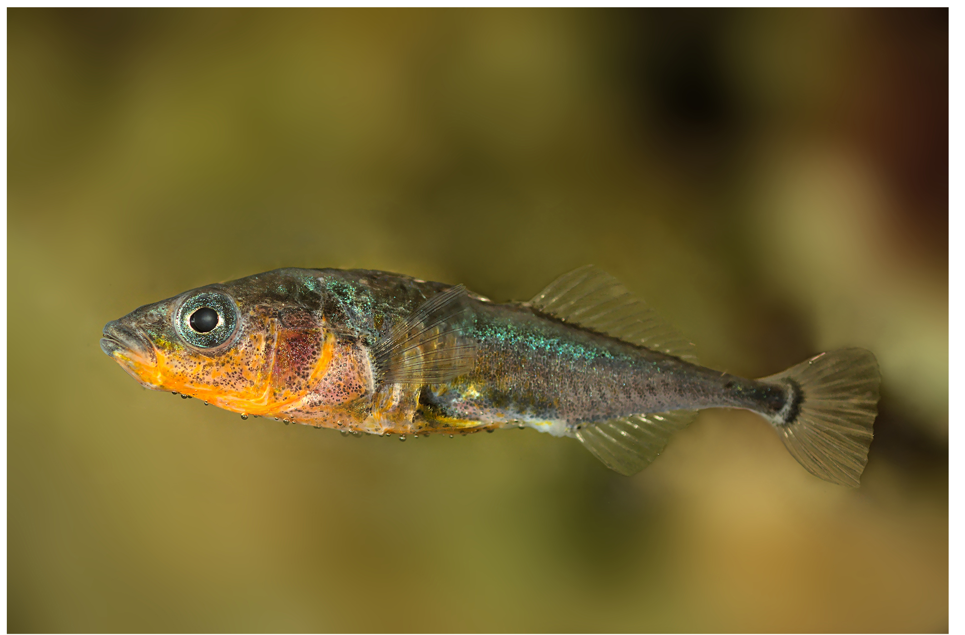
Evolution Connection
Three-Spined Stickleback
Dr. Luke Harmon's 2009 study demonstrated that the evolution of organisms into subspecies can directly affect their ecosystem environment.
The study focused on three-spined sticklebacks that evolved from saltwater to freshwater fish about 10,000 years ago, developing into single or double species in isolated lakes.
Researchers created artificial pond microcosms to study the effects of single-species and double-species stickleback populations.
They discovered that tanks with two-species fish had larger dissolved organic carbon (DOC) particles, resulting in darker water and less algal blooming, while single-species tanks had smaller DOC particles and more algal growth.
This study reveals that species evolution, and environmental changes can have reciprocal effects, potentially impacting the survival of other organisms in the ecosystem.
46.1 Figure 8: The three-spined stickleback evolved from a saltwater fish to a freshwater fish.
Gilles San Martin on Wikimedia Commons. "Three-spined stickleback."

Slide 18
Research into Ecosystem Dynamics: Ecosystem Experimentation and Modeling₁
Ecosystem dynamics: study of the changes in ecosystem structure caused by changes in the environment (disturbances) or by internal forces
Can be studied in controlled or natural systems:
A holistic ecosystem model quantifies the composition, interaction, and dynamics of entire natural ecosystems; it is the most representative of the ecosystem in its natural state, but is limited by time, expense, as well as feasibility and ethics.
Controlled conditions may change the dynamics of the system and include:
Mesocosm: outdoor experimental system that reflects that natural environment
Microcosm: an artificial, simplified ecosystem entirely in an indoor or outdoor experimental system

Slide 19
Research into Ecosystem Dynamics: Ecosystem Experimentation and Modeling₂
Scientists use the data generated by these experimental studies to develop ecosystem models that demonstrate the structure and dynamics of ecosystems.
A conceptual model consists of flow charts to show interactions of different compartments of the living and nonliving components of the ecosystem.
An analytical model is created using simple mathematical formulas to predict the effects of environmental disturbances on ecosystem structure and dynamics.
A simulation model is created using complex computer algorithms to holistically model ecosystems and to predict the effects of environmental disturbances on ecosystem structure and dynamics.

Slide 20
Group Activity₂
Break up into a group of 4–10, trying to maintain an even number of members in your group. Half the members of your group will design a simple ecological experiment taking the mesocosm approach. The other half is tasked with designing a simple ecological experiment taking the microcosm approach. Once you are done with your respective tasks, combine your team once more, and share your experiment with the other group. The other group will identify the strengths and weaknesses of your experiment. Switch roles and complete the exercise.

Slide 21
Conceptual Models
Conceptual models, often depicted as flow charts, are used to describe ecosystem structure, dynamics, and relationships between organisms and their environment.
These models, also called compartment models, group organisms and resources into specific compartments with arrows showing energy or nutrient transfer.
In modeling mineral nutrient cycling, nutrients are divided into bioavailable and non-bioavailable forms.
For example, carbon is available to plants in the form of carbon dioxide gas, but not as carbon-rich coal.

Slide 22
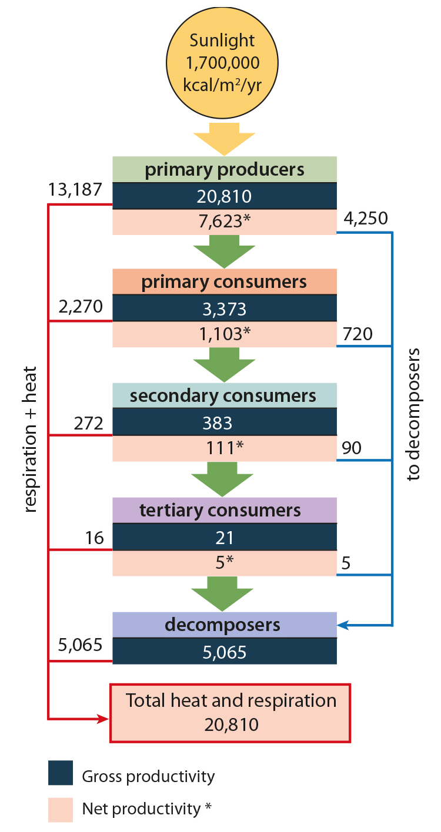
Think It Through₂
Why do you think the value for gross productivity of the primary producers is the same as the value for total heat and respiration (20,810 kcal/m2/yr)?
46.1 Figure 9: This conceptual model shows the flow of energy through a spring ecosystem in Silver Springs, Florida. Notice that the energy decreases with each increase in trophic level.
CNX OpenStax on Wikimedia Commons. "Gross productivity and net productivity." Modified.
Notes:
Originally an On Your Own. This is included here to use as a talking point or for a think-pair-share activity.

Slide 23
Analytical and Simulation Models
Conceptual models are limited in their ability to predict consequences of changes in ecosystem species and environment.
Ecosystems are dynamic and subject to various disturbances, often moving toward or away from equilibrium states.
Analytical models, while potentially powerful, are mathematically complex and may oversimplify ecosystems.
Simulation models, especially individual-based simulations using supercomputers, offer the most accurate predictions of ecosystem responses to disturbances.

Slide 24
Summary
Ecosystems exist on land, at sea, in the air, and underground.
Different ways of modeling ecosystems are necessary to understand how environmental disturbances will affect ecosystem structure and dynamics.
Conceptual models are useful to show the general relationships between organisms and the flow of materials or energy between them.
Analytical models are used to describe linear food chains, and simulation models work best with holistic food webs.

Slide 25

End of Hawkes Learning PowerPoint

