Slide 1
Lesson 46.2
Energy Flow through Ecosystems

Slide 2
Objectives
Describe how organisms acquire energy in a food web and in associated food chains.
Explain how the efficiency of energy transfers between trophic levels affects ecosystem structure and dynamics.
Discuss trophic levels and how ecological pyramids are used to model them
Discuss biomagnification and its consequences.

Slide 3
Energy Flow through Ecosystems
All living things require energy in one form or another.
Energy is required for many processes including:
  Metabolic pathways
  Assemble macromolecules
Food webs illustrate how energy flows directionally through ecosystems, including how efficiently organisms acquire it, use it, and how much remains for use by other organisms

Slide 4
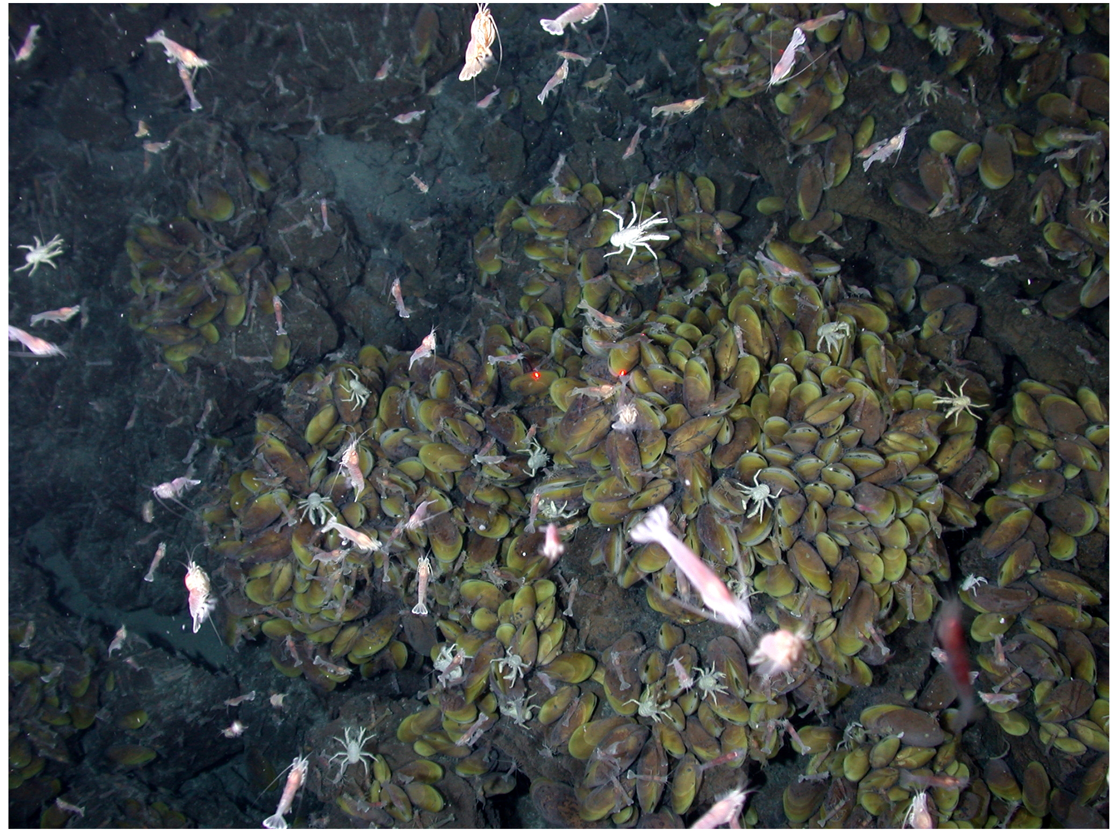
How Organisms Acquire Energy in a Food Web
Energy is acquired by living things in three ways: photosynthesis, chemosynthesis, and the consumption of other organisms.
Autotrophs are organisms capable of synthesizing their own food.
  Photoautotrophs (photosynthetic autotroph) serve as the energy source for most of the world's ecosystems.
  Chemoautotrophs (chemosynthetic autotrophs) are primarily bacteria found where sunlight is not available, such as dark caves or hydrothermal vents at the bottom of the ocean.
    Many near hydrothermal vents use hydrogen sulfide as a chemical energy source.
46.2 Figure 2: Swimming shrimp, a few squat lobsters, and hundreds of vent mussels are seen here at a hydrothermal vent at the bottom of the ocean.
NOAA Photo Library on Wikimedia Commons. "Fauna on hydrothermal vents."

Slide 5
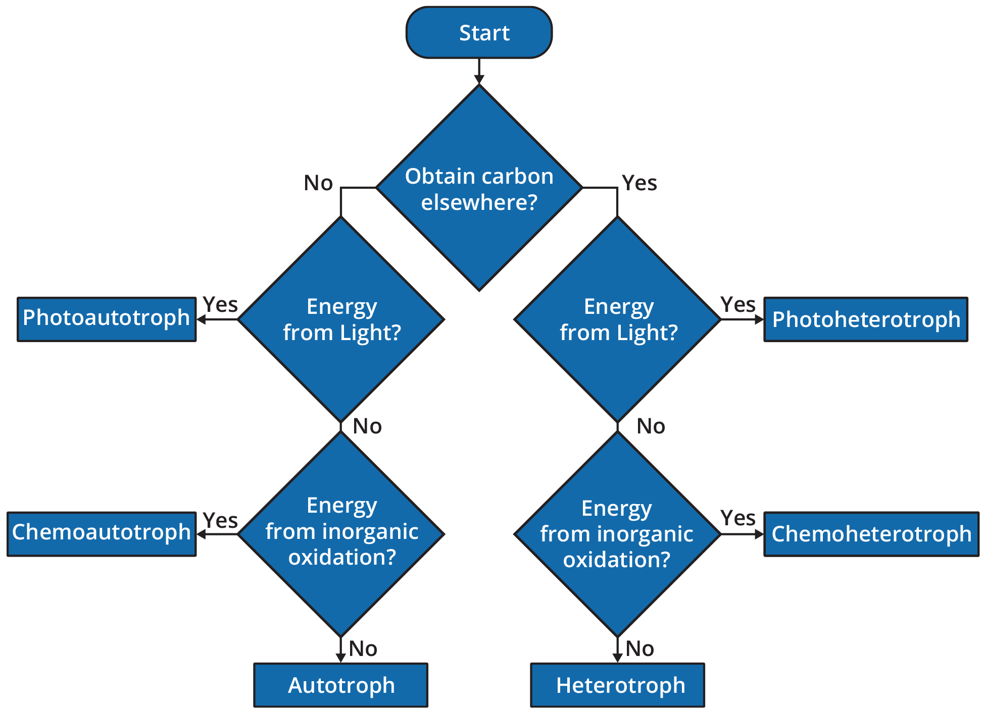
46.2 Figure 1
Cburnett on Wikimedia Commons. "Trophic flow chart."

Slide 6
Productivity within Trophic Levels
Productivity within an ecosystem can be defined as the percentage of energy entering the ecosystem incorporated into biomass in a particular trophic level.
Biomass is the total mass of living or previously living organisms within a trophic level.
The rate at which photosynthetic primary producers incorporate energy from the sun is called gross primary productivity.
Net primary productivity is the energy that remains in the primary producers after accounting for the organisms' respiration and heat loss.

Slide 7
Ecological Efficiency:
The Transfer of Energy between Trophic Levels₁
As energy flows from primary producers through the various trophic levels, the ecosystem loses large amounts of energy (second law of thermodynamics).
The measurement of energy transfer efficiency between two successive trophic levels is termed the trophic level transfer efficiency (TLTE).

Slide 8
Ecological Efficiency:
The Transfer of Energy between Trophic Levels₂
Net production efficiency (NPE) allows ecologists to quantify how efficiently organisms of a particular trophic level incorporate the energy they receive into biomass.
Net consumer productivity is the energy content available to the organisms of the next trophic level.
Assimilation is the biomass (energy content generated per unit area) of the present trophic level after accounting for the energy lost due to incomplete ingestion of food, energy used for respiration, and energy lost as waste.

Slide 9
Ecological Efficiency:
The Transfer of Energy between Trophic Levels₃
NPE measures how efficiently each trophic level uses and incorporates the energy from its food into biomass to fuel the next trophic level.
Ectotherms (organisms that are dependent on external sources of heat) use less energy than endotherms (organisms that produce their own body heat).
  Endotherms generally need more calories.

Slide 10
Think It Through₁
Identify the term associated with the given definition.
Energy content available to the organisms of the next trophic level
The measurement of energy transfer efficiency between two successive trophic levels
Energy that remains in the primary producers after accounting for the organisms' respiration and heat loss
Quantification of how efficiently organisms of a particular trophic level incorporate the energy they receive into biomass
The rate at which photosynthetic primary producers incorporate energy from the sun
Notes:
Originally an On Your Own. This is included here to use as a talking point or for a think-pair-share activity.

Slide 11
Modeling Ecosystems Energy Flow:
Ecological Pyramids
An ecological pyramid shows the relative amounts of various parameters (such as number of organisms, energy, and biomass) across trophic levels.
Pyramids of numbers can be either upright or inverted, depending on the ecosystem.
  Such as the number of organisms usually decrease at each trophic level
Pyramids of biomass measure the amount of energy converted into living tissue at the different trophic levels.

Slide 12
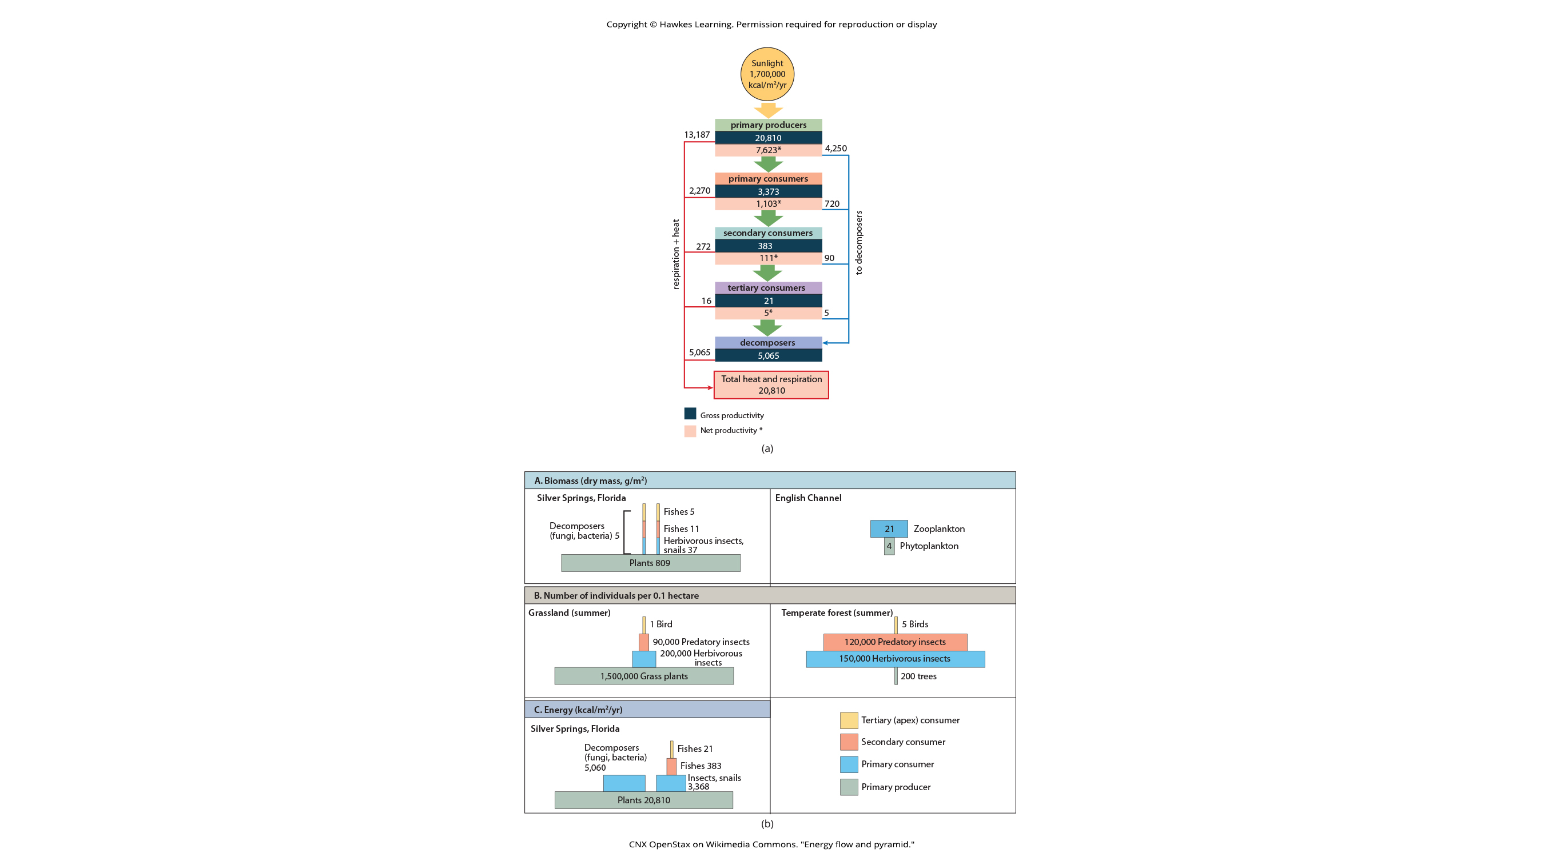
46.2 Figure 3A
CNX OpenStax on Wikimedia Commons. "Energy flow and pyramid."
Notes:
(a) The flow of energy through a sprint ecosystem in Silver Springs, Florida.

Slide 13
46.2 Figure 3B
CNX OpenStax on Wikimedia Commons. "Energy flow and pyramid."
Notes:
Ecological pyramids depict the (A) biomass, (B) number of organisms, and (C) energy in each trophic level.

Slide 14
Think It Through₂
Pyramids depicting the number of organisms or biomass may be inverted, upright, or even diamond shaped. Energy pyramids, however, are always upright. Why?
Notes:
Originally an On Your Own. This is included here to use as a talking point or for a think-pair-share activity.

Slide 15
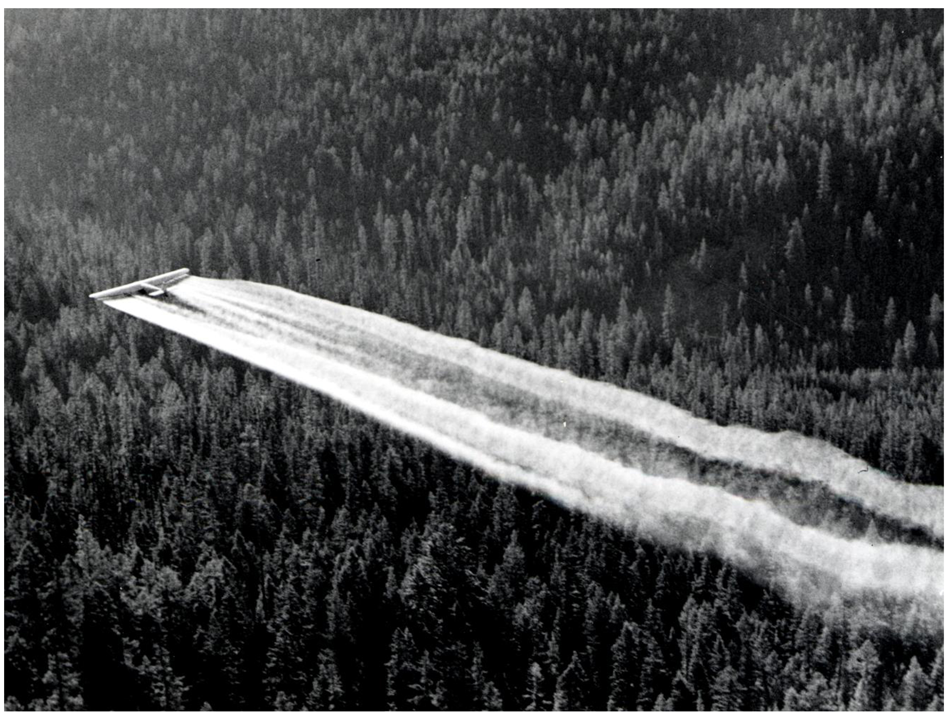
Consequences of Food Webs: Biological Magnification₁
Biomagnification is the increasing concentration of persistent, toxic substances in organisms at each trophic level, from the primary producers to the apex consumers.
Many substances bioaccumulate including dichlorodiphenyltrichloroethane (DDT), a pesticide.
  Bioaccumulation resulted in fragile bird eggshells that increased egg breakage and negatively affected he bird population.
46.2 Figure 4: This picture from 1955 shows a plane spreading DDT across a vast forest area.
R6, State & Private Forestry, Forest Health Protection on Wikimedia Commons. "DDT spraying."

Slide 16
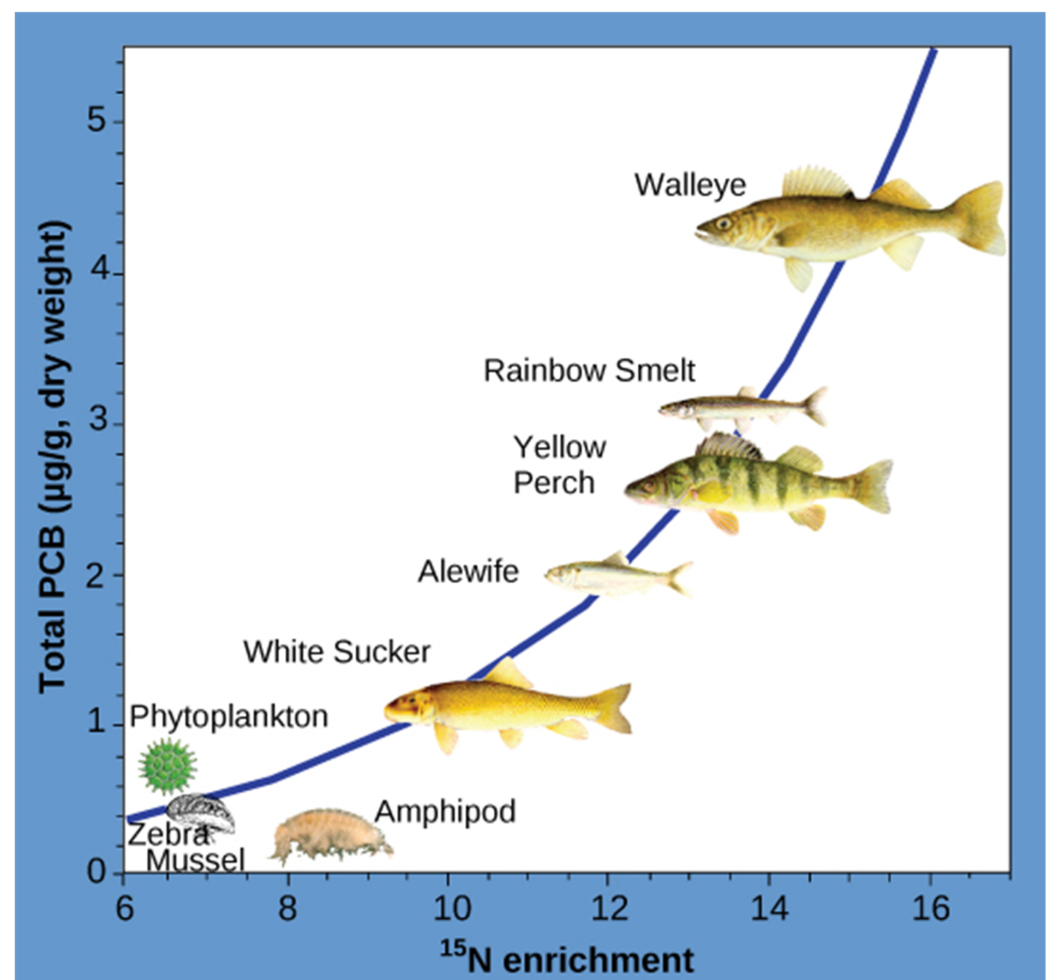
Consequences of Food Webs: Biological Magnification₂
Other substances that biomagnify:
Polychlorinated biphenyls (PCBs) used in coolant liquids
  Bioaccumulated in fish until the apex consumer (walleye) had more than 4x the amount of PCBs than phytoplankton.
Heavy metals: mercury (Hg), lead (Pb), and cadmium (Cd)
  Often bioaccumulate in fish, causing the EPA to put out consumption warnings.
Figure 5: This chart shows the PCB concentrations found at the various trophic levels in the Saginaw Bay ecosystem of Lake Huron. Notice that the fish in the higher trophic levels accumulate more PCBs than those in lower trophic levels.
Patricia Van Hoof, NOAA, GLERL on Wikimedia Commons. "PCB concentrations."

Slide 17
Summary
Organisms in an ecosystem acquire energy in a variety of ways, which is transferred between trophic levels as the energy flows from the bottom to the top of the food web, with energy lost at each transfer.
The efficiency of these transfers is important for understanding the different behaviors and eating habits of endothermic versus ectothermic animals.
Modeling of ecosystem energy is best done with ecological pyramids of energy although other ecological pyramids provide other vital information about ecosystem structure.

Slide 18

End of Hawkes Learning PowerPoint

