Slide 1
Lesson 46.3
Biogeochemical Cycles

Slide 2
Objectives
Discuss the biogeochemical cycles of water, carbon, nitrogen, phosphorus, and sulfur.
Explain how human activities have impacted these cycles and the potential consequences for Earth.

Slide 3
Biogeochemical Cycles₁
Energy flows directionally through ecosystems.
Enters as sunlight, leaves as heat
Matter that makes up organisms is conserved and recycled, existing in the atmosphere, on land, or beneath the surface.
Includes six elements associated with organic molecules: carbon (C), nitrogen (N), hydrogen (H), oxygen (O), phosphorus (P), and sulfur (S)
Geologic processes (weathering, erosion, water drainage, subduction of continental plates) help to recycle these materials.
Biogeochemical cycle: recycling of inorganic matter between living organisms and their environment

Slide 4
Biogeochemical Cycles₂
Water is essential to all living processes, containing both hydrogen and oxygen.
Hydrosphere: area of the Earth where water movement and storage occur
Organic molecules can be found in a variety of places.
Water: liquid or solid form in bodies of water, groundwater, polar ice caps, glaciers; vapor in the atmosphere
Carbon: macromolecules and fossil fuels
Nitrogen: nucleic acids and proteins
Phosphorus: nucleic acids and artificial fertilizers
Sulfur: 3-D folding of proteins

Slide 5
Biogeochemical Cycles₃
The cycling of elements like carbon, nitrogen, phosphorus, and sulfur is interconnected.
Example: Water is key in the movement of nitrogen and phosphate into rivers, lakes, and oceans.
These nutrients cycle between the biotic and abiotic components of ecosystems, influencing ecosystem dynamics.

Slide 6
The Water (Hydrologic) Cycle
Water is the foundation of all living processes.
97.5% of Earth's water is non-potable (not fit for human consumption) salt water.
99% of remaining water is underground as water or ice.
Less than 1% of fresh water is easily accessible from lakes or rivers.
Living things rely on this fresh water; they must adapt if it is in short supply.
Humans dig wells, store rainwater, and desalinate ocean water to increase water availability.

Slide 7
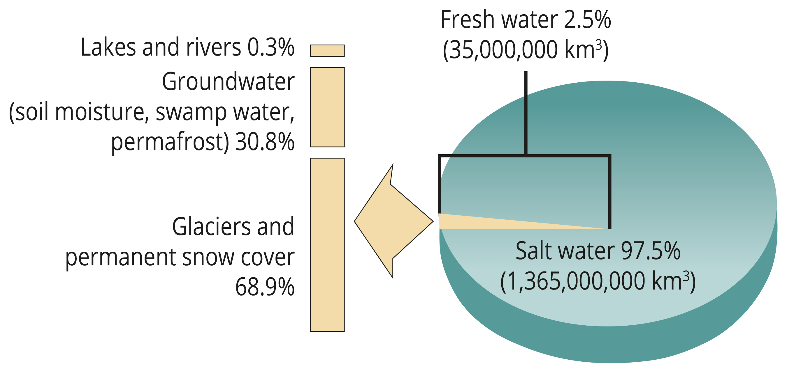
46.3 Figure 1
CNX OpenStax on Wikimedia Commons. "Water on Earth."
Notes:
Only 2.5% of water on Earth is fresh water, and less than 1% of fresh water is easily accessible to living things.

Slide 8
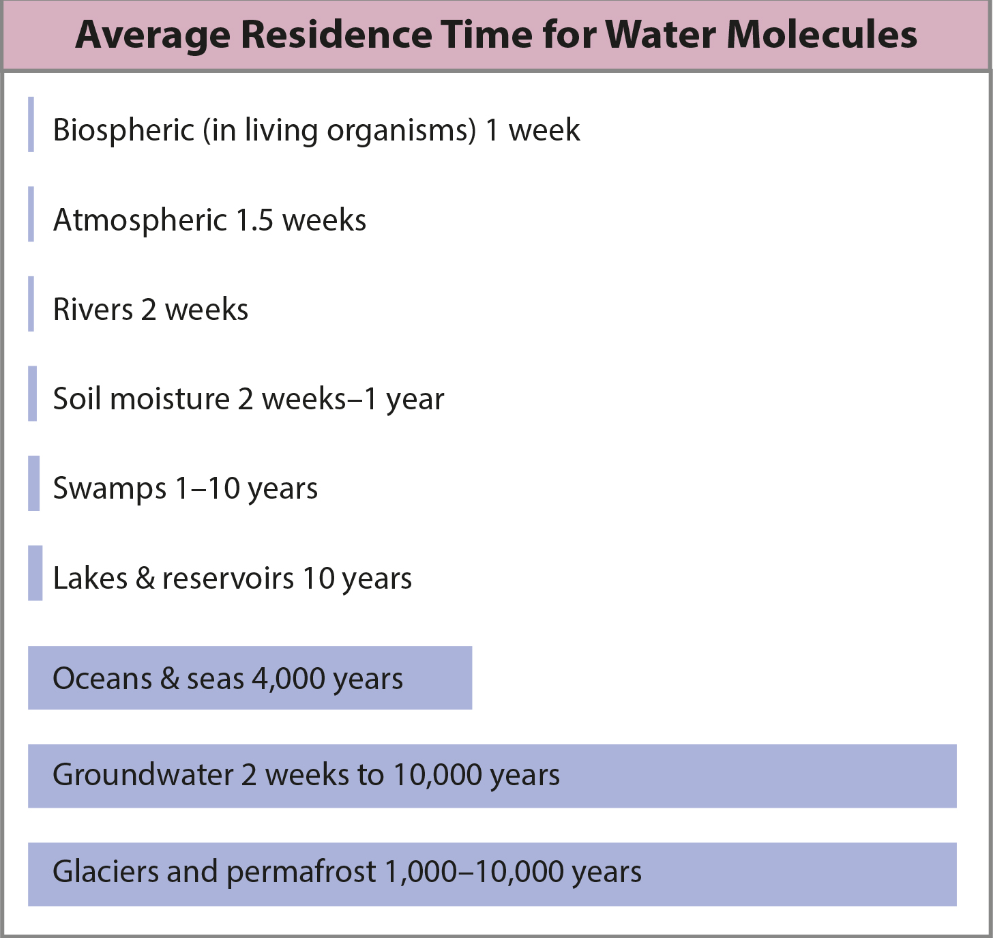
Residence Time
Water cycling influences climate, weather patterns, and the availability of fresh water, all of which affect ecosystem dynamics.
Stored in oceans, underground, or as ice
Residence time: measure of the average time an individual water molecule stays in a particular reservoir
46.3 Figure 2: This graph shows the average residence time for water molecules in the Earth's water reservoirs.
CNX OpenStax on Wikimedia Commons. "Water residence time."

Slide 9
The Water Cycle
Evaporation/sublimation: Water transforms into vapor from liquid surfaces and sublimation from ice, contributing to atmospheric moisture.
Condensation/precipitation: Water vapor condenses into clouds and eventually falls as precipitation, returning to Earth's surface.
Subsurface water flow: Rain permeates the ground, where it can evaporate, flow beneath the surface, or be stored.
Surface runoff/snowmelt: Fresh water flows from rain or melting ice.
Streamflow: Runoff makes its way through streams and lakes to the oceans.
Major way that minerals are cycled from land to water

Slide 10
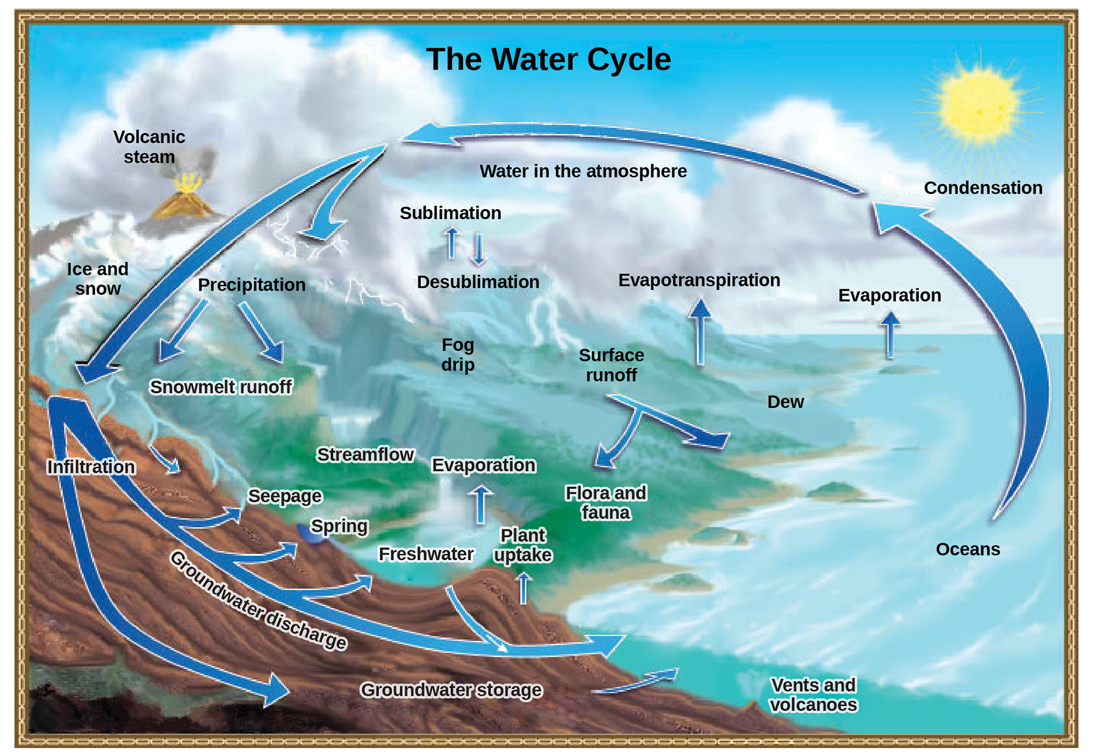
46.3 Figure 3
John M. Evans and Howard Perlman, USGS. "Water cycle."
Notes:
Water from the land and oceans enters the atmosphere by evaporation or sublimation, where it condenses into clouds and falls as rain or snow. Precipitated water may enter freshwater bodies or infiltrate the soil. The cycle is complete when surface or groundwater reenters the ocean.

Slide 11
The Carbon Cycle
Carbon is the second most abundant element in living organisms.
Present in all organic molecules
Has an important role in the structure of macromolecules
The carbon cycle is comprised of two interconnected sub-cycles:
Rapid carbon exchange among living organisms
Long-term cycling of carbon through geologic processes

Slide 12
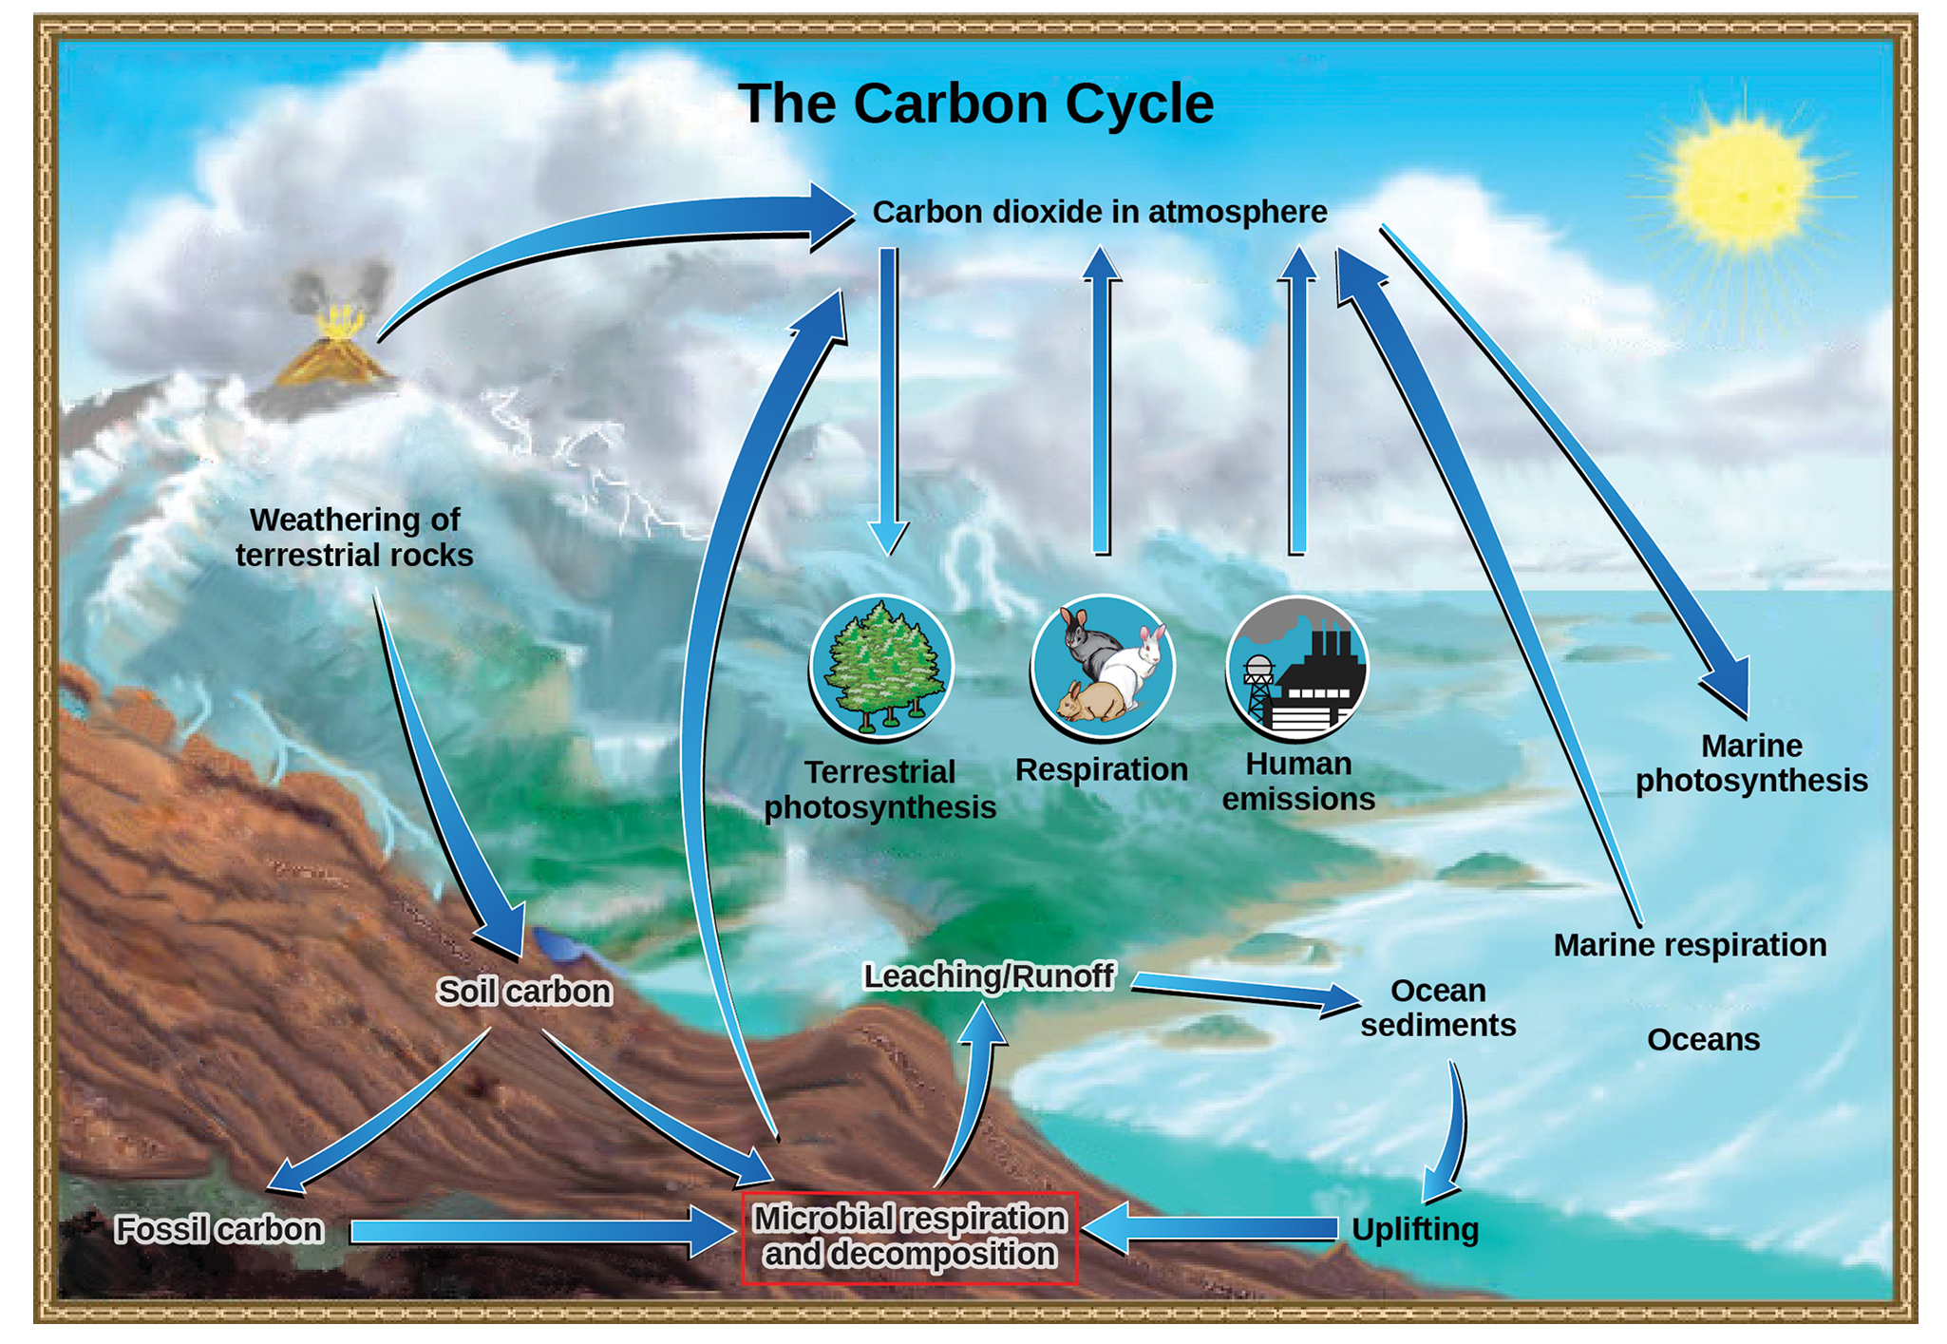
46.3 Figure 4
John M. Evans and Howard Perlman, USGS. "Carbon cycle." Modified.
Notes:
Carbon dioxide gas (CO₂) exists in the atmosphere and is dissolved in water. Photosynthesis converts carbon dioxide gas to organic carbon, and respiration cycles the organic carbon back into carbon dioxide gas. Long-term storage of organic carbon occurs when matter from living organisms is buried deep underground and becomes fossilized. Volcanic activity and, more recently, human emissions, bring this stored carbon back into the carbon cycle.

Slide 13
The Biological Carbon Cycle₁
There is a continuous exchange of carbon between autotrophs and heterotrophs by way of atmospheric carbon dioxide.
Most autotrophs use carbon dioxide to build compounds like glucose.
They use energy from the sun to form covalent bonds to link carbon atoms together.
These bonds store energy for later through respiration.
Terrestrial autotrophs obtain carbon dioxide from the atmosphere, while marine autotrophs obtain it as carbonic acid (H₂CO₃⁻).
Regardless of method, oxygen is a byproduct for autotrophs.

Slide 14
The Biological Carbon Cycle₂
Heterotrophs obtain carbon by consuming autotrophs and breaking them down via respiration.
They obtain cellular energy (ATP) through this process.
Aerobic respiration requires oxygen, which is why there is this constant exchange of oxygen and carbon dioxide.
Autotrophs: need carbon
Heterotrophs: need oxygen

Slide 15
The Biogeochemical Carbon Cycle₁
Carbon moves through land, water, and air much more slowly geologically than between living organisms.
Stored in various reservoirs: atmosphere, bodies of water (mostly oceans), ocean sediment, soil, land sediments (fossil fuels), and Earth's interior
Atmosphere: major reservoir of carbon dioxide; essential to photosynthesis
Greatly influenced by carbon reservoir in the oceans

Slide 16
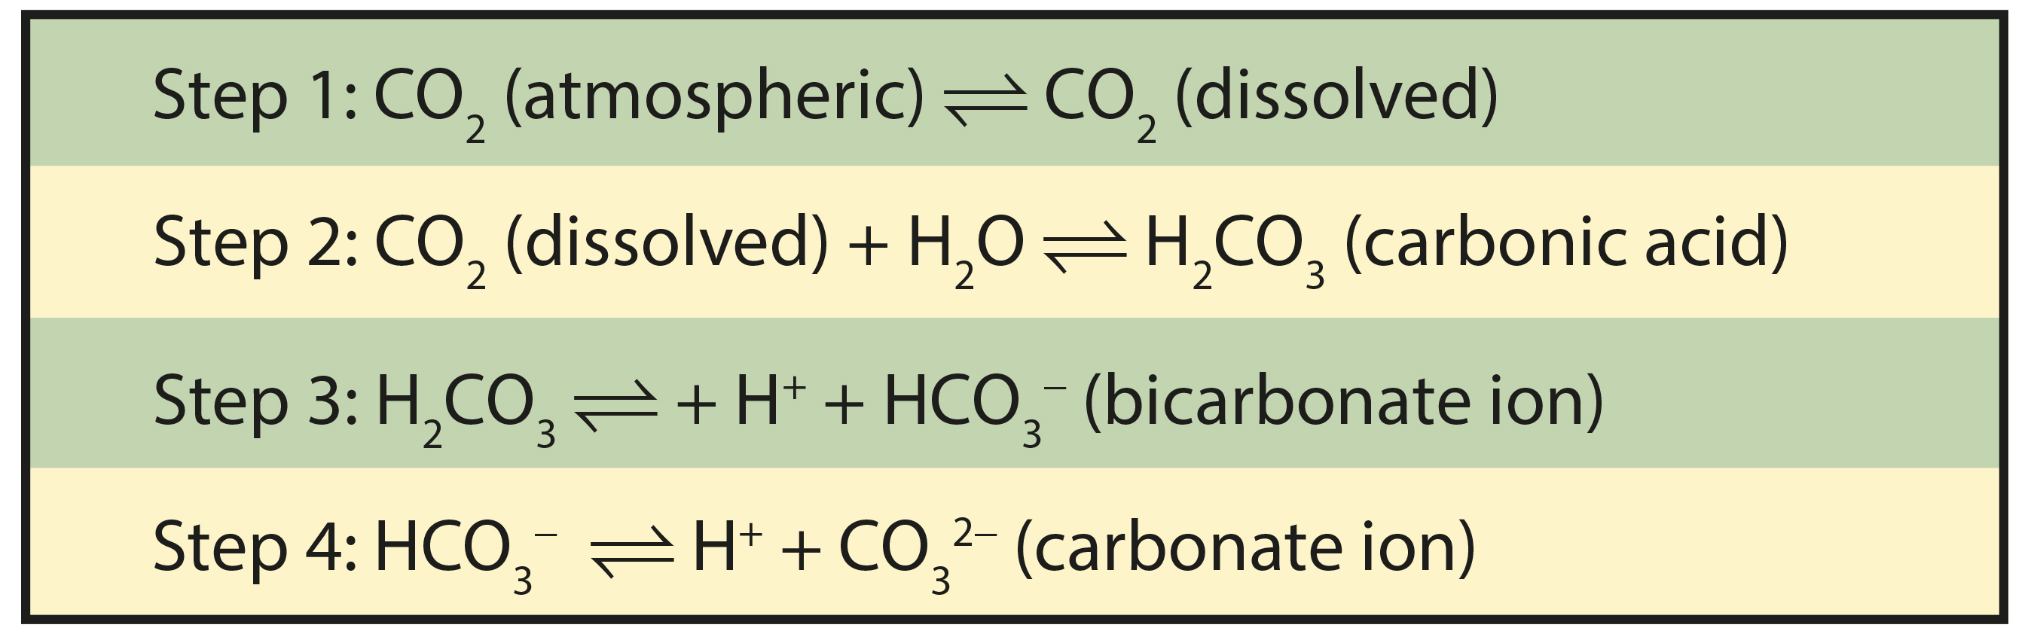
The Biogeochemical Carbon Cycle₂
Levels in the atmosphere are reciprocally influenced by how much carbon is found in water reservoirs, and vice versa.
Formation of carbonic acid when atmospheric carbon dioxide dissolves in water and combines with water molecules
Ionizes to carbonate (CO₃²⁻) and bicarbonate (HCO₃⁻) ions
46.3 Figure 5: Carbon dioxide reacts with water to form bicarbonate and carbonate ions.
CNX OpenStax on Wikimedia Commons. "Carbon dioxide and water."

Slide 17
Equilibrium Positions
More than 90% of carbon in the ocean is found as bicarbonate ions due to equilibrium positions.
Equilibrium positions: concentrations at which the rate of conversion of reactants to products equals the rate of conversion of products to reactants
Combine with seawater calcium (Ca) to form calcium carbonate (CaCO₃)
Major component of marine organisms' shells
Form sediments on ocean floor, which forms limestone over time
Limestone: comprises the largest carbon reservoir on Earth

Slide 18
Carbon on Land
Carbon is stored in soil due to decomposition and weathering.
Leached into water reservoirs by surface runoff
Fossil fuels: deeper in the ground and at sea; anaerobically decomposed remains of plants that take millions of years to form
Considered a nonrenewable resource (regenerated very slowly or not at all) since use exceeds rate of formation
Carbon can enter the atmosphere from land by eruption of volcanoes and other geothermal systems.
Taken from ocean floor deep into the Earth by subduction: movement of one tectonic plate beneath another
Released as carbon dioxide when volcano erupts or from hydrothermal vents

Slide 19
Human Contributions to Atmospheric Carbon
Human burning of fossil fuels significantly increases atmospheric carbon.
Animal husbandry by humans also contributes.
Effect of farming practices, respiration, and methane production on increased carbon dioxide levels
Human activities impact climate change through carbon cycle alteration.

Slide 20
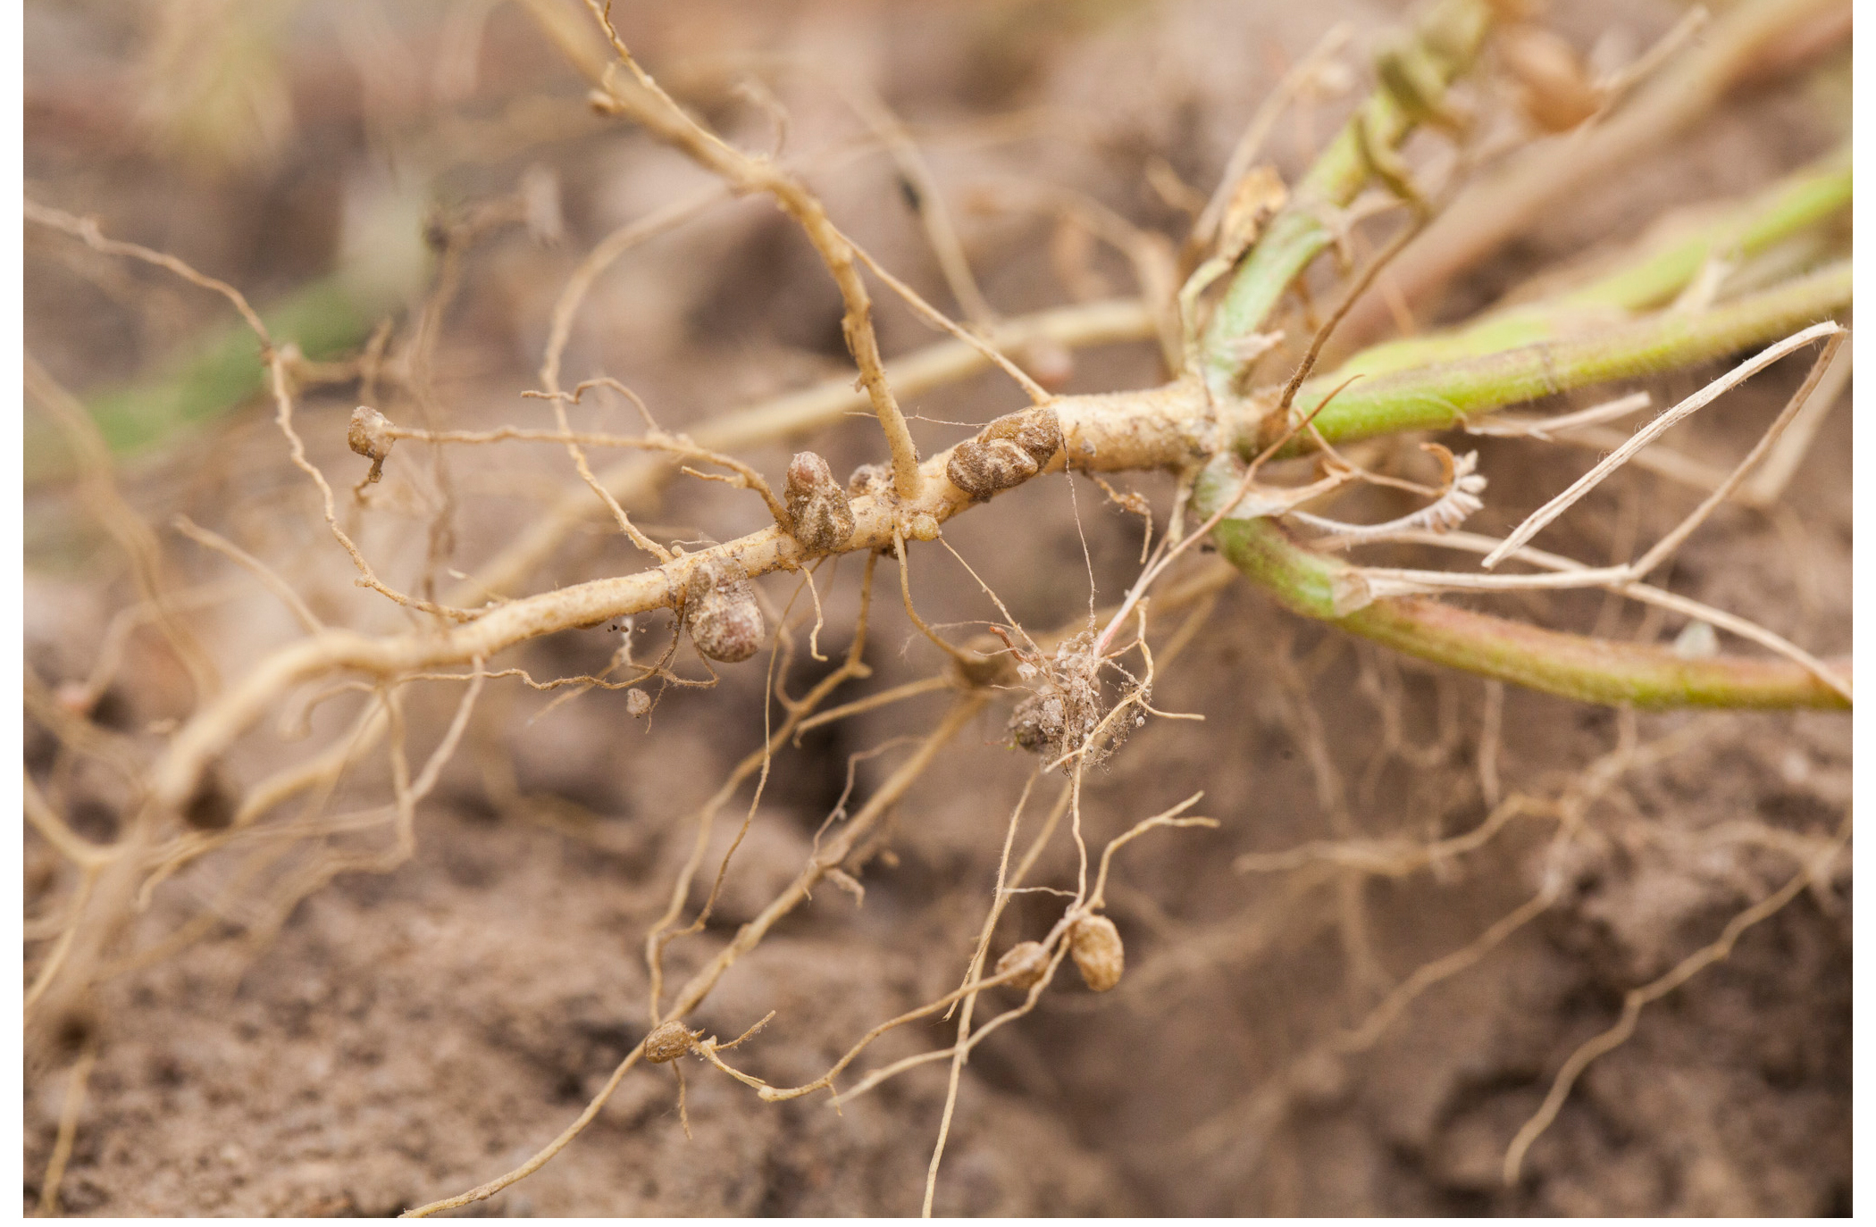
The Nitrogen Cycle
Nitrogen is difficult to get in the living world.
Even though it comprises ~78% of the atmosphere, plants and phytoplankton are not equipped to incorporate it.
It enters via free-living and symbiotic bacteria, which can incorporate via nitrogen fixation.
Nitrogen fixation: conversion of N₂ to nitrogenous compounds
Cyanobacteria play a key role in nitrogen fixation.
They use inorganic sources of nitrogen to "fix" it.
Example: Rhizobium bacteria living in root nodules of legumes, providing needed organic nitrogen
46.3 Figure 6: These legumes contain specialized nodules that harbor nitrogen-fixing bacteria. These bacteria convert atmospheric nitrogen into ammonia (NH₃) that can be used by the plant.
Terraprima on Wikimedia Commons. "Root nodules."

Slide 21
Organic Nitrogen
Organic nitrogen is important to ecosystem dynamics.
Many processes (primary production, decomposition) are limited by the available supply of nitrogen.
Nitrogen from fixation is converted from organic nitrogen back to nitrogen gas by bacteria.
There are three steps:
Ammonification: converts nitrogenous waste into ammonium (NH₄⁺) by certain bacteria and fungi
Nitrification: converts ammonium to nitrites (NO₂⁻) by nitrifying bacteria
Denitrification: converts nitrites to nitrates (NO₃⁻) by similar organisms

Slide 22
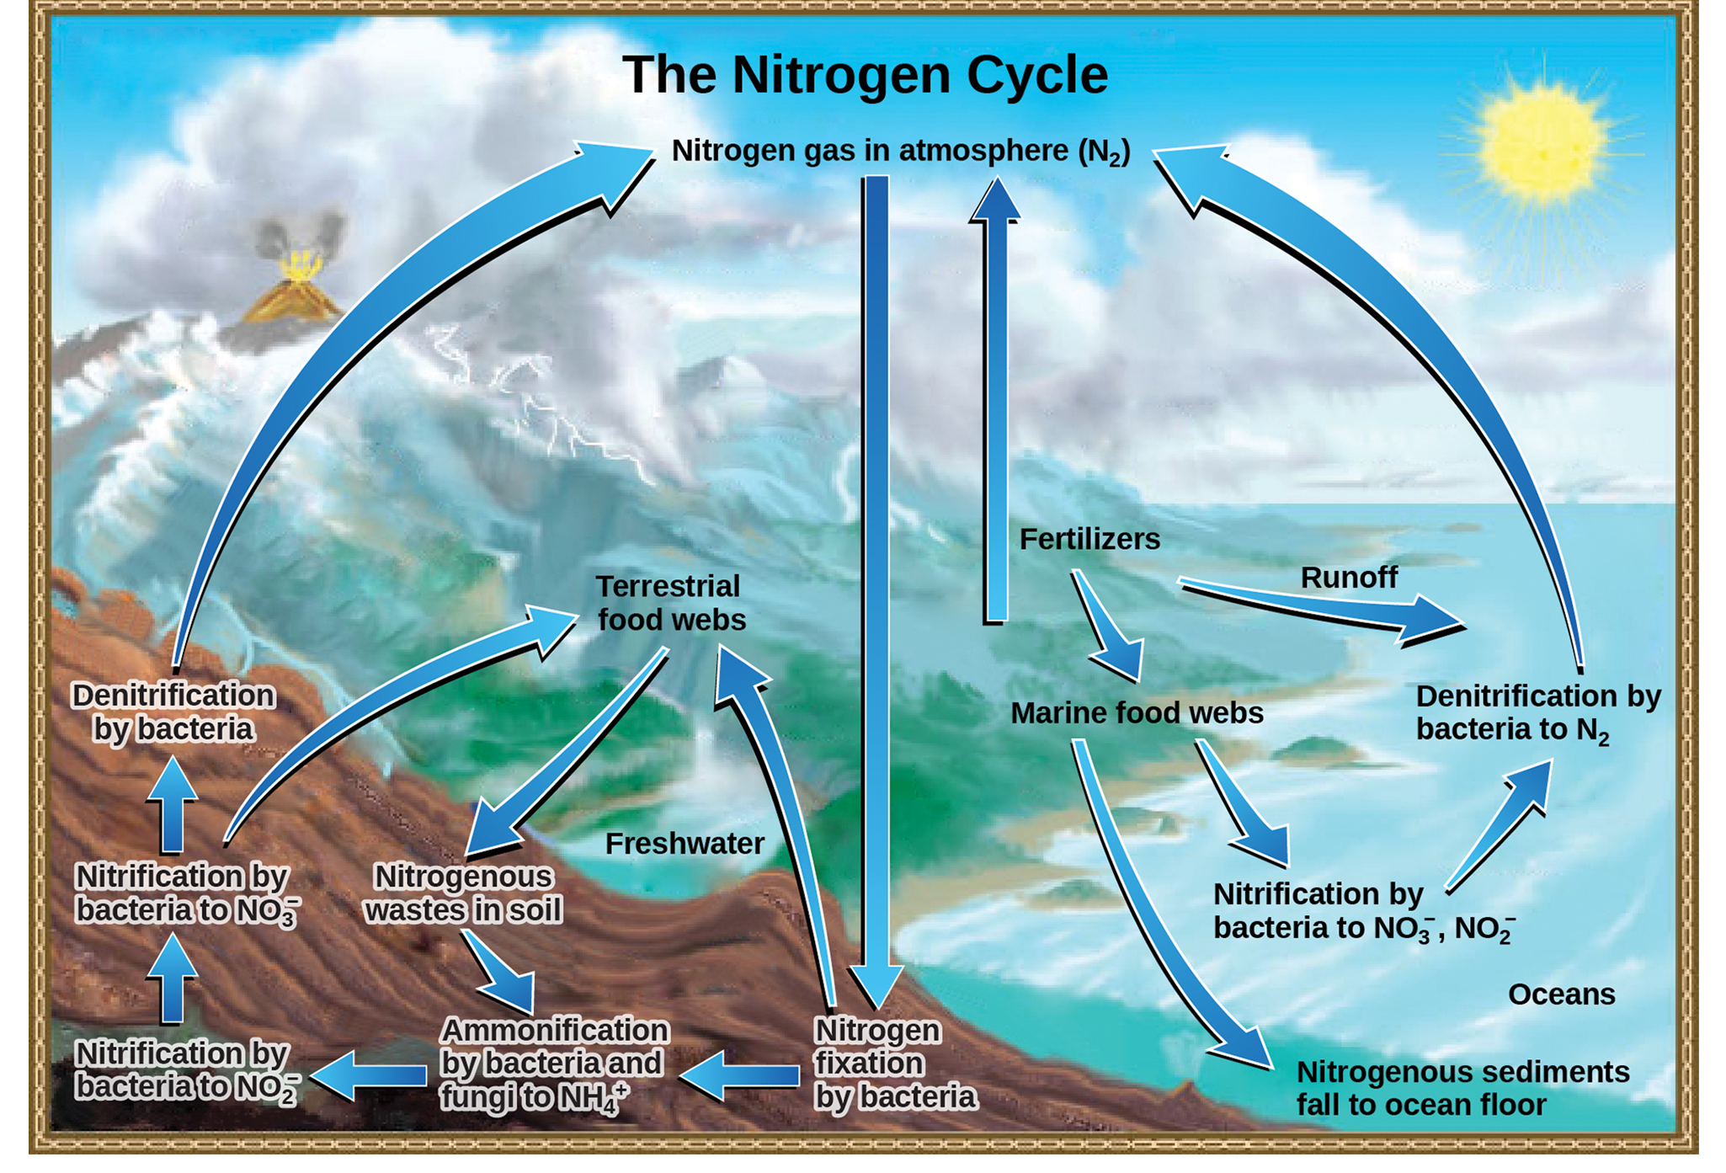
46.3 Figure 7
John M. Evans and Howard Perlman, USGS on Wikimedia Commons. "Nitrogen cycle."
Notes:
Nitrogen enters the living world from the atmosphere via nitrogen-fixing bacteria. Nitrogen and nitrogenous waste from animals are then processed back into gaseous nitrogen by soil bacteria, which also supply terrestrial food webs with the organic nitrogen they need.

Slide 23
Human Activity and Nitrogen Release
Human activity releases nitrogen into environment through:
Combustion of fossil fuels (releases nitrogen oxides)
Use of artificial fertilizers in agriculture (washed into bodies of water by surface runoff)
Atmospheric nitrogen contributes to:
Acid rain (nitric acid, HNO₃)
Greenhouse gases (nitrous oxide, N₂O)
Fertilizer runoff causes eutrophication in aquatic ecosystems.
Eutrophication: when nutrient runoff causes the excess growth of microorganisms, depleting oxygen levels and killing ecosystem fauna

Slide 24
The Marine Nitrogen Cycle
Follows a similar process including ammonification, nitrification, and denitrification, but with marine bacteria
Falling of nitrogen to the ocean floor as sediment, which then moves to land by uplift of the Earth's surface
Incorporated into terrestrial rock
Moving from rock to living systems insignificant compared to nitrogen from the atmosphere
Debated by a recent study (Morford et al., 2011)

Slide 25
The Phosphorus Cycle
Phosphorus is essential for living processes.
Major component of nucleic acid and phospholipids
As calcium phosphate, makes up supportive components of bones
Often a limiting nutrient (essential for growth) in aquatic ecosystems
Phosphorus occurs in nature as the phosphate ion (PO₄³⁻).
Sent to bodies of water via natural surface runoff leached from phosphate-containing rock due to weathering
Forms in ocean sediments from ocean organisms and their excretions
Can also be sourced from volcanic ash, aerosols, and mineral dust in remote regions
Reciprocally exchanged between phosphate in the ocean and marine ecosystems

Slide 26
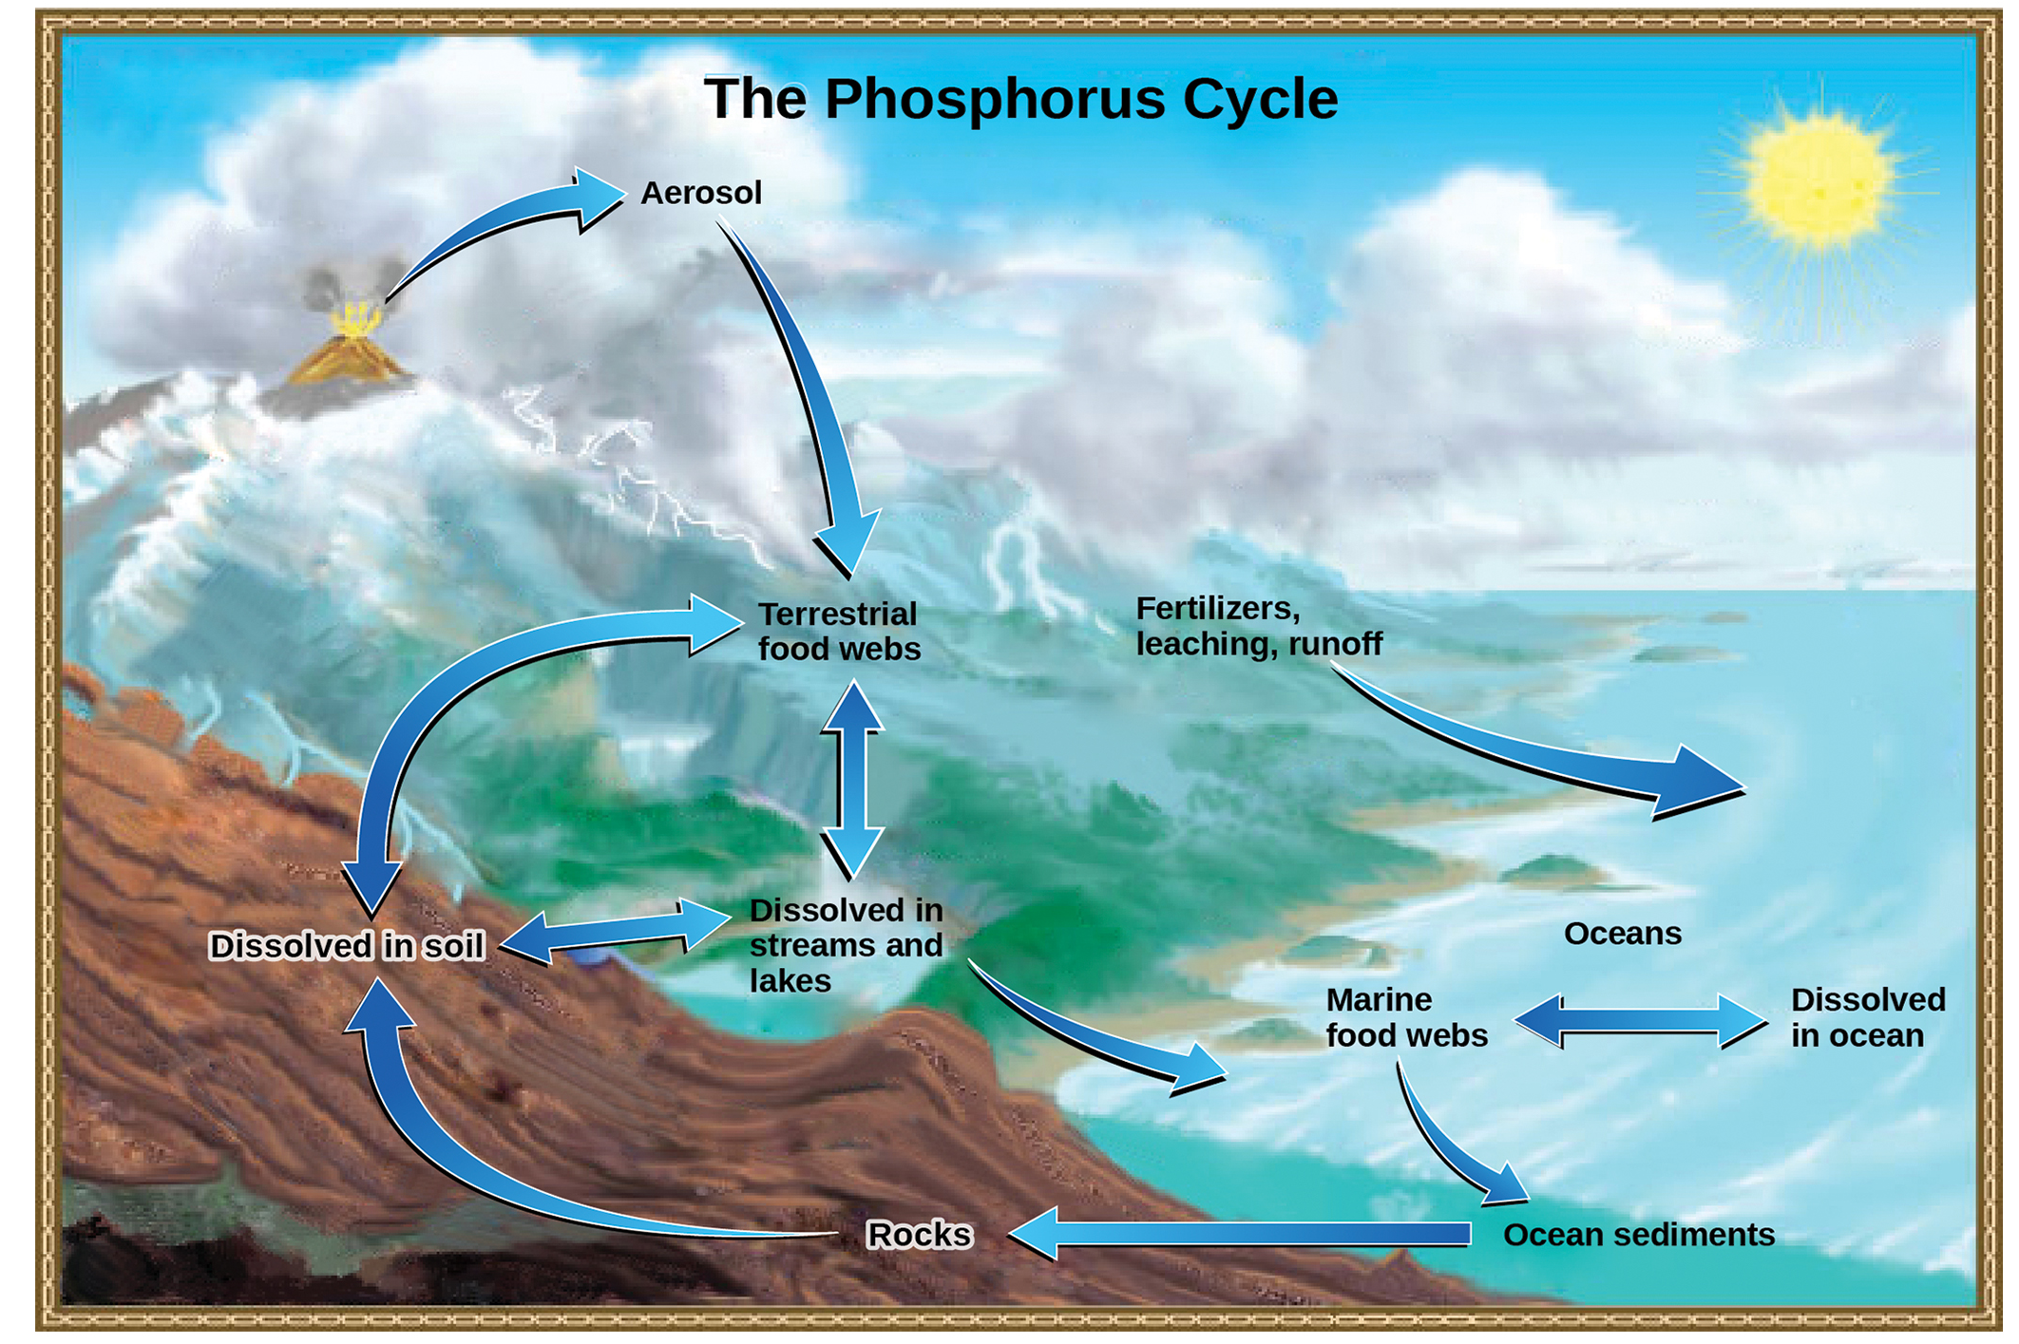
46.3 Figure 8
John M. Evans and Howard Perlman, USGS. "Phosphorus cycle."
Notes:
In nature, phosphorus exists as the phosphate ion (PO₄³⁻). Weathering of rocks and volcanic activity releases phosphate into the soil, water, and air, where it becomes available to terrestrial food webs. Phosphate enters the oceans via surface runoff, groundwater flow, and river flow. Phosphate dissolved in ocean water cycles into marine food webs. Some phosphate from the marine food webs falls to the ocean floor, where it forms sediment.

Slide 27
Reflection Question
Humans, like all animals, are a part of the phosphorus and nitrogen cycles. Can you think of ways phosphorus and nitrogen would be important to human biology?
Notes:
The reflection question is included here to use as a talking point or for a think-pair-share activity.

Slide 28
Dead Zones
Excess phosphorus and nitrogen enter marine ecosystems from fertilizer runoff.
Causes excessive growth of microorganisms and depletes dissolved oxygen
Leads to the death of many ecosystem fauna (shellfish and finfish)
Responsible for dead zones in lakes and river mouths
A dead zone is an area depleted of normal flora and fauna due to eutrophication, oil spills, toxic chemicals, or other human activity.
More than 400 present as of 2008
Example: fertilizer runoff from Mississippi River basin creating a dead zone of over 8,463 square miles

Slide 29
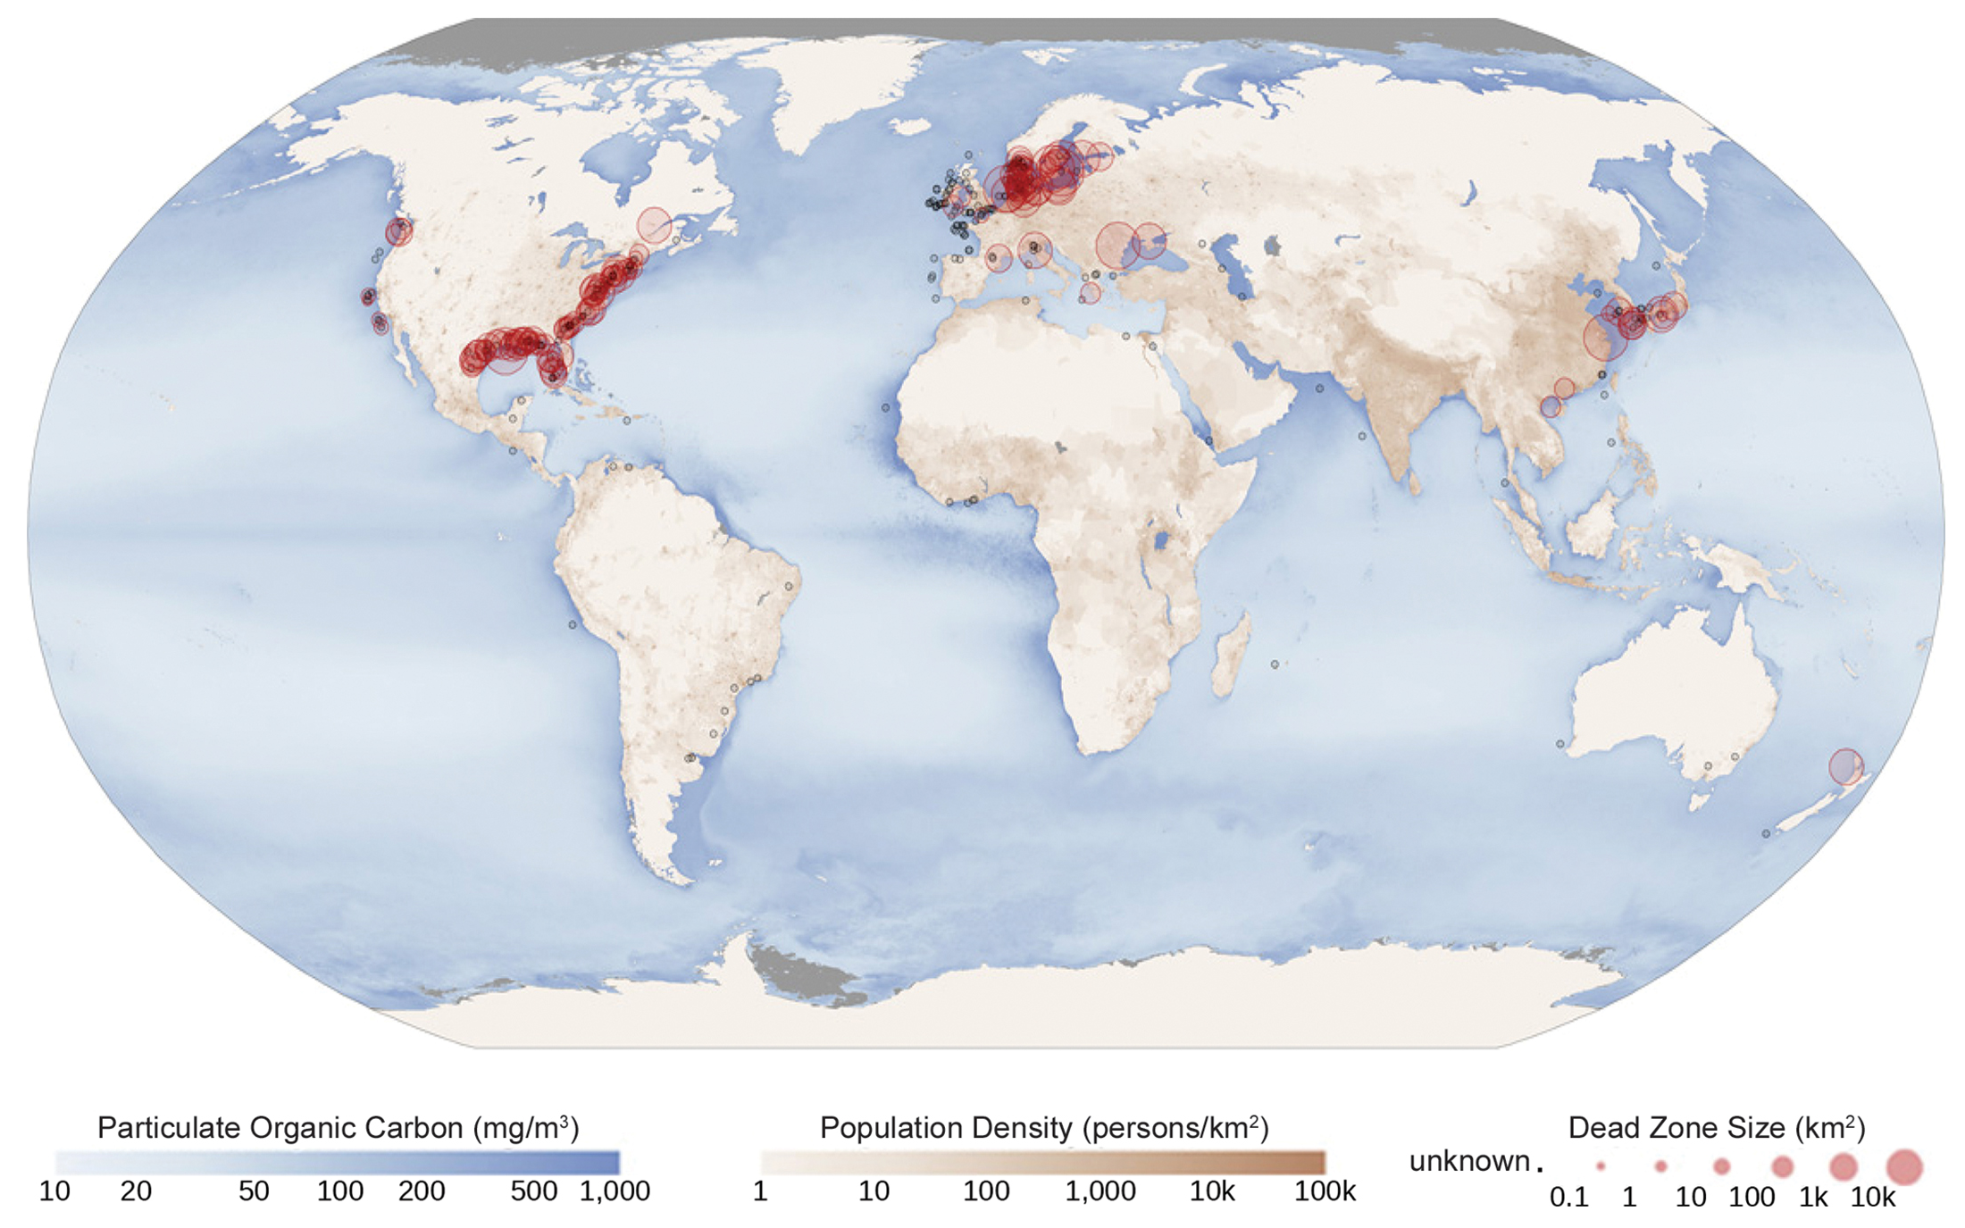
46.3 Figure 9
NASA Earth Observatory. "Dead zones."
Notes:
Dead zones occur when phosphorus and nitrogen from fertilizers cause excessive growth of microorganisms, which depletes oxygen and kills fauna. Worldwide, large dead zones are found in coastal areas of high population density.

Slide 30
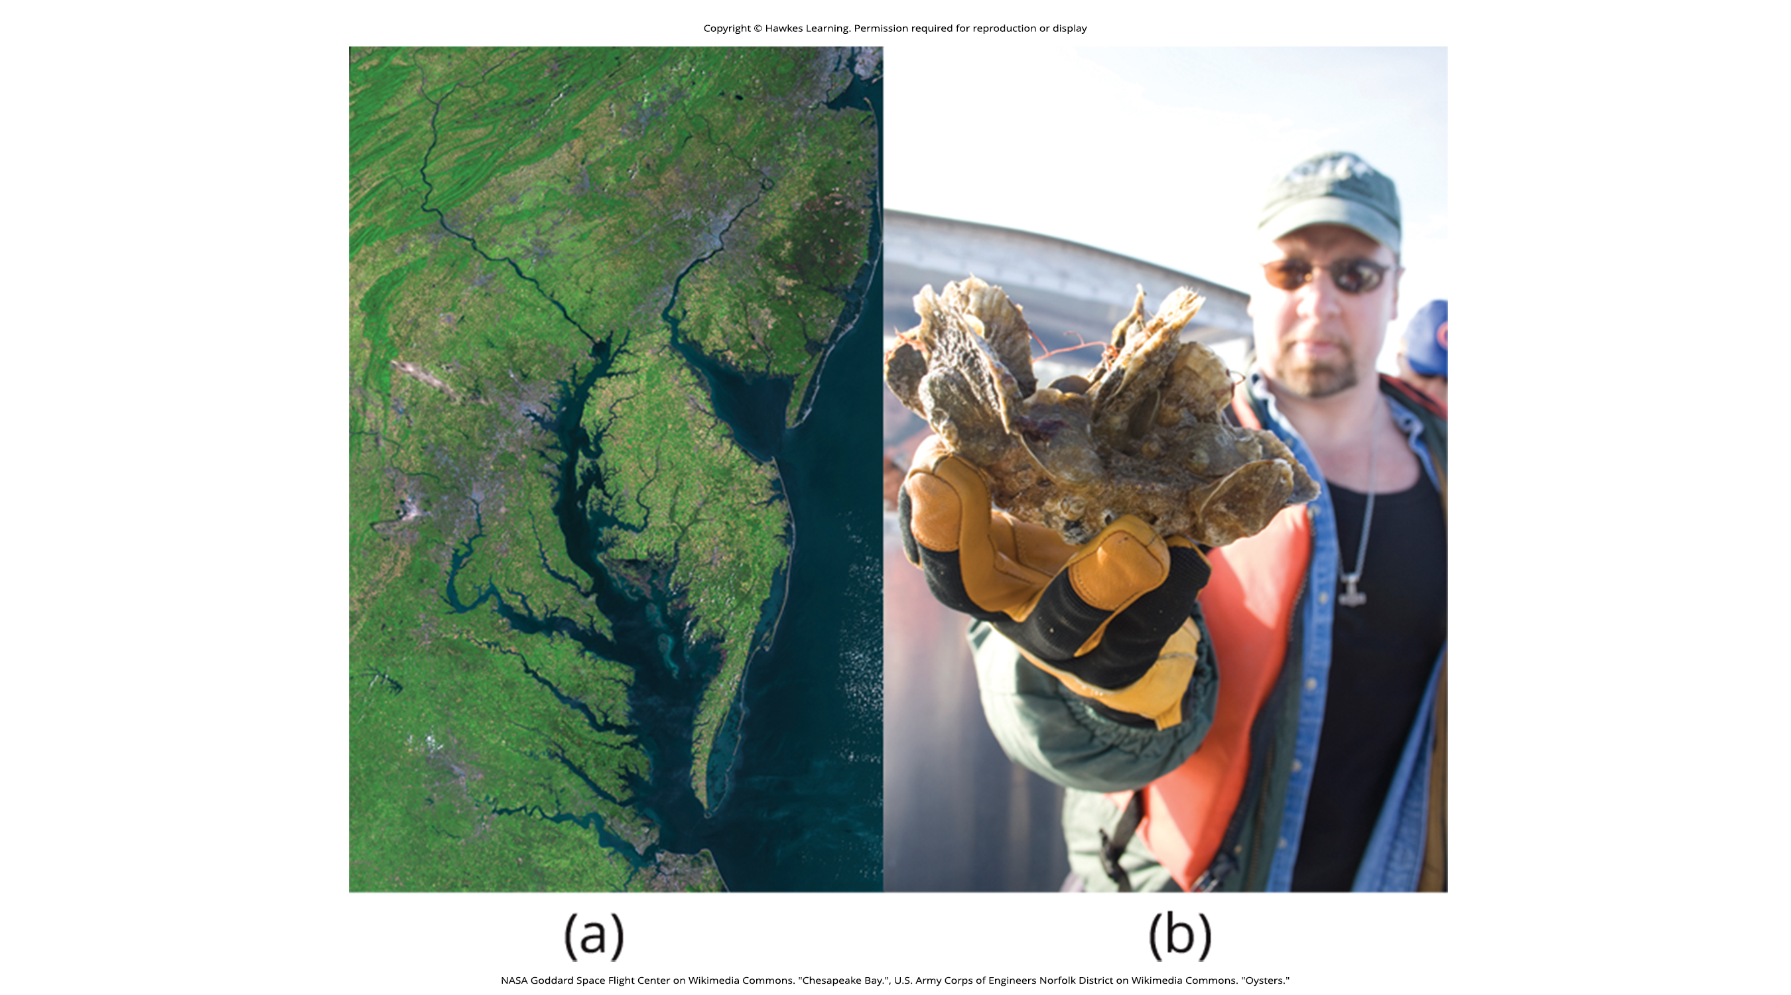
Science and You₁
The Chesapeake Bay
Ecosystem in decline after being valued as one of the most scenic areas
One of the first ecosystems to have dead zones
Fertilizer runoff not restricted to agriculture practices
Also due to urban runoff from lawns and gardens
Requires cooperation of industry, agriculture, and homeowners to fix
46.3 Figure 10: (a) This satellite image shows the Chesapeake Bay.
NASA Goddard Space Flight Center on Wikimedia Commons. "Chesapeake Bay."
Notes:
This is included as a relevant application for this topic.

Slide 31
Science and You₂
The Chesapeake Bay
Oyster population significantly reduced due to nutrient runoff and overharvesting
Require a minimum population density, but humans have altered their populations and locations
Important because oysters are filter feeders, water filters, and bay cleaners
In the 1700s, filtered the entire bay in a few days, but now it would take a whole year
Notes:
This is included as a relevant application for this topic.

Slide 32
Science and You₃
The Chesapeake Bay
Restoration efforts by nonprofit organizations, like the Chesapeake Bay Foundation
Increasing oyster population density
New oyster strains to make experimental oyster reefs
Attempts to clean the bay, but hampered by pollution from other states
Oyster aquaculture: new industry that supplies oysters for food and profit but also cleans the bay
46.3 Figure 10: (b) A member of the Army Corps of Engineers holds a clump of oysters being used as a part of the oyster restoration effort in the bay.
U.S. Army Corps of Engineers Norfolk District on Wikimedia Commons. "Oysters."
Notes:
This is included as a relevant application for this topic.

Slide 33
The Sulfur Cycle
Sulfur is essential for the macromolecules of living things.
Involved in formation of disulfide bonds in proteins, which determines folding patterns and functions
Cycles between atmosphere, land, and oceans
Enters atmosphere as sulfur dioxide (SO₂) in three ways:
Decomposition
Volcanic activity
Fossil fuel burning

Slide 34
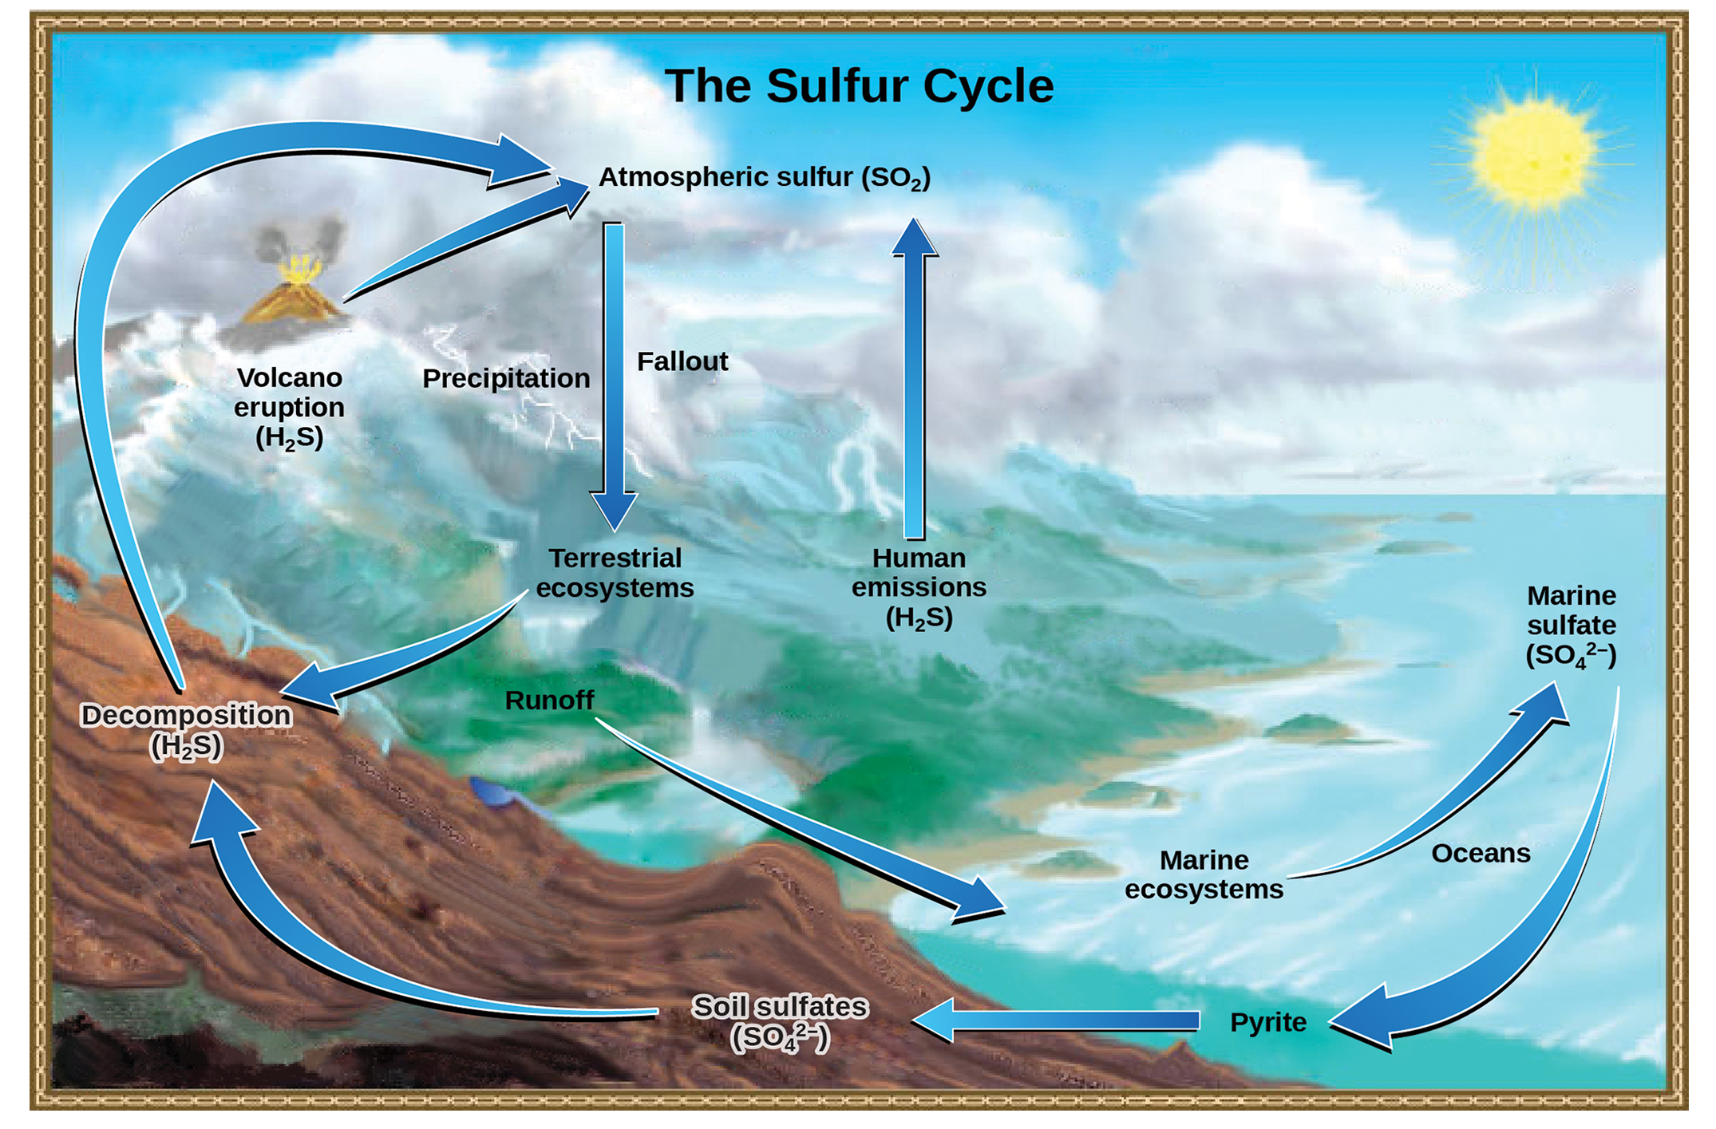
46.3 Figure 11
John M. Evans and Howard Perlman, USGS. "Sulfur cycle."
Notes:
Sulfur dioxide from the atmosphere becomes available to terrestrial and marine ecosystems when it is dissolved in precipitation as weak sulfurous acid or when it falls directly to the Earth as fallout. Weathering of rocks also makes sulfates available to terrestrial ecosystems. Decomposition of living organisms returns sulfates to the ocean, soil, and atmosphere.

Slide 35
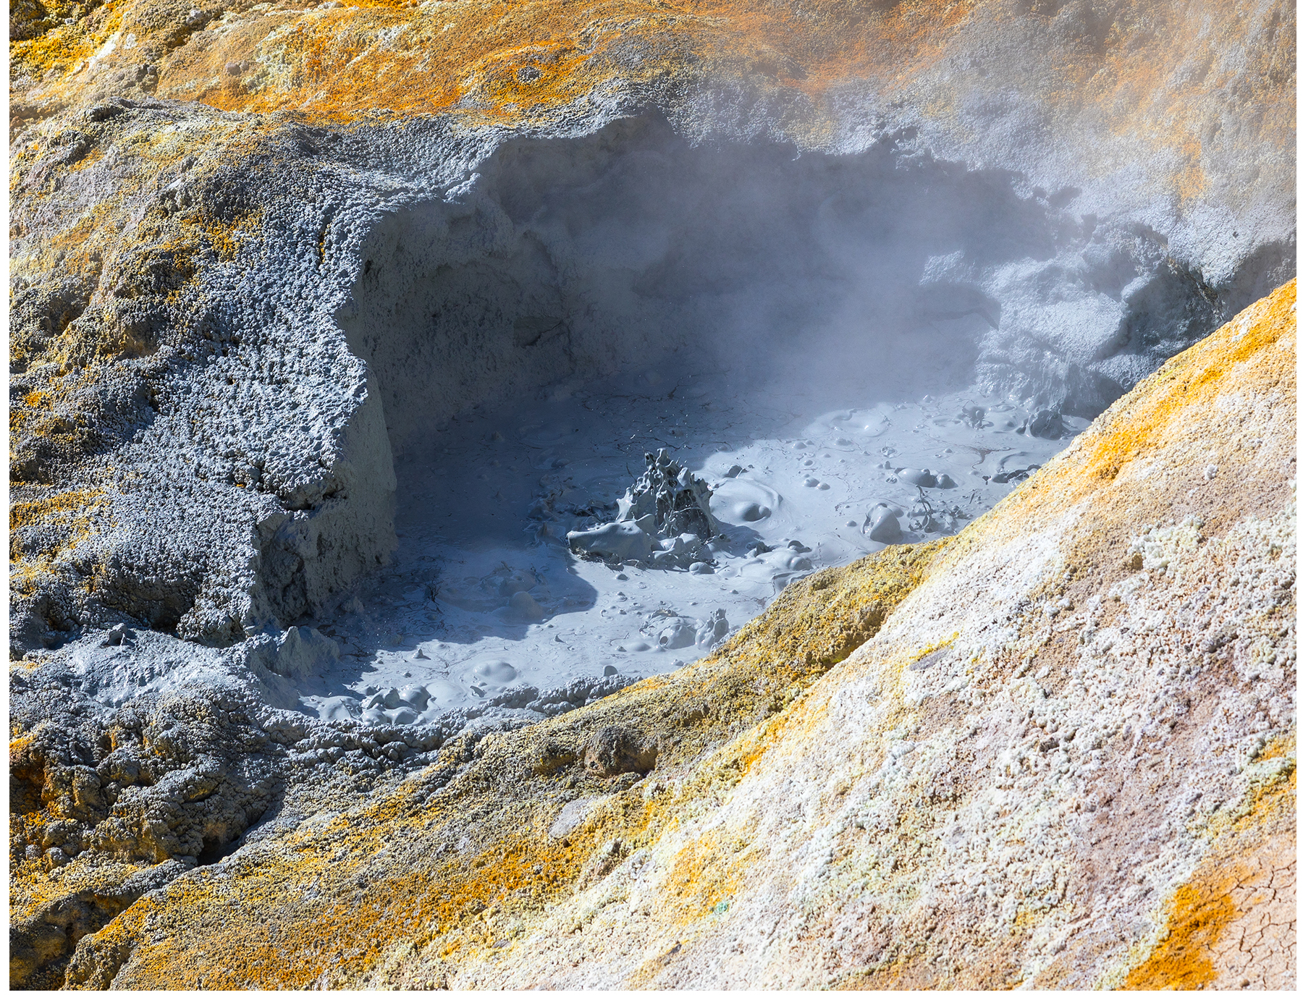
Sulfur Deposits
On land, sulfur is deposited in four ways:
Precipitation: when sulfur dissolves from SO₂ to weak sulfurous acid (H₂SO₃)
Fallout: when sulfur falls directly from the atmosphere
Rock weathering: when weathering of sulfur-containing rocks releases sulfur into the soil
Origination of rocks from ocean sediments moved to land by geologic uplifting
Geothermal vents: when terrestrial ecosystems use soil sulfates (SO₄⁻) and release sulfur into the atmosphere as hydrogen sulfide (H₂S) gas upon the decomposition of terrestrial organisms
46.3 Figure 12: At this sulfur vent in Lassen Volcanic National Park in northeastern California, yellowish sulfur deposits are visible near the mouth of the vent.
Frank Schulenburg on Wikimedia Commons. "Sulfur vent."

Slide 36
Human Activity and Sulfur
Alters the balance of the global sulfur cycle
Contributes to the release of increased amounts of hydrogen sulfide gas into the atmosphere by burning fossil fuels
Contributes to formation of acid rain: caused by rainwater falling to the ground through sulfur dioxide gas, turning it into weak sulfurous acid
Damages the natural environment by lowering pH of lakes
Affects man-made environment through chemical degradation of buildings

Slide 37
Summary
Mineral nutrients cycle through ecosystems and their environment.
Particularly water, carbon, nitrogen, phosphorus, and sulfur
Human activities significantly impact these cycles.
Understanding and protecting these cycles is crucial for Earth's health.

Slide 38

End of Hawkes Learning PowerPoint

