Slide 1
Lesson 47.1
The Biodiversity Crisis

Slide 2
Objectives
Define biodiversity in terms of species diversity and abundance.
Describe biodiversity as the equilibrium of naturally fluctuating rates of extinction and speciation.
Identify historical causes of high extinction rates in Earth's history.
Identify biodiversity hotspots around the planet.
Understand the numbers of organisms in each taxonomic group.

Slide 3
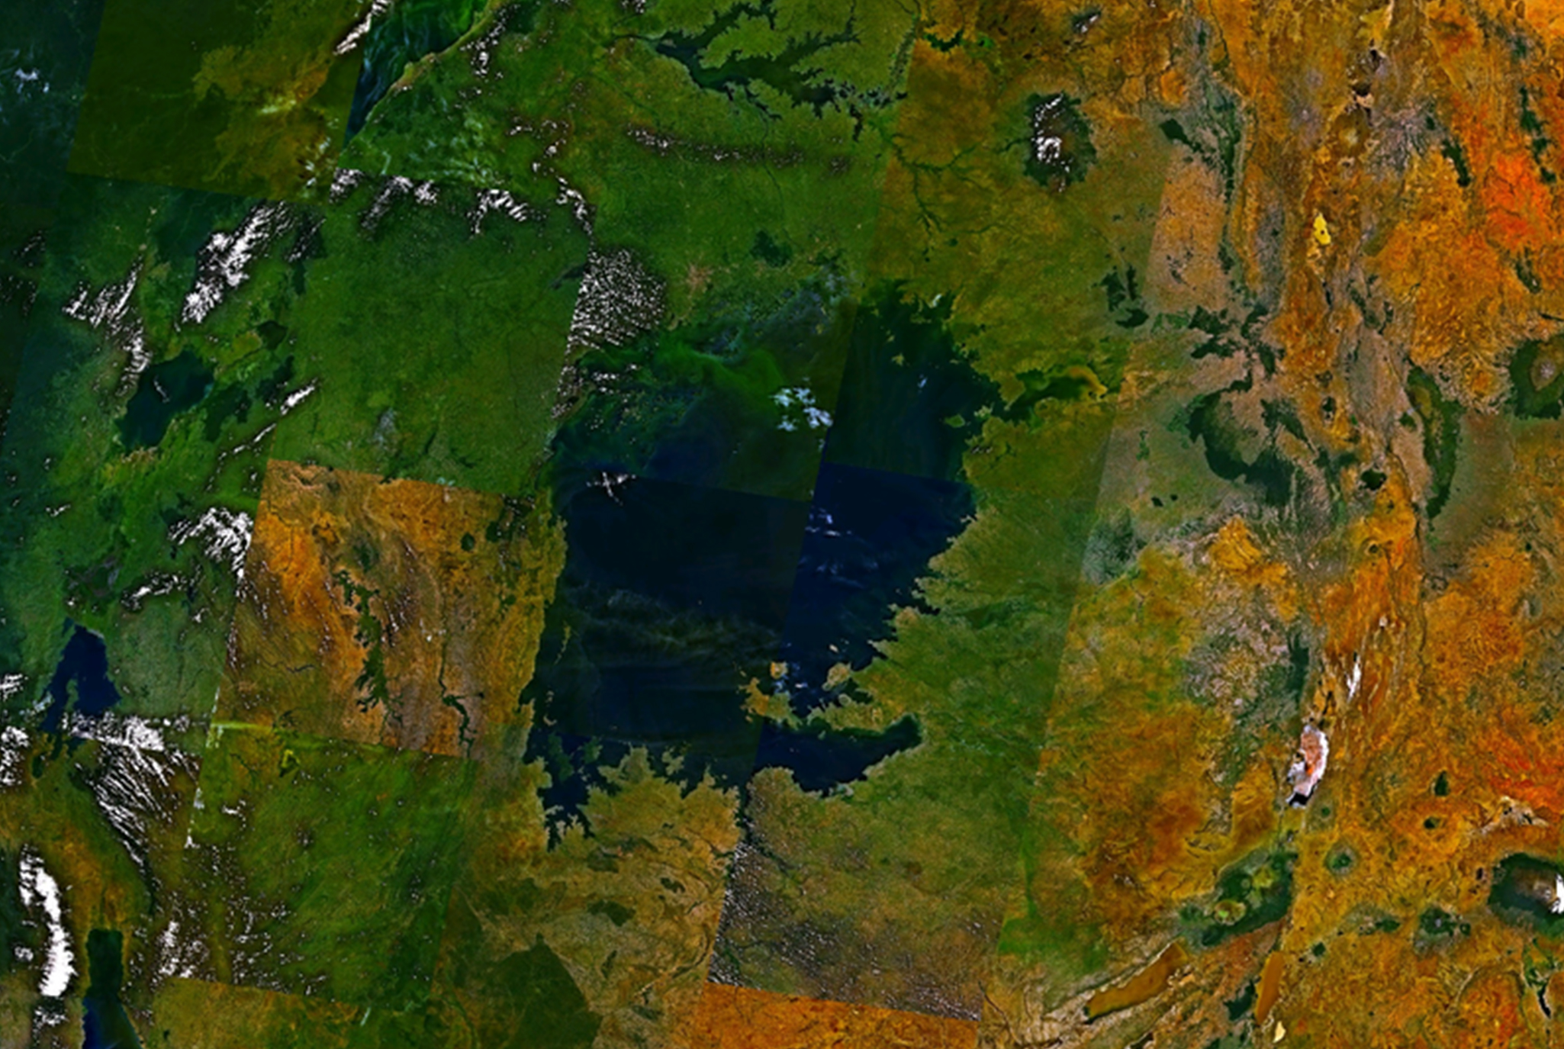
Conservation Biology and Biodiversity
Lake Victoria: in the Great Rift Valley in Africa, about 68,900 km² in area
In the 1980s, a place of one of the most extraordinary products of evolution
Contained over 500 evolved species of cichlids, a kind of fish
Also contained invasive Nile perch that threatened the cichlid population
47.1 Figure 1: Lake Victoria in Africa, shown in this satellite image, was the site of one of the most extraordinary evolutionary findings on the planet and a casualty of devastating biodiversity loss.
NAS on Wikimedia Commons. "Lake Victoria."

Slide 4
The Biodiversity Crisis
Biodiversity: number of species present in the biosphere
Measured by ecologists by considering both the number of species and their relative abundance to each other
Can be estimated at different levels of organization
Example: number of species in a particular ecosystem or entire biosphere
Useful first step in quantifying biodiversity, but less useful for biodiversity loss
May help focus efforts to preserve the biologically or technologically important elements of biodiversity

Slide 5
Example: Lake Victoria Cichlids₁
Lake Victoria cichlids are an example to understand biodiversity.
Home to over 500 evolved species of cichlid fish, some with specialized purpose
Example: consuming plankton, eating algae from rocks
Result of adaptive radiation over less than 3 million years
Adaptive radiation: rapid branching through speciation of a phylogenetic clade into many closely related species
Adapted to various ecological niches within the lake
Demonstrates rapid speciation and biodiversity development

Slide 6
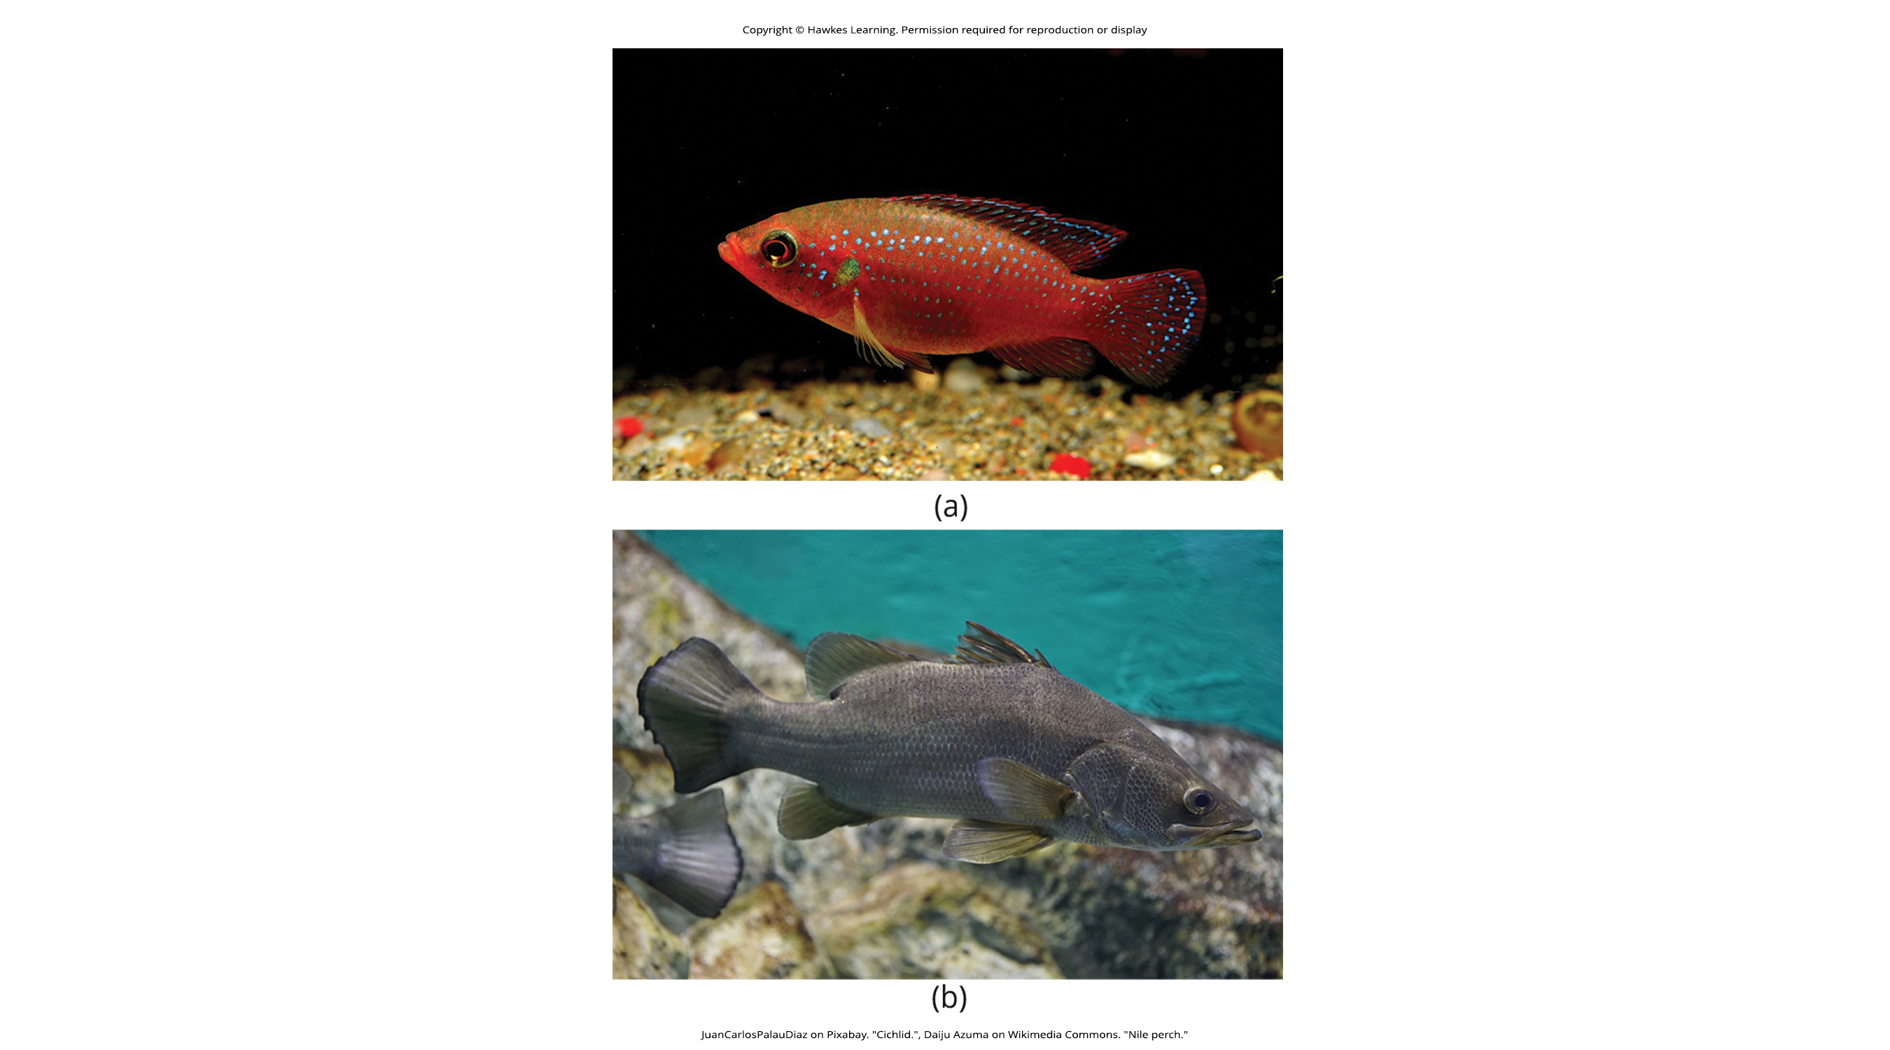
Example: Lake Victoria Cichlids₂
When biologists made this discovery, some species began to disappear.
Introduction of Nile perch in 1963
Large predatory fish that consumes cichlids
Accelerated by population surge of Nile perch in the 1980s
Resulted in the extinction of approximately 200 cichlid species
Extinction: disappearance of a species
Additional factors: declining water quality and increased fishing pressure
Example of rapid species loss caused primarily by human activity
47.1 Figure 2: Hundreds of species of (a) cichlids were present in Lake Victoria as a result of adaptive radiation. The introduction of the (b) Nile perch led to the extinction of many cichlid species.
JuanCarlosPalauDiaz on Pixabay. "Cichlid."
Daiju Azuma on Wikimedia Commons. "Nile perch."

Slide 7
Example: Lake Victoria Cichlids₃
Extinction is a natural process of macroevolution with a rate of one out of one million species going extinct per year.
At least five periods of mass extinction in history with higher rates of loss
Comparable rates of loss today
Human activity is the difference between the extinction rates today and during mass extinctions.
Three activities with major impact:
Destruction of habitat
Introduction of exotic species
Overharvesting
Loss predictions from 10% to 50% within the next century

Slide 8
Types of Biodiversity
The term biodiversity is generally accepted to mean the number and kinds of species and their abundance in a given location or on the planet.
Species can be difficult to define, but eukaryotic species are included in most contexts.
Alternate measures of biodiversity have been identified.
Some important in planning how to preserve biodiversity

Slide 9
Genetic Diversity
Genetic diversity provides the source of the phenotypic variation upon which selection can act.
Raw material for evolution and adaptation in a species
Important for species' future potential for adaptation
Higher genetic diversity increases the chances of survival in changing environments.
Crucial for maintaining healthy populations and species longevity

Slide 10
Chemical Diversity
Genetic diversity can be measured as chemical diversity, which refers to the variety of chemicals produced by living organisms.
Includes proteins, metabolites, and other biological compounds
Important source of pharmaceuticals and other beneficial substances
One way to measure diversity important to human health and welfare

Slide 11
Human-Generated Diversity
Humans have generated diversity in domestic animals, plants, and fungi.
Suffering losses due to migration, market forces, and increasing agricultural globalism
Important for food security and agricultural productivity
Preservation of agricultural biodiversity crucial for sustainable food systems

Slide 12
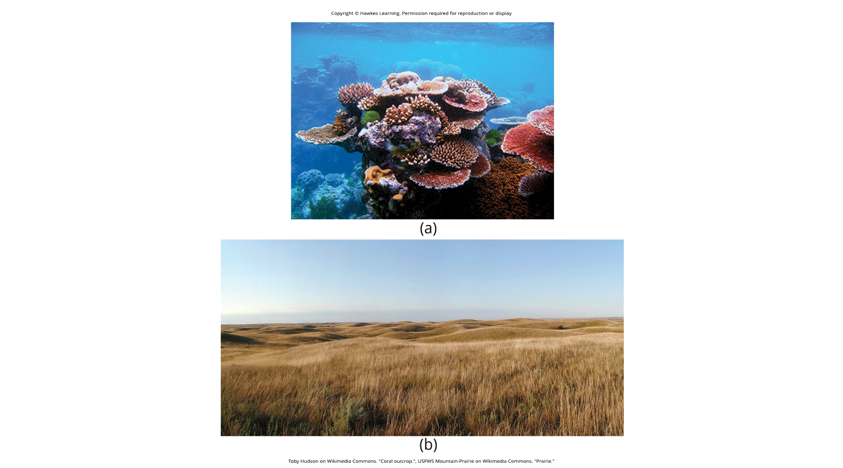
Ecosystem Diversity
Ecosystem diversity refers to the variety of ecosystems in a given area or on Earth.
Includes terrestrial, aquatic, and marine ecosystems
Can lead to loss of species interactions and adaptations if also suffering a loss
Example: North American prairie ecosystem being largely extinct
Crucial for maintaining global ecological balance
47.1 Figure 3: The variety of ecosystems on Earth—from (a) coral reefs to (b) prairies—enables a great diversity of species to exist.
Toby Hudson on Wikimedia Commons. "Coral outcrop."
USFWS Mountain-Prairie on Wikimedia Commons. "Prairie."

Slide 13
Current Species Diversity
Limited knowledge of species diversity due to lack of financial resources and political willpower
Recently estimated 1.5 million described eukaryotic species
Likely represents less than 20% of total eukaryotic species on Earth (estimated 8.7 million)
Prokaryotic diversity largely unknown and difficult to estimate

Slide 14
Table 1: Estimates of the Numbers of Described and Predicted Species by Taxonomic Group
 | Mora et al., 2011 |  | Chapman, 2009 |  | Groombridge & Jenkins, 2002
 | Described | Predicted | Described | Predicted | Described | Predicted
Animalia | 1,124,516 | 9,920,000 | 1,424,153 | 6,836,330 | 1,225,500 | 10,820,000
Chromista | 17,892 | 34,900 | 25,044 | 200,500 | ― | ―
Fungi | 44,368 | 616,320 | 98,998 | 1,500,000 | 72,000 | 1,500,000
Plantae | 224,244 | 314,600 | 310,129 | 390,800 | 270,000 | 320,000
Protozoa | 16,236 | 72,800 | 28,871 | 1,000,000 | 80,000 | 600,000
Prokaryotes | ― | ― | 10,307 | 1,000,000 | 10,175 | ―
Total | 1,427,256 | 10,958,620 | 1,897,502 | 10,927,630 | 1,657,675 | 13,240,000

Slide 15
Describing Life on Earth
There are ongoing efforts to catalog and describe new species.
Current rate of species description: 17,000–20,000 new species per year
Gets easier as species go extinct, but not a total positive due to loss of biodiversity
Describing species is a complex process to determine an organism's unique characteristics.
Involves comparing new specimens to known species and genera
Crucial for recognizing and studying species after initial discovery
Aids in understanding species' biology and potential value
Challenging due to vast number of undescribed species

Slide 16
Think It Through₁
In what ways does biodiversity impact our species?
Notes:
Originally an On Your Own. This is included here to use as a talking point or for a think-pair-share activity.

Slide 17
Patterns of Biodiversity
Biodiversity is not evenly distributed across the planet.
Endemic species: species found only in one location
Can be vulnerable to extinction
Example: Lake Victoria cichlids
Can also apply to higher taxonomic levels
Factors: latitude, ecosystem age, energy input

Slide 18
Science and You
Career: Biogeographer
Biogeography is the study of species distribution across time and space.
Combines knowledge of biology, ecology, evolution, and soil science, and climatology
Three main fields:
Ecological: current factors affecting the distribution of plants and animals
Historical: past distribution of species
Conservation: protection and restoration of species based upon known historical and current ecological information
Also involves studying both plant (phytogeography) and animal (zoogeography) distribution
Notes:
This is included as a relevant application for this topic.

Slide 19
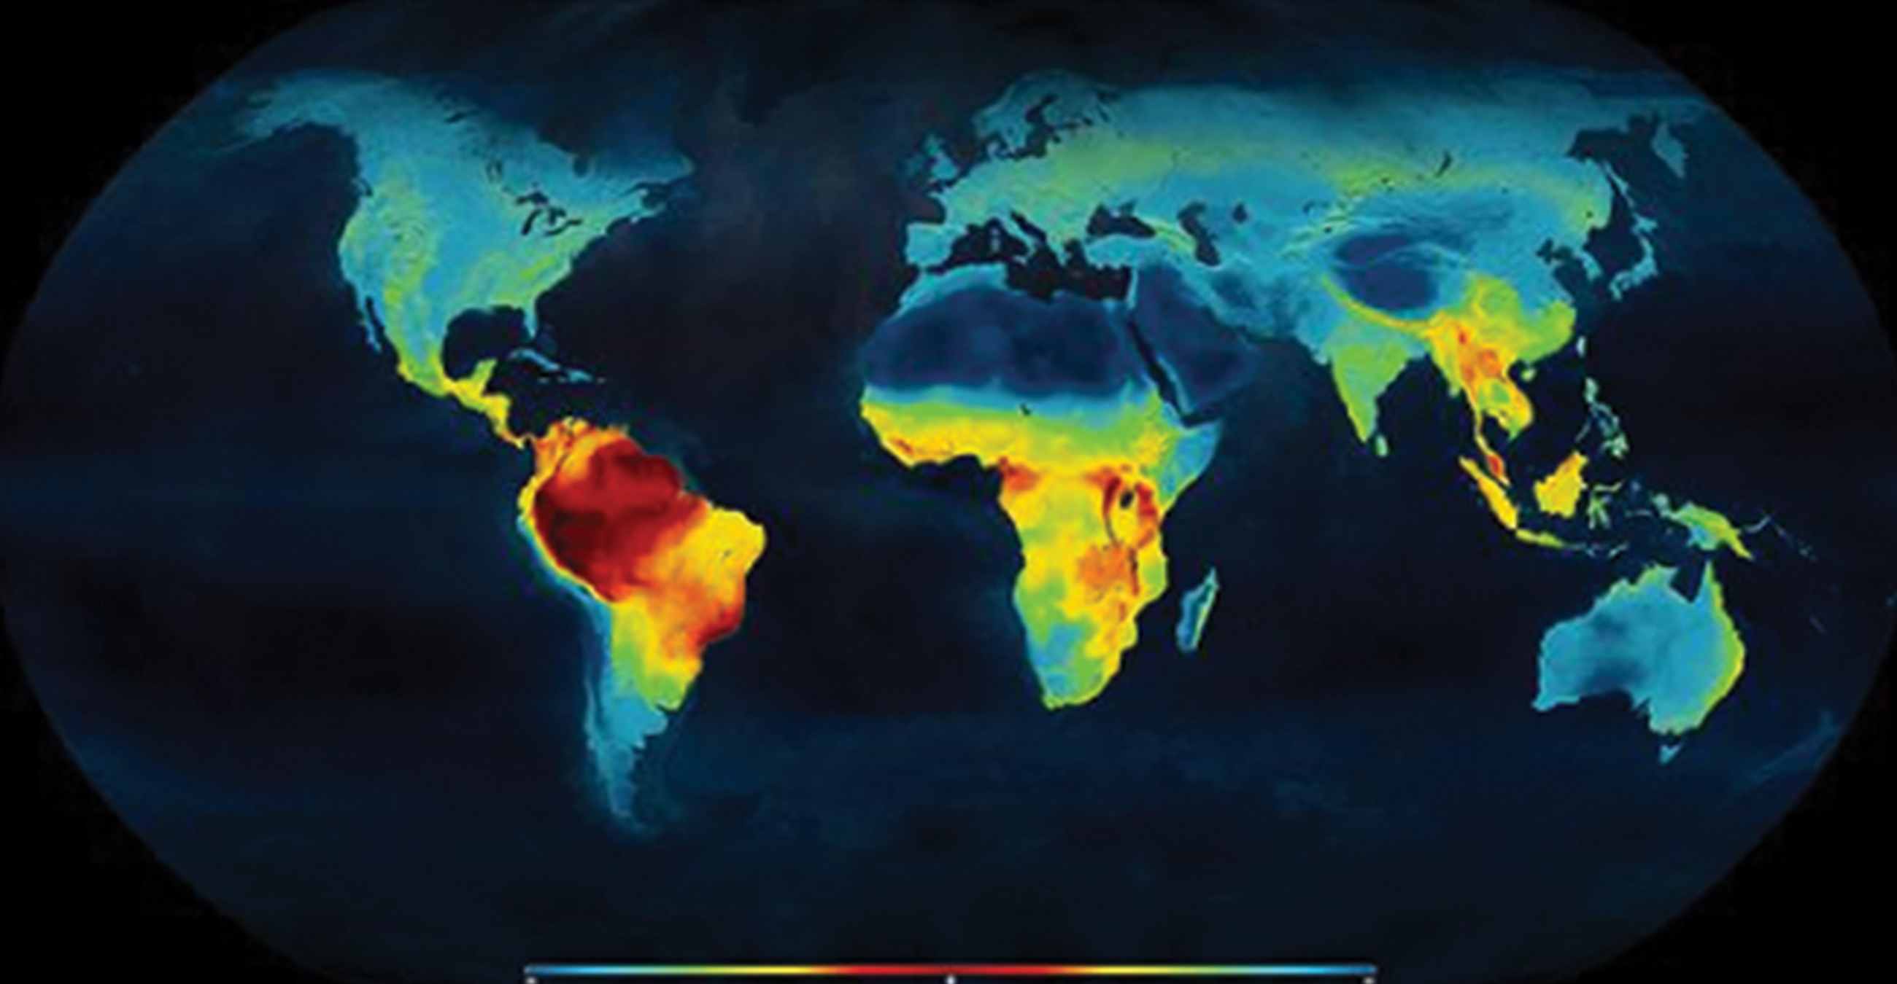
Biodiversity and the Equator
Biodiversity generally increases closer to the equator.
Possible explanations include:
Ecosystem age: idea that tropical ecosystems have a greater age than temperate regions; greater age = more time for speciation
Solar energy input: idea that tropics receive more sun than temperate and polar regions
Ecosystem complexity: idea that the tropics' complexity may promote speciation by increasing heterogeneity
47.1 Figure 4: This map illustrates the number of terrestrial vertebrate species across the globe and shows the trend toward higher biodiversity (red color, such as the top half of South America) at lower latitudes, and lower biodiversity (blue color, such as the top half of North America) at the poles.
Mannion, P. D., Upchurch, P., Benson, R. B. J. & Goswami, A., based on work by Clinton Jenkins on Wikimedia Commons. "Latitudinal gradient of biodiversity."

Slide 20
Heterogeneity
Heterogeneity refers to the number of ecological niches.
An ecological niche is the role an organism fulfills in its environment.
Greater heterogeneity often correlates with higher biodiversity.
Provides more ecological niches and opportunities for speciation
Can promote coevolution and specialization among species

Slide 21
Biodiversity in the Tropics
Have been perceived as more stable than temperate regions
Have their own forms of seasonality, but generally more stable than climate and day/length seasonality of temperate regions
May promote speciation into specialized niches
All levels of biodiversity greatest in the tropics
Highest rate of endemism
More biodiversity "hotspots"
Minimal knowledge of species, so high potential for biodiversity loss

Slide 22
Conservation of Biodiversity
Biodiversity hotspots: areas with high endemic species
Concept developed by British environmentalist Norman Myers in 1988
Focus on identifying important locations for conservation efforts
Protection leads to protecting a larger number of species
Criteria: 1,500+ endemic plant species, 70% of area disturbed by human activity
Approximately 35 biodiversity hotspots identified globally

Slide 23
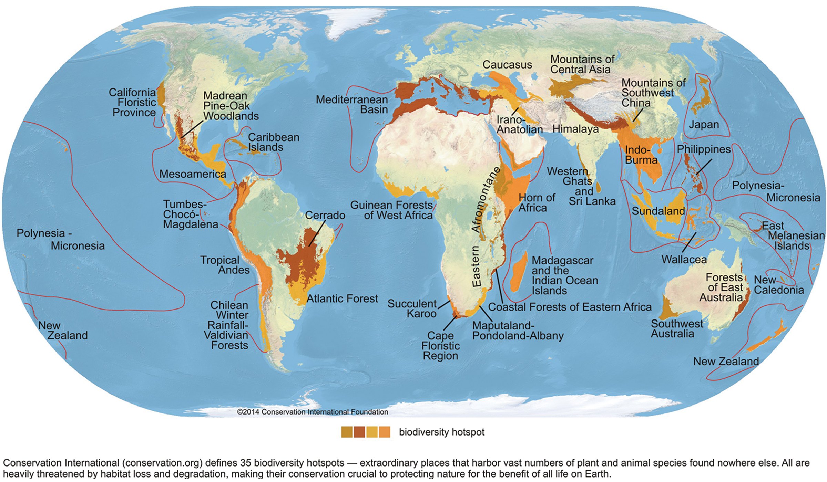
47.1 Figure 5
Conservation International on Wikimedia Commons. "Biodiversity hotspots."
Notes:
Conservation International has identified 35 biodiversity hotspots, which cover only 2.3% of the Earth's surface but have 42% of the terrestrial vertebrate species and 50% of the world's plants endemic to them.

Slide 24
Think It Through₂
What are some of the ways scientists can define a region as a biodiversity hotspot?
Notes:
Originally an On Your Own. This is included here to use as a talking point or for a think-pair-share activity.

Slide 25
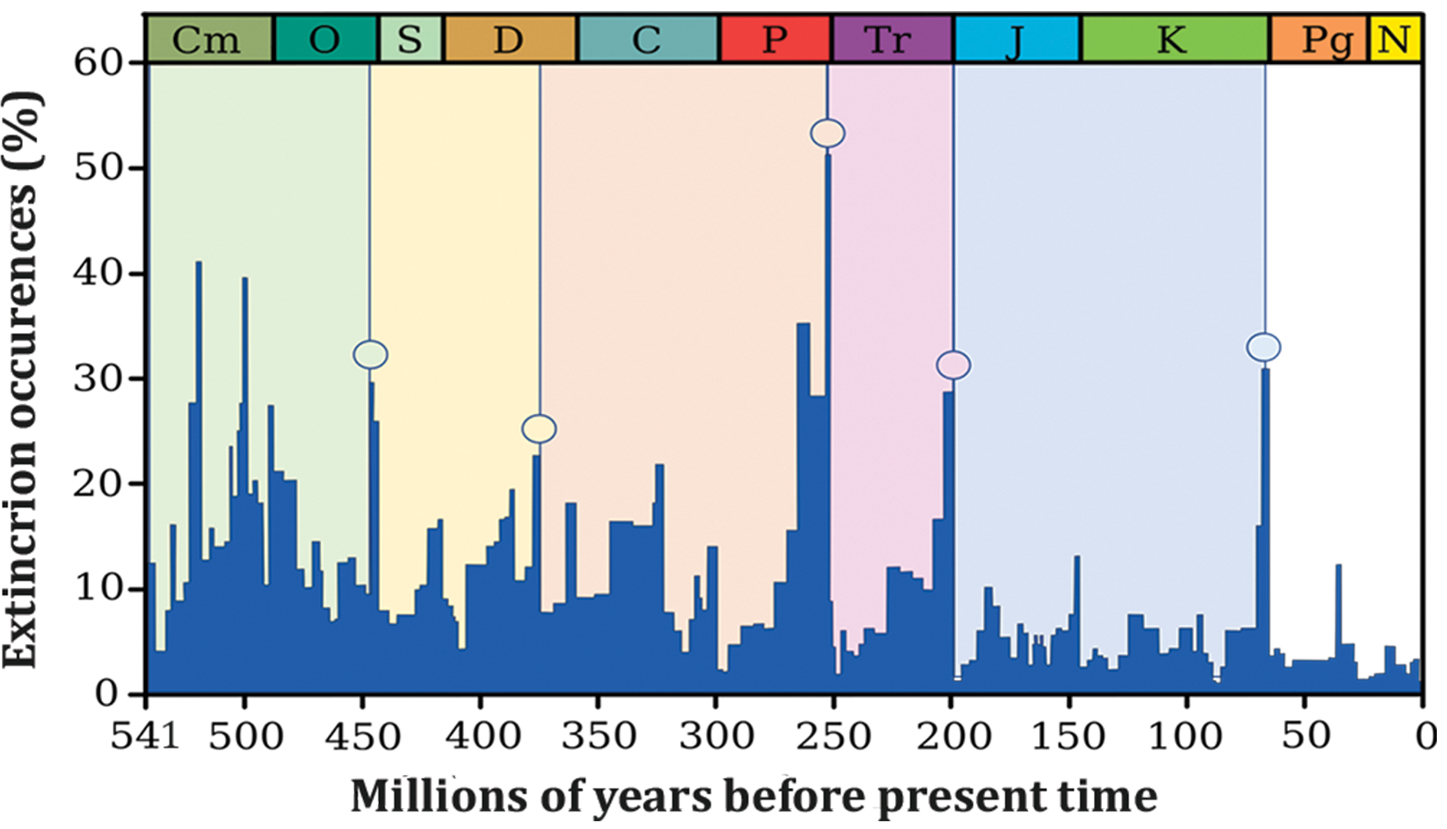
Biodiversity Change through Geological Time
Fluctuations of ongoing macroevolution processes of speciation ("birth") and extinction ("death") lead to changes in biodiversity over time.
When speciation rates pass extinction rates, the number will increase; the opposite is also true.
Fossil record shows periods of dramatic biodiversity loss (mass extinctions).
At least five major mass extinction events identified in Earth's history
47.1 Figure 6: Percent extinction occurrences, as reflected in the fossil record, have fluctuated throughout Earth's history. Sudden and dramatic losses of biodiversity, called mass extinctions, have occurred at least five times. The five major mass extinctions are each indicated by a circle. Note that each major mass extinction concludes the geologic period in which it occurred—from the Ordovician (O), Devonian (D), Permian (P), Triassic (Tr), and Cretaceous (K).
CNX OpenStax on Wikimedia Commons. "Extinctions."

Slide 26
The Five Mass Extinctions
Five major mass extinctions have been identified in the fossil record.
Mass extinction: sudden and dramatic losses in biodiversity
Many lesser, yet still dramatic, extinction events a well
Also referred to as the five most extreme events in a series of large extinction events since the Phanerozoic Eon (541 MYA)
Causes of these mass extinctions are controversial, but the most is known about the most recent extinction.

Slide 27
The Fossil Record of Mass Extinctions
The fossil record of mass extinctions was the basis for defining periods in geological history.
Typically occur at the transition point between geological periods
Reflects the dramatic loss of species and gradual origin of new ones, as seen in the rock strata

Slide 28
Table 2: Names and Dates for the Five Recorded Mass Extinctions in Earth's History
Geological Period | Mass Extinction Name | Time (Millions of Years Ago)
Ordovician–Silurian | end-Ordovician (O–S) | 450–440
late Devonian | end-Devonian | 375–360
Permian–Triassic | end-Permian | 252
Triassic–Jurassic | end-Triassic | 201
Cretaceous–Paleogene | end-Cretaceous (K–Pg or K–T) | 66

Slide 29
Ordovician-Silurian Extinction
First recorded mass extinction
Second largest extinction event, with ~85% of marine species lost
Hypothesized causes:
Actually two extinction events separated by 1 million years: a period of glaciation and then a period of warming
Possible contribution from gamma-ray burst stripping Earth's ozone layer
5 to 20 million years for recovery of biodiversity

Slide 30
Late Devonian Extinction
Occurred over a relatively long period of time
Primarily affected marine species, less impact on terrestrial life
Causes not well understood, possibly occurred over an extended period

Slide 31
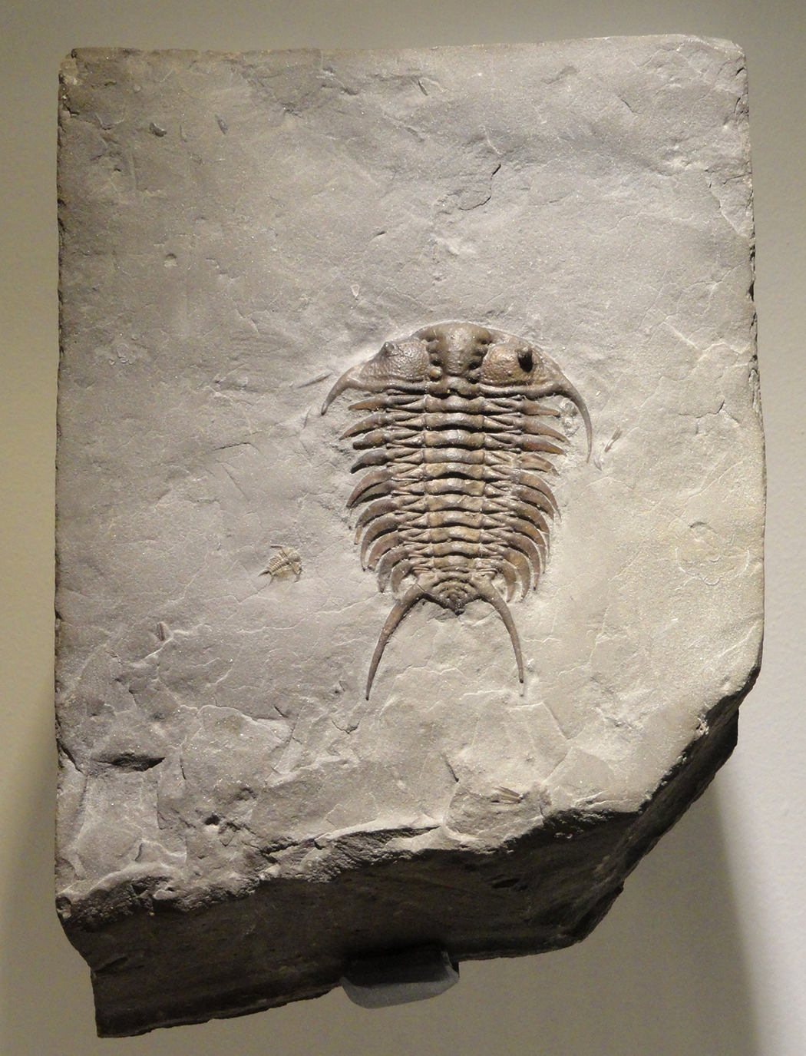
End-Permian Extinction
Largest mass extinction in Earth's history
Estimated 96% of marine species and 70% of terrestrial species lost
Example: trilobites going extinct
Possible cause: extended volcanic activity leading to global warming
Resulted in anoxic (lacking oxygen) oceans, suffocating marine life
30 million years for recovery of biodiversity
47.1 Figure 7: This is a trilobite fossil. The only observations we have of this now-extinct species are fossil records, such as this one, which also allow biologists to infer the time period in which trilobites existed.
Daderot on Wikimedia Commons. "Trilobite fossil."

Slide 32
Triassic-Jurassic Extinction
Occurred just before the breakup of Pangaea, the supercontinent
Causes unclear
Hypothesized causes: climate change, asteroid impact, volcanic eruptions
Recent research: the extinction may have been more gradual

Slide 33
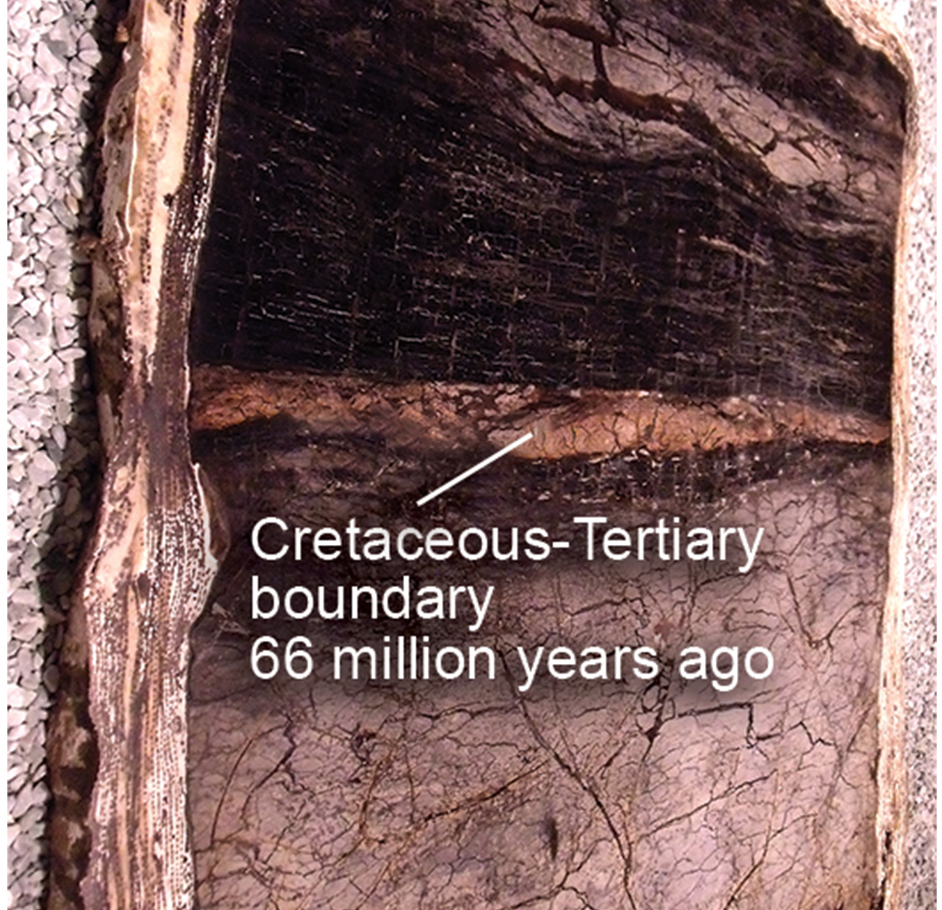
End-Cretaceous Extinction₁
Occurred ~66 million years ago
Best understood of the mass extinction events
Resulted in the disappearance of non-avian dinosaurs
Caused by the impact of a large asteroid or meteorite at the Chicxulub crater off the Yucatán Peninsula
Proposed due to a spike in iridium (Ir) levels in the rock stratum
Supported by geological evidence, though initially thought radical
10 million years for recovery of biodiversity
47.1 Figure 8: In 1980, Luis and Walter Alvarez, Frank Asaro, and Helen Michels discovered, across the world, a spike in the concentration of iridium within the sedimentary layer at the K–Pg boundary. In the photo, the iridium layer is the light band annotated as the Cretaceous-Tertiary boundary at 66 million years.
Mike Beauregard on Wikimedia Commons. "K–Pg boundary."

Slide 34
End-Cretaceous Extinction₂
Another possible cause is the extensive volcanism that formed 66 million years ago, around the time of the asteroid impact.
Lava flows covered 50% of what is now India.
Volcanic gas release (SO₂) contributed to climate change and potentially the mass extinction.

Slide 35
The Asteroid and Genetic Diversity
Species evolve in response to environmental changes and selective pressures.
Sudden environmental changes can lead to rapid loss of genetic diversity.
Example: the asteroid at the end of the Cretaceous Period
Did not allow for species to evolve adaptations, which led to extinction
Resulted in a bottleneck effect for remaining species
Bottleneck effect: drastic reduction in genetic diversity due to population decrease

Slide 36
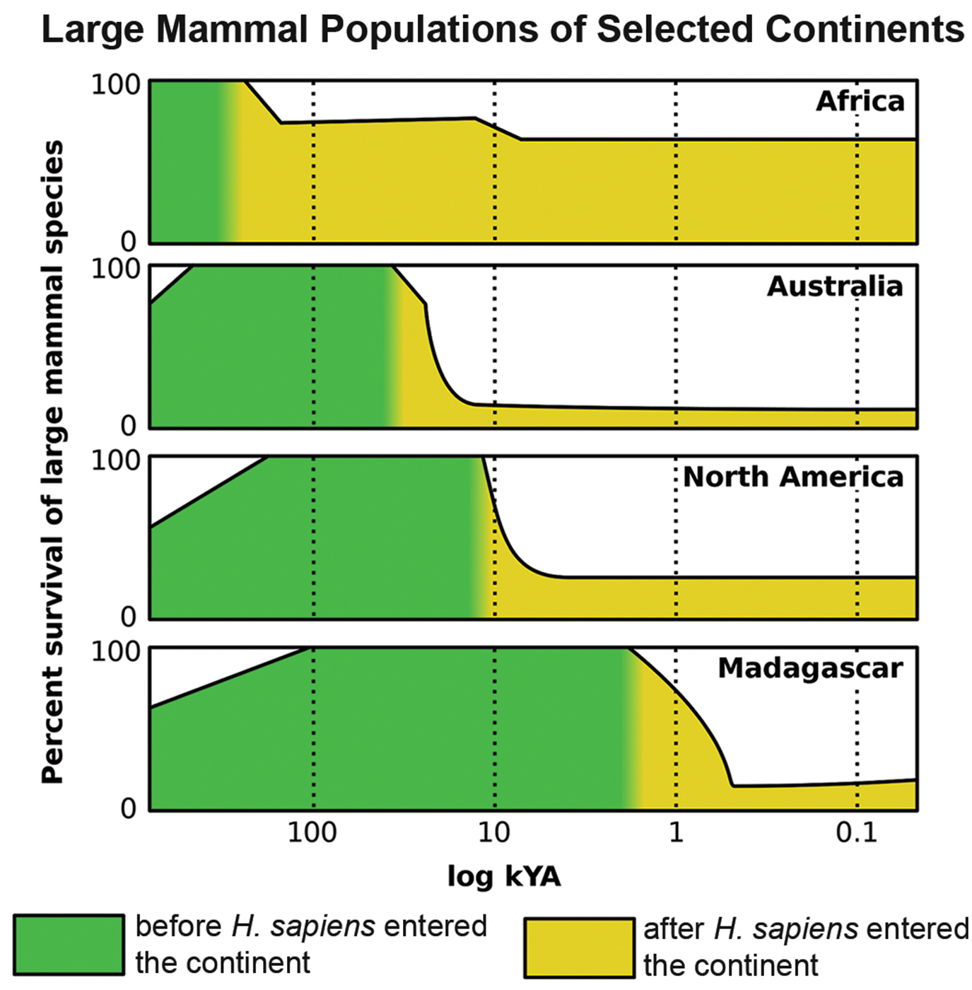
The Pleistocene Extinction₁
One of the lesser, more recent extinctions
Occurred ~10,000–12,000 years ago
Affected North America and Eurasia most significantly
Resulted in the loss of many large vertebrate species (megafauna)
Example: loss of woolly mammoths, mastodon, giant beavers, giant ground sloths, saber-toothed cats, and North American camel
Hypothesized cause: overhunting vs. climate change
47.1 Figure 9: The decrease in megafauna biodiversity during the Pleistocene extinction correlates well with the increasing presence of humans in the same areas, across different parts of the world or points during that era. The x-axis is a log scale of thousands of years.

Slide 37
The Pleistocene Extinction₂
Coincided with the arrival of paleo-humans in many regions
Australia: extinctions ~40,000–50,000 years ago
North America: extinctions ~10,000–12,000 years ago
Madagascar: extinctions with human colonization around 2,000 years ago
Remains a topic of active research

Slide 38
Holocene Mass Extinction
Sixth mass extinction; ongoing
Largely attributed to modern Homo sapiens activities
Accelerated since European colonial expansion in the 1500s
Example: dodo bird going extinct around 1662
Hunted for meat by sailors
Made for easy prey since they did not evolve with humans
Example: Steller's sea cow going extinct in 1768
First discovered in 1741 and overhunted
Last killed in 1768, just 27 years after discovery

Slide 39
Recent Extinctions
Passenger pigeon: extinct in 1914
Used to migrate across North America
Overhunted and suffered from habitat loss due to forest clearing
Carolina parakeet: extinct in 1918
Suffered habitat loss
Hunted for eating orchard fruit, which they only ate due to their native foods being destroyed
Japanese sea lion: extinct in the 1950s
Inhabited a broad area around Japan and Korea
Went extinct due to fishermen
Caribbean monk seal: extinct by 1952
Distributed throughout the Caribbean Sea
Driven to extinction by hunting

Slide 40
The Red List
The Red List is a list of extinct and endangered species.
Maintained by the International Union for Conservation of Nature (IUCN)
Not a complete list
Describes 380 extinct species of vertebrates after 1500 CE

Slide 41
Estimates of Present-Time Extinction Rates₁
Challenging to estimate due to unobserved extinctions
Background extinction rate estimated at one per million species per year (E/MSY)
Current extinction rates estimated to be much higher than background rate of 26 E/MSY
Many species not described until later in the time period
Extinct species being described from skeletal remains
Already extinct species, though conservationists reluctant to name them as such
Could be raised to 100 E/MSY
By end of century, predicted to be 1,500 E/MSY

Slide 42
Estimates of Present-Time Extinction Rates₂
Understanding of the species-area relationship is used to estimate extinction rates from habitat loss.
Species-area relationship: rate at which new species are seen when the area surveyed is increased
Shown that number of species present increases as land increases; the reverse also holds true
Holds in other island-like habitats as well
Can lead to overestimation of extinction rates
The endemics-area relationship may provide more accurate estimates, though still larger than the background rate.

Slide 43
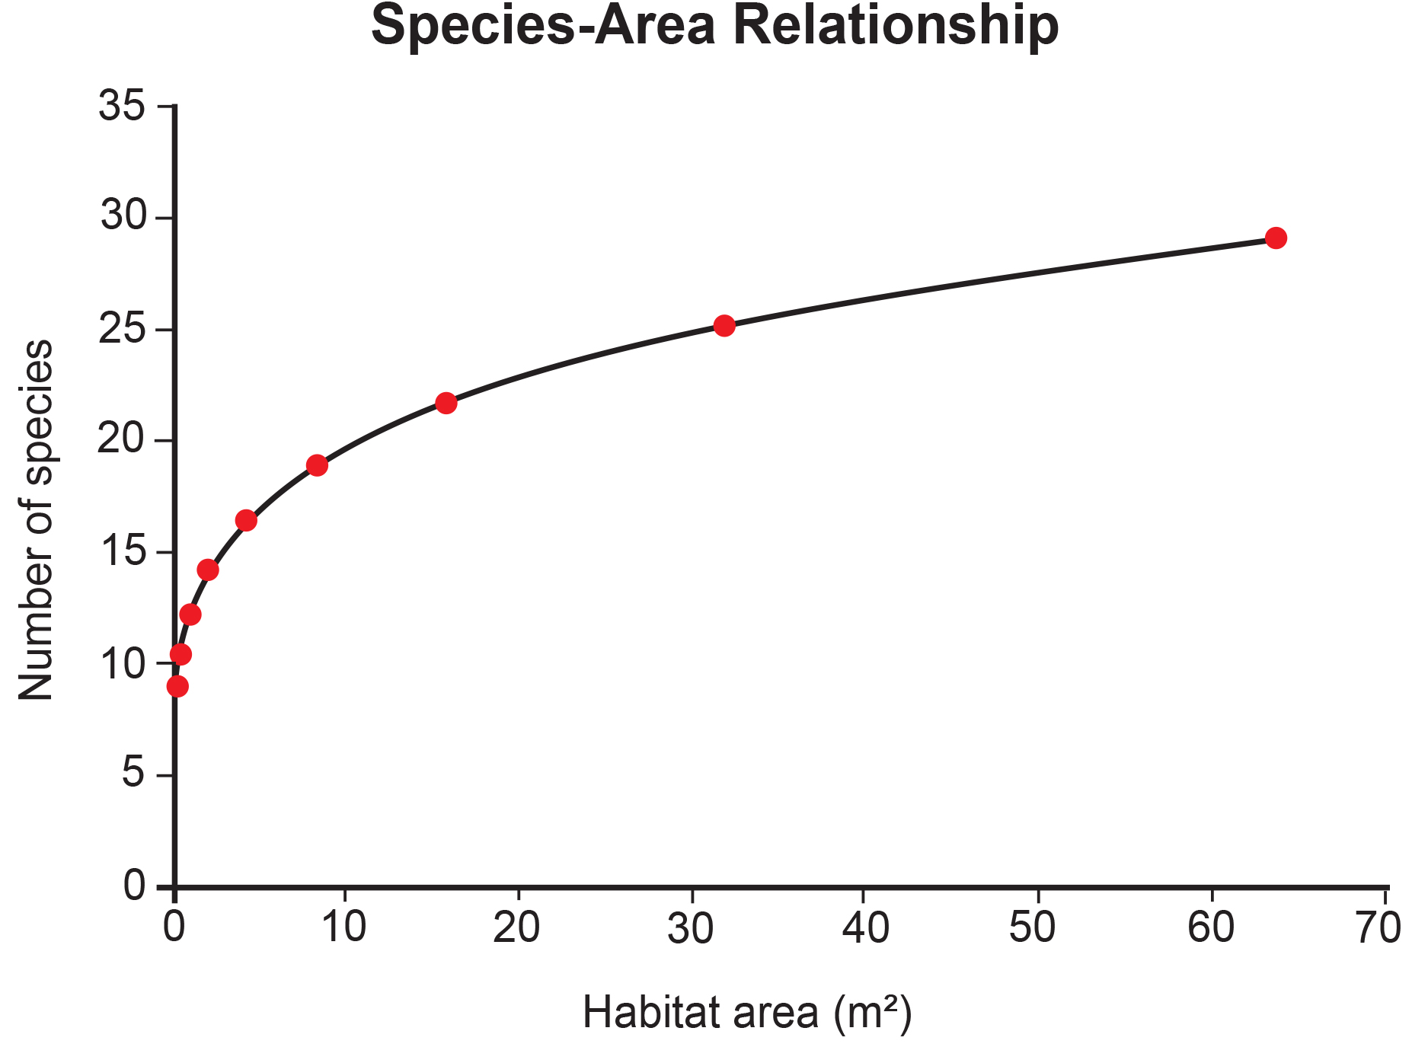
47.1 Figure 10
Adam B. Smith. "Species-area relationship."
Notes:
Studies have shown that the number of species present increases with the size of the habitat.

Slide 44
Summary
Biodiversity exists at multiple levels: numbers of species, genetic, chemical, and ecosystem.
There are an estimated 1.5 million described species, with potentially 10 million total species.
Biodiversity is generally higher in tropical regions.
Five major mass extinctions have been identified in Earth's history with varying biodiversity recovery periods.
Species-area relationships can be used to estimate contemporary extinction rates.
Current extinction rates are estimated to be 500 times the background rate.

Slide 45

End of Hawkes Learning PowerPoint

